Slide 1



Slide 2



As His representatives among men, God does not choose angels who have never fallen, but human beings, men of like passions with those they seek to save.
Christ took humanity that He might reach humanity. A divine-human Saviour was needed to bring salvation to the world. And to men and women has been committed the sacred trust of making known “the unsearchable riches of Christ.”—The Acts of the Apostles, 134. ChS 7.
There are qualifications that will help us show the Savior to others. God is willing to empower us with those we need to accomplish this mission.
Let's examine what these requirements are, what they mean, the people who used them, and how we can use them.
It is important that we know them, so that we ask God to endow us with those we lack, and to strengthen those we already have.

Slide 3



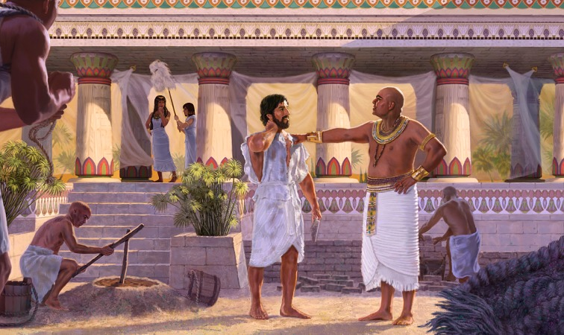

Listlessness and inefficiency are not piety. When we realize that we are working for God, we shall have a higher sense than we have ever had before of the sacredness of spiritual service. This realization will put life and vigilance and persevering energy into the discharge of every duty.—Testimonies for the Church 9:150. ChS 223
EFFICIENCY
The ability to dispose of someone or something to achieve a certain effect.
Gaining Efficiency MYP 208 In this work, as in every other, skill is gained in the work itself. It is by training in the common duties of life and in ministry to the needy and suffering that efficiency is assured.—Education, 268. MYP 208.
God calls for those who will be workers together with Him. Connected with Christ, human nature becomes pure and true. Christ supplies the efficiency, and man becomes a power for good. Truthfulness and integrity are attributes of God, and he who possesses these attributes possesses a power that is invincible.—The Review and Herald, March 10, 1903. MYP 35
The Spirit of God is a convincing power. When this is breathed upon the church, there will be a decided change in their spiritual efficiency. The Lord God is ready to give, but many do not realize their necessity of receiving. They are weak, when they might be strong; powerless, when they might be powerful through receiving the efficiency of the Holy Spirit. —UL 287
Joseph
Those who hunger for knowledge that they may bless their fellowmen will themselves receive blessing from God. Through the study of His Word their mental powers will be aroused to earnest activity. There will be an expansion and development of the faculties, and the mind will acquire power and efficiency.—Christ's Object Lessons, 334 (1900). 2MCP 447

Slide 4

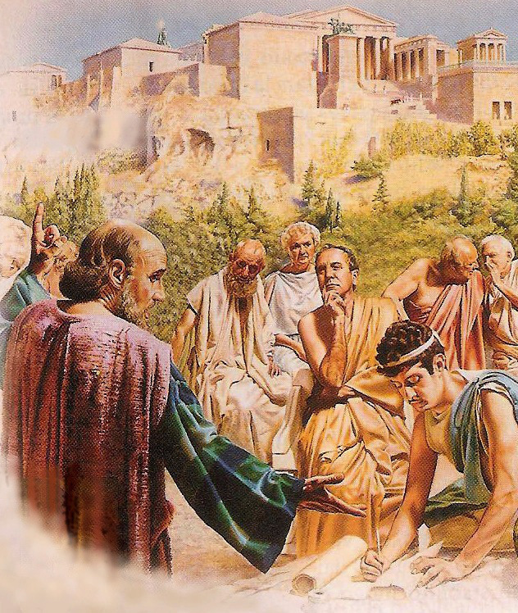


Paul
CULTURE OF SPEECH
The right culture and use of the power of speech has to do with every line of Christian work.... We should accustom ourselves to speak in pleasant tones, to use pure and correct language, and words that are kind and courteous.—Christ's Object Lessons, 336. ChS 223
A body of knowledge that allows someone to communicate with others correctly.
The truth spoken will judge them in the great day of final
reckoning. And with some souls the manner of the one delivering the message will determine its reception or rejection. Then let the word be so spoken that it will appeal to the understanding and impress the heart. Slowly, distinctly, and solemnly should it be spoken, yet with all the earnestness which its importance demands.—Christ's Object Lessons, 336. ChS 223
As you seek to draw others within the circle of His love, let the purity of your language, the unselfishness of your service, the joyfulness of your demeanor, bear witness to the power of His grace.—The Ministry of Healing, 156. ChS 224
Every Christian is called to make known to others the unsearchable riches of Christ; therefore he should seek for perfection in speech. He should present the Word of God in a way that will commend it to the hearers. God does not design that His human channels shall be uncouth. It is not His will that man shall belittle or degrade the heavenly current that flows through him to the world. VSS 36.

Slide 5



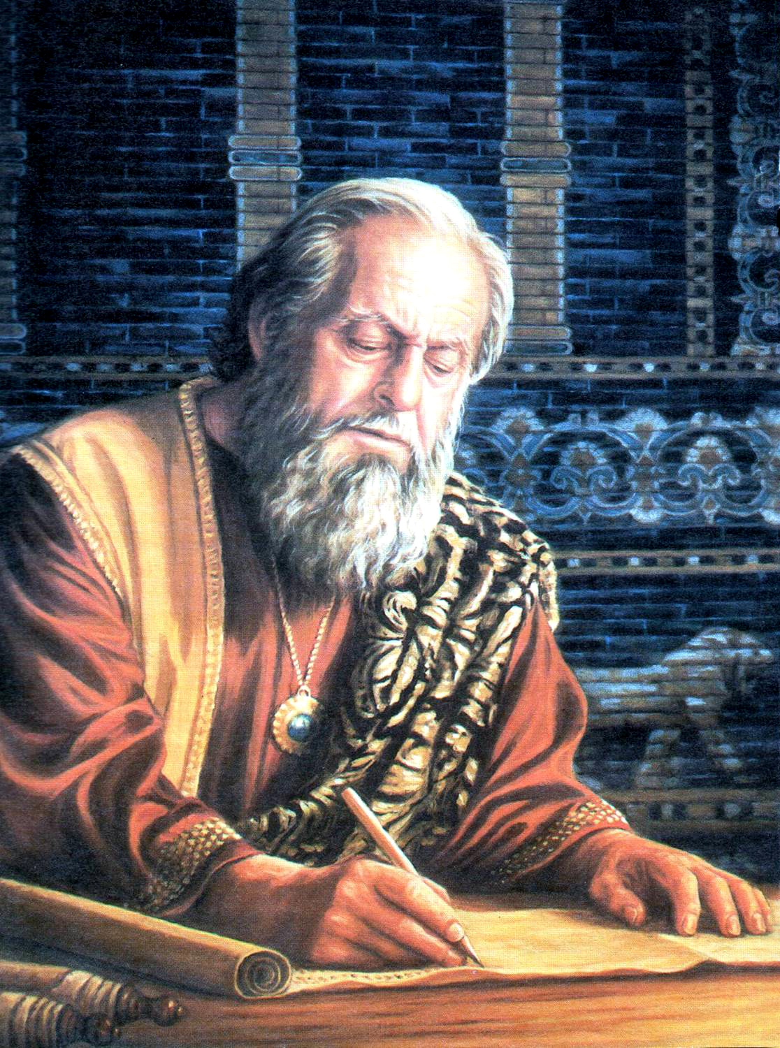
We must not enter into the Lord's work haphazard and expect success. The Lord needs men of mind, men of thought. Jesus calls for co-workers, not blunderers. God wants right-thinking and intelligent men to do the great work necessary to the salvation of souls. Pr 43
MENTAL CULTURE
A body of knowledge that allows someone to develop their critical judgment.
Some need to discipline the mind by exercise. They should force it to think. While they depend upon some one to think for them, to solve their difficulties, and they refuse to tax the mind with thought, the inability to remember, to look ahead and discriminate, will continue. Efforts must be made by every individual to educate the mind.—Testimonies for the Church 2:188. ChS 224.
Treasure the moments. ... The time we spend traveling; ... the moments we spend waiting for dinner, or for those who are late for an appointment; if you would have a book in your hand and use these fragments of time in studying, reading, or thinking carefully, how much could be accomplished!—COL 343.
Daniel
A resolute purpose, persistent industry, and careful economy of time, will enable men to acquire knowledge and mental discipline which will qualify them for almost any position of influence and usefulness.—Christ's Object Lessons, 334. ChS 225.
Mechanics, lawyers, merchants, men of all trades and professions, educate themselves that they may become masters of their business. Should the followers of Christ be less intelligent, and while professedly engaged in His service be ignorant of the ways and means to be employed? The enterprise of gaining everlasting life is above every earthly consideration. In order to lead souls to Jesus there must be a knowledge of human nature and a study of the human mind. Much careful thought and fervent prayer are required to know how to approach men and women upon the great subject of truth. 4T 67.2.

Slide 6


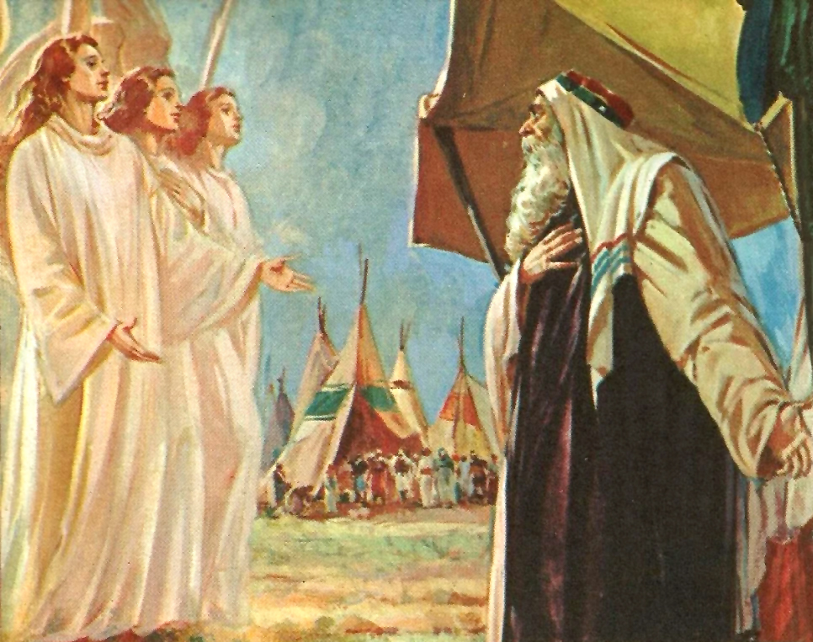
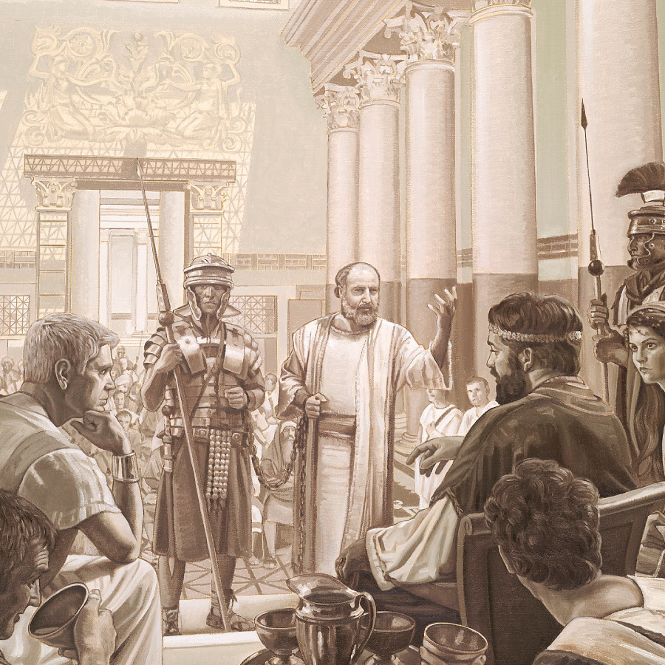
All coarseness and roughness must be put away from us. Courtesy, refinement, Christian politeness, must be cherished. Guard against being abrupt and blunt. Do not regard such peculiarities as virtues; for God does not so regard them. Endeavor not to offend any unnecessarily.—The Review and Herald, November 25, 1890. ChS 226.
COURTESY
Demonstration or act with which the attention, respect or affection that someone has for another person is manifested.
There is the greatest necessity that men and women who have a knowledge of the will of God, should learn to become successful workers in His cause. They should be persons of polish, of understanding, not having the deceptive outside gloss and simpering affectation of the worldling, but that refinement and true courteousness which savors of heaven, and which every Christian will have if he is a partaker of the divine nature.—Testimonies for the Church 4:358. ChS 226.
Abraham
Paul
Christ was courteous, even to His persecutors; and His true followers will manifest the same spirit. Look at Paul when brought before rulers. His speech before Agrippa is an illustration of true courtesy as well as persuasive eloquence. The gospel does not encourage the formal politeness current with the world, but the courtesy that springs from real kindness of heart. AH 425.

Slide 7



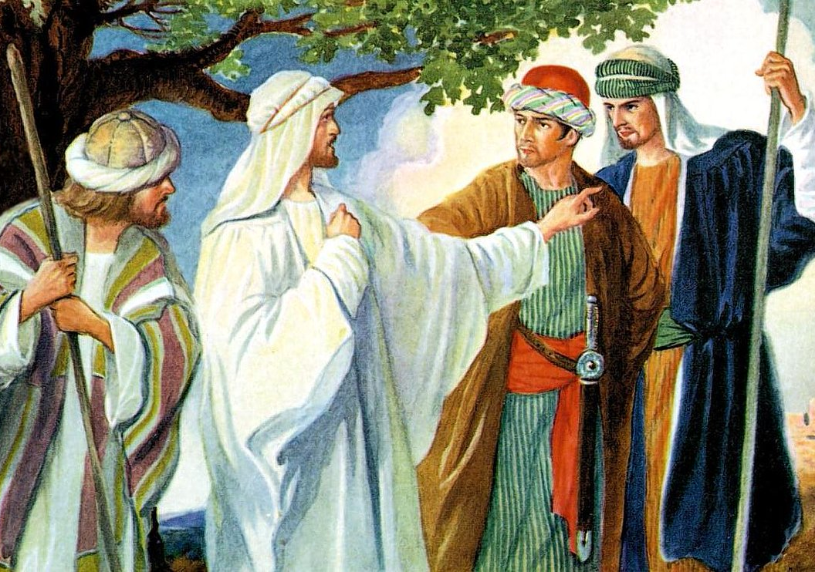
Paul carried with him the atmosphere of heaven. All who associated with him felt the influence of his union with Christ. The fact that his own life exemplified the truth he proclaimed, gave convincing power to his preaching. Here lies the power of the truth. The unstudied, unconscious influence of a holy life is the most convincing sermon that can be given in favor of Christianity.
Argument, even when unanswerable, may provoke only opposition; but a godly example has a power that it is impossible wholly to resist. GW 59.
SINCERITY
Simplicity, truthfulness, way of expressing oneself or behaving free of pretense.
Nathaniel
True character is not shaped from without, and put on; it radiates from within. If we wish to direct others in the path of righteousness, the principles of righteousness must be enshrined in our own hearts. Our profession of faith may proclaim the theory of religion, but it is our practical piety that holds forth the word of truth. The consistent life, the holy conversation, the unswerving integrity, the active, benevolent spirit, the godly example,—these are the mediums through which light is conveyed to the world. DA 307.
The soul that is sincere in its love, wholehearted in its devotion, God regards as more precious than the golden wedge of Ophir.... We are not to think of reward, but of service.—Thoughts From the Mount of Blessing, 120, 121. CS 196.
John 1:47

Slide 8



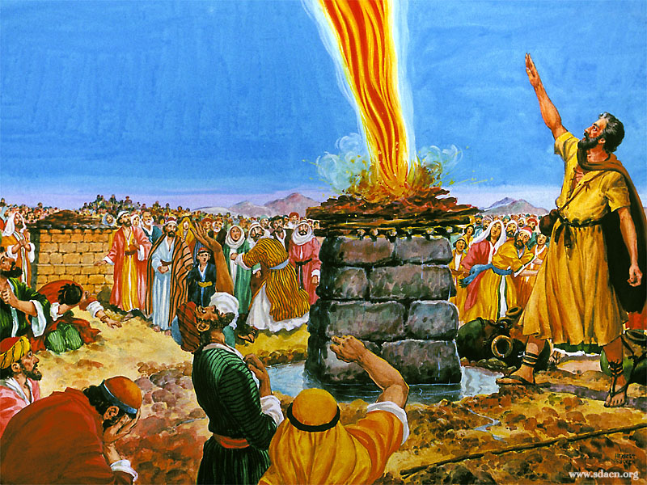
ENERGY
Some who engage in missionary service are weak, nerveless, spiritless, easily discouraged. They lack push. They have not those positive traits of character that give power to do something,—the spirit and energy that kindle enthusiasm. Those who would win success must be courageous and hopeful. They should cultivate not only the passive but the active virtues.—Gospel Workers, 290. ChS 228.
That he is effective, enthusiastic, active, resolute and firm.
The Lord is in need of workers who will push the triumphs of the cross of Christ.—The Review and Herald, May 6, 1890. ChS 228.5.
Elijah
Not with tame, lifeless utterance is the message to be given, but with clear, decided, stirring utterances.—Testimonies for the Church 8:16. ChS 229.
It is not silver-tongued orators that are needed to give this message. The truth in all its pointed severity must be spoken. Men of action are needed,—men who will labor with earnest, ceaseless energy for the purifying of the church and the warning of the world.—Testimonies for the Church 5:187. ChS 229.
God has no use for lazy men in His cause; He wants thoughtful, kind, affectionate, earnest workers.—Testimonies for the Church 4:411. ChS 229

Slide 9



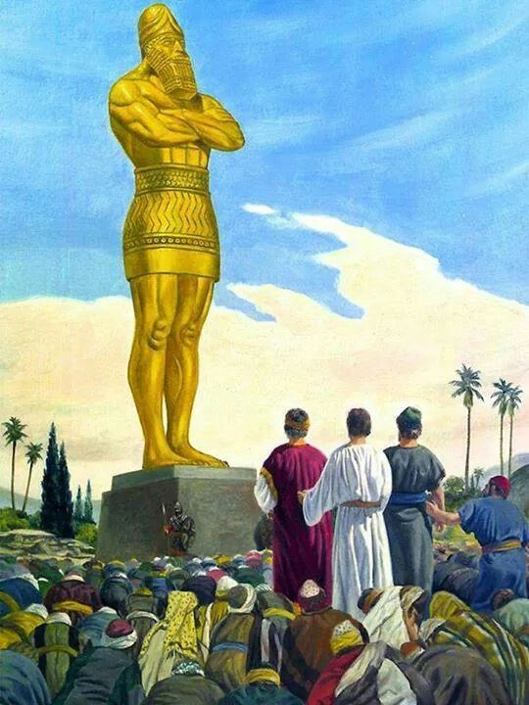
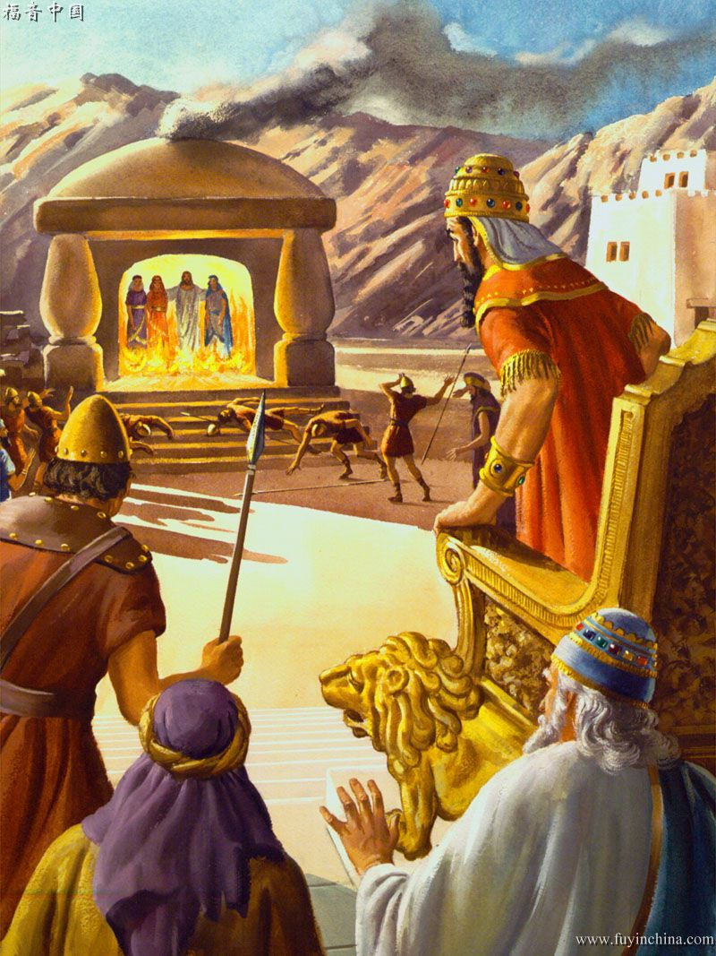
DETERMINATION
Those in the service of God must show animation and determination in the work of winning souls. Remember that there are those who will perish unless we as God's instrumentalities work with a determination that will not fail nor become discouraged. The throne of grace is to be our continual dependence. 3TT 51.
Audacity, value. It's a strong decision to keep going no matter what, and it helps you feel fulfilled with what you're doing.
He has given us a great work to do. Let us do it with accuracy and determination. Let us show in our lives what the truth has done for us.—Testimonies for the Church 6:418. ChS 229.
True Christian character is marked by a singleness of purpose, an indomitable determination, which refuses to yield to worldly influences, which will aim at nothing short of the Bible standard.... The consecration of Christ's follower must be complete.... He must be willing to bear patiently, cheerfully, joyfully, whatever in God's providence he may be called to suffer. His final reward will be to share with Christ the throne of immortal glory. AG 225.
Shadrach, Meshach, and Abednego
Resolve to reach a high and holy standard; make your mark high; act with earnest purpose, as did Daniel, steadily, perseveringly, and nothing that the enemy can do will hinder your improvement. HP 197.

Slide 10


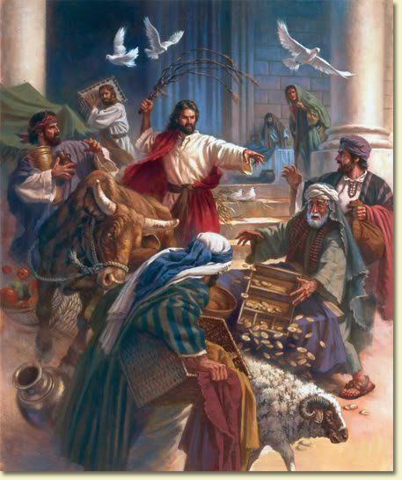
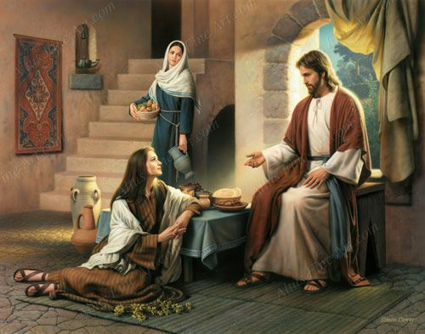
CHRISTIAN ZEAL
It is earnest Christian zeal that is wanted,—a zeal that will be manifested by doing something.... No more could a soul who possesses Christ be hindered from confessing Him, than could the waters of Niagara be stopped from flowing over the falls.—Testimonies for the Church 2:233. ChS 229.
Care, diligence and interest with which a person carries out his Christian duties or what he is in charge of.
Everyone who accepts Christ as his personal Saviour will long for the privilege of serving God. Contemplating what heaven has done for him, his heart is moved with boundless love and adoring gratitude. He is eager to signalize his gratitude by devoting his abilities to God's service. He longs to show his love for Christ and for His purchased possession. He covets toil, hardship, sacrifice. MH 502.
There is a wide field for the Marthas, with their zeal in active religious work. But let them first sit with Mary at the feet of Jesus. Let diligence, promptness, and energy be sanctified by the grace of Christ; then the life will be an unconquerable power for good.—The Desire of Ages, 525. ChS 230.
Jesus
In the name of the Lord, with the untiring perseverance and unflagging zeal that Christ brought into His labors, we are to carry forward the work of the Lord.—Testimonies for the Church 9:25. ChS 230.
We need to break up the monotony of our religious labor. We are doing a work in the world, but we are not showing sufficient activity and zeal. If we were more in earnest, men would be convinced of the truth of our message. The tameness and monotony of our service for God repels many souls of a higher class, who need to see a deep, earnest, sanctified zeal.—Testimonies for the Church 6:417. ChS 230.

Slide 11



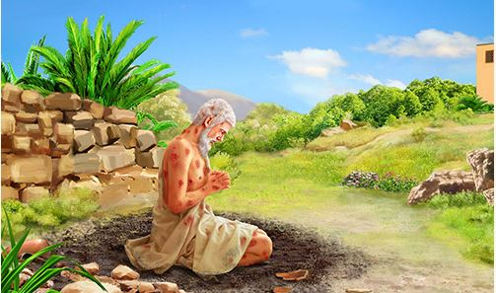
PATIENCE
To be a coworker with Jesus, you should have all patience with those for whom you labor, not scorning the simplicity of the work, but looking to the blessed result. When those for whom you labor do not exactly meet your mind, you often say in your heart, “Let them go; they are not worth saving.” What if Christ had treated poor outcasts in a similar manner? He died to save miserable sinners, and if you work in the same spirit and in the same manner indicated by the example of Him whom you follow, leaving the results with God, you can never in this life measure the amount of good you have accomplished.—Testimonies for the Church 4:132. ChS 230.
Capacity of suffering and tolerating misfortunes and adversities or annoying or offensive things, with fortitude, without complaining or rebelling.
Work disinterestedly, lovingly, patiently, for all with whom you are brought into contact. Show no impatience. Utter not one unkind word. Let the love of Christ be in your hearts, the law of kindness on your lips.—Testimonies for the Church 9:41. ChS 230.
Job
Patience under trials will keep us from saying and doing those things which will injure our own souls and injure those with whom we associate. Let your trials be what they will, nothing can seriously injure you if you exercise patience, if you are calm and unexcited when in trying positions.... OHC 70

Slide 12


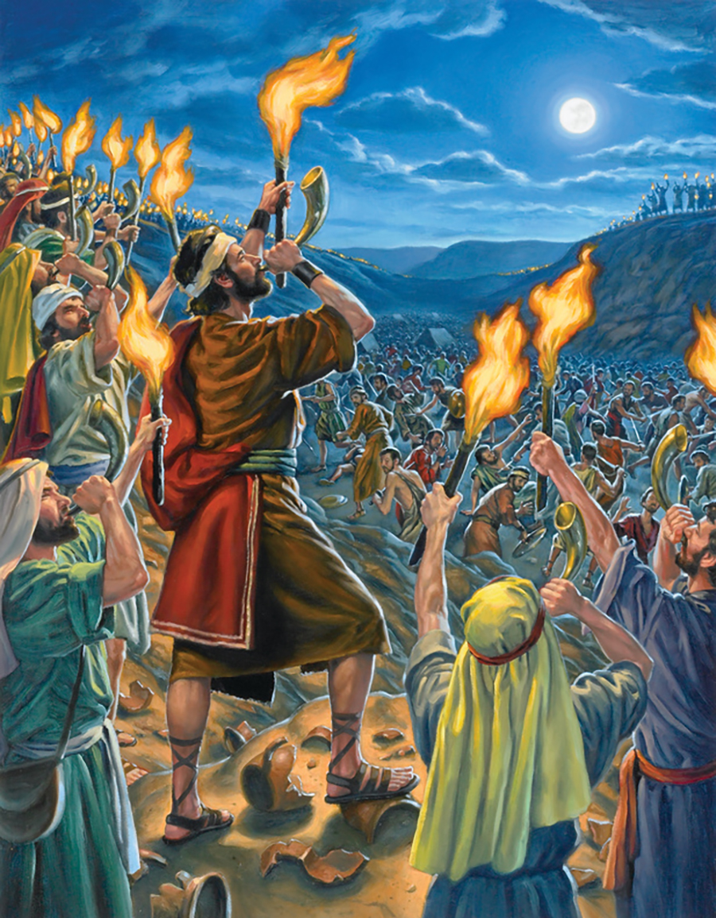
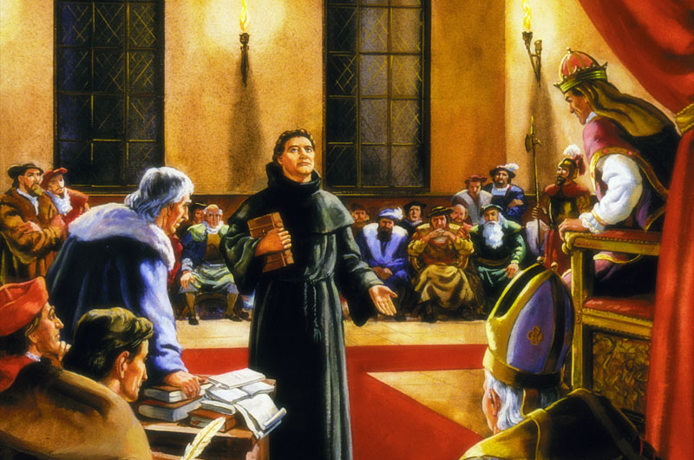
COURAGE
When in faith we take hold of His strength, He will change, wonderfully change, the most hopeless, discouraging outlook. He will do this for the glory of His name. God calls upon His faithful ones, who believe in Him, to talk courage to those who are unbelieving and hopeless. May the Lord help us to help one another, and to prove Him by living faith.—Testimonies for the Church 8:12. ChS 234.
Gideon
That acts
with courage and determination in the face of risky or difficult situations.
That implies or denotes courage.
A great work is to be accomplished; broader plans must be laid; a voice must go forth to arouse the nations. Men whose faith is weak and wavering are not the ones to carry forward the work at this important crisis. We need the courage of heroes and the faith of martyrs.—Testimonies for the Church 5:187. ChS 234.
Hope and courage are essential to perfect service for God. These are the fruit of faith. Despondency is sinful and unreasonable.—Prophets and Kings, 164. ChS 235.
Courage, energy, and perseverance they must possess. Though apparent impossibilities obstruct their way, by His grace they are to go forward. Instead of deploring difficulties, they are called upon to surmount them. They are to despair of nothing, and to hope for everything. With the golden chain of His matchless love, Christ had bound them to the throne of God. It is His purpose that the highest influence in the universe, emanating from the Source of all power, shall be theirs. They are to have power to resist evil, power that neither earth, nor death, nor hell can master, power that will enable them to overcome as Christ overcame. GW 39.

Slide 13

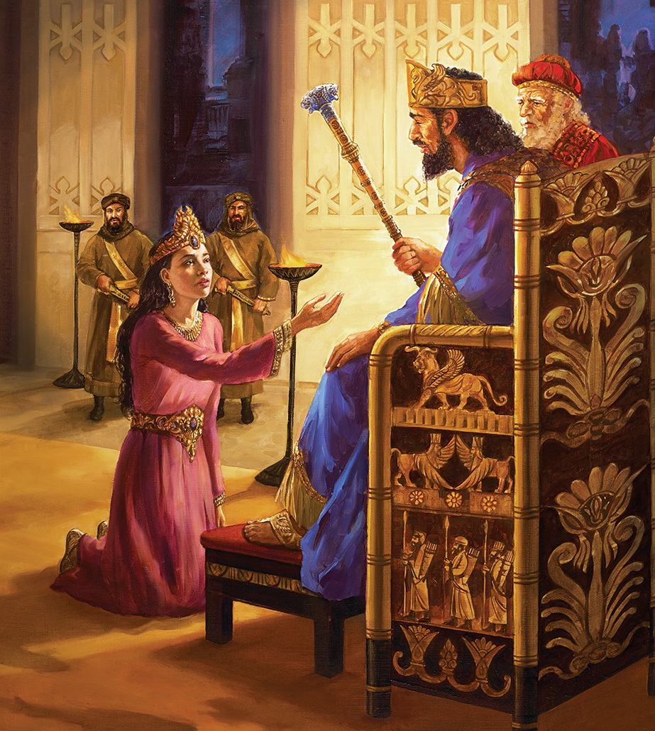
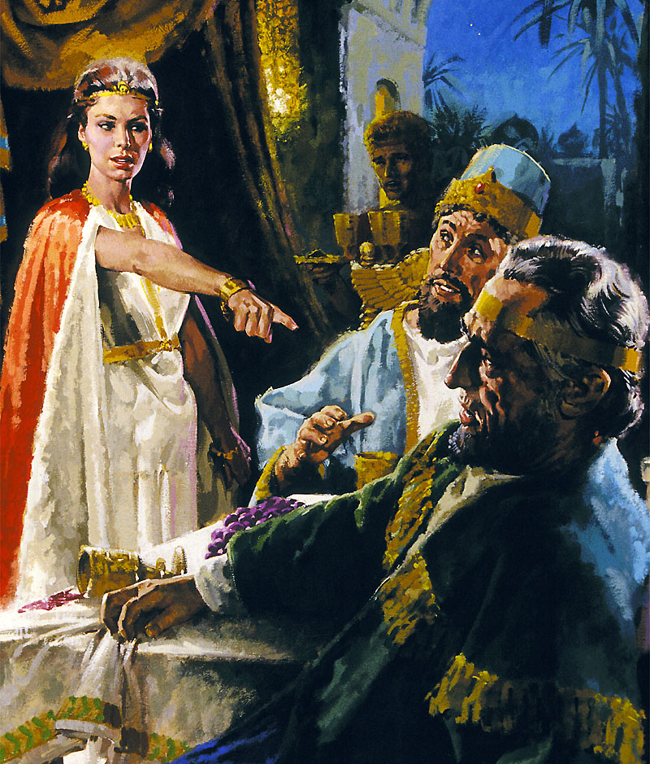

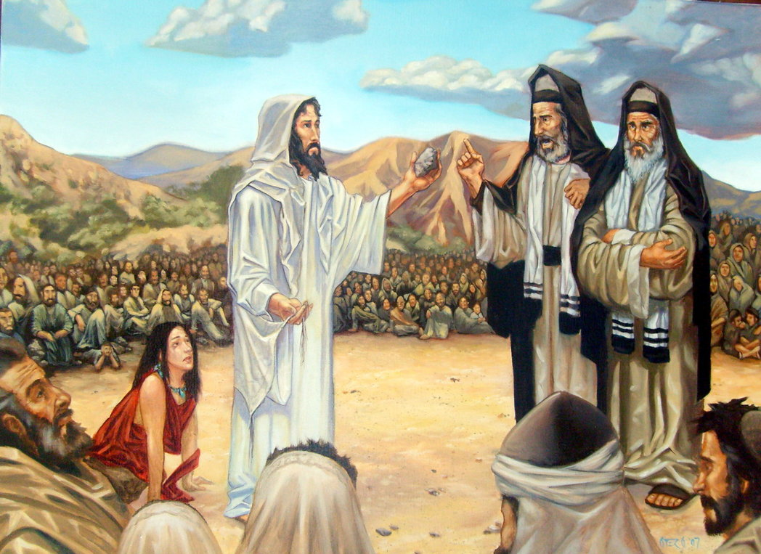
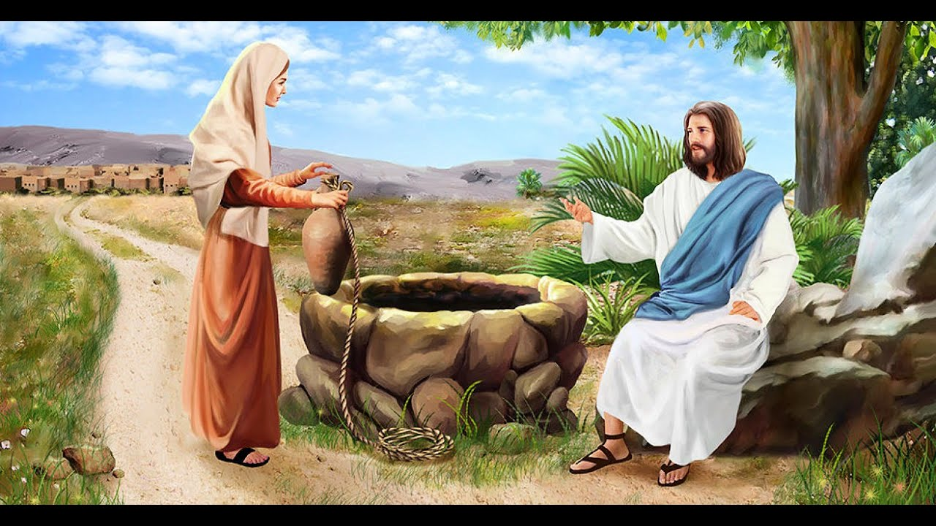
Ester
If a man has tact, industry, and enthusiasm, he will make a success in temporal business, and the same qualities, consecrated to the work of God, will prove even doubly efficient; for divine power will be combined with human effort.—Testimonies for the Church 5:276. ChS 231
TACT
Prudence to proceed in a delicate matter.
Those who surrender wholly to God will put thought and prayer and earnest, consecrated tact into their labors.—The Signs of the Times, May 29, 1893. ChS 230.
In the work of soul-winning, great tact and wisdom are needed. The Saviour never suppressed the truth, but He uttered it always in love. In His intercourse with others, He exercised the greatest tact, and He was always kind and thoughtful. He was never rude, never needlessly spoke a severe word, never gave unnecessary pain to a sensitive soul. He did not censure human weakness. He fearlessly denounced hypocrisy, unbelief, and iniquity, but tears were in His voice as He uttered His scathing rebukes. He never made truth cruel, but ever manifested a deep tenderness for humanity. Every soul was precious in His sight. He bore Himself with divine dignity; yet He bowed with the tenderest compassion and regard to every member of the family of God. He saw in all, souls whom it was His mission to save.—Gospel Workers, 117. ChS 231.
This message must be given, but while it must be given, we should be careful not to thrust and crowd and condemn those who have not the light that we have. We should not go out of our way to make hard thrusts at the Catholics. Among the Catholics there are many who are most conscientious Christians, and who walk in all the light that shines upon them, and God will work in their behalf.—Testimonies for the Church 9:243. ChS 231.

Slide 14


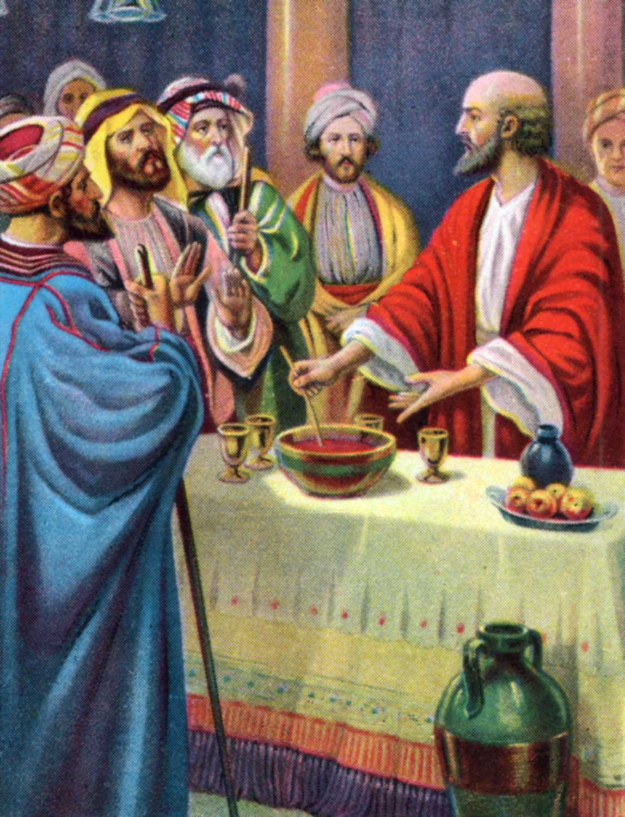
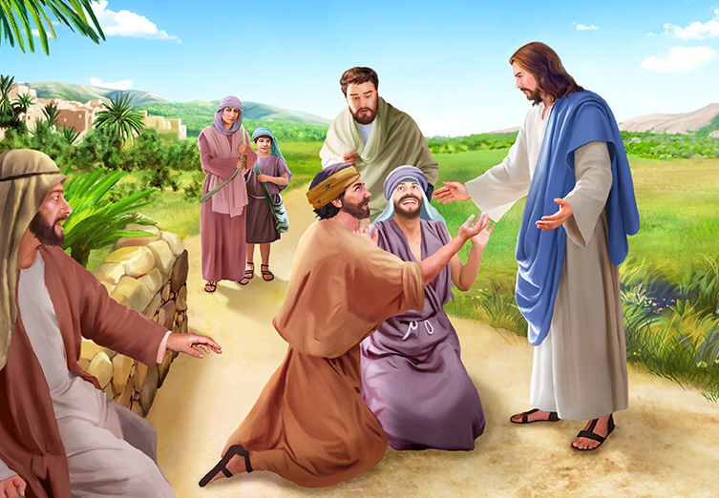
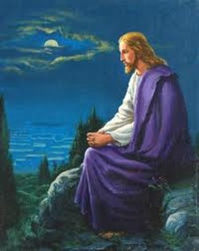
The true Christian works for God, not from impulse, but from principle; not for a day or a month, but during the entire life.—Counsels to Parents, Teachers, and Students, 518. ChS 232.
CONSTANCY
Firmness and perseverance of mind in resolutions and purposes.
The Saviour was an untiring worker. He did not measure His work by hours. His time, His heart, His strength, were given to labor for the benefit of humanity. Entire days were devoted to labor, and entire nights were spent in prayer, that He might be braced to meet the wily foe in all his deceptive working, and fortified to do His work of uplifting and restoring humanity. The man who loves God does not measure his work by the eight-hour system. He works at all hours, and is never off duty. As he has opportunity, he does good. Everywhere, at all times and in all places, he finds opportunity to work for God. He carries fragrance with him wherever he goes.—Testimonies for the Church 9:45. ChS 232.
Rechabites
In all ages God's appointed witnesses have exposed themselves to reproach and persecution for the truth's sake. Joseph was maligned and persecuted.... David, the chosen messenger of God, was hunted like a beast of prey by his enemies.... Stephen was stoned because he preached Christ and Him crucified. Paul was imprisoned, beaten with rods, stoned, and finally put to death.... John was banished to the Isle of Patmos “for the word of God, and for the testimony of Jesus Christ.” CC 369.2 These examples of human steadfastness bear witness to the faithfulness of God's promises—of His abiding presence and sustaining grace. They testify to the power of faith to withstand the powers of the world. CC 369.
Jeremiah 35:1-10

Slide 15

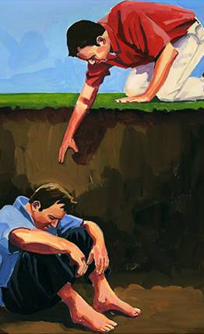

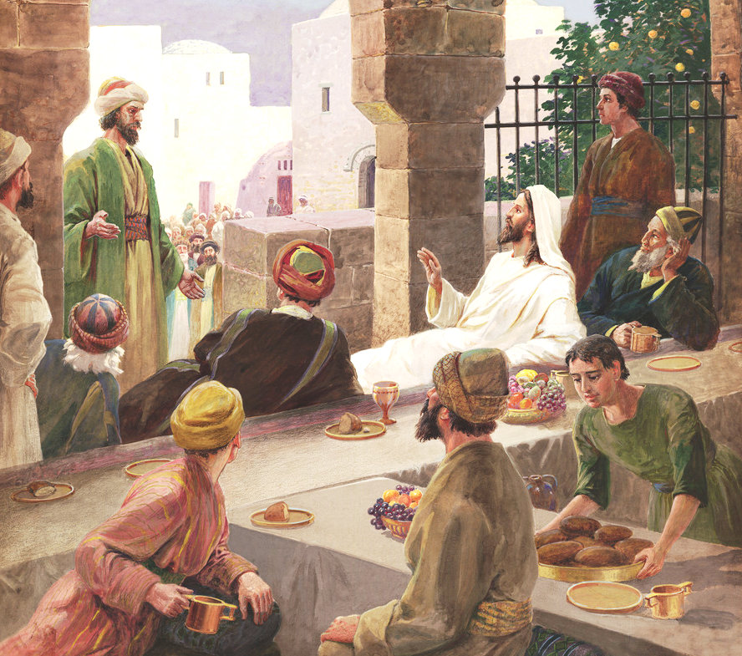
The Saviour was a guest at the feast of a Pharisee. He accepted invitations from the rich as well as the poor, and, according to His custom, He linked the scene before Him with His lessons of truth.—Christ's Object Lessons, 219. ChS 233.
SYMPATHY AND SOCIABILITY
Sympathy: It is the ability to perceive and feel, so that one experiences how another person feels emotions. Affinity, mutual inclination, and kindness.
Sociability: It is the ability to relate to one's peers.
We need more Christlike sympathy; not merely sympathy for those who appear to us to be faultless, but sympathy for poor, suffering, struggling souls, who are often overtaken in fault, sinning and repenting, tempted and discouraged. We are to go to our fellow-men, touched, like our merciful High Priest, with the feeling of their infirmities.—The Ministry of Healing, 163, 164. GW 141.
Jesus
As a people we lose much by lack of sympathy and sociability with one another. He who talks of independence and shuts himself up to himself, is not filling the position that God designed he should. We are children of God, mutually dependent upon one another for happiness. The claims of God and of humanity are upon us. We must all act our part in this life. It is the proper cultivation of the social elements of our nature that brings us into sympathy with our brethren, and affords us happiness in our efforts to bless others.—Testimonies 4:71, 72. ChS 233.
In every department of the cause of God, there is need of men and women who have sympathy for the woes of humanity ChS 232.

Slide 16


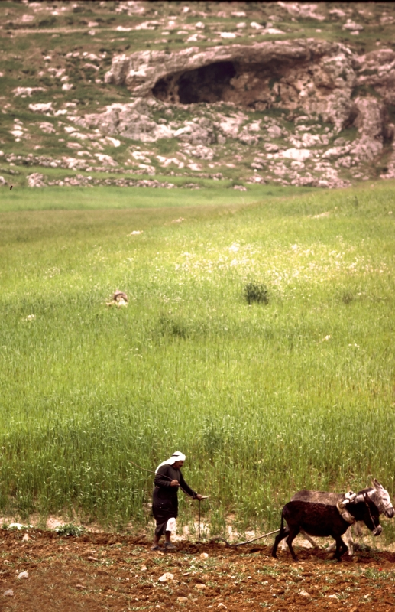

When Christ said to the disciples, Go forth in My name to gather into the church all who believe, He plainly set before them the necessity of maintaining simplicity. The less ostentation and show, the greater would be their influence for good. The disciples were to speak with the same simplicity with which Christ had spoken.—The Acts of the Apostles, 28. ChS 233.
SIMPLICITY
Amos
It is the quality of being simple, not difficult, that does not offer major challenges to understanding. That has no composition, lacks ostentation or does not offer difficulty.
Thousands can be reached in the most simple and humble way. The most intellectual, those who are looked upon as the world's most gifted men and women, are often refreshed by the simple words of one who loves God, and who can speak of that love as naturally as the worldling speaks of the things that interest him most deeply. COL 232.1
Often the words well prepared and studied have but little influence. But the true, honest expression of a son or daughter of God, spoken in natural simplicity, has power to unbolt the door to hearts that have long been closed against Christ and His love. COL 232.
(Amos 7:14-15)
Kindly words simply spoken, little attentions simply bestowed, will sweep away the clouds of temptation and doubt that gather over the soul. The true heart-expression of Christlike sympathy, given in simplicity, has power to open the door of hearts that need the simple, delicate touch of the Spirit of Christ.—Testimonies For The Church 9:30 (1909). Ev 483.

Slide 17


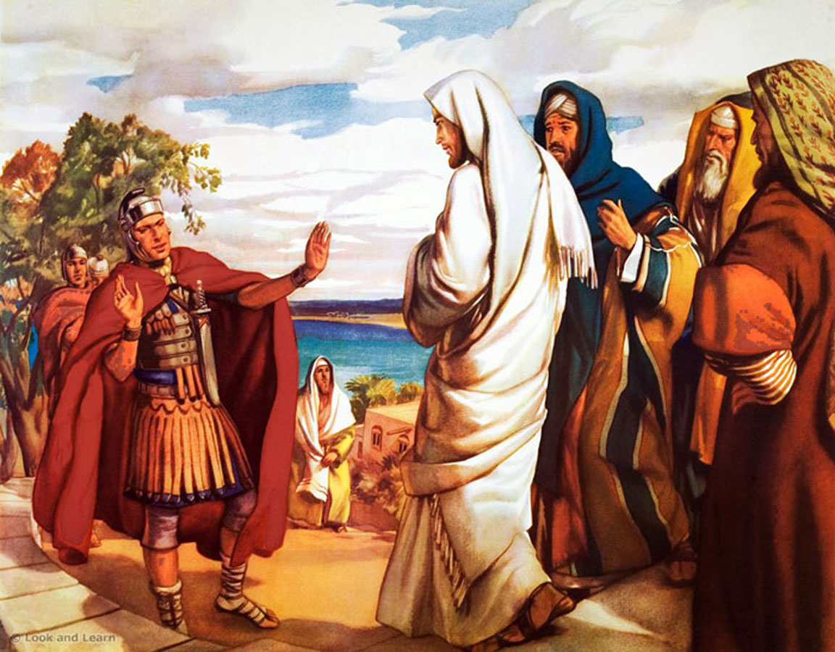
There is in genuine faith a buoyancy, a steadfastness of principle, and a fixedness of purpose, that neither time nor toil can weaken.—Christ's Object Lessons, 147. ChS 234.
FAITH
Believe and trust. It is the security that a person feels with respect to God, something or someone.
The worker for God needs strong faith. Appearances may seem forbidding; but in the darkest hour there is light beyond. The strength of those who, in faith, love and serve God, will be renewed day by day.—Gospel Workers, 262. ChS 234.
God's workers need faith in God. He is not unmindful of their labors. He values their work. Divine agencies are appointed to co-operate with those who are laborers together with God. When we think that God will not do as He has said, and that He has no time to notice His workers, we dishonor our Maker.—The Southern Watchman, August 2, 1904 (The Review and Herald, July 30, 1901). ChS 233.
Centurion
Often the Christian life is beset by dangers, and duty seems hard to perform. The imagination pictures impending ruin before and bondage or death behind. Yet the voice of God speaks clearly, “Go forward.” We should obey this command, even though our eyes cannot penetrate the darkness, and we feel the cold waves about our feet. The obstacles that hinder our progress will never disappear before a halting, doubting spirit. Those who defer obedience till every shadow of uncertainty disappears and there remains no risk of failure or defeat will never obey at all. Unbelief whispers, “Let us wait till the obstructions are removed, and we can see our way clearly”; but faith courageously urges an advance, hoping all things, believing all things.—Patriarchs and Prophets, 289, 290. BLJ 331.

Slide 18

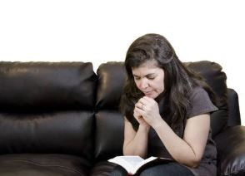

It is not a conclusive evidence that a man is a Christian because he manifests spiritual ecstasy under extraordinary circumstances. Holiness is not rapture: it is an entire surrender of the will to God; it is living by every word that proceeds from the mouth of God; it is doing the will of our heavenly Father; it is trusting God in trial, in darkness as well as in the light; it is walking by faith and not by sight; it is relying on God with unquestioning confidence, and resting in His love. FLB 140.
CONSECRATION
To dedicate oneself with great efficiency and ardor to a certain end, or to God.
Samuel
This is the condition of true Christian living. Christ asks for an unreserved consecration, for undivided service. He demands the heart, the mind, the soul, the strength. Self is not to be cherished. He who lives to himself is not a Christian. COL 48.
When the grace of God takes possession of the heart, it is seen that the inherited and cultivated tendencies to wrong must be crucified. A new life, under new control, must begin in the soul. All that is done must be done to the glory of God. This work includes the outward as well as the inward man. The entire being, body, soul, and spirit, must be brought into subjection to God, to be used by Him as an instrument of righteousness. MYP 68.

Slide 19

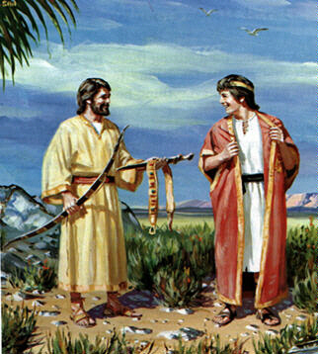

The Lord abhors indifference and disloyalty in a time of crisis in His work. The whole universe is watching with inexpressible interest the closing scenes of the great controversy between good and evil. The people of God are nearing the borders of the eternal world; what can be of more importance to them than that they be loyal to the God of heaven? All through the ages, God has had moral heroes, and He has them now—those who, like Joseph and Elijah and Daniel, are not ashamed to acknowledge themselves His peculiar people. His special blessing accompanies the labors of men of action, men who will not be swerved from the straight line of duty, but who with divine energy will inquire, “Who is on the Lord's side?” (Exodus 32:26), men who will not stop merely with the inquiry, but who will demand that those who choose to identify themselves with the people of God shall step forward and reveal unmistakably their allegiance to the King of kings and Lord of lords. Such men make their wills and plans subordinate to the law of God. For love of Him they count not their lives dear unto themselves. Their work is to catch the light from the Word and let it shine forth to the world in clear, steady rays. Fidelity to God is their motto. PK 148.
LOYALTY
That keeps someone or something the due fidelity. Trustworthy, truthful and faithful, in the treatment or in the performance of an office or position.
Jonathan
The greatest want of the world is the want of men—men who will not be bought or sold, men who in their inmost souls are true and honest, men who do not fear to call sin by its right name, men whose conscience is as true to duty as the needle to the pole, men who will stand for the right though the heavens fall. Ed 57.

Slide 20


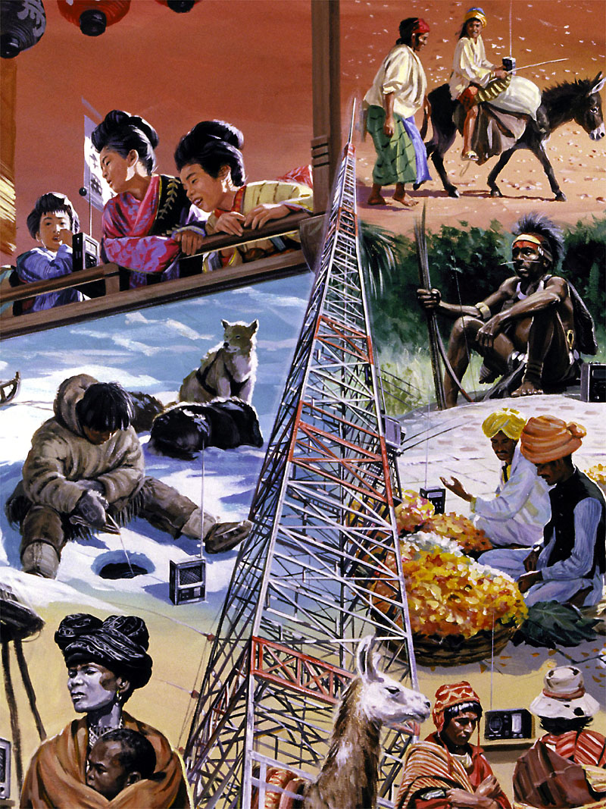
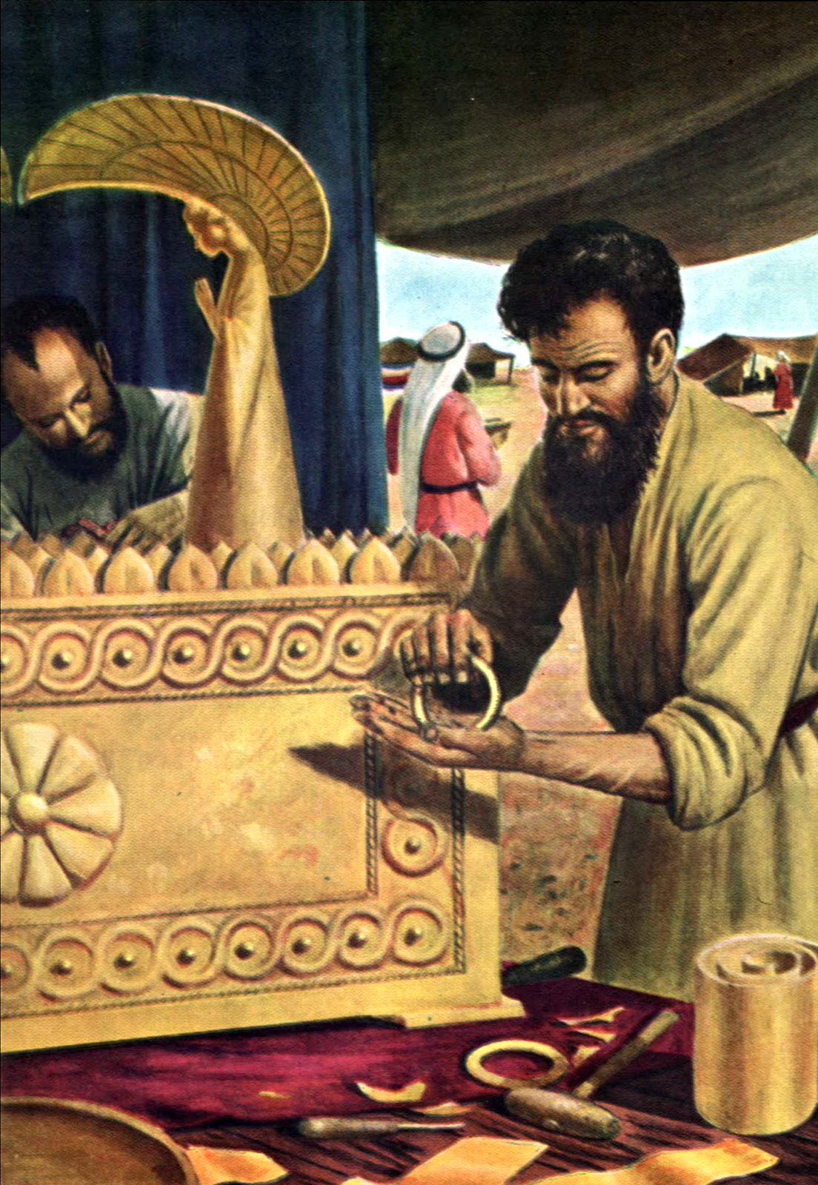
SKILL
Industry in a God-appointed duty is an important part of true religion. Men should seize circumstances as God's instruments with which to work His will. Prompt and decisive action at the right time will gain glorious triumphs, while delay and neglect result in failure and dishonor to God.—Prophets and Kings, 676. ChS 238.
Ability, art, elegance or propriety with which something is done.
It is the duty of every Christian to acquire habits of order, thoroughness, and dispatch. There is no excuse for slow bungling at work of any character. When one is always at work and the work is never done, it is because mind and heart are not put into the labor. The one who is slow and who works at a disadvantage should realize that these are faults to be corrected.
Bezaleel
He needs to exercise his mind in planning how to use the time so as to secure the best results. By tact and method, some will accomplish as much in five hours as others do in ten. Some who are engaged in domestic labor are always at work not because they have so much to do but because they do not plan so as to save time. By their slow, dilatory ways they make much work out of very little. But all who will, may overcome these fussy, lingering habits. In their work let them have a definite aim. Decide how long a time is required for a given task, and then bend every effort toward accomplishing the work in the given time. The exercise of the will power will make the hands move deftly. COL 344.

Slide 21

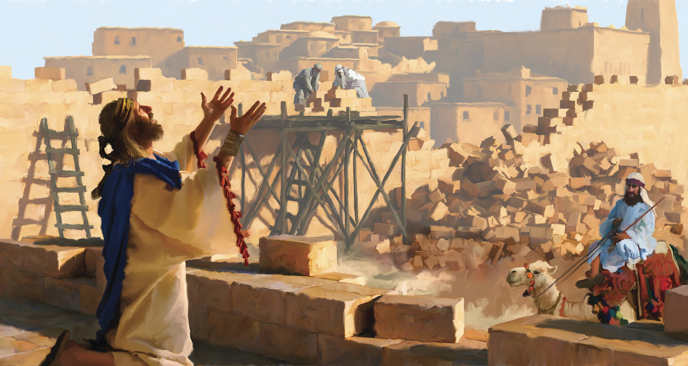
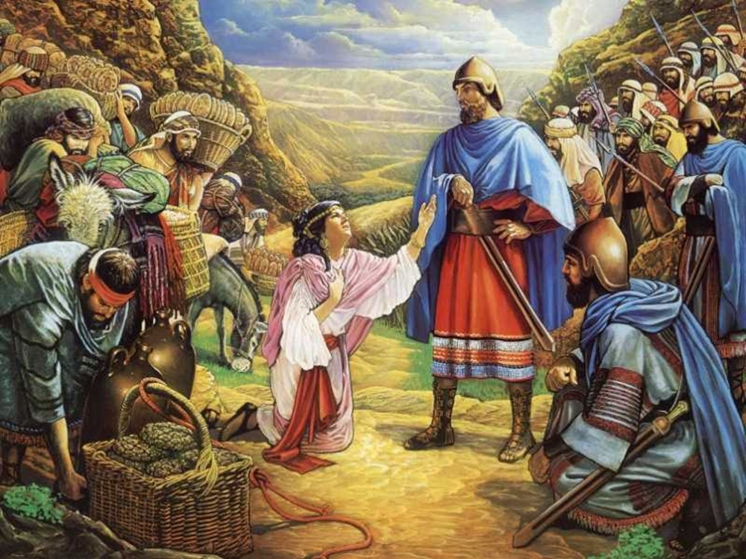
PRUDENCE AND FORESIGHT
Nehemiah
Without consulting her husband or telling him of her intention, Abigail made up an ample supply of provisions, which, laded upon asses, she sent forward in the charge of servants, and herself started out to meet the band of David. She met them in a covert of a hill. “And when Abigail saw David, she hasted, and lighted off the ass, and fell before David on her face, and bowed herself to the ground, and fell at his feet, and said, Upon me, my lord, upon me let this iniquity be: and let thine handmaid, I pray thee, speak in thine audience.” DG 42
Prudence: Temperance, caution, moderation. Reasonableness, good judgment.
Foresight: The action of arranging what is convenient to meet contingencies or foreseeable needs, seeing in advance to dispose or prepare means against future contingencies.
The example of this holy man [Nehemiah] should be a lesson to all the people of God, that they are not only to pray in faith, but to work with diligence and fidelity. How many difficulties we encounter, how often we hinder the working of Providence in our behalf, because prudence, forethought, and painstaking are regarded as having little to do with religion! This is a grave mistake. It is our duty to cultivate and to exercise every power that will render us more efficient workers for God. Careful consideration and well-matured plans are as essential to the success of sacred enterprises today as in the time of Nehemiah.—The Southern Watchman, March 15, 1904. ChS 239.

Slide 22


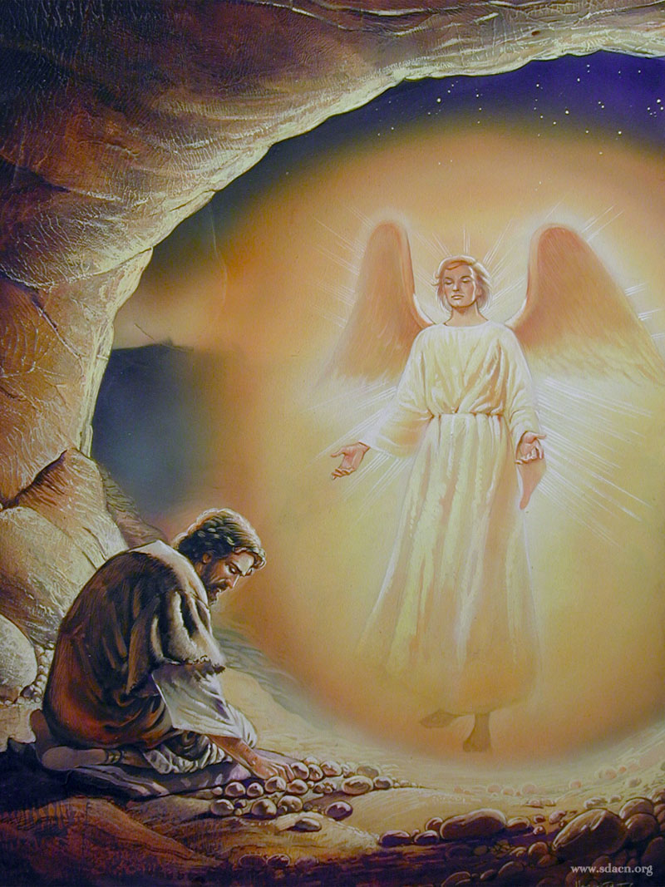

Cheer
Those who, standing in the forefront of the conflict, are impelled by the Holy Spirit to do a special work, will frequently feel a reaction when the pressure is removed. Despondency may shake the most heroic faith and weaken the most steadfast will. But God understands, and He still pities and loves. He reads the motives and the purposes of the heart. To wait patiently, to trust when everything looks dark, is the lesson that the leaders in God's work need to learn. Heaven will not fail them in their day of adversity. Nothing is apparently more helpless, yet really more invincible, than the soul that feels its nothingness and relies wholly on God. PK 174.
Elijah
Vigor of spirit, effort, courage. Consolation, relief.
The Lord calls for soldiers who will not fail nor be discouraged; but who will accept the work with all its disagreeable features. He would have us all take Christ for our pattern.—The Review and Herald, July 17, 1894. ChS 240.
Those who today teach unpopular truths need not be discouraged if at times they meet with no more favorable reception, even from those who claim to be Christians, than did Paul and his fellow workers from the people among whom they labored. The messengers of the cross must arm themselves with watchfulness and prayer, and move forward with faith and courage, working always in the name of Jesus. AA 230.

Slide 23

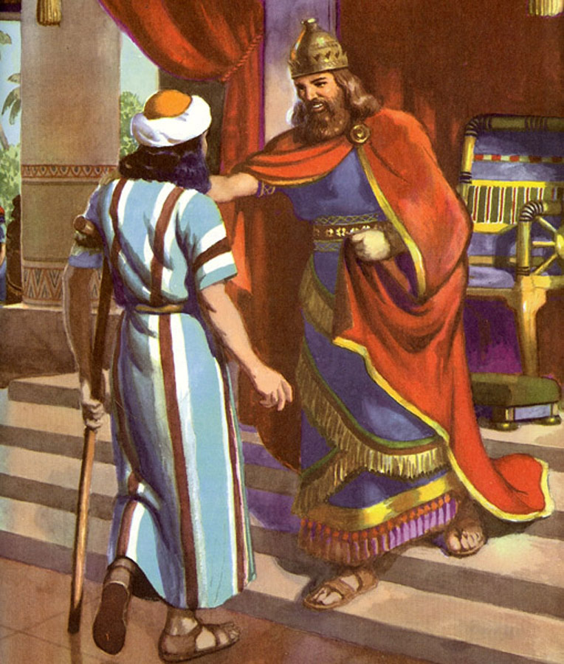
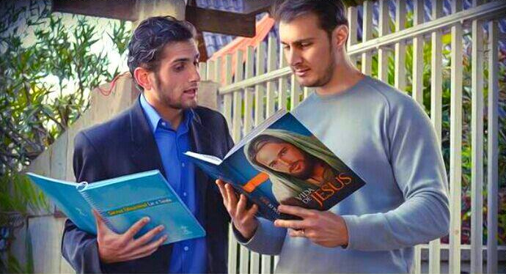
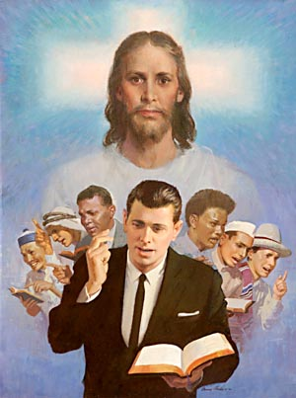
A tender spirit, a gentle, winning deportment, may save the erring, and hide a multitude of sins. The revelation of Christ in your own character will have a transforming power upon all with whom you come in contact. Let Christ be daily made manifest in you, and He will reveal through you the creative energy of His words,—a gentle, persuasive, yet mighty influence to re-create other souls in the beauty of the Lord our God.—Thoughts From the Mount of Blessing, 129. ChS 241.
BENEVOLENCE
Who exercises goodwill or sympathy towards people or their deeds.
David
As the dew and the still showers fall upon the withering plants, so let words fall gently when seeking to win men from error. God's plan is first to reach the heart. We are to speak the truth in love, trusting in Him to give it power for the reforming of the life. The Holy Spirit will apply to the soul the word that is spoken in love. MH 157.
The spirit that is kept gentle under provocation will speak more effectively in favor of the truth than will any argument, however forcible.—The Desire of Ages, 353. ChS 241.

Slide 24

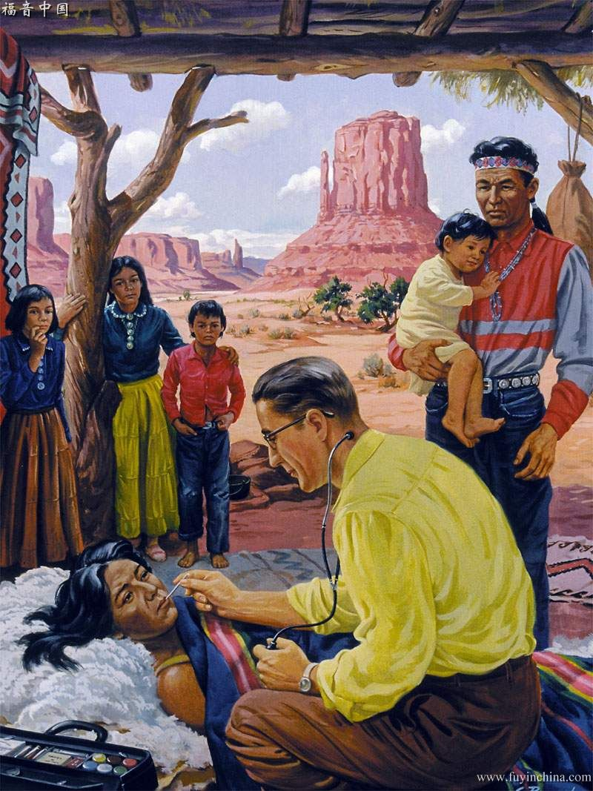

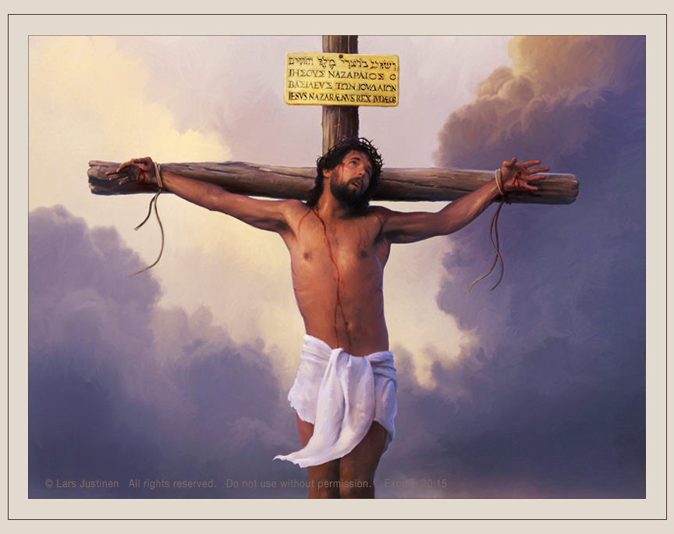
Christ's work is to be our example. Constantly He went about doing good. In the temple and the synagogues, in the streets of the cities, in the market place and the workshop, by the seaside and among the hills, He preached the gospel and healed the sick. His life was one of unselfish service, and it is to be our lesson book. His tender, pitying love rebukes our selfishness and heartlessness. 3TT 298.
ABNEGATION
Sacrificing or renouncing one’s desires or interests, usually for religious reasons or altruism.
The motive that prompts us to work for Lord should have in it nothing akin to self-serving. Unselfish devotion and a spirit of sacrifice have always been and always will be the first requisite of acceptable service. Our Lord and Master designs that not one thread of selfishness shall be woven into His work. Into our efforts we are to bring the tact and skill, the exactitude and wisdom, that the God of perfection required of the builders of the earthly tabernacle; yet in all our labors we are to remember that the greatest talents or the most splendid services are acceptable only when self is laid upon the altar, a living, consuming sacrifice.—Prophets and Kings, 65. ChS 242.

Slide 25

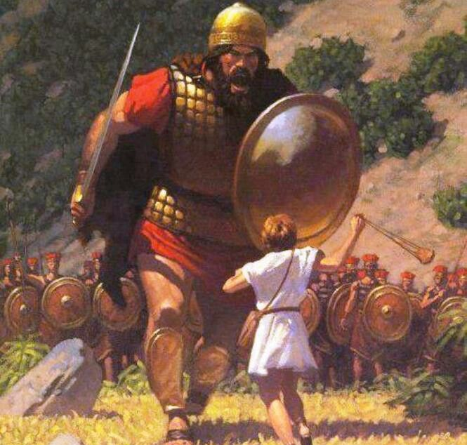
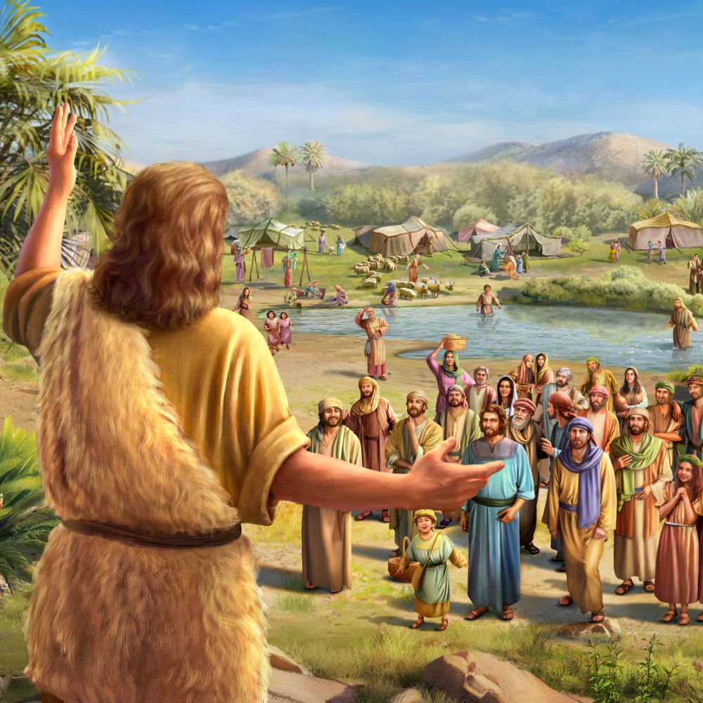
God calls for men like Elijah, Nathan, and John the Baptist,—men who will bear His message with faithfulness, regardless of the consequences; men who will speak the truth bravely, though it call for the sacrifice of all they have.—Prophets and Kings, 142. ChS 245.
BRAVE AND TRUTHFUL
Brave: Capable of undertaking a risky undertaking despite the danger and possible fear it raises.
Truthful: Who always says, uses or professes the truth.
What the church needs in these days of peril is an army of workers who, like Paul, have educated themselves for usefulness, who have a deep experience in the things of God, and who are filled with earnestness and zeal. Sanctified, self-sacrificing men are needed; men who will not shun trial and responsibility; men who are brave and true; men in whose hearts Christ is formed “the hope of glory,” and who with lips touched with holy fire will “preach the word.” For want of such workers the cause of God languishes, and fatal errors, like a deadly poison, taint the morals and blight the hopes of a large part of the human race. AA 507.
David
God cannot use men who, in time of peril, when the strength, courage, and influence of all are needed, are afraid to take a firm stand for the right. He calls for men who will do faithful battle against wrong, warring against principalities and powers, against the rulers of the darkness of this world, against spiritual wickedness in high places. It is to such as these that He will speak the words: “Well done, good and faithful servant; ... enter thou into the joy of thy Lord.” Matthew 25:23 PK 142.

Slide 26

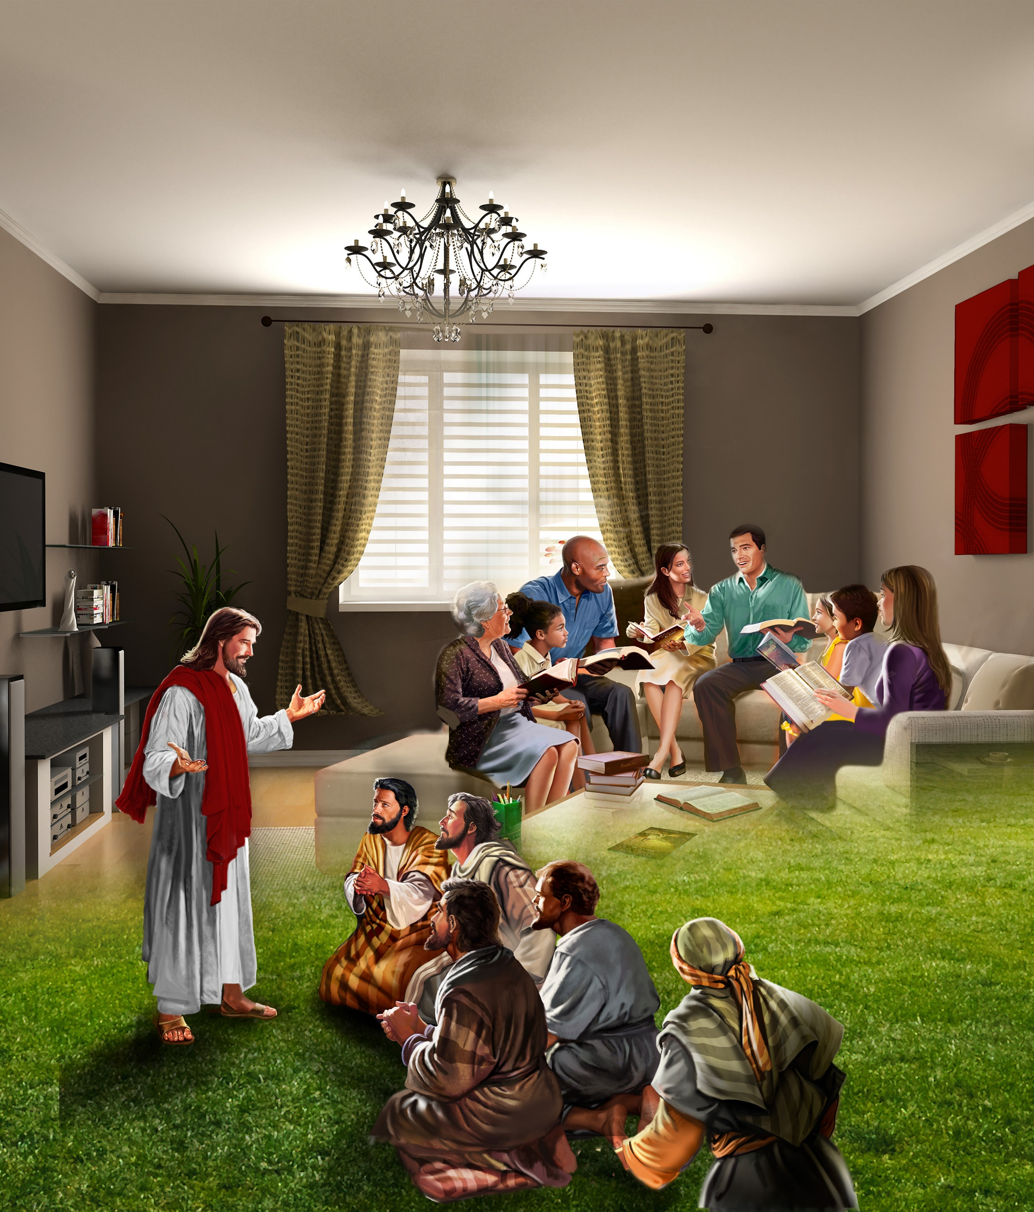

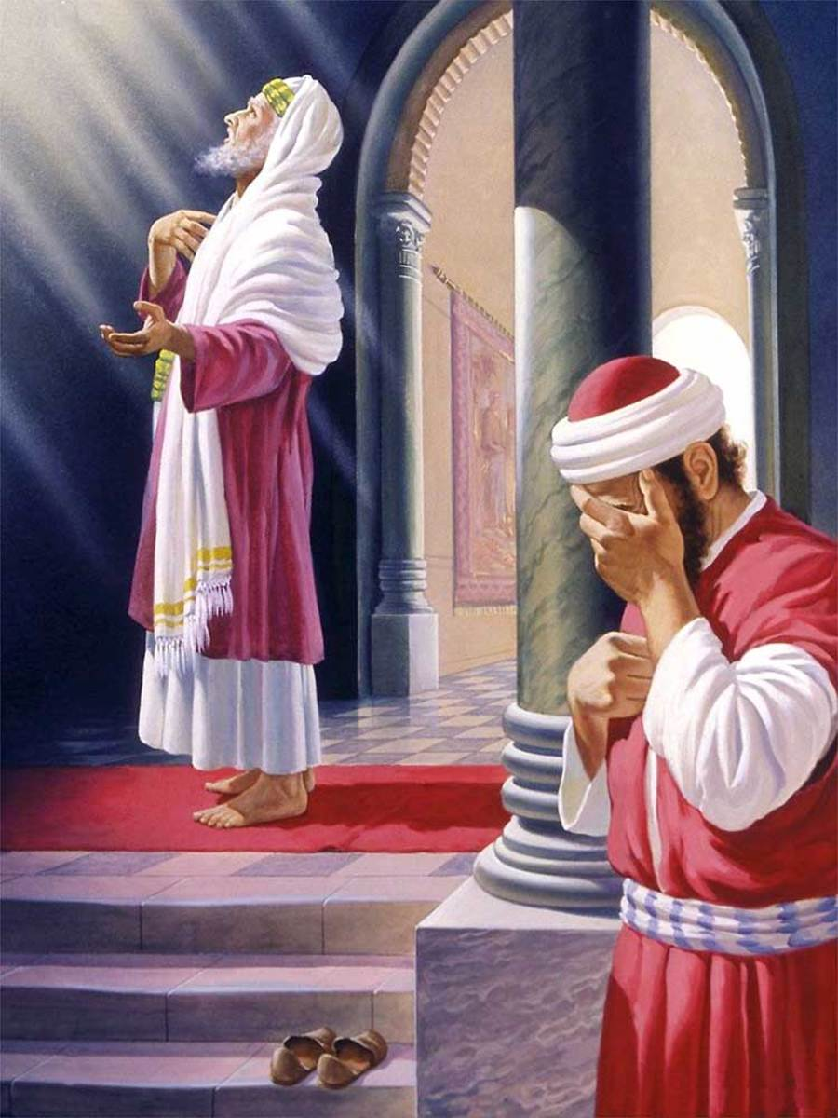
In choosing men and women for His service, God does not ask whether they possess learning or eloquence or worldly wealth. He asks: “Do they walk in such humility that I can teach them My way? Can I put My words into their lips? Will they represent Me?”—Testimonies for the Church 7:144. ChS 246.
HUMILITY
A virtue that consists in the knowledge of one's own limitations and weaknesses and in acting in accordance with this knowledge.
All heaven is interested in this work that God's messengers are carrying forward in the world, in the name of Jesus Christ of Nazareth. This is a great work, brethren and sisters, and we should humble ourselves daily before God, and not feel that our wisdom is perfect. We should take hold of the work with earnestness. We should not pray for God to humble us; for when God takes hold of us, He will humble us in a way that we would not enjoy. But we must day by day humble ourselves under the mighty hand of God. We are to work out our own salvation with fear and with trembling. While it is God that works in us to will and to do of His own good pleasure, we are to co-operate with Him while He works through us.—The Review and Herald, July 12, 1887. ChS 246.
Publican
Before honor is humility. To fill a high place before men, Heaven chooses the worker who, like John the Baptist, takes a lowly place before God. The most childlike disciple is the most efficient in labor for God. The heavenly intelligences can co-operate with him who is seeking, not to exalt self, but to save souls. DA 436.

Slide 27


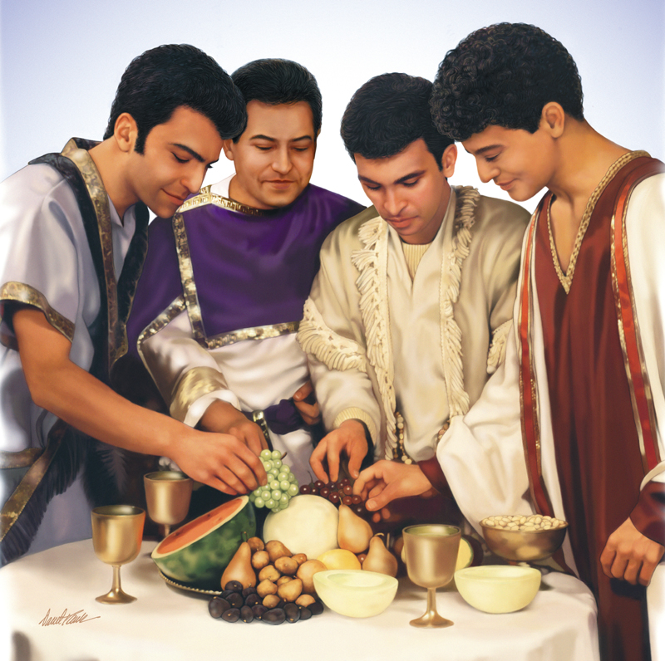
The misuse of our physical powers shortens the period of time in which our lives can be used for the glory of God. And it unfits us to accomplish the work God has given us to do. By allowing ourselves to form wrong habits, by keeping late hours, by gratifying appetite at the expense of health, we lay the foundation for feebleness. By neglecting physical exercise, by overworking mind or body, we unbalance the nervous system. Those who thus shorten their lives and unfit themselves for service by disregarding nature's laws, are guilty of robbery toward God. And they are robbing their fellow men also. The opportunity of blessing others, the very work for which God sent them into the world, has by their own course of action been cut short. And they have unfitted themselves to do even that which in a briefer period of time they might have accomplished. The Lord holds us guilty when by our injurious habits we thus deprive the world of good. COL 346.
TEMPERATE
Moderate, restrained, and sparing in food or drink or in some other appetite or passion.
Daniel
Would that every child of God might be impressed with the necessity of being temperate in his eating, dressing, and working, that he may do the best work for the cause of God. When the laborer has been under a pressure of work and care, and is overworked in mind and body, he should turn aside and rest awhile, not for selfish gratification, but that he may be better prepared for future duties. We have a vigilant foe, who is ever upon our track, to take advantage of every weakness, that he may make his temptations effective for evil. When the mind is overstrained and the body enfeebled, he can take advantage, and press the soul with his fiercest temptations, that he may cause the downfall of the child of God. Let the laborer for God carefully husband his strength; and when wearied with toil that must come upon him, let him turn aside and rest and commune with Jesus.—The Review and Herald, November 14, 1893. ChS 247.

Slide 28
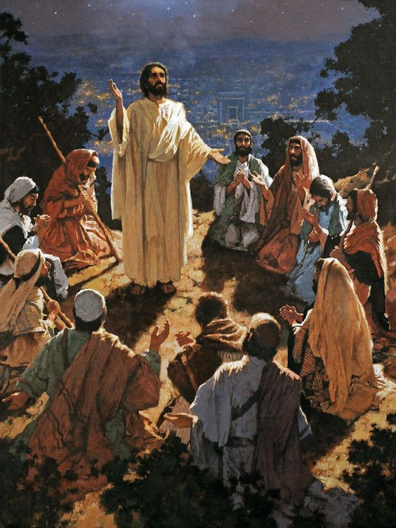


The disciples of Jesus needed to be educated as to how they should labor, and how they should rest. Today there is need that God's chosen workmen should listen to the command of Christ to go apart and rest awhile. Many valuable lives have been sacrificed, that need not have been, through ignorance of this command.... Though the harvest is great and the laborers are few, nothing is gained by sacrificing health and life.... There are many feeble, worn workmen who feel deeply distressed when they see how much there is to be done, and how little they can do. How they long for physical strength to accomplish more; but it is to this class that Jesus says, “Come ye yourselves apart into a desert place, and rest awhile.”—The Review and Herald, November 7, 1893. ChS 249.1.
REST AND REFLECTION
Rest: Rest, interrupt activity to recover from fatigue.
Reflect: To think carefully and carefully about something.
Disciples
All who are under the training of God need the quiet hour for communion with their own hearts, with nature, and with God.... They need to have a personal experience in obtaining a knowledge of the will of God. We must individually hear Him speaking to the heart. When every other voice is hushed, and in quietness we wait before Him, the silence of the soul makes more distinct the voice of God.... Amidst the hurrying throng, and the strain of life's intense activities, he who is thus refreshed will be surrounded with an atmosphere of light and peace. He will receive a new endowment of both physical and mental strength. His life will breathe out a fragrance, and will reveal a divine power that will reach men's hearts. CC 340.

Slide 29
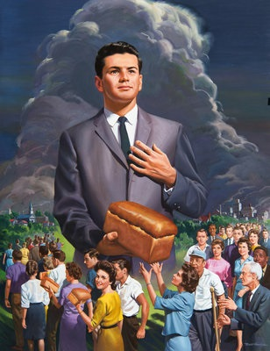
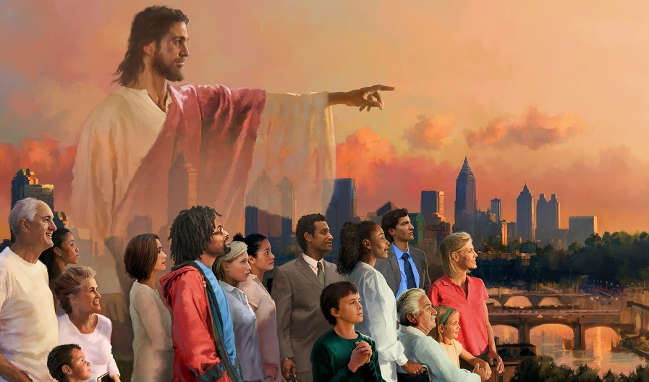

CONCLUSION
When we labor diligently for the salvation of our fellow men, God will prosper our every effort.—Testimonies for the Church 9:85. ChS 257.
God does not ask us to do in our own strength the work before us. He has provided divine assistance for all the emergencies to which our human resources are unequal. He gives the Holy Spirit to help in every strait, to strengthen our hope and assurance, to illuminate our minds and purify our hearts.—The Southern Watchman, August 1, 1905 (Testimonies for the Church 8:19). ChS 253.
The promise of the Holy Spirit is not limited to any age or to any race. Christ declared that the divine influence of His Spirit was to be with His followers unto the end. From the day of Pentecost to the present time, the Comforter has been sent to all who have yielded themselves fully to the Lord and to His service.—The Acts of the Apostles, 49. ChS 250.
Ask God to give you the Holy Spirit and He will put in you the attributes you need for your benefit, and to share His message with others.

