Slide 1
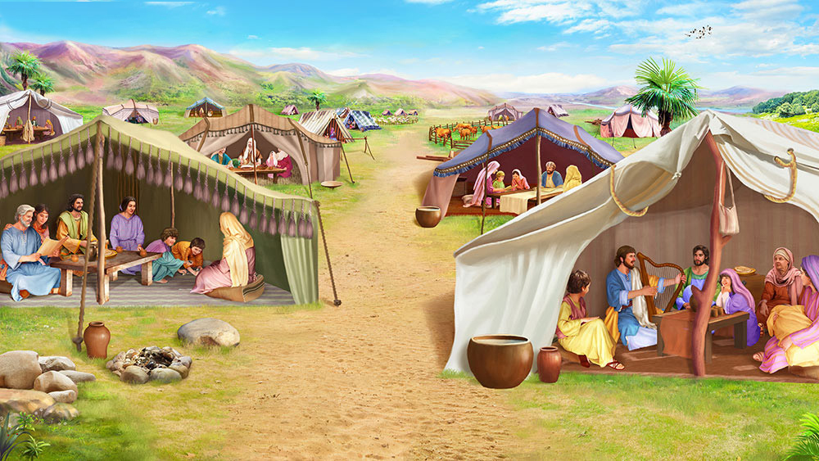

Slide 2

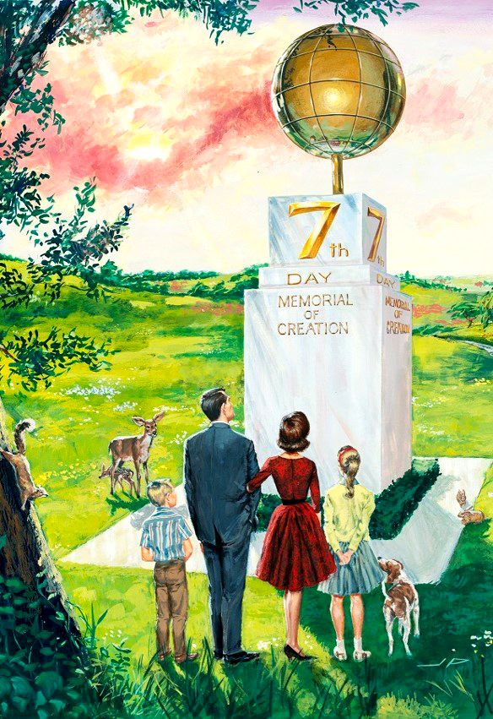
I would like to ask you a question: What is the Sabbath, a sign or a holiday?
Why speak of the Sabbath as a sign? Would it not be more appropriate to refer to the Sabbath in terms of a feast day? To answer these questions, we must first understand the meaning of the word "sign.”
The signs on the route help us to locate ourselves when we are lost. When a person knows where he is going, these are not necessary. However, in the opposite case, there is nothing better.
God says to Moses,: “Speak thou also unto the children of Israel, saying, Verily my sabbaths ye shall keep: for it is a sign between me and you throughout your generations; that ye may know that I am the LORD that doth sanctify you.” Exodus 31:13
Therefore, the Sabbath is a sign. By leading such a hectic and creative life, we tend to turn away from God. That is why the Sabbath is a "signposting" that leads us back to our Creator and strengthens our relationship with Him.
What benefits does Saturday bring me?

Slide 3


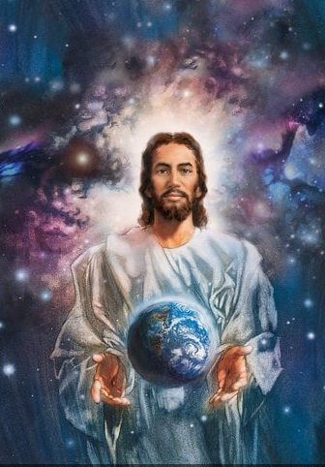
1
Sabbath
It helps me to believe and remember creation.
“Thus the heavens and the earth were finished, and all the host of them. And on the seventh day God ended his work which he had made; and he rested on the seventh day from all his work which he had made. And God blessed the seventh day and sanctified it: because that in it he had rested from all his work which God created and made.” Genesis 2:1-3.
“I am the Lord your God; walk in my statutes, and keep my judgments, and do them; And hallow my sabbaths; and they shall be a sign between me and you, that ye may know that I am the LORD your God.” Ezekiel 20:19, 20.
“The Sabbath was given to all mankind to commemorate the work of Creation. The great Jehovah, when He had laid the foundations of the earth, when he had dressed the whole world in its garb of beauty, and created all the wonders of the land and the sea, instituted the Sabbath day and made it holy. When the morning stars sang together, and all the sons of God shouted for joy, the Sabbath was set apart as God's memorial. God sanctified and blessed the day in which he had rested from all His wondrous work…” OHC 343

Slide 4


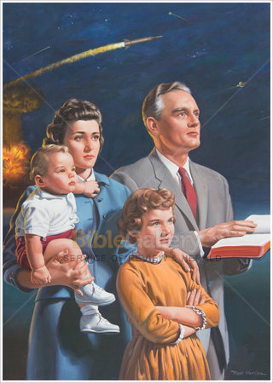

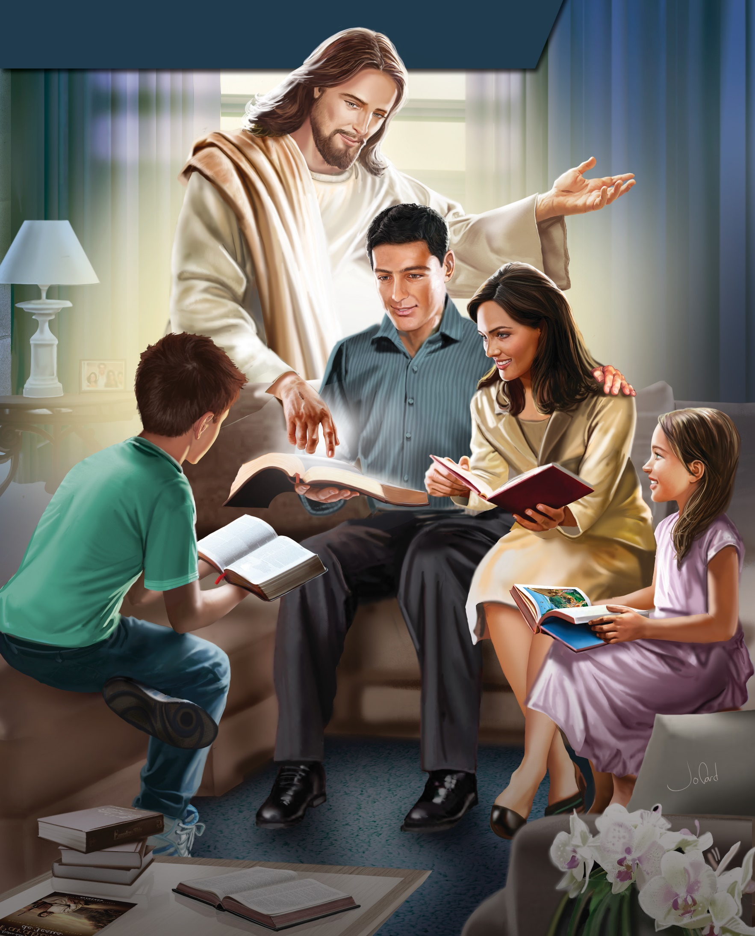
2
Sabbath
It's a benefit for the whole family.
In our socioeconomic context, financial responsibilities consume our time. Many families suffer from the effects of the lack of time to strengthen interpersonal relationships. Economic gains are achieved at the cost of the loss of the family. God has a better plan. The Sabbath provides an opportunity for the family to share quality time and develop healthy family relationships. For those who do not have a family, the Sabbath offers the benefit of living with an extended spiritual family. At Psalm 122:1, we read: "I was glad when they said unto me, Let us go into the house of the Lord.’”
3
Sabbath
It helps me keep the family together.
But the Sabbath is not a day of forced inactivity. On the contrary: it is an opportunity to obtain great achievements. It's a perfect day for the family to finally be united, after six days in which everyone looked out for their own interests, enjoying a Sabbsath meal and the company of their loved ones. The Sabbath meal, which is supplemented by praises to God and the words of the Bible in a peaceful atmosphere, provides a greater opportunity for interaction among family members. Perhaps the Sabbath is what allows for greater stability in an Adventist family.

Slide 5


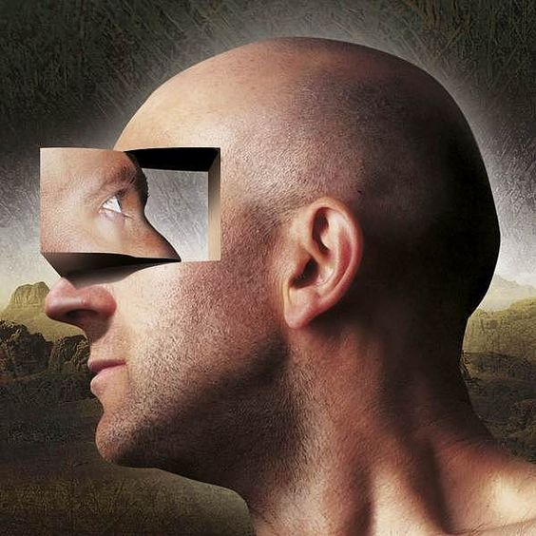
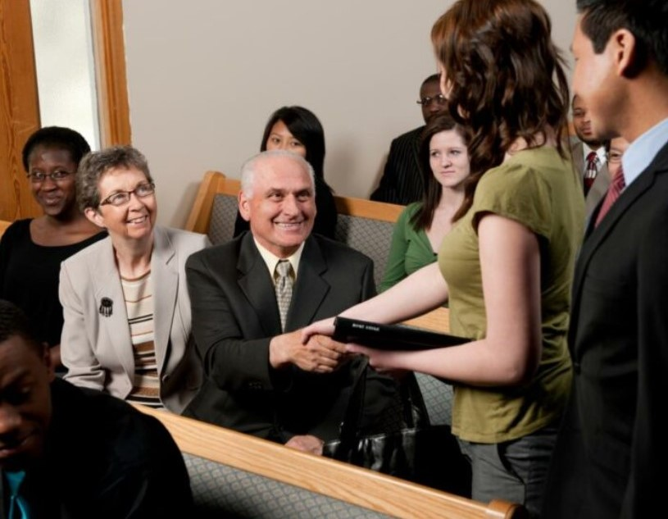

4
Sabbath
It helps me to self-evaluate.
The Sabbath helps man to have a deeper view of himself. It's a day when you don't have to worry about the demands of your employer or teacher. On that day, free from all pressure, a self-evaluation can be made: what has been done; the current moment; Goals... You may struggle with yourself and look for ways to improve. This day of rest is a day of introspection.
5
Sabbath
Combats loneliness.
Loneliness alters our emotional state. We were created to live in community. God said, "It is not good for man to be alone" (Genesis 2:18). Many people suffer the effects of loneliness today. With the Sabbath, God offers a solution to the problem of loneliness. On a spiritual level, each week we have the opportunity to commune with God and with others in the church. to share together the praise of God; and enjoy fellowship.

Slide 6



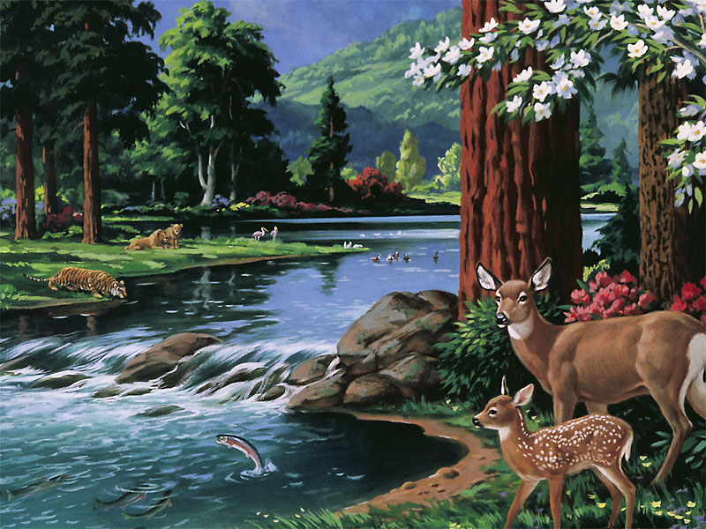

6
Compels me to work six days..
Sabbath
“Remember the sabbath day, to keep it holy. Six days shalt thou labour, and do all thy work:” Exodus 20:8-9
“The first six days of each week are given to us in which to labor, because God employed the same period of the first week in the work of Creation. The seventh day God has reserved as a day of rest, in commemoration of His rest during the same period of time after He had performed the work of Creation in six days.” BLJ 153.3
7
It reminds us that we are stewards of everything and not owners.
Sabbath
When God placed man in the garden of Eden, he had already taken all the provisions for his proper existence. God created him in the last place to realize that he was not the owner of anything, but a steward, and that in order to satisfy all his needs he must depend on his Creator, and not on things, for if he depended on them he would become a slave to them.

Slide 7


8
Relieves stress and anxiety.
Sabbath
In general, stress and anxiety are produced by worries, negative thoughts, fear, and uncertainty.
The word Sabbath derives from the Hebrew verb sabbath, which means rest. The benefit of the Sabbath is that it gives us physical rest, and mental and emotional renewal. Think about this: If God gave Adam and Eve the Sabbath at creation (Genesis 2:1-3), when they were in their state of perfection and their bodies were not deteriorating or getting sick, how much more will the Sabbath not benefit us today, who suffer from tiredness, decay, stress, and anxiety? Experts in the field say that one of the keys to solving the problem of stress and anxiety is rest.
Look at how God anticipated this situation. The fourth commandment says, "Six days you shall labor and do all your work; but on the seventh day is the Sabbath of the Lord thy God..." (Exodus 20:8-11). Notice that the blessing of work and the benefit of rest appear in the text. God's plan is for us to have balanced, healthy lives. With the benefits of the Sabbath, no one needs to suffer the effects of stress and anxiety.

Slide 8







9
It helps us fight depression.
Sabbath
Depression is classified as a mental illness and causes anhedonia, which is the inability to enjoy life. People with low levels of the hormone serotonin, which is responsible for well-being, more easily suffer from depression when they don't rest. In these particular situations, the physical benefits of Sabbath rest are necessary to live the optimistic and positive side of life.
Sabbath rest promotes enjoyment of life, because it raises self-esteem to healthy levels. Of the ten commandments of the Decalogue, only the fourth mentions God as Creator: "For in six days the Lord made the heavens and the earth, the sea, and all things in them, and rested on the seventh day..." (Exodus 20:8-11). Thus, Saturday helps you say goodbye to depression and to welcome happiness!
10
It helps us to be ecological.
Sabbath
On the Sabbath we remember that the world is not ours to do with as we please, but it is God's creation. "God will come to destroy those who destroy the earth." We consume less, no TV, no washing machine…

Slide 9


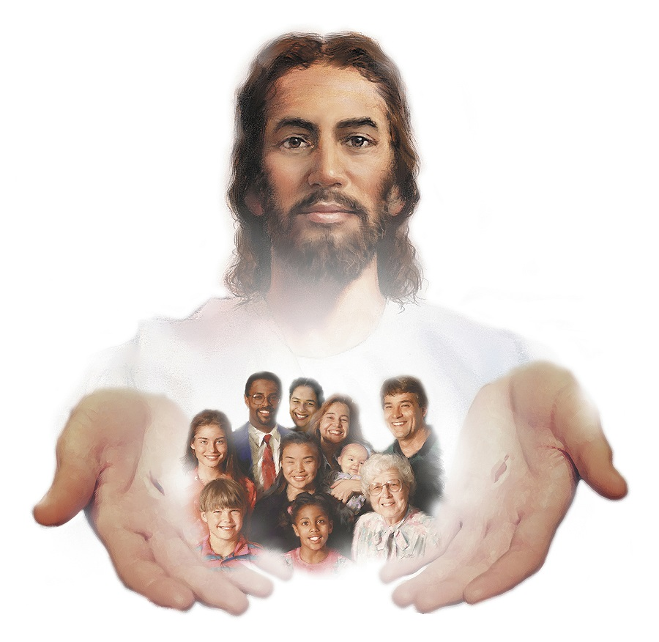



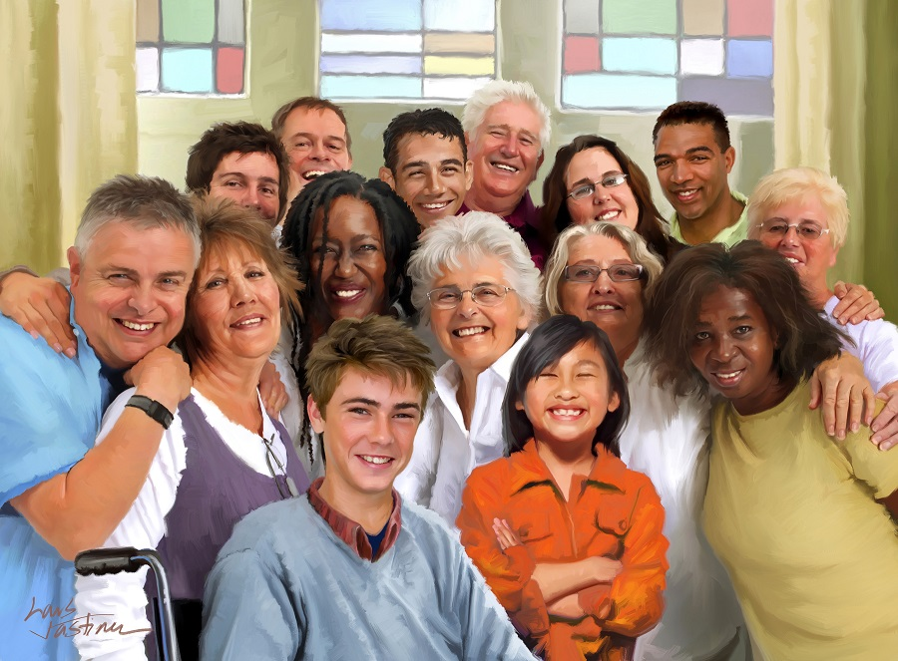

11
It gives purpose to life.
Sabbath
First, it defines our origins. We are the product of an intelligent Designer who created us with a purpose. We're not here by accident.
Second, the Sabbath defines our identity. God is our Creator and heavenly Father, and therefore we are the King's family.
Finally, it marks our future. We have an appointment with God in eternity, as every Sabbath we will worship Him on the New Earth (Isaiah 66:23).
12
It is the solution to sociological problems.
Sabbath
Man was created by God in His image and likeness, and therefore he must regard his fellow men in the same way that he sees himself in relation to God. This approach will make him not give too much importance to sex and not worship the body, and it will also always remind him not to exploit his neighbors—exploitation that has unleashed racial, labor, and nationalist conflicts—for we are all made of "one [one] blood."

Slide 10


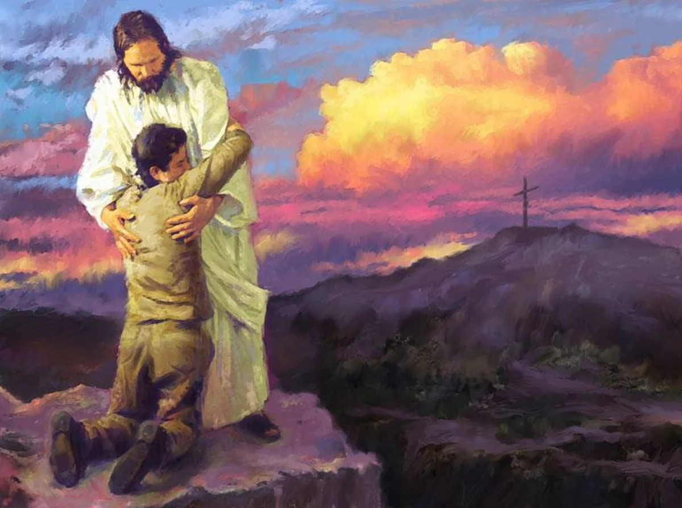
13
And the feeling of guilt.
Sabbath
The feeling of guilt is responsible for the fact that many live in anguish and that they cannot reconcile with peace and happiness.
If this is your case for you, I have good news for you. Just as God gave man the Sabbath as a rest for the body and renewal of his mind, so he has given Christ as his spiritual rest. Listen to his invitation: "Come unto me, all ye that labor and are heavy laden, and I will give you rest" (Matthew 11:28). He offers us rest for the heavy burdens of our heart. If you feel the need for forgiveness, accept Jesus as your Savior. The promise is that, "He is faithful and just to forgive us our sins, and to cleanse us from all unrighteousness" (1 John 1:9). Jesus wants to be his rest today.
The meaning of the Sabbath is momentous. It is literally God's appointed Sabbath for our physical rest (Exodus 20:8-11). And symbolically it represents peace and rest in Christ, on whom we depend for our salvation (Ephesians 2:8). One does not cancel out the other, but rather they complement each other.

Slide 11


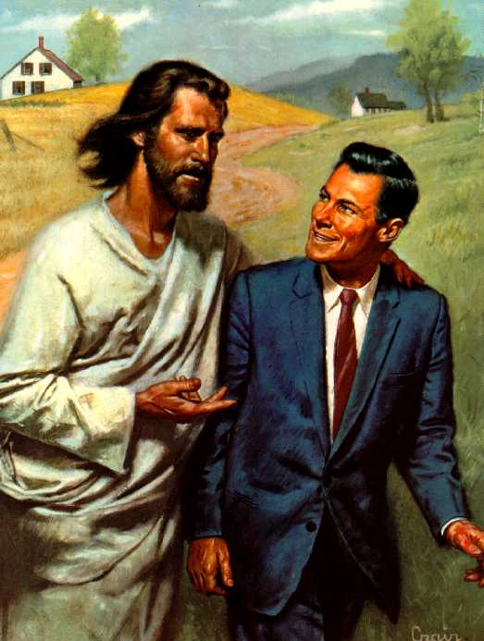

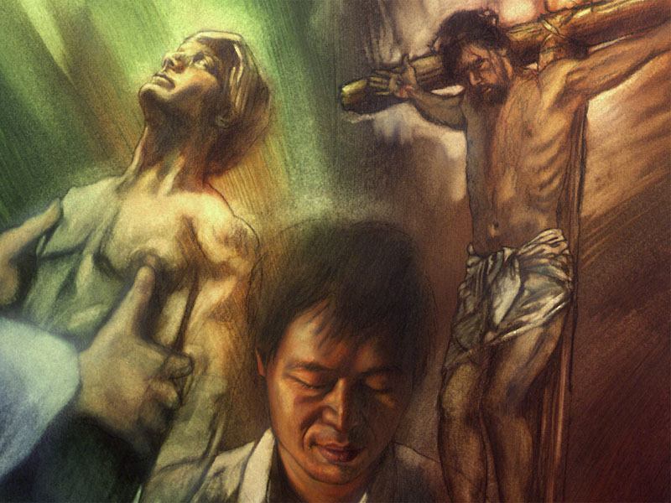
14
Sabbath
Improves Our Relationship with God.
Man is in danger of being trapped by his many tasks. We might forget about God and our relationship with Him. In addition, on the Sabbath one has time to devote oneself to the study of the Bible and to consider the greatness of God.
Even Adam, before sin, had admirable conversations with God during the week; But this was not enough. God longed for man to cease his labors one day each week—the seventh—so that he might devote this time more fully to knowing and worshiping his Creator. God wanted man to develop during the six days of work, but the Sabbath activities would complement him, for he would be learning more intimately from his Maker.
15
Sabbath
Improve my relationship with myself.
The Sabbath helps man to remember who he is. As long as I kept the Sabbath I would not suffer from identity crises because every week I would remember that God was the Creator and Giver of everything. This concept would deepen in man the thought that he is a creature of God. A concept, no doubt, of profound meaning and value: he is not simply "a cog in the gear", but a being of the utmost importance in God's plan, a being made in the divine likeness.

Slide 12


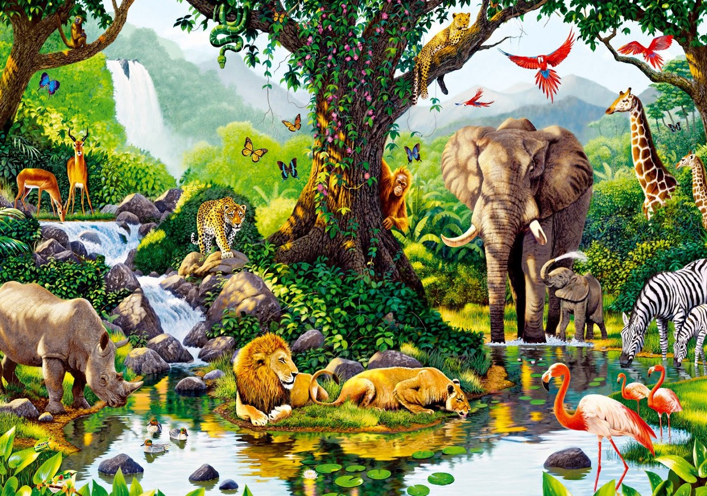

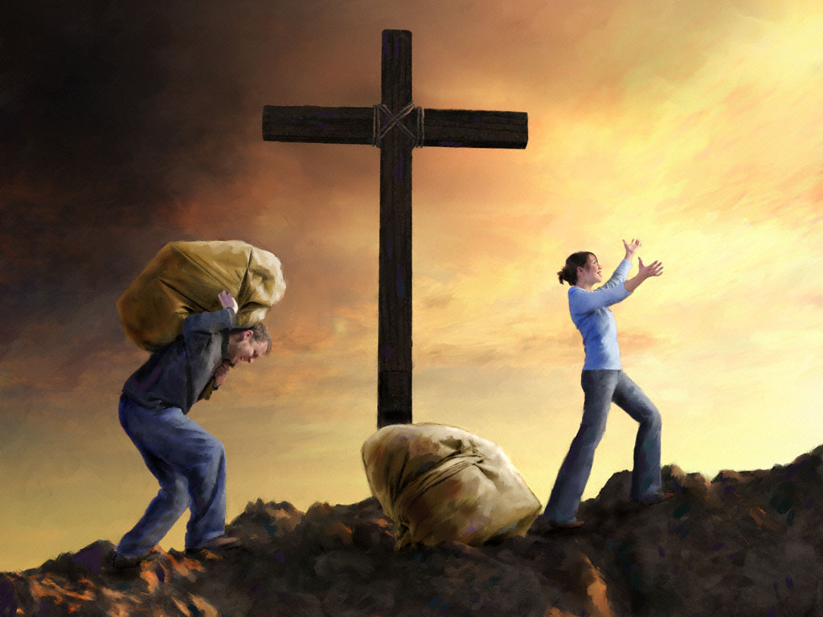
16
It improves my relationship with the rest of creation.
Sabbath
The religious observance of the Sabbath teaches two very important truths: man should not worship nature because he is above [is superior to] it, and because he already has a supreme Being to worship, God. The Sabbath protects against paganism in both its ancient idolatrous form and its modern form: the worship of pleasure, money, and power. Man should not exploit nature irrationally either, because he is not the owner, but the steward that God placed over all things.
17
It reminds me that I am no longer a slave, but free.
Sabbath
On the Sabbath we also remember that God brought us out of Egypt and decreed that we would no longer be slaves of any master, but free in Christ Jesus. Our jobs, financial and material needs, are the tools with which we fulfill our divine purpose, not the masters of our lives. In addition, God brought us out of the bondage of sin and gave us forgiveness. "I am the Lord your God, who brought you out of the land of Egypt, out of the house of bondage" (Deuteronomy 5:6).

Slide 13

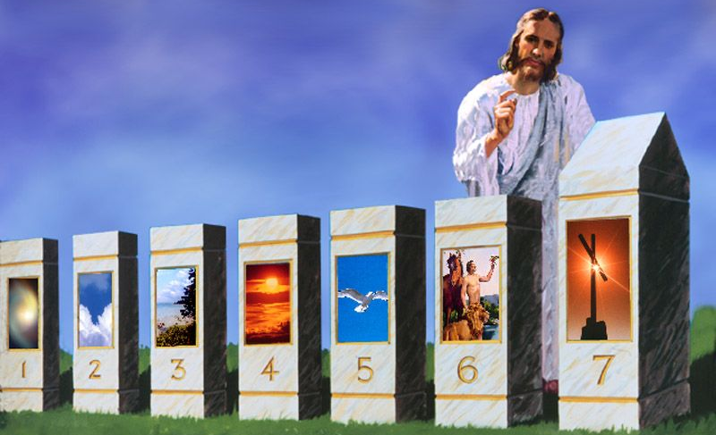




18
It helps me remember God throughout the week.
Sabbath
“At the very beginning of the fourth commandment the Lord said, “Remember.” He knew that amid the multitude of cares and perplexities man would be tempted to excuse himself from meeting the full requirement of the law, or would forget its sacred importance. Therefore He said: “Remember the sabbath day, to keep it holy.” “All through the week we are to have the Sabbath in mind and be making preparation to keep it according to the commandment ... “When the Sabbath is thus remembered, the temporal will not be allowed to encroach upon the spiritual. No duty pertaining to the six working days will be left for the Sabbath. During the week our energies will not be so exhausted in temporal labor that on the day when the Lord rested and was refreshed we shall be too weary to engage in His service...
On Friday let the preparation for the Sabbath be completed. See that all the clothing is in readiness and the cooking done... the Sabbath is not to be given to the repairing of garments, to the cooking of food, to pleasure seeking, or to any other worldly employment. [This should be done throughout the week]” FLB 34

Slide 14

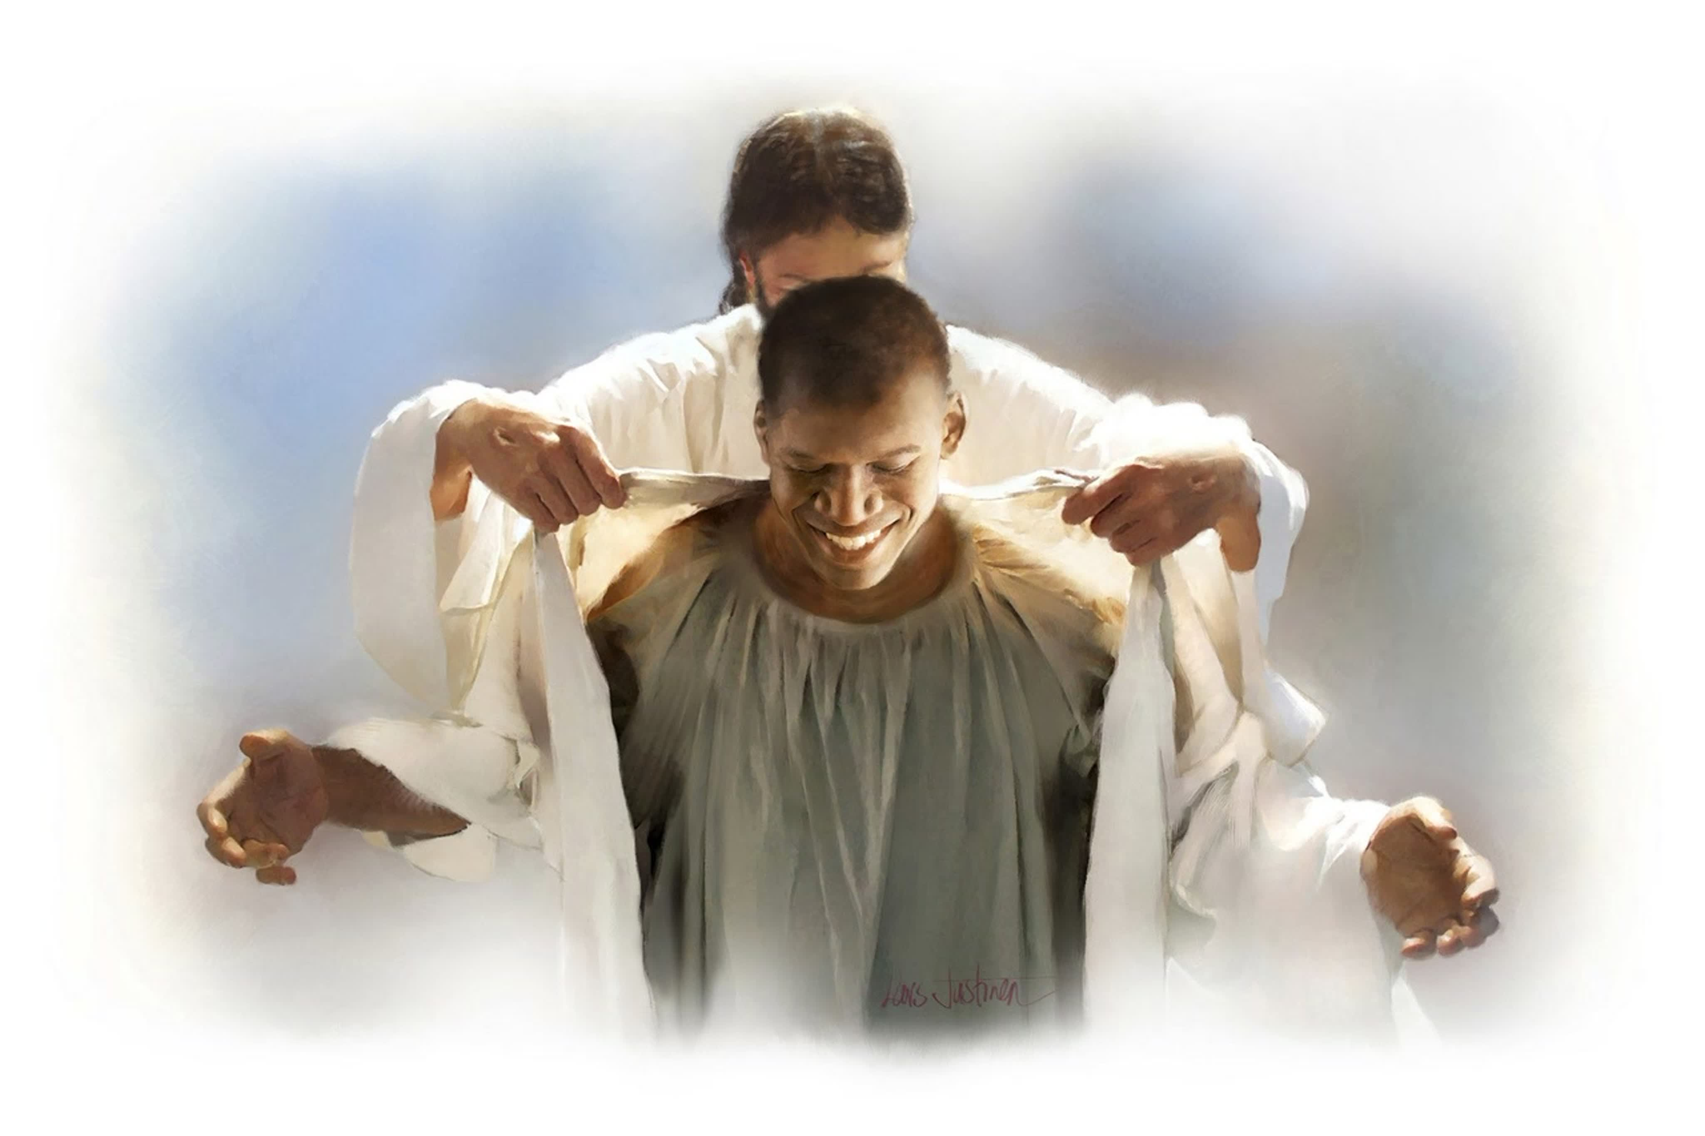
19
Sabbath
It is a sign of sanctification.
From the pillar of cloud Christ declared concerning the Sabbath: “Verily My Sabbaths ye shall keep: for it is a sign between Me and you throughout your generations; that ye may know that I am the Lord that doth sanctify you.” Exodus 31:13. The Sabbath given to the world as the sign of God as the Creator is also the sign of Him as the Sanctifier. The power that created all things is the power that re-creates the soul in His own likeness. To those who keep holy the Sabbath day it is the sign of sanctification. True sanctification is harmony with God, oneness with Him in character. It is received through obedience to those principles that are the transcript of His character. And the Sabbath is the sign of obedience. He who from the heart obeys the fourth commandment will obey the whole law. He is sanctified through obedience. CCh 261

Slide 15

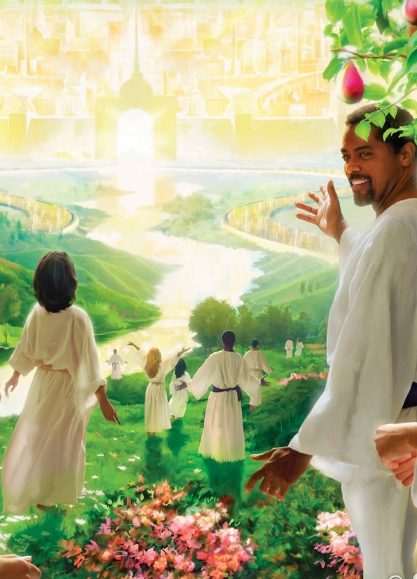
20
Sabbath
It's a taste of the world to come.
For all the blessings we have seen, the Sabbath becomes a foretaste of all that we will enjoy in the world to come.
There, in the New Earth, we will continue to keep the Sabbath.
“I was shown that the law of God would stand fast forever and exist in the new earth to all eternity. At the creation, when the foundations of the earth were laid, the sons of God looked with admiration upon the work of the Creator, and all the heavenly host shouted for joy. It was then that the foundation of the Sabbath was laid. At the close of the six days of creation, God rested on the seventh day from all His work which He had made; and He blessed the seventh day and sanctified it, because that in it He had rested from all His work. The Sabbath was instituted in Eden before the fall, and was observed by Adam and Eve, and all the heavenly host. God rested on the seventh day, and blessed and hallowed it. I saw that the Sabbath never will be done away; but that the redeemed saints, and all the angelic host, will observe it in honor of the great Creator to all eternity.” EW 217

Slide 16
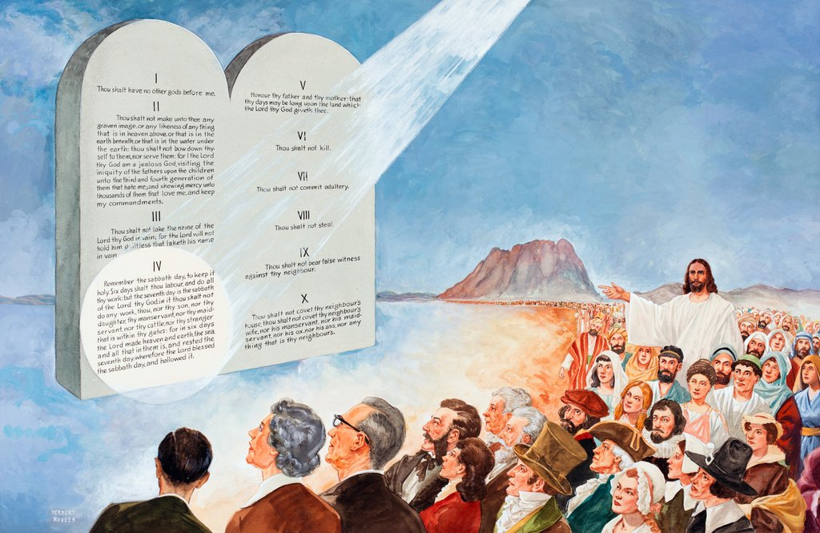
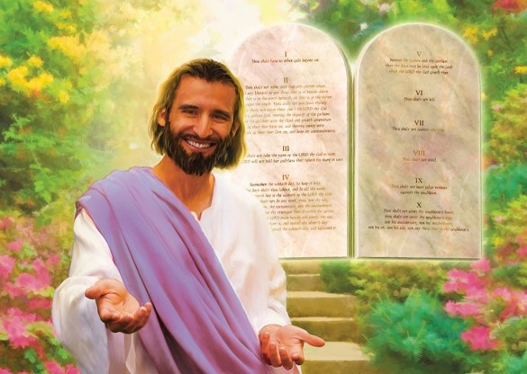
God offers the blessing of the Sabbath to remedy emotional imbalance and human restlessness. Millions of people around the world are receiving these benefits.
I invite you to receive the benefits of the weekly Sabbath break. At the same time, I want you to make Jesus your spiritual rest today. In Christ, the Sabbath will have a double blessing. Allow Jesus to apply the benefits of his saving grace in your life.
The benefits that the Sabbath bestows upon us are eternal and priceless. How might we set a value for things like a secure family life, or be at peace with ourselves? If we want to achieve these benefits, our sacrifices are only tiny compared to our reward.
Decide today to keep the Sabbath according to the commandment (Luke 23:56) and enjoy life to the fullest.

