Slide 1

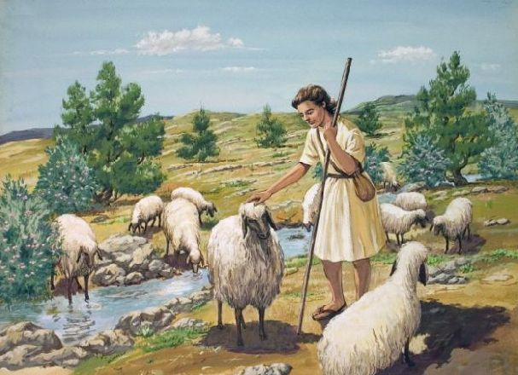
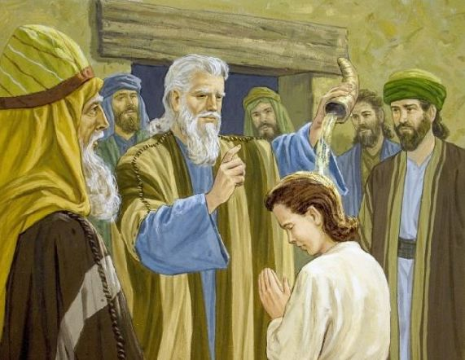
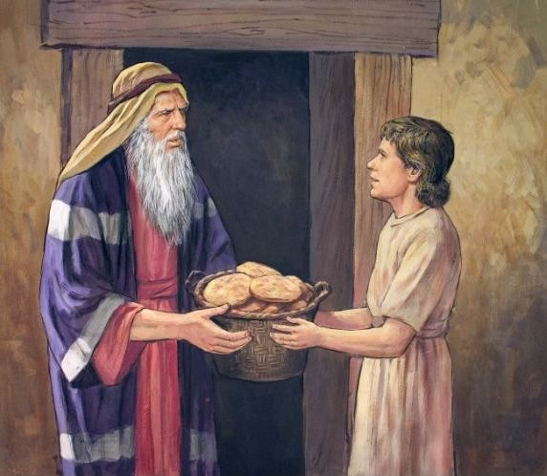
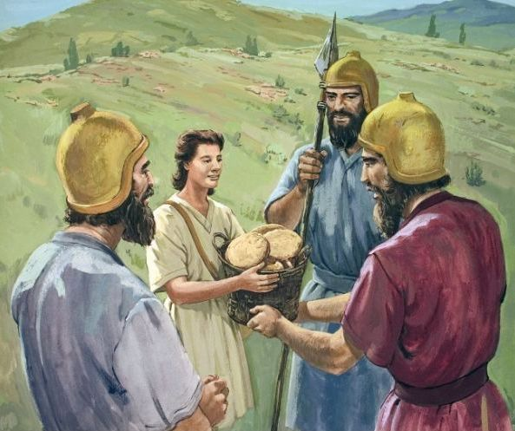
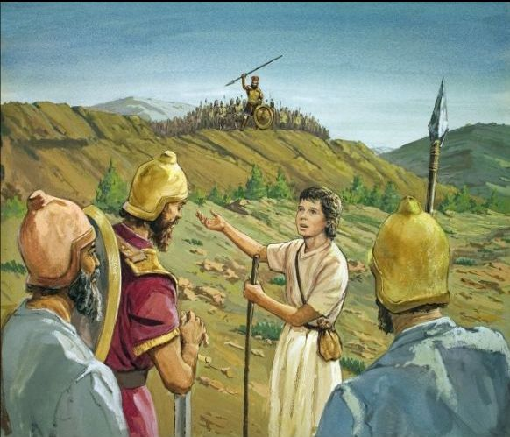
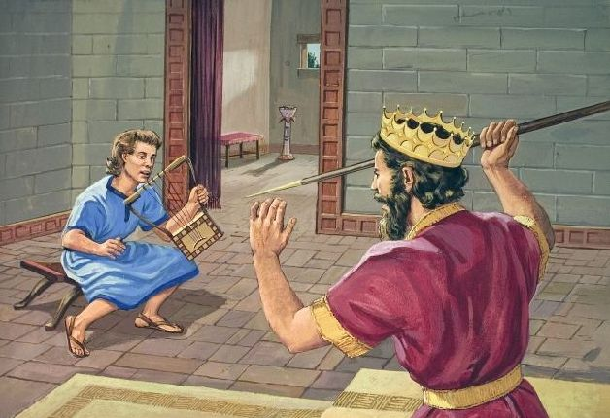

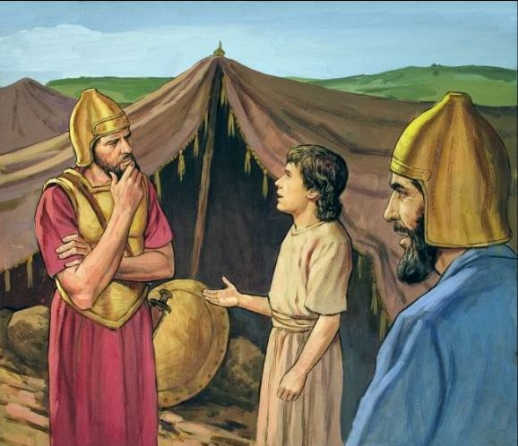

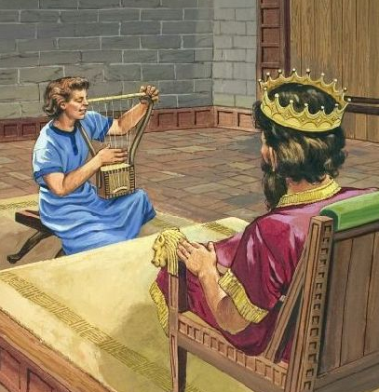
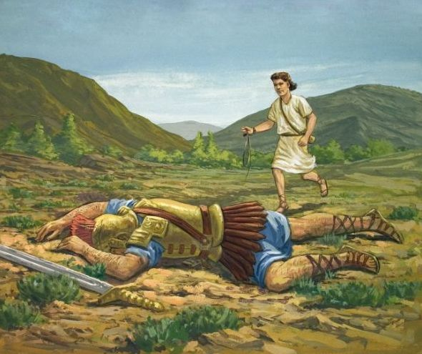
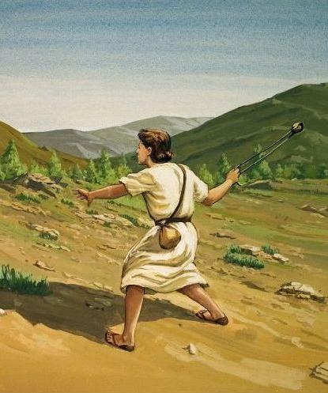
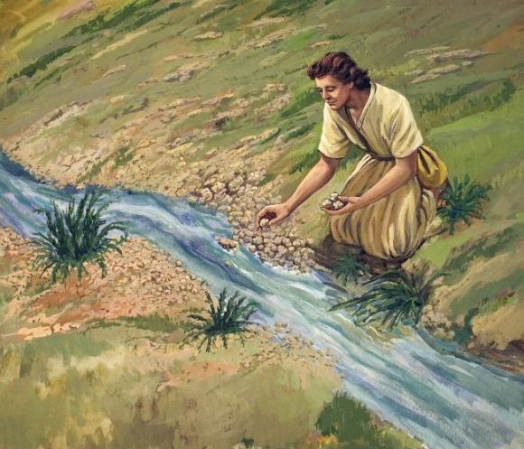
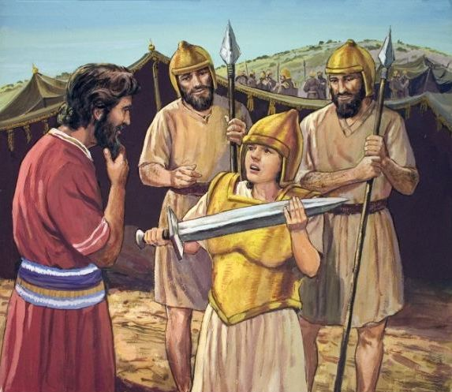

Slide 2
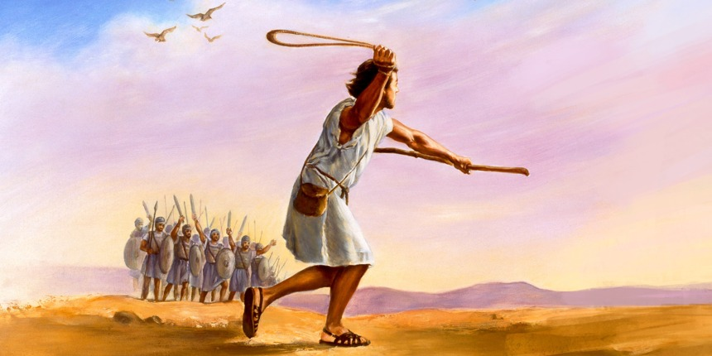
The story of David is one of the most fascinating in the Bible. Today we will base our study on verse 14 of 1 Samuel 16. Saul is presented to us as the object of divine punishment. A Bible commentary tells us: "The pathological symptoms of their psychological degeneration (1 Samuel 18:11; 20:30; 31:5) suggest a progressive case of paranoid schizophrenia" (Biblia de Estudios Caribe, pp. 319, 320). That's a terrible mental illness.
At the suggestion of his servants, Saul asked that a good musician be found for him to reassure him during his crises, as we read in 1 Samuel 16:14-17.
Then in verse 18, we read, "Then answered one of the servants, and said, Behold, I have seen a son of Jesse the Bethlehemite, that is cunning in playing, and a mighty valiant man, and a man of war, and prudent in matters, and a comely person, and the Lord is with him." One of Saul's servants recommended David, highlighting to the king the qualities of this young man. We are going to analyze these qualities, which are worthy of imitation by every young person and adult.

Slide 3

“Then answered one of the servants, and said, Behold, I have seen a son of Jesse the Bethlehemite, that is cunning in playing, and a mighty valiant man, and a man of war, and prudent in matters, and a comely person, and the Lord is with him.”
1 Samuel 16:18

Slide 4
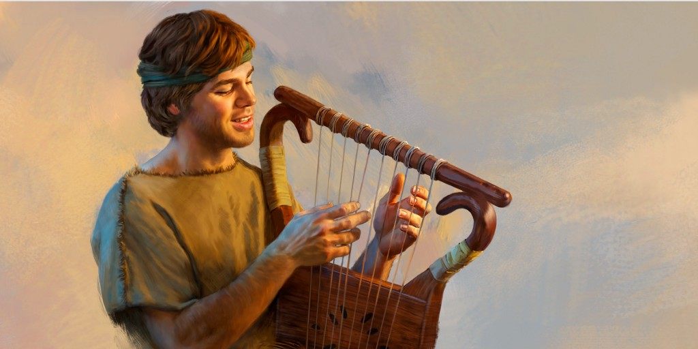
Those who are called to work for God must know how to do things. God has called you and me; Therefore, He has given us gifts and talents, skills and abilities, to develop by studying, practicing, reading, and taking time to prepare for excellent service.
Can Play
When God asks us to do a job, He always gives us His power and empowers us with His wisdom to accomplish that task. For example, if someone asks you to have a meditation, don't be scared, don't refuse;
surely that is an opportunity that God gave you to develop part of your skills. Accept, study, prepare, pray, and you will see that on the day it is your turn to present the meditation, you will do it as David did before Saul.
What do you know or what do you like to do? Do you sing, paint, play an instrument, act, are you good with the computer, with crafts, do you know languages? Use all that you know and like to do to serve the Lord.

Slide 5

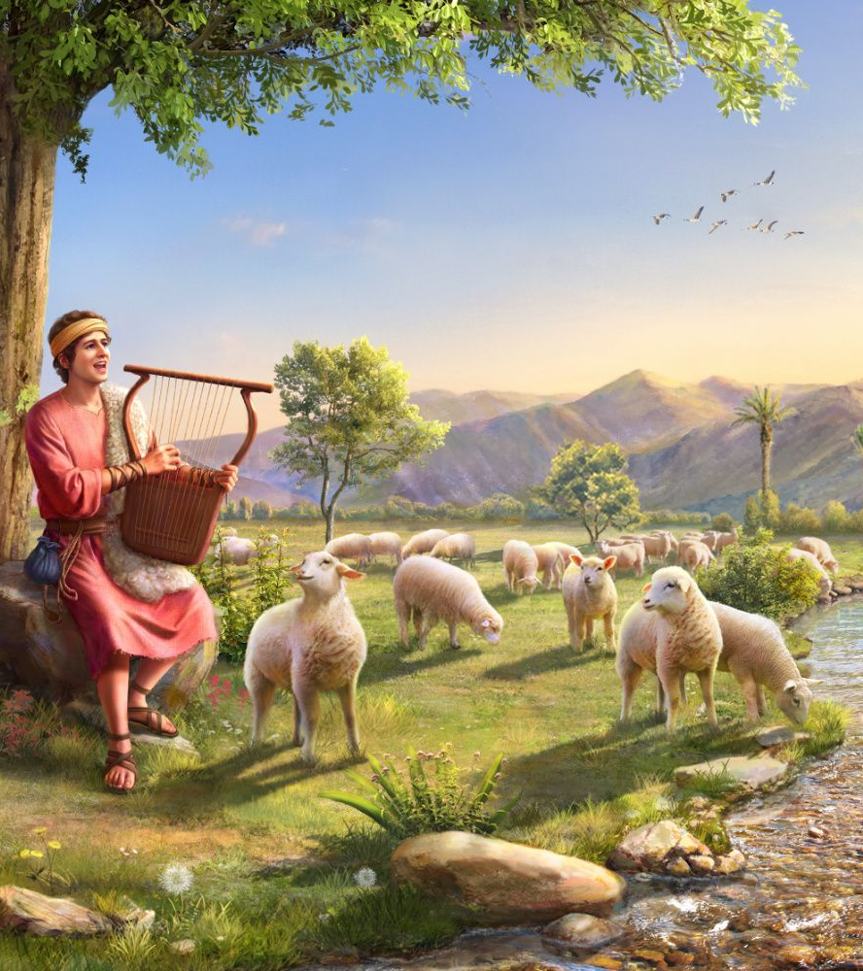
David, in the beauty and vigor of his youth, was preparing to occupy a high position among the noblest of the earth.
Can Play
He used his talents, as precious gifts from God, to praise the glory of the divine Giver. The opportunities he had to give himself up to contemplation and meditation served to enrich him with that wisdom and piety which made him the beloved of God and of the angels. As he contemplated the perfections of his Creator, clearer conceptions of God were revealed to his soul. Subjects that were formerly obscure to him were cleared to him by a clear light, difficulties were smoothed out, perplexities were harmonized, and each new ray of light wrested from him new raptures and sweeter hymns of devotion, to the glory of God and of the Redeemer.
The love that moved him, the sorrows that beset him, the triumphs that attended him, were all themes for his active thought; and as he beheld the love of God in all the providences of his life, his heart throbbed with more fervent adoration and gratitude, his voice rang out in a richer melody, his harp was swept with more exultant joy; and the shepherd boy proceeded from strength to strength, from knowledge to knowledge; for the Spirit of the Lord was upon him. PP 642.2

Slide 6

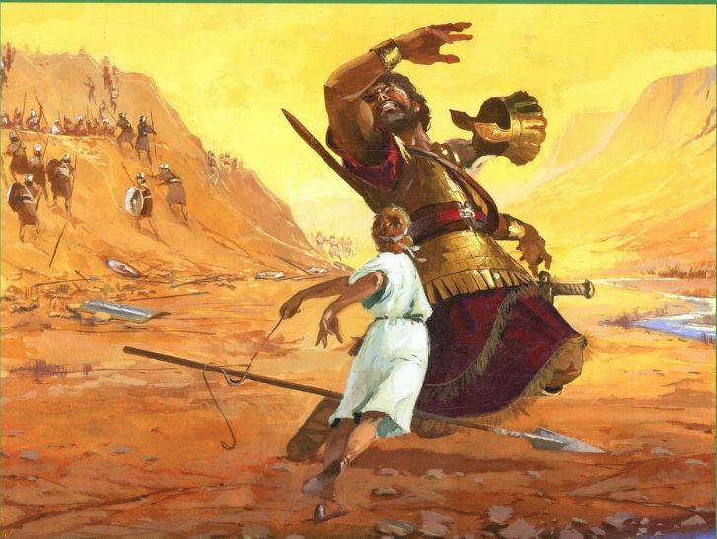
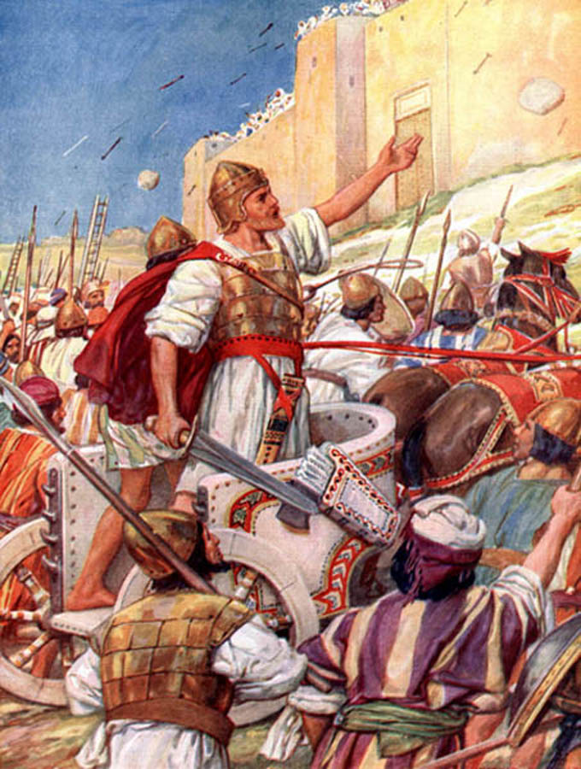
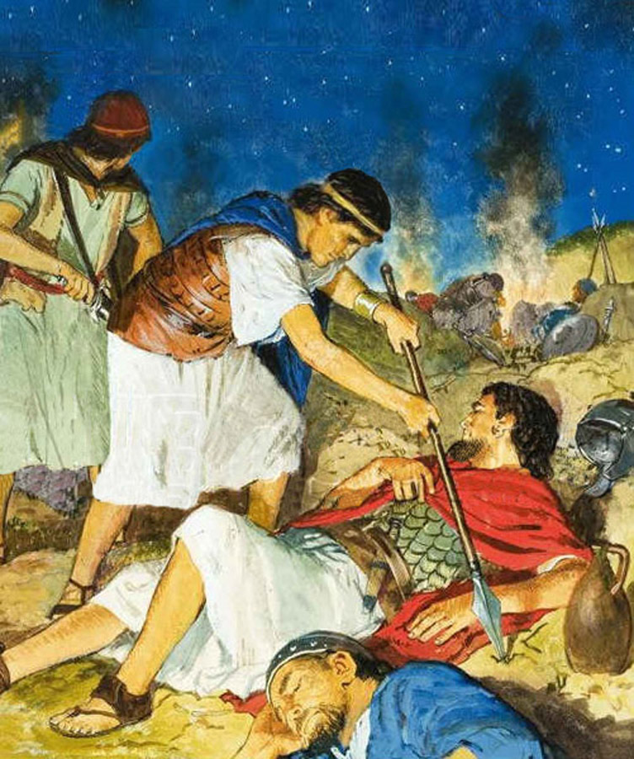
David showed his courage especially when he faced Goliath. He alone against a giant of about three meters.
Brave
Throughout his entire ministry as king, courage was a virtue that characterized David. Do you remember when David showed his courage?
Today I invite you to replace the fear of being rejected, criticized or mocked, with the assurance that what you do is first and foremost for God and that your desire is for your actions, talents or works to become a blessing to those around you. It is not as important what people think or say, as what God thinks and says about you; and God always loves you, always understands you and receives everything you give him from the heart, with care and with all love. Don't let fear come between you and the full development of your talents. Be brave.

Slide 7


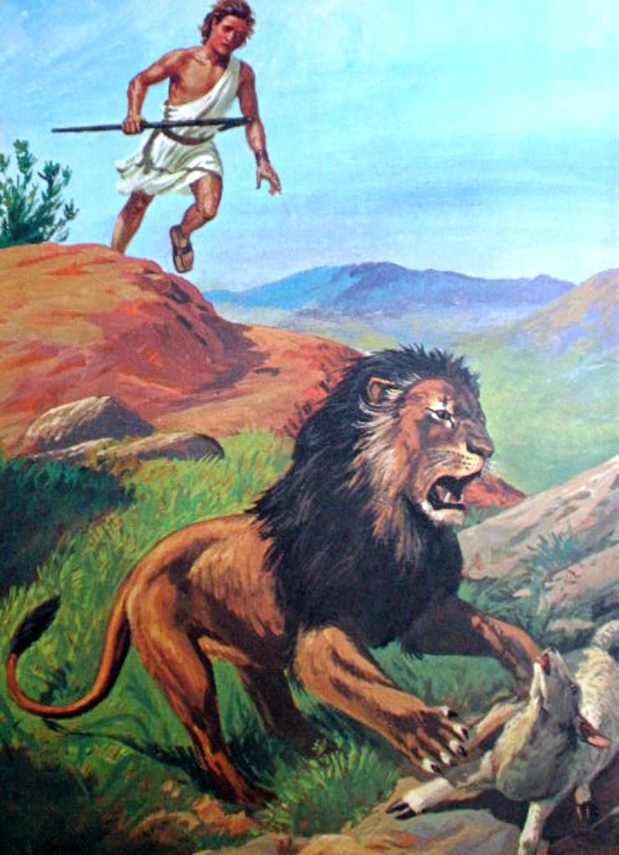



Christian teens and youth should have courage, strength, desires, and impulses motivated by the Holy Ghost.
Vigorous
In their character they must emphasize self-initiative, consistency, perseverance and temperance, if they yearn to be successful in all areas of life.
Perfect obedience to God's commands calls for conformity to the laws of the being.... RC 147.8.... The time spent in physical exercise is not lost. The student who is constantly poring over his books, while he takes but little exercise in the open air, does himself an injury. A proportionate exercise of the various organs and faculties of the body is essential to the best work of each. When the brain is constantly taxed while the other organs are left inactive, there is a loss of physical and mental strength. The physical powers are robbed of their healthy tone, the mind loses its freshness and vigor, and a morbid excitability is the result. In order for men and women to have well-balanced minds, all the powers of the being should be called into use and developed CT 295.... [The Lord] bids us reason from cause to effect, to remember that we are His property, and to unite with Him in keeping the body pure and healthy, and the whole being sanctified to Him.—Counsels to Parents and Teachers, 295-300. RC 147
We should practice temperance in our labor. It is not our duty to place ourselves where we shall be overworked. Some may at times be placed where this is necessary, but it should be the exception, not the rule. We are to practice temperance in all things. If we honor the Lord by acting our part, He will on His part preserve our health. We should have a sensible control of all our organs. By practicing temperance in eating, in drinking, in dressing, in labor, and in all things, we can do for ourselves what no physician can do for us. CG 397

Slide 8


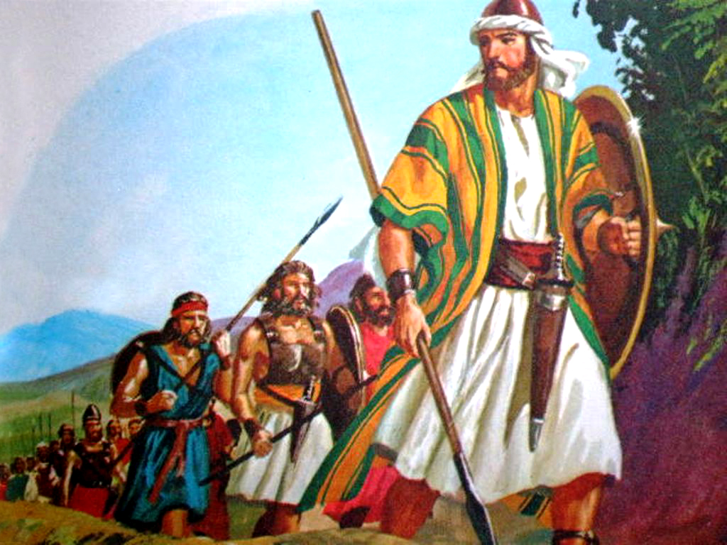

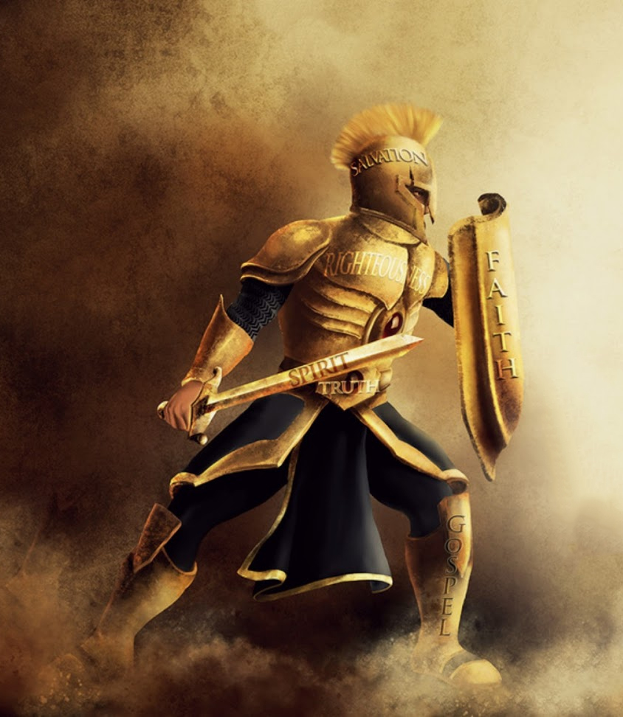
Even before he was summoned to the court of Saul, David had distinguished himself by deeds of valor. PP 644.3
Man of War
David did not provoke wars, but he defended himself in wars and he did it very well. Christ's followers do not provoke wars, but defend themselves well. In what ways can a young Christian defend himself and in what situations?
Fervent and effectual prayer will be regarded in heaven. When the servants of Christ take the shield of faith for their defense, and the sword of the Spirit for war, there is danger in the enemy's camp 1TT 159
The work of conquering evil is to be done through faith. Those who go into the battlefield will find that they must put on the whole armor of God. The shield of faith will be their defense and will enable them to be more than conquerors. Nothing else will avail but this—faith in the Lord of hosts, and obedience to His orders. Vast armies furnished with every other facility will avail nothing in the last great conflict. Without faith, an angel host could not help. Living faith alone will make them invincible and enable them to stand in the evil day, steadfast, unmovable, holding the beginning of their confidence firm unto the end. AG 33

Slide 9


David knew how, when, and what to speak. When his brother Eliab spoke to David angrily and with false accusations, David responded respectfully but decisively.
Prudent in His Words
David asked the soldiers about Goliath fearlessly, though prudently. Although Saul sought to dissuade David from his purpose; The young man was not convinced. He answered simply and without boasting, relating what happened to him while tending his father's flocks. He said: "David added, 'Jehovah, who has delivered me from the claws of the lion and the claws of the bear, he also will deliver me from the hand of this Philistine. And Saul said to David, "Go, and the Lord be with thee." (1 Samuel 17:37)
We cannot be light with our words. Before saying anything, let's analyze the effects, both positive and negative, that it will produce when it lands in the ears of those who listen to us.
We must speak words that comfort and encourage, words that are affectionate and encouraging. May they be helpful and a blessing. Let's talk in nice and pleasant tones.
If provoking words are spoken to you, do not utter a word. The best rebuke you can give the one who has uttered the provoking word is to keep silent until you can speak in a calm, pleasant voice. VSS 64
How much strength a word of hope, courage, and determination in a right course will give one who is inclined to slide into habits that are demoralizing! TMK 161
“A word fitly spoken is like apples of gold in pictures of silver.” (Proverbs 25:11)

Slide 10


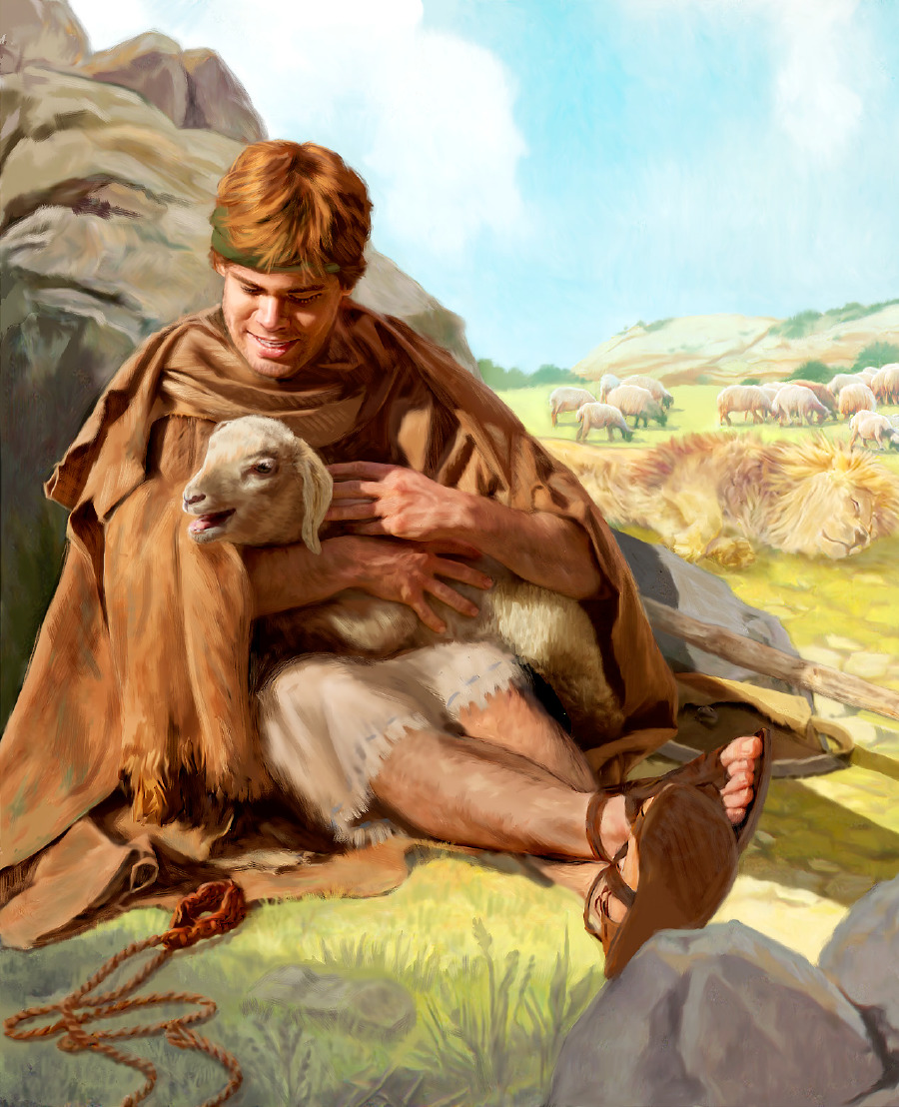
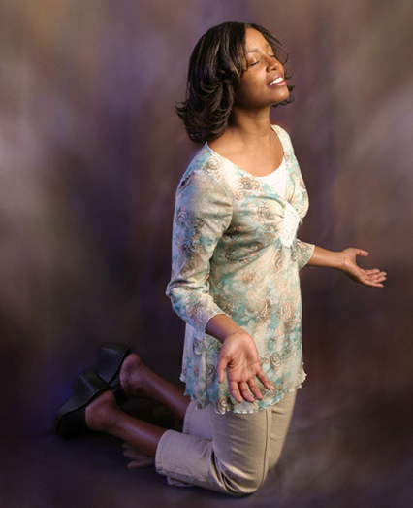
Although physically David was attractive and handsome, his outward appearance was a representation of his inner character. The beauty of the heart beautifies the face, makes your personality attractive and beautiful.
Beautiful
What spiritual beauty treatment could we apply daily? (prayer, Bible reading, Sabbath school lesson study, singing spiritual songs, reflecting on Christ's life by reading about His life each day, etc.). Let's use more spiritual beauty treatments and we will be more beautiful.
“Whose adorning let it not be that outward adorning of plaiting the hair, and of wearing of gold, or of putting on of apparel; But let it be the hidden man of the heart, in that which is not corruptible, even the ornament of a meek and quiet spirit, which is in the sight of God of great price.” (1 Pedro 3:3-4 ).
No outward beauty can recommend the soul to God. The wisdom and excellence revealed in the character and deportment, express the true beauty of the man; and it is the inner worth, the excellency of the heart, that determines our acceptance with the Lord of hosts. How deeply should we feel this truth in the judgment of ourselves and others. We may learn from the mistake of Samuel how vain is the estimation that rests on beauty of face or nobility of stature. PP 638.1

Slide 11


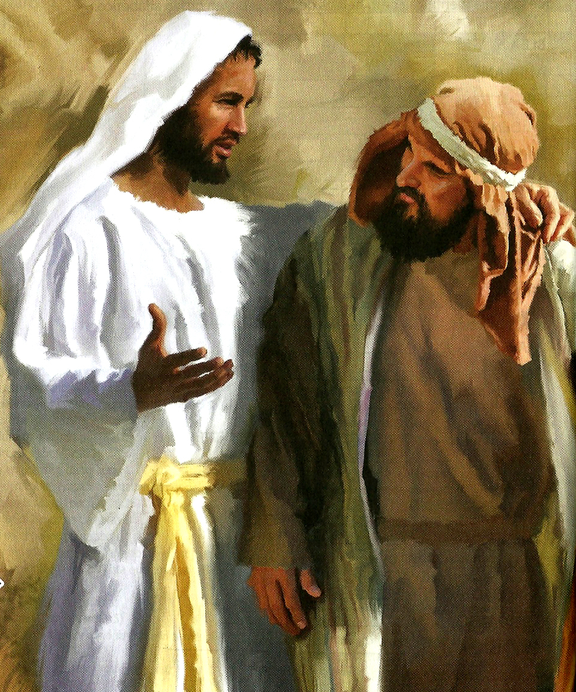
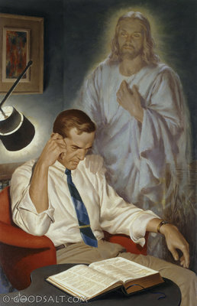
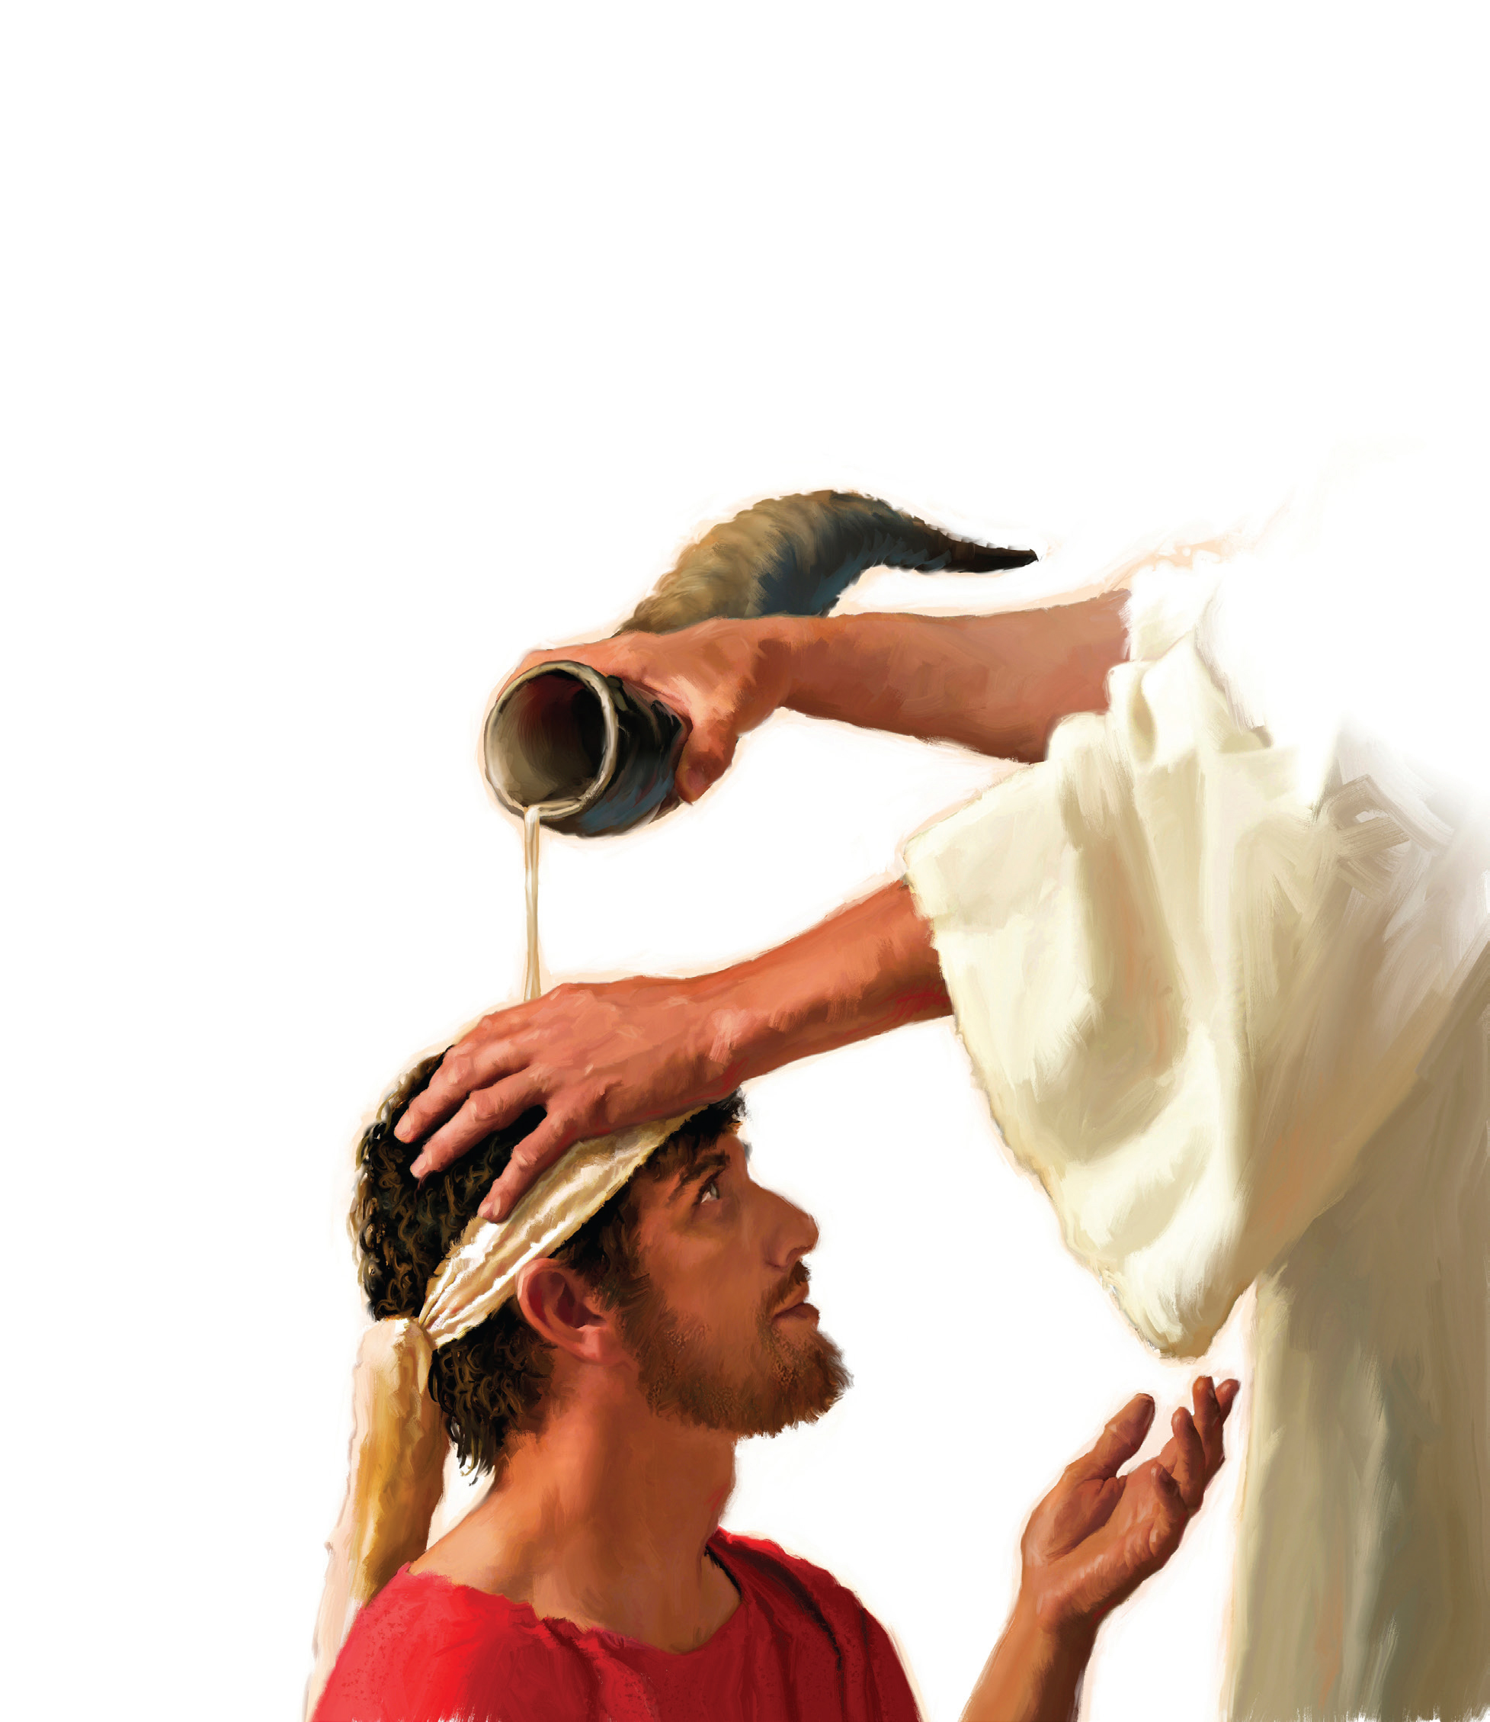
All of these descriptions of David should have begun with this statement.
Jehovah Is With Him
Although the news that David had been anointed king had not been made public, nothing could hide the fact that the Holy Spirit - who had taken possession of his life in a special way since his anointing - was duly preparing him for the important tasks ahead. (ABC about 1 Samuel 16:18)
Every human quality that is not based on our relationship, experience, and fellowship with God is vain and worthless. David was David because God was with him. At what times in his life can we see that he was with him?
Just as God was with David, he was with Isaac: " And the Lord appeared unto him the same night, and said, I am the God of Abraham thy father: fear not, for I am with thee, and will bless thee, and multiply thy seed for my servant Abraham's sake.." (Genesis 26:24). He was with Jeremiah: "Be not afraid of their faces: for I am with thee to deliver thee, saith the Lord.." (Jeremiah 1:8)
He was with Paul: "For I am with thee, and no man shall set on thee to hurt thee: for I have much people in this city." (Acts 18:10)
Remember that God is also with you: Fear thou not; for I am with thee: be not dismayed; for I am thy God: I will strengthen thee; yea, I will help thee; yea, I will uphold thee with the right hand of my righteousness." (Isaiah 41:10)

Slide 12

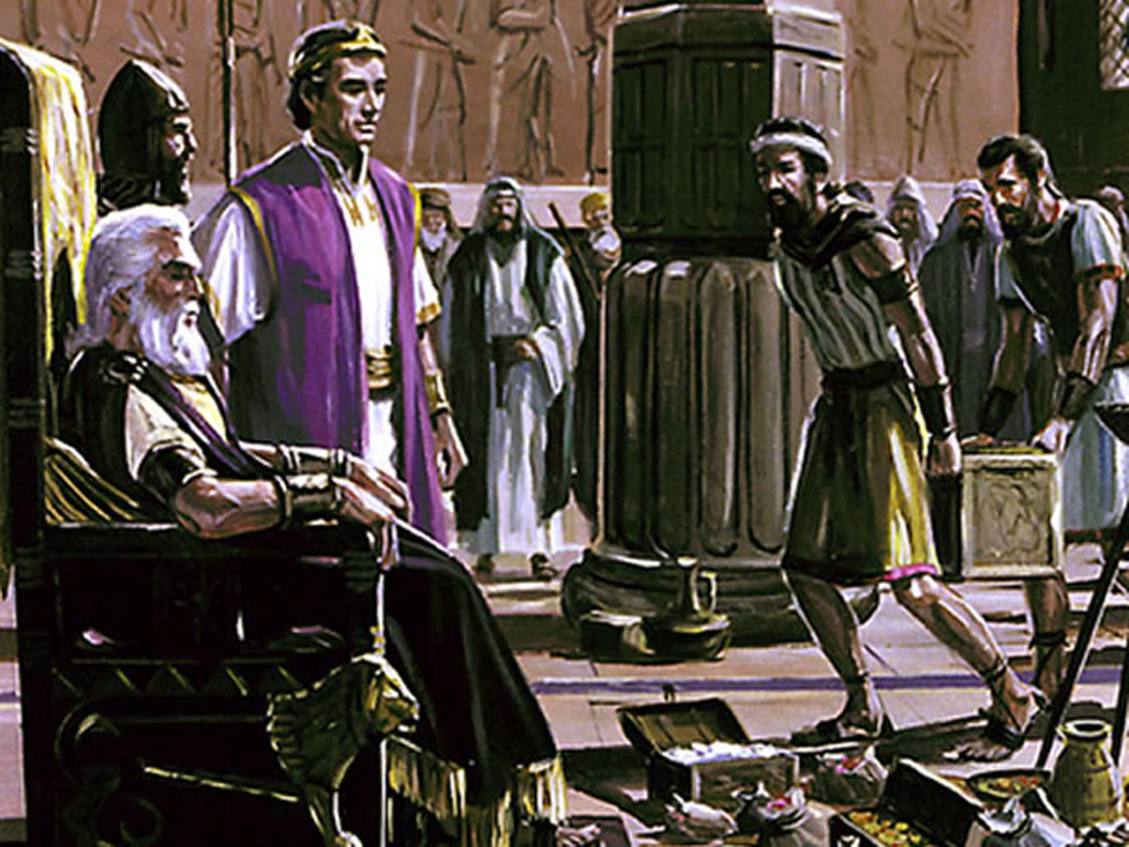
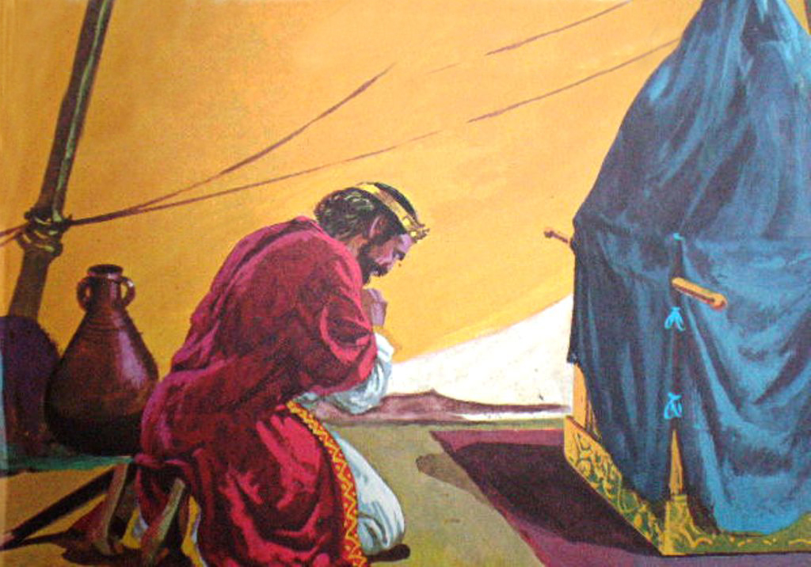
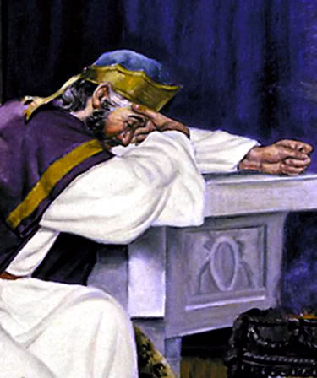
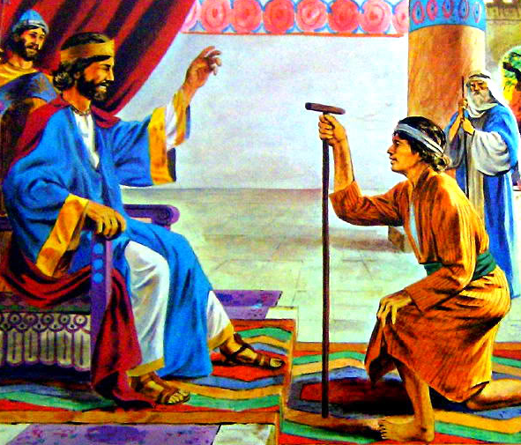
David's whole life inspires us, excites us, brings us hope.
David was a great man of God who committed grievous and terrible sins, but who always genuinely repented and returned to the divine ways, and always recognized God as the owner and guide of his ways. God says of David, "And when he had removed him, he raised up unto them David to be their king; to whom also he gave their testimony, and said, I have found David the son of Jesse, a man after mine own heart, which shall fulfil all my will.'" (Acts 13:22)
May God be your intimate friend, and may He speak of you as well as He spoke of David.

