Slide 1


Slide 2

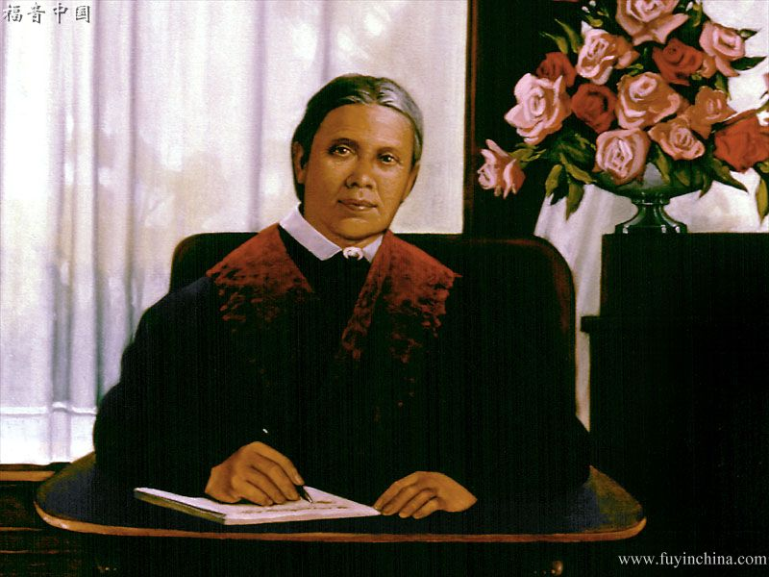


How will I solve the problems that arise every day in the task of properly directing my children? This question often comes to the minds of conscientious parents who desire the best for their children and who are unwilling to see them go astray into the paths of sin, vice, and all the ways in which the divine will can be disobeyed.
This presentation is based on the book "Child Guidance," written by Ellen G. White.
This book answers all the basic problems on this subject and presents the essential principles capable of guiding the correct orientation of the minor elements of the home.
The pen that moved the spirit of prophecy is clear and categorical. It authoritatively describes the forms, methods and manners that must be applied to the various situations that arise in the difficult mission of ensuring that the character of children and adolescents matures properly.
This book is comprehensive in its approach to the most important factors of correct early childhood pedagogy.
I encourage you to read the book prayerfully, seeking God's help so that your home may be a foretaste of heaven.

Slide 3
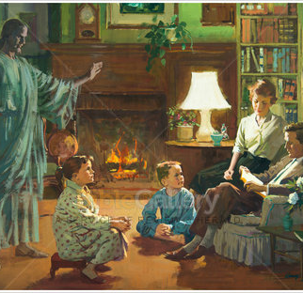
Where does education begin?
It is in the home that the education of the child is to begin. Here is his first school. Here, with his parents as instructors, he is to learn the lessons that are to guide him throughout life—lessons of respect, obedience, reverence, self-control. The educational influences of the home are a decided power for good or for evil. They are in many respects silent and gradual, but if exerted on the right side, they become a far-reaching power for truth and righteousness. If the child is not instructed aright here, Satan will educate him through agencies of his choosing. How important, then, is the school in the home! CG 17.

Slide 4
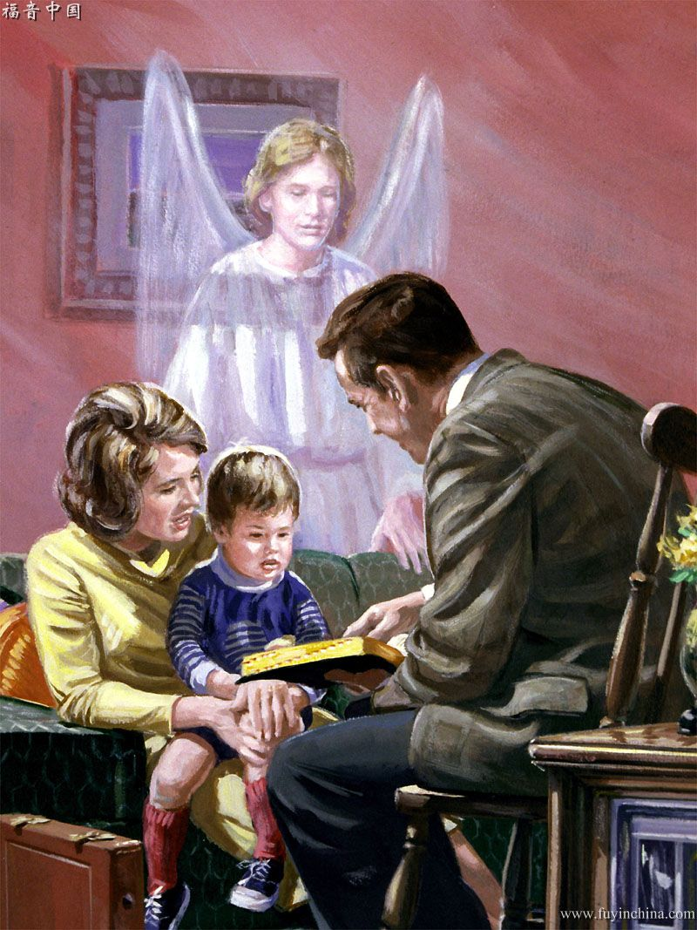
Who are the first teachers?
The father and the mother should be the first teachers of their children. CG 21.
Husband and wife are to be closely united in their work in the home school. They are to be very tender and very guarded in their speech, lest they open a door of temptation through which Satan will enter to obtain victory after victory. They are to be kind and courteous to each other, acting in such a way that they can respect one another. Each is to help the other to bring into the home a pleasant, wholesome atmosphere. They should not differ in the presence of their children. Christian dignity is ever to be preserved. CG 24.
The work of parents, which means so much, is greatly neglected. Awake, parents, from your spiritual slumber and understand that the very first teaching the child receives is to be given to him by you. You are to teach your little ones to know Christ. This work you must do before Satan sows his seeds in their hearts. Christ calls the children, and they are to be led to Him, educated in habits of industry, neatness, and order. This is the discipline Christ desires them to receive. CG 23.

Slide 5

When to start education?
The effect of prenatal influences is by many parents looked upon as a matter of little moment; but heaven does not so regard it… CC 130
The word “education” means more than a course of study at college. Education begins with the infant in its mother's arms. While the mother is molding and fashioning the character of her children, she is educating them. CG 26.
Education… it comprises the whole process by which the child is instructed from babyhood to childhood, from childhood to youth, and from youth to manhood. As soon as a child is capable of forming an idea, his education should begin. CG 26.
The early training of children is a subject that all should carefully study. We need to make the education of our children a business, for their salvation depends largely upon the education given them in childhood. Parents and guardians must themselves maintain purity of heart and life, if they desire their children to be pure. As fathers and mothers, we should train and discipline ourselves. Then as teachers in the home, we can train our children, preparing them for the immortal inheritance. CG 27.

Slide 6

What Teaching Methods Do I Use For The Education Of My Children?

Slide 7



Arrange matters so that your children obey your commands with joy.
Teach them to ask the Lord for help with the little things in life.
Instruct them to be wide awake to notice the small duties that need to be done. Teach them to be helpful by giving them something to do at home. Encourage them to help their father and mother.
Approach education and preparation with a calm spirit and a loving heart and treat them with kindness, tenderness, and love.
Imbue them with pure aspirations and cultivate in them a love for things that are honest, pure, and holy.
Let your manners be gentle but firm, even in the care of the baby. This tends to quiet the child's nervousness.
Through singing, prayer, and Bible lessons, you need to teach your children the law of God that is an expression of their character. Thus, as they receive into their heart the principles of that law, the image of God will be outlined in their mind and soul.
Do not rebuke them, for it will do them no good. Talk to them as if you have confidence in their intelligence.
Tell them what God expects them to do. Tell them that God wants them to be educated and prepared to be laborers with Him.

Slide 8




Confirm them in doing well.
Reason with your children, to correct their mistakes, and patiently teach them the right behavior.
Teach them simple lessons from the book about nature and the things around them.
Make the lessons you want to teach them short and interesting, teaching the precept and setting the example.
Ask them to learn how to draw lessons and discover truths for themselves.
Encourage them to have self-denial and self-control; to put the happiness of others and the interests of others before their own, to encourage and help their brothers and playmates, and to be kind to the elderly, the sick, and the unfortunate.
Strive not to unduly censure them, but do not burden them with undue praise and flattery.
They must be taught to trust themselves. A wise teacher will give special attention to the development of the weaker traits, so that they form a well-balanced and harmonious character.
Homeschooling encompasses the practice of temperance, brotherly kindness, and godliness. the fulfillment of our duty to ourselves, our neighbors, and God.

Slide 9


What Two Books Are Essential In Education?

Slide 10





The Bible should be the child's first textbook. From this book, parents are to give wise instruction. The Word of God is to be made the rule of the life. From it the children are to learn that God is their father, and from the beautiful lessons of His Word they are to gain a knowledge of His character. Through the inculcation of its principles, they are to learn to do justice and judgment. CG 41.
The Bible
The mother must keep her mind refreshed and stored with the promises and blessings of God's Word, and also the forbidden things, that when her children do wrong she may present as a reproof the words of God, and show them how they are grieving the Spirit of God. Teach them that the approbation and smiles of Jesus are of greater value than the praise or flattery or approval of the most wealthy, the most exalted, the most learned of the earth. Lead them to Jesus Christ day by day, lovingly, tenderly, earnestly. You must not allow anything to come between you and this great work. CG 41.
The parents are to teach their children lessons from the Bible, making them so simple that they can readily be understood .—Letter 189, 1903.
each your children that the commandments of God must become the rule of their life. Circumstances may occur to separate them from the parents and from their homes, but the lessons of instruction given in childhood and youth will be a blessing to them throughout their lifetime. —Manuscript 57, 1897.

Slide 11
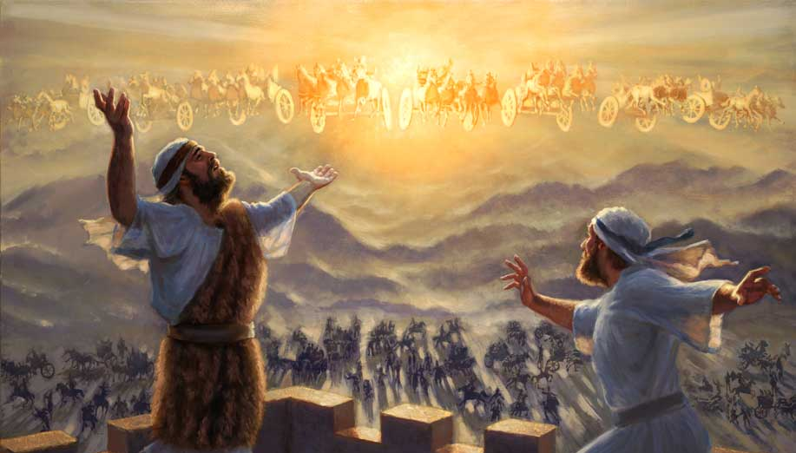
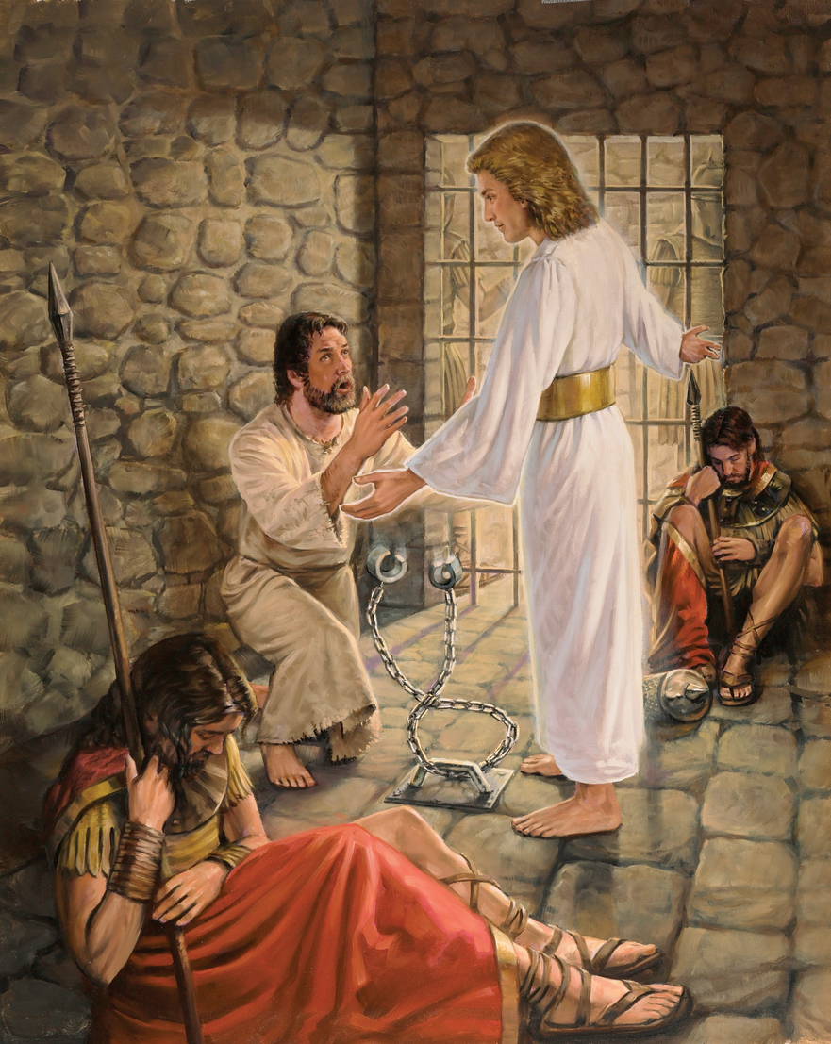
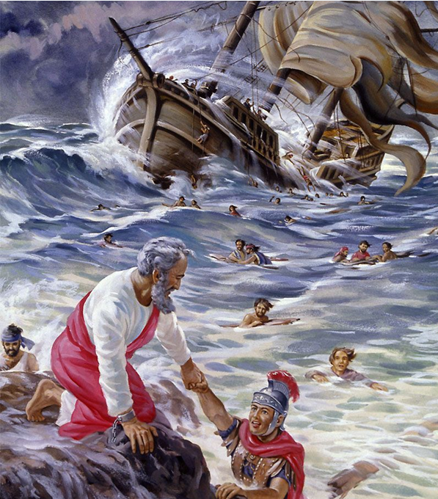
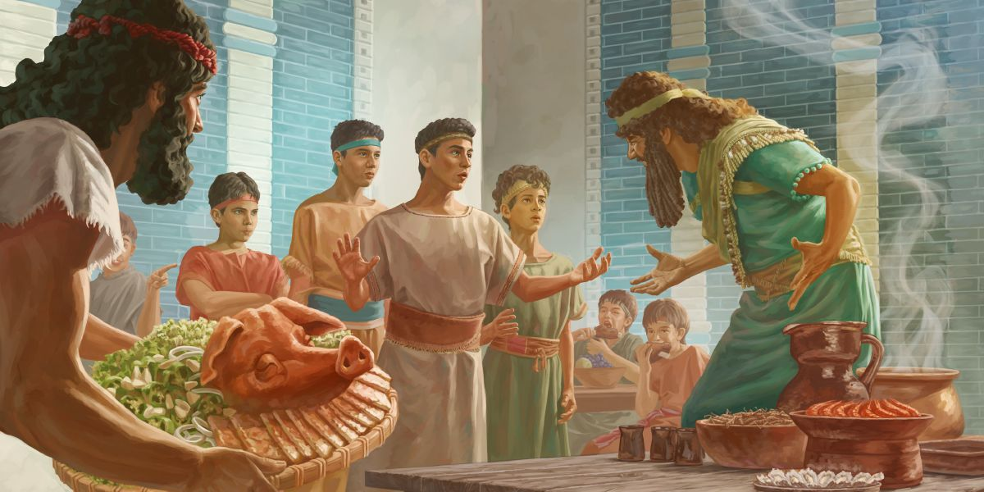
Let him read that wonderful story of Elisha in the mountain city, and, between him and the hosts of armed foemen, a mighty encircling band of heavenly angels. 2MCP 478.
Let him read how to Peter, in prison and condemned to death, God's angel appeared; how, past the armed guards, the massive doors and great iron gateway with their bolts and bars, the angel led God's servant forth in safety. 2MCP 478
Let him read of that scene on the sea, when to the tempest-tossed soldiers and seamen, worn with labor and watching and long fasting, Paul the prisoner, on his way to trial and execution, spoke those grand words of courage and hope: “Be of good cheer: for there shall be no loss of any man's life among you.… For there stood by me this night the angel of God, whose I am, and whom I serve, saying, Fear not, Paul; thou must be brought before Caesar: and, lo, God hath given thee all them that sail with thee.” In the faith of this promise Paul assured his companions, “There shall not an hair fall from the head of any of you.” So it came to pass. Because there was in that ship one man through whom God could work, the whole shipload of heathen soldiers and sailors was preserved. “They escaped all safe to land” (Acts 27:22-24, 34, 44).—Education, 255, 256 (1903). 2MCP 479 …
Read to them the story of the four Hebrew children and impress their minds with a realization of the influence for good that was exerted in Daniel's time because of strict adherence to principle. CG 43—Manuscript 33, 1909.
These things were not written merely that we might read and wonder, but that the same faith which wrought in God's servants of old might work in us. In no less marked a manner than He wrought then will He work now wherever there are hearts of faith to be channels of His power CG 43.—Education, 255-256.

Slide 12




Next to the Bible, nature is to be our great lesson book. CG 45.—Testimonies for the Church 6:185.
To the little child, not yet capable of learning from the printed page or of being introduced to the routine of the schoolroom, nature presents an unfailing source of instruction and delight. The heart not yet hardened by contact with evil is quick to recognize the Presence that pervades all created things. The ear as yet undulled by the world's clamor is attentive to the Voice that speaks through nature's utterances. And for those of older years, needing continually its silent reminders of the spiritual and eternal, nature's teaching will be no less a source of pleasure and of instruction. CG 45—Educatcion, 100.
Nature
Children should be encouraged to search out in nature the objects that illustrate Bible teachings, and to trace in the Bible the similitudes drawn from nature. They should search out, both in nature and in Holy Writ, every object representing Christ, and those also that He employed in illustrating truth. Thus may they learn to see Him in tree and vine, in lily and rose, in sun and star. They may learn to hear His voice in the song of birds, in the sighing of the trees, in the rolling thunder, and in the music of the sea. And every object in nature will repeat to them His precious lessons. CG 46.
To those who thus acquaint themselves with Christ, the earth will nevermore be a lonely and desolate place. It will be their Father's house, filled with the presence of Him who once dwelt among men CG 47.—Education, 120.

Slide 13


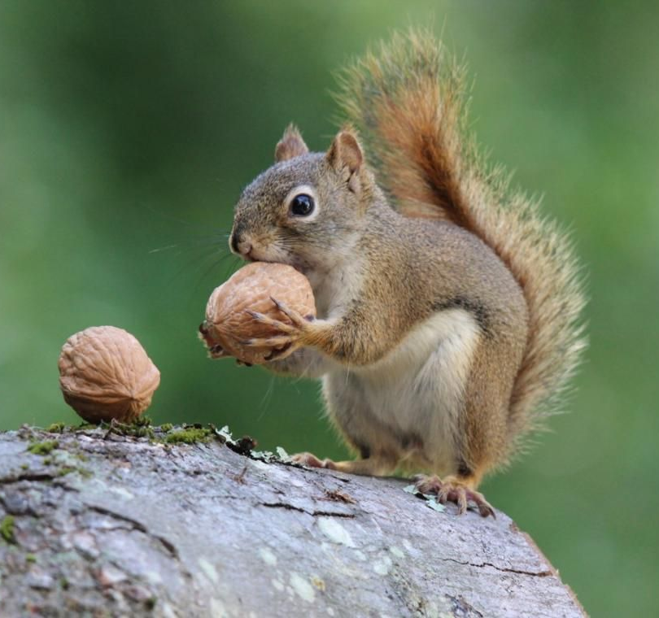
Let her point them to the glories spread out in the heavens, to the thousand forms of beauty that adorn the earth, and then tell them of Him who made them all. Thus she can lead their young minds up to the Creator, and awaken in their hearts reverence and love for the Giver of every blessing. The fields and hills—nature's audience chamber—should be the schoolroom for little children. Her treasures should be their textbook. The lessons thus imprinted upon their minds will not be soon forgotten. CG 48.—The Signs of the Times, December 6, 1877.
In the study of nature there are topics that demand deep thought, and the expansion of the imagination. —Testimonies for the Church 4:581.
Teach them to see the wisdom and love of God in His created works; and as their hearts swell with joy and grateful love, let them join the birds in their songs of praise. CG 48.
he children need to be given lessons that will nurture in them courage to resist evil. Point them from nature to nature's God, and they will thus become acquainted with the Creator. How can I best teach my children to serve and glorify God? should be the question occupying the minds of parents. If all heaven is interested in the welfare of the human race, should not we be diligent to do all in our power for the welfare of our children? CG 49.1—Manuscript 29, 1886.
Shall we, then, in the enjoyment of His gifts, forget the Giver? Let them rather lead us to contemplate His goodness and His love. Let all that is beautiful in our earthly home remind us of the crystal river and green fields, the waving trees and living fountains, the shining city and the white-robed singers, of our heavenly home—that world of beauty which no artist can picture, no mortal tongue describe. “Eye hath not seen, nor ear heard, neither have entered into the heart of man, the things which God hath prepared for them that love Him.” 1 Corinthians 2:9. CT 55.

Slide 14

Wherever we turn, we hear the voice of God and behold His handiwork. CG 53

Slide 15
From the solemn roll of the deep-toned thunder and old ocean's ceaseless roar, to the glad songs that make the forests vocal with melody, nature's ten thousand voices speak His praise.
In earth and sea and sky, with their marvelous tint and color, varying in gorgeous contrast or blended in harmony, we behold His glory.
The canopy over our head, and the earth beneath covered with a carpet of green, call to remembrance the power of God and also His loving-kindness.
The trees that wave their green banners in the sunlight and the flowers in their delicate beauty point to their Creator.
The living green that carpets the brown earth tells of God's care for the humblest of His creatures.
The caves of the sea and the depths of the earth reveal His treasures.
He who placed the pearls in the ocean and the amethyst and chrysolite among the rocks is a lover of the beautiful.
Wherever we turn, we hear the voice of God and behold His handiwork. CG 53

Slide 16

Wherever we turn, we hear the voice of God and behold His handiwork. CG 53

Slide 17
The sun rising in the heavens is a representative of Him who is the life and light of all that He has made.
Every leaf and flower with their varied tints, perfuming the air, teach them that God is love.
For all the objects of His creation the condition is the same—a life sustained by receiving the life
of God, a life exercised in harmony with the Creator's will.
The Lord puts His vital power into the seed, causing it to spring forth into life. A good example of God's power to work miracles
And the birds are teachers of the sweet lesson of trust. Our heavenly Father provides for them; but they must gather the food, they must build their nests and rear their young... Yet how cheerily they go about their work! How full of joy are their little songs!
Insects show industriousness. Ants teach lessons of patient work, of perseverance to overcome obstacles, of foresight for the future. The industrious bees observe perfect order, and no idlers are tolerated. They carry out the work assigned to each one with an intelligence and an activity that escapes our understanding.
Different varieties of plants require different soil and cultivation, and the condition of success is obedience to the laws that govern each. They teach lessons about care, patience, attention to detail, and obedience to the law.
Wherever we turn, we hear the voice of God and behold His handiwork. CG 53

Slide 18
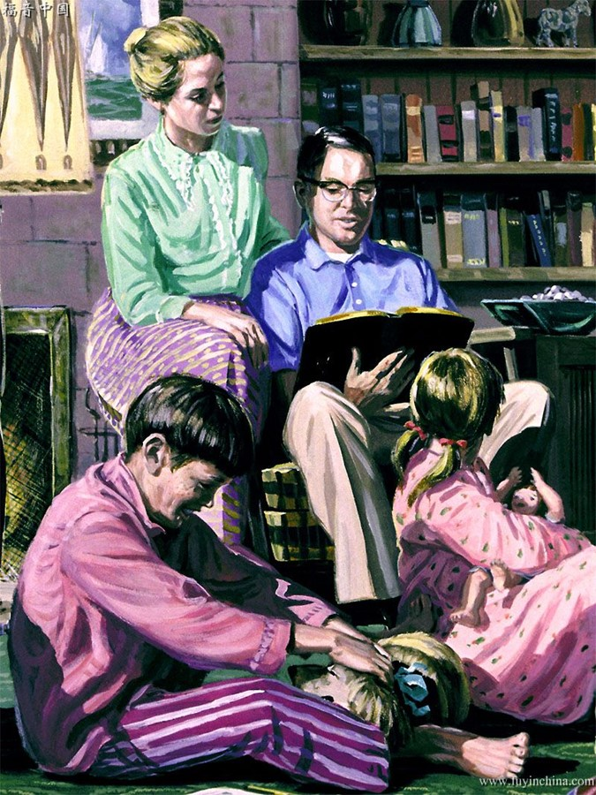
What Preparation Should I Do To Educate My Children Well?

Slide 19







Upon fathers as well as mothers rests a responsibility for the child's earlier as well as its later training, and for both parents the demand for careful and thorough preparation is most urgent. Before taking upon themselves the possibilities of fatherhood and motherhood, men and women should become acquainted with the laws of physical development—with physiology and hygiene, with the bearing of prenatal influences, with the laws of heredity, sanitation, dress, exercise, and the treatment of disease; they should also understand the laws of mental development and moral training CG 63.— La Education, 275, 276.
Parents may well inquire, “Who is sufficient for these things?” God alone is their sufficiency, and if they leave Him out of the question, seeking not His aid and counsel, hopeless indeed is their task. But by prayer, by study of the Bible, and by earnest zeal on their part, they may succeed nobly in this important duty, and be repaid a hundredfold for all their time and care.
The source of wisdom is open, from which they may draw all necessary knowledge in this direction. CG 64.—Testimonies for the Church 4:198.
The work of parents is an important, a solemn, work; the duties devolving upon them are great. But if they will study the Word of God carefully, they will find in it full instructions and many precious promises made to them on condition that they perform their work faithfully and well CG 65.—The Signs of the Times, April 8, 1886.

Slide 20


To parents who have begun their training wrong, I would say, Do not despair. You need to be soundly converted to God. You need the true spirit of obedience to the Word of God. You must make decided reforms in your own customs and practices, conforming your life to the saving principles of the law of God. When you do this, you will have the righteousness of Christ which pervades that law, because you love God and recognize His law as a transcript of His character. True faith in the merits of Christ is not fancy. It is of the highest importance that you bring the attributes of Christ into your own life and character, and educate and train your children with persevering effort to be obedient to the commandments of God. A “Thus saith the Lord” should guide you in all your plans of education...
Let there be a deep and thorough repentance before God. Commence the year ... by earnestly seeking God for grace, for spiritual discernment to discover the defects in the work of the past. Repent before God for your neglected work as home missionaries. CG 69.—Manuscript 12, 1898.
This is your day of trust, your day of responsibility and opportunity. Soon will come your day of reckoning. Take up your work with earnest prayer and faithful endeavor. Teach your children that it is their privilege to receive every day the baptism of the Holy Spirit. Let Christ find you His helping hand to carry out His purposes. By prayer you may gain an experience that will make your ministry for your children a perfect success. CG 69. -Counsels to parents, teachers, and students, 131.

Slide 21

What is the most important lesson I should teach them?

Slide 22




Prompt and continual obedience to wise parental rule will promote the happiness of the children themselves, as well as the honor of God and the good of society. Children should learn that in submission to the laws of the household is their perfect liberty. Christians will learn the same lesson—that in their obedience to God's law is their perfect freedom CG 79.—The Review and Herald, August 30, 1881.
Obedience
A sacred duty rests upon parents to guide their children into paths of strict obedience. True happiness in this life and in the future life depends upon obedience to a “Thus saith the Lord.”
Parents, let Christ's life be the pattern. Satan will devise every possible means to break down this high standard of piety as one altogether too strict. It is your work to impress upon your children in their early years the thought that they are formed in the image of God. Christ came to this world to give them a living example of what they all must be, and parents who claim to believe the truth for this time are to teach their children to love God and to obey His law. This is the greatest and most important work that fathers and mothers can do.
It is God's design that even the children and youth shall understand intelligently what God requires, that they may distinguish between righteousness and sin, between obedience and disobedience. CG 80.— Manuscript 67, 1909.
Parents should educate their children line upon line, precept upon precept, here a little and there a little, not allowing any disregard of God's holy law. They should rely upon divine power, asking the Lord to help them to keep their children true to Him who gave His only-begotten Son to bring the disloyal and disobedient back to their allegiance. God longs to pour upon men and women the rich current of His love CG 81. —Manuscript 36, 1900.

Slide 23


Some parents think that they can let their little ones have their own way in their babyhood, and then when they get older, they will reason with them; but this is a mistake. Begin in the baby life to teach obedience.... Require obedience in your home school CG 82.—Letter 75, 1898. From their earliest life children should be taught to obey their parents, to respect their word, and to reverence their authority CG 82—The Review and Herald, July 16, 1895 The mother's work should commence with the infant. She should subdue the will and temper of the child and bring its disposition into subjection. Teach it to obey, and as the child grows older, relax not the hand CG 82.—The Signs of the Times, February 26, 1880.
Strict discipline may at times cause dissatisfaction, and children will want their own way; yet where they have learned the lesson of obedience to their parents, they are better prepared to submit to the requirements of God. Thus the training received in childhood influences the religious experience and molds the character of the man CG 85.—The Signs of the Times, February 26, 1880.
When parents fail to require prompt and perfect obedience in their children, they fail to lay the right foundation of character in their little ones. They prepare their children to dishonor them when they are old. CG 86.—Manuscript 18, 1891.
Lessons on obedience, on respect for authority, need to be often repeated. This kind of work done in the family will be a power for good, and not only will the children be restrained from evil and constrained to love truth and righteousness, but parents will be equally benefited. This kind of work which the Lord requires cannot be done without much serious contemplation on their part, and much study of the Word of God, in order that they may instruct according to His directions CG 88.—Manuscript 24b, 1894.

Slide 24

What basic lessons should I teach my child?

Slide 25




Well may the mother inquire with deep anxiety, as she looks upon the children given to her care, What is the great aim and object of their education? Is it to fit them for life and its duties, to qualify them to take an honorable position in the world, to do good, to benefit their fellow-beings, to gain eventually the reward of the righteous? If so, then the first lesson to be taught them is self-control; for no undisciplined, headstrong person can hope for success in this world or reward in the next. CG 91.—Pacific Health Journal, May, 1890.
Self-control
One precious lesson which the mother will need to repeat again and again is that the child is not to rule; he is not the master, but her will and her wishes are to be supreme. Thus she is teaching them self-control CG 92. —Manuscript 43, 1900.
Children need to learn early that they cannot be gratified when selfishness prompts their wishes CG 91.—The Signs of the Times, August 13, 1896.
Give them nothing for which they cry, even if your tender heart desires ever so much to do this; for if they gain the victory once by crying they will expect to do it again. The second time the battle will be more vehement CG 92.—Manuscript 43, 1900.
Children should not be allowed to manifest anger; they should not be permitted to throw themselves upon the floor, striking and crying because something has been denied them which was not for their best good CG 92.—The Signs of the Times, March 16, 1891.

Slide 26



It is the duty of parents to exercise judgment and discretion for them. Their habits must be carefully watched. Evil tendencies are to be restrained, and the mind stimulated in favor of the right. The child should be encouraged in every effort to govern itself CG 93.— Christian Temperance and Bible Hygiene, 61.
Self-control
Perverse temper should be checked in the child as soon as possible... Children of quick, passionate disposition need the special care of their parents. They should be dealt with in a particularly kind but firm manner; there should be no wavering or indecision on the part of the parents in their case CG 93.—Pacific Health Journal, January, 1890.
If parents desire to teach their children self-control, they must first form the habit themselves. The scolding and faultfinding of parents encourages a hasty, passionate temper in their children CG 94.—The Signs of the Times, November 24, 1881.
We should not see the terrible state of evil that exists among the youth of today if they had been properly trained at home. If parents would take up their God-given work and would teach self-restraint, self-denial, and self-control to their children, both by precept and example, they would find that while they were seeking to do their duty, so as to meet the approval of God, they would be learning precious lessons in the school of Christ. They would be learning patience, forbearance, love, and meekness; and these are the very lessons that they must teach to their children CG 94. —The Review and Herald, July 10, 1888,

Slide 27





When parents do not maintain their authority, when the children go to school, they have no particular respect for the teachers or principal of the school. The reverence and respect that they should have, they were never taught to have at home. Father and mother were on the same level with the children CG 98.—Manuscript 14, 1894.
Self-Control
Tranquility, Respect and Reverence
Parents do their children great wrong when they allow them to scream and cry.
They should not be allowed to be careless and boisterous. If these objectionable traits of character are not checked in their early years, the children will take them with them, strengthened and developed, into religious and business life. Children will be just as happy if they are taught to be quiet in the house CG 97.—The Signs of the Times, September 25, 1901.
Parents can and should interest their children in the varied knowledge found in the sacred pages. But if they would interest their sons and daughters in the Word of God, they must be interested in it themselves. They must be familiar with its teachings and, as God commanded Israel, speak of it “when thou sittest in thine house, and when thou walkest by the way, when thou liest down, and when thou risest up.” Deuteronomy 11:19. Those who desire their children to love and reverence God must talk of His goodness, His majesty, and His power, as revealed in His Word and in the works of creation CG 99.— Patriarchs and Prophets, 504.

Slide 28


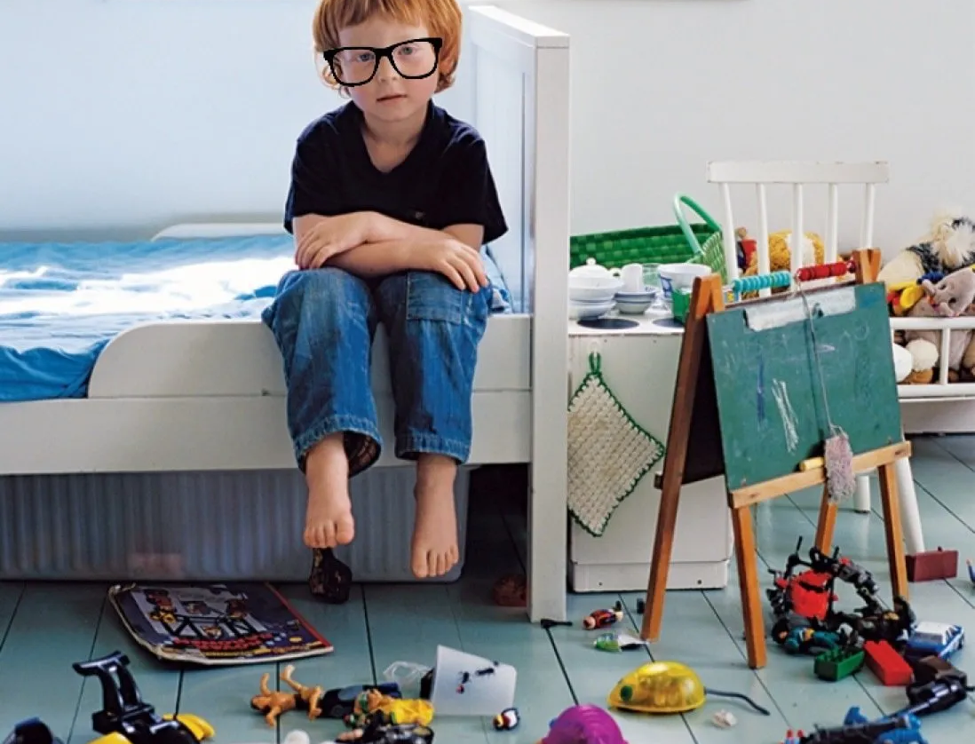

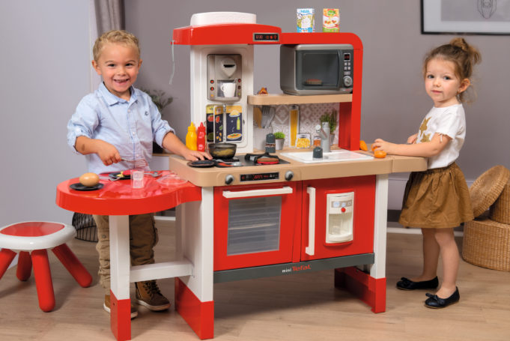

Some parents allow their children to be destructive, to use as playthings things which they have no right to touch. Children should be taught that they must not handle the property of other people. For the comfort and happiness of the family, they must learn to observe the rules of propriety. Children are no happier when they are allowed to handle everything they see. If they are not educated to be caretaking, they will grow up with unlovely, destructive traits of character. CG 101.—The Signs of the Times, September 25, 1901.
Self-control
Tranquility, Respect and Reverence
Care in Property Management
With firmness they are to refuse to allow everything in the home to be handled freely and thrown about on the floor or in the dirt. Those who allow a child to pursue such a course are doing him a great wrong. He may not be a bad child, but his education is making him very troublesome and destructive CG 101.—Manuscript 64, 1899.
Do not give the children playthings that are easily broken. To do this is to teach lessons in destructiveness. Let them have a few playthings, and let these be strong and durable. Such suggestions, small though they may seem, mean much in the education of the child. CG 102.—Counsels to Parents, Teachers and Students, 123

Slide 29






Teach your children to study from cause to effect; show them that if they violate the laws of their being, they must pay the penalty by suffering disease...
Press on until the victory is gained. Continue to teach your children in regard to their own bodies, and how to take care of them. Recklessness in regard to bodily health tends to recklessness in moral character. CG 104.—Testimonies for the Church 2:536, 537
Self-control
Tranquility, Respect and Reverence
Care in Property Management
Health Principles
Physical training, the development of the body, is far more easily given than spiritual training. The nursery, the playground, the workshop; the sowing of the seed, and the gathering of the harvest—all these give physical training. Under ordinarily favorable circumstances a child naturally gains healthful vigor and a proper development of the bodily organs. Yet even in physical lines the child should be carefully trained. CG 104.

Slide 30


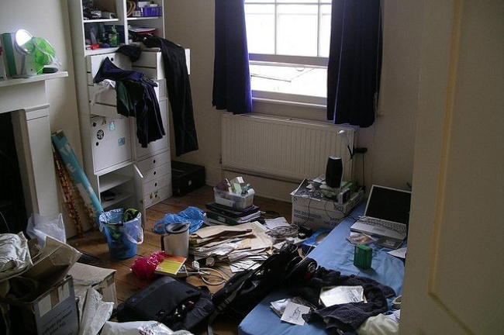


You have in trust the Lord's little ones, and that God who was so particular that the children of Israel should grow up with habits of cleanliness will not sanction any impurity in the home today. God has given you the work of educating your children in these lines, and in training your children in habits of cleanliness, you teach them spiritual lessons.
Self-control
Tranquility, Respect and Reverence
They will see that God would have them clean in heart as well as in body, and will be led to an understanding of the pure principles which God designs should prompt every act of their lives. CG 106.
Care in Property Management
Health Principles
Cleaning
Uncleanness in the home is a great mistake, for it is educating in its effects and casts its influence abroad. Even in babyhood a right direction should be given to the minds and habits of children.... Show them that uncleanness, whether in body or dress, is objectionable to God. Teach them to eat in a clean manner. Constant vigilance must be exercised that these habits may become second nature to them.... Impurity will be despised as it should be. CG 106—Manuscript 32, 1899.

Slide 31


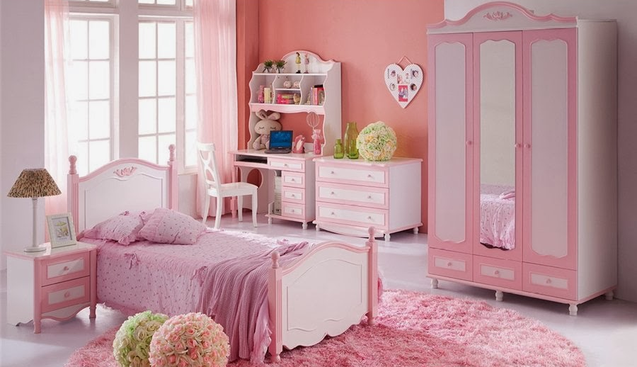

The cultivation of order and taste is an important part of the education of children ... As the guardian and teacher of your children, you are in duty bound to do every little thing in the home with nicety and in order CG 110 —Letter 47a, 1902.
Self-control
Tranquility, Respect and Reverence
If the children have a room which they know is their own, and if they are taught how to keep it tidy and make it pleasant, they will have a sense of ownership—they will feel that they have within the home a home of their own, and will have a satisfaction in keeping it neat and nice. The mother will necessarily have to inspect their work and make suggestions and give instruction. This is the mother's work. CG 111—Christian Temperance and Bible Hygiene, 143.
Care in Property Management
Health Principles
Cleaning
Neatness, Order and Regularity
It is the duty of all to observe strict rules in their habits of life. This is for your own good, dear youth, both physically and morally. When you rise in the morning, take into consideration, as far as possible, the work you must accomplish during the day.
If necessary, have a small book in which to jot down the things that need to be done, and set yourself a time in which to do your work. CG 112.—The Youth’s Instructor, January 28, 1897.

Slide 32

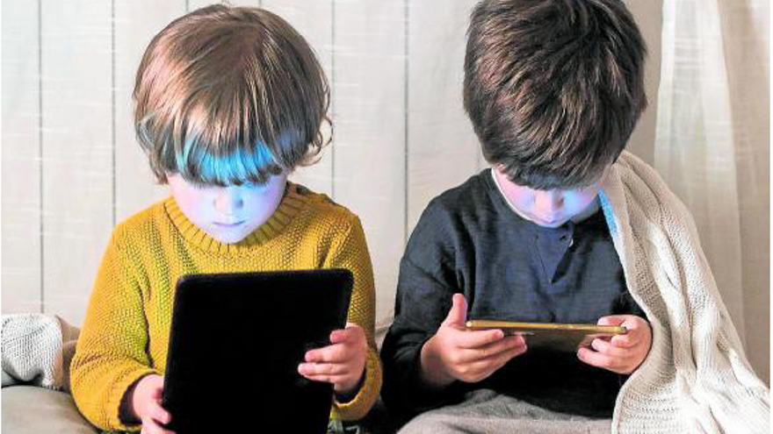

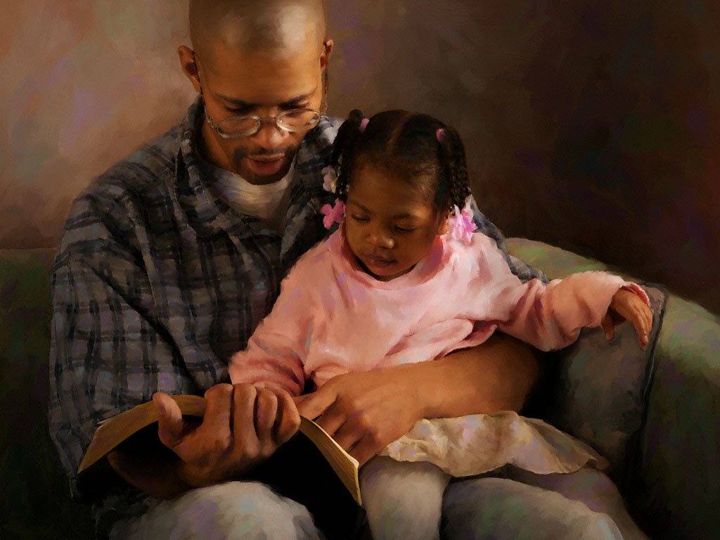
If in their tender years the minds of children are filled with pleasant images of truth, of purity and goodness, a taste will be formed for that which is pure and elevated, and their imagination will not become easily corrupted or defiled. While if the opposite course is pursued, if the minds of the parents are continually dwelling upon low scenes; if their conversation lingers over objectionable features of character; if they form a habit of speaking complainingly of the course others have pursued, the little ones will take lessons from the words and expressions of contempt and will follow the pernicious example. The evil impress, like the taint of the leprosy, will cleave to them in afterlife. CG 116.—Good Health, January 1880.
Self-control
Tranquility, Respect and Reverence
Care in Property Management
Health Principles
Cleaning
Those who have charge of God's property in the souls and bodies of the children formed in His image should erect barriers against the sensual indulgence of the age, which is ruining the physical and moral health of thousands. —The Review and Herald, June 27, 1899.
Neatness, Order and Regularity
Purity
If parents desire their children to be pure, they must surround them with pure associations such as God can approve CG 114. —Christian Temperance and Bible Hygiene, 142.
Parents and guardians must themselves maintain purity of heart and life if they would have their children pure. They must give the needed instruction, and in addition to this they must exercise unceasing watchfulness. Every day new thoughts are awakened in the minds of the young, new impressions made upon their hearts. The associations they form, the books they read, the habits they cherish—all must be guarded. CG 113.—The Signs of the Times, May 25, 1882.

Slide 33
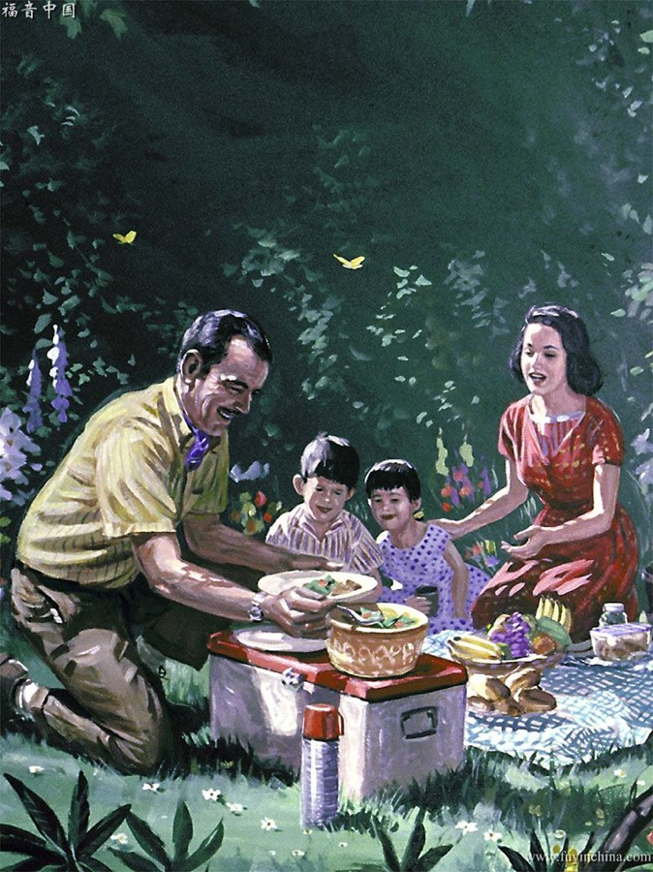
What practical virtue lessons should I instill in my child?

Slide 34




Usefulness
Thousands in their own homes are left almost uneducated. “It is so much trouble,” says the mother. “I would rather do these things myself; it is such a trouble; you bother me.” Does not mother remember that she herself had to learn in jots and tittles before she could be helpful? It is a wrong to children to refuse to teach them little by little. Keep these children with you. Let them ask questions, and in patience answer them. Give your little children something to do, and let them have the happiness of supposing they help you. There must be no repulsing of your children when trying to do proper things. If they make mistakes, if accidents happen and things break, do not blame them. Their whole future life depends upon the education you give them in their childhood years. Teach them that all their faculties of body and mind were given to them to use, and that all are the Lord's, pledged to His service. To some of these children the Lord gives an early intimation of His will. Parents and teachers, begin early to teach the children to cultivate their God-given faculties. CG 119.—Letter 104, 1897.
Make the life of your children pleasant, and at the same time teach them to be obedient and helpful, bearing small burdens as you bear larger ones. Educate them to habits of industry, so that the enemy will not make a workshop of their minds. Give your children something to think of, something to do, that they may be fitted for usefulness in this life and in the future life CG 120.—Manuscript 62, 1901.

Slide 35

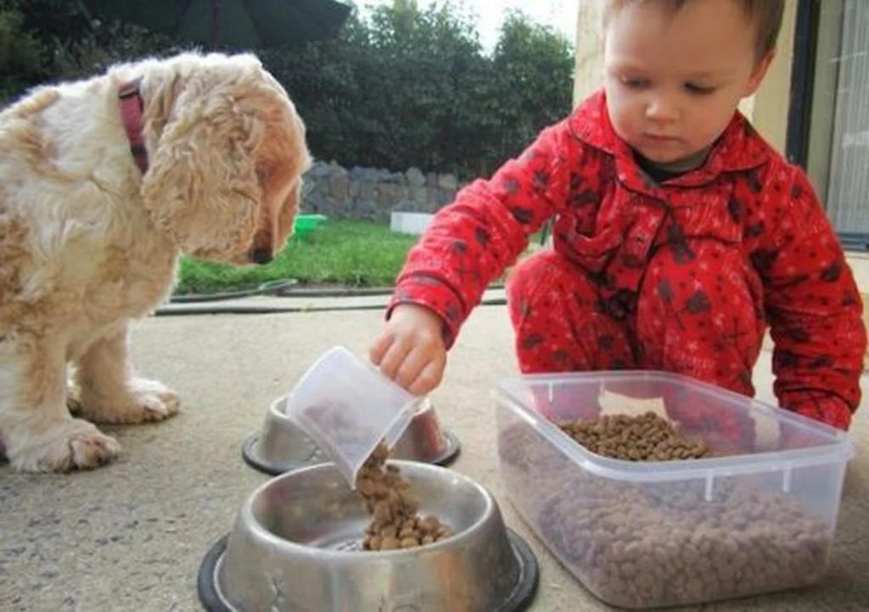


Usefulness
One of the surest safeguards of the young is useful occupation. Children who are trained to industrious habits, so that all their hours are usefully and pleasantly employed, have no inclination to repine at their lot and no time for idle daydreaming. They are in little danger of forming vicious habits or associations. CG 122. Counsels to Parents, Teachers and Students, 122.
Industriousness
Parents cannot commit a greater sin than to neglect their God-given responsibilities in leaving their children with nothing to do; for these children will soon learn to love idleness and grow up to be shiftless, useless men and women… the youth should be “diligent in business, fervent in spirit, serving the Lord”; for he that is unfaithful in that which is least is unfaithful also in much. CG 122.—Manuscript 117, 1899.
Why Work Before Play?—My mother taught me to work. I used to ask my mother, “Why must I always do so much work before I play?” “It is to educate and train your mind for useful labor, and another thing, to keep you out of mischief; and when you get older, you will thank me for it.” CG 124—Manuscript 19, 1887.
As far as possible, it is well to consider what is to be accomplished through the day. Make a memorandum of the different duties that await your attention, and set apart a certain time for the doing of each duty. Let everything be done with thoroughness, neatness, and dispatch. CG 124 —The Youth’s Instructor, September 7, 1893.
Let us teach the little ones to help us while their hands are small and their strength is slight. Let us impress upon their minds the fact that labor is noble, that it was ordained to man of heaven, that it was enjoined upon Adam in Eden, as an essential to the healthy development of mind and body CG 127.—Pacific Health Journal, May, 1890.
Notes:
Foto de <a href="https://unsplash.com/@tysonbrand?utm_source=unsplash&utm_medium=referral&utm_content=creditCopyText">Tyson</a> en <a href="https://unsplash.com/es/fotos/zIzsLS2rYF8?utm_source=unsplash&utm_medium=referral&utm_content=creditCopyText">Unsplash</a>

Slide 36


Children frequently begin a piece of work with enthusiasm; but, becoming perplexed or wearied with it, they wish to change and take hold of something new. Thus they may take hold of several things, meet with a little discouragement, and give them up; and so they pass from one thing to another, perfecting nothing. Parents should not allow the love of change to control their children. They should not be so much engaged with other things that they will have no time to patiently discipline the developing minds. A few words of encouragement, or a little help at the right time, may carry them over their trouble and discouragement; and the satisfaction they will derive from seeing the task completed that they undertook will stimulate them to greater exertion. CG 128 —Testimonies for the Church 1:392, 393.
Usefulness
Industriousness
Diligence and Perseverance
To allow a child to take an hour or two in doing a piece of work that could easily be done in half an hour is to allow it to form dilatory habits. Habits of industry and thoroughness will be an untold blessing to the youth in the larger school of life, upon which they must enter as they grow older. CT 122.
Never underrate the importance of little things. Little things supply the actual discipline of life. It is by them that the soul is trained that it may grow into the likeness of Christ, or bear the likeness of evil. God help us to cultivate habits of thought, word, look, and action that will testify to all about us that we have been with Jesus and learned of Him! CG 129.3—The Youth’s Instructor, March 9, 1893.
Let the child and the youth be taught that every mistake, every fault, every difficulty, conquered, becomes a stepping-stone to better and higher things. It is through such experiences that all who have ever made life worth the living have achieved success. Ed 296.

Slide 37

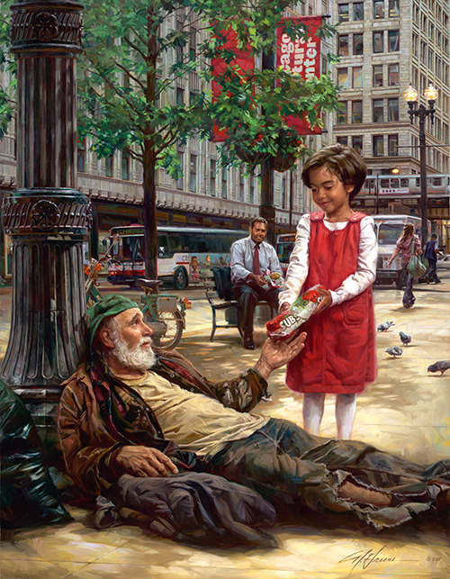
In every home there should be taught lessons of self-denial. Fathers and mothers, teach your children to economize. Encourage them to save their pennies for missionary work. Christ is our example. For our sakes He became poor, that we through His poverty might be made rich. He taught that all should come together in love and unity, to work as He worked, to sacrifice as He sacrificed, to love as the children of God. CG 131. Testimonies for the Church 9:130, 131.
Usefulness
Industriousness
Children of two to four years of age should not be encouraged to think that they must have everything that they ask for. Parents should teach them lessons of self-denial and never treat them in such a way as to make them think they are the center, and that everything revolves about them … Christ gave many reproofs to those who were covetous and selfish. Parents should seek, on the first exhibition of selfish traits of character, whether in their presence, or when in association with other children, to restrain and uproot these traits from the character of their children. CG 132.—The Signs of the Times, August 13, 1896.
Diligence and Perseverance
Abnegation, Generosity and Foresight
Sacrifice must become habitual in all our character building in this life, if we would have a building not made with hands, eternal in the heavens. CG 131. —Testimonies for the Church 6: 214.
One of the characteristics that should be especially cherished and cultivated in every child is that self-forgetfulness which imparts to the life such an unconscious grace. Of all excellences of character this is one of the most beautiful, and for every true lifework it is one of the qualifications most essential. CG 133. —Education 237.
Study how to teach the children to be thoughtful of others. The youth should be early accustomed to submission, self-denial, and regard for others’ happiness. They should be taught to subdue the hasty temper, to withhold the passionate word, to manifest unvarying kindness, courtesy, and self-control. CG 133. Counsels to Parents, Teachers and Students, 123, 124.

Slide 38


If you have extravagant habits, cut them away from the life as soon as possible. Unless you do this, you will be bankrupt for eternity. And habits of economy, industry, and sobriety are, even in this world, a better portion for you and your children than a rich dowry. CG 134.1.—Manuscript 139, 1898.
Usefulness
Industriousness
Parents are to instruct their children in lessons of economy, in order that the younger members of the flock may learn to share the responsibility of supporting the cause of God at this time CG 134.—Letter 4, 1911.
Diligence and Perseverance
Parents, for Christ's sake do not use the Lord's money to please the fancies of your children. Do not teach them to seek after style and ostentation in order to obtain an influence in the world.... Do not educate your children to think that your love for them must be expressed by indulging their pride, their extravagance, their love of display. There is no time now to invent ways of using money. Your inventive faculties are to be put to the stretch, to see how you can economize CG 135.—Manuscript 139, 1898.
Abnegation, Generosity and Foresight
Economy and Savings
Nothing that can be utilized should be thrown away. This will require wisdom, and forethought, and constant care CG 135.—Manuscript 3, 1912.
Let every youth and every child be taught, not merely to solve imaginary problems, but to keep an accurate account of his own income and outgoes. Let him learn the right use of money by using it. Whether supplied by their parents or by their own earnings, let boys and girls learn to select and purchase their own clothing, their books, and other necessities; and by keeping an account of their expenses, they will learn, as they could learn in no other way, the value and the use of money. CG 136 —Counsels on Stewardship, 294.

Slide 39

What Christian qualities should I pass on to my child?

Slide 40


The little ones should be educated in childlike simplicity. They should be trained to be content with the small, helpful duties and the pleasures and experiences natural to their years… Children should not be forced into a precocious maturity, but as long as possible should retain the freshness and grace of their early years. The more quiet and simple the life of the child—the more free from artificial excitement and the more in harmony with nature—the more favorable it is to physical and mental vigor and to spiritual strength. CG 139.— Education, 107.
Simplicity
Girls should be taught that the true charm of womanliness is not alone in beauty of form or feature, nor in the possession of accomplishments; but in a meek and quiet spirit, in patience, generosity, kindness, and a willingness to do and suffer for others. They should be taught to work, to study to some purpose, to live for some object, to trust in God and fear Him, and to respect their parents. Then as they advance in years, they will grow more pure-minded, self-reliant, and beloved. It will be impossible to degrade such a woman. She will escape the temptations and trials that have been the ruin of so many. CG 140.—The Health Reformer, December, 1877.
In many families the seeds of vanity and selfishness are sown in the hearts of the children almost during babyhood. Their cunning little sayings and doings are commented upon and praised in their presence and repeated with exaggerations to others. The little ones take note of this and swell with self-importance; they presume to interrupt conversations and become forward and impudent. Flattery and indulgence foster their vanity and willfulness, until the youngest not unfrequently rules the whole family, father and mother included. CG 140.—Testimonies for the Church 4:200, 201.
We should teach our children lessons in simplicity and trust. We should teach them to love, and fear, and obey their Creator. In all the plans and purposes of life His glory should be held paramount; His love should be the mainspring of every action CG 141.4.—The Review and Herald, June, 1882.

Slide 41



Parents, teach your children... how to conduct themselves in the home with true politeness. Educate them to show kindness and tenderness to one another. Allow no selfishness to live in the heart or find room in the home. CG 143—Manuscript 74, 1900.
Simplicity
Courtesy and Reservation
Let the youth take warning; let them not be forward in conversation, but be modest and retiring. Let them be quick to hear things that will profit the soul, and be slow to speak, unless it be to represent Jesus, and to witness to the truth. Show humility of mind by modesty of demeanor CG 144.3.—The Youth’s Instructor, July 11, 1895.
Children, as well as those of older years, are exposed to temptations; and the older members of the family should give them, by precept and example, lessons in courtesy, cheerfulness, affection, and in the faithful discharge of their daily duties. CG 143.— Manuscript 27, 1896.
I feel impelled by the Spirit of the Lord to urge my sisters who profess godliness to cherish modesty of deportment and a becoming reserve.... I have inquired, When will the youthful sisters act with propriety? I know there will be no decided change for the better until parents feel the importance of greater carefulness in educating their children correctly. Teach them to act with reserve and modesty. CG 144.
—Testimonies for the Church 2:458, 459.
A child's truest graces consist in modesty and obedience—in attentive ears to hear the words of direction, in willing feet and hands to walk and work in the path of duty. And a child's true goodness will bring its own reward, even in this life. CG 145.—The Review and Herald, May 10, 1898.

Slide 42



There is nothing gloomy in the religion of Jesus. While all lightness, trifling, and jesting, which the apostle says are not convenient, are to be studiously avoided, there is a sweet rest and peace in Jesus that will be expressed in the countenance. Christians will not be mournful, depressed, and despairing. They will be sober-minded, yet they will show to the world a cheerfulness which only grace can impart. CG 146.—The Review and Herald, April 15, 1884.
Simplicity
Courtesy and Reservation
Joy and Gratitude
Educate the soul to cheerfulness, to thankfulness, and to the expression of gratitude to God for the great love wherewith He hath loved us.... Christian cheerfulness is the very beauty of holiness CG 146.—The Youth’s Instructor, July 11, 1895.
If there is anyone who should be continually grateful, it is the Christian. If there is anyone who enjoys happiness, even in this life, it is the faithful follower of Jesus Christ. It is the duty of God's children to be cheerful. They should encourage a happy frame of mind. God cannot be glorified by His children living continually under a cloud and casting a shadow wherever they go. The Christian should cast sunshine instead of a shadow.... He will bear a cheerful countenance. CG 147.—The Review and Herald, April 28, 1859.
Make your work pleasant with songs of praise. If you would have a clean record in the books of heaven, never fret or scold. Let your daily prayer be, “Lord, teach me to do my best. Teach me how to do better work. Give me energy and cheerfulness.” ... Bring Christ into all that you do. Then your lives will be filled with brightness and thanksgiving.... Let us do our best, moving forward cheerfully in the service of the Lord, with our hearts filled with His joy. CG 148.—Australasian Union Record, November 15, 1903

Slide 43




Parents, never prevaricate; never tell an untruth in precept or in example. If you want your child to be truthful, be truthful yourself. Be straight and undeviating. Even a slight prevarication should not be allowed. Because mothers are accustomed to prevaricate and be untruthful, the child follows her example. CG 151.3.— Manuscript 126, 1897.
Simplicity
Courtesy and Reservation
Joy and Gratitude
Truthfulness
Parents and teachers, be true to God. Let your life be free from deceitful practices. Let no guile be found in your lips. However, disagreeable it may be to you at the time, let your ways, your words, and your works show uprightness in the sight of a Holy God. Oh, the effect of the first lesson in deceit is terrible! Shall any who claim to be sons and daughters of God give themselves up to deceitful practices and lying ? Never let your children have the semblance of an excuse for saying, Mother does not tell the truth. Father does not tell the truth. When you are tried in the heavenly courts, shall the record be made against your name, A deceiver? Shall your offspring be perverted by the example of those who ought to guide them in the way of truth? Instead of this, shall not the converting power of God enter the hearts of mothers and fathers? Shall not the Holy Spirit of God be allowed to make its mark upon their children?—The Review and Herald, April 13, 1897.
Do not become impatient with your children when they err. When you correct them, do not speak abruptly and harshly. This confuses them, making them afraid to tell the truth CG 151.—Manuscript 2, 1903.

Slide 44

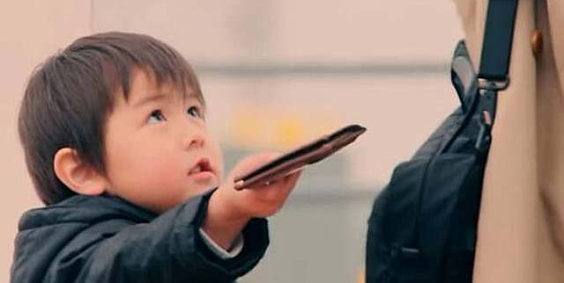
God wants men in His service, under His banner, to be strictly honest, unimpeachable in character, that their tongues shall not utter a semblance of untruth. The tongue must be true, the eyes must be true, the actions wholly and entirely such as God can commend. We are living in the sight of a holy God, who solemnly declares, “I know thy works.” The divine eye is ever upon us. We cannot cover one act of unjust deal from God. The witness of God to our every action is a truth which but few realize. CCh 84.—Letter 41, 1888.
Simplicity
Courtesy and Reservation
Joy and Gratitude
Veracity
Men are wanted whose sense of justice, even in the smallest matters, will not allow them to make an entry of their time that is not minute and correct—men who will realize that they are handling means that belong to God, and who would not unjustly appropriate one cent to their own use; men who will be just as faithful and exact, careful and diligent, in their labor, in the absence of their employer as in his presence, proving by their faithfulness that they are not merely men-pleasers, eyeservants, but are conscientious, faithful, true workmen, doing right, not for human praise, but because they love and choose the right from a high sense of their obligation to God. CG 153.—Testimonies for the Church 3:25.
Honesty and Integrity
An honest man, according to Christ's measurement, is one who will manifest unbending integrity. Deceitful weights and false balances, with which many seek to advance their interests in the world, are abomination in the sight of God… The angels of God, who watch the development of character and weigh moral worth, record in the books of heaven these minor transactions which reveal character. CG 152. —Testimonies for the Church 4:310.

Slide 45



So far as possible, every child should be trained to self-reliance. By calling into exercise the various faculties, he will learn where he is strongest, and in what he is deficient. A wise instructor will give special attention to the development of the weaker traits, that the child may form a well-balanced, harmonious character. CG 156.—Fundamentals of Christian Education, 57.
Simplicity
Courtesy and Reservation
Joy and Gratitude
Veracity
Honesty and Integrity
Self-Trust and Honor
It is obstacles that make men strong. It is not helps, but difficulties, conflicts, rebuffs, that make men of moral sinew CG 156.—Testimonies for the Church 3:495.
If parents, while they live, would assist their children to help themselves, it would be better than to leave them a large amount at death. Children who are left to rely principally upon their own exertions make better men and women and are better fitted for practical life than those children who have depended upon their father's estate. The children left to depend upon their own resources generally prize their abilities, improve their privileges, and cultivate and direct their faculties to accomplish a purpose in life. They frequently develop characters of industry, frugality, and moral worth, which lie at the foundation of success in the Christian life. CG 156. —Testimonies for the Church 3:122, 123.

Slide 46
We have learned:
Where Education Begins
Who are the first teachers
When to Start Education
What teaching methods do I use for my children's education
What two books are essential in education
What preparation should I do to educate my children well
What is the most important lesson I should teach them
What basic lessons should I teach my child
What practical virtue lessons should I instill in my child
What Christian qualities should I pass on to my child
“We see a retinue of angels on either side of the gate; and as we pass in, Jesus speaks, “Come, ye blessed of my Father, inherit the kingdom that is prepared for you from the foundation of the world.” Here He tells you to be a partaker of His joy, and what is that? It is the joy of seeing of the travail of your soul, fathers. It is the joy of seeing that your efforts, mothers, are rewarded. Here are your children; the crown of life is upon their heads, and the angels of God immortalize the names of the mothers whose efforts have won their children to Jesus Christ. CG 567.—Manuscript 12, 1895.

