Slide 1


Slide 2


In this presentation we will learn the importance of modeling the character of our children in the likeness of Jesus.
“Character building is the most important work ever entrusted to human beings, and never before was its diligent study so important as now. Never was any previous generation called to meet issues so momentous; never before were young men and young women confronted by perils so great as confront them today.” CG 169. Education 225
We will also learn how to discipline them to be citizens of the kingdom of heaven.
“Parents who truly love Christ will bear witness to this in a love for their children that will not indulge, but will work wisely for their highest good. They will lend every sanctified energy and ability to the work of saving their children. Instead of treating them as playthings, they will regard them as the purchase of Christ, and will teach them that they are to become the children of God. Instead of allowing them to indulge evil temper and selfish desires, they will teach them lessons of self-restraint. And the children will be happier, far happier, under proper discipline than if left to do as their unrestrained impulses suggest. A child's truest graces consist in modesty and obedience—in attentive ears to hear the words of direction, in willing feet and hands to walk and work in the path of duty.” CT 113

Slide 3


THE CHARACTER

Slide 4

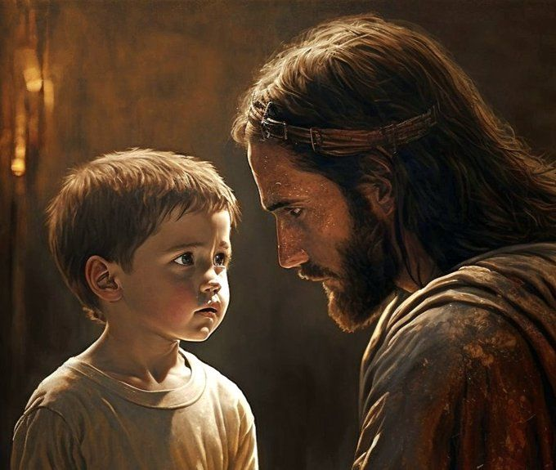



A character formed according to the divine likeness is the only treasure that we can take from this world to the next. Those who are under the instruction of Christ in this world will take every divine attainment with them to the heavenly mansions. And in heaven we are continually to improve. How important, then, is the development of character in this life. COL 332.
The Importance of Character
Mental ability and genius are not character, for these are often possessed by those who have the very opposite of a good character. Reputation is not character. True character is a quality of the soul, revealing itself in the conduct. CG 161.—The Youth’s Instructor, November 3, 1886.
Strength of character consists of two things—power of will and power of self-control. Many youth mistake strong, uncontrolled passion for strength of character; but the truth is that he who is mastered by his passions is a weak man. The real greatness and nobility of the man is measured by his power to subdue his feelings, not by the power of his feelings to subdue him. The strongest man is he who, while sensitive to abuse, will yet restrain passion and forgive his enemies. CT 222.

Slide 5

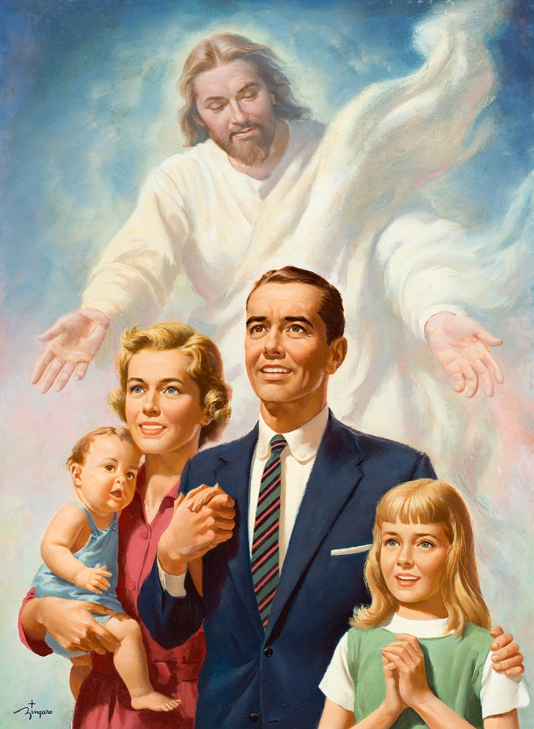
The formation of character is the work of a lifetime, and it is for eternity. If all could realize this, if they would awake to the thought that we are individually deciding our own destiny for eternal life or eternal ruin, what a change would take place! How differently would this probationary time be occupied, and what different characters would fill our world!—The Youth’s Instructor, February 19, 1903.
The Importance of Character
No higher work was ever committed to mortals than the shaping of character. Children are not only to be educated, but trained as well; and who can tell the future of a growing child, or youth? Let the greatest care be bestowed upon the culture of your children. One child, properly disciplined in the principles of truth, who has the love and fear of God woven through the character, will possess a power for good in the world that cannot be estimated. —The Signs of the Times, July 13, 1888.

Slide 6




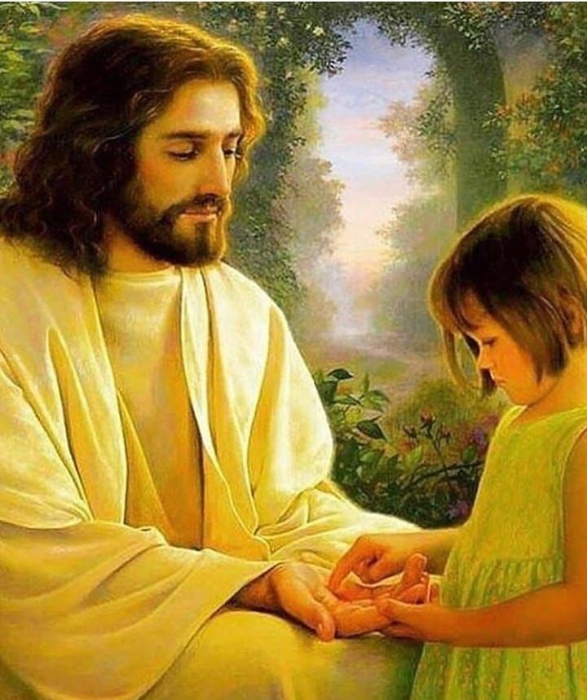
Character does not come by chance. It is not determined by one outburst of temper, one step in the wrong direction. It is the repetition of the act that causes it to become habit, and molds the character either for good or for evil. Right characters can be formed only by persevering, untiring effort, by improving every entrusted talent and capability to the glory of God. Instead of doing this, many allow themselves to drift wherever impulse or circumstances may carry them... This is not because they are lacking in good material, but because they do not realize that in their youth God wants them to do their very best.—The Youth’s Instructor, July 27, 1899.
How Character Is Formed
To a great extent everyone is the architect of his own character. Every day the structure more nearly approaches completion. The Word of God warns us to take heed how we build, to see that our building is founded upon the Eternal Rock. The time is coming when our work will stand revealed just as it is. Now is the time for all to cultivate the powers that God has given them, that they may form characters for usefulness here and for a higher life hereafter. CG 164.3 Faith in Christ as a personal Saviour will give strength and solidity to the character. Those who have genuine faith in Christ will be sober-minded, remembering that God's eye is upon them, that the Judge of all men is weighing moral worth, that heavenly intelligences are watching to see what manner of character is being developed. CG 165.1.—Counsels to parents, teachers, and students, 222-223.

Slide 7


God expects us to build characters in accordance with the pattern set before us. We are to lay brick by brick, adding grace to grace, finding our weak points and correcting them in accordance with the directions given. When a crack is seen in the walls of a mansion, we know that something about the building is wrong. In our character building, cracks are often seen. Unless these defects are remedied, the house will fall when the tempest of trial beats upon it. —The Youth’s Instructor, October 25, 1900.
How Character Is Formed
Those who are defective in character, in conduct, in habits and practices, are to take heed to counsel and reproof. This world is God's workshop, and every stone that can be used in the heavenly temple must be hewed and polished, until it is a tried and precious stone, fitted for its place in the Lord's building. But if we refuse to be trained and disciplined, we shall be as stones that will not be hewed and polished, and that are cast aside at last as useless. —The Youth’s Instructor, August 31, 1893.
If the youth rightly appreciate this important matter of character building, they will see the necessity of doing their work so that it will stand the test of investigation before God. The humblest and weakest, by persevering effort in resisting temptation and seeking wisdom from above, may reach heights that now seem impossible. These attainments cannot come without a determined purpose to be faithful in the fulfillment of little duties. It requires constant watchfulness that crooked traits shall not be left to strengthen. The young may have moral power, for Jesus came into the world that He might be our example and give to all youth and those of every age divine help. —The Youth’s Instructor, November 3, 1886.

Slide 8
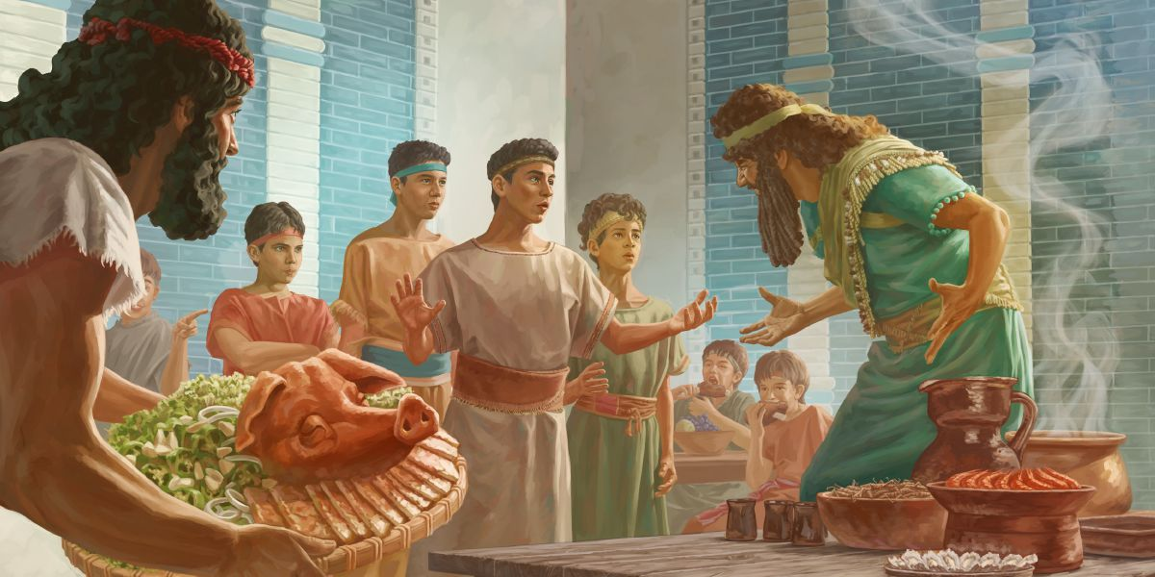
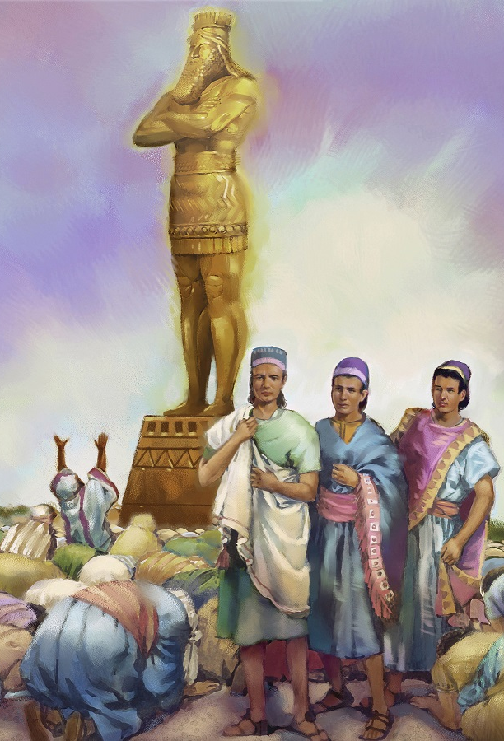
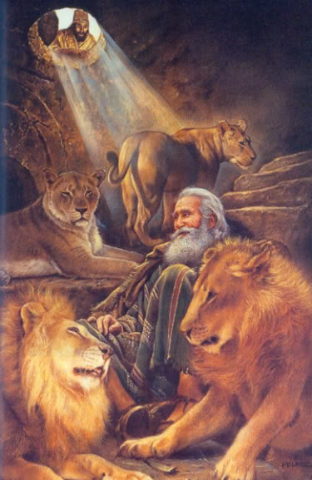
The life of Daniel is an inspired illustration of what constitutes a sanctified character. It presents a lesson for all, and especially for the young. A strict compliance with the requirements of God is beneficial to the health of body and mind.—Fundamentals of Christian Education, 80.
How Character Is Formed
Daniel's parents had trained him in his childhood to habits of strict temperance. They had taught him that he must conform to nature's laws in all his habits; that his eating and drinking had a direct influence upon his physical, mental, and moral nature, and that he was accountable to God for his capabilities; for he held them all as a gift from God and must not, by any course of action, dwarf or cripple them. As the result of this teaching, the law of God was exalted in his mind and reverenced in his heart. During the early years of his captivity Daniel was passing through an ordeal which was to familiarize him with courtly grandeur, with hypocrisy, and with paganism. A strange school indeed to fit him for a life of sobriety, industry, and faithfulness! And yet he lived uncorrupted by the atmosphere of evil with which he was surrounded.
Daniel and his companions enjoyed the benefits of correct training and education in early life, but these advantages alone would not have made them what they were. The time came when they must act for themselves—when their future depended upon their own course. Then they decided to be true to the lessons given them in childhood. The fear of God, which is the beginning of wisdom, was the foundation of their greatness. His Spirit strengthened every true purpose, every noble resolution.—Manuscript 132, 1901.

Slide 9






God has given parents their work, to form the characters of their children after the divine Pattern. By His grace they can accomplish the task; but it will require patient, painstaking effort, no less than firmness and decision, to guide the will and restrain the passions.—The Signs of the Times, November 24, 1881.
The Responsibility of Parents in the Formation of Character
Here is your work, parents, to develop the characters of your children in harmony with the precepts of the Word of God. This work should come first, for eternal interests are here involved. The character building of your children is of more importance than the cultivation of your farms, more essential than the building of houses to live in, or of prosecuting any manner of business or trade.— The Signs of the Times, September 10, 1894.
Those who take upon themselves the responsibility of mothers should feel under the most solemn obligation to God and to their children to so educate them that they will have amiable and affectionate dispositions, and that they will be pure in morals, refined in taste, and lovely in character. —The Signs of the Times, August 5, 1875.
Shall we consider that we are capable of fashioning our lives and characters to enter into the portals of glory? We cannot do it. We are dependent every moment upon the Spirit of God operating upon us and upon our children.—Manuscript 12, 1895.

Slide 10
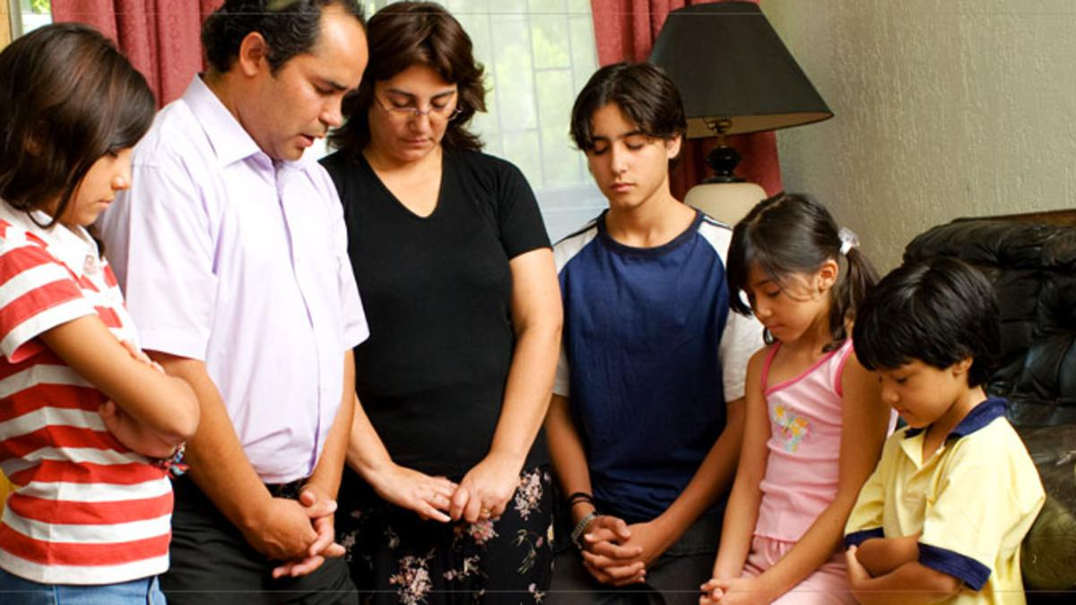

An error on your part in neglect of faithful instruction, or in the indulgence of that unwise affection which blinds your eyes to their defects and prevents you from giving them proper restraint, will prove their ruin. Your course may give a wrong direction to all their future career. You determine for them what they will be and what they will do for Christ, for men, and for their own souls. —CG 170.3
The Responsibility of Parents in the Formation of Character
Deal honestly and faithfully with your children. Work bravely and patiently. Fear no crosses, spare no time or labor, burden or suffering. The future of your children will testify the character of your work. Fidelity to Christ on your part can be better expressed in the symmetrical character of your children than in any other way. They are Christ's property, bought with His own blood. If their influence is wholly on the side of Christ, they are His colaborers, helping others to find the path of life. If you neglect your God-given work, your unwise course of discipline places them among the class who scatter from Christ and strengthen the kingdom of darkness.—Testimonies for the Church 5:39, 40.
Parents, it is your work to develop in your children patience, constancy, and genuine love. In dealing aright with the children God has given you, you are helping them lay the foundation for pure, well-balanced characters. You are instilling into their minds principles which they will one day follow in their own families. The effect of your well-directed efforts will be seen as they conduct their households in the way of the Lord. —The Review and Herald, June 6, 1899.

Slide 11





1
By indulgence or iron authority
By the failure to educate for God
By the neglect that toys with sin
Due to lack of subordination to authority
By overlooking glaring errors
By pampering and pleasing children
By sowing seeds of vanity
By becoming slaves of teenagers
By a wayward love and sympathy
By not requiring obedience
By allowing children to follow their own will
By tolerating the wrong attitudes
By educating them addicted to social norms
By allowing the selfish pursuit of happiness
By lack of mercy in the home
2
Ways in Which Character Is Ruined
3
4
5
The Lord will not vindicate the misrule of parents. Today hundreds of children swell the ranks of the enemy, living and working apart from the purpose of God. They are disobedient, unthankful, unholy; but the sin lies at the door of their parents. Christian parents, thousands of children are perishing in their sins because of the failure of their parents to rule the home wisely.
If parents were obedient to the unseen Leader of the armies of Israel, whose glory was enshrouded in the pillar of cloud, the unhappy state of affairs now existing in so many families would not be seen. —The Review and Herald, June 6, 1899.
6
7
8
9
10
11
12
13
14
15

Slide 12





When parents see the importance of their work in training their children, when they see that it involves eternal interest, they will feel that they must devote their best time and thought to this work.—The Signs of the Times, March 16, 1891.
Building Strong Characters
We are living in an age when almost everything is superficial. There is but little stability and firmness of character, because the training and education of children from their cradle is superficial. Their character is built upon sliding sand. Self-denial and self-control have not been molded into their characters. They have been petted and indulged until they are spoiled for practical life. The love of pleasure controls minds, and children are flattered and indulged to their ruin. —The Health Reformer, December, 1872.
Build a fortification of prayer and faith about your children, and exercise diligent watching thereunto. You are not secure a moment against the attacks of Satan. You have no time to rest from watchful, earnest labor. You should not sleep a moment at your post. This is a most important warfare. Eternal consequences are involved. It is life or death with you and your family. —Testimonies for the Church 2:397, 398.
Exhort, reprove, counsel them when you rise up, and when you sit down; when you go out, and when you come in; “line upon line, precept upon precept, here a little, and there a little.” Subdue your children when they are young. With many parents this is sadly neglected. They do not take as firm and decided a stand as they should in regard to their children. —Testimonies for the Church 1:156

Slide 13

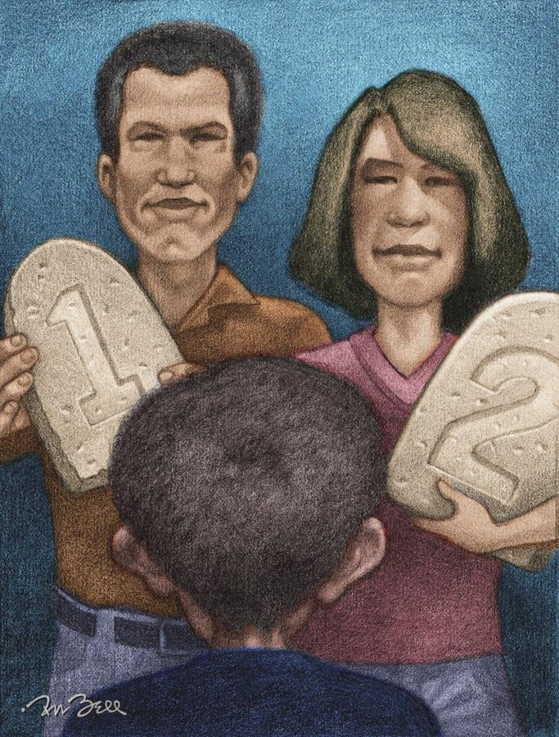

Be patient with their imperfections, as God is patient with you in your imperfections, bearing with you, watching over you, that you may bring forth fruit unto His glory. Encourage your children to strive to add to their attainments the virtues they lack.—Manuscript 136, 1898.
Building Strong Characters
Fathers and mothers, be sensible. Teach your children that they must be subordinate to law. — Manuscript 49, 1901.
The physical, mental, and spiritual capabilities should be developed in order to form a properly balanced character. Children should be watched, guarded, and disciplined in order to successfully accomplish this. —Testimonies for the Church 4:197, 198.
How important, then, that the minds of parents should be as free as possible from perplexing, wearing care in needless things, that they may think and act with calm consideration, wisdom, and love, making the physical and moral health of their children the first and highest consideration.—The Health Reformer, December 1872.
You may be pleased with the brilliant intellect of your child; but unless it is under the control of a sanctified heart, it will work at cross-purposes with God. Nothing but a high sense of the claims of God upon us can give us the proper stability of character, penetration of mind, and depth of understanding essential to success, both in this world and in the world to come. —The Review and Herald, April 23 1889.

Slide 14






The lessons that the child learns during the first seven years of life have more to do with forming his character than all that it learns in future years.—Manuscript 2, 1903.
Advantages of the First Years
Mothers, be sure that you properly discipline your children during the first three years of their lives. Do not allow them to form their wishes and desires. The mother must be mind for her child.
The first three years is the time in which to bend the tiny twig. Mothers should understand the importance attaching to this period. It is then that the foundation is laid. If these first lessons have been defective, as they very often are, for Christ's sake, for the sake of your children's future and eternal good, seek to repair the wrong you have done. If you have waited until your children were three years old to begin to teach them self-control and obedience, seek to do it now, even though it will be much harder.—Manuscript 64, 1899.
Not only should children in these first years of life be obtaining book knowledge, but they should be learning the arts essential for practical life; the latter should not be neglected for the former. —Manuscript 43, 1900.

Slide 15
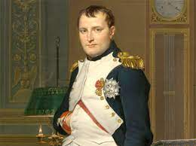
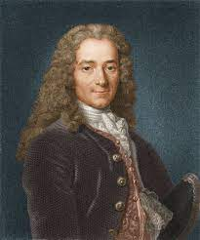
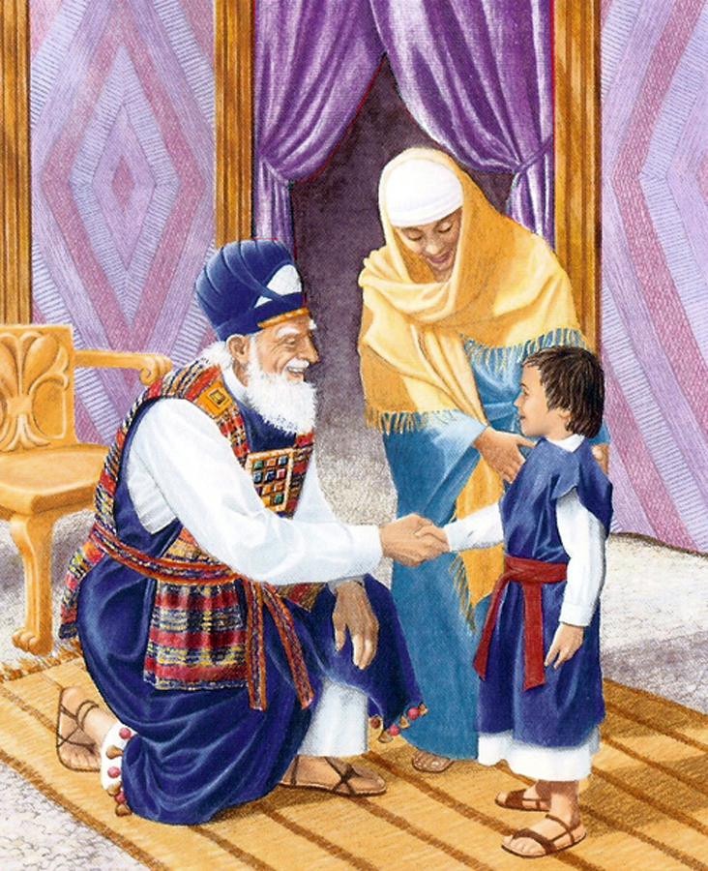
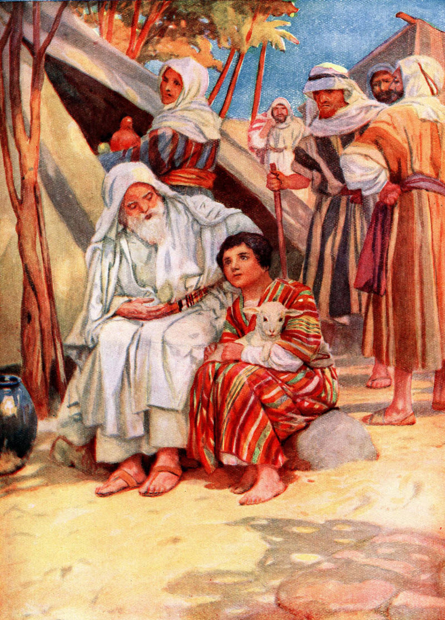
Unwise instructors inspired in him (Napoleon) a love for conquest, forming mimic armies and placing him at their head as commander. Here was laid the foundation for his career of strife and bloodshed. —The Signs of the Times, October 11, 1910.
Advantages of the First Years
When Voltaire was five years old, he committed to memory an infidel poem, and the pernicious influence was never effaced from his mind. He became one of Satan's most successful agents to lead men away from God. Thousands will rise up in the judgment and charge the ruin of their souls upon the infidel Voltaire. —The Signs of the Times, 11 October, 1910.
During the first three years of the life of Samuel the prophet, his mother carefully taught him to distinguish between good and evil. By every familiar object surrounding him she sought to lead his thoughts up to the Creator. In fulfillment of her vow to give her son to the Lord, with great self-denial she placed him under the care of Eli the high priest, to be trained for service in the house of God.... His early training led him to choose to maintain his Christian integrity. What a reward was Hannah's! And what an encouragement to faithfulness is her example! —The Review and Herald, September 8, 1904.
The lessons given Joseph in his youth by Jacob in expressing his firm trust in God and relating to him again and again the precious evidences of His loving-kindness and unceasing care were the very lessons he needed in his exile among an idolatrous people. In the testing time he put these lessons to a practical use. When under the severest trial, he looked to his heavenly Father, whom he had learned to trust. Had the precepts and example of the father of Joseph been of an opposite character, the pen of inspiration would never have traced upon the pages of sacred history the story of integrity and virtue that shines forth in the character of Joseph.”—Good Health, January, 1880.

Slide 16







The character is formed, to a great extent, in early years. The habits then established have more influence than any natural endowment, in making men either giants or dwarfs in intellect; for the very best talents may, through wrong habits, become warped and enfeebled.
The Power of Habit
The earlier in life one contracts hurtful habits, the more firmly will they hold their victim in slavery, and the more certainly will they lower his standard of spirituality. On the other hand, if correct and virtuous habits are formed in youth, they will generally mark the course of the possessor through life.—Christian Temperance and Bible Hygiene, 45.
Habits of sobriety, of self-control, of economy, of close application, of sound, sensible conversation, of patience and true courtesy, are not gained without diligent, close watching over self. It is much easier to become demoralized and depraved than to conquer defects, keeping self in control and cherishing true virtues. Persevering efforts will be required if the Christian graces are ever perfected in our lives.—Testimonies for the Church 4:452
The lives of those who form right habits, and are faithful in the performance of every duty, will be as shining lights, shedding bright beams upon the pathway of others; but if habits of unfaithfulness are indulged, if lax, indolent, neglectful habits are allowed to strengthen, a cloud darker than midnight will settle on the prospects in this life, and forever debar the individual from the future life. —Testimonies for the Church 4:452.

Slide 17




Parents should never hurry their children out of their childhood. Let the lessons given them be of that character which will inspire their hearts with noble purposes; but let them be children and grow up with that simple trust, candor, and truthfulness which will prepare them to enter the kingdom of heaven.—Good Health, 1880, par. 2.
Study Age, Character, and Temperament
Parents and teachers should aim so to cultivate the tendencies of the youth that at each stage of life they may represent the beauty appropriate to that period, unfolding naturally, as do the plants in the garden. —Education, 107.
Marked diversities of disposition and character frequently exist in the same family, for it is in the order of God that persons of varied temperament should associate together. When this is the case, each member of the household should sacredly regard the feelings and respect the right of the others. By this means mutual consideration and forbearance will be cultivated, prejudices will be softened, and rough points of character smoothed. Harmony may be secured, and the blending of the varied temperaments may be a benefit to each.—The Signs of the Times, September 9, 1886.

Slide 18



All children cannot be treated in the same way, for that restraint which must be kept upon one would crush out the life of another. —Manuscript 32, 1899.
Children must have constant care, but you need not let them see that you are ever guarding them. Learn the disposition of each as revealed in their association with one another, and then seek to correct their faults by encouraging opposite traits. —The Signs of the Times, February 9, 1882
Study Age, Character, and Temperament
Children have varied temperaments, and parents cannot always give the same manner of discipline to each. There are different qualities of mind, and they should be made a prayerful study that they may be molded so as to accomplish the purpose God designed. —Good Health, July de 1880.
Mothers, ... take time to get acquainted with your children. Study their dispositions and temperaments, that you may know how to deal with them. Some children need more attention than others.—The Review and Herald, July 9, 1901.
If you have children with peculiar temperaments, do not, because of this, let the blight of discouragement rest upon their lives.... Help them by the manifestation of forbearance and sympathy. Strengthen them by loving words and kindly deeds to overcome their defects of character.—Counsels to parents, teachers, and students, 115-116.

Slide 19





The will is the governing power in the nature of man, bringing all the other faculties under its sway. The will is not the taste or the inclination, but it is the deciding power, which works in the children of men unto obedience to God, or unto disobedience. — Testimonies for the Church 5:513.
The Will As a
Success Factor
Children should early be trained to submit their will and inclination to the will and authority of their parents. When parents teach their children this lesson, they are educating them to submit to God's will and obey His requirements, and fitting them to be members of Christ's family. —Manuscript 119, 1899.
Children who are allowed to have their own way are not happy. The unsubdued heart has not within itself the elements of rest and contentment. The mind and heart must be disciplined and brought under proper restraint, in order for the character to harmonize with the wise laws that govern our being. Restlessness and discontent are the fruits of indulgence and selfishness. —Testimonies for the Church 4:202.
The mother must realize that God is her helper, that love is her success, her power. If she is a wise Christian, she will not attempt to force the child into submission. She will pray; and as she prays, she will be conscious of a renewal of spiritual life within herself. And she will see that at the same time the power that is working in her is working also in the child. And the child, in the place of being compelled, is led and grows gentler; and the battle is gained. Each kindly thought, each patient action, each word of wise restraint, is like apples of gold in pictures of silver. The mother has gained a victory more precious than language can express. She has renewed light and increased experience. The “true Light, which lighteth every man that cometh into the world,” has subdued her will. There is peace after the storm, like the shining of the sun after rain. —Letter 55, 1902.

Slide 20





Your tones of voice, your deportment, your spirit, are copied by your little ones. —The Signs of the Times, March 11, 1886.
Exemplify Christian Principles
Children imitate their parents; hence great care should be taken to give them correct models. Parents who are kind and polite at home, while at the same time they are firm and decided, will see the same traits manifested in their children. If they are upright, honest, and honorable, their children will be quite likely to resemble them in these particulars. If they reverence and worship God, their children, trained in the same way, will not forget to serve Him also. —Testimonies for the Church 5:319, 320.
Speak kindly to your children. Remember how sensitive you are, how little you can bear to be blamed, and do not lay upon them that which you cannot bear; for they are weaker than you and cannot endure as much. The fruits of self-control, thoughtfulness, and painstaking on your part will be a hundredfold. CG 217.2 Let your pleasant, cheerful words ever be like sunbeams in your family. —The Signs of the Times, April 10, 1884.
If parents desire their children to be right and do right, they must be right themselves in theory and in practice. — Good Health, January 1880.
Parents cannot with safety be in any way overbearing. They must not show a masterly, criticizing, faultfinding spirit. The words they speak, the tone in which they speak, are lessons, either for good or ill, to their children. Fathers and mothers, if cross words fall from your lips, you are teaching your children to speak in the same way, and the refining influence of the Holy Spirit is made of none effect. Patient continuance in well-doing is essential if you would do your duty to your children.—Letter 8a, 1896.

Slide 21


DISCIPLINE

Slide 22





The object of discipline is the training of the child for self-government. He should be taught self-reliance and self-control. Therefore, as soon as he is capable of understanding, his reason should be enlisted on the side of obedience. Let all dealing with him be such as to show obedience to be just and reasonable. Help him to see that all things are under law, and that disobedience leads, in the end, to disaster and suffering. When God says “Thou shalt not,” He in love warns us of the consequences of disobedience, in order to save us from harm and loss. —Education, 872.
Purposes of Discipline
The severe training of youth—without properly directing them to think and act for themselves as their own capacity and turn of mind will allow, that by this means they may have growth of thought, feelings of self-respect, and confidence in their own ability to perform—will ever produce a class who are weak in mental and moral power. And when they stand in the world to act for themselves, they will reveal the fact that they were trained, like the animals, and not educated. Their wills, instead of being guided, were forced into subjection by the harsh discipline of parents and teachers. —Testimonies for the Church 3:132-133.

Slide 23





The moment that the child begins to choose his own will and way, that moment his education in discipline is to begin. This may be called an unconscious education. It is then that a work, conscious and powerful, is to begin. The greatest burden of this work necessarily rests on the mother. She has the first care of the child, and she is to lay the foundation of an education that will help the child to develop a strong, symmetrical character.... CG 230.1 Frequently mere babies show a most determined will. If this will is not brought into subjection to a wiser authority than the child's untrained desires, Satan takes control of the mind and fashions the disposition in harmony with his will.—Letter 9, 1904
The Time to Start Discipline
God will bless a just and correct discipline. But “without me,” says Christ, “ye can do nothing.” The heavenly intelligences cannot co-operate with fathers and mothers who are neglecting to train their children, who are allowing Satan to handle that little piece of infant machinery, that youthful mind, as an instrument through whom he can work to counteract the working of the Holy Spirit. —Manuscript 126, 1897.
Children are the heritage of the Lord, and unless parents give them such a training as will enable them to keep the way of the Lord, they neglect solemn duty. It is not the will or purpose of God that children shall become coarse, rough, uncourteous, disobedient, unthankful, unholy, heady, high-minded, lovers of pleasures more than lovers of God. The Scriptures state that this condition of society shall be a sign of the last days. CG 229.2.—The Signs of the Times, September 17, 1894.

Slide 24














Parents should restrict their children and instruct them according to Bible principles.
Wise parents will not say to their children, "Follow your own choice; go where you want, and do what you want"; but: "Listen to the instruction of the Lord”.
Blind parental affection is the greatest obstacle in the way of the proper education of children. It prevents the discipline and education that the Lord requires.
You must be impartial and not overlook what would be censored in other children.
Do not compromise with the stubborn will that defies authority or resort to begging or bribing to obtain obedience.
Discipline in the Home
God does not accept excuses when it comes to disciplining to form good and harmonious characters.
Never say to your children, "I can't tolerate you." Cry out to Jesus and he will help you to lead your little ones to God.
Parents must unite to lay the foundation for good Christian character in their children.
There should be no parental partiality, no oppression; the combined influence of affection and authority will give the proper mold to the family.
Fathers, you are the light of your home. Let your light shine in the form of kind words, in soothing tones of voice. Remove the thorn from them by praying to God for self-control.

Slide 25




If disobedience is obstinate, take extreme measures. If the child or young person wants to leave home, say to him: "My son, if you are determined to leave home rather than submit to just and proper rules, we will not prevent you. If you think the world is friendlier than the parents who have taken care of you since childhood, you should discover your mistake for yourself. You will be welcome when you wish to return to your father's house to be subjected to his authority. The obligations are mutual. While you have food, clothing, and parental care, you are also obliged to submit to the rules of the home and to sound discipline. My house cannot be sullied with the stench of tobacco, with vile words or drunkenness. I want God's angels to be in my home. If you are fully determined to serve Satan, you will be better off with those whose company you love, than you would be at home”.
The work of the fathers is continuous. "Let us not grow weary, then, of doing good; for in due season we will reap, if we do not faint" Galatians 6:9
When children err, parents should take time to read tenderly to them from God's Word those admonitions that are especially applicable to their case. When they are tried, tempted, or discouraged, quote them the precious words of comfort and gently lead them to put their trust in Jesus.
If your children have done something that demands punishment, before correcting them, ask the Lord alone to soften and subdue the hearts of your children and to give you wisdom to deal with them.
To manifest anger towards a child who makes a mistake is to increase the evil. That awakens the worst passions in the child and leads him to believe that you do not care about him. Reason with yourself that you could not treat him like this if you loved him.
Discipline in the Home

Slide 26


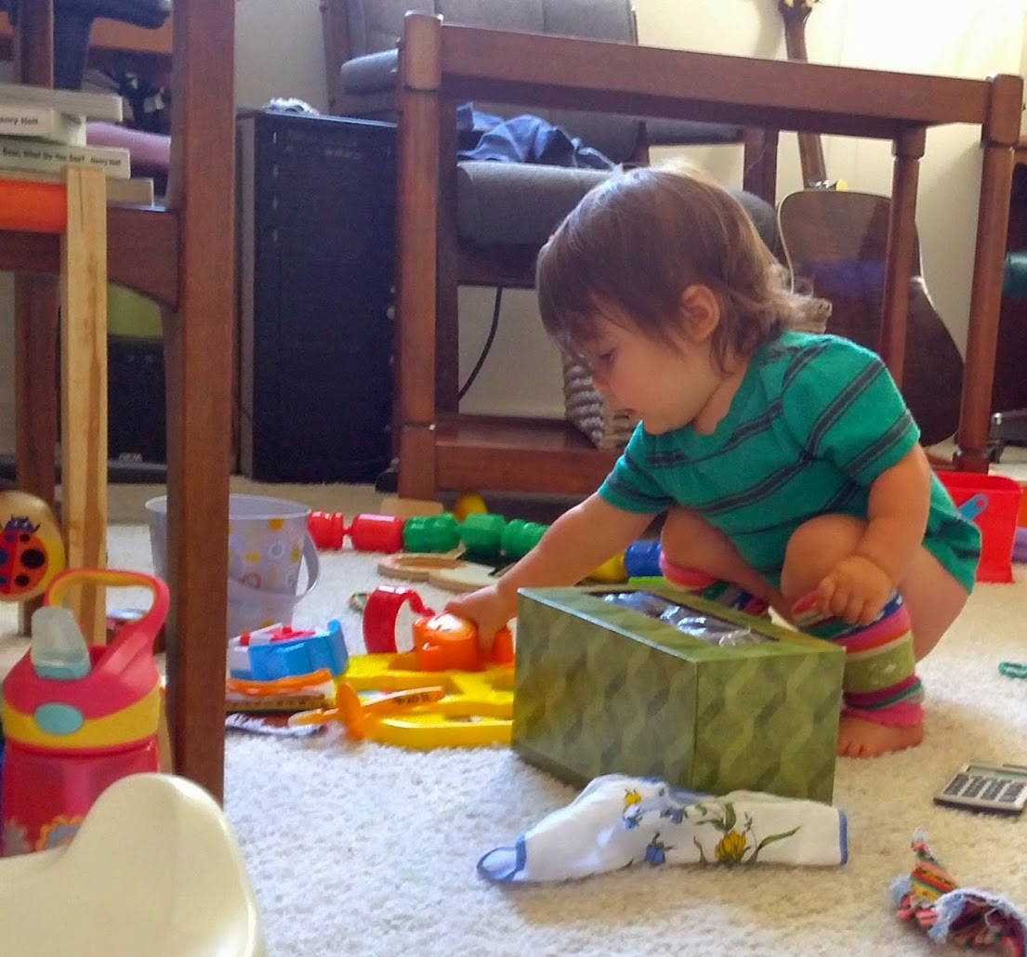
I beg you, do not correct your children in anger, do not raise the tone of your voice... Do not lose your self-control. You must act with humility, patience and prayer. That's when you should kneel down with the children and ask for the Lord's forgiveness.
Discipline in the Home
No matter how much your children irritate you in their ignorance, do not be impatient. Teach them patiently and lovingly. Be firm with them.
When your children act badly and are full of rebellion and you are tempted to speak and act harshly, wait before correcting them. Give them a chance to think and calm your spirits. Treat them kindly and tenderly, and you will receive the blessing of the Lord.
When you ask your child to do something and he replies, "Yes, I will," and then he does not keep his word, you must not leave the matter at that. You must make your child account for his negligence. If you overlook it without calling attention to it, you educate your child in habits of neglect and infidelity.
When children have committed a fault, reprimanding them frequently will result in making them stubborn and bitter.
Instead of punishing them when they have a persistent, rebellious attitude, persuade them to do the right thing through a reward, if they abandon their attitude.
Bad behavior should be dealt with wisely, firmly, and decisively.

Slide 27




If you reason with them kindly, they will not need you to hit them. Whipping will be necessary in the last resort when all other resources fail, but the child should be seriously inculcated with the thought that punishment is administered not for the satisfaction of the parents or as an act of arbitrary authority, but for his own benefit. He must be taught that every uncorrected defect will bring him misfortune, and will displease God. Under such discipline, children will find their greatest happiness in submitting their will to the will of their heavenly Father.
Never shake an irritated child.
Reason first with your children, point out to them clearly their faults, and impress them with the fact that they have sinned not only against you but against God. With your heart filled with compassion and sorrow for your wayward children, pray with them before correcting them.
If your child has committed a fault, kneel with him in prayer to God and let him pray for forgiveness from God.
When you feel irritated and tempted to say words that would embarrass you, be quiet, leave the room, and ask God to give you patience to teach these children. Then you can go back and talk to them and tell them that they should not do wrong again.
When you are provoked to impatience, go into your chamber and kneel down and ask God to help you so that you may have a right influence upon your children.
Praise children when they behave well, for judicious praise is as helpful to them as it is to those who are mature in years and understanding.
The Bible is a guide in guiding children. If parents wish, here they can find a course indicated for the education and preparation of their children so that they do not make mistakes.
Discipline in the Home

Slide 28










See if your child's misbehavior is related to any reaction to these attitudes of yours.
“Do not provoke your children to anger but bring them up in discipline" Harsh and injudicious actions awaken the worst passions in the hearts of children.
Reactions of
the Children
To provocation
You have no right to overshadow the happiness of your children by criticizing them for petty faults. They will believe that they have no hope of improving and gaining your trust and approval.
To criticism
A spirit of obstinacy and stubbornness is awakened in the children. It leads to contempt for authority and ultimately to disobedience of those rules that Christ would have observed.
To too harsh discipline
The child comes to regard this lack as a peculiarity of his own, something against which it is vain to fight. This gives rise to discouragement and despair that are often hidden under an aspect of indifference or nonsense.
To continuous censorship
Ask them kindly to do things. If you give them orders in a tone of rebuke, censure, or reproach, they will carry out your orders, not out of love, but because they dare not act otherwise. It will be painful for them and not a pleasure to obey.
To orders and rebuke
To arbitrary conduct
Sometimes they are treated severely and sometimes leniently with the same issue. Then they awaken a feeling of injustice.

Slide 29









Children are sensitive to the slightest injustice, and some are discouraged by it, and will no longer heed the loud and angry voice in which orders are given, nor will they heed threats of punishment. Too often children are provoked to rebel in their hearts because of being treated unfairly.
To injustice
Reactions of the Children
To a jolt or a blow
The child tends to create bad feelings in the heart and the child is not corrected in anything.
The words thus spoken irritate the ears, wear out the nerves, cause mental suffering, and create a state of mind which makes it impossible to control the character of the child to whom those words are spoken. This is often why children speak disrespectfully to their parents.
To harsh and unsympathetic words
To ridicule and mockery
This kind of discipline will never cure the bad of the character. Your children will grow up with an inferiority complex.
To impatience
Impatience creates anger in children, and awakes the evil in their nature.
To reprimands alternated with pleas
This behavior only fosters the child's passions and his stubbornness will be increased, hoping to win the victory.
Children have the constant hope that entreaties, crying, or bad temper can achieve their object, or that they can dare to disobey without suffering punishment. In this way, they are kept in a state of desire, hope and uncertainty that makes them restless, irritable and insubordinate.
To lack of firmness and decisiveness

Slide 30




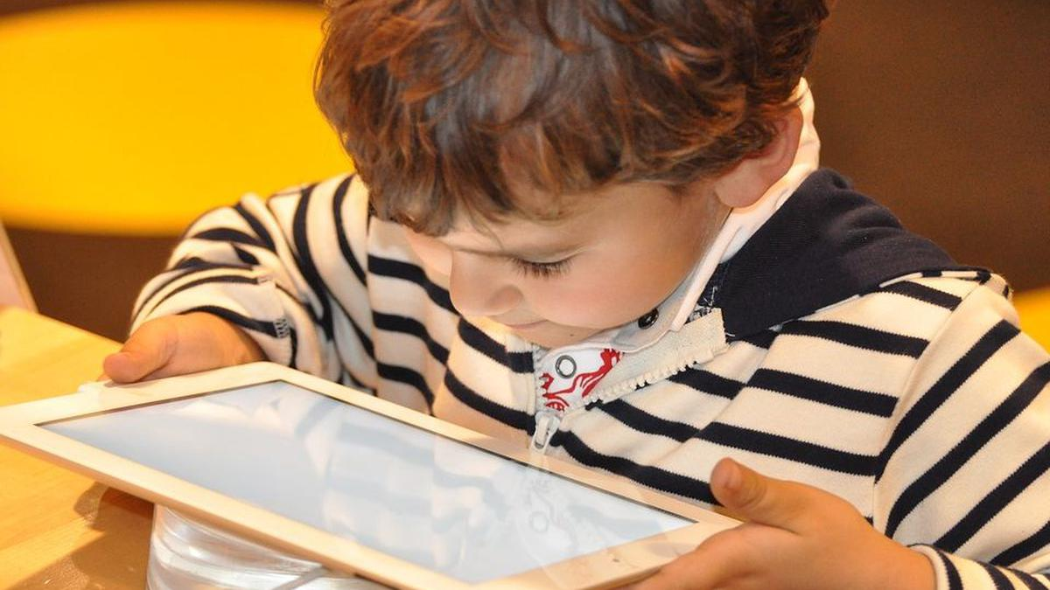

Many parents deny their children to indulge them in something that is safe and innocent, so children think that no favor is worth expecting and therefore do not ask for it. They are inclined to pleasures that they think are forbidden. This destroys trust between parents and children.
To unnecessary restrictions
Reactions of the Children
The greater the efforts to restrict, the more determined will be the desire to obtain what is denied, and the result will be disobedience to parental authority. The father thinks that his refusal is sufficient reason for his son to abstain from his desire. But parents should remember that their children are intelligent beings and that they should treat them as they would like to be treated themselves.
To the refusal of reasonable concessions
By the severity with which they treat their mistakes, they awaken the worst passions in the human heart and leave their children with a feeling of injustice and mistake. Stern parents turn their children away from God by talking to them about religious topics; for the Christian religion is not attractive and is even repulsive because of this false representation of the truth. The children will say, "If this is religion, I don't want it”.
To severity
By proceeding calmly and kindly
The child will have a kind character.
Speak lovingly to your children, telling them how much they wronged the Savior by their conduct. and then kneel with them before the mercy seat and present them to Christ, praying that He will have compassion on them and lead them to repentance and to the petition for forgiveness. Such discipline will almost always break the most stubborn heart.
To the loving plea

Slide 31
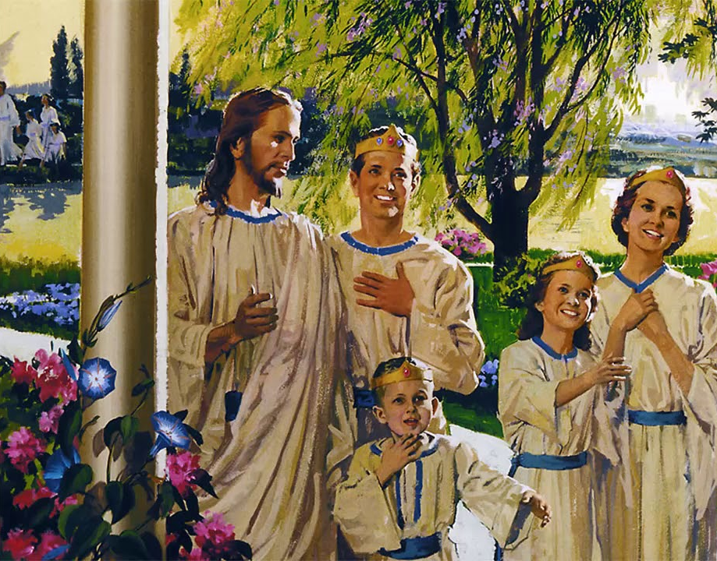
A father must not be as a child, moved merely by impulse. He is bound to his family by sacred, holy ties. Every member of the family centers in the father. His name, “house-band,” is the true definition of husband. He is the lawmaker, illustrating in his own manly bearing the sterner virtues, energy, integrity, honesty, and practical usefulness. The father is in one sense the priest of the household, laying upon the altar of God the morning and evening sacrifice, while the wife and children unite in prayer and praise. With such a household Jesus will tarry, and through His quickening influence the parents’ joyful exclamations shall yet be heard amid more exalted scenes, saying: “Behold, I and the children whom the Lord hath given me.” 1TPI 477

