Slide 1


Slide 2




In this third part we will learn how to prepare our children to go to school, and how to cooperate with teachers.
We will see the fundamental importance of physical development: exercise, cleanliness, work, learning a trade, natural remedies…
We will study tips that will teach us how to maintain physical fitness with food and temperance.
And finally, some recommendations on the blessings of correct clothing and the harm of living to follow fashions.
All this with the goal that our children lead a life according to God's will.

Slide 3


Helping to Develop Mental Faculties

Slide 4



It includes the harmonious development of all the physical powers and the mental faculties. It teaches the love and fear of God, and is a preparation for the faithful discharge of life's duties.—CT 64
Proper education includes not only mental discipline, but that training which will secure sound morals and correct deportment.—CT 331
What does true education include?
At such a time as this, what is the trend of the education given? To what motive is appeal most often made? To self-seeking. Much of the education given is a perversion of the name. In true education the selfish ambition, the greed for power, the disregard for the rights and needs of humanity, that are the curse of our world, find a counterinfluence. God's plan of life has a place for every human being. Each is to improve his talents to the utmost; and faithfulness in doing this, be the gifts few or many, entitles one to honor.
In God's plan there is no place for selfish rivalry. Those who measure themselves by themselves, and compare themselves among themselves, are not wise. (2 Corinthians 10:12.) Whatever we do is to be done “as of the ability which God giveth.” 1 Peter 4:11. It is to be done “heartily, as to the Lord, and not unto men; knowing that of the Lord ye shall receive the reward of the inheritance: for ye serve the Lord Christ.” Colossians 3:23, 24. Precious the service done and the education gained in carrying out these principles. —CG 293-294
The highest class of education is that which will give such knowledge and discipline as will lead to the best development of character, and will fit the soul for that life which measures with the life of God. —CT 45

Slide 5





For the first eight or ten years of a child's life the field or garden is the best schoolroom, the mother the best teacher, nature the best lesson book. Even when the child is old enough to attend school, his health should be regarded as of greater importance than a knowledge of books. He should be surrounded with the conditions most favorable to both physical and mental growth. —Ed 208
School Readiness
Infancy extends to the age of six or seven years. Up to this period, children should be left like little lambs, to roam around the house, and in the yards, in the buoyancy of their spirits, skipping and jumping free from care and trouble. —2SM 437
Mothers, let the little ones play in the open air; let them listen to the songs of the birds and learn the love of God as expressed in His beautiful works. Teach them simple lessons from the book of nature and the things about them; and as their minds expand, lessons from books may be added and firmly fixed in the memory. But let them also learn, even in their earliest years, to be useful. Train them to think that, as members of the household, they are to act an interested, helpful part in sharing the domestic burdens, and to seek healthful exercise in the performance of necessary home duties. —CG 301
Do not send your little ones to school too early. The mother should be careful how she trusts the molding of the infant mind to other hands. —CG 302.1

Slide 6

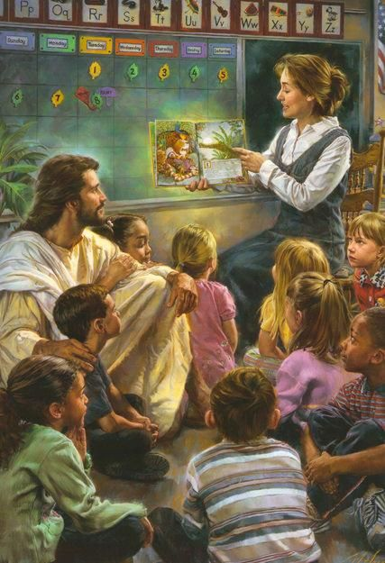
In planning for the education of their children outside the home, parents should realize that it is no longer safe to send them to the public school, and should endeavor to send them to schools where they will obtain an education based on a Scriptural foundation. Upon every Christian parent there rests the solemn obligation of giving to his children an education that will lead them to gain a knowledge of the Lord and to become partakers of the divine nature through obedience to God's will and way —CT 205
School Choice
As far as possible, all our children should have the privilege of a Christian education. To provide this we must sometimes establish home church schools. It would be well if several families in a neighborhood would unite to employ a humble, God-fearing teacher to give to the parents that help that is needed in educating their children. This will be a great blessing to many isolated groups of Sabbathkeepers, and a plan more pleasing to the Lord than that which has been sometimes followed, of sending young children away from their homes to attend one of our larger schools. —CG 307
To parents He sends the warning cry, Gather your children into your own houses; gather them away from those who are disregarding the commandments of God, who are teaching and practicing evil. Get out of the large cities as fast as possible. Establish church schools. Give your children the Word of God as the foundation of all their education. This is full of beautiful lessons, and if pupils make it their study in the primary grade below, they will be prepared for the higher grade above. —CG 310

Slide 7

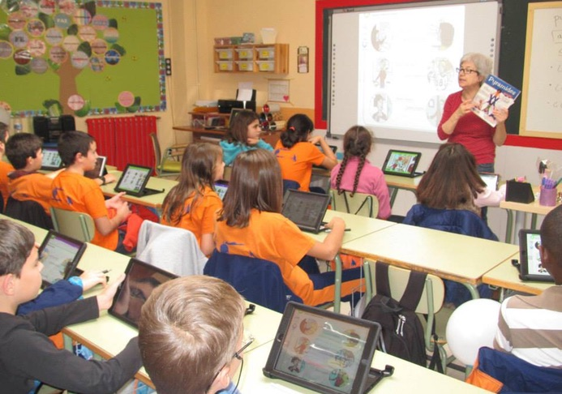


The Responsibility of the Church
The Lord would use the church school as an aid to the parents in educating and preparing their children for this time before us. Then let the church take hold of the schoolwork in earnest and make it what the Lord desires it to be. —CG 312
The churches in different localities should feel that a solemn responsibility rests upon them to train youth and educate talent to engage in missionary work. When they see those in the church who give promise of making useful workers, but who are not able to support themselves in the school, they should assume the responsibility of sending them to one of our training schools. There is excellent ability in the churches that needs to be brought into service. There are persons who would do good service in the Lord's vineyard, but many are too poor to obtain without assistance the education that they require. The churches should feel it a privilege to take a part in defraying the expenses of such. Those who have the truth in their hearts are always openhearted, helping where it is necessary. They lead out, and others imitate their example. If there are some who should have the benefit of the school, but who cannot pay full price for their tuition, let the churches show their liberality by helping them. —CG 313-314

Slide 8



Teachers and Parents in Society
Parents should remember that much more will be accomplished by the work of the church school if they themselves realize the advantage that their children will obtain in such a school, and unite wholeheartedly with the teacher. By prayer, by patience, by forbearance, parents can undo much of the wrong caused by impatience and unwise indulgence. Let parents and teacher take hold of the work together, the parents remembering that they themselves will be helped by the presence in the community of an earnest, God-fearing teacher. —CT 155
The parents’ intimate knowledge both of the character of the children and of their physical peculiarities or infirmities, if imparted to the teacher, would be an assistance to him. It is to be regretted that so many fail of realizing this. By most parents little interest is shown either to inform themselves as to the teacher's qualifications, or to co-operate with him in his work. —Ed 284
They [parents] must feel it their duty to co-operate with the teacher, to encourage wise discipline, and to pray much for the one who is teaching their children. —CG 321

Slide 9




Unity Between Parents and Teachers
When parents justify the complaints of their children against the authority and discipline of the school, they do not see that they are increasing the demoralizing power which now prevails to such a fearful extent. Every influence surrounding the youth needs to be on the right side, for youthful depravity is increasing. —CG 325
If criticism or suggestion in regard to the teacher's work becomes necessary, it should be made to him in private. If this proves ineffective, let the matter be referred to those who are responsible for the management of the school. Nothing should be said or done to weaken the children's respect for the one upon whom their well-being in so great degree depends. —CT 161
In allowing children to do as they please, parents may think themselves affectionate, but they are practicing the veriest cruelty. Children are able to reason, and their souls are hurt by inconsiderate kindness, however proper this kindness may be in the eyes of the parents. As the children grow older, their insubordination grows. Their teachers may try to correct them, but too often the parents side with the children, and the evil continues to grow, clothed, if possible, with a still darker covering of deception than before. Other children are led astray by the wrong course of these children, and yet the parents cannot see the wrong. The words of their children are listened to before the words of teachers, who mourn over the wrong. —CG 326

Slide 10

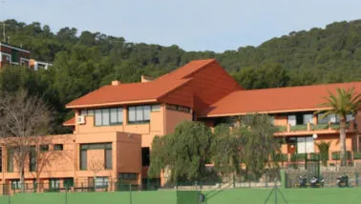

In the home school, during their early years, train and discipline your children in the fear of God. And then be careful lest you place them where the religious impressions they have received will be effaced, and the love of God taken out of their hearts. Let no inducement of high wages or of apparently great educational advantages lead you to send your children away from your influence, to places where they will be exposed to great temptations. “What shall it profit a man, if he shall gain the whole world, and lose his own soul? Or what shall a man give in exchange for his soul. —CG 328. Manuscript 30, 1904.
Preparation at School and in a Higher Course
The youth are to be encouraged to attend our schools, which should become more and more like the schools of the prophets. Our schools have been established by the Lord. —CG 329
Unless the parents are convinced that it would be for the best interests of their children to place them under the school home discipline, they should be permitted to keep them under their own control as far as possible. In some places parents living near the school may see that their children would be benefited by living at the school home, where they can receive certain lines of instruction that they could not receive so well in their own homes. But let it not be urged that children must in all cases be separated from their parents in order to get the advantages of any one of our schools. Parents are the natural guardians of their children, and they have a solemn responsibility to oversee their education and training. —CG 331
They all need an education, that they may be fitted for usefulness, qualified for places of responsibility in both private and public life. — CG 332

Slide 11



Fundamental Importance of the Physical Development

Slide 12



Exercise and Health
Those who do not use their limbs every day will realize a weakness when they do attempt to exercise. The veins and muscles are not in a condition to perform their work and keep all the living machinery in healthful action, each organ in the system doing its part. The limbs will strengthen with use. Moderate exercise every day will impart strength to the muscles, which without exercise become flabby and enfeebled. By active exercise in the open air every day, the liver, kidneys, and lungs also will be strengthened to perform their work.
Bring to your aid the power of the will, which will resist cold and will give energy to the nervous system. In a short time you will so realize the benefit of exercise and pure air that you would not live without these blessings. Your lungs, deprived of air, will be like a hungry person deprived of food. Indeed, we can live longer without food than without air, which is the food that God has provided for the lungs. —CG 339
Students should not be permitted to take so many studies that they will have no time for physical training. The health cannot be preserved unless some portion of each day is given to muscular exertion in the open air. Stated hours should be devoted to manual labor of some kind, anything that will call into action all parts of the body. Equalize the taxation of the mental and the physical powers, and the mind of the student will be refreshed. If he is diseased, physical exercise will often help the system to recover its normal condition. When students leave college, they should have better health and a better understanding of the laws of life than when they enter it. The health should be as sacredly guarded as the character. —CG 342

Slide 13


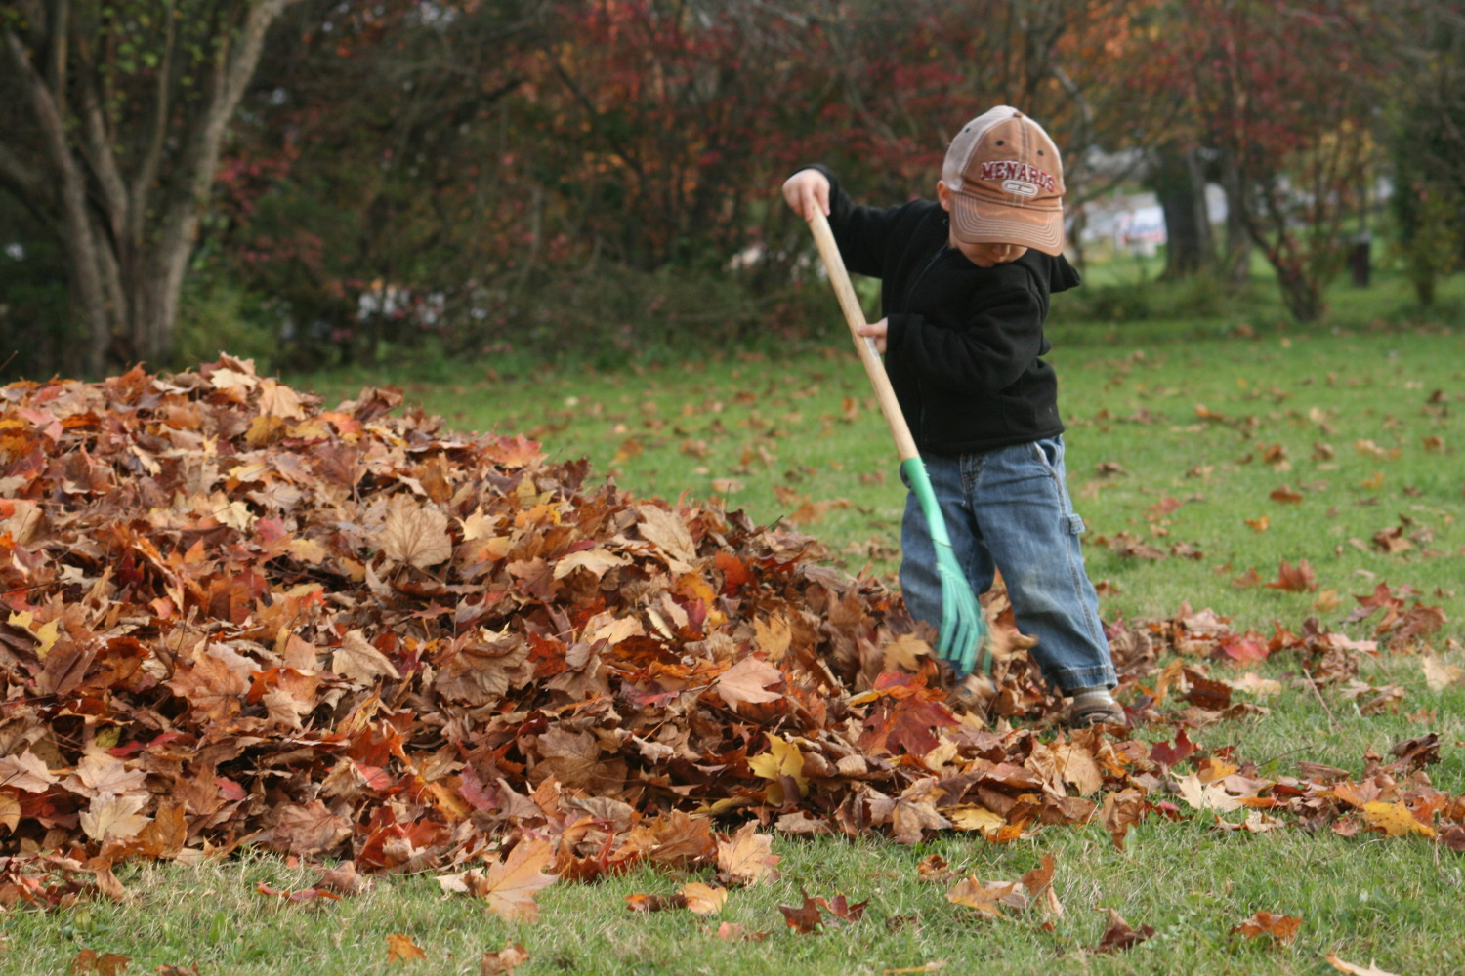

The exercise that develops mind and character, that teaches the hands to be useful, that trains the young to bear their share of life's burdens, is that which gives physical strength and quickens every faculty. And there is a reward in virtuous industry, in the cultivation of the habit of living to do good. —CT 147
Preparation for Practical Life
The youth need to be taught that life means earnest work, responsibility, caretaking. They need a training that will make them practical—men and women who can cope with emergencies. They should be taught that the discipline of systematic, well-regulated labor is essential, not only as a safeguard against the vicissitudes of life, but as an aid to all-round development. —CG 347
None of us should be ashamed of work, however small and servile it may appear. Labor is ennobling. All who toil with head or hands are working men or working women. And all are doing their duty and honoring their religion as much while working at the washtub or washing dishes as they are in going to meeting. While the hands are engaged in the most common labor, the mind may be elevated and ennobled by pure and holy thoughts.—CG 348
Many who in youth were in affluent circumstances may be robbed of all their riches, and be left with parents and brothers and sisters dependent upon them for sustenance. Then how important that every youth be educated to labor, that they may be prepared for any emergency! Riches are indeed a curse when their possessors let them stand in the way of their sons and daughters obtaining a knowledge of useful labor, that they may be qualified for practical life. —CG 349

Slide 14




From childhood, boys and girls should be taught to bear heavier and still heavier burdens, intelligently helping in the work of the family firm. Mothers, patiently show your children how to use their hands. Let them understand that their hands are to be used as skillfully as are yours in the household work. —CG 350
Preparation for Practical Life
Since both men and women have a part in homemaking, boys as well as girls should gain a knowledge of household duties. To make a bed and put a room in order, to wash dishes, to prepare a meal, to wash and repair his own clothing, is a training that need not make any boy less manly; it will make him happier and more useful. And if girls, in turn, could learn to harness and drive a horse, [Note: This was written in 1903. The principles are fully applicable today.] and to use the saw and the hammer, as well as the rake and the hoe, they would be better fitted to meet the emergencies of life. —CG 351
*Note: This was written in 1903, but the implied principle still applies today.
Never will children and youth feel the peace of contentment until by the faithful performance of home duties they relieve the tired hands and weary heart and brain of the mother. These are steps on the ladder of progress that will carry them forward to receive the higher education. … Many are leaving unlearned the most useful lessons, which it is essential for their future good to understand. —CG 352

Slide 15
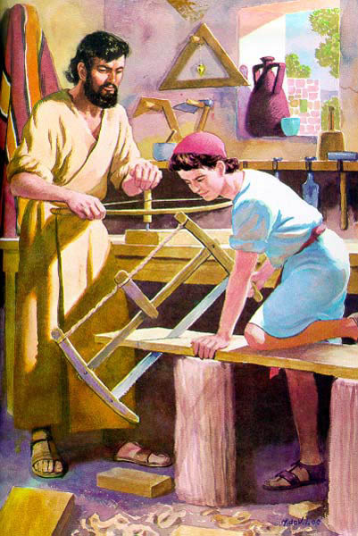

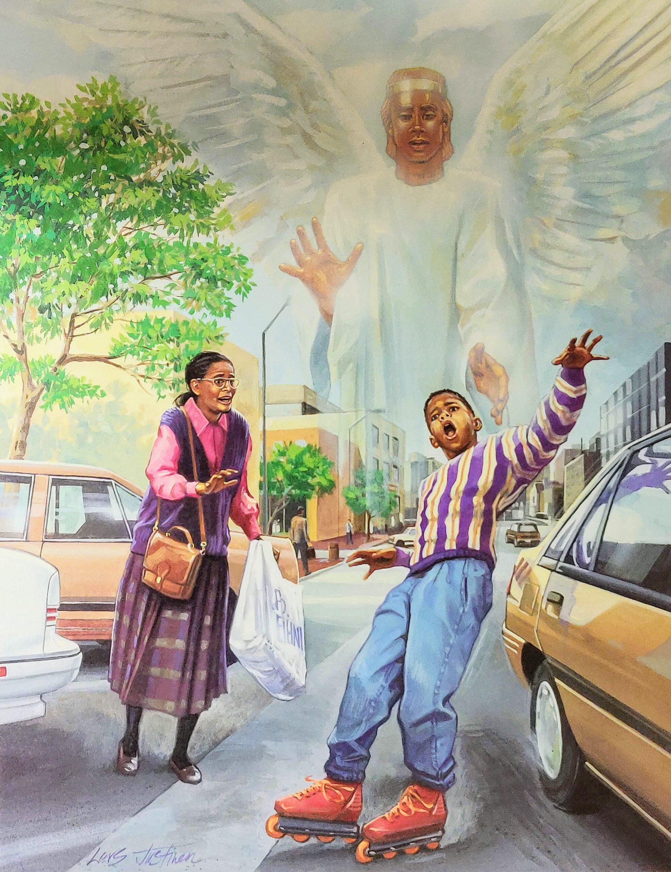

Adam and Eve: When in counsel with the Father before the world was, it was designed that the Lord God should plant a garden for Adam and Eve in Eden and give them the task of caring for the fruit trees and cultivating and training the vegetation. Useful labor was to be their safeguard, and it was to be perpetuated through all generations to the close of earth's history. —The Signs of the Times, August 13, 1896.
Preparation for Practical Life
Jesus: As Jesus worked in childhood and youth, mind and body were developed. He did not use His physical powers recklessly, but in such a way as to keep them in health, that He might do the best work in every line. He was not willing to be defective, even in the handling of tools. He was perfect as a workman, as He was perfect in character. —LHU 174
The Angels: The angels are workers; they are ministers of God to the children of men. —CG 353.
Angels guard us, enlighten our minds, help us do what is right, help us in efforts to recover the lost, strengthen our faith, supply our needs, promptly obey God's commands, etc.
The Redeemed: Those slothful servants who look forward to a heaven of inaction have false ideas of what constitutes heaven. The Creator has prepared no place for the gratification of sinful indolence. Heaven is a place of interested activity; yet to the weary and heavy laden, to those who have fought the good fight of faith, it will be a glorious rest; for the youth and vigor of immortality will be theirs, and against sin and Satan they will no longer have to contend. To these energetic workers a state of eternal indolence would be irksome. It would be no heaven to them. The path of toil appointed to the Christian on earth may be hard and wearisome, but it is honored by the footprints of the Redeemer, and he is safe who follows in that sacred way. —Christian Temperance and Bible Hygiene, 99.

Slide 16




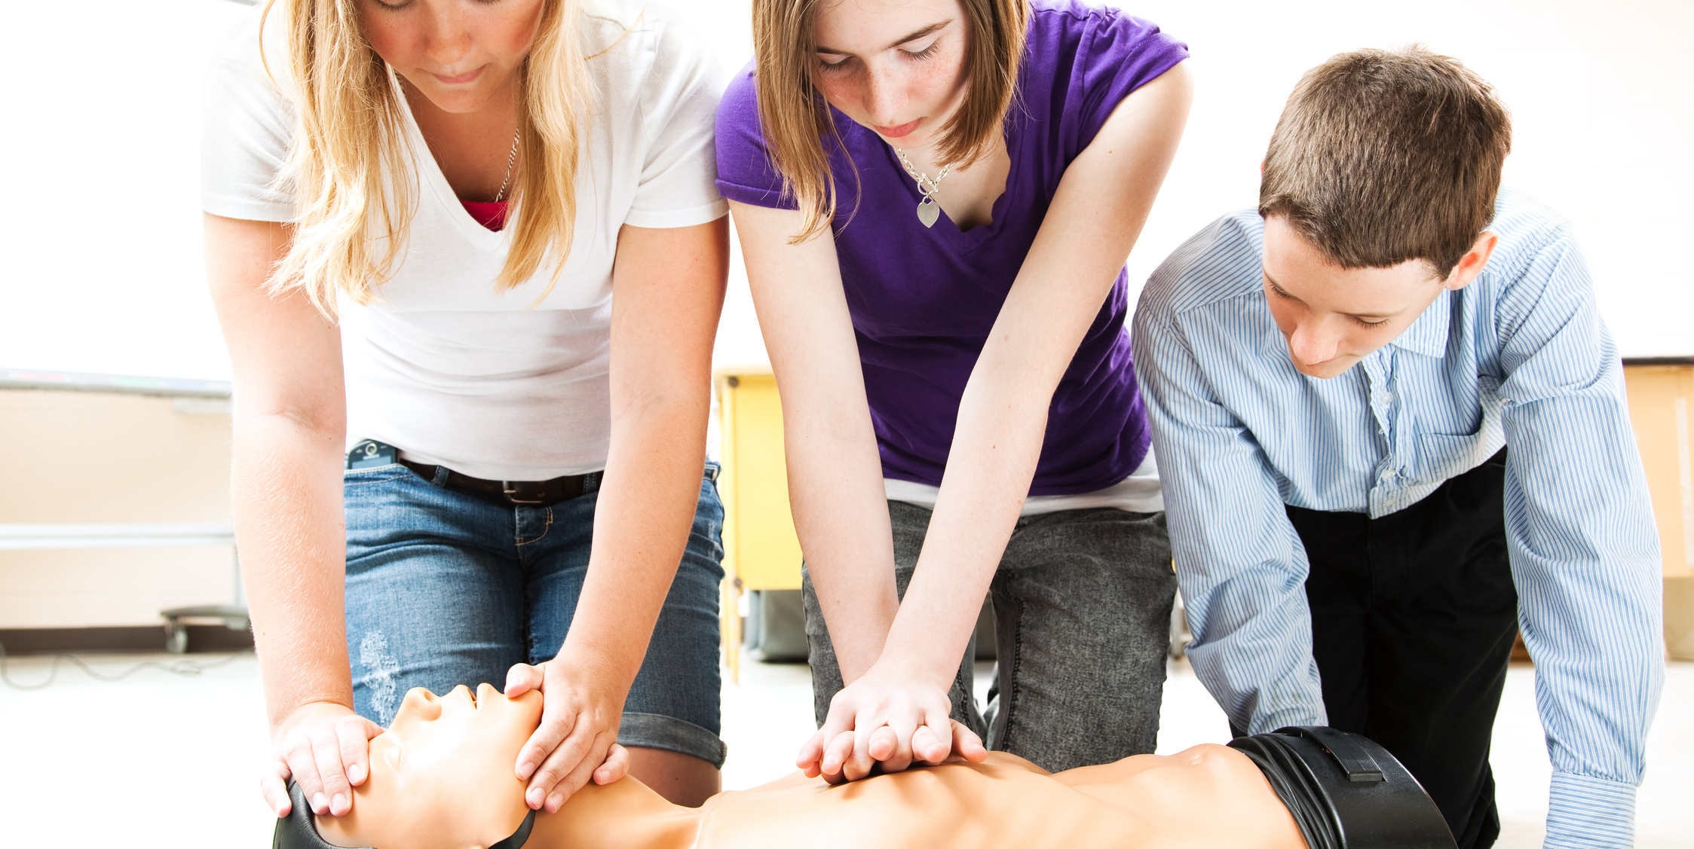
The Teaching of Useful Trades
It is a great mistake to permit young men to grow up without learning some trade. —Manuscript 121, 1901. From the pillar of cloud Jesus gave directions through Moses to the Hebrews that they should educate their children to work, that they should teach them trades, and that none should be idle. —Manuscript 24b, 1894.
No line of manual training is of more value than agriculture. A greater effort should be made to create and to encourage an interest in agricultural pursuits… He who earns his livelihood by agriculture escapes many temptations and enjoys unnumbered privileges and blessings denied to those whose work lies in the great cities.—Education, 219
Schools should be established that, in addition to the highest mental and moral culture, shall provide the best possible facilities for physical development and industrial training. Instruction should be given in agriculture, manufactures—covering as many as possible of the most useful trades—also in household economy, healthful cookery, sewing, hygienic dressmaking, the treatment of the sick, and kindred lines. Gardens, workshops, and treatment rooms should be provided, and the work in every line should be under the direction of skilled instructors. —CG 357
If there is no human eye to criticize our work, nor voice to praise or blame, it should be done just as well as if the Infinite One Himself were personally to inspect it. We should be as faithful in the minor details of our business as we would in the larger affairs of life. —Health Reformer, October 1, 1876.

Slide 17







Since the mind and the soul find expression through the body, both mental and spiritual vigor are in great degree dependent upon physical strength and activity; whatever promotes physical health, promotes the development of a strong mind and a well-balanced character. Without health no one can as distinctly understand or as completely fulfill his obligations to himself, to his fellow beings, or to his Creator. Therefore, the health should be as faithfully guarded as the character. A knowledge of physiology and hygiene should be the basis of all educational effort. —Education 195
Knowledge and Obedience to the Laws of Life
Those who study and practice the principles of right living will be greatly blessed, both physically and spiritually. An understanding of the philosophy of health is a safeguard against many of the evils that are continually increasing. —CT 138
Children should be early taught, in simple, easy lessons, the rudiments of physiology and hygiene… They should understand the importance of guarding against disease by preserving the vigor of every organ and should also be taught how to deal with common diseases and accidents.— Education, 196.

Slide 18





Regularity in sleep: Since the work of building up the body takes place during the hours of rest, it is essential, especially in youth, that sleep should be regular and abundant. —CG 363. Students should not form the habit of burning the midnight oil and taking the hours of the day for sleep. —CT 297.
The importance of the correct posture: God made man upright, and He desires him to possess not only the physical but the mental and moral benefit, the grace and dignity and self-possession, the courage and self-reliance, which an erect bearing so greatly tends to promote. Let the teacher give instruction on this point by example and by precept. Show what a correct position is, and insist that it shall be maintained. —Education, 198.
Breathing: Show how the healthy action of the respiratory organs, assisting the circulation of the blood, invigorates the whole system, excites the appetite, promotes digestion, and induces sound, sweet sleep, thus not only refreshing the body, but soothing and tranquilizing the mind.
—Education 198
Vocal culture: To ensure correct delivery in reading and speaking, see that the abdominal muscles have full play in breathing and that the respiratory organs are unrestricted. Let the strain come on the muscles of the abdomen rather than on those of the throat. Great weariness and serious disease of the throat and lungs may thus be prevented. Careful attention should be given to securing distinct articulation, smooth, well-modulated tones, and a not-too-rapid delivery. This will not only promote health, but will add greatly to the agreeableness and efficiency of the student's work. — Ed 199
Knowledge and Obedience to the Laws of Life

Slide 19


Cleanliness: show the necessity of perfect cleanliness both in personal habits and in all one's surroundings. The value of the daily bath in promoting health and in stimulating mental action should be emphasized. Attention should be given also to sunlight and ventilation, the hygiene of the sleeping room and the kitchen. —CG 365
Nature’s Remedies: Pure air, sunlight, abstemiousness, rest, exercise, proper diet, the use of water, trust in divine power,—these are the true remedies. Every person should have a knowledge of nature's remedial agencies and how to apply them. It is essential both to understand the principles involved in the treatment of the sick and to have a practical training that will enable one rightly to use this knowledge. —CD 301
An All-encompassing Code: I must become acquainted with myself. I must be a learner always as to how to take care of this building, the body God has given me, that I may preserve it in the very best condition of health. I must eat those things which will be for my very best good physically, and I must take special care to have my clothing such as will conduce to a healthful circulation of the blood. I must not deprive myself of exercise and air. I must get all the sunlight that it is possible for me to obtain. I must have wisdom to be a faithful guardian of my body. —CG 366
Knowledge and Obedience to the Laws of Life
We are to do all in our power to keep ourselves in health, in order that we may have sweetness of disposition, a clear mind, and be able to distinguish between the sacred and the common, and honor God in our bodies and in our spirits, which are His. —The Youth’s Intructor, August 24, 1893.

Slide 20


Maintaining Physical Fitness

Slide 21





To the health and happiness of the whole family nothing is more vital than skill and intelligence on the part of the cook. By ill-prepared, unwholesome food she may hinder and even ruin both the adult's usefulness and the child's development. Or by providing food adapted to the needs of the body, and at the same time inviting and palatable, she can accomplish as much in the right as otherwise she accomplishes in the wrong direction. So, in many ways, life's happiness is bound up with faithfulness in common duties. —Education, 216.
The Housewife in the Kitchen
Many, many mothers need to take lessons in cooking, that they may set before the family well-prepared, neatly served food CG 372.3. — Counsels on Diet and Foods, 263.
The meals should be varied. The same dishes, prepared in the same way, should not appear on the table meal after meal and day after day. The meals are eaten with greater relish, and the system is better nourished, when the food is varied. —MH 300.
The serving of a great variety of dishes absorbs time, money, and taxing labor, without accomplishing any good… How much better it would be for the health of the household if the table preparations were more simple.—Christian Temperance and Bible Hygiene, 73
Scanty, ill-cooked food depraves the blood by weakening the blood-making organs. It deranges the system and brings on disease, with its accompaniment of irritable nerves and bad tempers.—The Ministry of Healing, 302.

Slide 22

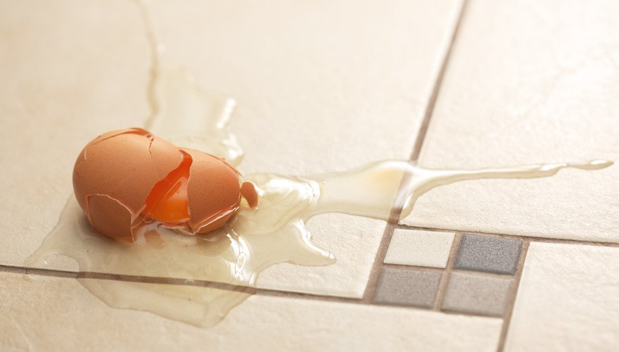


Do not neglect to teach your children how to cook. In so doing, you impart to them principles which they must have in their religious education. In giving your children lessons in physiology, and teaching them how to cook with simplicity and yet with skill, you are laying the foundation for the most useful branches of education. —Testimonies for the Church 2:537.
The Housewife in the Kitchen
If they fail once, twice, or thrice, censure not. Already discouragement is doing its work and tempting them to say, “It is of no use; I can't do it.” This is not the time for censure. The will is becoming weakened. It needs the spur of encouraging, cheerful, hopeful words, as, “Never mind the mistakes you have made. You are but a learner, and must expect to make blunders. Try again. Put your mind on what you are doing. Be very careful, and you will certainly succeed.” —Testimonies for the Church 1:684, 685.
Men, as well as women, need to understand the simple, healthful preparation of food. Their business often calls them where they cannot obtain wholesome food; then, if they have a knowledge of cookery, they can use it to good purpose. CG 376.— The Ministry of Healing, 323.
And there should be careful study that the fragments of food left over from the table be not wasted. Study how, that in some way these fragments of food shall not be lost. This skill, economy, and tact is a fortune. In the warmer parts of the season, prepare less food. —Counsels on Diet and Foods, 258.
“Whether therefore ye eat, or drink, or whatsoever ye do, do all to the glory of God”. 1 Corinthians 10:31.

Slide 23






It was God's design that reason should rule the appetites, and that they should minister to our happiness. And when they are regulated and controlled by a sanctified reason, they are holiness unto the Lord CG 378.1.—Temperance, 12.
Eating to Live
The importance of training children to right dietetic habits can hardly be overestimated. The little ones need to learn that they eat to live, not live to eat. The training should begin with the infant in its mother's arms…
Care and regularity in the feeding of infants will not only promote health, and thus tend to make them quiet and sweet-tempered, but will lay the foundation of habits that will be a blessing to them in after years. —MH 383.
Our bodies are built up from the food we eat. There is a constant breaking down of the tissues of the body; every movement of every organ involves waste, and this waste is repaired from our food. Each organ of the body requires its share of nutrition. The brain must be supplied with its portion; the bones, muscles, and nerves demand theirs. It is a wonderful process that transforms the food into blood and uses this blood to build up the varied parts of the body; but this process is going on continually, supplying with life and strength each nerve, muscle, and tissue. —MH 295

Slide 24



Sweets: The pains and money so often lavished upon unwholesome dainties lead the young to think that the highest object in life, and that which yields the greatest amount of happiness, is to be able to indulge the appetite. The result of this training is gluttony... Parents should train the appetites of their children, and should not permit the use of unwholesome foods.—CD 230.
Eating to Live
The Ideal Food: He who created man and who understands his needs appointed Adam his food... Grains, fruits, nuts, and vegetables constitute the diet chosen for us by our Creator.—MH 295-296
Simple Preparation: Foods prepared in a simple way, without condiments or fats of any kind, constitute the healthiest diet.
Appetite: Foods that best provide the elements necessary for the reconstitution of the body should be chosen. In this choice, appetite is not a sure guide.
Meat: We do not mark out any precise line to be followed in diet; but we do say that in countries where there are fruits, grains, and nuts in abundance, flesh food is not the right food for God's people. I have been instructed that flesh food has a tendency to animalize the nature, to rob men and women of that love and sympathy which they should feel for everyone, and to give the lower passions control over the higher powers of the being. If meat eating was ever healthful, it is not safe now. —3TT 359.

Slide 25



Meat: Flesh was never the best food; but its use is now doubly objectionable, since disease in animals is so rapidly increasing. Those who use flesh foods little know what they are eating. Often if they could see the animals when living and know the quality of the meat they eat, they would turn from it with loathing. People are continually eating flesh that is filled with tuberculous and cancerous germs. Tuberculosis, cancer, and other fatal diseases are thus communicated. —MH 313.
Meat: Among those who are waiting for the coming of the Lord, meat eating will eventually be done away; flesh will cease to form a part of their diet. We should ever keep this end in view and endeavor to work steadily toward it. I cannot think that in the practice of flesh eating we are in harmony with the light which God has been pleased to give us. —Counsels on Diet and Foods, 380, 381.
Eating to live
The Table is Attractive: Let the table be made inviting and attractive as it is supplied with the good things which God has so bountifully bestowed. —The Ministry of Healing, 385.
Mealtime: Mealtime should be a season for social intercourse and refreshment. Everything that can burden or irritate should be banished. Let trust and kindliness and gratitude to the Giver of all good be cherished, and the conversation will be cheerful, a pleasant flow of thought that will uplift without wearying. —Education 206.
Well Prepared Food: The food should be carefully chosen and prepared with intelligence and skill. —MH 300

Slide 26


Our diet should be suited to the season, to the climate in which we live, and to the occupation we follow. Some foods that are adapted for use at one season or in one climate are not suited to another. So there are different foods best suited for persons in different occupations. Often food that can be used with benefit by those engaged in hard physical labor is unsuitable for persons of sedentary pursuits or intense mental application. God has given us an ample variety of healthful foods, and each person should choose from it the things that experience and sound judgment prove to be best suited to his own necessities..—MH, 296.
Eating to Live
Eat at regular intervals and nothing between meals: The stomach calls for food at the time it is accustomed to receive it. If that time is delayed, the vitality of the system decreases, and finally reaches so low an ebb that the appetite is entirely gone. If food is then taken, the stomach is unable to properly care for it. The food cannot be converted into good blood. If all would eat at regular periods, not tasting anything between meals, they would be ready for their meals, and would find a pleasure in eating that would repay them for their effort.—Manuscript 1, 1876 CD, 179
Not tolerating cravings: Children are generally untaught in regard to the importance of when, how, and what they should eat. They are permitted to indulge their tastes freely, to eat at all hours, to help themselves to fruit when it tempts their eyes; and this, with the pie, cake, bread and butter, and sweetmeats eaten almost constantly, makes them gourmands and dyspeptics. The digestive organs, like a mill which is continually kept running, become enfeebled, vital force is called from the brain to aid the stomach in its overwork, and thus the mental powers are weakened. —CG 388

Slide 27





Rest of the stomach: After the regular meal is eaten, the stomach should be allowed to rest for five hours. Not a particle of food should be introduced into the stomach till the next meal. In this interval the stomach will perform its work and will then be in a condition to receive more food. —Counsels on Diet and Foods, 173, 179.
Not eating before bedAnother pernicious habit is that of eating just before bedtime. The regular meals may have been taken; but because there is a sense of faintness, more food is taken. The sleep is often disturbed with unpleasant dreams, and in the morning the person awakes unrefreshed and with little relish for breakfast. CG 389.
Eating to Live
The main meal: It is the custom and order of society to take a slight breakfast. But this is not the best way to treat the stomach. At breakfast time the stomach is in a better condition to take care of more food than at the second or third meal of the day. The habit of eating a sparing breakfast and a large dinner is wrong. Make your breakfast correspond more nearly to the heartiest meal of the day. —Counsels on Diet and Foods, 173.
Do not give too much food: Parents, place before your children the amount they should eat. Leave it not with them to eat just as much as they may feel inclined.... Parents, unless this point is guarded, your children will have dull perceptions. They may attend school, but they will be unable to learn as they ought; for the strength which should go to the brain is used in taking care of the extra food that burdens the stomach. Parents need to be educated to see that too much food given to children makes them feeble instead of robust. —Manuscript 155, 1899.
The importance of food: What we eat and drink has an important bearing upon our lives and characters, and Christians should bring their habits of eating and drinking into conformity to the laws of nature. We must sense our obligations to God in these matters.—Manuscript 47, 1896

Slide 28



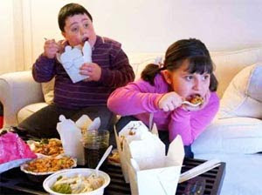


Intemperance is at the foundation of the larger share of the ills of life. It annually destroys tens of thousands. We do not speak of intemperance as limited only to the use of intoxicating liquors, but give it a broader meaning, including the hurtful indulgence of any appetite or passion. —Pacific Health Journal, April, 1890.
Temperance in All Things
Excessive indulgence in eating, drinking, sleeping, or seeing is sin. The harmonious healthy action of all the powers of body and mind results in happiness; and the more elevated and refined the powers, the more pure and unalloyed the happiness. CG 394.—Counsels on Diet and Foods, 44.
Every faculty with which the Creator has endowed us should be cultivated to the highest degree of perfection, that we may be able to do the greatest amount of good of which we are capable. Hence that time is spent to good account which is directed to the establishment and preservation of sound physical and mental health. —The Signs of the Times, November 17,1890.
Every day men in positions of trust have decisions to make upon which depend results of great importance. Often they have to think rapidly, and this can be done successfully by those only who practice strict temperance. —The Ministry of Healing, 309.

Slide 29




Temperance in Study: Intemperance in study is a species of intoxication; and those who indulge in it, like the drunkard, wander from safe paths and stumble and fall in the darkness. The Lord would have every student bear in mind that the eye must be kept single to the glory of God. He is not to exhaust and waste his physical and mental powers in seeking to acquire all possible knowledge of the sciences, but is to preserve the freshness and vigor of all his powers to engage in the work which the Lord has appointed him in helping souls to find the path of righteousness. —CT 405-406.
Temperance in All Things
Temperance at Work: We should practice temperance in our labor. It is not our duty to place ourselves where we shall be overworked. Some may at times be placed where this is necessary, but it should be the exception, not the rule. We are to practice temperance in all things. If we honor the Lord by acting our part, He will on His part preserve our health. —Temperance, 139
Temperance in dress: Clothing should have the grace, beauty, and suitability of simplicity. Christ warned us against the pride of life, but not against its grace and natural beauty. —CT 303.
Temperance in Eating and Drinking: True temperance teaches us to dispense entirely with everything hurtful, and to use judiciously that which is healthful... The body should be servant to the mind, and not the mind to the body. —The Review and Herald, 23 de septiembre de 1884
Temperance in all details: We urge that the principles of temperance be carried into all the details of home life; that the example of parents should be a lesson of temperance; that self-denial and self-control should be taught to the children and enforced upon them, so far as consistent, from babyhood. —The Review and Herald, September 23, 1884.

Slide 30






The only way in which any can be secure against the power of intemperance is to abstain wholly from wine, beer, and strong drinks. —Christian Temperance and Bible Hygiene, 37.
The Home and the Crusade for Temperance
Idleness, lack of aim, or evil associations may be the predisposing cause. —CG 402
Tea and coffee produce an immediate effect. Under the influence of these poisons the nervous system is excited; and in some cases, for the time being, the intellect seems to be invigorated, the imagination more vivid. Because these stimulants produce such agreeable results, many conclude that they really need them; but there is always a reaction. 2MCP 484.3 The nervous system has borrowed power from its future resources for present use, and all this temporary invigoration is followed by a corresponding depression. The suddenness of the relief obtained from tea and coffee is an evidence that what seems to be strength is only nervous excitement, and consequently must be an injury to the system.—Christian Temperance and Bible Hygiene, 31, (1890).
Tobacco ... affects the brain and benumbs the sensibilities, so that the mind cannot clearly discern spiritual things, especially those truths which would have a tendency to correct this filthy indulgence. Those who use tobacco in any form are not clear before God. In such a filthy practice it is impossible for them to glorify God in their bodies and spirits, which are His. —Counsels on Health, 81.

Slide 31



The effect of stimulants and narcotics is to lessen physical strength, and whatever affects the body will affect the mind. A stimulant may for a time arouse the energies and produce mental and physical activity; but when the exhilarating influence is gone, both mind and body will be in a worse condition than before… As the control of reason is set aside, the animal passions will bear sway. The more freely these poisons are used, the more brutish will become the nature. —The Signs of the Times, September 13,de 1910.
The Home and the Crusade for Temperance
Parents should make it their first business to understand the laws of life and health, that nothing shall be done by them in the preparation of food, or through any other habits, which will develop wrong tendencies in their children… the children, who are God's blood-bought property.— Testimonies for the Church 3: 568.
God calls upon us to stand upon the broad platform of temperance in eating, drinking, and dressing. Parents, will you not awaken to your God-given responsibilities? Study the principles of health reform and teach your children that the path of self-denial is the only path of safety. —Manuscript 86, 1897.

Slide 32


The Right Attire

Slide 33



Let our sisters dress plainly, as many do, having the dress of good, durable material, appropriate for this age, and let not the dress question fill the mind. Our sisters should dress with simplicity. They should clothe themselves in modest apparel, with shamefacedness and sobriety. Give to the world a living illustration of the inward adorning of the grace of God. —Manuscript 167, 1897.
The Blessings of Right Dress
If the world introduce a modest, convenient, and healthful mode of dress, which is in accordance with the Bible, it will not change our relation to God or to the world to adopt such a style of dress. Christians should follow Christ and make their dress conform to God's Word. They should shun extremes. —Testimonies for the Church 1:458, 459.
I was directed to the following scriptures. Said the angel, “They are to instruct God's people.” 1 Timothy 2:9, 10: “In like manner also that women adorn themselves in modest apparel, with shamefacedness and sobriety; not with broided hair, or gold, or pearls, or costly array; but (which becometh women professing godliness) with good works.” 1 Peter 3:3-5: “Whose adorning let it not be that outward adorning of plaiting of the hair and of wearing of gold, or of putting on of apparel; but let it be the hidden man of the heart, in that which is not corruptible, even the ornament of a meek and quiet spirit, which is in the sight of God of great price. For after this manner in the old time the holy women also, ... adorned themselves.” —Testimonies for the Church 1:189.

Slide 34

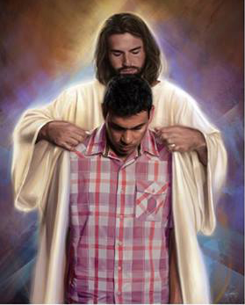
The Blessings of Right Dress
The love of dress endangers the morals and makes woman the opposite of the Christian lady, characterized by modesty and sobriety. Showy, extravagant dress too often encourages lust in the heart of the wearer and awakens base passions in the heart of the beholder. God sees that the ruin of the character is frequently preceded by the indulgence of pride and vanity in dress. He sees that the costly apparel stifles the desire to do good. —Testimonies for the Church 4:645.
There is a dress which every child and youth may innocently seek to obtain. It is the righteousness of the saints. If they will only be as willing and persevering in obtaining this as they are in fashioning their garments after the standard of worldly society, they will very soon be clothed with the righteousness of Christ, and their names will not be blotted out of the book of life. Mothers, as well as youth and children, need to pray, “Create in me a clean heart, O God, and renew a right spirit within me.” [Psalm 51:10.] This purity of heart and loveliness of spirit are more precious than gold, both for time and for eternity. Only the pure in heart shall see God. CG 417.5 Then, mothers, teach your children, line upon line and precept upon precept, that the righteousness of Christ is the only dress in which they can be admitted into heaven, and that robed in this apparel they will be constantly doing duties in this life which will glorify God. —Christian Temperance and Bible Hygiene, 95.

Slide 35


Teach your children these principles about dress:
Teaching the Fundamental Principles of Dress
That their clothing is clean and attractive. Modest, not flashy.
That it is appropriate. Avoid the superfluous and ostentatious.
Good taste should be manifested in colors and patterns.
Good quality and suitable for use.
It must provide adequate coverage and protection.
Practice economy in what you spend on clothes. Do not lavish upon yourselves means which are greatly necessary for the work of God.
People of good judgment will regard your attempts to beautify the external as proof of a weak mind and a proud heart.
When you set aside precious time to groom your attire, remember that the King of glory wore a simple, seamless robe.
Additional embellishments are left out, even if they cost a trifle. Dispense with unnecessary ornaments, and reserve for the advancement of the cause of God the means thus economized. Learn the lesson of self-denial and teach it to your children.

Slide 36

Teaching the Fundamental Principles of Dress:
Teaching the Fundamental Principles of Dress
Any means designed to attract the attention of the person thus dressed, or to arouse admiration, is excluded from the modest clothing imposed by the Word of God.
There is an ornament that will never perish, that will promote the happiness of all those around us in this life and will shine with luster, unfading in the immortal future. It is the ornament of a meek and humble spirit. Instead of procuring gold ornaments for the eye, a earnest effort should be made to obtain the wisdom that is of more value than fine gold; Yes, it is more beautiful than rubies.
Teach your children to distinguish between what is sensible and what is foolish in the matter of dress.
Wear dresses that feel good, appropriate for age and life circumstances.
The dress should be loose, without obstructing the circulation of the blood or free, full and natural breathing. The feet should be adequately protected from cold and moisture.

Slide 37


Teach your children these principles about dress:
Teaching the Fundamental Principles of Dress
If the child's attire provides warmth, covering and comfort, one of the main causes of irritation and uneasiness will be eliminated.
The clothing of all children should be so loose that it allows them the freest and most complete breathing; and it must be adapted in such a way to the body that the shoulders carry the whole weight of it.
Parents who leave their children with bare or nearly naked limbs are sacrificing their children's health... If these parts are not as warm as the body, circulation is not balanced, blood is pushed to the head causing headache or nosebleeds, coughing, the stomach becomes overloaded with blood and indigestion is caused.
God wanted there to be a clear distinction between men's and women's dress, and He has considered the matter of sufficient importance to give explicit instructions about it; for the same dress worn by both sexes would cause confusion and a great increase in crime.
Talk about Jesus' love and humility but do not encourage brothers and sisters to find fault with the dress or appearance of others.

Slide 38




Fashion rules the world; and she is a tyrannical mistress, often compelling her devotees to submit to the greatest inconvenience and discomfort. Fashion taxes without reason and collects without mercy. She has a fascinating power and stands ready to criticize and ridicule all who do not follow in her wake.—Christian Temperance and Bible Hygiene, 85.
Fashion Is a Fascinating Power
Pride and vanity are manifested everywhere; but those who are inclined to look into the mirror to admire themselves will have little inclination to look into the law of God, the great moral mirror. This idolatry of dress destroys all that is humble, meek, and lovely in character. It consumes the precious hours that should be devoted to meditation, to searching the heart, to the prayerful study of God's Word.—The Review and Herald, March 31, 1891.
Your daughters are inclined, if they see a dress different from that which they have, to desire a dress similar to that. Or perhaps they want something else that they see others have, which you do not feel would be in accordance with your faith to grant them. Will you allow them to tease this thing out of you, letting them mold you instead of molding them according to the principles of the gospel? Our children are very precious in the sight of God. Let us teach them the Word of God and train them in His ways. It is your privilege to teach your children to live so that they will have the commendation of Heaven... The fashions of the world often take a ridiculous form, and you must take a firm position against them.—Manuscript 45, 1911.

Slide 39

Parents may lay for their children the foundation for a healthy, happy life. They may send them forth from their homes with moral stamina to resist temptation, and courage and strength to wrestle successfully with life's problems. They may inspire in them the purpose and develop the power to make their lives an honor to God and a blessing to the world. They may make straight paths for their feet, through sunshine and shadow, to the glorious heights above.
—The Ministry of Healing, 352.

