Slide 1


Slide 2


“Therefore shall ye lay up these my words in your heart and in your soul, and bind them for a sign upon your hand, that they may be as frontlets between your eyes. And ye shall teach them your children, speaking of them when thou sittest in thine house, and when thou walkest by the way, when thou liest down, and when thou risest up. And thou shalt write them upon the door posts of thine house, and upon thy gates.”
(Deuteronomy 11:18-20)
In this last part, we will learn about the vices and harmful practices that can affect our children, and how we can help them reform their behavior and character. We will look at how the training at home influences the church. We will also study about the importance of the Bible, prayer, and reverence. Finally, we will know the results of our neglect, or the rewards of our effort.

Slide 3


Preservation of Moral Integrity

Slide 4

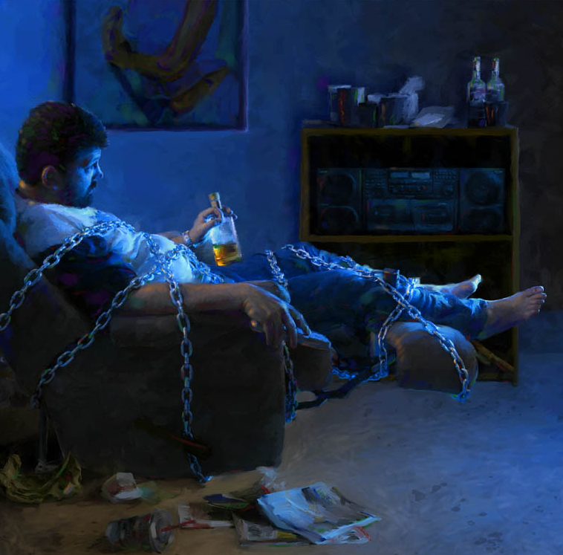


This is an age when corruption is teeming everywhere. The lust of the eye and corrupt passions are aroused by beholding and by reading. The heart is corrupted through the imagination. The mind takes pleasure in contemplating scenes which awaken the lower and baser passions. These vile images, seen through defiled imagination, corrupt the morals and prepare the deluded, infatuated beings to give loose rein to lustful passions. Then follow sins and crimes which drag beings formed in the image of God down to a level with the beasts, sinking them at last in perdition. —Testimonies for the Church 2:410.
Predominance of Corrupting Vices
The youth of today are a sure index to the future of society; and as we view them, what can we hope for that future? The majority are fond of amusement and averse to work.... They have but little self-control and become excited and angry on the slightest occasion. Very many in every age and station of life are without principle or conscience; and with their idle, spendthrift habits they are rushing into vice and are corrupting society, until our world is becoming a second Sodom. If the appetites and passions were under the control of reason and religion, society would present a widely different aspect. —Christian Temperance and Bible Hygiene, 45.

Slide 5





Youth and children of both sexes engage in moral pollution and practice this disgusting, soul-and-body- destroying vice. Many professed Christians are so benumbed by the same practice that their moral sensibilities cannot be aroused to understand that it is sin, and that if continued its sure results will be utter shipwreck of body and mind. Man, the noblest being upon the earth, formed in the image of God, transforms himself into a beast! He makes himself gross and corrupt. Every Christian will have to learn to restrain his passions and be controlled by principle. Unless he does this, he is unworthy of the Christian name. —Testimonies for the Church 2:347.
Effects of Harmful Practices
The practice of secret habits surely destroys the vital forces of the system. All unnecessary vital action will be followed by corresponding depression. Among the young the vital capital, the brain, is so severely taxed at an early age that there is a deficiency and great exhaustion, which leaves the system exposed to disease of various kinds.—An Appeal to Mothers, 28
Foto de Annie Spratt en Unsplash
To take one's life instantly is no greater sin in the sight of heaven than to destroy it gradually, but surely. Persons who bring upon themselves sure decay, by wrongdoing, will suffer the penalty here, and without a thorough repentance, will not be admitted into heaven hereafter any sooner than the one who destroys life instantly. The will of God establishes the connection between cause and its effects. —An Appeal to Mothers, 26.

Slide 6

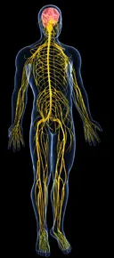


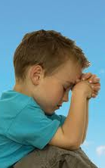
The minds of some of these children are so weakened that they have but one half or one third of the brilliancy of intellect that they might have had, had they been virtuous and pure. They have thrown it away in self-abuse. —Testimonies for the Church 2:361.
Effects of Harmful Practices
The brain nerves which communicate with the entire system are the only medium through which Heaven can communicate to man and affect his inmost life. Whatever disturbs the circulation of the electric currents in the nervous system lessens the strength of the vital powers, and the result is a deadening of the sensibilities of the mind. In consideration of these facts, how important that ministers and people who profess godliness should stand forth clear and untainted from this soul-debasing vice! —Testimonies for the Church 2:347.
All who have any true sense of what is embraced in being a Christian know that the followers of Christ are under obligation as His disciples to bring all their passions, their physical powers and mental faculties into perfect subordination to His will. —An Appeal to Mothers, 9, 10.
If the mind were accustomed to contemplate elevating subjects, the imagination trained to behold pure and holy things, it would be fortified against temptation. It would linger upon the heavenly, the pure, the sacred, and could not be attracted to the base, corrupt, and vile.—Christian Temperance and Bible Hygiene, 135.

Slide 7


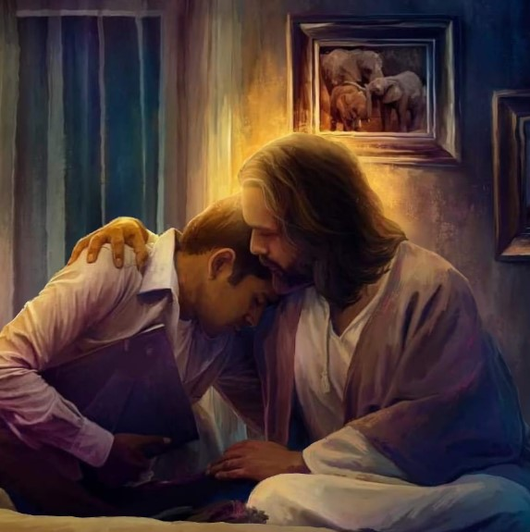

Our only safety is to stand as God's peculiar people. We must not yield one inch to the customs and fashions of this degenerate age, but stand in moral independence, making no compromise with its corrupt and idolatrous practices. —Testimonies for the Church 5:78.
Precautions and Tips
Again I warn you as one who must meet these lines in that day when the case of everyone shall be decided. Yield yourself to Christ without delay; He alone, by the power of His grace, can redeem you from ruin. He alone can bring your moral and mental powers into a state of health. Your heart may be warm with the love of God; your understanding, clear and mature; your conscience, illuminated, quick, and pure; your will, upright and sanctified, subject to the control of the Spirit of God. You can make yourself what you choose... “Choose you this day whom ye will serve”.—Testimonies for the Church 2:559-565.
Do not deceive yourselves into the belief that, after all, this matter is placed before you in an exaggerated light. I have not colored the picture. I have stated facts which will bear the test of the judgment. Awake! Awake! I beseech you, before it shall be too late for wrongs to be righted, and you and your children perish in the general ruin. Take hold of the solemn work, and bring to your aid every ray of light you can gather than has shone upon your pathway, and that you have not cherished; and, together with the aid of the light now shining, commence an investigation of your life and character as if you were before the tribunal of God.—Testimonies for the Church 2:401.

Slide 8





Teach your children self-control:
How important that we teach our children self-control from their very infancy, and teach them the lesson of submitting their wills to us. If they should be so unfortunate as to learn wrong habits, not knowing all the evil results, they can be reformed by appealing to their reason and convincing them that such habits ruin the constitution and affect the mind.—An Appeal to Mothers, 10.
Parental Supervision and Help
Warn them against vile habits:
Mothers, you cannot be too careful in preventing your children from learning low habits. It is easier to learn evil than to eradicate it after it is learned.—An Appeal to Mothers, 10, 11.
If you don't know how to act:
You may inquire, How can we remedy the evils which already exist? How shall we begin the work? If you lack wisdom, go to God; He has promised to give liberally. Pray much, and fervently, for divine aid. One rule cannot be followed in every case. The exercise of sanctified judgment is now needful. Be not hasty and agitated and approach your children with censure. Such a course would only cause rebellion in them. —An Appeal to Mothers, 20, 21.

Slide 9





Present to them the consequences of their actions.
With self-possession and feelings of the deepest sympathy and pity, you should approach your erring children and faithfully present to them the sure work of ruin upon their constitutions if they continue the course they have begun... You should make them feel, if possible, that it God, the pure and holy that they have been sinning against... If you can so impress your children that they will exercise that repentance which is acceptable to God… the work will be thorough, the reform certain. They will not feel sorrow merely because their sins are known; but they will view their sinful practices in their aggravated character and will be led to confess them to God, without reserve, and will forsake them. They will feel to sorrow for their wrong course, because they have displeased God and sinned against Him and dishonored their bodies before Him who created them and has required them to present their bodies a living sacrifice, holy and acceptable unto Him, which is their reasonable service. —An Appeal to Mothers, 21, 22.
Parental Supervision and Help
Do not give them heavy or stimulating food:
Gross and stimulating food fevers the blood, excites the nervous system, and too often dulls the moral perceptions so that reason and conscience are overborne by the sensual impulses. It is difficult, and often well-nigh impossible, for one who is intemperate in diet to exercise patience and self-control.—Christian Temperance and Bible Hygiene, 134, 1890.
Bathe them frequently:
Frequent bathing is very beneficial, especially at night, just before retiring, or upon rising in the morning... This brings the blood to the surface, relieving the brain; and there will be less inclination to indulge in impure practices.—Christian Temperance and Bible Hygiene, 141, 142.

Slide 10



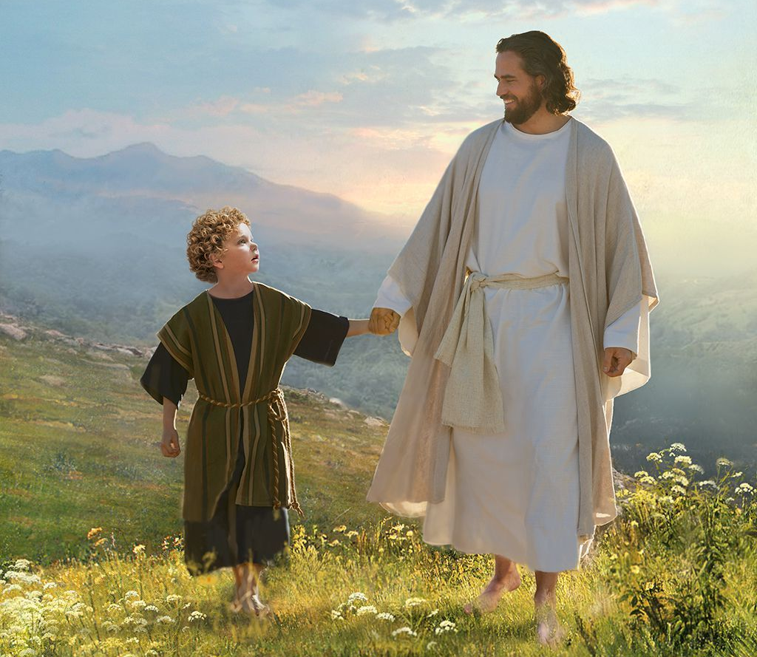
Put clean, neat and non-tight clothes on them:
Having the clothing neat and clean will be one means of keeping the thoughts pure and sweet… Nothing of an irritating character should touch the bodies of children, nor should their clothing be allowed to bind them in any way.—Christian Temperance and Bible Hygiene, 142.
Parental Supervision and Help
Give them work to do:
Give your children physical labor, which will call into exercise the nerves and muscles. The weariness attending such labor will lessen their inclination to indulge in vicious habits.—Testimonies for the Church 2:348-349.
Indolence will not be favorable to physical, mental, or moral health... By indolence not only the moral strength is weakened, and the impulse of passion increased, but Satan's angels take possession of the whole citadel of the mind and compel conscience to surrender to vile passion. We should teach our children habits of patient industry.—An Appeal to Mothers, 18, 19.
Teach them that if they repent, God accepts them:
You should present encouragements before your children that a merciful God will accept true heart repentance and will bless their endeavors to cleanse themselves from all filthiness of the flesh and spirit... If they in humility entreat God for purity of thought and a refined and sanctified imagination, He will hear them and grant their petitions. God has not left them to perish in their sins, but will help the weak and helpless, if they cast themselves in faith upon Him. —An Appeal to Mothers, 22, 23.

Slide 11






DO YOU WANT TO REFORM YOUR HABITS?
Repent sincerely and make a determined effort to resist temptation and refuse corrupt indulgence.
Master your thoughts, direct them to pure, holy, and uplifting themes. The power of God's grace alone can accomplish this most desirable work.
It submits passions and affections to reason. Hold back your thoughts, your reading, and your words. Avoid reading and seeing things that would suggest impure thoughts.
Cultivate moral and intellectual faculties.
Close your eyes so as not to see or learn evil.
Avoid inactivity coupled with excessive studying.
The Battle for Reform
Don't be hesitant. Satan tells the young that there is time enough yet, that they may indulge in sin and vice this once and never again; but that one indulgence will poison their whole life… heartfelt cry of the young be raised to heaven: “Wherewithal shall a young man cleanse his way?”… the answer, “By taking heed thereto, according to thy word.”—Testimonies for the Church 2:408, 409.
Trust in God. The only safety for the youth in this age of pollution is to make God their trust. Without divine help they will be unable to control human passions and appetites. In Christ is the very help needed.—Testimonies for the Church 2:409.
Read the Bible and pray. The reading of God's Word will not fascinate the imagination and inflame the passions, like a fictitious storybook, but softens, soothes, elevates, and sanctifies the heart. When in trouble, when assailed by fierce temptations, they have the privilege of prayer. What an exalted privilege! —An Appeal to Mothers, 23, 24.

Slide 12

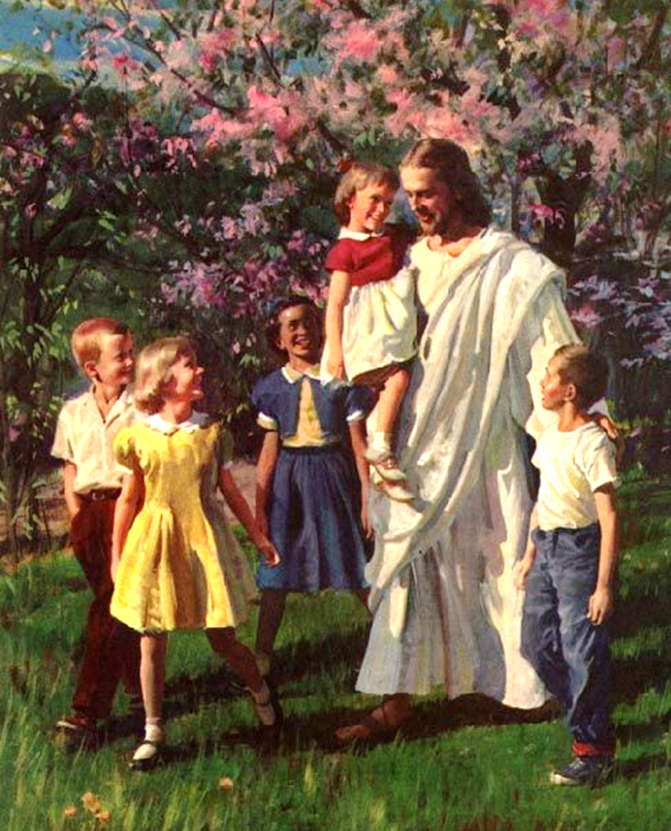
The Awakening of the Spiritual Faculties

Slide 13




While he [Satan] is seeking to accomplish the ruin of their children, let not parents flatter themselves that there is no particular danger. Let them not give thought and care to the things of this world, while the higher, eternal interests of their children are neglected.—The Review and Herald, June 13, 1882.
Responsibility for Eternal Interests
If Christ is in the home, if mothers have made Him their counselor, they will educate their children from their very babyhood in the principles of true religion.—The Signs of the Times, July 22, 1889.
Parents, you have taken the responsibility of bringing children into the world without any voice of theirs, and you are responsible for the lives and souls of your children. They have the attractions of the world to fascinate and allure. You can educate them so as to fortify them against its corrupting influence. You can train them to bear life's responsibilities and to realize their obligations to God, truth, and duty, and the bearing that their actions will have upon their future immortal life.—The Signs of the Times, December 9, 1875.
Parents should allow nothing to prevent them from giving to their children all the time that is necessary to make them understand what it means to obey and trust the Lord fully.—Counsels to parents, teachers, and students, 129.

Slide 14



Make it your lifework to form the characters of your children according to the divine Pattern. If they ever possess the inward adorning, the ornament of a meek and quiet spirit, it will be because you perseveringly trained them to love the teachings of God's Word and to seek the approval of Jesus above the approbation of the world.—The Review and Herald, October 9, 1883.
Responsibility for Eternal Interests
As workers for God, our work is to begin with those nearest. It is to begin in our own home. There is no more important missionary field than this.—Manuscript 19, 1900.
As the patient artist studies, and works, and forms plans to make the results of his labors more perfect, so should the parent consider time well spent that is occupied in training the children for useful lives and fitting them for the immortal kingdom. The artist's work is small and unimportant compared with that of the parent. The one deals with lifeless material, from which he fashions forms of beauty; but the other deals with a human being whose life can be shaped for good or ill, to bless humanity or to curse it; to go out in darkness, or to live forever in a future sinless world.—Pacific Health Journal, May 1890.

Slide 15
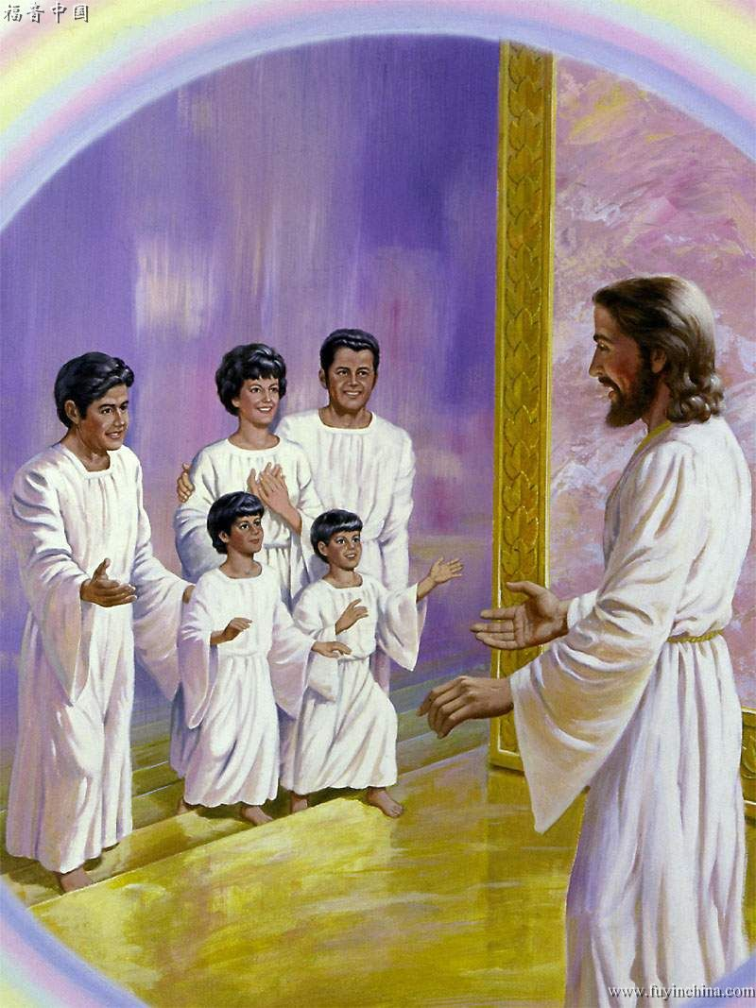

God loves them, and He calls upon you to co-operate with Him in teaching them to form perfect characters. The Lord requires perfection from His redeemed family. He expects from us the perfection which Christ revealed in His humanity.—Manuscript 19, 1900.
Responsibility for Eternal Interests
Parents, … Pray much more than you do. Lovingly, tenderly, teach your children to come to God as their heavenly Father. By your example teach them self-control and helpfulness. Tell them that Christ lived not to please Himself…
As you take hold of the work of helping your children to serve God, the most provoking trials will come; but do not lose your hold; cling to Jesus. He says, “Let him take hold of My strength, that he may make peace with Me; and he shall make peace with Me.” Isaiah 27:5. Difficulties will arise; you will meet with obstacles; but look constantly to Jesus. When an emergency arises, ask, Lord, what shall I do now? If you refuse to fret or scold, the Lord will show you the way. He will help you to use the talent of speech in so Christlike a way that peace and love will reign in the home. By following a consistent course of action, you may be evangelists in the home, ministers of grace to your children.—CT 156.

Slide 16


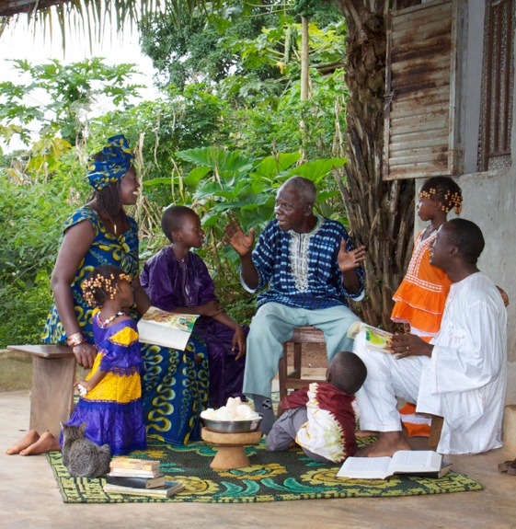
Parents are to consider that they are in the place of God to their children, to encourage every right principle and repress every wrong thought.—Letter 104, 1897.
A knowledge of the character of God and our obligations to Him should not be regarded as a matter of minor consequence. The religion of the Bible is the only safeguard for the young.— Testimonies for the Church 5:23-24
Every Home a Church
Consider the family institution a training school, preparatory for the performance of religious duties. Your children are to act a part in church capacity, and every power of the mind, every physical capacity is to be kept strong and active for the service of Christ. CG 482.1.—Manuscript 12, 1898
The home is to be regarded as a sacred place… Every word should be guarded, for we are responsible to God to represent in our lives as far as possible the character of Christ.—Manuscript 140, 1897.
We know not in what line our children may be called to serve. They may spend their lives within the circle of the home; they may engage in life's common vocations or go as teachers of the gospel to heathen lands; but all are alike called to be missionaries for God, ministers of mercy to the world. They are to obtain an education that will help them to stand by the side of Christ in unselfish service.—Prophets and Kings, 245.
If they are instructed to rely upon divine aid in their difficulties and dangers, they will not lack power to curb passion and to check the inward temptations to do wrong. Connection with the Source of wisdom will give light and the power of discernment between right and wrong. Those so endowed will become morally and intellectually strong and will have clearer views and better judgment even in temporal affairs. —The Health Reformer, November 1, 1878

Slide 17

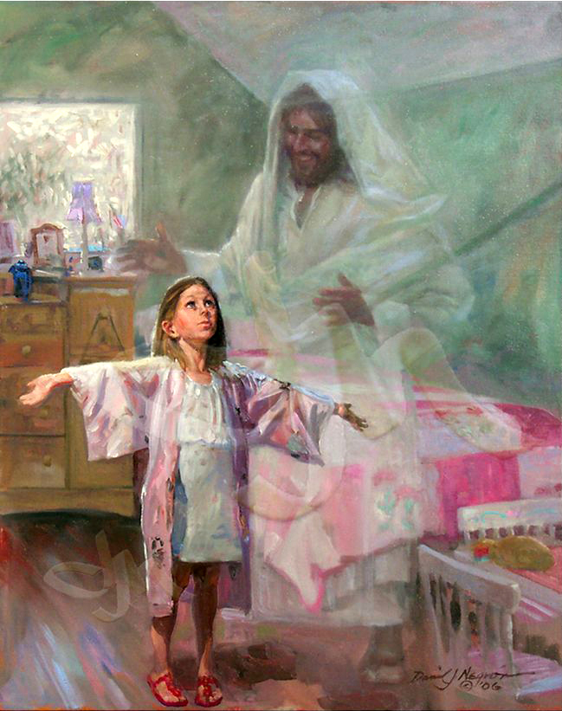

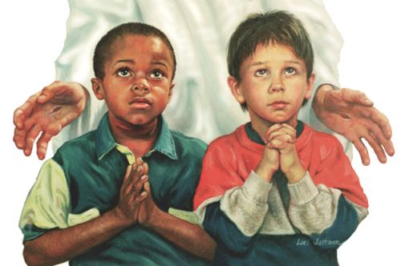
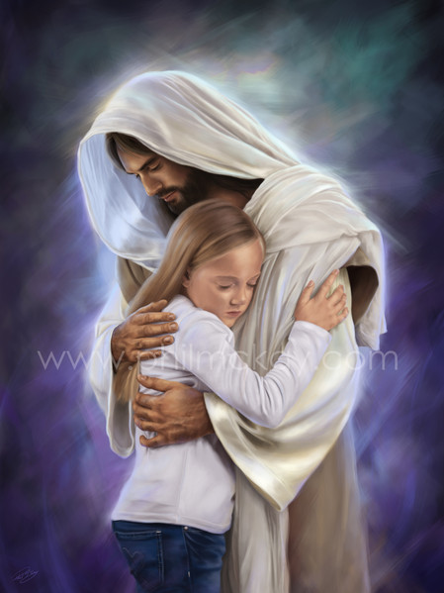
AT WHAT AGE DO YOU LEAD CHILDREN TO JESUS?
God wants every child of tender age to be His child, to be adopted into His family. Young though they may be, the youth may be members of the household of faith and have a most precious experience. They may have hearts that are tender and ready to receive impressions that will be lasting. They may have their hearts drawn out in confidence and love for Jesus and live for the Saviour.—CG 486
Leading Little Children to Christ
WHAT CAN I TEACH HIM?
God is love: In every lesson it should be taught that God is love.—The Review and Herald, 6 June, 1899.
Fathers and mothers should teach the infant, the child, and the youth of the love of Jesus. Let the first baby lispings be of Christ.—The Review and Herald, October 9, 1900.
The name of Jesus: One of the first sounds that should attract their attention is the name of Jesus, and in their earliest years they should be led to the footstool of prayer. Their minds should be filled with stories of the life of the Lord, and their imaginations encouraged in picturing the glories of the world to come.—The Review and Herald, February, 1895.

Slide 18

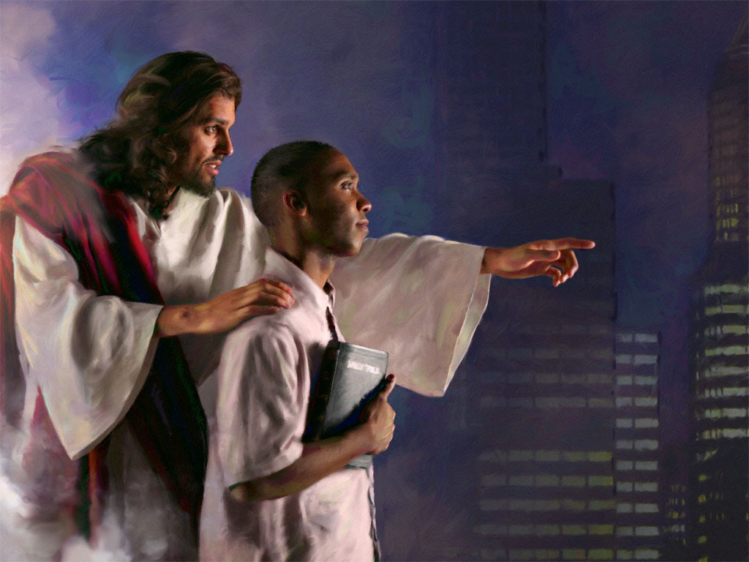
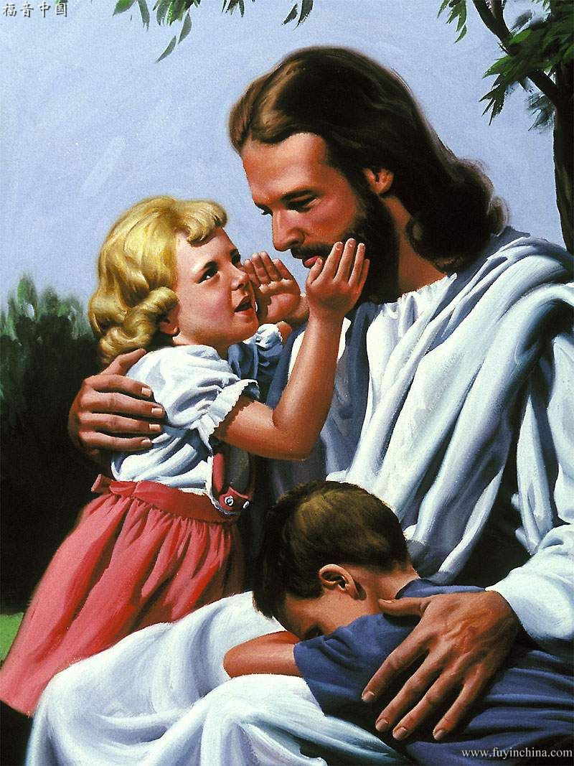
Obedience to God: Shall we not teach our children that willing obedience to the will of God proves whether those claiming to be Christians are Christians indeed? The Lord means every word He says.—Manuscript 64, 1899.
Leading Little Children to Christ
God's Law: We are to present to the world in clear, distinct lines the need of obedience to His law. The great reformative movement must begin in the home. Obedience to God's law is the great incentive to industry, economy, truthfulness, and just dealing between man and man.—Letter 74, 1900.
A personal religion: Children of eight, ten, or twelve years are old enough to be addressed on the subject of personal religion. Do not teach your children with reference to some future period when they shall be old enough to repent and believe the truth. If properly instructed, very young children may have correct views of their state as sinners and of the way of salvation through Christ.—Testimonies for the Church 1:400.

Slide 19



Strengthen yourselves for future trials: Believing parents, your children will have to fight decisive battles for the Lord in the day of conflict; and while they win victories for the Prince of peace, they may be gaining triumphs for themselves. But if they have not been brought up in the fear of the Lord; if they have no knowledge of Christ, no connection with heaven, they will have no moral power, and they will yield to earthly potentates.—The Review and Herald, April 23, 1889.
Leading Little Children to Christ
Religion helps you in your study and work: Religion helps children to study better and to do more faithful work. A little girl of twelve was telling, in a simple way, the evidence that she was a Christian. “I did not like to study, but to play. I was idle at school and often missed my lessons. Now I learn every lesson well, to please God. I was mischievous at school, when the teachers were not looking at me, making fun for the children to look at. Now I wish to please God by behaving well and keeping the school laws. I was selfish at home, didn't like to run errands, and was sulky when mother called me from play to help her in work. Now it is a real joy for me to help mother in any way and to show that I love her.”—Counsels on Sabbath School Work, 79.

Slide 20


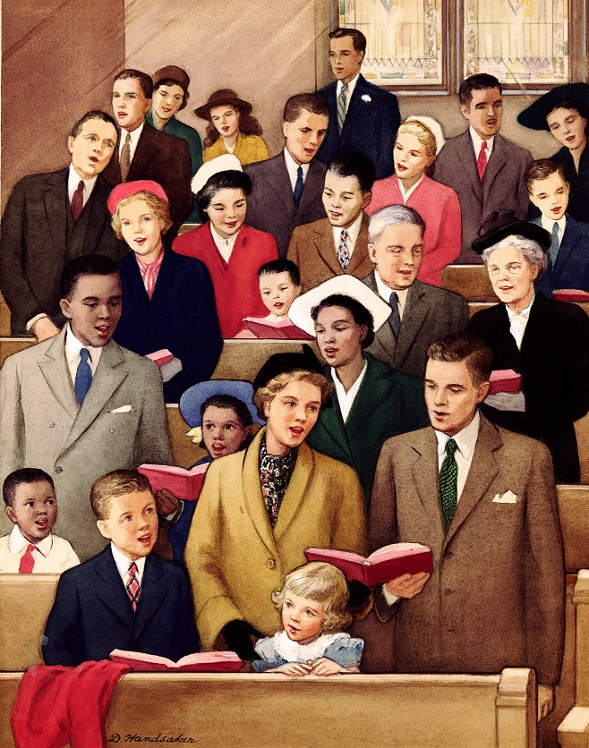
WHAT DO WE TEACH OUR CHILDREN FOR THEM TO BECOME CHURCH MEMBERS?
Of Jesus, His life and His ministry.
That knowing God is eternal life.
To ask forgiveness daily for any mistakes they have made, and how Jesus will forgive them.
The great doctrines of our faith, and the reasons why we are Seventh-day Adventists.
That we are called to be a peculiar people, a holy nation, separate and distinct from all other peoples on the face of the earth.
Spiritual things, taught briefly but often repeatedly, and not with long discourses that will tire you.
The path of righteousness, especially in the early hours of the night.
The promises made by the great Teacher. The Holy Spirit will direct the children, he will reveal to them the treasures and beauties of the Word.
Which means to be a child of God and to surrender one's will in obedience to Him. Spiritual lessons from household chores. For example, by sweeping a room they can learn how the Lord purifies the heart.
That they are children of God until they are old enough to be baptized.
That when they go to church it is not so important that they appear in fine clothes as that they appear before God with clean hands and pure hearts.
Preparing for Church Membership

Slide 21


Maintaining the Religious Experience

Slide 22

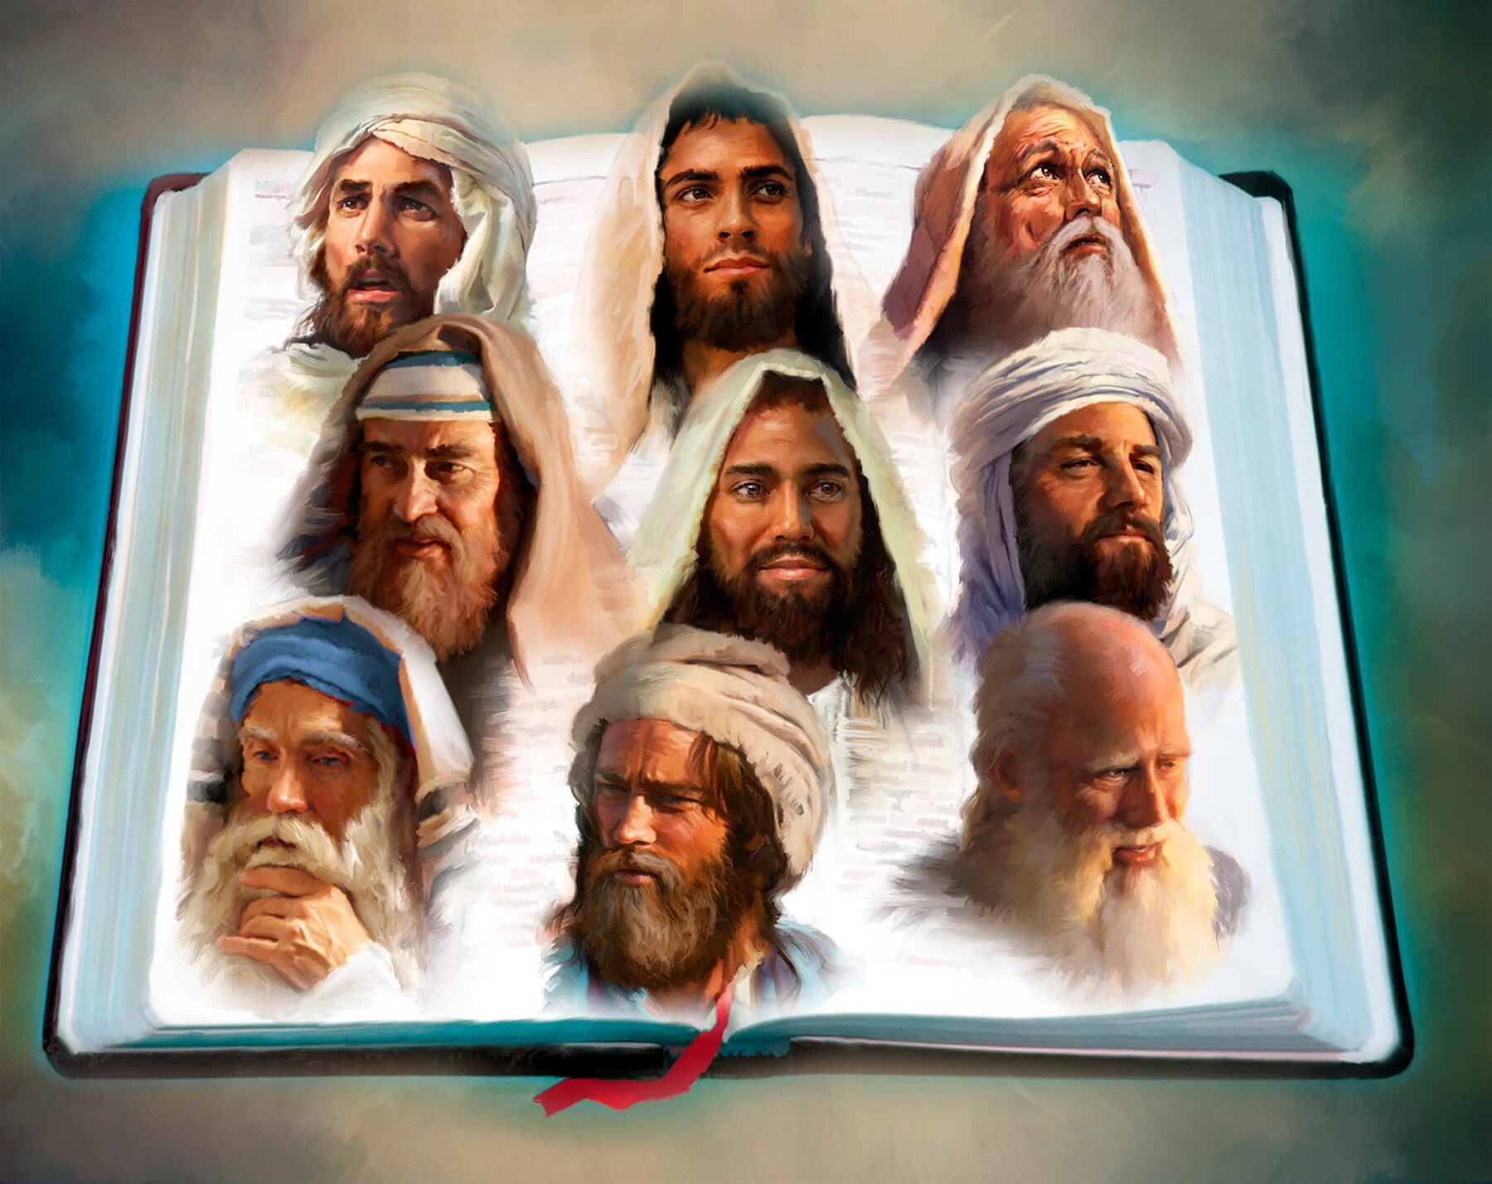

The Bible is a very varied book: In its wide range of style and subjects, the Bible has something to interest every mind and appeal to every heart. In its pages are found history the most ancient; biography the truest to life; principles of government for the control of the state, for the regulation of the household—principles that human wisdom has never equaled. It contains philosophy the most profound; poetry the sweetest and the most sublime, the most impassioned and the most pathetic [moving]… Viewed in the light of this thought, every topic has a new significance. In the most simply stated truths are involved principles that are as high as heaven and that compass eternity.—Education, 125.
Benefits of reading the Bible: Our spiritual strength is increased; we grow in grace and in a knowledge of the truth. Habits of self-control are formed and strengthened. The infirmities… disappear.— Counsels to parents, teachers, and students, 207.
The Bible is the standard of righteousness: The Holy One of Israel has made known to us the statutes and laws which are to govern all human intelligences. These precepts, which have been pronounced “holy, and just, and good,” are to form the standard of action in the home.—The Review and Herald, November 13, 1888.
The Bible at Home
The Bible strengthens the intellect: If the Bible were read more, if its truths were better understood, we should be a far more enlightened and intelligent people. Energy is imparted to the soul by searching its pages.—Christian Temperance and Bible Hygiene, 126.
The Bible is the Foundation of Prosperity: The teaching of the Bible has a vital bearing upon man's prosperity in all the relations of this life. It unfolds the principles that are the cornerstone of a nation's prosperity—principles with which is bound up the well-being of society, and which are the safeguard of the family—principles without which no man can attain usefulness, happiness, and honor in this life, or can hope to secure the future, immortal life. —Patriarchs and Prophets, 599.

Slide 23
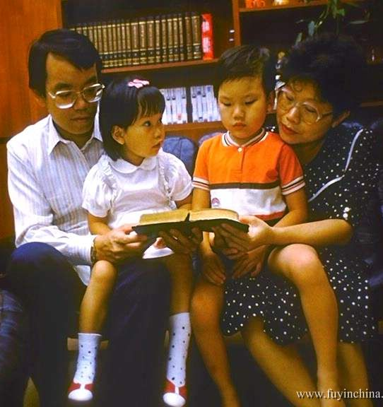
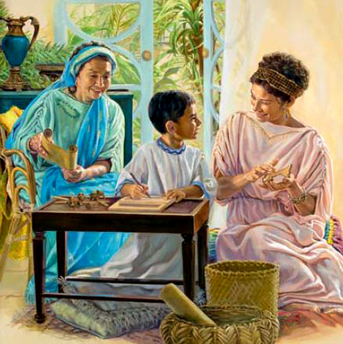
Do not neglect Bible study: Youthful minds fail to reach their noblest development when they neglect the highest source of wisdom—the word of God.—Counsels to parents, teachers, and students, 139.
El libro de texto del hogar: Parents, if you would educate your children to serve God and do good in the world, make the Bible your textbook. It exposes the wiles of Satan. It is the great elevator of the race, the reprover and corrector of moral evils, the detector which enables us to distinguish between the true and the false.
The Bible at Home
Study the Bible diligently and systematically: It is impossible to estimate the good results of one hour or even half an hour each day devoted in a cheerful, social manner to the Word of God.—The Review and Herald, October 9, 1883.
Knowledge of the Scriptures is a safeguard: From a child, Timothy knew the Scriptures; and this knowledge was a safeguard to him against the evil influences surrounding him and the temptation to choose pleasure and selfish gratification before duty. Such a safeguard all our children need, and it should be a part of the work of parents and of Christ's ambassadors to see that the children are properly instructed in the Word of God.—Testimonies for the Church 4:398.
Memorize and Study Sabbath School: Parents, set apart a little time each day for the study of the Sabbath school lesson with your children… Parents as well as children will receive benefit from this study. Let the more important passages of Scripture connected with the lesson be committed to memory, not as a task, but as a privilege. Though at first the memory be defective, it will gain strength by exercise, so that after a time you will delight thus to treasure up the words of truth. And the habit will prove a most valuable aid to spiritual growth.—Counsels to parents, teachers, and students, 137-138.

Slide 24

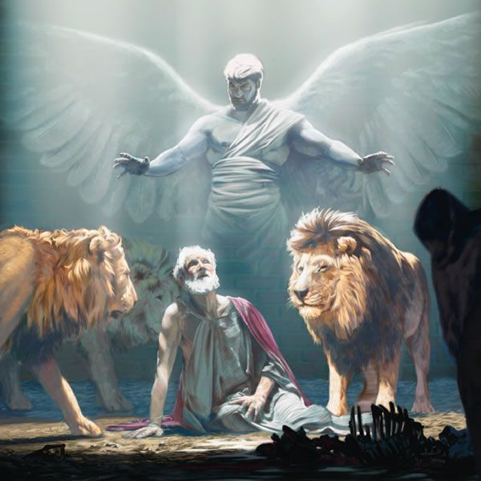
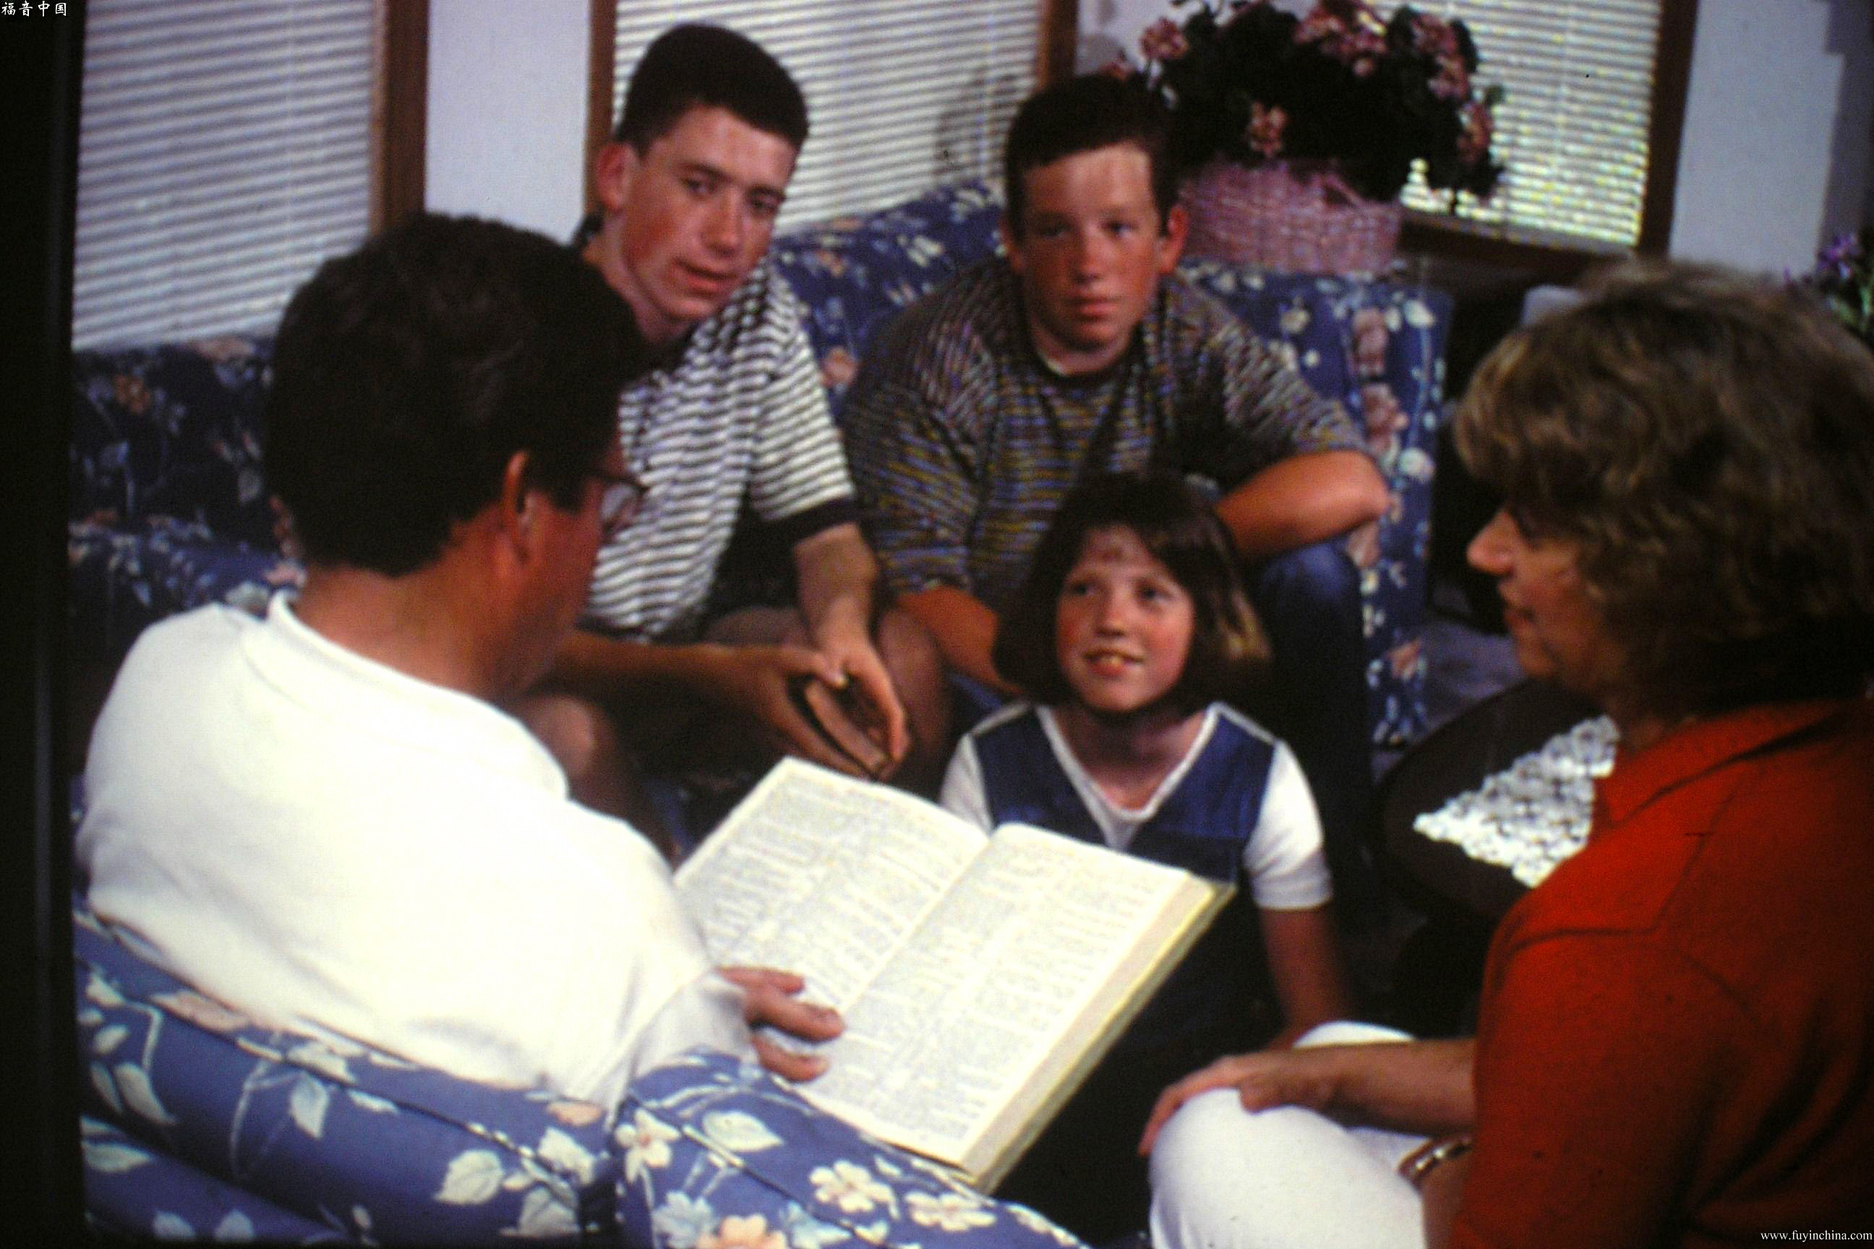
The Bible is the best counselor: Give the Word its honored position as a guide in the home. Let it be regarded as the counselor in every difficulty, the standard of every practice.—Letter 107, 1898.
Use simple methods and object lessons: In these simple stories may be made plain the great principles of the law of God… he use of object lessons, blackboards, maps, and pictures will be an aid in explaining these lessons and fixing them in the memory. Parents and teachers should constantly seek for improved methods. The teaching of the Bible should have our freshest thought, our best methods, and our most earnest effort.—Education, 185, 186.
The Bible at Home
The Bible is the guide: You must make the Bible your guide if you would bring up your children in the nurture and admonition of the Lord. Let the life and character of Christ be presented as the pattern for them to copy. If they err, read to them what the Lord has said concerning similar sins. There is need of constant care and diligence in this work. One wrong trait tolerated by parents, uncorrected by teachers, may cause the whole character to become deformed and unbalanced. Teach the children that they must have a new heart; that new tastes must be created, new motives inspired. They must have help from Christ; they must become acquainted with the character of God as revealed in His Word. CG 515

Slide 25



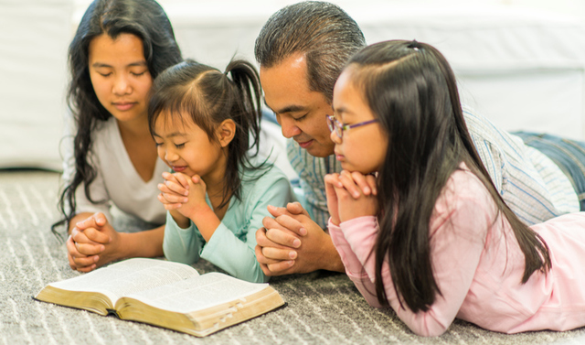
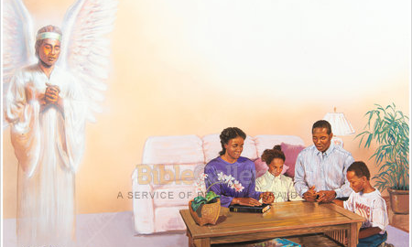
Fathers, mothers, you need to seek God morning and evening at the family altar, that you may learn how to teach your children wisely, tenderly, lovingly.— The Review and Herald, June 27, 1899.
The Power of Prayer
Evening and morning join with your children in God's worship, reading His Word and singing His praise. Teach them to repeat God's law.—VSS 410
They should be taught to respect the hour of prayer; they should be required to rise in the morning so as to be present at family worship.—Testimonies for the Church 5:424.
Fathers and mothers should often lift up their hearts to God in humble supplication for themselves and their children. Let the father, as priest of the household, lay upon the altar of God the morning and evening sacrifice, while the wife and children unite in prayer and praise. In such a household Jesus will love to tarry.—Patriarchs and Prophets, 144.
Before leaving the house for labor, all the family should be called together; and the father, or the mother in the father's absence, should plead fervently with God to keep them through the day. Come in humility, with a heart full of tenderness, and with a sense of the temptations and dangers before yourselves and your children; by faith bind them upon the altar, entreating for them the care of the Lord. Ministering angels will guard children who are thus dedicated to God.—Testimonies for the Church 1:397-398.

Slide 26


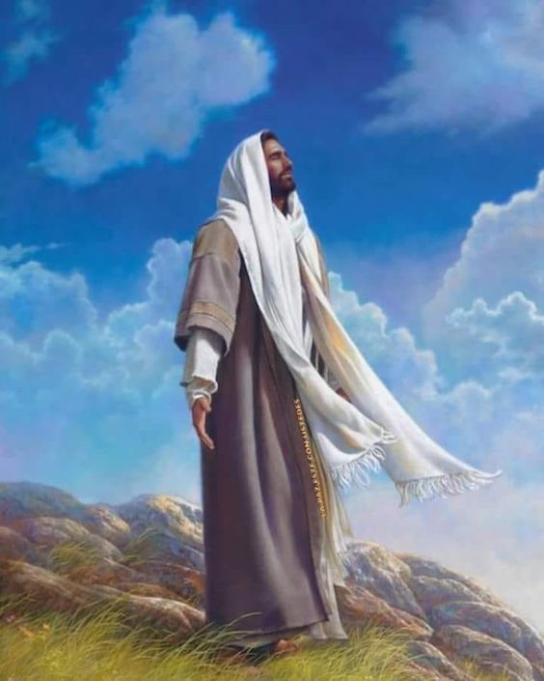

You are not to pray occasionally and, when you have a large day's work to do, neglect it. In thus doing you lead your children to look upon prayer as of no special consequence.—Manuscript 12, 1898.
The Power of Prayer
By your own example teach your children to pray with clear, distinct voice. Teach them to lift their heads from the chair and never to cover their faces with their hands.— Manuscript 12, 1898.
As a part of religious service singing is as much an act of worship as is prayer. Indeed, many a song is a prayer. If the child is taught to realize this, he will think more of the meaning of the words he sings and will be more susceptible to their power. — Education, 167, 178.
There is great strength and blessing in praying together in our families, with and for our children. When my children have done wrong, and I have talked with them kindly and then prayed with them, I have never found it necessary after that to punish them. Their hearts would melt in tenderness before the Holy Spirit that came in answer to prayer.—Manuscript 47, 1908.
It was in hours of solitary prayer that Jesus in His earth-life received wisdom and power. Let the youth follow His example in finding at dawn and twilight a quiet season for communion with their Father in heaven.—Education, 259.
The prayers of Christian mothers are not disregarded by the Father of all, who sent His Son to the earth to ransom a people for Himself. He will not turn away your petitions and leave you and yours to the buffetings of Satan in the great day of final conflict. It is for you to work with simplicity and faithfulness, and God will establish the work of your hands.—The Review and Herald, April 23, 1889.

Slide 27

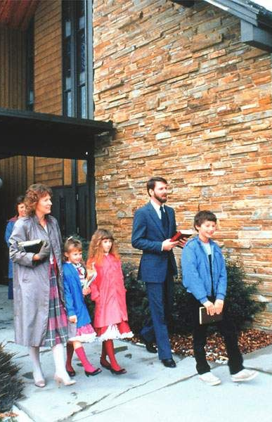




Parents, you need to remember the Sabbath day yourselves to keep it holy. And if you do this, you are giving the proper instruction to your children.—Manuscript 57, 1897.
No duty incumbent on the six working days shall be left until the Sabbath.
During the week our energies will not be so exhausted in temporal labor that on the day when the Lord rested and was refreshed, we shall be too weary to engage in His service.—Testimonies for the Church 6:334.
Sabbath the Day
of Delight
During the week, everything should have been arranged by the children and under the direction of the mother. On Friday let the preparation for the Sabbath be completed. See that all the clothing is in readiness, and that all the cooking is done. Let the boots be blacked, and the baths be taken. It is possible to do this.—Testimonies for the Church 6:335,336.
There is another work that should receive attention on the preparation day. On this day all differences between brethren, whether in the family or in the church, should be put away.—Testimonies for the Church 6:356.
Before the setting of the sun, let the members of the family assemble to read God's Word, to sing and pray.—Testimonies for the Church 6:356,357.
But that the mind be disciplined to dwell upon sacred themes. The Fourth Commandment is virtually transgressed by conversing upon worldly things or by engaging in light and trifling conversation. Talking upon anything or everything which may come into the mind is speaking our own words.—Testimonies for the Church 2:702,703.

Slide 28
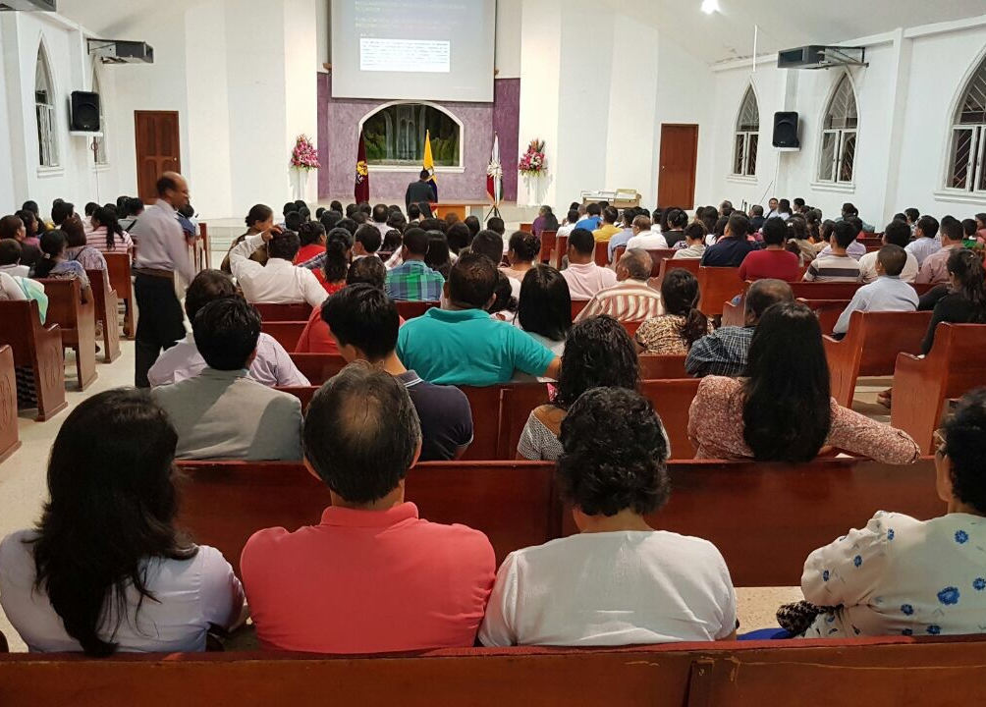



Let not the precious hours of the Sabbath be wasted in bed. On Sabbath morning the family should be astir early. If they rise late, there is confusion and bustle in preparing for breakfast and Sabbath school. There is hurrying, jostling, and impatience.—Testimonies for the Church 6:357.
Sabbath the Day
of Delight
Fathers and mothers should make it a rule that their children attend public worship on the Sabbath, and should enforce the rule by their own example.—The Review and Herald, June 13, 1882.
All should have a special Sabbath suit, to be worn when attending service in God's house. While we should not conform to worldly fashions, we are not to be indifferent in regard to our outward appearance. We are to be neat and trim, though without adornment. The children of God should be pure within and without. —Testimonies for the Church 6:355.
Parents should explain to their children the words spoken from the pulpit, that they also may understand and have that knowledge which if which if put into practice brings abundant grace and peace—Manuscript 41, 1903.
Instead of this [on Sabbath] the food should be more simple, and less should be eaten, in order that the mind may be clear and vigorous to comprehend spiritual things. —CG 532.
Provide something that will be regarded as a treat, something the family do not have every day.—Testimonies for the Church 3:24.
The Sabbath school and the meeting for worship occupy only a part of the Sabbath. The portion remaining to the family may be made the most sacred and precious season of all the Sabbath hours. Much of this time parents should spend with their children .—Testimonies for the Church 6:358.

Slide 29
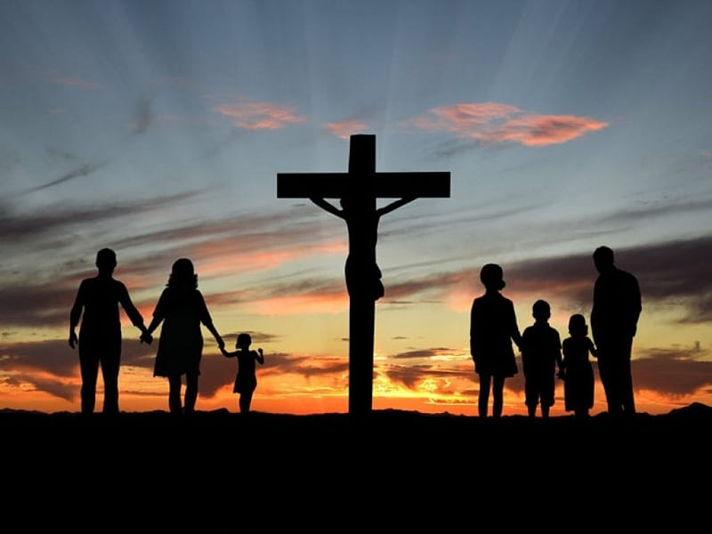



Parents can and should give attention to their children… educating them to reverence the Sabbath day, keeping it according to the commandment.—The Review and Herald, April 14, 1885.
You may just as well break the Sabbath yourselves as to let your children do it, and when you suffer your children to wander about and suffer them to play upon the Sabbath, God looks upon you as Sabbathbreakers.—The Review and Herald, September 19 1854.
Sabbath the Day
of Delight
The parents may take their children outdoors to view God in nature.—Manuscript 3, 1879.
In no better way can parents exalt and honor the Sabbath than by devising means to impart proper instruction to their families and interesting them in spiritual things, giving them correct views of the character of God and what He requires of us in order to perfect Christian characters and attain to eternal life. —Testimonies for the Church 2:584, 585.
Parents, make the Sabbath a delight, that your children may look forward to it and have a welcome in their hearts for it. CG 536, Testimony Treasures 1, 281
As the sun goes down, let the voice of prayer and the hymn of praise mark the close of the sacred hours, and invite God's presence through the cares of the week of labor.—Testimonies for the Church 6:359

Slide 30

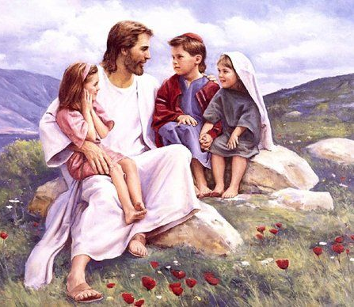


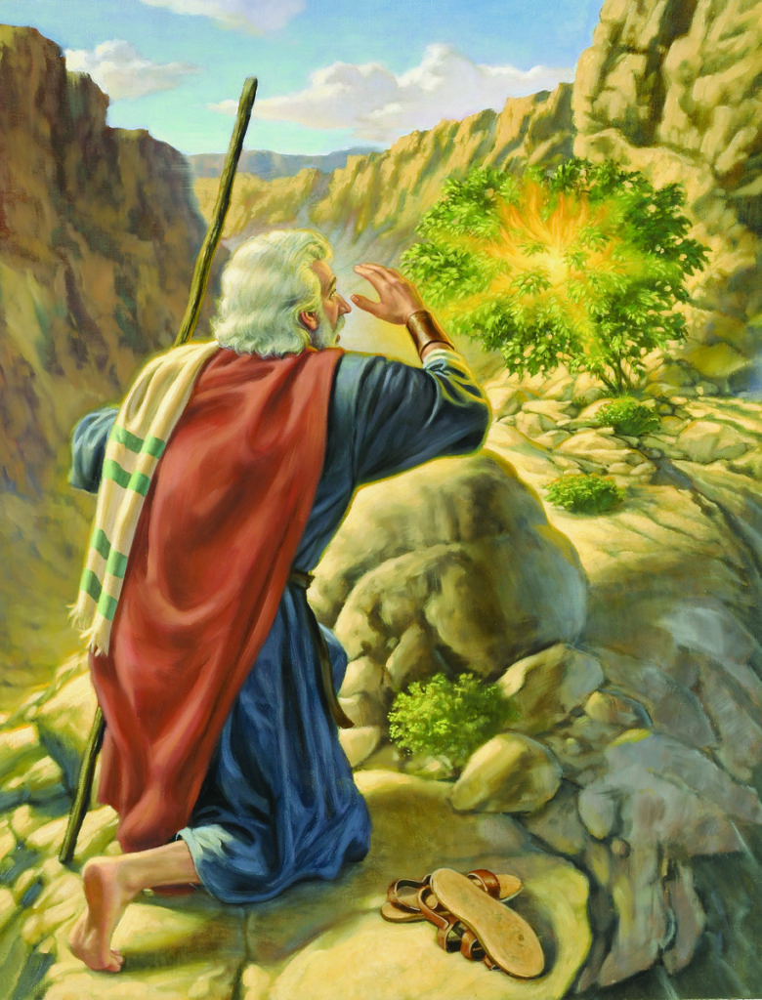
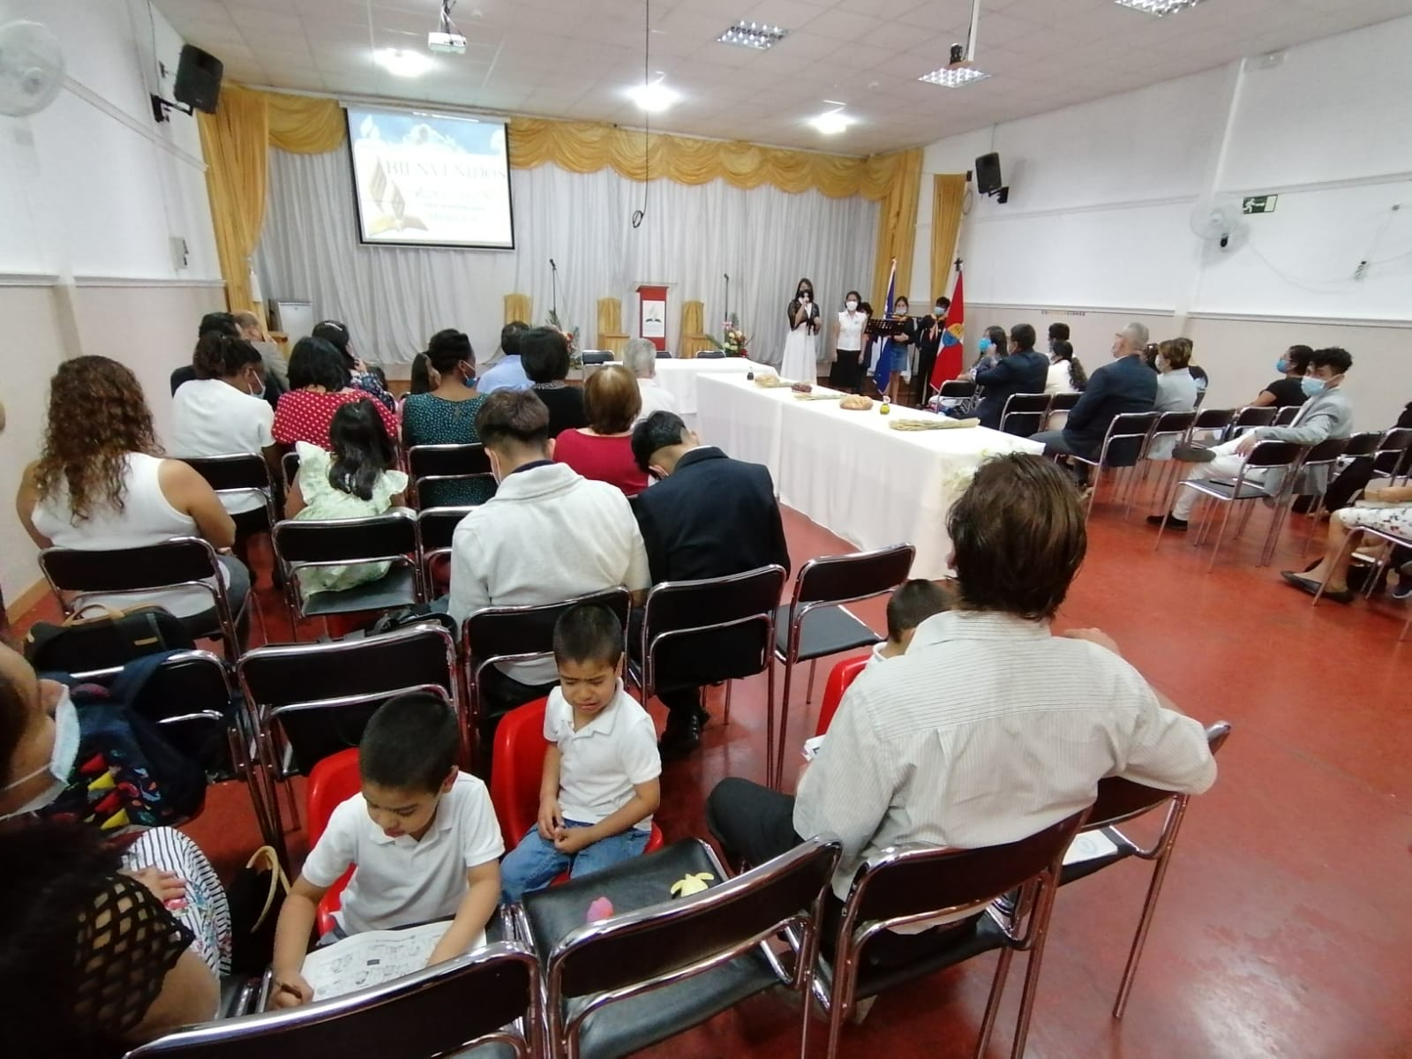
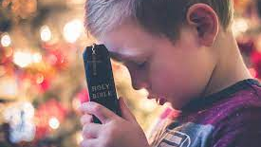
The education and training of the youth should be of a character that would exalt sacred things and encourage pure devotion for God in His house.—Testimonies for the Church 5:496
Reverence for What is Holy
True reverence for God is inspired by a sense of His infinite greatness and a realization of His presence. With this sense of the Unseen the heart of every child should be deeply impressed. Education, 242.
Reverence should be shown also for the name of God. Never should that name be spoken lightly or thoughtlessly. Even in prayer its frequent or needless repetition should be avoided. “Holy and reverend is his name.” Psalm 111:9. Angels, as they speak it, veil their faces. With what reverence should we, who are fallen and sinful, take it upon our lips!—Education, 243.
We should reverence God's Word. For the printed volume we should show respect, never putting it to common uses or handling it carelessly. And never should Scripture be quoted in a jest or paraphrased to point a witty saying.—Education, 244.
The hour and place of prayer and the services of public worship the child should be taught to regard as sacred because God is there. And as reverence is manifested in attitude and demeanor, the feeling that inspires it will be deepened.—Education, 242, 243.

Slide 31

Many ... have no true appreciation of the sacredness of eternal things. Nearly all need to be taught how to conduct themselves in the house of God. Parents should not only teach, but command, their children to enter the sanctuary with sobriety and reverence.—Testimonies for the Church 5:496.
Reverence for What is Holy
The house of God is often desecrated, and the Sabbath violated by Sabbath-believers’ children. In some cases they are even allowed to run about the house, play, talk, and manifest their evil tempers in the very meetings where the saints should worship God in the beauty of holiness. And the place that should be holy, and where a holy stillness should reign, and where there should be perfect order, neatness, and humility, is made to be a perfect Babylon, “confusion.” This is enough to bring God's displeasure and shut His presence from our assemblies.—The Review and Herald, September 19, 1854.
Remain With Their Parents. They are too often found in groups, away from the parents, who should have charge of them. Notwithstanding they are in the presence of God, and His eye is looking upon them; they are light and trifling; they whisper and laugh, are careless, irreverent, and inattentive.—Testimonies for the Church 5:496, 497.
Parents… teach them to have the highest reverence for the house of God and to understand that when they enter the Lord's house, it should be with hearts that are softened and subdued by such thoughts as these: “God is here; this is His house. I must have pure thoughts and the holiest motives. I must have no pride, envy, jealousy, evil surmising, hatred, or deception in my heart; for I am coming into the presence of the holy God. This is the place where God meets with and blesses His people. The high and holy One who inhabiteth eternity looks upon me, searches my heart, and reads the most secret thoughts and acts of my life. CG 541.3”.—Testimonies for the Church 5:494.

Slide 32





If the children cannot be restrained, if the parents feel that the restraint is too much of an exaction, the child should be removed from the church at once; it should not be left to divert the minds of the hearers by talking or running about. God is dishonored by the loose way in which parents manage their children while at church.—Letter 1, 1877.
Reverence for What is Holy
Reverence should be shown for God's representatives—for ministers, teachers, and parents who are called to speak and act in His stead. In the respect shown to them He is honored CG 544.3.—La Education, 244.
The delicate and susceptible minds of the youth obtain their estimate of the labors of God's servants by the way their parents treat the matter. Many heads of families make the service a subject of criticism at home, approving a few things and condemning others. Thus the message of God to men is criticized and questioned and made a subject of levity …
The children see and understand these things very much quicker than parents are apt to think. Their moral senses receive a wrong bias that time will never fully change. The parents mourn over the hardness of heart in their children and the difficulty in arousing their moral sensibility to answer to the claims of God—5 T 497.
Children and youth should never feel that it is something to be proud of to be indifferent and careless in meetings where God is worshiped… Practice reverence until it becomes a part of yourself.—The Youth’s Instructor, October 8 1896.

Slide 33



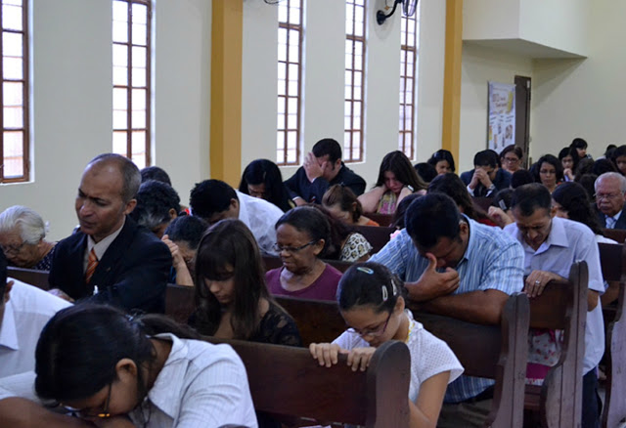
Parents, begin the work of grace in the church in your own home, so conducting yourselves that your children will see that you are co-operating with the heavenly angels CG 548.1.—Manuscript 93, 1901.
Home and Church Coordination
When the father and mother as priest and teacher of the family take their position fully on the side of Christ, a good influence will be exerted in the home. And this sanctified influence will be felt in the church and will be recognized by every believer.—Manuscript 57, 1903.
Let there be peace in the home, and there will be peace in the church. This precious experience brought into the church will be the means of creating a kindly affection one for another. Quarrels will cease. True Christian courtesy will be seen among church members.—Manuscrito 60, 1903.
Often the church has to suffer through its members because of the wrong education received by them in childhood. When children, they were allowed to practice deception in order to gain their own way; and the spirit that was permitted to be rebellious in the home will be the last to render obedience to the requirements of God's Word.—The Review and Herald, March 30, 1897.
The influence of the family is to be such that it will be a help and a blessing in the church. Never speak a word of complaint or faultfinding… To be silent is the strongest rebuke that you can give to one who is speaking harsh, discourteous words to you. Keep perfectly silent. Often silence is eloquence.—Manuscript 21, 1903.
At every suitable opportunity let the story of Jesus’ love be repeated to the children. In every sermon let a little corner be left for their benefit. The servant of Christ may make lasting friends of these little ones. Then let him lose no opportunity of helping them to become more intelligent in a knowledge of the Scriptures…—Gospel Workers, 208.

Slide 34

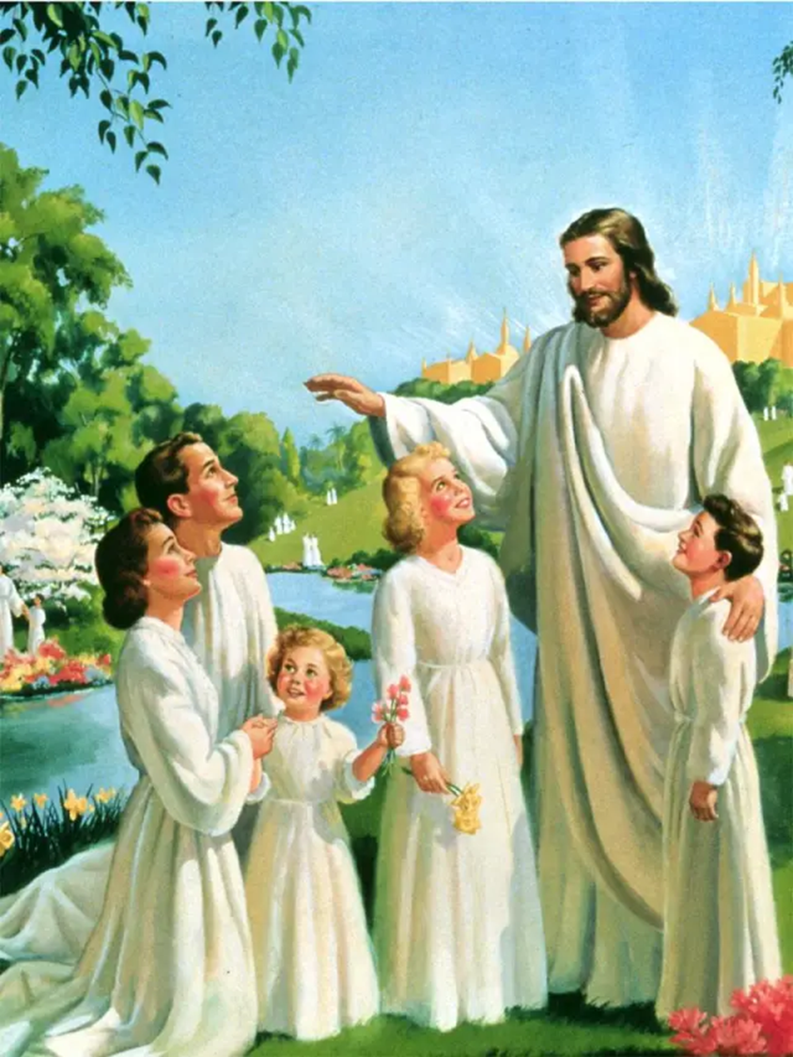
The Day of the Final Count

Slide 35

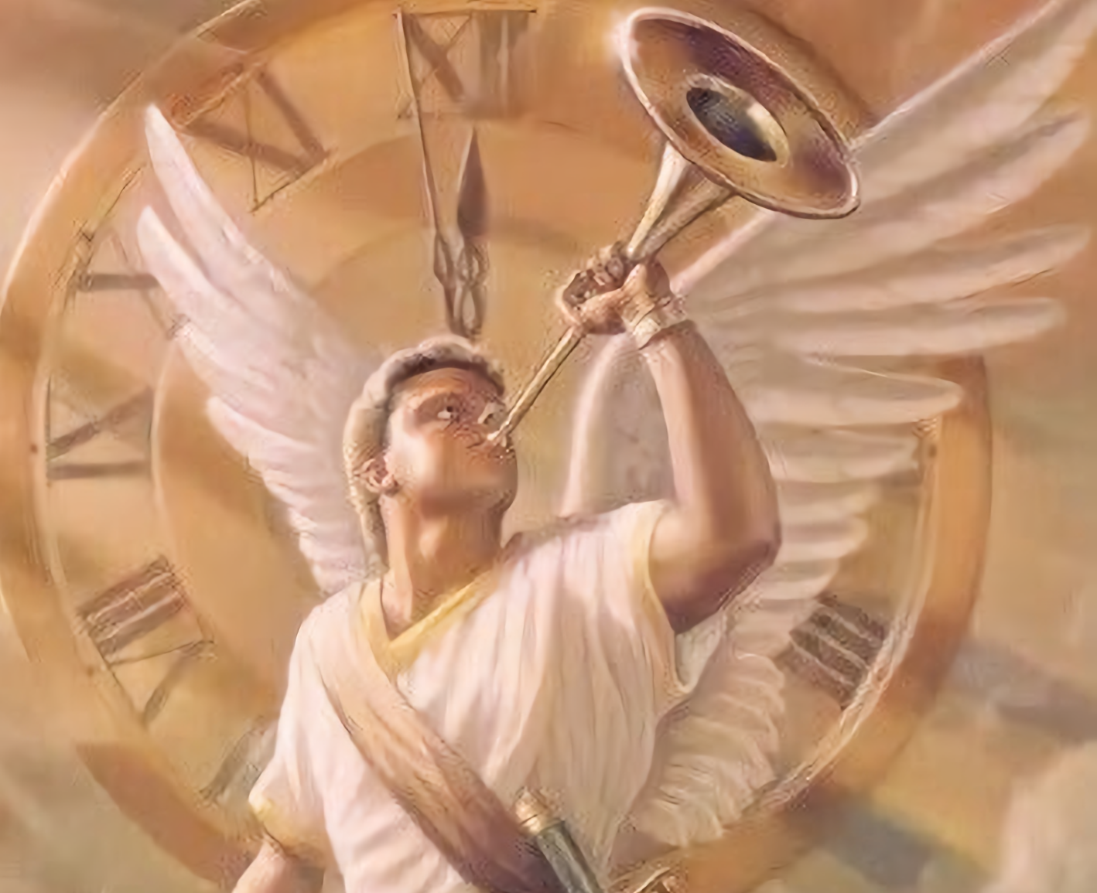

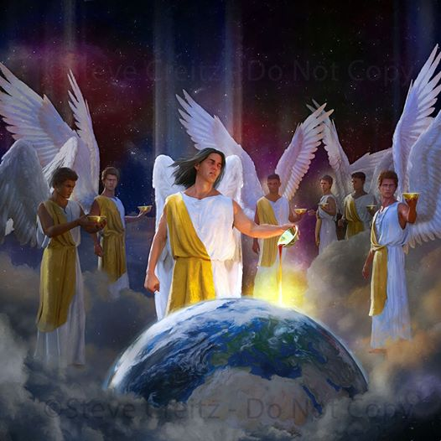

Are our children forming habits of decision, that they may be firm and unyielding in every matter of principle and duty? I pray that we all may understand the signs of the times, and that we may so prepare ourselves and our children that in the time of conflict God may be our refuge and defense.—The Review and Herald, April 23, 1889.
The Time Is Late
Transgression has almost reached its limit. Confusion fills the world, and a great terror is soon to come upon human beings. The end is very near. God's people should be preparing for what is to break upon the world as an overwhelming surprise. Our time is precious. We have but a few, a very few, days of probation in which to make ready for the future, immortal life CG 555.3.—The Youth’s Instructor, April 28, 1908.
Our young people need to be helped, uplifted, and encouraged, but in the right manner; not, perhaps, as they would desire it, but in a way that will help them to have sanctified minds. They need good, sanctifying religion more than anything else. —MYP 287.

Slide 36
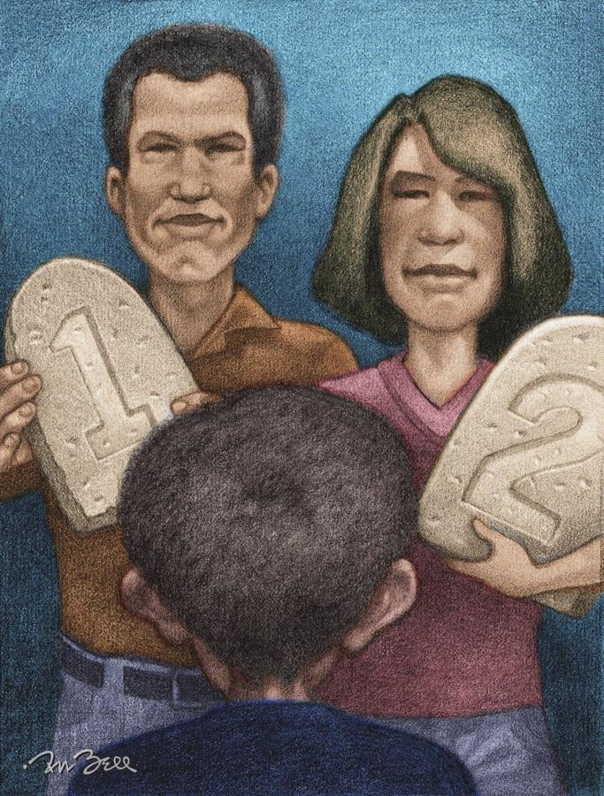

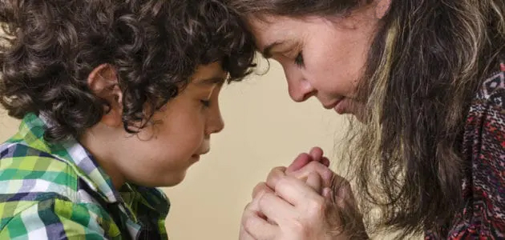
Fathers, mothers, I appeal to you to make most earnest efforts now for your children. Give them daily religious instruction. Teach them to love God and to be true to the principles of right. With lofty, earnest faith, directed by the divine influence of the Holy Spirit, work, work now. Do not put it off one day, one hour.—The Review and Herald, April 23, 1889.
The Time is Late
The special work of parents is to make the laws of God plain to their children and to urge their obedience to them, that they may see the importance of obeying God all the days of their life.—Letter 90, 1898.
Teach your children that the heart must be trained to self-control and self-denial. The motives of the life must be in harmony with the law of God. Never be satisfied to have your children grow up apart from Christ. Never feel at ease while they are cold and indifferent. Cry to God day and night. Pray and work for the salvation of the souls of your children.—The Review and Herald, April 23, 1889.

Slide 37


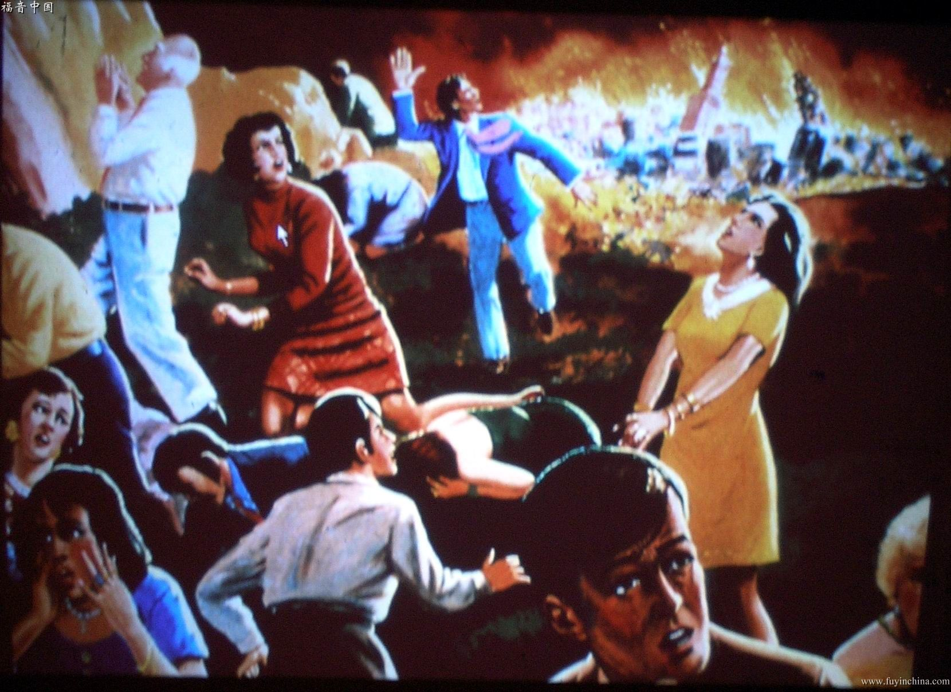
In the solemn assembly of the last day, in the hearing of the universe, will be read the reason of the condemnation of the sinner. For the first time parents will learn what has been the secret life of their children. Children will see how many wrongs they have committed against their parents. There will be a general revealing of the secrets and motives of the heart, for that which is hid will be made manifest. Those who have made sport of solemn things connected with the judgment will be sobered as they face its terrible reality.—The Youth’s Instructor, July 21, 1892.
The Rewards
Parents, if you lose your opportunity, God pity you; for in the day of judgment God will say, “What have you done with My flock, My beautiful flock?”... CG 561.2 Suppose you should get to heaven and none of your children be there. How could you say to God, “Here am I, Lord, and the children which Thou hast given me”? Heaven marks the neglect of parents. It is recorded in the books of heaven.—Manuscript 62, 1901.
Oh, that parents would look prayerfully and carefully after their children's eternal welfare! Let them ask themselves, Have we been careless? Have we neglected this solemn work? Have we allowed our children to become the sport of Satan's temptations? Have we not a solemn account to settle with God because we have permitted our children to use their talents, their time and influence, in working against the truth, against Christ? Have we not neglected our duty as parents and increased the number of the subjects of Satan's kingdom?—3 TT 63.
Many children will rise up in judgment and condemn their parents for not restraining them, and charge upon them their destruction. The false sympathy and blind love of parents causes them to excuse the faults of their children and pass them by without correction, and their children are lost in consequence, and the blood of their souls will rest upon the unfaithful parents.—CCh 194

Slide 38

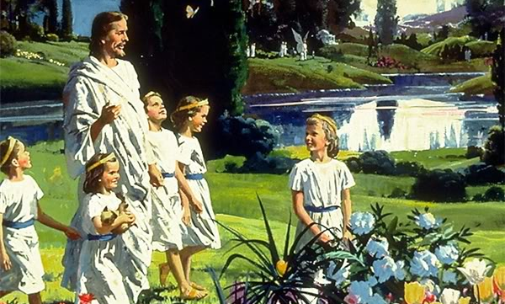

The Lord has often instructed me that many little ones are to be laid away before the time of trouble. We shall see our children again. We shall meet them and know them in the heavenly courts. Put your trust in the Lord, and be not afraid.—Letter 196, 1899.
The Rewards
[On the day of resurrection] Little children are borne by holy angels to their mothers.—The Great Controversy 645.1
When the judgment shall sit, and the books shall be opened; when the “well done” of the great Judge is pronounced, and the crown of immortal glory is placed upon the brow of the victor, many will raise their crowns in sight of the assembled universe and, pointing to their mother, say, “She made me all I am through the grace of God. Her instruction, her prayers, have been blessed to my eternal salvation.”—Messages to Young People, 330 (1881). LDE 294.1.
We see a retinue of angels on either side of the gate; and as we pass in, Jesus speaks, “Come, ye blessed of my Father, inherit the kingdom that is prepared for you from the foundation of the world.” Here He tells you to be a partaker of His joy, and what is that? It is the joy of seeing of the travail of your soul, fathers. It is the joy of seeing that your efforts, mothers, are rewarded. Here are your children; the crown of life is upon their heads, and the angels of God immortalize the names of the mothers whose efforts have won their children to Jesus Christ.—Manuscript 12, 1895.
With joy unutterable, parents see the crown, the robe, the harp, given to their children. The days of hope and fear are ended. The seed sown with tears and prayers may have seemed to be sown in vain, but their harvest is reaped with joy at last. Their children have been redeemed.—The Signs of the Times, July 1 1886.

Slide 39

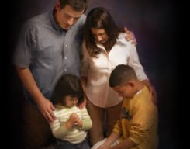

How can we carry out this work of leading our children to the New Earth?
Praying every day and studying the Bible together so that God will do his work in us and in our children.
The reward is great, and it's worth the effort here to see our kids there.
“But thus saith the LORD, Even the captives of the mighty shall be taken away, and the prey of the terrible shall be delivered: for I will contend with him that contendeth with thee, and I will save thy children”
(Isaiah 49:25)

