Slide 1

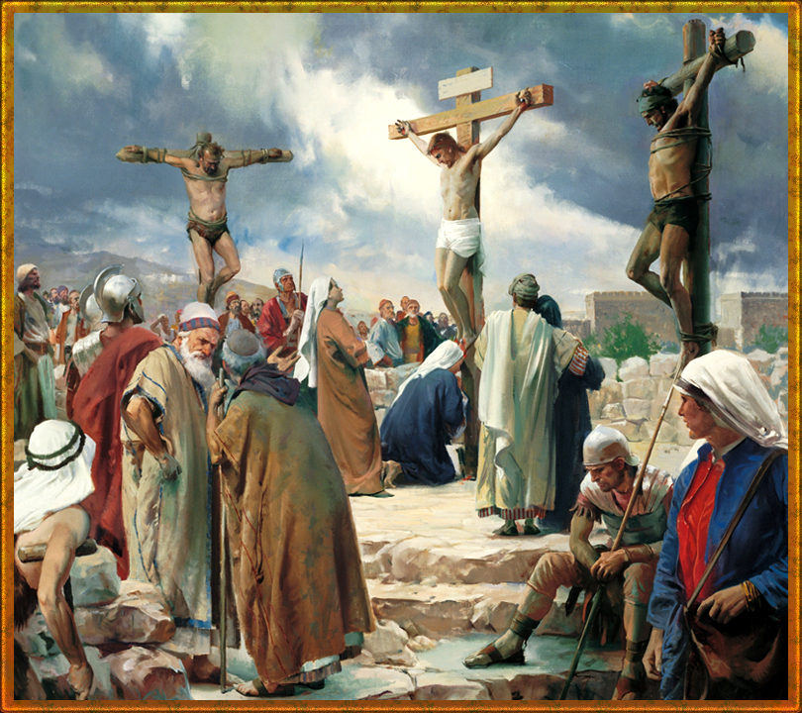


Slide 2

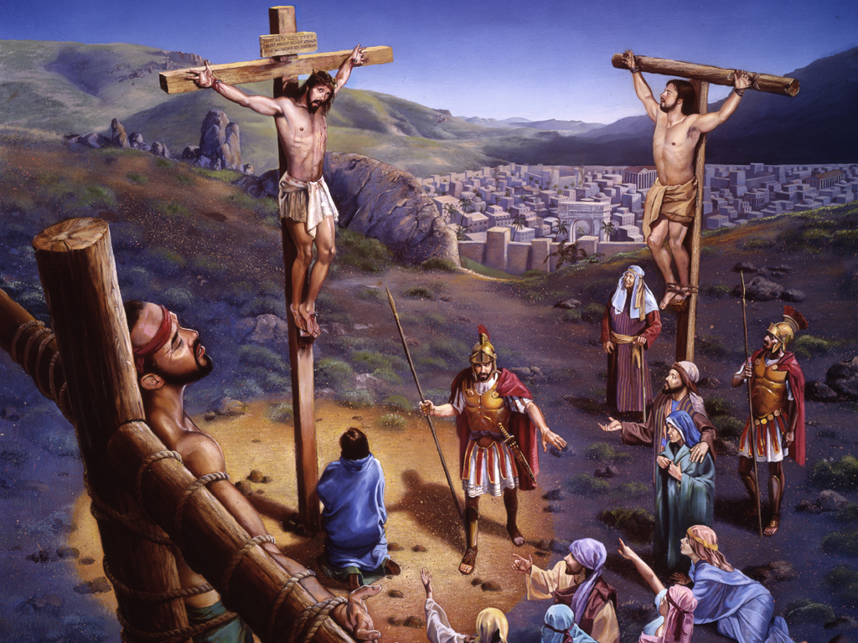
“And he bearing his cross went forth into a place called the place of a skull, which is called in the Hebrew Golgotha: Where they crucified him, and two other with him, on either side one, and Jesus in the midst.” (John 19:17-18).
Several people or groups of people attended Jesus' crucifixion. What attitude did they have toward Jesus? What decisions did they make? Did witnessing the crucifixion change their life at all?

Slide 3

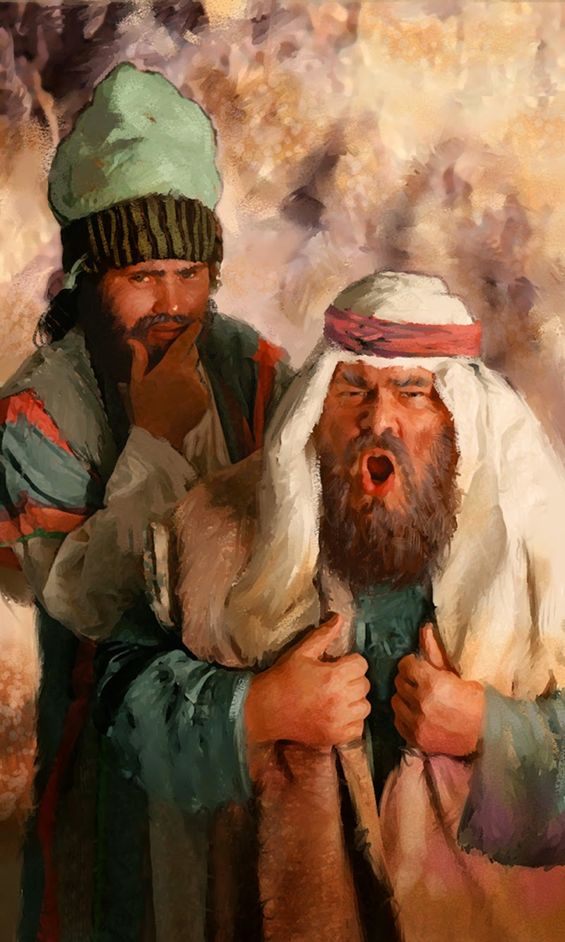

Throughout His earthly ministry, Jesus was beset with criticism, ridicule, and vilification of the worst kind. His every act was misinterpreted by His detractors, who wanted to instill doubt and unbelief in His believers. All this was the work of the religious leaders of the day, who hid their criminal hatred for Jesus under a cloak of superficial holiness. Jesus dedicated His whole life to sowing love in the hearts of His hearers, in the hope that the seed of faith and hope would germinate. The battle between good and evil raged throughout His life and revolved dramatically around His person. He was slandered and criticized by His enemies, who eagerly awaited the moment when they could catch Him and take His life. They finally achieved their goal and took him prisoner before Annas and Caiaphas, who represented the religious authority of their time, to be tried by them. The whole truth was on Jesus' side. The arguments that were raised against Him were totally superfluous and lying. He knew that if He spoke He could clearly demonstrate the falsity of the accusations against Him, but he was also aware that His accusers were determined not to accept the truth; On the other hand, it was evident that they wanted to poison the populace against Him. The attitude that Christ displayed at that time had been foretold by the prophet Isaiah centuries earlier when he said: "He was oppressed, and he was afflicted, yet he opened not his mouth: he is brought as a lamb to the slaughter, and as a sheep before her shearers is dumb, so he openeth not his mouth." (Isaiah, 53:7).
REJECTIONS AND STRIFE

Slide 4
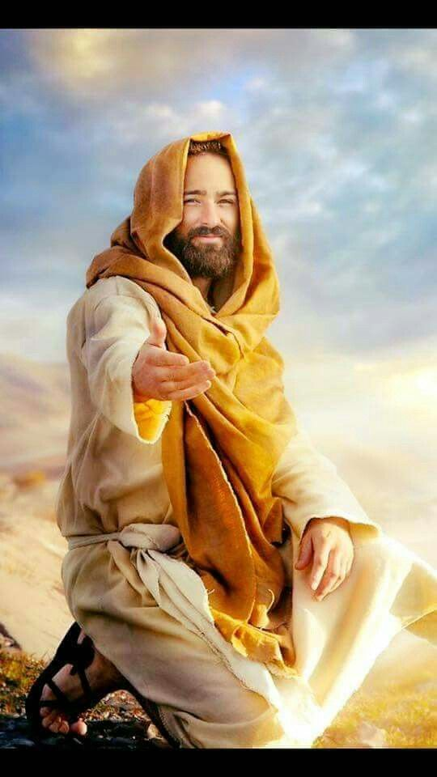
The final verdict of the Jewish court found Him guilty. But he declared, "And again, I say unto you, Ye shall henceforth see the Son of Man seated at the right hand of the power of God, and coming in the clouds of heaven" (Matt. 26:64). The rejection of the leaders brought about the national ruin of the people whom he came to save: their sin overtook them. For believers, Jesus' declaration to His enemies gives us confidence for the present and for the future. Accepting His loving invitation means finding a reason to live. He calls our hearts and invites us to be part of His great family, which will receive eternal life and a renewed earth where pain, wickedness, and death will never meet.
Christ expects us to receive Him as the Savior and Lord of our lives to give us that peace that only He can bring and that our suffering souls so desperately need. To receive Jesus as our Savior is to have it all; to reject Him is to be left adrift and finally lose everything. Christ expects different treatment from us than He received from the religious leaders of His day. We have to make the most transcendental decision we can make. Meanwhile, Jesus remains expectant.
REJECTIONS AND STRIFE

Slide 5


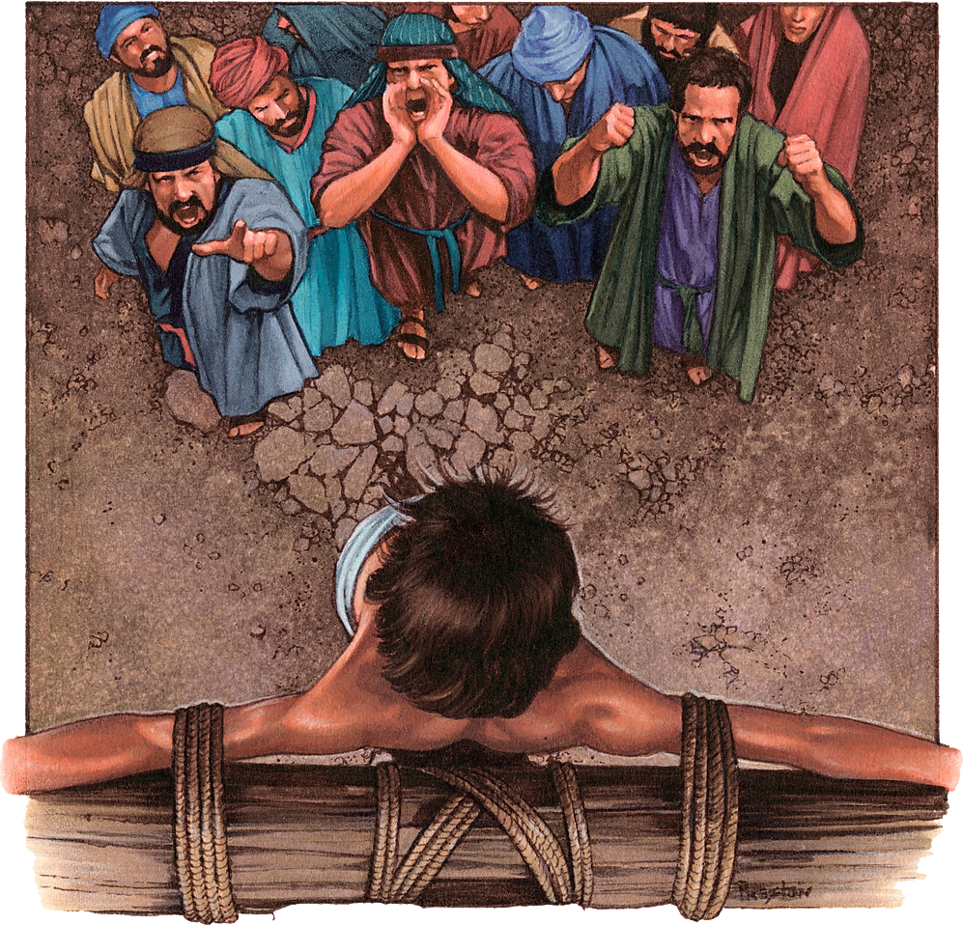
Some people did not join in the taunts of the mob because their sympathies were with Jesus; for they had felt His great sympathy and admirable power. They knew Him as their Savior because He had given them health of body and soul. However, most of the crowd around the cross mocked and despised Jesus: "And they that passed by railed on him, shaking their heads, and saying, Ah, thou that destroyest the temple, and buildest it in three days, Save thyself, and come down from the cross." (Mark 15:29-30). Some of those who days before had shouted hosannas as Jesus passed by, now mocked the Savior by letting themselves be carried away by the satanic spirit that dominated the mob. During the long hours of agony, Jesus endured the reviling, ridicule, mockery, and curses of the crowd.
MOCKERY AND CONTEMPT

Slide 6


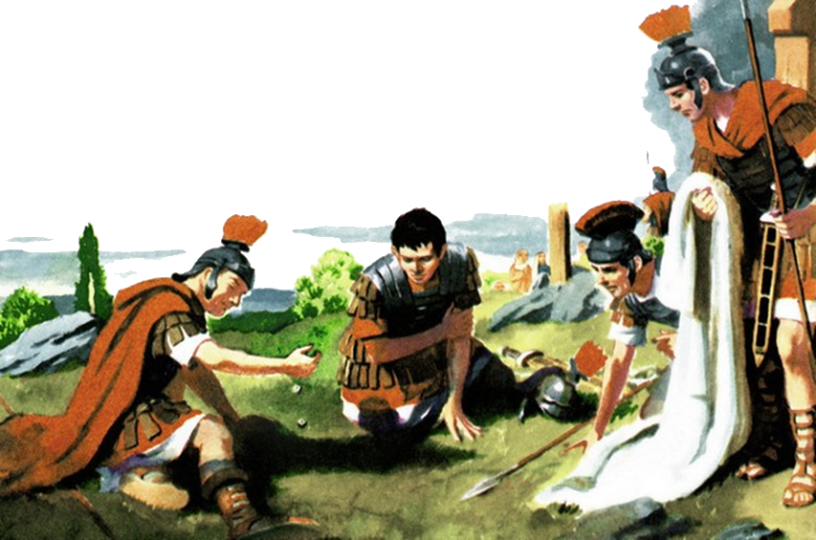
After Jesus' arrest, following Judas' infamous betrayal, the Savior had to appear before various Jewish authorities, and was eventually handed over to Roman soldiers to execute the death sentence. In his book entitled The Roman Soldier, the writer H. E. L. Mellersh describes the military of imperial Rome in these words: "The job of a soldier is to kill, but in the case of the Roman soldier, it was often to kill in a vile and despicable way." This obviously explains the horrific and cruel handling of Jesus at the hands of His executioners.
It was the Roman soldiers who mercilessly whipped Him, girded His temples with a crown of sharp thorns, and mocked Him, scorned Him and ridiculed His claims to Divine kingship. Then, on the painful road to Calvary, they rejoiced in scourging Him again and again until He fell repeatedly under the weight of the cross. And when they came to the place of crucifixion, without mercy, they pierced His hands and feet with thick nails. All this was done with ostensible and cruel indifference, to the point that while Jesus was dying on the cross, they cast lots by disputing His clothes (Matthew 27:35).
As we read and think about the cruelty of the Roman soldiers to Jesus, we experience an inevitable sense of intense repudiation of such abusive and inhumane treatment. But we must not forget that, because of our sins, we too are guilty of Jesus' crucifixion. Like the Roman soldiers, we have all crucified Him. This being so, we must all humbly and lovingly seek the forgiveness of the Divine Savior, accepting Him as such, in order to enjoy the peace and ineffable joy of eternal and free salvation.
CRUELTY AND INDIFFERENCE

Slide 7


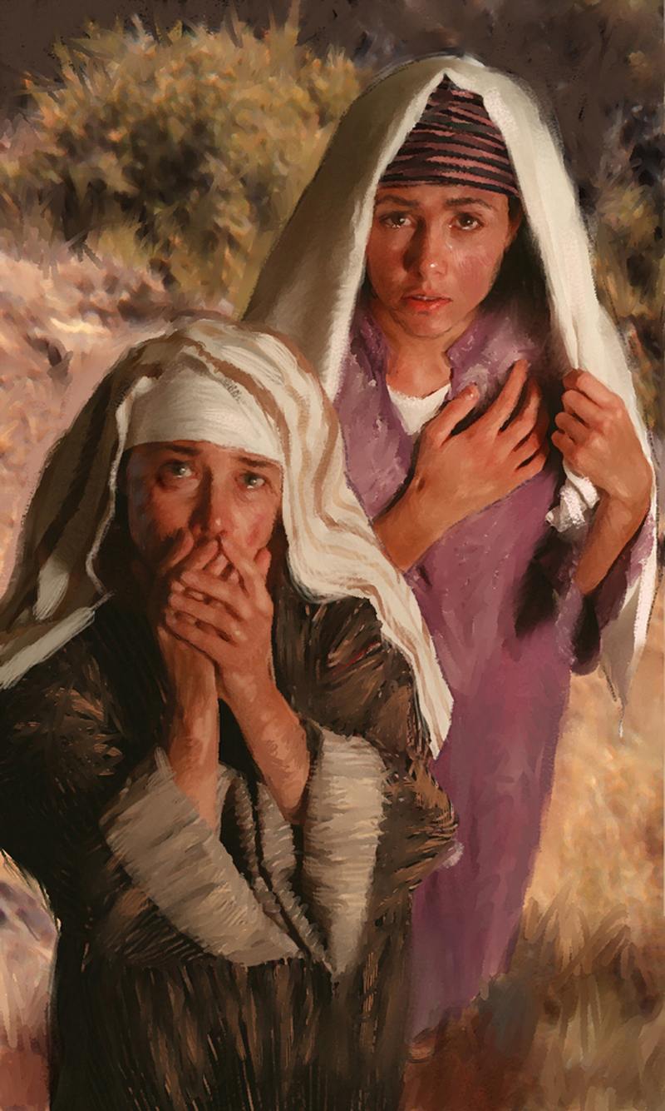
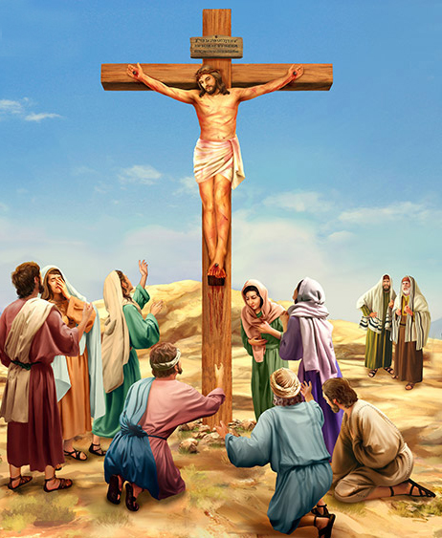
Stop for a moment and look towards Calvary... if you look into the distance, you will see the physical darkness that surrounds you (Matt. 27:45), but if you get closer you will see the spiritual darkness that envelops all who have allowed themselves to be controlled by hatred. There are the religious leaders blinded by their own traditions; the ungrateful crowd that wants the death of the one who has done them so much good; the centurion and the sadistic Roman soldiers, representatives of the powerful empire that dominates Israel.
But get a little closer... Look at the foot of the cross. Everything is different there! There is no darkness there. Why? you ask. There is love there, and true love casts out the darkness of fear (1 John 4:18). There, at the foot of the cross, are the pious women who, although confused and plunged into deep sorrow, have followed Jesus to Calvary. From the physical point of view they cannot do anything for Him; yet they are lavishing on Him what He most needs in His hour of infinite agony; They are showering Him with love.
LOVE AND COMPASSION

Slide 8
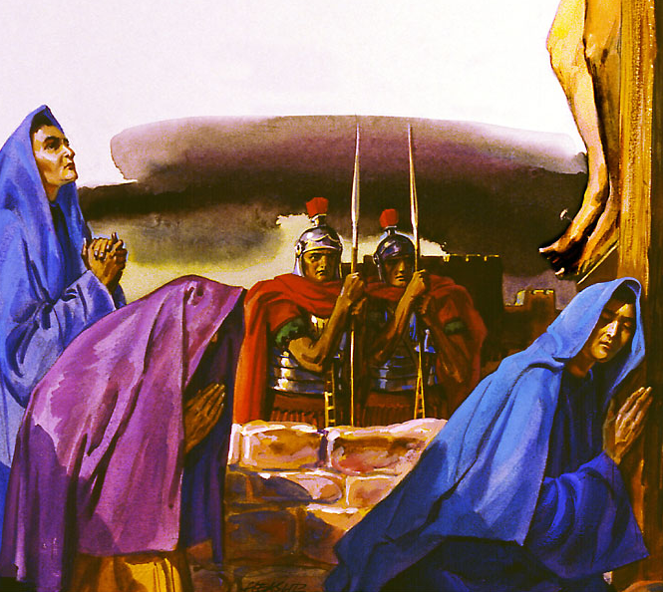
And who are these women (Mark 15:40; Matthew 27:56; John 19:25)? Salome, who ahead of her time claimed her "rights" and made a bold request to Jesus (Matt. 20:20-21). Mary Magdalene, the great forgiven sinner, who out of gratitude anointed Jesus with an expensive perfume (Jn. 12:3). Mary, the wife of Clopas, who like many women of her time – and of any era – is little recognized. All that is known about her is that she is there facing danger.
And of course, there is also the one who a little more than thirty years earlier received ridicule and scorn for carrying in her womb the “Miracle of miracles": the Baby whose father was of heavenly origin. The sweet and good Mary, who, although she did not fully understand the mission of her Son, dedicated the best of her life to Him. There she is with her bleeding heart and her arms outstretched. The same arms that lulled her Little One and delivered Him from danger, now try to touch and ease the sufferings of her mocked Son. Although many of the frightened disciples abandoned their Master, these women have decided to be with Him until the end. They are not afraid of what may happen to them. The love forged between them and Jesus pierces the portals of fear. Do you possess the love that radiated Calvary? If the women of the past possessed it, you can have it too. Open your heart and let the loving Jesus fill it with love, then everyone will know that you not only looked up to Calvary, but that, like Mary and the other women, you gave your love to the Savior there, at the foot of the cross.
LOVE AND COMPASSION

Slide 9


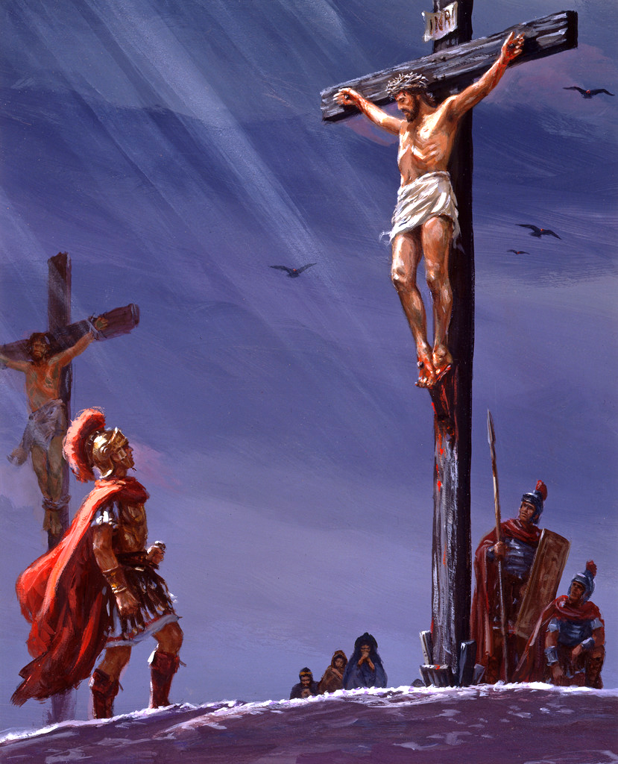
At Calvary, more than one person had the opportunity to change their mind about Jesus and exercise new faith in Him in the course of just a few hours. The Roman Centurion was one of these. The Centurion beheld Jesus and what he saw made him believe in Him as the Savior of the world. It was his newfound faith that prompted him to say, "Truly this was the Son of God" (Matt. 27:54). The centurion was the officer in charge of carrying out the order of crucifixion and of preventing and controlling any disturbance in the crowd of spectators. Perhaps he watched Jesus carrying the heavy cross on the Via Dolorosa and saw his own soldiers hammer the nails that pierced the Lord's hands and feet. Perhaps he felt sadness for what he saw and for the mercy and truth expressed in the face of the Divine Suffering. The fact is that he was impressed with the bearing and words of the dying Savior. He noted His humility, His willingness to forgive His enemies, His patience, and His cry for victory proclaimed just before He died, "it is finished" (John 19:30). His faith grew as a result of contemplating the Son of God, and his words were evidence that Jesus' redemptive work would not be in vain. Christ's atoning death provides the basis for the salvation of mankind (Col. 1:20), but faith is the condition for this salvation. We cannot have salvation without the Savior. We cannot obtain the gift of life without the Giver of that gift. Eternal life is not a gift from Jesus to us, but Jesus Himself is the gift.
FAITH AND SALVATION

Slide 10


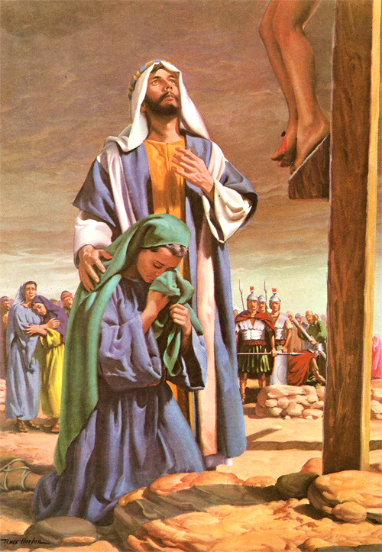
COMFORT AND FIDELITY
Of all the disciples, John was the only apostle who stood at the foot of the cross. Mary, the mother of Jesus, had turned away from the cross because she could not bear the sufferings of her Son. But she could not remain far from Him. So, when John saw that the end was near, he took Mary and accompanied her again to the foot of the cross to be with her Son at those critical moments. At the moment of death, Christ remembered His mother. Looking at her sorrowful face and then at John, He said, "Woman, behold your son," and then to John, "Behold your mother." "John well understood the words of Jesus, and the sacred trust which was committed to him. He immediately removed the mother of Christ from the fearful scene of Calvary. From that hour he cared for her as would a dutiful son, taking her to his own home. " DG 56.5 In this way, John was a comfort to Mary, and, at the same time, he received a great blessing, because he could continue to show his fidelity to the Master by taking care of her.

Slide 11


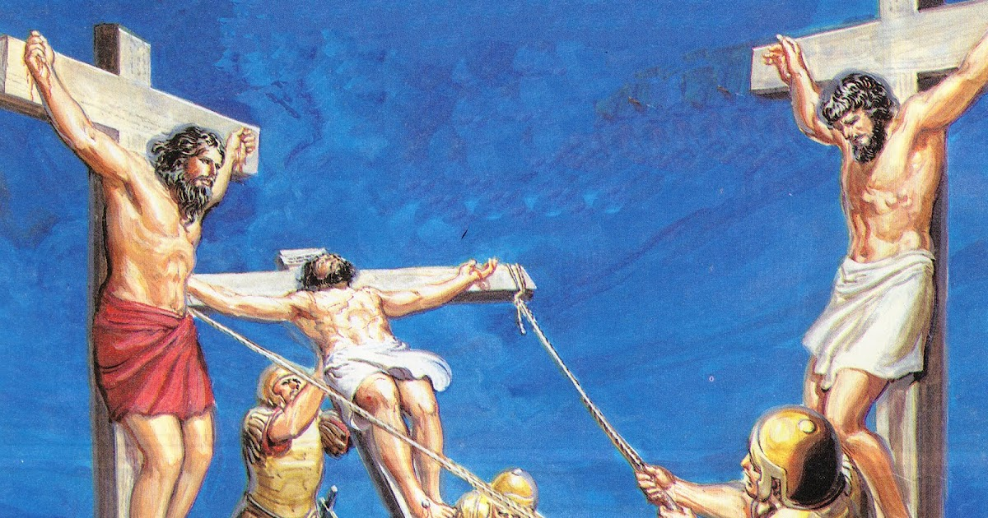
The way to the cross represented for many of those who participated in those disastrous events a crossroads between life and death. Here we have to meditate on the crossroads that was offered to the two criminals when they accompanied the Son of God in His same torture. These men had lived on the margins of society. For whatever reasons, both were executed for their crimes and were the only ones who deserved the punishment received by the three crucified that day on the Mount of the Skull. The executioners purposely placed the innocent Son of God between the two criminals to suggest that, of the three, Jesus was the greatest Criminal. But God was to use this blatant humiliation to place two souls, at the last moment of their lives, at the crossroads between eternal life and eternal death.
It is worth noting what happened shortly before the first evildoer spoke. The punishment of crucifixion was extremely cruel and painful.
They laid the prisoner on the cross in such a way that the arms were extended on both sides and then the nail passed through the wrist. Then the feet were nailed to the cross. We can imagine the screams of pain and the insults of the executed when the nails entered their bodies; and then, when the cross was raised and abruptly settled in the hole. Jesus had to endure not only the excruciating pain of all that torture in His own body, but the curses and shrieks of two souls for whom He was about to die. The sensitive heart of the Son of God felt deeply the suffering of these two sons of His.
ETERNAL DEATH AND ETERNAL LIFE

Slide 12
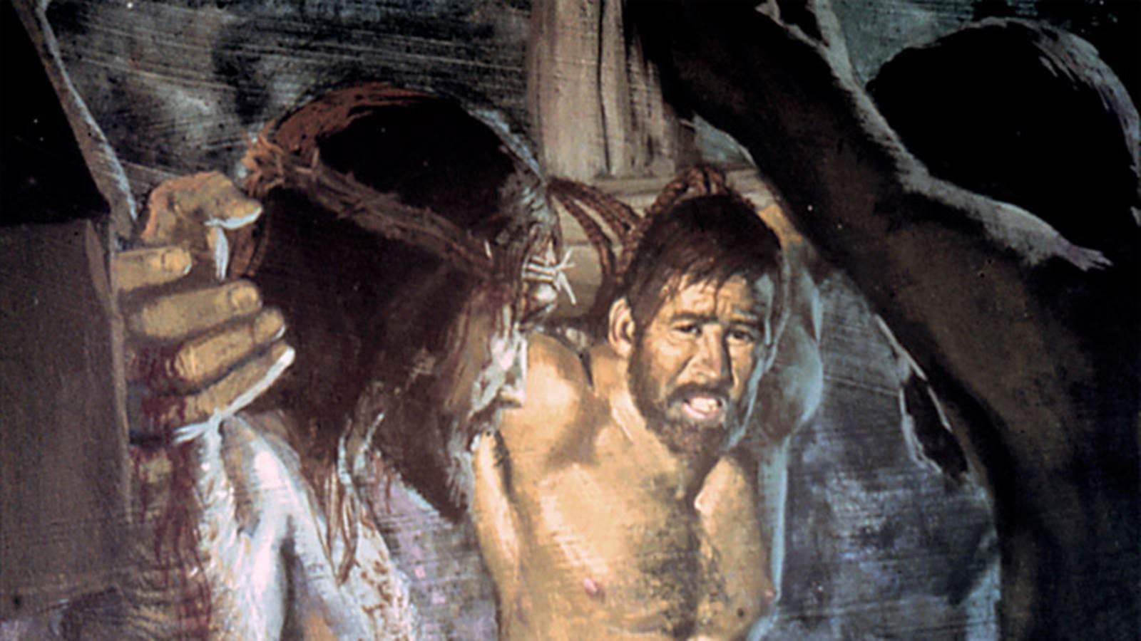
In Jesus' eyes, these two men were highly redeemable. He was about to die for the two of them and for the whole world. Because Christ's sacrifice was for ALL sinners. But the decision to accept that sacrifice was in the hands of each of them. And soon that crossroads, the moment of decision, was approaching for these thieves. On the one hand, the sweet words of Jesus' forgiveness resound in the ears of the two evildoers; on the other, the carnival of the jesters is heard. What would you expect in this difficult time? First the voice of the first evildoer is heard: "Are you not the Christ? So save yourself, and save us" (Luke 23: 39). This man reveals that he had at least heard of this Jesus who called Himself the Son of God, the Christ and Messiah. We don't know how much he knew about Jesus, but no one could have lived in Palestine without at least having heard of Him. The fact is that this man, at the crossroads, chose to think first of his own comfort and his own pain than of honoring the Son of God. He did not want to take the blame for what he had done, nor to confess his crime. He preferred to blame his misfortune on an innocent person. He was not condemned by his life badly lived, but by his inability and his unwillingness to acknowledge his sin before the clemency of Christ. Was it pride? Or was it the bad habit confirmed through a lifetime of blaming others for their own poorly made decisions? We do not know which of these obstacles prevented this man from accepting the offer of salvation. What we do know is that He did not choose to humble himself to confess his sin, not even at the time of his death.
ETERNAL DEATH AND ETERNAL LIFE

Slide 13
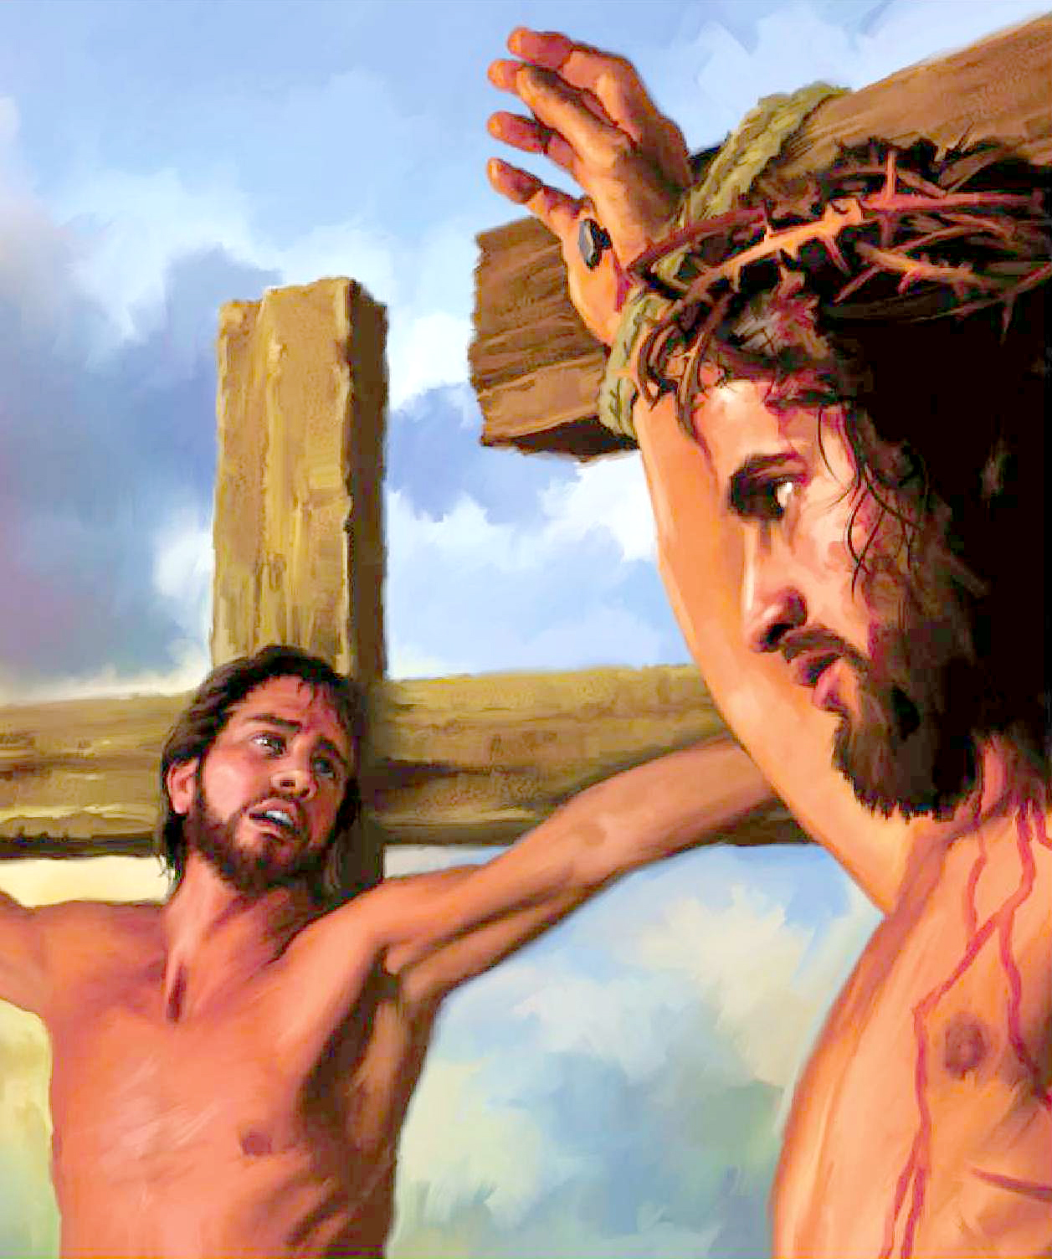
ETERNAL DEATH AND ETERNAL LIFE
The second thief let the Holy Spirit convince him of Christ's innocence, beauty, and nobility. Moved by his remorse, he turns to Jesus, filled with a new vision of himself: " Lord, remember me when thou comest into thy kingdom" (Luke 23:42). Even that, this man knew—that Christ Jesus had a kingdom that was not earthly and that He would come to rescue those who believe in Him. The penitent thief received from Jesus some words that served as immense encouragement in his terrible physical pain: "Verily I say unto thee, Today shalt thou be with me in paradise." (Luke 23: 43). What did this promise consist of? The same thief had recognized moments earlier that salvation would come with the coming kingdom of Christ Jesus: "Remember me when you come into your kingdom." This man longed for that glorious moment when the innocent dying man, whom he now looked at with pleading eyes, would return in glory surrounded by His angels as King of kings and Lord of lords. His faith, strengthened by his confession and by the Holy Spirit who now overwhelmed him, grasped that moment as if it were a reality, and that realization filled him with an inexpressible hope in this last trance of his life. You too have to make a decision either for life or for death in the face of what Jesus has done on your behalf. Choose life.

Slide 14


ACCEPTANCE, TRUST, SURRENDER, OBEDIENCE …
Everyone who attended the crucifixion made short- or medium-term decisions. One thief decided to accept Jesus and the other rejected Him. The centurion believed in Jesus. The leaders of the people hardened their attitude toward Jesus and His disciples more and more, persecuting the church until divine patience was exhausted in the martyrdom of Stephen.
And you? What decision do you make before the cross?
"Before the cross the sinner sees his unlikeness of character to Christ. He sees the terrible consequences of transgression; he hates the sin that he has practiced, and he lays hold upon Jesus by living faith. He has judged his position of uncleanness in the light of the presence of God and the heavenly intelligences. He has measured it by the standard of the cross. He has weighed it in the balances of the sanctuary. The purity of Christ has revealed to him his own impurity in its odious colors. He turns from the defiling sin; he looks to Jesus, and lives. " TSB 108.3

