Slide 1
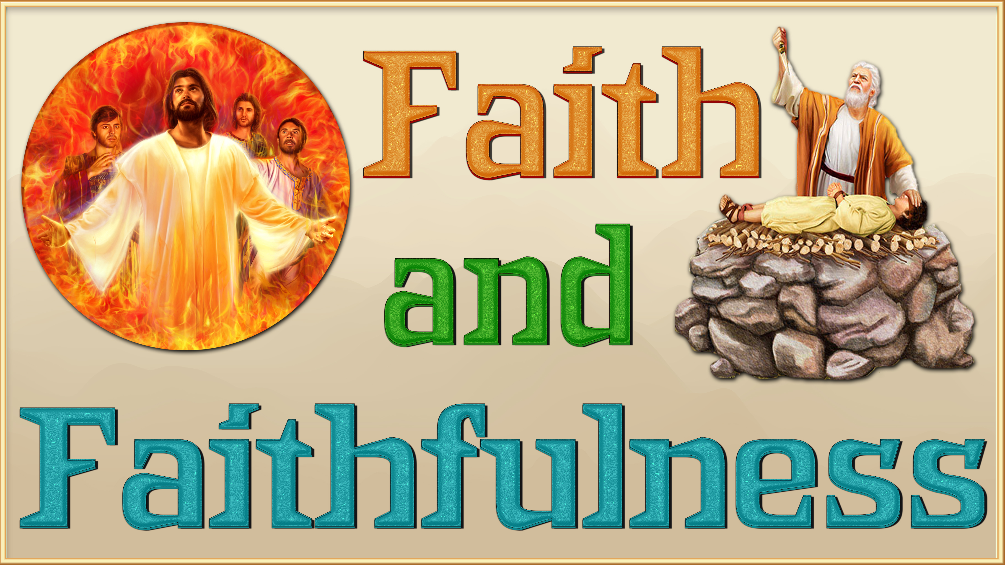

Slide 2


Hebrews 11 is called the "chapter of faith," or "gallery of faith." It highlights biblical characters who lived as pilgrims, trusting in eternal and non-earthly promises. It is a call to faithfulness, obedience and perseverance in the midst of difficulties. What is faith? The apostle Paul answers it in verse 1: "Faith is the substabce of things hoped for, the conviction of things not seen." He goes on to tell us in verse 6, "But without faith it is impossible to please God; for he who comes to God must believe that he is, and that he is a rewarder of those who diligently seek him." In this presentation we are going to remember people who manifested their faith, what actions led them to realize that faith and a personal application.
“Faith is trusting in God,—believing that He loves us, and knows what is for our best good. Thus, instead of our own way, it leads us to choose His way. In place of our ignorance, it accepts His wisdom; in place of our weakness, His strength; in place of our sinfulness, His righteousness. Our lives, ourselves, are already His; faith acknowledges His ownership, and accepts its blessings. Truth, uprightness, purity, are pointed out as secrets of life’s success. It is faith that puts us in possession of these. Every good impulse or aspiration is the gift of God; faith receives from God the life that alone can produce true growth and efficiency.”— Gospel Workers 259

Slide 3


By faith we mean that the universe was constituted by the word of God, so that what is seen was made of what was not seen. (v. 3) [Genesis 1]
I believe that God made the universe and sustains it.
Notes:
Creó que Dios creó el universo y lo sustenta.

Slide 4

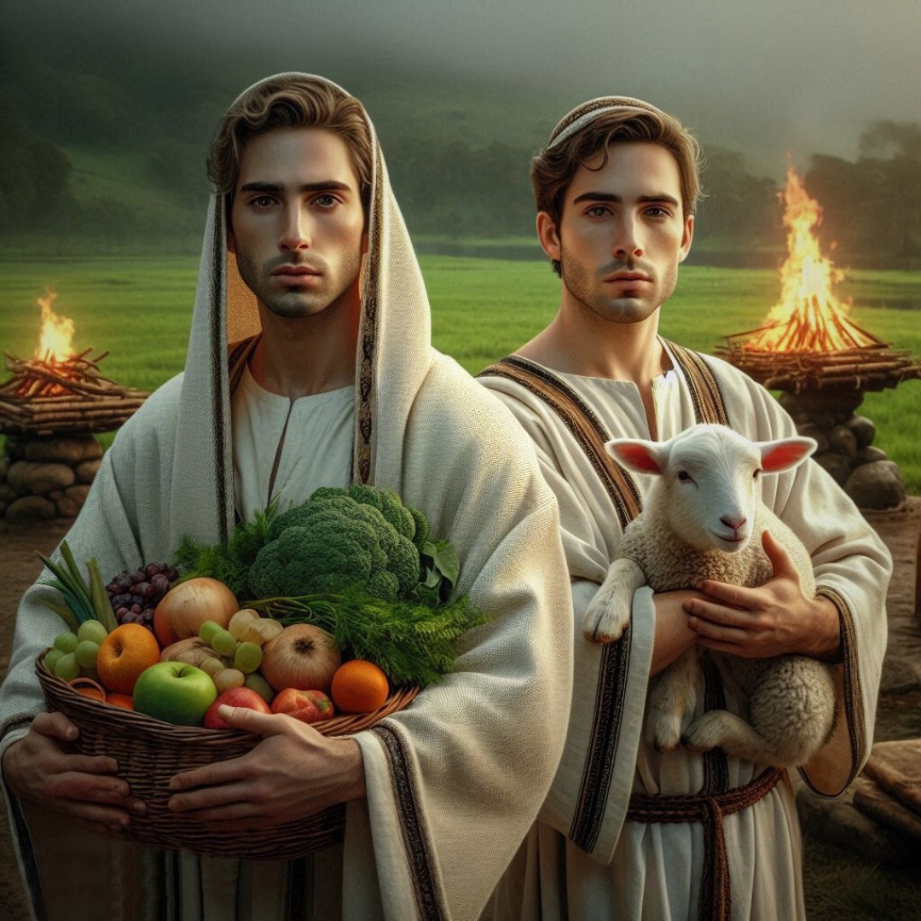
By faith, I follow God's instructions
By faith ____ offered to God a more excellent sacrifice than Cain, by which he obtained witness that he was righteous, God testifying of his gifts: and by it he being dead yet speaketh. (v. 4) [Genesis 4:2-8]
Abel
Notes:
Obedezco, obedezco, obedezco

Slide 5

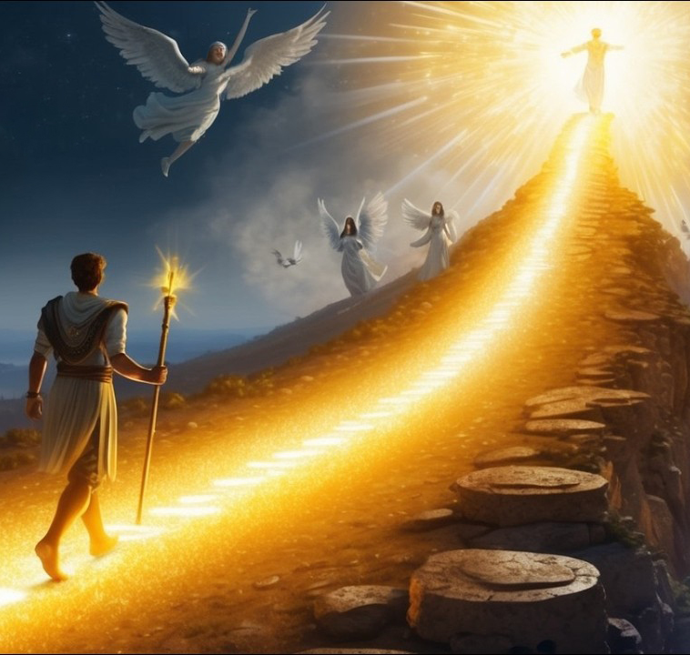
My goal in this life is to please God and walk with Him
By faith______ was translated that he should not see death; and was not found, because God had translated him: for before his translation he had this testimony, that he pleased God.
(v. 5) [Genesis 5:24]
Enoch
Notes:
Mi meta en esta vida es agradar a Dios y caminar con Él

Slide 6

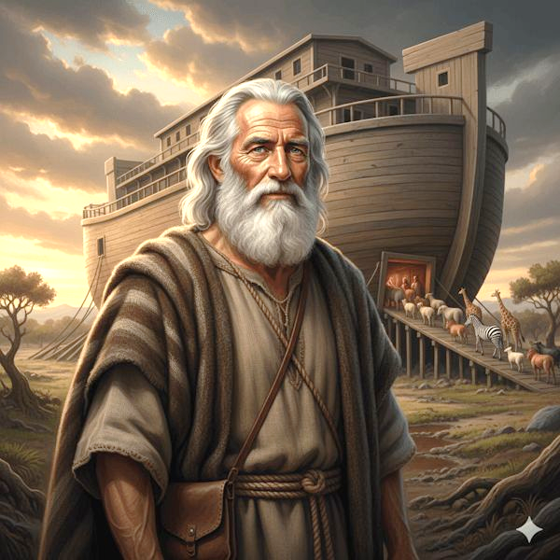
Even if something is impossible, if God has said it will happen, I believe it and act accordingly.
Noah
By faith ____, being warned of God of things not seen as yet, moved with fear, prepared an ark to the saving of his house; by the which he condemned the world, and became heir of the righteousness which is by faith. (v. 7) [Genesis 6]
Notes:
Aunque algo sea imposible si Dios ha dicho que sucederá yo lo creo

Slide 7

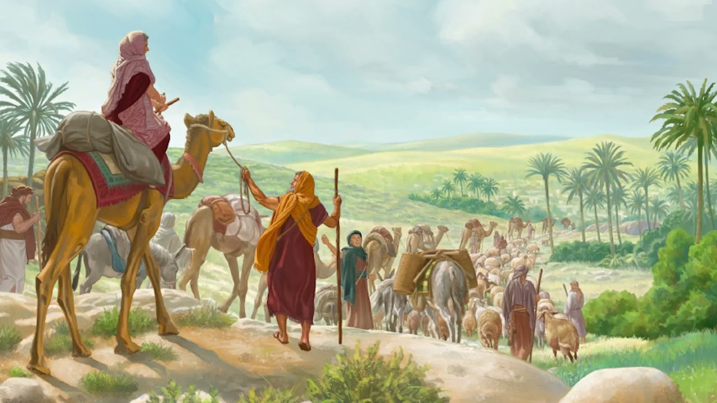
I do not look at the present, but at the glorious future that God is preparing for me
Abraham
By faith _________ sojourned in the land of promise, as in a strange country... For he looked for a city which hath foundations, whose builder and maker is God. (v. 8-10) [Genesis 12:1-4]
Notes:
No miro el presente sino el futuro glorioso que Dios me está preparando

Slide 8

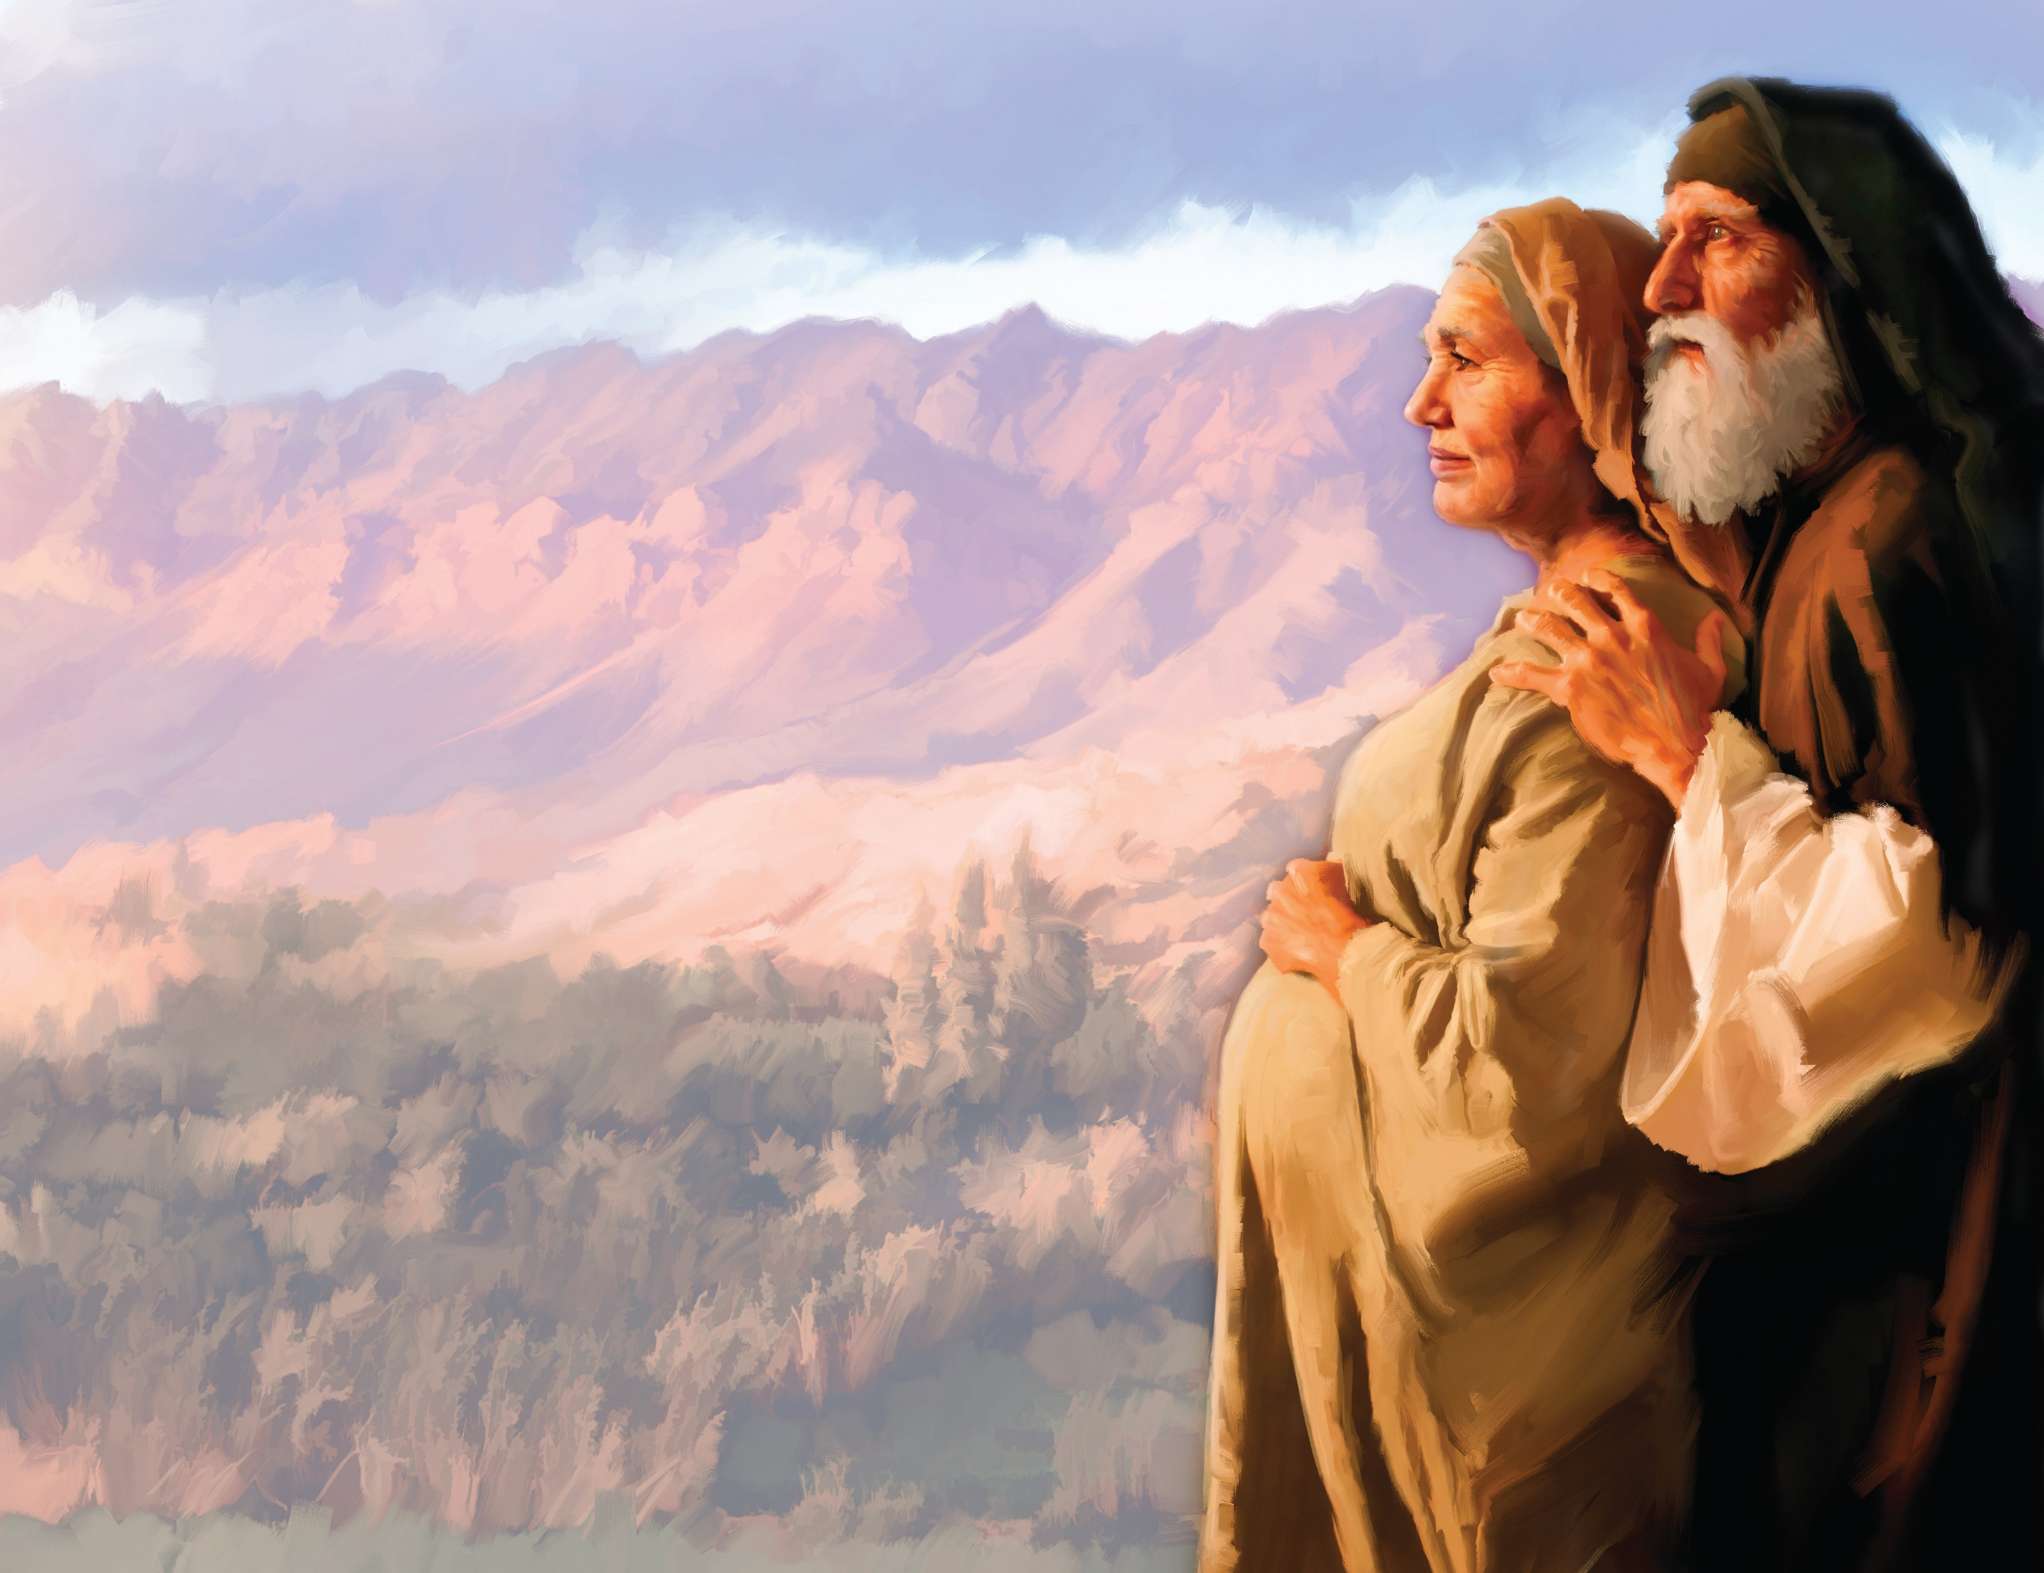
I believe in their promises, even if they take a long time to be fulfilled.
Through faith also _____ herself received strength to conceive seed, and was delivered of a child when she was past age, because she judged him faithful who had promised. (v. 11) [Genesis 21:1-7]
Sarah
Notes:
Creo en sus promesas por más que tarden en cumplirse

Slide 9

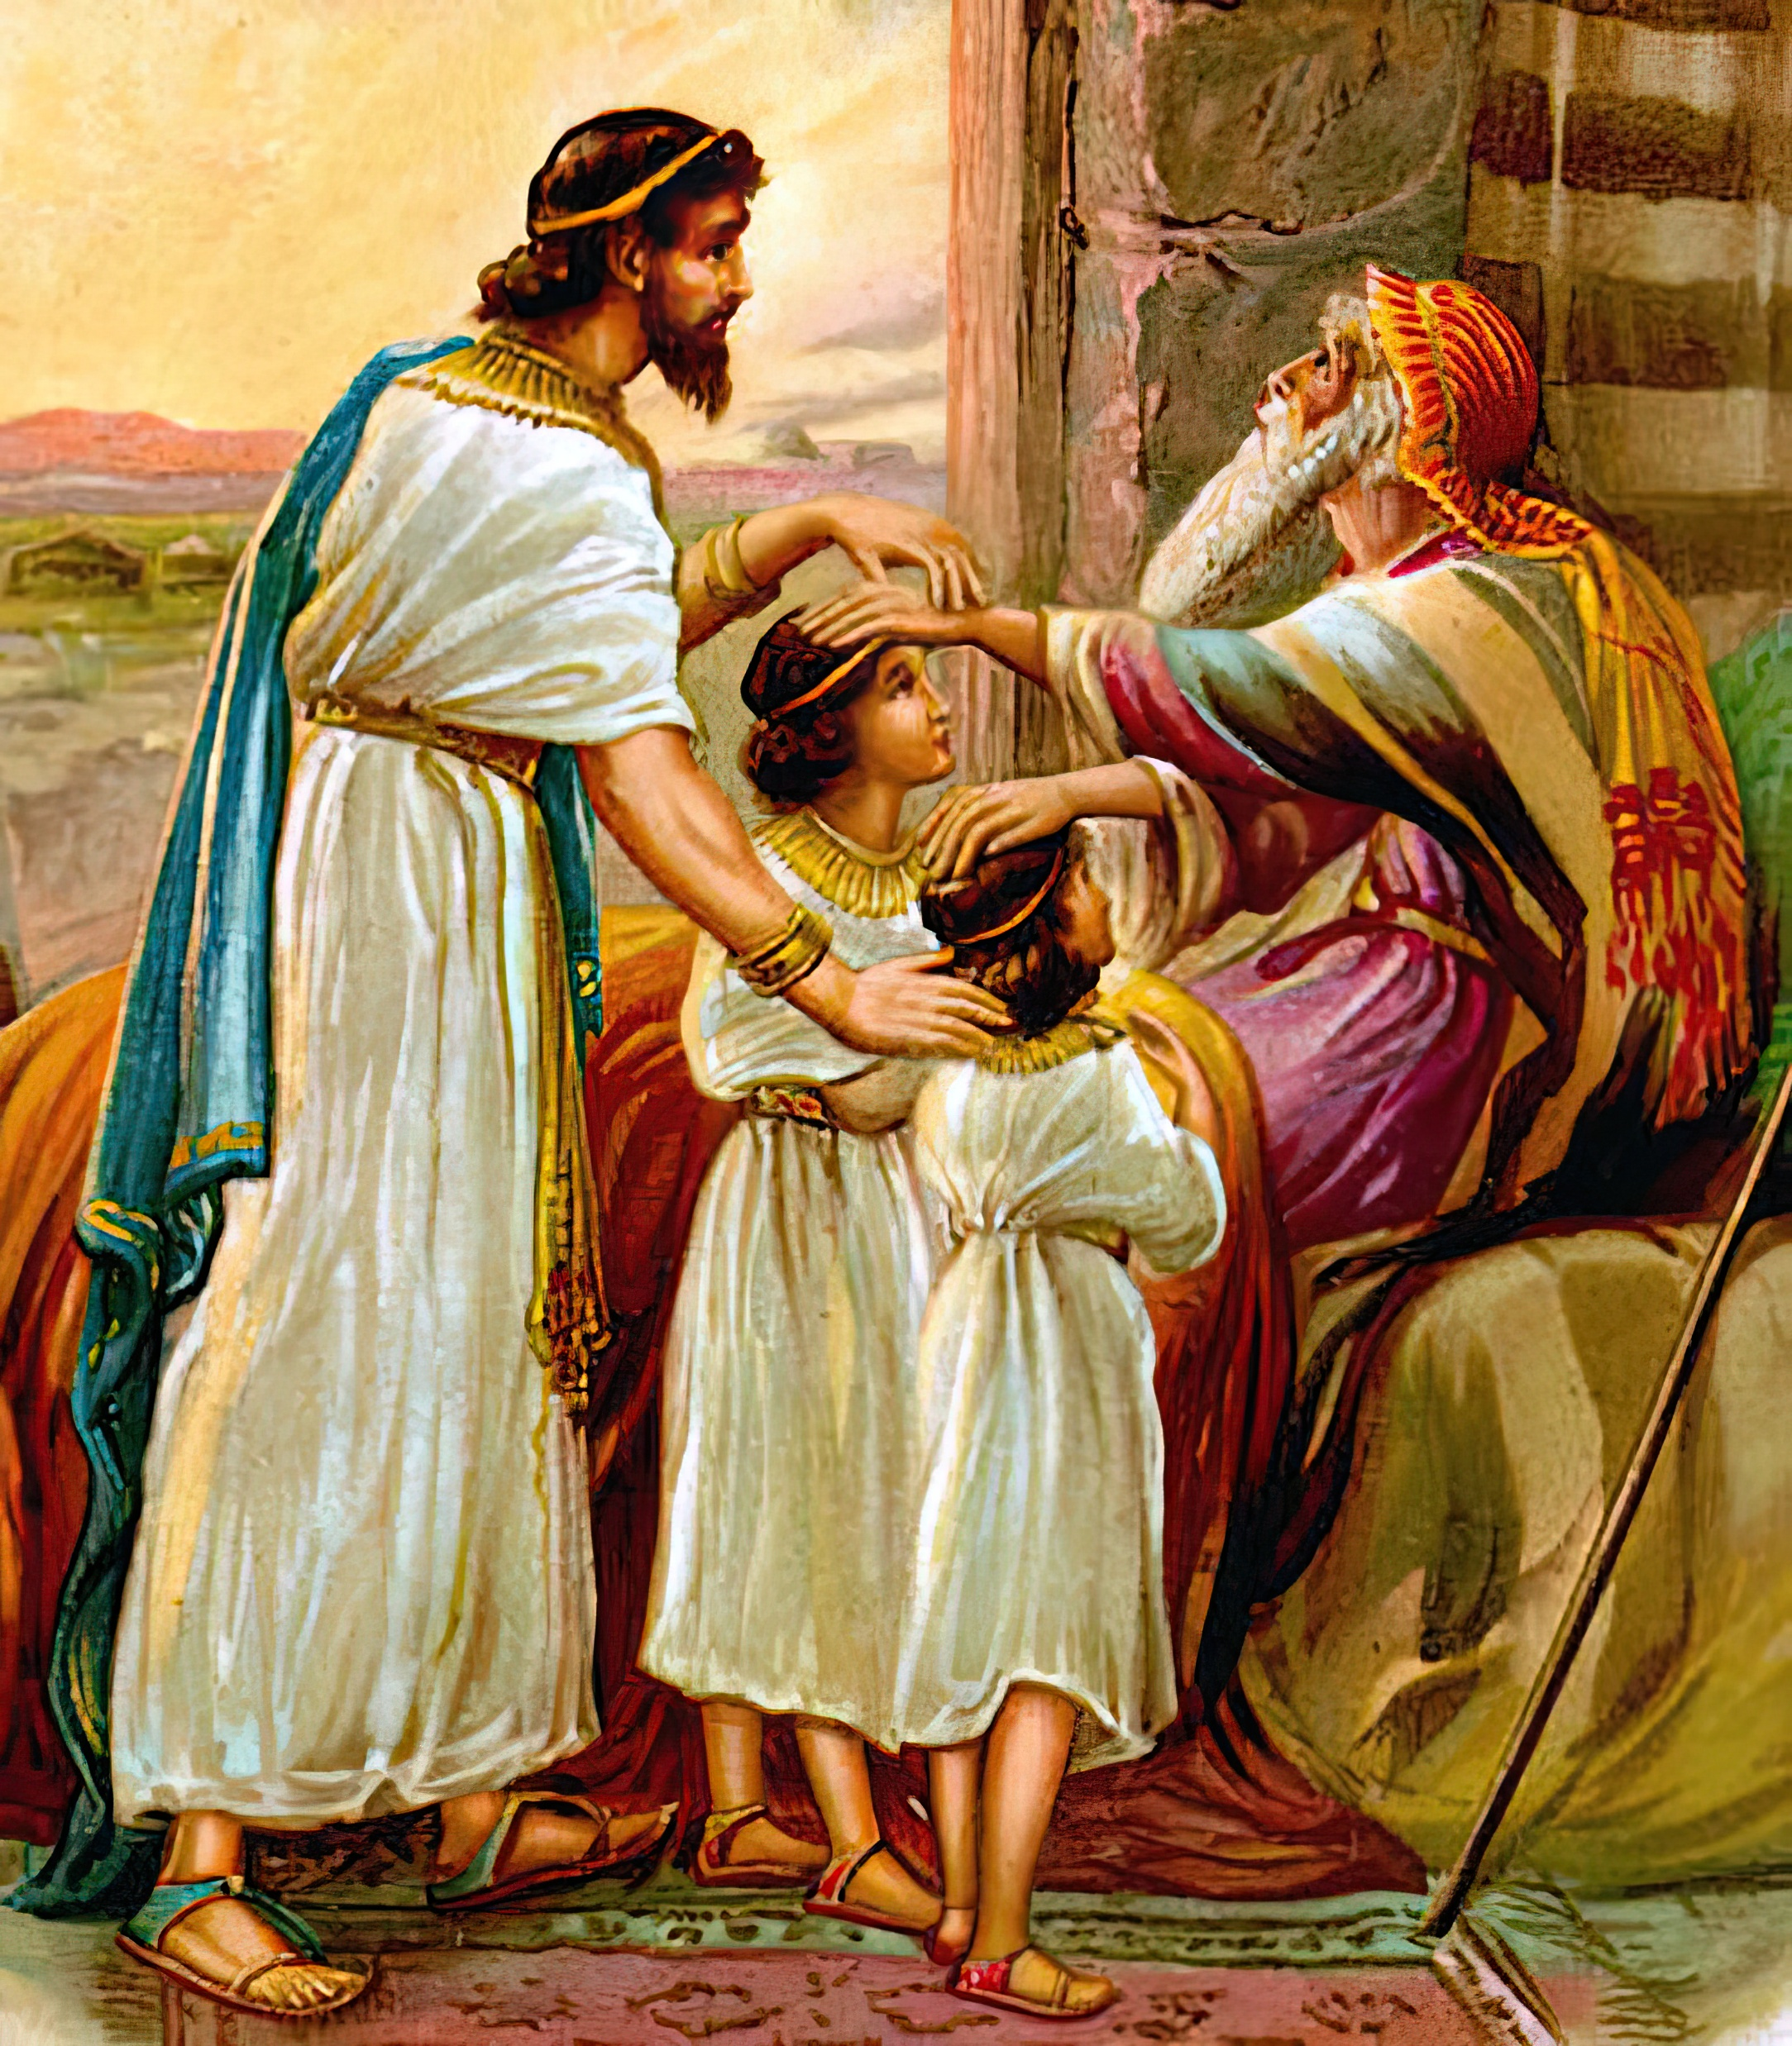
I worship God and bless, even when I am about to die.
Jacob
By faith _____, when he was a dying, blessed both the sons of Joseph; and worshipped, leaning upon the top of his staff. (v. 21) [Genesis 48:8-20]
Notes:
Adoro a Dios aun cuando estoy a punto de morir

Slide 10

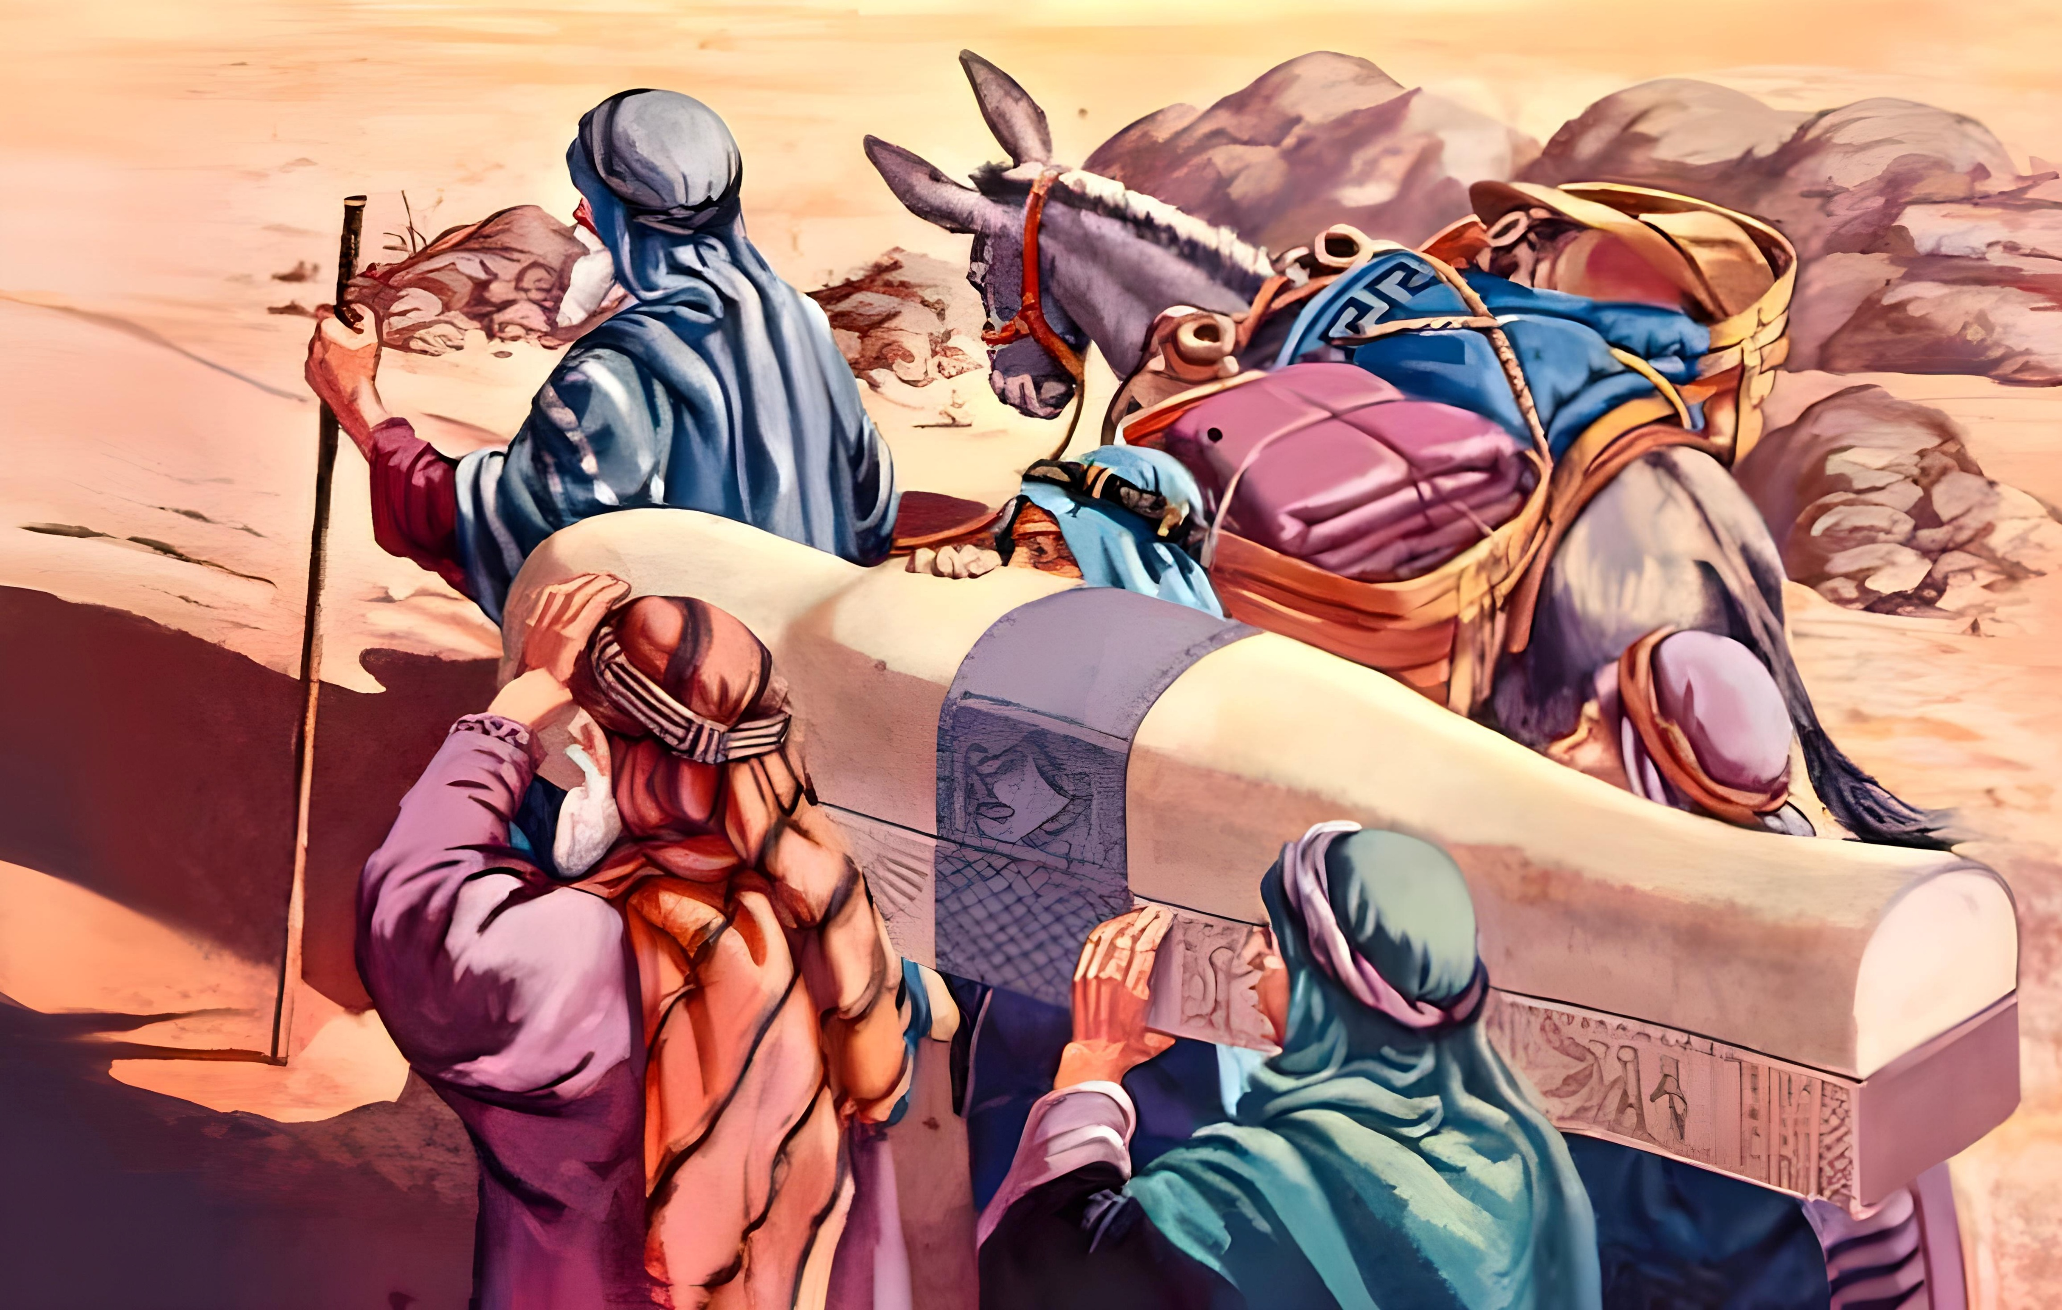
By faith_______, when he died, made mention of the departing of the children of Israel; and gave commandment concerning his bones. (v. 22) [Genesis 50:25-26]
Joseph
I leave testimony to the following generations of the assurance that God will come to set us free.
Notes:
Creo que lo que Dios ha dicho se cumplirá

Slide 11

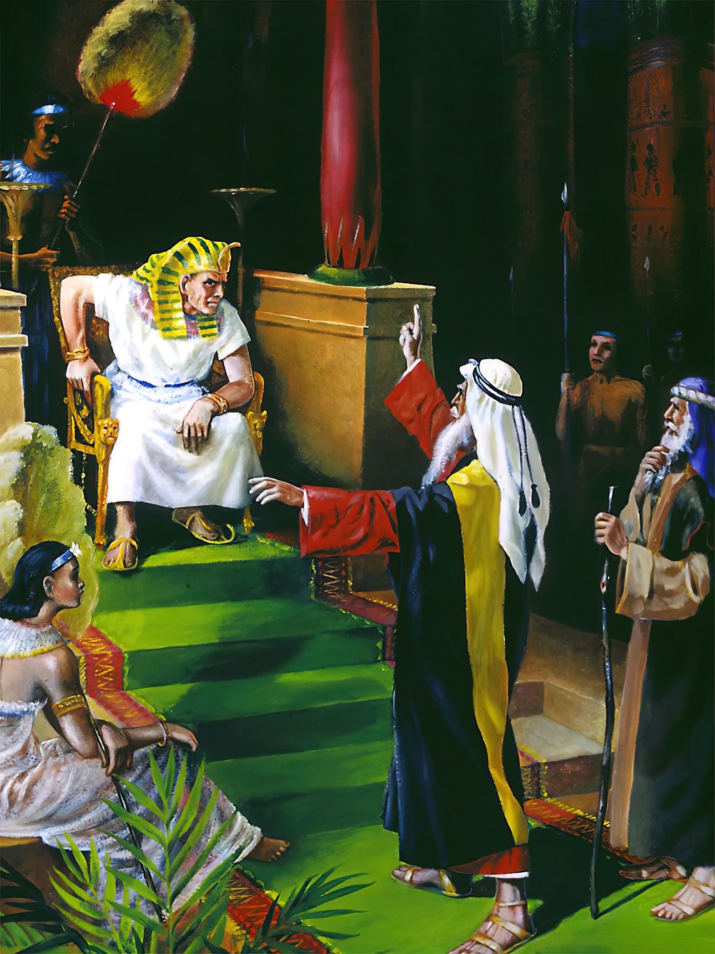
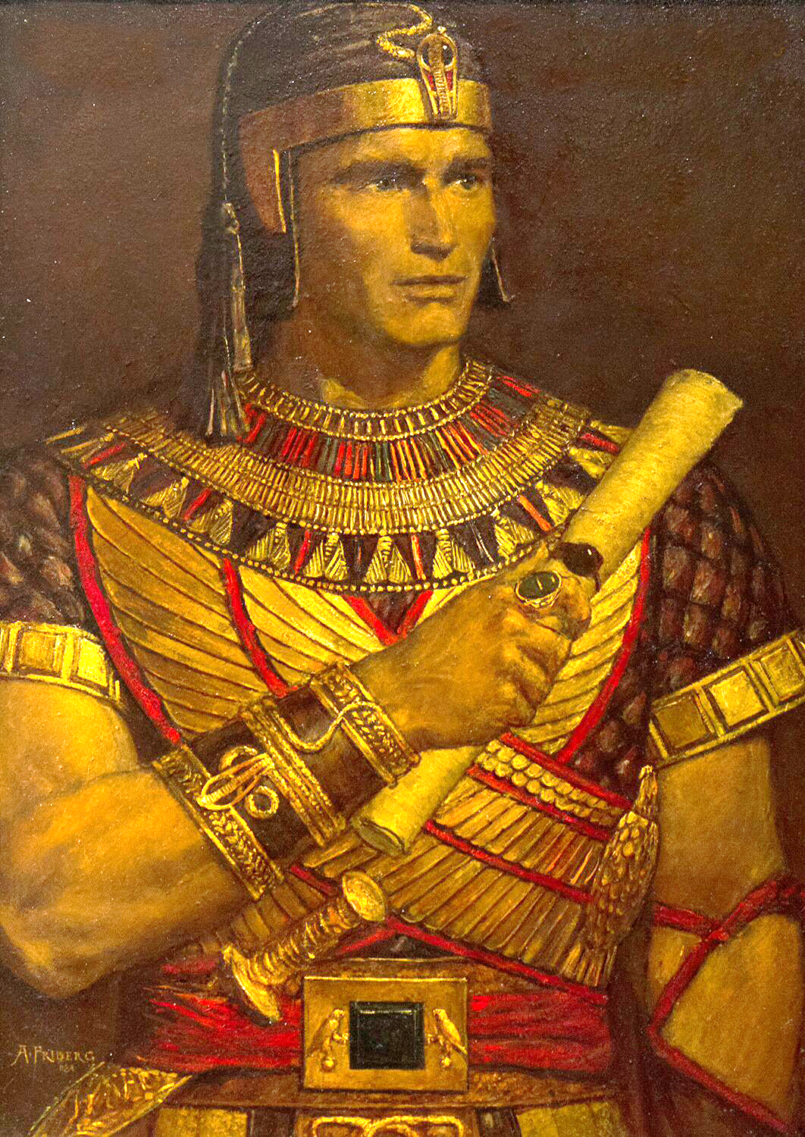
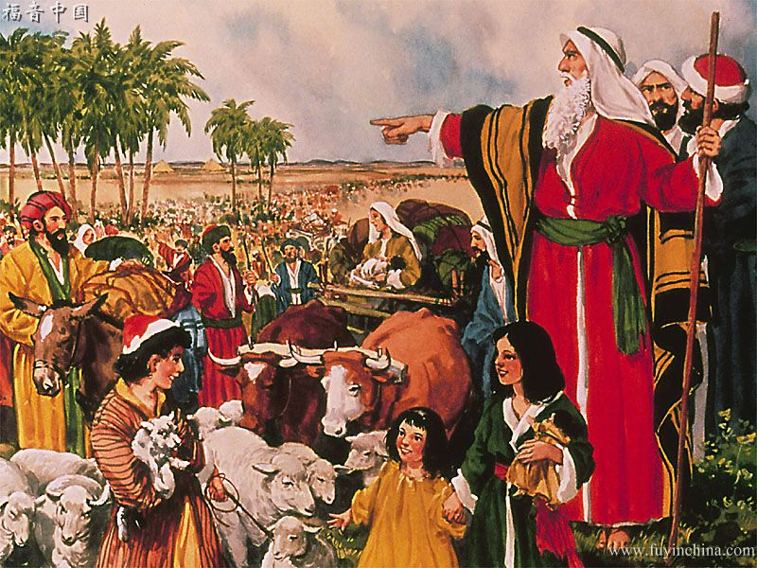
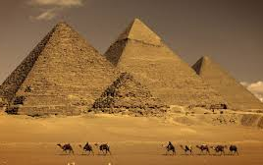
I reject worldly honors and glories, and I choose to be part of God's people.
Moses
By faith, ______ when he was come to years, refused to be called the son of Pharaoh's daughter; Choosing rather to suffer affliction with the people of God, than to enjoy the pleasures of sin for a season; Esteeming the reproach of Christ greater riches than the treasures in Egypt: (vv. 24-27) [Exodus 5:1]
Notes:
Rechazo los honores y glorias mundanas por ser parte del pueblo de Dios

Slide 12

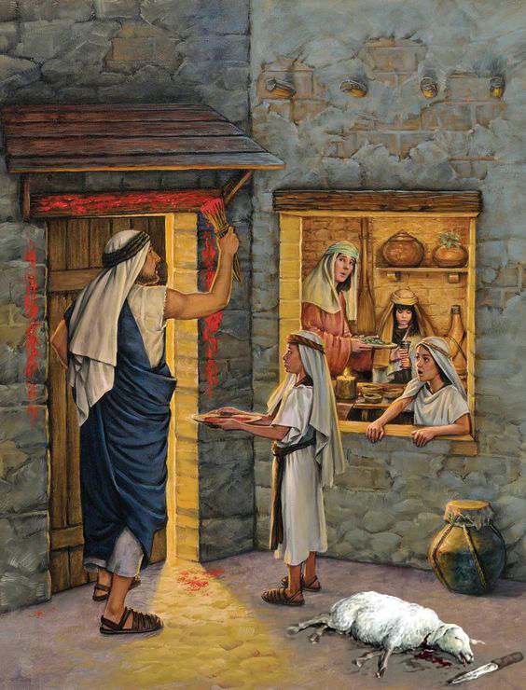
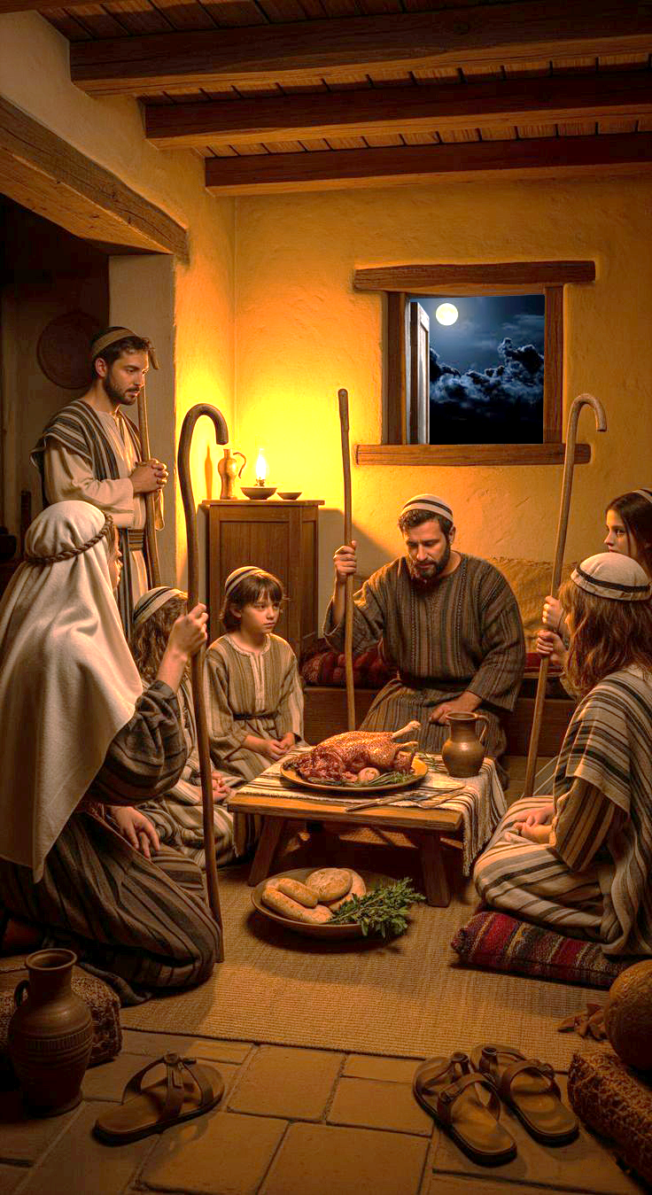
Through faith________ kept the passover, and the sprinkling of blood, lest he that destroyed the firstborn should touch them.
(v. 28) [Exodus 12]
Moses
I accept the substitute God prepared
Notes:
Acepto al sustituto que Dios preparó

Slide 13

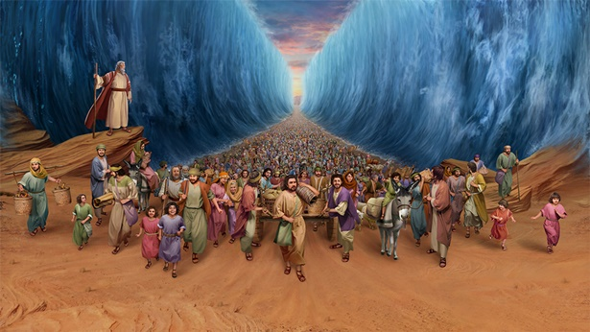
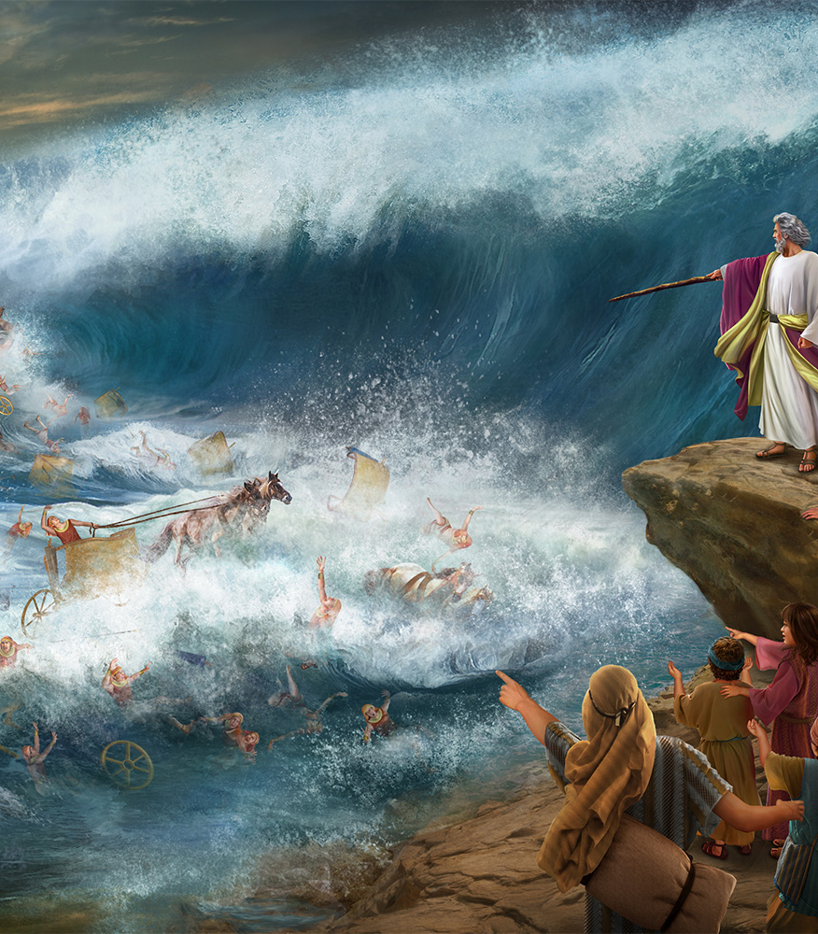
By faith, _____________ passed through the Red sea as by dry land: which the Egyptians assaying to do were drowned.
(v. 29) [Exodus 14]
the Israelites
I move forward in the midst of persecutions, knowing that God will ultimately destroy evil.
Notes:
Avanzo en medio de persecuciones sabiendo que Dios destruirá el mal

Slide 14

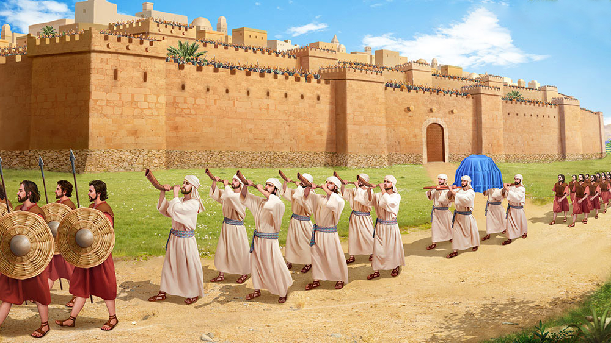
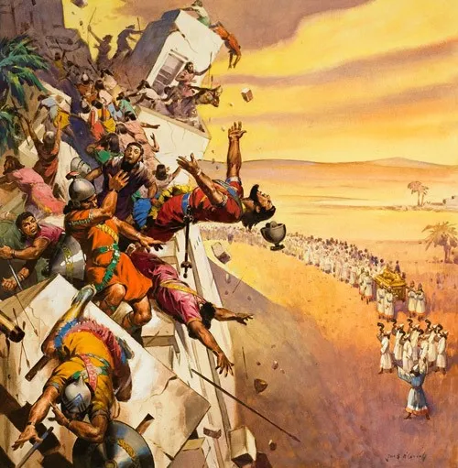
I do what God commands me, knowing that God will do His part.
of the people of Israel
By the faith __________________ the walls of Jericho fell after they were compassed about seven days. (v. 30) [Joshua 6]
Notes:
Hago lo que Dios me ordena sabiendo que Dios hará su parte

Slide 15


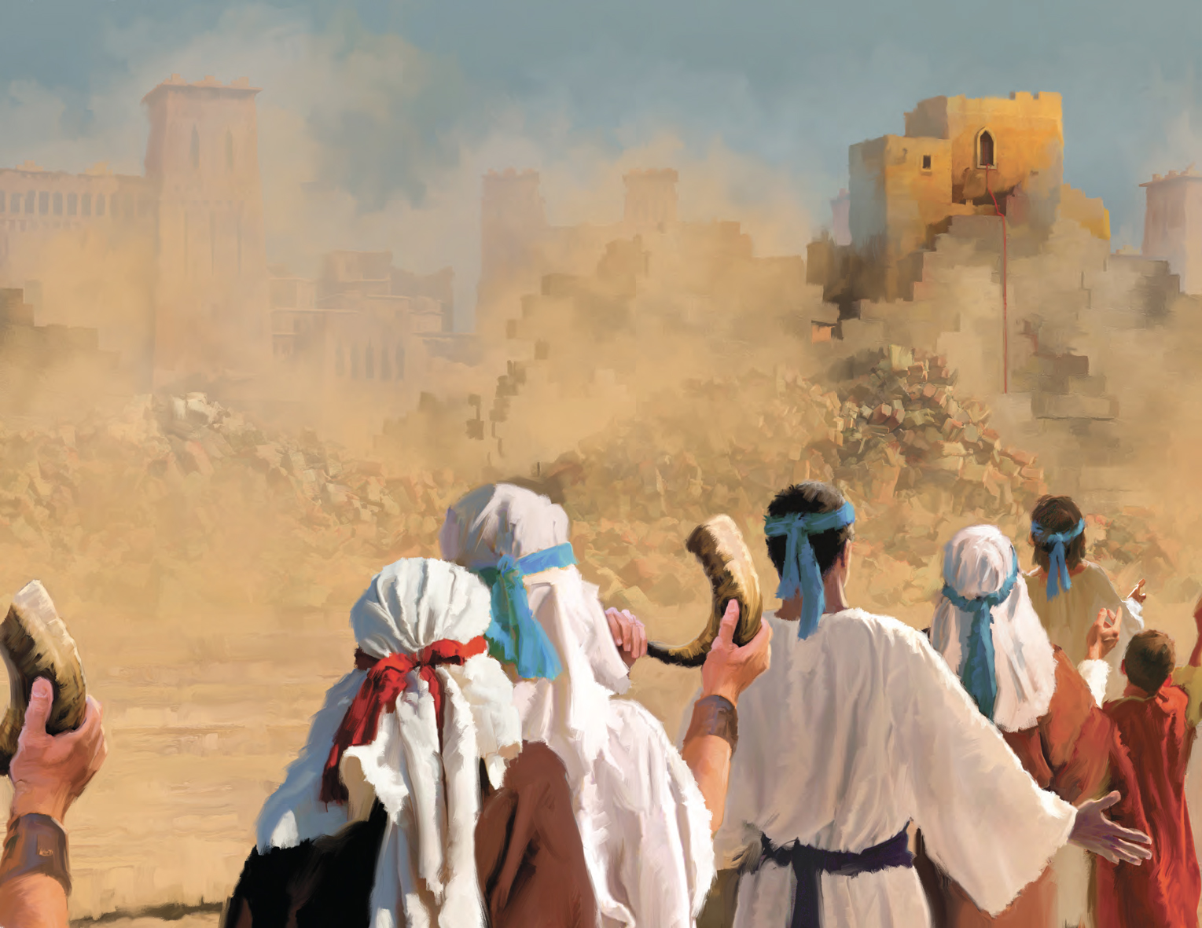
I treat God's messengers well
By faith _______ the harlot perished not with them that believed not, when she had received the spies with peace. (v. 31) [Joshua 2]
Rahab
Notes:
Trato bien a los mensajeros de Dios

Slide 16

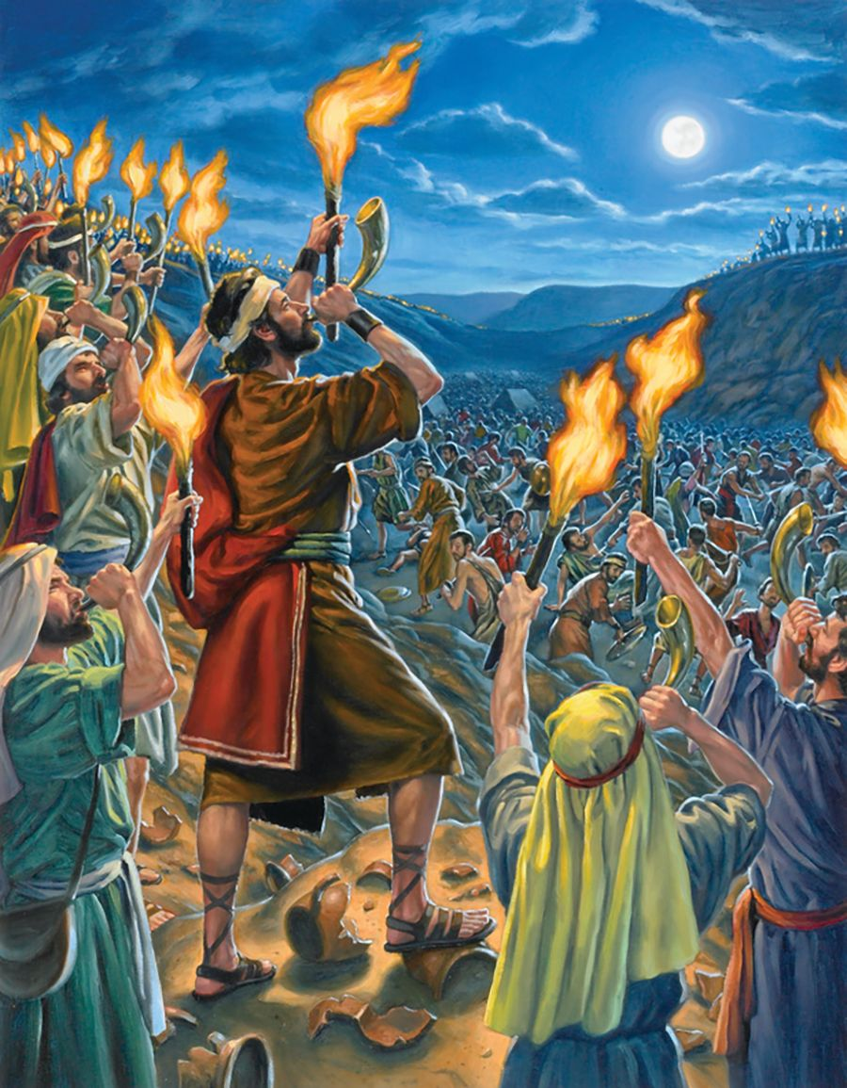
Gedeon
By faith ________ won over an army of Midianites and Amalekites, who were like locusts in multitudes, with only 300 men, all of them with trumpets in their hands, and lamps inside pitchers. (v. 32) [Judges 7]
With God, I face any problem, and I use the wit He gave me.
Notes:
Enfrento lo que sea con Dios y uso el ingenio

Slide 17

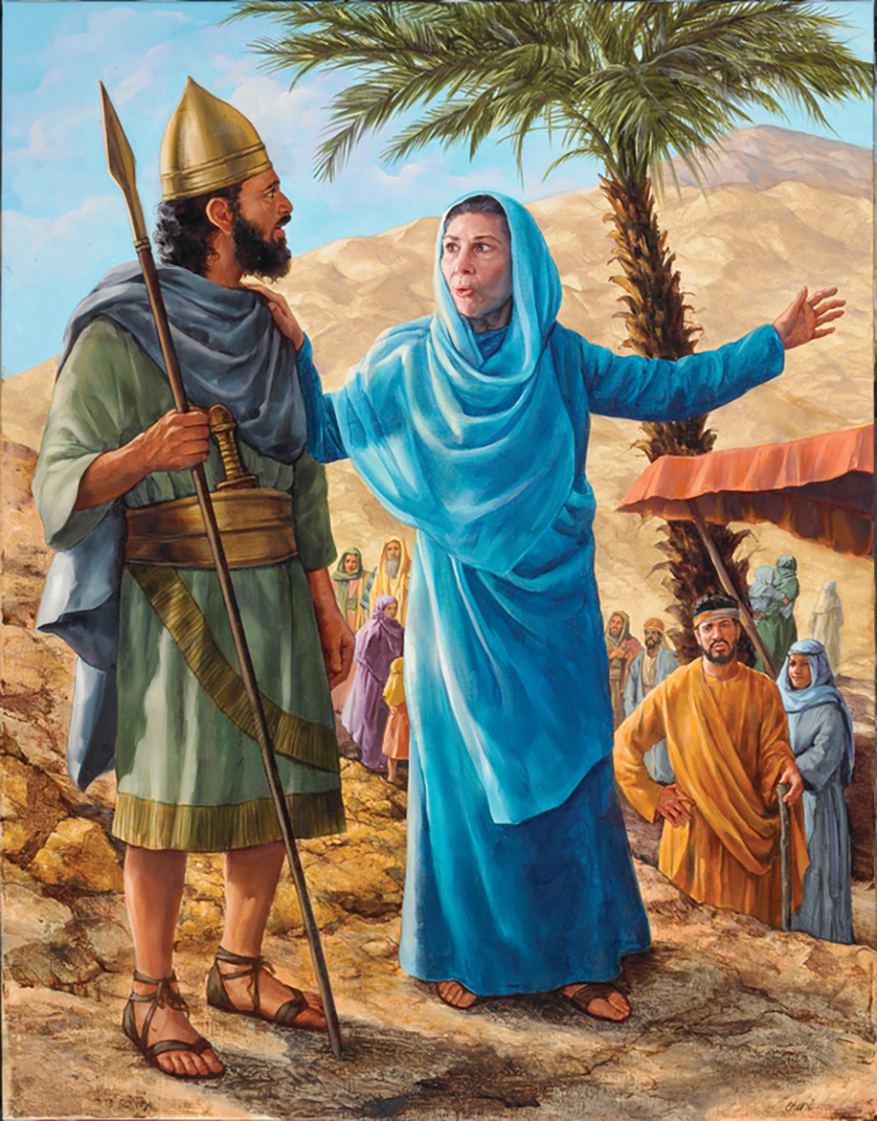
I win battles, it doesn't matter however great or powerful my enemy may be.
By faith ______ went up to fight with ten thousand men against Sisera who had nine hundred horse-shod chariots and many people. Barak fought until he didn't leave a single one. (v. 32) [Judges 4]
Barak
Notes:
Con Dios libro mis batallas no importa cuan grande o poderoso sea mi enemigo.

Slide 18

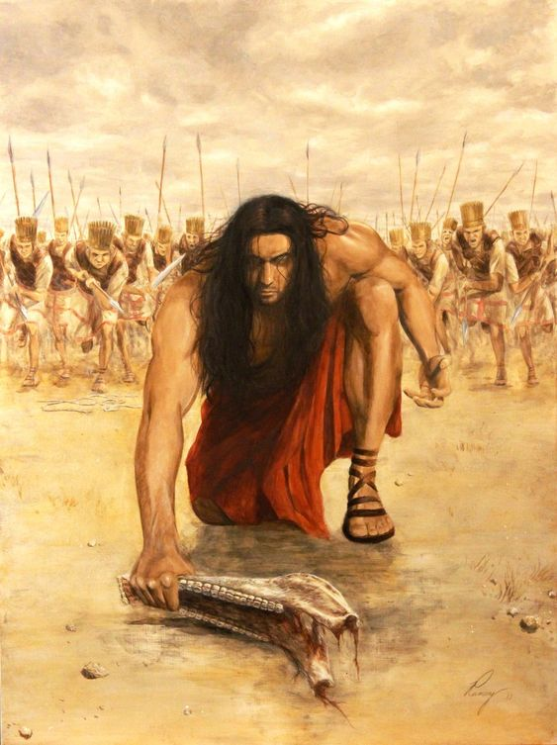
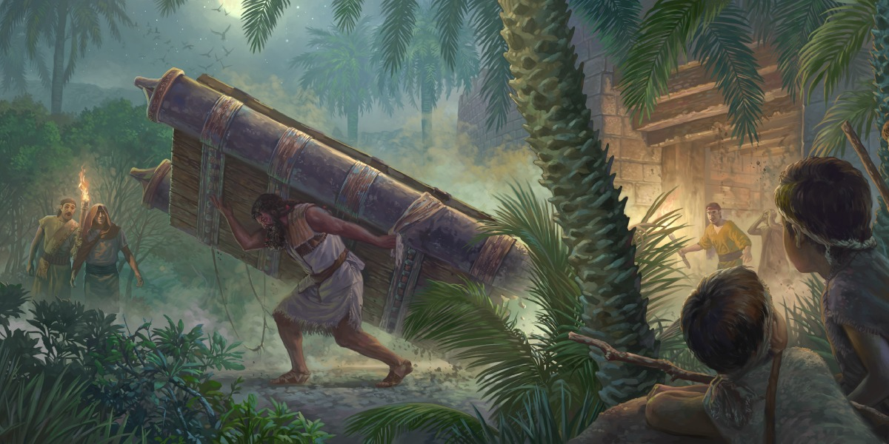
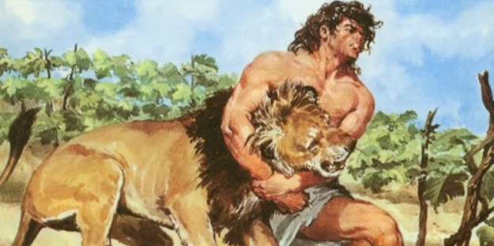
By the power of God I can do things beyond my capacity
By faith ________ killed a thousand men with a jawbone, tore out the gate of a city, and judged Israel for 20 years. (v. 32) [Judges 15:15-20]
Samson

Slide 19

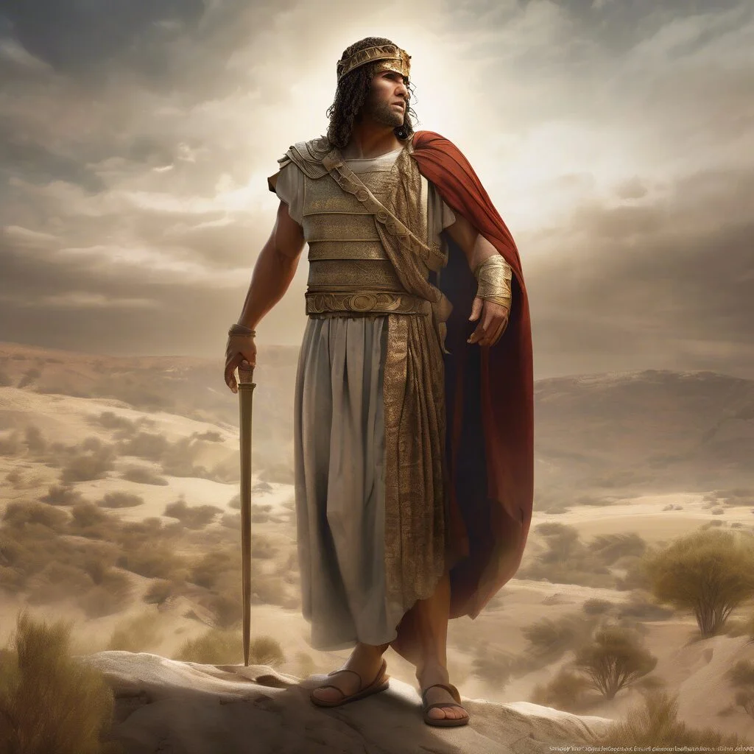
Even though I am rejected by men, I believe that God has a mission for me.
Jephthah
By faith, _________ the Gileadite judge, delivered the Israelites from the Ammonites, effectively breaking their power. (v. 32) [Judges 11:32-33]

Slide 20

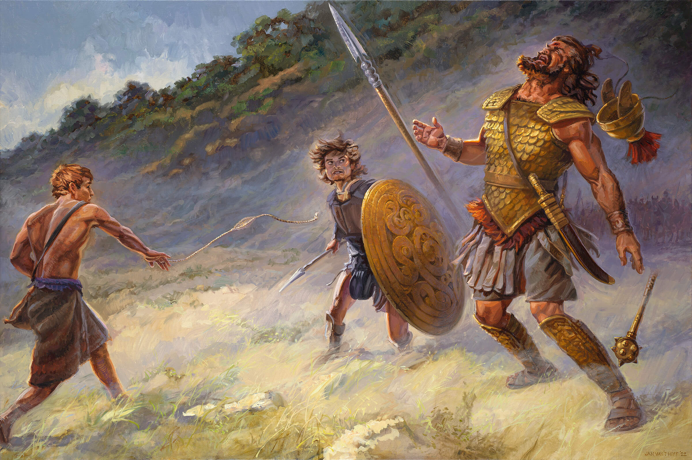
By faith, ______ faced Goliath, a giant, and defeated him with his sling and a stone. (v. 32) [1 Samuel 17]
David
Giants dwarf when I trust God.
Notes:
Derroto al enemigo confiando en Dios y con lo que se hacer.

Slide 21

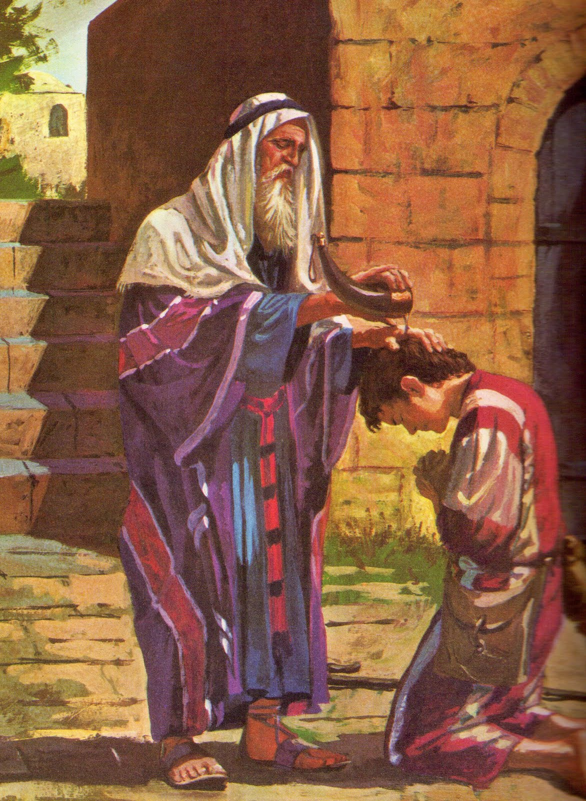
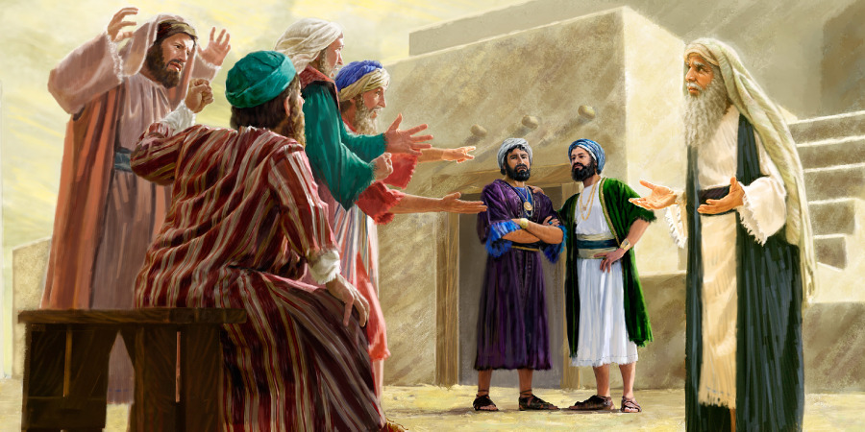
I recognize that, up to this point, God's hand has been at work in my life.
Samuel
By faith, ________ the last judge of Israel, erected a monument: “Thus far the Lord has helped us” (v. 32) [1 Samuel 7:12-17]
Notes:
Sigo mi andar sabiendo que “hasta aquí me ha ayudado Dios”.

Slide 22

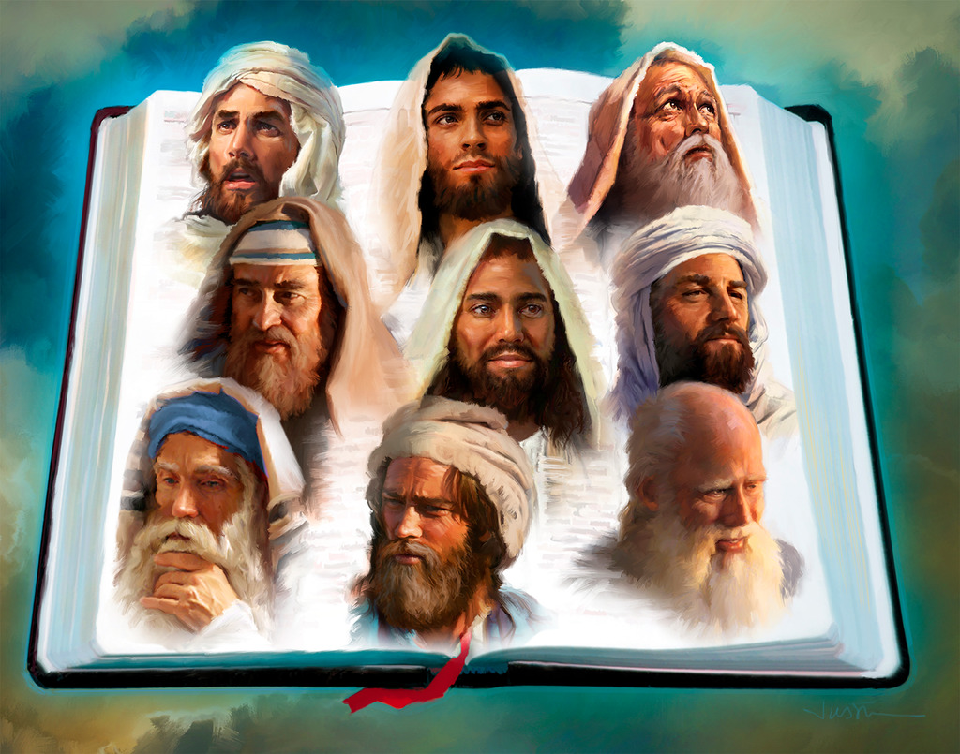
By faith, ____________ went to give God's message wherever and whenever God directed them. (v. 32) [1 Kings 19:15; Amos 7:15; Jonah 1:1-2; Haggai 1:1]
the prophets
I go anywhere God sends me to take His Word.
Notes:
Llevaré el mensaje de Dios aún en medio de dificultades

Slide 23

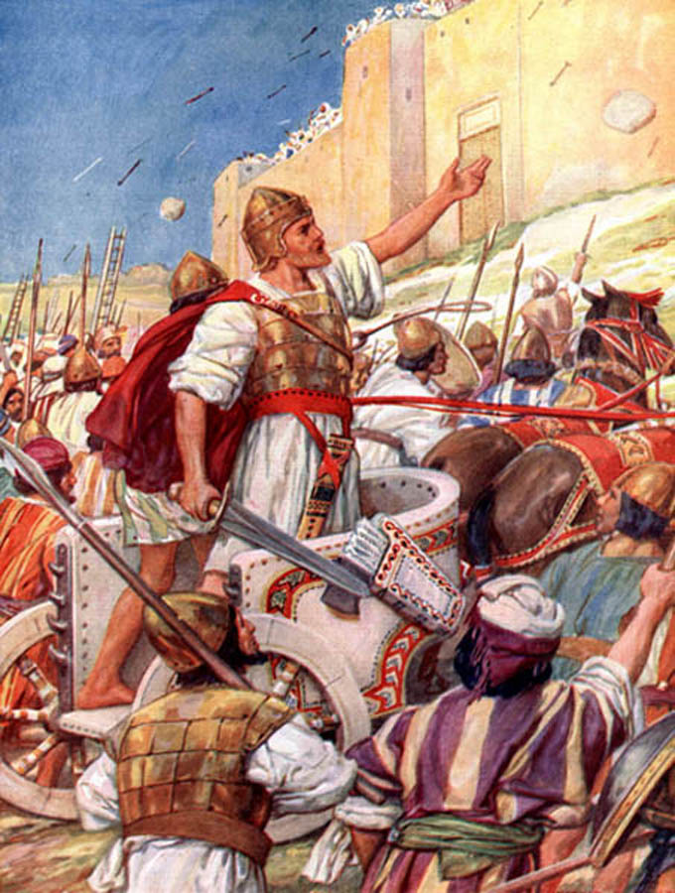
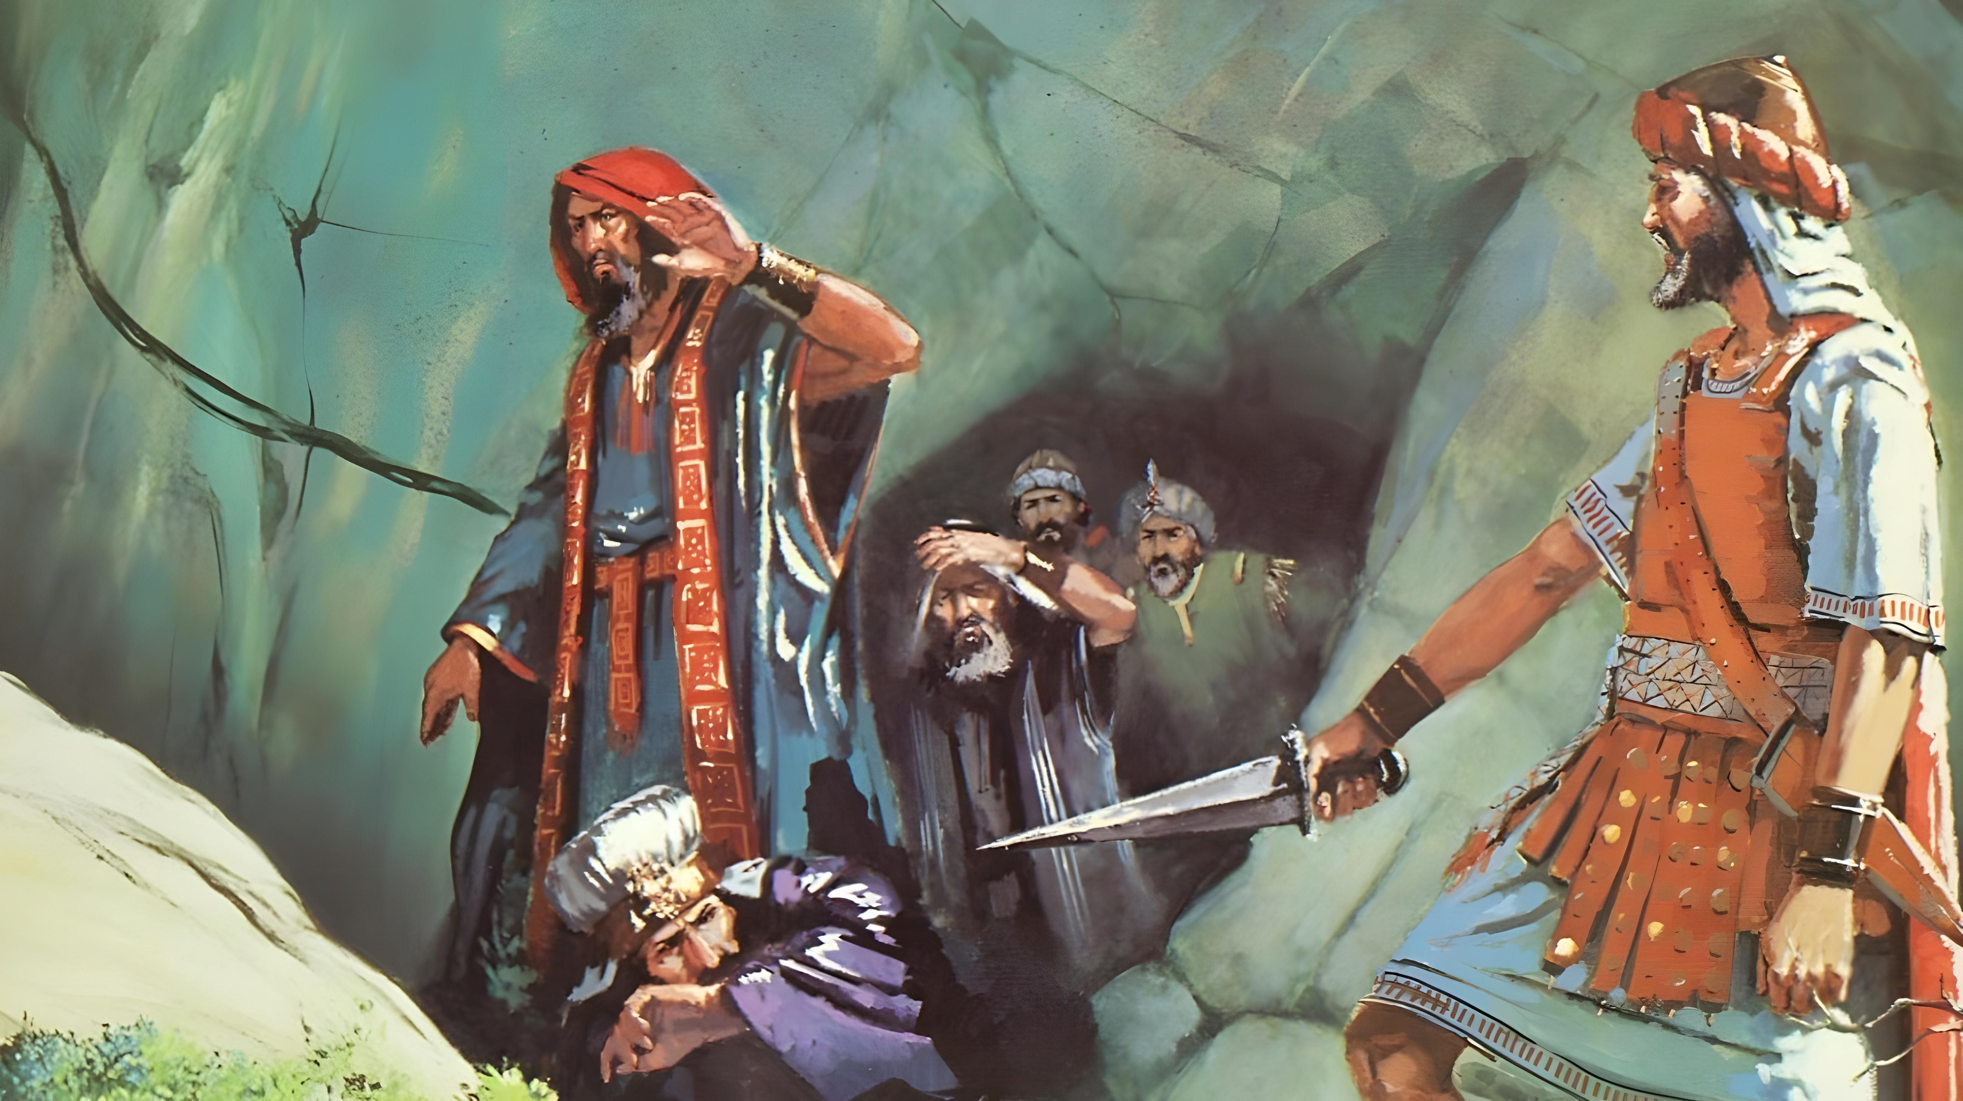
The conquests of my life are always for the glory of God.
Joshua and David
By faith _________________ conquered kingdoms. (v. 33) [Numbers 31:8; 2 Samuel 5:6-9]

Slide 24

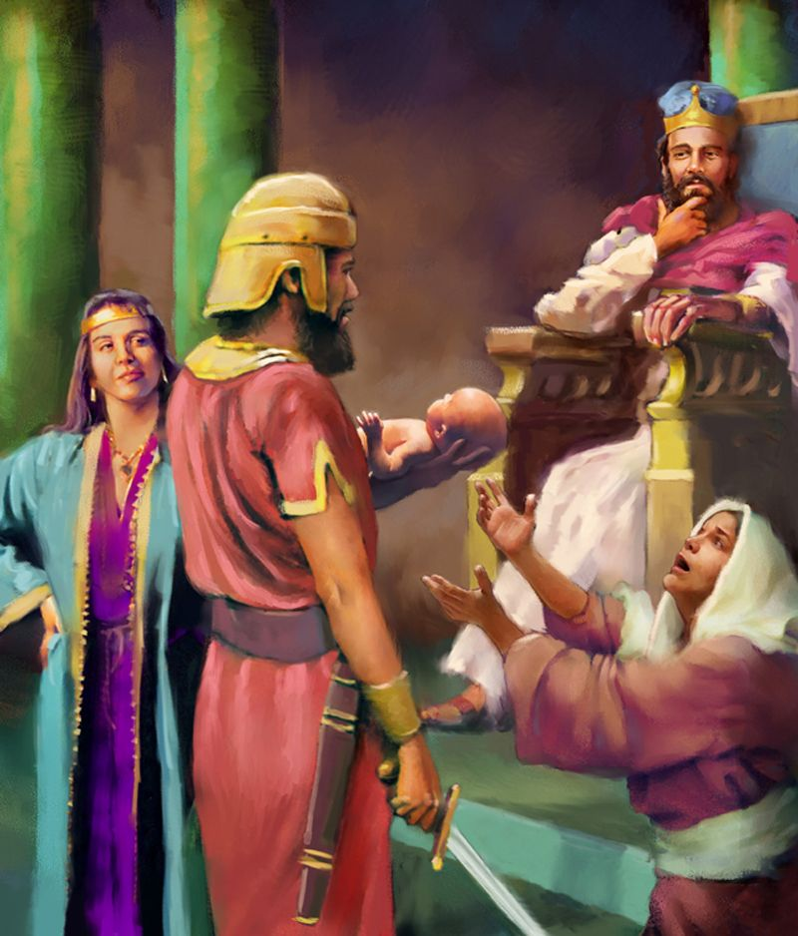
God gives me the wisdom to do justice.
Solomon
By faith _________ did righteousness and justice with the wisdom God had promised him. Numerous judges and kings could be included in this category. (v. 33) [1 Kings 3:16-28]
Notes:
Confío en la sabiduría que Dios le había dado.

Slide 25

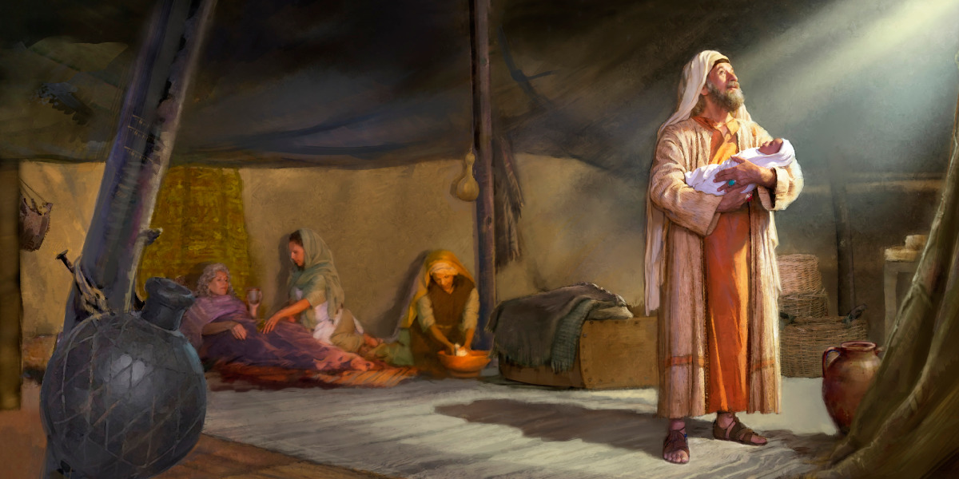
Abraham
By faith ___________ obtained the promise God had given him. (v. 33) [Genesis 15:4; 21:2-5]
I believe that God's promises are always fulfilled.

Slide 26

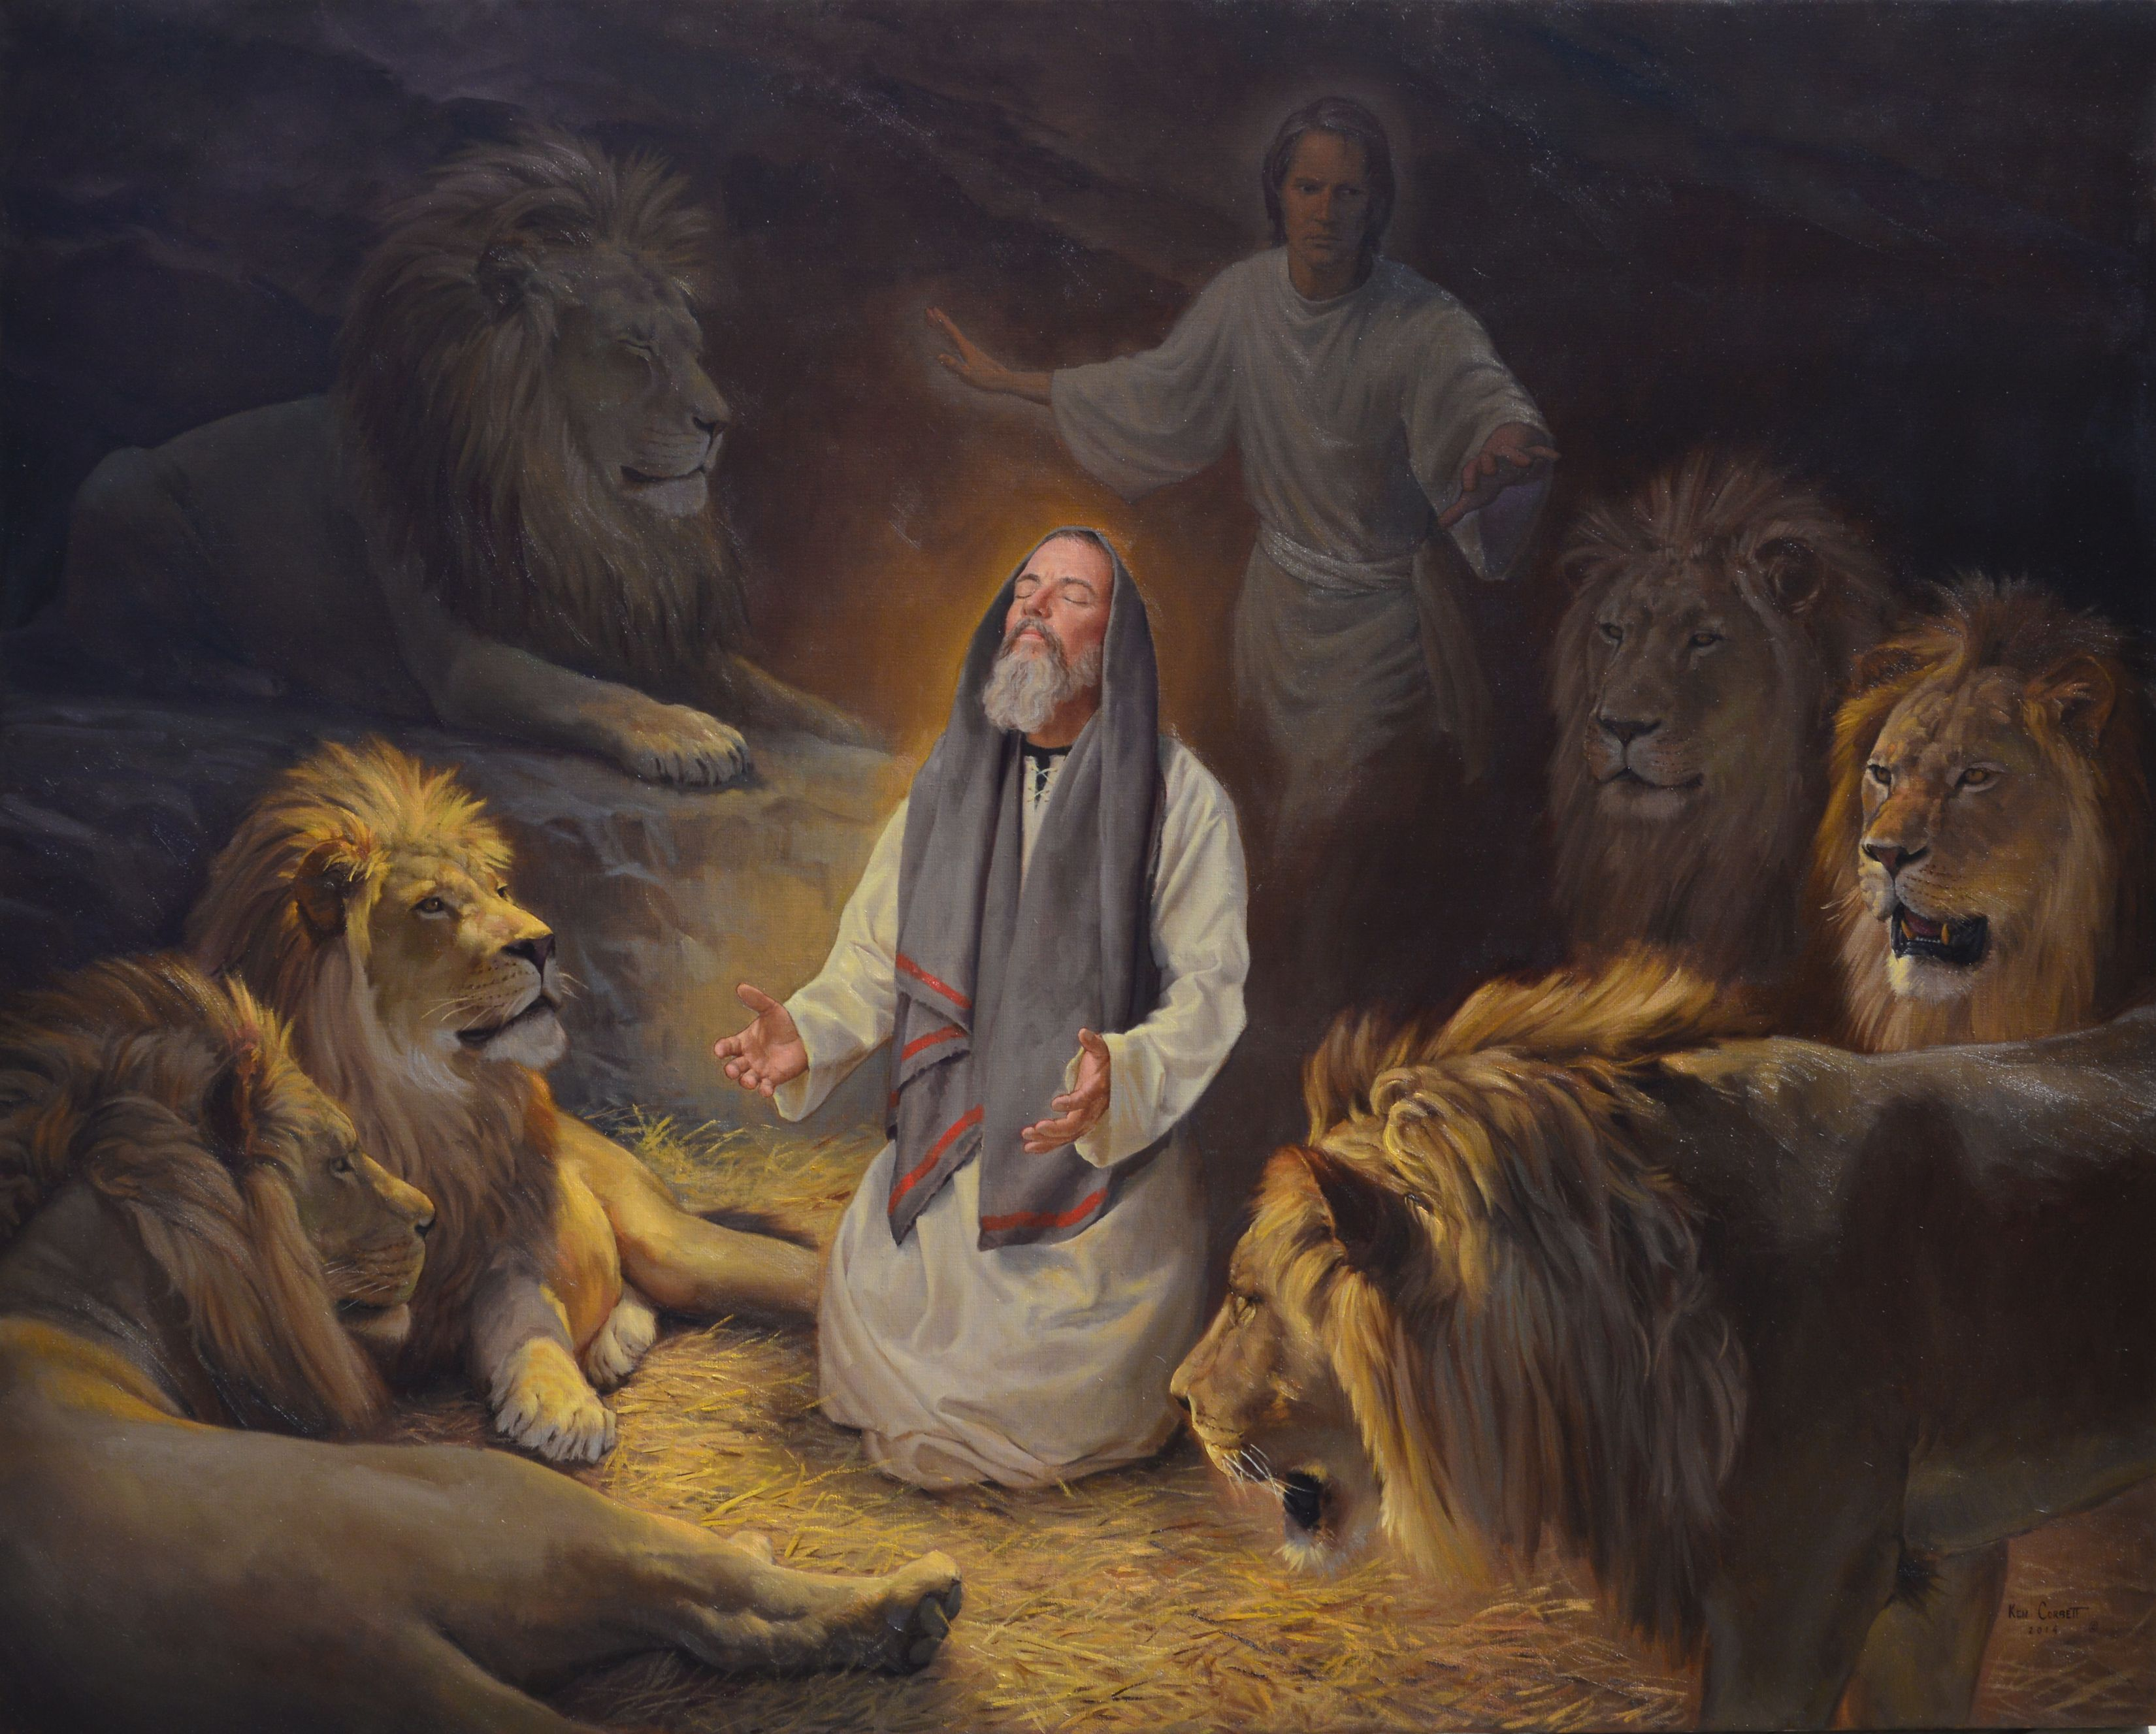
I know that God can deliver me even from certain death.
By faith ______ stopped the mouths of the lions.
(v. 33) [Daniel 6]
Daniel

Slide 27

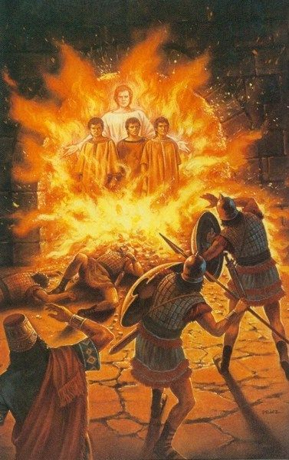
In the most difficult moments, I know that God is with me.
By faith __________________________________ were unharmed when they were thrown into an oven heated seven times more than normal.
(v. 34) [Daniel 3]
Shadrach, Meshach, and Abed-nego

Slide 28

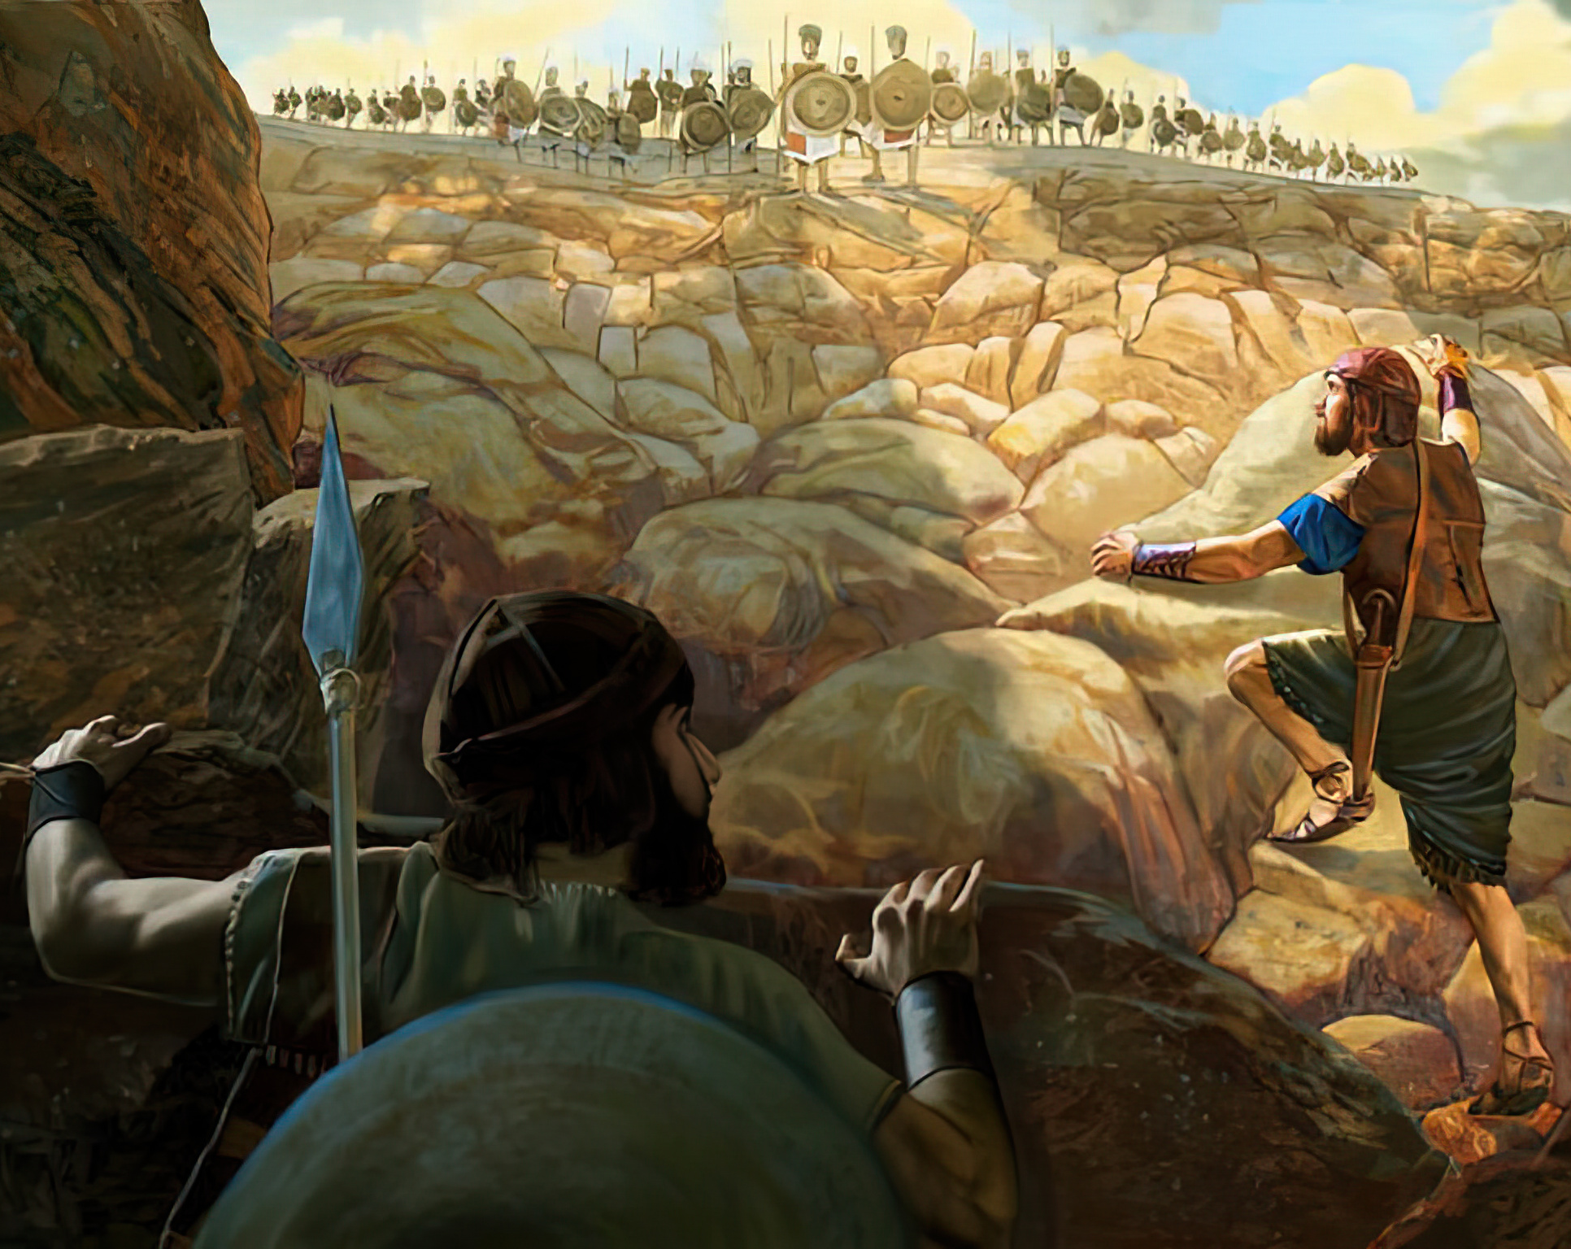
By faith _________ avoided the edge of the sword when he fought against the Philistines, together with his armor-bearer.(v. 34) [1 Samuel 14:1-23]
Jonathan
I know that God gives victory, whether we are few or many.

Slide 29

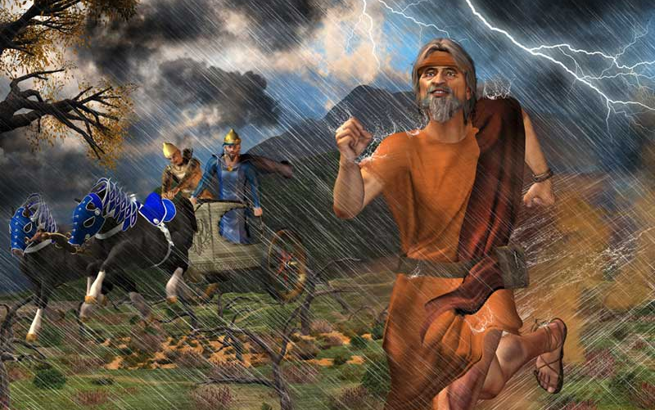
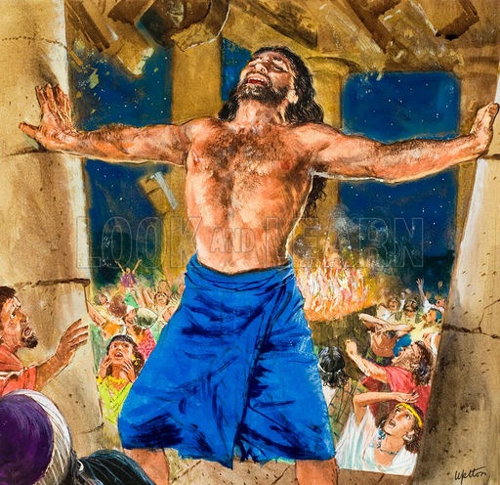
By faith ______________ drew strength from weakness. Elijah, after the miracle of Carmel, ran before Ahab who was riding with his chariot. Samson asked God for strength to destroy the Philistines. (v. 34) [1 Kings 18:42-46] [Judges 16:23-30]
Elijah and Samson
In moments of weakness, God gives me the strength I need.

Slide 30

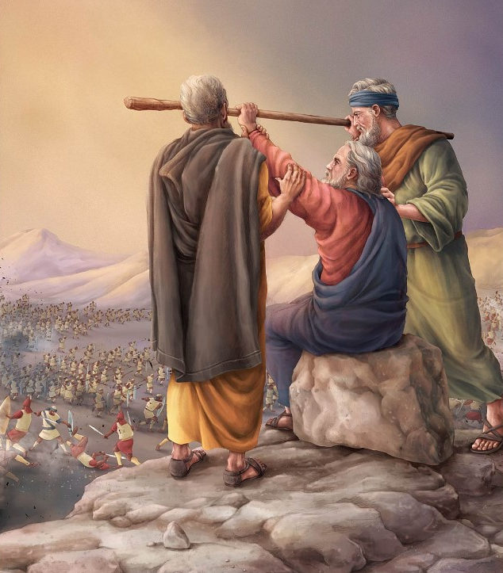
By faith ______ became strong in battle. He fought with the people of Israel against Amalek. Israel won while Moses raised his arms, supported by Aaron and Ur.
(v. 34) [Exodus17:8-13]
Joshua
God makes me strong and gives me victory when I trust Him.

Slide 31

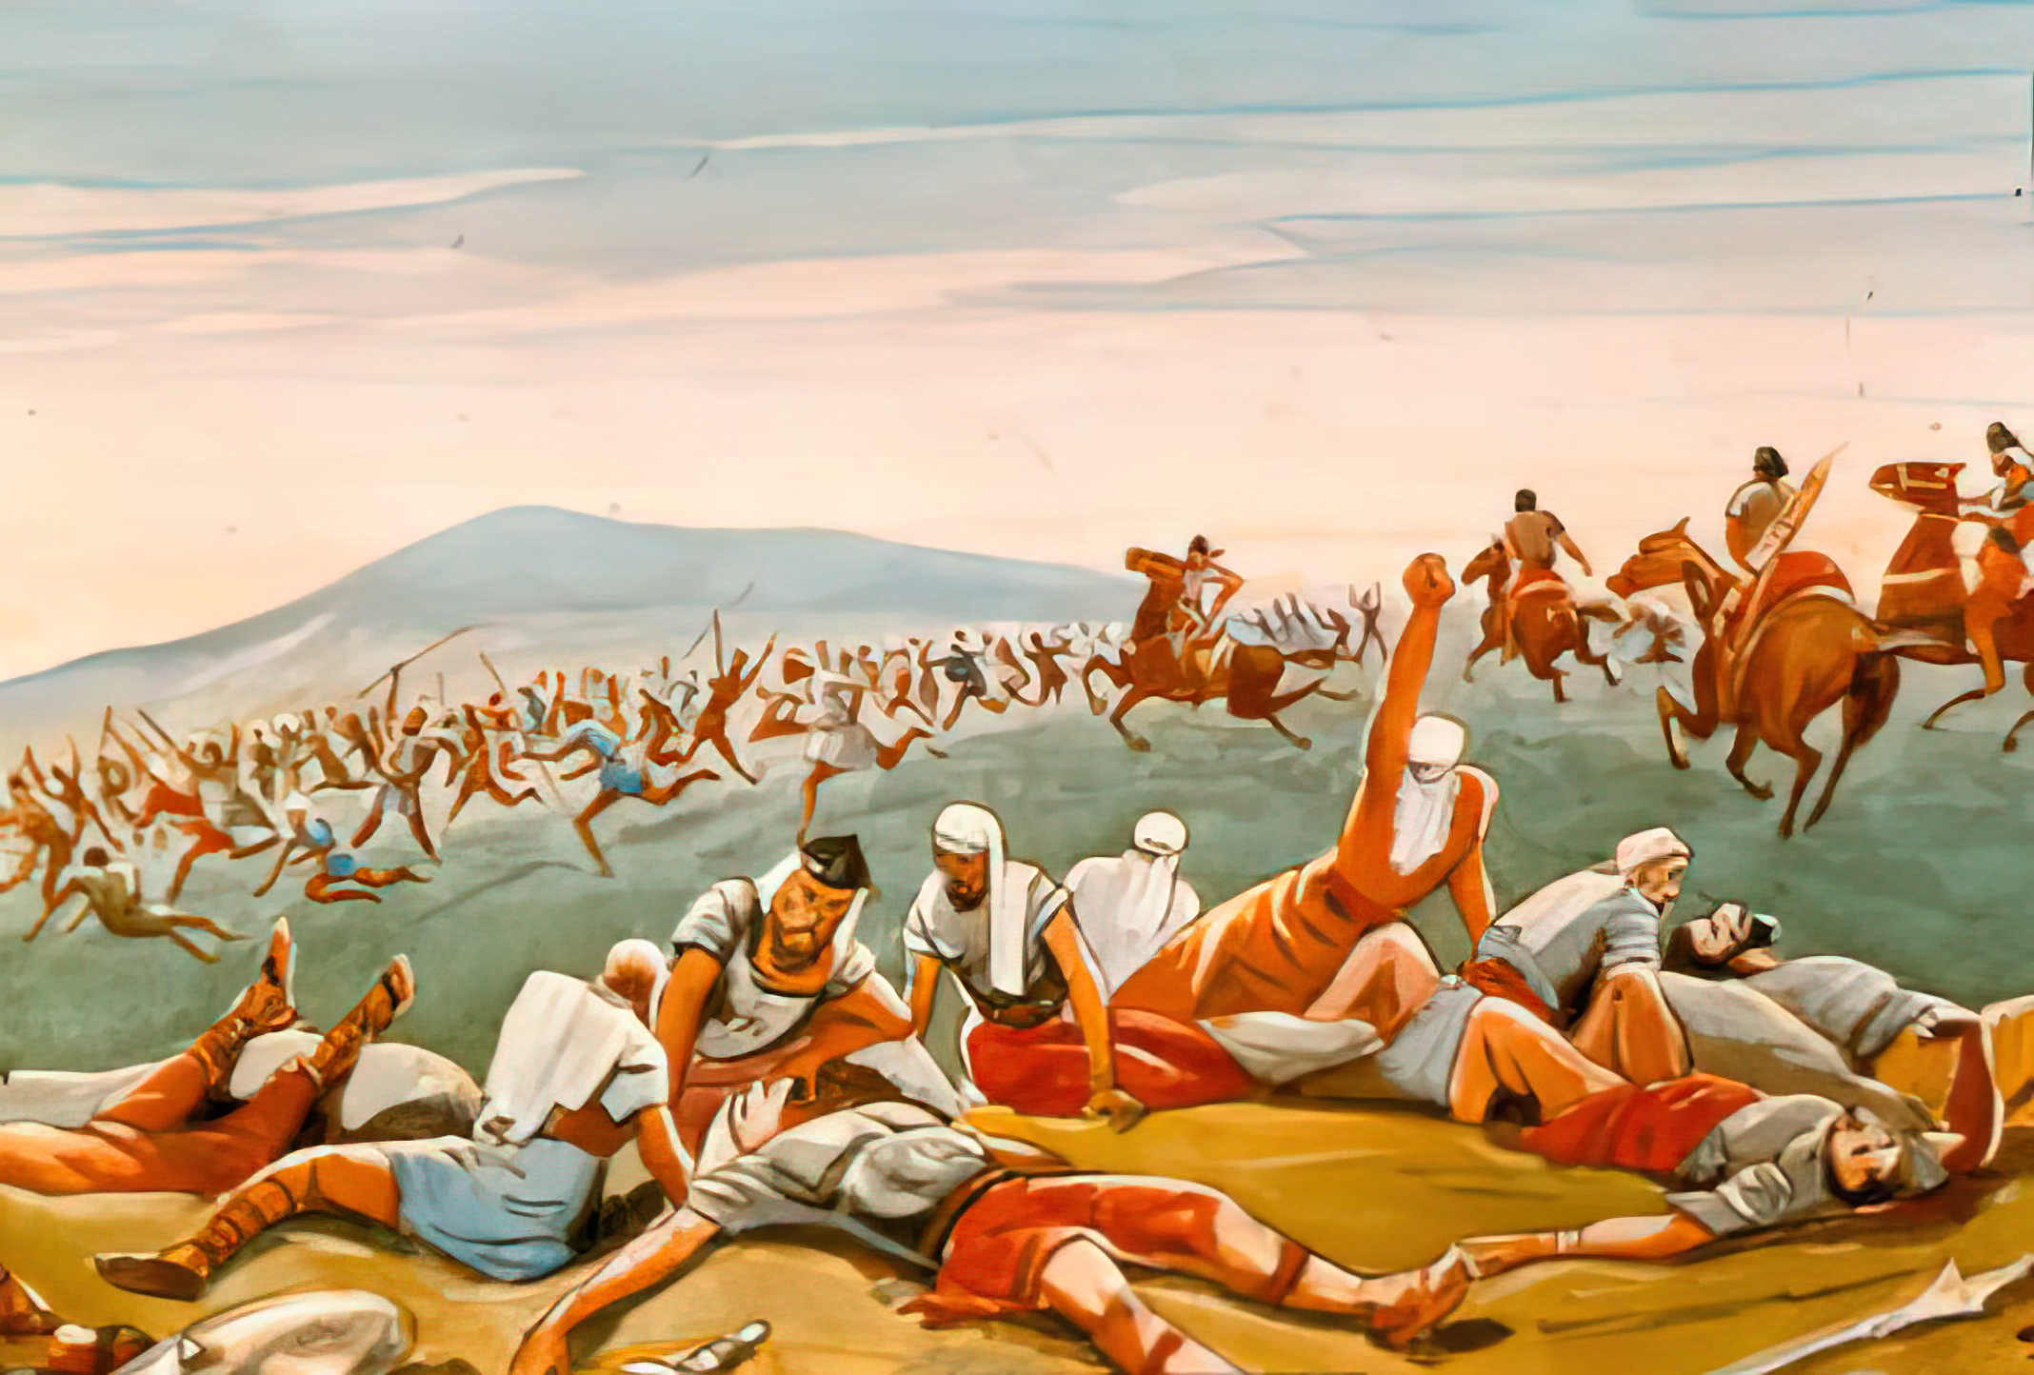
The enemy flees from me in the name of God.
By faith _____ foreign armies put to flight.
(v. 34) [2 Samuel 10: 6-14]
Joab

Slide 32

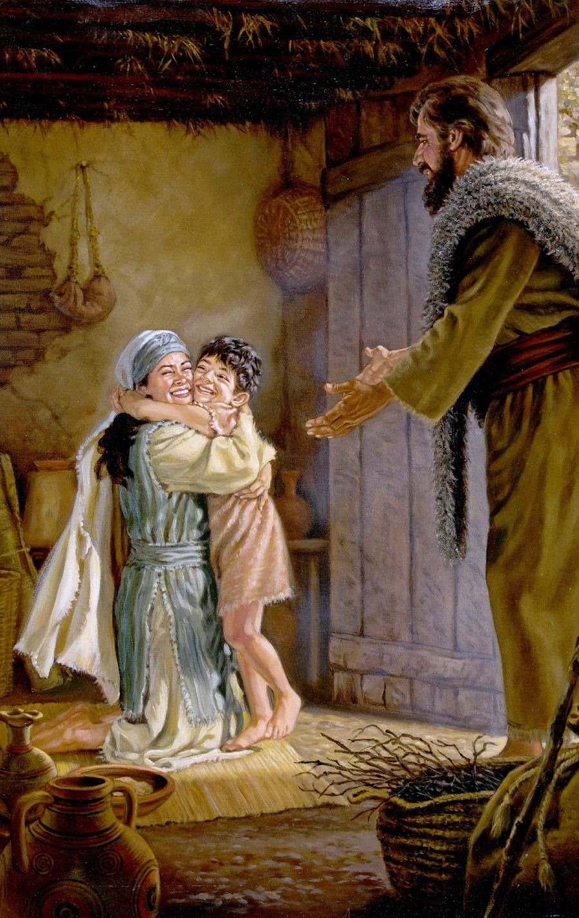
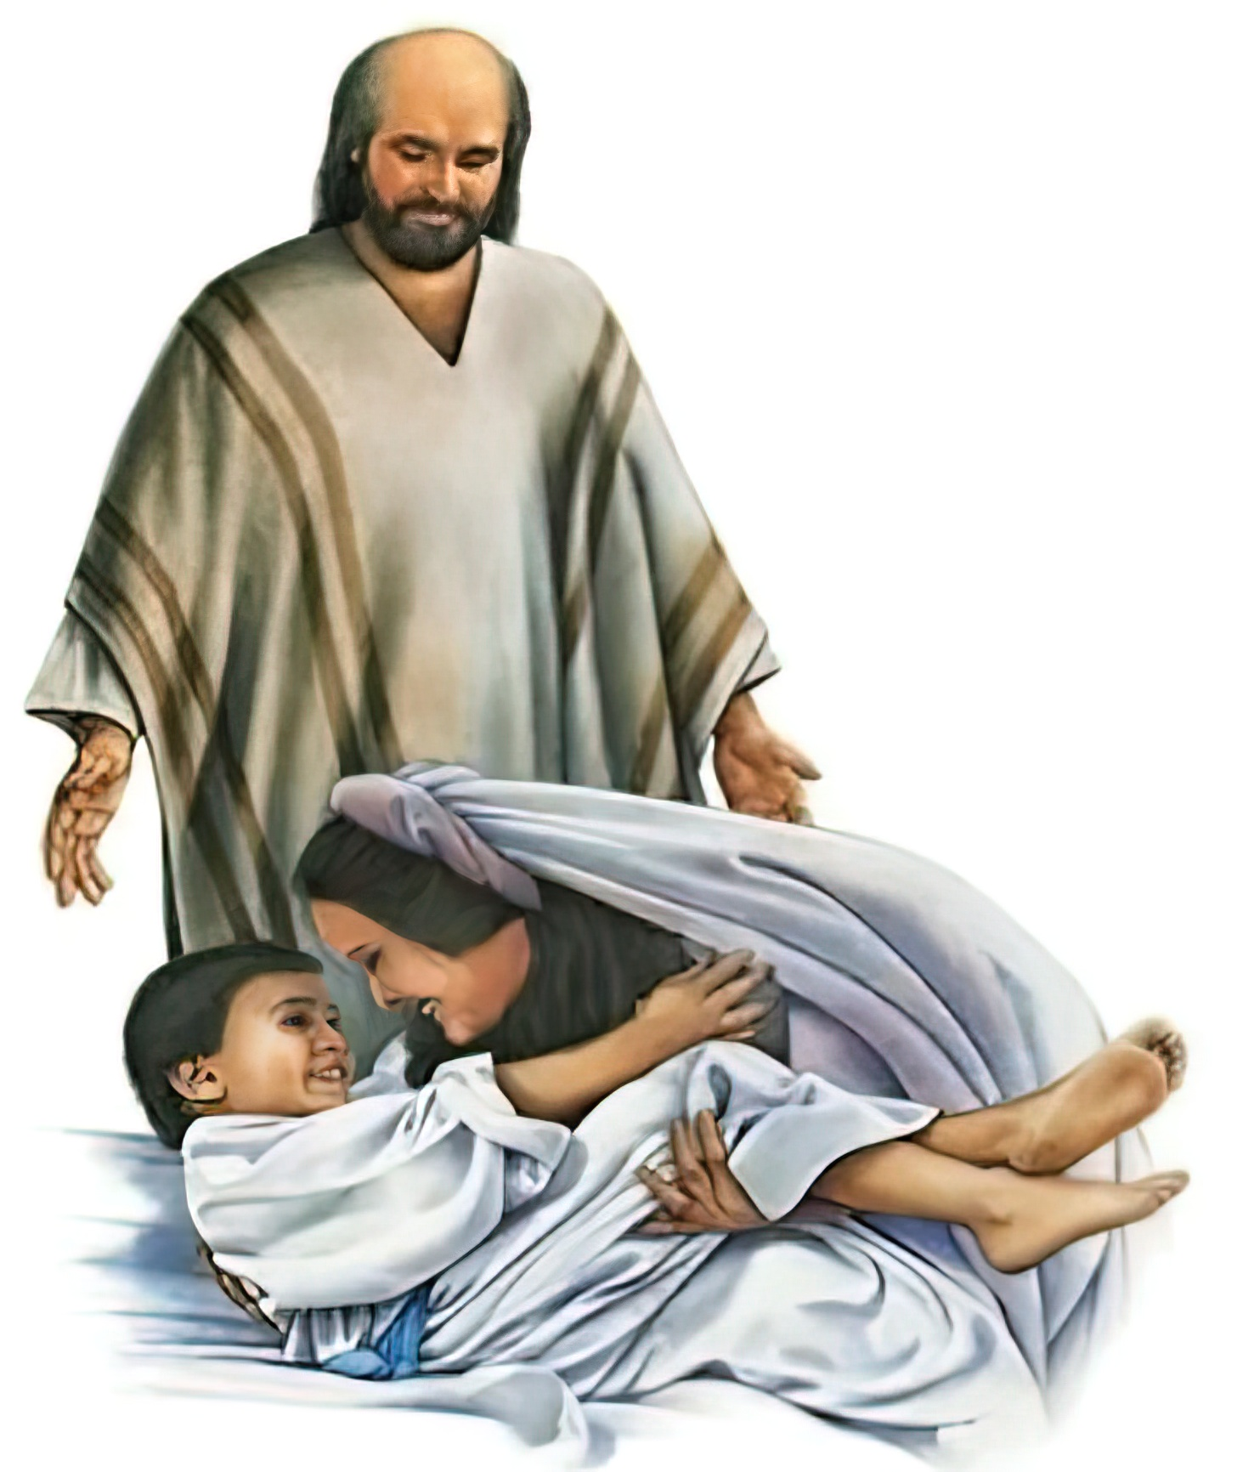
Even death is not a problem for God.
By faith _________________________________ received their dead raised to life again.
(v. 35) [2 Kings 4:18-37] [1 Kings 17:17-24]
the Shunammite
and the widow of Zarephath

Slide 33

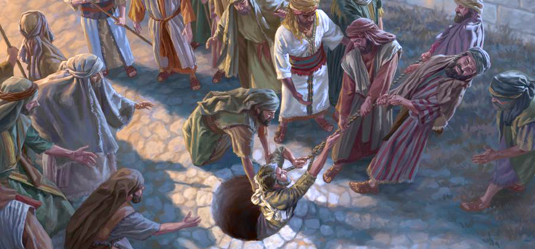
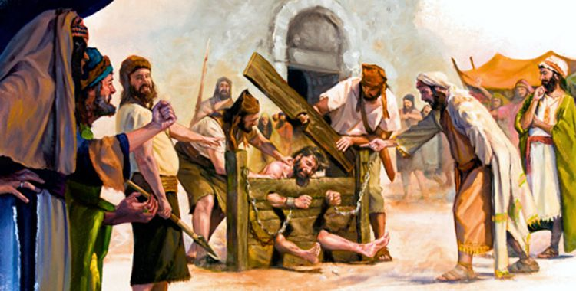
I will stand firm, even at the risk of my life, trusting in the resurrection.
By faith _________ was tormented, deliverance; that they might obtain a better resurrection. (v. 35) [Jeremías 20:2; 38:6]
Jeremiah

Slide 34

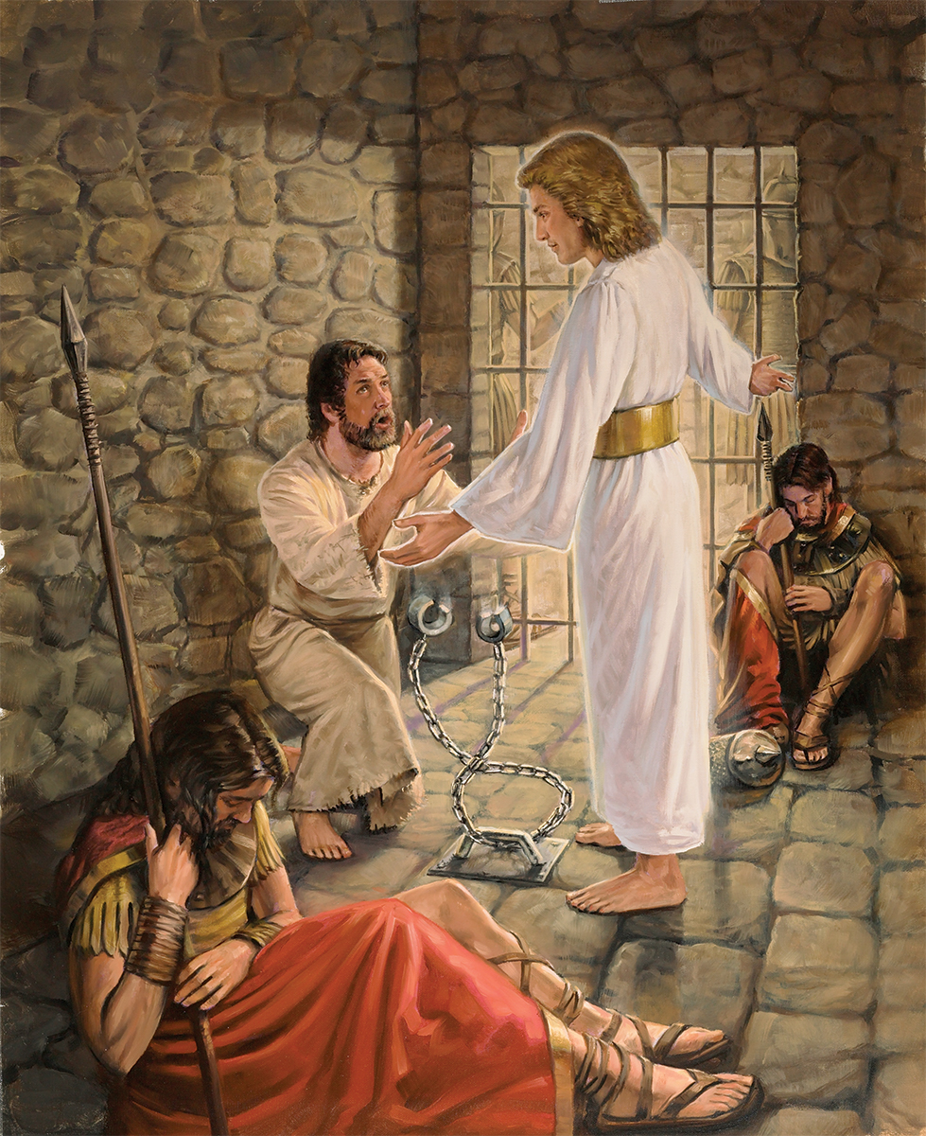
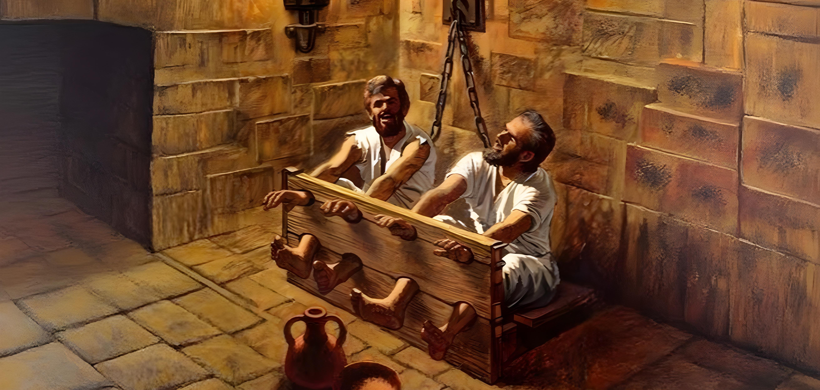
In the midst of problems, I sleep peacefully or sing happily, trusting in God.
For the faith ______, _______, ________, etc. suffered reproaches and scourgings, prisons and jails. (v. 36) [Genesis 37:13-24; Acts 12:1-19; Acts 16:19-24]
Joseph
Peter
Paul

Slide 35

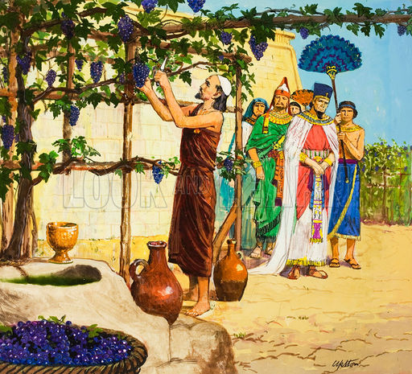
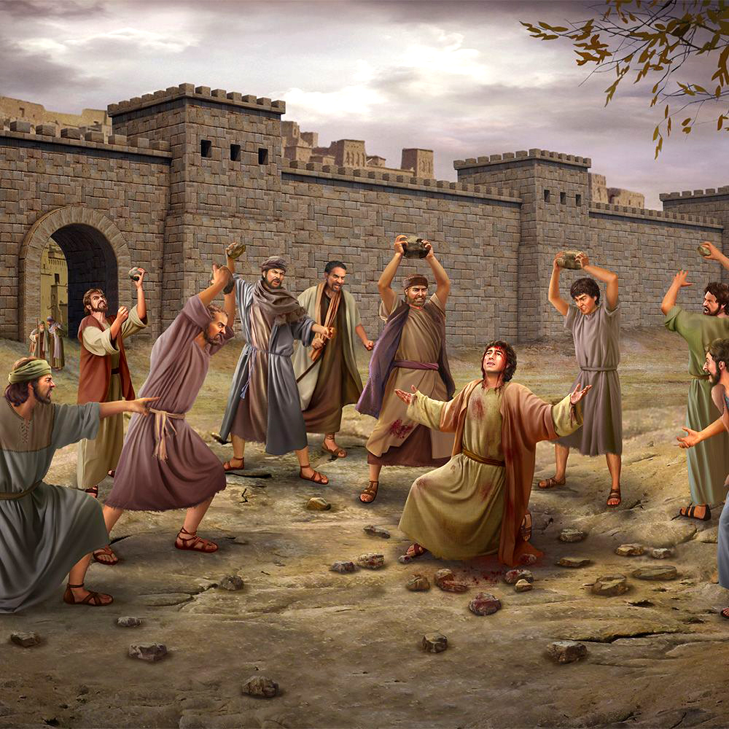
If I must die to remain faithful, or to bear witness to the truth, I will not doubt.
For the faith ______________ and _________ were stoned.
(v. 37) [1 Kings 21:1-16; Acts 7:59]
Jezreel's Nabot
Stephen

Slide 36

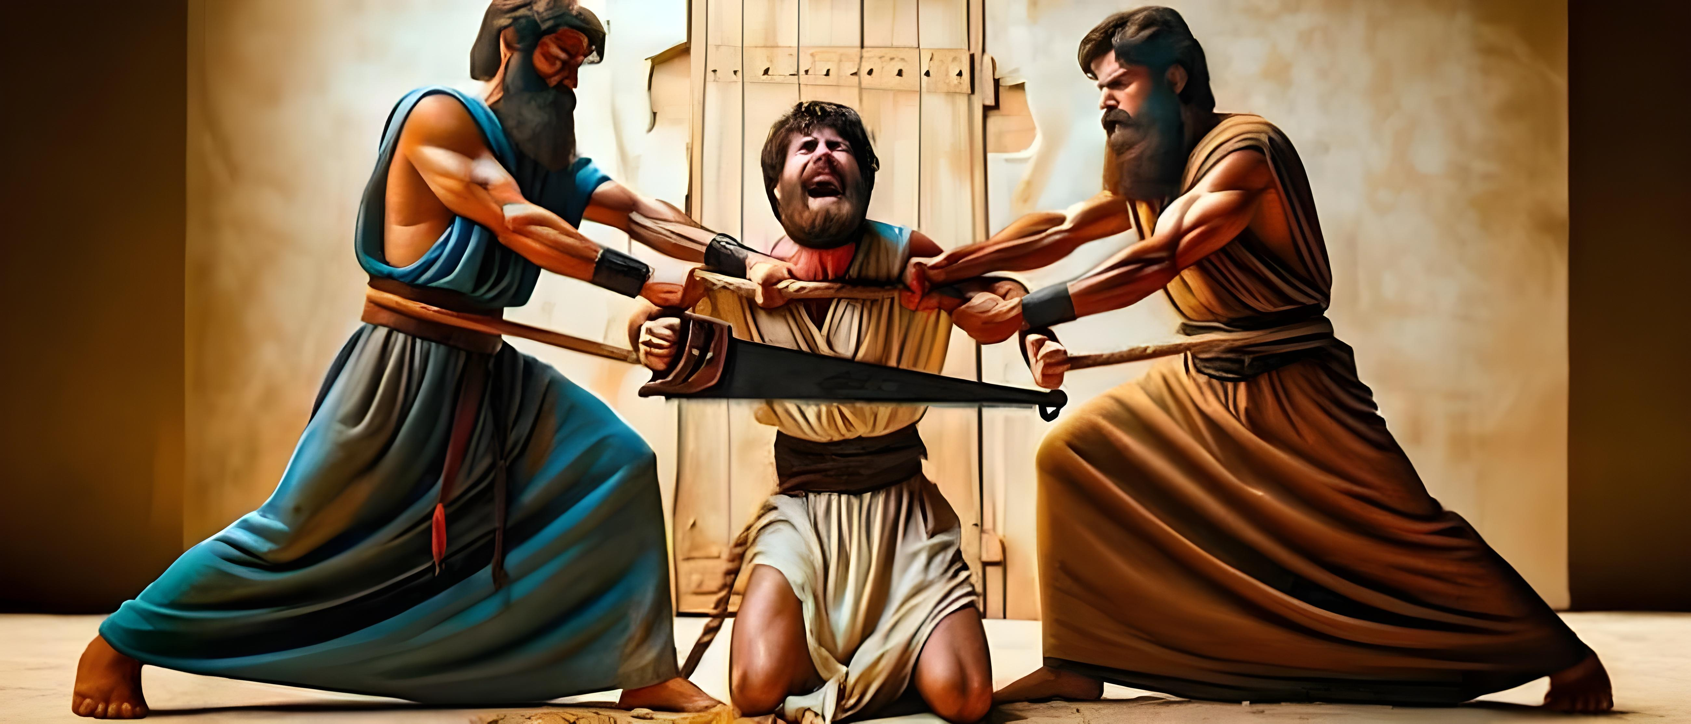
Isaiah
By faith ______ died sawn to death. (according to tradition). (v. 37) (ST February 17, 1898)
It doesn't matter what kind of death you have to face. I will be faithful to God.

Slide 37

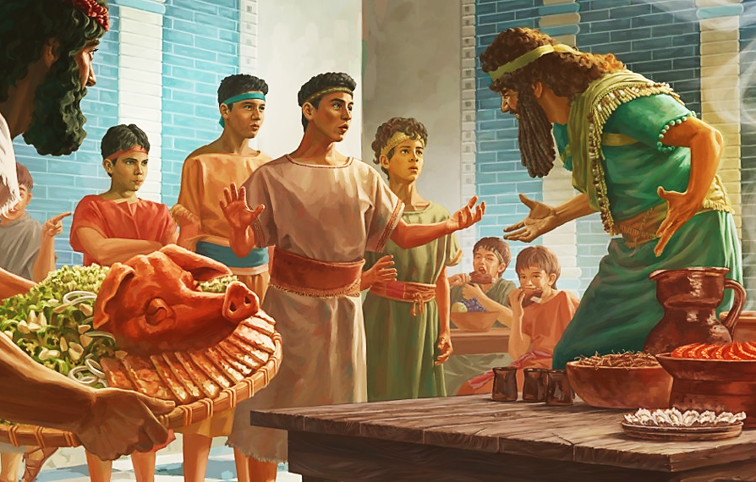

I will stand firm when my beliefs are tested.
By faith ___________________ were tested as to what they would eat. (v. 37) [Daniel 1]
Daniel and his friends

Slide 38




Even if I die unjustly suffering the wrath of others, my reward is assured.
Gedaliah
By the faith _________, the priests of _____ and _______, John's brother were put to death by the sword.(v. 37) [1 Samuel 22:6-23; Jeremiah41:2; Acts 12:1-2]
Nob
James

Slide 39


By faith _______________, among many others, walked to and fro covered with sheep and goat skins, being destitute, afflicted, tormented. (v. 37) [Matthew3:1-6]
John the Baptist
I will preach the message I have to give, no matter my personal situation.

Slide 40



Even though I'm having a hard time now, I know that in time, God will fulfill what He promised.
By faith ______ wandered in deserts, and in mountains, and in dens and caves of the earth, trusting that, when he wanted, God would give him the kingdom. (v. 38) [1 Samuel 24]
David

Slide 41



By faith ___________________
(Put your name here)
I hope to be victorious and to meet Jesus very soon, on the New Earth, for all eternity.

Slide 42

And all these, though they obtained a good report through faith, did not receive what was promised; God providing something better for us, that they should not be perfected apart from us. (Hebrews 11:39-40)

