Slide 1
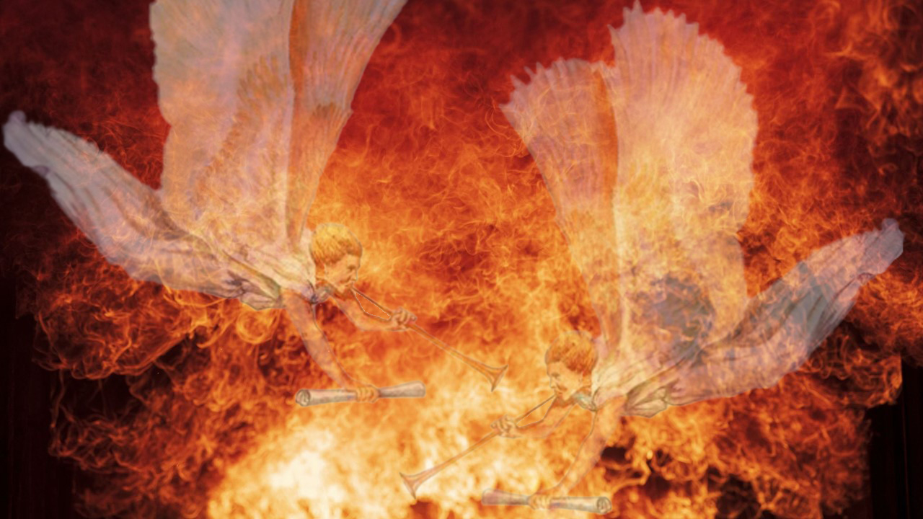

Slide 2

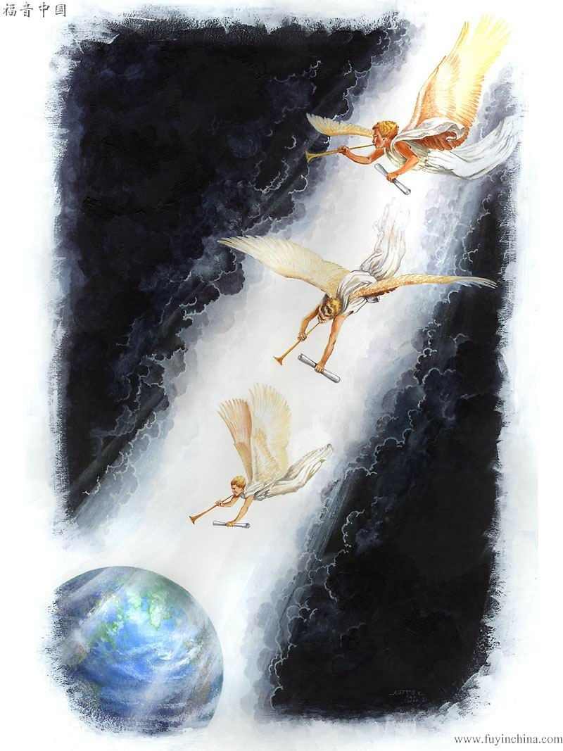
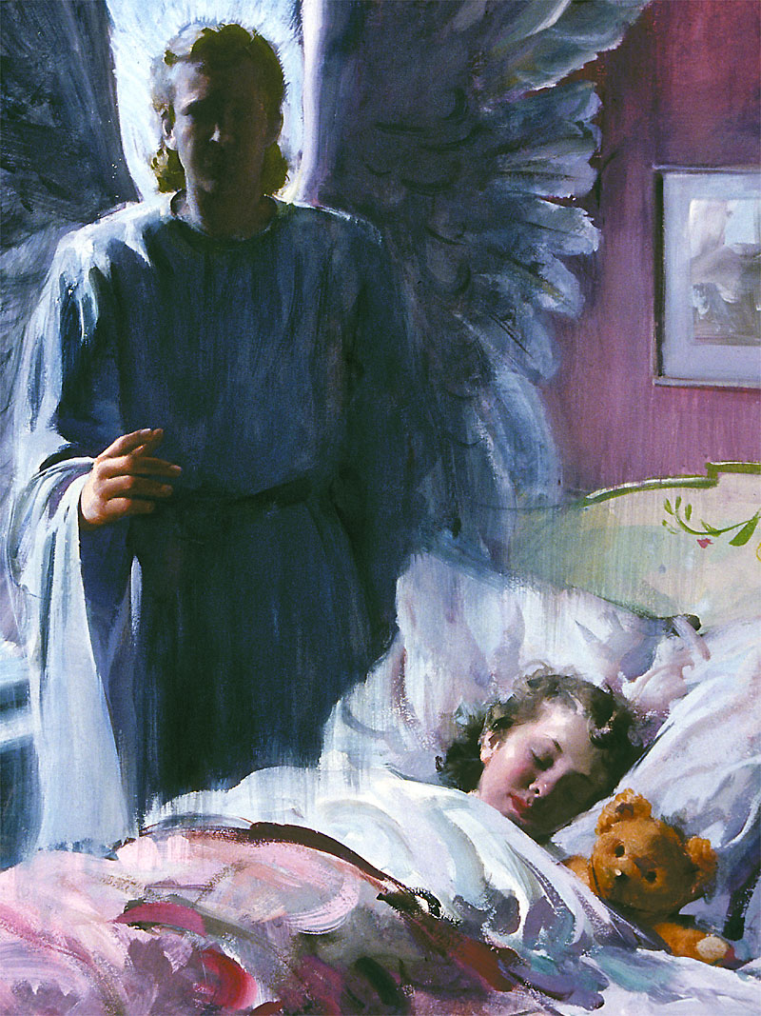
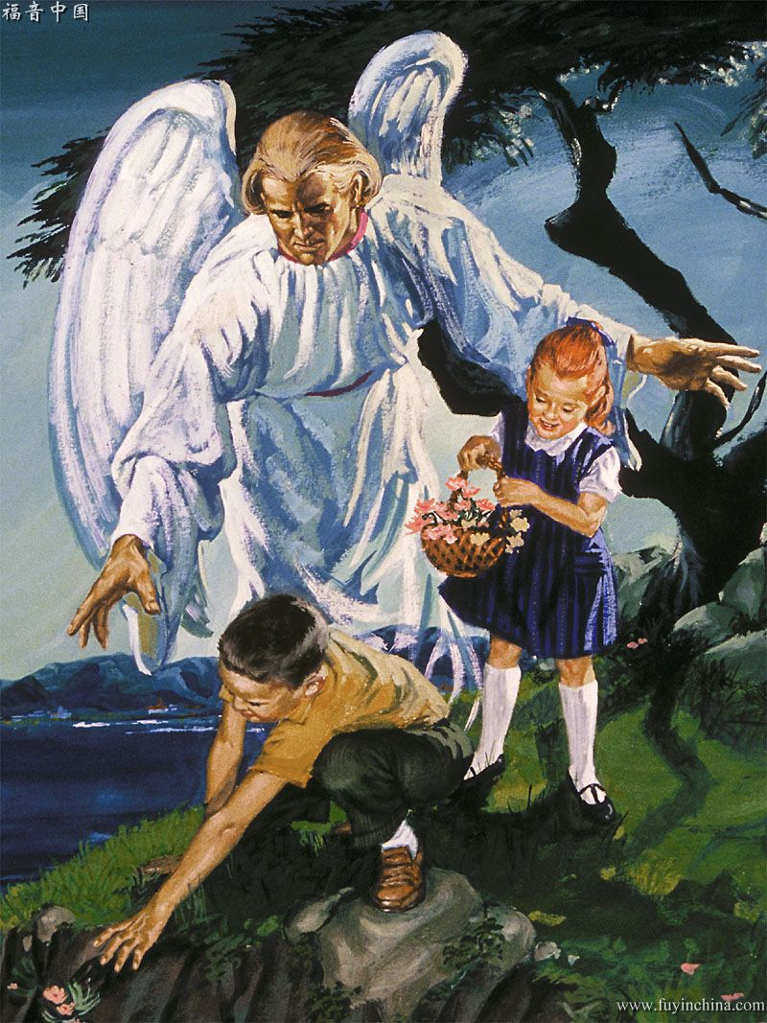
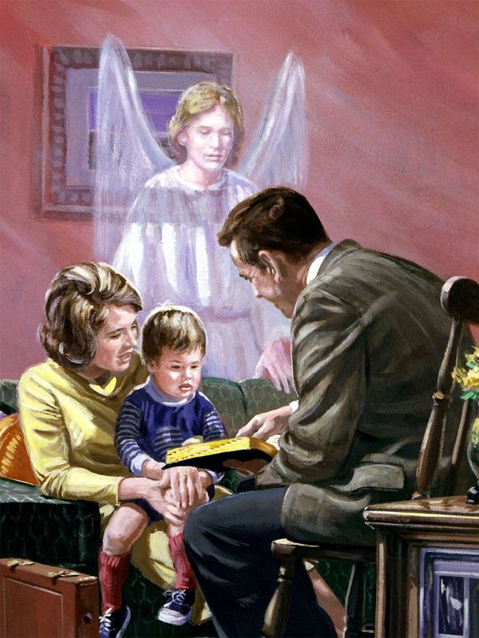
The relationship between the visible and the invisible worlds is very close, and it is the angels who unite heaven with earth.
We are going to study and answer some questions that we ask ourselves about angels.
We will see who they are; their work in the Old Testament; how they supported Jesus; their intervention in the early church; and how they support us today.

Slide 3


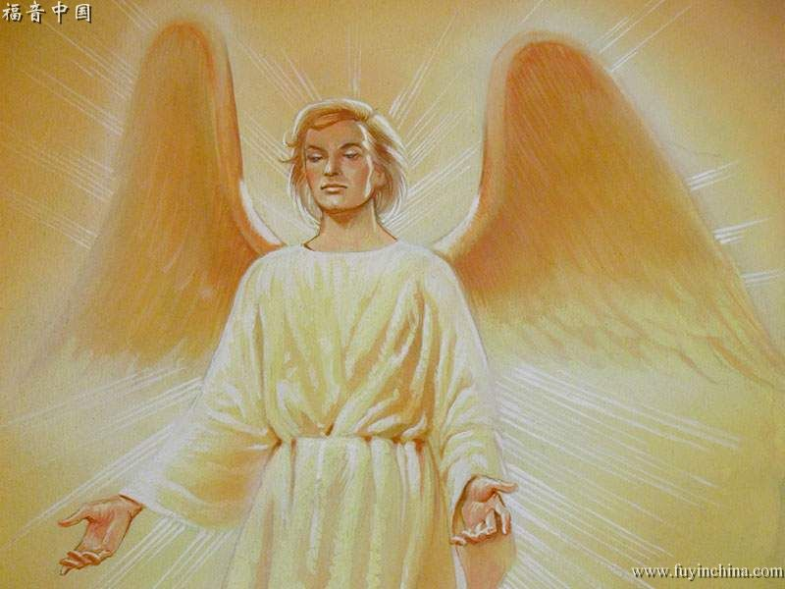

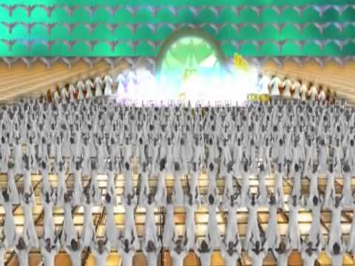


What are the angels?
“Are they not all ministering spirits, sent forth to minister for them who shall be heirs of salvation?” (Hebrews 1:14).
Angels are by nature superior to man, for the psalmist of man says: “For thou hast made him a little lower than the angels” (Psalms 8:5)
What do they look like?
“As God's messengers they go forth, like “the appearance of a flash of lightning,” (Ezekiel 1:14) (TA 10)
We cannot see and could not endure the glory of angelic ministrations if their glory was not veiled in condescension to the weakness of our human nature. The blaze of the heavenly glory, as seen in the angels of light, would extinguish earthly mortals. (MS1, p. 10).
How many are there?
“And I beheld, and I heard the voice of many angels round about the throne and the beasts and the elders: and the number of them was ten thousand times ten thousand, and thousands of thousands” (Revelation 5:11).
Were they created?
The Father wrought by His Son in the creation of all heavenly beings. “By Him were all things created, ... whether they be thrones, or dominions, or principalities, or powers; all things were created by Him, and for Him.”—(Patriarchs and Prophets, 34. TA 25).

Slide 4


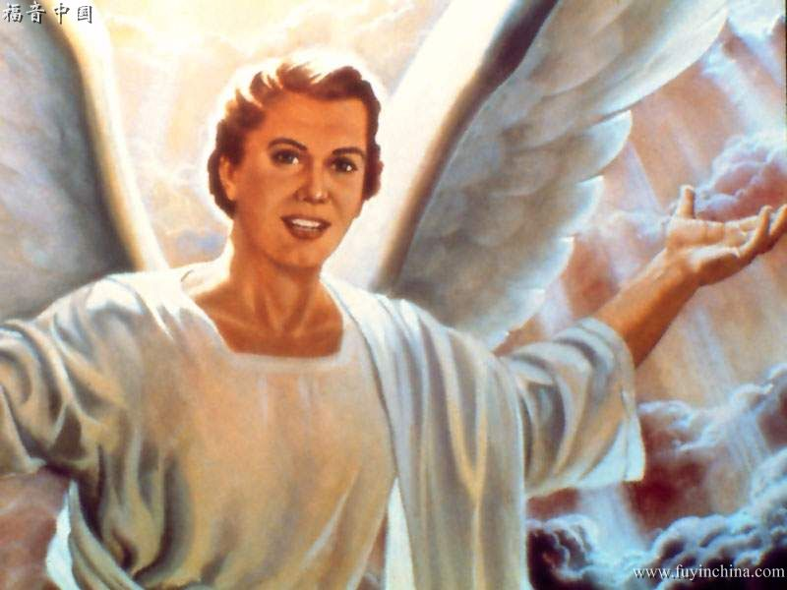

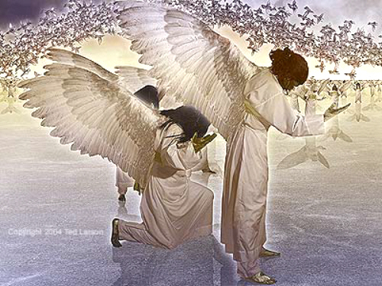
What attributes do they possess?
Perfect peace is an attitude of heaven which angels possess (Testimonies for the Church 2:326, 327). (LHU 94.6).
When the Lord created these [angelic] beings to stand before His throne, they were beautiful and glorious. Their loveliness and holiness were equal to their exalted station. They were enriched by the wisdom of God and girded with the panoply of heaven. (The Signs of the Times, April 14, 1898. TA 26).
How do they work?
Angels work harmoniously. Perfect order characterizes all their movements. The more closely we imitate the harmony and order of the angelic host, the more successful will be the efforts of these heavenly agents in our behalf. If we see no necessity for harmonious action, and are disorderly, undisciplined, and disorganized in our course of action, angels, who are thoroughly organized and move in perfect order, cannot work for us successfully. They turn away in grief, for they are not authorized to bless confusion, distraction, and disorganization. (TM 28.).

Slide 5



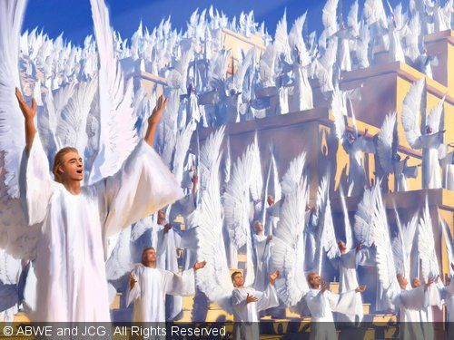





How do angels intervene in human history?
In creation
“Where wast thou when I laid the foundations of the earth? declare, if thou hast understanding. Who hath laid the measures thereof, if thou knowest? or who hath stretched the line upon it? Whereupon are the foundations thereof fastened? or who laid the corner stone thereof; When the morning stars sang together, and all the sons of God shouted for joy?” (Job 38:4-7).
In Eden
When the Lord presented Eve to Adam, angels of God were witnesses to the ceremony. (In Heavenly Places, 203. TA 48).
Holy angels often visited the garden, and gave instruction to Adam and Eve concerning their employment and also taught them concerning the rebellion and fall of Satan. (EW 147).
Angels held communication with Adam after his fall, and informed him of the plan of salvation, and that the human race was not beyond redemption. (Spiritual Gifts 3:52. TA 63).

Slide 6


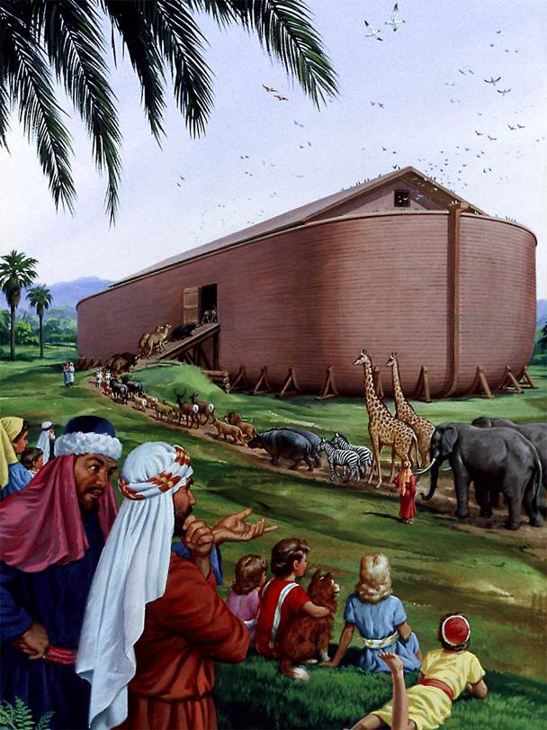

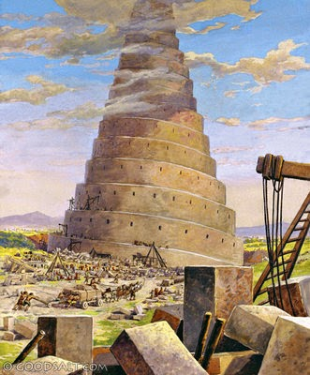
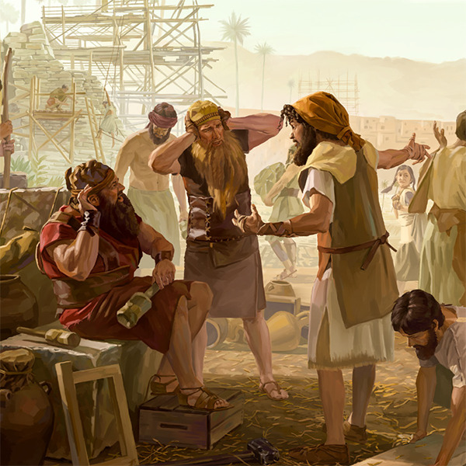
How do angels intervene in human history?
In Noah's Time
More than one hundred years before the Flood the Lord sent an angel to faithful Noah to make known to him that He would no longer have mercy upon the corrupt race. (SR 62.3).
Angels were sent to collect from the forest and field the beasts which God had created. Angels went before these animals, and they followed, two and two, male and female, and clean beasts by sevens. These beasts, from the most ferocious, down to the most gentle and harmless, peacefully and solemnly marched into the ark. (SR 65.1).
Everything was now ready for the closing of the ark, which could not have been done by Noah from within. An angel is seen by the scoffing multitude descending from heaven, clothed with brightness like the lightning. He closes that massive outer door, and then takes his course upward to heaven again. (The Spirit of Prophecy 1:72. TA 69).
Angels that excel in strength guided the ark and preserved it from harm. Every moment during that frightful storm of forty days and forty nights the preservation of the ark was a miracle of almighty power. (The Spirit of Prophecy 1:73, 75. TA 70).
At the Tower of Babel
They had built their tower to a lofty height when the Lord sent two angels to confound them in their work. Men had been appointed for the purpose of receiving word from the workmen at the top of the tower, calling for material for their work, which the first would communicate to the second, and he to the third, until the word reached those on the ground. As the word was passing from one to another in its descent, the angels confounded their language. (SR 73.).

Slide 7

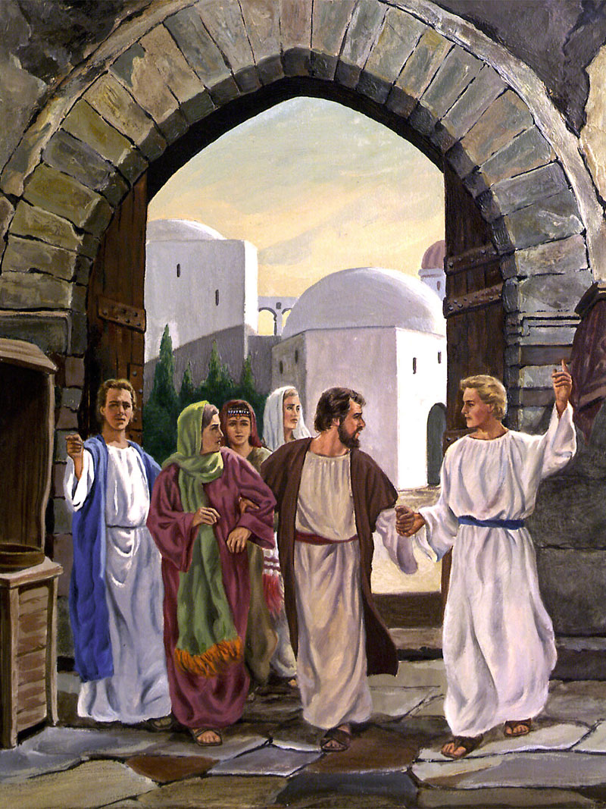


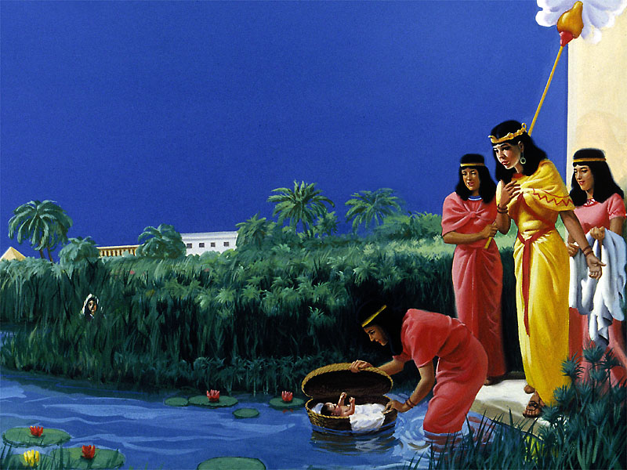
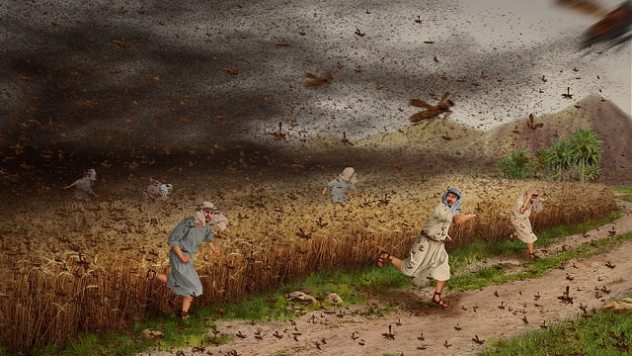
How do angels intervene in human history?
In the time of the patriarchs
They stayed with Abraham and Lot (Genesis 18-19). “And there came two angels to Sodom at even; and Lot sat in the gate of Sodom: and Lot seeing them rose up to meet them; and he bowed himself with his face toward the ground” (Genesis 19:1).
Heavenly beings were witnesses of the scene as the faith of Abraham and the submission of Isaac were tested.... All heaven beheld with wonder and admiration Abraham's unfaltering obedience. All heaven applauded his fidelity. (TA 80).
“And Jacob went on his way, and the angels of God met him” (Genesis 32:1).
In Egypt
His sister, Miriam, lingered near, apparently indifferent, but anxiously watching to see what would become of her little brother. And there were other watchers. The mother's earnest prayers had committed her child to the care of God; and angels, unseen, hovered above his lowly resting place. Angels directed Pharaoh's daughter thither. (PP 243).
The elders of Israel were taught by angels that the time for their deliverance was near, and that Moses was the man whom God would employ to accomplish this work. Angels instructed Moses also that Jehovah had chosen him to break the bondage of his people (Patriarchs and Prophets, 245. TA 89).
Aaron, being instructed by angels, went forth to meet his brother, from whom he had been so long separated; and they met amid the desert solitudes, near Horeb. (PP 257).
“He cast upon them the fierceness of his anger, wrath, and indignation, and trouble, by sending evil angels among them” (Psalms 78:49).

Slide 8

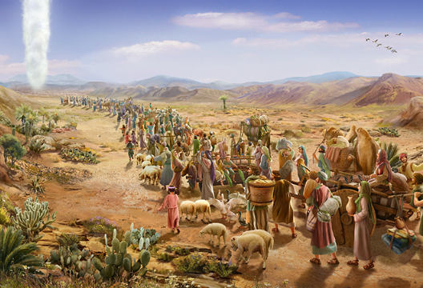

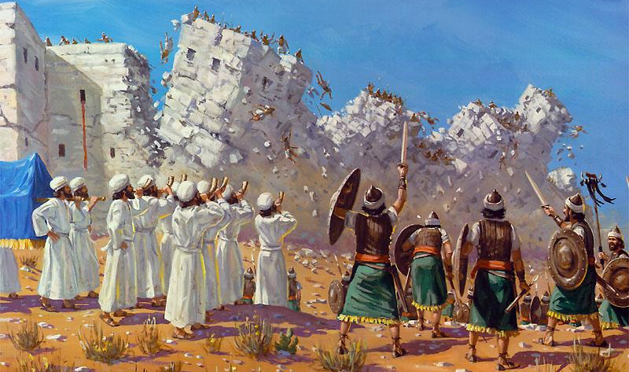

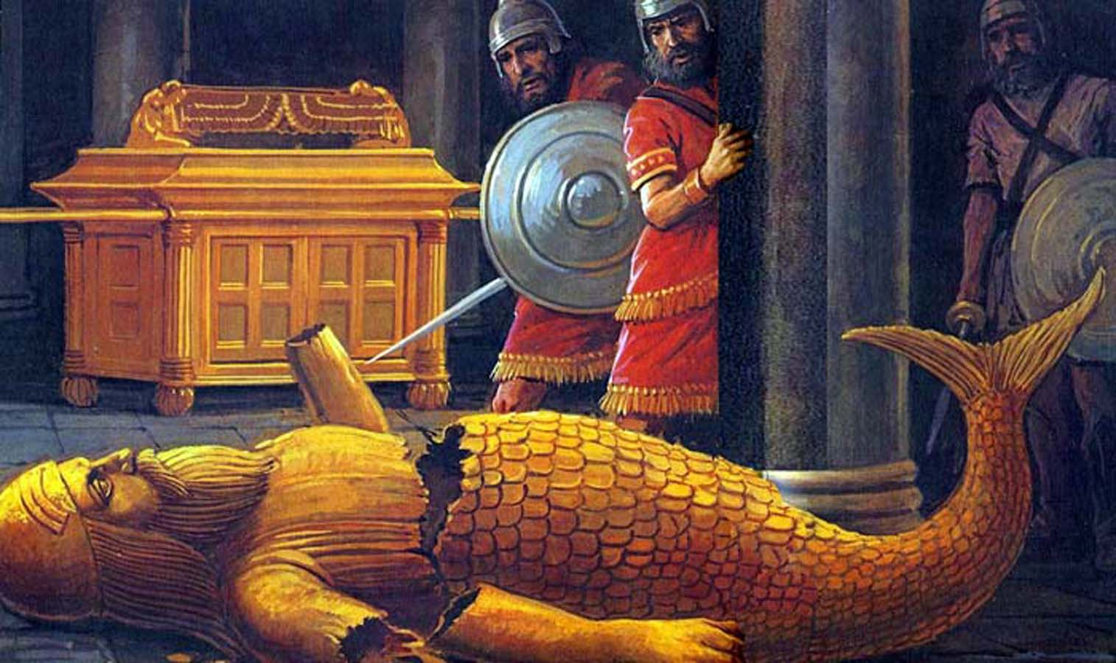
How do angels intervene in human history?
In the Exodus
Wherefore then serveth the law? It was added because of transgressions, till the seed should come to whom the promise was made; and it was ordained by angels in the hand of a mediator. (Galatians 3:19)
They protected the Israelites during the exodus. Angels of God went through their host and removed their chariot wheels.—The Spirit of Prophecy 1:209. TA 96).
In the Time of Joshua and the Judges
Four heavenly angels always accompanied the ark of God in all its journeyings, to guard it from all danger, and to fulfill any mission required of them in connection with the ark… Christ and angels attended the circuit of the ark around Jericho, and finally cast down the massive walls of the city, and delivered Jericho into the hands of Israel. (The Spirit of Prophecy 1:399. TA 109; 111).
The angels of God, who ever accompanied the ark, prostrated the senseless idol god, and afterward mutilated it, to show that God, the living God, was above all gods, and before Him every heathen God was as nothing. (TA 118).

Slide 9

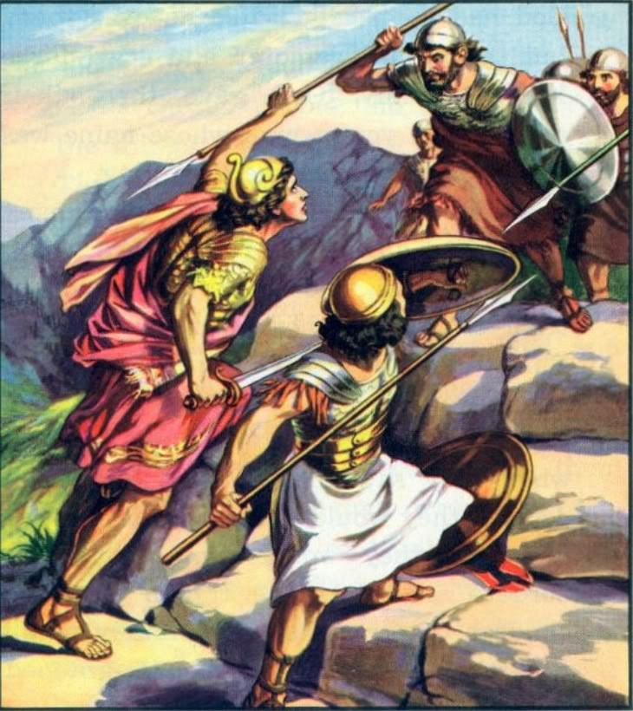
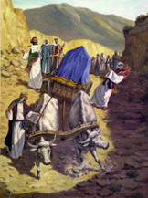


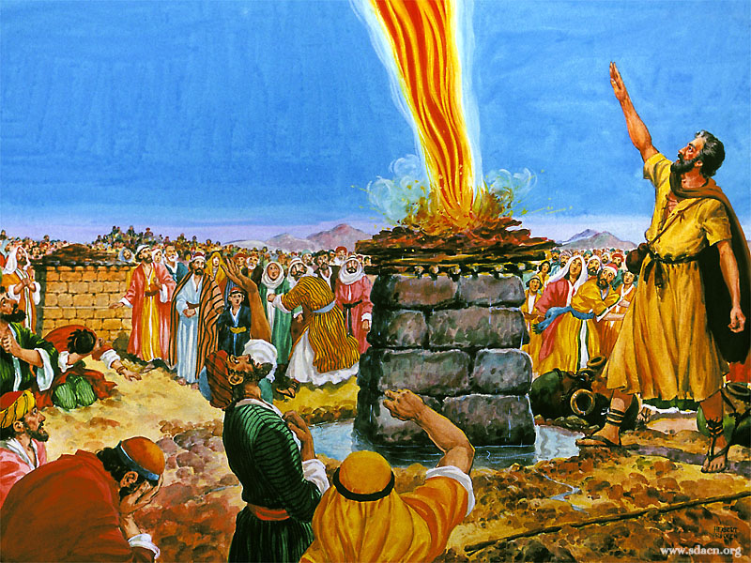
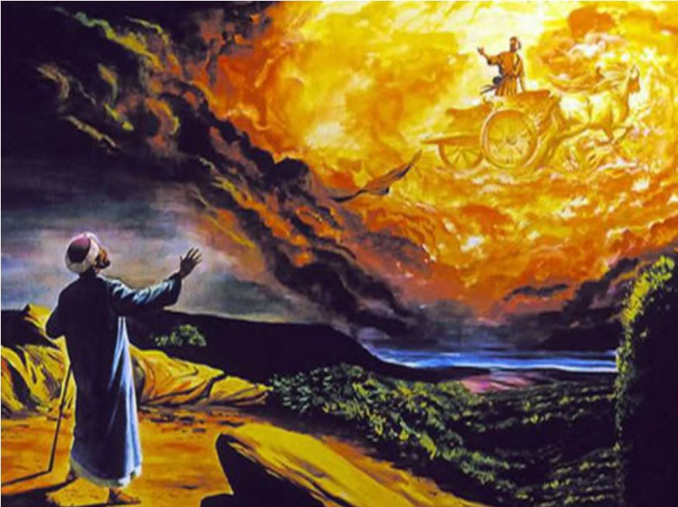
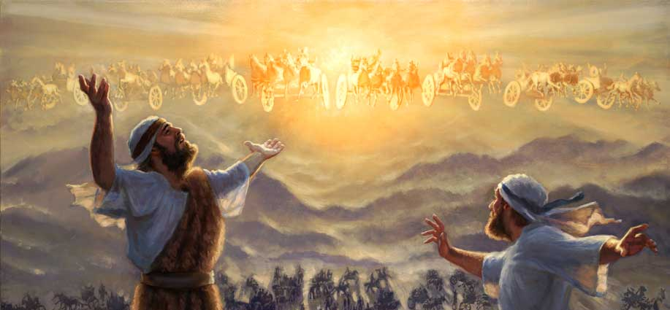
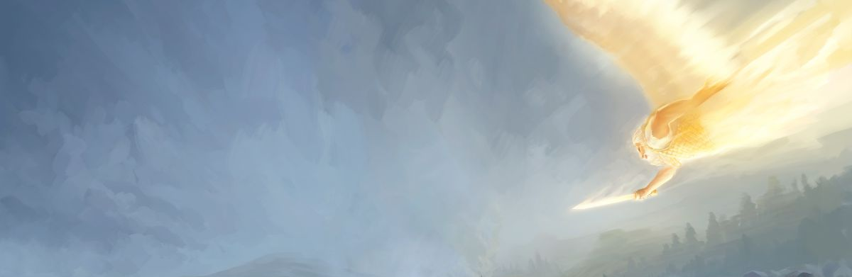
How do angels intervene in human history?
In the first kings
Angels of heaven shielded Jonathan and his attendant, angels fought by their side, and the Philistines fell before them. (PP 623).
Angels who attended the ark struck down Uzzah for presuming impatiently to put his hand upon the ark of God. (Spiritual Gifts 4a:111. TA 126).
In the divided kingdom
Facing King Ahab and the false prophets, and surrounded by the assembled hosts of Israel, Elijah stands, the only one who has appeared to vindicate the honor of Jehovah. He whom the whole kingdom has charged with its weight of woe is now before them, apparently defenseless in the presence of the monarch of Israel, the prophets of Baal, the men of war, and the surrounding thousands. But Elijah is not alone. Above and around him are the protecting hosts of heaven, angels that excel in strength. (PK 147).
[Elijah] Angels bore him in glory and triumph to heaven. (SR 206).
And Elisha prayed, and said, Lord, I pray thee, open his eyes, that he may see. And the Lord opened the eyes of the young man; and he saw: and, behold, the mountain was full of horses and chariots of fire round about Elisha” (2 Kings 6:17).
And the Lord sent an angel, which cut off all the mighty men of valour, and the leaders and captains in the camp of the king of Assyria. So he returned with shame of face to his own land. And when he was come into the house of his god, they that came forth of his own bowels slew him there with the sword. (2 Chronicles 32:21).

Slide 10

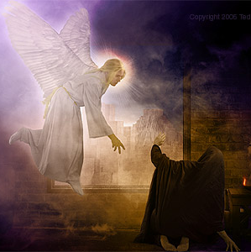
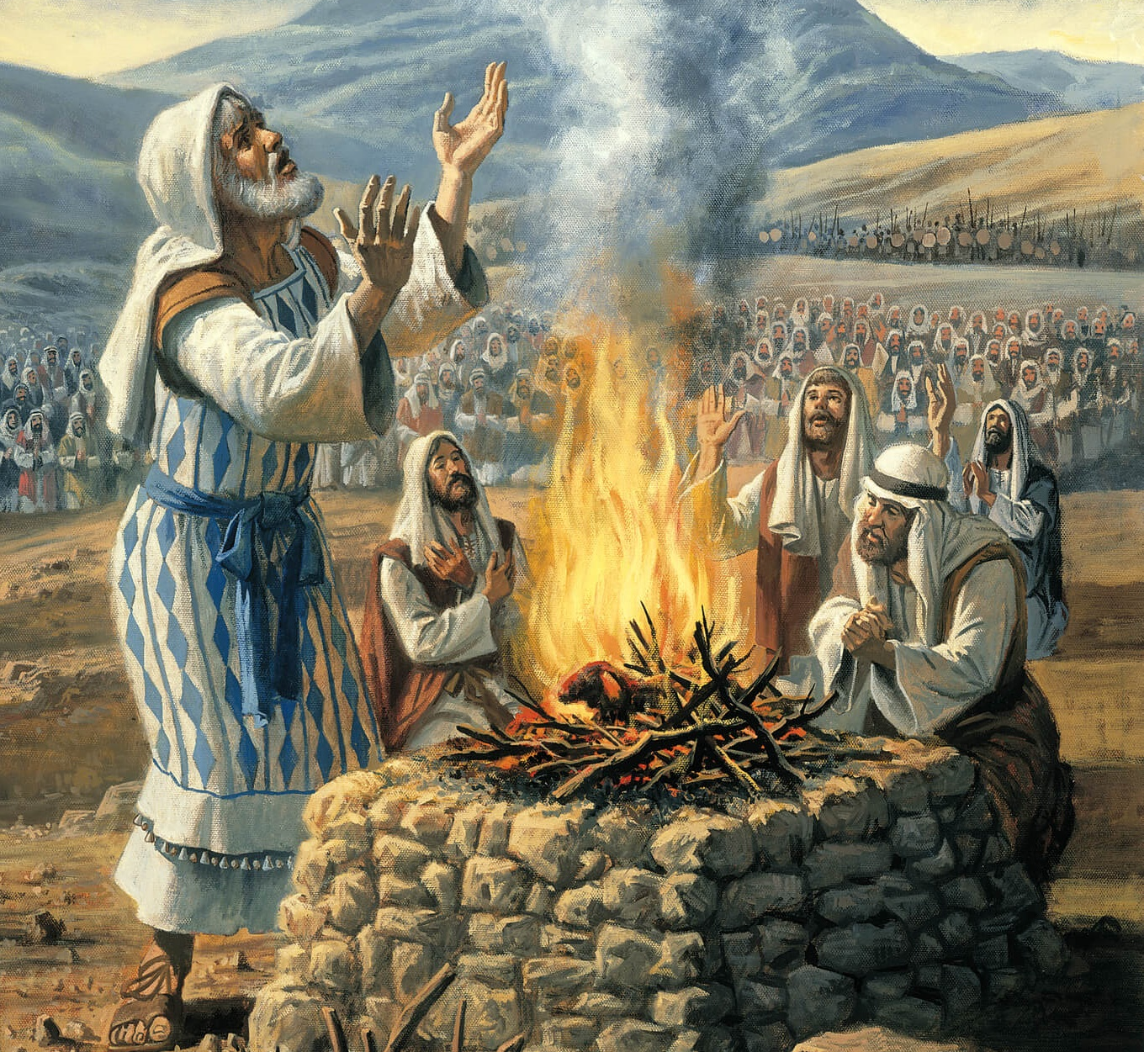

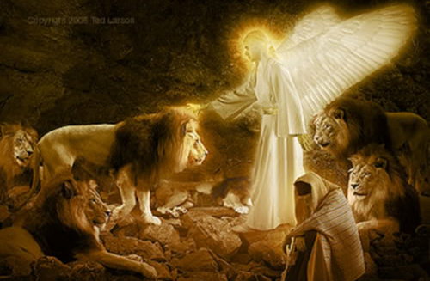
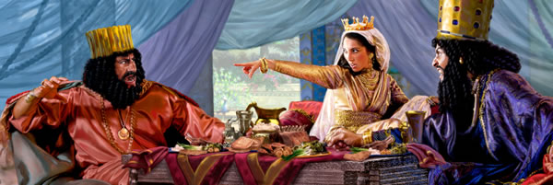
How do angels intervene in human history?
In exile
“Yea, whiles I was speaking in prayer, even the man Gabriel, whom I had seen in the vision at the beginning, being caused to fly swiftly, touched me about the time of the evening oblation. And he informed me, and talked with me, and said, O Daniel, I am now come forth to give thee skill and understanding.” (Daniel 9:21-22).
“My God hath sent his angel, and hath shut the lions' mouths, that they have not hurt me: forasmuch as before him innocency was found in me; and also before thee, O king, have I done no hurt.” (Daniel 6:22).
On the day appointed for their destruction, “the Jews gathered themselves together in their cities throughout all the provinces of the king Ahasuerus, to lay hand on such as sought their hurt: and no man could withstand them; for the fear of them fell upon all people.” Angels that excel in strength had been commissioned by God to protect His people while they “stood for their lives.” (Esther 9:2, 16. PK 602).
The children of the captivity who had returned with Ezra “offered burnt offerings unto the God of Israel” for a sin offering and as a token of their gratitude and thanksgiving for the protection of holy angels during the journey. (PK 619.3).

Slide 11



How did angels intervene in Jesus' life?
Gabriel announced the birth of John the Baptist
(Luke 1:8-20)
Gabriel announced the birth of Jesus
(Luke 1:26-38)
They appeared in a dream to Joseph (Matthew 1:20)
They announced the birth to the shepherds
(Luke 2:8-15)
They formed the star of Bethlehem. This light was a distant cluster of flaming angels, which appeared like a luminous star. (LHU 30)
Joseph was instructed to return from Egypt
(Matthew 2:19-20)
They protected Jesus during His childhood and youth. From His earliest years Jesus was guarded by heavenly angels. (DA 71)
IN
THE BIRTH

Slide 12

How did angels intervene in Jesus' life?
IN HIS MINISTRY
In the temptations, angels that excel in strength were on the battleground, guarding the interest of the tempted soul, and ready to resist the foe. (The Review and Herald, April 24, 1894. TA 177)
They served Jesus after temptation (Mark 1:13). After Satan had ended his temptations, he departed from Jesus for a season, and angels prepared Him food in the wilderness. (Early Writings, 158. TA 178)
They saved Jesus from dying in Nazareth. Angels of God attended Jesus in the midst of that infuriated mob, and preserved His life. The heavenly messengers were by His side in the synagogue, while He was speaking; and they accompanied Him when pressed and urged on by the unbelieving, infuriated Jews. These angels blinded the eyes of that maddened throng, and conducted Jesus to a place of safety. (TA 183)

Slide 13

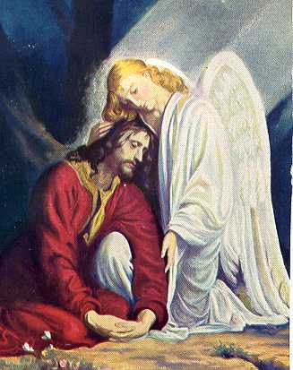
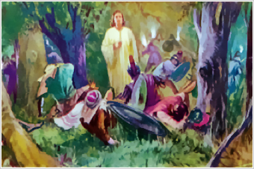
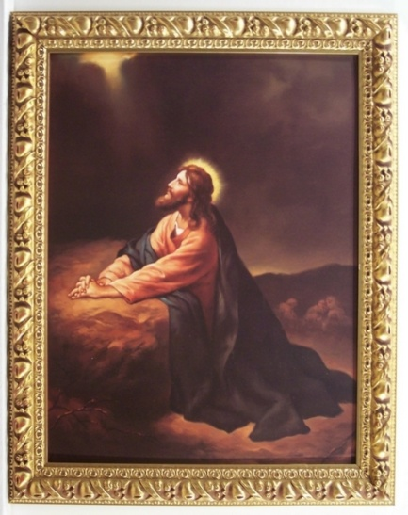
How did angels intervene in Jesus' life?
An angel comforted Jesus (Luke 22:43). In the supreme crisis, when heart and soul are breaking under the load of sin, Gabriel is sent to strengthen the divine Sufferer, and brace Him to tread His bloodstained path. (The Signs of the Times, December 9, 1897. TA 195)
IN GETSEMANE
In the arrest, they stood between Jesus and the crowd. Standing in advance of His disciples He said, “Whom seek ye?” They answered, “Jesus of Nazareth.” Jesus replied, “I am He.” As these words were spoken, the angel who had lately ministered to Jesus moved between Him and the mob. A divine light illuminated the Saviour's face, and a dovelike form overshadowed Him. In the presence of this divine glory, the murderous throng could not stand for a moment. They staggered back. Priests, elders, soldiers, and even Judas, fell as dead men to the ground. (DA 694)

Slide 14

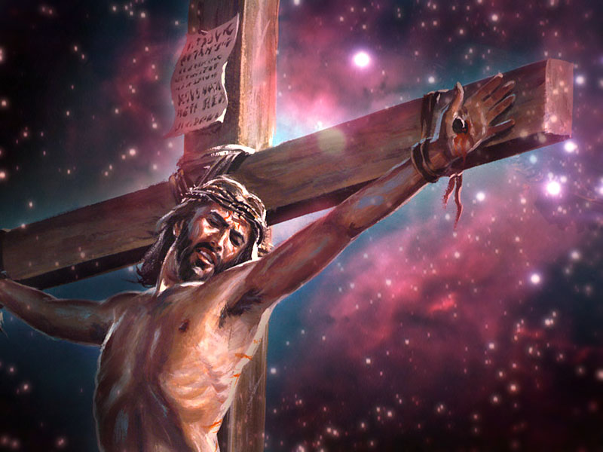
How did angels intervene in Jesus' life?
IN HEAVEN
IN
THE CRUCIFIXION
Angels beheld the Saviour's agony. They saw their Lord enclosed by legions of satanic forces, His nature weighed down with a shuddering, mysterious dread. There was silence in heaven. No harp was touched. Could mortals have viewed the amazement of the angelic host as in silent grief they watched the Father separating His beams of light, love, and glory from His beloved Son, they would better understand how offensive in His sight is sin. (DA 693)
ON EARTH
Companies of angels were marshaled in the air above the place. The angels who hovered over the scene of Christ's crucifixion were moved to indignation as the rulers derided Him and said, “If He be the Son of God, let Him deliver Himself”. They wished there to come to the rescue of Jesus and deliver Him, but they were not suffered to do so. The object of His mission was not yet accomplished. (EW 175; 177)

Slide 15

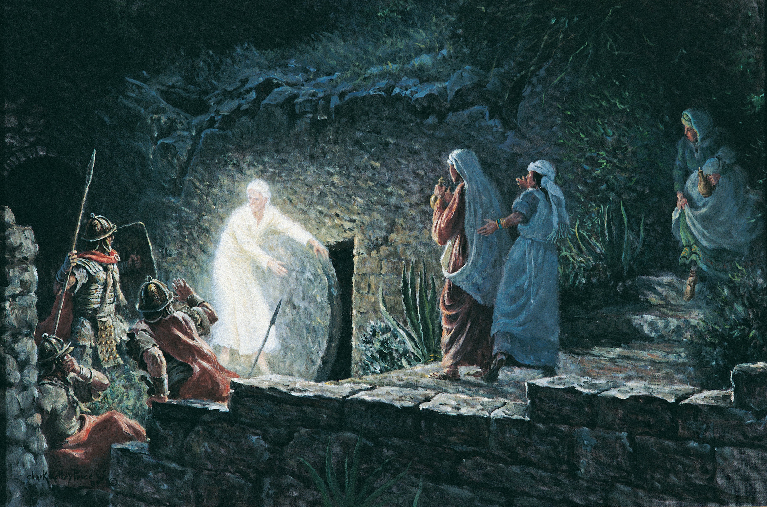
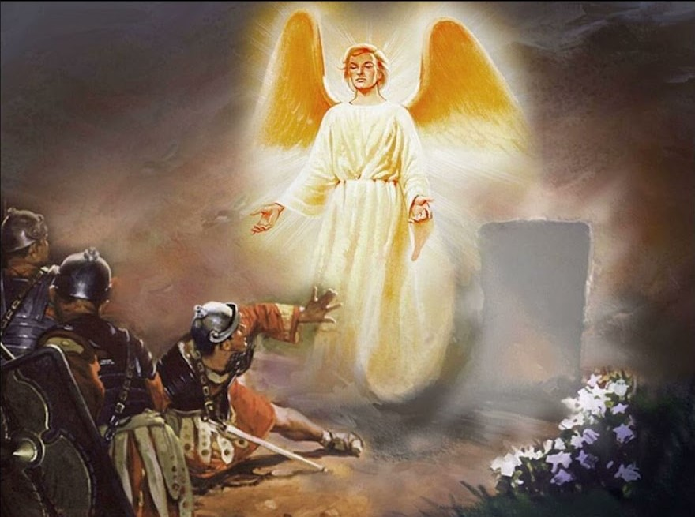
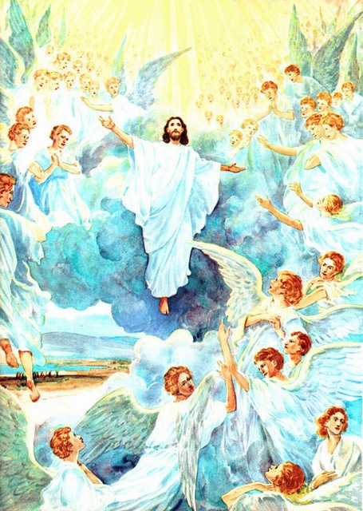
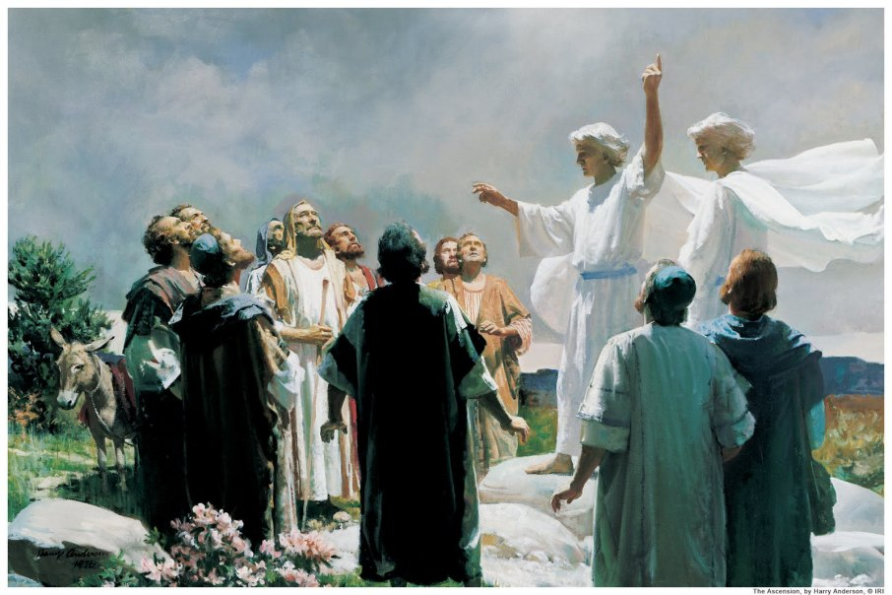
How did angels intervene in Jesus' life?
They rolled away the stone from the tomb
(Matthew 28:2)
They struck down the Roman guard
(Matthew 28:4)
Two angels announced to the apostles the Second Coming
(Acts 1:10-11)
IN THE RESURRECTION
AND IN THE ASCENSION
They took Jesus to heaven. While the disciples were gazing upward to catch the last glimpse of their ascending Lord, He was received into the rejoicing ranks of heavenly angels. As these angels escorted Him to the courts above, they sang in triumph, “Sing unto God, ye kingdoms of the earth; O sing praises unto the Lord, to Him that rideth upon the heavens of heavens.... Ascribe ye strength unto God: His excellency is over Israel, and His strength is in the heavens.” Psalm 68:32-34, margin. (AA 32).

Slide 16


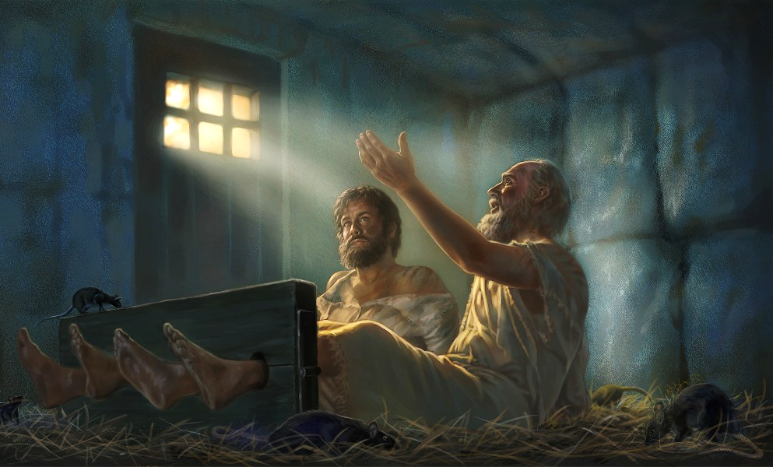
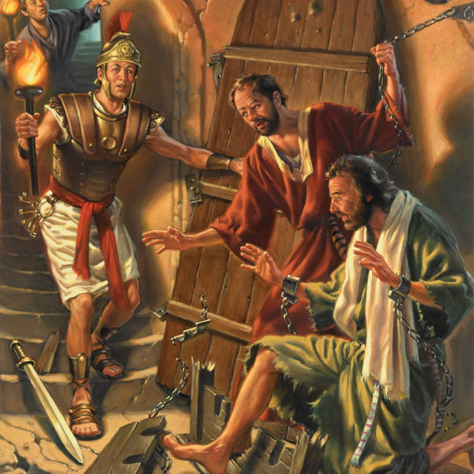
¿Cómo intervinieron los ángeles en la vida de Jesús?
How do angels intervene in the early church?
They delivered the apostles from prison
(Acts 5:17-20)
They impressed Gamaliel. They were planning to do this, when an angel from God moved upon the heart of Gamaliel to counsel the priests and rulers. (EW 195)
Philip was brought before the Ethiopian (Acts 8:26)
They appeared to Cornelius
(Acts 10:1-8)
They Delivered Peter from Prison
(Acts 12:6-10)
They struck Herod
(Acts 12:21-23)
They released Paul and Silas from the prison of Philippi. All heaven was interested in the men who were suffering for Christ's sake, and angels were sent to visit the prison. At their tread the earth trembled. The heavily bolted prison doors were thrown open; the chains and fetters fell from the hands and feet of the prisoners; and a bright light flooded the prison. (AA 215)

Slide 17



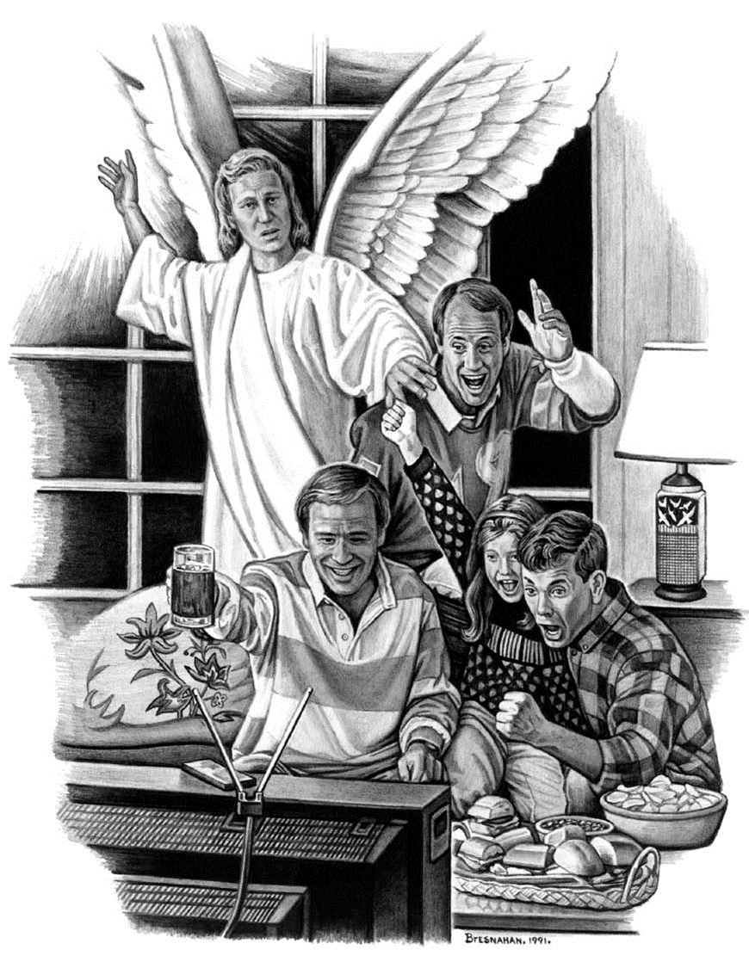
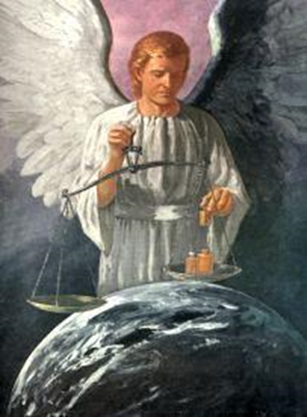



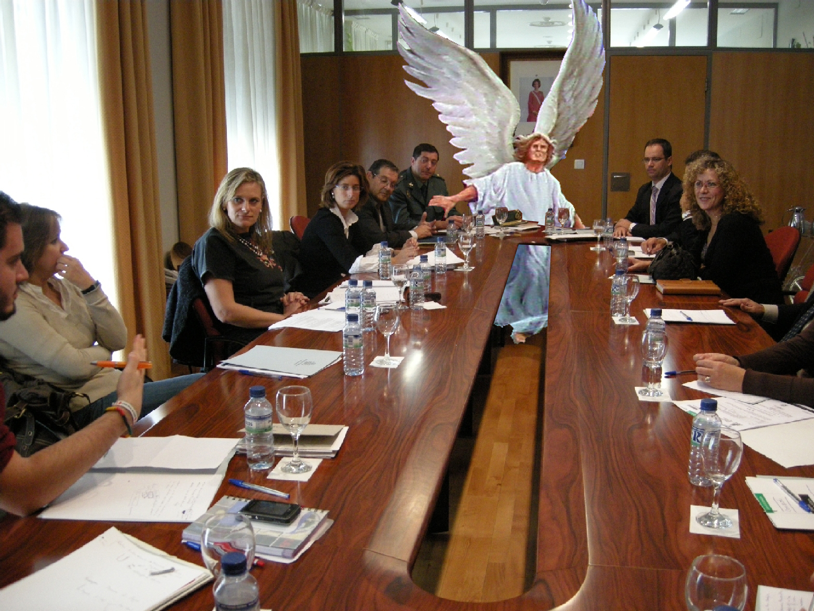


How do angels intervene in our lives today?
Angels are sent on missions of mercy to the children of God. (GC 512).
The agency by which God protects His people is presented in the words of the psalmist: “The angel of the Lord encampeth round about them that fear Him, and delivereth them.” Psalm 34:7 (GC 512).
But those who follow Christ are ever safe under His watchcare. Angels that excel in strength are sent from heaven to protect them. The wicked one cannot break through the guard which God has stationed about His people. (GC 517).
Though the rulers of this world know it not, yet often in their councils angels have been spokesmen… In the council hall and the court of justice these heavenly messengers have shown an intimate acquaintance with human history; they have proved themselves better able to plead the cause of the oppressed than were their ablest and most eloquent defenders. (GC 632).
Heavenly angels watch those who are seeking for enlightenment (TA 17).

Slide 18
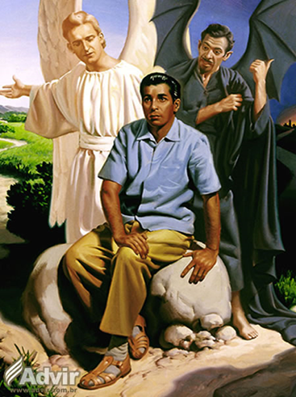



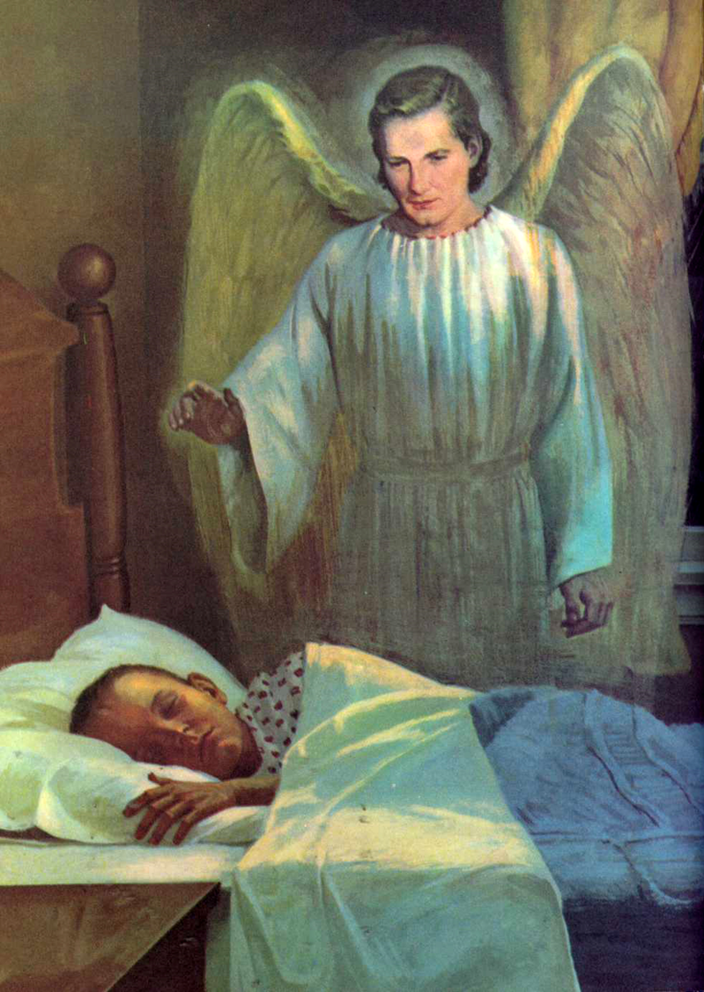


How do angels intervene in our lives today?
They cooperate with those who try to win souls to Christ (The Bible Echo, December 10, 1900. TA 17).
Tell the dear Saviour just what you need… will not reject your prayer. But He will send His angels to guard you and protect you from the evil angels, and will make it easy for you to do right (VAAn 19).
Those who labor for the good of others are working in union with the heavenly angels. They have their constant companionship, their unceasing ministry. Angels of light and power are ever near, to protect, to comfort, to heal, to instruct, to inspire (TA 21).
The highest education, the truest culture, the most exalted service possible to human beings in this world, are theirs. (The Review and Herald, July 11, 1912.
TA 21).
A guardian angel is appointed to every follower of Christ. (TA 14). Said the Saviour, speaking of those that believe in Him: “Take heed that ye despise not one of these little ones; for I say unto you, That in heaven their angels do always behold the face of My Father.” Matthew 18:10. The angels appointed to minister to the children of God have at all times access to His presence. (GC 5122).

Slide 19

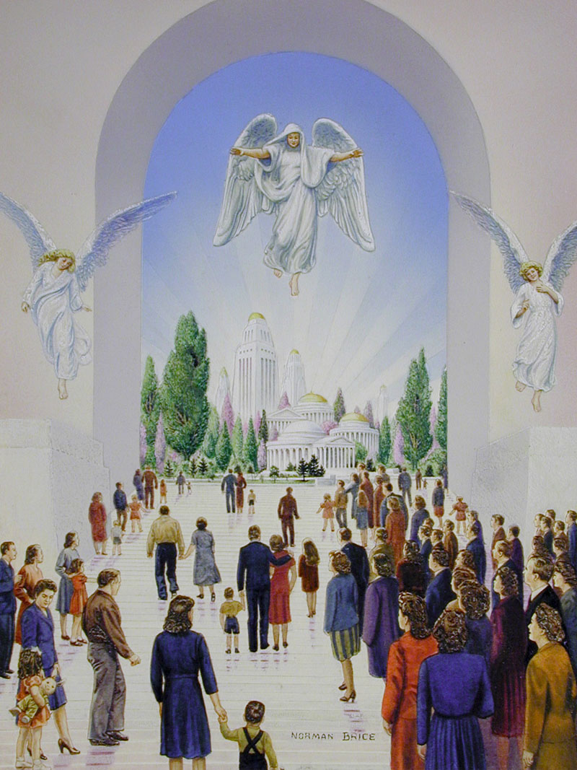
“Every redeemed one will understand the ministry of angels in his own life. The angel who was his guardian from his earliest moment; the angel who watched his steps, and covered his head in the day of peril; the angel who was with him in the valley of the shadow of death, who marked his resting place, who was the first to greet him in the resurrection morning—what will it be to hold converse with him, and to learn the history of divine interposition in the individual life, of heavenly co-operation in every work for humanity!” (Ed 305.2)

