Slide 1

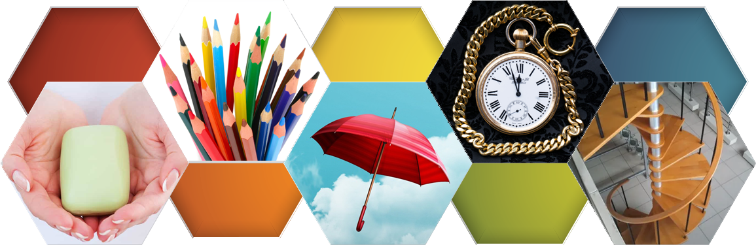







Slide 2
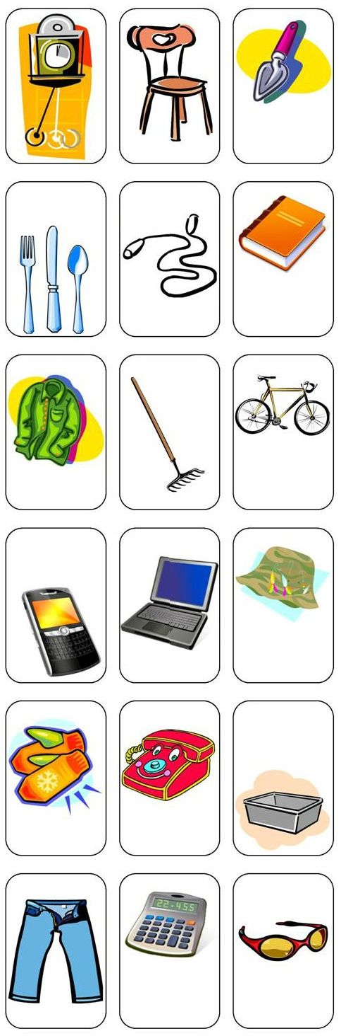
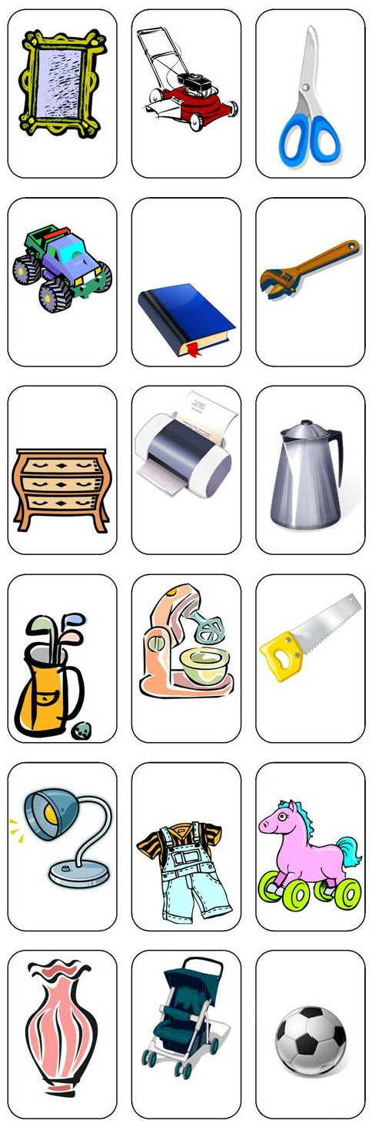

At home we have an infinite number of objects that we use daily or at least once a week.
The learning we gain from them can be wonderful, when we are willing to draw out their spiritual teachings.
We are going to analyze ten objects of daily use and learn a practical lesson for our Christian life.

Slide 3


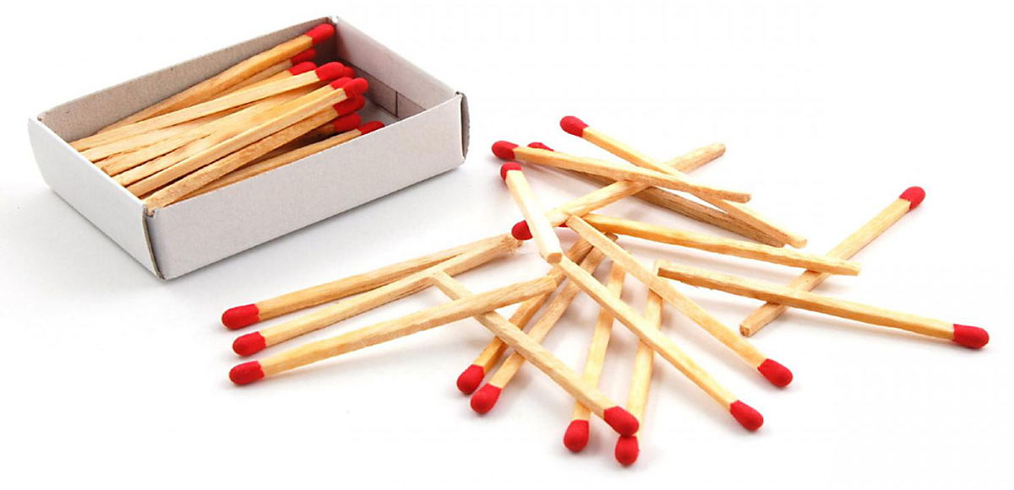

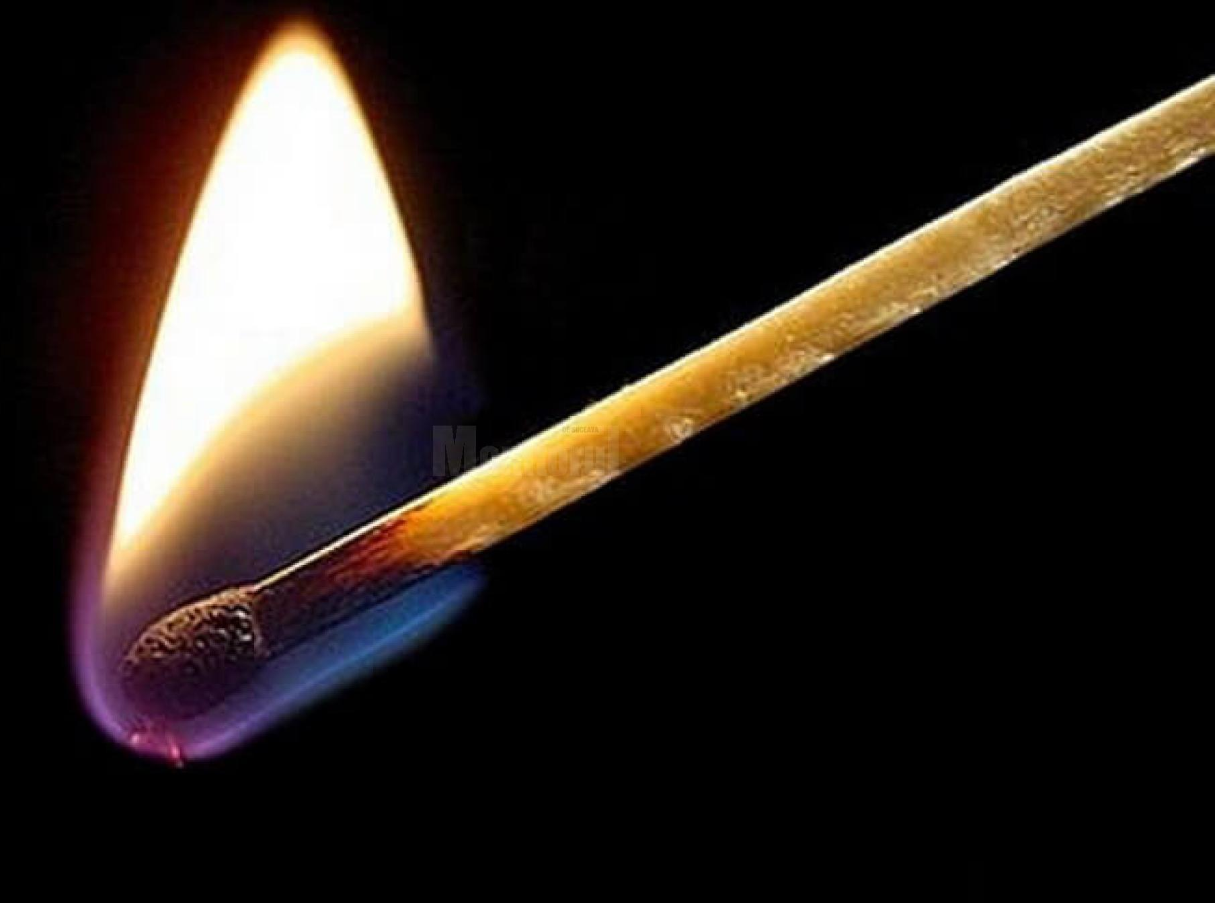
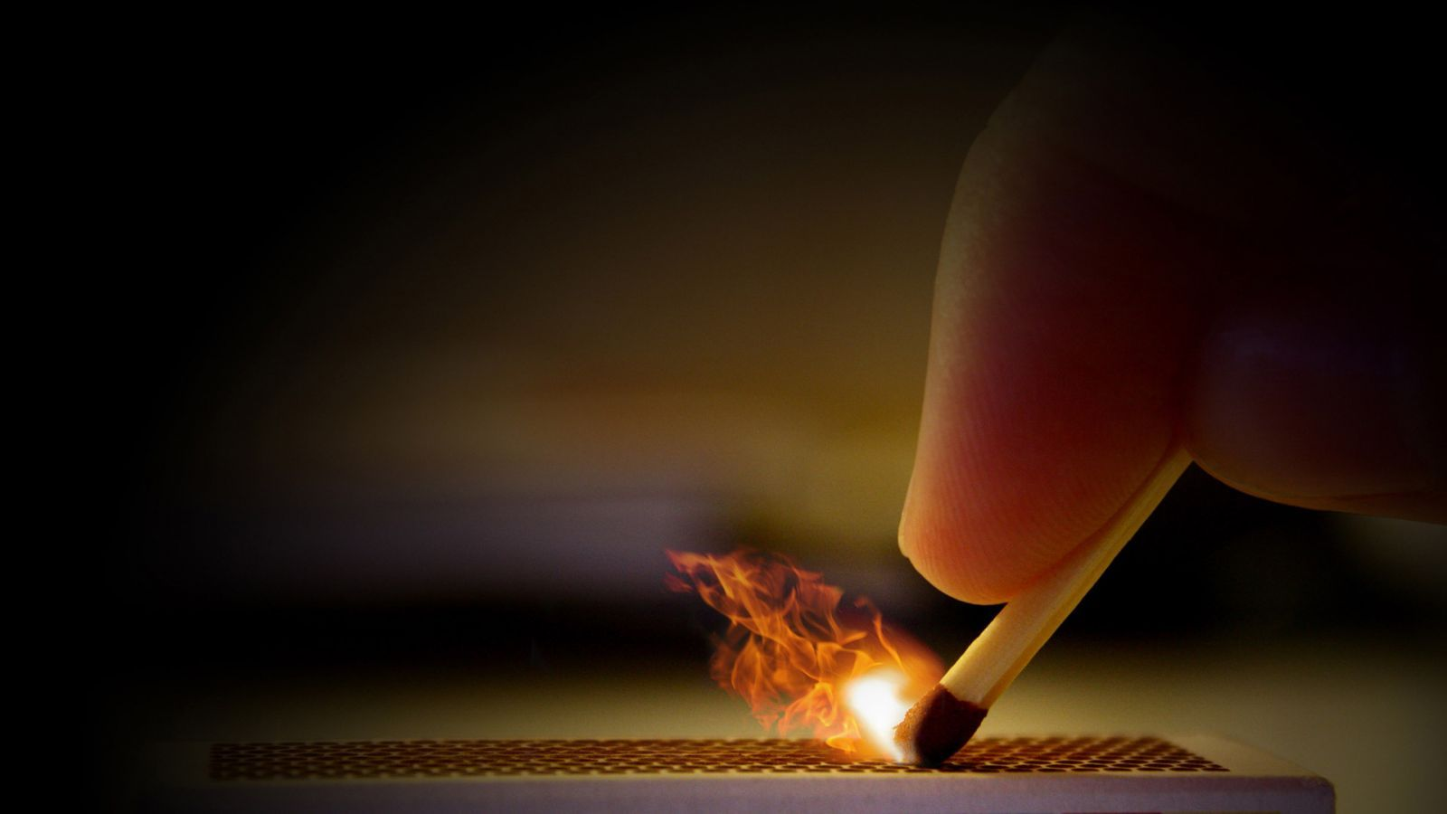
A very common element in the house is a box of matches.
A match, misto or mixed (Greek: φωσφόρος, lit. 'light-bearer') is a fungible utensil, consisting of a rod of combustible material with one end (called a head) covered by a substance such that, when rubbed against a suitable rough surface, it causes the head to ignite.
The ignition principle consists of reaching the ignition temperature, by means of friction that produces heat, to generate the reduction-oxidation reaction and ignite the fuel that forms the head, a short-term combustion that is then maintained in the rod.

Slide 4
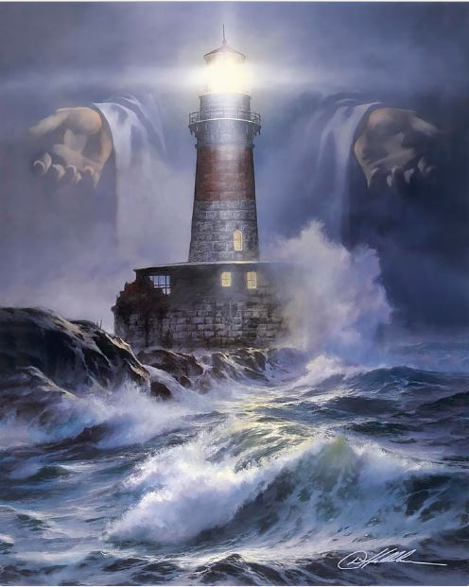

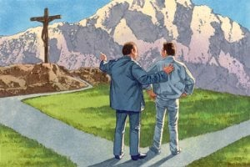
The light that matches give us is very useful. We use matches in different circumstances, darkness is overcome with just a flame that gives us a match, the practical lesson is that we can be that little flame that illuminates in a world of darkness.
Ye are the light of the world. A city that is set on an hill cannot be hid. Neither do men light a candle, and put it under a bushel, but on a candlestick; and it giveth light unto all that are in the house. Let your light so shine before men, that they may see your good works, and glorify your Father which is in heaven. (Matthew 5:14-16)
Arise, shine; for thy light is come, and the glory of the LORD is risen upon thee. (Isaiah 60:1)
For so hath the Lord commanded us, saying, I have set thee to be a light of the Gentiles, that thou shouldest be for salvation unto the ends of the earth. (Acts. 13:47)
The members of the churches should be made to understand that they are the light of the world, and according to their several ability the Lord expects them to enlighten and bless others. Whether they are rich or poor, great or humble, God calls them into active service for Him. He depends upon the church for the forwarding of His work, and He expects His professed followers to do their duty as intelligent beings. There is great need that every trained mind, every disciplined intellect, every jot of ability, be brought into the work of saving souls. 6T 432

Slide 5

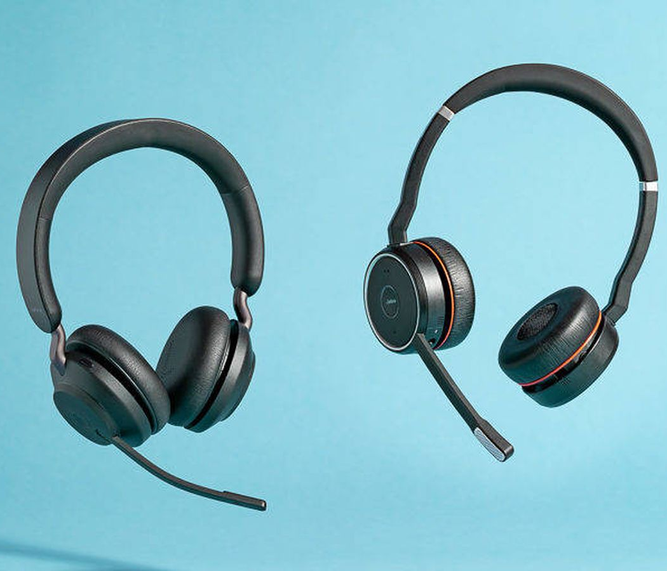


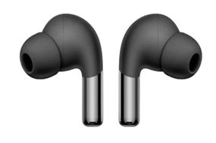
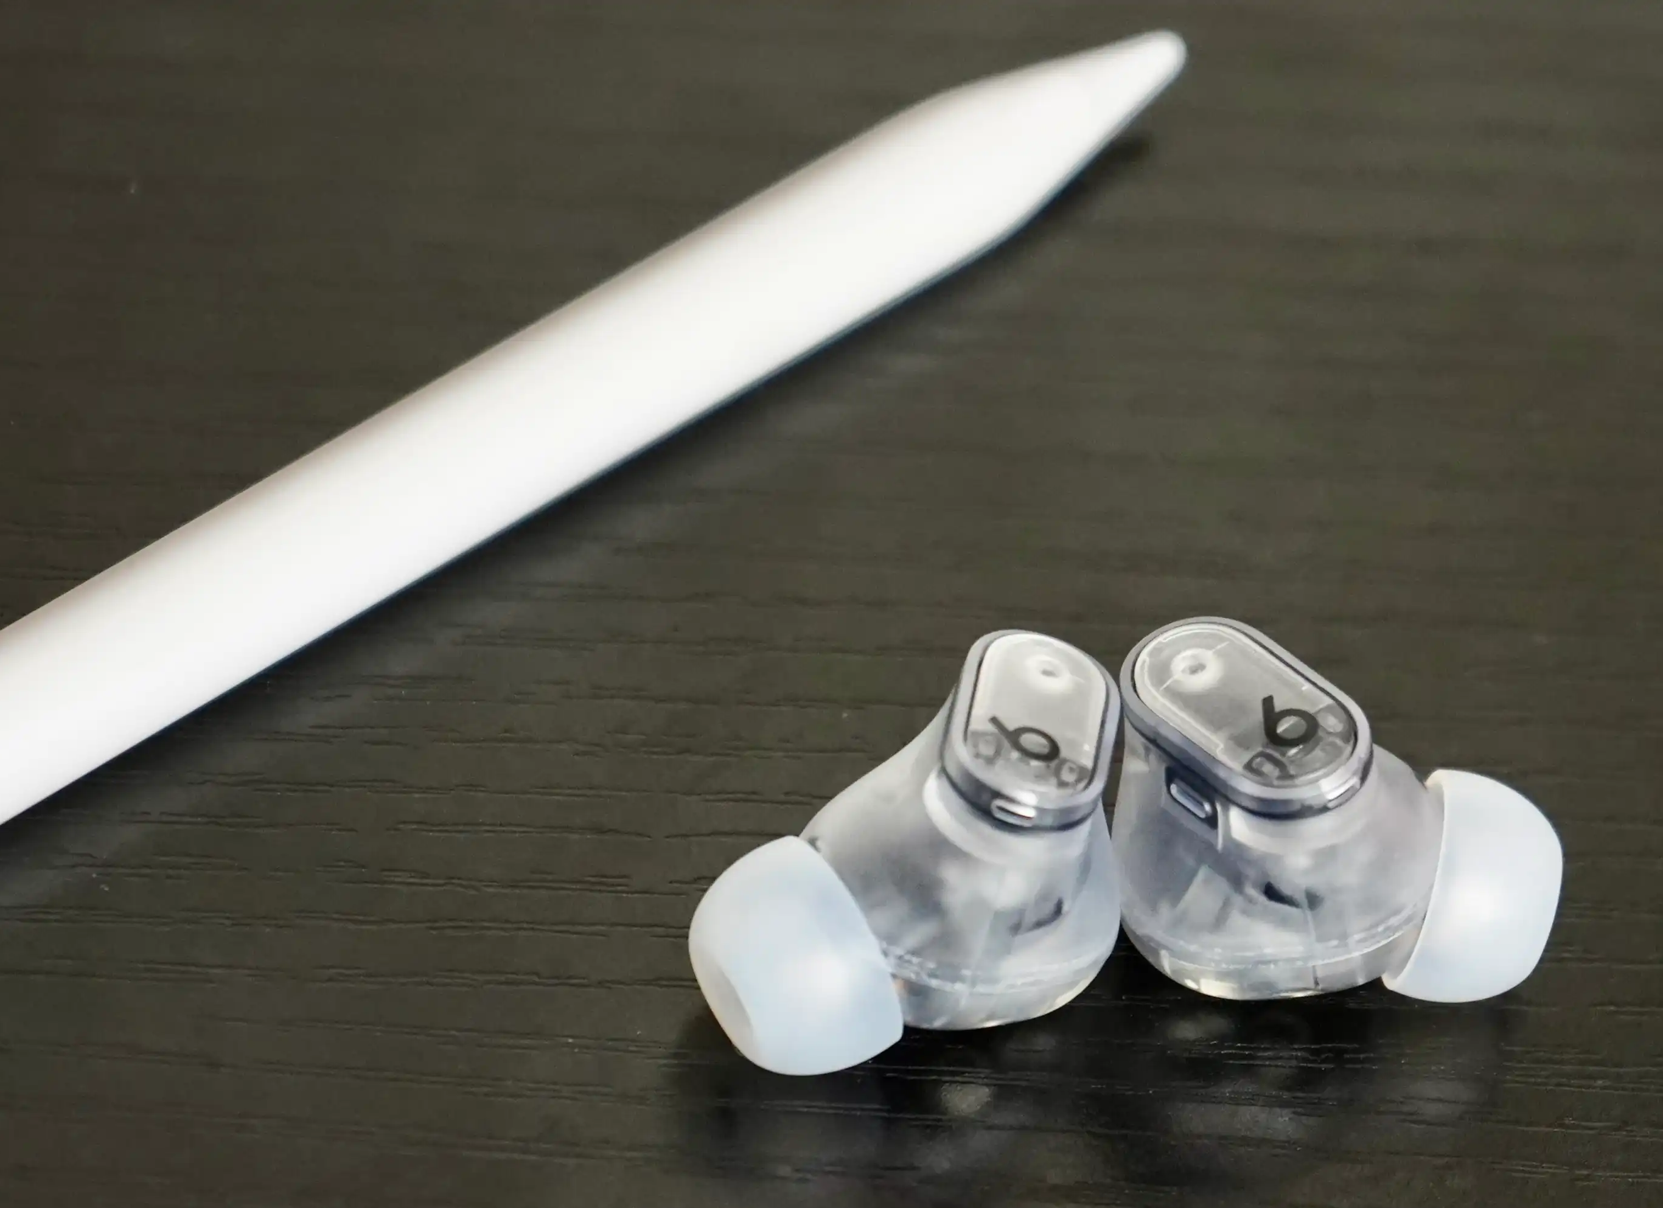
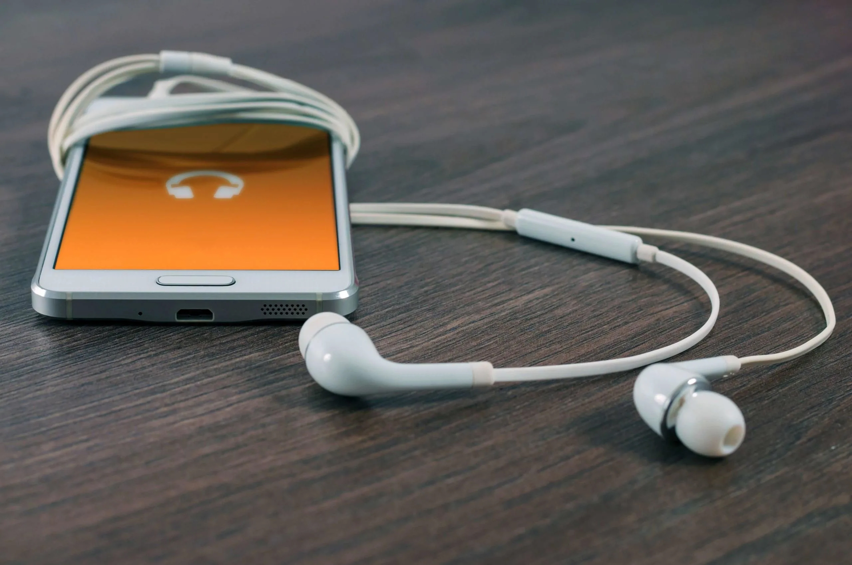
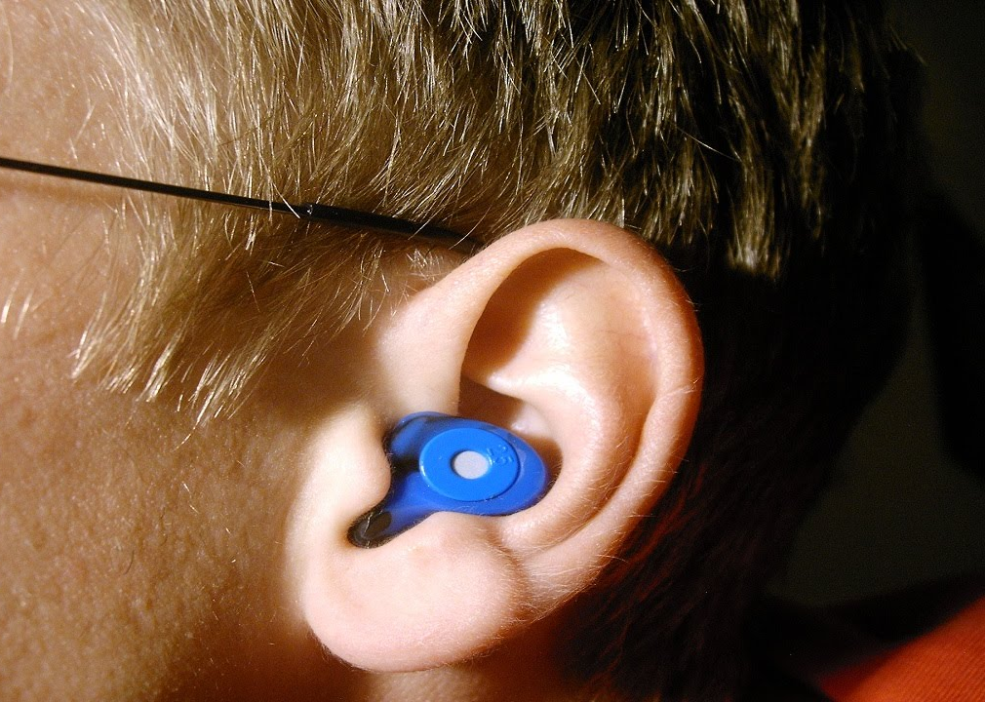
A headset is usually worn one in each ear, so it is common to use the plural name: headphones, earphones or also helmets​.
It is a transducer that receives an electrical signal originating from an electronic source (such as a radio, synthamplifier or audio player) and that by its design allows speakers to be placed near the ears to generate audible sound waves.​
Headphones are usually detachable and interchangeable, meaning they can be easily plugged in or unplugged from the equipment that requires them. The same headphones can be used by different audio systems.
With the advancement of electronics, the AM/FM radio receiver has been incorporated and other capabilities have been acquired, such as wireless communication (through infrared, bluetooth, or wifi) to receive signals.

Slide 6

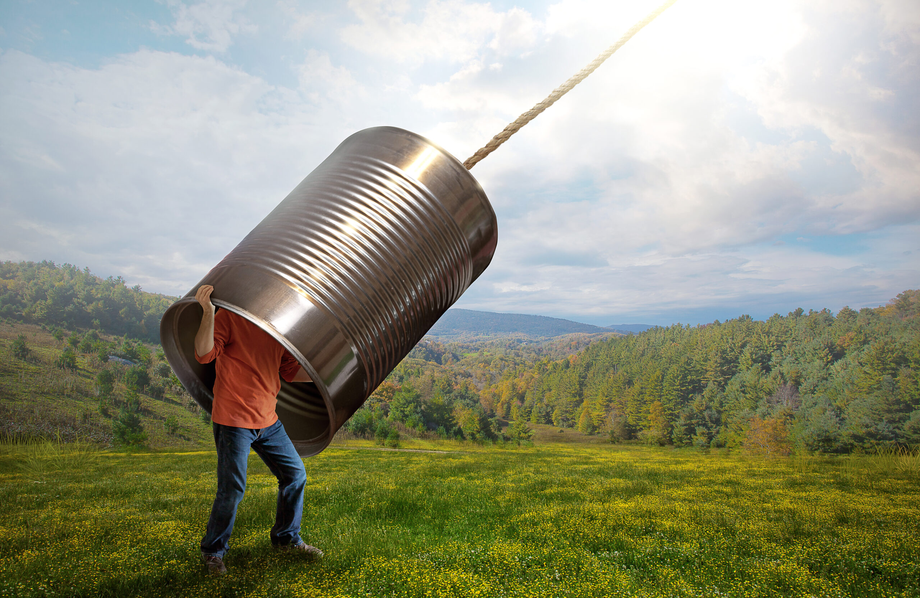
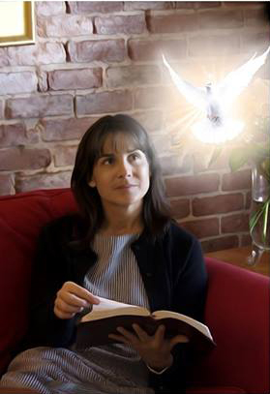
Give ear, O my people, to my law: incline your ears to the words of my mouth. (Psalms 78:1)
Hear counsel, and receive instruction, that thou mayest be wise in thy latter end. (Proverbs. 19:20)
But this thing commanded I them, saying, Obey my voice, and I will be your God, and ye shall be my people: and walk ye in all the ways that I have commanded you, that it may be well unto you. (Jeremiah 7:23)
I will hear what God the LORD will speak: for he will speak peace unto his people, and to his saints: but let them not turn again to folly. (Psalms 85:8)

Slide 7



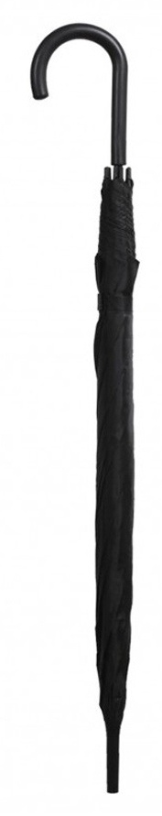
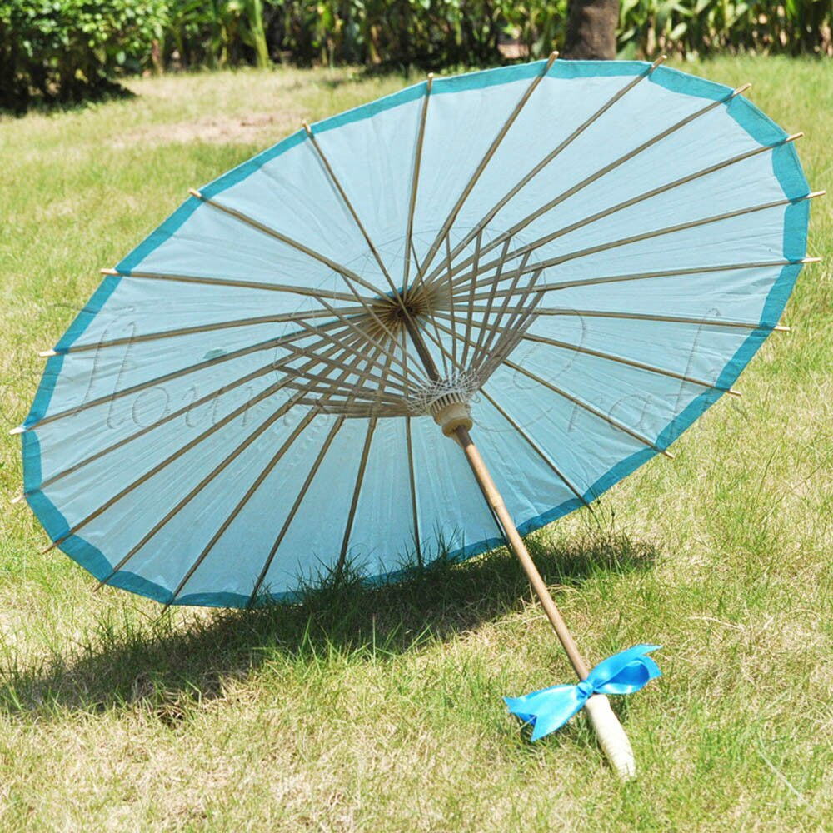
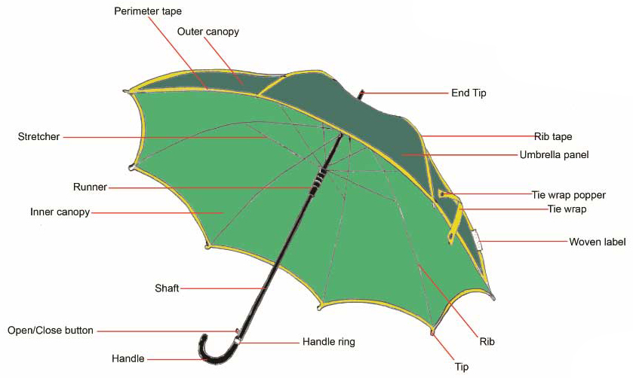

An umbrella is a portable object to protect yourself from the rain. It is made up of a fold-out concave surface, usually made of waterproof fabric or plastic, attached to a surface of rods arranged around a central axis topped at one end by a butt cap that serves as a support, and on the other side terminated in a handle or handle, suitable for carrying it with one hand. The device composed of spokes and rods allows it to be closed when it is not raining or in a protected place.
A classic closed umbrella can serve as a cane; not so, due to its short size, the "pocket" version, which has rods that fold in two or more places, more comfortable to store it when it does not rain.
Both for its etymology and for its use, it should not be confused with the parasol, also called sun shade.

Slide 8
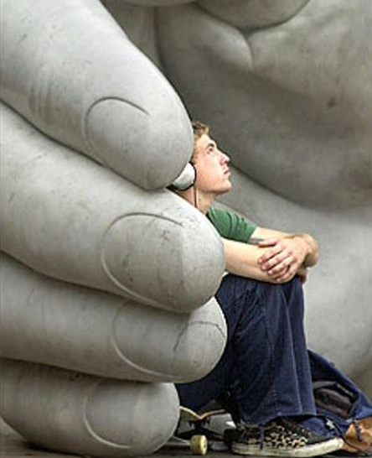
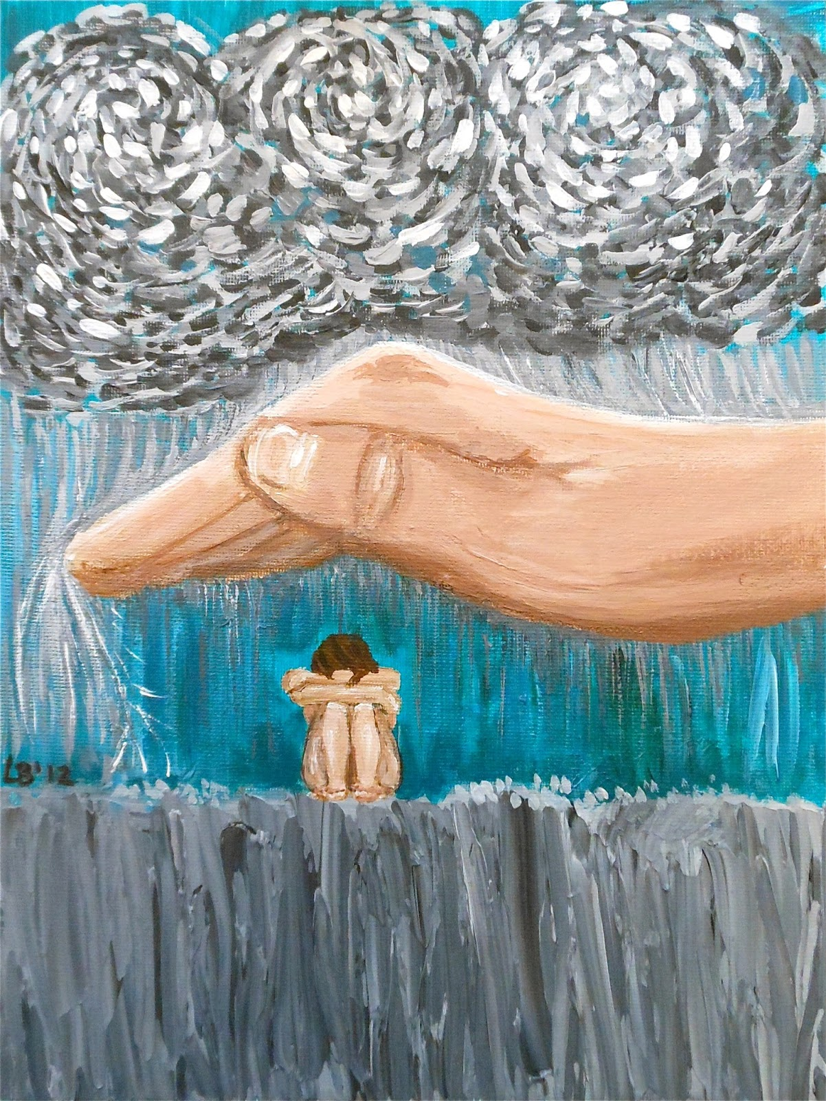

He that dwelleth in the secret place of the most High shall abide under the shadow of the Almighty. I will say of the LORD, He is my refuge and my fortress: my God; in him will I trust. Surely he shall deliver thee from the snare of the fowler, and from the noisome pestilence. He shall cover thee with his feathers, and under his wings shalt thou trust: his truth shall be thy shield and buckler. (Psalms 91:1-4)
And there shall be a tabernacle for a shadow in the daytime from the heat, and for a place of refuge, and for a covert from storm and from rain. (Isaiah 4:6)
Preserve my soul; for I am holy: O thou my God, save thy servant that trusteth in thee (Psalms 86:2)
Keep me, O LORD, from the hands of the wicked; preserve me from the violent man; who have purposed to overthrow my goings. (Psalms 140:4)

Slide 9

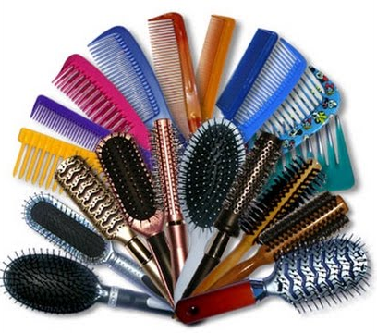


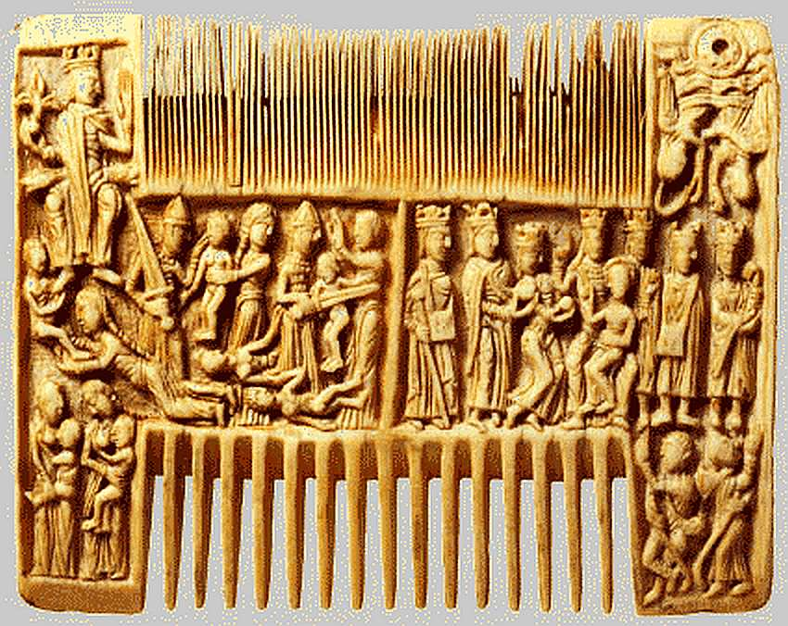
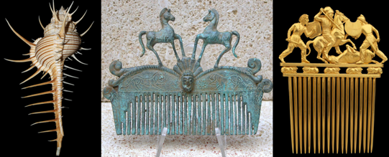
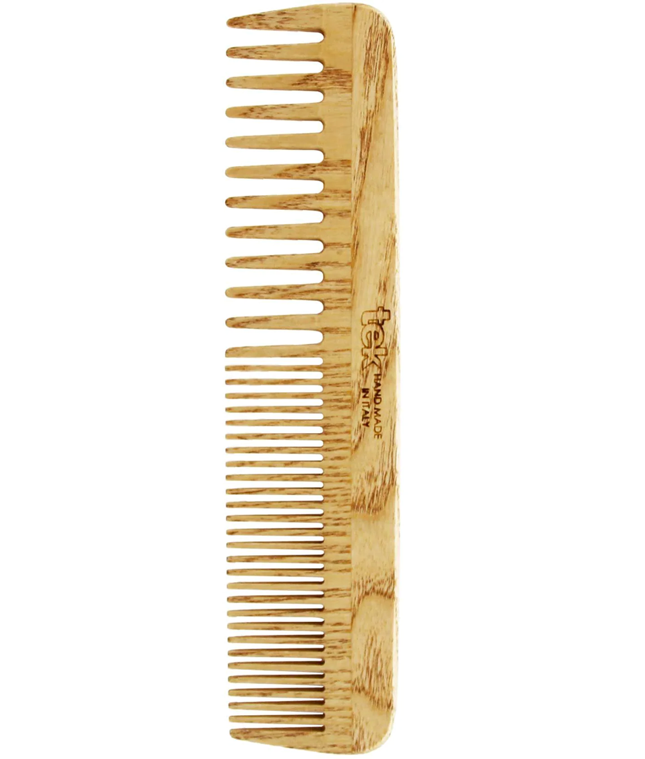
The comb is a flat utensil with barbs that is used to fix, detangle and clean the hair or compose other fibers. The barbs extend from a solid band or strip called the spine. The combs were once made from hawksbill turtle shells, but as hunting of this turtle is prohibited, now the most common materials are plastic and wood.
There are different models that vary in the number and thickness of the bristles, depending on the type of hair or fiber you want to fix. Basically, there are the following types of combs:
Wide-toothed combs: they are used to style manes with a lot of hair and to define curls.
Narrow-toothed combs: These are useful for styling wet hair.
Mixed combs: combine wide and narrow barbs, usually located on both sides of the spine. One or the other can be used simply by turning the comb upside down.

Slide 10
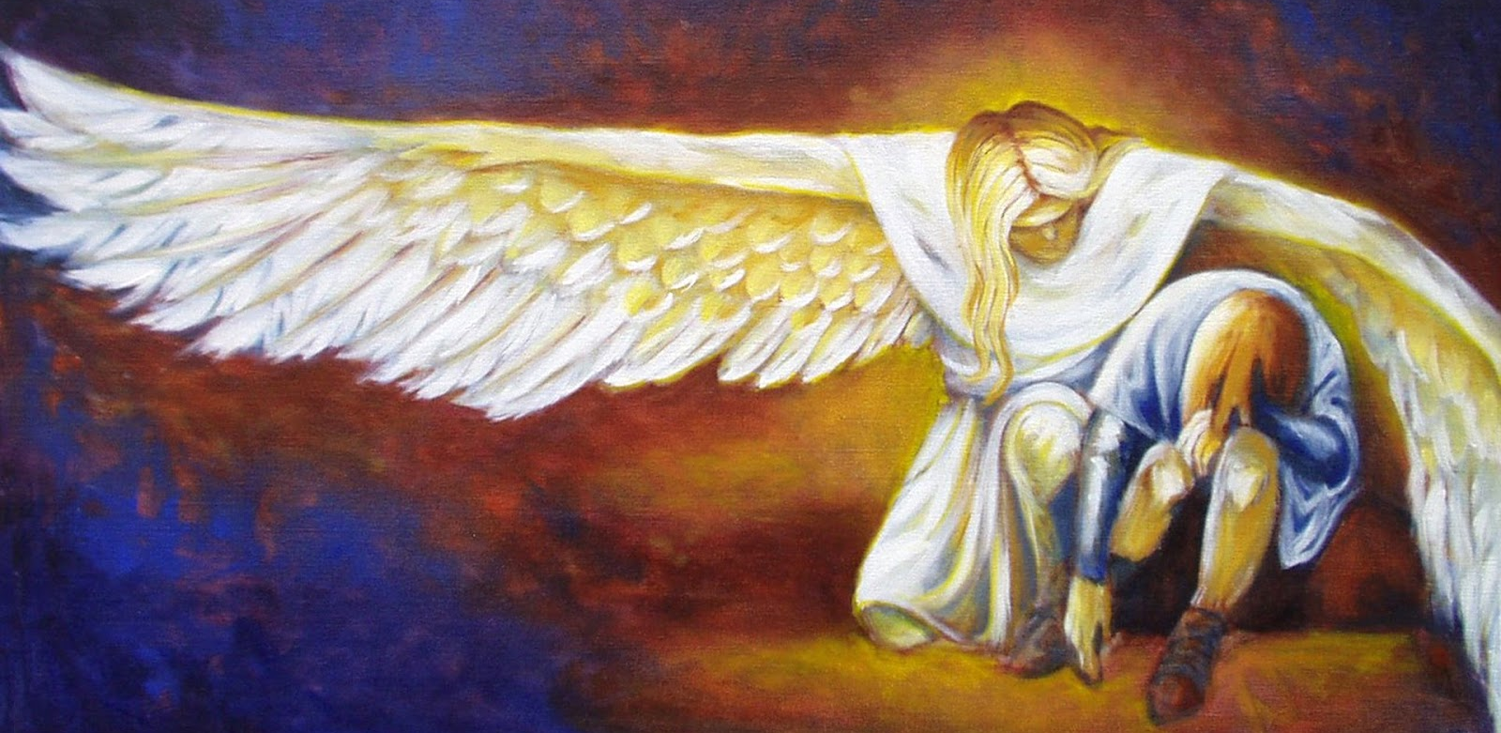
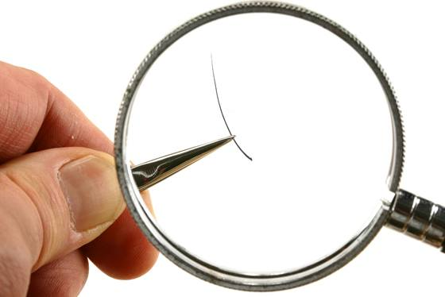
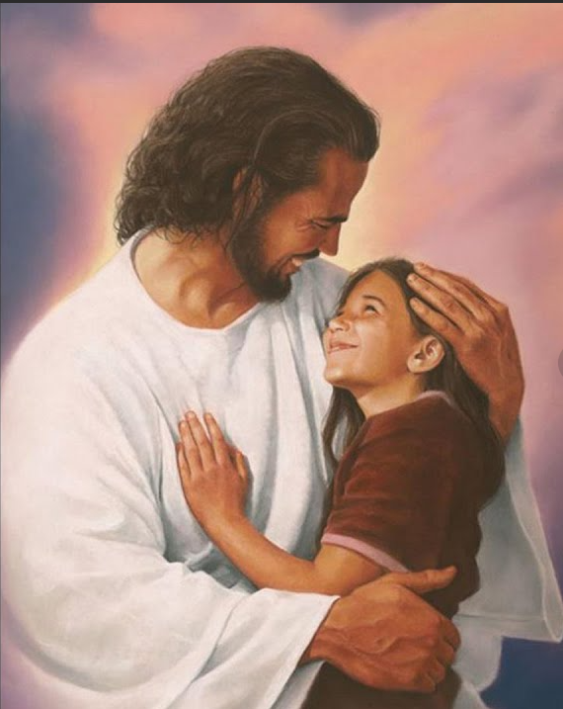

And ye shall be betrayed both by parents, and brethren, and kinsfolks, and friends; and some of you shall they cause to be put to death. And ye shall be hated of all men for my name's sake. But there shall not an hair of your head perish. (Luke 21:16-18)
And fear not them which kill the body, but are not able to kill the soul: but rather fear him which is able to destroy both soul and body in hell. Are not two sparrows sold for a farthing? and one of them shall not fall on the ground without your Father. But the very hairs of your head are all numbered. Fear ye not therefore, ye are of more value than many sparrows. (Matthew 10:28-31)

Slide 11


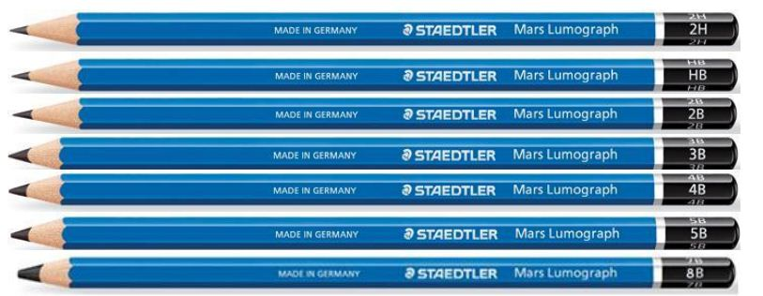

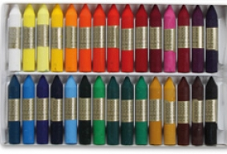
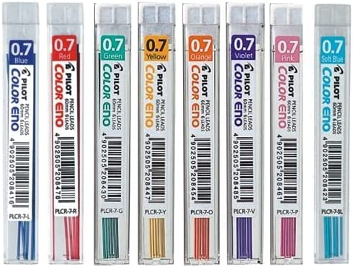

A pencil is a writing or drawing instrument consisting of a lead or stick of pigment, usually graphite, and a special fat or clay. The pencil can also be colored charcoal pigment and encapsulated usually in a fine wood cylinder, but also in plastic, paper, and metal wrappings.
A pencil that has a lead made with more clay mixed with the graphite is a stronger pencil. They differ, on the one hand, with the letters H (from the English hard = hard) and B (from the English black = black), and, on the other hand, with a number from 1 to 4, with the number 4 being the hardest. There may also be combinations of the letters: HH, for example, refers to a very hard mine.
Unlike graphite and charcoal pencils, the lead of colored pencils is made from wax or oil, which contains varying proportions of pigments, additives and binders. Pencils with water-soluble leads (watercolor) and pastel pencils are also manufactured, as well as colored leads for mechanical pencils.

Slide 12

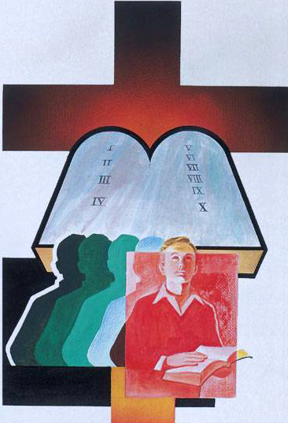
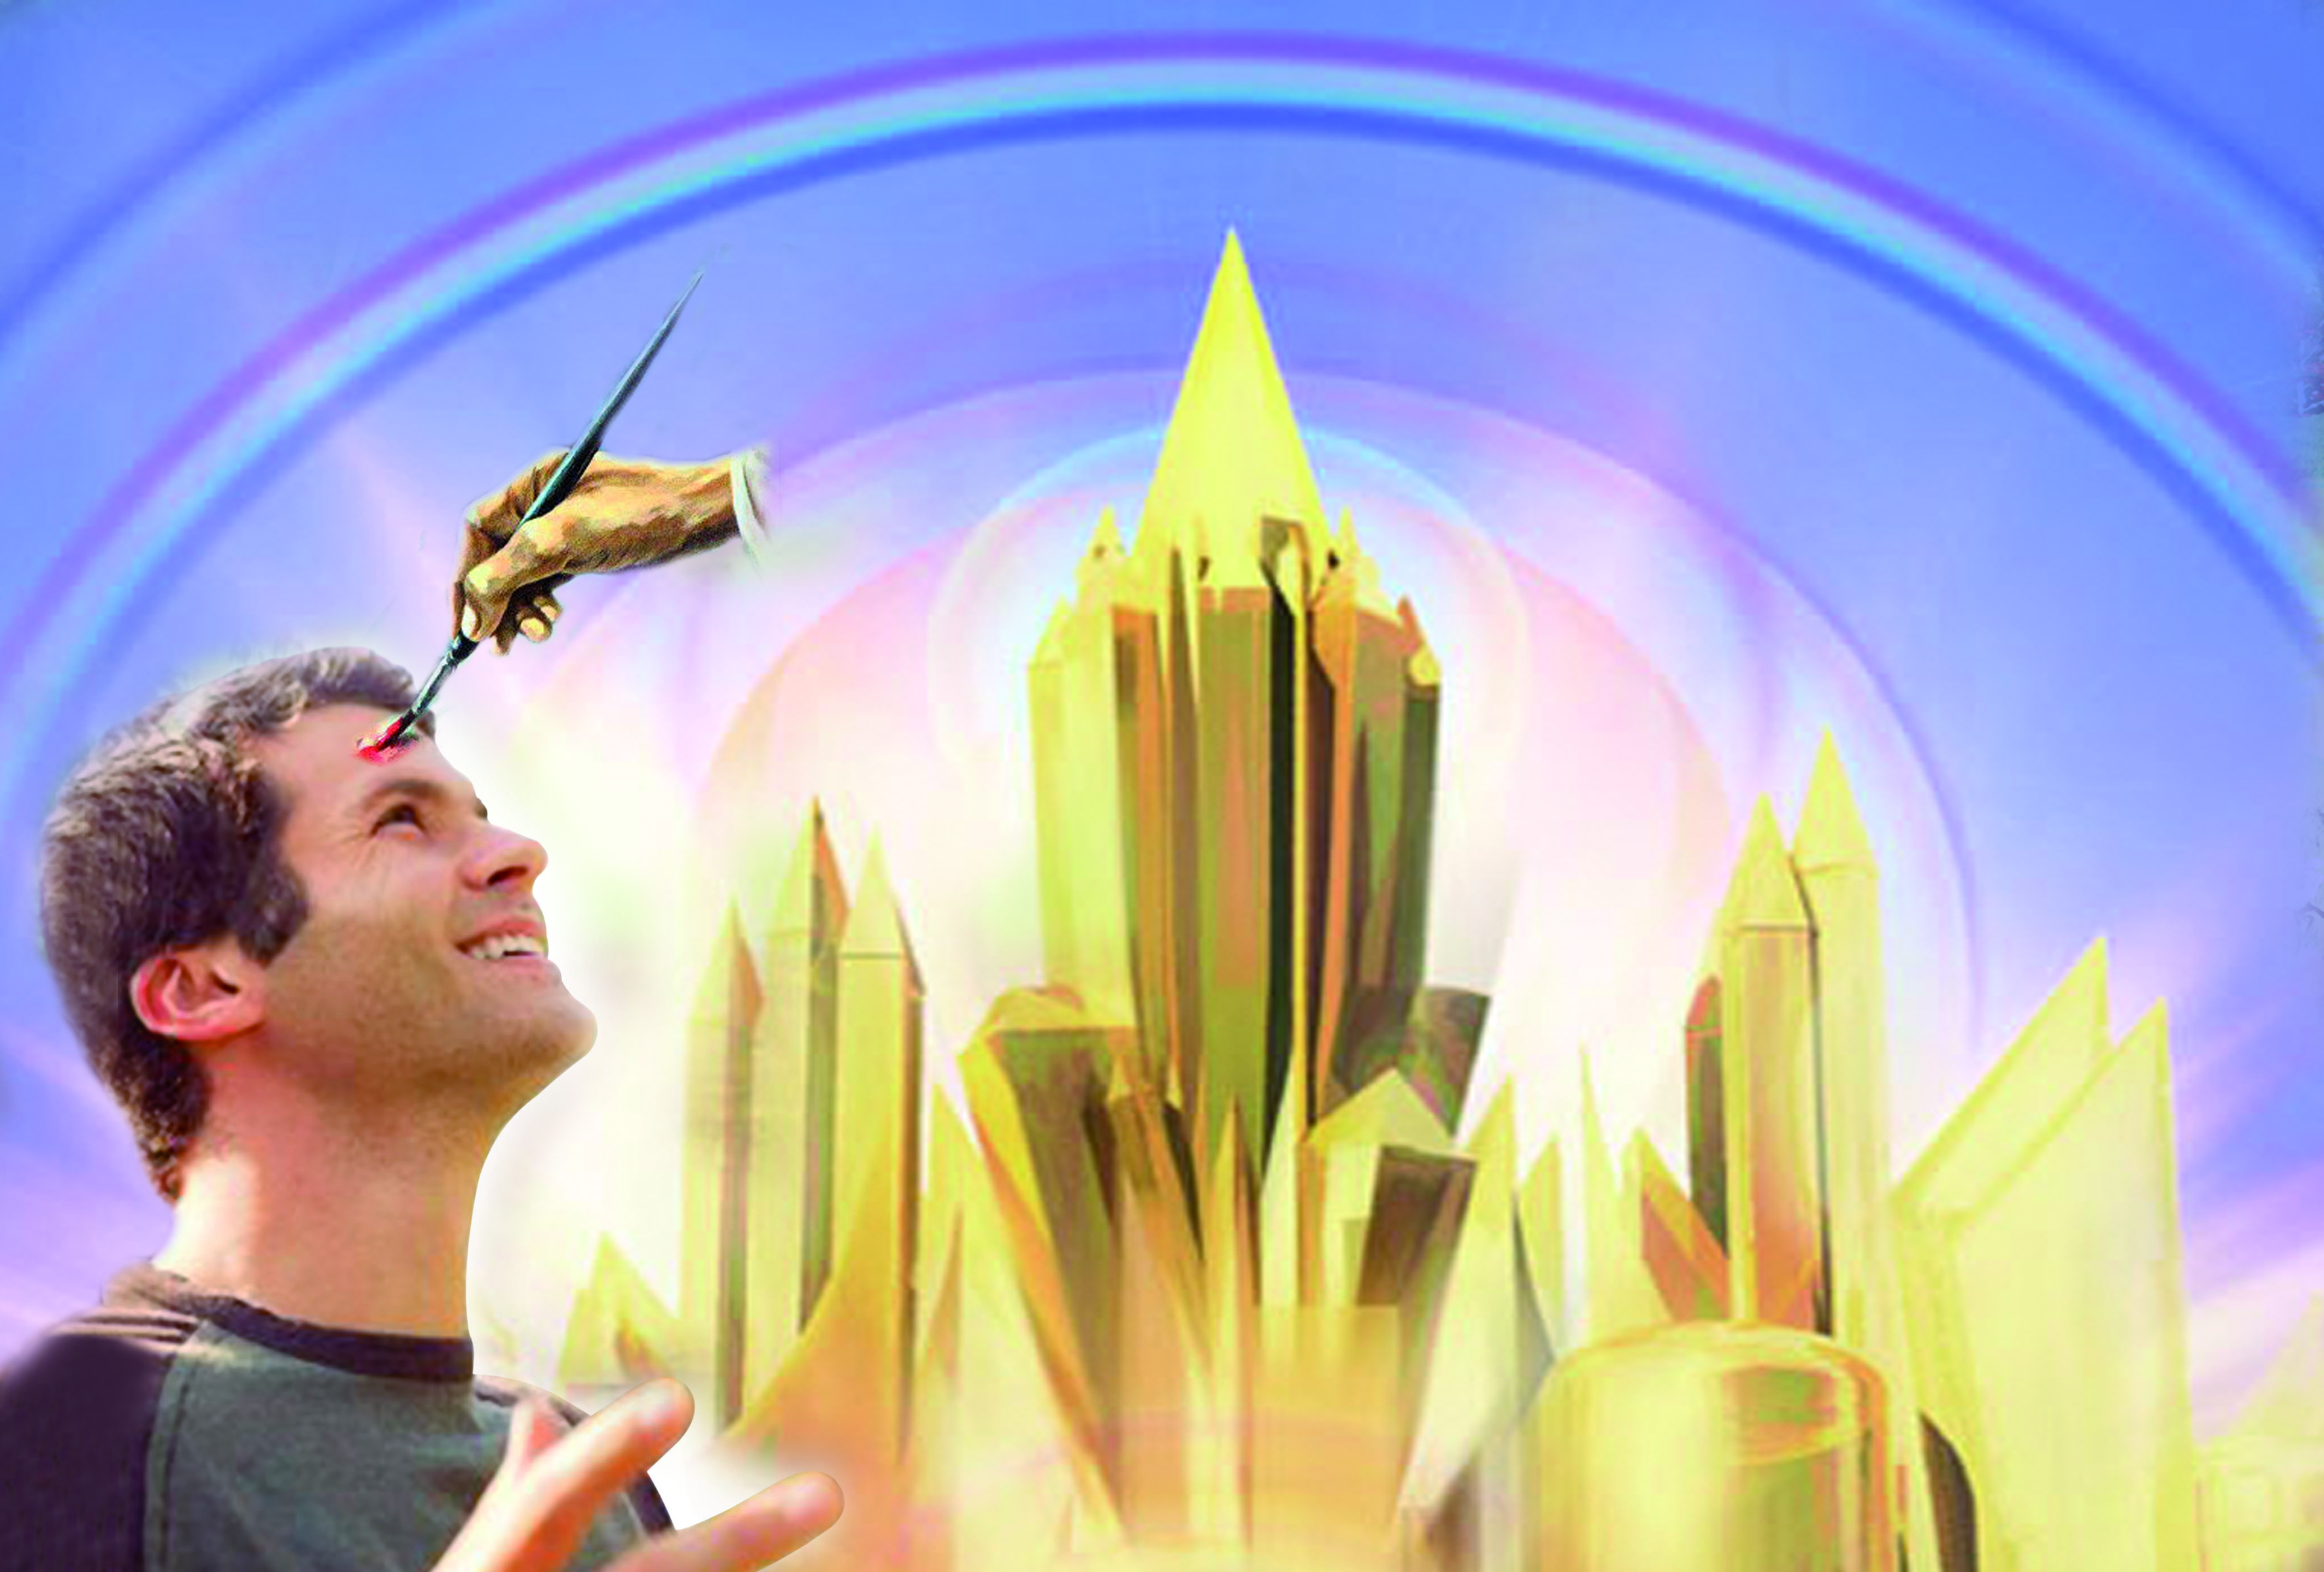
Now these are the commandments, the statutes, and the judgments, which the LORD your God commanded to teach you, that ye might do them in the land whither ye go to possess it… And thou shalt write them upon the posts of thy house, and on thy gates. (Deuteronomy 6:1-9)
For this is the covenant that I will make with the house of Israel after those days, saith the Lord; I will put my laws into their mind, and write them in their hearts: and I will be to them a God, and they shall be to me a people (Hebrews 8:10)
This is the covenant that I will make with them after those days, saith the Lord, I will put my laws into their hearts, and in their minds will I write them. (Hebrews 10:16)
Him that overcometh will I make a pillar in the temple of my God, and he shall go no more out: and I will write upon him the name of my God, and the name of the city of my God, which is new Jerusalem, which cometh down out of heaven from my God: and I will write upon him my new name. (Rev. 3:12)

Slide 13





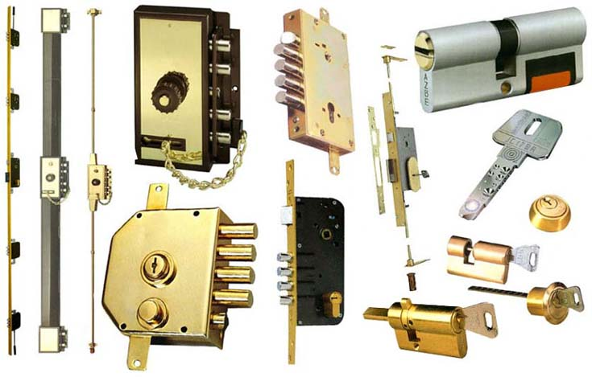
A key is an instrument used to operate locks, incorporated into objects that are intended to be protected from unwanted access.
Mechanisms of this type have been used since ancient times. There is a belief that the first locks were large metal boxes that needed very large and heavy iron keys to be opened, which is only partly true, because small keys were also used for the lids of small boxes, such as jewelry boxes or other types of furniture.
Most classic keys are metal (steel, brass or aluminium), and are used to open the lock by inserting it into it and turning. In general, they consist of a wide part, in a more or less round or oval shape, with or without perforations, which serves as a support to handle it, and a stem with various notches, grooves or paddles that form a more or less complicated code.
The grooves, both on the stem and, where appropriate, on the paddle, form a first step of the code, since they prevent other keys, with different grooves, from being inserted into the lock. The second code is given by the notches, which lift or move a series of cams of different lengths that, when they coincide, allow the key to be rotated by releasing the locking mechanism.

Slide 14
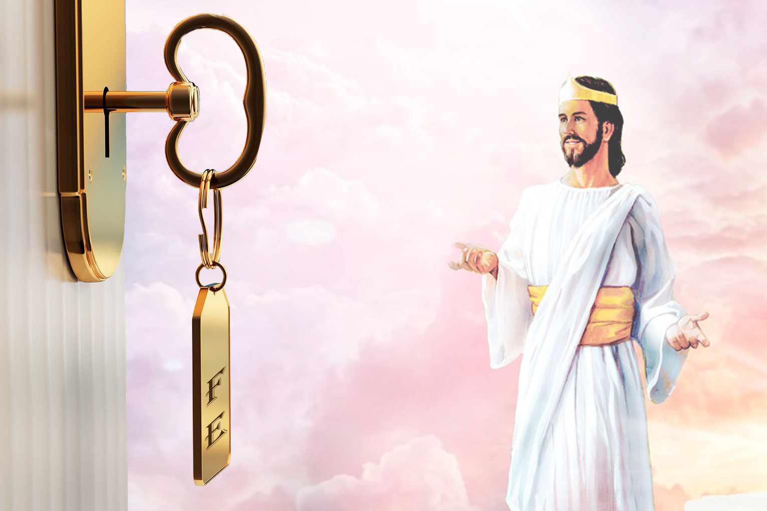

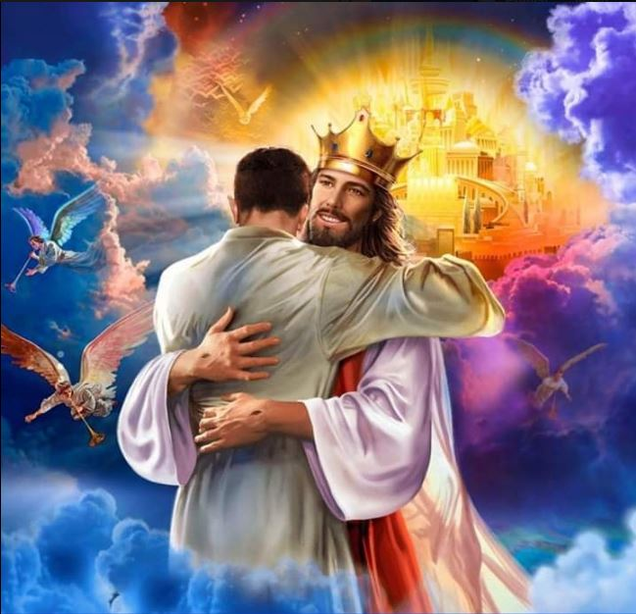
There is no need for us to hunger, there is no need for us to thirst, while the storehouse of heaven is open for us and the key is given into our possession. What is the key? Faith, which is the gift of God. Unlock the storehouse; take of its rich treasures. —TMK 7, The Review and Herald, March 15, 1892.
Why should the sons and daughters of God be reluctant to pray, when prayer is the key in the hand of faith to unlock heaven's storehouse, where are treasured the boundless resources of Omnipotence? Without unceasing prayer and diligent watching we are in danger of growing careless and of deviating from the right path. The adversary seeks continually to obstruct the way to the mercy seat, that we may not by earnest supplication and faith obtain grace and power to resist temptation. SC 94
The knowledge of God and of Jesus Christ expressed in character is the very highest education. It is the key that opens the portals of the heavenly city. This knowledge it is God's purpose that all who put on Christ shall possess. CT 37

Slide 15






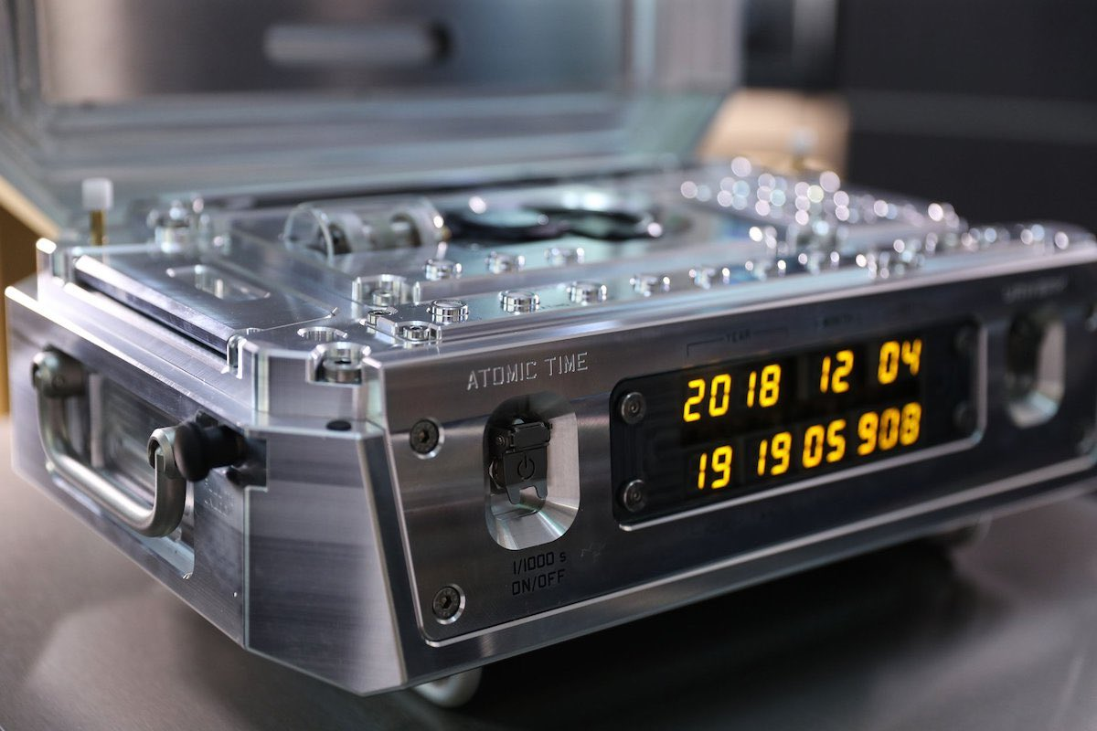
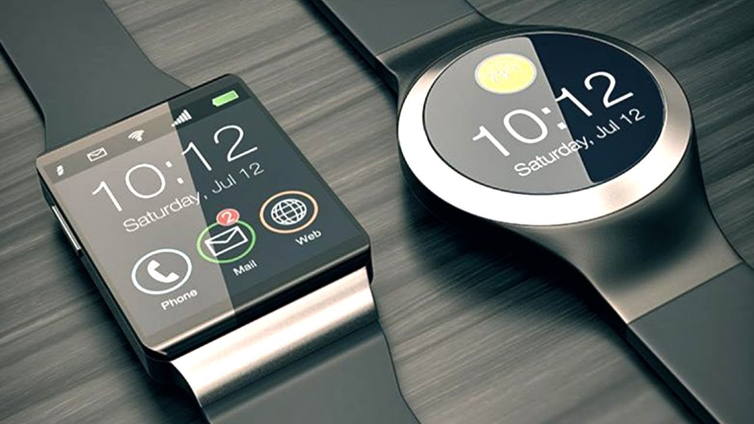
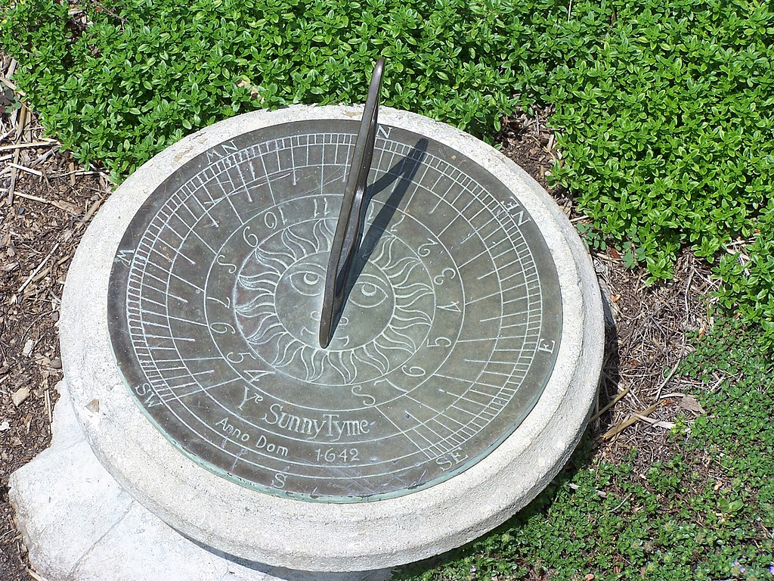
A clock is an instrument capable of measuring, maintaining and indicating time in conventional units (hours, minutes or seconds). Fundamentally, it allows you to know the current time, although it can have other functions, such as measuring the duration of an event or activating a signal at a certain specific time.
Watches have been used since ancient times and as the technology of their manufacture has evolved, new models have appeared with greater precision, better performance and presentation and lower manufacturing costs.
It is one of the most popular instruments, since practically many people have one or more watches, mainly wristwatches, so that in many homes there may be several clocks, many appliances incorporate them in the form of digital clocks and in each computer there is a clock.
Atomic clock
Sundial
The latest atomic clock developed by the National Bureau of Standards (NIST) of the United States, the NIST-F1 launched in 1999, is so accurate that it has a margin of error of only one second every 45 million years.

Slide 16

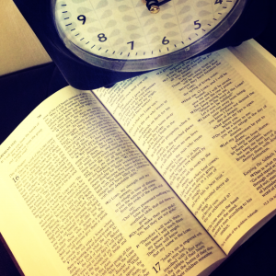
To every thing there is a season, and a time to every purpose under the heaven. (Ecclesiastes 3:1)
…redeeming the time. (Colossians 4:5)
See then that ye walk circumspectly, not as fools, but as wise, Redeeming the time, because the days are evil. (Ephesians 5:15-16)
But this I say, brethren, the time is short (1 Corinthians 7:29)
And that, knowing the time, that now it is high time to awake out of sleep: for now is our salvation nearer than when we believed. (Romans 13:11)

Slide 17

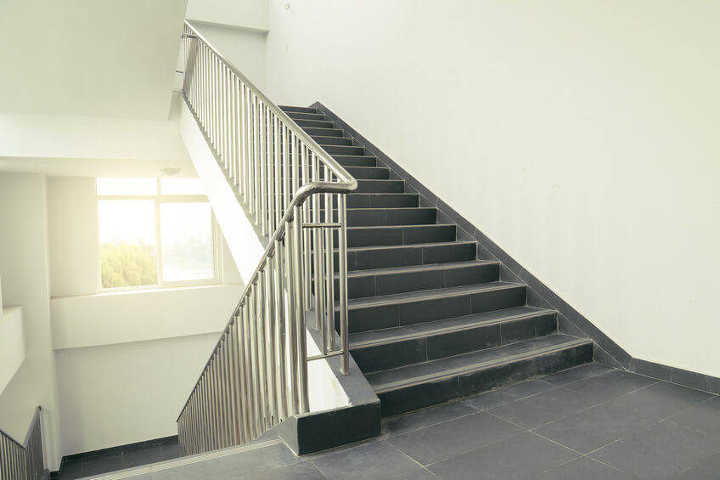

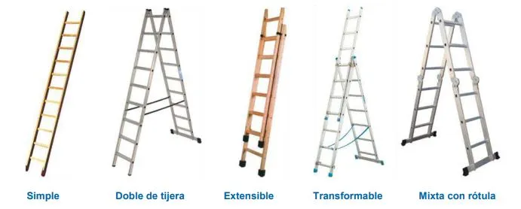
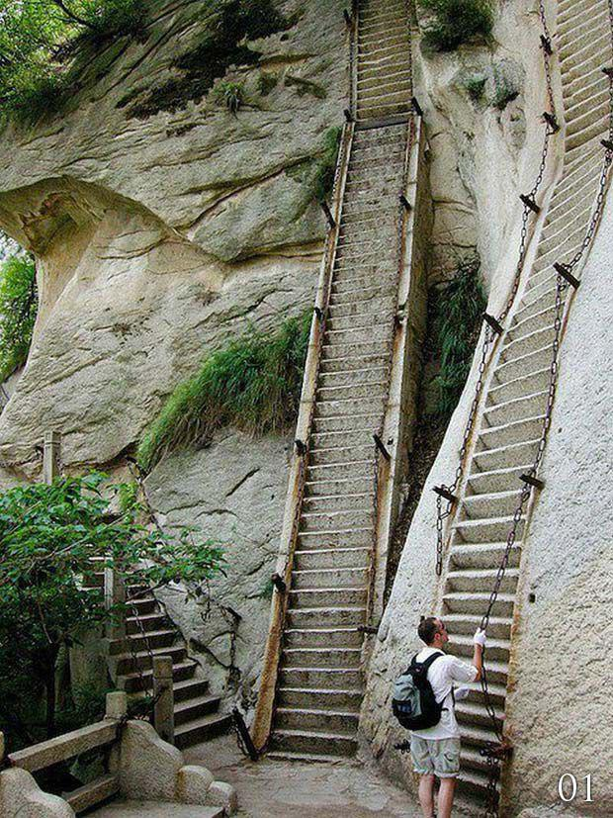
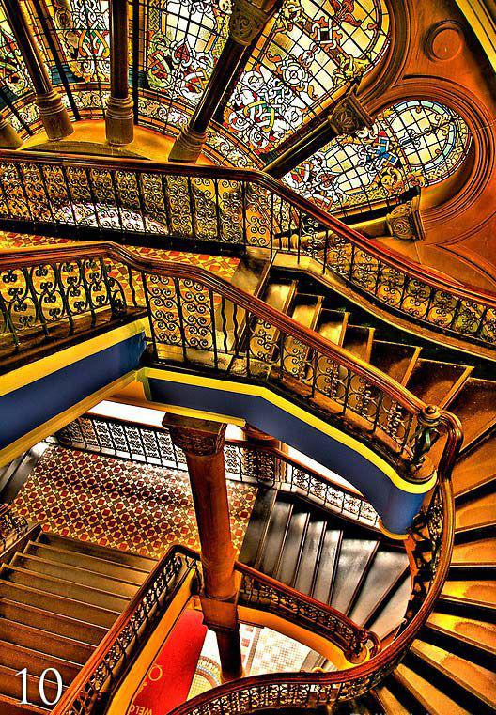
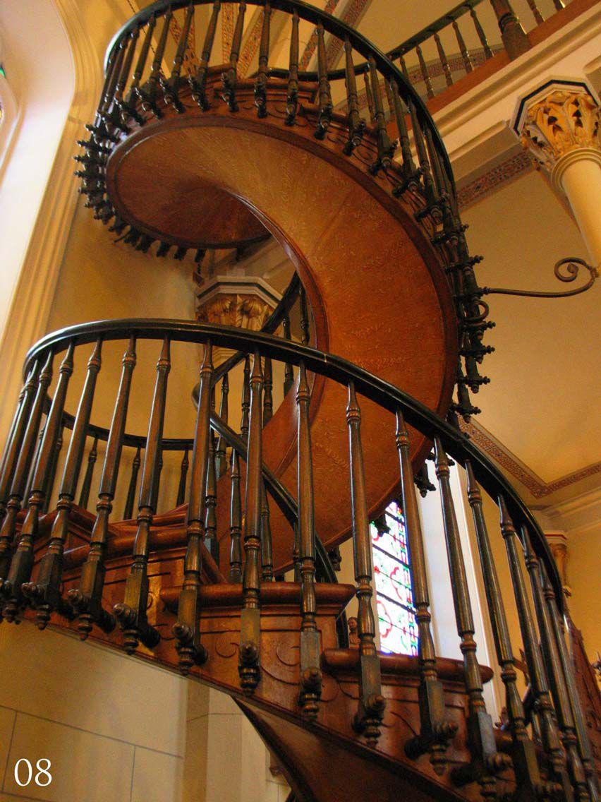

A ladder is a construction designed to connect several spaces located at different heights. It is made up of steps (footsteps) and can have several sections separated by landings, plateaus or landings. They can be fixed, transportable or mobile.
The wide staircase, usually artistic or monumental, is called a staircase. The transportable or "hand-held" ladder, made of wood, rope or both, is called a ladder or portable ladder.
The ladder is made up of two beams of variable length joined transversely through equidistant crossbars called steps or steps that allow progressive ascent to the desired area. They are easily transportable due to their lightness. Originally they were made of wood, currently the most used material is aluminum because of its lightness and because it allows joints between steps and beams of greater consistency, which prolong the life of the ladder.
Stairs must be able to be climbed at a pace to prevent falls. To do this, its slope must be constant. That is, the geometric ratio between the depth of its steps (called 'footprint') and their height (called 'riser', partition or cant) must be constant.

Slide 18
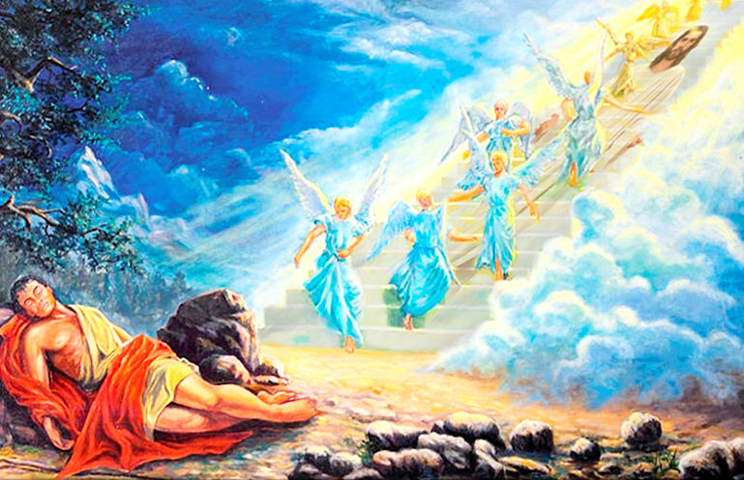
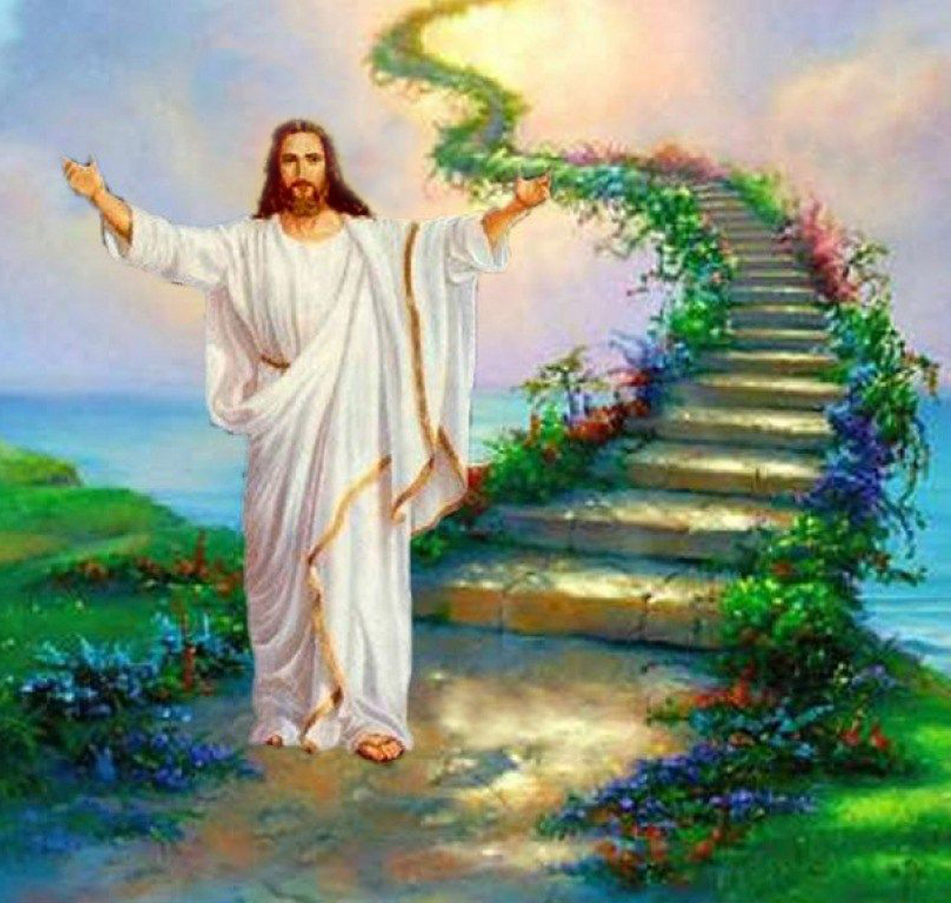
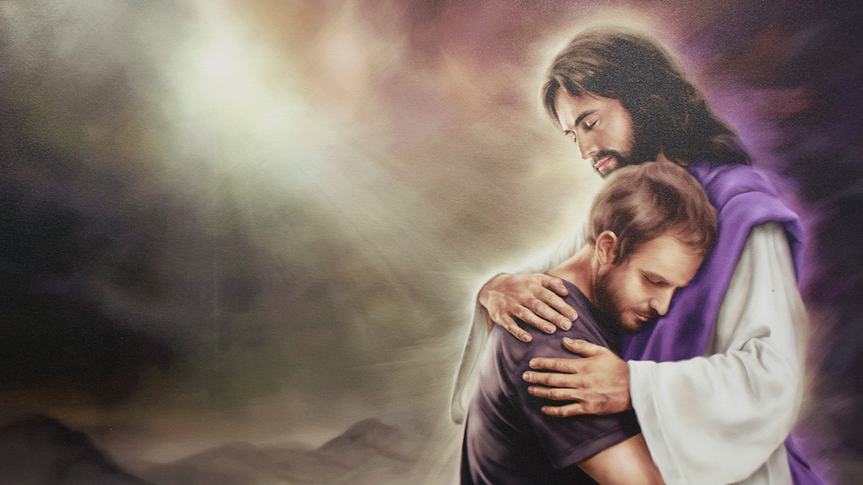
Christ is the ladder which Jacob saw whose base rested on the earth and whose topmost round reached the highest heavens. This shows the appointed method of salvation. We are to climb round after round of this ladder. If any one of us shall finally be saved, it will be by clinging to Jesus as to the rounds of a ladder. Christ is made unto the believer wisdom and righteousness, sanctification, and redemption.... 3SM 154.
Many are the figures by which the Spirit of God has sought to illustrate this truth, and make it plain to souls that long to be freed from the burden of guilt. When, after his sin in deceiving Esau, Jacob fled from his father's home, he was weighed down with a sense of guilt. Lonely and outcast as he was, separated from all that had made life dear, the one thought that above all others pressed upon his soul, was the fear that his sin had cut him off from God, that he was forsaken of Heaven. In sadness he lay down to rest on the bare earth, around him only the lonely hills, and above, the heavens bright with stars. As he slept, a strange light broke upon his vision; and lo, from the plain on which he lay, vast shadowy stairs seemed to lead upward to the very gates of heaven, and upon them angels of God were passing up and down; while from the glory above, the divine voice was heard in a message of comfort and hope. Thus was made known to Jacob that which met the need and longing of his soul—a Saviour. With joy and gratitude he saw revealed a way by which he, a sinner, could be restored to communion with God. The mystic ladder of his dream represented Jesus, the only medium of communication between God and man. SC 19

Slide 19



A furnace is a device that stores heat, generates it through combustion, and keeps it inside a closed compartment. It is used both in the kitchen to prepare, heat or dry food, and in industry. The heat energy used may be different. There are different types of oven.
Wood-fired oven or clay oven: It works from forest materials.
Gas oven: Reduces cooking times and reaches high temperatures in less time.
Electric oven: Powered by electric energy. Widely used, due to its comfort and easy handling.
Crucible furnace: Used to melt non-ferrous metals. You get a cleaner alloy, faster maintenance times, and more precise energy control.
Microwave oven: It works by generating electromagnetic waves that interact with the water molecules contained in food.
Cupola oven: It takes the metals placed in it to the liquid state and allows them to be strained.
Induction furnace: It is an electric furnace in which heat is generated by the electrical induction of a conductive medium (a metal) in a crucible, around which magnetic coils are wound.
Resistance furnace: It is a mechanism designed to produce heat by means of the Joule effect, in which it is stipulated that a conductive material is capable of transporting electrical energy and transforming a part of the kinetic energy into heat.

Slide 20
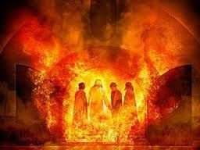
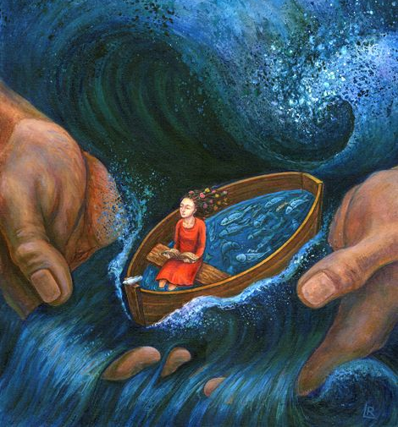
Behold, I have refined thee, but not with silver; I have chosen thee in the furnace of affliction. (Isaiah 48:10)
Those who hold fast their faith unto the end will come forth from the furnace of trial as fine gold seven times purified....
When in trouble, remember that faith tried in the furnace of affliction is more precious than gold tried with fire... The refining process is hard for human nature to endure; but only by it can the dross be purged from the character. In the furnace of trial we are purified from the dross that prevents us from reflecting the image of Christ. God measures every trial; He watches the furnace fire that must test every soul. RC 349
My brethren, count it all joy when ye fall into divers temptations; Knowing this, that the trying of your faith worketh patience. But let patience have her perfect work, that ye may be perfect and entire, wanting nothing. (James 1:2-4)
The assaults of Satan are fierce and determined, his delusions are terrible; but the Lord's eye is upon His people, and His ear listens to their cries. Their affliction is great, the flames of the furnace seem about to consume them; but the Refiner will bring them forth as gold tried in the fire. God's love for His children during the period of their severest trial is as strong and tender as in the days of their sunniest prosperity; but it is needful for them to be placed in the furnace of fire; their earthliness must be consumed, that the image of Christ may be perfectly reflected. BLJ 329

Slide 21



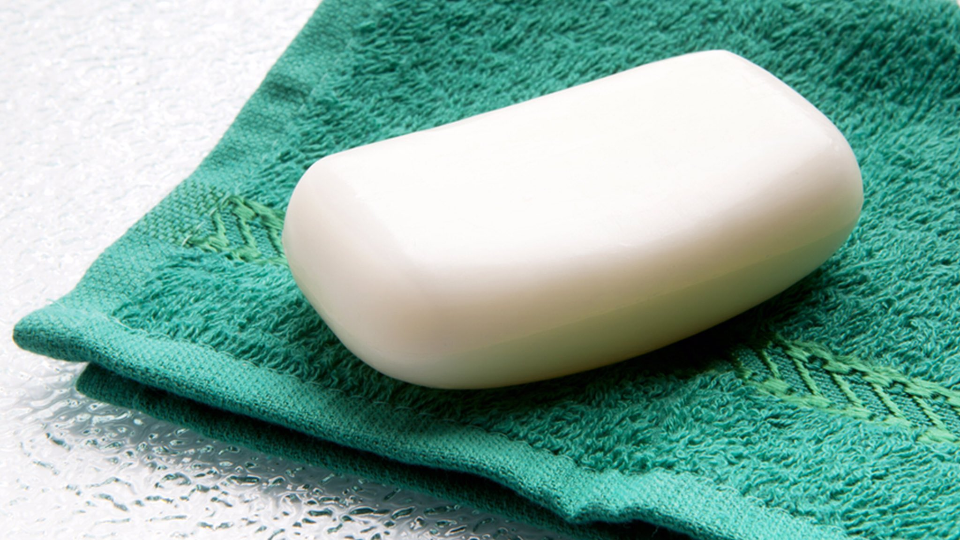



Soap (from the Latin sapo, -ōnis, and this from the Germanic saipôn) is a product that is used for personal hygiene and for washing certain objects. It can be found in pill, powder, cream or liquid.
Soap is basically a sodium or potassium salt resulting from the chemical reaction between an alkali (sodium or potassium hydroxide) and a lipid; This reaction is called saponification. The lipid can be of plant origin (such as coconut oil) or animal (such as lard). Soap is soluble in water. Due to its detergent properties, it is used for washing clothes, body washing, etc.​
The fatty acids used as soap raw materials are the following:
Vegetable oils: coconut, soybean, corn, olive, flax, cotton. Animal oils: fish, animal fats. Then, these are combined with creams, perfumes and colorants to give them showiness.
Soaps exert their cleansing action on fats in the presence of water due to the structure of their molecules. These have a fat-soluble part and a water-soluble part.
The fat-soluble component causes the soap to "wet" the fat by dissolving it and the water-soluble component causes the soap to dissolve in the water.
Grease stains cannot be removed with water alone, as they are insoluble in it. Soap, on the other hand, which is soluble in both, allows the fat to be diluted in the water.
When a soap is dissolved in water, it decreases its surface tension, which favors its penetration into the interstices of the substance to be washed. On the other hand, the hydrophobic groups of soap dissolve in each other, while the hydrophilic groups are oriented towards the water, generating a colloid, that is, an aggregate of many molecules conveniently oriented. As colloidal micelles are charged and mutually repellent, they exhibit great stability.

Slide 22



When we have to wash or bathe, we use soap to stay clean. We must ask God to cleanse our whole being of sin. Only God can do it.
For though thou wash thee with nitre, and take thee much soap, yet thine iniquity is marked before me, saith the Lord GOD. (Jeremiah 2:22)
… and the blood of Jesus Christ his Son cleanseth us from all sin. (1 John 1:7)
Come now, and let us reason together, saith the LORD: though your sins be as scarlet, they shall be as white as snow; though they be red like crimson, they shall be as wool. (Isaiah 1:18)
Purge me with hyssop, and I shall be clean: wash me, and I shall be whiter than snow. (Psalms 51:7)
Wash me throughly from mine iniquity and cleanse me from my sin. (Psalms 51:2)
Do not listen to the enemy's suggestion to stay away from Christ until you have made yourself better, until you are good enough to come to God. If you wait until then you will never come. When Satan points to your filthy garments, repeat the promise of the Saviour, “Him that cometh to Me I will in no wise cast out.” John 6:37. Tell the enemy that the blood of Jesus Christ cleanses from all sin. Make the prayer of David your own: “Purge me with hyssop, and I shall be clean: wash me, and I shall be whiter than snow.” Psalm 51:7. PK 320

Slide 23








“The parables by which [Jesus], during His ministry, He loved to teach His lessons of truth, show how open His spirit was to the influences of nature, and how, in His youth, He had delighted to gather the spiritual teaching from the surroundings of His daily life”. FE 442
What lessons have you learned from these objects of daily life?
God cares about every detail
Jesus unites me to Heaven
God cleanses my sin
I listen to God
Prayer is essential in my life
I am light of the world
God writes His law on me
God purifies me
God Protects Me
I make good use of the time
In everything we have at hand in our daily lives we can find spiritual applications for our lives. I encourage you to seek new teachings for your spiritual growth in the everyday things you use.

