Slide 1
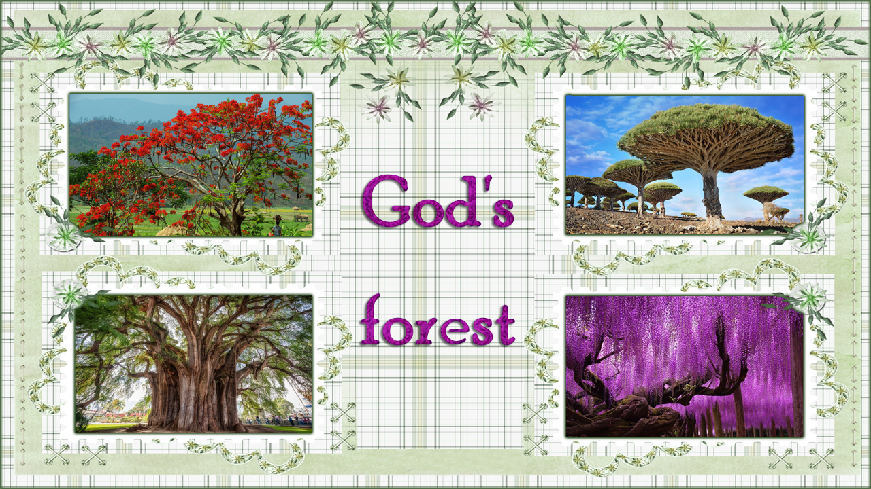

Slide 2
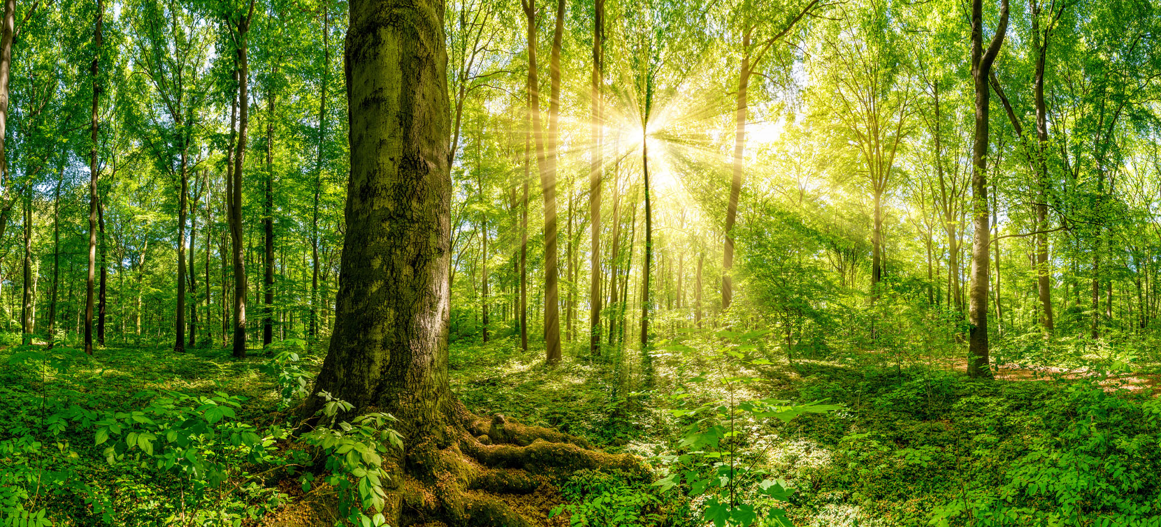
We are going to take a tour of the forest of God.
We will study some of the trees that God created with their characteristics.
We will also draw from them spiritual applications that will help us on the path we are traveling.
Feel free to pull out your own personal applications.

Slide 3

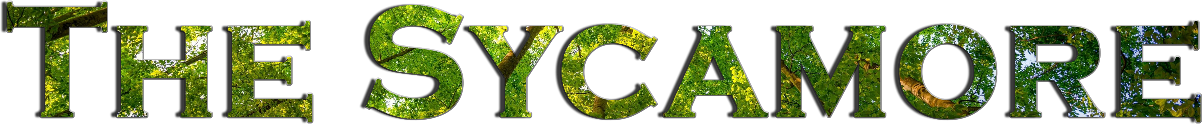
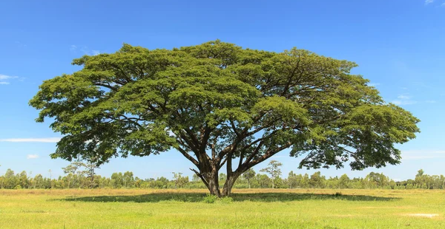
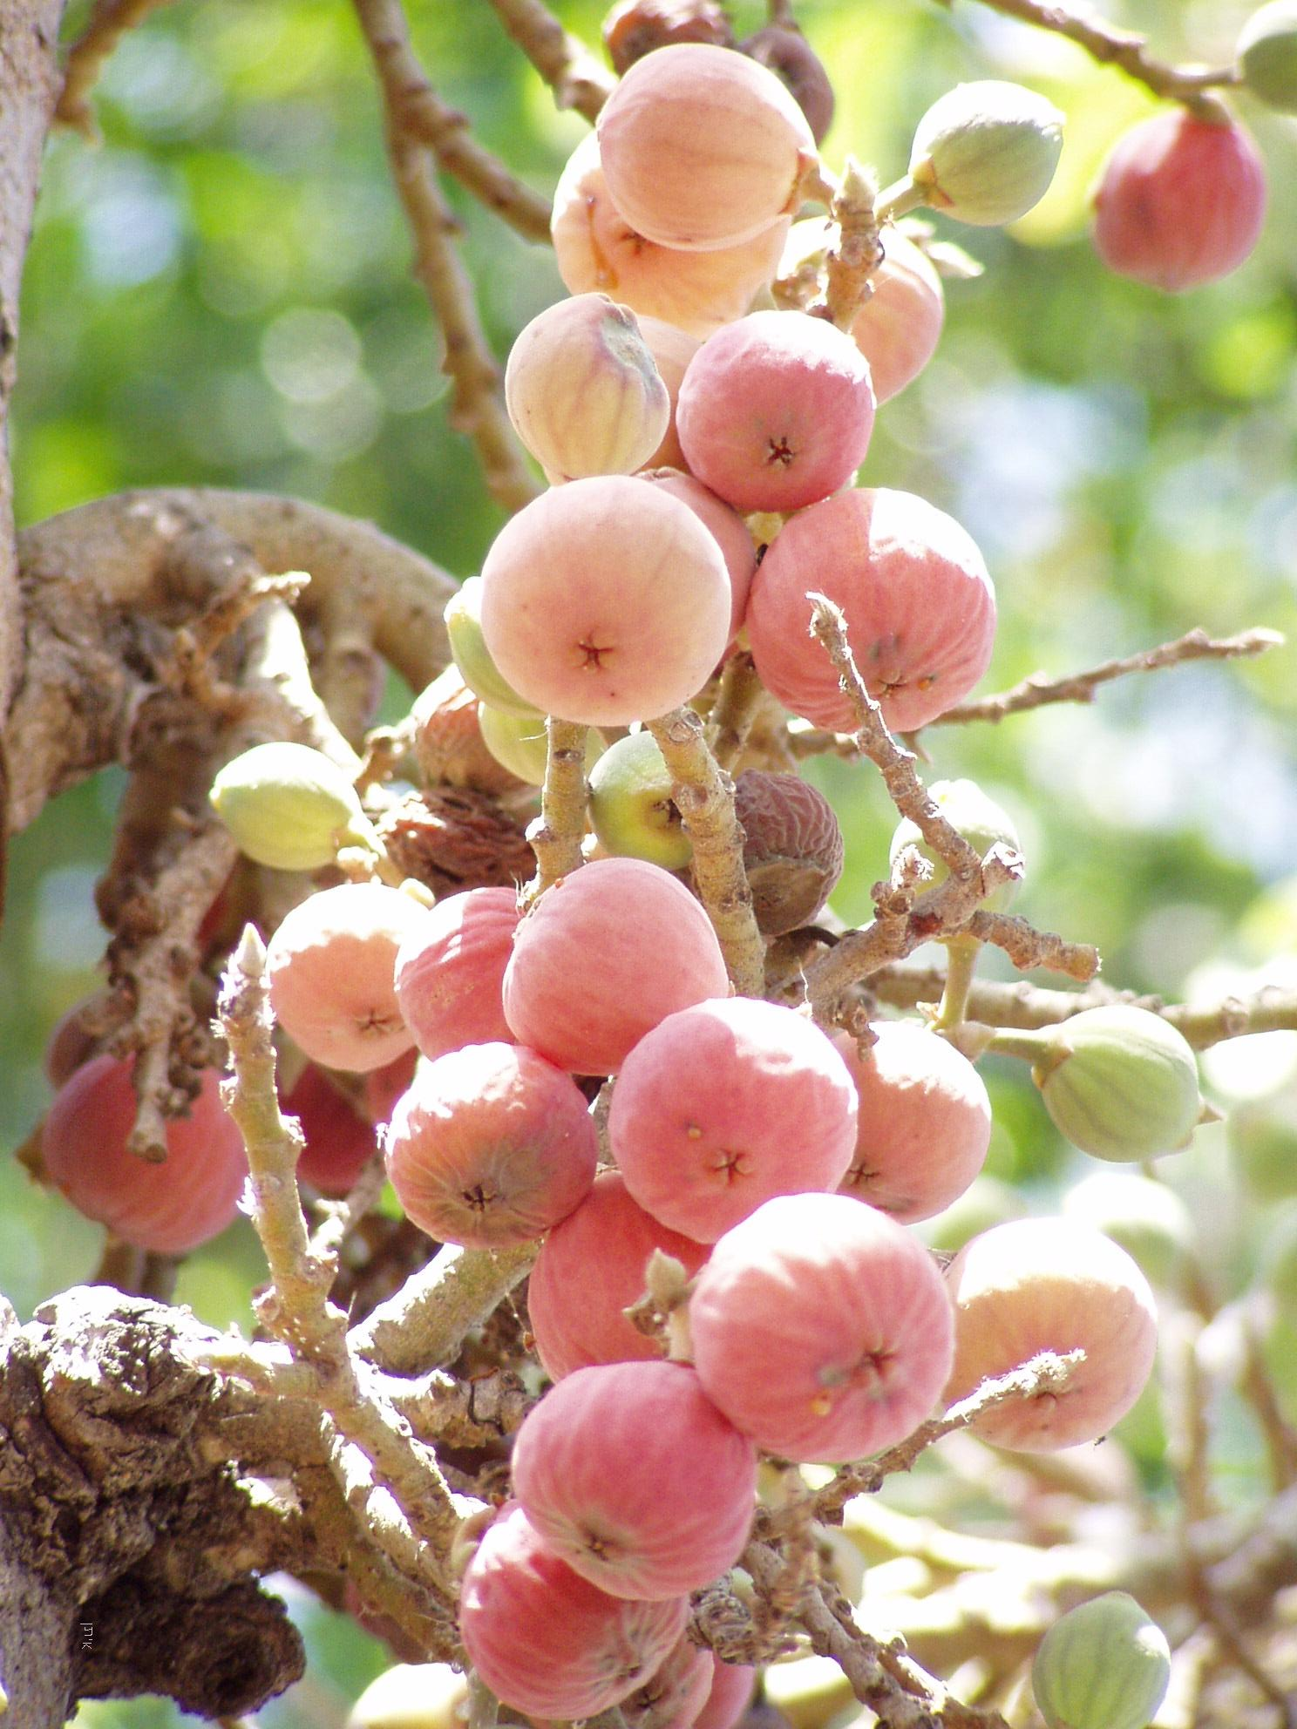
The sycamore can measure up to 20 meters in height and 6 meters in width. The bark is yellowish-green and exfoliates into strips that appear inside. Like all fig trees, the sycamore tree contains latex.
The cordiform (heart-shaped) leaves are dark green, rough and about 14 cm long and about 10 cm wide and spirally arranged around the branch. On its light green back you can see the prominent nerves.
The juice has a softening virtue, healing wounds. It is drunk and applied as an ointment against snake bites, hardening of the spleen, stomach pains and chills; The juice eats away quickly.
Just as God endowed the sycamore tree with healing juice, so he calls us to bring relief and healing to the wounded and helpless.
“Then shall the King say unto them on his right hand, Come, ye blessed of my Father, inherit the kingdom prepared for you from the foundation of the world: For I was an hungred, and ye gave me meat: I was thirsty, and ye gave me drink: I was a stranger, and ye took me in: Naked, and ye clothed me: I was sick, and ye visited me: I was in prison, and ye came unto me.” (Matthew 25:34-36)

Slide 4

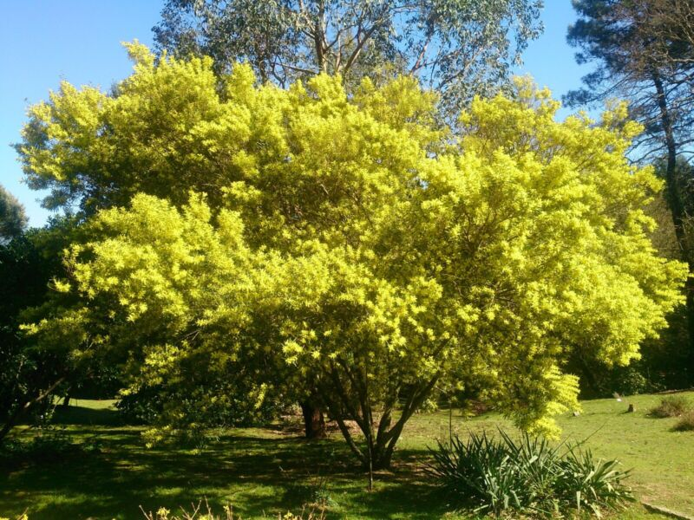

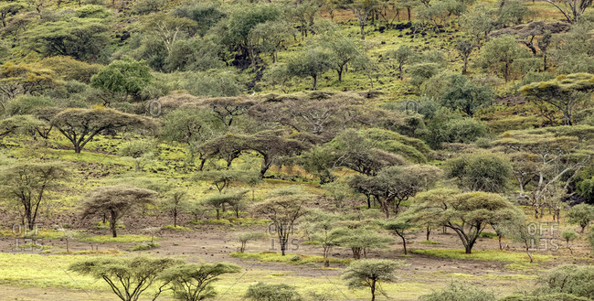
Among the Hebrews, it is cited by the name of shitim wood and in the construction of the tabernacle the only wood that was used was the Acacia seyal.
Some species of acacia trees have a defense system that some biologists consider to be unique in the Plant Kingdom. In clusters where each individual tree is in close contact with another, if the latter is approached by a predator of its foliage, the plant reacts chemically by releasing substances that are airborne transfer and reach the other plants "giving the alarm"; Immediately, the rest of the specimens of the conglomerate begin to secrete a toxic substance in their leaves – they change color, darkening – which is harmful in contact and ingestion and even deadly to the animal predator (which can be, for example, a large mammal such as a giraffe). This reaction is temporary, but the acacia species should be appropriately selected for gardening to avoid these effects on animals and people.
Just as trees protect each other in the same way, we must intercede for one another in prayer and guard against the attack of the enemy.
“Wherefore comfort yourselves together, and edify one another, even as also ye do.” (1 Thessalonians 5:11).

Slide 5

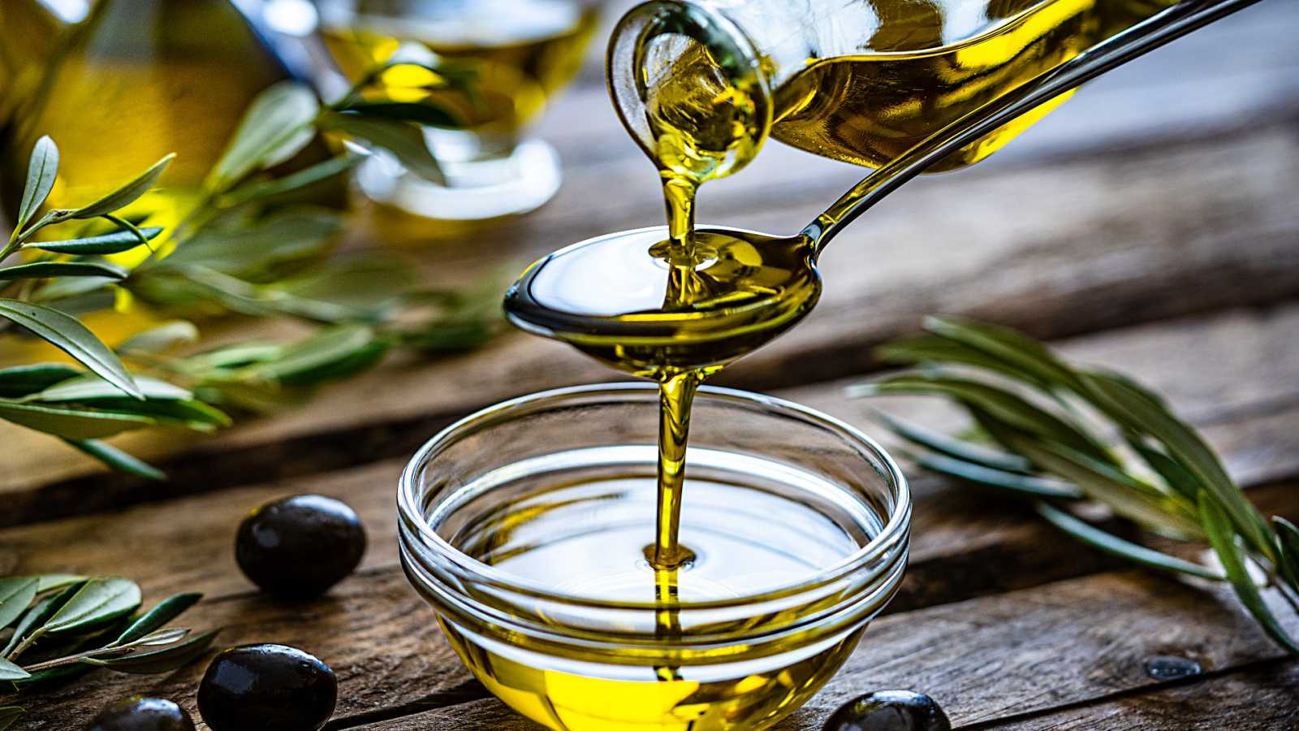
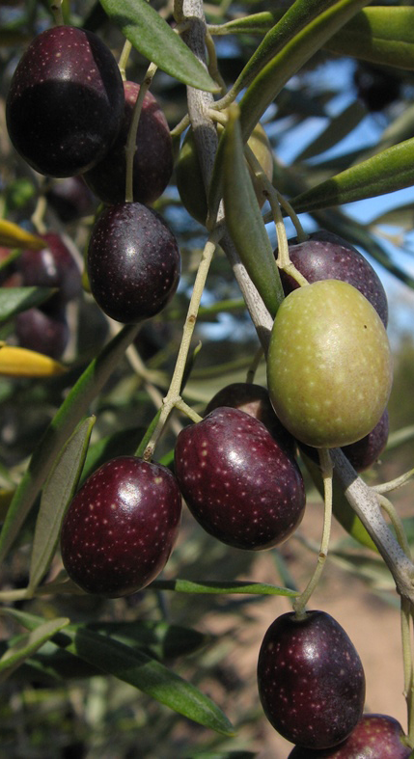
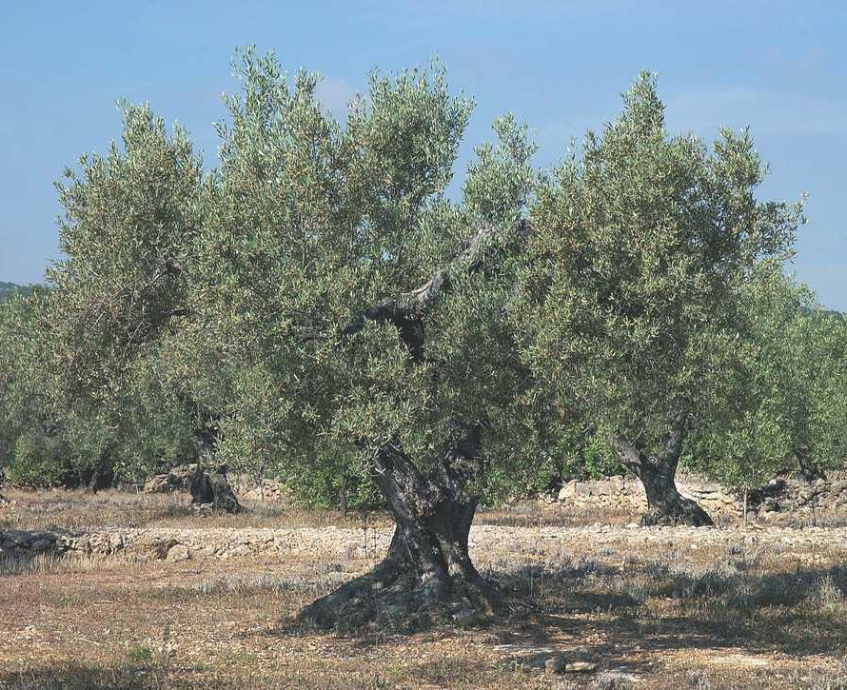
The olive tree appears as a cultivated tree in practically all regions of Mediterranean climate with sunny exposure free of frost. The cultivated olive tree comes from the wild olive tree that can be easily seen in uncultivated specimens born from olives that have not been grafted.
The wild olive tree differs from the cultivated species by its more bushy appearance, by the presence of thorns on its branches, by its smaller leaves and fruits. Properly grafted, it becomes a cultivated species, acquiring the appearance of the latter. In the same way, the cultivated olive tree, if it is not worked, over time can also acquire the appearance of wild olive trees.
So is with the Christian. The more he studies God's Word, the more he becomes like God's ideal for him. But you must be careful, because if you give up Bible study and your relationship with God you may return to your old way of life and soon stop looking like Christ. May God endow us with persistence, so that we may never separate ourselves from the trunk that is Christ and thus continue to be grafted onto Him.
“For the word of God is quick, and powerful, and sharper than any twoedged sword, piercing even to the dividing asunder of soul and spirit, and of the joints and marrow, and is a discerner of the thoughts and intents of the heart.” (Hebrews 4:12)

Slide 6

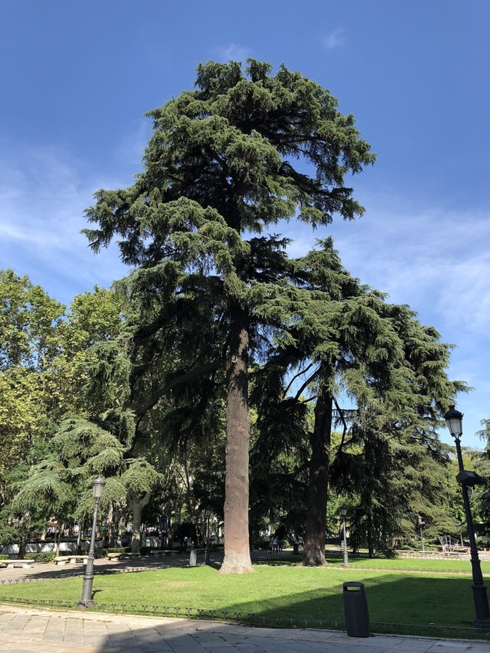

Cedars are large trees 25 to 50 m tall. Its wood has the quality of repelling insects and worms, and a peculiar smell.
The cedar of Lebanon is the most cited tree in the Bible. Solomon's Temple was built with its wood.
The noble wood of this tree is useful for creating musical instruments, such as guitars, of great sonority and beauty, as well as for making artisan objects (chests, jewelry boxes, etc.). It is also commonly used in the manufacture of pencils.
Cedars can live up to 2,000 years. Its wood does not rot. For this reason, it was used to build ships and sarcophagi.
Just as the Cedar has a long life, God will give us eternal life and we will never again know rot or death. “The righteous… he shall grow like a Cedar in Lebanon. ” (Psalm 92:12)
Just as Cedar has a peculiar smell, we spread the sweet smell of Christ by sharing the gospel with others who do not know Him. “For we are unto God a sweet savour of Christ, in them that are saved, and in them that perish: To the one we are the savour of death unto death; and to the other the savour of life unto life. And who is sufficient for these things?” (2 Corinthians 2:15)

Slide 7

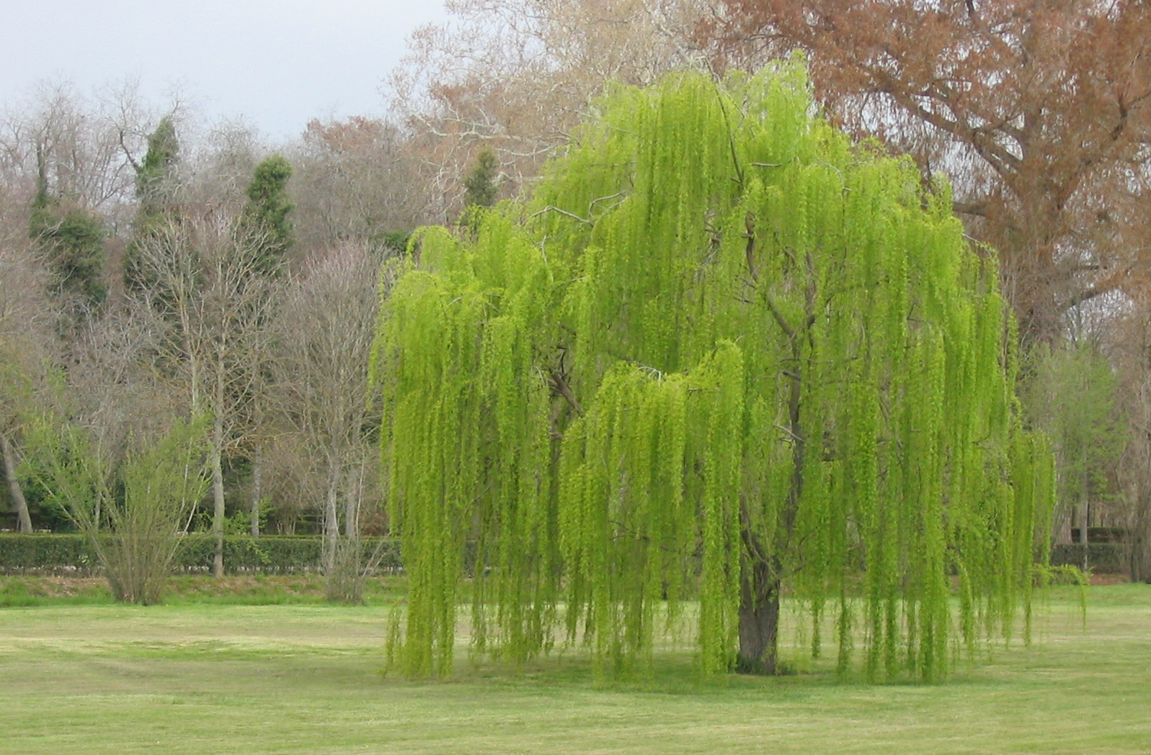

The wood of willows is hard and flexible. They have slender and fibrous branches, and often stoloniferous roots, whose most notable characteristics are their hardness, length and resistance. They also easily develop aerial roots.
Willow bark has been mentioned in ancient texts from Assyria, Sumeria and Egypt as a remedy against pain and fever, the Greek physician Hippocrates wrote about its medicinal properties around the fifth century BC.
The active extract of the bark called salicin, was isolated in its crystalline form in 1828 by Henry Leroux, a French pharmacist and the Italian chemist Raffaele Piria, who then succeeded in separating the acid in its pure state, salicin is acidic in a solution saturated in water, and is called salicylic acid for that reason (salix = willow). It has a wide variety of uses in medicine and cosmetics. From there, aspirin was developed.
The willow known as the "weeping willow" gets its name from Psalm 137. It grows next to streams of water and its presence always announces the proximity of water.
God promises that He will send His Holy Spirit as abundant waters upon believers, and they will grow in grace and holiness, sprouting like lush willows by the water's banks.
“For I will pour water upon him that is thirsty, and floods upon the dry ground: I will pour my spirit upon thy seed, and my blessing upon thine offspring: And they shall spring up as among the grass, as willows by the water courses..” (Isaiah 44:3-4)

Slide 8

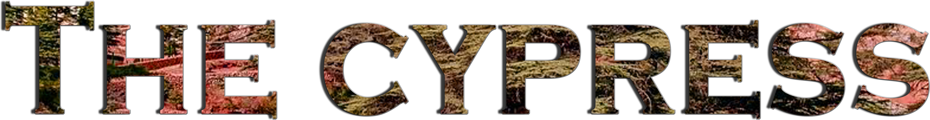
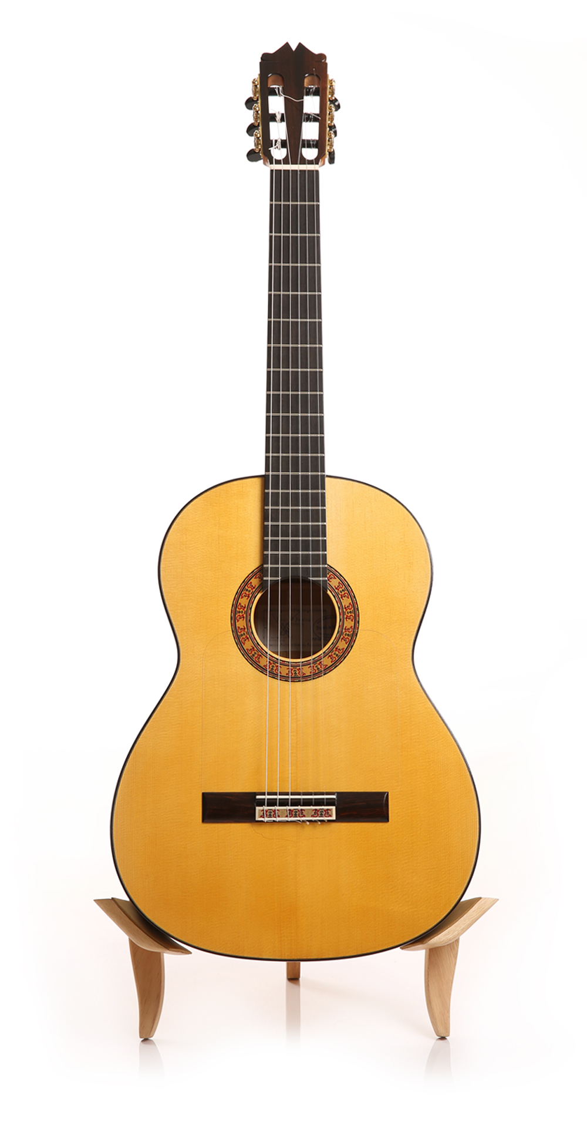
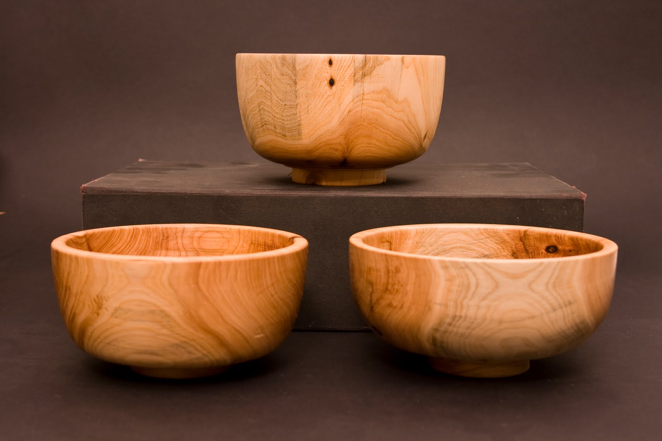
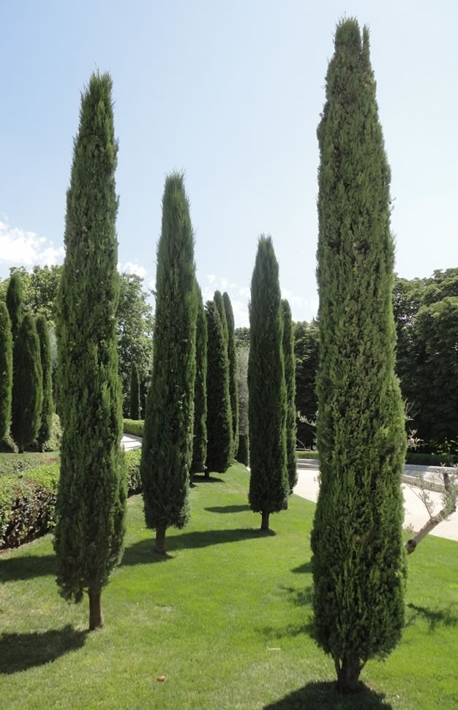
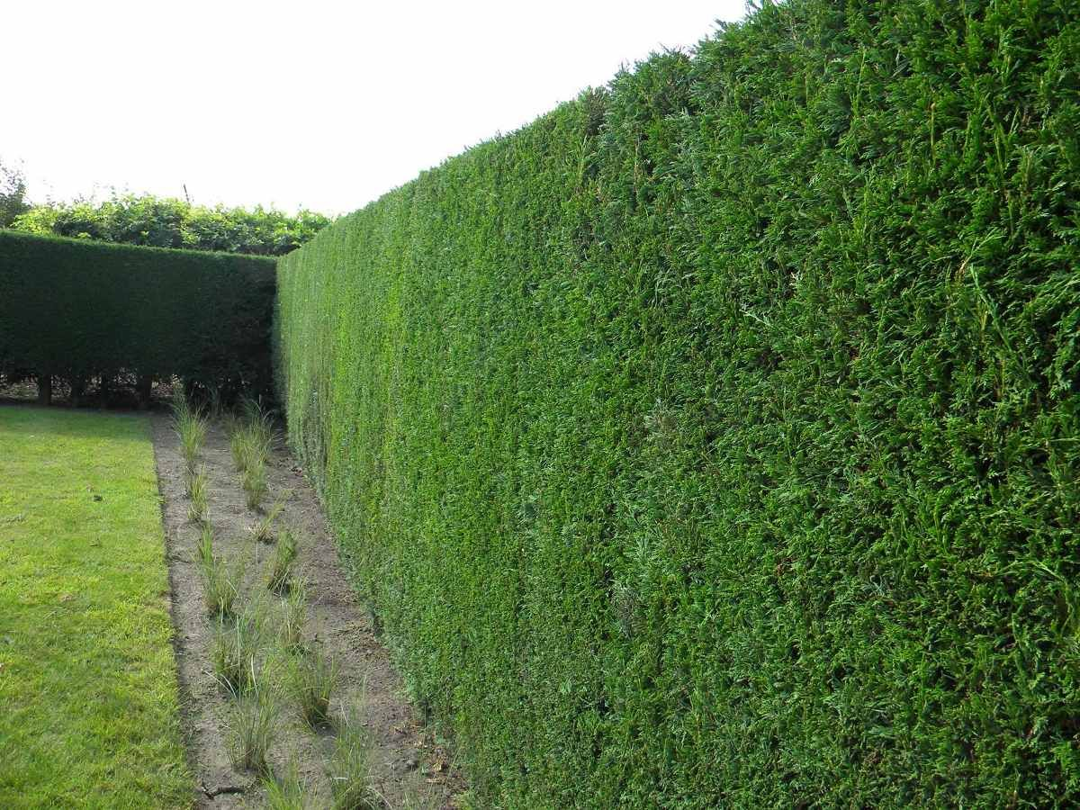
Like most conifers, cypresses are evergreen, they can reach 20 m in height with an approximate diameter of about 60 cm.
Many of the species are grown as an ornamental tree in parks and gardens in Europe. In Asia they are located next to temples. Cypresses are also widely used as hedges since their roots are pivoting, that is, they grow deep and do not damage the walls. For the same reason, they are also planted in cemeteries.
Its wood is often used for the construction of boxes, and the best selections of it can also be used in decorative boards, turning, guitar veneers, etc.
The roots of the cypress sink deep into the earth. We must be rooted in Christ, that is, have a deep relationship with Jesus.
“As ye have therefore received Christ Jesus the Lord, so walk ye in him: Rooted and built up in him, and stablished in the faith, as ye have been taught, abounding therein with thanksgiving.” (Colossians 2:6-7)

Slide 9

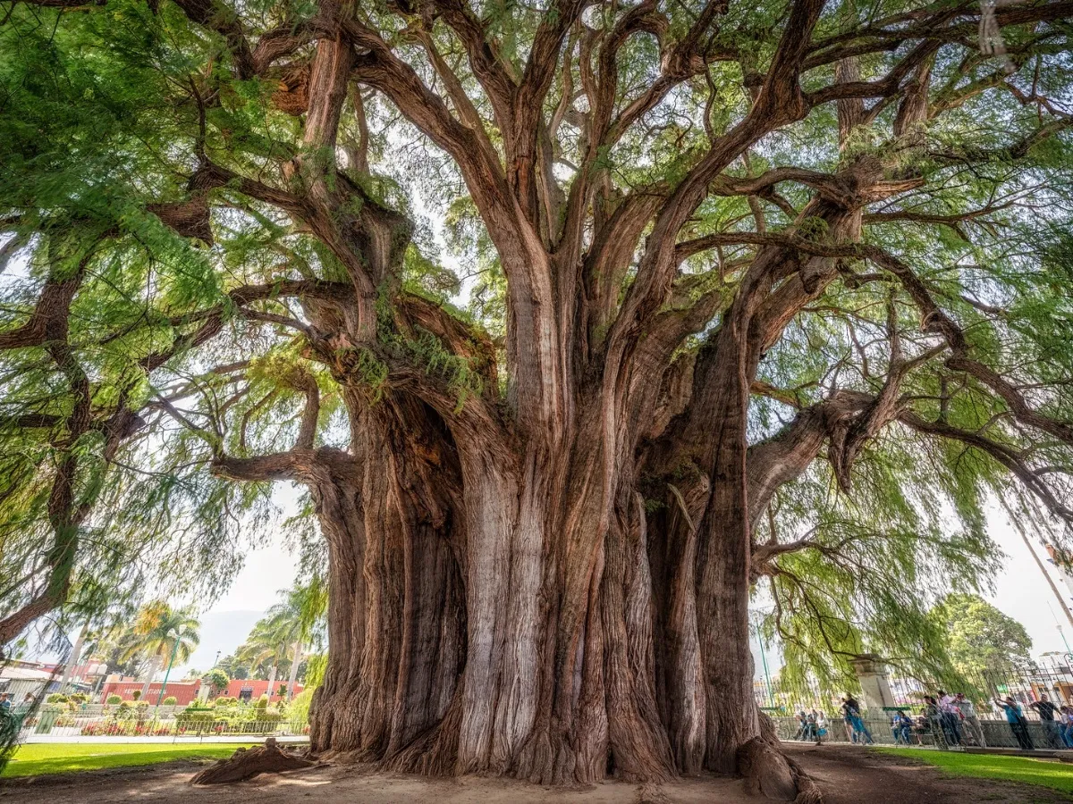

The Tule tree is the tree with the largest trunk diameter in the world.
This tree is located in the center of the city of Santa María del Tule, in the Mexican state of Oaxaca. It is so large that it was originally thought to be several trees, but DNA tests have shown that it is just one tree. The tree is estimated to be between 1,200 and 3,000 years old.
It is an ahuehuete with a crown circumference of approximately 58 meters and a height of 42 meters. With a trunk with a diameter of 14.5 meters, it is estimated that at least 30 people with their hands clasped would be necessary to be able to cover it. Approximately 500 people can fit in its shade.
We can all be under God's protection. Under His "shadow" there is no room for only 500 people, but all those who want to take shelter. God offers you His care and protection in the difficulties of this life.
“He that dwelleth in the secret place of the most High shall abide under the shadow of the Almighty.” (Psalms 91:1)

Slide 10


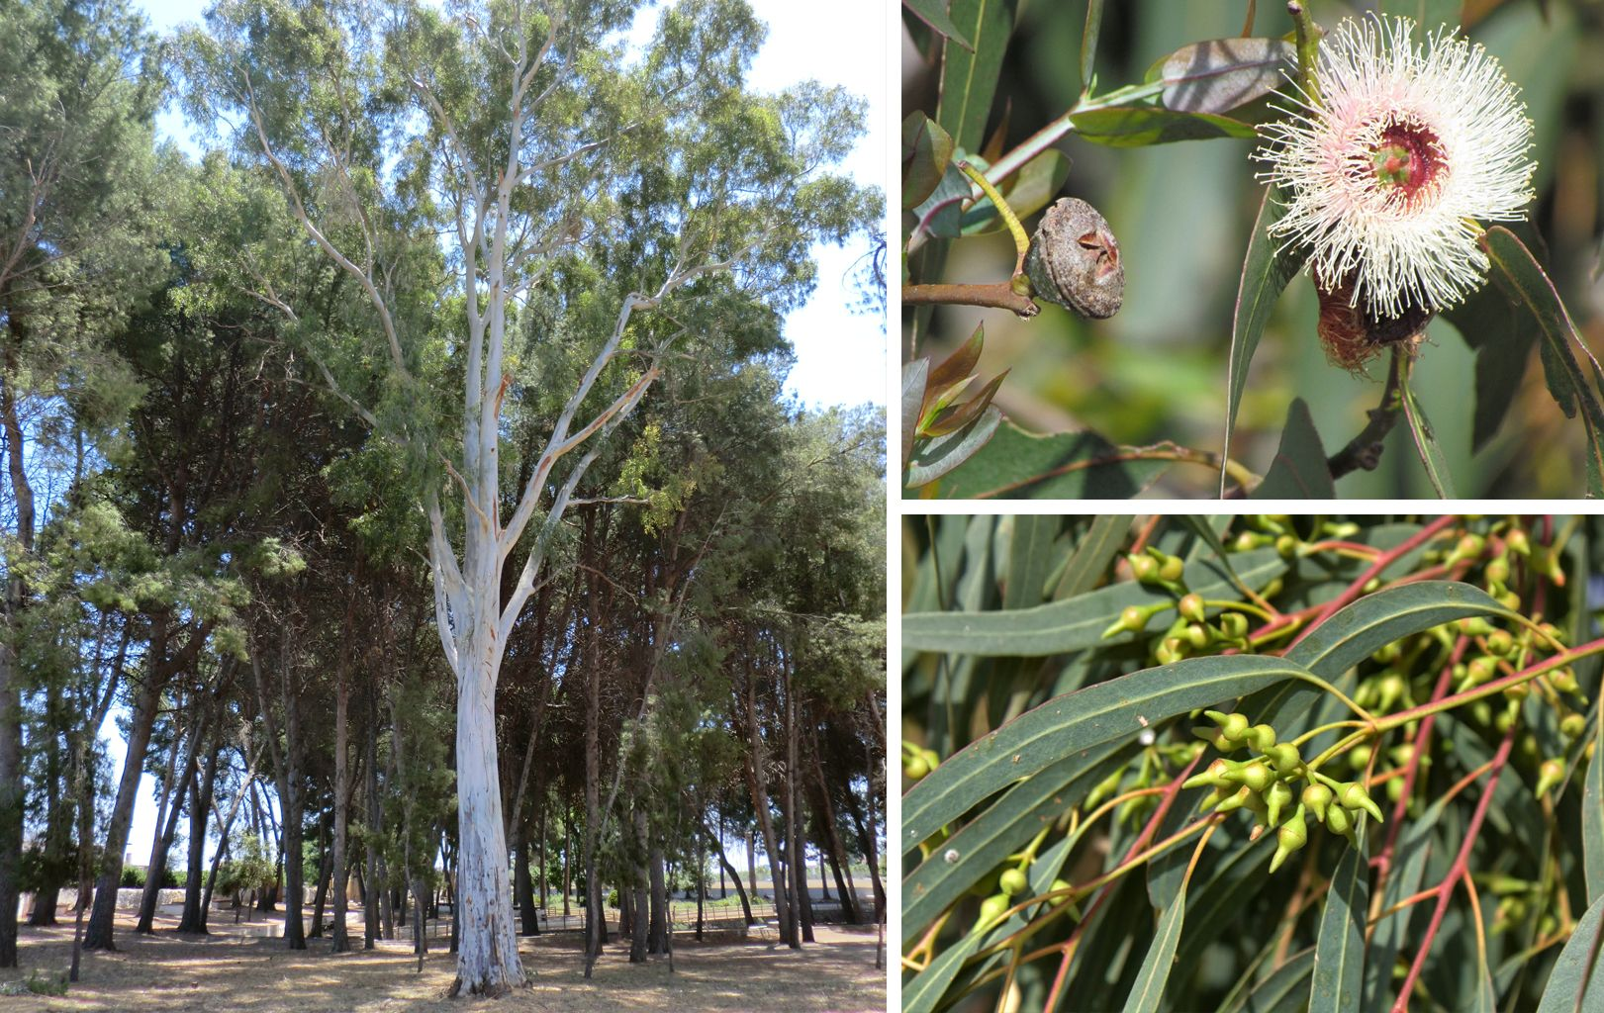
Eucalyptus trees and perennial medicinal plants are pyrophytic, straight in size. They can reach more than 60 m in height, although there is talk of specimens that have already disappeared and have reached 150 m.
Its main use is in forest monocultures for the production of cellulose pulp for the paper industry. Depending on the type of paste, it is used for the manufacture of packaging boxes and cartons, newspaper, product labels, among other uses.
To a lesser extent, it is used as fuel, in the wood industry or to obtain chemical products, in addition to its ornamental value.
The essential oil of eucalyptus leaves is used as a nasal decongestant and to fight respiratory infections. It is used in the form of ointment, in lozenges, inhalant candies, infusions, syrups or in vaporizations. The oil is used topically as a treatment for muscle and joint pain, as well as to treat cold sores. It also serves as a natural mosquito repellent.
God has eucalyptus ointments, lozenges, candies, syrups, and vaporizers that will help us breathe a sigh of relief when we need encouragement and strength to keep going. What are they? The promises he has left us in his Word.
“Whereby are given unto us exceeding great and precious promises: that by these ye might be partakers of the divine nature, having escaped the corruption that is in the world through lust.”
(2 Peter 1:4)

Slide 11

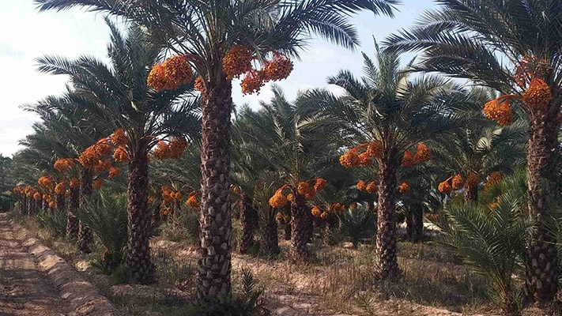
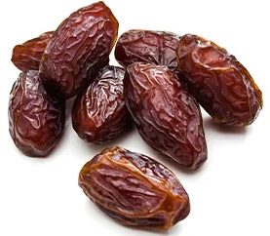
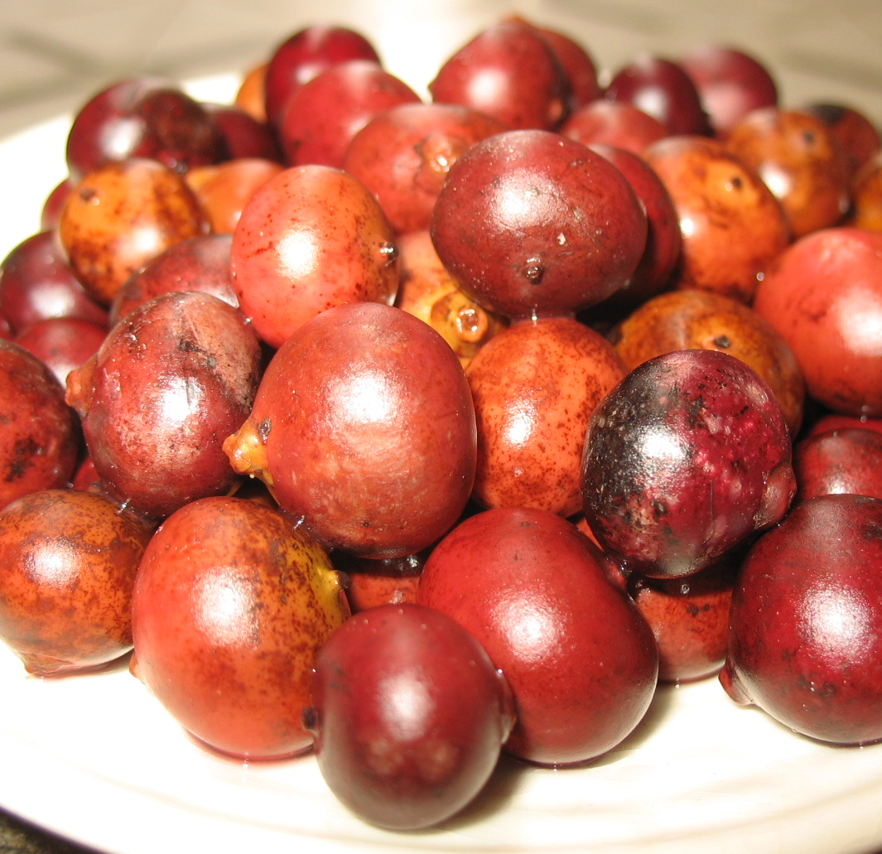
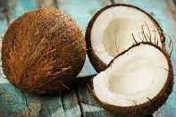
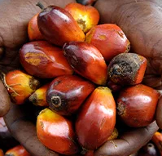
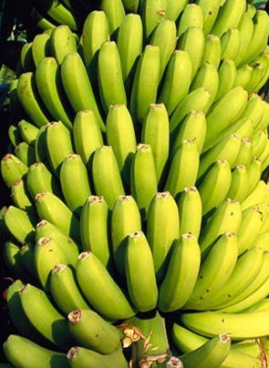
Palm trees can reach up to 30 m in height and 20 to 50 cm in diameter.
The date palm tree must have a regular supply of water, being the most expensive in a palm plantation, since the roots must have a constant supply of moisture. It can be irrigated with salt water, loaded with too much salt for most crops.
Depending on their type, palm trees can produce different fruits: dates, coconuts, bananas, açaí, corozos and chontaduros.
It is used commercially for the use of its fruits. It is also used as an ornamental in warm coastal areas, as an isolated element, in rows or groups (forming palm groves). On Margarita Island, Venezuela, palms are used to create traditional hats, known as sombrero de cogollo. In North Africa, the leaves are commonly used for cottage making. Mature leaves are also used to make mats, screens, baskets and fans. The processed sheets can be used for insulating boards. Dried leaf petioles are a source of cellulose pulp, which is used for walking sticks, brooms, fishing floats, and fuel. The leaf pods are highly prized for their aroma, and the fiber from them is also used for rope, thick fabric, and large hats.
The wood is used for posts and beams of huts. It is also used for construction, such as bridges and aqueducts, and parts of barges. The wood scraps are burned as fuel.
Just as the palm tree can produce very different fruits, the Holy Spirit endows us with various gifts to put at the service of God, and for the benefit of the Church.
“Now there are diversities of gifts, but the same Spirit… But all these worketh that one and the selfsame Spirit, dividing to every man severally as he will.” (1 Corinthians 12:4, 11)

Slide 12


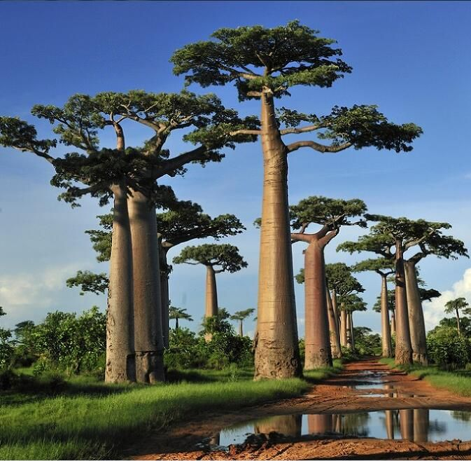
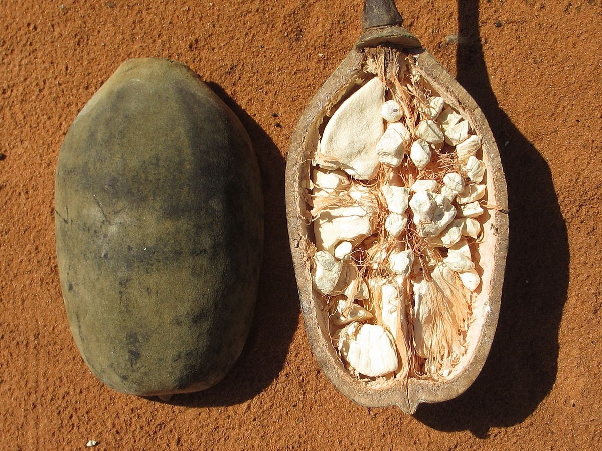
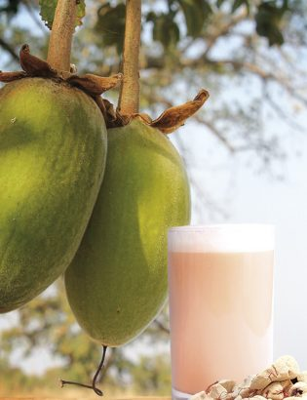
The African Adansonia (or baobab, bottle tree or monkey bread), is a tree with a large, bottle-shaped or irregular trunk and full of knots. Its height can range from 5 to 30 m, and the diameter of the crown exceeds 11 m.
The bark is smooth and the wood is fibrous, where it stores water. The leaves only sprout in the rainy season, in summer in the southern hemisphere and in winter in the northern hemisphere. The fruit is a dried berry or a thick capsule shaped like an elongated melon. The seeds are numerous, large, kidney-shaped.
As part of the national coat of arms and symbol, this tree represents the country where it proliferates.
We, as citizens of the kingdom of heaven, are God's representatives to all nations.
“Now then we are ambassadors for Christ, as though God did beseech you by us: we pray you in Christ's stead, be ye reconciled to God.” (2 Corinthians 5:20)
When it has no leaves (most of the time) this curious tree looks like it is planted upside down, with the roots facing up.
In good conditions, on sandy soil, with a temperate climate and rainfall between 300 and 500 mm they can live up to 800 or 1000 years, although there is talk of specimens that have reached 5000 years.
It is part of the coat of arms of Senegal. It is the national symbol of Madagascar, where the Avenue of the Baobabs is located.

Slide 13

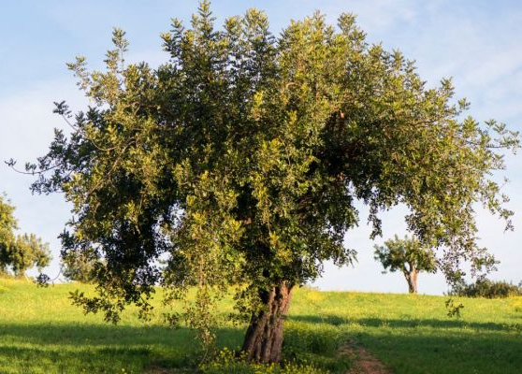
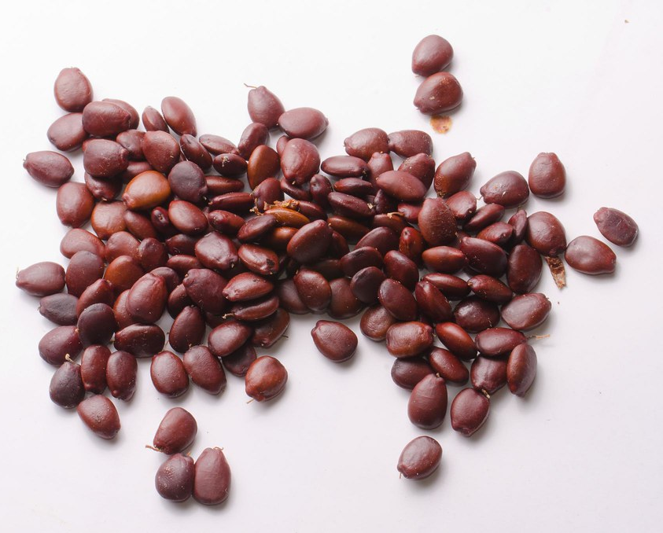
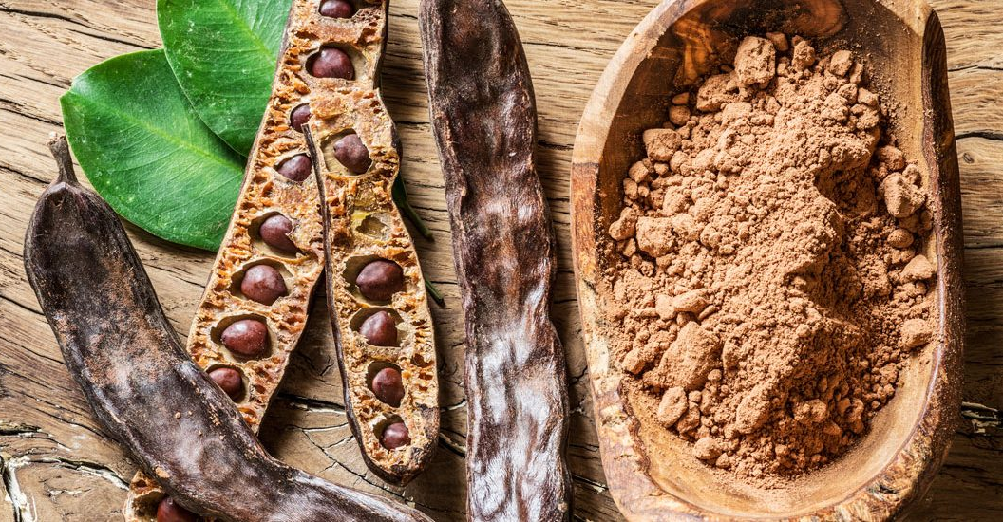
The carob tree is a tree up to 10 m. high, its average height is 5 to 6 m.
The fruit, called carob or garrofa, is a dark chestnut leathery pod, 1 to 3 dm long, containing a gummy pulp with a sweet and pleasant taste that surrounds the seeds. The pods are edible and used as fodder.
The fruit of the carob tree, known as carob, can be eaten raw once ripe, and care must be taken to remove or not bite into its hard seeds. It is used as a natural food thickener or ingredient for the cosmetic and pharmaceutical industry. With carob beans it is possible to prepare a substitute for chocolate widely used in diet foods.
The seeds of this fruit were the original standard of the carat—the unit of weight used in jewelry—for weighing precious metals, gems, and jewelry due to the notoriously uniform size and weight of the seeds, close to 0.2 g, the same weight as a carat of diamonds today. The term carat also comes from the Greek word kerátion [κεράτιον].
How many "carats" of Jesus do we weigh? The measure by which we are to compare ourselves is Christ. We must grow in grace and holiness so that each day our character becomes more like that of Jesus.
“Till we all come in the unity of the faith, and of the knowledge of the Son of God, unto a perfect man, unto the measure of the stature of the fulness of Christ.” (Ephesians 4:13)

Slide 14



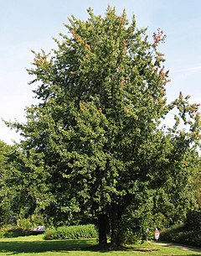
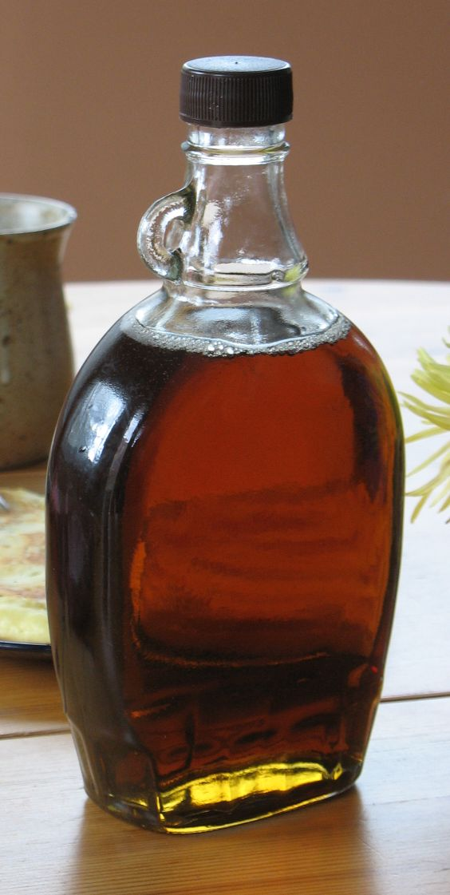
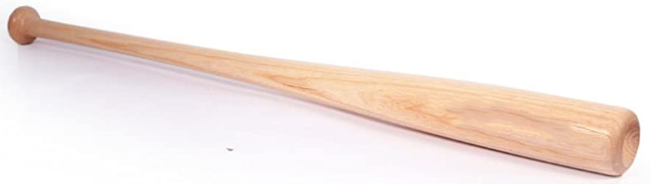
It is a tall tree, which can reach up to 90 m in height, with a wide crown and open branches, with smooth and greyish bark. Maple can live up to 200 years. It is widely used as an ornamental tree and has shown to have a very high tolerance to environmental pollution. A regular visitor to the red maple is the squirrel.
Acer saccharum is used to extract the sap, which after being boiled produces maple syrup, with which candies are made. Maple sap, also known as maple syrup, is a sweet substance that is made from the sap of different species of maple (such as black maple, red maple, or sugar maple). It is used in waffles, crepes and various desserts.
Its wood is used in the manufacture of baseball bats approved by the MLB and various baseball leagues in the world, as well as in the manufacture of musical instruments; Its high density and sound properties make it a favorite for such use.
The maple leaf is a prominent national symbol in Canada and is represented on its flag.
The sap of the maple brings sweetness to food. Likewise, our words should be spoken with love and grace.
“Let your speech be always with grace, seasoned with salt, that ye may know how ye ought to answer every man.” (Colossians 4:6)

Slide 15

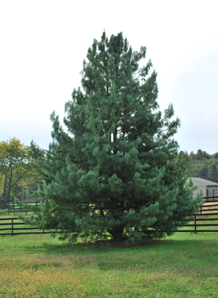
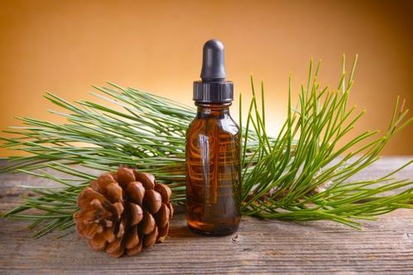
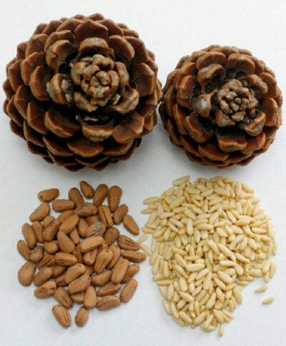
They are trees that can reach up to 40 m in height, with a straight trunk on which several floors of branches are arranged in a horizontal position. The crown is usually pyramidal, although in the oldest specimens this shape is lost. There are about 110 species of pine in the world. We use pine nuts in the kitchen.
It is very resistant, both to pests and diseases. However, there are some species, such as Pinus halepensis, which is especially vulnerable to the pine processionary.
At Christmas, one of the most widespread traditions is to decorate a pine tree with various decorations, such as stars, bows, colorful balls, etc.
Pine wood, on the other hand, is one of the most appreciated for its natural characteristics. It is a resistant wood, of good durability, which can be treated or painted easily.
Pine essence can be prepared with any part of the plant and has expectorant, mucolytic and antiseptic properties that have been used to treat various diseases of the respiratory system. As if all this were not enough, pine is a great antipyretic, that is, it serves to reduce the fever that usually accompanies many of the most common chest diseases.
One of the characteristics of pine is its resistance. The apostle Paul encourages us to resist in the Christian struggle, and tells us how to do so.
“Wherefore take unto you the whole armour of God, that ye may be able to withstand in the evil day, and having done all, to stand.” (Ephesians 6:13)

Slide 16


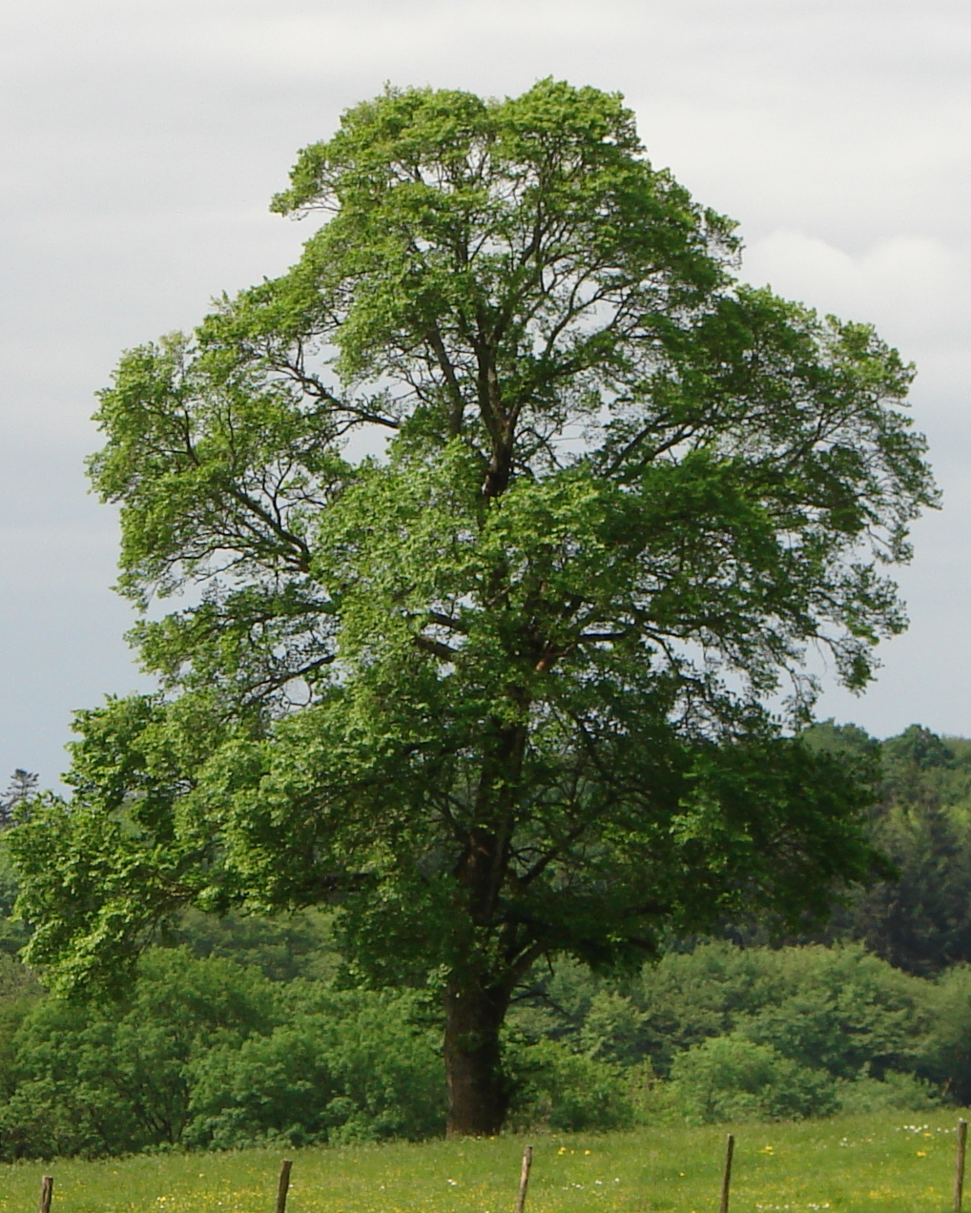
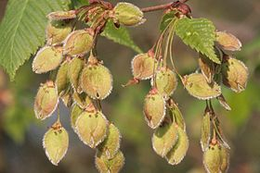
The elm is a deciduous tree with a tall and robust stature, which can reach a height of up to 40 m. It is grown in cool, deep soils, mainly in groves and riverbanks. It prefers temperate climates, hence they do not rise much above 1,000 m.
The wood of the elm has a light brown or reddish-brown heart, with very marked growth rings and a somewhat coarse texture; It is easy to work, difficult to split and very resistant to rot if kept moist, so it is used in shipbuilding, mine piles, and was formerly the preferred one to make water pipes. The elm is one of the best shade trees, easy to transplant and reproduce, since the seed is born without any problem, if it is sown shortly after ripening, and especially the sprouts and shoots that its roots produce.
It has the disadvantage of frequently suffering from a disease, graphiosis, which is caused by a fungus of the Ophistomataceae family (Ceratocystis ulmi), which obstructs the vessels and causes the leaves to dry out; this disease has practically decimated the native specimens of the Iberian Peninsula and much of Europe; For this reason, exotic species that are more resistant to the disease have been introduced.
We, too, suffer the inconveniences of a serious disease called sin. Thankfully, God did not choose to discard us and "transplant" other beings to replace us but sent His own Son to heal us forever of this terrible disease.
“For God so loved the world, that he gave his only begotten Son, that whosoever believeth in him should not perish, but have everlasting life.” (John 3:16)

Slide 17
Bring Relief and Healing to Others
Interced for Others in Prayer
Study the Bible
Be a sweet savor of Christ by sharing the gospel with others
Ask for the Holy Spirit to Grow in Grace and Holiness
Have a Deep Relationship with Christ
Live Under God's Protection
Seek encouragement and strength in God's promises
Put my gifts at the service of God
Worthily Represent God to All
Make my character more and more like Jesus
Take up the whole armor of God to resist evil
Thank God for sending His Son to deliver us from sin
Always speak with love and grace
From the forest of God I have learned to…

