Slide 1
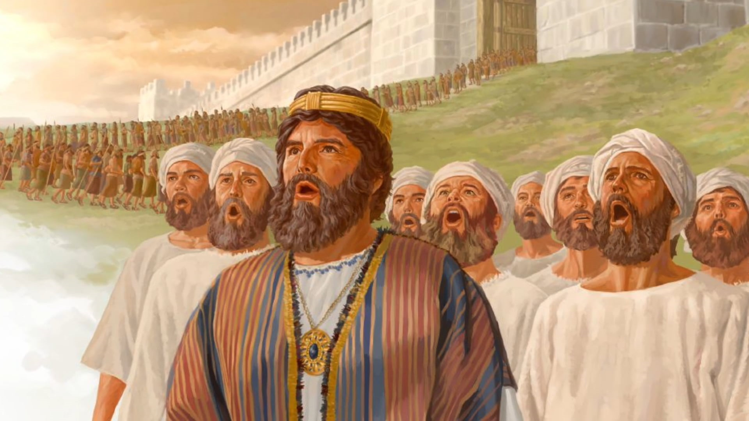
GREAT SONGS OF THE BIBLE

Slide 2

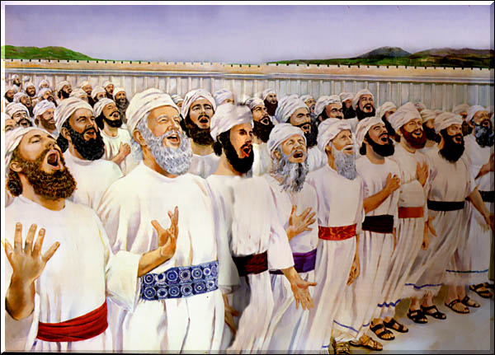
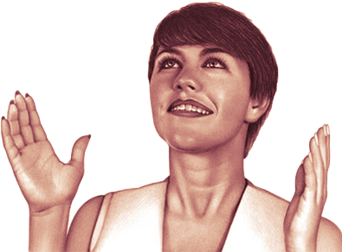
The purpose of worship is to recognize the greatness and power of the true God, and to dedicate one's life to His service in obedience, loyalty, and love always and in all circumstances.
Just as the Israelites, when they walked in the desert, made their way happy with the music of sacred song, God invites us to brighten, by the same means, our life of pilgrimage. There are few more effective means of engraving his words in the memory than that of repeating them by singing. That kind of singing has wonderful power. It has power to subdue rude and uncultured natures, to enliven thought and arouse sympathy, to promote harmony in action, and to dispel melancholy and presentiments that destroy courage and weaken effort.
How often the memory recalls some word of God to the soul oppressed and on the verge of despair, through the forgotten theme of some song of childhood.
As you sing, temptations lose their power, life takes on new meaning and new purpose, and courage and joy are imparted to other souls.
In the Bible we find certain moments in which songs of sublime worship were sung recognizing divine intervention in several situations.
We will see some examples.

Slide 3


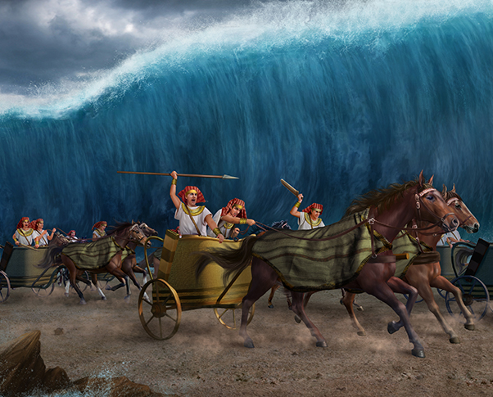
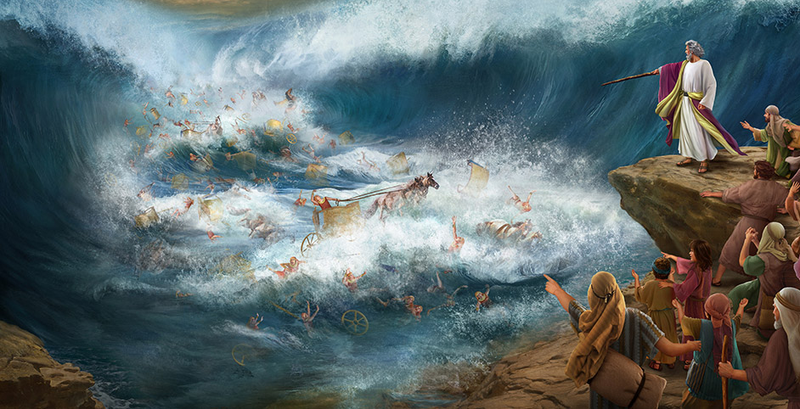
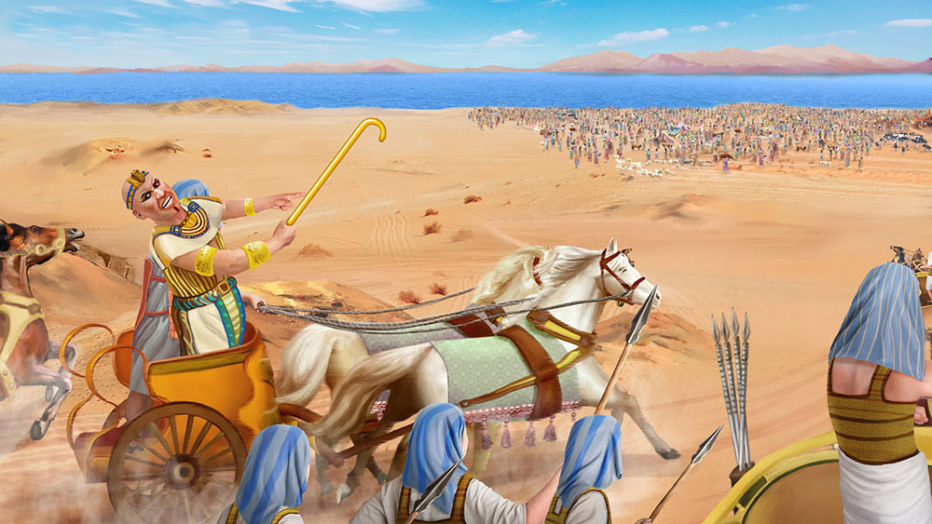
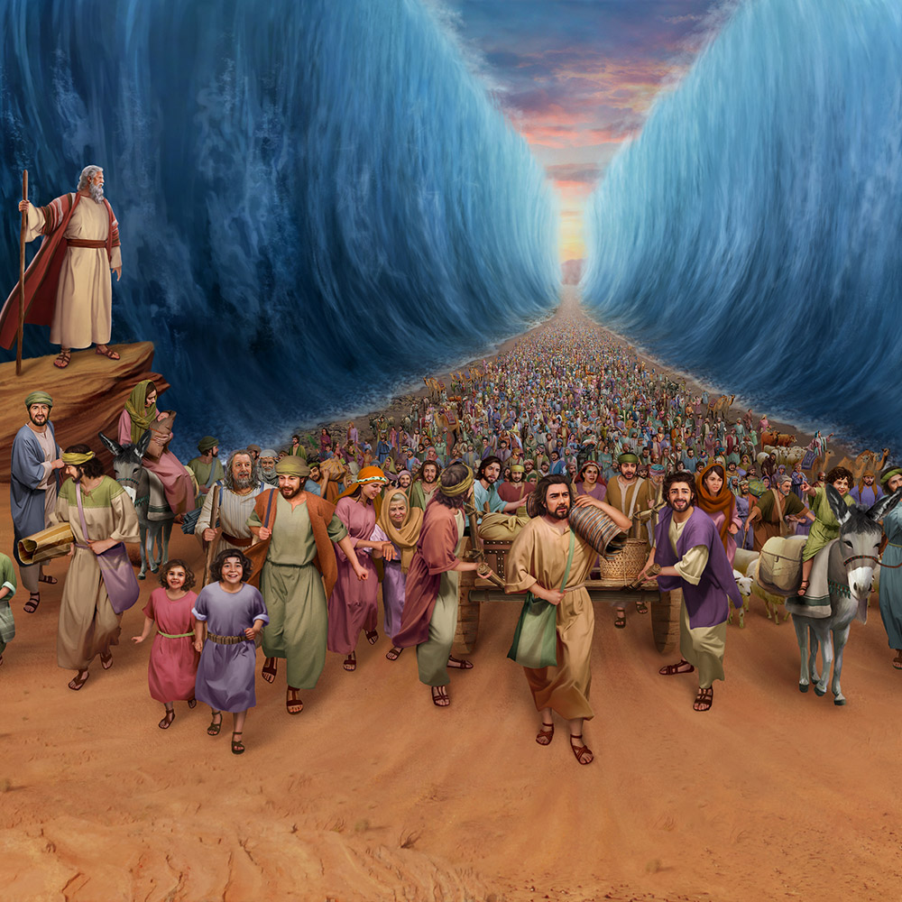
THE SONG OF MOSES (Exodus 15)
To human eyes the situation of the people of Israel seemed hopeless. The Egyptians were pursuing them, and they were unarmed and unprepared for combat. Moreover, they were enclosed on the east by the sea, on the south by a rugged mountain, on the west by mountainous deserts, and on the north by the pursuing Egyptians. The conclusion is that their escape was impossible. God commanded them to go forward and toward the sea. They advanced, the sea was divided into two parts, and they passed dry. The Egyptians followed them, the sea closed in on them, and they were buried by the waters (Exodus 14).
Exodus 15 is the song they sang after they were delivered by God from certain death at the hands of the Egyptians.

Slide 4
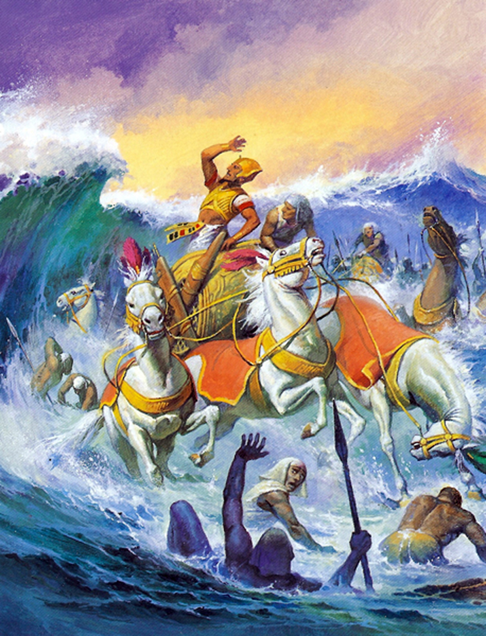
THE SONG OF MOSES (Exodus 15)
I will sing to the Lord, for he has greatly magnified himself; He has cast the horse and the rider into the sea.
Jehovah is my strength and my song, and he has been my salvation.
This is my God, and I will praise him; God of my father, and I will exalt him.
Jehovah is a man of war; Jehovah is his name.
He cast Pharaoh's chariots and his army into the sea; and their chosen captains were sunk in the Red Sea.
The abysses covered them; they descended into the depths like stone.
Thy right hand, O Lord, hath been magnified in power; thy right hand, O Lord, hath broken the enemy.
And by the greatness of your power you have struck down those who rose up against you. You sent your wrath; he consumed them like leaf litter.
At the breath of your breath the waters piled up; the currents came together as if in a heap; the abysses curdled in the middle of the sea.
The enemy said, "I will pursue, I will capture, I will divide spoils; my soul will be satisfied with them; I will draw my sword, my hand will destroy them.
You blew with your wind; they were covered by the sea; they sank like lead in the rushing waters.

Slide 5
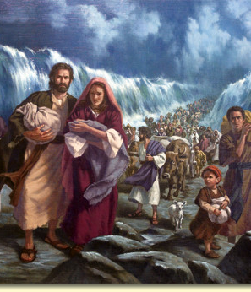
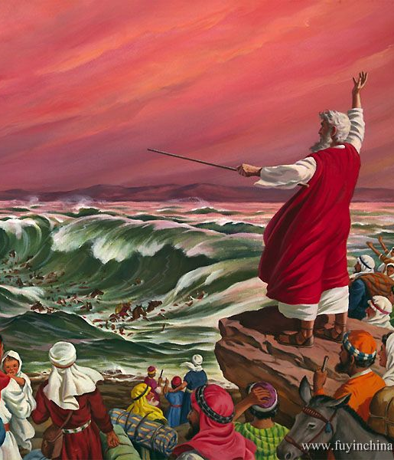

THE SONG OF MOSES (Exodus 15)
Who is like you, O Jehovah, among the gods? Who is like you, magnificent in holiness, terrible in marvellous deeds, a workman of wonders?
You stretched out your right hand; the earth swallowed them.
You led in your mercy this people whom you redeemed; You carried it with your power to your holy dwelling.
The people will hear it, and they will tremble; Sorrow will take over the land of the Philistines.
Then the leaders of Edom will be troubled; the mighty men of Moab will be overcome by trembling; all the inhabitants of Canaan will be cowed.
Let trembling and fright fall upon them; at the greatness of your arm they are silent like a stone; until thy people have passed away, O Lord, until this people whom thou hast rescued shall pass away.
You shall bring them in and plant them in the mountain of your inheritance, in the place of your dwelling, which you have prepared, O Lord, in the sanctuary which your hands, O Lord, have established.
Jehovah will reign forever and ever.

Slide 6
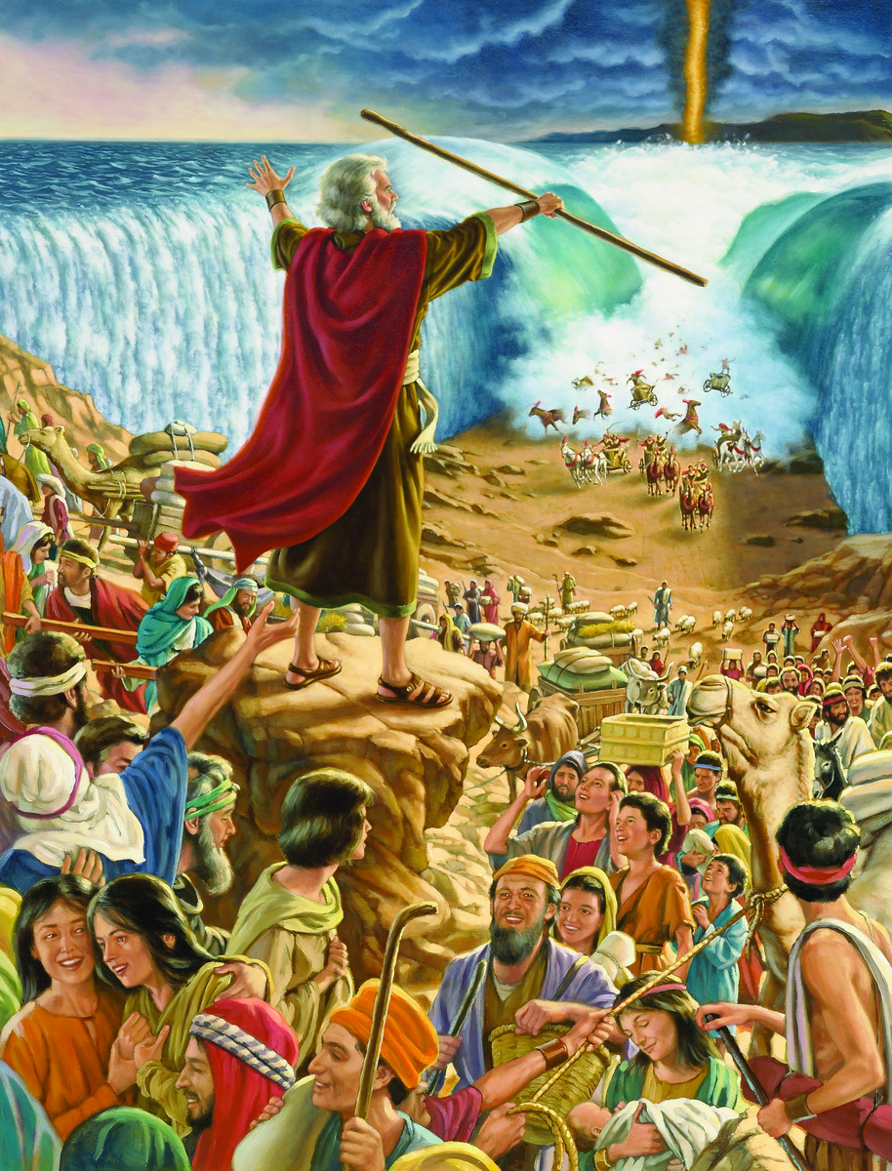
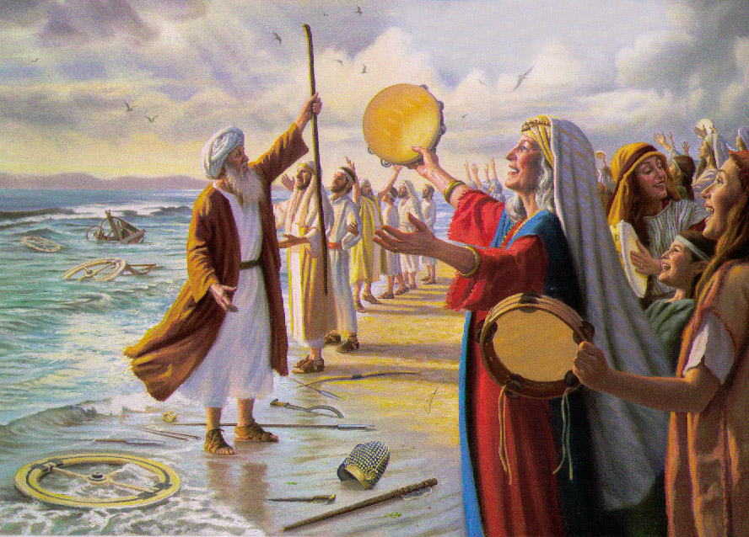
THE SONG OF MOSES (Exodus 15)
The singing of Moses on the shores of the Red Sea has always provided God's church with a pattern of praise in all its conflicts with the powers of darkness (PP 293). The majestic theme of this song resounds through all the songs of Israel, in praise of God for His glorious works on their behalf.
The hymn is composed of three salient stanzas, each beginning with praise to God and ending with a description of the defeat of the Egyptian host (Ex. 15:2-5, 6-10, 11-18). In each of them, God's omnipotence predominates.
The last stanza shows Israel's glory in their future homeland, and the sanctuary as God's dwelling place.
Singing exalts God for his power and majesty. It is a praise to God for His glorious works on behalf of His people.
Let us praise God because He is Omnipotent and shows His power in our lives.

Slide 7

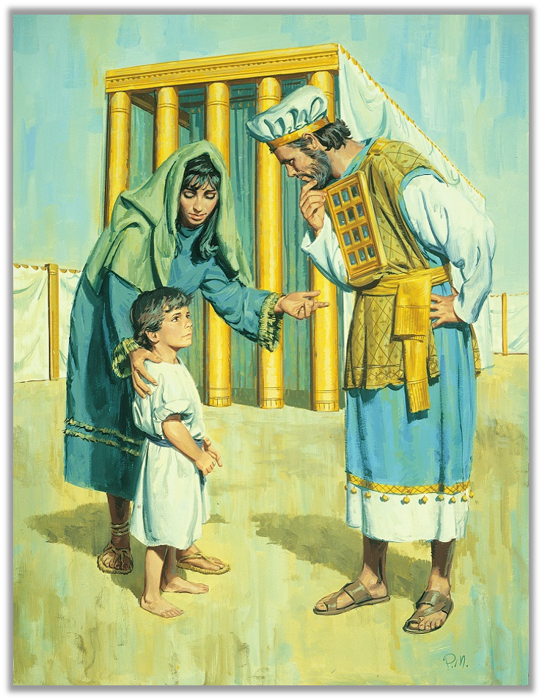
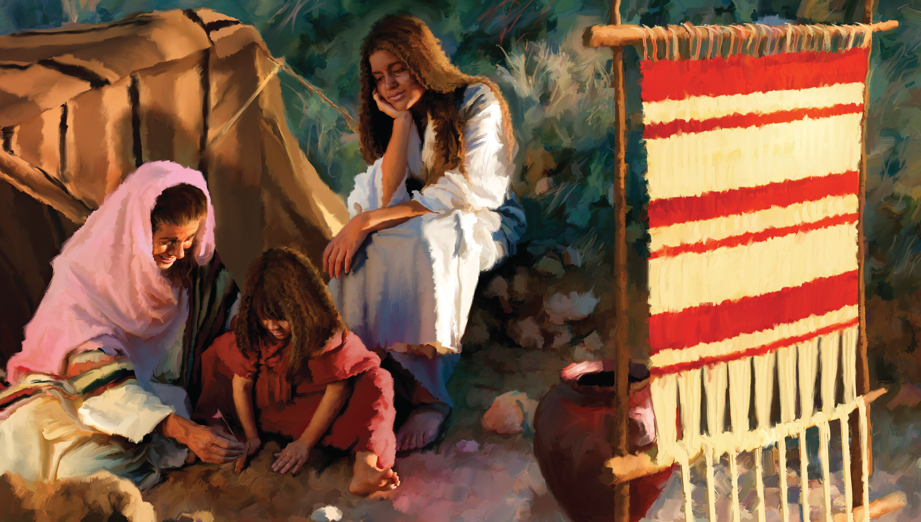
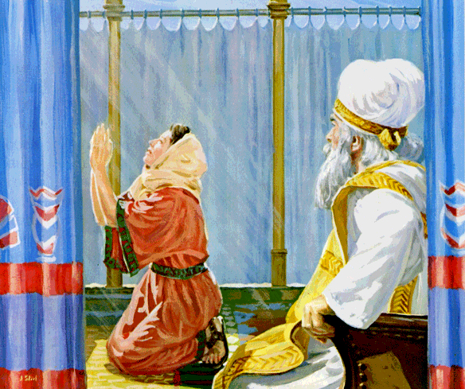
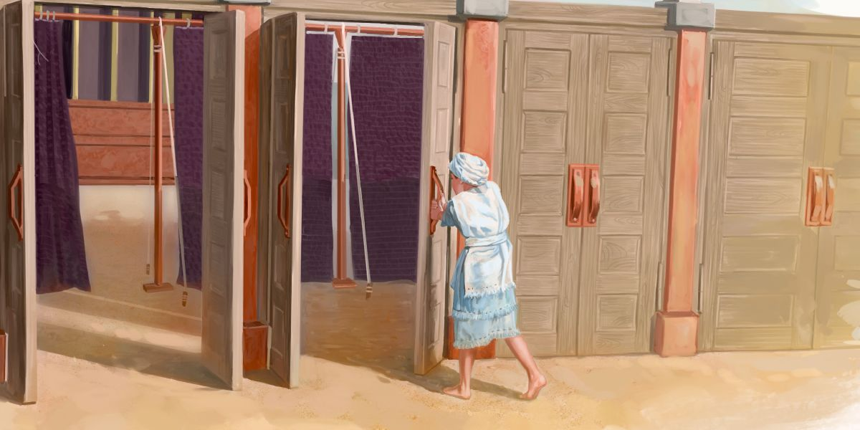
THE SONG OF HANNAH (1 SAMUEL 2:1-10)
Hannah could not have children. Her husband Elkanah, because he loved her, comforted her and treated her as if she has had a child. His other wife, Peninnah, made fun of Hannah and made her life impossible.
As every year, the family went up to the sanctuary to offer sacrifices to God.
Hannah got up after the meal, went to the entrance of the sanctuary, and prayed asking God to give her a son.
God granted her heart's desire, and she gave her son to God's service. This song came from the heart of a woman who was troubled but who, cared for by God's mercy, obtained what she longed for most in life: a child.
Let us hear her praise.

Slide 8
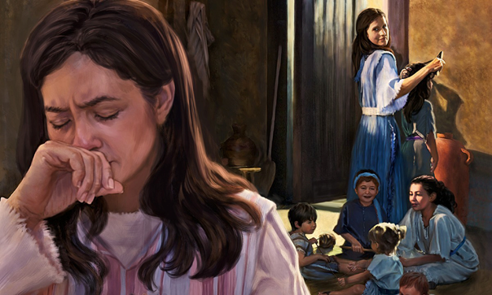
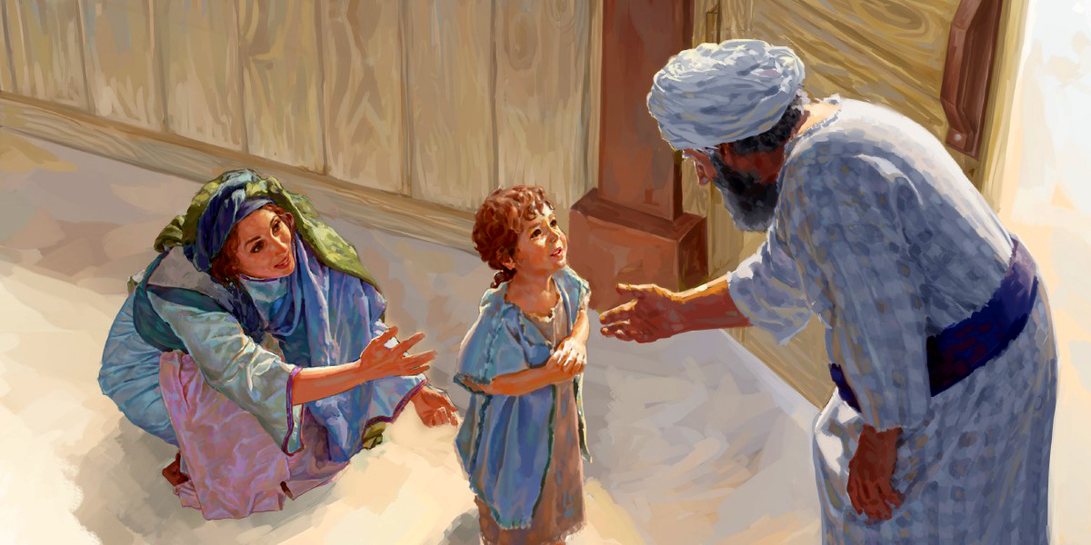
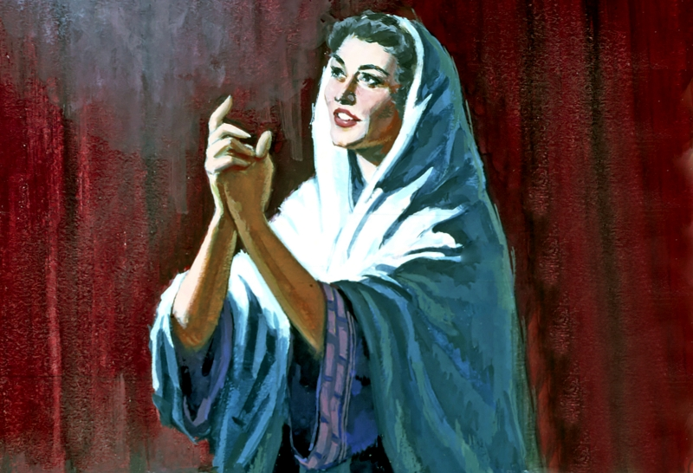
THE SONG OF HANNAH (1 SAMUEL 2:1-10)
“My heart rejoices in the Lord, my power is exalted in the Lord;
my mouth was enlarged over my enemies, because I rejoiced in your salvation.
There is no saint like Jehovah; for there is none besides you, and there is no refuge like our God.
Do not multiply words of greatness and haughtiness; let the arrogant words of your mouth cease; for the God of all knowledge is the Lord, and it is his duty to weigh one's actions.
The bows of the strong were broken, and the weak were girded with power.
The satiated hired themselves for bread, and the hungry were no longer hungry; even the barren has given birth to seven, and the one who had many children languishes.
Jehovah kills, and he gives life; He brings down Sheol, and brings up.
Jehovah impoverishes, and he makes rich; he brings down, and exalts.
He raises the poor from the dust, and exalts the needy from the dunghill, to make him sit with princes and inherit a place of honor. For the pillars of the earth are the Lord's, and he established the world upon them.
He guards the feet of his saints, but the wicked perish in darkness; for no one will be strong by his own strength.
His adversaries will be broken before the LORD, and he will thunder over them from heaven; Jehovah will judge the ends of the earth, give power to his King, and exalt the might of his Anointed One.”

Slide 9
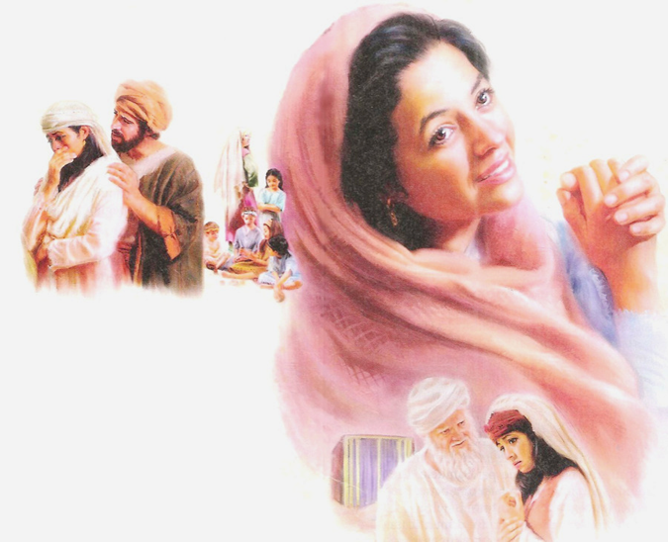
THE SONG OF HANNAH (1 SAMUEL 2:1-10)
Hannah extolled God as the author of mercy, revealed in His compassion for the helpless. She gained a new vision of the power of God, whose dominion over the hidden forces of nature was now evident in His quiet action to counteract the forces of evil, which discouraged her and could defeat her, and who had also caused a negative environment to contribute immeasurably to the depth and fullness of her joy. She understood in a new way the covenant made with her forefathers: that the children of God would become a blessing to all nations. Hannah's hymn of joy was a prophecy concerning David and the Messiah.
We praise God because He is the One who gives us everything we have and need. We praise Him because He answers our prayers.

Slide 10

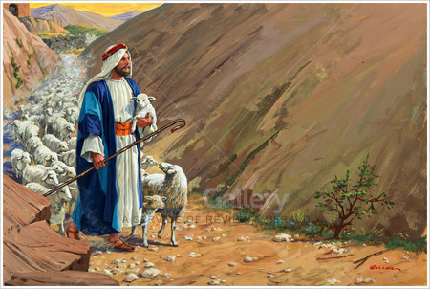
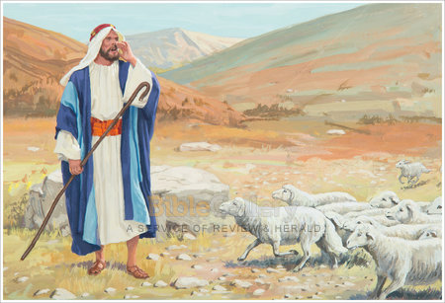
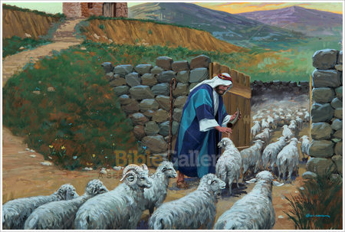
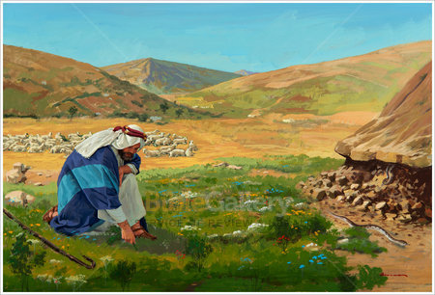
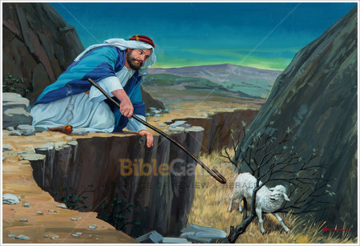
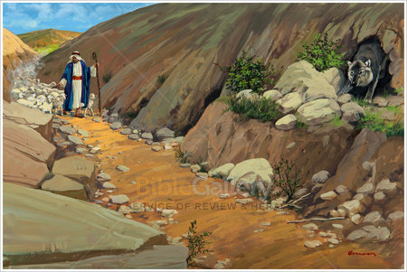
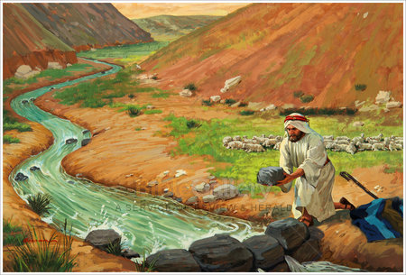
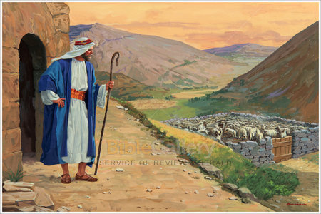
THE SONG OF DAVID (Psalm 23)
This psalm is perhaps the most read, best known, and most loved of all David's psalms.
It is called “Psalm of the Good Shepherd”, “The Pearl of Psalms”, “The Nightingale's Psalm”, “The Shepherd's Song About His Shepherd”, etc.
Psalm 23 contains a message for people in all ages.
There is no doubt that David's experiences as a shepherd on the rugged hills of Judea, and later as a royal host in the opulence of the court of his capital city, prepared him to write this most sweet piece of sacred lyric.
Let us recite it.

Slide 11
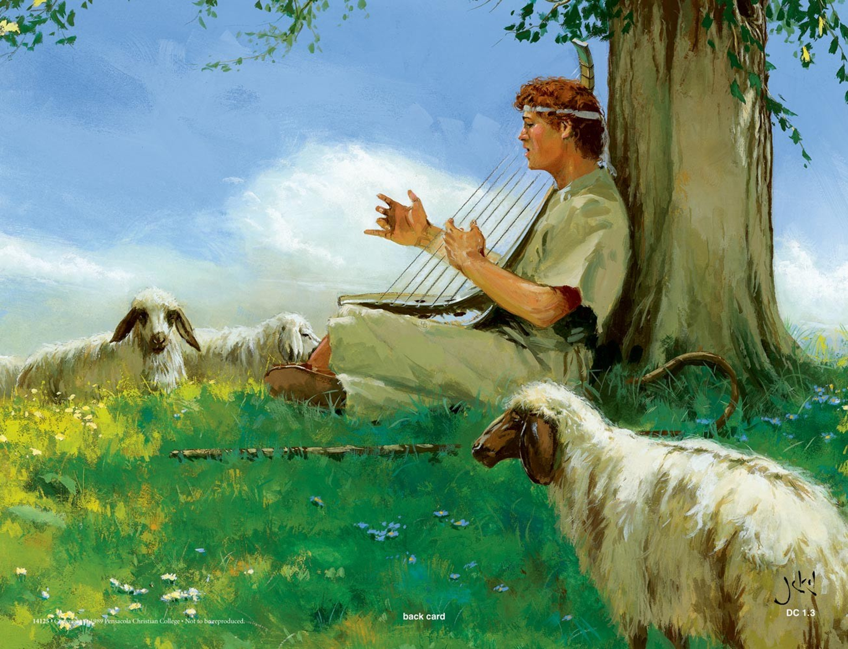
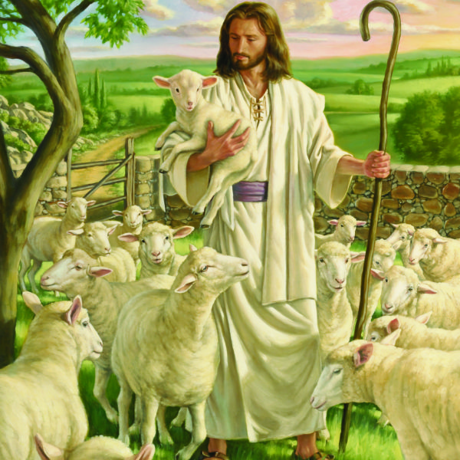
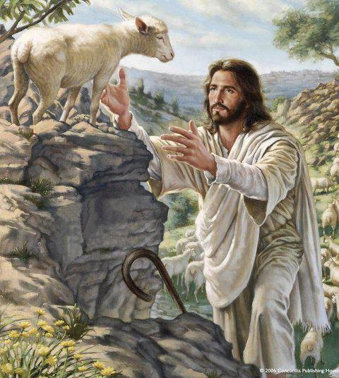
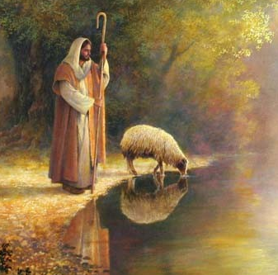
THE SONG OF DAVID (Psalm 23)
The Lord is my shepherd; I shall not want.
He maketh me to lie down in green pastures:
he leadeth me beside the still waters.
He restoreth my soul:
he leadeth me in the paths of righteousness for his name's sake.
Yea, though I walk through the valley of the shadow of death,
I will fear no evil: for thou art with me;
thy rod and thy staff they comfort me.
Thou preparest a table before me in the presence of mine enemies:
thou anointest my head with oil; my cup runneth over.
Surely goodness and mercy shall follow me all the days of my life;
and I will dwell in the house of the Lord for ever.

Slide 12
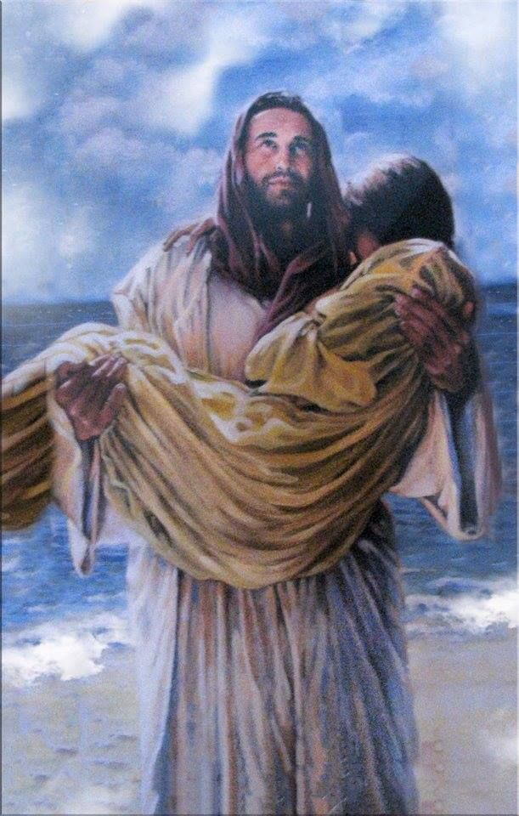
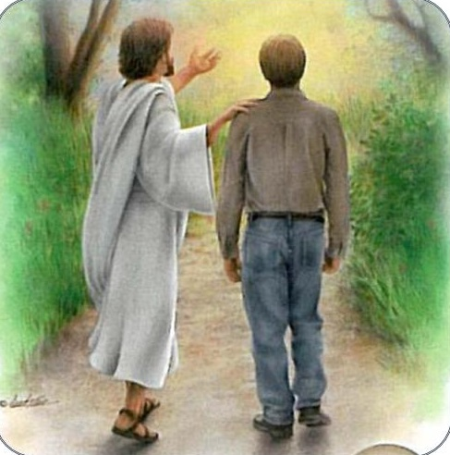
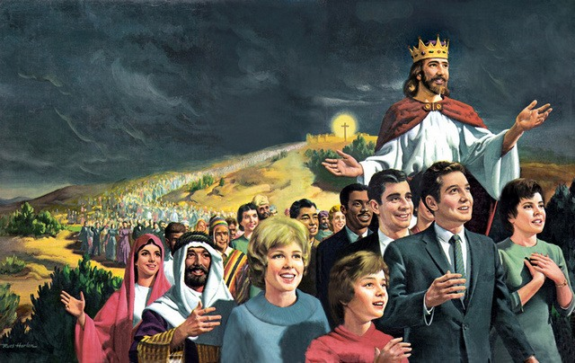
THE SONG OF DAVID (Psalm 23)
In this psalm David describes the tender Shepherd who leads his flock to rest, feeds them "in places of delicate pastures... by still waters," and protects the flock from the dangers of the desert. In addition, the portrait of the kind Host who provides abundant food and solicitous attention to his guest is sketched in it.
The psalm ends with a confession of absolute trust in God, who will guide His son with love through this life and receive him as His guest until the end of his days.
This psalm, through the ages, has brought assurance and hope to those who make the decision to recognize and accept God as the True Shepherd.
David sang that God, as Shepherd, gives care and direction to his flock until he brings it into the fold of eternity.
We praise God because He cares for us, protects us, and will take us home with Him one day.

Slide 13

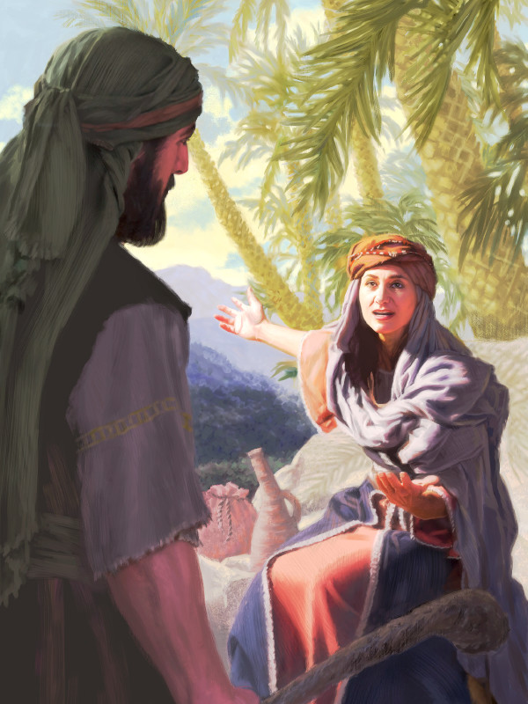
THE SONG OF DEBORAH (Judges 5)
Deborah was a prophetess; she corrected abuses and did justice. He sat under a tree that was between Ramah and Bethel. This type of court allowed the people to approach it easily, and "the children of Israel went up to it for judgment" in this place.
The Israelites had forsaken God, and in order to awaken His people, the Lord allowed the Canaanite ruler, Sisera, who commanded the strong chain of fortifications in northern Palestine, to oppress the Hebrew tribes.
Deborah sent for Barak to gather an army to fight his enemies, promising him that God would give him victory. Because of the way Barak approached this matter, the glory would not be his, but the Lord would deliver Sisera into the hands of a woman. And so, it happened.
Sisera was tired and fled on foot to Jael's tent, with whose clan he had good relations.
When Sisera asked for water, Jael gave him milk. When he fell into a deep sleep, Jael nailed him to the ground with a tent stake.
God gave them victory on that day against their enemies.

Slide 14
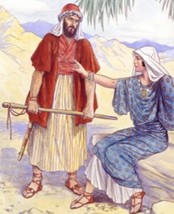
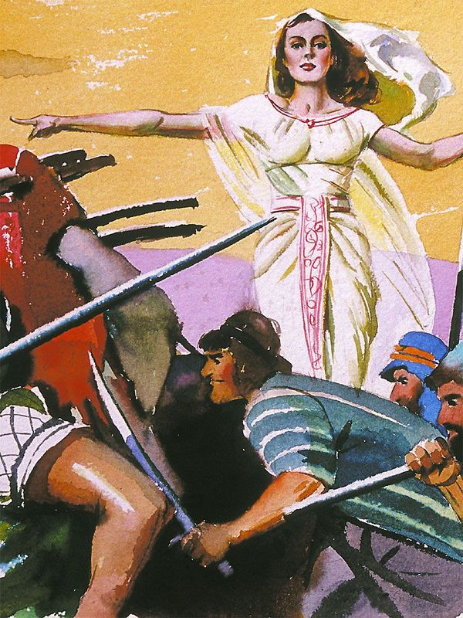
THE SONG OF DEBORAH (Judges 5)
Praise ye the Lord for the avenging of Israel, when the people willingly offered themselves.
Hear, O ye kings; give ear, O ye princes; I, even I, will sing unto the Lord; I will sing praise to the Lord God of Israel.
Lord, when thou wentest out of Seir, when thou marchedst out of the field of Edom, the earth trembled, and the heavens dropped, the clouds also dropped water.
The mountains melted from before the Lord, even that Sinai from before the Lord God of Israel.
In the days of Shamgar the son of Anath, in the days of Jael, the highways were unoccupied, and the travellers walked through byways.
The inhabitants of the villages ceased, they ceased in Israel, until that I Deborah arose, that I arose a mother in Israel.
They chose new gods; then was war in the gates: was there a shield or spear seen among forty thousand in Israel?
My heart is toward the governors of Israel, that offered themselves willingly among the people. Bless ye the Lord.
Speak, ye that ride on white asses, ye that sit in judgment, and walk by the way.
They that are delivered from the noise of archers in the places of drawing water, there shall they rehearse the righteous acts of the Lord, even the righteous acts toward the inhabitants of his villages in Israel: then shall the people of the Lord go down to the gates.

Slide 15
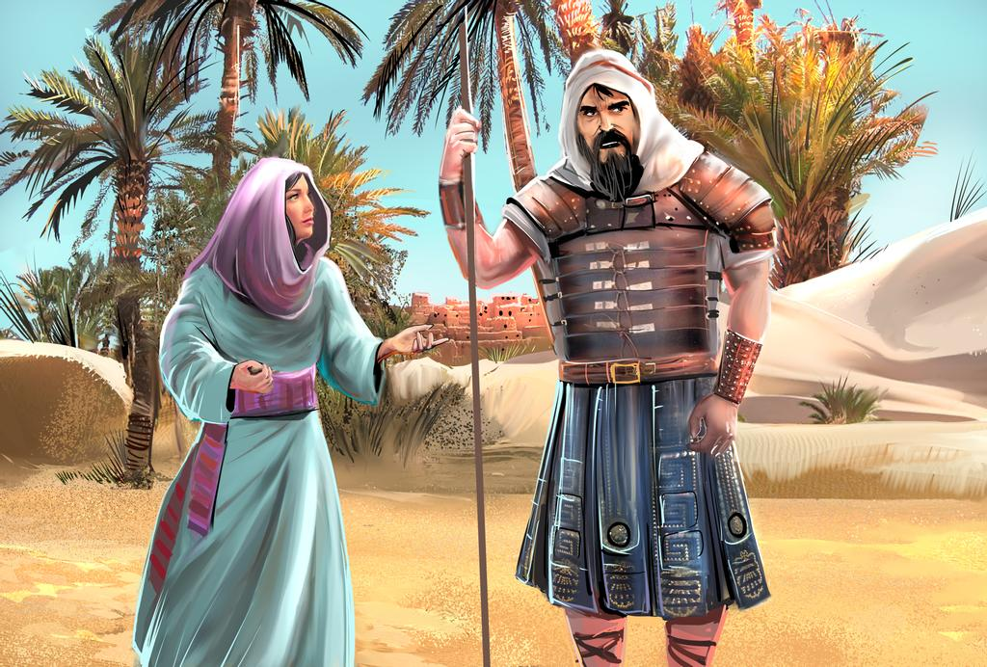
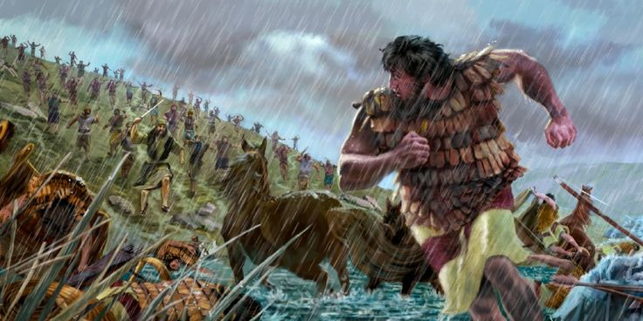
THE SONG OF DEBORAH (Judges 5)
Arise, Barak, and lead thy captivity captive, thou son of Abinoam.
Then he made him that remaineth have dominion over the nobles among the people: the Lord made me have dominion over the mighty. Out of Ephraim was there a root of them against Amalek; after thee, Benjamin, among thy people; out of Machir came down governors, and out of Zebulun they that handle the pen of the writer. And the princes of Issachar were with Deborah; even Issachar, and also Barak: he was sent on foot into the valley..
For the divisions of Reuben there were great thoughts of heart.
Why abodest thou among the sheepfolds, to hear the bleatings of the flocks? For the divisions of Reuben there were great searchings of heart.
Gilead abode beyond Jordan: and why did Dan remain in ships? Asher continued on the sea shore, and abode in his breaches. Zebulun and Naphtali were a people that jeoparded their lives unto the death in the high places of the field.
The kings came and fought, then fought the kings of Canaan in Taanach by the waters of Megiddo; they took no gain of money. They fought from heaven; the stars in their courses fought against Sisera. The river of Kishon swept them away, that ancient river, the river Kishon. O my soul, thou hast trodden down strength. Then were the horsehoofs broken by the means of the pransings, the pransings of their mighty ones. Curse ye Meroz, said the angel of the Lord, curse ye bitterly the inhabitants thereof; because they came not to the help of the Lord, to the help of the Lord against the mighty…

Slide 16
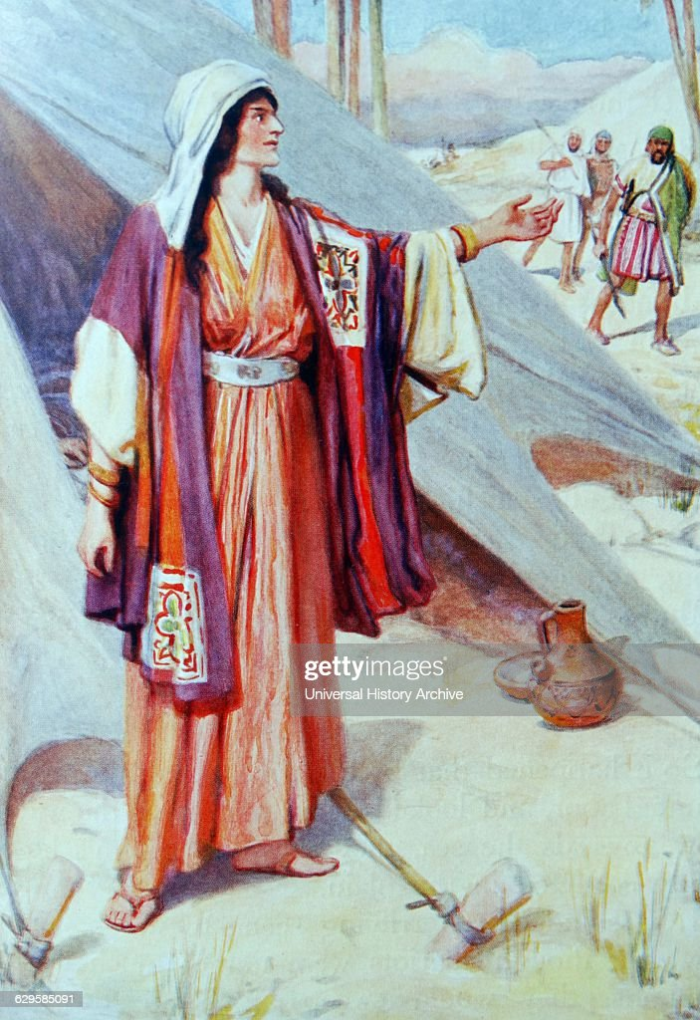
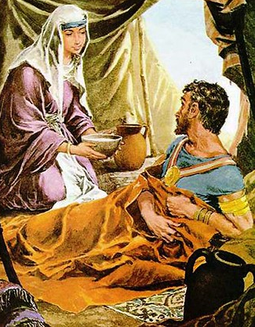
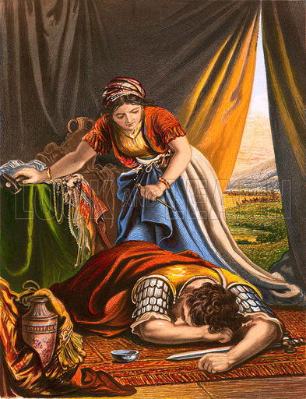
THE SONG OF DEBORAH (Judges 5)
Blessed above women shall Jael the wife of Heber the Kenite be, blessed shall she be above women in the tent. He asked water, and she gave him milk; she brought forth butter in a lordly dish. She put her hand to the nail, and her right hand to the workmen's hammer; and with the hammer she smote Sisera, she smote off his head, when she had pierced and stricken through his temples. At her feet he bowed, he fell, he lay down: at her feet he bowed, he fell: where he bowed, there he fell down dead. .
The mother of Sisera looked out at a window, and cried through the lattice, Why is his chariot so long in coming? why tarry the wheels of his chariots? Her wise ladies answered her, yea, she returned answer to herself, Have they not sped? have they not divided the prey;
to every man a damsel or two; to Sisera a prey of divers colours, a prey of divers colours of needlework, of divers colours of needlework on both sides, meet for the necks of them that take the spoil.
So let all thine enemies perish, O Lord: but let them that love him be as the sun when he goeth forth in his might. And the land had rest forty years.

Slide 17
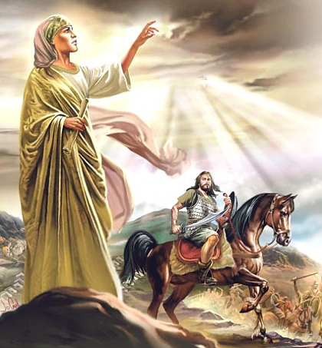
THE SONG OF DEBORAH (Judges 5)
This poem begins with words of praise to God for the victory (vv. 2-5), followed by a description before the battle (vv. 6-8). There is abundant praise for the tribes that participated in the uprising, while those who did not respond in the hour of crisis are harshly reproached (vv. 14-17). This is followed by a description of the battle (vv. 18-22), the account of Sisera's death at the hands of Jael (vv. 24-27), and the anxiety of Sisera's mother who waits for her son to return from the war (vv. 28-31).
This song of Deborah and Barak was an expression of gratitude for the victory over their enemies. Likewise, today we sing with gratitude to God for helping us win our daily battles. Perhaps we no longer have an enemy army like the one Israel of old had, but we must not forget that we are still immersed in a great conflict where our struggle is not “against flesh and blood, but against principalities, against powers... against spiritual hosts of wickedness in the heavenly places” (Ephesians 6:12).
We praise God because He gives us victory over the enemy.

Slide 18

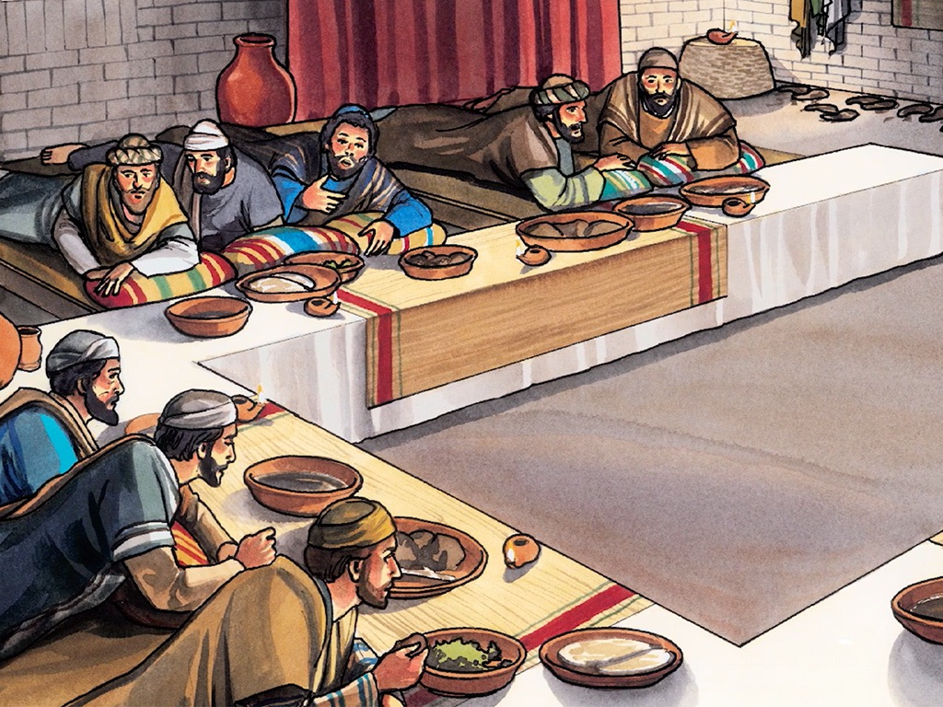
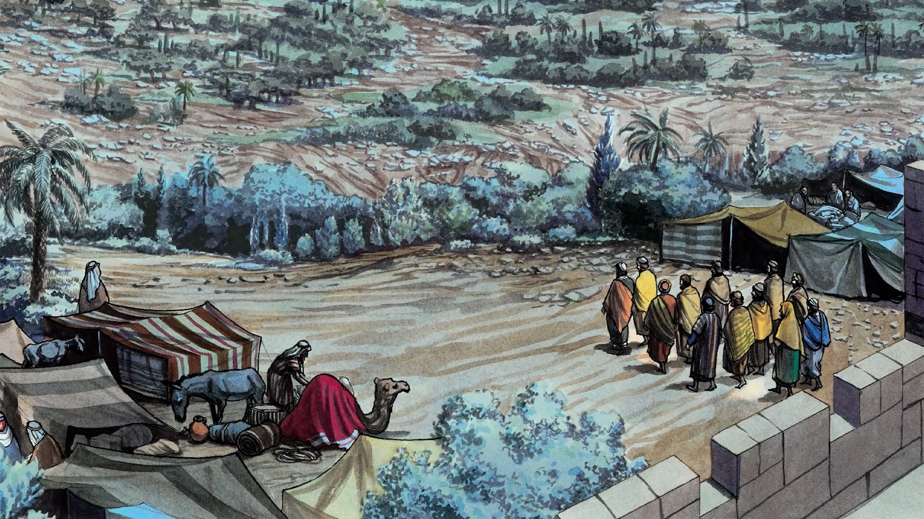
THE SONG OF JESUS AND HIS DISCIPLES (Psalm 113:2-3; 116:1-8)
On that sad night of the Last Passover Supper, when He was about to go out to face betrayal and death, Jesus and His disciples raised their voices in psalms.
In spite of his sorrow, Jesus did not allow this to prevent him from praising God in song, as He was wont to do.
Scripture says, “And when they had sung the hymn, they went out to the Mount of Olives” (Matthew 26:30).
Ellen G. White in the book “Education, page 166” mentions that the hymn they sang was, specifically, Psalm 113:2-3 and 116:1-8.
Let's read them while paying attention to the content.

Slide 19
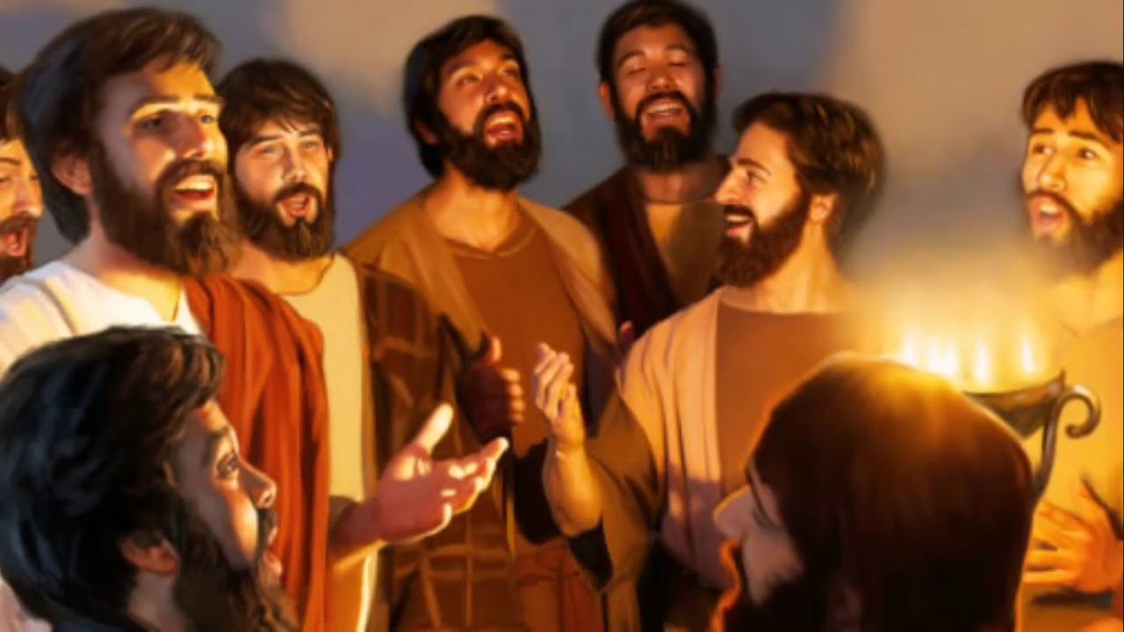
THE SONG OF JESUS AND HIS DISCIPLES (Psalm 113:2-3; 116:1-8)
Blessed be the name of the Lord from this time forth and for evermore. From the rising of the sun unto the going down of the same the Lord’s name is to be praised. (Psalm 113:2-3 KJV)
I love the Lord, because he hath heard my voice and my supplications.
Because he hath inclined his ear unto me, therefore will I call upon him as long as I live.
The sorrows of death compassed me, and the pains of hell gat hold upon me: I found trouble and sorrow.
Then called I upon the name of the Lord; O Lord, I beseech thee, deliver my soul.
Gracious is the Lord, and righteous; yea, our God is merciful.
The Lord preserveth the simple: I was brought low, and he helped me. Return unto thy rest, O my soul; for the Lord hath dealt bountifully with thee.
For thou hast delivered my soul from death, mine eyes from tears, and my feet from falling.
I will walk before the Lord in the land of the living. I believed, therefore have I spoken: I was greatly afflicted:
I said in my haste, All men are liars. What shall I render unto the Lord for all his benefits toward me?
I will take the cup of salvation, and call upon the name of the Lord. I will pay my vows unto the Lord now in the presence of all his people. Precious in the sight of the Lord is the death of his saints.
O Lord, truly I am thy servant; I am thy servant, and the son of thine handmaid: thou hast loosed my bonds.
I will offer to thee the sacrifice of thanksgiving, and will call upon the name of the Lord.
I will pay my vows unto the Lord now in the presence of all his people (Psalm 116:1-18 KJV )

Slide 20
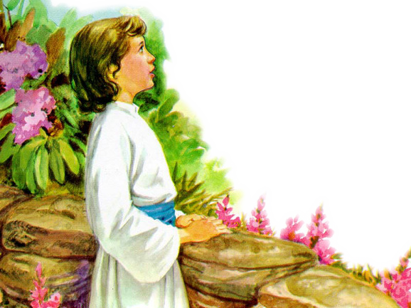
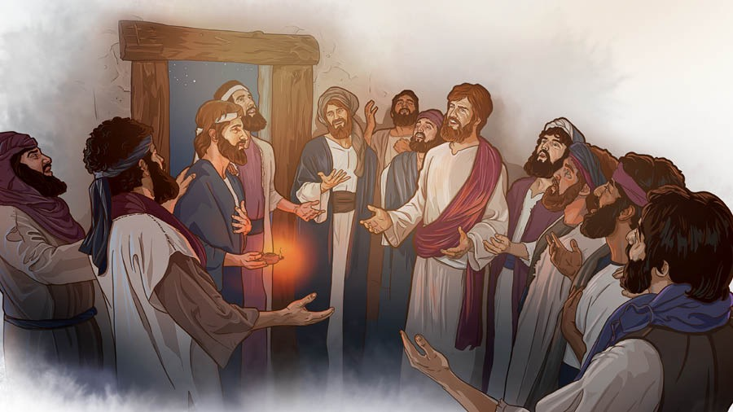
THE SONG OF JESUS AND HIS DISCIPLES (Psalm 113:2-3; 116:1-8)
During his mortal life, Jesus met temptation with song. Often, when scathing and offensive words were spoken, when the atmosphere around Him was gloomy with melancholy, disgust, distrust, or oppressive fear, His song of faith and holy joy was heard.
Many times they heard His voice rise in prayer and thanksgiving to God; and those who associated with Him, who often complained of weariness, were gladdened by the sweet melody that came from His lips.
Jesus sang songs of thanksgiving, praise and thanksgiving to God.
In this last song there is gratitude to God for delivering a person from pain and anguish, specifically, from certain death.
The author of this psalm puts his trust in God for His mercy and justice. He says that he will always be His servant and that he will praise Him and call on Him.
Praise God because He delivers us from anguish and pain, and even from death. Praise Him because He is praiseworthy.

Slide 21

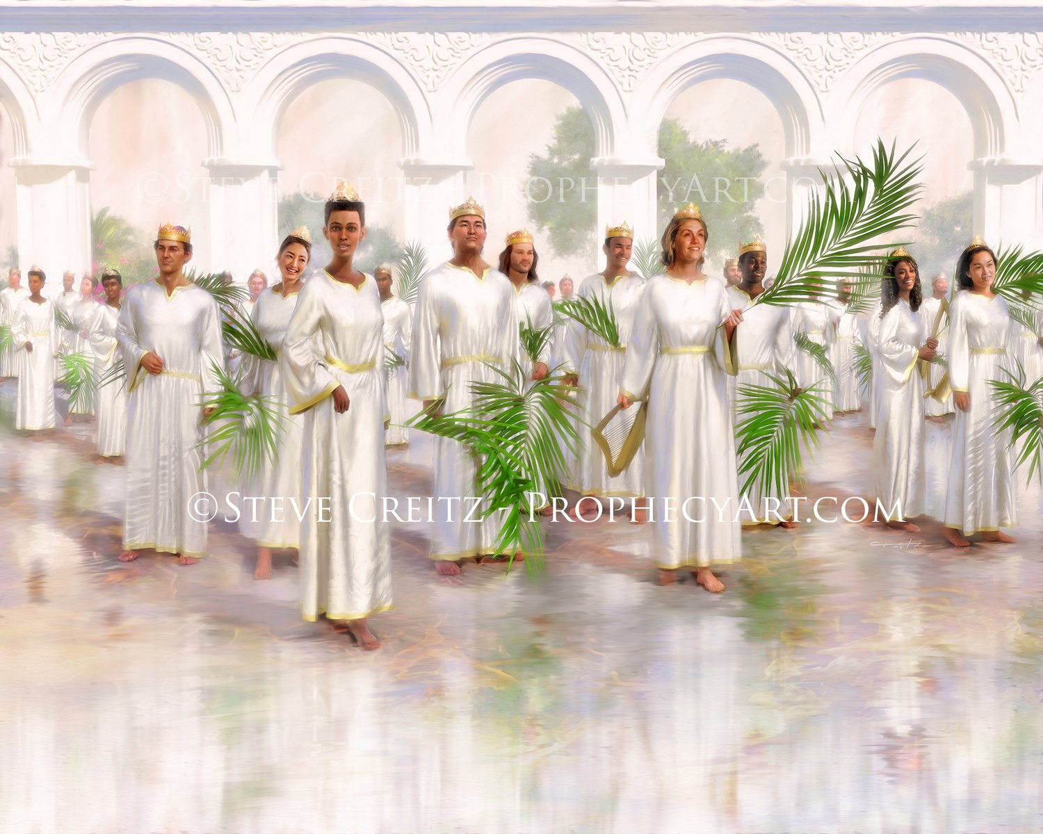
THE SONG OF MOSES AND THE LAMB (Revelation 15:2-3)
I also saw a sea of glass mixed with fire; and to those who had gained victory over the beast and his image, and his mark and the number of his name, standing on the sea of glass, with the harps of God.
And they sing the song of Moses the servant of God, and the song of the Lamb, saying:
“Great and wonderful are your works, Lord God Almighty; just and true are your ways, King of saints.”

Slide 22



THE SONG OF MOSES AND THE LAMB (Revelation 15:2-3)
Here it is mentioned that those who have achieved victory over evil in the great final crisis will sing the song of Moses and the song of the Lamb.
What do these songs express?
The song of Moses is a praise to God for delivering from the oppressive power of enemies, and having saved His people from certain death.
The song of the Lamb is a song of praise and thanks to Jesus for what He has done for us to give us salvation.
The deliverance of the saints was made by Christ, the Lamb of God, and so He is worthy to receive worship and to be exalted with the song of deliverance.
We praise God and Jesus Christ for delivering us from sin and death, and for all they have done to give us the ultimate victory.

Slide 23




These scripture personages rose above the circumstances by singing these beautiful songs. We want each of us, in our daily lives, to keep a song in our hearts.
A song that lifts us into the presence of God, allows us to contemplate Him in the magnificence of His power, and gives us the strength to face any battle and achieve victory for the glory and honor of His precious Name.
“As our Redeemer leads us to the threshold of the Infinite, flushed with the glory of God, we may catch the themes of praise and thanksgiving from the heavenly choir round about the throne; and as the echo of the angels’ song is awakened in our earthly homes, hearts will be drawn closer to the heavenly singers. Heaven's communion begins on earth. We learn here the keynote of its praise”
(Education, page 168)

