Slide 1

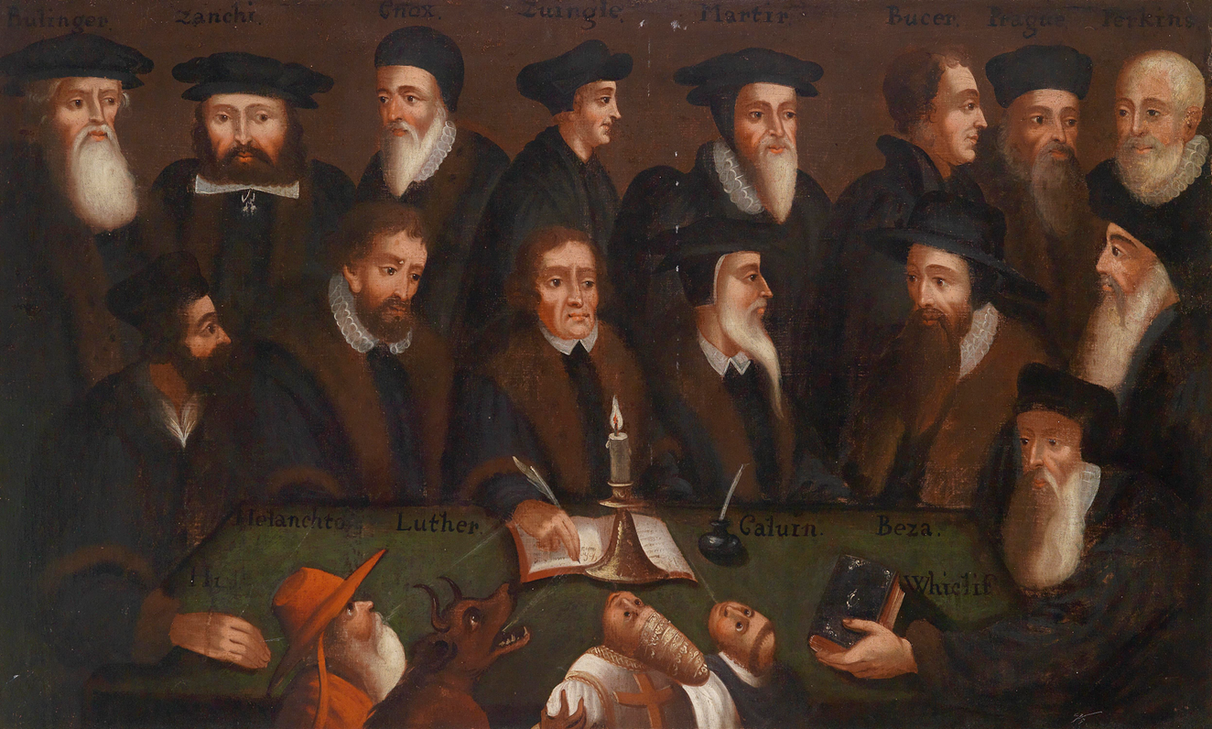

Slide 2






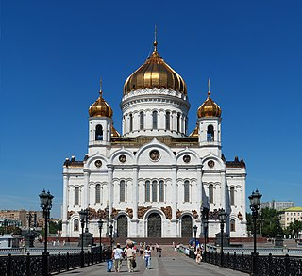
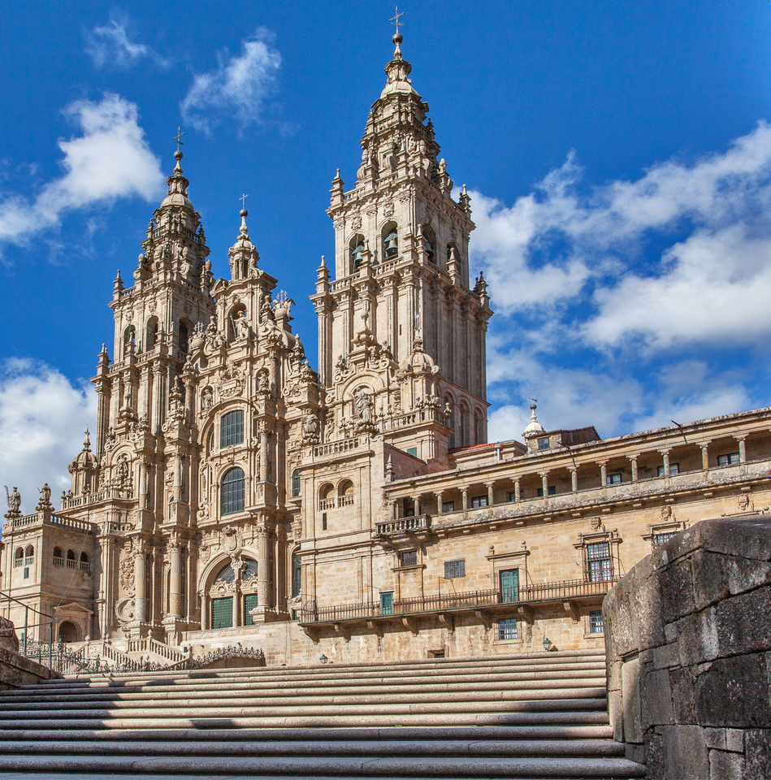
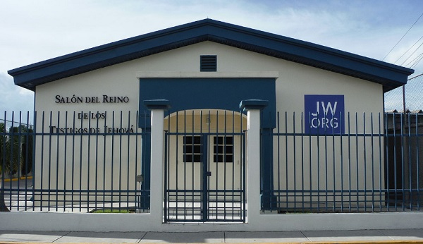
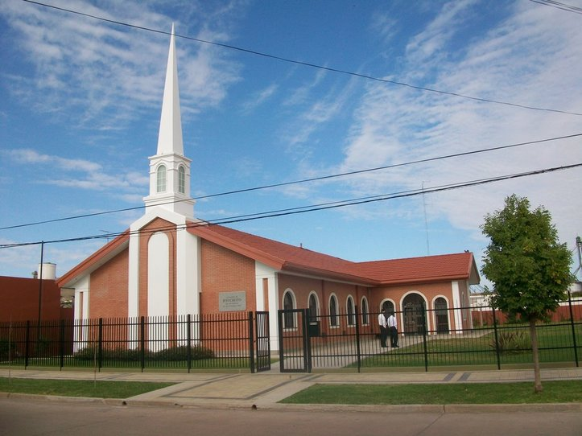

476
-
1453
THE MIDDLE AGES
Have you ever wondered why there are so many different Christian churches, each believing only a little different from what the others believe? Where do all of them come from? And why are they different? We're going to look at what happened to the Christian Church after Jesus returned to heaven, and the reason why it split into all the different churches that we have today.
For many years after Jesus' return to heaven, there was only one Christian church, but gradually, many of the beliefs of the Christian church were mixed with things believed by non-Christians.
Traditions became as important as the things taught in the Bible. Do you know what traditions are? One answer may be that traditions are rules that people set just because that's the way things have been done in the past.
Many people confused the rules of God found in the Bible and the rules made by other people. After a while, most people did not know how to differentiate. It became a time of spiritual darkness. In fact, people became so confused, that this period of the Middle Ages has been called the Dark Ages.

Slide 3


What kind of problems do you think Christians had with their church in the Middle Ages? Imagine that you have done something wrong for which you feel regretful.
Rich Man: I've done something wrong and I feel really sad about it. Do you think God can forgive me?
Priest: Yes, but it's going to cost you a lot of money.
Rich Man: Here's the money.
Priest: Here's an indulgence that says God has forgiven you.
Second man: I've done something very bad and I feel really sad about it. Will God forgive me?
Priest: That's going to cost you a lot of money, too.
Second man: I don't have all that money.
Priest: Well, come back when you have it, and maybe God can forgive you then.
How would you have felt if you had been the second man? How do you think God felt ? Do you think God would more easily forgive a rich person than a poor one? Do we have him than to pay money to God to forgive us our sins? How would you have felt if your church was like that? Read 1 John 1:9.
Many Christians became concerned when a loved one died. They didn't know what the Bible says about the dead being asleep, so they worried that the dead person would be suffering.
First man: I am worried about my grandfather who died recently. What can I do to make sure I am in heaven with God?
Priest: You must pay a lot of money and light this candle and pray for him, and that may move him a little bit to heaven. He is in purgatory, which is located halfway between heaven and hell. If you pay enough money and pray enough times, he will eventually get to heaven.
Is this what the Bible says about the place where the dead are found? What happens to people when they die? Read the following scriptures: Ecclesiastes 9:5; John 11:11-14; Psalm 115:17; Psalm 6:5; 1 Thessalonians 4:16. Here he tells us that the dead are sleeping, waiting for Jesus to wake them up, and that they know nothing.

Slide 4
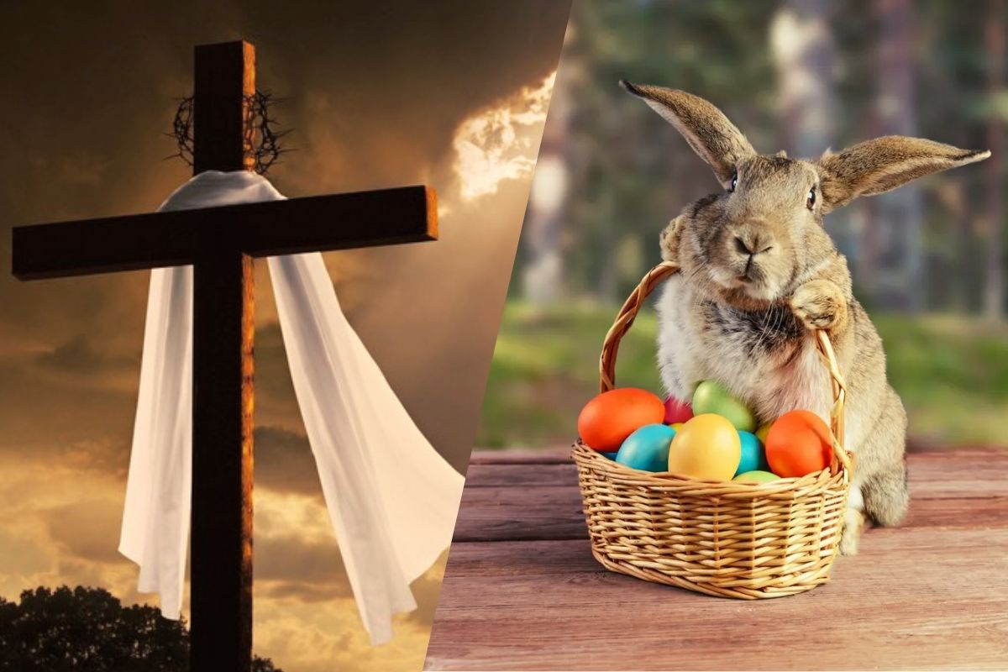
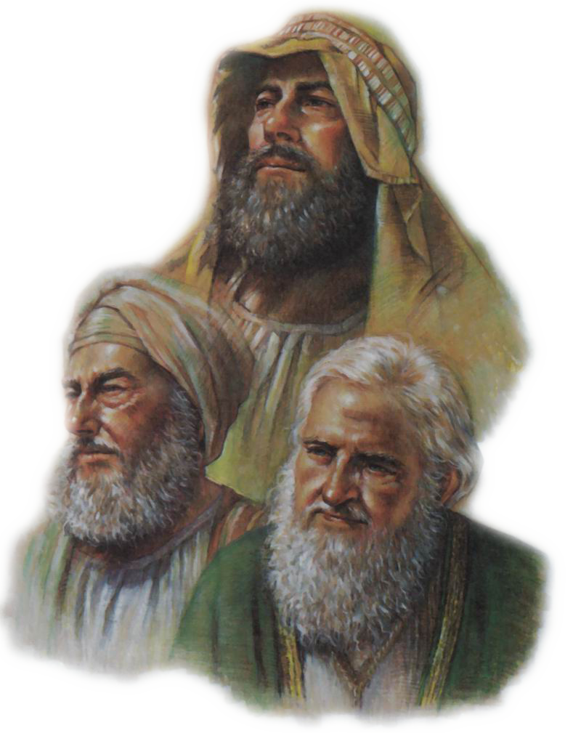

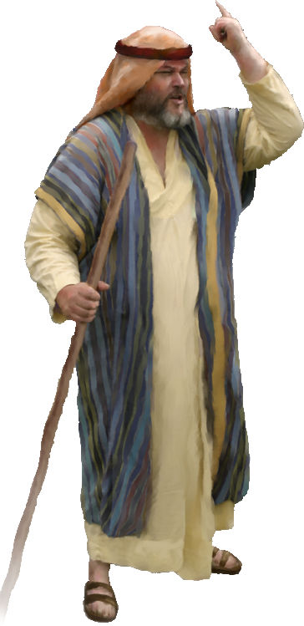
Many of the leaders of the Christian church during the Middle Ages wished to attract non-Christians to their Christian church. They thought that if they added some of the pagan celebrations and ideas to those of the Christian church, then everyone would find something pleasurable in the church and attend it.
Such mixtures can still be found today. What do you think of when you think of Easter? It can be: crosses, empty tomb, chocolate Easter eggs, etc.
The feast equivalent to Easter or Resurrection was a very special feast for pagans, or non-Christians, long before Jesus was even born. The Easter bunny and colored eggs were part of their pagan festival celebrating spring. Christian leaders tried to mix the two feasts in order to make the Christian feast a special occasion for all.
What happens when you mix some things that are true with things that are not?
Take a glass of crystal clear water. Use salt to represent the truth and betadine for what is not the truth. When you add the salt that represents the truth [add it and stir] you will notice that the water remains clear. If we add betadine, what happens? The water becomes cloudy.
What happens when we add up a little bit of truth and a little bit of lies? This is what happened to the Christian church during the Middle Ages.
How did they do it? What happened in Bible times when the people of Israel had trouble obeying God in refraining from acting like the pagans? God sent prophets to reform the people of Israel and bring them back to their ways. And that's exactly what God did in the Middle Ages. God sent reformers who helped Christians recognize what was true and what was not.

Slide 5


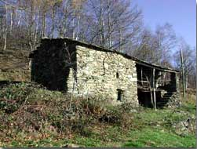
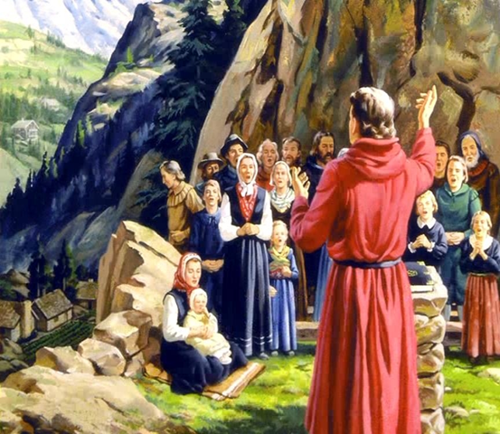
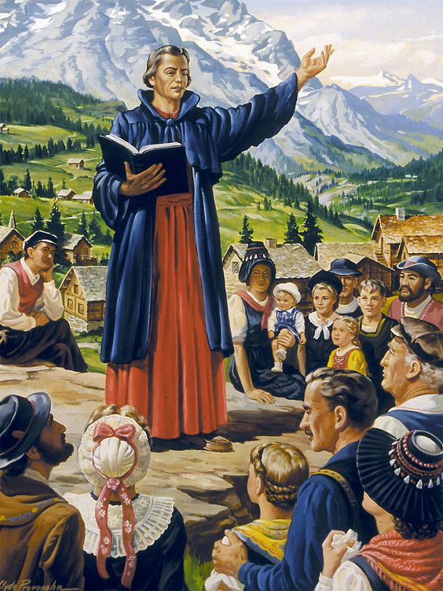
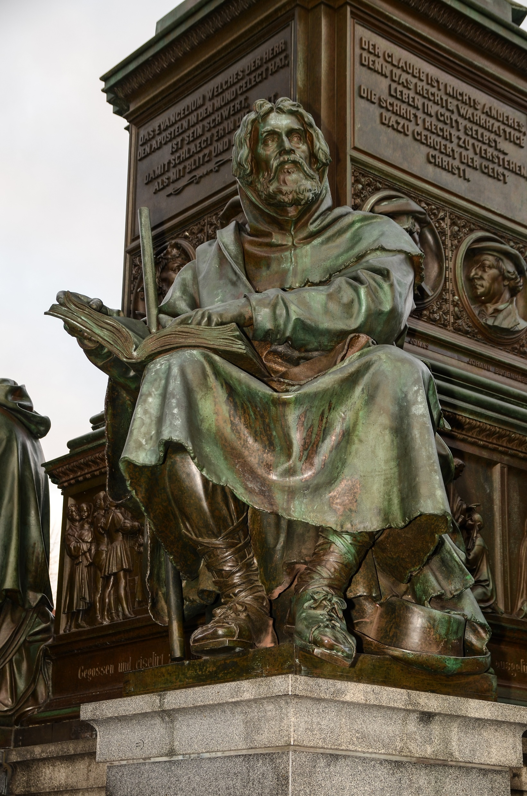
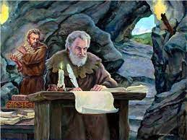
1170
-
1620
THE WALDENSES
Typical Waldensian house
Who were the Waldenses and when did they live? The Waldenses were people who desired to do all things directed by the Bible.
This was a problem for them, because the Bible was not available to everyone. The Scriptures were kept in monasteries and churches, and only priests and church leaders were allowed to use them. They were not translated into the languages that the common people of the village spoke. They were preserved in the original Greek and Hebrew languages, and their translation into Latin, which only a few highly educated people could understand. Ordinary people could not search the Bible for what it said about different subjects. The Waldenses decided to do something about it.
The Waldenses lived in France and Italy, from 1170 AD to 1620 AD. During this period, the Waldenses were persecuted for their beliefs and for their actions. They were called Waldensians in honor of Peter Waldo, one of their great leaders, who lived in the eleventh century.
What did the Waldenses do that made them have so many problems? The Waldenses believed that each person should be able to research the Bible as he wished and read it for himself. The Waldenses were among the first to translate it into the language of the people. This made the church leaders very angry.

Slide 6
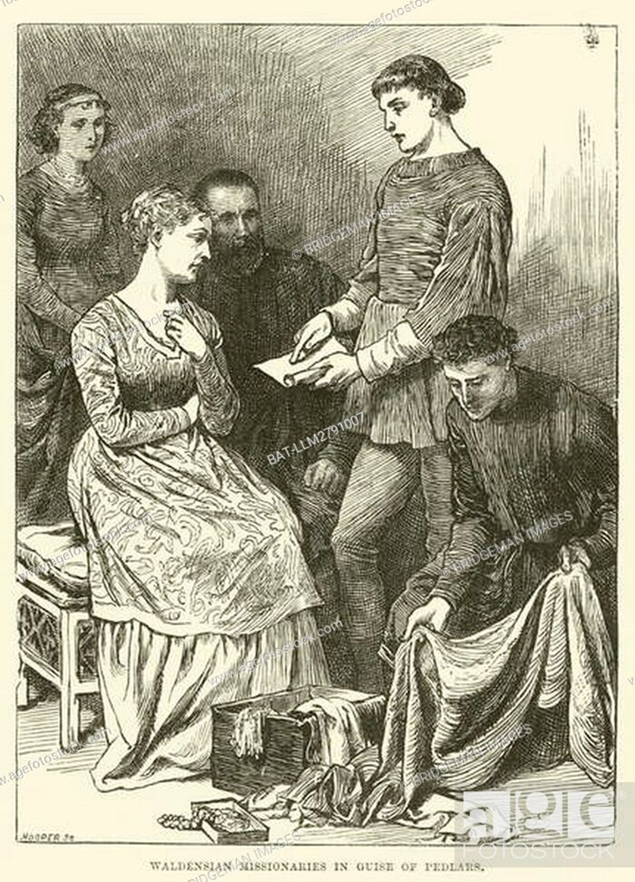
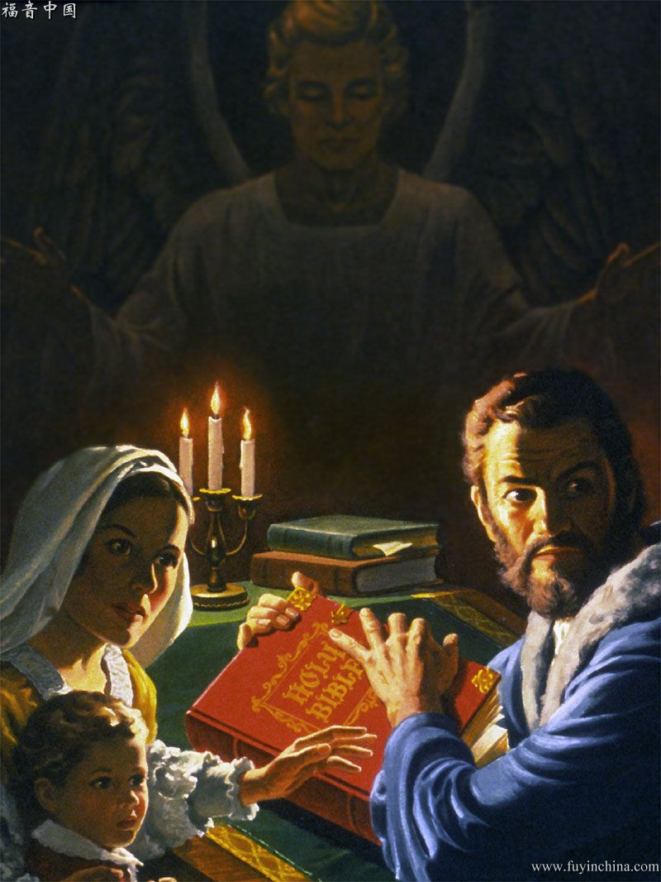
In secret, often hidden in caves, the Waldenses wrote down small portions of Scripture and hid them in their clothes. So they shared them by traveling from place to place selling clothes, jewelry, kitchen utensils and other things that people needed. By selling, they also witnessed and gave the scriptures to anyone who wished to read it. This angered the church leaders. They then sent soldiers to break into the homes of the Waldenses and burn the books, Bibles, or portions of the Scriptures they found in them.
The Waldenses were very creative in hiding their Bibles. His children carried portions of the scriptures with them. They sewed them to their clothes, to the fold or hem that they unstitched a little, or to the folds or cuffs of the sleeves, so that they always had the Word of God hidden in them. That way they could share it with anyone who was interested. Look at the clothes you are wearing. If you were a Waldense, where would you hide the Scriptures?
On one occasion, the home of a Waldensian family was invaded unexpectedly. The mother was baking bread. I had just kneaded the dough for the bread and was ready to place it in the oven when the soldiers burst through the door. Where could I hide the Bible? Want to guess?
He quickly took the scriptures, put them in the dough, and placed it in the oven. The soldiers searched the house for the Bible.
They emptied the drawers of the cupboards, searched under the mattresses, shook the blankets, and looked as much as they could. During all this time, the bread continued to cook slowly in the oven. Finding nothing, the soldiers moved away. After they left, the mother took the bread out of the oven and broke it in half.

Slide 7
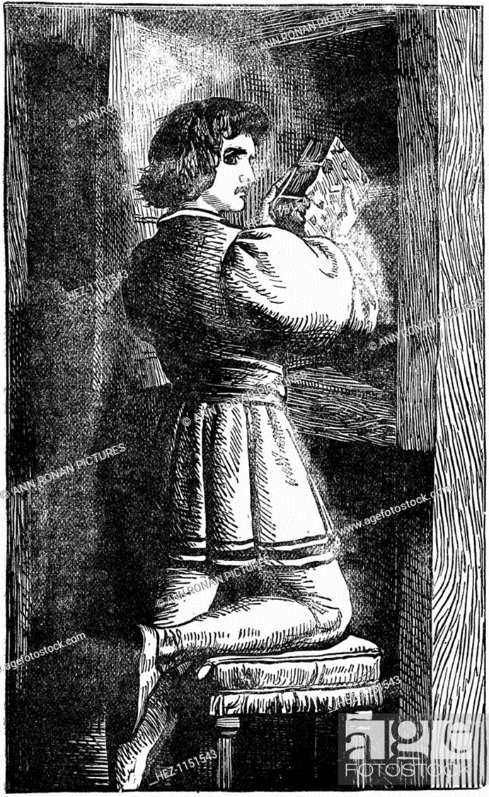
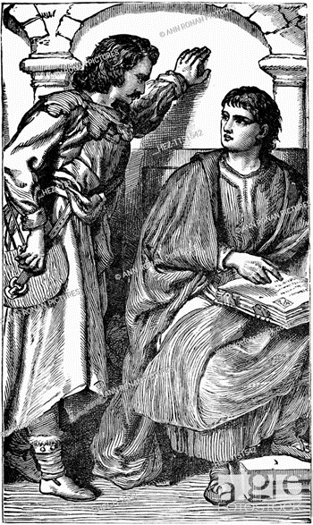
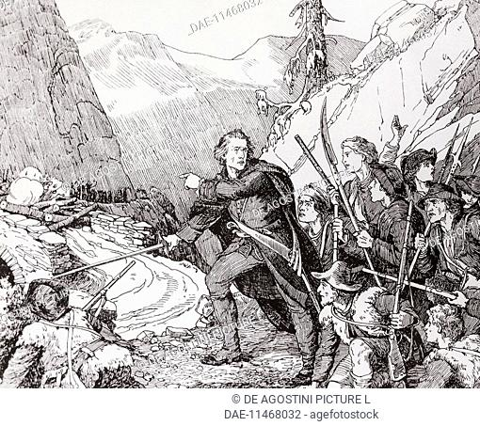
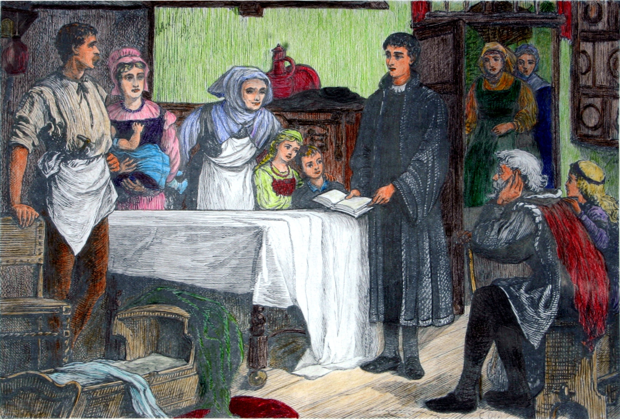
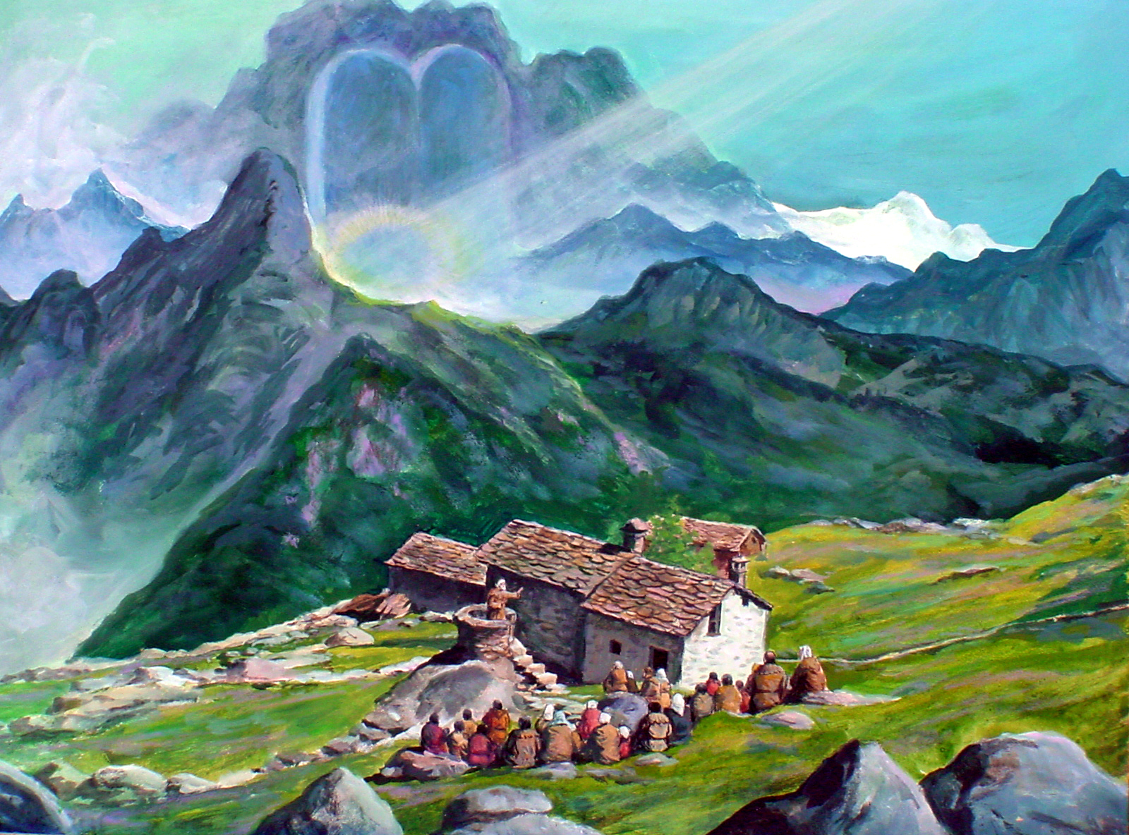
Although the Waldenses were so shrewd in hiding the Scriptures, sometimes the soldiers found them.
What does the Bible say about hiding Scripture? Read Psalm 119:11
How can we hide God's Word in our hearts?
We retain many of the beliefs that the Waldenses had. Some of the Waldenses kept the Sabbath. The rest of the Christians had begun to keep Sunday in order to have a day that would unite both Christians and non-Christians. The Waldenses stuck with the original day of worship. On what day do you worship? Why? Read Exodus 20:8-11.
Another of the beliefs of the Waldenses that we still have is that we should only pray to God and not to saints or relics of saints, or to idols of wood or stone. Why do we believe that? Read Exodus 20:3-5.
Don't you think we're fortunate to have the Bible translated into our own language?
No one tries to take it away from us or we get in trouble for owning it. God is very good to us. Study your Bible.

Slide 8


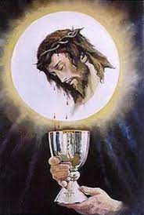
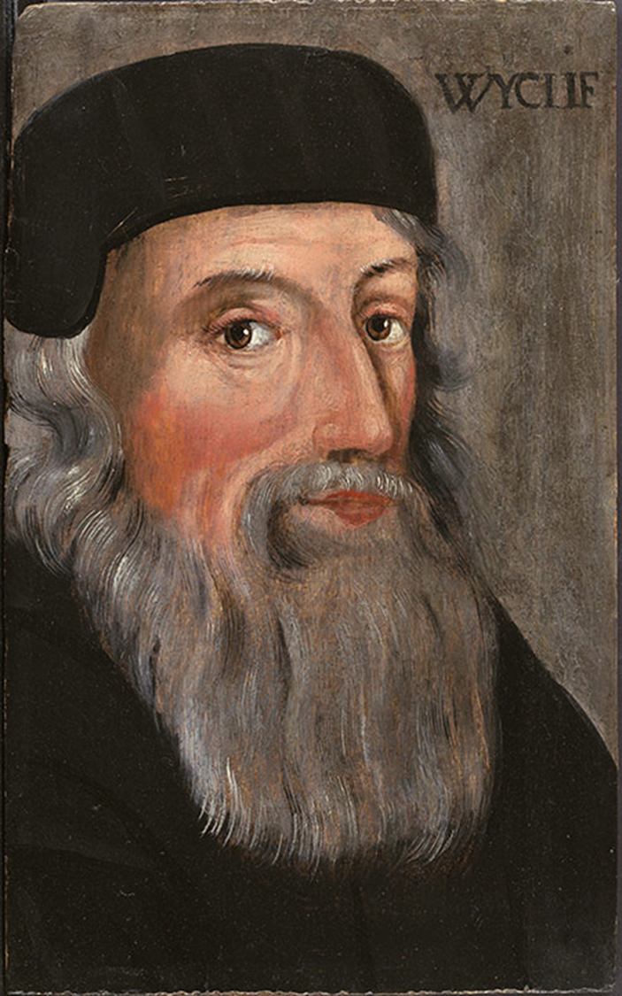
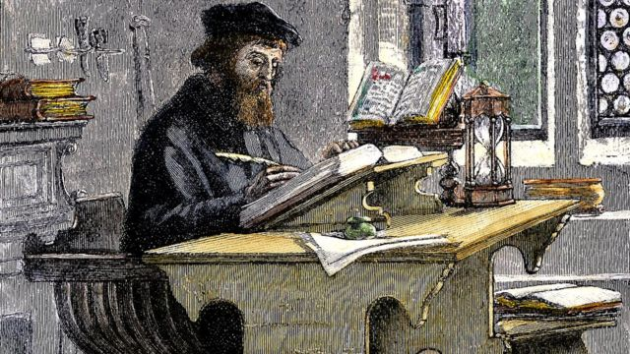
John Wyclef is known as the morning star of the Reformation. He was an English priest and one of the first reformers. Many of John Wyclef's teachings had a great effect on John Hus and Martin Luther. The teachings of John Wyclef still affect us today.
1320
-
1384
JOHN WYCLEF
John Wyclef is perhaps best known for his translation of the Bible into the English language. He lived in England from 1320 to 1384. How many years did John Wyclef live?
John Wyclef was a priest and also a teacher at the University of England. From his study of the Bible he believed that the Pope, or top leader of the Christian church at the time, did not have the authority to change the commands or decide which sins could be forgiven and which could not. John Wyclef believed that the gospel of Christ was sufficient, and that if the Bible said that Christ forgave us, that was the truth.
He also believed that religious ministers could not add to or subtract anything from the Bible.
Another of his beliefs was that the bread and grape juice served in the communion service were only symbols of the body of Christ, to remind us of what Jesus did for us. The Christian church at the time believed that these foods actually became the body and blood of Christ when the person ate and drank them.

Slide 9
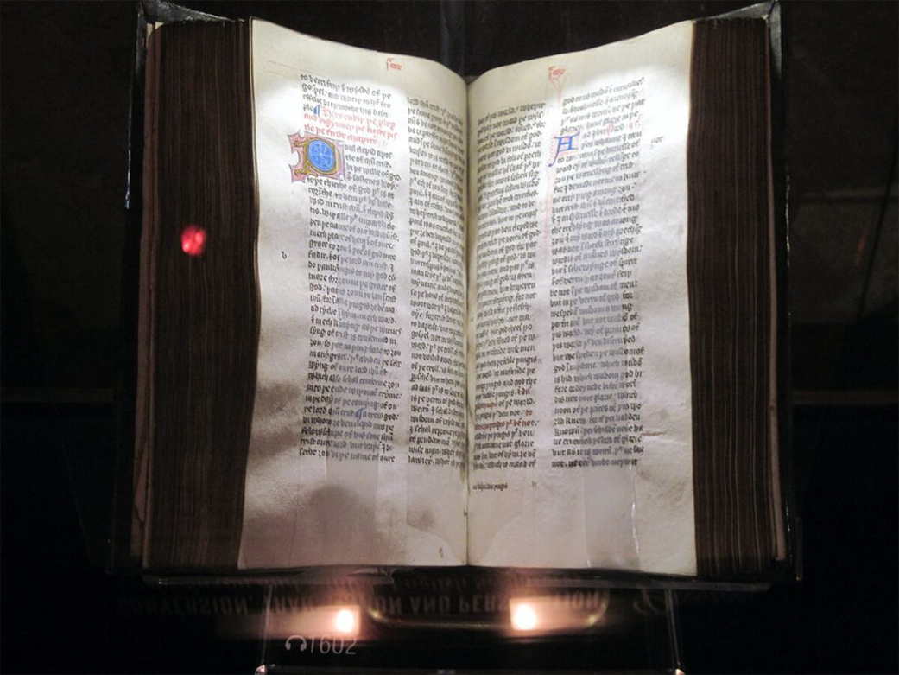
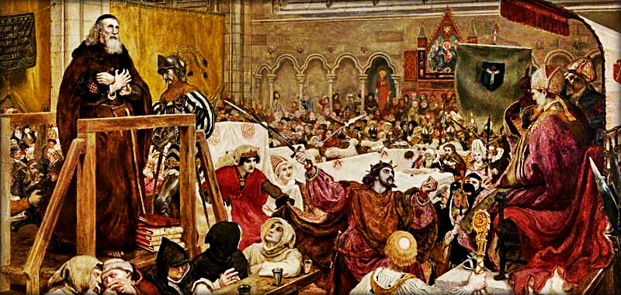
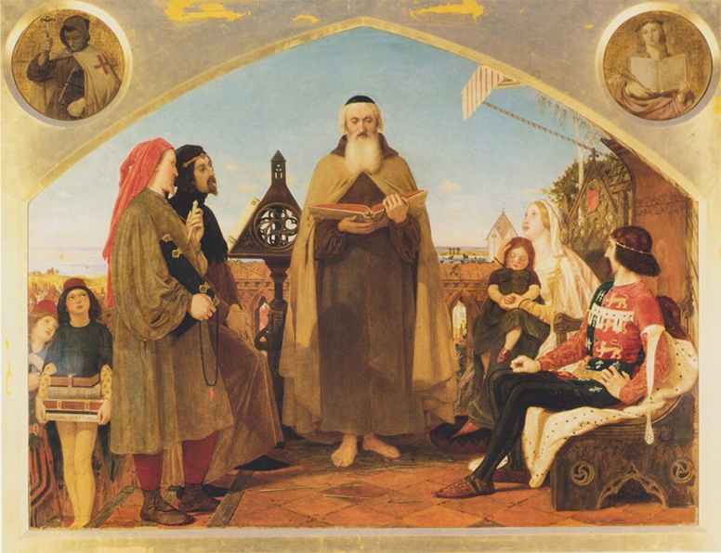
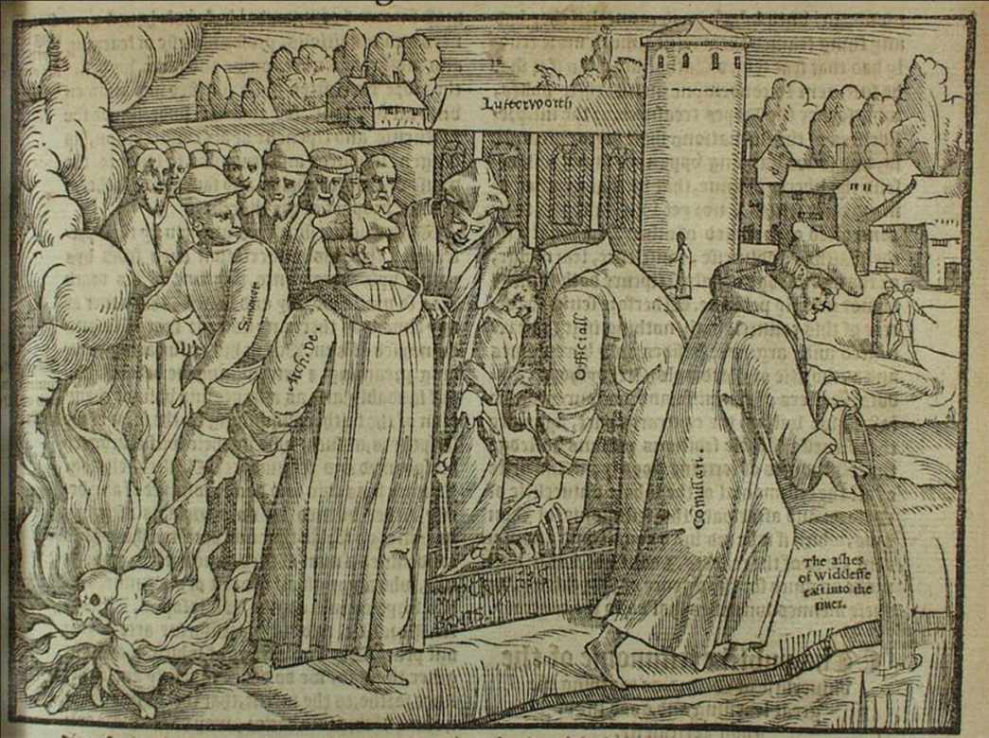
Because of these differences, the church leaders were very angry with John Wycliffe. The nobles and wealthy of England protected and supported him because they felt sympathy for some of the things he taught. Later, Wyclef told those nobles that they needed to clean up their lives and live purely and properly, or God would take away their riches. This made the nobles very irate and they did not help or support him anymore.
John Wyclef eventually had to leave the university, and be the pastor of a small church in a small place called Lutterworth.
There he continued his translation of the Bible into the English language, so that the common people of the town could read for themselves what the Bible really said. John Wyclef had many loyal followers. Those followers were called Lollards. People called them that way because of their funny accent when they sang. Has anyone made fun of you for your accent, for the way you sing, or for what you believe?
John Wyclef and the Lollards paid no attention to the taunts because they knew what the Bible said about it. You also don't have to worry when people make fun of you. Read Matthew 5:11.

Slide 10


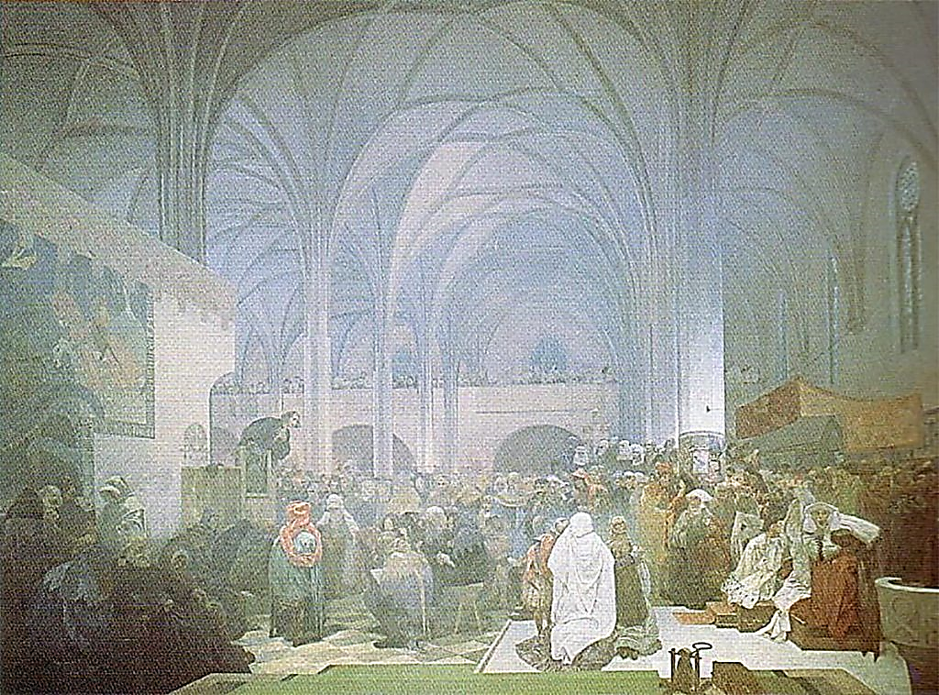
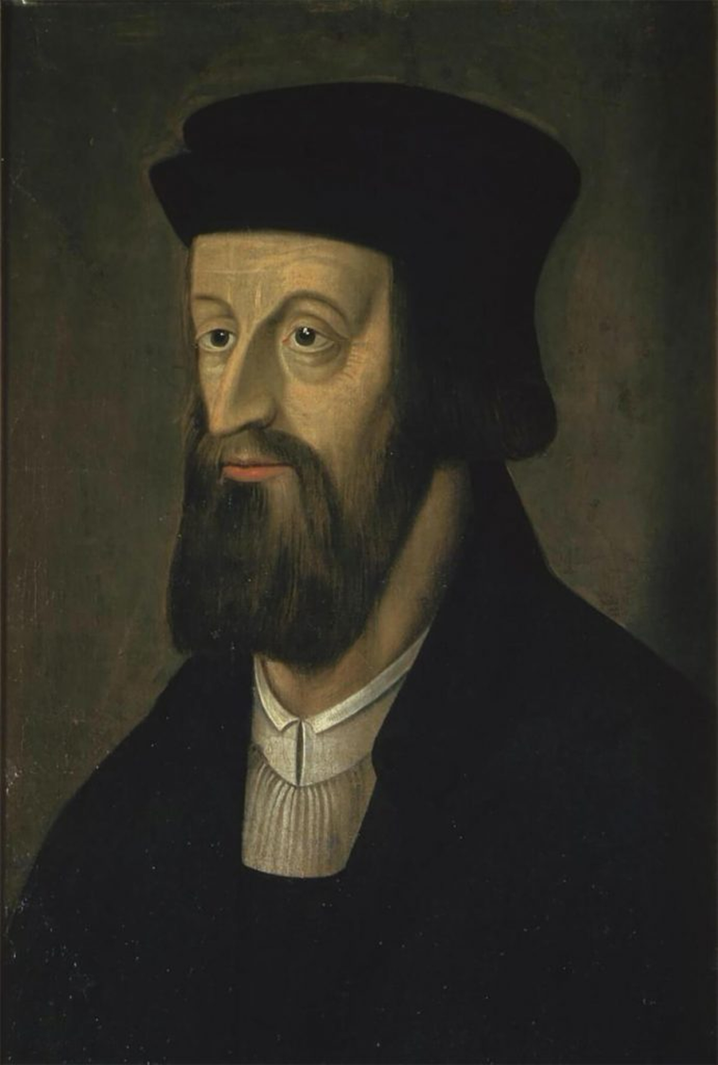
1380
-
1415
JOHN HUS
John Hus lived in the Czech Republic and Slovakia. He was born around the year 1380 and lived until 1415. John Hus lived in Bohemia (now divided between the Czech Republic and Slovakia) and attended school to become a priest. He studied John Wyclef and became convinced that such things were true and important. He began by teaching them to his students and parishioners. This angered the church leaders. John Hus wrote many letters explaining to the people why Wyclef's teachings were true.
The archbishop obtained permission from the pope to prevent Dr. Hus from publishing Wyclef's teachings or writing any further letters concerning them. John Hus was charged with the following:
To say that people should not adore the Pope;
To say that priests could not forgive sins, but that God was the only one who could forgive sins;
Saying that he did not have to obey the priests, his superiors, or his ministers if the commands were not just or correct according to the Bible;
And to say that when the church excommunicated someone, God would still communicate with that person, and he could still direct his prayers to Him. Being excommunicated meant that the church punished someone by saying that they were separated from God and the church. No one should have a relationship with that person.
Hus went on to write many books that were published and went as far away as England.

Slide 11
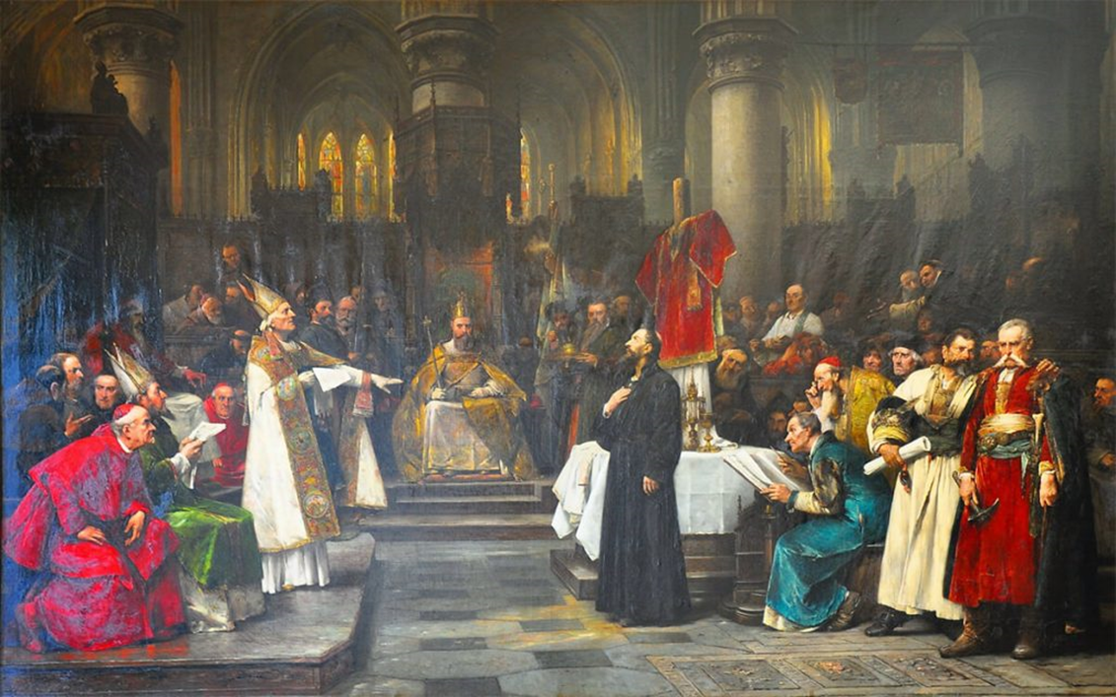
By the year 1414, the church leaders were so mad with Dr. Hus that they sent him a safe-conduct to Constance, Germany, where they were holding a large meeting. A safe-conduct meant that nothing bad would happen to him and he would be able to return home safely after the meeting. Many people attended this meeting. Some records tell us that there were more than 100,000 visitors in the city. Six hundred people accompanied the Pope, 4,000 people came accompanying the Emperor.
There were 30 cardinals, four patriarchs, and two ambassadors accompanied by 1,200 courtiers, 27 archbishops, 206 bishops, 33 other bishops, and 150 prelates, 203 abbots, and 5,000 accompanying servants. There were also 18,000 priests, plus 80,000 lay people. The list goes on and on. All of these people were there to attend meetings where they would vote to allow no more heresy in the church. This was the group before which John Hus had to appear. They were all on one side, John Hus was alone on the opposite side of the confrontation. How do you think it felt to be the only one who had to face all those people? When John Hus refused to change his mind or admit that he was wrong, he was thrown in prison.

Slide 12
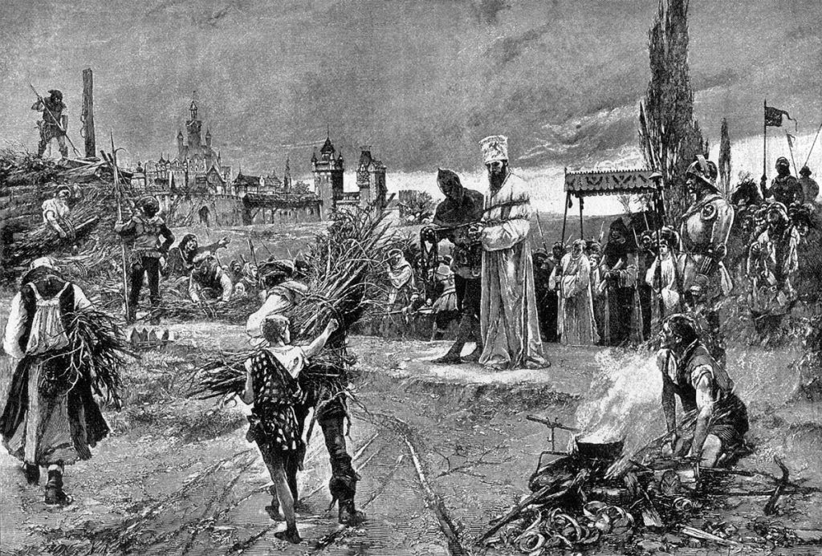
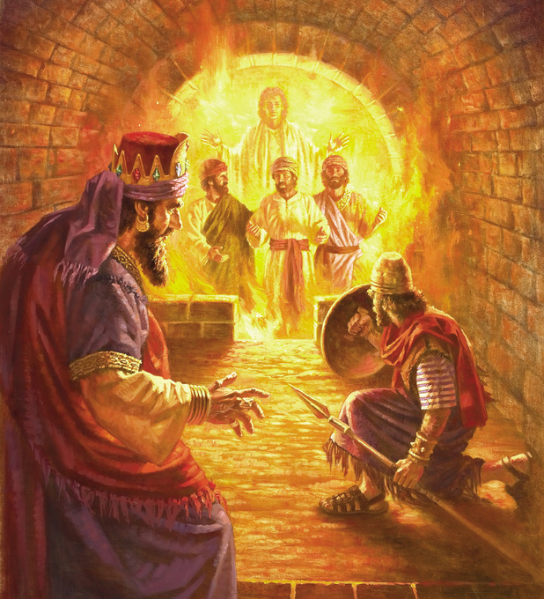
On July 4, 1415, Dr. Hus was brought before the court. After a long discussion, in which he refused to change his mind, the judgement was pronounced. Hus's books were condemned to be burned, and all who possessed one of them were to burn it. The council also decided that Hus should be burned at the stake. John Hus took everything very calmly. He knelt down and prayed. When he was chained to the stake where he would be burned, he smiled and said, "My Lord Jesus Christ was bound with chains harder than mine.
Why should I care about this rusty one?" When the fire was lit, John Hus sang in a loud and cheerful voice and continued to sing joyfully until he died. The people watching were very surprised, because it seemed as if he was not suffering any pain.
After the trial, they also dug up the remains of John Wyclef and burned them, even though he had been dead for many years. Then they threw his ashes into the river. Did the above hurt John Wyclef? Why or why not? [Read Ecclesiastes 9:5 in your Bible].
Can you think of a biblical character who was sentenced to burn to death, but didn't feel any pain? What happened? [Read Daniel 3:20-25 in your Bible.] Who were Shadrach, Meshach, and Abednego? Who was with John Hus when he was burned at the stake?
When Shadrach, Meshach, and Abednego were thrown into the fiery furnace, they did not know whether or not God would deliver them, or whether or not they would make it out alive. They said to the king, "Our God is able to deliver us from the fiery furnace burning" [Daniel 3:17]. They knew God could do it, but they didn't know if He would. John Hus also knew that God could do it. John Hus died painless, singing praises to God all the while.
Only God knows what is best for each of us. God knew what was best for Shadrach, Meshach, and Abednego, and God knew what was best for John Hush. But no matter what God decides, and whether he chooses to deliver his children from death or not, God is always with them.

Slide 13


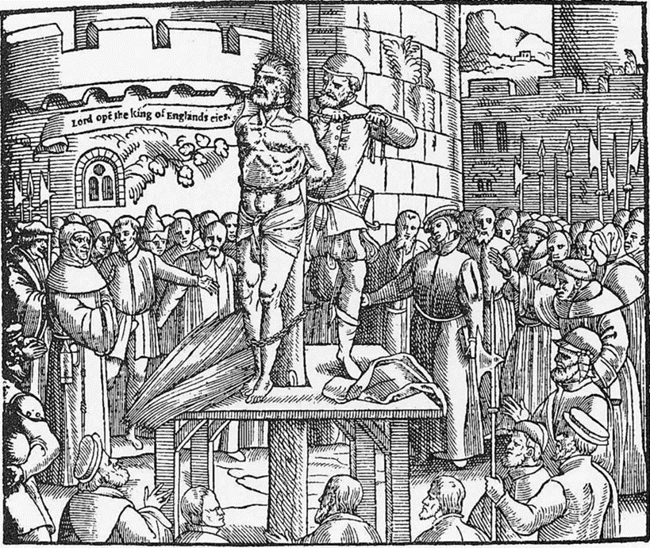
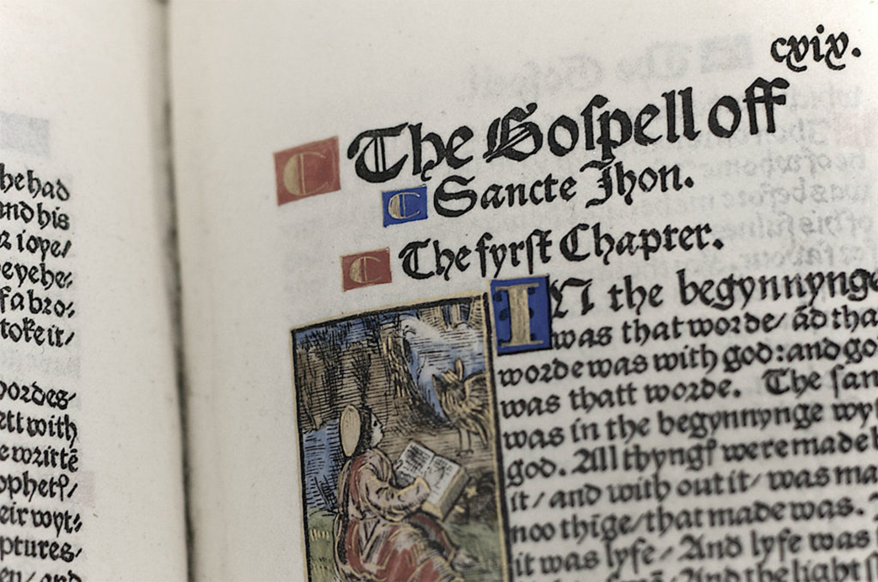
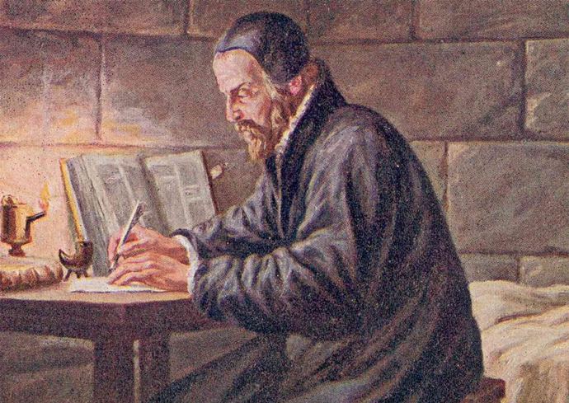
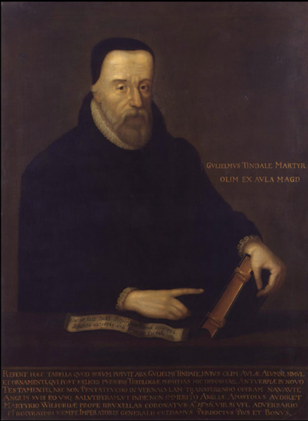
William Tyndale was another English leader of the Reformation. He lived from 1494 to 1536, in Germany and Belgium.
Mr. Tyndale believed that every person should be able to read the Bible in his or her own language. So he translated the Bible from Latin to English. His work became the basis for what was later used for the English version of the Bible known as the King James Version.
1494
-
1536
WILLIAM TYNDALE
How many pages are in the Bible? How long do you think it would take to translate all those pages into another language?
William Tyndale began with the translation of the New Testament. He wanted the stories of Jesus to be available to the people of England in their own language, so that they could personally read what Jesus had actually said, and how Jesus felt in his relationship with people. He did not succeed in getting his translation published in England. So in 1524 he went to Germany and got his Bible published there. He then smuggled the Bibles by ship to England. The authorities bought some of them and burned them. The money from that sale made it possible for even more Bibles to be published.
William Tyndale stayed in Europe after the above, continually trying to publish more Bibles and smuggle more of them into England, in order to help the people of that country. The ecclesiastical authorities finally arrested him in 1536 and executed him as a heretic in Belgium.

Slide 14


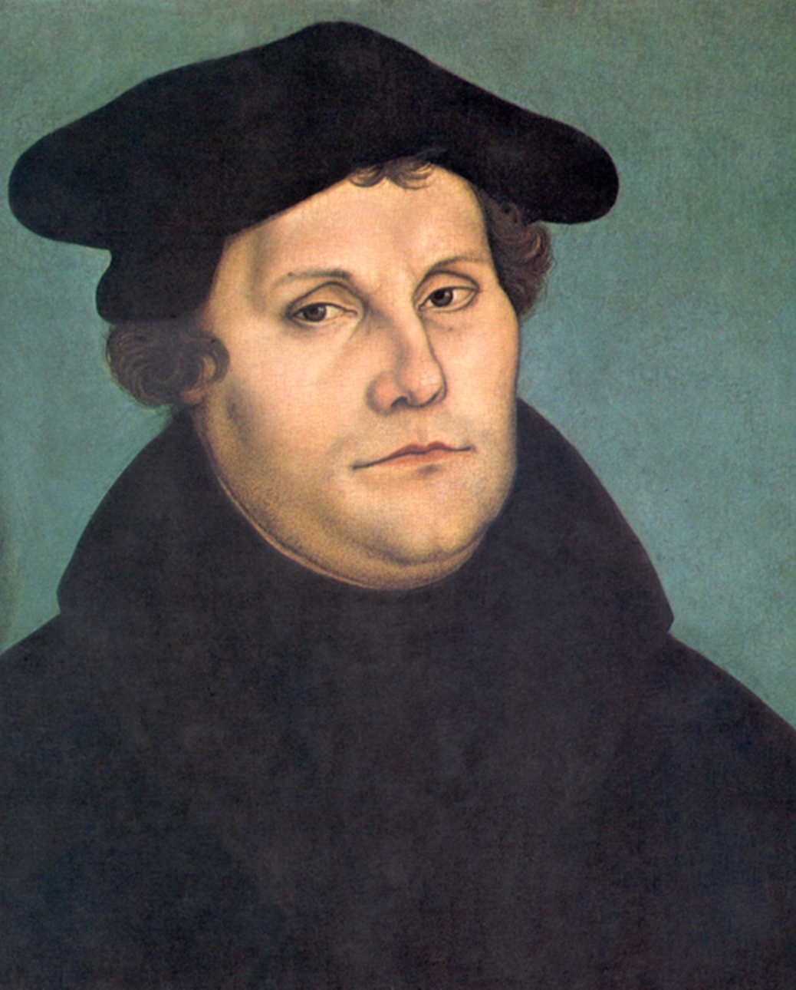
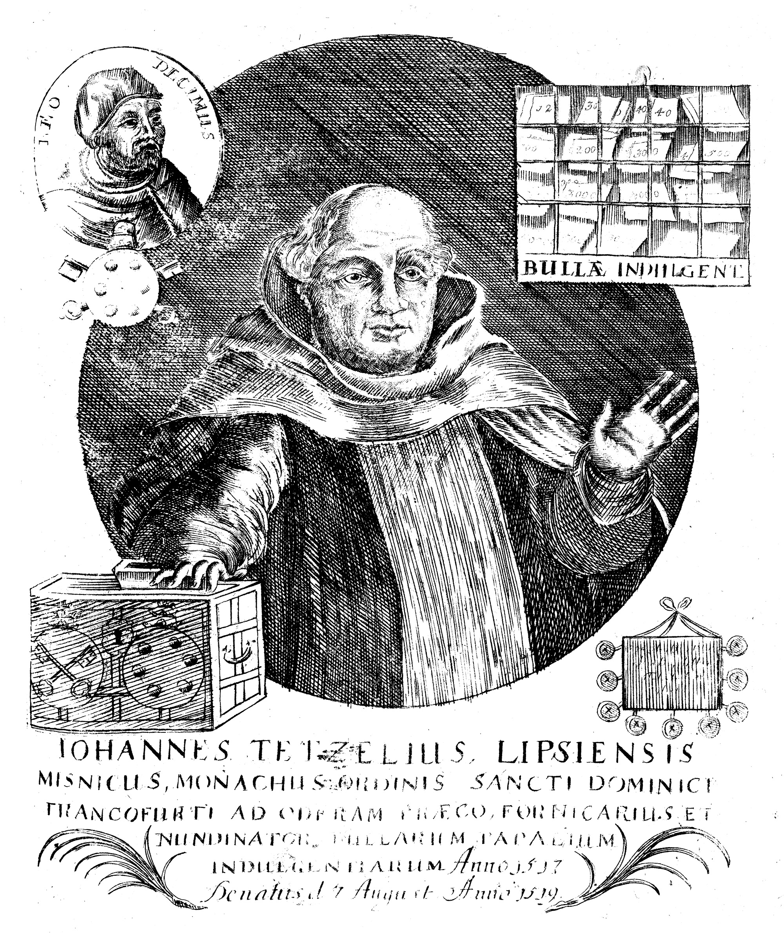
Martin Luther was born in Germany. He was only 9 years old when Christopher Columbus discovered America. When he was 22, he decided to become a monk instead of becoming a lawyer as he had planned. His father became very frustrated with this decision and became angry with him.
1483
-
1546
MARTIN LUTHER
While Martin was studying to be a monk or friar, he found many things in the Christian church that were not in accordance with the teachings of the Bible.
When people did something wrong, they had to pay money to buy an indulgence that represented God's forgiveness. They could even buy indulgences in advance for sins they planned to commit.
Tetzel was a famous man who sold indulgences. One day, as he was leaving the church in Leipzig, Germany, a man of nobility asked him if he could buy an indulgence for a sin he had plans to commit. Tetzel told him that it was possible, but that indulgences for future sins cost an extra amount of money. The nobleman paid him and received his pardon document, and Tetzel went on his way. Later, at a lonely bend in the road, the nobleman seized Tetzel and stripped him of all the money he had collected selling indulgences in Leipzig. While Tetzel threatened him very angrily with the punishment of being burned in hell for that act, the nobleman showed him his indulgence and informed him that this was the sin he was thinking of committing when he paid for forgiveness of it.
Even though Martin read in Romans 6:23 that eternal life was a gift from God and not something we have to buy [for the wages of sin is death, but the gift of God is eternal life in Christ Jesus our Lord.], he was still confused and thought that he must be good enough to receive the gift of forgiveness from God.

Slide 15
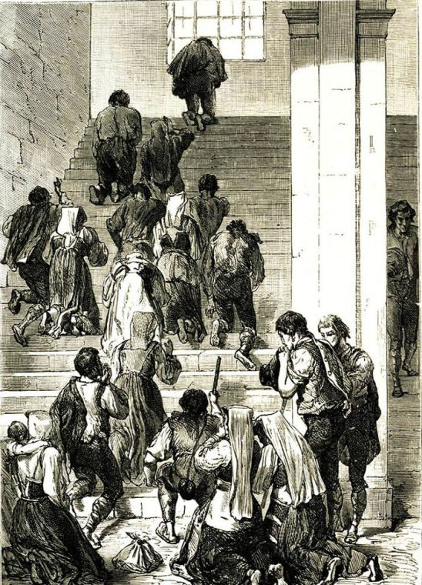
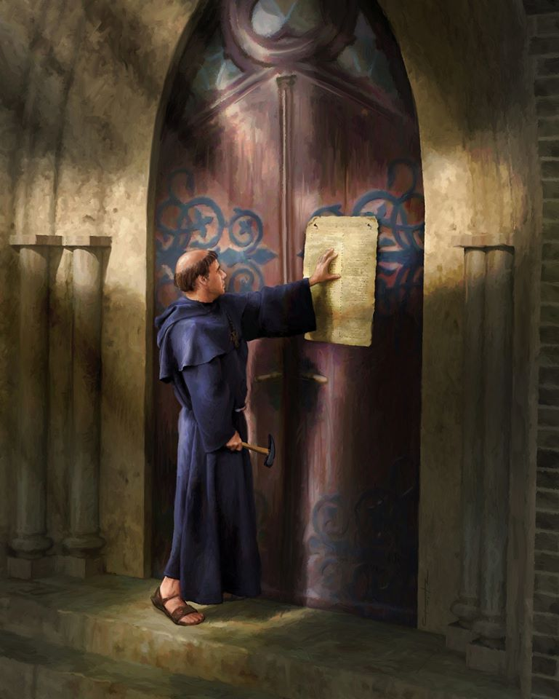
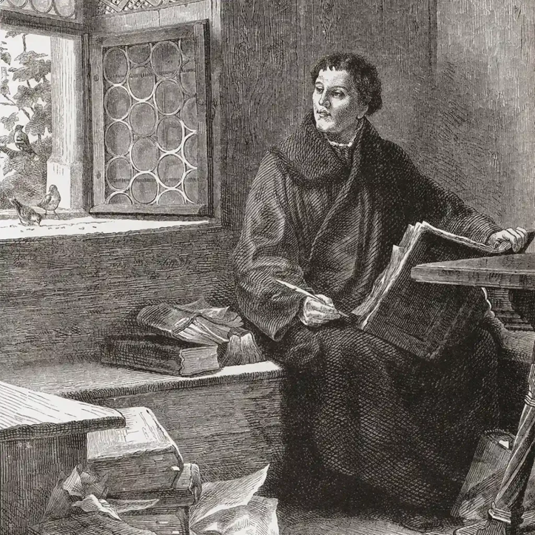
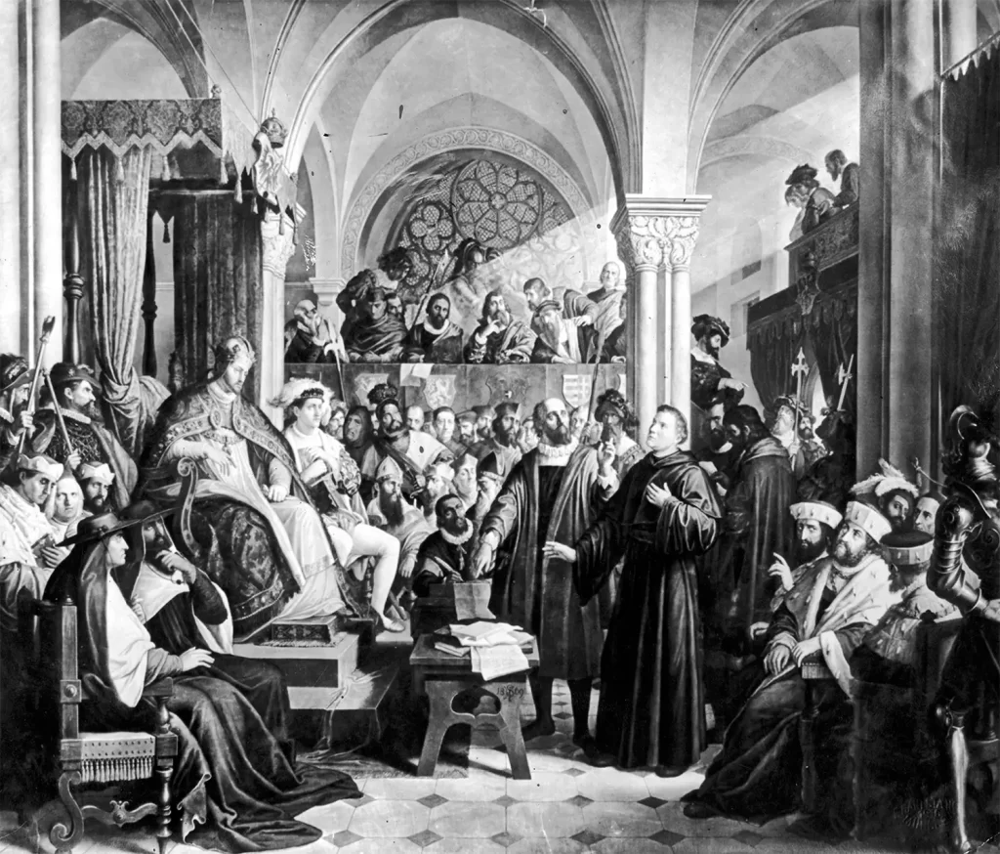
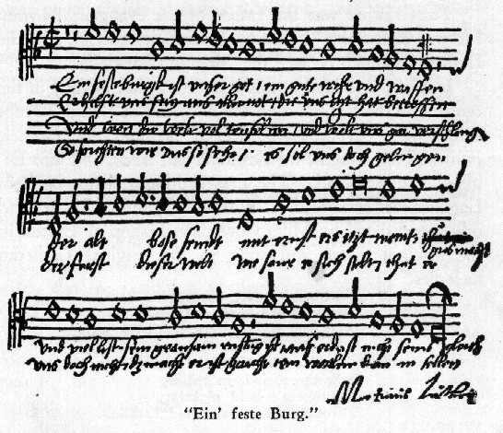
Martin tried to do things to pay for his sins. Sometimes he would whip himself trying to pay for his sins. Once, at one time in his life, he climbed Pilate's ladder on his knees, praying and kissing each step. (Supposedly, that staircase had been moved from Jerusalem to Rome and was the same staircase that Jesus had ascended before he died.) His knees were lacerated and bleeding, but Martin believed that by doing so he would gain God's special favor.
Martin's great discoveries are found in 1 John 1:9 and Hebrews 10:38. He gathered these and many other examples of differences between what the church of his day taught and what the Bible teaches. On October 31, 1517, Martin nailed to the doors of the church in Wittenberg, a list of 95 differences. These differences are now called Luther's 95 Theses.
The church leaders became enraged with Martin and thought about punishing him. They excommunicated him, which means that he was expelled from the church and that according to them he could not pray to God anymore. How do you think God feels about men who make a law saying that someone can't pray to God anymore?
Since Luther had very powerful friends, he was able to hide in a German castle. For many years he lived under the name Junker George. During this time he translated the Bible into German.
He also wrote a hymn: "A Mighty Fortress is Our God." He also wrote "To Shepherds, as they watched by Night", a lullaby for one of his sons.

Slide 16


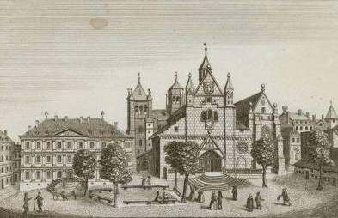
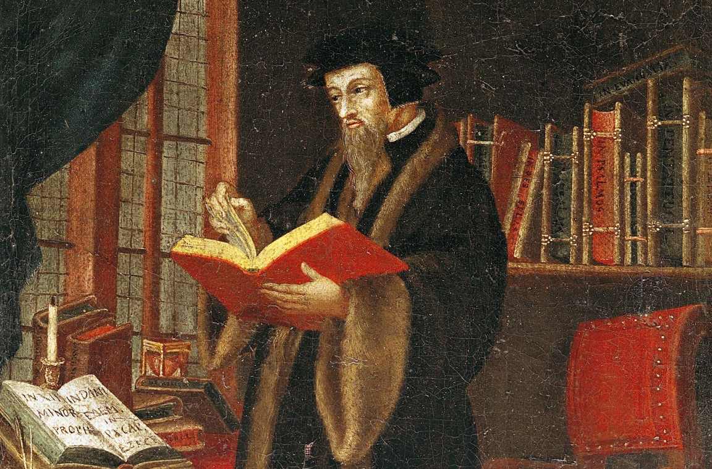
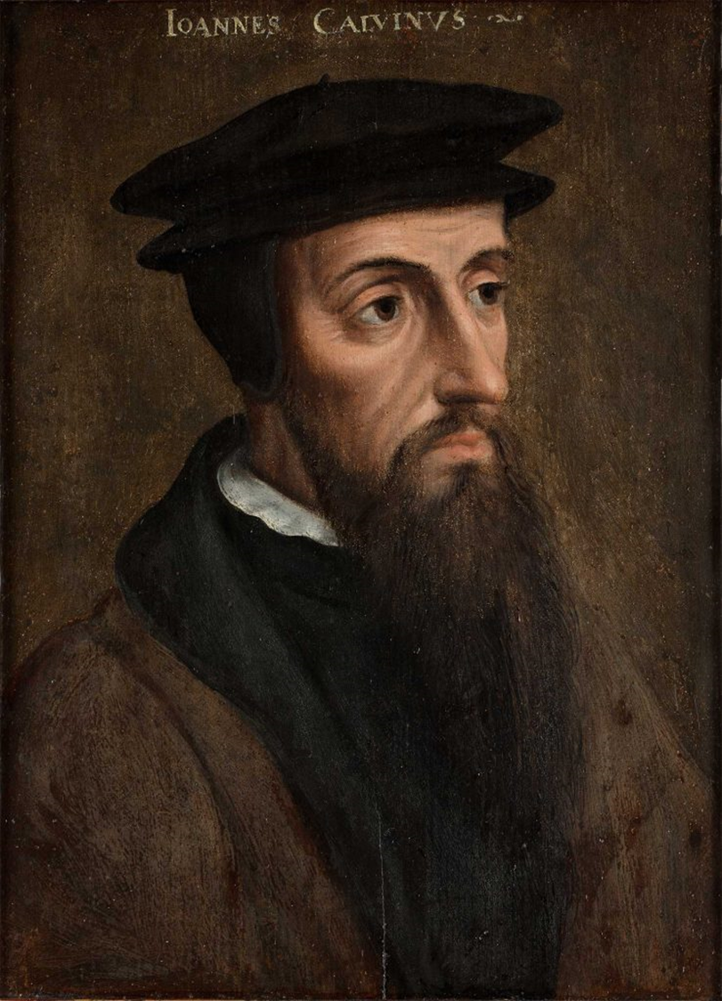
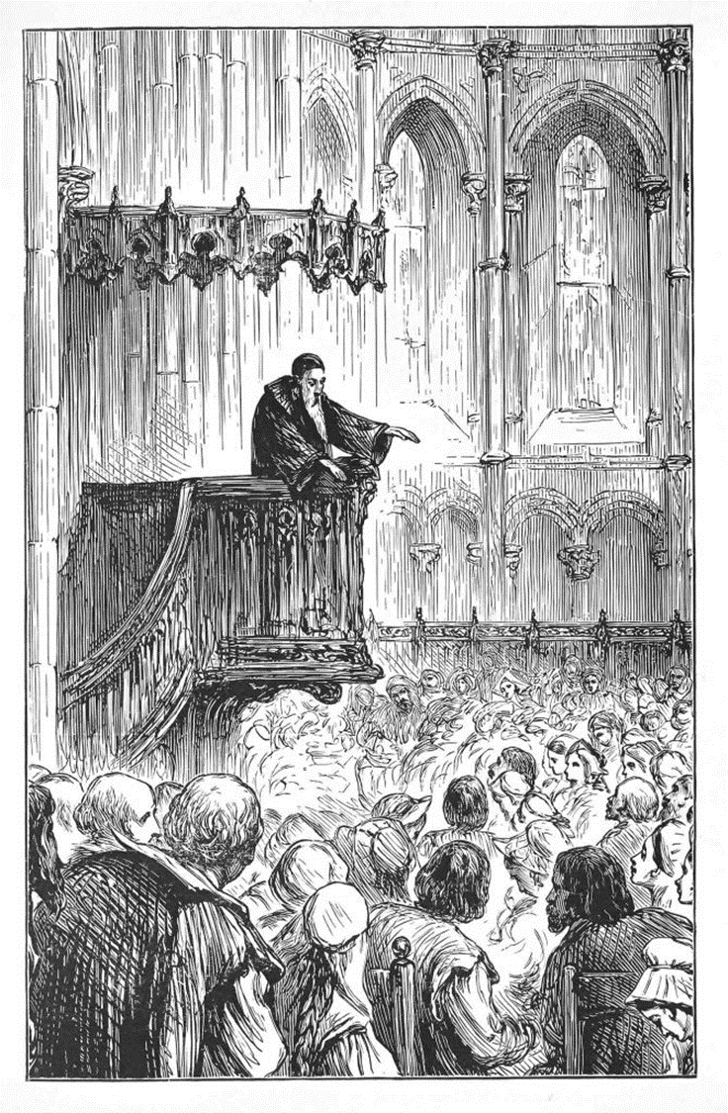
Drawing from 1750 of St. Peter's Cathedral in Geneva, where Calvin preached
John Calvin was born in France and also lived in Switzerland. When he was just a young child, he heard about Martin Luther and, growing up, joined the Protestant Reformation movement when Luther was still its leader. However, Calvin worked in different places.
1509
-
1564
JOHN CALVIN
When Calvin was young, he became convinced that God had called him to be a priest. When he was 22 years old, after studying the writings of Martin Luther, he experienced a conversion and felt that he should leave the church organization and follow Luther's teachings. The Christian church still regarded these ideas as heresies, so Calvin was forced to leave France.
A friend of his lived in Geneva, Switzerland, where there were many Protestants. Protestants was the name people gave to the followers of Martin Luther and the other Reformers because of the protest of the princes from the established church, at a meeting of the Diet (government). Calvin remained in Switzerland for the rest of his life.
Calvin became a great leader. He emphasized his ideas of simplicity, purity, and devout religious life. He became a leader in civil and spiritual matters and made Geneva one of the most famous cities in Europe. They called it the city of God.
John Calvin still has a following today. His teachings form the basis of Presbyterian and Reformed churches. His teachings spread among the Huguenots and the Puritans, of whom we will speak later. Those who followed Calvin's teachings in England were unable to practice their religion, so they had to abandon England and go to the New World in the 17th century. We call them the Pilgrim Fathers. Where in the New World did they arrive?
Many of the things that Calvin believed and taught we continue to believe and teach in our church today.

Slide 17

John Calvin was unyielding (not bending) and immovable in his spiritual beliefs.
In the book Education, p. 57, Ellen G. White says that:
"The greatest want of the world is the want of men,—men who will not be bought or sold; men who in their inmost souls are true and honest; men who do not fear to call sin by its right name; men whose conscience is as true to duty as the needle to the pole; men who will stand for the right though the heavens fall. CM 54".

Slide 18


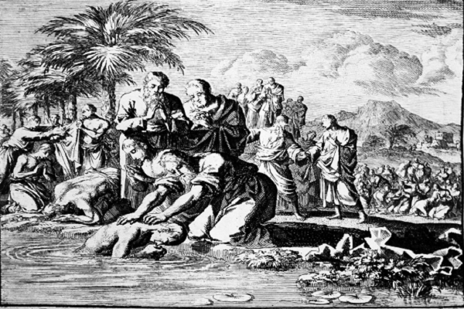
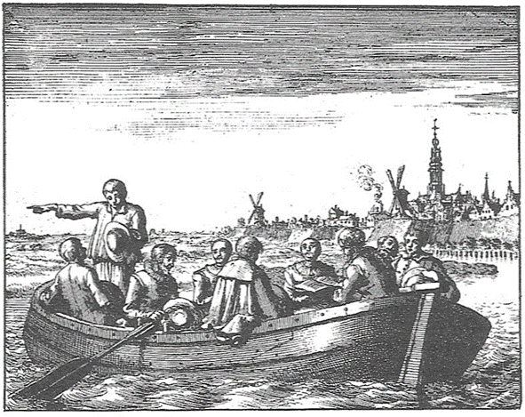
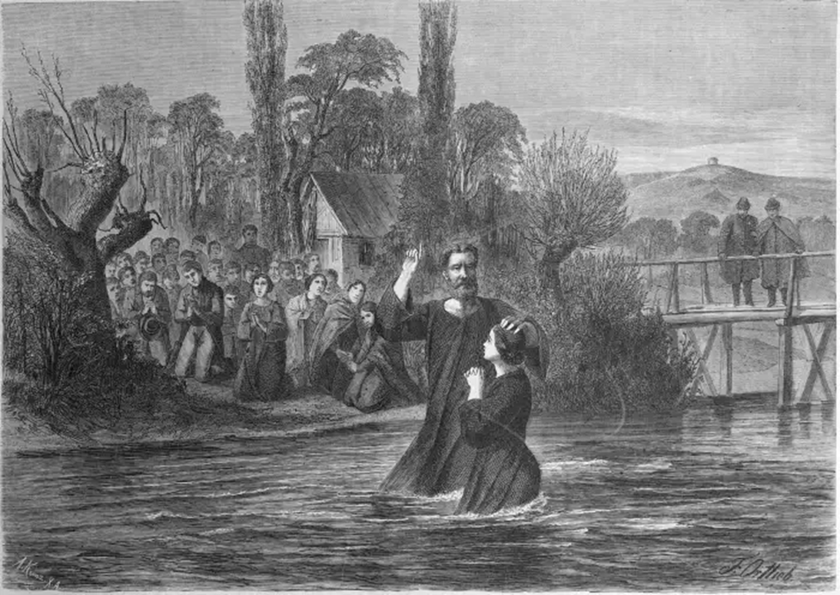
The Anabaptists and Huguenots lived in France, Switzerland, and Germany. During this time the Christian church believed that baptism was so important that unless the person was baptized he could not go to heaven. So to make sure that every person went to heaven, the religious leaders insisted that every baby be brought to church to be baptized. They were baptized by being sprinkled with special water that the priest had blessed.
The Anabaptists thought this was not right. They believed that people should not be baptized until they were old enough to make their own decision to follow Jesus. They also believed that people should be baptized by immersion, which means that the person should be completely immersed in water, rather than just being sprinkled with it.
1500
-
1789
ANABAPTISTS AND HUGUENOTS
Anabaptists Secretly Gathered in Peter Piersz's Boat
Their name, Anabaptists, means to be baptized again. They believed that people who had been sprinkled as infants should be baptized again by immersion when they became old enough to make that decision.
Can you think of something we do in the Adventist Church today that comes from the Anabaptists? Do you think you're old enough to make decisions? Have you thought about becoming baptized?
The Anabaptists, Huguenots, and followers of other Reformers were called Protestants because they protested against various beliefs and practices of the Christian church.

Slide 19



The Huguenots were French Protestants who believed much like the Swiss and German Anabaptists. Its name was taken from the Swiss word meaning Protestant, or confederate.
The Huguenots were skilled in silk work. Do you know where silk comes from?
The silk thread is made by the silkworm.
Because of persecution, the Word of God was carried to all the countries to which the Huguenots and Anabaptists fled. What other things did they bring to those countries?
They took with them what they knew about the silk business and other types of business. The countries that had to leave suffered financial losses by losing these honest and hardworking people.
French Protestants were hated and persecuted by the church in France. On one occasion many Huguenot believers were gathered in a farmer's barn holding a religious service, when French soldiers surrounded the barn and set it on fire, killing all the Huguenots inside.
But other Huguenots fought in their defense. During this time there were eight different wars between the Huguenots and the established church.
Constance Tower in Aigues-Mortes, in the south of France and Huguenot women prisoners.
When Henry IV became king of France, there was a period of peace for the French Protestants. Henry IV had been a Huguenot, but he had been forced to change his beliefs. Once he became king, he enacted several laws protecting his former friends. But after his death, the persecution began again.
After 1685 it became so dangerous for Protestants to live in France, that Huguenots and Protestants fled to other countries. One of those Protestants who fled was the Anabaptist leader named Menno Simmons. The Mennonite church took its name from there, and its followers still follow its teachings today.

Slide 20






1628
-
1688
PURITANS AND JOHN BUNYAN
Representation of the Puritans emigrating to North America
John Bunyan was born at a time when Protestants were
not persecuted in England. He lived from 1628 to 1688.
While serving as a soldier in the army, his spouse gave him a Bible and the "Book of Martyrs," a book that talks about Christians who died in the past for their faith. John Bunyan was converted by reading these books and decided to become a minister of the Puritan church.
Shortly after John became a minister, Oliver Cromwell, who was the ruler of England and also a Puritan, died, King Charles II assuming the reign. King Charles was not a Puritan, and he put laws back into force against the Puritans' forms of worship.
John Bunyan spent twelve years in prison for preaching. The jailer told him that he could leave the prison whenever he wished, provided he promised not to preach. John always said, "If you let me go free today, I will preach tomorrow." The jailer took pity on him and occasionally released him to go see his spouse and four young daughters, but John always ended up in jail the next day for preaching.
The Puritan Pilgrims on their first Thanksgiving in North America.

Slide 21






Bunyan's wife interceding for him with the authorities

Slide 22
While John was in prison, he wrote a book entitled "The Pilgrim's Progress." He is more famous for his book than for his preaching. [Save the slide below to .jpg. Print it on a sheet. Cut the sheet in half and glue the two on top of each other. Cut the paper along the dotted lines to form windows through which you can see the illustrations of the main parts of the story. As you read the story, you can open the window for each part.].
Notice that in every situation God sent someone to help the Christian on his journey to the heavenly city.
Synopsis of the book "The Pilgrim's Progress”:
1. Christian lives in the City of Destruction. Evangelist tells him about the Celestial City and helps him start his journey.
2. Christian gets distracted out of the way and sinks into the Slough (swamp) of Despond. A friend named Help pulls him out of the swamp.
3. Christian climbs a steep peak and reaches the Cross. The burden he had brought on his back falls.
Three angels come to meet him and assure him of forgiveness, give him new clothes and a rolled-up map.
4. Christian goes to the Beautiful Palace where he receives an armor from the hands of the ladies who live there.
5. Fight and win the fight with a monster named Apollyon.
6. Christian meets a traveling companion named Faithful. Christian and Faithful enter the Vanity Fair, a place of entertainment, but are captured and exhibited in a cage because they are so different from the locals. Faithful is killed, but Christian escapes with the help of a lady who sympathizes with him.
7. Christian meets another fellow traveler named Hopeful. Both fall asleep on the grounds of the Castle of Doubt and are captured by the Giant Despair who throws them into a dungeon. They escape after Hopeful finds the key named Promise in hir pocket, which opens any lock.
8. Christian and Hopeful must cross the black River of Death to reach the Celestial City. Christian fears drowning but manages to cross it thanks to Hopeful who holds Christian's head out of the water.
9. They both enter the Celestial City and live happily.
Notice that God always sends us His help when we need it.
Learn the story and tell it to others.

Slide 23



Slide 24



1703
-
1791
WESLEY'S FOLLOWERS
In a small cabin lived a family that had 10 children (eleven more children had died). Every morning, the mother sat on a stool in the center of the room with the apron over her head. This was the only way he could spend time with Jesus and have her private devotions. As long as the apron was covering her head, all of her children knew to be still. When she took off his apron, they could play and make noise again.
Charles and John Wesley were two of the brothers who lived in that cramped house. They had been born in England.
They learned from their mother, Susanna, the importance of living Christian lives. She was also the first teacher of all her children. They were not allowed to read until the age of five, but by then they had been taught so much by heart that they learned to read in two days. Susanna had a schedule to spend an hour privately with each of her children each week.
Every Thursday night she and John talked for an hour. He never forgot those wonderful hours with his mother. Both John and Charles studied to become ministers. They lived very strict lives and were so attached to the rules of the Bible that their friends mocked them by calling them "The Holy Club." Later they were called by the Methodists, because of their methodical way of life. When the Wesley brothers became famous preachers, their followers were also called Methodists.

Slide 25

Their relative, Arthur Wesley, was so ashamed of being related to such religious cousins that he eventually changed his surname to Wellesley. In time, William Wellesley became a famous soldier who defeated Napoleon. He is better known as the Duke of Wellington.
John Wesley became a powerful preacher. In 1735, he and his brother went on a missionary journey through America. A terrible storm broke out at sea, and many of the passengers thought the ship was going to sink. On that same ship was a group of Moravians from Australia. The Moravians did not fear the storm. They trusted that God would take care of them. Whether they arrived safely in America, or whether the ship sank, they felt no fear. John was so impressed with the quiet faith of his traveling companions that he began to study their doctrines. By attending their meetings, he truly came to know Jesus as her personal Savior.
Once he began to preach the new Reformed faith, he found that the doors of the churches were closed to him. He was not going to be allowed to enter their churches or preach in them.
Wesley traveled about 5,000 miles on horseback each year and preached about 15 sermons a week. Can you imagine listening to 15 sermons a week? Now imagine all the work that goes into preaching those 15 sermons each week.
Wesley organized his converts into prayer bands and church societies. He appointed leaders to serve the groups as lay pastors, and later ordained those leaders. John Wesley was one of the great organizers of the new Protestant movement. His brother Charles traveled with him wherever he went. Although both brothers preached and both wrote hymns, Charles became best known for the hymns he wrote. He went on to publish more than 4,500 hymns and left more than 3,000 unpublished before his death in 1788.

Slide 26





Using your church hymnal, find all the hymns written by the Wesley brothers. Look for them in the Authors, Translators, and Sources index if your hymnal has them.
Some of the most well-known hymns are:
"His works include: "And Can It Be", "O for a Thousand Tongues to Sing", "Christ the Lord Is Risen Today", "Love Divine, All Loves Excelling", the carol "Hark! The Herald Angels Sing", and "Lo! He Comes With Clouds Descending".

Slide 27





1795
-
1862
Joseph Wolff was born in Germany to a Jewish family, and he believed that one day the Messiah would come and then the Jews would rule the world. He lived from 1795 to 1862. The same way that Protestants were mistreated, so were Jews. But Joseph was waiting for the coming of the Messiah so that the persecution would end.
When Joseph was only seven years old, he boasted to a Christian of the triumph of the Hebrews when the Messiah would come. The Christian sat down next to him and explained, using his Bible, that Jesus was the Messiah. Even though his family was very upset, Joseph accepted Jesus.
When Joseph was only 11 years old, his family forced him to leave home and look for a job. While earning his living teaching Hebrew, Joseph was very cold and hungry.
JOSEPH
WOLFF
Joseph Wolff left Germany, and made missionary trips. Joseph preached the soon coming of Jesus in Egypt, Turkey, Saudi Arabia, Syria, Iraq, Iran, India, Afghanistan, North America, South America, and other countries.
On one of his missionary journeys, Joseph was sold into slavery. He was taken to prison and sentenced to death three times. On one occasion, Joseph was stripped of all his clothes and shoes and had to travel naked and barefoot walking through the snow to reach the next village. No matter what happened to Joseph, God always cared for him and so he was able to preach the message of Jesus' soon coming.
Joseph Wolff died waiting to see the return of his Savior.

Slide 28







Since the time of the Reformers, there have been many missionaries who have spread God's Word throughout the world. Can you think of some of them?
Some missionaries that may sound familiar to you are:
David Livingstone—Missionary in Southern and Central Africa.
Mary Slessor—Missionary in West Africa.
Dr. Miller—Missionary in China.
Ellen G. White—Missionary in Australia.
Pastor y Mrs. Stahl—Missionaries in South America.
J. N. Andrews—Missionary in Switzerland.
19th Century – 21st Century
OTHER MISSIONARIES
For some time in Scandinavia, adults were forbidden to talk about their religious beliefs if they were too different from those of the official religion of that country. Certain laws were put into effect that included very severe punishments for those who disobeyed. However, such laws only applied to adults. Children of six and eight years old began to preach and share the Word of God with adults, because their parents could not do so. They preached very simple sermons, using Bible verses to explain their beliefs. God's Word was spread throughout Scandinavia by young children. Mrs. White made an interesting statement concerning children:
"In the closing scenes of this earth's history many of these children and youth will astonish people by their witness to the truth, which will be borne in simplicity, yet with spirit and power. They have been taught the fear of the Lord, and their hearts have been softened by a careful and prayerful study of the Bible. In the near future many children will be endued with the Spirit of God, and will do a work in proclaiming the truth to the world, that at that time cannot well be done by the older members of the church.” CT 166. We can all be missionaries.

Slide 29



We have learned how and why the Christian church has been divided into many churches throughout history.
With great effort and dedication (and sometimes giving their lives for it), each reformer has contributed to bringing to light some truth that had been hidden for some time.
If each of us asks the Holy Spirit to teach us what we need to learn, He is willing to show us more of God.
Therefore, we must diligently search the Bible to extract the truths that are still there and that we need to learn.
Like the ancient Reformers, all of us who love pure truth, as presented in God's Word, are called to share the good news of the gospel with all who do not yet know what God has made, and what He has in store for them.

