Slide 1
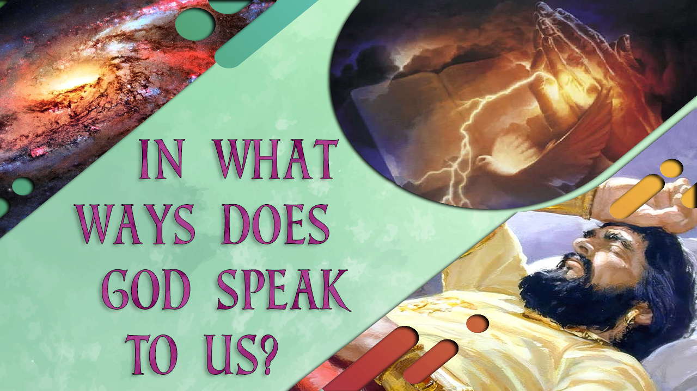

Slide 2


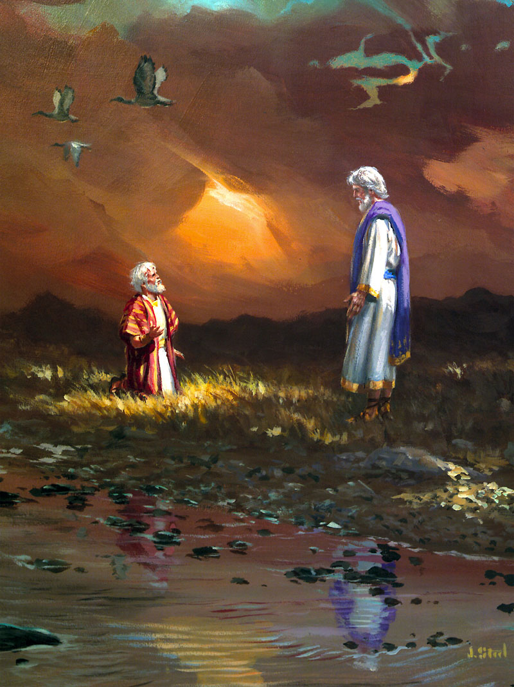
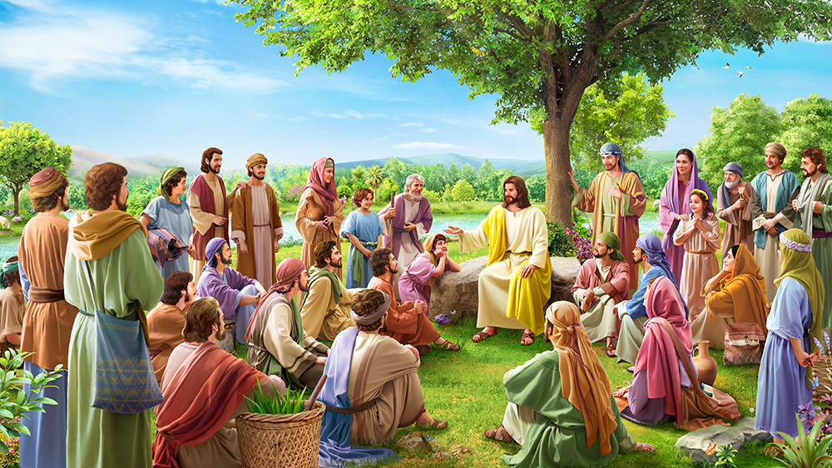
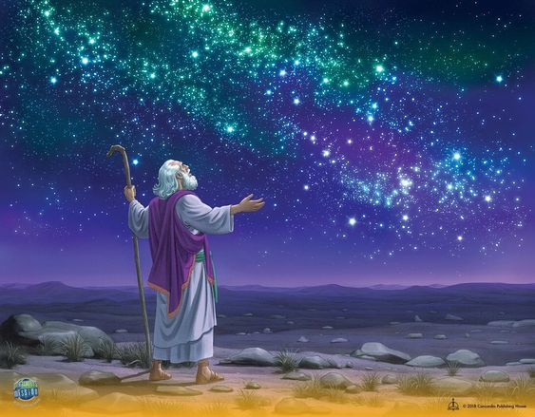
God wants to communicate with us. He has always sought the human being. It began in Eden, even after sin. Then he spoke with Abraham, with Moses. And then he set his house among men, the sanctuary which he set up in the midst of the people of Israel.
God communicated to the prophets and, later, through Jesus Christ.
“God, who at sundry times and in divers manners spake in time past unto the fathers by the prophets, Hath in these last days spoken unto us by his Son, whom he hath appointed heir of all things, by whom also he made the worlds” (Hebrews 1:1-2)
God speaks in many ways, sometimes audible and sometimes not. Let's learn some of them.

Slide 3

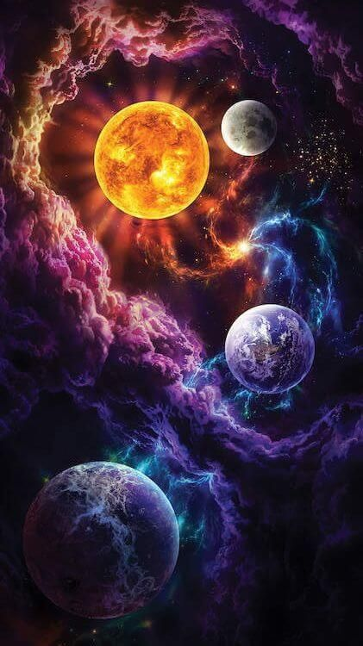




God created this world, and by seeing the wonders in it, we can understand God's character.
Through nature
“The heavens declare the glory of God; and the firmament sheweth his handywork. Day unto day uttereth speech, and night unto night sheweth knowledge.” (Psalm 19:1-2).
“Because that which may be known of God is manifest in them; for God hath shewed it unto them. For the invisible things of him from the creation of the world are clearly seen, being understood by the things that are made, even his eternal power and Godhead; so that they are without excuse.” (Romans 1:19-20).
We can also draw spiritual teachings from what we see in nature, as Jesus did.
“Therefore I say unto you, Take no thought for your life, what ye shall eat, or what ye shall drink; nor yet for your body, what ye shall put on. Is not the life more than meat, and the body than raiment?” (Matthew 6:26).
“And why take ye thought for raiment? Consider the lilies of the field, how they grow; they toil not, neither do they spin: And yet I say unto you, That even Solomon in all his glory was not arrayed like one of these.” (Matthew 6:28-29).

Slide 4

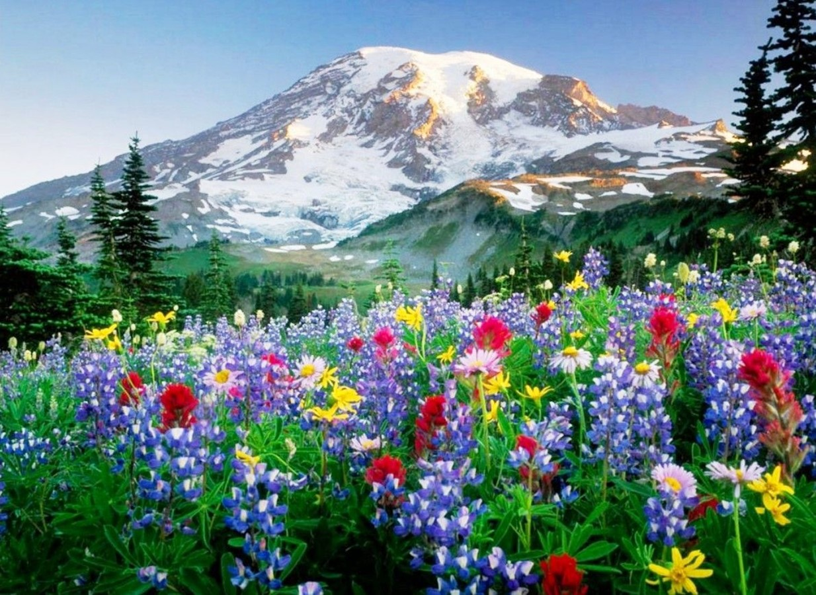

“God speaks to us in nature. It is His voice we hear as we gaze upon the beauty and richness of the natural world. We view His glory in the beauteous things His hand has made. We stand and behold His works without a veil between. God has given us these things that in beholding the works of His hands we may learn of Him. UL 327.2.
God has given us these precious things as an expression of His love. The Lord is a lover of the beautiful, and to please and gratify us He has spread before us the beauties of nature, even as an earthly parent seeks to place beautiful things before the children that he loves. The Lord is always pleased to see us happy. Sinful as it is with all its imperfections, the Lord has lavished upon this earth the useful and the beautiful. The beautiful, tinted flowers tell of His tenderness and love. They have a language of their own, reminding us of the Giver. UL 327.3.
We may look up through nature to nature's God. In the beautiful, lofty trees, the shrubs, the flowers, God reveals His character. He is to be compared to the most beautiful lilies and roses and pinks. I love to look upon the things of God in nature, for the Lord impresses upon them His character. In love to us He has given them, and He means that we shall have pleasure in them. Then let us not worship the beautiful things in nature, but let us look up through them to nature's God, and be led to worship the Giver. Let these beautiful ministries of love answer the purpose of God, and draw our hearts to Him, to be filled with the beauties of His character, and adore His goodness, His compassion, His inexpressible love.” UL 327.4.

Slide 5


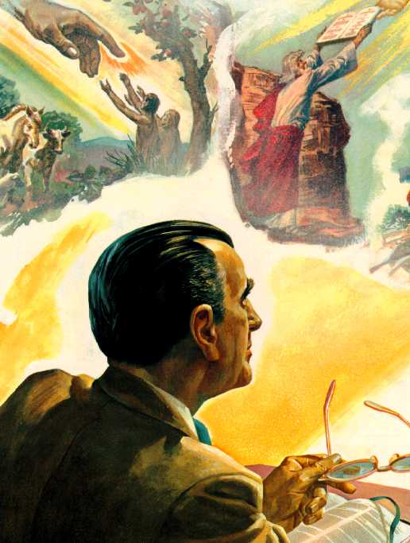
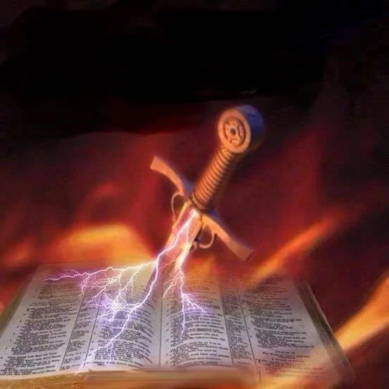


“For the word of God is quick, and powerful, and sharper than any twoedged sword, piercing even to the dividing asunder of soul and spirit, and of the joints and marrow, and is a discerner of the thoughts and intents of the heart” (Hebrews 4:12).
Through the written word
“Thy word is a lamp unto my feet, and a light unto my path” (Psalm 119:105).
When you read the Bible you find stories, examples, and teachings. With prayer, through it, God will speak to you showing you what you need that day for your spiritual growth, and what you can share with others.
He also gives you advice on what you should avoid and the fruits you should manifest: “Now the works of the flesh are manifest, which are these; Adultery, fornication, uncleanness, lasciviousness, Idolatry, witchcraft, hatred, variance, emulations, wrath, strife, seditions, heresies, Envyings, murders, drunkenness, revellings, and such like: of the which I tell you before, as I have also told you in time past, that they which do such things shall not inherit the kingdom of God. But the fruit of the Spirit is love, joy, peace, longsuffering, gentleness, goodness, faith, Meekness, temperance: against such there is no law. And they that are Christ's have crucified the flesh with the affections and lusts. If we live in the Spirit, let us also walk in the Spirit.” (Galatians 5:19-25).
It also tells you about the only way of salvation: Jesus; and how He can transform you.

Slide 6
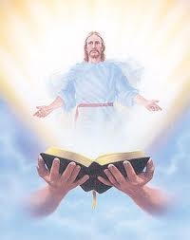
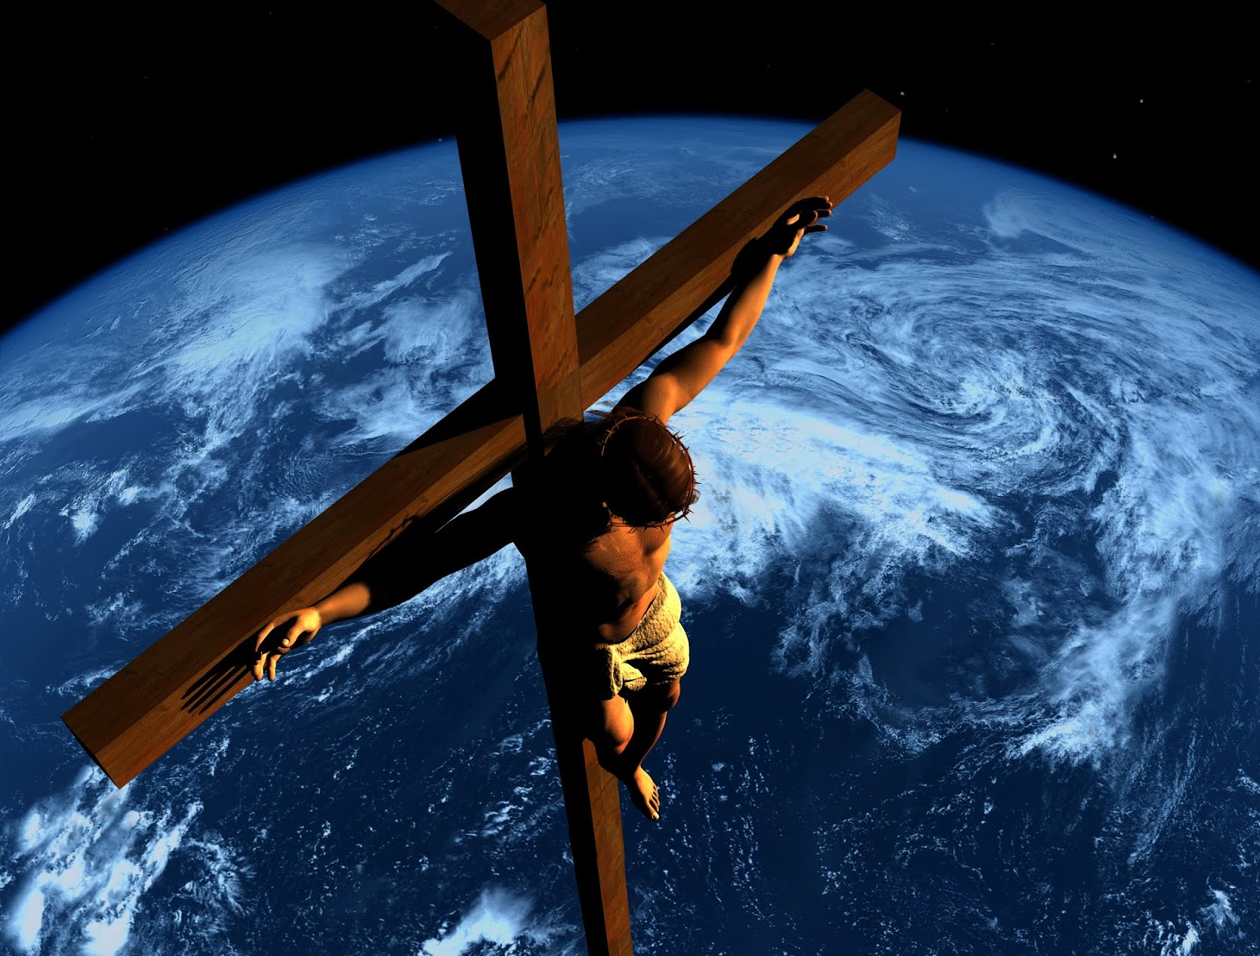
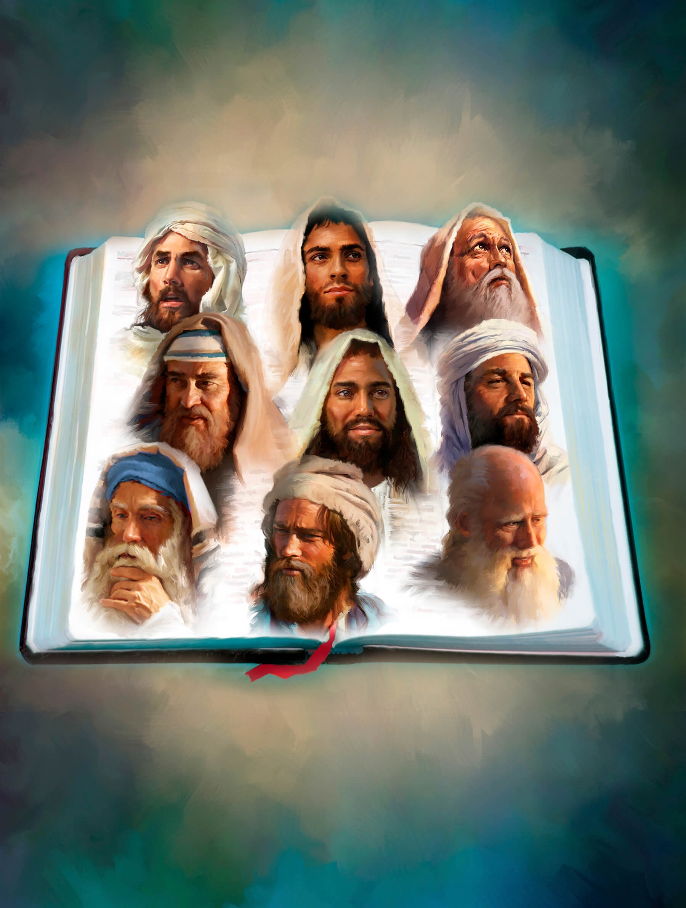
“God speaks to us in His word. Here we have in clearer lines the revelation of His character, of His dealings with men, and the great work of redemption.
Here is open before us the history of patriarchs and prophets and other holy men of old. They were men “subject to like passions as we are.” James 5:17. We see how they struggled through discouragements like our own, how they fell under temptation as we have done, and yet took heart again and conquered through the grace of God; and, beholding, we are encouraged in our striving after righteousness.
As we read of the precious experiences granted them, of the light and love and blessing it was theirs to enjoy, and of the work they wrought through the grace given them, the spirit that inspired them kindles a flame of holy emulation in our hearts and a desire to be like them in character—like them to walk with God.” SC 87

Slide 7

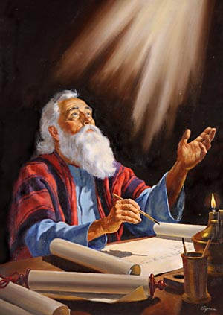
By the Holy Spirit
“I have yet many things to say unto you, but ye cannot bear them now. Howbeit when he, the Spirit of truth, is come, he will guide you into all truth: for he shall not speak of himself; but whatsoever he shall hear, that shall he speak: and he will shew you things to come.” (John 16:12-13).
“For as many as are led by the Spirit of God, they are the sons of God” (Romans 8:14).
“A new heart also will I give you, and a new spirit will I put within you: and I will take away the stony heart out of your flesh, and I will give you an heart of flesh. And I will put my spirit within you, and cause you to walk in my statutes, and ye shall keep my judgments, and do them.” (Ezekiel 36:26-27).
“Knowing this first, that no prophecy of the scripture is of any private interpretation. For the prophecy came not in old time by the will of man: but holy men of God spake as they were moved by the Holy Ghost.” (2 Peter 1:20-21).

Slide 8
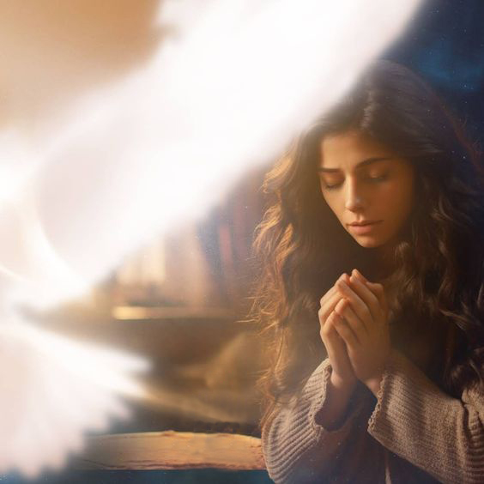
“The influence of the Holy Spirit is the life of Christ in the soul. We do not now see Christ and speak to Him, but His Holy Spirit is just as near us in one place as another. It works in and through every one who receives Christ. Those who know the indwelling of the Spirit reveal the fruit of the Spirit—love, joy, peace, long-suffering, gentleness, goodness, faith. TMK 57.
“But God is ever seeking to impress our hearts by His Holy Spirit, that we shall be convinced of sin, of righteousness, and of judgment to come. We may place our will on the side of God's will, and in His strength and grace resist the temptations of the enemy. As we yield to the influence of the Spirit of God, our conscience becomes tender and sensitive, and sin that we have passed by with little thought, becomes exceeding sinful. OHC 153.
The Spirit works in us by bringing to mind, vividly and often, the precious truths of the plan of redemption. We should forget these truths, and for us God's rich promises would lose their efficiency, were it not for the Spirit, who takes of the things of God, and shows them to us.... The Spirit illumines our darkness, informs our ignorance, and helps us in our manifold necessities. But the mind must be constantly going out after God OHC 154

Slide 9

“The promised Holy Spirit, that He would send after He ascended to His Father, is constantly at work to draw the attention to the great official sacrifice upon the cross of Calvary, and to unfold to the world the love of God to man, and to open to the convicted soul the precious things in the Scriptures, and to open to darkened minds the bright beams of the Sun of Righteousness, the truths that make their hearts burn within them with the awakened intelligence of the truths of eternity. 2MR 14.5.
Who but the Holy Spirit presents before the mind the moral standard of righteousness and convinces of sin, and produces godly sorrow which worketh repentance that needeth not to be repented of, and inspires the exercise of faith in Him who alone can save from all sin?
Who but the Holy Spirit can work with human minds to transform character by withdrawing the affections from those things which are temporal, perishable, and imbue the soul with earnest desire by presenting the immortal inheritance, the eternal substance which is imperishable, and recreates, refines, and sanctifies the human agents that they may become members of the royal family, children of the heavenly King?—Manuscript 1, 1892, 1-3. (“Obedience to God,” November 13, 1892.) 2MR 15.

Slide 10

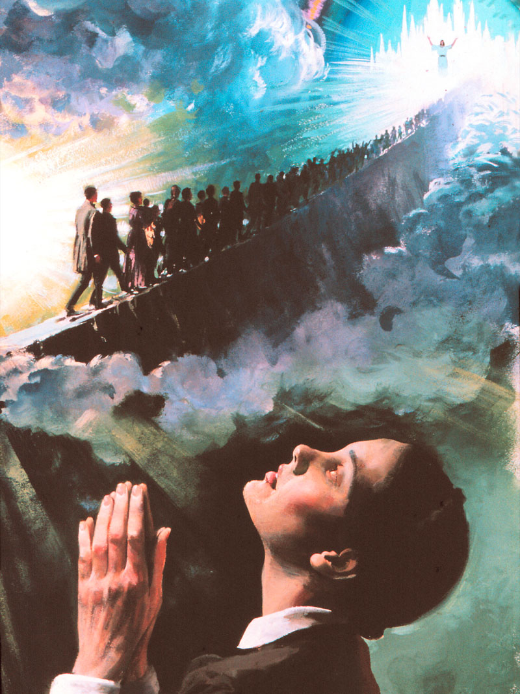
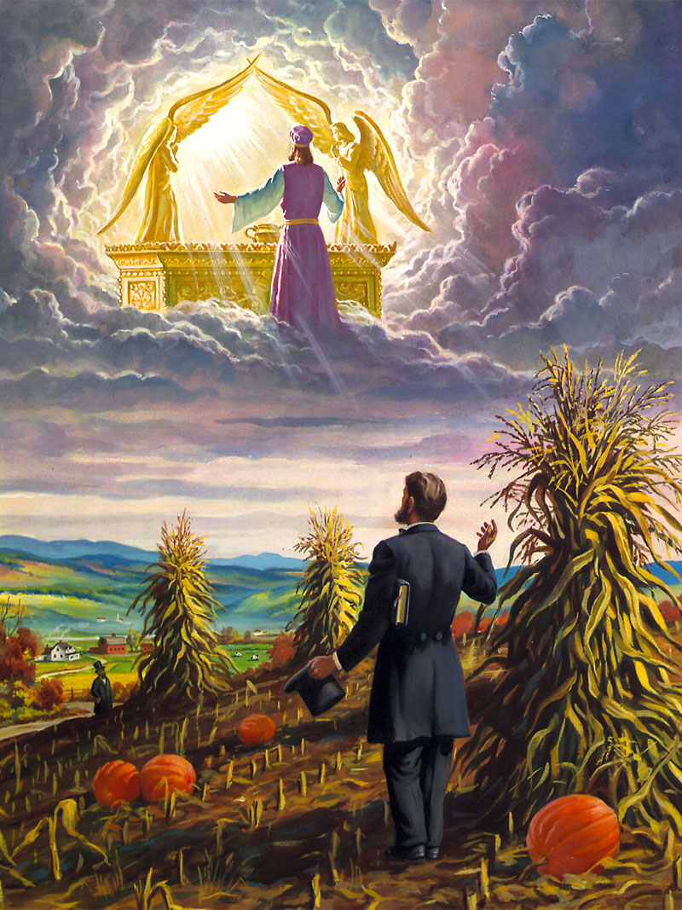

“And he said, Hear now my words: If there be a prophet among you, I the LORD will make myself known unto him in a vision, and will speak unto him in a dream” (Numbers 12:6).
Through dreams and visions
There are many examples in the Bible where God has shown His will and purposes through dreams and visions.
Pharaoh: Genesis 41:1-8
Nebuchadnezzar: Daniel 2, 4
Daniel: Daniel 2, 7, 8
Jacob: Genesis 28: 10-13
Peter: Acts 10
In the middle of the field Hiram Edson was stopped as if by a hand on his shoulder. He looked up at the gray sky and it seemed to him that a view of the third heaven was opening up before him. I saw unmistakably and clearly, that instead of our High Priest leaving the Holy of Holies of the Heavenly Sanctuary to come to this earth on the tenth day of the seventh month, at the end of the 2,300 days, He entered on that day for the first time into the second apartment of the Sanctuary and that He had a work to do in the Holy of Holies before He came to this earth.
God can speak to us through dreams and visions. But not all dreams come from God, for the mind processes by sleeping. We cannot depend on these to follow God. We have the Bible, nature, and the Holy Spirit.
Ellen G. White: In 1844 she had her first vision. November 18, 1848 had the vision of publications. On June 6, 1863, in Otsego, Michigan, he had the vision of health reform.

Slide 11




“And it shall come to pass afterward, that I will pour out my spirit upon all flesh; and your sons and your daughters shall prophesy, your old men shall dream dreams, your young men shall see visions” (Joel 2:28).
God has ... promised to give visions in the “last days”; not for a new rule of faith, but for the comfort of His people, and to correct those who err from Bible truth.” FLB 293.5
“There will be false dreams and false visions, which have some truth, but lead away from the original faith. The Lord has given men a rule by which to detect them: “To the law and to the testimony: if they speak not according to this word, it is because there is no light in them” (Isaiah 8:20) 2SM 98.3
“There are many dreams arising from the common things of life with which the Spirit of God has nothing to do. There are also false dreams, as well as false visions, which are inspired by the spirit of Satan. But dreams from the Lord are classed in the word of God with visions and are as truly the fruits of the spirit of prophecy as visions. Such dreams, taking into the account the persons who have them, and the circumstances under which they are given, contain their own proofs of their genuineness.” 2TT 274.2

Slide 12

HUNCHES. They are a strong intuitive sensation concerning a future event or outcome.
Through impressions in the heart
INTUITION. It is the ability or faculty to obtain direct knowledge or cognition without resorting to rational knowledge and objective information.
CALLS FOR ATTENTION. Sudden or surprising warnings or warnings that can be grasped by a visceral sensation, intuition, or physical obstacle. They can take the form of an ear whisper or a mental impression that is perceived as an unmistakably alien idea.
“And thine ears shall hear a word behind thee, saying, This is the way, walk ye in it, when ye turn to the right hand, and when ye turn to the left” (Isaiah 30:21).

Slide 13

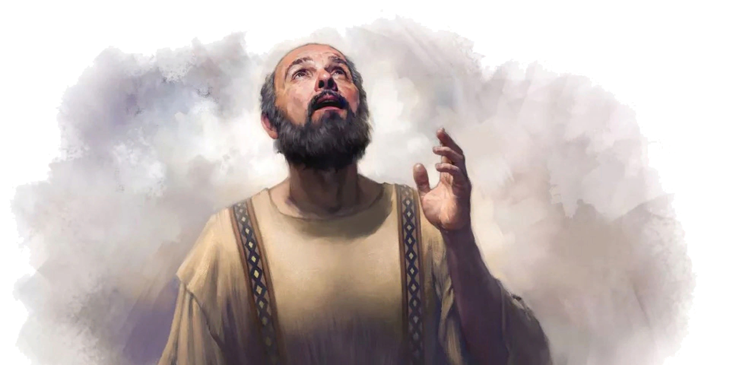
God opens doors and closes others. Sometimes events seem to have some kind of connection without, apparently, any plan or project. God is working to bring His plan to fruition.
Through life's circumstances
Paul planned to go to Rome, but circumstances prevented him from doing so:
“Making request, if by any means now at length I might have a prosperous journey by the will of God to come unto you” (Romans 1:10).
“For which cause also I have been much hindered from coming to you” (Romans 15:22).

Slide 14



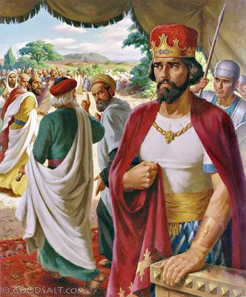
God can use friends, faithful brothers,
teachers, parents or children, or a
preacher to convey to us his message of
truth. He once spoke through a donkey
(Numbers 22:28). Why then, can't you speak through someone at any time or in any way you want?
Through other people
His words can come as a warning, a blessing, or as a prophetic truth about our lives. Whether we choose to listen to it or ignore it is up to us. Do your words align with Scripture? Will God confirm or affirm that truth in us? "The wisdom that comes from heaven is first of all pure; then peace-loving, considerate, submissive, full of mercy and good fruits, impartial and sincere" (James 3:17).
Be careful who you take for a counselor remember Rehoboam: 1 Kings 12:6-14.
You can also ask for advice on marriage or finances from those who have done well in those areas.
“Those who have not good judgment in the use of time and money, should advise with those who have had experience.” MYP 300.2.
“If you are blessed with God-fearing parents, seek counsel of them. Open to them your hopes and plans, learn the lessons which their life experiences have taught, and you will be saved many a heartache. Above all, make Christ your counselor.” MYP 435.

Slide 15
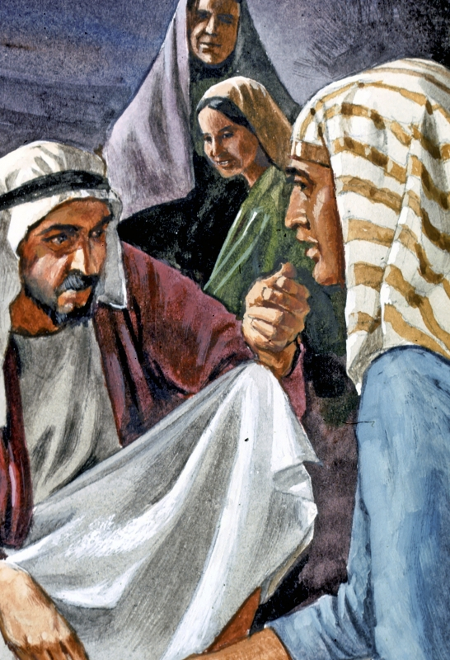
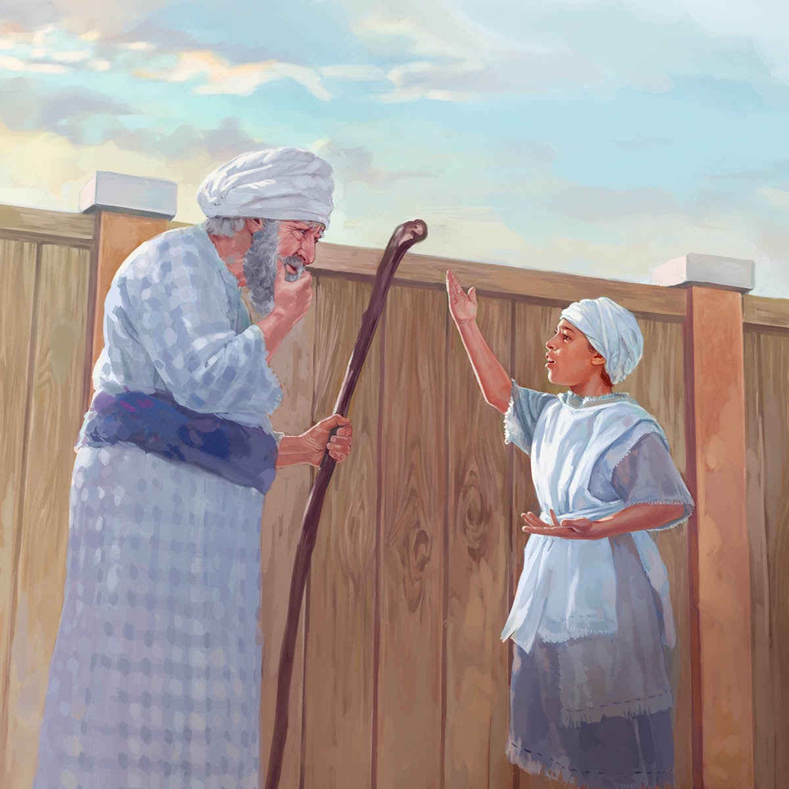
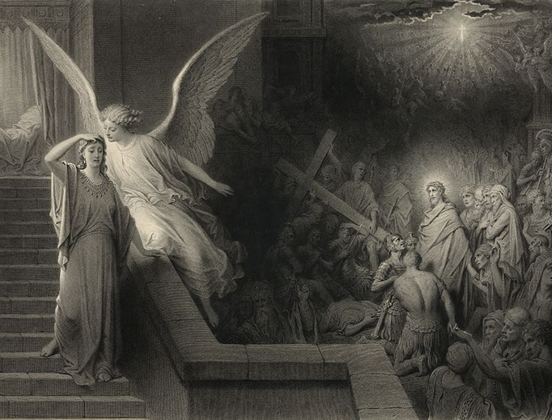
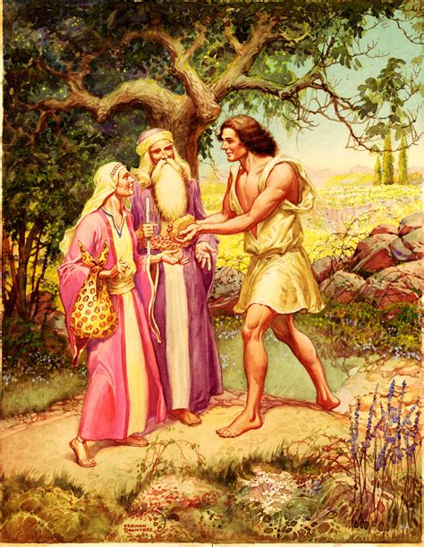
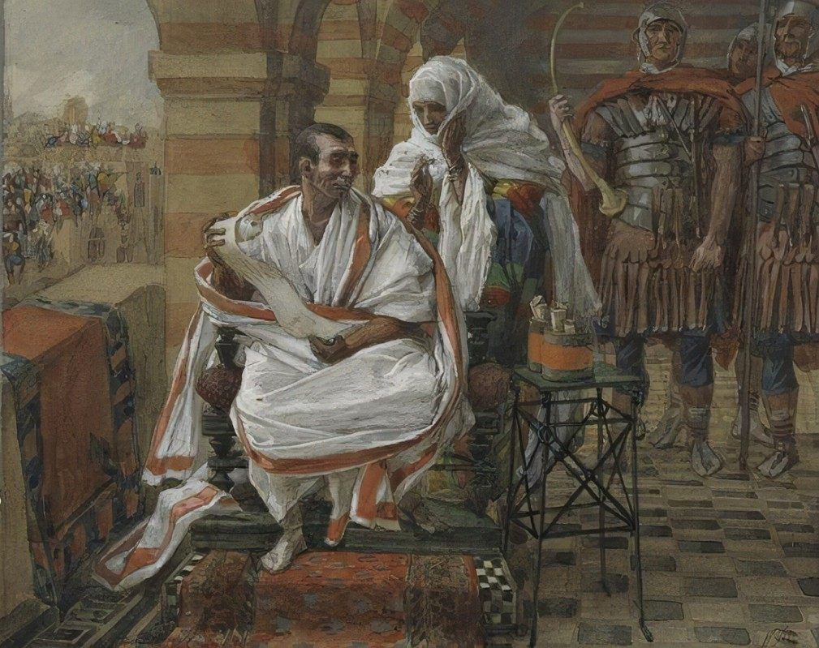
There are biblical examples of people who counseled:
Jethro counseled his son-in-law Moses: Exodus 18: 13-27.
A prophet, and the child Samuel spoke to Eli: 1 Samuel 2: 27-30.
Pilate's wife: Matthew 27:19.
Samson's parents, to Samson: Judges 14:3.
“Some men have insight into matters, having ability to counsel. It is a gift of God. In moments when the cause of God is in need of words, sound and solemn and solid, they can speak words which will lead minds perplexed and in darkness, to see as a quick flash of sunlight the course for them to pursue, [the answer to the question] which has filled them with perplexity and baffled their minds in study for weeks and months. There is an unraveling, a clearing up of the path before them, and the Lord has let His sunlight in, and they see their prayers are answered, their way is made clear.” 2SM 361.4

Slide 16
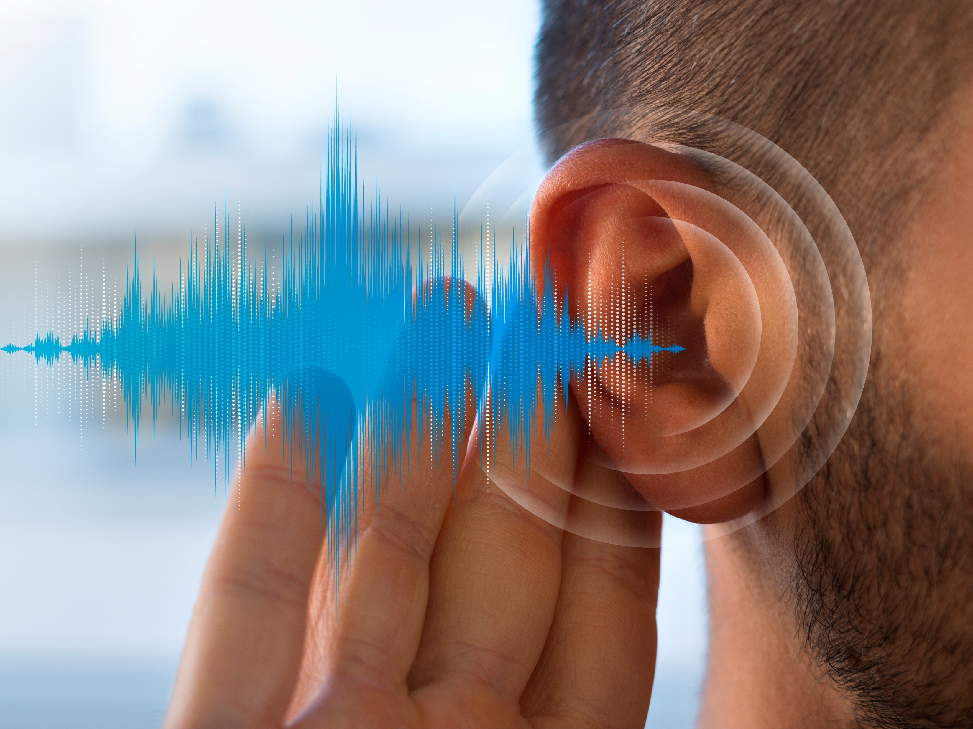
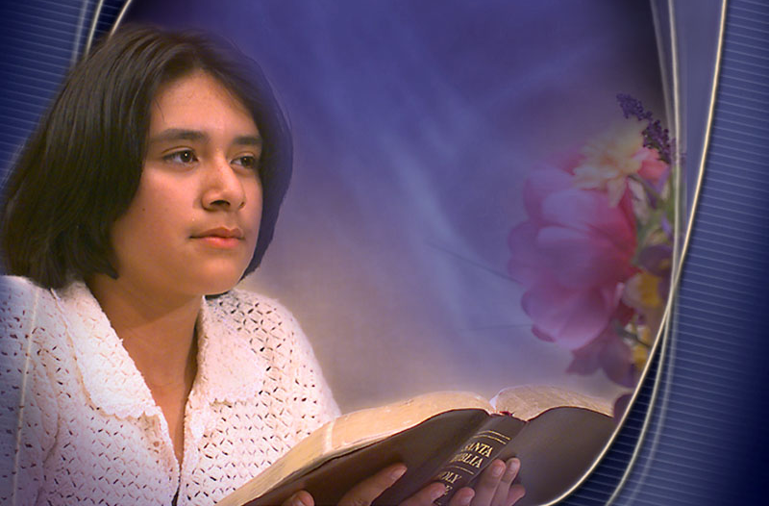
“All who are under the training of God need the quiet hour for communion with their own hearts, with nature, and with God [...]. We must individually hear Him speaking to the heart. When every other voice is hushed, and in quietness we wait before Him, the silence of the soul makes more distinct the voice of God. He bids us, “Be still, and know that I am God.” ... Amid the hurrying throngs and the strain of life's intense activities he who is thus refreshed will be surrounded with an atmosphere of light and peace. He will receive a new endowment of both physical and mental strength.”—The Ministry of Healing, 58 (1905). 1MCP 11.
Based on a sermon by Yoane Sanchez

