Slide 1


Slide 2

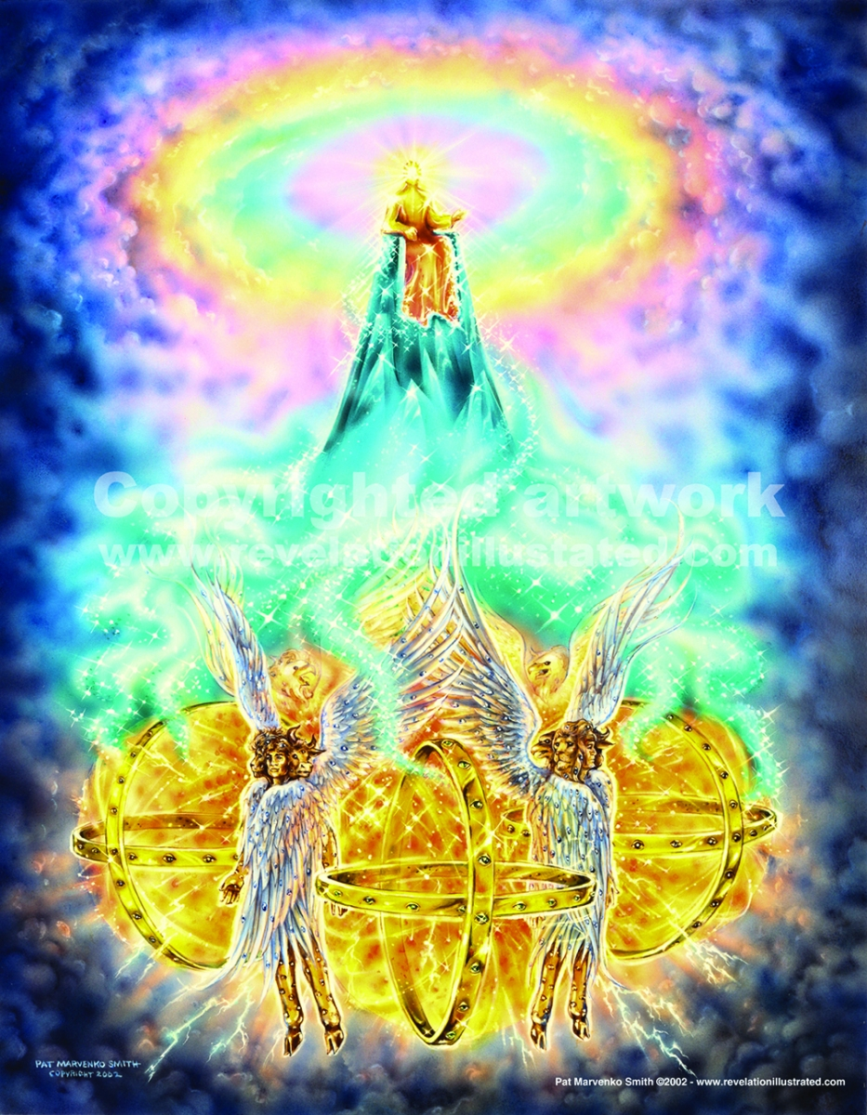
To the most discerning intellect, to the most highly educated mind, God, the holy Self, will always remain shrouded in mystery. “Canst thou by searching find out God? canst thou find out the Almighty unto perfection? It is as high as heaven; what canst thou do? deeper than hell; what canst thou know?” Job 11:7-8.
The apostle Paul exclaims: “O the depth of the riches both of the wisdom and knowledge of God! how unsearchable are his judgments, and his ways past finding out!” (Romans 11:33).
The more we understand the ways in which God works with us, and the motives that move Him to act in this or that way, the more we can discern the boundless love and mercy united to infinite power. We can understand of its purposes as much as it is good for us to know; And beyond this, we must continue to trust in that omnipotent hand and in that heart full of love.
Through God's attributes, we will understand something more about what God is like and how He acts with us.

Slide 3


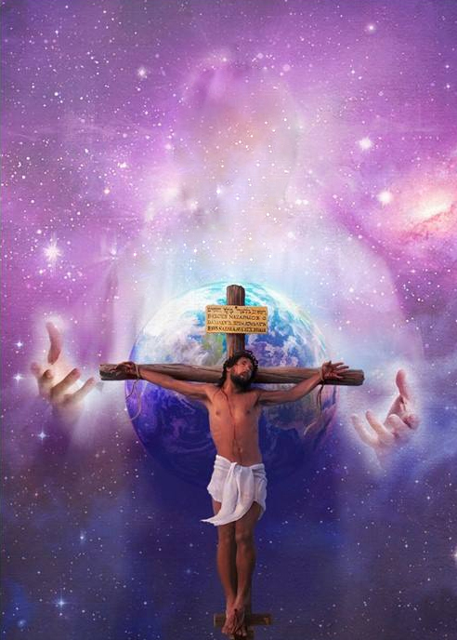
God, apart from having the capacity to love (and in fact has loved humanity with eternal love), has the quality of being love Himself.
For God so loved the world, that he gave his only begotten Son, that whosoever believeth in him should not perish, but have everlasting life. John 3:16
He that loveth not knoweth not God; for God is love. 1 John 4:8
The LORD hath appeared of old unto me, saying, Yea, I have loved thee with an everlasting love: therefore with lovingkindness have I drawn thee. Jeremiah 31:3
Unto thee, O my strength, will I sing: for God is my defence, and the God of my mercy. Psalms 59:17

Slide 4


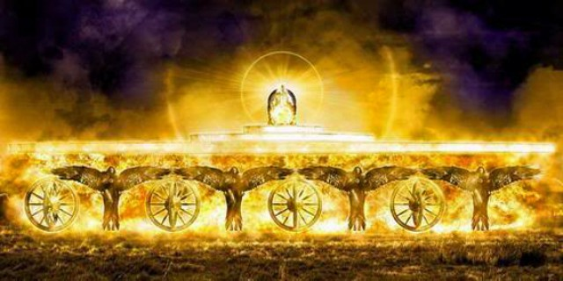
In God there is no moral or any other kind of corruption. From Him comes all separation from uncleanness and sin. Therefore, God does not like corruption. He dwells in holiness.
And Joshua said unto the people, Ye cannot serve the LORD: for he is an holy God; he is a jealous God; he will not forgive your transgressions nor your sins. Joshua 24:19.
Exalt the LORD our God, and worship at his holy hill; for the LORD our God is holy. Psalms 99:9
And one cried unto another, and said, Holy, holy, holy, is the LORD of hosts: the whole earth is full of his glory. Isaiah 6:3

Slide 5


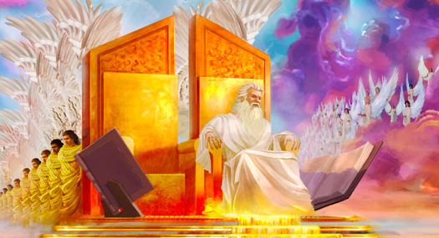
“He is the Rock, his work is perfect: for all his ways are judgment: a God of truth and without iniquity, just and right is he.” Deuteronomy 32:4
God knows how to give each one his due. He does not overlook wickedness and rewards the one who has done good.
God, in His dealings, shows no partiality; He does not mistreat others; perfectly execute revenge against the oppressors. God is just in the fulfillment of rewards and punishments.
Justice and righteousness, which always go hand in hand, are the foundation of God.
God judgeth the righteous, and God is angry with the wicked every day. Psalms 7:11
Therefore hath the Lord watched upon the evil, and brought it upon us: for the Lord our God is righteous in all his works which he doeth: for we obeyed not his voice. Daniel 9:14

Slide 6


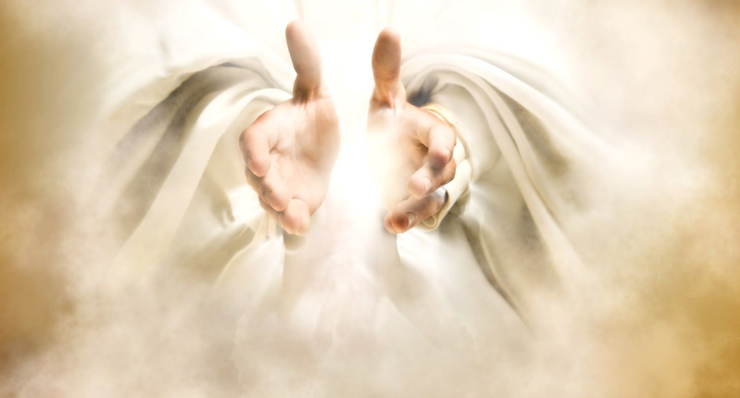
Know therefore that the LORD thy God, he is God, the faithful God, which keepeth covenant and mercy with them that love him and keep his commandments to a thousand generations. Deuteronomy 7:9
Because God is faithful, all His words and all His deeds are faithful. He is constant in his affections, in the fulfillment of his obligations and does not disappoint the trust placed in him. Because God is faithful, trustworthy, will not break His covenants, and He will honor His promise.
…yet he abideth faithful: he cannot deny himself.
2 Timothy 2:13
God is faithful, by whom ye were called unto the fellowship of his Son Jesus Christ our Lord.
1 Corinthians 1:9

Slide 7


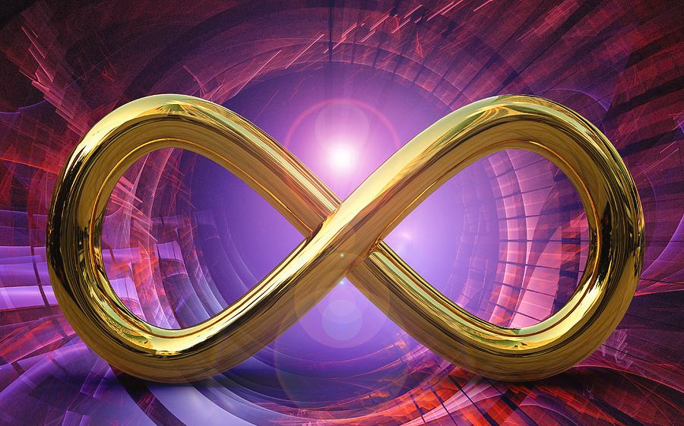
Hast thou not known? hast thou not heard, that the everlasting God, the LORD, the Creator of the ends of the earth, fainteth not, neither is weary? there is no searching of his understanding. Isaiah 40:28
God has no beginning and will have no end. He has existed forever and will exist for all eternity. God is not limited by time.
God was not created by anyone: He IS. When Moses asked God for his name, God replied, "I AM THAT I AM." That is the eternal name of God, and the name by which He is and will be known to all generations. A name that proclaims its eternity.
The eternal God is thy refuge, and underneath are the everlasting arms. Deuteronomy 33:27a
Before the mountains were brought forth, or ever thou hadst formed the earth and the world, even from everlasting to everlasting, thou art God. Psalms 90:2

Slide 8


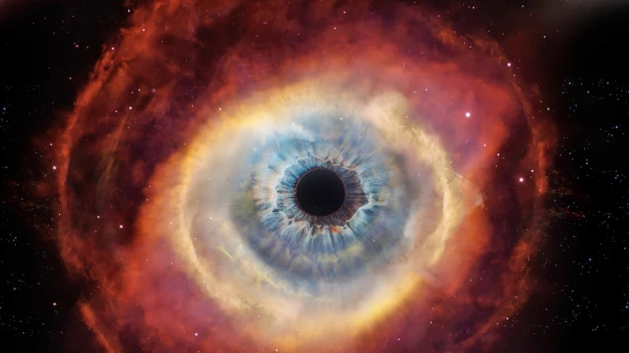
Neither is there any creature that is not manifest in his sight: but all things are naked and opened unto the eyes of him with whom we have to do. Hebrews 4:13
Thou knowest my downsitting and mine uprising, thou understandest my thought afar off. Thou compassest my path and my lying down, and art acquainted with all my ways. For there is not a word in my tongue, but, lo, O LORD, thou knowest it altogether. Thou hast beset me behind and before, and laid thine hand upon me. Such knowledge is too wonderful for me; it is high, I cannot attain unto it.
Psalms 139:2-6
God knows everything; he is aware of everything; and scrutinizes everything, regardless of whether it is past, present or future.
He knows our deepest thoughts and what is going to happen to us. He has knowledge of everything about every created being.
For if our heart condemn us, God is greater than our heart, and knoweth all things. 1 John 3:20

Slide 9


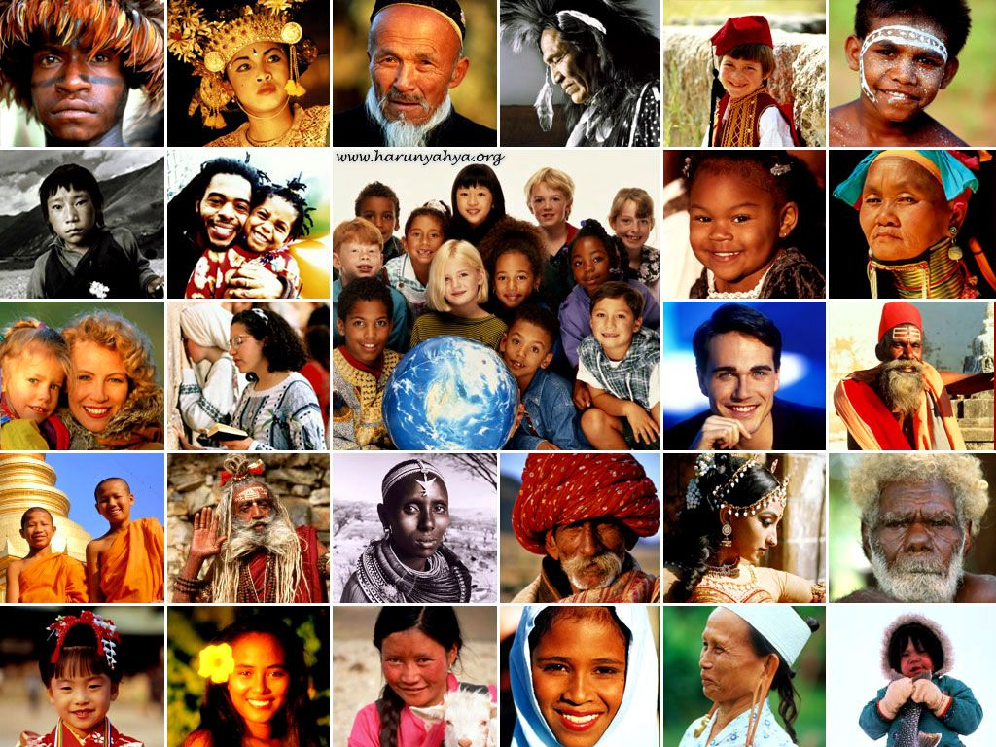
God is no respecter of persons; He has no favorites whom He benefits more than others. Each and every human being is equally the object of God's love. He bought us by the sacrifice of his Son.
And, ye masters, do the same things unto them, forbearing threatening: knowing that your Master also is in heaven; neither is there respect of persons with him. Ephesians 6:9
For the LORD your God is God of gods, and Lord of lords, a great God, a mighty, and a terrible, which regardeth not persons, nor taketh reward. Deuteronomy 10:17
Wherefore now let the fear of the LORD be upon you; take heed and do it: for there is no iniquity with the LORD our God, nor respect of persons, nor taking of gifts. 2 Chronicles 19:7

Slide 10


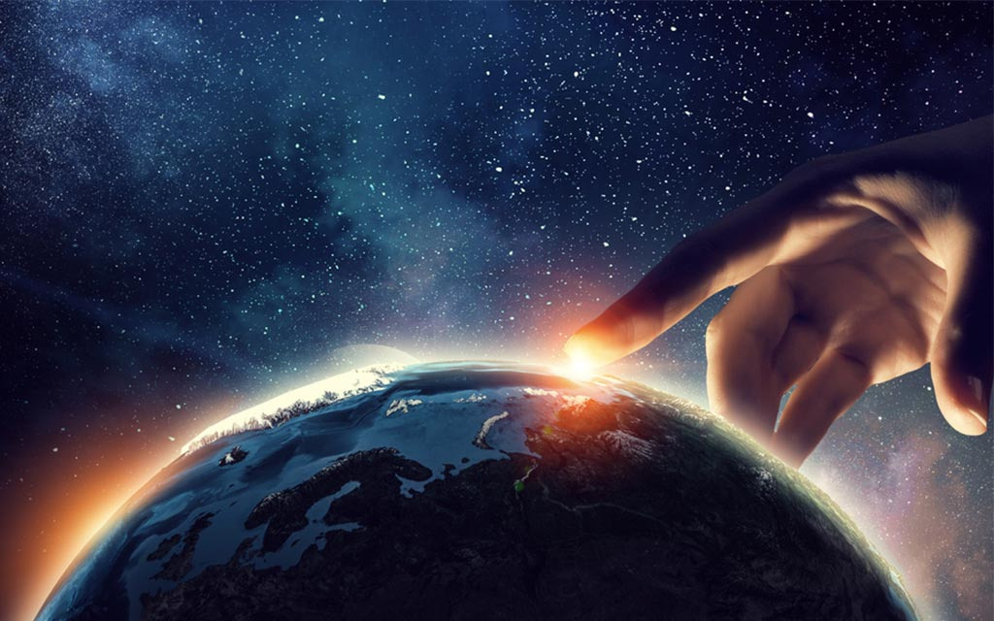
Whither shall I go from thy spirit? or whither shall I flee from thy presence? If I ascend up into heaven, thou art there: if I make my bed in hell, behold, thou art there. If I take the wings of the morning, and dwell in the uttermost parts of the sea; Even there shall thy hand lead me, and thy right hand shall hold me. If I say, Surely the darkness shall cover me; even the night shall be light about me. Yea, the darkness hideth not from thee; but the night shineth as the day: the darkness and the light are both alike to thee. For thou hast possessed my reins: thou hast covered me in my mother's womb.
Psalms 139:7-13.
God is present everywhere and at all times. He can be present at the same time with one person, and simultaneously with another. At the same time, it is present in every situation that occurs in all creation, at any given moment. God is present in all ranges of time and space.
Can any hide himself in secret places that I shall not see him? saith the LORD. Do not I fill heaven and earth? saith the LORD?
Jeremiah 23:24
For his eyes are upon the ways of man, and he seeth all his goings.
Job 34:21

Slide 11


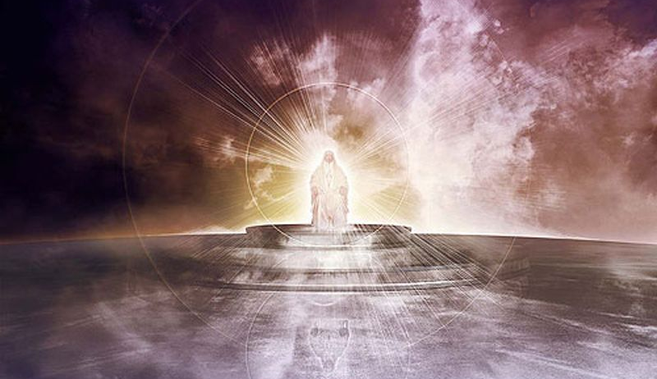
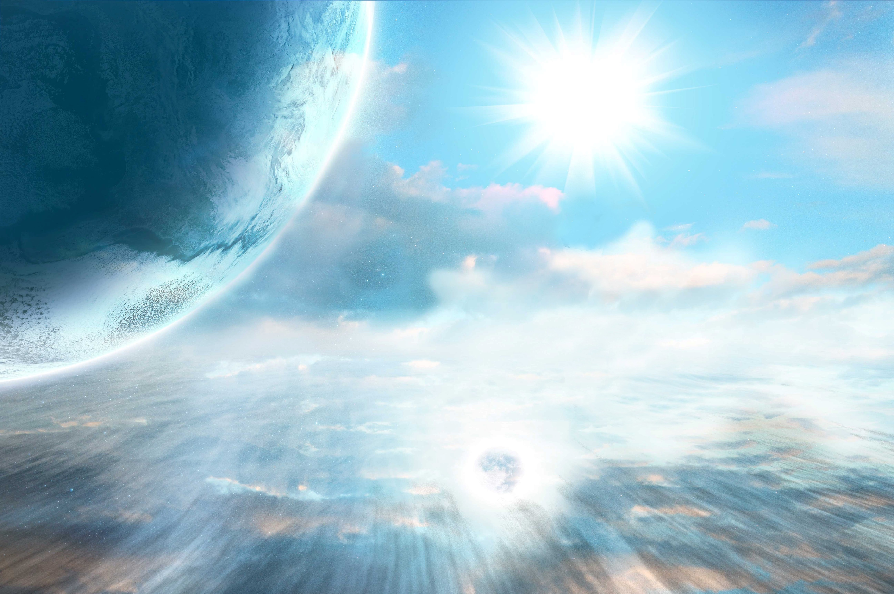
Only God has life without end. He has no chance of dying. His life cannot cease, it cannot end. Death has no power over Him, nor can He be annihilated.
That is, only God inherently possesses eternal life.
Now unto the King eternal, immortal, invisible, the only wise God, be honour and glory for ever and ever. Amen.” 1 Timothy 1:17
Who only hath immortality, dwelling in the light which no man can approach unto; whom no man hath seen, nor can see: to whom be honour and power everlasting. Amen. 1 Timothy 6:16

Slide 12



And I heard as it were the voice of a great multitude, and as the voice of many waters, and as the voice of mighty thunderings, saying, Alleluia: for the Lord God omnipotent reigneth.
Revelation 19:6
And when Abram was ninety years old and nine, the LORD appeared to Abram, and said unto him, I am the Almighty God; walk before me, and be thou perfect. Genesis 17:1
God can do all things. There is nothing God cannot do! God's power is unlimited in every aspect and never ends. For this reason, God can do what He wants at the time and in the way He wants.
He that dwelleth in the secret place of the most High shall abide under the shadow of the Almighty. Psalms 91:1

Slide 13


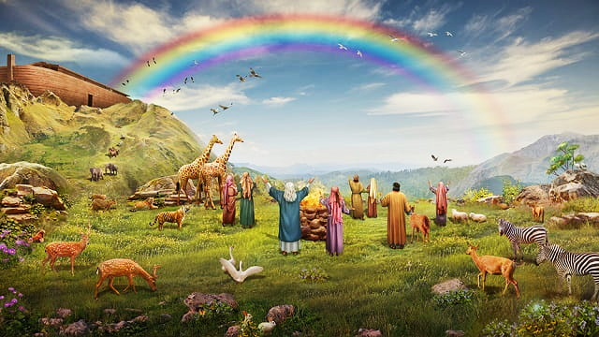
God does not change and cannot change. Unlike human beings, God gives us the assurance of always being the same.
Because God does not change, neither does He change His way of thinking, nor His will, nor His nature, nor His law.
For I am the LORD, I change not.
Malachi 3:6a
The counsel of the LORD standeth for ever, the thoughts of his heart to all generations.
Psalms 33:11
God is not a man, that he should lie; neither the son of man, that he should repent: hath he said, and shall he not do it? or hath he spoken, and shall he not make it good? Numbers 23:19
Every good gift and every perfect gift is from above, and cometh down from the Father of lights, with whom is no variableness, neither shadow of turning. James 1:17

Slide 14



For the mountains shall depart, and the hills be removed; but my kindness shall not depart from thee, neither shall the covenant of my peace be removed, saith the LORD that hath mercy on thee.
Isaiah 54:10
But God, who is rich in mercy, for his great love wherewith he loved us, Even when we were dead in sins, hath quickened us together with Christ, (by grace ye are saved. Ephesians 2:4-5
God has compassion, kindness, and sympathy for mankind.
God does not punish us for being sinners, but shows us His grace and His forgiveness.
It is of the LORD'S mercies that we are not consumed, because his compassions fail not. Lamentations 3:22
The LORD your God is gracious and merciful, and will not turn away his face from you, if ye return unto him.
2 Chronicles 30:9b
For thou, Lord, art good, and ready to forgive; and plenteous in mercy unto all them that call upon thee.
Psalms 86:5

Slide 15


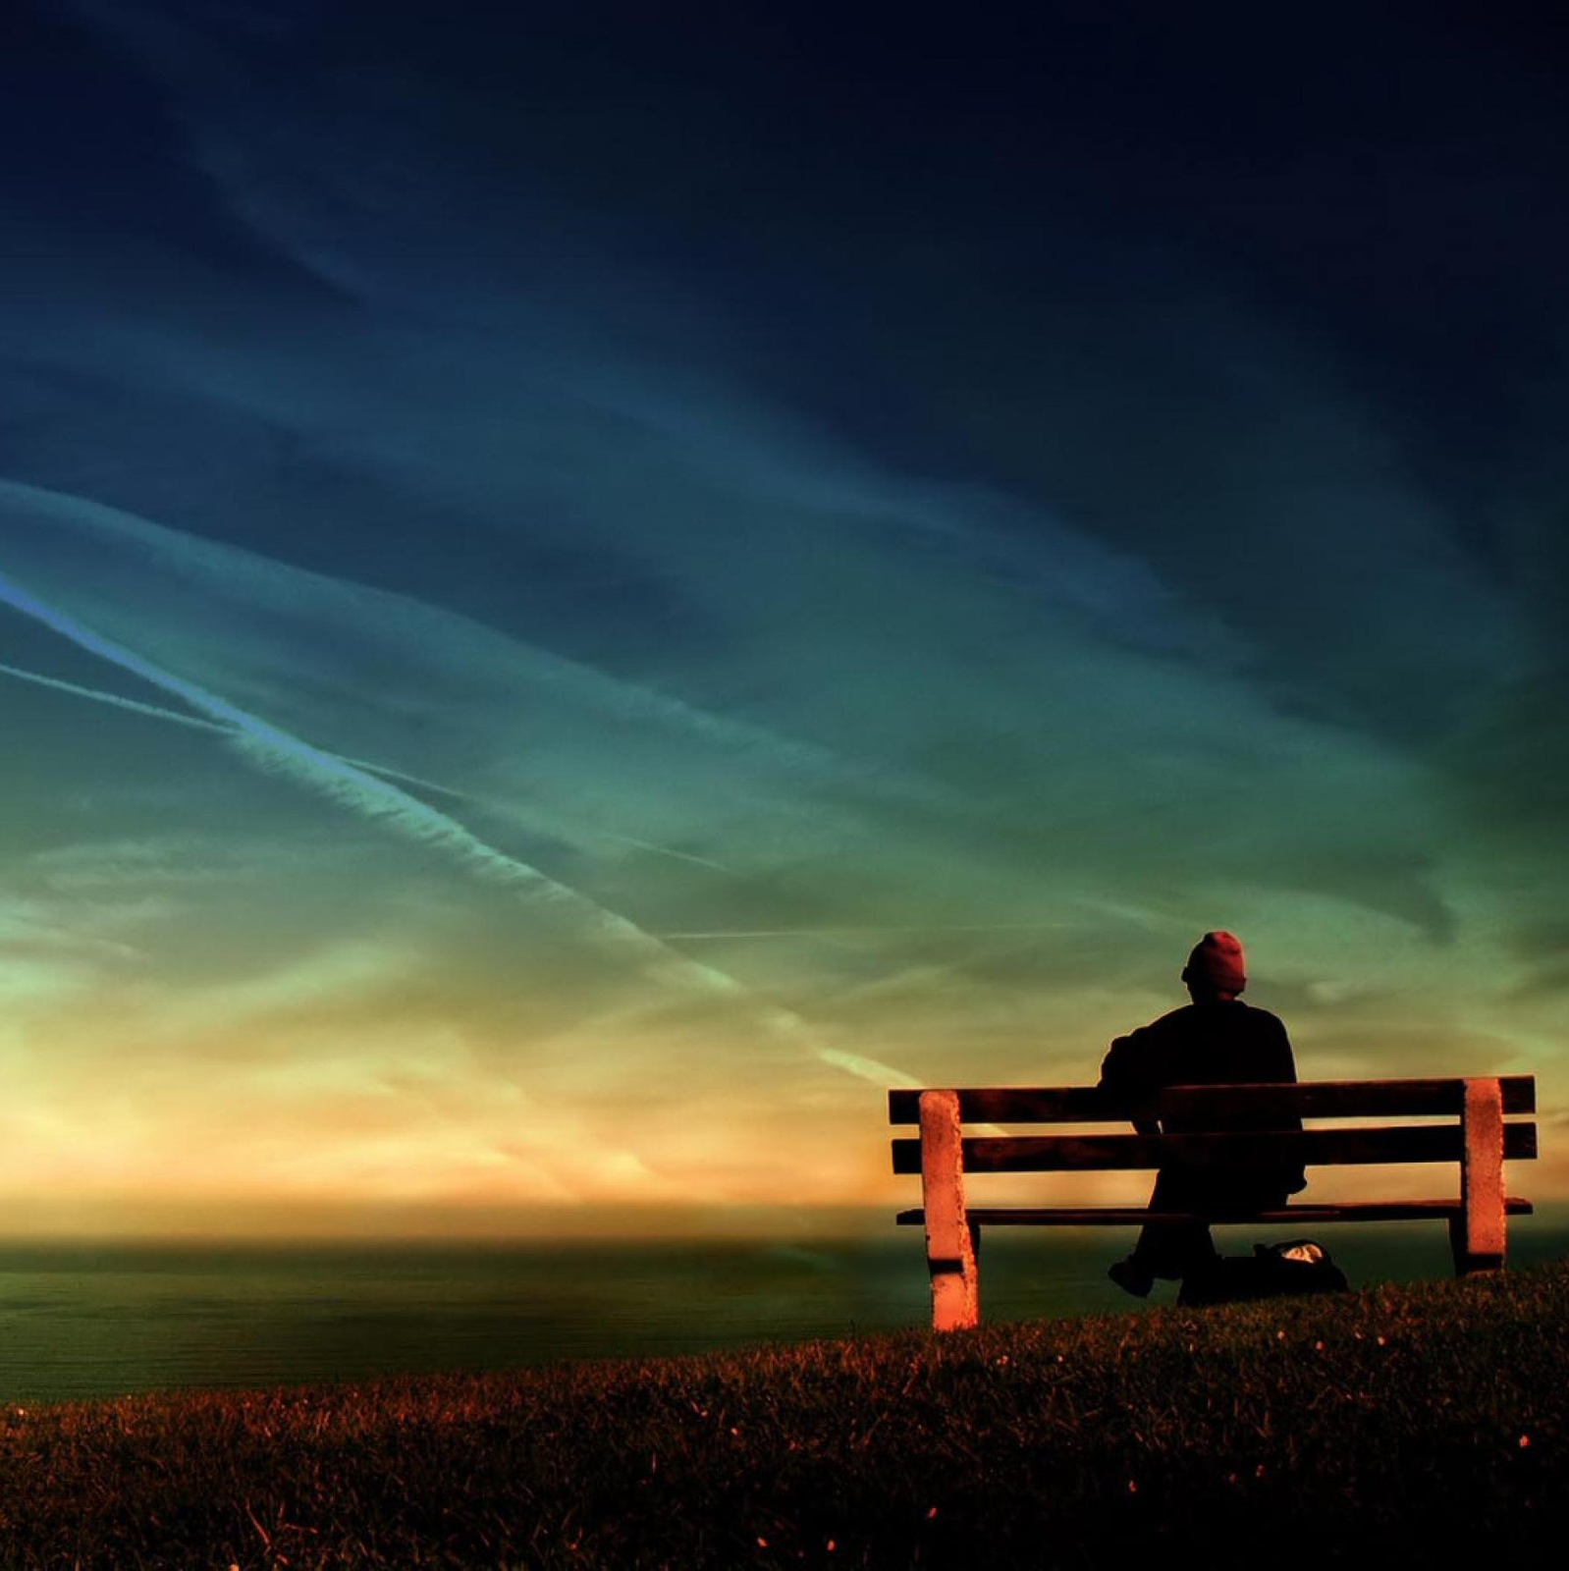
Great is the LORD, and greatly to be praised; and his greatness is unsearchable.
Psalms 145:3
This is an awesome characteristic of God. He is not someone we can know, define, describe, let alone fully understand.
Which doeth great things and unsearchable; marvellous things without number.
Job 5:9
O the depth of the riches both of the wisdom and knowledge of God! how unsearchable are his judgments, and his ways past finding out! Romans 11:33

Slide 16


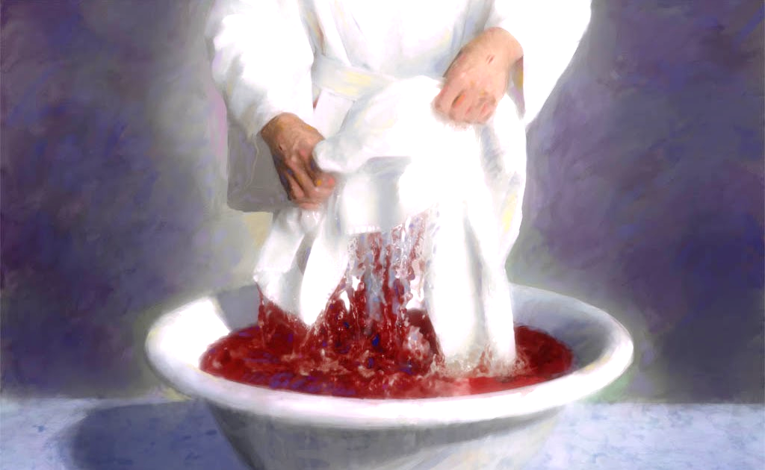
By His own will and in perfect accord with His holiness and justice, God chooses to blot out the sin of His beloved elect. For this reason, we are declared holy and blameless before Him through the precious blood of Jesus.
Who is a God like unto thee, that pardoneth iniquity, and passeth by the transgression of the remnant of his heritage? he retaineth not his anger for ever, because he delighteth in mercy. He will turn again, he will have compassion upon us; he will subdue our iniquities; and thou wilt cast all their sins into the depths of the sea. Micah 7:18-19
Come now, and let us reason together, saith the LORD: though your sins be as scarlet, they shall be as white as snow; though they be red like crimson, they shall be as wool. Isaiah 1:18
For thou, Lord, art good, and ready to forgive; and plenteous in mercy unto all them that call upon thee.
Psalms 86:5
Thou answeredst them, O LORD our God: thou wast a God that forgavest them, though thou tookest vengeance of their inventions. Psalms 99:8

Slide 17


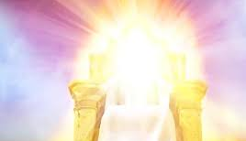
In our attempt to understand God, we must start from the basis that there is nothing and no one to which we can compare to Him. God is above all, He is sovereign over everything and He is the judge of all.
To whom then will ye liken me, or shall I be equal? saith the Holy One. Lift up your eyes on high, and behold who hath created these things, that bringeth out their host by number: he calleth them all by names by the greatness of his might, for that he is strong in power; not one faileth. Isaiah 40:25-26
For who in the heaven can be compared unto the LORD? who among the sons of the mighty can be likened unto the LORD? God is greatly to be feared in the assembly of the saints, and to be had in reverence of all them that are about him. O LORD God of hosts, who is a strong LORD like unto thee? or to thy faithfulness round about thee? Psalms 89:6-8
Remember the former things of old: for I am God, and there is none else; I am God, and there is none like me. Isaiah 46:9

Slide 18



Or despisest thou the riches of his goodness and forbearance and longsuffering; not knowing that the goodness of God leadeth thee to repentance? Romans 2:4
And therefore will the LORD wait, that he may be gracious unto you, and therefore will he be exalted, that he may have mercy upon you: for the LORD is a God of judgment: blessed are all they that wait for him. Isaiah 30:18
God doesn't get angry quickly. Instead, He waits patiently, giving people a chance to turn from their evil ways. He is patient with you when it comes to your sanctification and your relationship with him and with others.
The Lord is not slack concerning his promise, as some men count slackness; but is longsuffering to us-ward, not willing that any should perish, but that all should come to repentance.
2 Peter 3:9
And the LORD passed by before him, and proclaimed, The LORD, The LORD God, merciful and gracious, longsuffering, and abundant in goodness and truth. Exodus 34:6

Slide 19



The root of this word means "to blush very intensely" because of a deep emotion such as love, jealousy, or anger.
Only God is worthy of worship. He does not tolerate the worship of anyone but Himself. God refuses to share His glory with idols. The worship and service of a divided heart, He declines.
Thou shalt not make unto thee any graven image, or any likeness of any thing that is in heaven above, or that is in the earth beneath, or that is in the water under the earth: Thou shalt not bow down thyself to them, nor serve them: for I the LORD thy God am a jealous God, visiting the iniquity of the fathers upon the children unto the third and fourth generation of them that hate me; And shewing mercy unto thousands of them that love me, and keep my commandments. Exodus 20:4-6
For thou shalt worship no other god: for the LORD, whose name is Jealous, is a jealous God.
Exodus 34:14
For they provoked him to anger with their high places, and moved him to jealousy with their graven images. Psalms 78:58

Slide 20


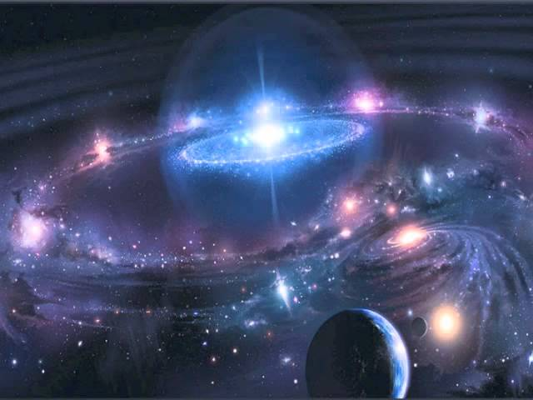
In the beginning God created the heaven and the earth. Genesis 1:1
Happy is he that hath the God of Jacob for his help, whose hope is in the LORD his God: Which made heaven, and earth, the sea, and all that therein is: which keepeth truth for ever. Psalms 146:5-6
For, behold, I create new heavens and a new earth: and the former shall not be remembered, nor come into mind. Isaiah 65:17
Through His wisdom and perfect knowledge, God has shaped all that exists to reflect His glory.
Thou, even thou, art LORD alone; thou hast made heaven, the heaven of heavens, with all their host, the earth, and all things that are therein, the seas, and all that is therein, and thou preservest them all; and the host of heaven worshippeth thee. Nehemiah 9:6
Know ye that the LORD he is God: it is he that hath made us, and not we ourselves; we are his people, and the sheep of his pasture. Psalms 100:3
Thus saith God the LORD, he that created the heavens, and stretched them out; he that spread forth the earth, and that which cometh out of it; he that giveth breath unto the people upon it, and spirit to them that walk therein. Isaiah 42:5

Slide 21


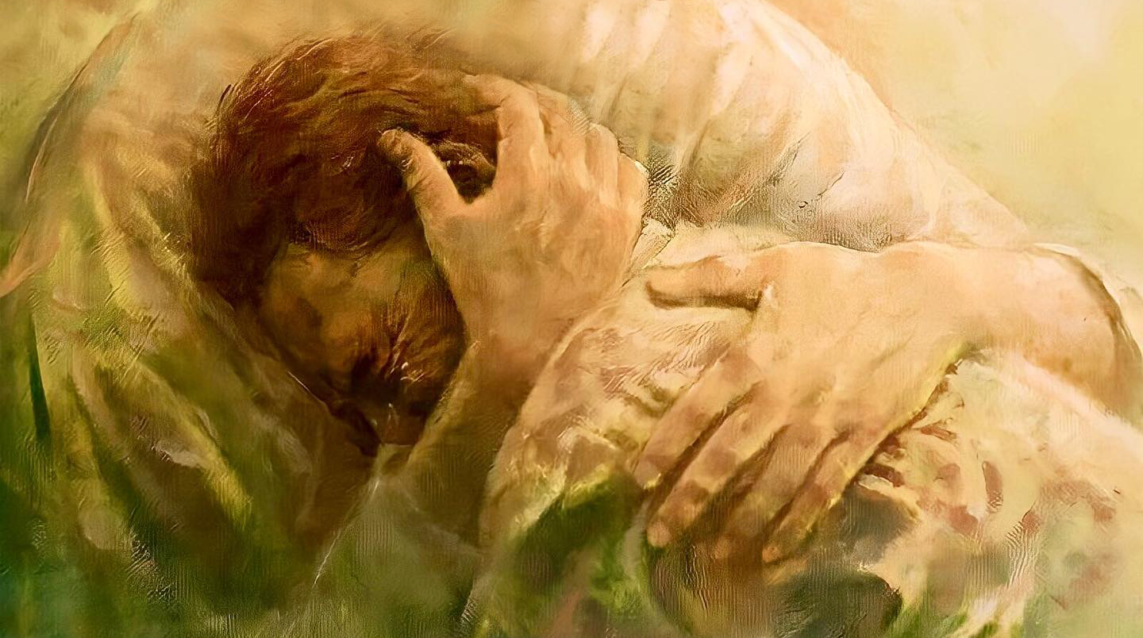
God relieves our sorrows and afflictions. When we feel sad or troubled, we ask Him to comfort us. He will do it by giving us peace, tranquility and everything we need.
Blessed be God, even the Father of our Lord Jesus Christ, the Father of mercies, and the God of all comfort; Who comforteth us in all our tribulation, that we may be able to comfort them which are in any trouble, by the comfort wherewith we ourselves are comforted of God. 2 Corinthians 1:3-4
I, even I, am he that comforteth you: who art thou, that thou shouldest be afraid of a man that shall die, and of the son of man which shall be made as grass;
And forgettest the LORD thy maker, that hath stretched forth the heavens, and laid the foundations of the earth... The captive exile hasteneth that he may be loosed, and that he should not die in the pit, nor that his bread should fail. But I am the LORD thy God, that divided the sea, whose waves roared: The LORD of hosts is his name. Isaiah 51:12-15
I have seen his ways, and will heal him: I will lead him also, and restore comforts unto him and to his mourners.
Isaiah 57:18
In the multitude of my thoughts within me thy comforts delight my soul. Psalms 94:19

Slide 22


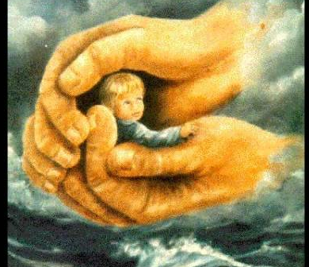
God compares Himself to a shepherd who cares for His sheep, including their protection against enemies and against internal or external dangers.
The LORD is good, a strong hold in the day of trouble; and he knoweth them that trust in him.
Nahum 1:7
Every word of God is pure: he is a shield unto them that put their trust in him.
Proverbs 30:5
There is none holy as the LORD: for there is none beside thee: neither is there any rock like our God 1 Samuel 2:2
But thou, O LORD, art a shield for me; my glory, and the lifter up of mine head. Psalms 3:3

Slide 23



The Hebrew word for "peace" is Shalom, which means peace, tranquility, and security. God shows this attribute by establishing a peace treaty with us, His enemies. By believing in Jesus, we have been reconciled to God through the blood of Jesus Christ. We can rest, confident that He is our peace and there is nothing to fear.
Thou wilt keep him in perfect peace, whose mind is stayed on thee: because he trusteth in thee. Isaiah 26:3
And the peace of God, which passeth all understanding, shall keep your hearts and minds through Christ Jesus. Philippians 4:7
Now the Lord of peace himself give you peace always by all means. The Lord be with you all.
2 Thessalonians 3:16

Slide 24


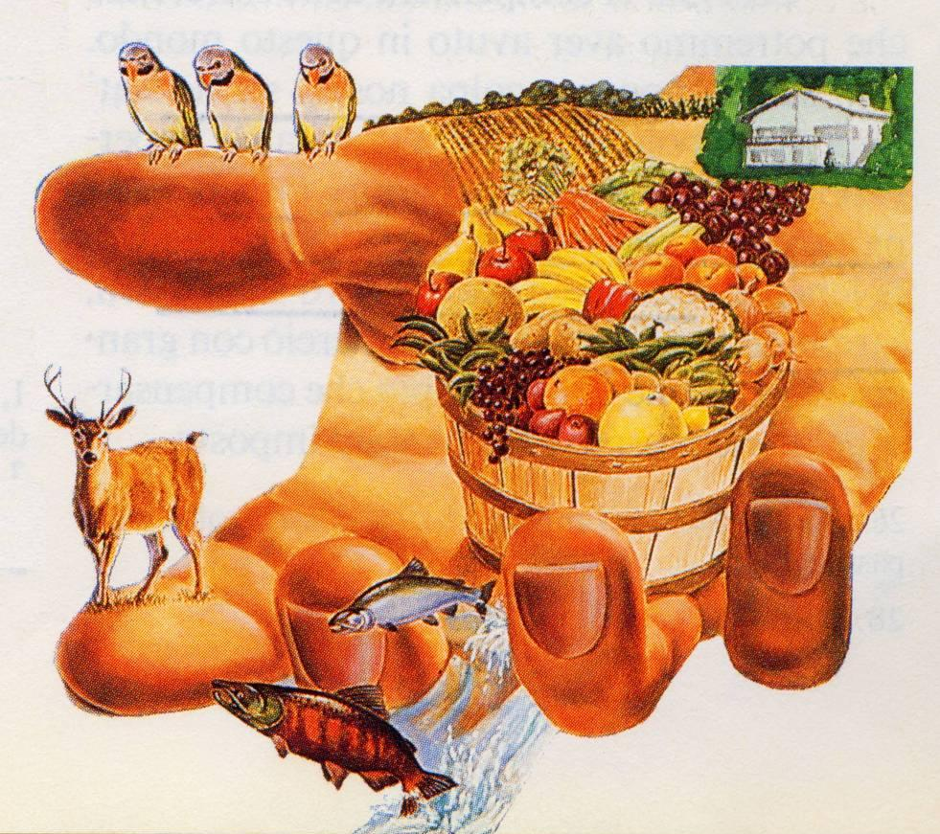
And God is able to make all grace abound toward you; that ye, always having all sufficiency in all things, may abound to every good work.
2 Corinthians 9:8
But my God shall supply all your need according to his riches in glory by Christ Jesus. Philippians 4:19
God knows what we need both materially and spiritually and has foreseen all our needs.
It has provided us with what we needed in the past and will also do so in the present and in the future. God is willing to meet all the needs of His loved ones. Ask Him, He will give you what you need.
Thou openest thine hand, and satisfiest the desire of every living thing.
Psalms 145:16
He that spared not his own Son, but delivered him up for us all, how shall he not with him also freely give us all things? Romans 8:32

Slide 25


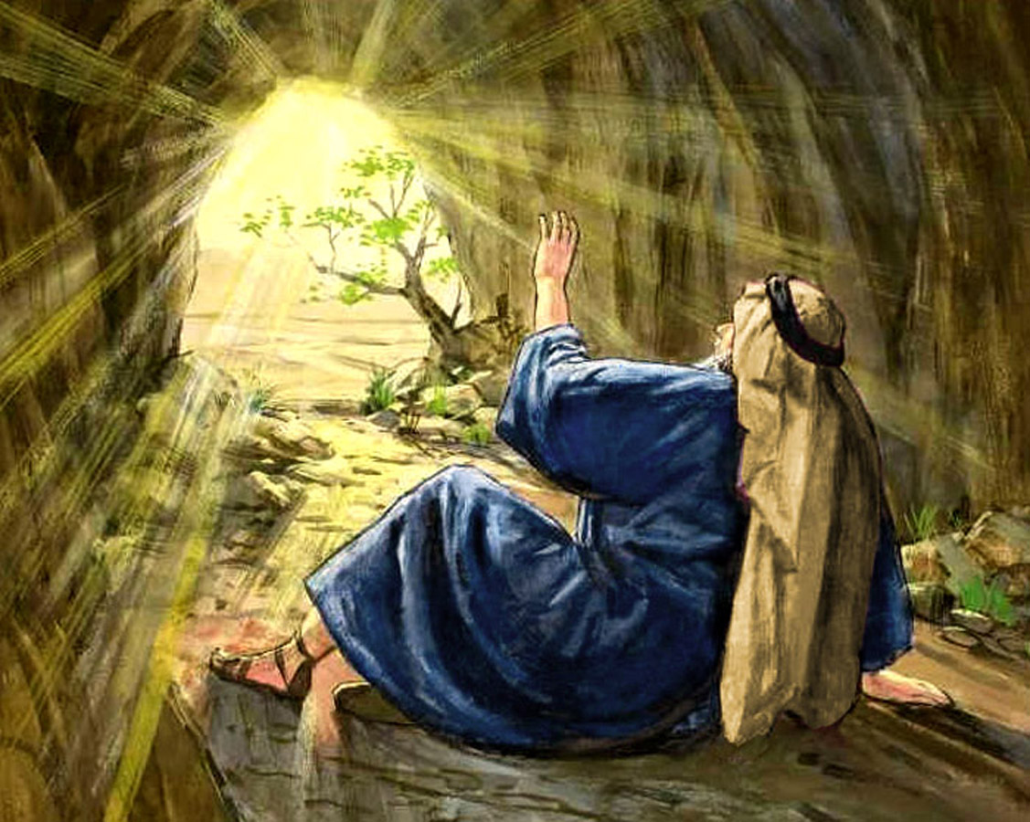
The LORD is merciful and gracious, slow to anger, and plenteous in mercy. He will not always chide: neither will he keep his anger for ever. He hath not dealt with us after our sins; nor rewarded us according to our iniquities. Psalms 103:8-10
The essence of God is to be kind, tender, sweet, gentle in conversation, and cordial in dealings.
God is pleasant, kind, and approachable in dealing with us, even if we don't deserve it.
And after the earthquake a fire; but the LORD was not in the fire, but the LORD was not in the fire: and after the fire a still small voice… And, behold, there came a voice unto him, and said, What doest thou here, Elijah? 1 Kings 19:12-13
They shall abundantly utter the memory of thy great goodness, and shall sing of thy righteousness.
Psalms 145:7
I had fainted, unless I had believed to see the goodness of the LORD in the land of the living. Psalms 27:13.

Slide 26
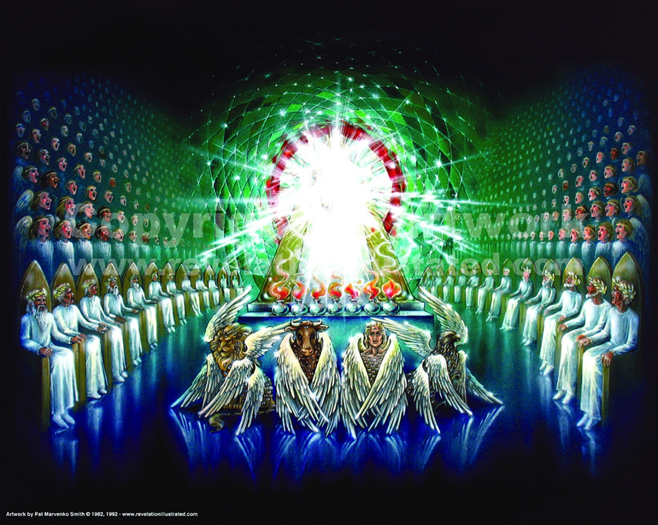
The word of God, like the character of its divine Author, presents mysteries that can never be fully comprehended by finite beings. The entrance of sin into the world, the incarnation of Christ, regeneration, the resurrection, and many other subjects presented in the Bible, are mysteries too deep for the human mind to explain, or even fully to comprehend. But we have no reason to doubt God's word because we cannot understand the mysteries of His providence. In the natural world we are constantly surrounded with mysteries that we cannot fathom. The very humblest forms of life present a problem that the wisest of philosophers is powerless to explain. Everywhere are wonders beyond our ken. Should we then be surprised to find that in the spiritual world also there are mysteries that we cannot fathom? The difficulty lies solely in the weakness and narrowness of the human mind. God has given us in the Scriptures sufficient evidence of their divine character, and we are not to doubt His word because we cannot understand all the mysteries of His providence. SC 106
Keep discovering the wonderful God we have.

