Slide 1
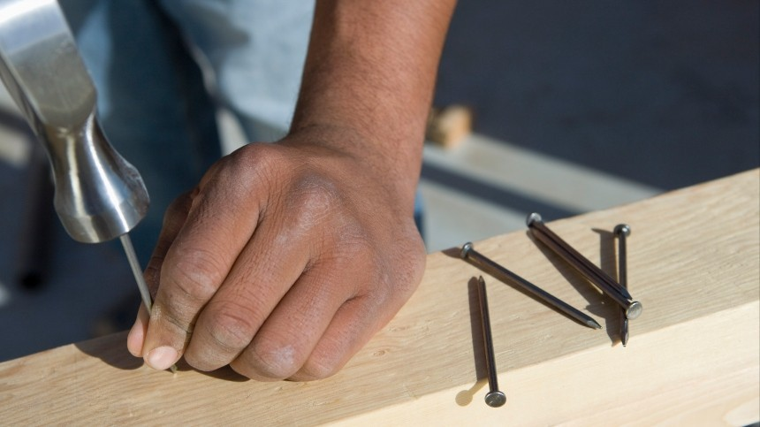
LESSONS FROM A NAIL

Slide 2
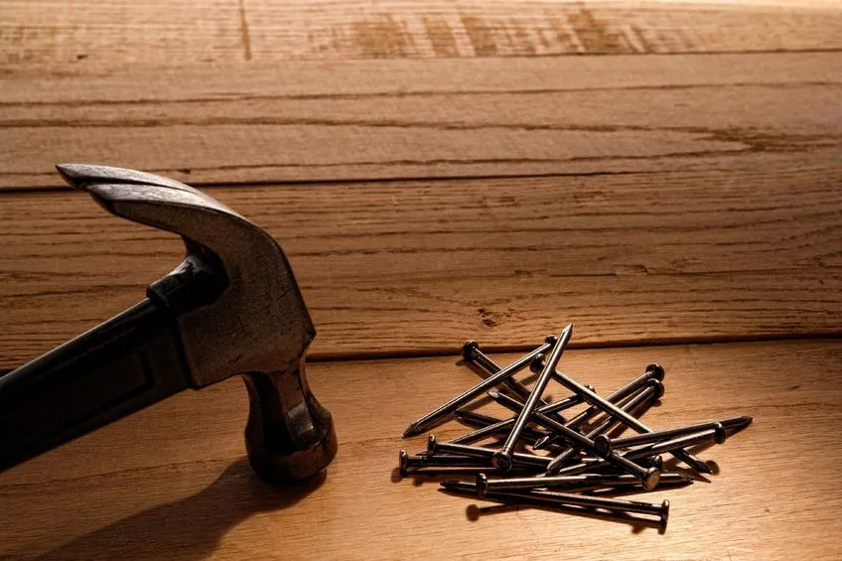
Surely, on some occasion you have had to use a nail, or you have seen how someone has used it. Thanks to nails, we can have well-fitted furniture, well-built houses, etc.
What happens when the nail bends? What if it is rusty?
Our Christian life has certain similarities to nails. Let's look at some of them.

Slide 3



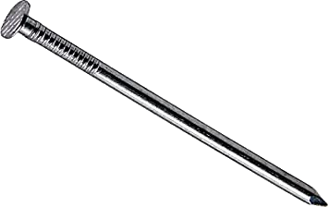
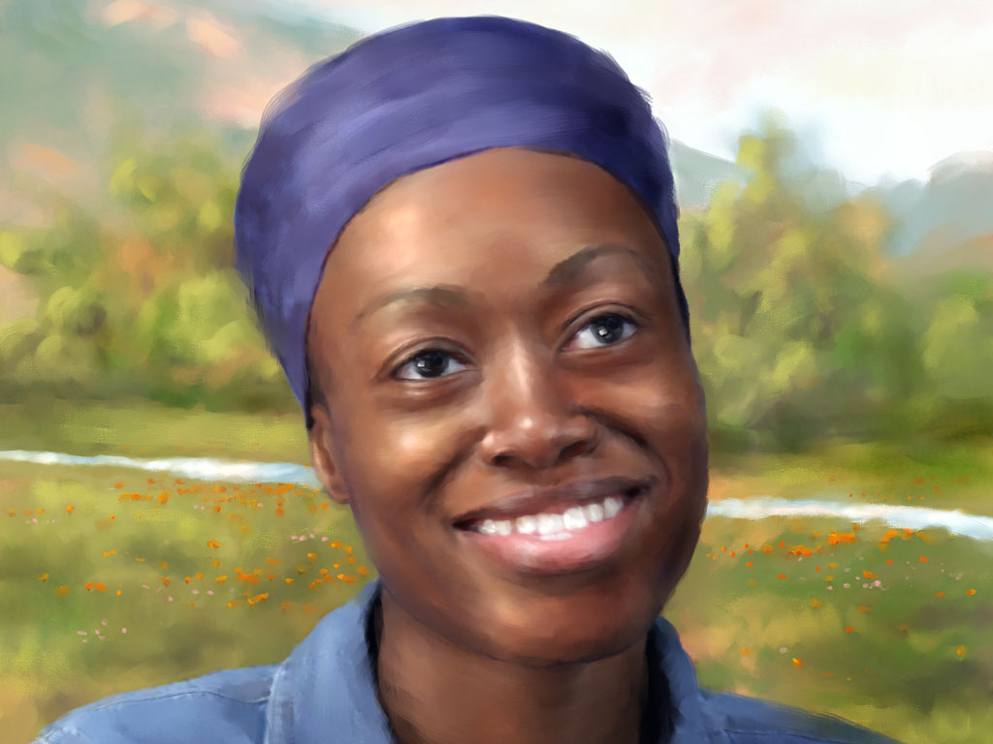
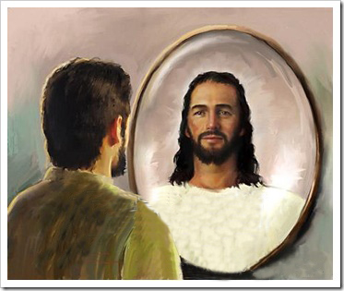
First lesson
A NAIL MUST BE CLEAN
We all like to have a clean house, a clean kitchen, a clean room. When everything is clean it makes us feel good. In the case of the nail, it must be clean so that it can be used and that it is easily inserted into place, because when it is dirty, it rusts, becomes ugly and does not work.
To be clean is to have purity of heart. All who will dwell in the city of God will have become here clean and pure in heart. As you learn from Jesus, there will be a growing repugnance for careless habits, vulgar language, and impure thoughts. When Christ lives in the heart, there will be cleanliness and culture in thought and manners. Moreover, those who are pure in heart are free from sensuality and lust and are faithful in the thoughts and motives of the soul, free from pride and self-love; humble, generous and are like children.
The pure in heart see God in a new and attractive aspect, as their Redeemer; As they discern the purity and beauty of His character, they long to reflect His image. To them He is a Father who longs to embrace a repentant son; and their hearts overflow with joy unspeakable and full glory. The pure in heart perceive the Creator in the works of His mighty hand, in the works of beauty that make up the universe. In His written Word they see even more clearly the revelation of His mercy, His goodness and His grace. The pure in heart live as in the presence of God during the days that He grants them here on earth and will see Him face to face in the future and immortal state, just as Adam did when he walked and talked with Him in Eden. "For now we see through a glass, darkly; but then face to face." 1 Corinthians 13:12

Slide 4



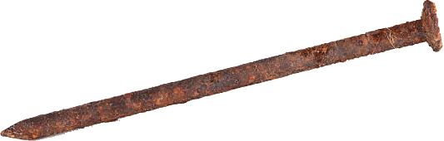
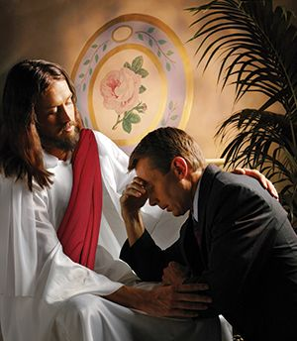
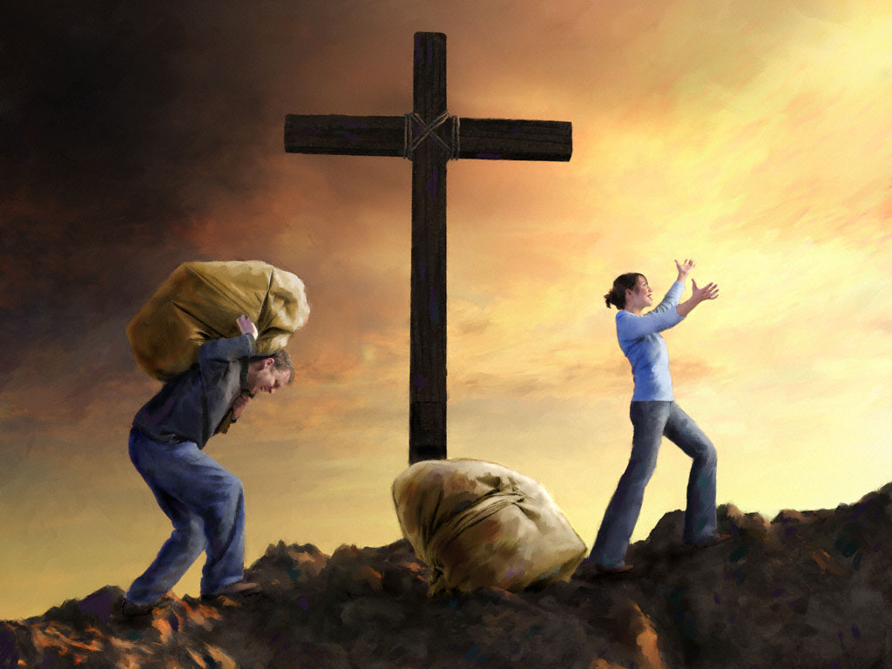
Second lesson
A NAIL SHOULD NOT BE RUSTY
If a nail is rusty, that will make it resist entering the wood, or wherever we want to insert it. And if it enters, it soils everything around it.
We can compare tartar to sin that sticks to us. If you err, say so in prayer to Christ. The virtue that comes out of Christ will lead you to genuine repentance. In addition to helping, you repent; it will give you forgiveness and implant enmity against sin in your heart.
David's prayer after his fall illustrates the nature of true sorrow for sin. His repentance was sincere and profound. He made no effort to mitigate his guilt; No desire to escape the judgment that threatened him inspired his prayer. David saw the enormity of his transgression; he saw the stains of his soul; he hated his sin. He pleaded not only for forgiveness, but also for purity of heart. He desired to have the joy of holiness: to be restored to harmony and communion with God. This was the language of his soul:
“Blessed is he whose transgression is forgiven, whose sin is covered. Blessed is the man unto whom the Lord imputeth not iniquity, and in whose spirit there is no guile.” Psalm 32:1-2
“Have mercy upon me, O God, according to thy lovingkindness: according unto the multitude of thy tender mercies blot out my transgressions....
For I acknowledge my transgressions: and my sin is ever before me... Purge me with hyssop, and I shall be clean: wash me, and I shall be whiter than snow...
Create in me a clean heart, O God; and renew a right spirit within me. Cast me not away from thy presence; and take not thy holy spirit from me. Restore unto me the joy of thy salvation; and uphold me with thy free spirit…”. Psalm 51

Slide 5



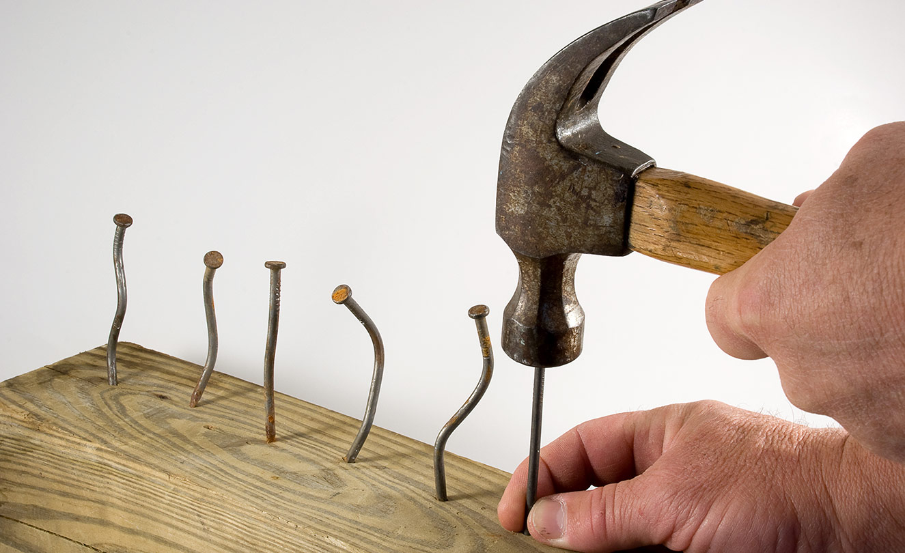
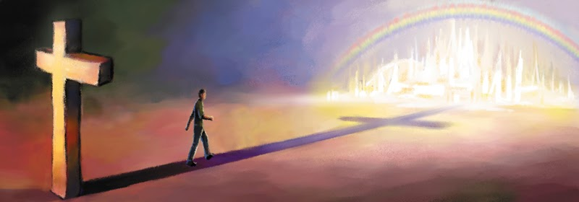

Third Lesson
A NAIL MUST BE STRAIGHT
If it is bent, it is not good for much, unless it can be straightened. Our character must remain upright and firm, without duplicity. Many times, we see that our character is twisted, that it needs to be straightened.
This is what happens in our lives when we want to modify our character. By our own efforts we cannot achieve it, we need to let the Holy Spirit transform us.
Wrongs cannot be righted, nor can reformations in character be made, by a few feeble, intermittent efforts… The struggle for conquest over self, for holiness and heaven, is a lifelong struggle. Without continual effort and constant activity there can be no advancement in the divine life, no attainment of the victor's crown RC 291
The change we need is a change of heart and can only be obtained by seeking God individually for His blessing, by pleading with Him for His power, by fervently praying that His grace may come upon us, and that our characters may be transformed. This is the change we need today, and for the attainment of this experience we should exercise persevering energy and manifest heartfelt earnestness. We should ask with true sincerity, “What shall I do to be saved?” We should know just what steps we are taking heavenward.—(Selected Messages 1:187. Pr 94)

Slide 6



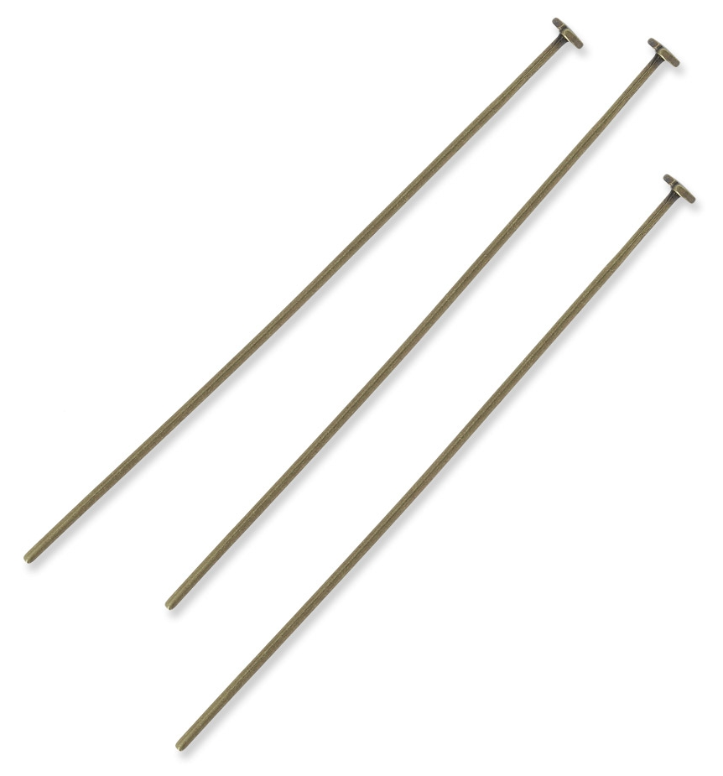
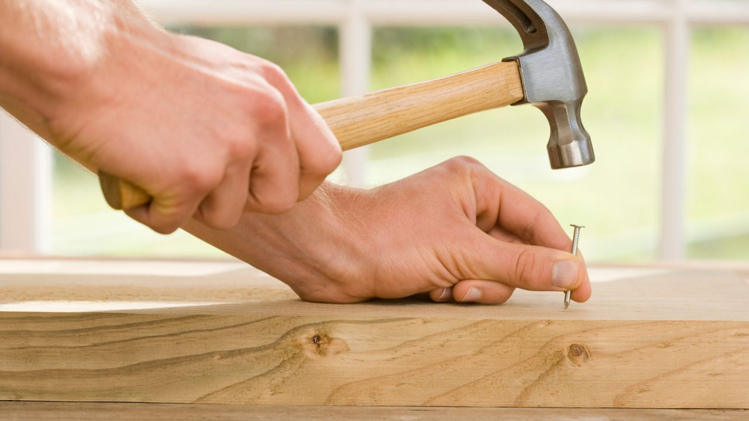
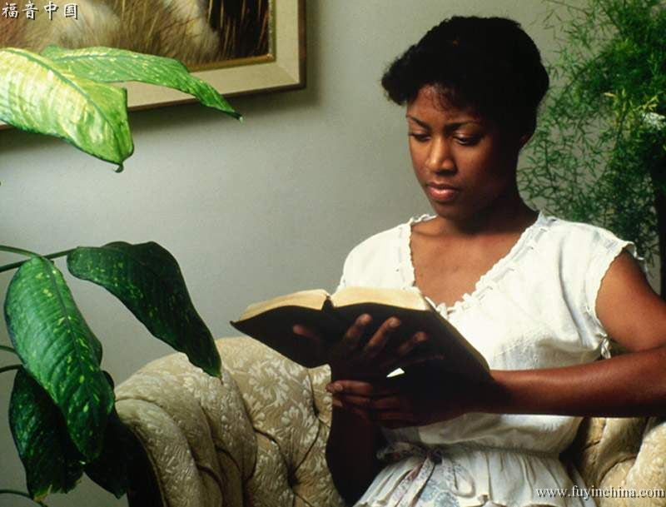
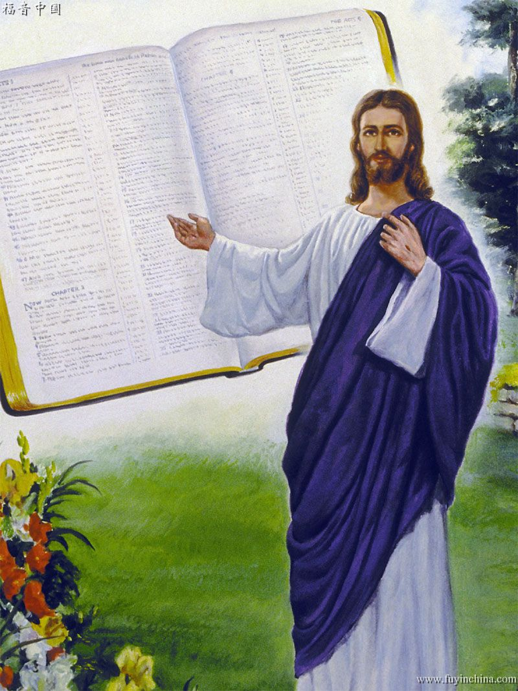
Fourth Lesson
A NAIL SHOULD BE POINTED
The tip serves to make the nail easier to insert and to guide the entire nail. The Bible should be the one to guide your life on this earth, study it.
No other book is so potent to elevate the thoughts, to give vigor to the faculties, as the broad, ennobling truths of the Bible. If God's word were studied as it should be, men would have a breadth of mind, a nobility of character, and a stability of purpose rarely seen in these times... Keep your Bible with you. As you have opportunity, read it; fix the texts in your memory. Even while you are walking the streets you may read a passage and meditate upon it, thus fixing it in the mind... SC 90
Said Christ: “Search the Scriptures; for in them ye think ye have eternal life: and they are they which testify of Me.” The Bible is an unerring guide. It demands perfect purity in word, in thought, and in action. Only virtuous and spotless characters will be permitted to enter the presence of a pure and holy God. The word of God, if studied and obeyed, would lead the children of men, as the Israelites were led by a pillar of fire by night and a pillar of cloud by day. The Bible is God's will expressed to man. It is the only perfect standard of character, and marks out the duty of man in every circumstance of life 4T 312.2. 1JT 512.3

Slide 7



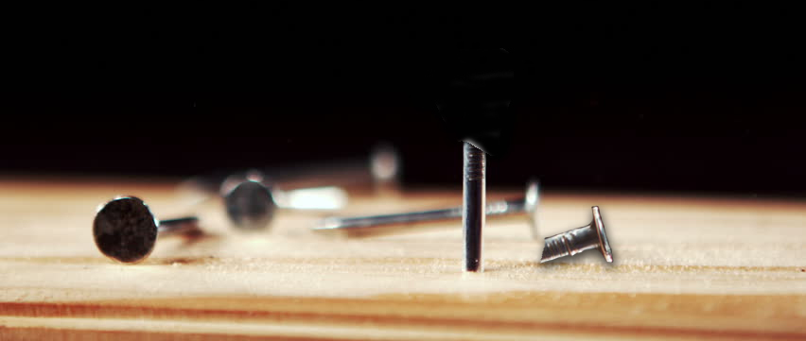
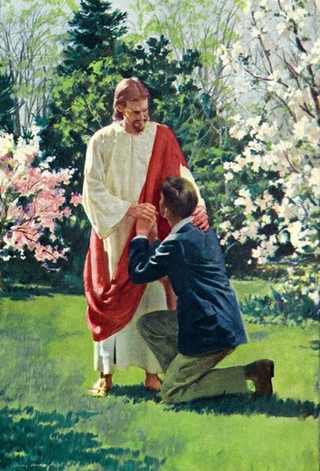
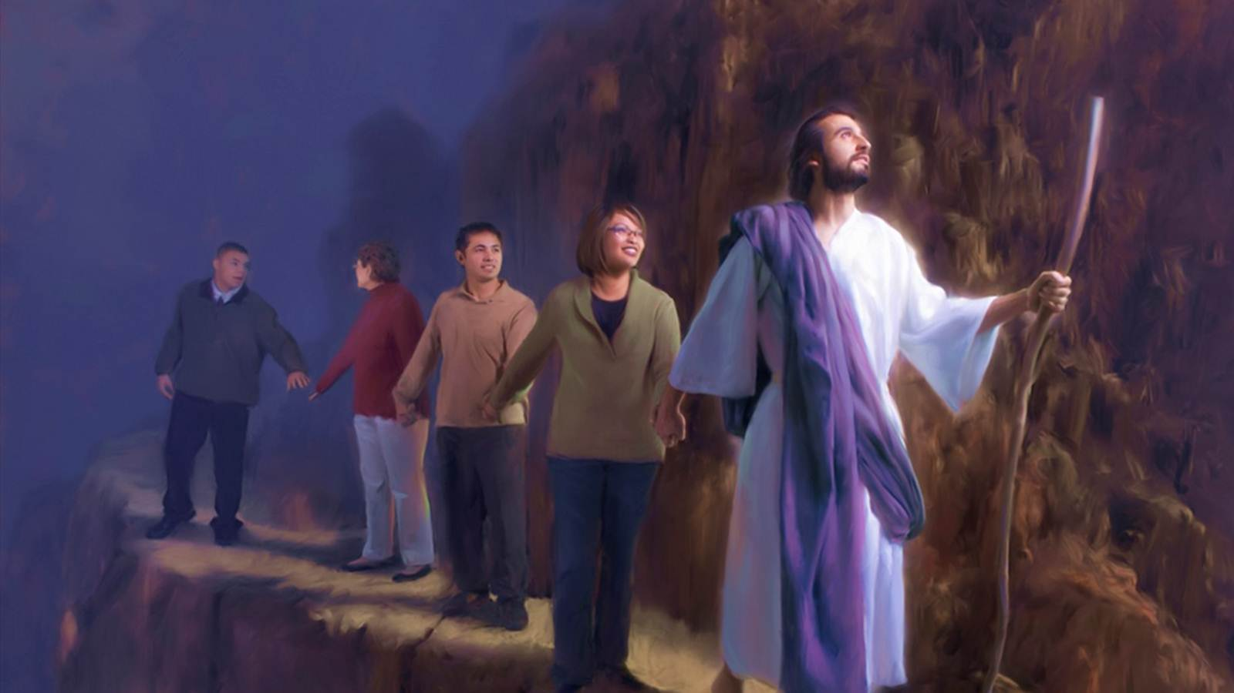
Fifth Lesson
A NAIL SHOULD NOT BREAK
A nail should not break. If it is broken, it no longer fulfills its mission.
You're broken when you're divided, wanting to serve God and the world, or when you want to earn salvation for yourself.
In giving ourselves to God, we must necessarily give up all that would separate us from Him. Hence the Saviour says, “Whosoever he be of you that forsaketh not all that he hath, he cannot be My disciple.” Luke 14:33. Whatever shall draw away the heart from God must be given up. Mammon is the idol of many. The love of money, the desire for wealth, is the golden chain that binds them to Satan. Reputation and worldly honor are worshiped by another class. The life of selfish ease and freedom from responsibility is the idol of others. But these slavish bands must be broken. We cannot be half the Lord's and half the world's. We are not God's children unless we are such entirely. SC 44
There are those who profess to serve God, while they rely upon their own efforts to obey His law, to form a right character, and secure salvation. Their hearts are not moved by any deep sense of the love of Christ, but they seek to perform the duties of the Christian life as that which God requires of them in order to gain heaven. Such religion is worth nothing. When Christ dwells in the heart, the soul will be so filled with His love, with the joy of communion with Him, that it will cleave to Him; and in the contemplation of Him, self will be forgotten. Love to Christ will be the spring of action SC 44

Slide 8



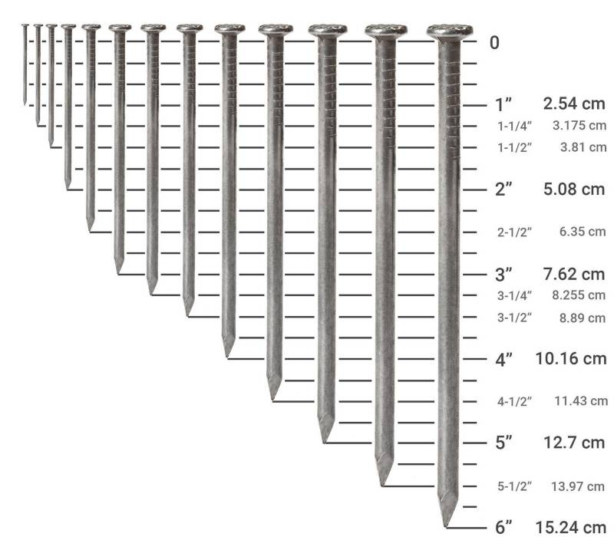
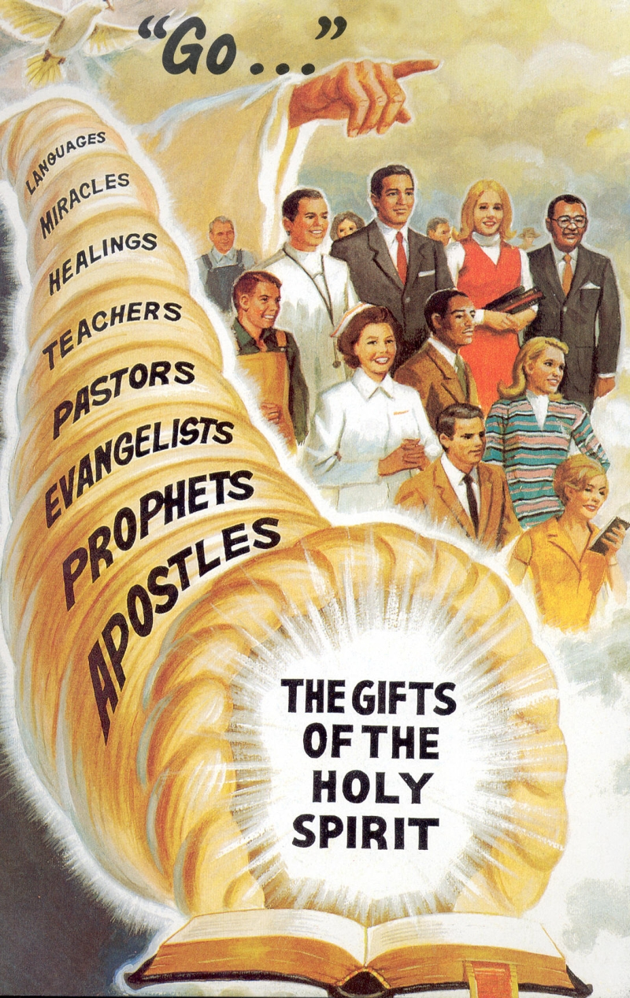

Sixth Lesson
A NAIL MUST HAVE AN EXACT MEASUREMENT
When we buy a nail, we ask for it with an exact measurement. If it is short, it is useless, and if it is very long it is not very useful. Generally, we order as many as we need in the same size, and in the same color.
Each one has a gift, which can be small or great. This gift must be put at the service of God. Using our gifts, we give an exact measurement. That is, we do exactly the work God has assigned us by granting us these gifts.
One worker may be a ready speaker; another a ready writer; another may have the gift of sincere, earnest, fervent prayer; another the gift of singing; another may have special power to explain the word of God with clearness. And each gift is to become a power for God because He works with the laborer. To one God gives the word of wisdom, to another knowledge, to another faith; but all are to work under the same Head. The diversity of gifts leads to a diversity of operations, but “it is the same God which worketh all in all.” 1 Corinthians 12:6. 9T 144.4
God also gives gifts to all of us: “Skill in the common arts is a gift from God. He provides the gift and also the wisdom to use the gift correctly”. CV 96.7 “Every good impulse or aspiration is the gift of God” Ed 253 “The gift of speech is a valuable talent... With the talent of speech we are to communicate the truth as we have opportunity. It should ever be used in God's service” VSS 14
The gifts of Jesus are ever fresh and new.... Each new gift increases the capacity of the receiver to appreciate and enjoy the blessings of the Lord. He gives grace for grace. There can be no failure of supply. If you abide in Him, the fact that you receive a rich gift today insures the reception of a richer gift tomorrow… AG 104

Slide 9



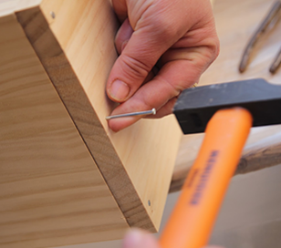
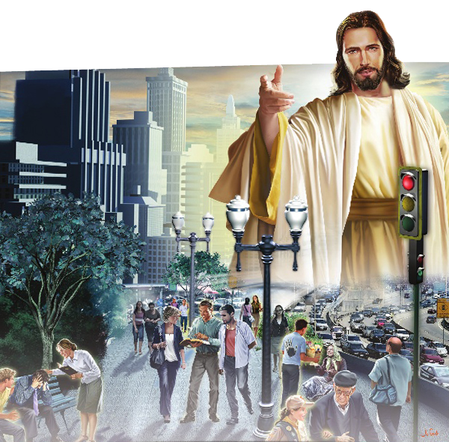

Seventh Lesson
A NAIL MUST FULFILL ITS MISSION
The nail was made to fulfill a mission. With a nail you can join two surfaces and keep them firm, and it must serve for what it was made for. A nail can prick a finger, or it can render a service.
In the Scriptures we read that to every man God has given his work. What does this mean?—It means that every one of us has a work to do. All do not have the same work, but all are to act their part in the service of God.” 18LtMs, Ms 91, 1903, par. 14”. “God knows with what fidelity and spirit of consecration everyone fulfills his mission. There is no place for the slothful in this great work, no place for the self-indulgent or those who are incapable of making life a success in any calling, no place for halfhearted men who are not fervent in spirit, willing to endure hardness, opposition, reproach, or death for Christ's sake. 2TT 227.3
In addition to working to spread the gospel, each woman has a mission: God has assigned woman her mission; and if she, in her humble way, yet to the best of her ability, makes a heaven
of her home, faithfully and lovingly performing her duties to her husband and children, continually seeking to let a holy light shine from her useful, pure, and virtuous life to brighten all around her, she is doing the work left her of the Master, and will hear from His divine lips the words: Well done, good and faithful servant, enter thou into the joy of thy Lord. These women who are doing with ready willingness what their hands find to do, with cheerfulness of spirit aiding their husbands to bear their burdens, and training their children for God, are missionaries in the highest sense. They are engaged in an important branch of the great work to be done on earth to prepare mortals for a higher life, and they will receive their reward. Children are to be trained for heaven and fitted to shine in the courts of the Lord's kingdom. 2TPI 414.1

Slide 10



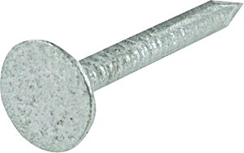
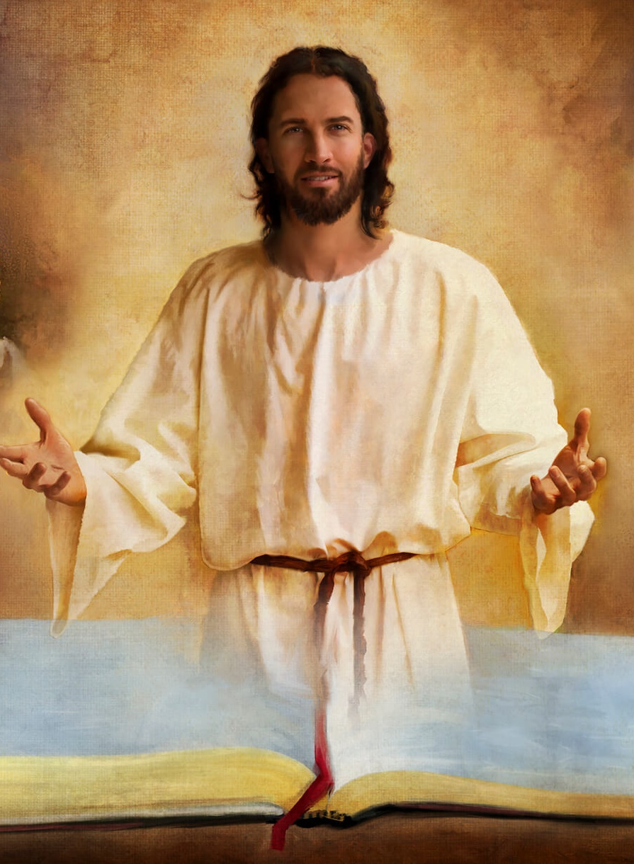
Eighth Lesson
A NAIL MUST HAVE A GOOD HEAD
The head on the nail has the function of ensuring that the nail does not go beyond the head. The head tells you when to stop.
“But speaking the truth in love, may grow up into him in all things, which is the head, even Christ” Ephesians 4:15.
It is no real evidence that you are a Christian because your emotion is stirred, your spirit stirred by truth. The question is, Are you growing up into Christ, your living head? Is the grace of Christ manifested in your life? God gives His grace to men, that they may desire more of His grace. God's grace is ever working upon the human heart, and when it is received, the evidence of its reception will appear in the life and character of its recipient, for spiritual life will be seen developing from within. The grace of Christ in the heart will always promote spiritual life, and spiritual advancement will be made. We each need a personal Saviour or we shall perish in our sins. Let the question be asked of our souls, Are we growing up unto Christ, our living head? Am I gaining advanced knowledge of God, and of Jesus Christ whom He hath sent? We do not see the plants grow in the field, and yet we are assured that they do grow, and may we not know of our own spiritual strength and growth? TMK 163.

Slide 11



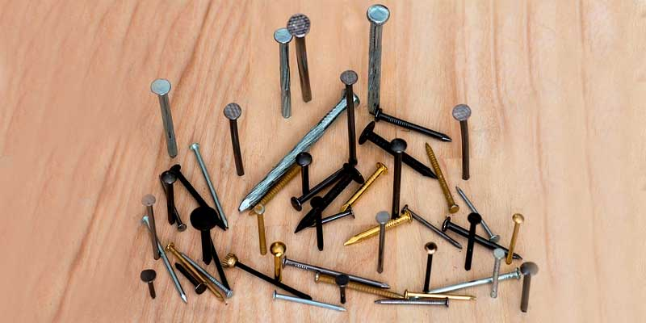

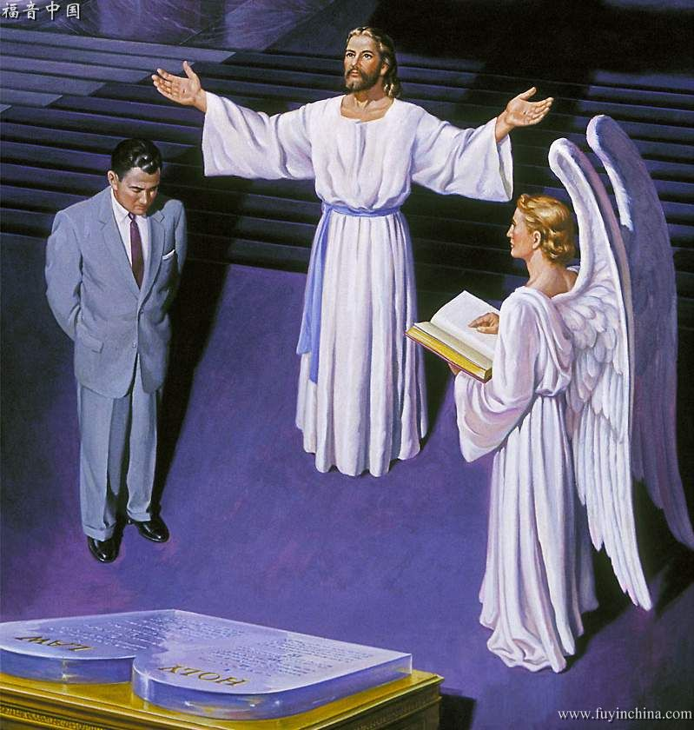
Ninth Lesson
ONE NAIL SHOULD NOT DISCARD ANOTHER
Let's not throw away any nails. If it is very large or very small and, therefore, it is not useful to us at a certain time, it does not mean that it is not useful for another occasion. Let us be careful not to dismiss people for any reason, for then we are judging them and only God who knows the heart can judge.
The people [Israel] shared to a large degree the same spirit [Pharisaical];
invaded the sphere of consciousness, and judged one another in matters that touched
only the soul and God. Referring to this spirit and practice, Jesus said, "Do not judge, lest you be judged." He meant: Do not consider yourselves as norms. Do not make your opinions and your concepts of duty, your interpretations of the Scriptures, a criterion for others, nor condemn them if they fall short of your ideal. Do not reproach others; Do not make assumptions about their motives or judge them.
“Therefore judge nothing before the time, until the Lord come, who both will bring to light the hidden things of darkness, and will make manifest the counsels of the hearts.” 1 Corinthians 4:5. We cannot read the heart. Ourselves faulty, we are not qualified to sit in judgment upon others. Finite men can judge only from outward appearance. To Him alone who knows the secret springs of action, and who deals tenderly and compassionately, is it given to decide the case of every soul. MB 124.1 “Therefore thou art inexcusable, O man, whosoever thou art that judgest: for wherein thou judgest another, thou condemnest thyself; for thou that judgest doest the same things..” Romans 2:1. Thus those who condemn or criticize others, proclaim themselves guilty, for they do the same things. In condemning others, they are passing sentence upon themselves, and God declares that this sentence is just. He accepts their own verdict against themselves. MB 124.

Slide 12

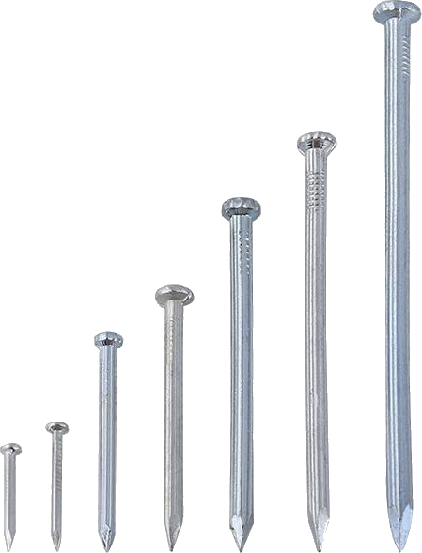

LET US PRAY THAT:
God keep our thoughts and actions pure and clean.
When we sin, let us ask God for forgiveness right away and to give us what we need not to fall again.
God change our hearts and transform our character.
Our priority is to study the Bible deeply.
God help us to renounce everything that distances us from Him and to make the love for Christ the motive of our actions.
May we use our gifts for the service of God.
God show us what our personal mission is and that we can fulfill it as for the Lord.
Let us grow in Christ, our living head.
Let us not judge anyone, let us not condemn, but let us leave the judgment to God.

