Slide 1

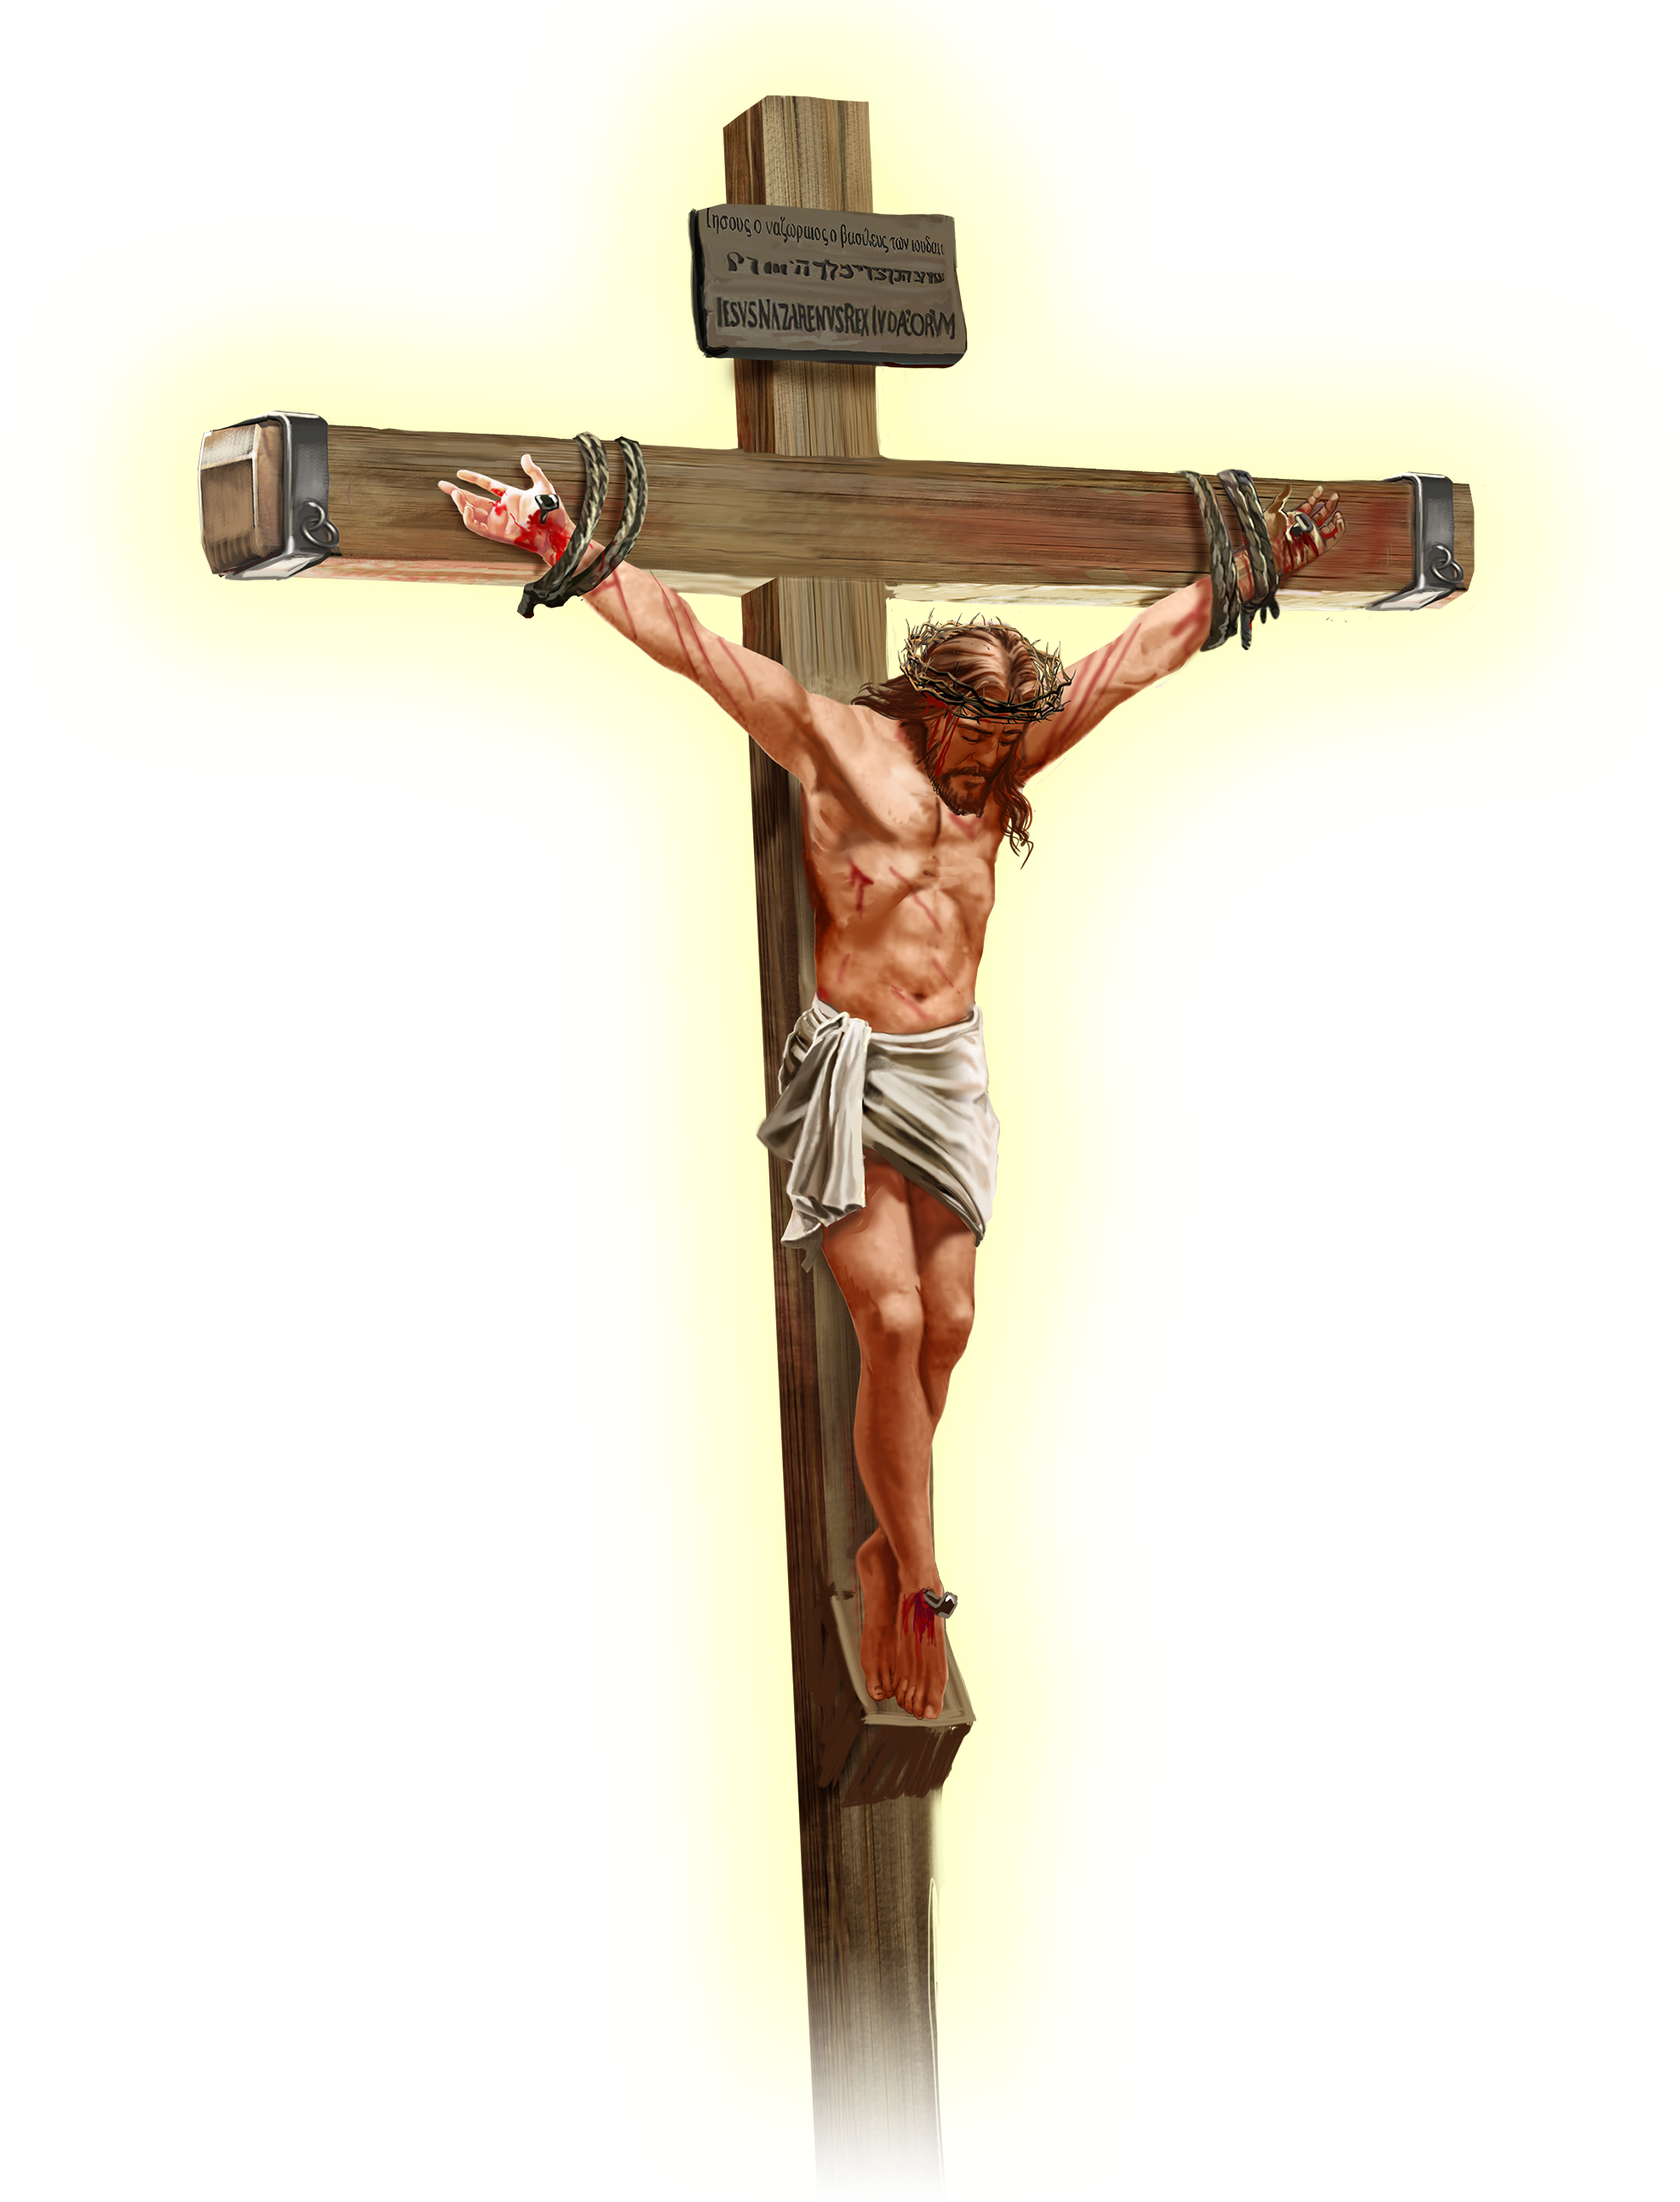
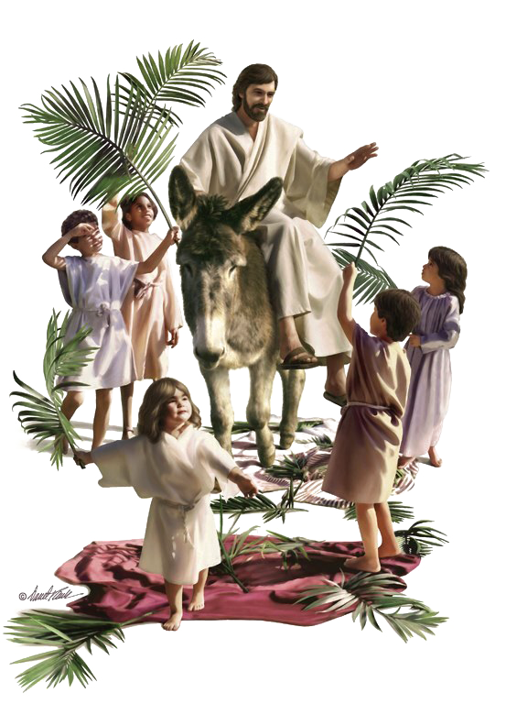


Slide 2
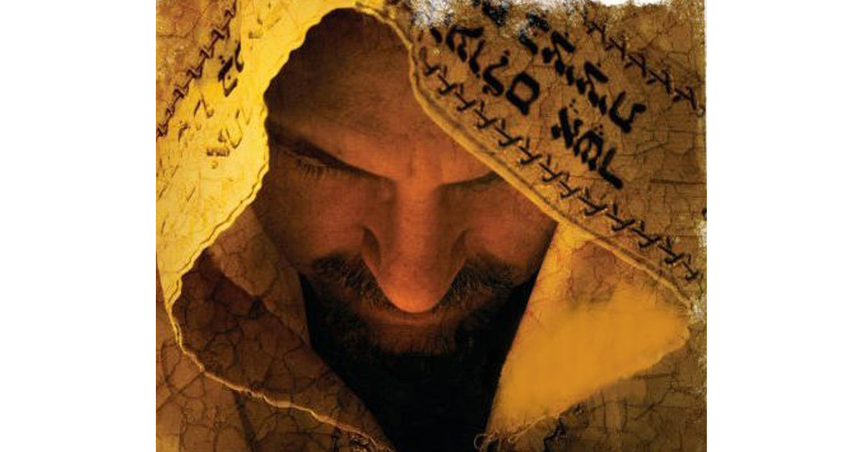
The Pharisees hoped for a political messiah who would free them from pagan Rome, and who would open the doors to a Jewish nation-state.
The Zealots were looking for a military solution to the problem.
The Essenes, frustrated with religious corruption, retreated to isolated hills to work for their salvation. They meticulously observed all the rules of purity and waited for the "Teacher of Righteousness" to confirm their holiness and justice. Each of these groups relied on specific texts to defend their ideas about the Messiah.
In reality, the Messiah was to be a prophet (Deut. 18:18); priest (Psalm 110:4); king (Psalm 2:6-7); and he had to fulfill the predictions that were told of him in the Old Testament.
Did Jesus of Nazareth fulfill all these conditions? Is Jesus the Messiah awaited by Israel?
Let's compare some Old Testament texts that speak of the Messiah and how they were fulfilled in Jesus of Nazareth.
Based on this evidence, will you accept Jesus as the promised Messiah and your personal Savior?

Slide 3
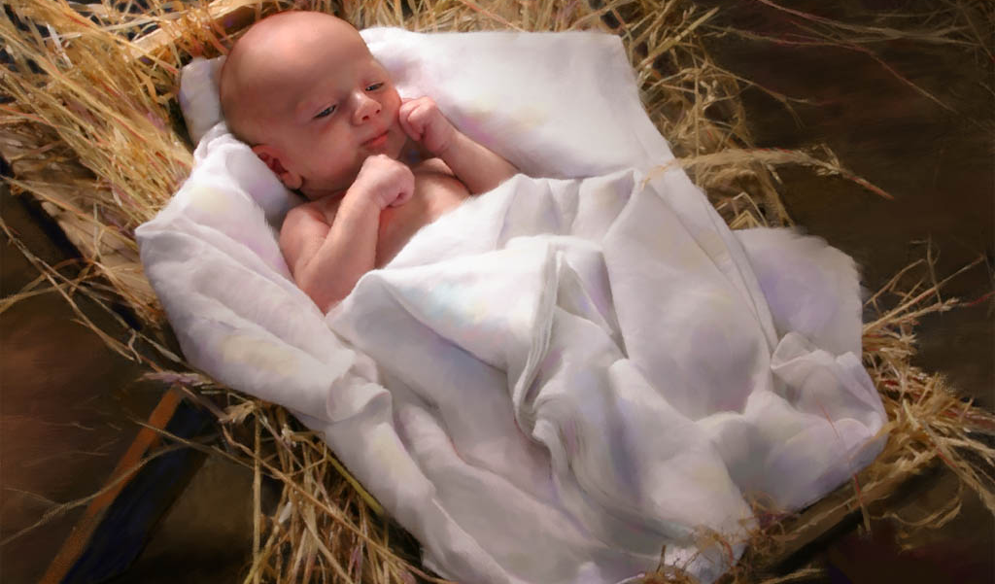
HIS BIRTH

Slide 4
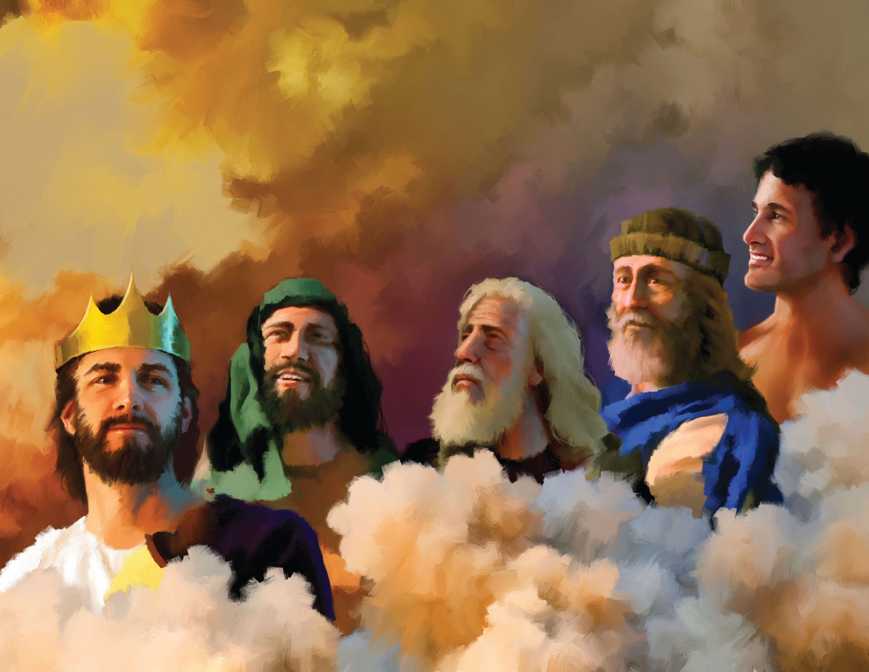
Now the Lord had said unto Abram, Get thee out of thy country, and from thy kindred, and from thy father's house, unto a land that I will shew thee: And I will make of thee a great nation, and I will bless thee, and make thy name great; and thou shalt be a blessing: And I will bless them that bless thee, and curse him that curseth thee: and in thee shall all families of the earth be blessed. (Genesis 12:1-3)
Descendant of Abraham
The book of the generation of Jesus Christ, the son of David, the son of Abraham. (Matthew 1:1)

Slide 5
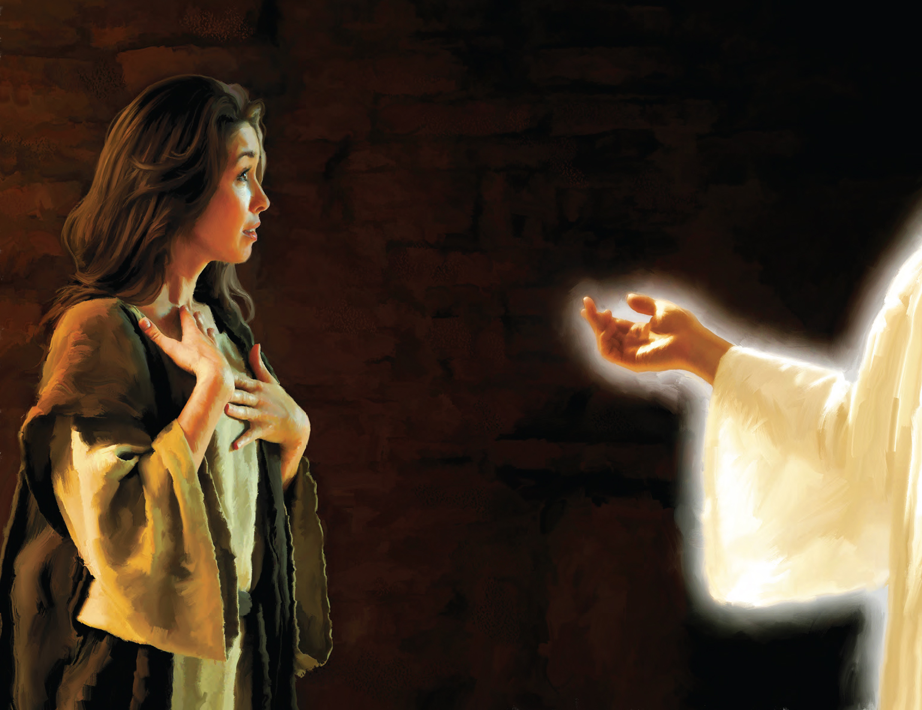
Therefore the Lord himself shall give you a sign; Behold, a virgin shall conceive, and bear a son, and shall call his name Immanuel. (Isaiah 7:14)
Born of a Virgin
Now the birth of Jesus Christ was on this wise: When as his mother Mary was espoused to Joseph, before they came together, she was found with child of the Holy Ghost. Then Joseph her husband, being a just man, and not willing to make her a public example, was minded to put her away privily. But while he thought on these things, behold, the angel of the Lord appeared unto him in a dream, saying, Joseph, thou son of David, fear not to take unto thee Mary thy wife: for that which is conceived in her is of the Holy Ghost. And she shall bring forth a son, and thou shalt call his name JESUS: for he shall save his people from their sins. Now all this was done, that it might be fulfilled which was spoken of the Lord by the prophet, saying, Behold, a virgin shall be with child, and shall bring forth a son, and they shall call his name Emmanuel, which being interpreted is,
God with us. (Matthew 1:18-23)

Slide 6
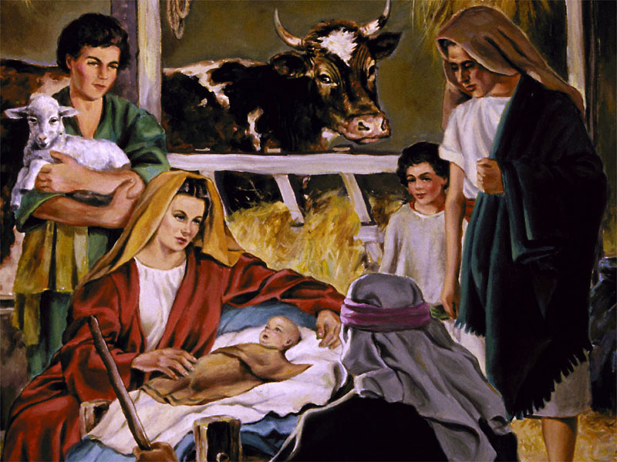
Born in Bethlehem
But thou, Bethlehem Ephratah, though thou be little among the thousands of Judah, yet out of thee shall he come forth unto me that is to be ruler in Israel; whose goings forth have been from of old, from everlasting. (Micah 5:2)
And Joseph also went up from Galilee, out of the city of Nazareth, into Judaea, unto the city of David, which is called Bethlehem; (because he was of the house and lineage of David:) To be taxed with Mary his espoused wife, being great with child. And so it was, that, while they were there, the days were accomplished that she should be delivered. And she brought forth her firstborn son, and wrapped him in swaddling clothes, and laid him in a manger; because there was no room for them in the inn. (Luke 2:4-7)

Slide 7
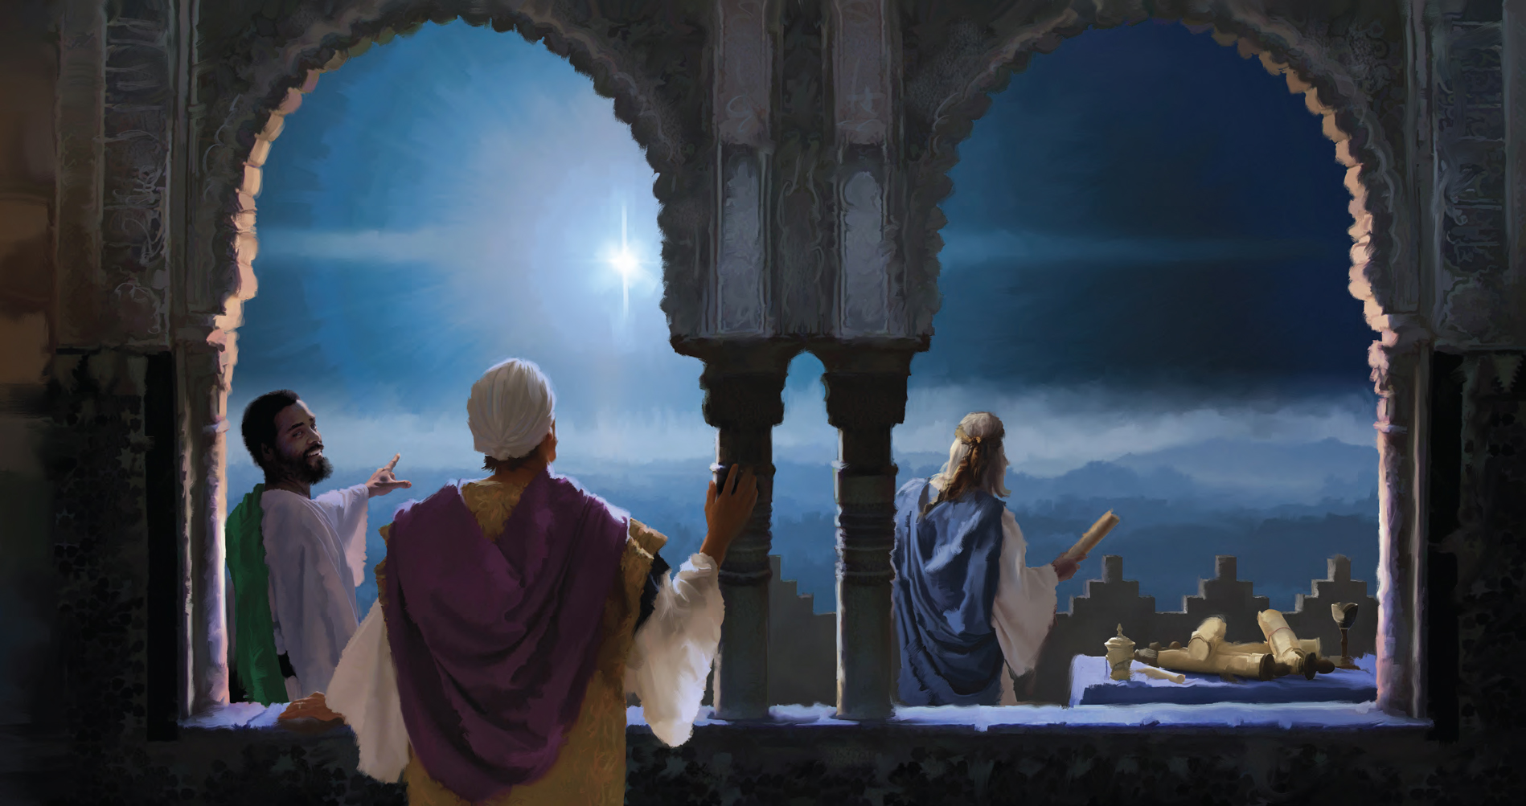
I shall see him, but not now: I shall behold him, but not nigh: there shall come a Star out of Jacob, and a Sceptre shall rise out of Israel, and shall smite the corners of Moab, and destroy all the children of Sheth. And Edom shall be a possession, Seir also shall be a possession for his enemies; and Israel shall do valiantly. Out of Jacob shall come he that shall have dominion, and shall destroy him that remaineth of the city. (Numbers 24:17-19)
Announced by a star
Saying, Where is he that is born King of the Jews? for we have seen his star in the east, and are come to worship him. (Matthew 2:2)

Slide 8
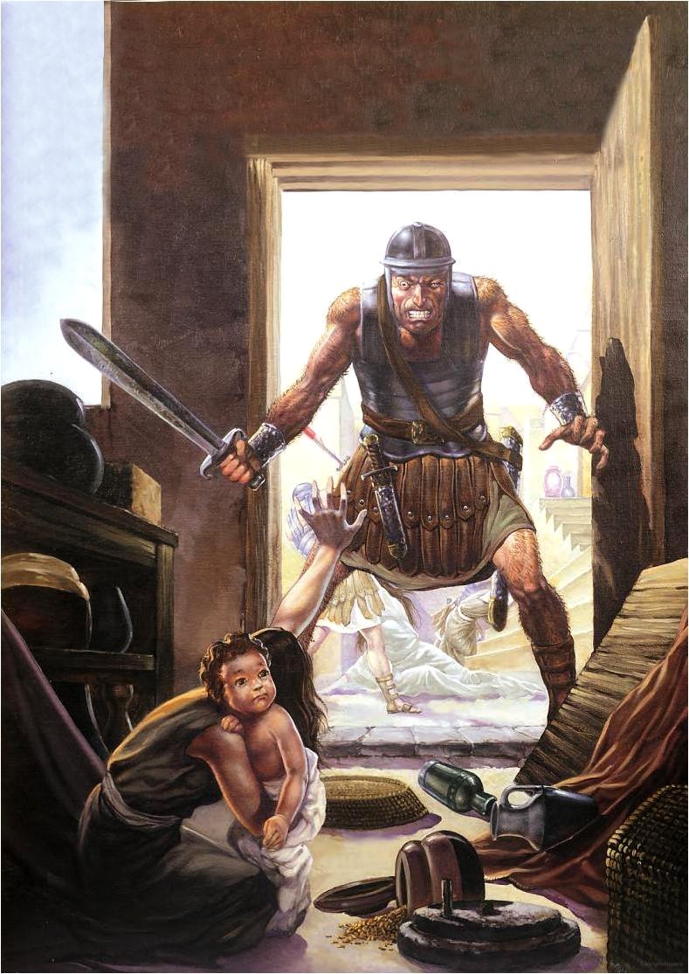
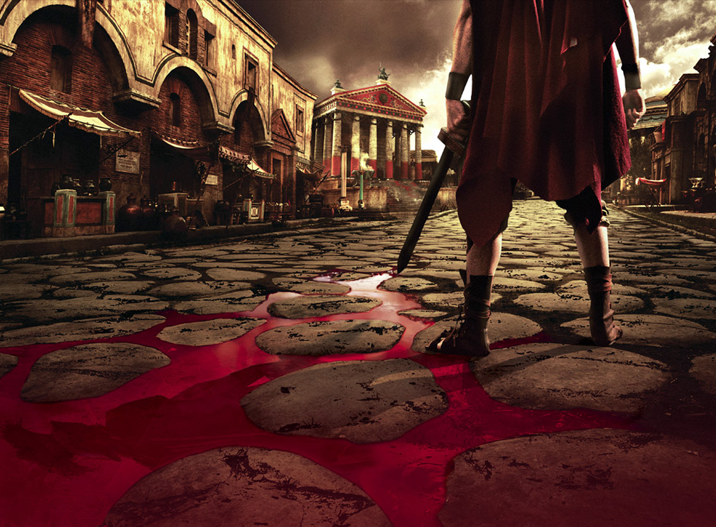
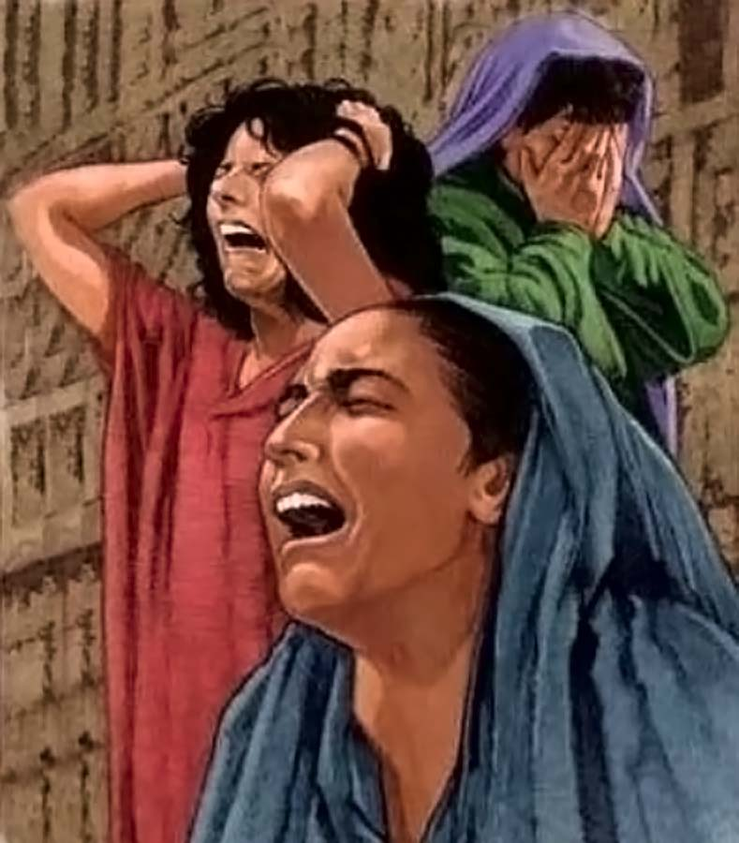
Death of the children of Bethlehem
Thus saith the Lord; A voice was heard in Ramah, lamentation, and bitter weeping; Rachel weeping for her children refused to be comforted for her children, because they were not .
(Jeremiah 31:15)
Then Herod, when he saw that he was mocked of the wise men, was exceeding wroth, and sent forth, and slew all the children that were in Bethlehem, and in all the coasts thereof, from two years old and under, according to the time which he had diligently enquired of the wise men. Then was fulfilled that which was spoken by Jeremiah the prophet, saying, In Rama was there a voice heard, lamentation, and weeping, and great mourning, Rachel weeping for her children, and would not be comforted, because they are not. (Matthew 2:16-18)

Slide 9
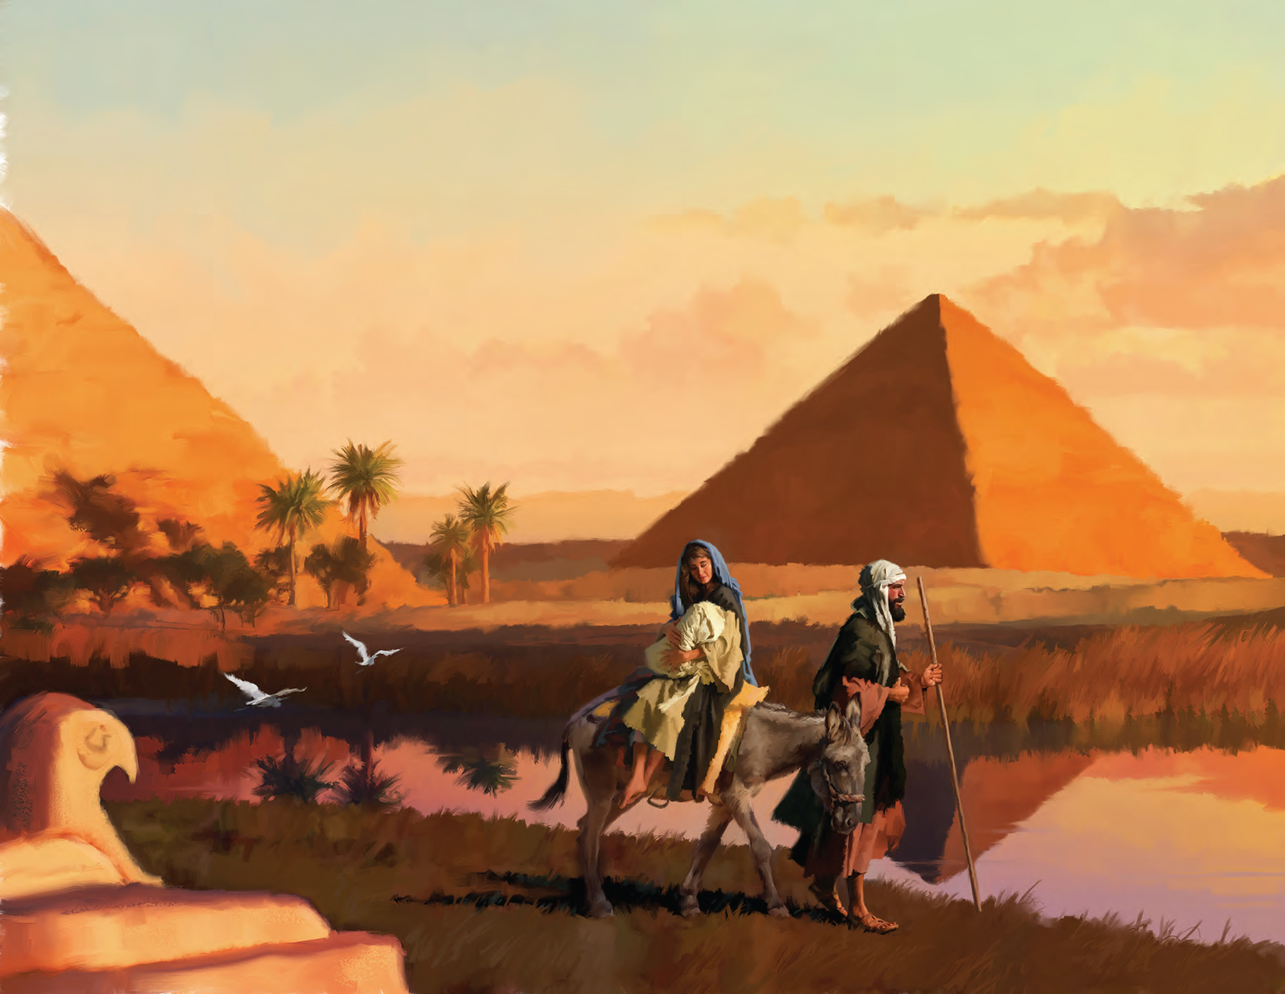
When Israel was a child, then I loved him, and called my son out of Egypt. (Hosea 11:1)
Taken to Egypt
When he arose, he took the young child and his mother by night, and departed into Egypt: And was there until the death of Herod: that it might be fulfilled which was spoken of the Lord by the prophet, saying, Out of Egypt have I called my son. (Matthew 2:14-15)

Slide 10
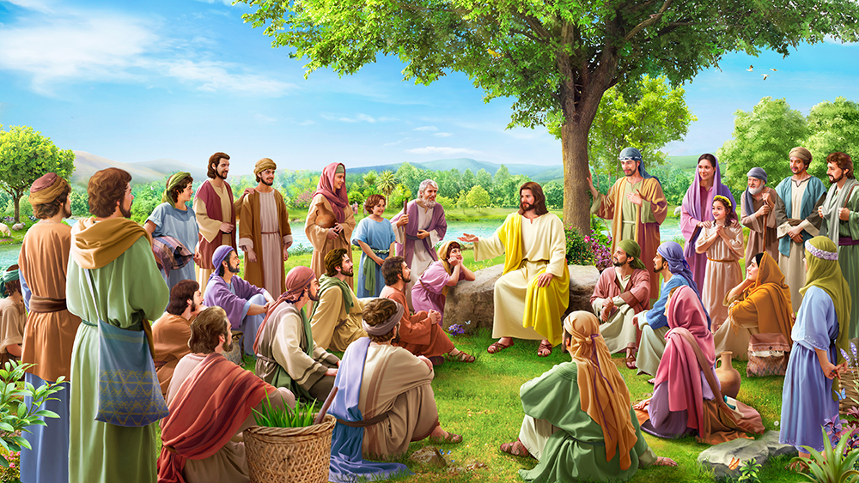
HIS MINISTRY

Slide 11
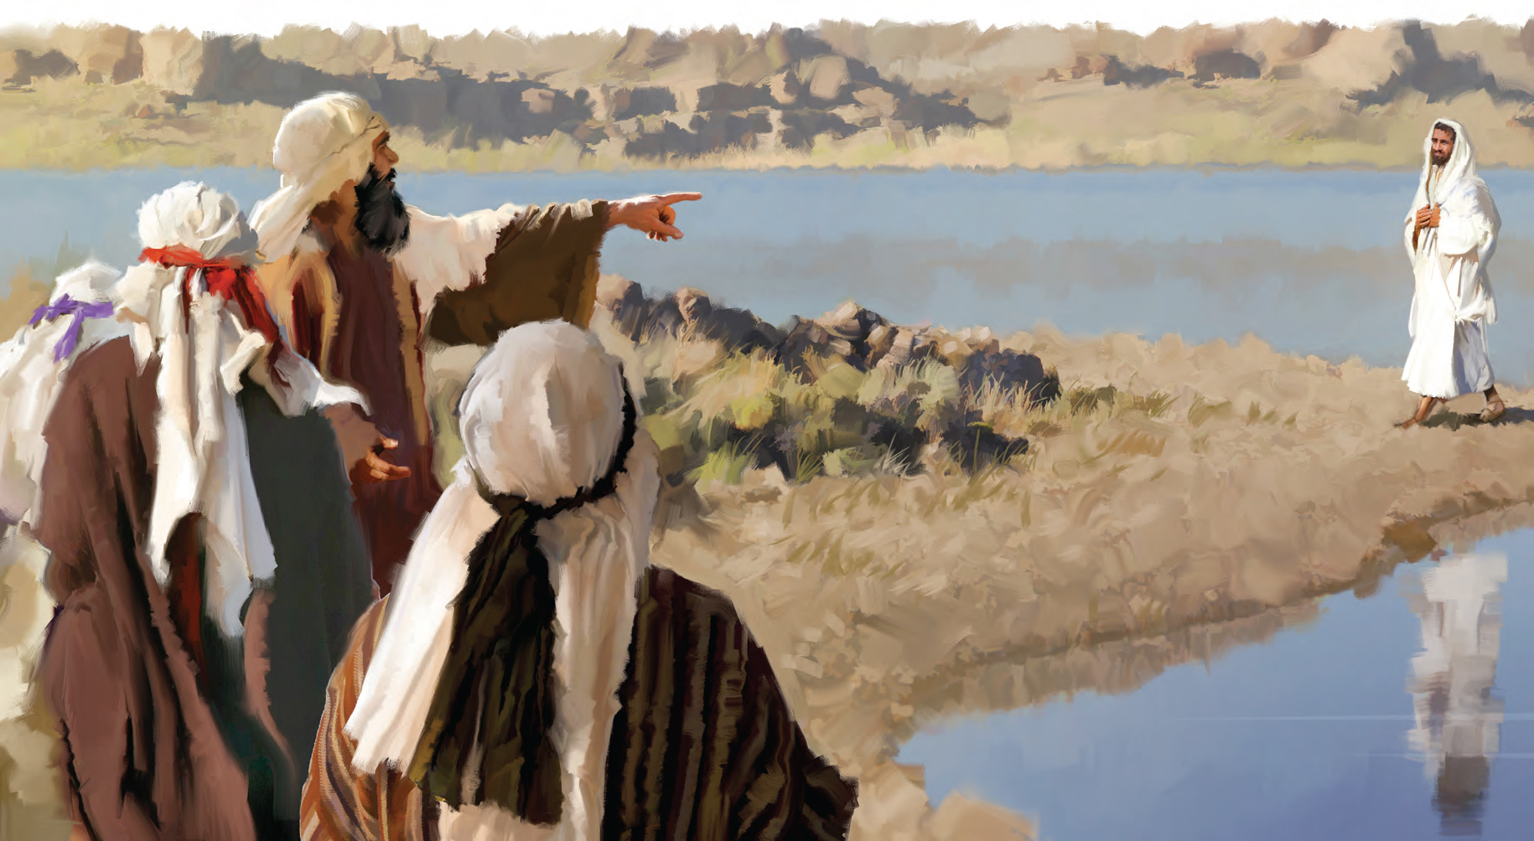
Preceded by a Herald
In those days came John the Baptist, preaching in the wilderness of Judaea, And saying, Repent ye: for the kingdom of heaven is at hand. For this is he that was spoken of by the prophet Esaias, saying, The voice of one crying in the wilderness, Prepare ye the way of the Lord, make his paths straight. (Matthew 3:1-3)
The voice of him that crieth in the wilderness, Prepare ye the way of the LORD, make straight in the desert a highway for our God. (Isaiah 40:3)

Slide 12
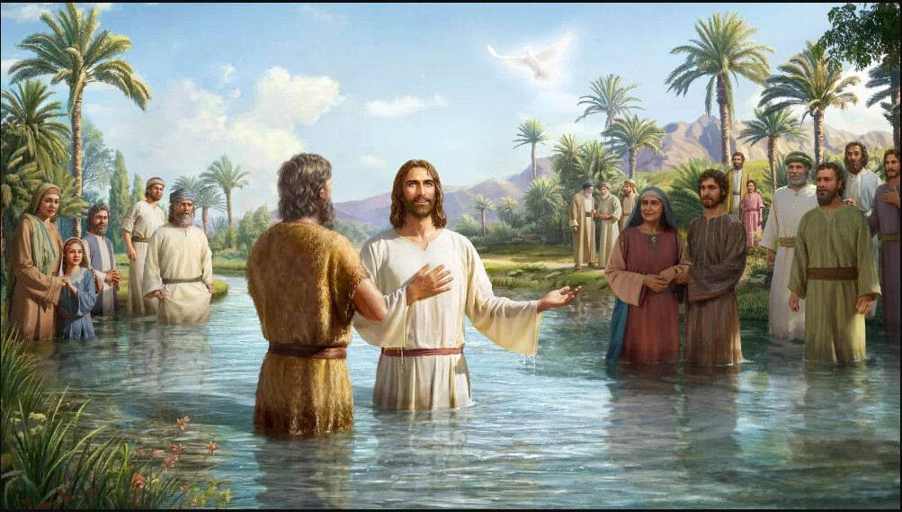
Anointed by the Holy Spirit
And the spirit of the Lord shall rest upon him, the spirit of wisdom and understanding, the spirit of counsel and might, the spirit of knowledge and of the fear of the Lord. (Isaiah 11:2)
And Jesus, when he was baptized, went up straightway out of the water: and, lo, the heavens were opened unto him, and he saw the Spirit of God descending like a dove, and lighting upon him: And lo a voice from heaven, saying, This is my beloved Son, in whom I am well pleased. (Matthew 3:16-17)

Slide 13
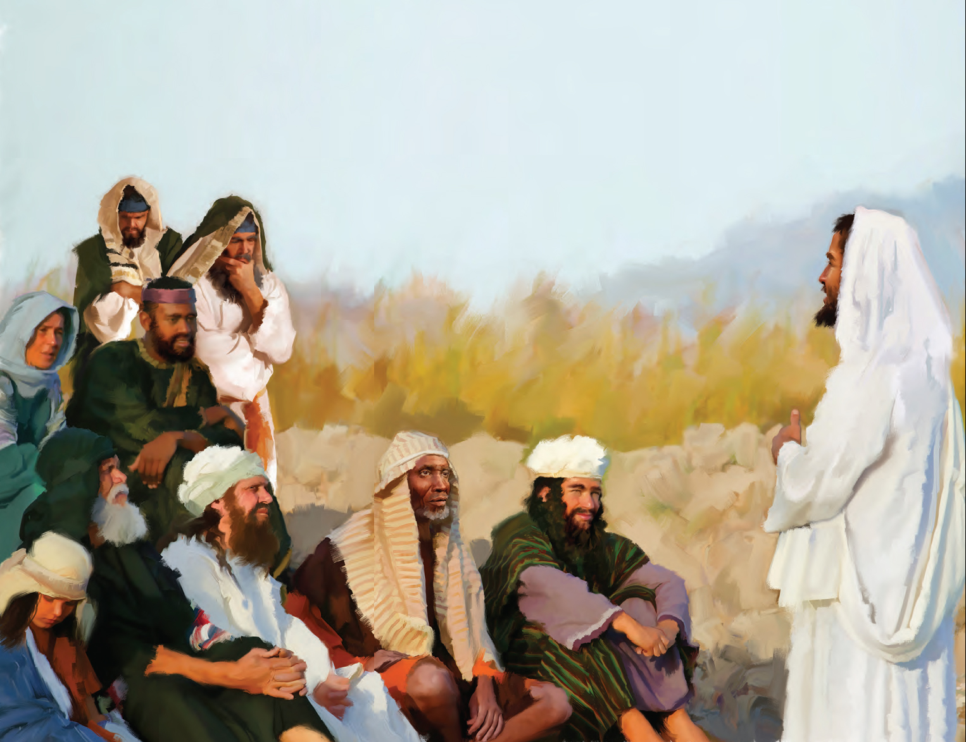
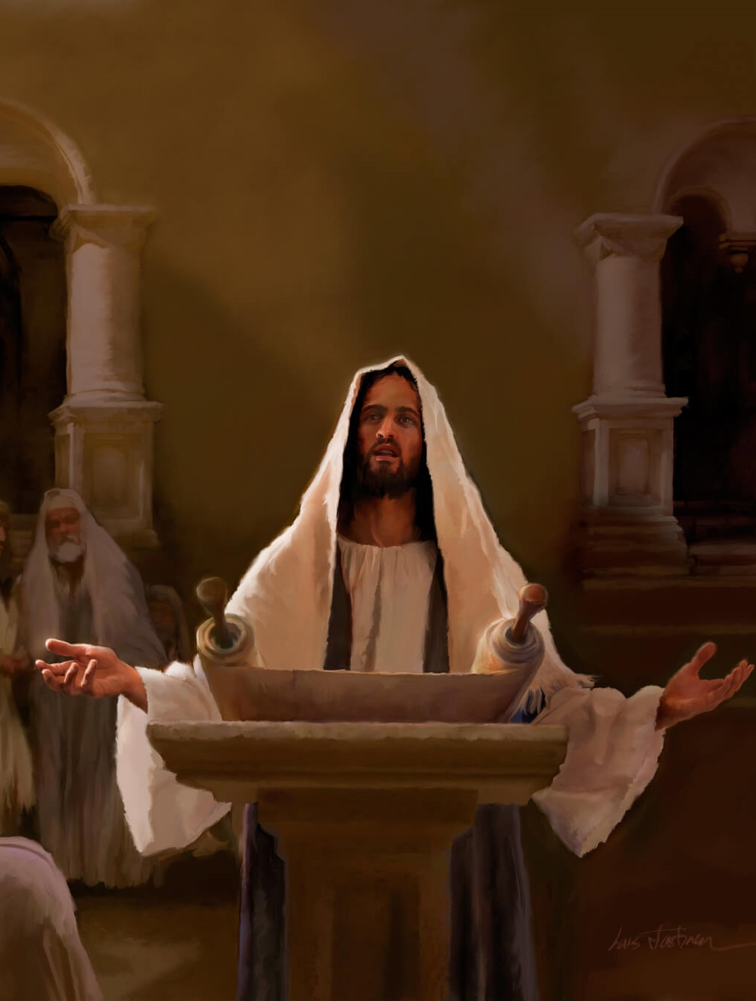
The Spirit of the Lord God is upon me; because the Lord hath anointed me to preach good tidings unto the meek; he hath sent me to bind up the brokenhearted, to proclaim liberty to the captives, and the opening of the prison to them that are bound.
(Isaiah 61:1)
He Would Preach Good News
And he came to Nazareth, where he had been brought up: and, as his custom was, he went into the synagogue on the sabbath day, and stood up for to read. And there was delivered unto him the book of the prophet Esaias. And when he had opened the book, he found the place where it was written, The Spirit of the Lord is upon me, because he hath anointed me to preach the gospel to the poor; he hath sent me to heal the brokenhearted, to preach deliverance to the captives, and recovering of sight to the blind, to set at liberty them that are bruised, To preach the acceptable year of the Lord. And he closed the book, and he gave it again to the minister, and sat down. And the eyes of all them that were in the synagogue were fastened on him. And he began to say unto them, This day is this scripture fulfilled in your ears. (Luke 4:16-21)

Slide 14
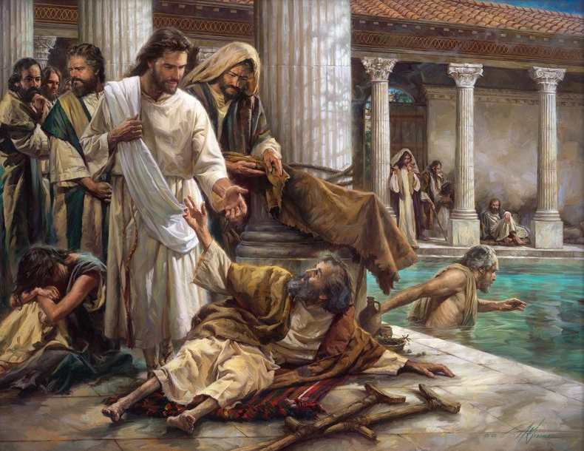
Then the eyes of the blind shall be opened, and the ears of the deaf shall be unstopped. Then shall the lame man leap as an hart, and the tongue of the dumb sing: for in the wilderness shall waters break out, and streams in the desert. (Isaiah 35:5-6)
He Would Work Miracles
And Jesus went about all the cities and villages, teaching in their synagogues, and preaching the gospel of the kingdom, and healing every sickness and every disease among the people. (Matthew 9:35)

Slide 15
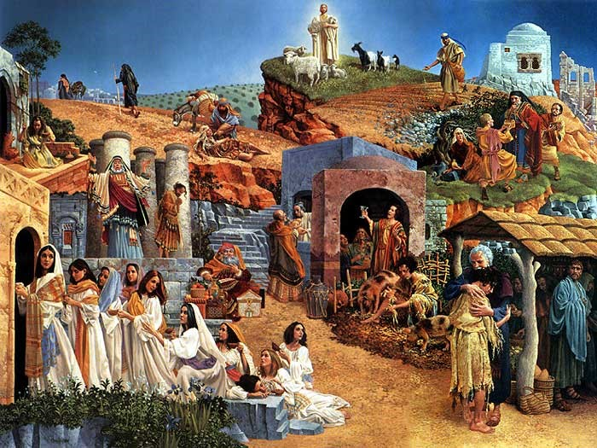
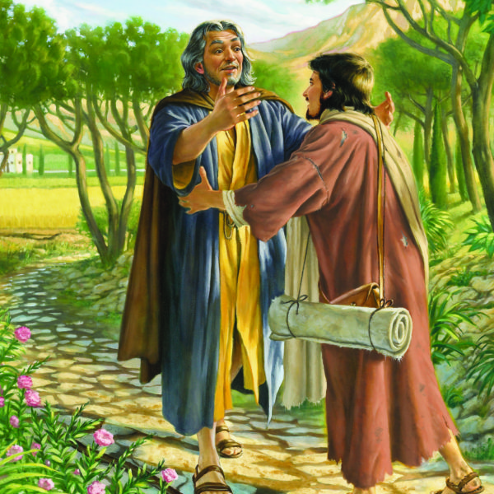
I will open my mouth
in a parable: I will utter dark sayings of old: (Psalms 78:2)
He Would Speak in Parables
And he said, Unto you it is given to know the mysteries of the kingdom of God: but to others in parables; that seeing they might not see, and hearing they might not understand. (Luke 8:10)

Slide 16
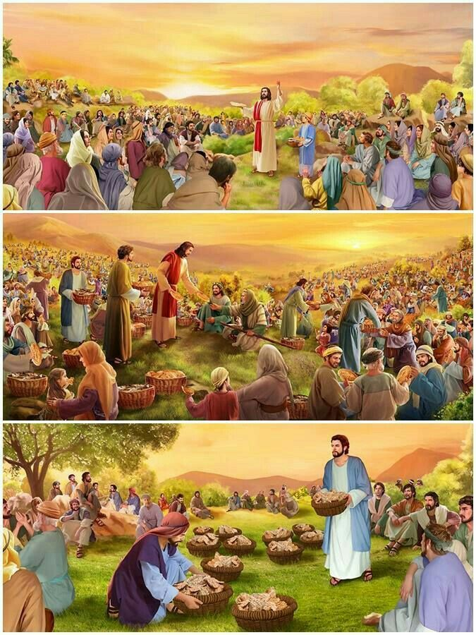
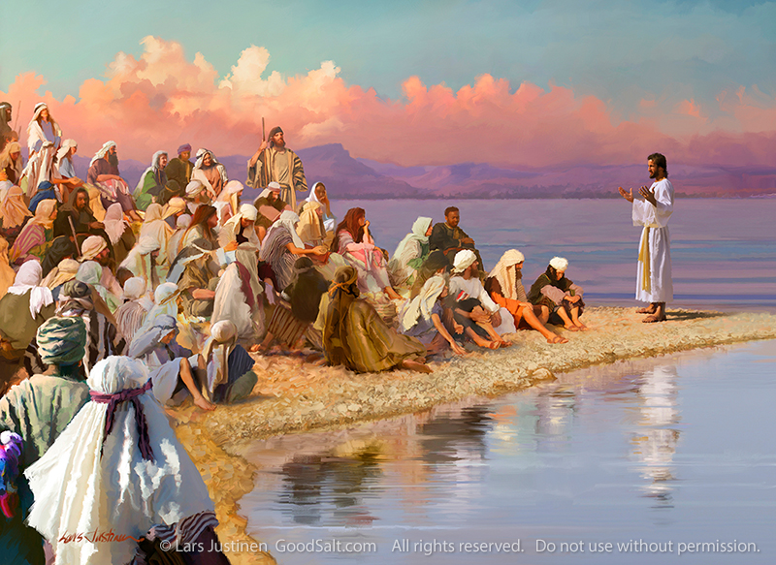
He Would Minister in Galilee
Nevertheless the dimness shall not be such as was in her vexation, when at the first he lightly afflicted the land of Zebulun and the land of Naphtali, and afterward did more grievously afflict her by the way of the sea, beyond Jordan, in Galilee of the nations. (Isaiah 9:1)
Now when Jesus had heard that John was cast into prison, he departed into Galilee; And leaving Nazareth, he came and dwelt in Capernaum, which is upon the sea coast, in the borders of Zabulon and Nephthalim: That it might be fulfilled which was spoken by Esaias the prophet, saying, The land of Zabulon, and the land of Nephthalim, by the way of the sea, beyond Jordan, Galilee of the Gentiles; The people which sat in darkness saw great light; and to them which sat in the region and shadow of death light is sprung up. (Matthew 4:12-16)

Slide 17
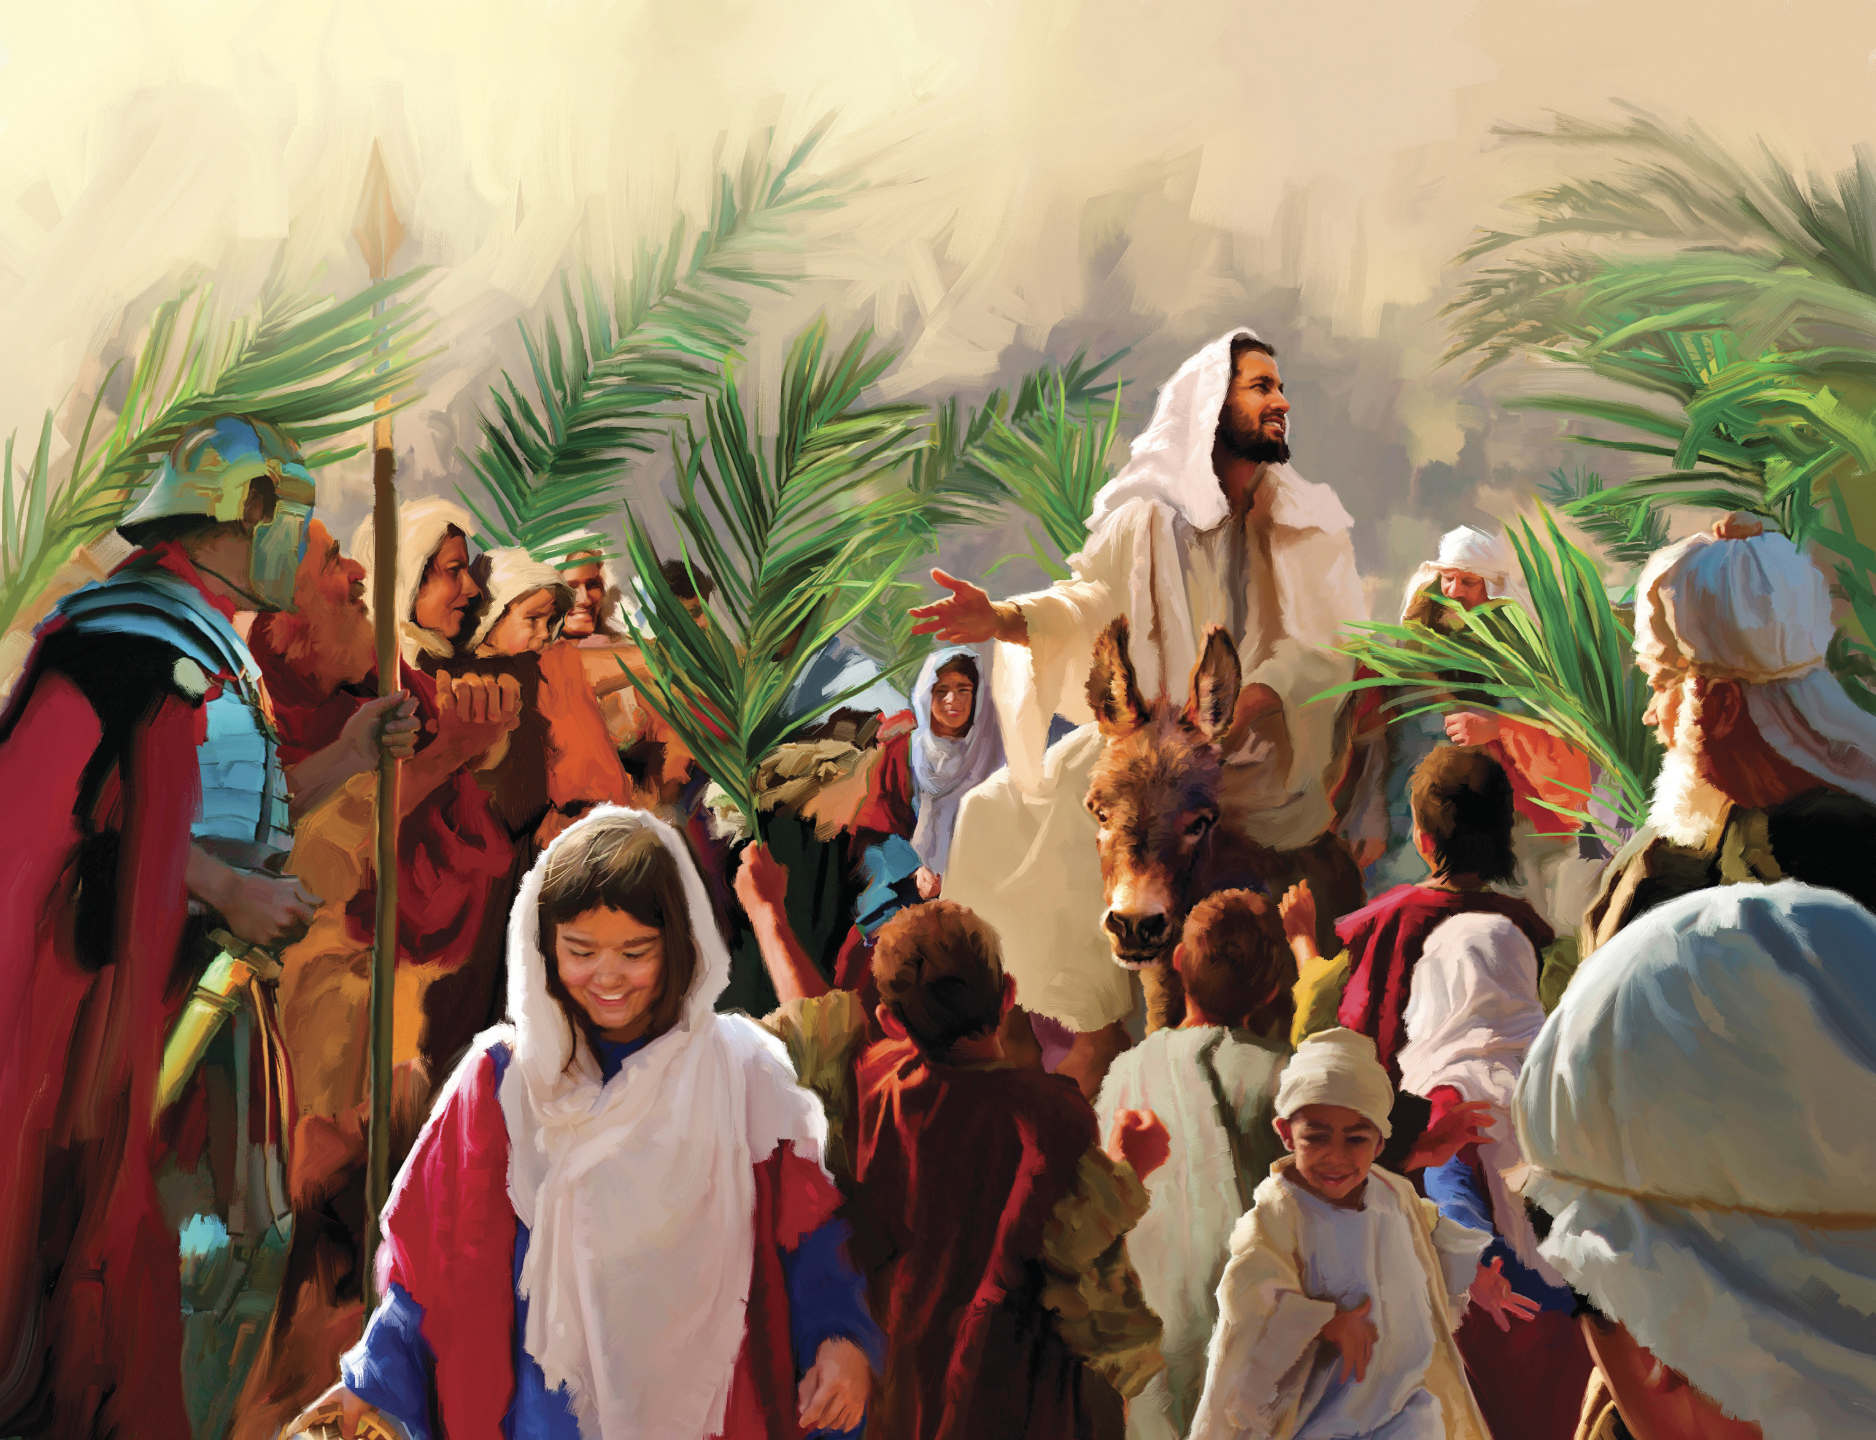
Rejoice greatly, O daughter of Zion; shout, O daughter of Jerusalem: behold, thy King cometh unto thee: he is just, and having salvation; lowly, and riding upon an ass, and upon a colt the foal of an ass. (Zechariah 9:9)
He Would Enter Jerusalem on a Donkey
All this was done, that it might be fulfilled which was spoken by the prophet, saying, Tell ye the daughter of Sion, Behold, thy King cometh unto thee, meek, and sitting upon an ass, and a colt the foal of an ass. And the disciples went, and did as Jesus commanded them, And brought the ass, and the colt, and put on them their clothes, and they set him thereon. And a very great multitude spread their garments in the way; others cut down branches from the trees, and strawed them in the way. And the multitudes that went before, and that followed, cried, saying, Hosanna to the Son of David: Blessed is he that cometh in the name of the Lord; Hosanna in the highest. (Matthew 21:4-9)

Slide 18
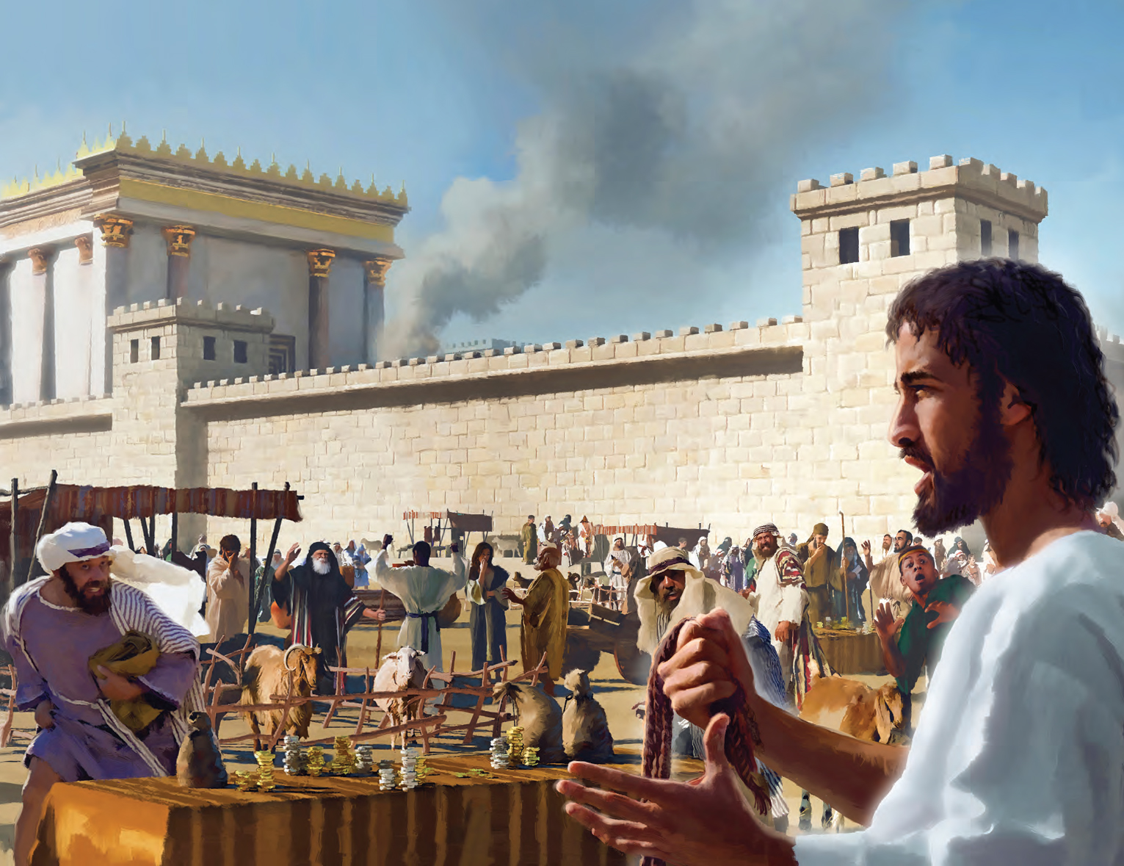
Behold, I will send my messenger, and he shall prepare the way before me: and the Lord, whom ye seek, shall suddenly come to his temple, even the messenger of the covenant, whom ye delight in: behold, he shall come, saith the Lord of hosts.
(Malachi 3:1)
He Would Clean the Temple
And Jesus went into the temple of God, and cast out all them that sold and bought in the temple, and overthrew the tables of the moneychangers, and the seats of them that sold doves, And said unto them, It is written, My house shall be called the house of prayer; but ye have made it a den of thieves.
(Matthew 21:12-13)

Slide 19
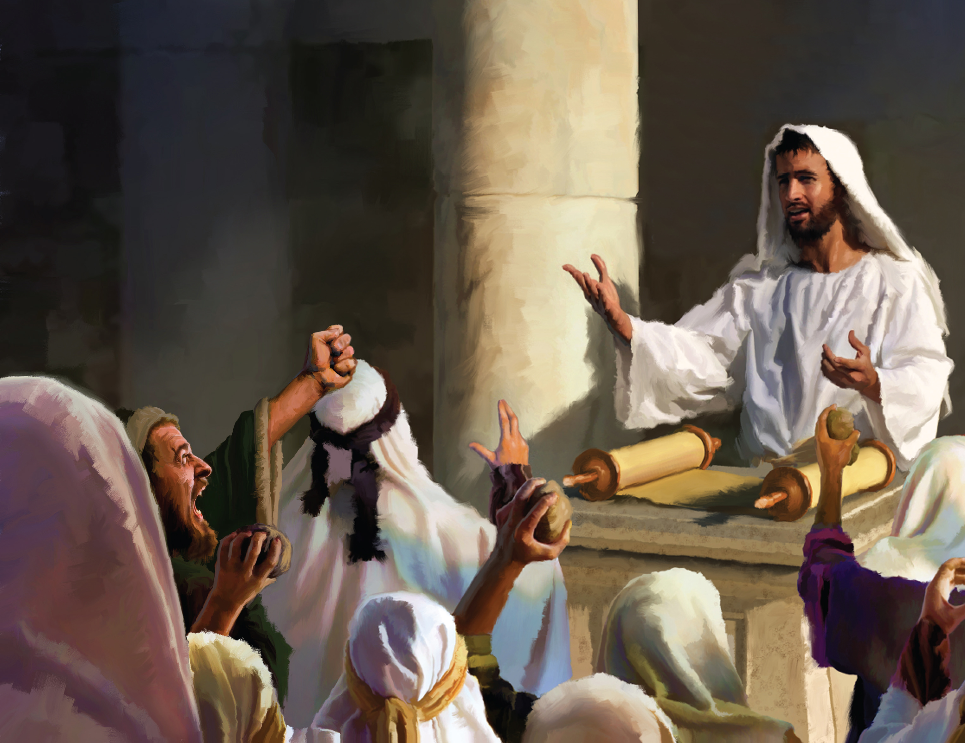
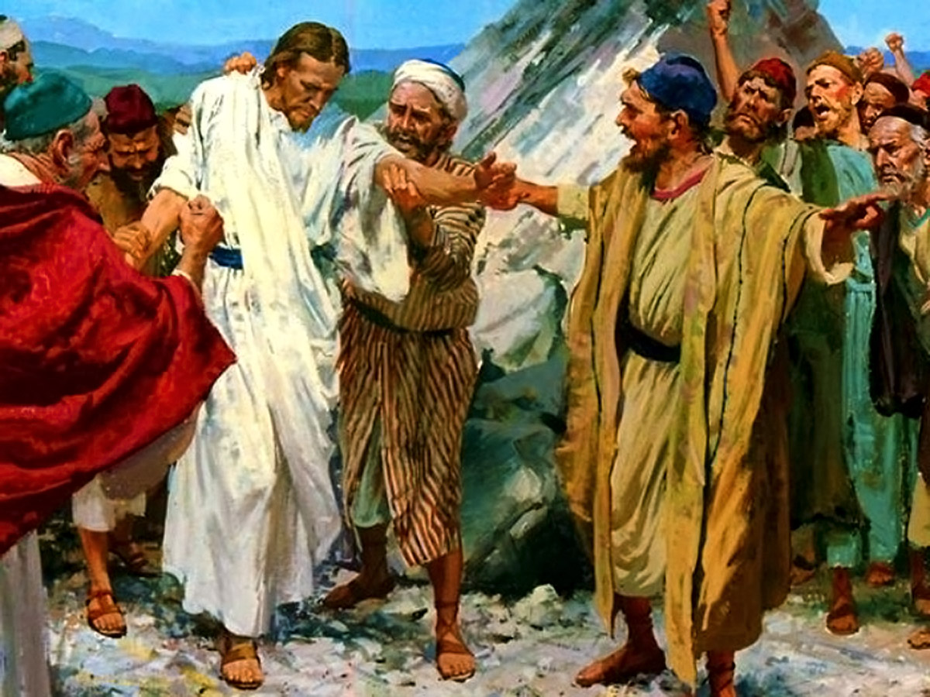
The stone which the builders refused is become the head stone of the corner. (Psalms 118:22)
He Would be Rejected
Unto you therefore which believe he is precious: but unto them which be disobedient, the stone which the builders disallowed, the same is made the head of the corner (1 Peter 2:7)

Slide 20
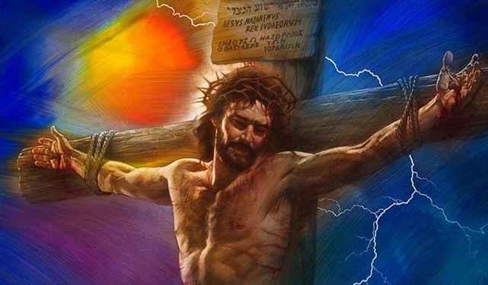
HIS DEATH

Slide 21
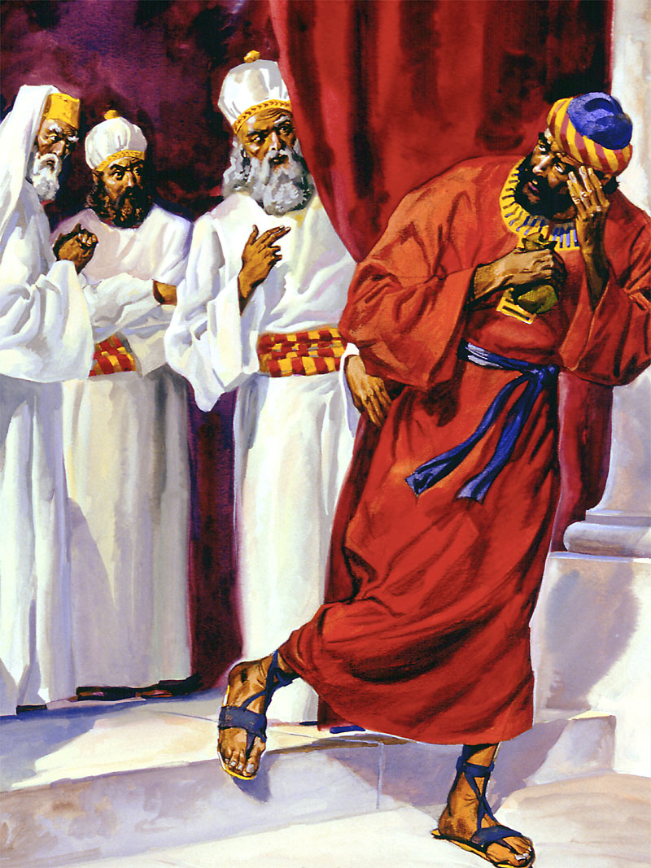
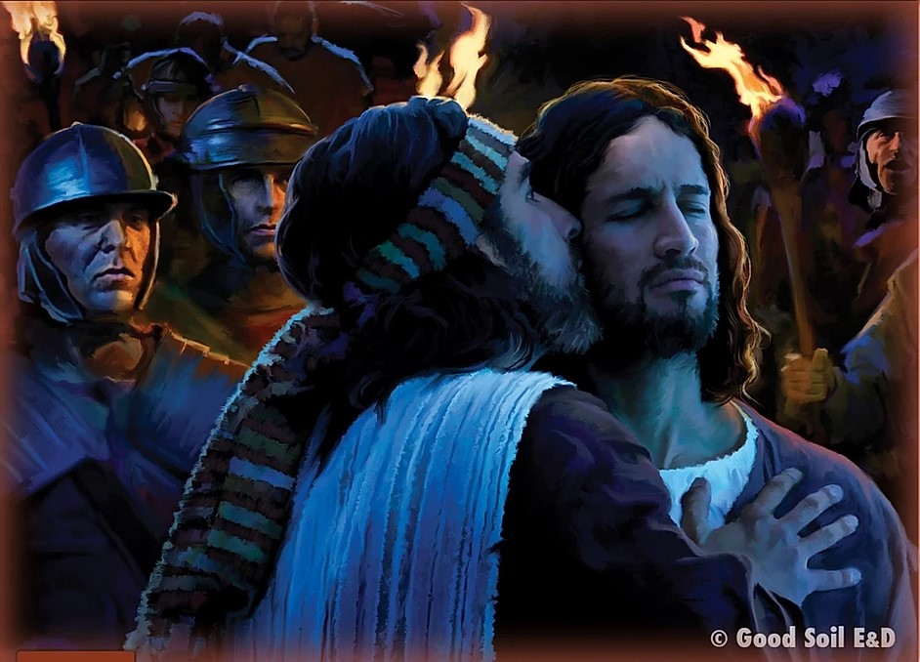
Betrayed By a Friend
Then entered Satan into Judas surnamed Iscariot, being of the number of the twelve. And he went his way, and communed with the chief priests and captains, how he might betray him unto them. (Luke 22:3-4)
Yea, mine own familiar friend, in whom I trusted, which did eat of my bread, hath lifted up his heel against me. (Psalms 41:9)

Slide 22
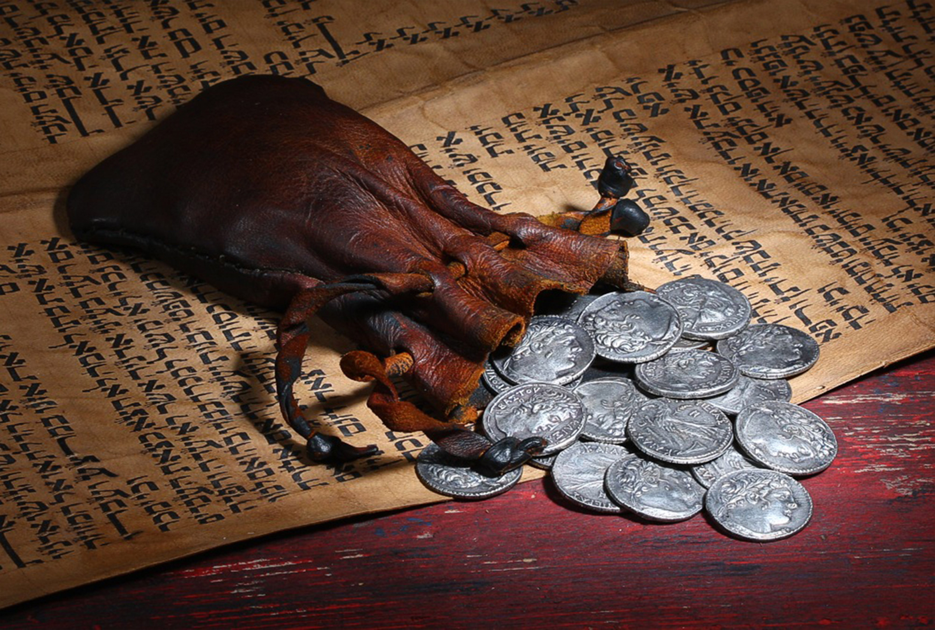
And I said unto them, If ye think good, give me my price; and if not, forbear. So they weighed for my price thirty pieces of silver. (Zechariah 11:12)
Then one of the twelve, called Judas Iscariot, went unto the chief priests, And said unto them, What will ye give me, and I will deliver him unto you? And they covenanted with him for thirty pieces of silver. (Matthew 26:14-15)
Sold for 30 Silver Coins

Slide 23
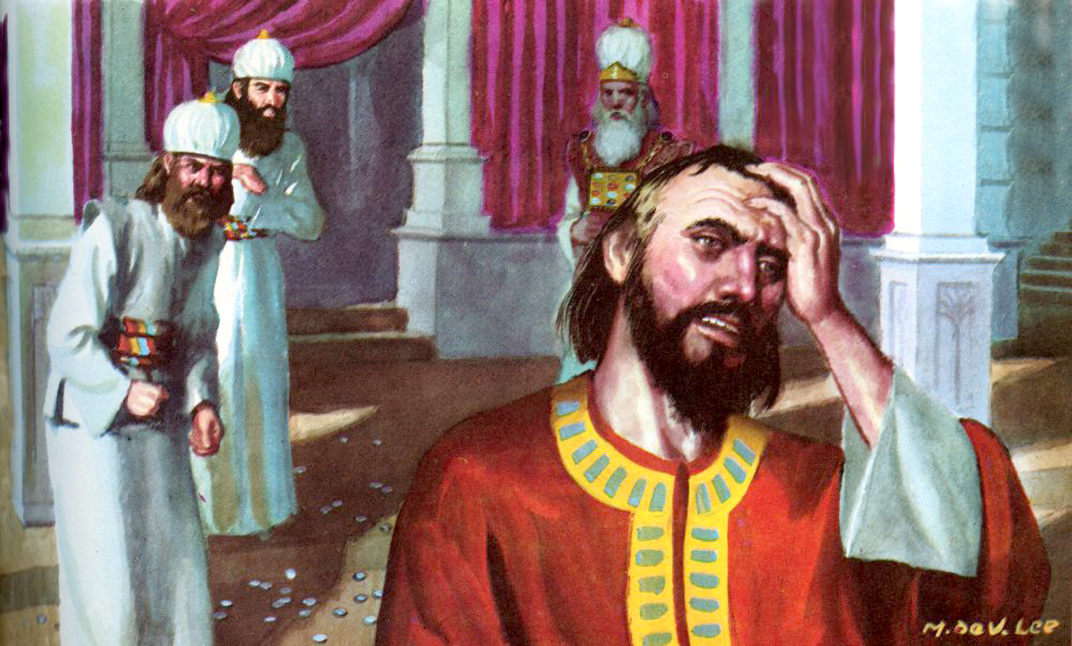
The 30 coins would be returned to the temple
Then Judas, which had betrayed him, when he saw that he was condemned, repented himself, and brought again the thirty pieces of silver to the chief priests and elders, Saying, I have sinned in that I have betrayed the innocent blood. And they said, What is that to us? see thou to that. And he cast down the pieces of silver in the temple, and departed, and went and hanged himself. (Matthew 27:3-5)
And the Lord said unto me, Cast it unto the potter: a goodly price that I was prised at of them. And I took the thirty pieces of silver, and cast them to the potter in the house of the Lord. (Zechariah 11:13)

Slide 24
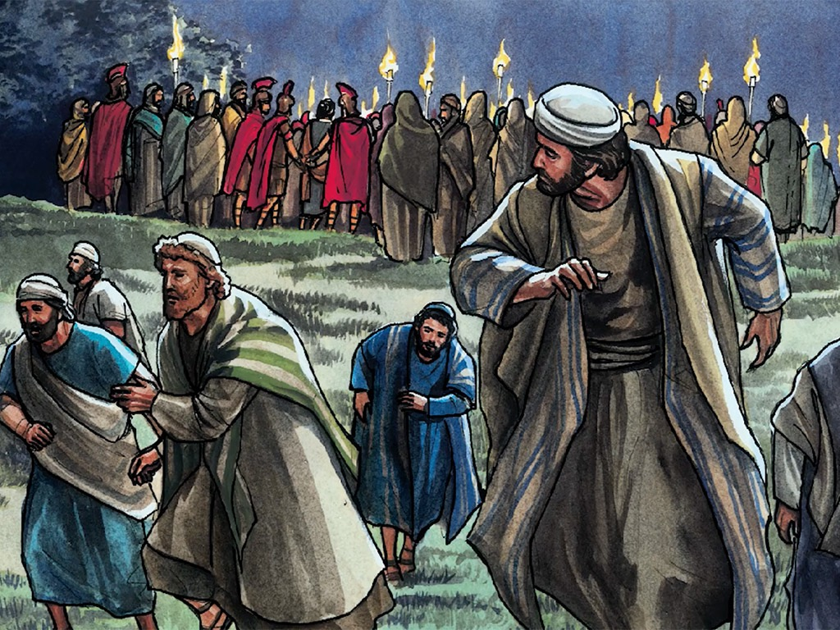
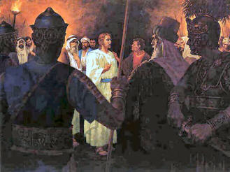
Awake, O sword, against my shepherd, and against the man that is my fellow, saith the Lord of hosts: smite the shepherd, and the sheep shall be scattered: and I will turn mine hand upon the little ones. (Zechariah 13:7)
His Disciples Would Scatter
And Jesus saith unto them, All ye shall be offended because of me this night: for it is written, I will smite the shepherd, and the sheep shall be scattered. (Mark 14:27)

Slide 25
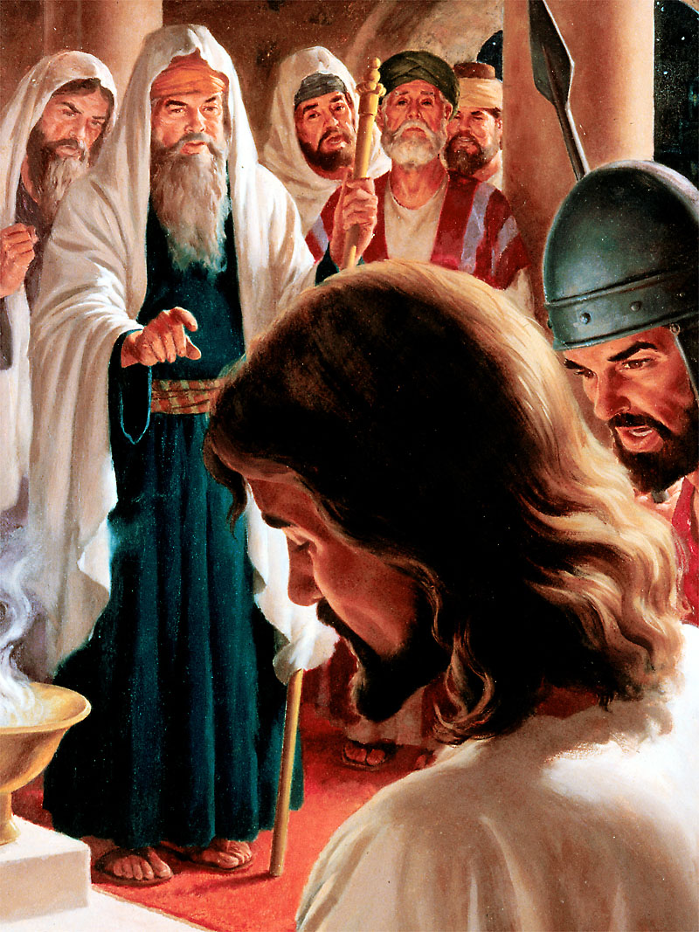
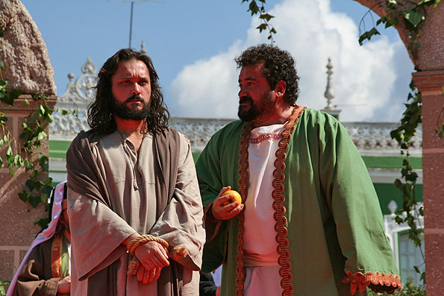
Silence Before His Accusers
He was oppressed, and he was afflicted, yet he opened not his mouth: he is brought as a lamb to the slaughter, and as a sheep before her shearers is dumb, so he openeth not his mout.h (Isaiah 53:7)
And when he was accused of the chief priests and elders, he answered nothing. Then said Pilate unto him, Hearest thou not how many things they witness against thee? And he answered him to never a word; insomuch that the governor marvelled greatly. (Matthew 27:12-14)

Slide 26
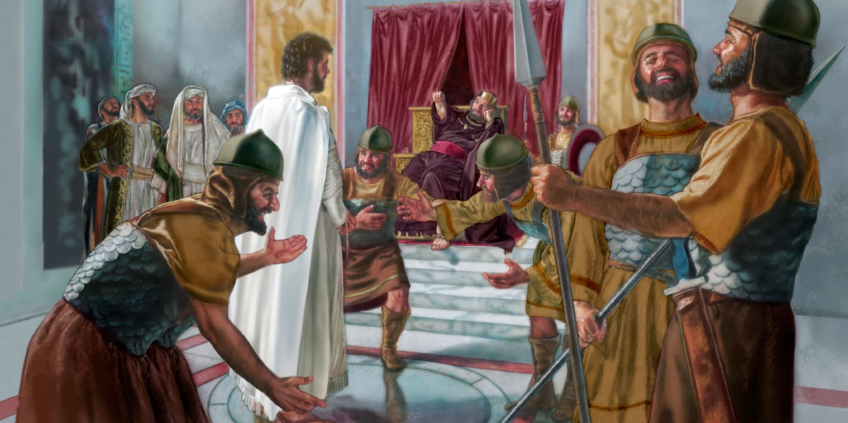
They Would Mock Him
Then the soldiers of the governor took Jesus into the common hall, and gathered unto him the whole band of soldiers. And they stripped him, and put on him a scarlet robe. And when they had platted a crown of thorns, they put it upon his head, and a reed in his right hand: and they bowed the knee before him, and mocked him, saying, Hail, King of the Jews! And they spit upon him, and took the reed, and smote him on the head. And after that they had mocked him, they took the robe off from him, and put his own raiment on him, and led him away to crucify him. (Matthew 27:27-31)
All they that see me laugh me to scorn: they shoot out the lip, they shake the head, saying, He trusted on the Lord that he would deliver him: let him deliver him, seeing he delighted in him. (Psalms 22:7-8)

Slide 27
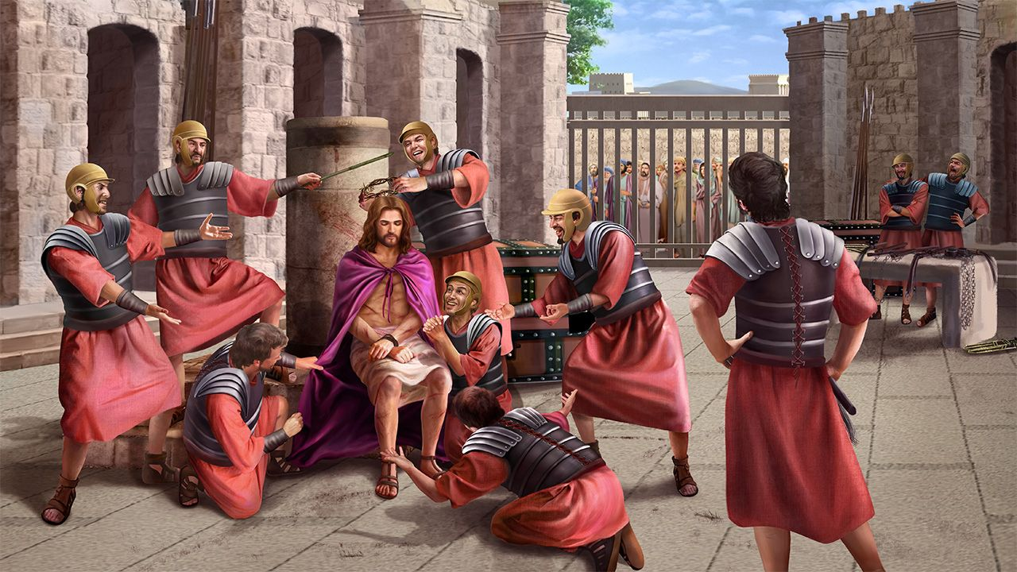
They Wounded Him and Spat on Him
I gave my back to the smiters, and my cheeks to them that plucked off the hair: I hid not my face from shame and spitting.
(Isaiah 50:6)
And they spit upon him, and took the reed, and smote him on the head.
(Matthew 27:30)

Slide 28
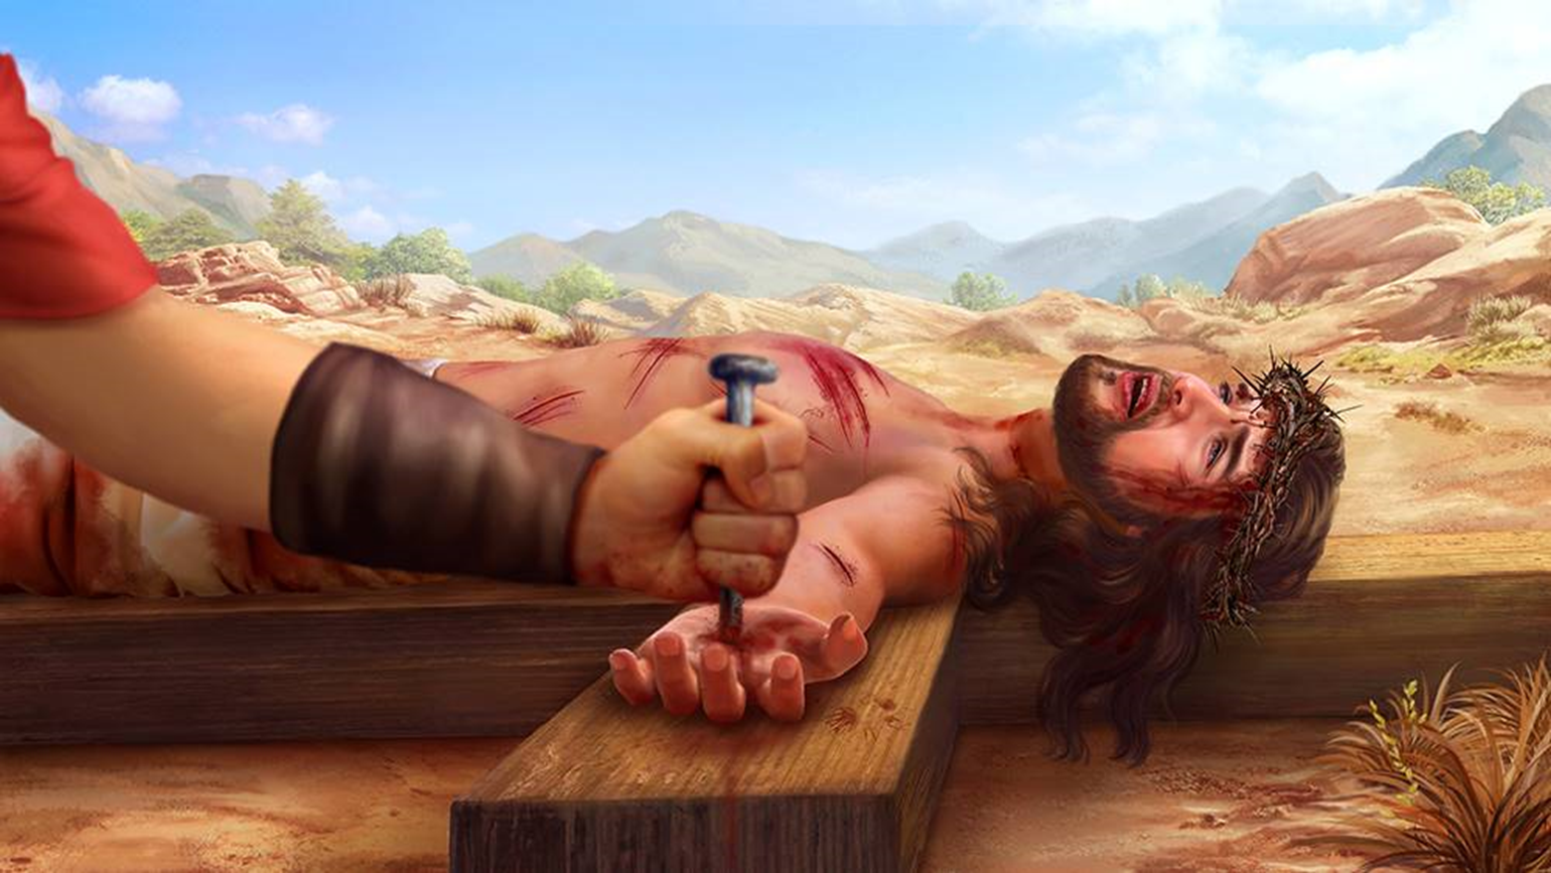
He Would Pray for His Persecutors
Therefore will I divide him a portion with the great, and he shall divide the spoil with the strong; because he hath poured out his soul unto death: and he was numbered with the transgressors; and he bare the sin of many, and made intercession for the transgressors. (Isaiah 53:12)
Then said Jesus, Father, forgive them; for they know not what they do. And they parted his raiment, and cast lots. (Luke 23:34)

Slide 29
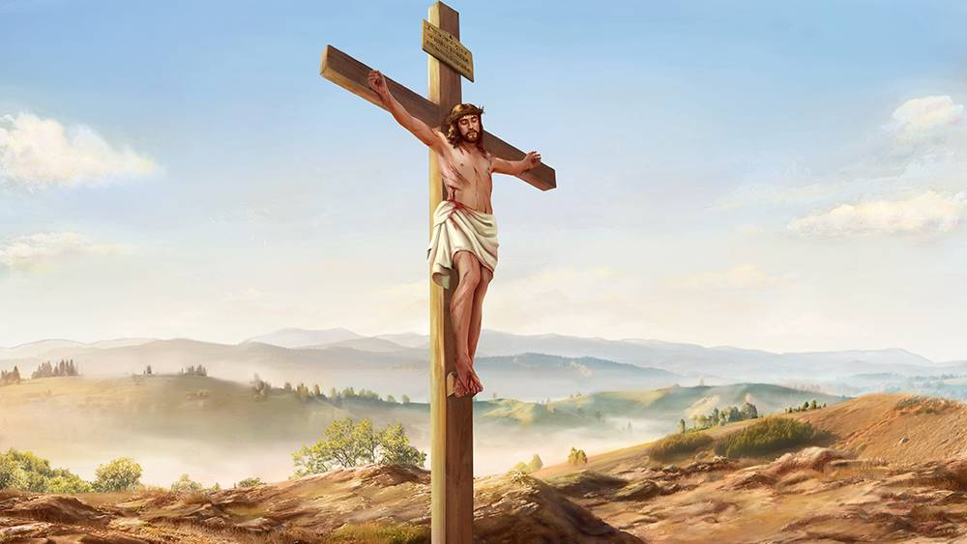
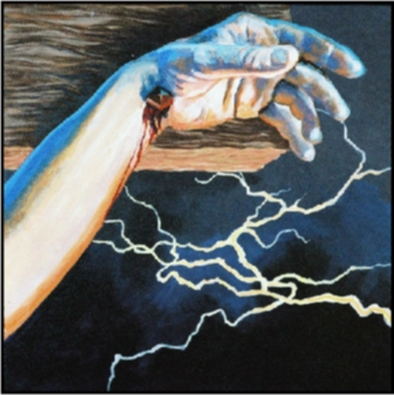
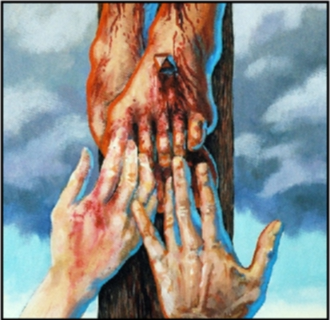
They Would Pierce His Hands and Feet
The other disciples therefore said unto him, We have seen the Lord. But he said unto them, Except I shall see in his hands the print of the nails, and put my finger into the print of the nails, and thrust my hand into his side, I will not believe. (John 20:25)
For dogs have compassed me: the assembly of the wicked have inclosed me: they pierced my hands and my feet (Psalms 22:16)

Slide 30
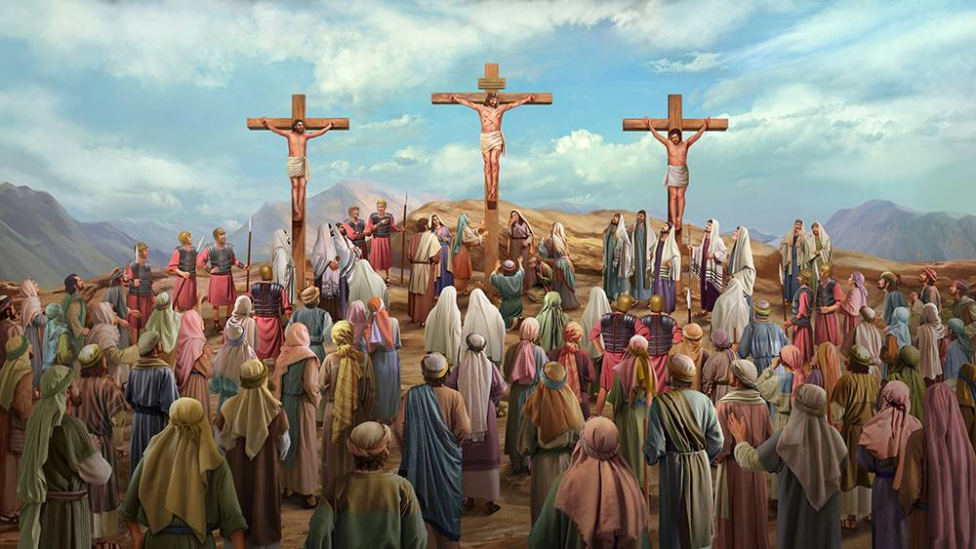
He Would Be Crucified Among Thieves
Therefore will I divide him a portion with the great, and he shall divide the spoil with the strong; because he hath poured out his soul unto death: and he was numbered with the transgressors; and he bare the sin of many, and made intercession for the transgressors. (Isaiah 53:12)
Then were there two thieves crucified with him, one on the right hand, and another on the left (Matthew 27:38)

Slide 31
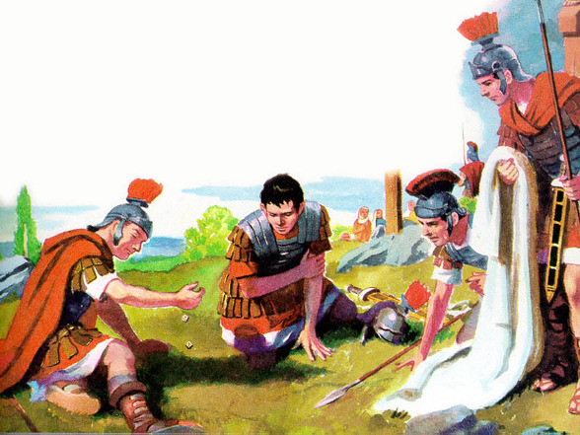
They Would Cast Lots on His Garments
They part my garments among them, and cast lots upon my vesture.
(Psalms 22:18)
Then the soldiers, when they had crucified Jesus, took his garments, and made four parts, to every soldier a part; and also his coat: now the coat was without seam, woven from the top throughout. They said therefore among themselves, Let us not rend it, but cast lots for it, whose it shall be: that the scripture might be fulfilled, which saith, They parted my raiment among them, and for my vesture they did cast lots. These things therefore the soldiers did.
(John 19:23-24)

Slide 32
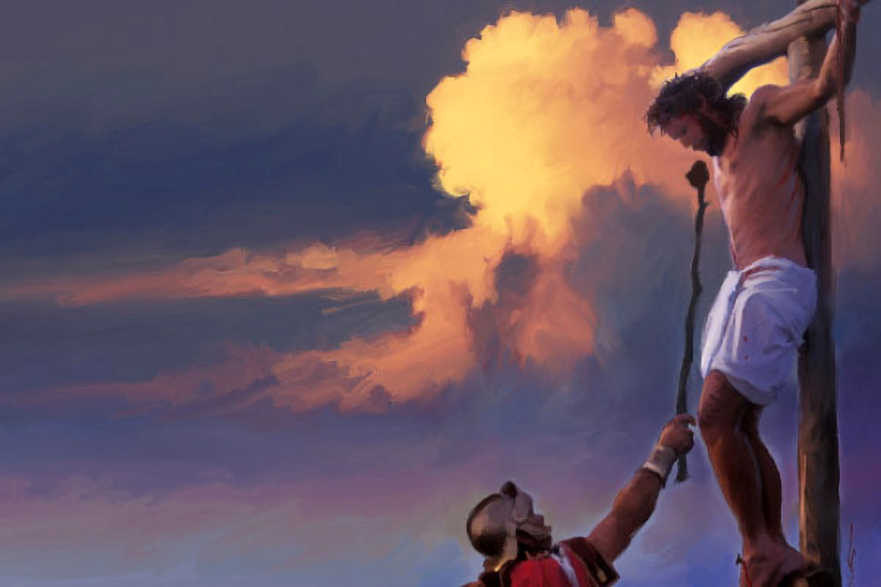
They Would Give Him Gall and Vinegar to Drink
They gave me also gall for my meat; and in my thirst they gave me vinegar to drink. (Psalms 69:21)
And when they were come unto a place called Golgotha, that is to say, a place of a skull, They gave him vinegar to drink mingled with gall: and when he had tasted thereof, he would not drink. (Matthew 27:33-34)

Slide 33
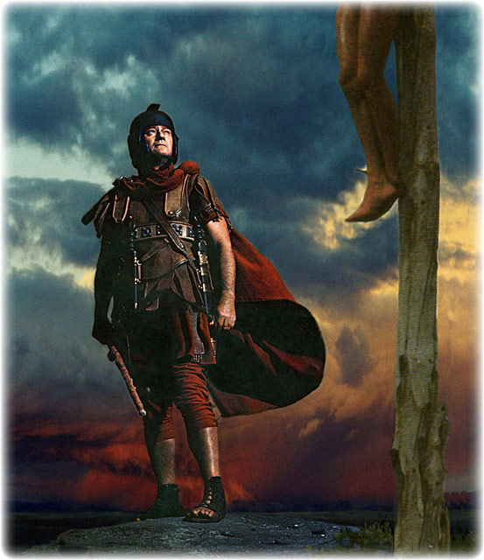
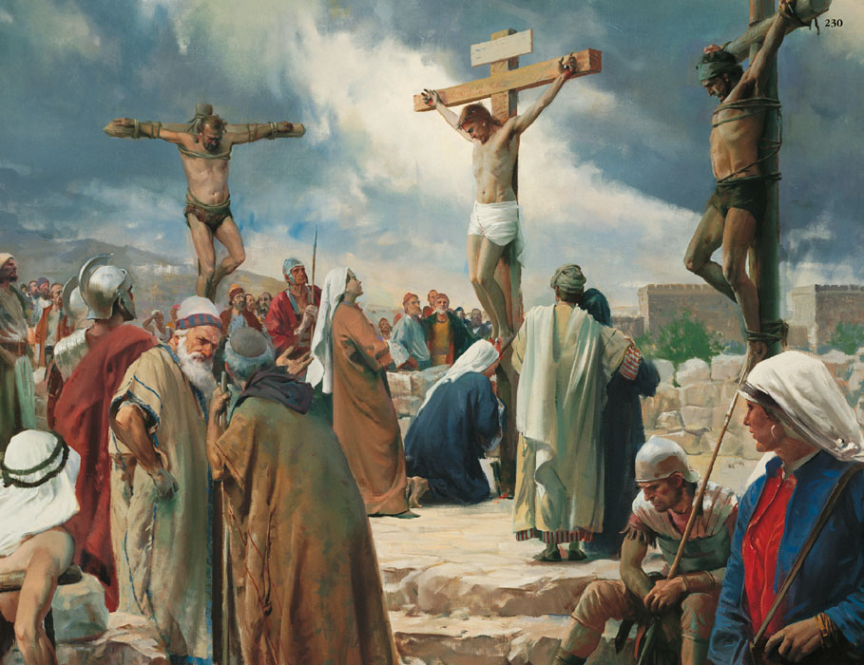
They Wouldn’t Break His Bones
He keepeth all his bones: not one of them is broken. (Psalms 34:20)
Then came the soldiers, and brake the legs of the first, and of the other which was crucified with him. But when they came to Jesus, and saw that he was dead already, they brake not his legs: But one of the soldiers with a spear pierced his side, and forthwith came there out blood and water. And he that saw it bare record, and his record is true: and he knoweth that he saith true, that ye might believe. For these things were done, that the scripture should be fulfilled, A bone of him shall not be broken. (John 19:32-36)

Slide 34
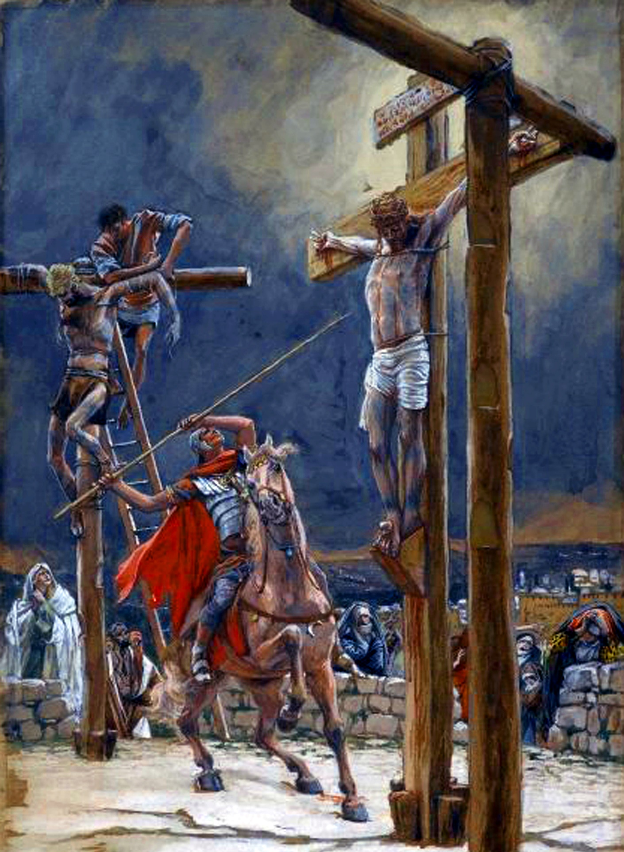
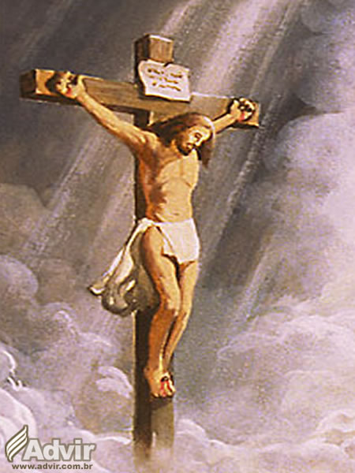
They Would Pierce His Side
And I will pour upon the house of David, and upon the inhabitants of Jerusalem, the spirit of grace and of supplications: and they shall look upon me whom they have pierced, and they shall mourn for him, as one mourneth for his only son, and shall be in bitterness for him, as one that is in bitterness for his firstborn. (Zechariah 12:10)
But one of the soldiers with a spear pierced his side, and forthwith came there out blood and water. And he that saw it bare record, and his record is true: and he knoweth that he saith true, that ye might believe. For these things were done, that the scripture should be fulfilled, A bone of him shall not be broken. And again another scripture saith, They shall look on him whom they pierced. (John 19:34-37)

Slide 35
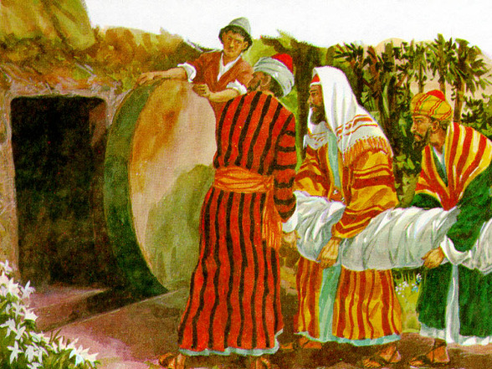
And he made his grave with the wicked, and with the rich in his death; because he had done no violence, neither was any deceit in his mouth.
(Isaiah 53:9)
When the even was come, there came a rich man of Arimathaea, named Joseph, who also himself was Jesus' disciple: He went to Pilate, and begged the body of Jesus. Then Pilate commanded the body to be delivered. And when Joseph had taken the body, he wrapped it in a clean linen cloth, And laid it in his own new tomb, which he had hewn out in the rock: and he rolled a great stone to the door of the sepulchre, and departed.
(Matthew 27:57-60)
Buried With the Rich

Slide 36
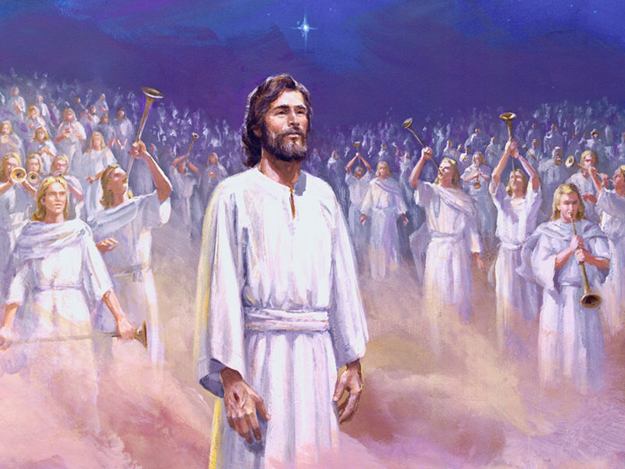
HIS GLORIFICATION

Slide 37


HE WOULD RISE FROM THE DEAD
For thou wilt not leave my soul in hell; neither wilt thou suffer thine Holy One to see corruption. (Psalms 16:10)
And he saith unto them, Be not affrighted: Ye seek Jesus of Nazareth, which was crucified: he is risen; he is not here: behold the place where they laid him. (Mark 16:6)

Slide 38

He Would Ascend to the Heavens
Thou hast ascended on high, thou hast led captivity captive: thou hast received gifts for men; yea, for the rebellious also, that the Lord God might dwell among them. (Psalms 68:18)
And when he had spoken these things, while they beheld, he was taken up; and a cloud received him out of their sight. (Acts 1:9)

Slide 39

The Lord said unto my Lord, Sit thou at my right hand, until I make thine enemies thy footstool.
(Psalms 110:1)
He Would Sit at the Right Hand of God
Who being the brightness of his glory, and the express image of his person, and upholding all things by the word of his power, when he had by himself purged our sins, sat down on the right hand of the Majesty on high.
(Hebrews 1:3)

Slide 40


He Would Be a Priest After the Order of Melchizedek
The Lord hath sworn, and will not repent, Thou art a priest for ever after the order of Melchizedek. (Psalms 110:4)
Whither the forerunner is for us entered, even Jesus, made an high priest for ever after the order of Melchisedec. (Hebrews 6:20)

Slide 41

As we have seen, Jesus Christ is the promised Messiah.
He is the child who was born in a manger; the One who died to save us; the One who is risen and is seated at the right hand of God; the One who intercedes for us; and the One who will one day come to look for us so that we can be with Him for eternity.
“He that believeth on the Son hath everlasting life: and he that believeth not the Son shall not see life; but the wrath of God abideth on him” (John 3:36).
“And this is the will of him that sent me, that every one which seeth the Son, and believeth on him, may have everlasting life: and I will raise him up at the last day” (John 6:40).
“Verily, verily, I say unto you, He that believeth on me hath everlasting life” (John 6:47).
“Who is he that overcometh the world, but he that believeth that Jesus is the Son of God?” (1 John 5:5)
“For God so loved the world, that he gave his only begotten Son, that whosoever believeth in him should not perish, but have everlasting life” (John 3:16).
It is urgent that you take a stand and make a choice on your part. Accept Jesus Christ as your Savior and assume Him as your Lord and Owner.

