Slide 1
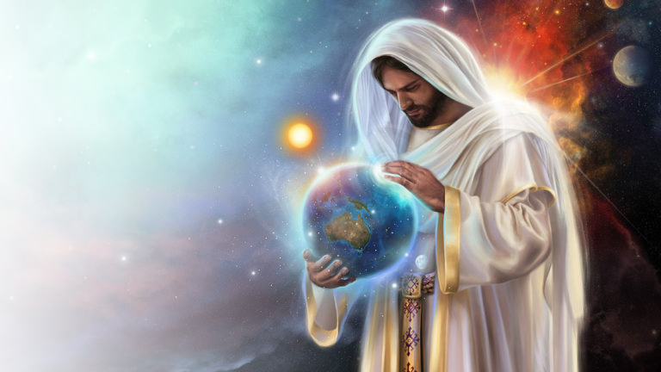

Psalm 104

Slide 2

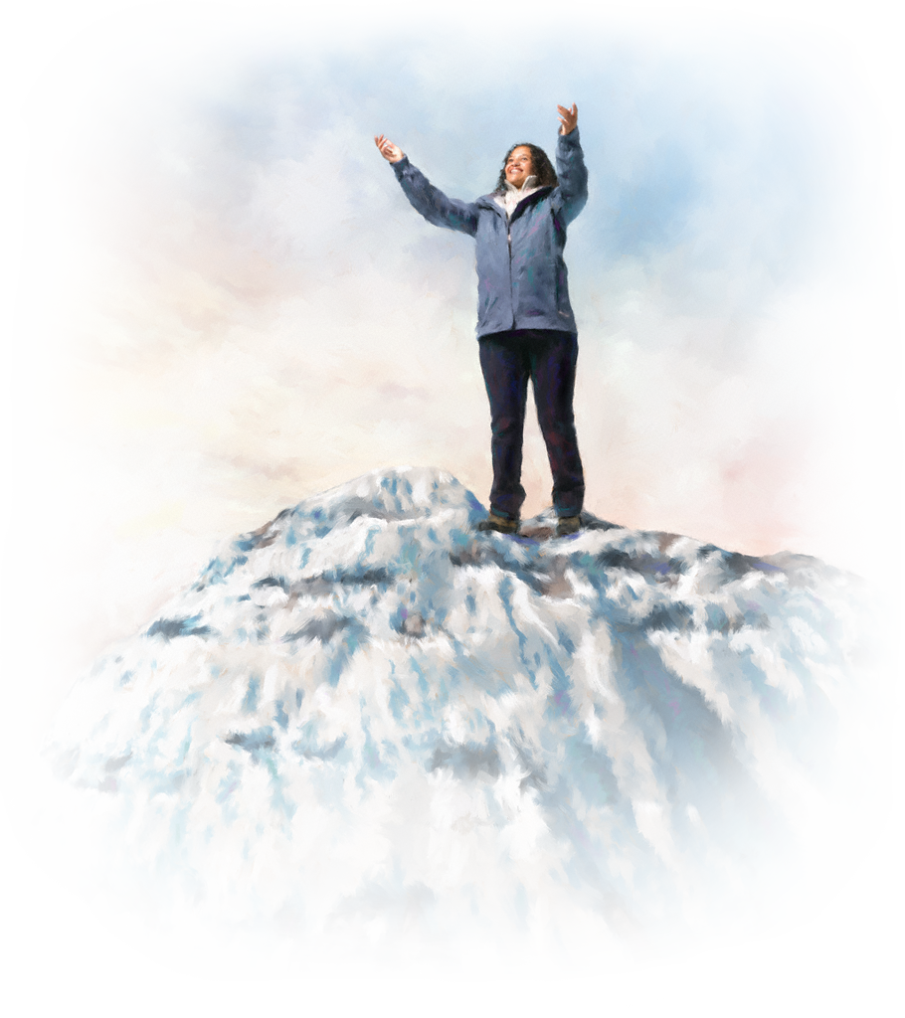
Bless the Lord, O my soul. O Lord my God, thou art very great; thou art clothed with honour and majesty.

Slide 3
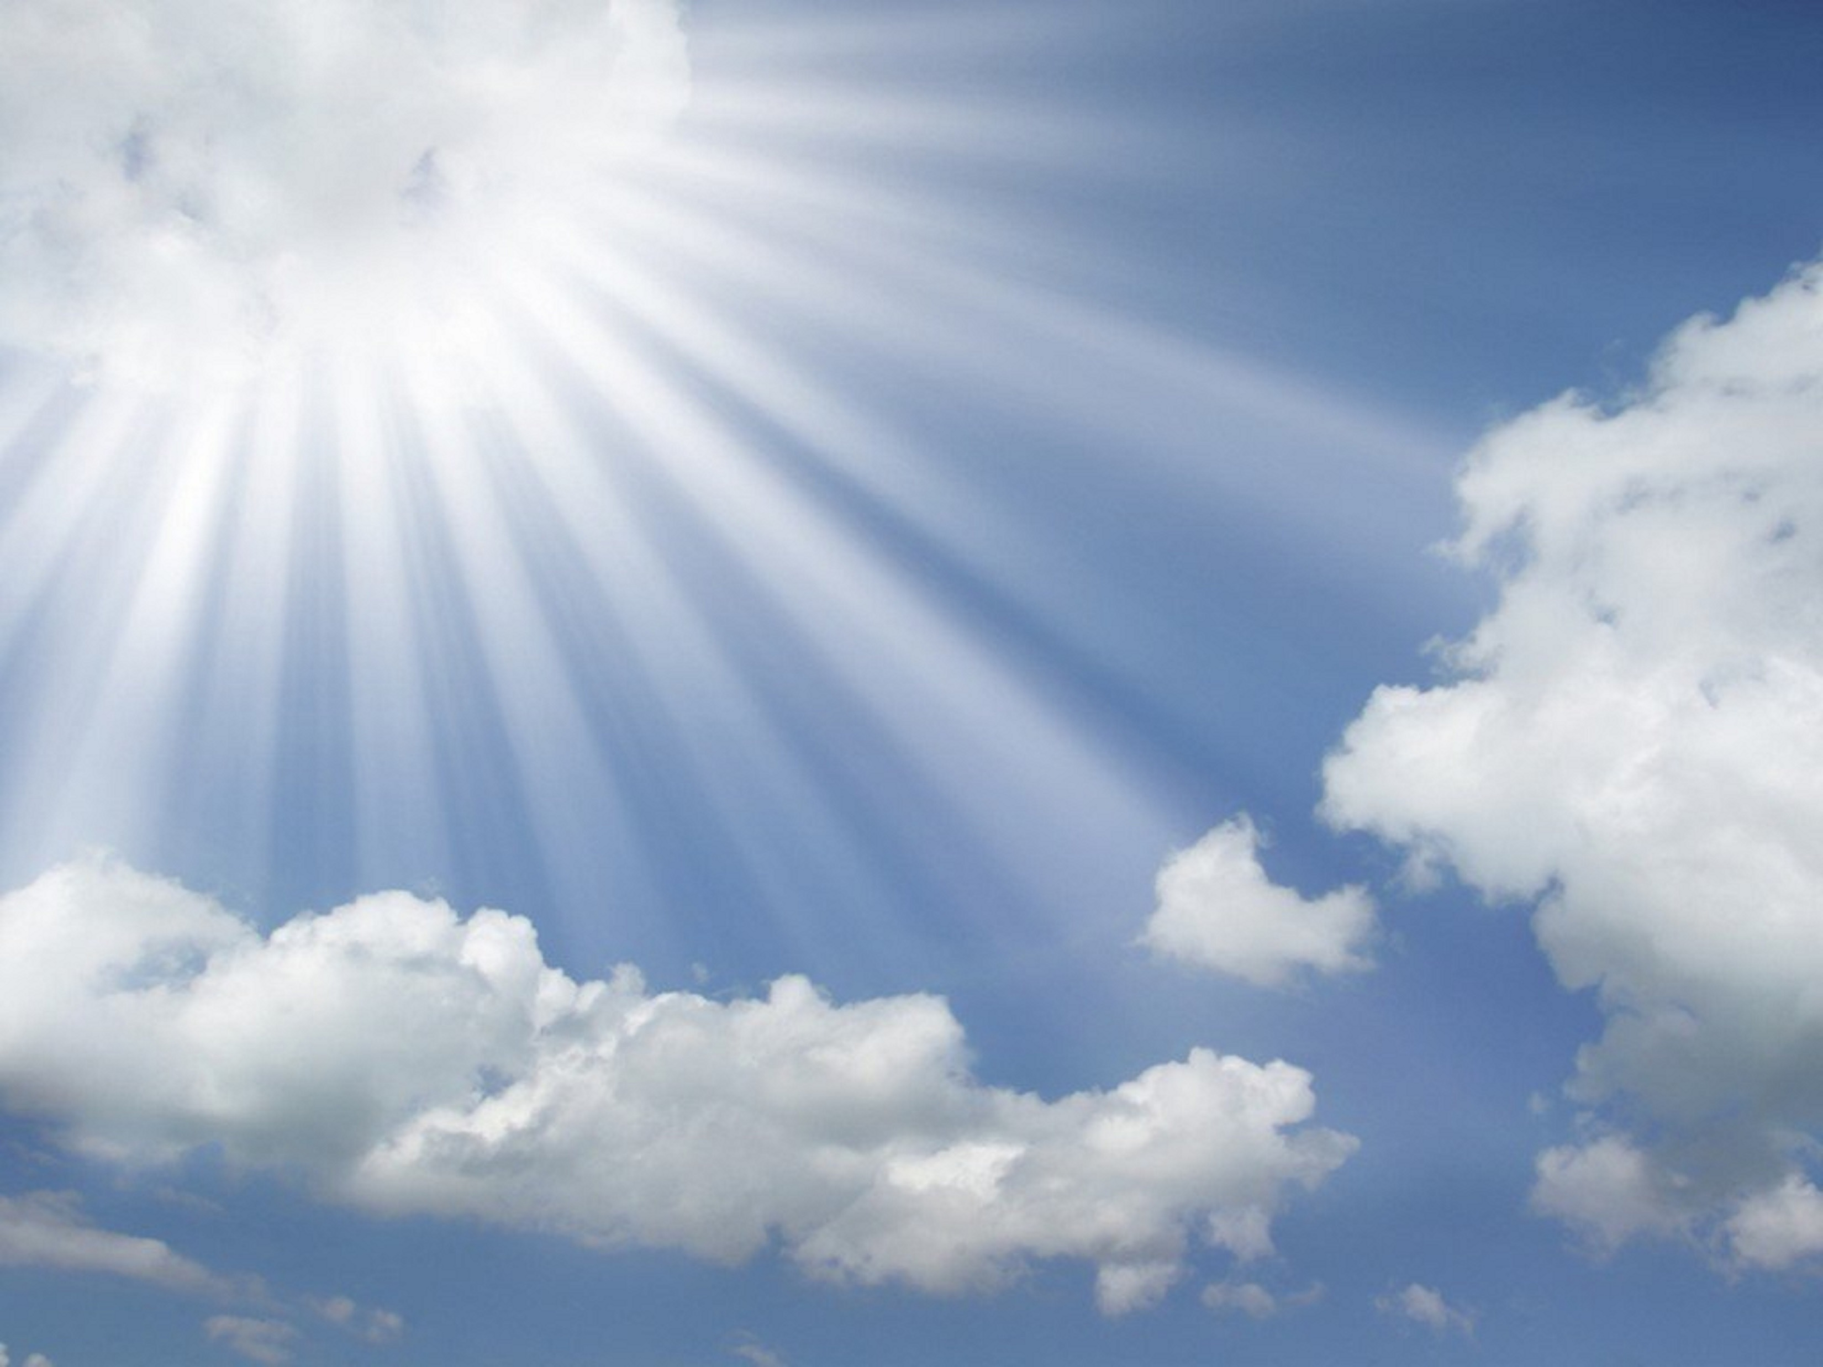
Who coverest thyself with light as with a garment: who stretchest out the heavens like a curtain:

Slide 4
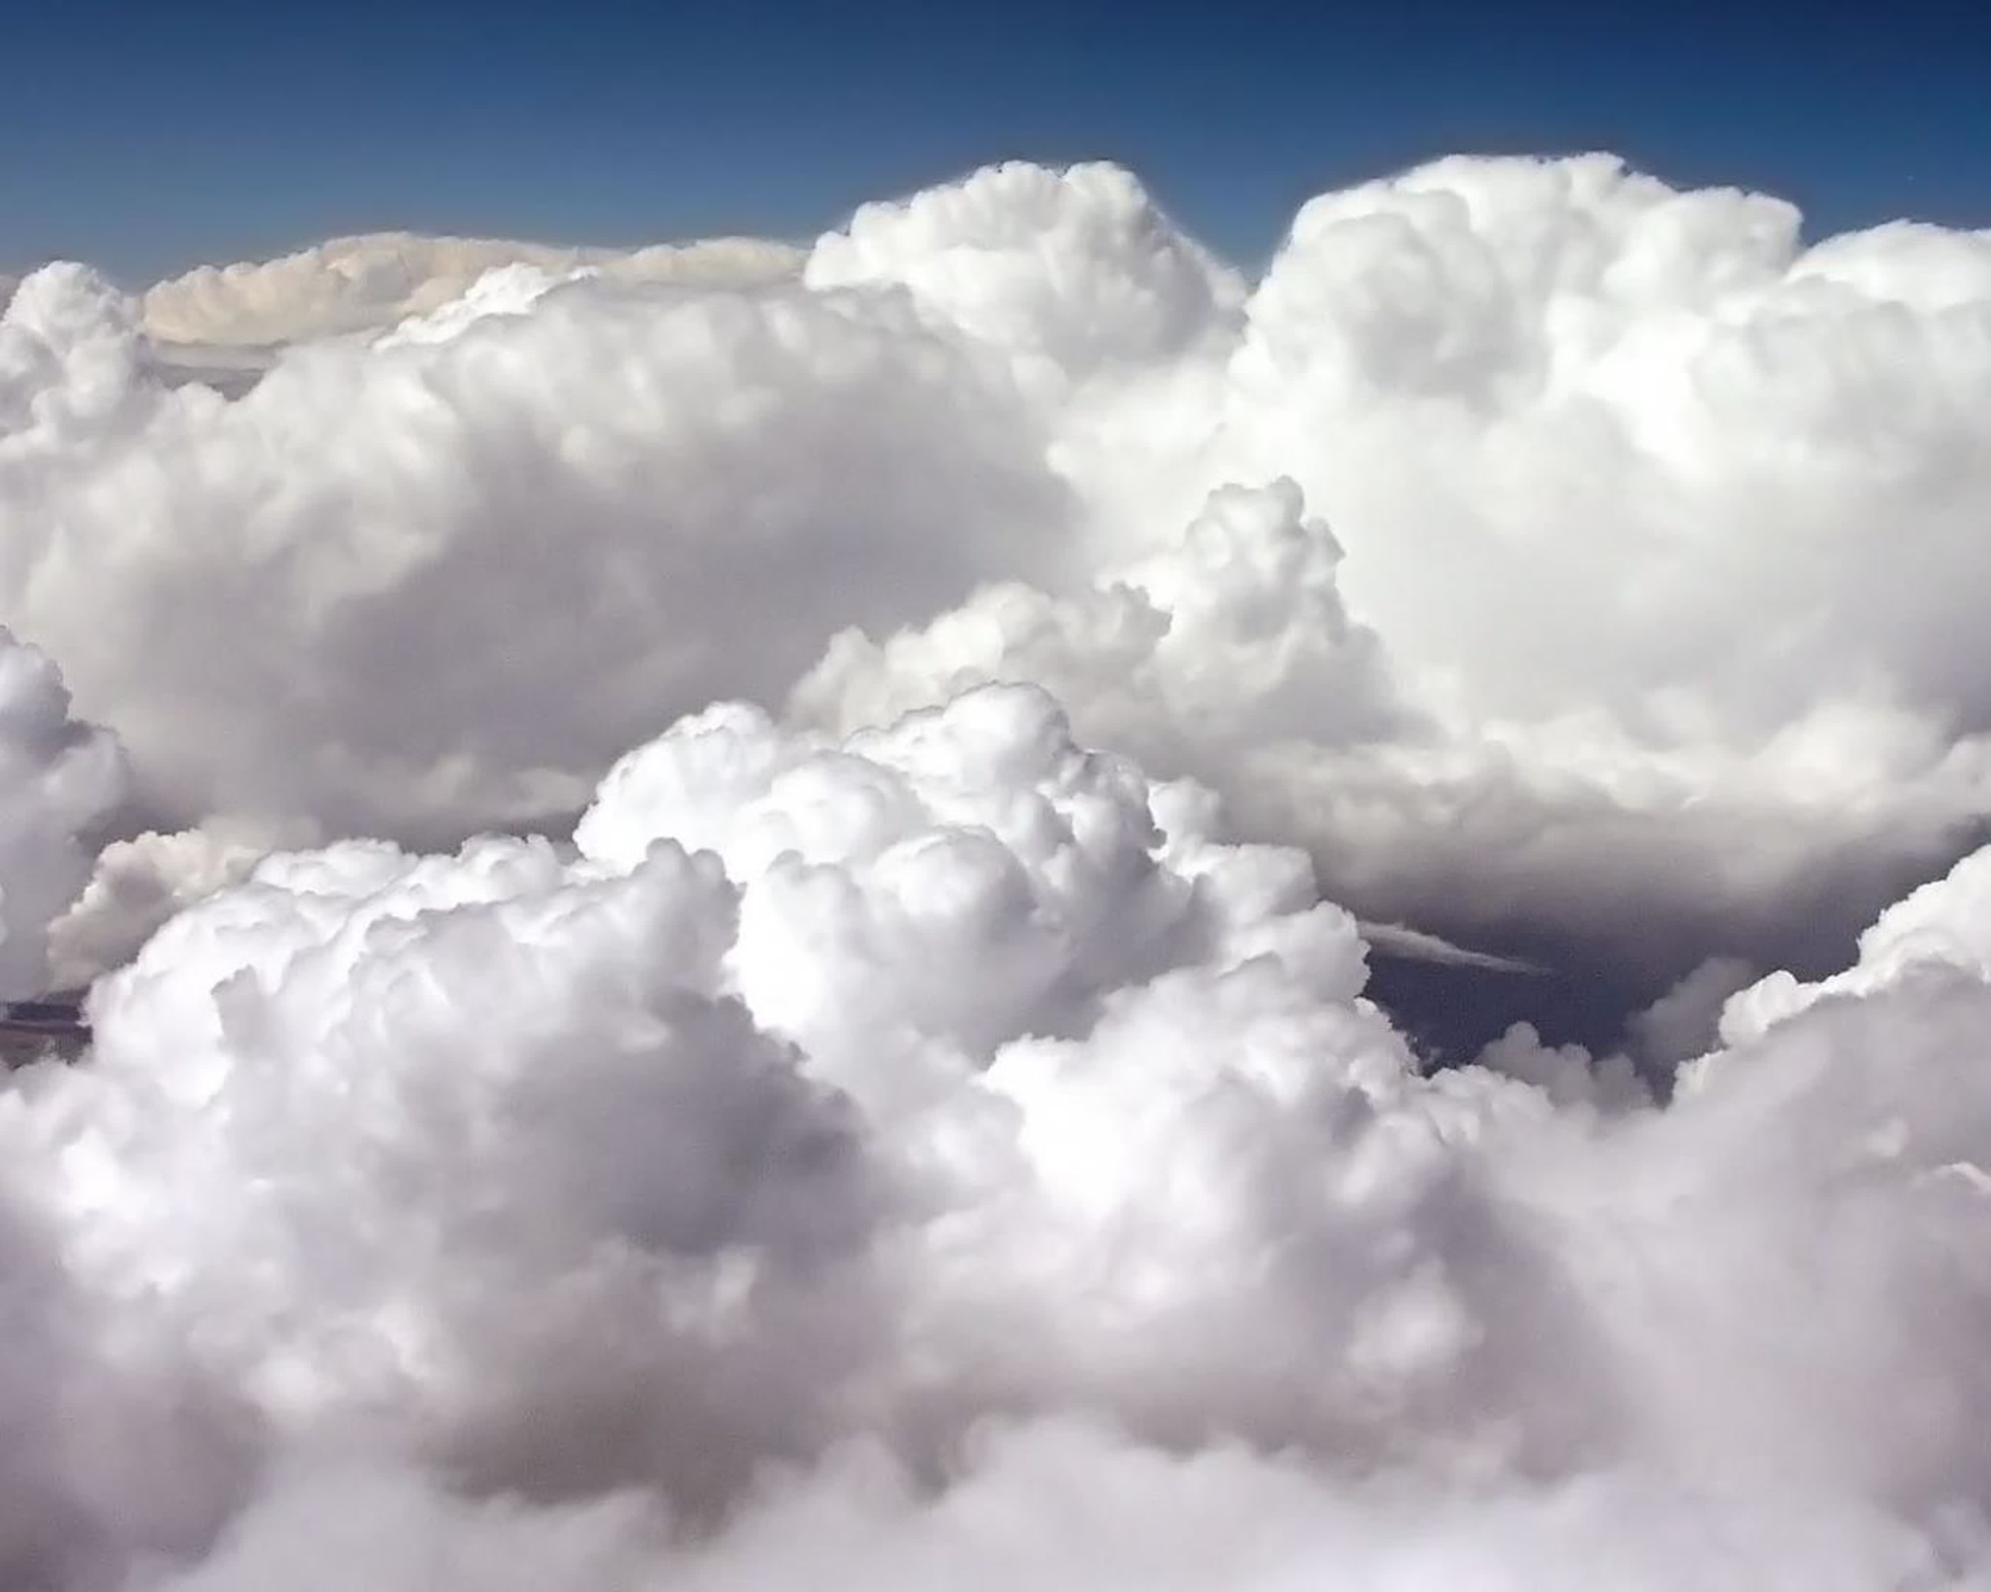
Who layeth the beams of his chambers in the waters: who maketh the clouds his chariot: who walketh upon the wings of the wind:

Slide 5
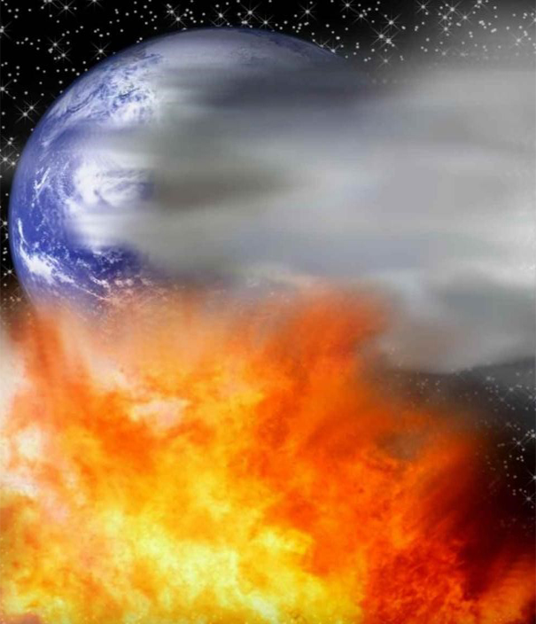

Who maketh his angels spirits; his ministers a flaming fire:

Slide 6
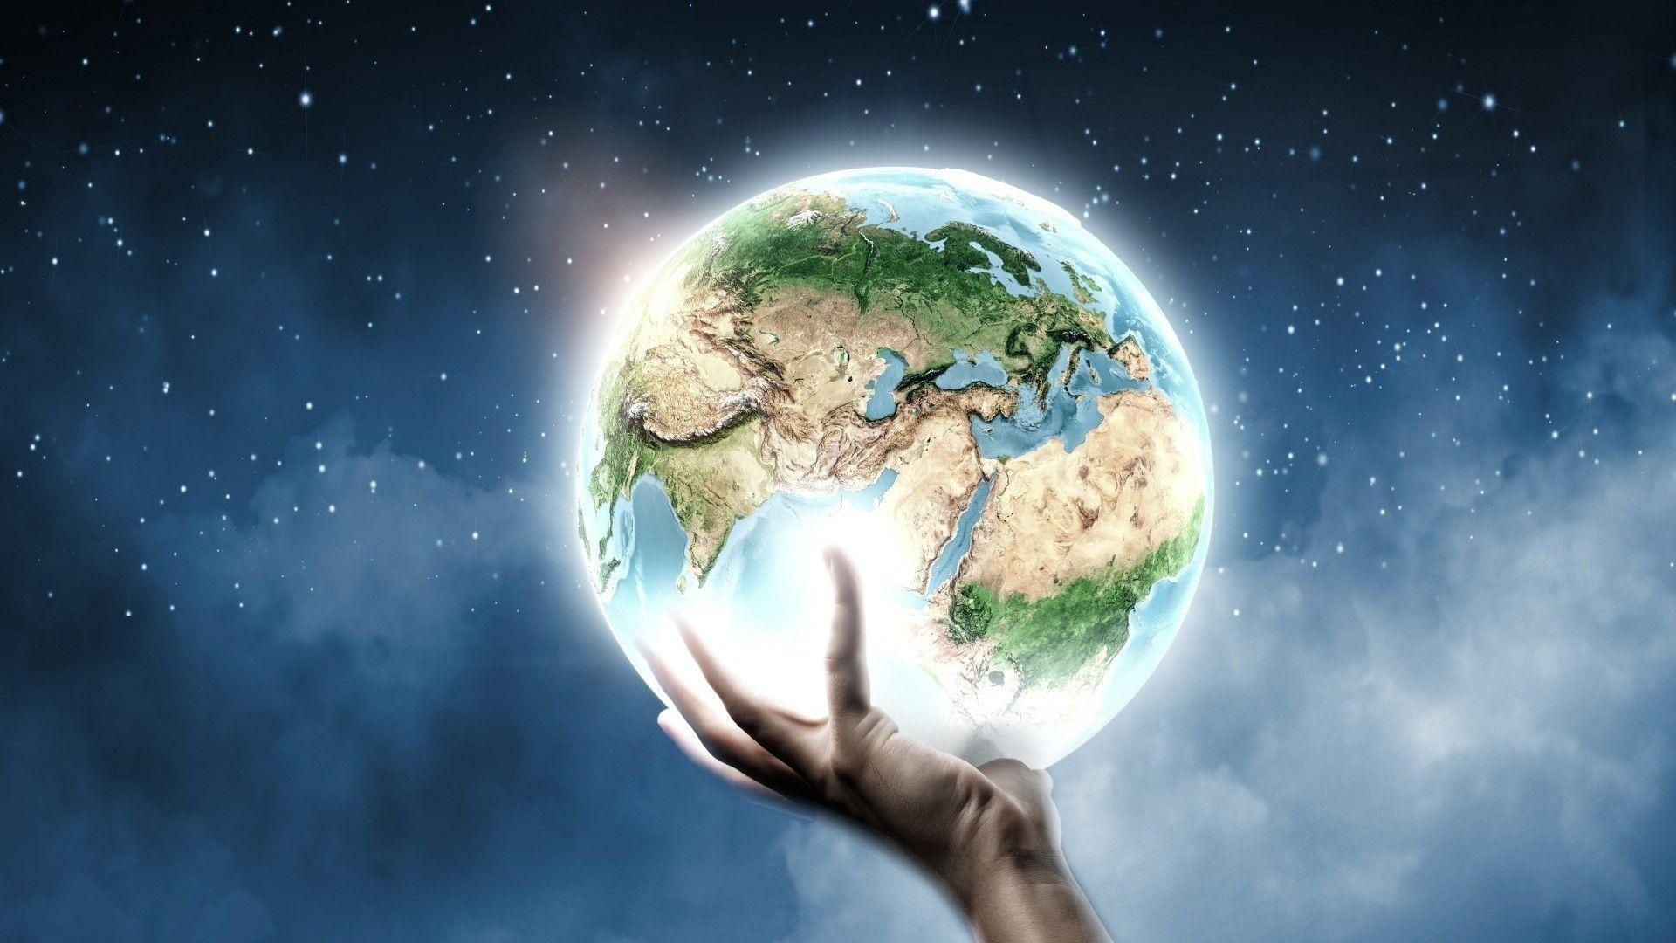
Who laid the foundations of the earth, that it should not be removed for ever.

Slide 7
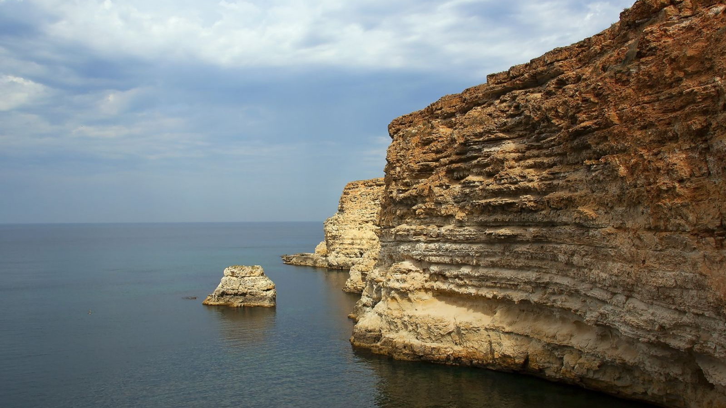
Thou coveredst it with the deep as with a garment: the waters stood above the mountains.

Slide 8
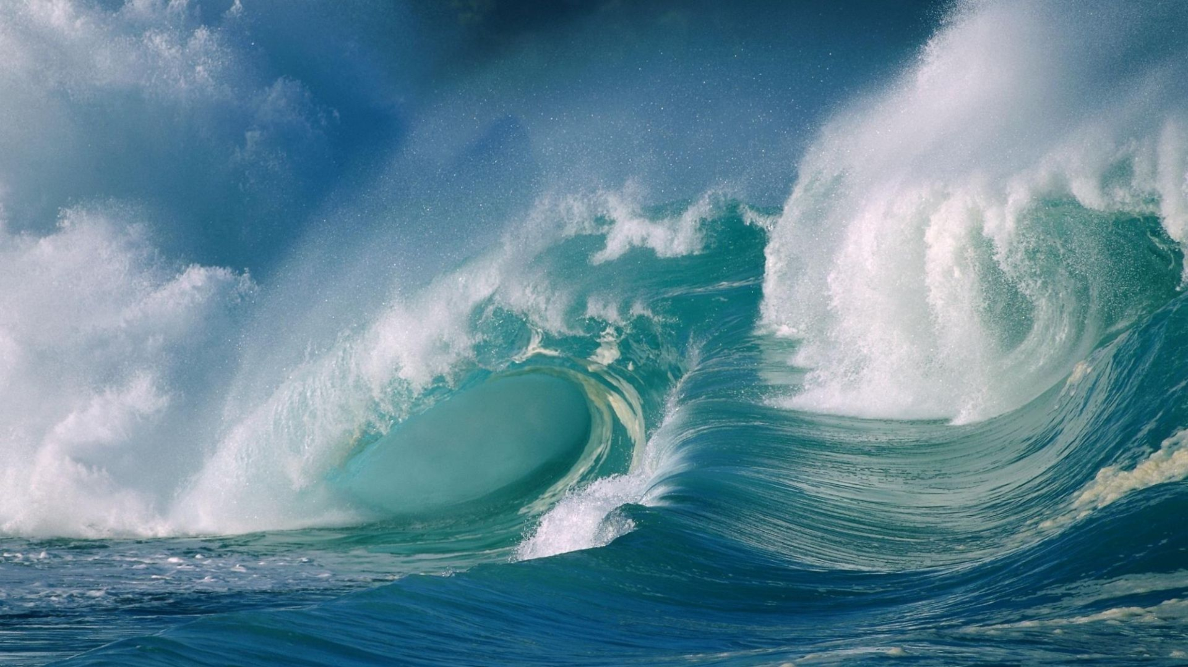
At thy rebuke they fled; at the voice of thy thunder they hasted away.

Slide 9
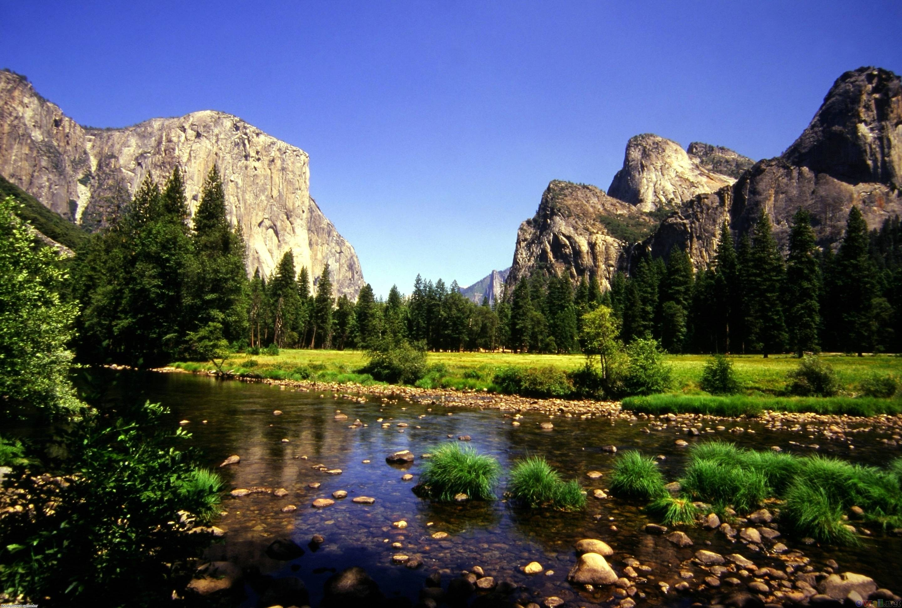
They go up by the mountains; they go down by the valleys unto the place which thou hast founded for them.

Slide 10
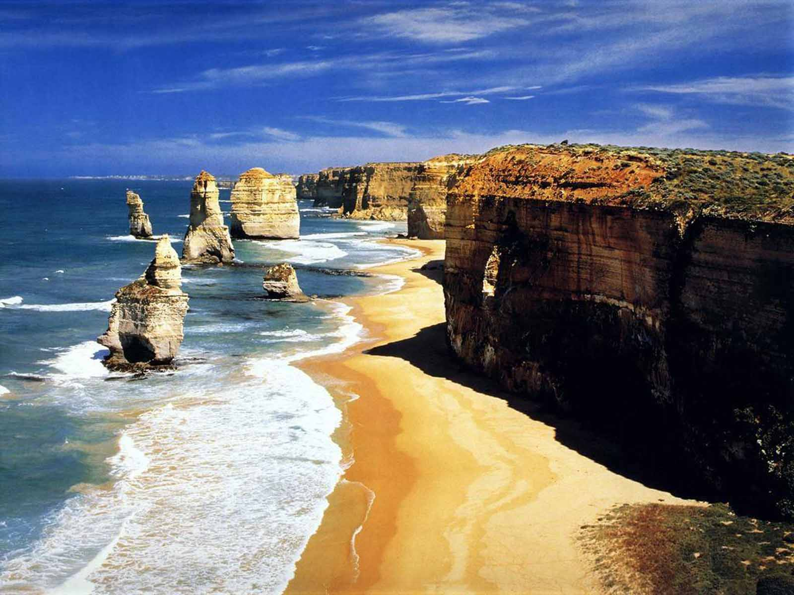
Thou hast set a bound that they may not pass over; that they turn not again to cover the earth.

Slide 11
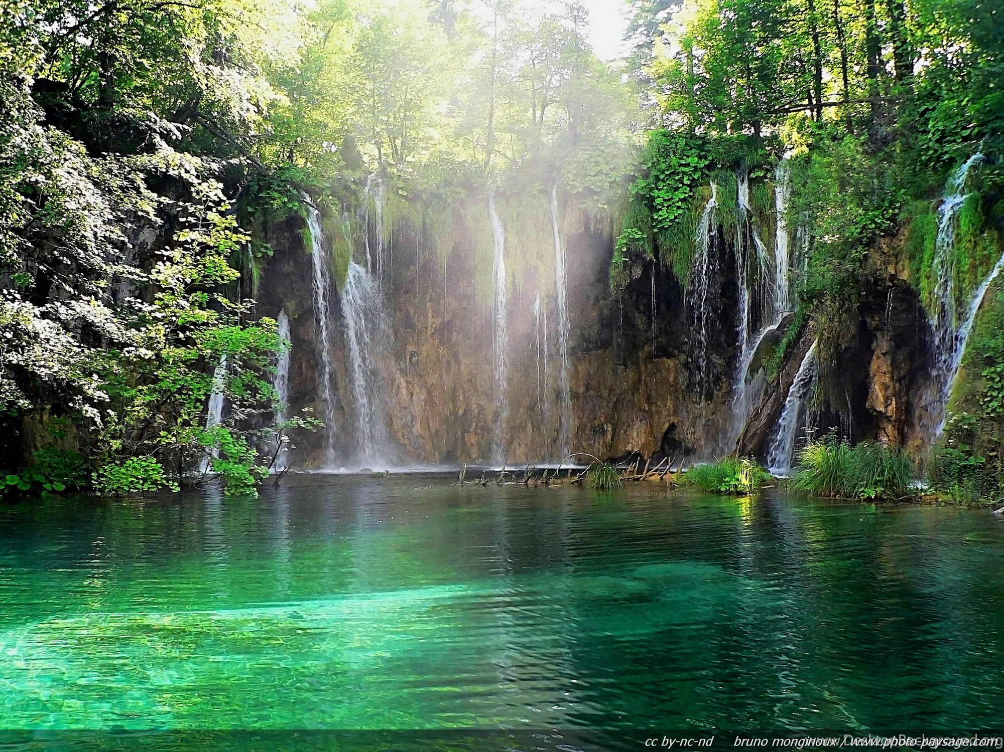
He sendeth the springs into the valleys, which run among the hills.

Slide 12
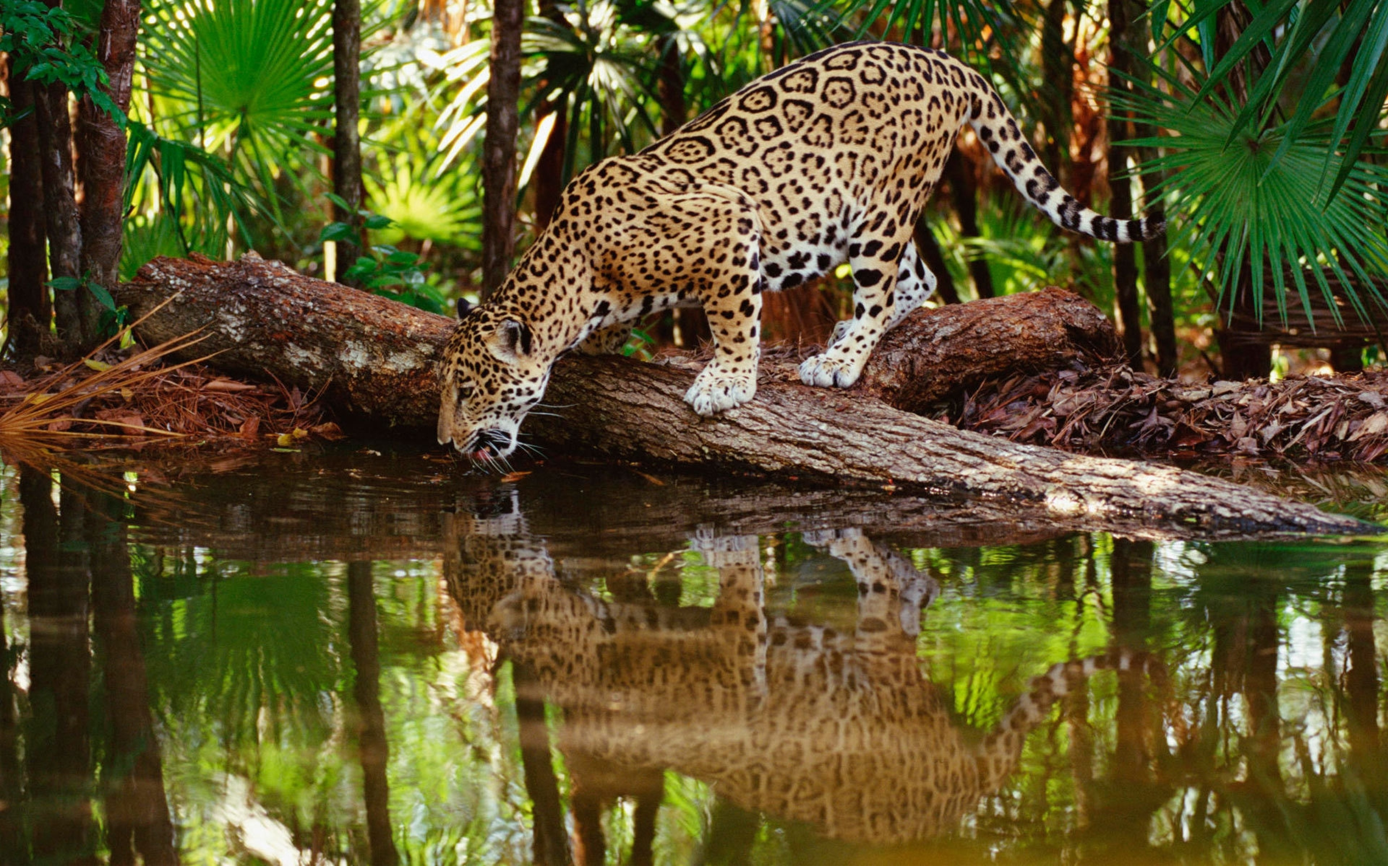
They give drink to every beast of the field: the wild asses quench their thirst.

Slide 13
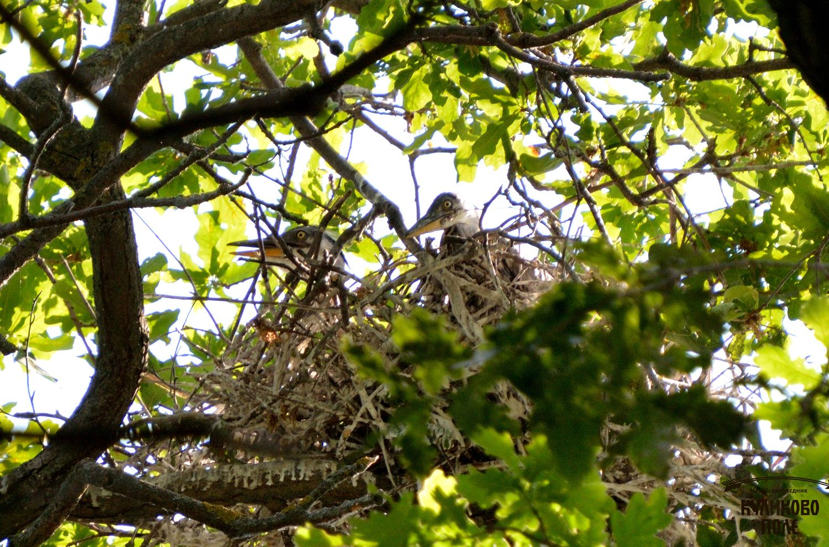
By them shall the fowls of the heaven have their habitation, which sing among the branches.

Slide 14
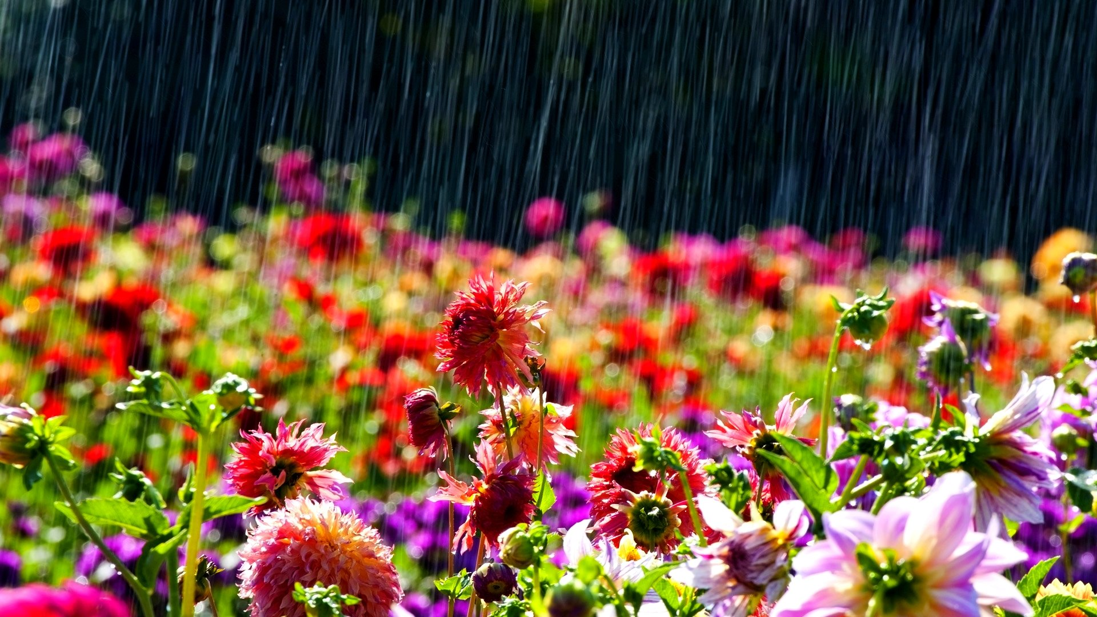
He watereth the hills from his chambers: the earth is satisfied with the fruit of thy works.

Slide 15
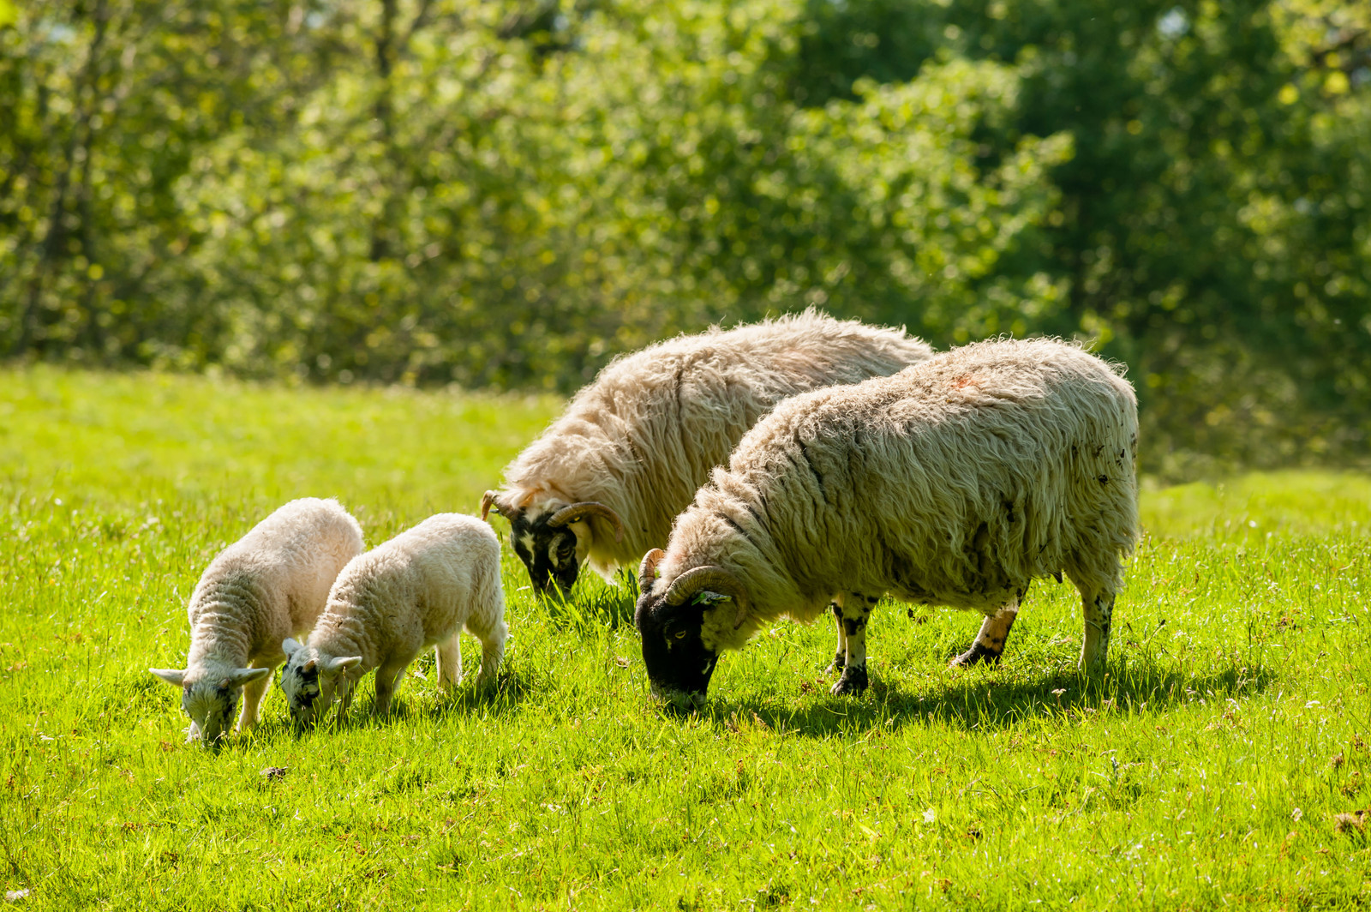
He causeth the grass to grow for the cattle, and herb for the service of man: that he may bring forth food out of the earth;

Slide 16
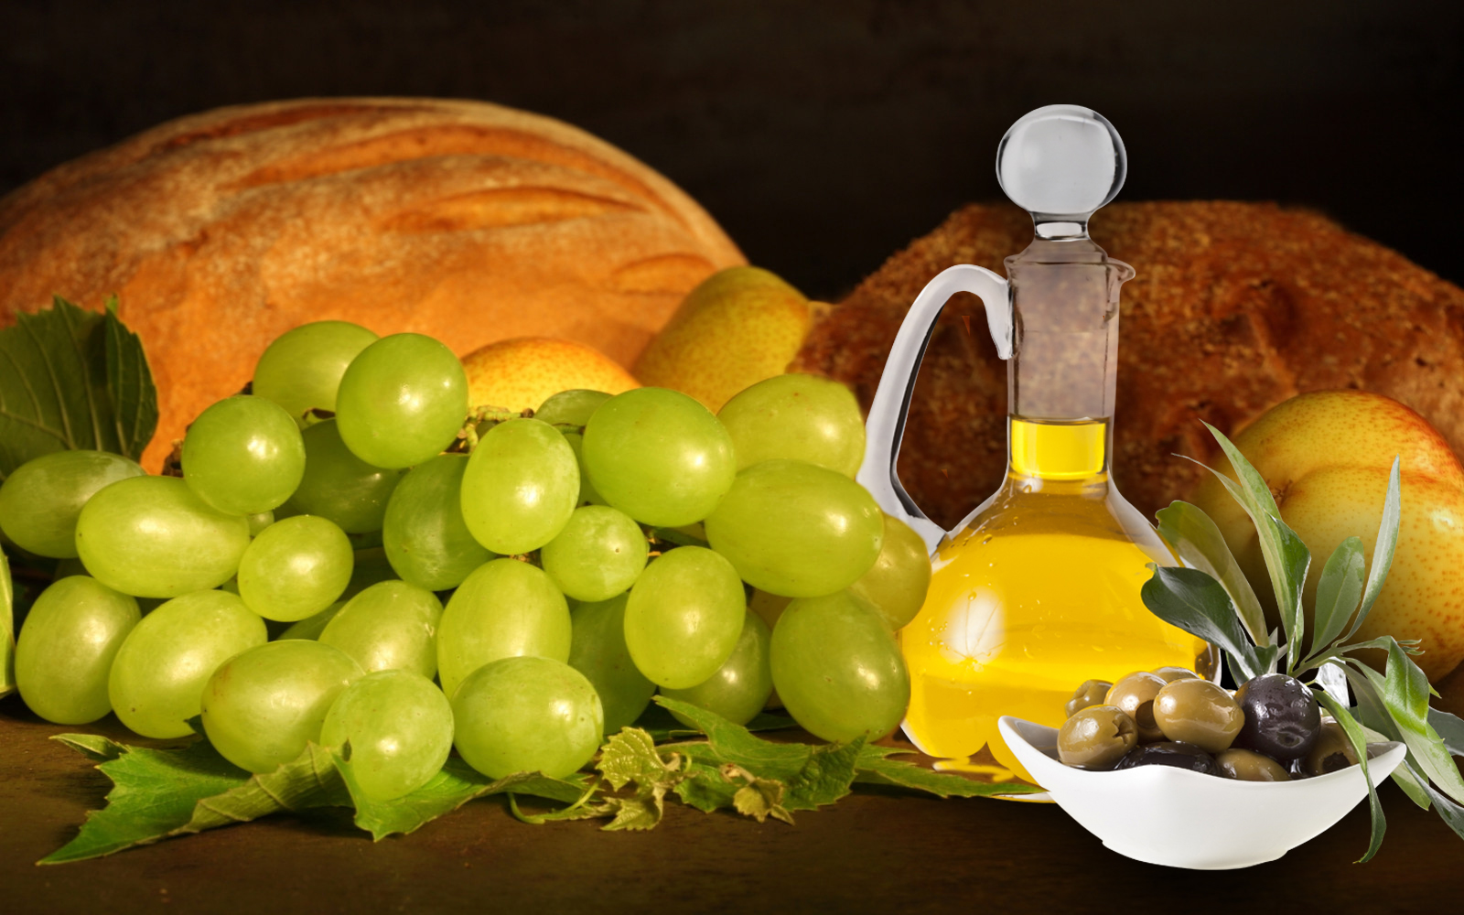
And wine that maketh glad the heart of man, and oil to make his face to shine, and bread which strengtheneth man's heart.

Slide 17
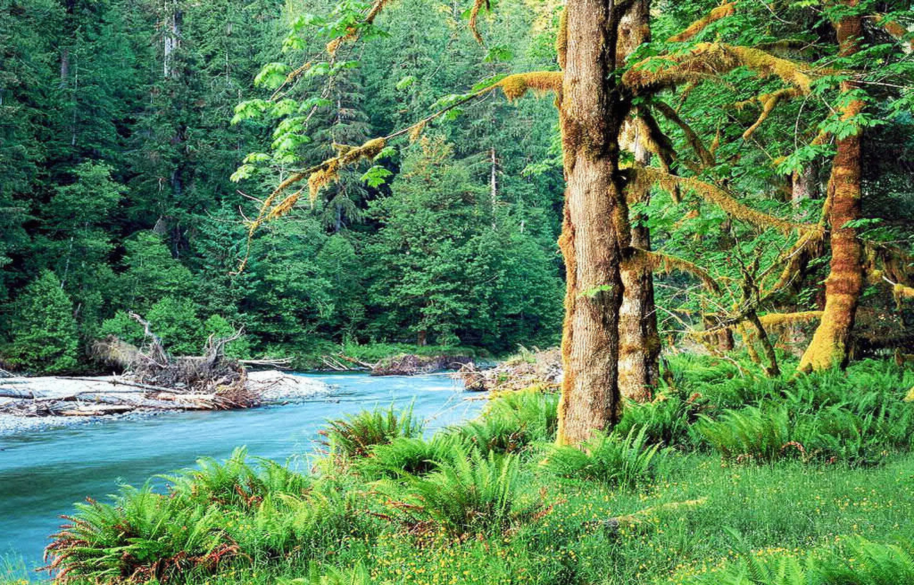
The trees of the Lord are full of sap; the cedars of Lebanon, which he hath planted;

Slide 18
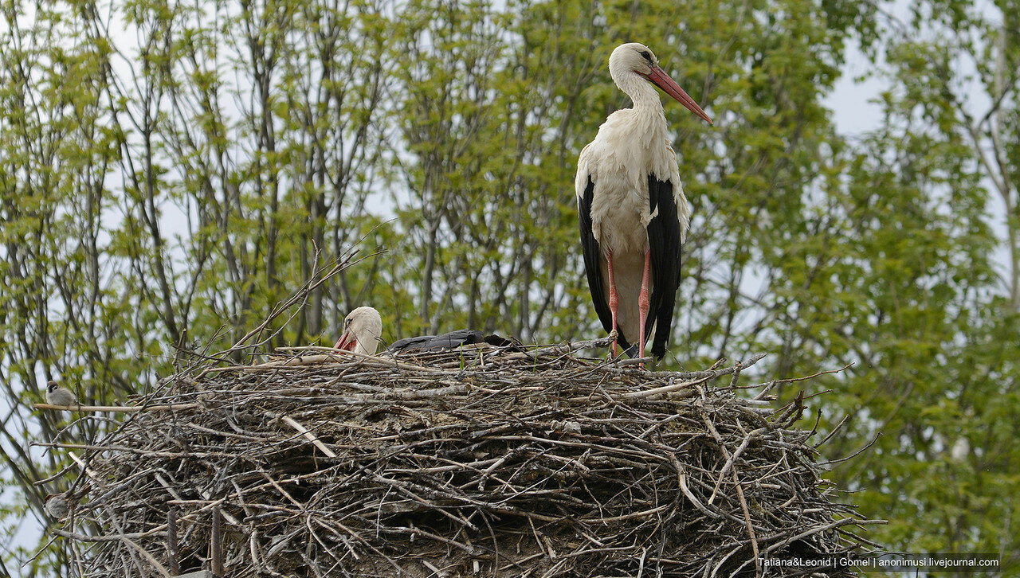
Where the birds make their nests: as for the stork, the fir trees are her house.

Slide 19
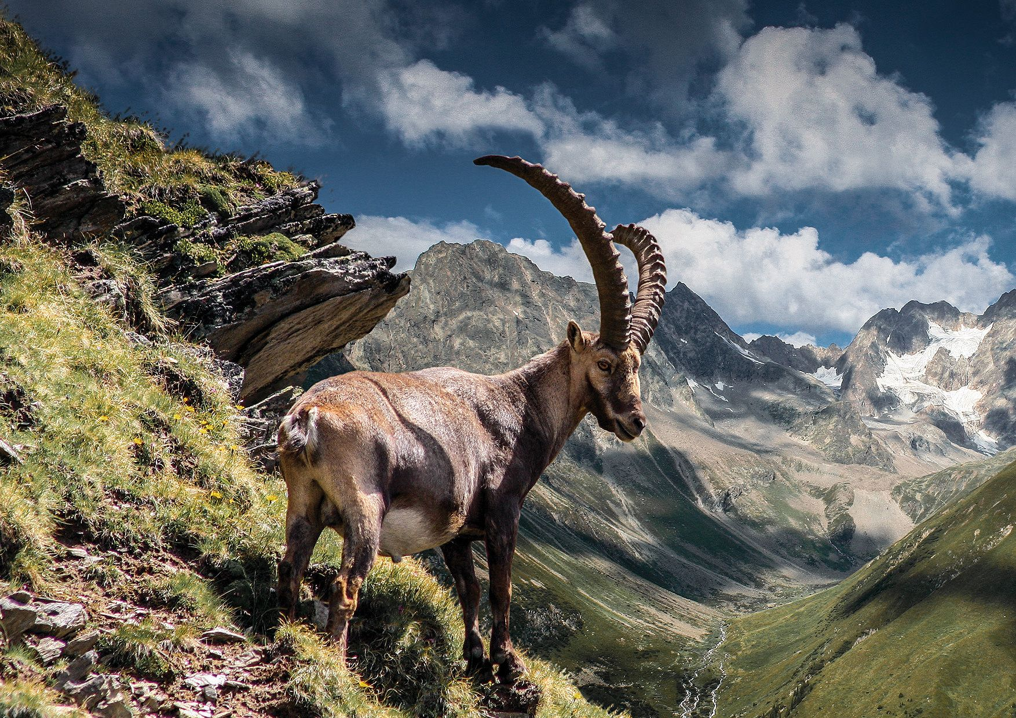
The high hills are a refuge for the wild goats; and the rocks for the conies.

Slide 20
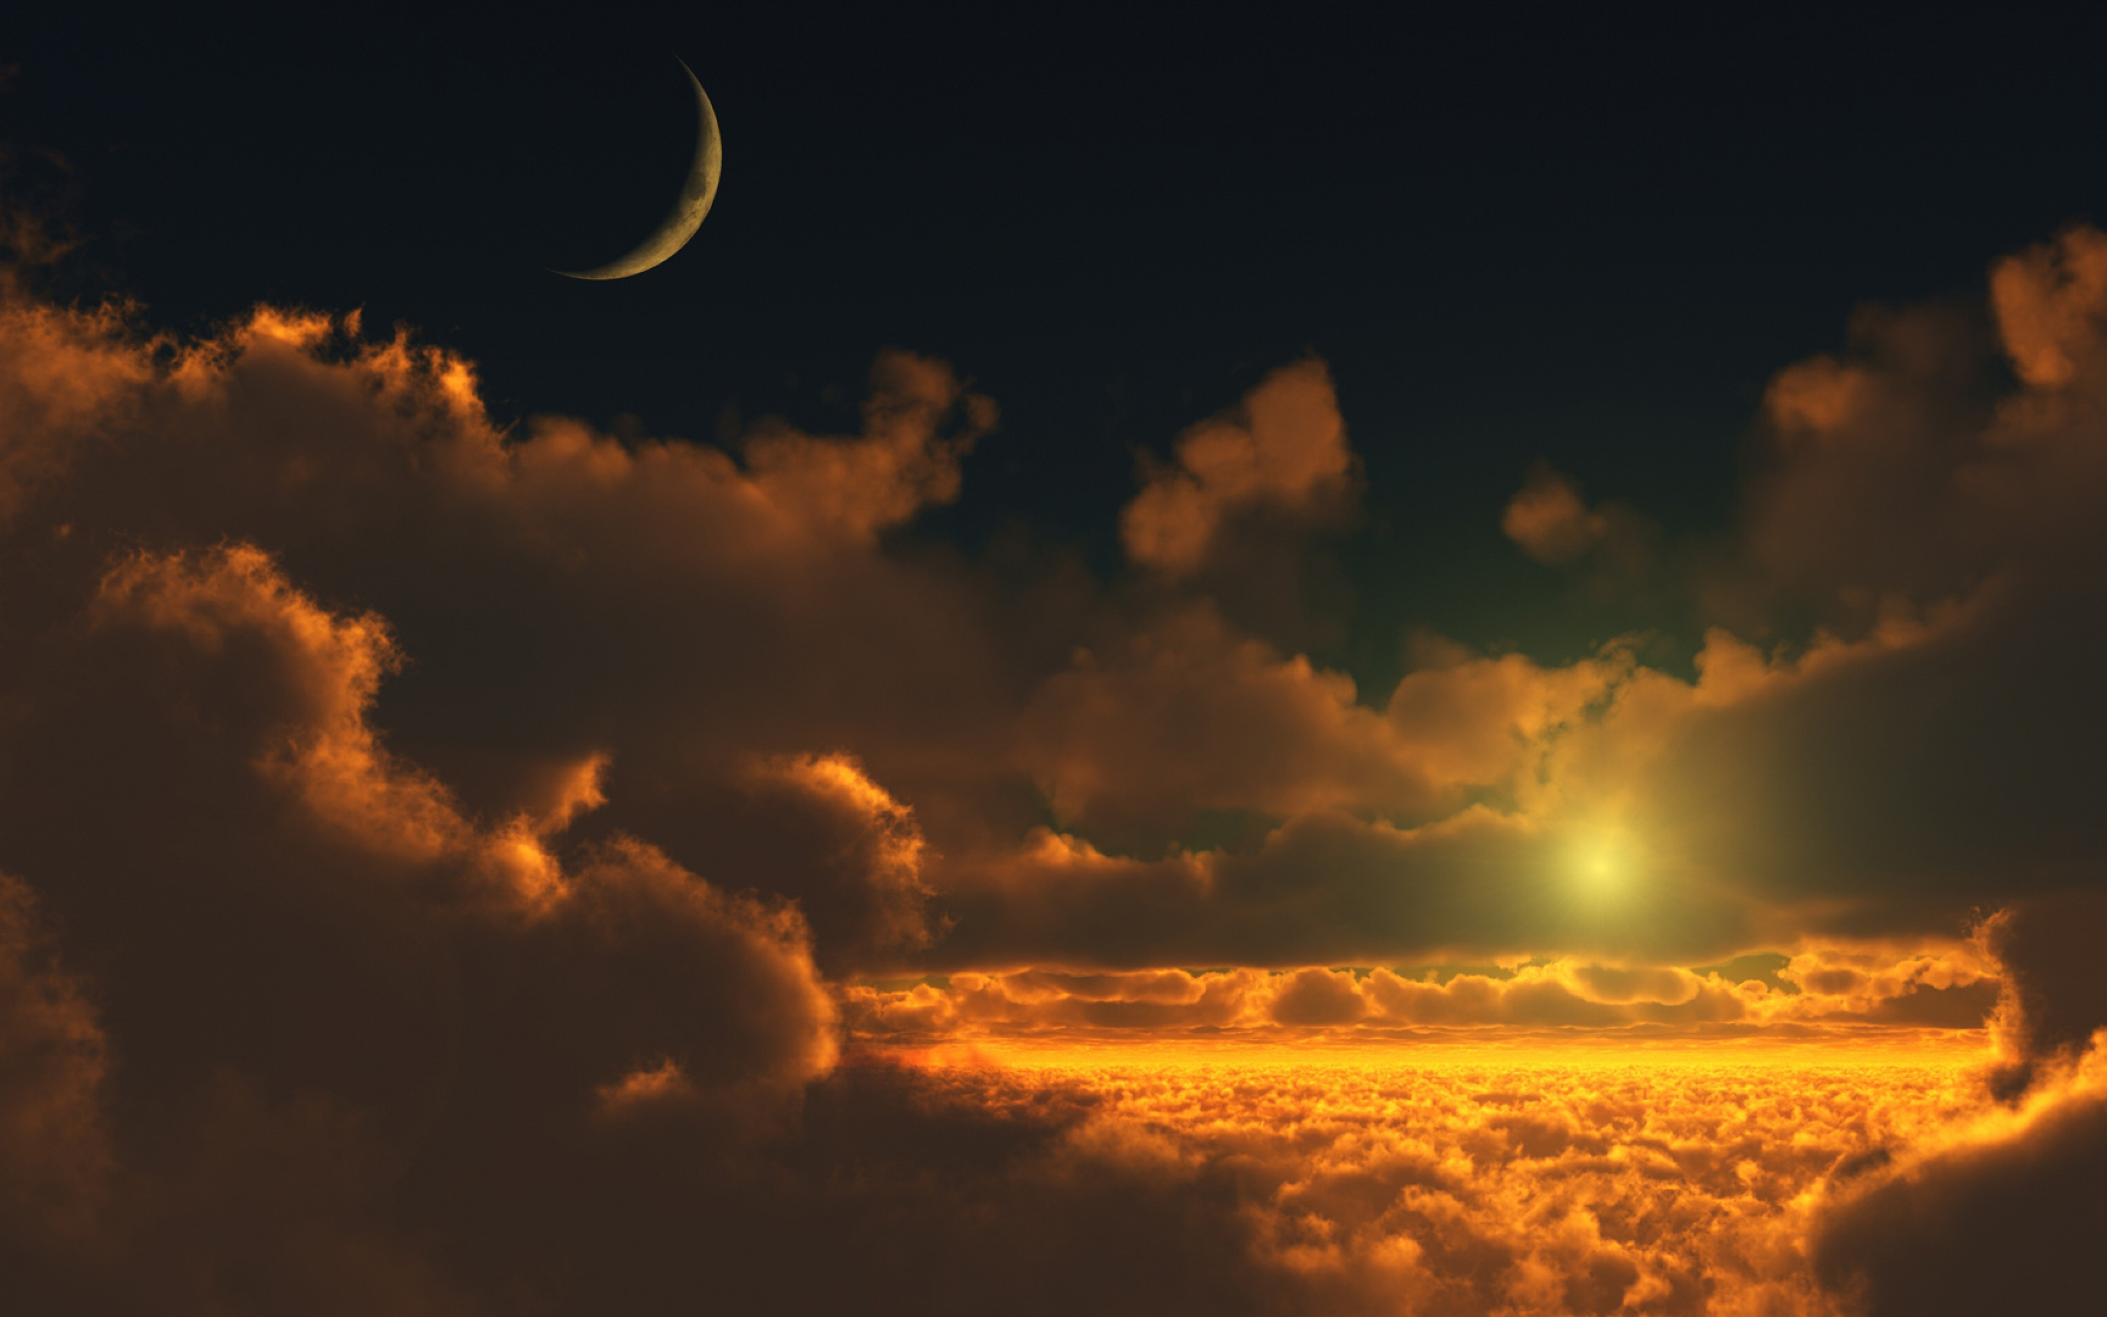
He appointed the moon for seasons: the sun knoweth his going down.

Slide 21
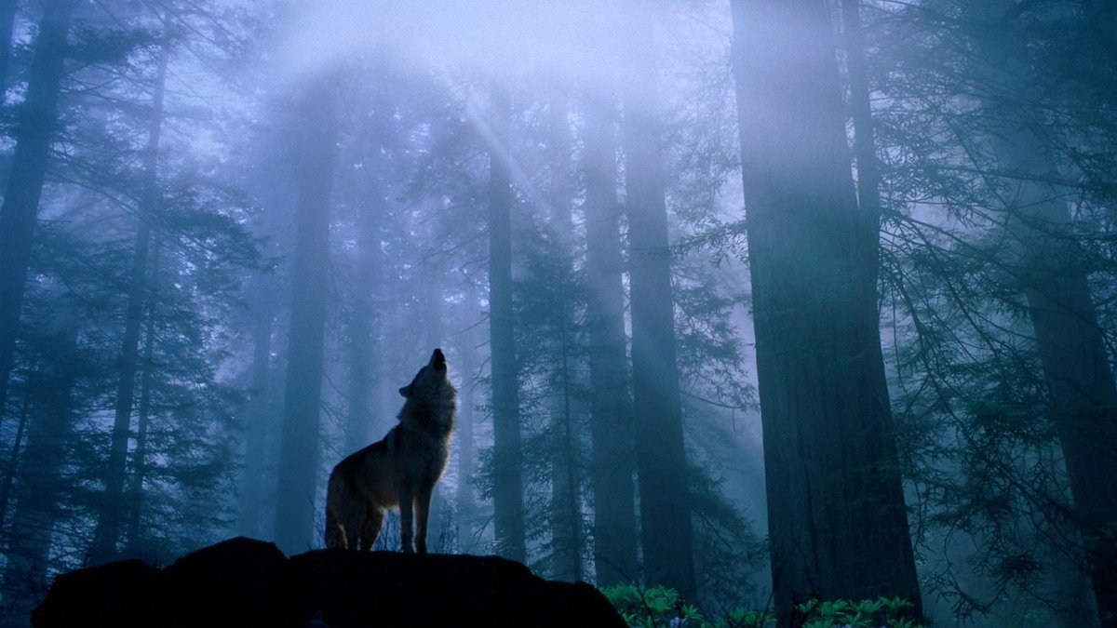
Thou makest darkness, and it is night: wherein all the beasts of the forest do creep forth.

Slide 22
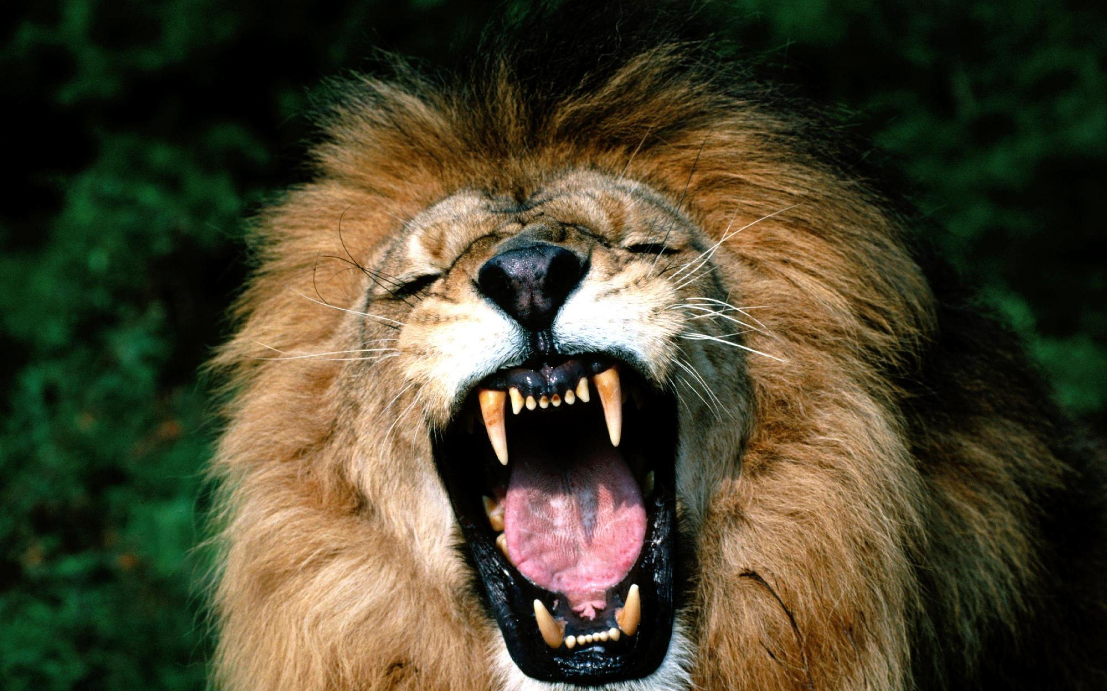
The young lions roar after their prey, and seek their meat from God.

Slide 23
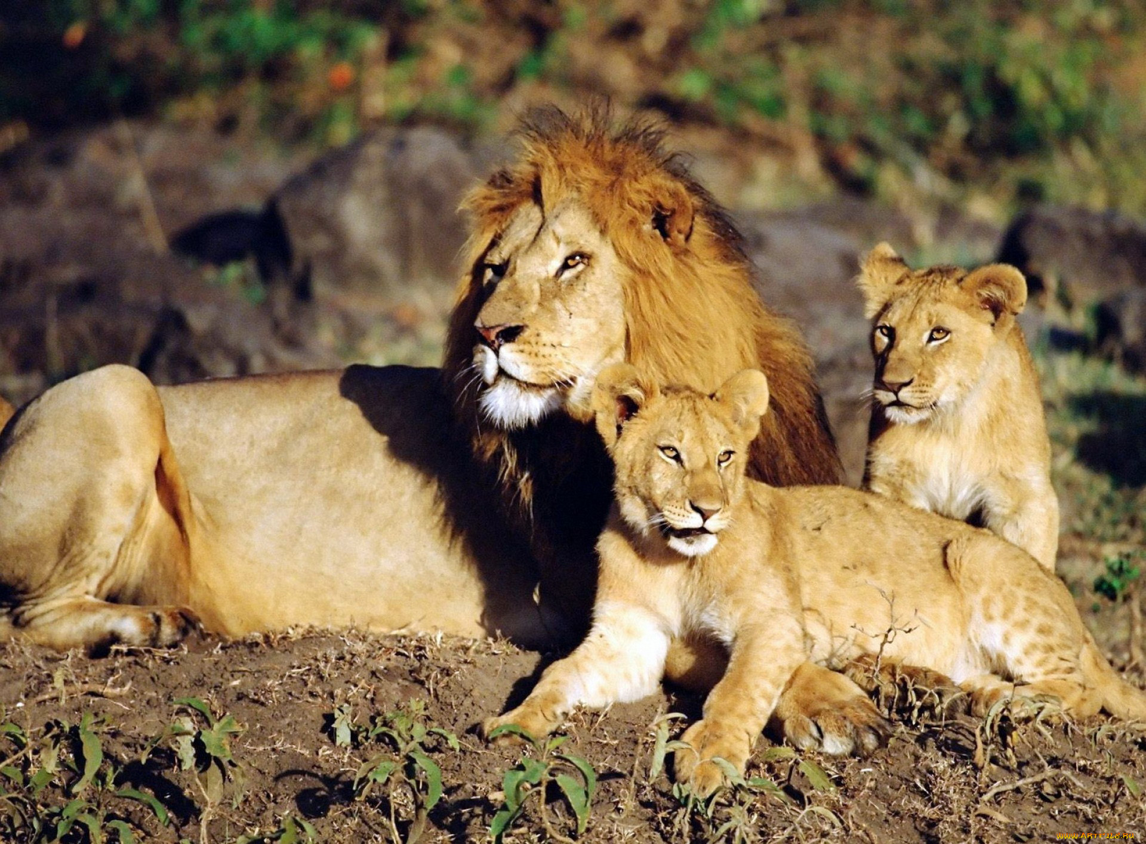
The sun ariseth, they gather themselves together, and lay them down in their dens.

Slide 24
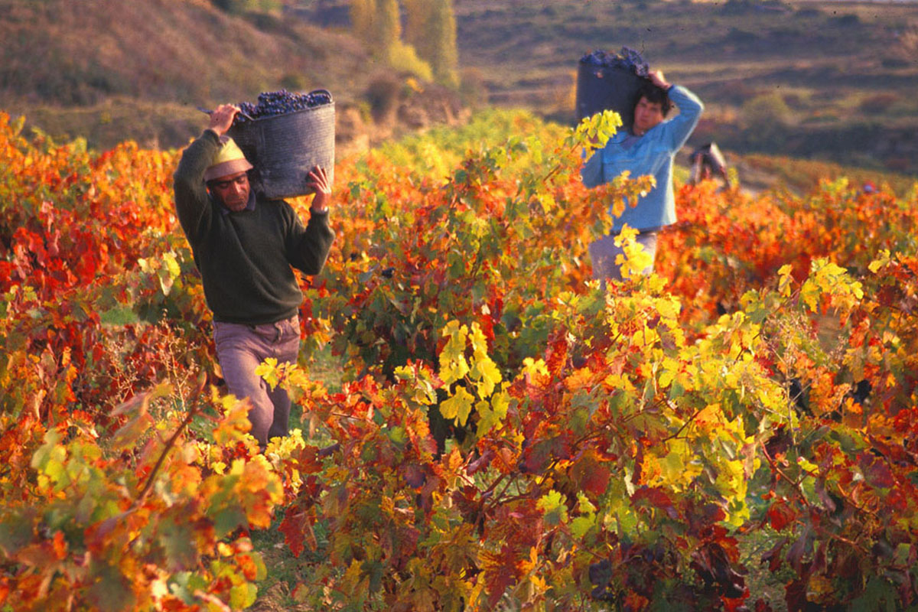
Man goeth forth unto his work and to his labour until the evening.

Slide 25

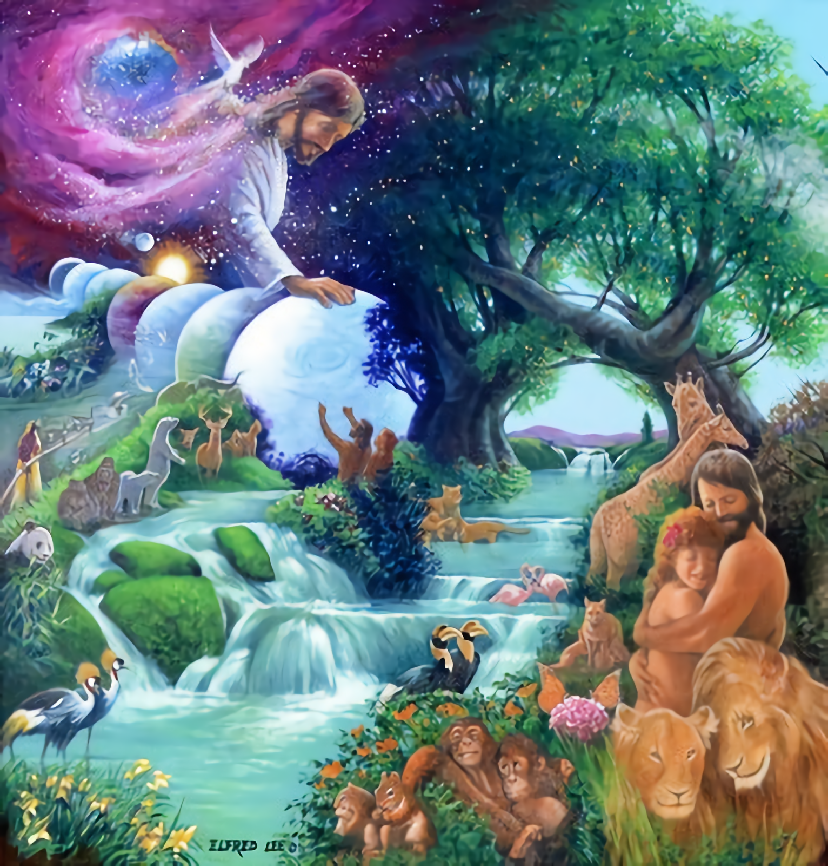
O Lord, how manifold are thy works! in wisdom hast thou made them all: the earth is full of thy riches.

Slide 26
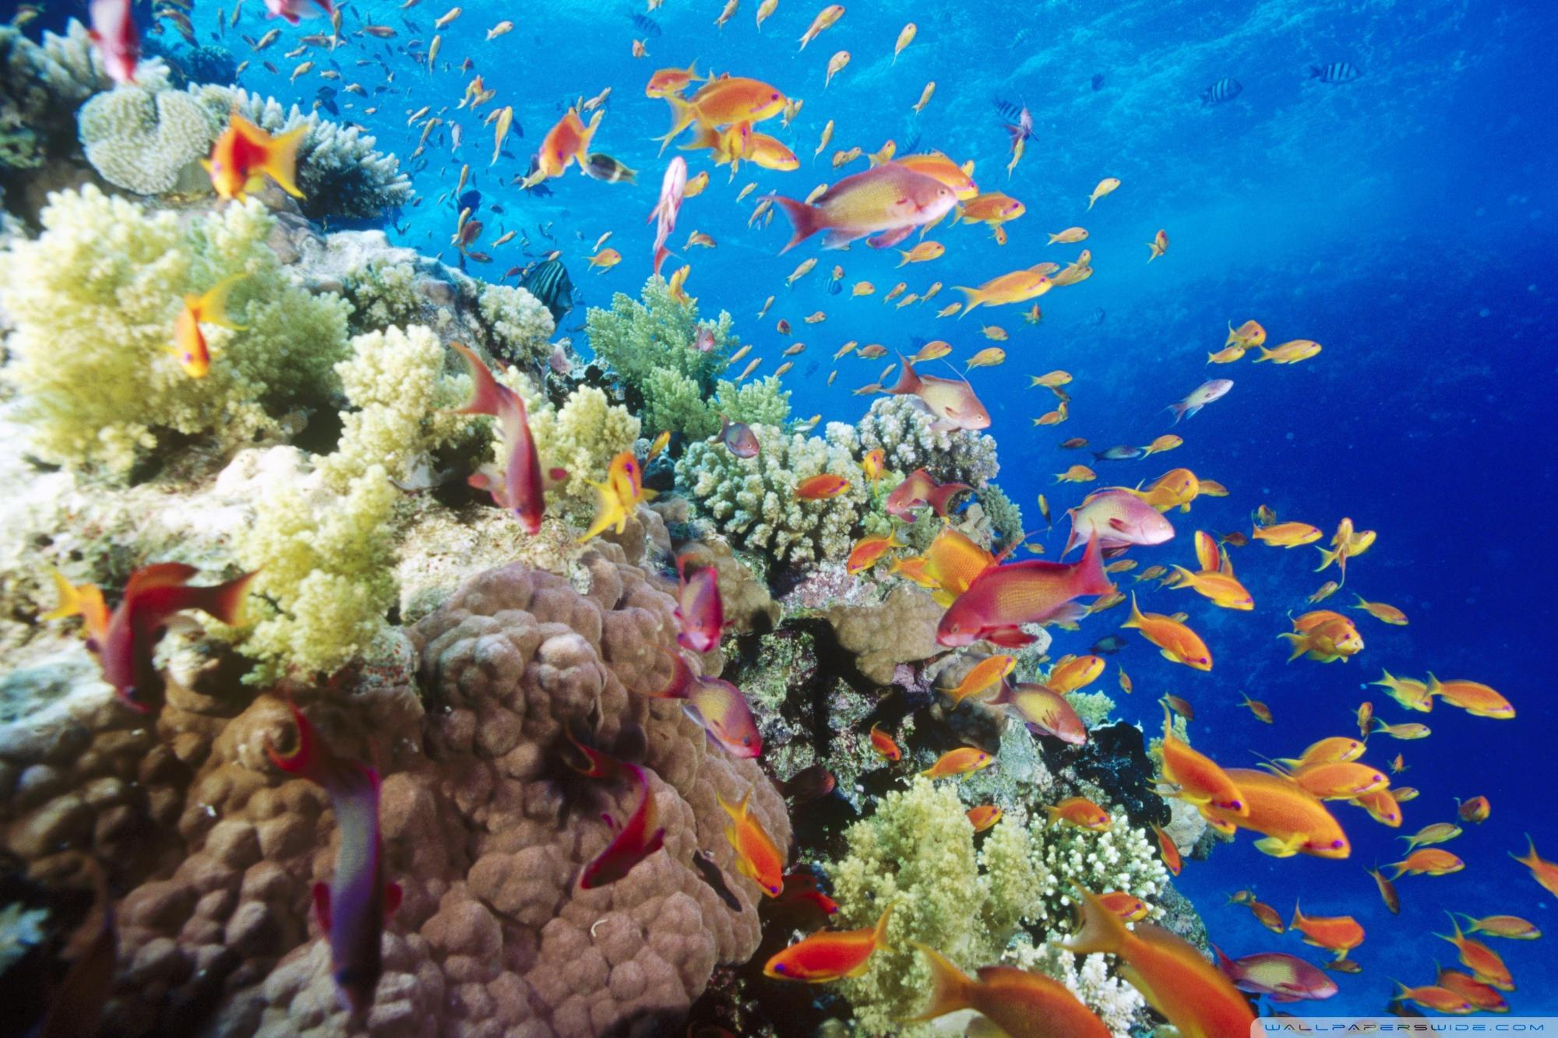
So is this great and wide sea, wherein are things creeping innumerable, both small and great beasts.

Slide 27
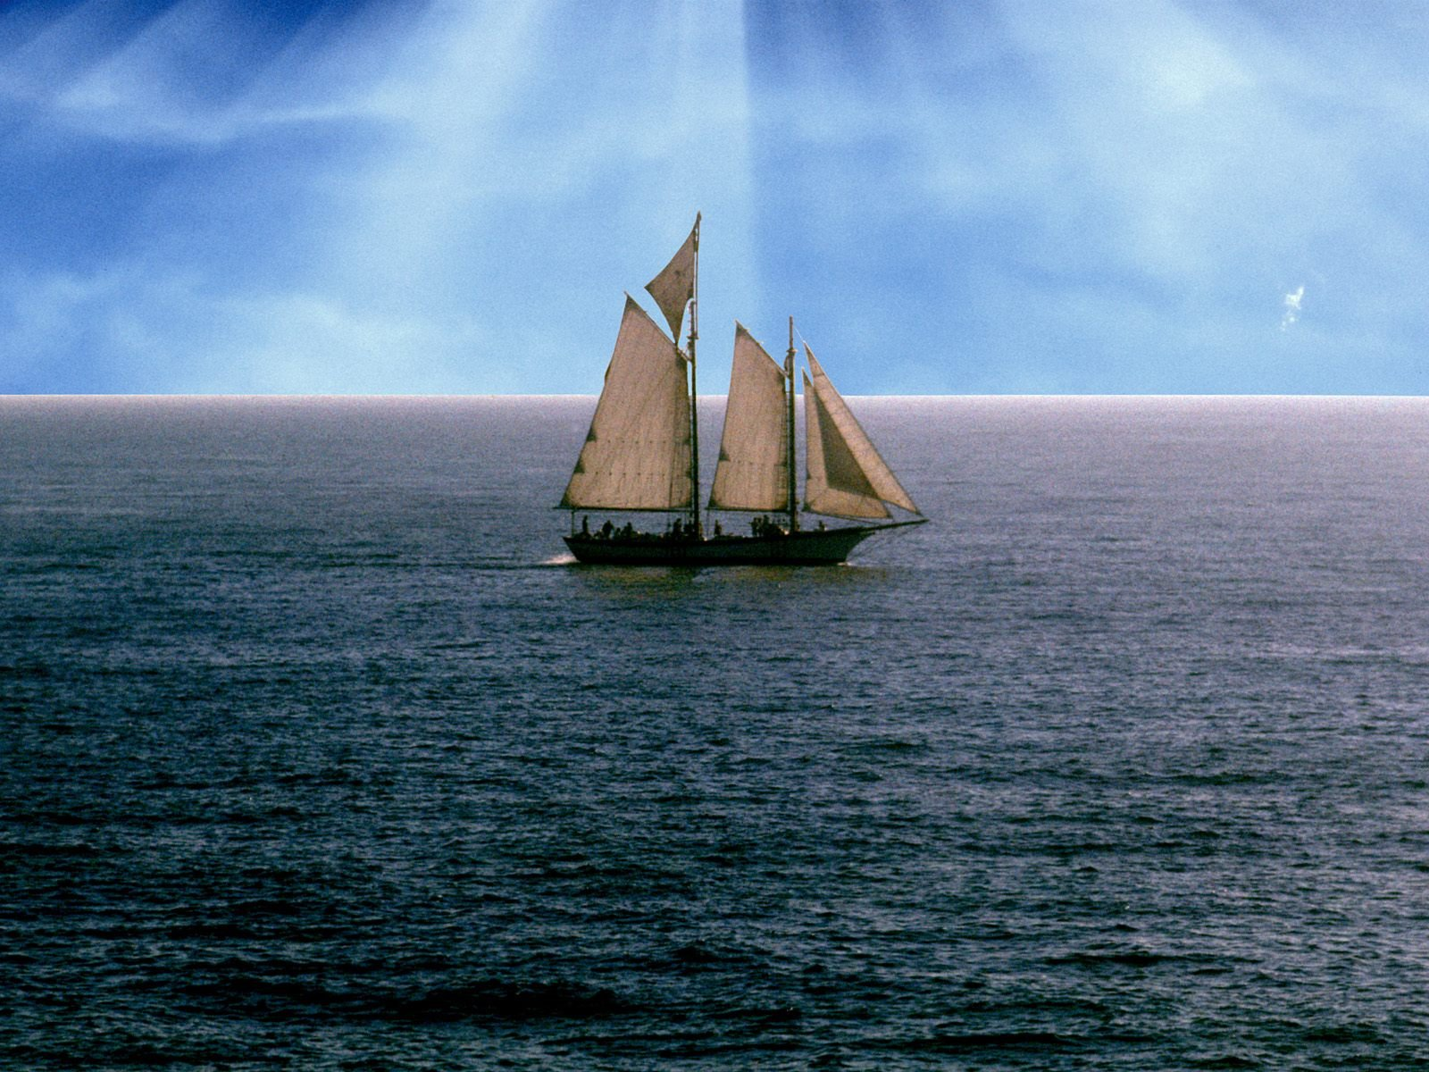
There go the ships: there is that leviathan, whom thou hast made to play therein.

Slide 28
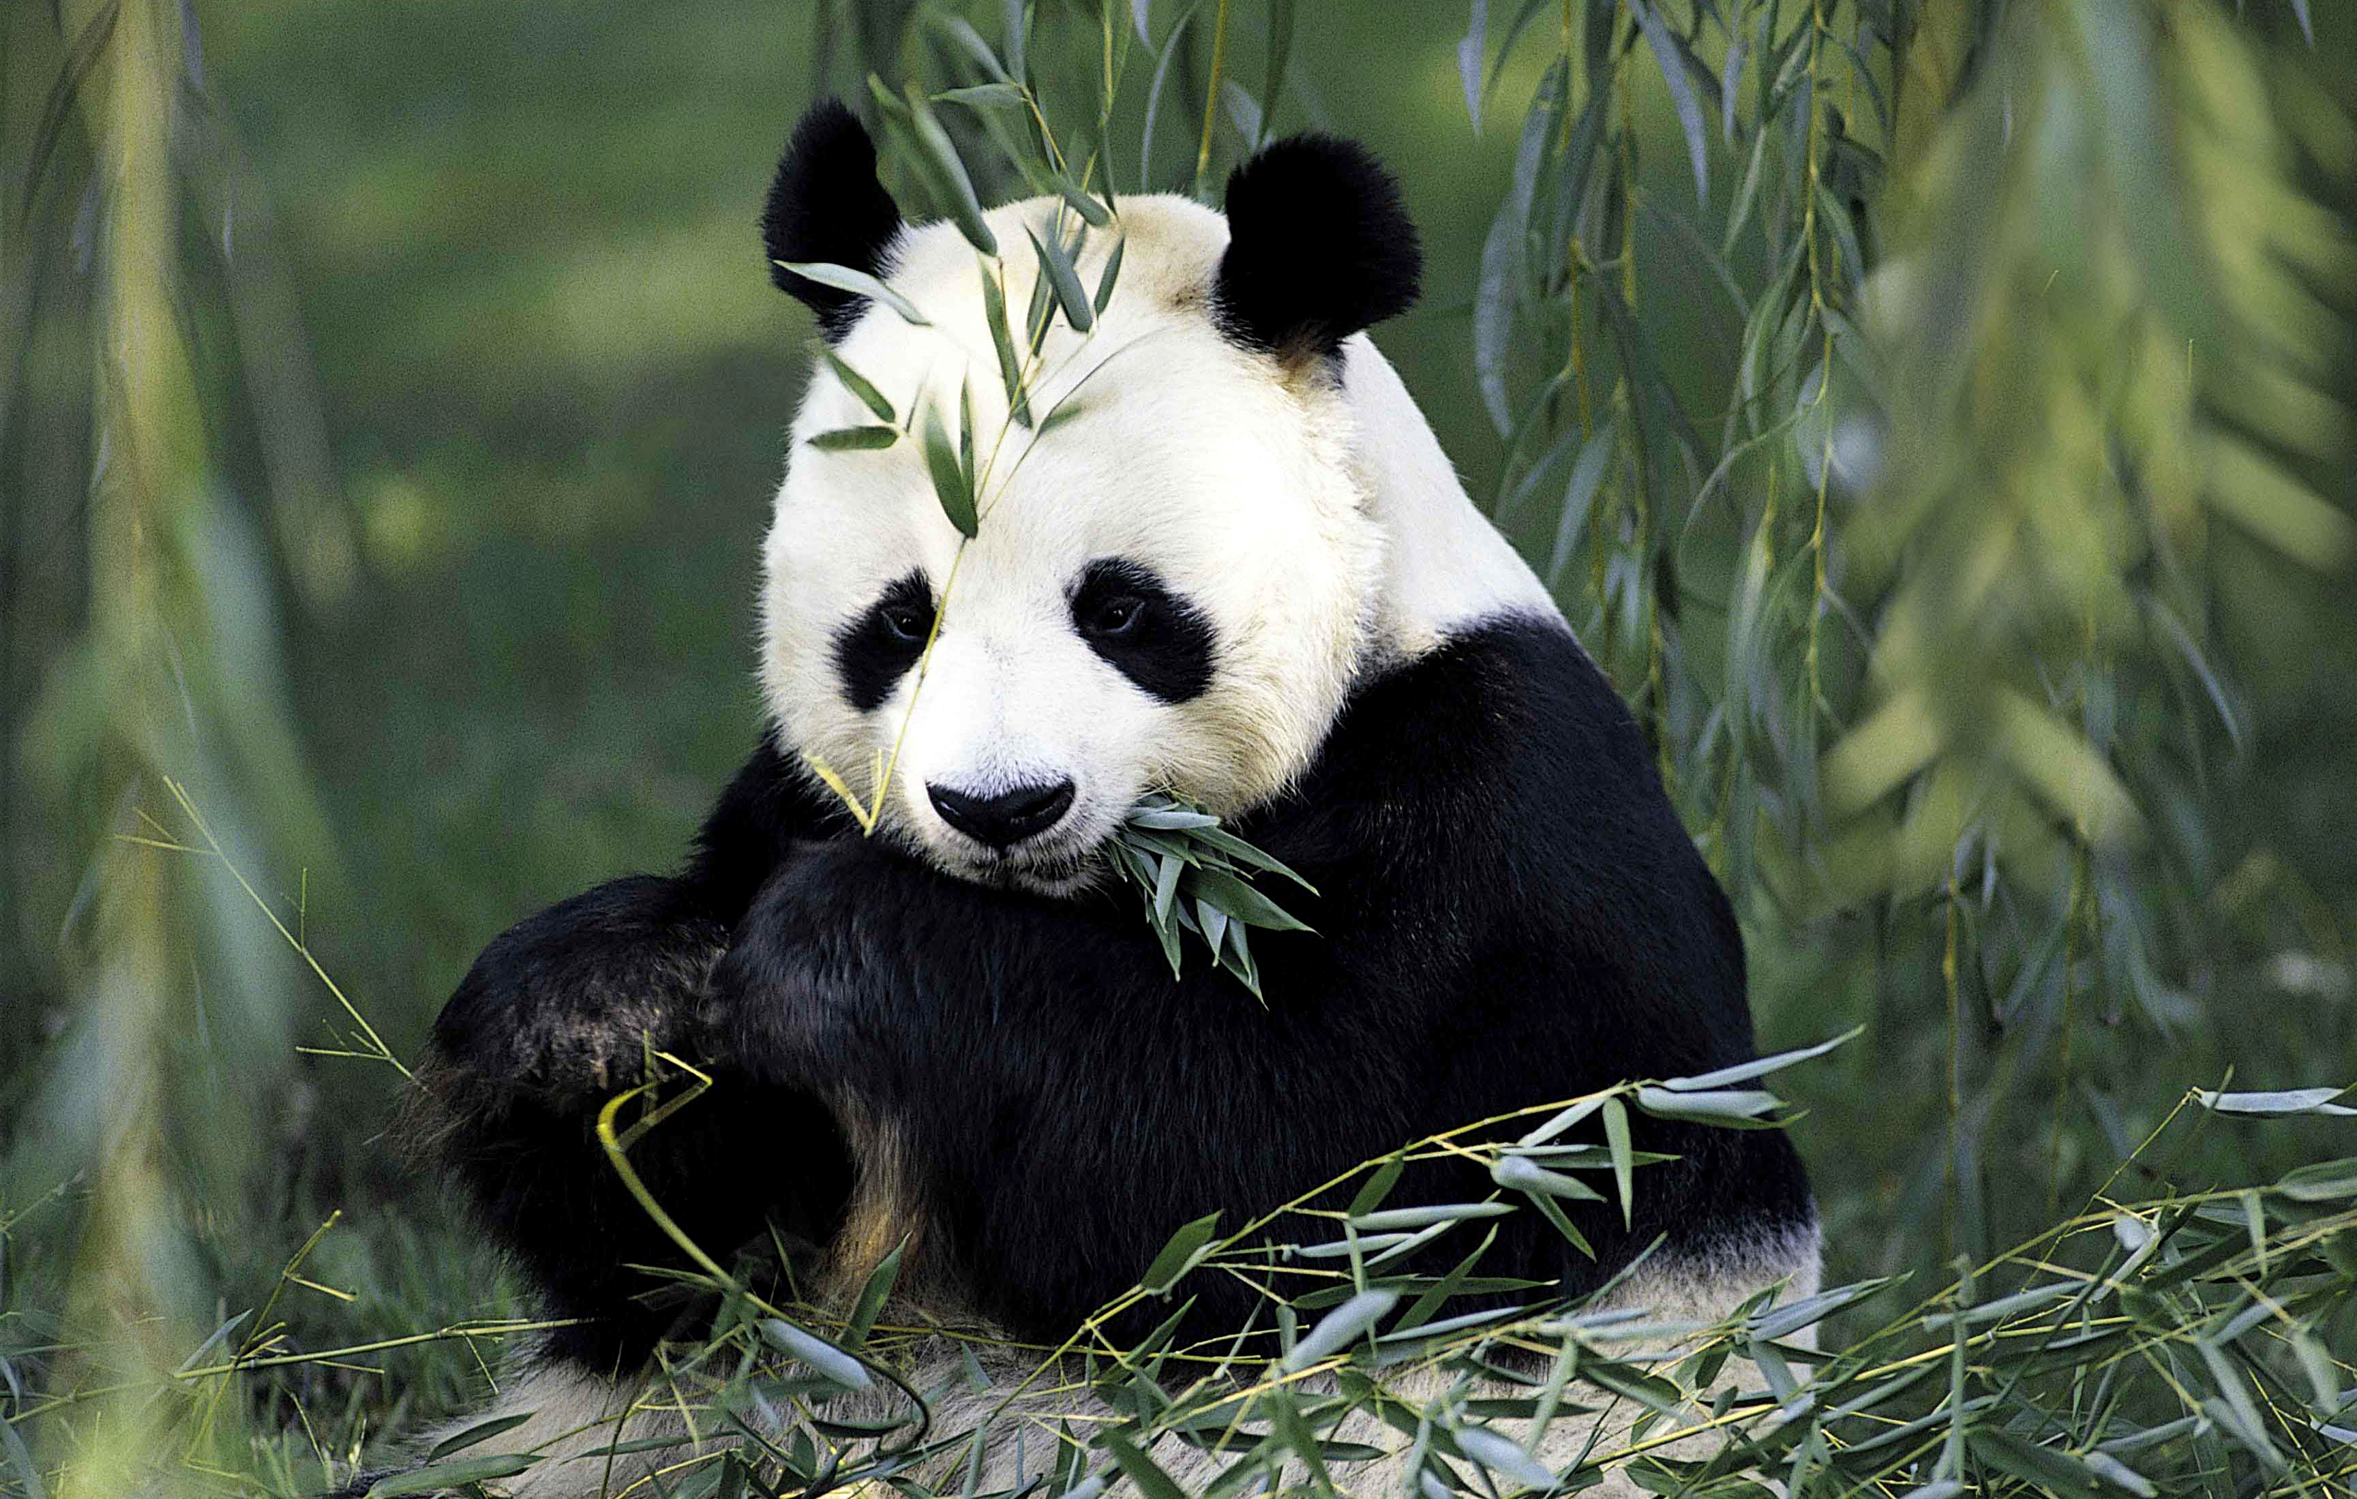
These wait all upon thee; that thou mayest give them their meat in due season.

Slide 29
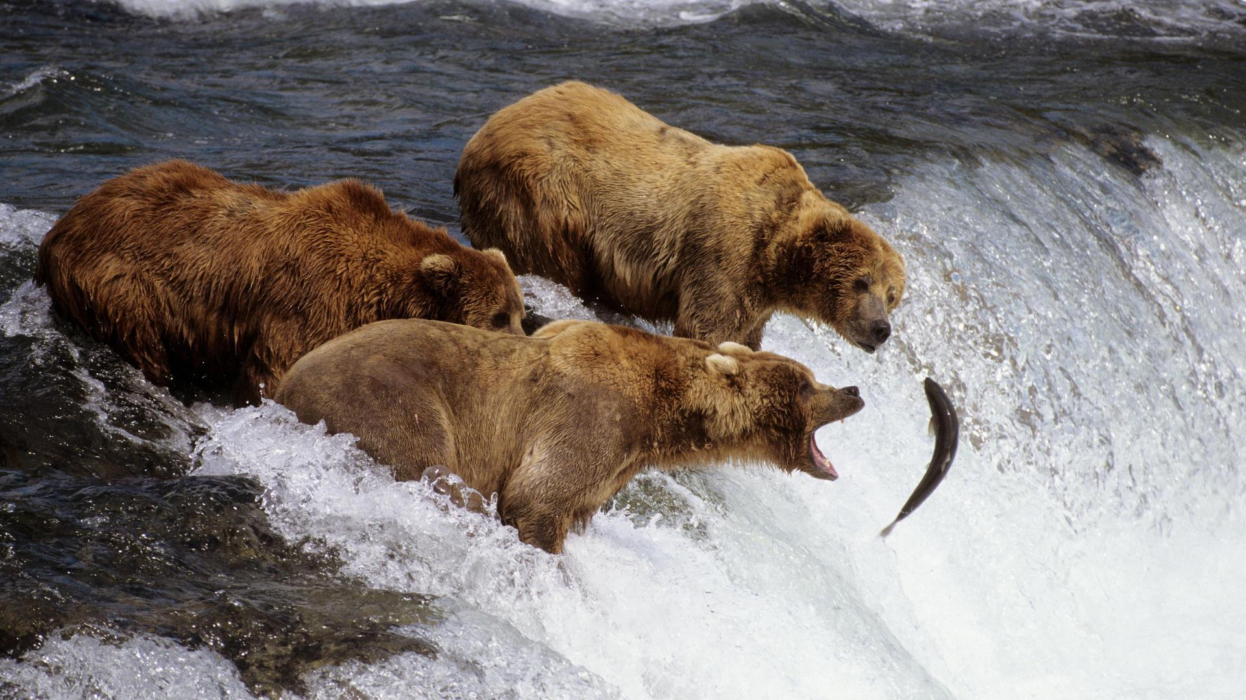
That thou givest them they gather: thou openest thine hand, they are filled with good.

Slide 30
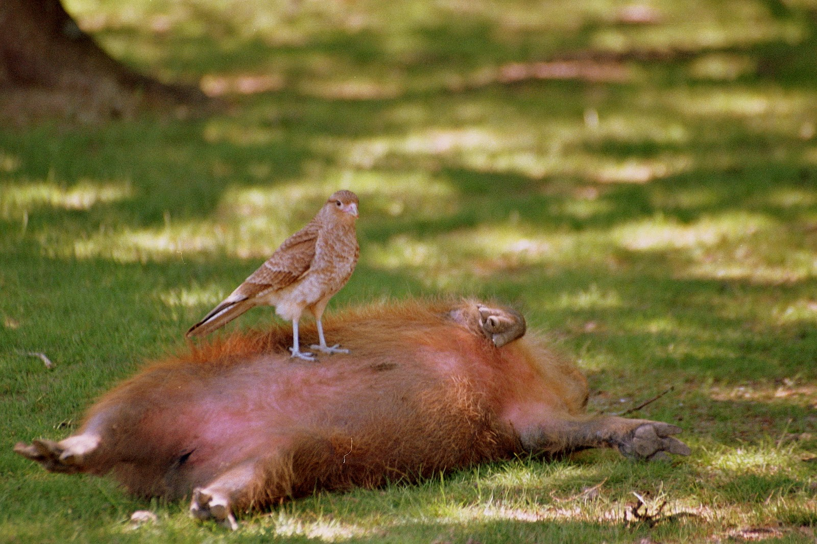
Thou hidest thy face, they are troubled: thou takest away their breath, they die, and return to their dust.

Slide 31
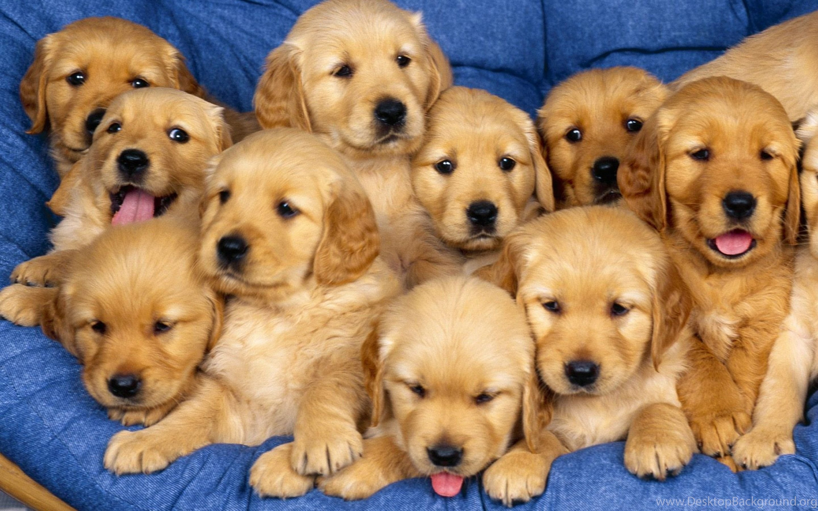
Thou sendest forth thy spirit, they are created: and thou renewest the face of the earth.

Slide 32
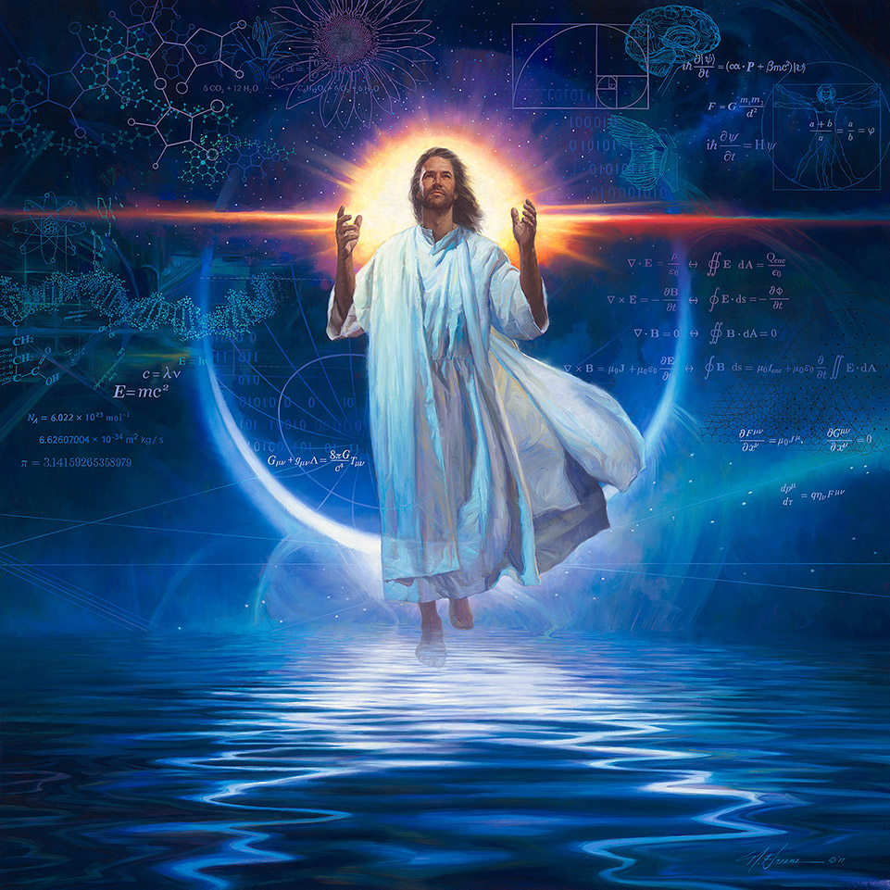
The glory of the Lord shall endure for ever: the Lord shall rejoice in his works.

Slide 33
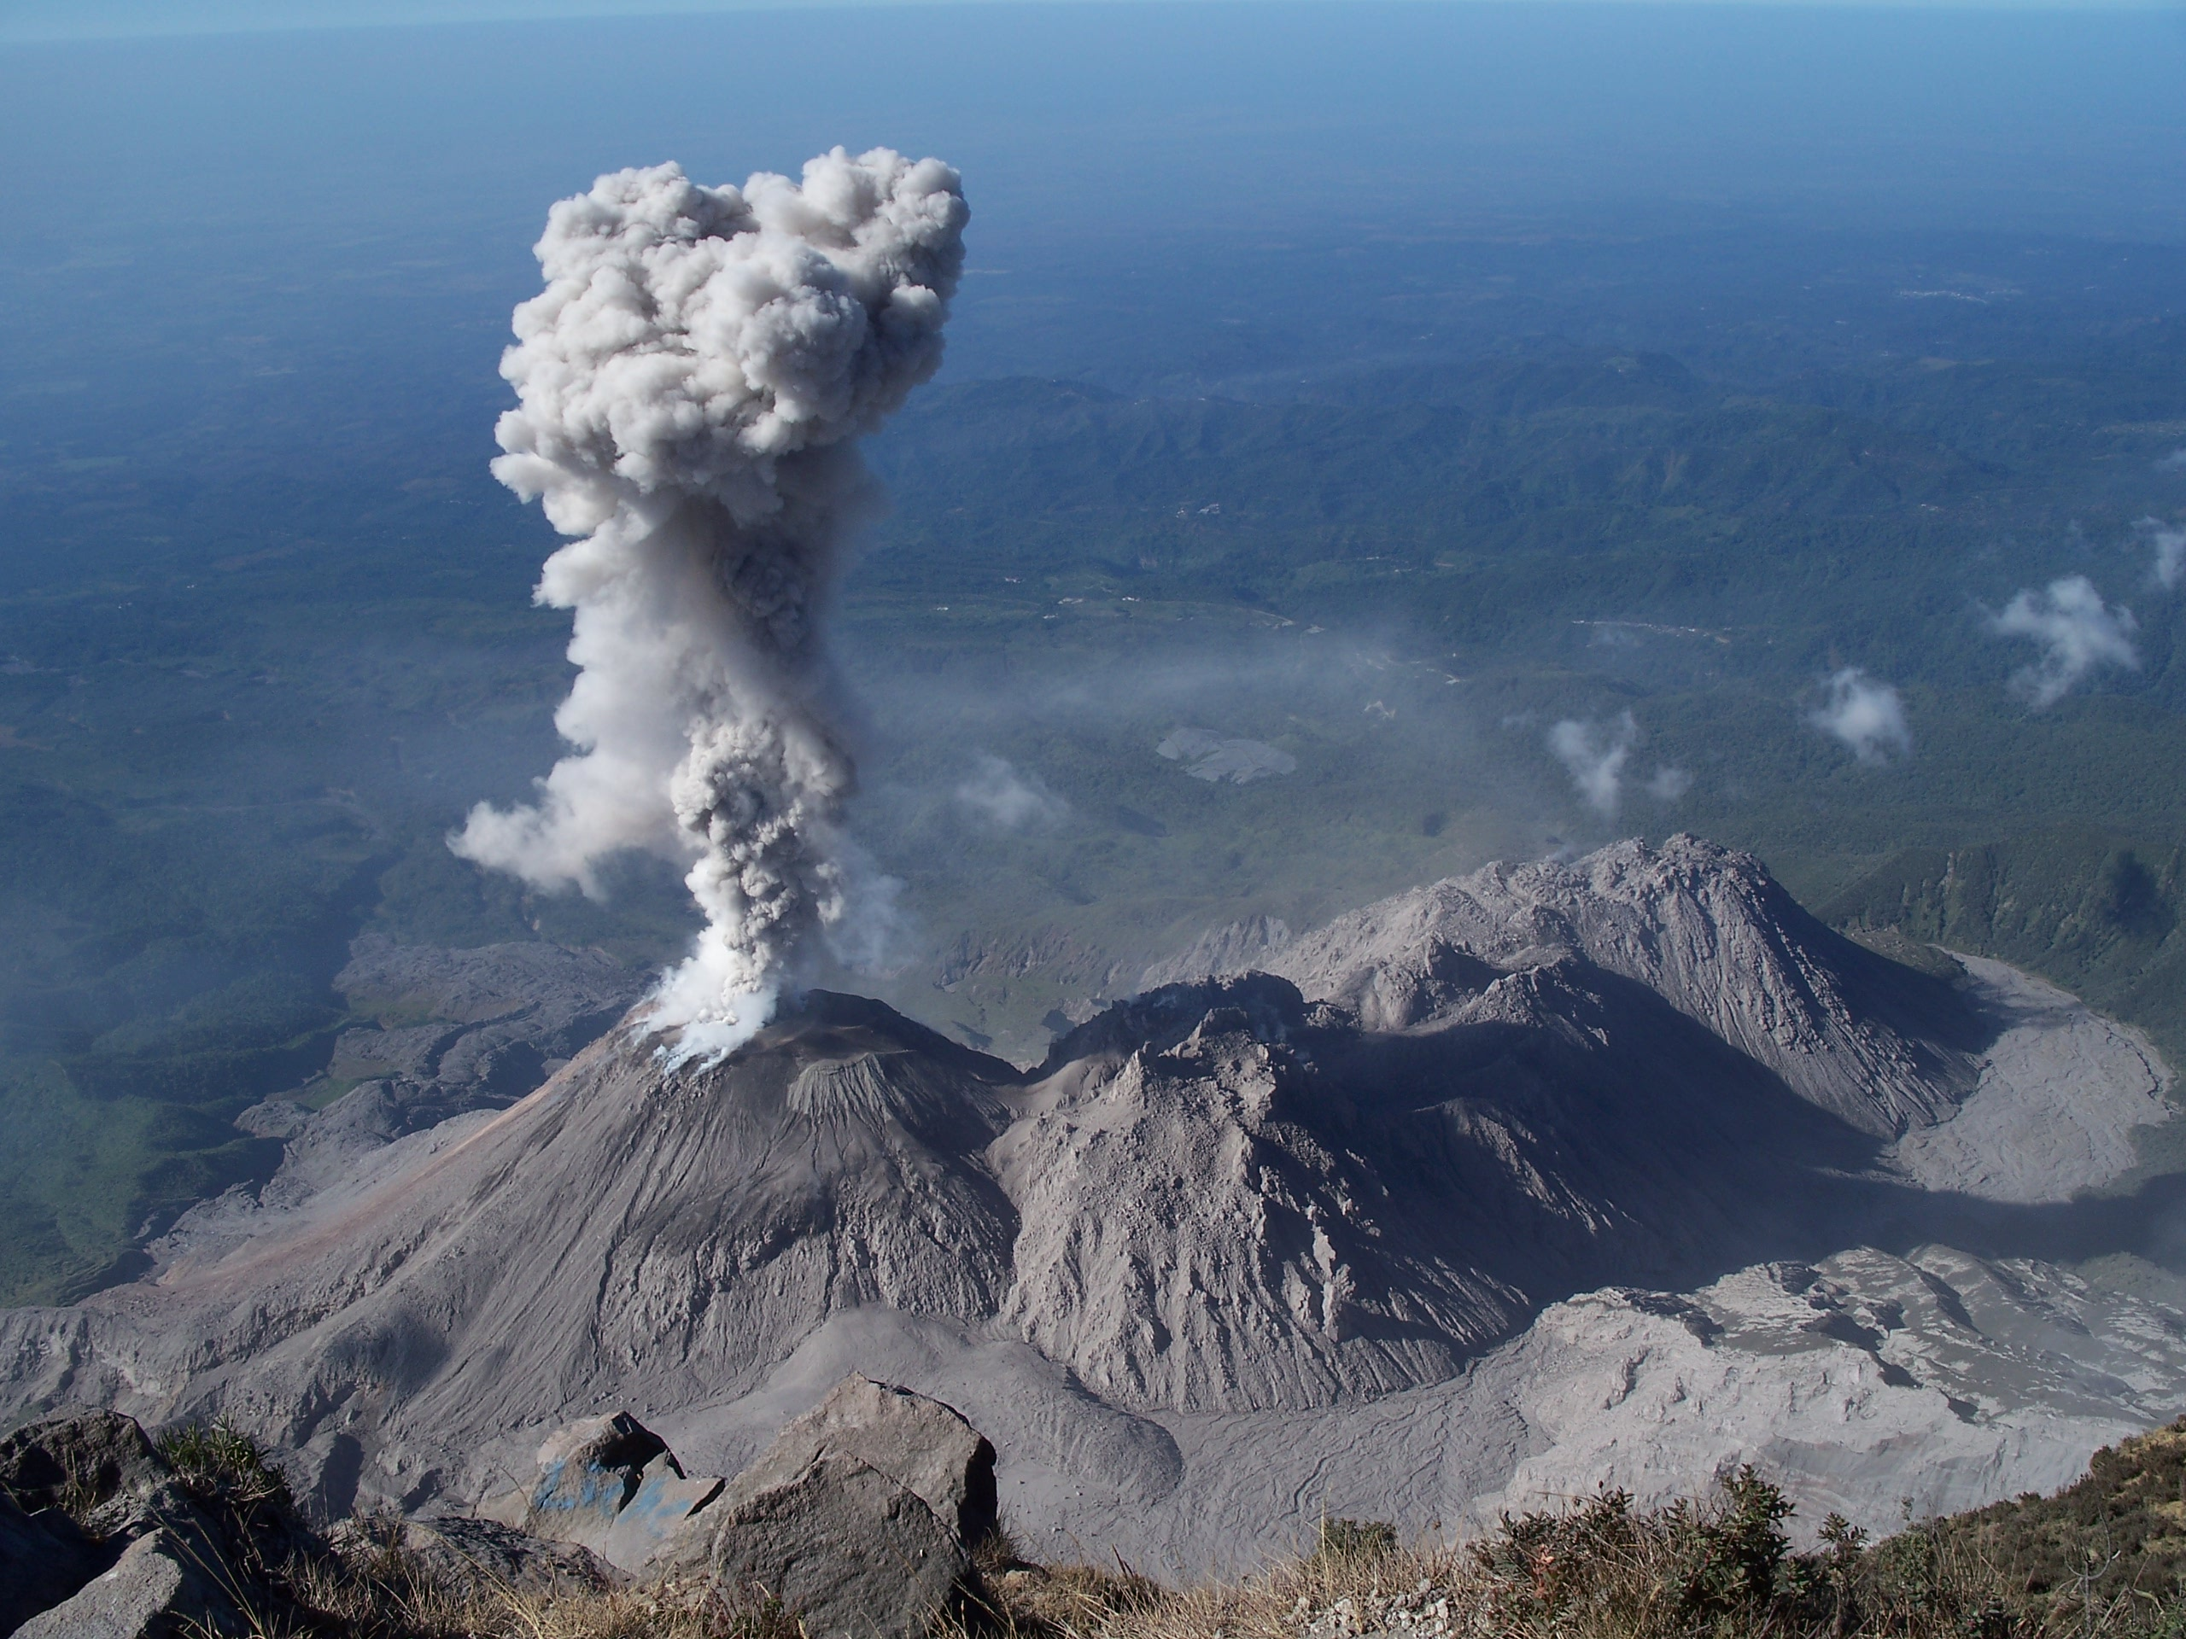
He looketh on the earth, and it trembleth: he toucheth the hills, and they smoke.

Slide 34

I will sing unto the Lord as long as I live: I will sing praise to my God while I have my being.

Slide 35
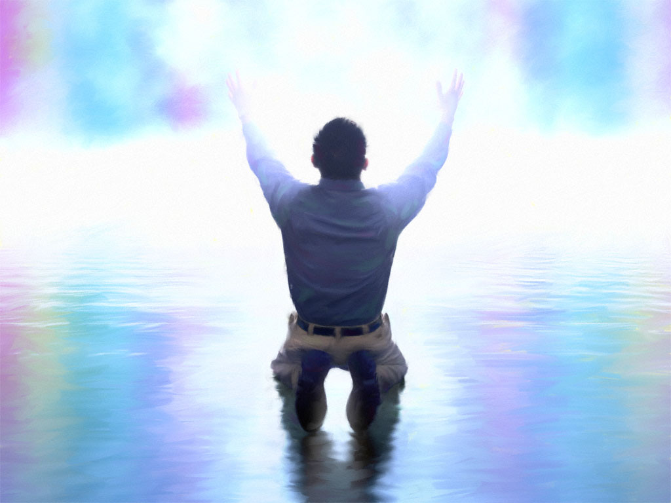
My meditation of him shall be sweet: I will be glad in the Lord.

Slide 36
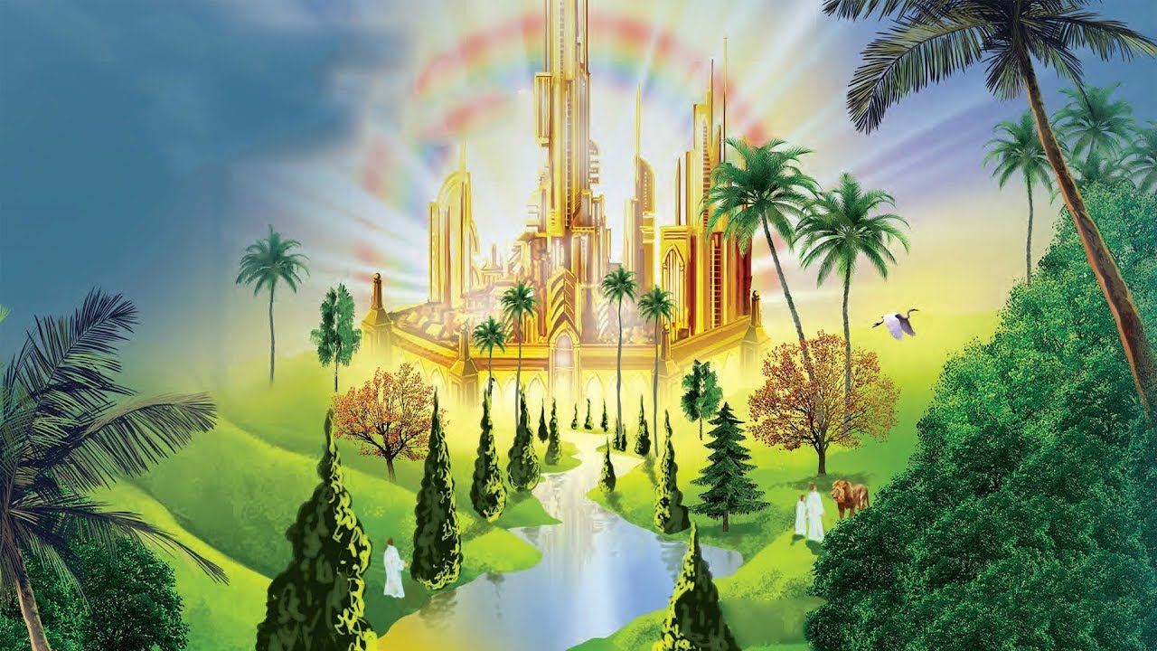
Let the sinners be consumed out of the earth, and let the wicked be no more.

Slide 37

Bless thou the Lord, O my soul.
Praise ye the Lord.

