Slide 1
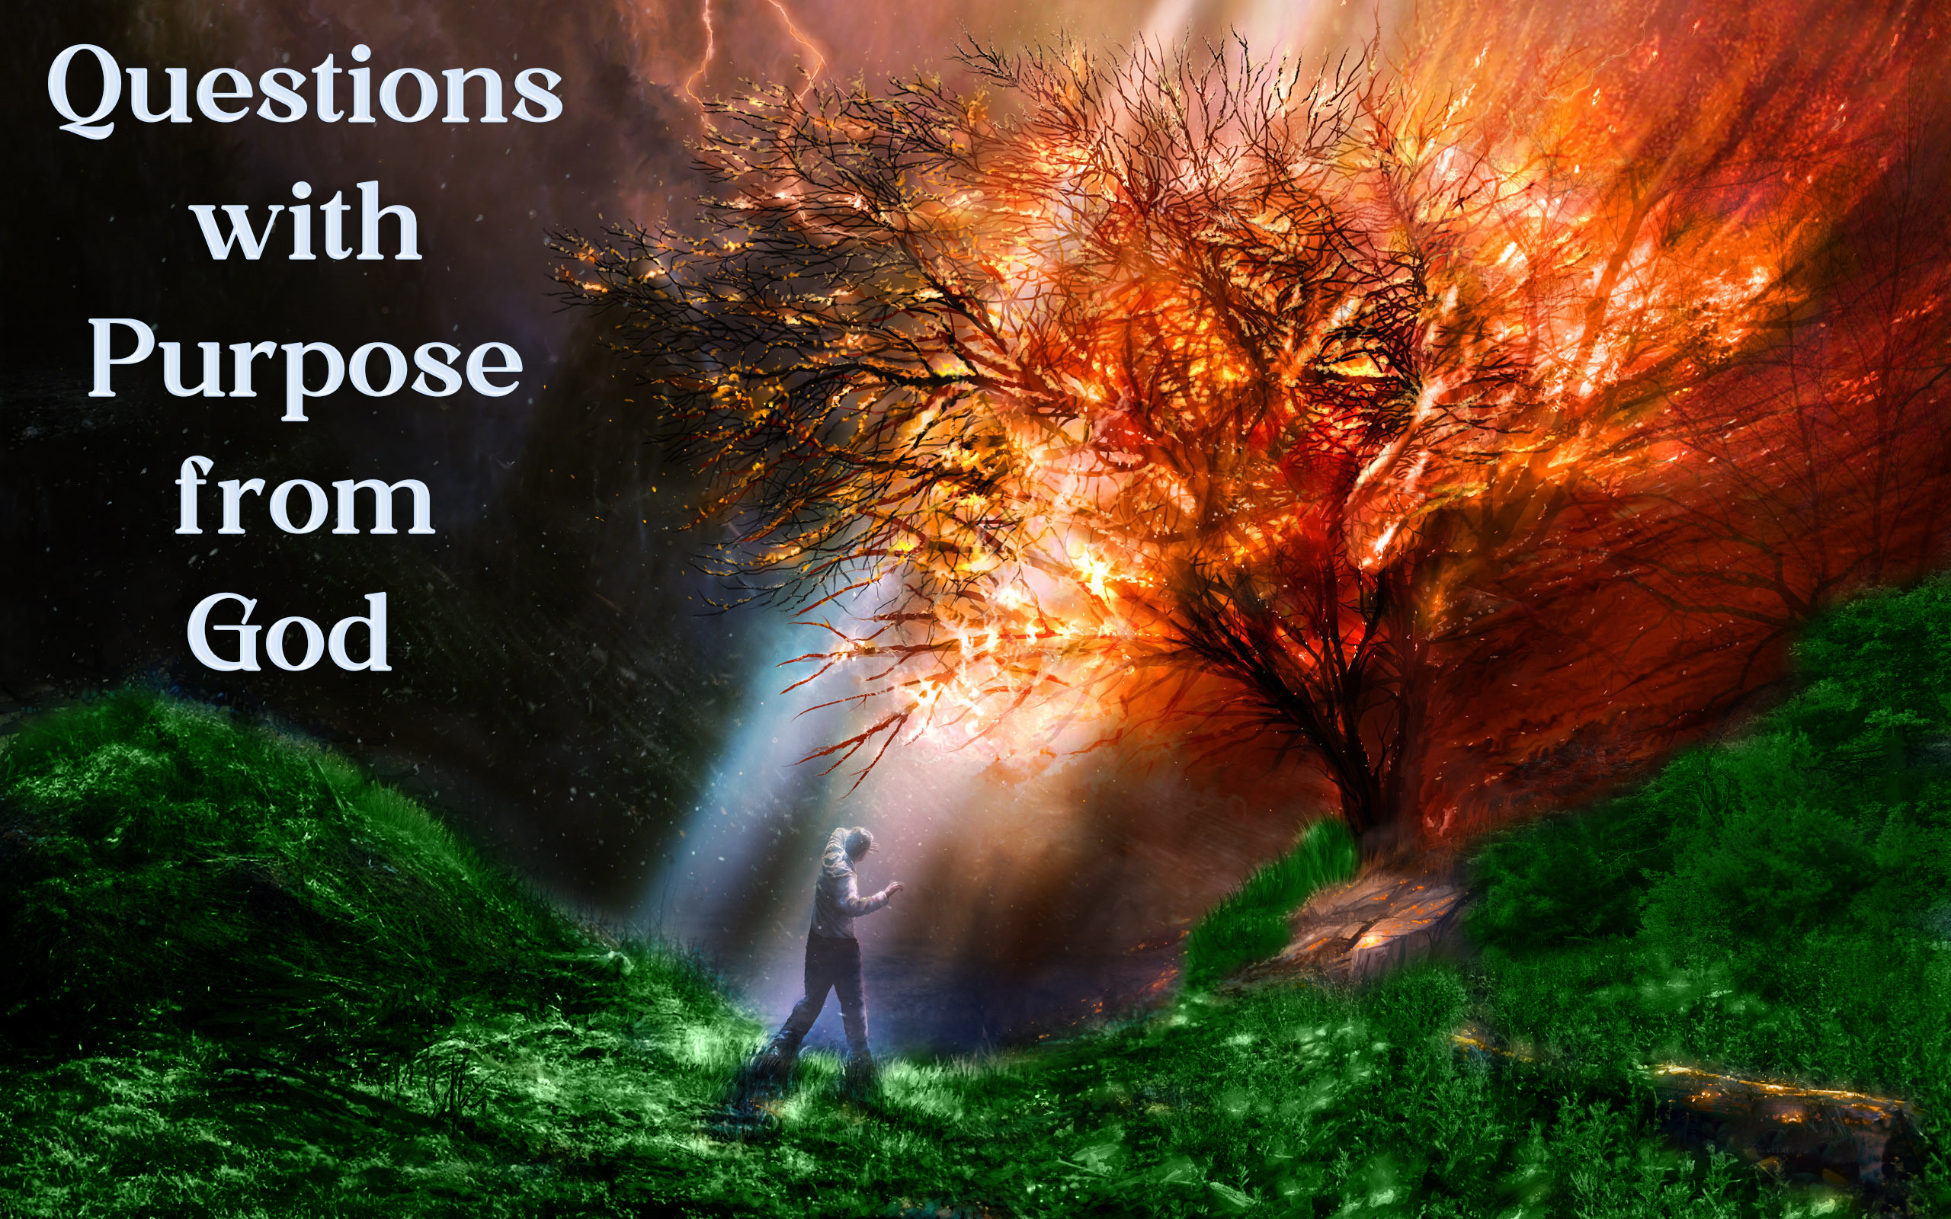

Slide 2

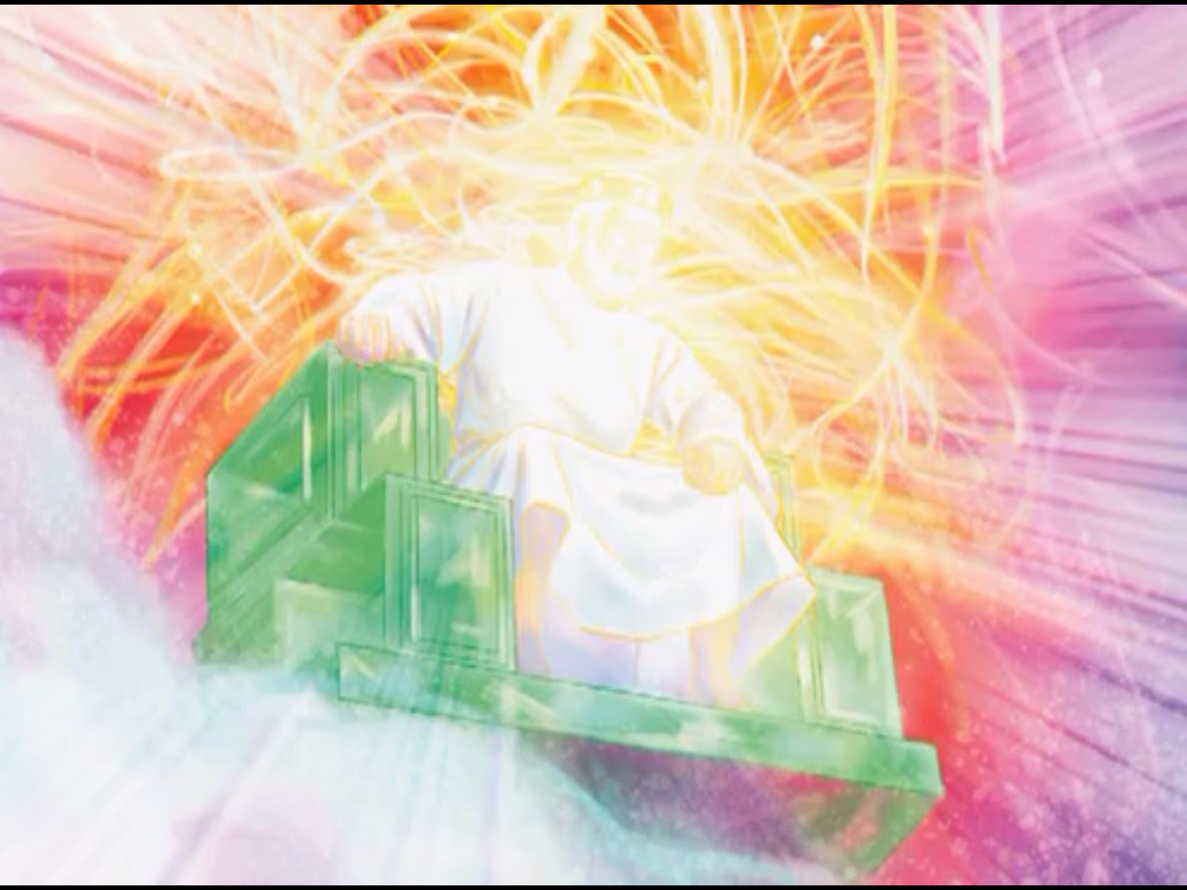
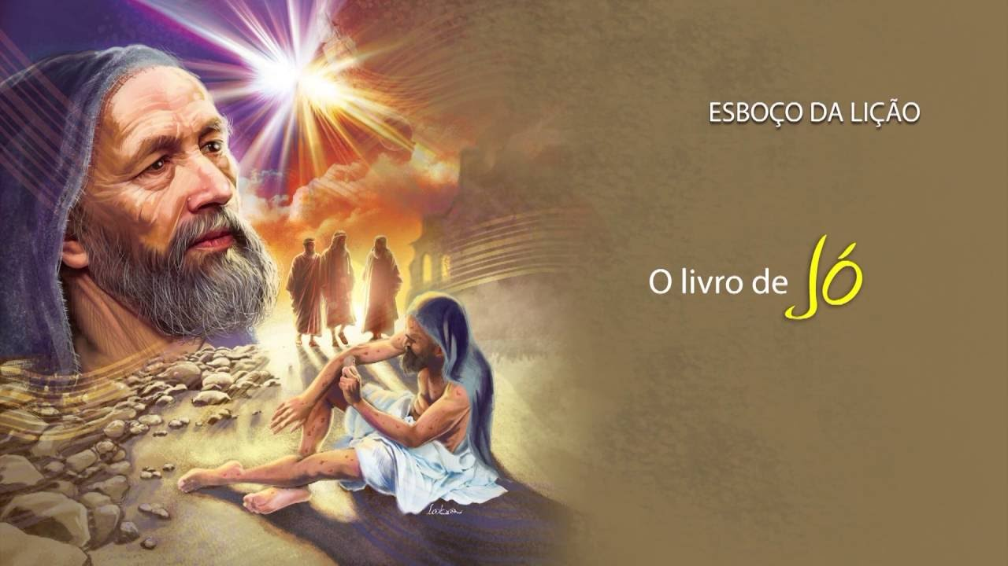
The questions God asks always have a purpose. He does not ask for information, since He already knows everything. Your questions serve a different purpose. That purpose varies depending on the context of the question and the person's needs.
These questions help us understand ourselves, and understand God's character. They force us to act, or they refer us to Scripture. God is ultimately teaching us spiritual lessons that will help us in our walk with Him. God's questions are never asked in vain. They serve the eternal purpose of strengthening our spiritual foundation and bringing us to Him. The Lord always exhorts man to reason and think seriously about his life.
God is omniscient, that is, He knows everything. Psalm 147:5 says that "his understanding is infinite." Since God knows all things, He also knows everything about us, even to "the secrets of the heart" (Psalm 44:21; see also 1 John 3:20). So why does God ask people questions throughout the Bible? Why do you still ask us questions today? We are going to look at various teachings that God wants to transmit to us through several of his questions.

Slide 3





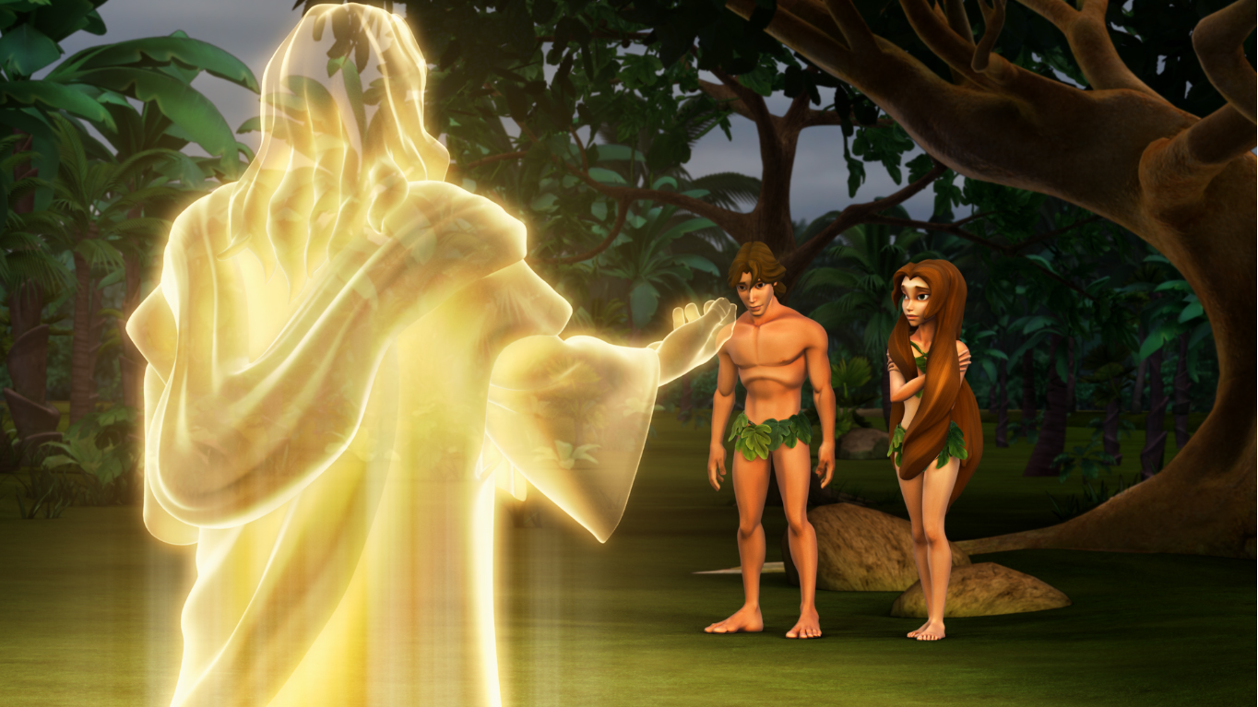


And the Lord God called unto Adam, and said unto him, Where art thou? And he said, I heard thy voice in the garden, and I was afraid, because I was naked; and I hid myself. And he said, Who told thee that thou wast naked? Hast thou eaten of the tree, whereof I commanded thee that thou shouldest not eat? (Genesis 3:9-11).
And the Lord God said unto the woman, What is this that thou hast done? And the woman said, The serpent beguiled me, and I did eat. (Genesis 3:13).
After Adam and Eve ate the forbidden fruit and hid from God, God exclaimed, "Where are you?" (Genesis 3:9). Of course, God knew Adam's physical location; That was not precisely the purpose of the question. The question was designed to give Adam pause.
God could have approached His sinful creation in wrath, with harsh words of condemnation and immediate judgment, but He didn't. On the contrary, God approached Adam with a question and thus demonstrated His grace, His goodness, and His desire for reconciliation.
When asking the woman "what have you done?" God revealed that He knew the transgression of Adam and Eve, and that He was meant to awaken within them a conviction of sin.
Acknowledge the situation you are in, and confess your sin

Slide 4

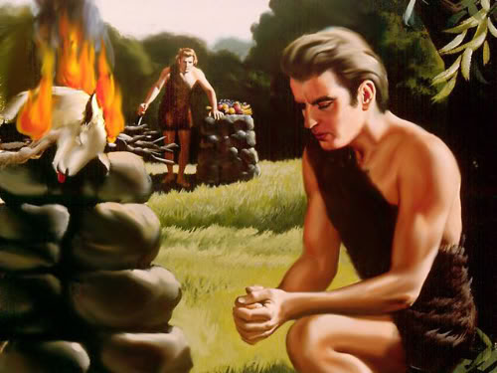


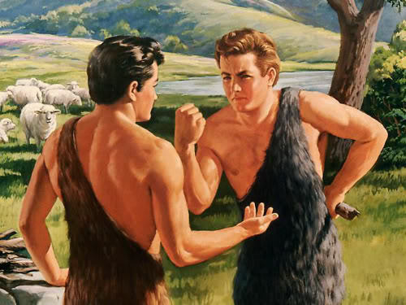


And the Lord said unto Cain, Why art thou wroth? and why is thy countenance fallen? If thou doest well, shalt thou not be accepted? and if thou doest not well, sin lieth at the door. And unto thee shall be his desire, and thou shalt rule over him. (Genesis 4:6-7).
Abel presented a lamb as an offering to God in obedience to His command. Cain, for his part, offered fruit. God sent fire from heaven and consumed Abel's offering, but not Cain's. Cain noticed the absence of a visible sign of God's liking and acceptance of his offering. As a result, he was filled with a refocused and reckless anger. He felt a fierce resentment against his brother and toward God. Surely he did not experience pain for sin, nor did he feel the need to examine himself or pray for light or forgiveness. Cain did not hide his feelings of frustration, disgust, and anger. His face showed his resentment. So God asks the question, "Why have you been angry, and why has your countenance fallen?" God wants Cain to understand that even though he refuses his offering, he has not rejected him. God, with mercy and patience, is ready to give you another chance. God appears and reasons with him to persuade him of the error of his course and the unreasonableness of his anger.
God tries to prevent Cain from further leading to his sin and his estrangement from God. If he amended his conduct and lived according to the divine precepts, there would no longer be any reason for God to show his displeasure. However, if Cain did not change, if he continued on the path of evil, sin would overwhelm him.
God wants to awaken your conscience and prevent you from delving into sin

Slide 5

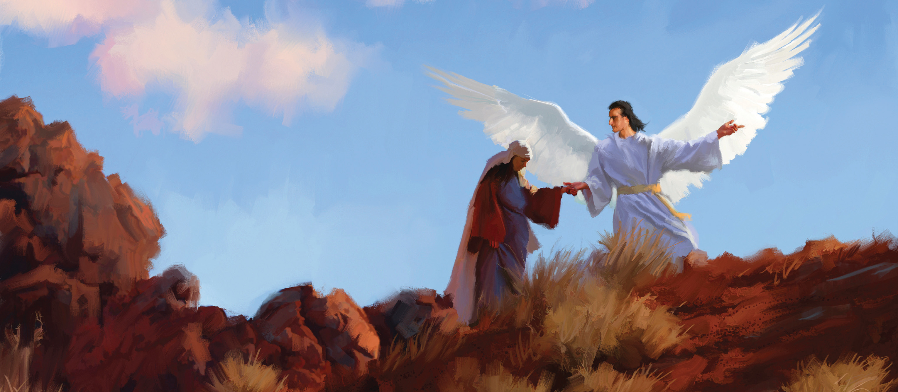


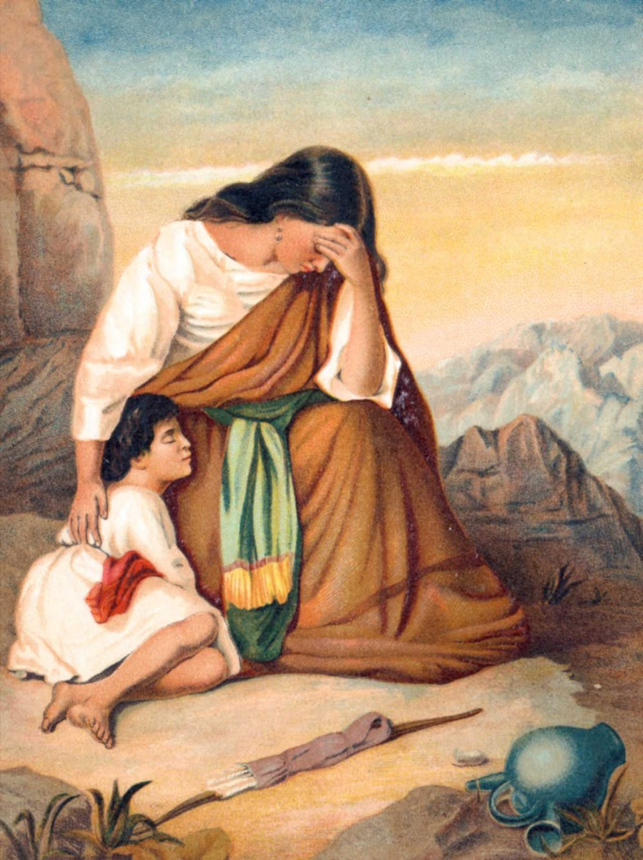

And he said, Hagar, Sarai's maid, whence camest thou? and whither wilt thou go? And she said, I flee from the face of my mistress Sarai.(Genesis 16:8).
And God heard the voice of the lad; and the angel of God called to Hagar out of heaven, and said unto her, What aileth thee, Hagar? fear not; for God hath heard the voice of the lad where he is. (Genesis 21:17).
Hagar was coming from a bitter situation with Sarai, Abraham's wife, and she was on the run, not really knowing where she was going. God asks him: where do you come from, and where are you going? This question is for today. People today often don't know where they come from or where they're going. Christians know where we come from and where we are going; both in terms of eternal destiny and also, to a lesser extent, in terms of how we are moving toward the higher calling of our God. All believers should know that they were created in God's purpose and plan, and that their destiny is to be with Him and enjoy Him forever.
The questions God asks us have no expiration date, they continue to resonate in the minds of those who love Him. What do you have, what's wrong with you? a question from the Eternal Father to a marginalized, discarded and abandoned woman in the desert. God heard the agonizing cry of that mother in the midst of loneliness. The one who still knew his name and saw the tears that mixed with the sand and the cold wind, asked him the question: "What's wrong with you?" A question, which goes beyond a simple formalism, and which denotes a real interest. The God who knows our walk, and pays attention to every circumstance, reminds us with his question: "I will fulfill what I promised you."
Knowing this, where you come from and where you are going, leads you to real purpose and focus on the things that matter in this current life.
God wants you to know that He is with you in your loneliness, or in the midst of your difficulties

Slide 6

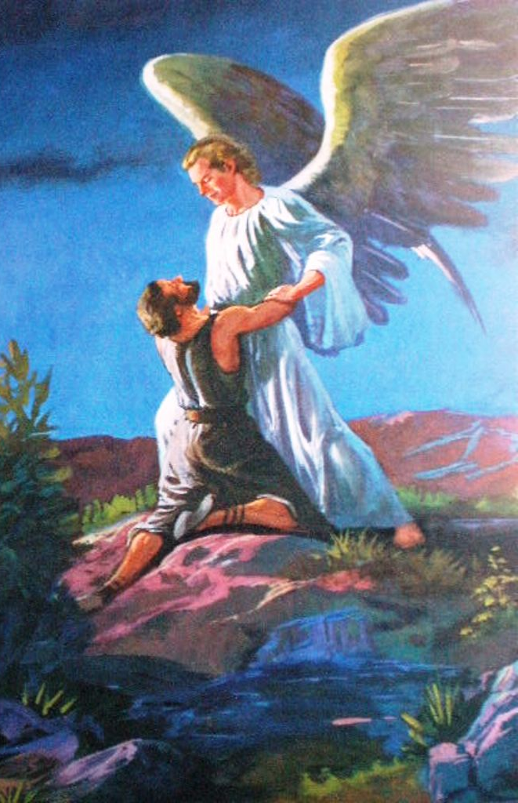



And Jacob was left alone; and there wrestled a man with him until the breaking of the day. And when he saw that he prevailed not against him, he touched the hollow of his thigh; and the hollow of Jacob's thigh was out of joint, as he wrestled with him.
And he said, Let me go, for the day breaketh. And he said, I will not let thee go, except thou bless me. And he said unto him, What is thy name? And he said, Jacob. And he said, Thy name shall be called no more Jacob, but Israel: for as a prince hast thou power with God and with men, and hast prevailed.(Genesis 32:24-28).
Jacob had wrestled with God all night and wouldn't give up! Then God asks the question, "What is your name?" Obviously, God knew Jacob's name, but He wanted to ask the question so that Jacob would say who he was. Jacob means "supplanter" or "cheater." That was naturally the way he was, and Jacob recognized it. But God has something else for this man. His name will no longer be Jacob, but Israel ("prince with God"). The great spiritual change that had come upon Jacob was then symbolized by a change of name indicating the nature of his new relationship with God. God has always been concerned with changing people. A name change is nothing more than an external sign of the internal change.
What would you say if God asked you your name? Have you seen who you are naturally? God is in the business of changing names and lives!
God wants to change your character

Slide 7


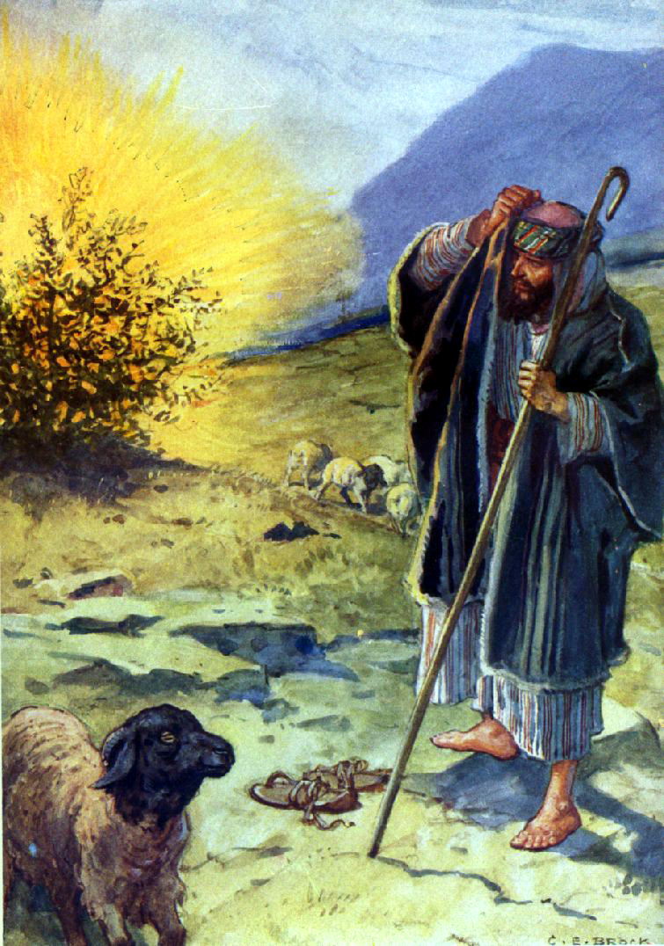
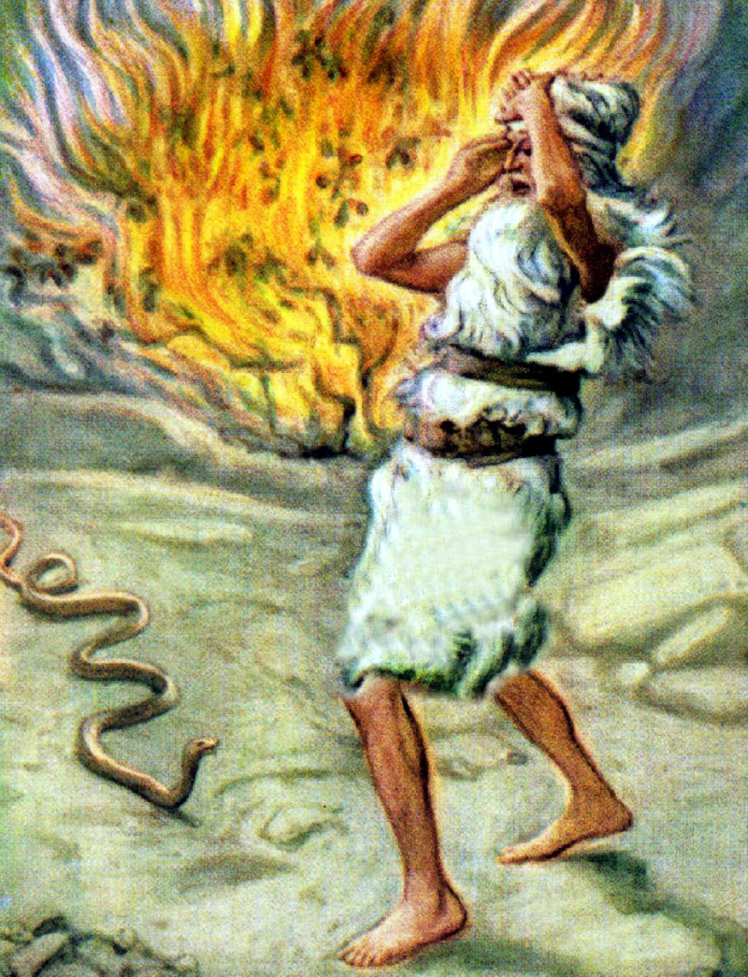


And Moses answered and said, But, behold, they will not believe me, nor hearken unto my voice: for they will say, The Lord hath not appeared unto thee. And the Lord said unto him, What is that in thine hand? And he said, A rod. And he said, Cast it on the ground. And he cast it on the ground, and it became a serpent; and Moses fled from before it. And the Lord said unto Moses, Put forth thine hand, and take it by the tail. And he put forth his hand, and caught it, and it became a rod in his hand: That they may believe that the Lord God of their fathers, the God of Abraham, the God of Isaac, and the God of Jacob, hath appeared unto thee. (Exodus 4:1-5).
It is not only Moses to whom God asks this question. Ask yourself, "What is that thing in your hand? What do you have to offer?" Maybe you don't have much, just an old stick. God is always trying to remind us that it is not your ability but your availability that He is looking for. You may have very little in your hand that you can offer to God. But that's enough for Him to do great things through you!
He is more interested in using the small thing you have (so that the glory belongs to Him) than using someone who sees himself as a big person who believes he has everything he needs in himself. What is it that you have in your hand? It's not what you have. It’s Who you present it to.
God is willing to use you with what you have, whether it is a little or a lot

Slide 8

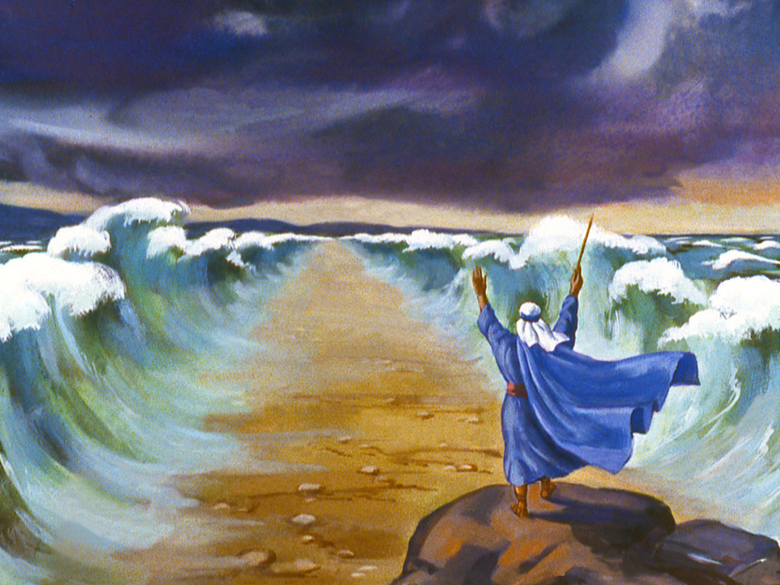


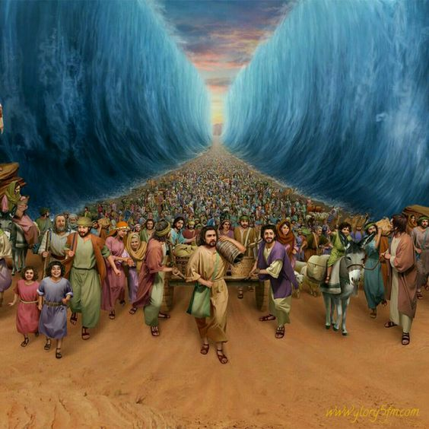
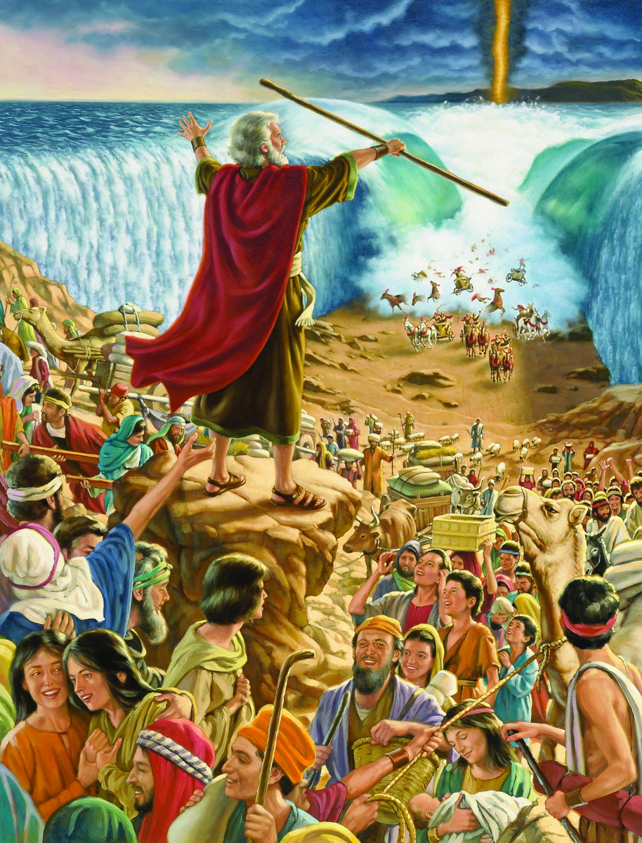

Y …And Moses said unto the people, Fear ye not, stand still, and see the salvation of the Lord, which he will shew to you to day: for the Egyptians whom ye have seen to day, ye shall see them again no more for ever. The Lord shall fight for you, and ye shall hold your peace. And the Lord said unto Moses, Wherefore criest thou unto me? speak unto the children of Israel, that they go forward: But lift thou up thy rod, and stretch out thine hand over the sea, and divide it: and the children of Israel shall go on dry ground through the midst of the sea. And I, behold, I will harden the hearts of the Egyptians, and they shall follow them: and I will get me honour upon Pharaoh, and upon all his host, upon his chariots, and upon his horsemen… (Exodus 14:10-21).
"Why are you crying out to me?" This question from the Lord implies that Moses had turned to God for help, perhaps setting before Him the complaints of the people. God's question does not imply a reproach on his part, but constitutes a request for him to act resolutely.
Stop crying, complaining, lamenting. Walk. March. We are one of those who believe that you have to pray, but there also comes a time when you have to leave, you have to do something. Move forward trusting that God will help you.
Walk. Don't know where? Walk. Have you prayed yet? Did you fast? Well, now go out and do something.
Act with confidence that God will work miracles

Slide 9



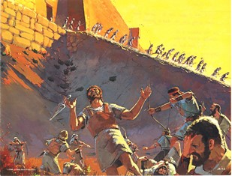
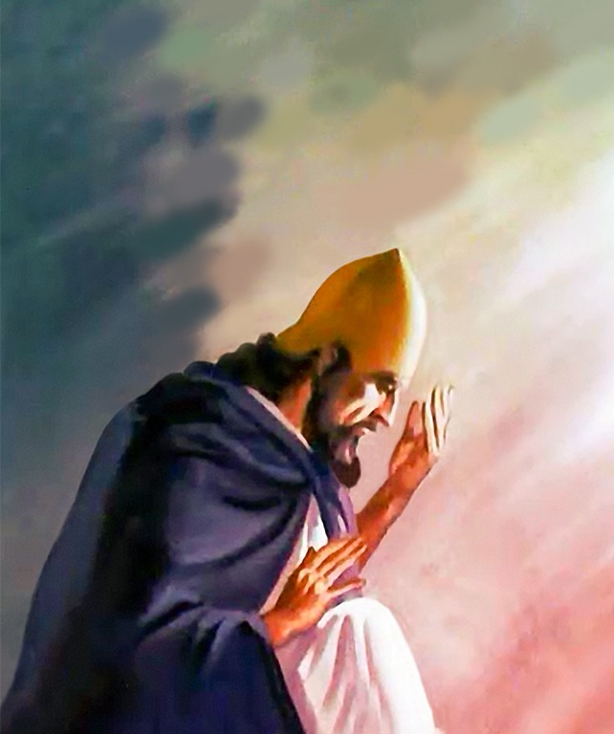

And Joshua rent his clothes, and fell to the earth upon his face before the ark of the Lord until the eventide, he and the elders of Israel, and put dust upon their heads. And Joshua said, Alas, O Lord God, wherefore hast thou at all brought this people over Jordan, to deliver us into the hand of the Amorites, to destroy us? would to God we had been content, and dwelt on the other side Jordan! O Lord, what shall I say, when Israel turneth their backs before their enemies!
For the Canaanites and all the inhabitants of the land shall hear of it, and shall environ us round, and cut off our name from the earth: and what wilt thou do unto thy great name? And the Lord said unto Joshua, Get thee up; wherefore liest thou thus upon thy face? (Joshua 7:4-10)
Joshua found it difficult to face failure and defeat. We've all been through disappointment in life, so we know that feeling of longing for something and not getting it. Sometimes these defeats lower our spirits and self-esteem, we become depressed, we are filled with anger with ourselves and with the world, we reproach ourselves, we feel like losers and are down. God does not want to see us fallen, He motivates us and urges us to get up, He tells us: "What are you doing there prostrate?" Stop complaining. Consecrate yourself to God and act.
In the face of special dangers and calamities, there must be periods of self-examination and sincere reform. Take time to do this searching of the heart.
Stop complaining, sanctify yourself, and take action

Slide 10



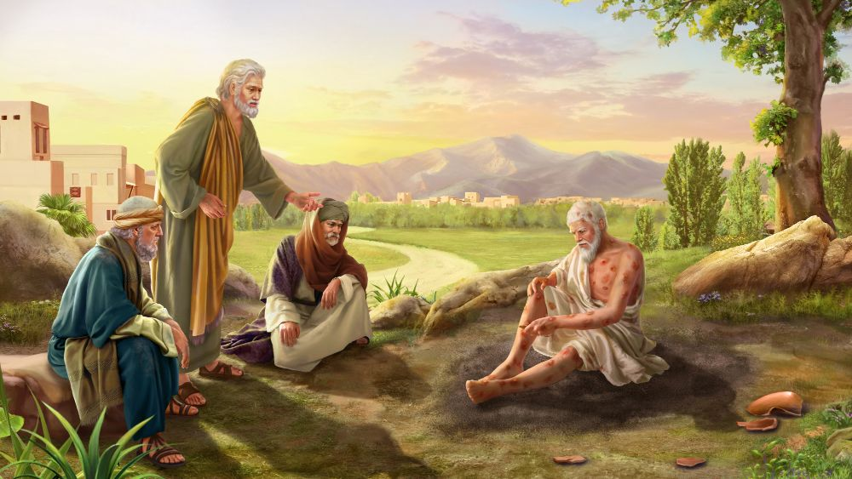
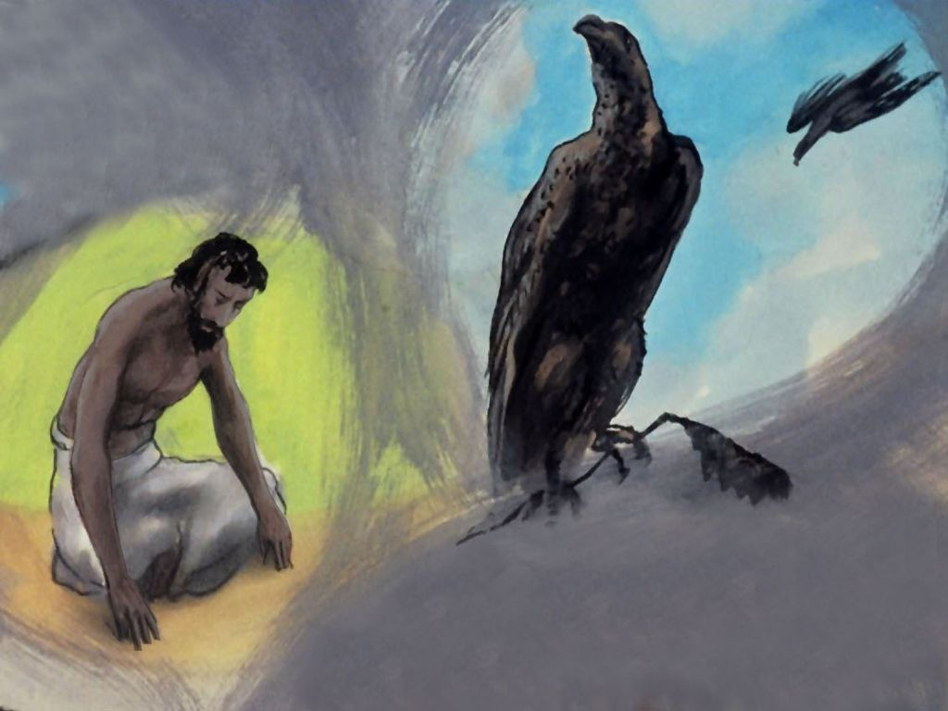
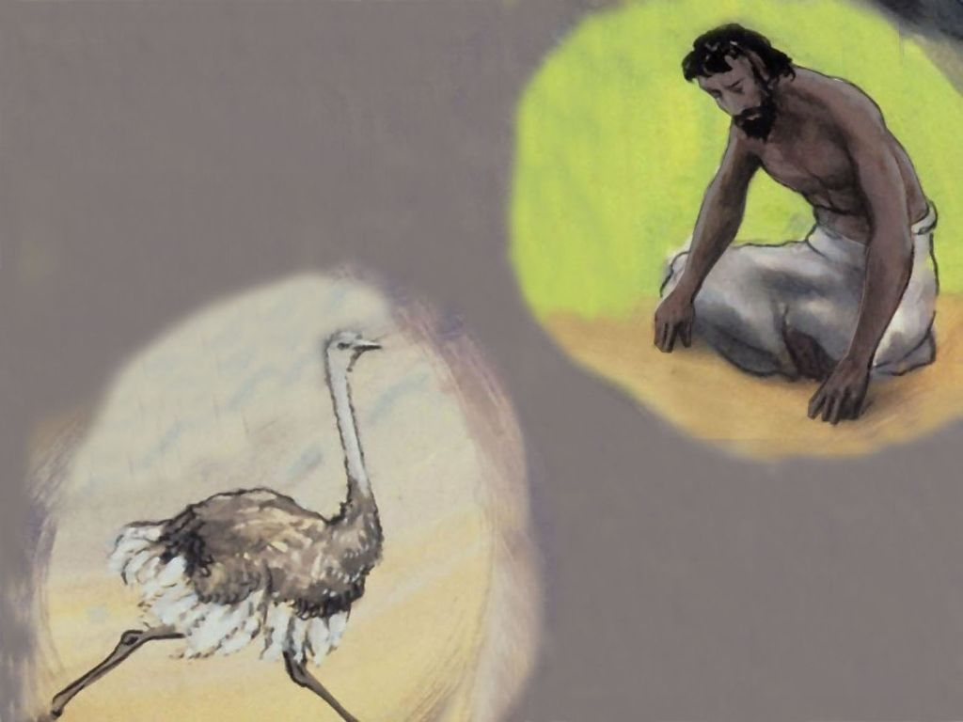
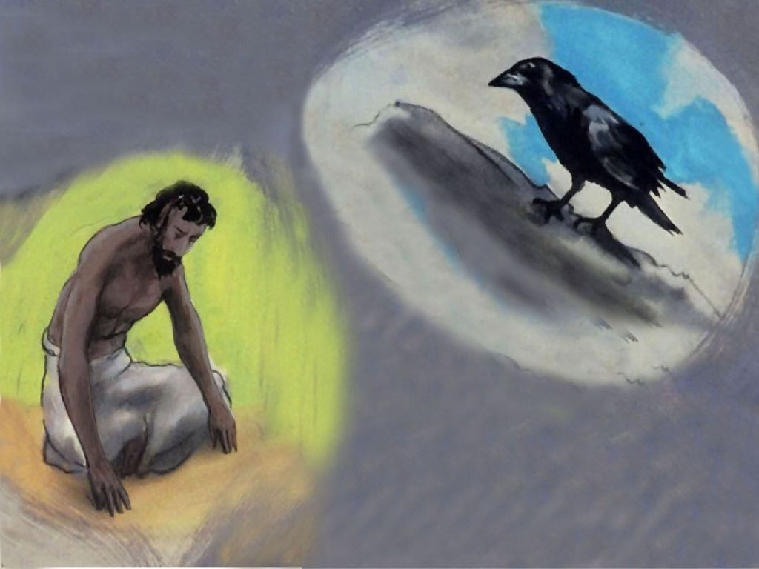
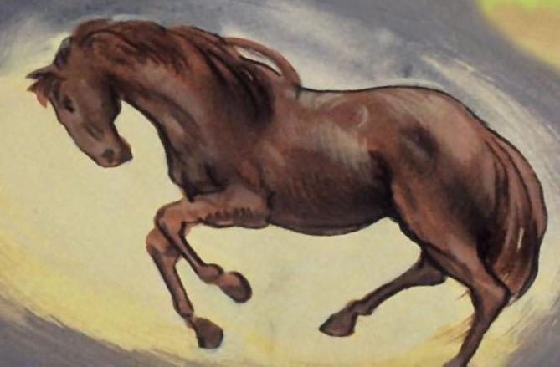

Where wast thou when I laid the foundations of the earth? Hast thou entered into the springs of the sea? or hast thou walked in the search of the depth? Have the gates of death been opened unto thee? or hast thou seen the doors of the shadow of death? 18 Hast thou perceived the breadth of the earth? declare if thou knowest it all." (Job 38:4, 16-18; see Job 38-41).
In Job 38-41, God questions Job tirelessly about everything, starting from Job's absence when the foundations of the earth were laid (Job 38:4) to Job's inability to catch sea monsters (Job 41:1).
God can choose to reveal an attribute of Himself by asking questions. He can ask us questions that lead us to better understand a specific part of His character. Of course, there was no way for Job to know the answers. Only an omniscient God could know these things. God used His interrogation of Job to reveal to him the attributes of His sovereignty and His ultimate power.
The Lord strives to expand Job's concept of the Godhead. God did not immediately defend Job, for His purpose was not to settle a dispute, but to reveal Himself. Nor did he explain to Job the reason for his sufferings. Clearly understanding God is more important than unraveling all of His motives. God did not explain why the wicked prosper or why the righteous suffer; He said nothing about the future world or the rewards to come as compensation for the inequalities of today. He only revealed His goodness, His power, and His wisdom to solve Job's problems.
God wants to reveal His character to you

Slide 11
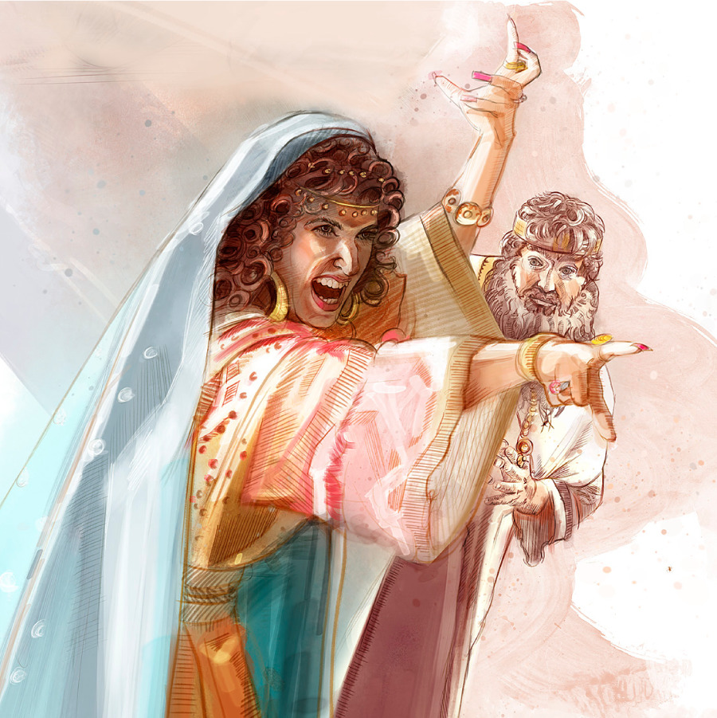
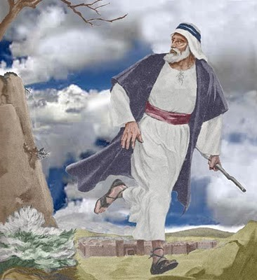
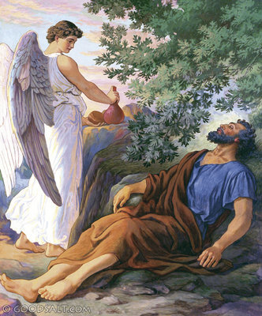


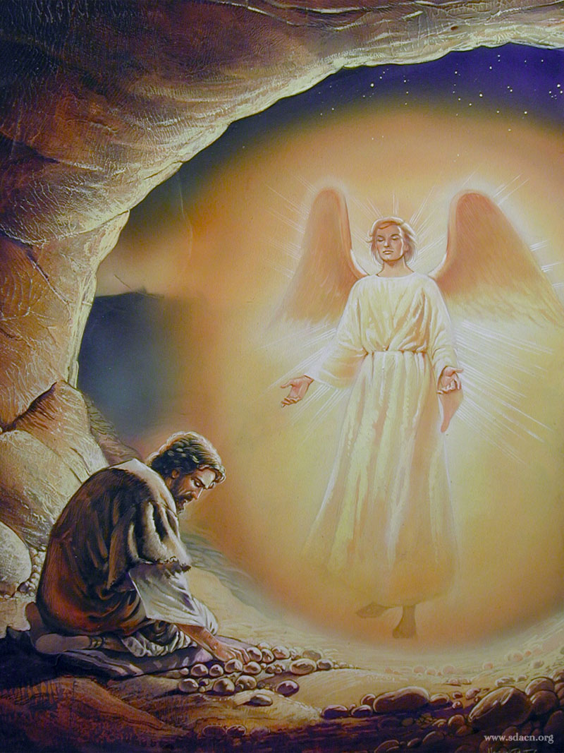

And he came thither unto a cave, and lodged there; and, behold, the word of the Lord came to him, and he said unto him, What doest thou here, Elijah? (1KIngs 19:9).
By asking him, "What are you doing here?" God wanted Elijah to let go of his fears, and to see that he was straying from his purpose for Him.
Having faced the prophets of Baal with tremendous faith, Elijah faced the wrath of Jezebel—and fear took over! Elijah ran and hid in a cave. When the word of the Lord came to him, he was very direct: "What are you doing here?" This was not the place where the Lord wanted His prophet to be. Not the place physically, and certainly not the place spiritually! This question speaks to all of us when we act out of fear or when we disobey.
If we are hiding at home in fear or self-pity, the Lord will say to us, "What are you doing here, my son?" What response will you give to God, knowing that God has a special purpose for you?
God was looking for Elijah to recognize that he was acting in fear, not faith, and that he had taken his eyes off Him. God requires an honest assessment on our part of our relationship with Him. Only then can we start moving in the right direction again.
God wants you to examine where you are in your relationship with Him

Slide 12


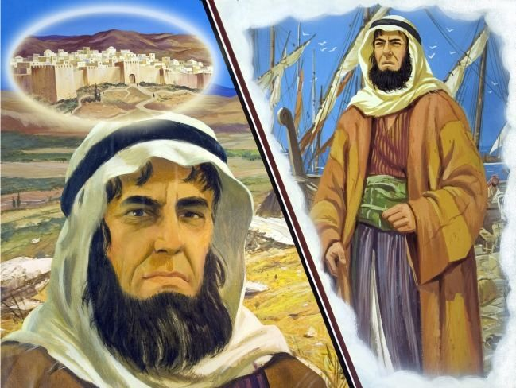
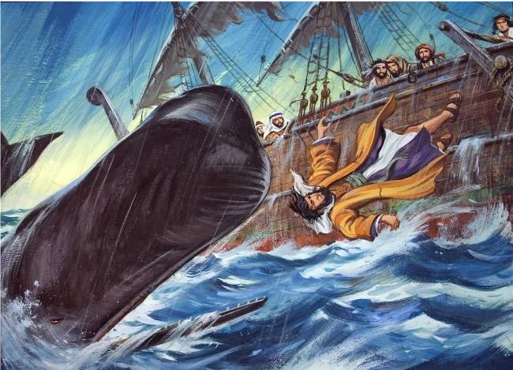
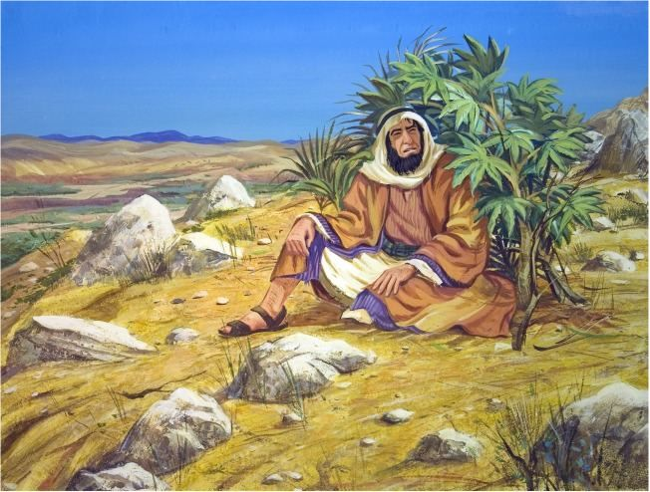
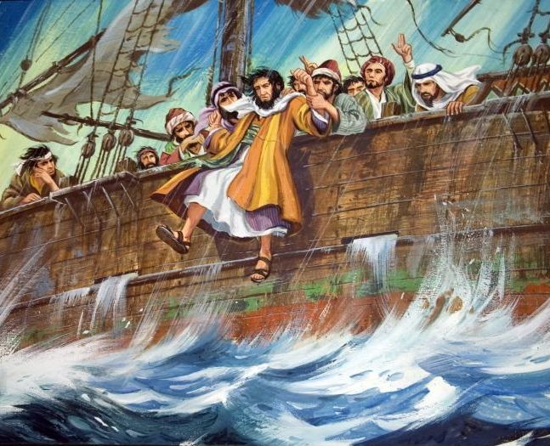
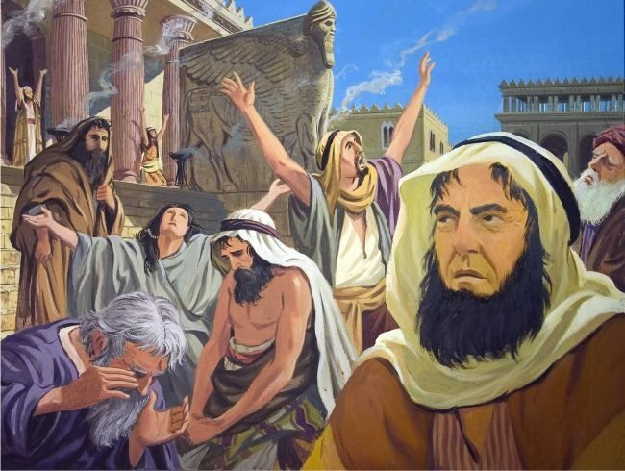
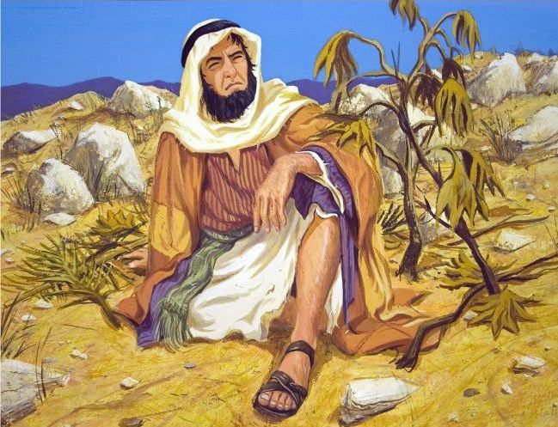

But it displeased Jonah exceedingly, and he was very angry. And he prayed unto the Lord, and said, I pray thee, O Lord, was not this my saying, when I was yet in my country? Therefore I fled before unto Tarshish: for I knew that thou art a gracious God, and merciful, slow to anger, and of great kindness, and repentest thee of the evil. Therefore now, O Lord, take, I beseech thee, my life from me; for it is better for me to die than to live. Then said the Lord, Doest thou well to be angry? (Jonah 4:1-4)
Jonah wanted God to judge the Assyrians of Nineveh severely, but the Ninevites had done the unthinkable: they had repented of their sin. This is what Jonah didn't want. He wanted these people to be destroyed because they were an evil and ruthless nation that acted as a great threat against the nation of Israel. By repenting, God, who is merciful and forgiving, gave them another chance. Jonah's may seem like an odd reaction, for his preaching has been a success as his audience has repented and returned to God. Jonah is angry, furious that the Ninevites are not going to be destroyed. He is angry at the grace God had shown to the city of Nineveh. And then comes the Lord's question, "Do you have the right to be angry?" In the deepest sense, this is a question for all of us when we are angry about what God does, or apparently does not do.
The fact is that we only see things on one level. God sees all things. God's actions are performed with the past, present, and future in mind. He takes into account the motives of the heart as well as the words of the mouth. God has compassion for the sinner who repents, forgives him, and it is as if he had never sinned. Let us rejoice in his Grace with everyone.
Remember that God is merciful, gracious, and forgiving, and that He wants us to do the same with others

Slide 13


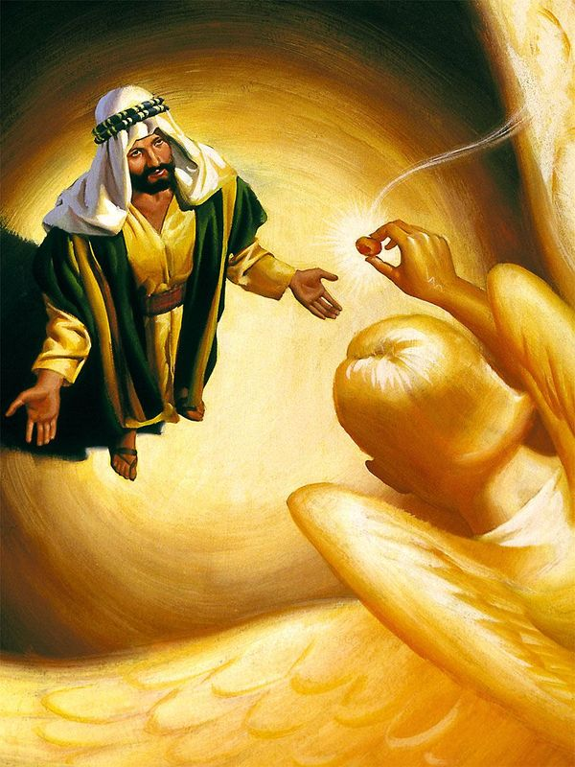

Also I heard the voice of the Lord, saying, Whom shall I send, and who will go for us? Then said I, Here am I; send me. (Isaiah 6:8).
God's question to Isaiah, "Whom shall I send, and who shall go for us?" had the effect of prompting the prophet to volunteer himself.
Isaiah was given a tremendous vision of the Lord in His heavenly kingdom. And when the word of the Lord came, it was an interesting question: "Whom shall I send? And who will go for us?" It's interesting because God, with all His power, still asks who would go for Him. In other words, even though God can do whatever He wants, He chooses to use weak vessels to fulfill His commands. That included Isaiah in his day, but it could also include you and me. God has not changed and continues to use people like you and me to carry out His will. This is both a privilege and a responsibility. How would you respond if you heard God say, "Who will go for us?" If I were honest, I'd probably be thinking "what exactly is the task then? Where am I meant to go? Whether I speak or not depends on what the task is!" Isaiah, of course, didn't think so. Having seen God and His glory, he hastened to reply, "Here I am. Send me!" "Ooh, ooh, choose me, choose me!" Perhaps if we knew God better and knew that we can trust Him, we would also be quicker to raise our hands and realize that, in everything He asks us to do, He will be with us.
God calls you to proclaim the good news of salvation

Slide 14


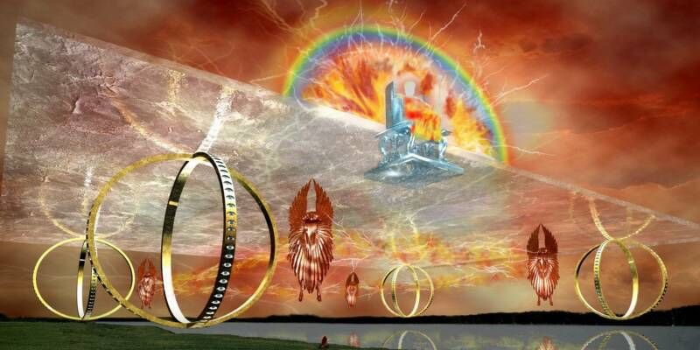
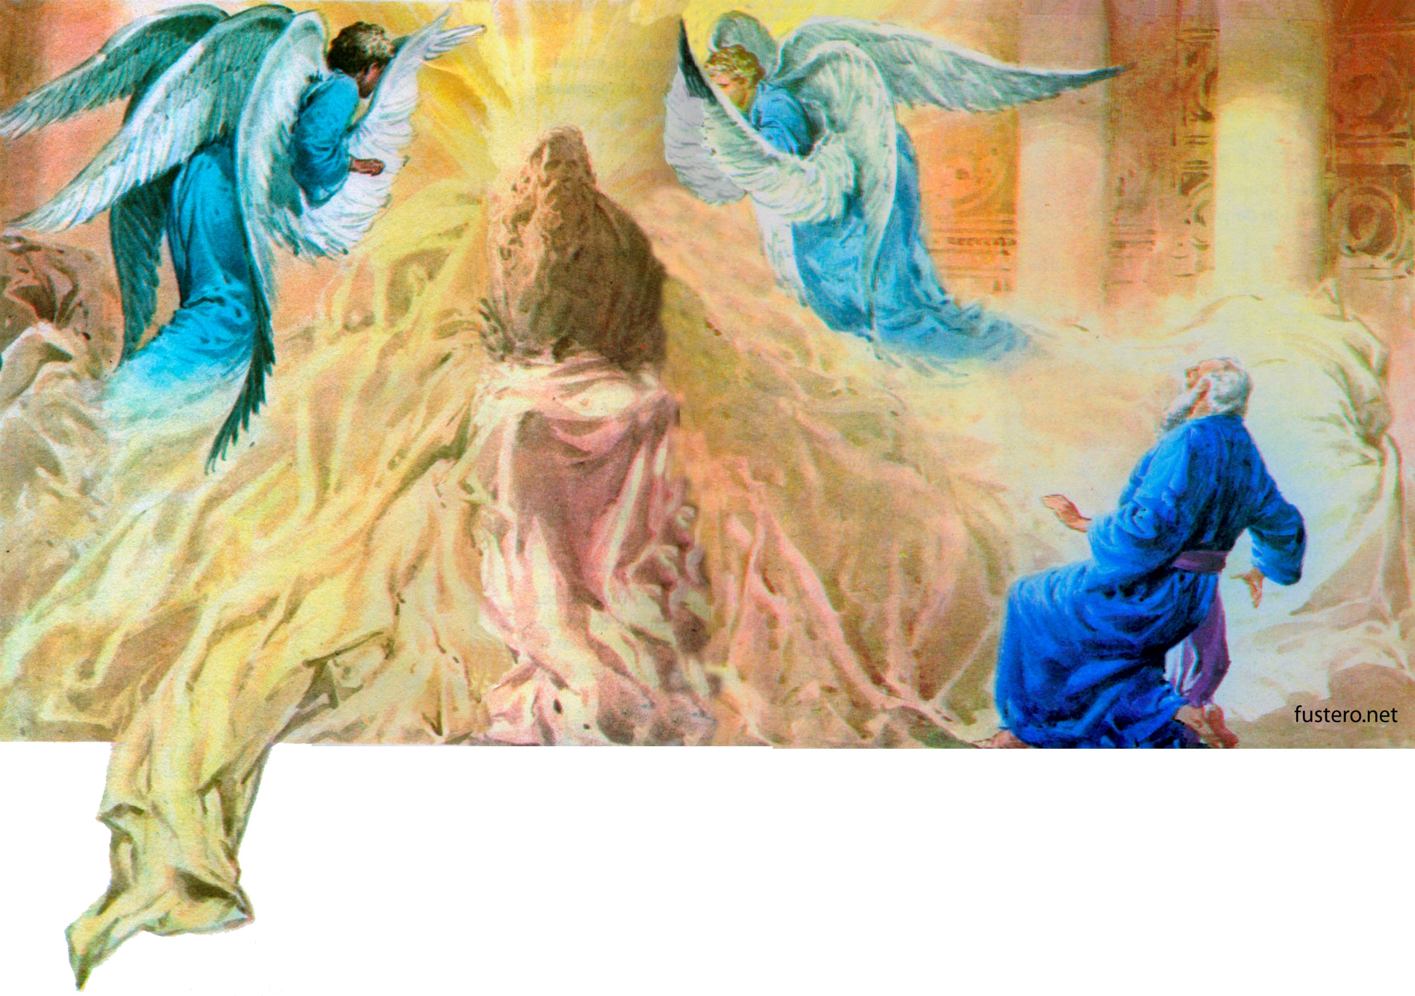

"To whom then will ye liken me, or shall I be equal? saith the Holy One." (Isaiah 40:25).
God's characteristic attribute is not so much His great wisdom or power as His perfect holiness. That is the secret of his wisdom and his power. Justice is the foundation of his throne. In sharp contrast to God, the pagan deities—Baal, Moloch, Ishtar, etc.—are vile creatures, the very deification of men's vices and passions.
Remember that you are related to a holy God; a pure, noble, good, upright and loving God. Therefore, He cannot see evil, hatred, or selfishness without feeling deep pain and inner rejection. His holiness is goodness, righteousness, justice, moral purity and love raised to the nth power. Hence, you can be sure that all His intentions for your life are full of kindness, righteousness, and love. And the most wonderful thing is that he invites you to the possibility of participating in this holiness, so that, in a gradual process, through the presence of his Holy Spirit in you, you can be transformed more and more into the likeness of his holy character.
It recognizes that God is unique and that apart from Him no one has the power to save and sanctify

Slide 15



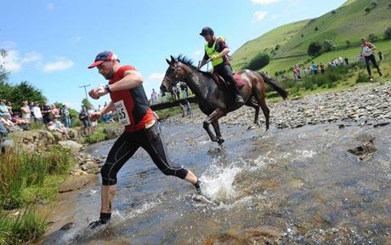

If thou hast run with the footmen, and they have wearied thee, then how canst thou contend with horses? and if in the land of peace, wherein thou trustedst, they wearied thee, then how wilt thou do in the swelling of Jordan? (Jeremiah 12:5 ).
God asks Jeremiah to compare his petty sorrows with the greater difficulties of others or with the most intense adversities that would come upon him.
If we neglect the petty tasks of life, how can we undertake the greater responsibilities that can fall to us? If we succumb to the little temptations of daily busyness, how will we be able to cope with the terrible tribulations that will befall us in the future? If we cannot face the situations of the present with faith and confidence, how can we endure the almost intolerable hardships and almost irresistible deceptions that will occur during the "time of trouble"?
Trust God in small trials, for you will continue to do so in the most intense ones

Slide 16



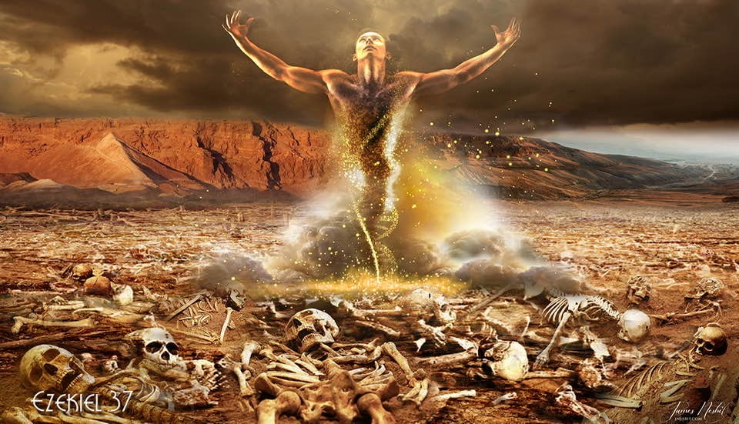
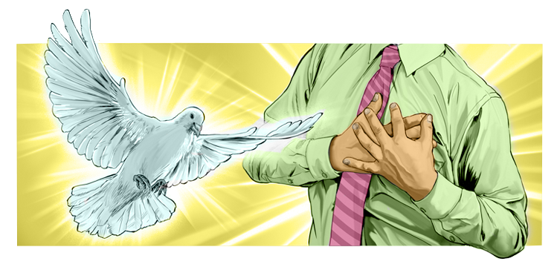
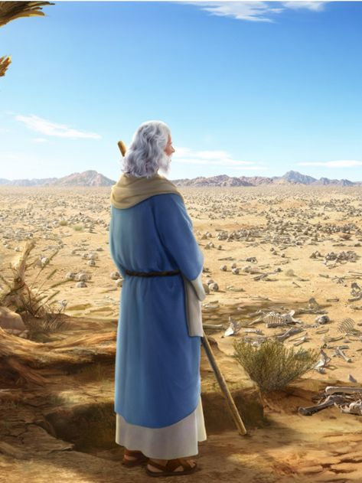

“And caused me to pass by them round about: and, behold, there were very many in the open valley; and, lo, they were very dry. And he said unto me, Son of man, can these bones live? And I answered, O Lord God, thou knowest.” (Ezequiel 37:2-3).
For this question, it will be worth reading the entire chapter. But as a summary, the prophet Ezekiel was given an amazing vision of a valley of dry bones and the question came to him as to whether bones can live. Ezekiel was not sure and replied to the Lord that only He knew. He was then asked to prophesy to the bones and tell them to live! The bones began to sound and came together. Soon there were sinews, flesh and skin... what was dead had come to life!
But digging a little deeper, this question to Ezekiel also speaks to us. "Son of man, will these bones live?" In other words, do you believe that I am the God of the impossible? Do you believe that I am the God who brings life out of death? He is the living God, and when we find ourselves in seemingly hopeless situations, let us remember this question: "Will these bones live?" If they can live, then God Himself can bring deliverance to you as well. God is a God of life and gives life to the spiritual dead. The regenerating influence of the Holy Spirit renews the heart. The power of Christ's love works a transformation of character.
This is the sure result of union with Jesus. When Christ dwells in the heart, the whole of nature is transformed. The Spirit of Christ and His love soften the heart, subdue the soul, and lift up thoughts and desires to God and heaven.
God can give you spiritual life through His Holy Spirit

Slide 17


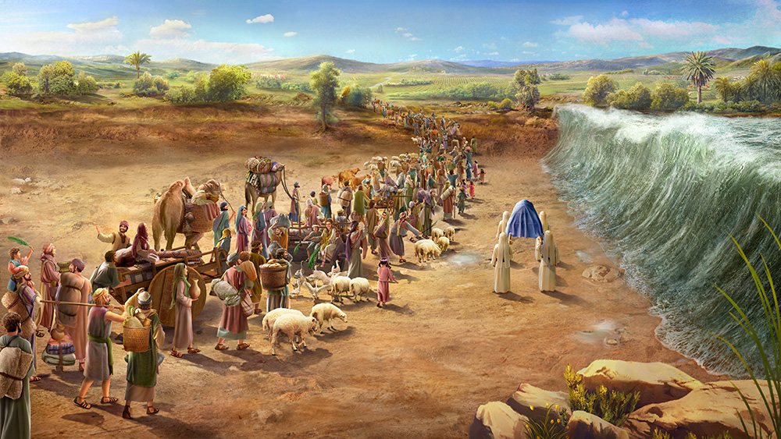
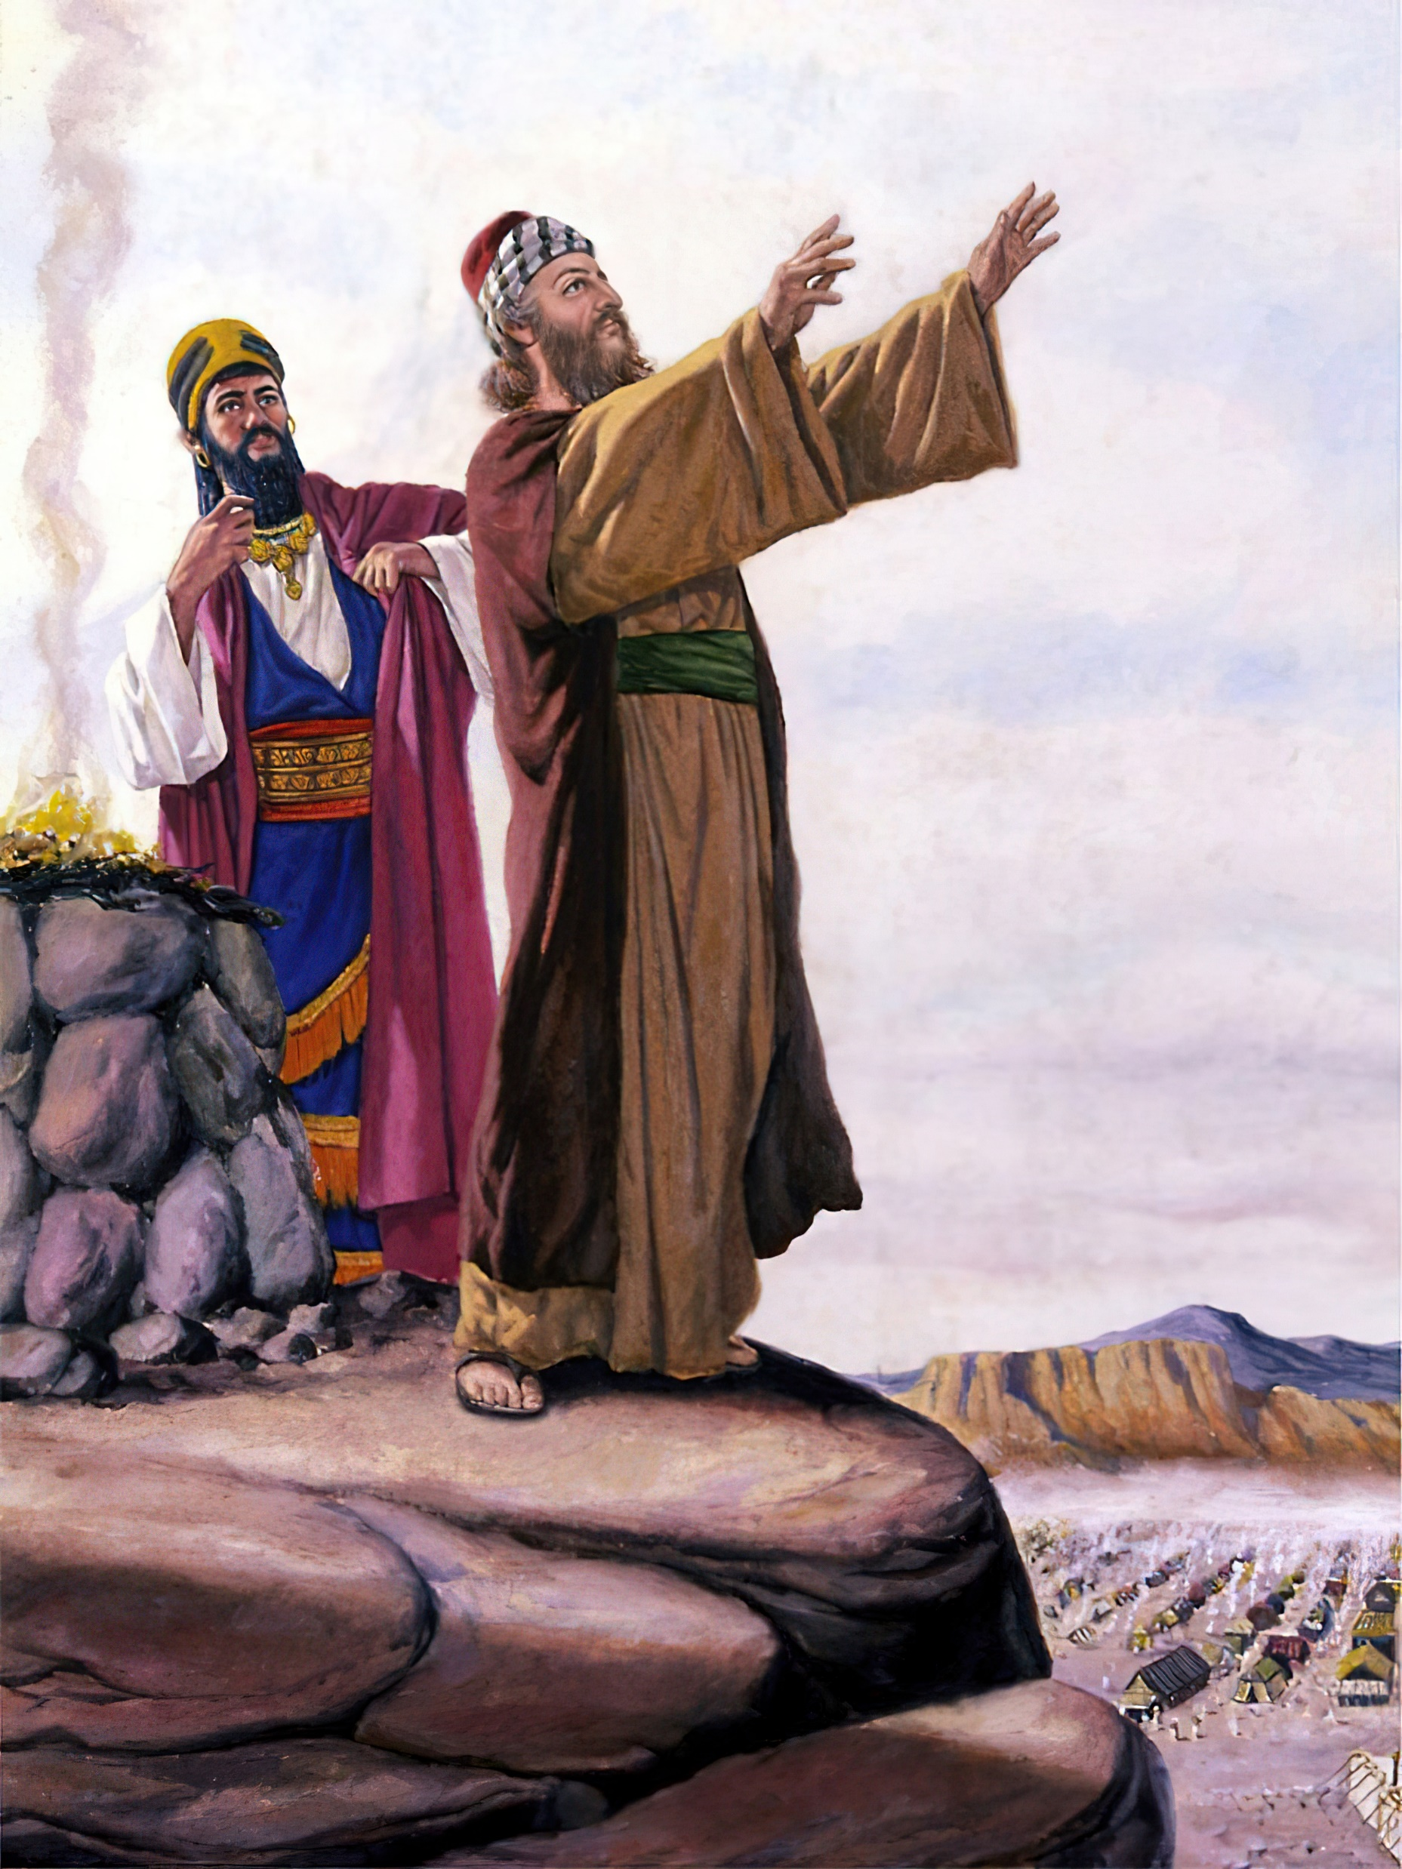
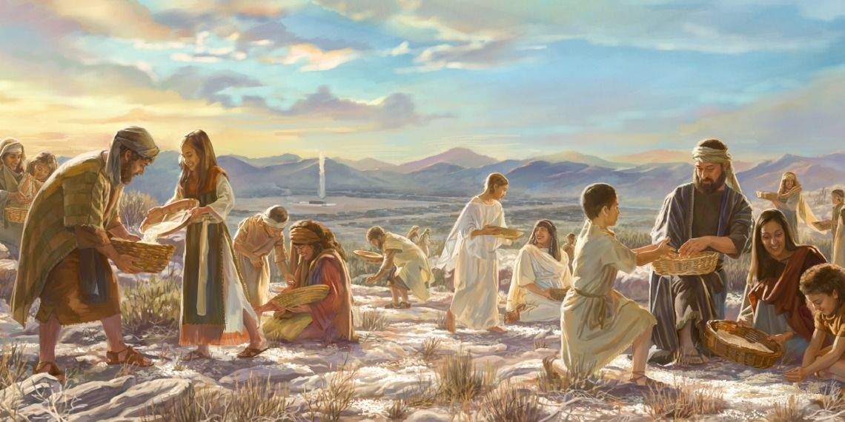
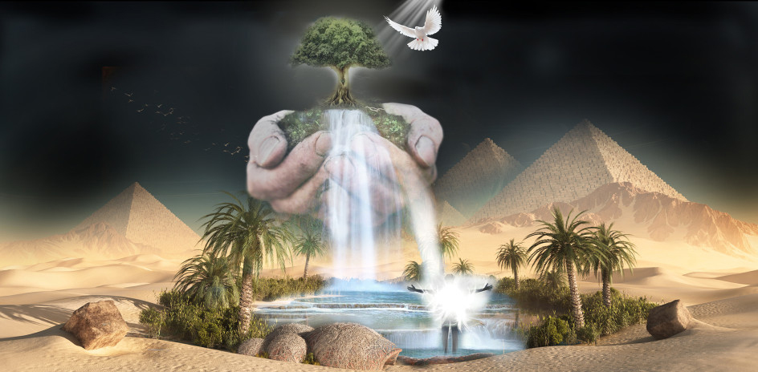

“O my people, what have I done unto thee? and wherein have I wearied thee? testify against me.” (Micah 6:3).
In the face of indifference, complaints, apathy, nonconformity and constant denials, God asks us: "What have I done to you, how have I bothered you?" A question to react. Let us remember the wonders He has done for us.
At a time when friends, family, even the church itself may have failed us, God asks us: "What wrong have I done you?" On many occasions, the adverse things we go through are the result of our bad decisions and consequences of the same disobedience. Let us bring to mind where God rescued us, how we lived before we met Him, and the wonders He has done in our pilgrimage through life.
Remember the remarkable benefits God has lavished on you

Slide 18


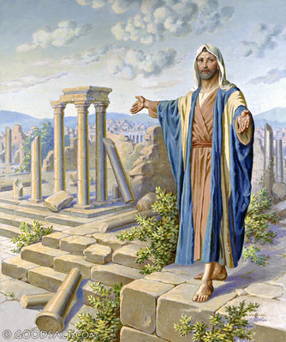


“Then came the word of the Lord by Haggai the prophet, saying, Is it time for you, O ye, to dwell in your cieled houses, and this house lie waste? (Haggai 1:3-4).
God rebukes the Jews because they allowed their comfortable way of living in comfortable homes to prevent them from seeing the need to rebuild the temple. Men often take into account their material needs and do not see their spiritual needs or those of God's work on earth.
Some, fearing they will suffer loss of earthly treasure, neglect prayer and the assembling of themselves together for the worship of God, that they may have more time to devote to their farms or their business. They show by their works which world they place the highest estimate upon. They sacrifice religious privileges, which are essential to their spiritual advancement, for the things of this life and fail to obtain a knowledge of the divine will. They come short of perfecting Christian character and do not meet the measurement of God. They make their temporal, worldly interests first, and rob God of the time which they should devote to His service. Such persons God marks, and they will receive a curse rather than a blessing. 2T 654.1
Evaluate your priorities and put God first

Slide 19


















Acknowledge the situation you are in and confess your sin.
It recognizes that God is unique and that apart from Him no one has the power to save and sanctify
God wants to awaken your conscience and prevent you from delving into sin.
Trust God in small trials, for you will continue to do so in the most intense ones
God wants you to know that He is with you in your loneliness or in the midst of your difficulties.
God wants to reveal His character to you.
God wants you to examine where you are in your relationship with Him.
God wants to change your character.
God can give you spiritual life through His Holy Spirit
God is willing to use you with what you have, whether it is a little or a lot.
Remember that God is merciful, gracious, and forgiving, and that He wants us to do so with others.
Remember the remarkable benefits God has lavished on you
Act with confidence that God is going to work miracles.
God calls you to proclaim the good news of salvation
Evaluate your priorities and put God first
Stop complaining, sanctify yourself, and act.

