Slide 1
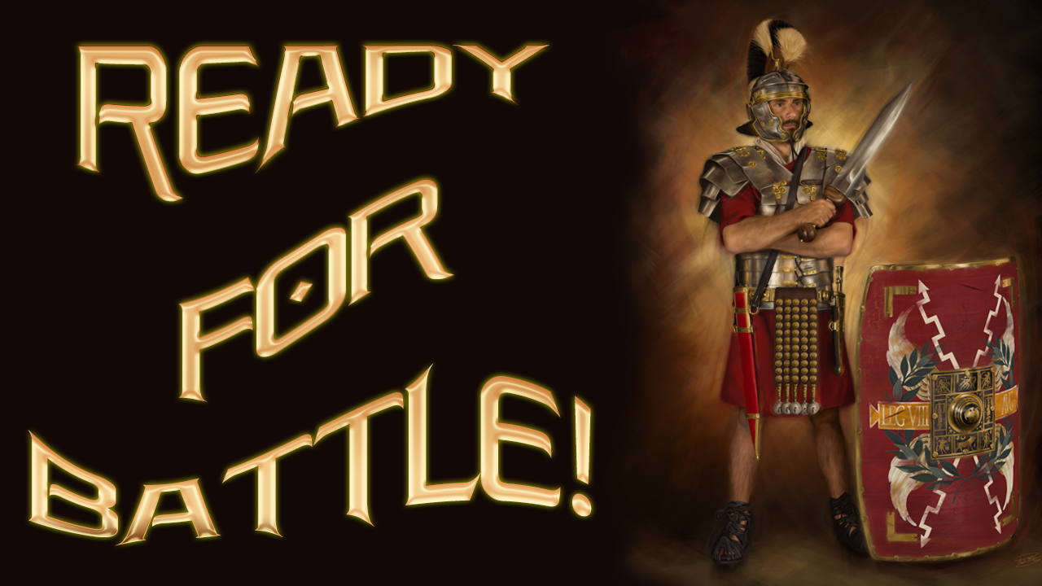

Slide 2

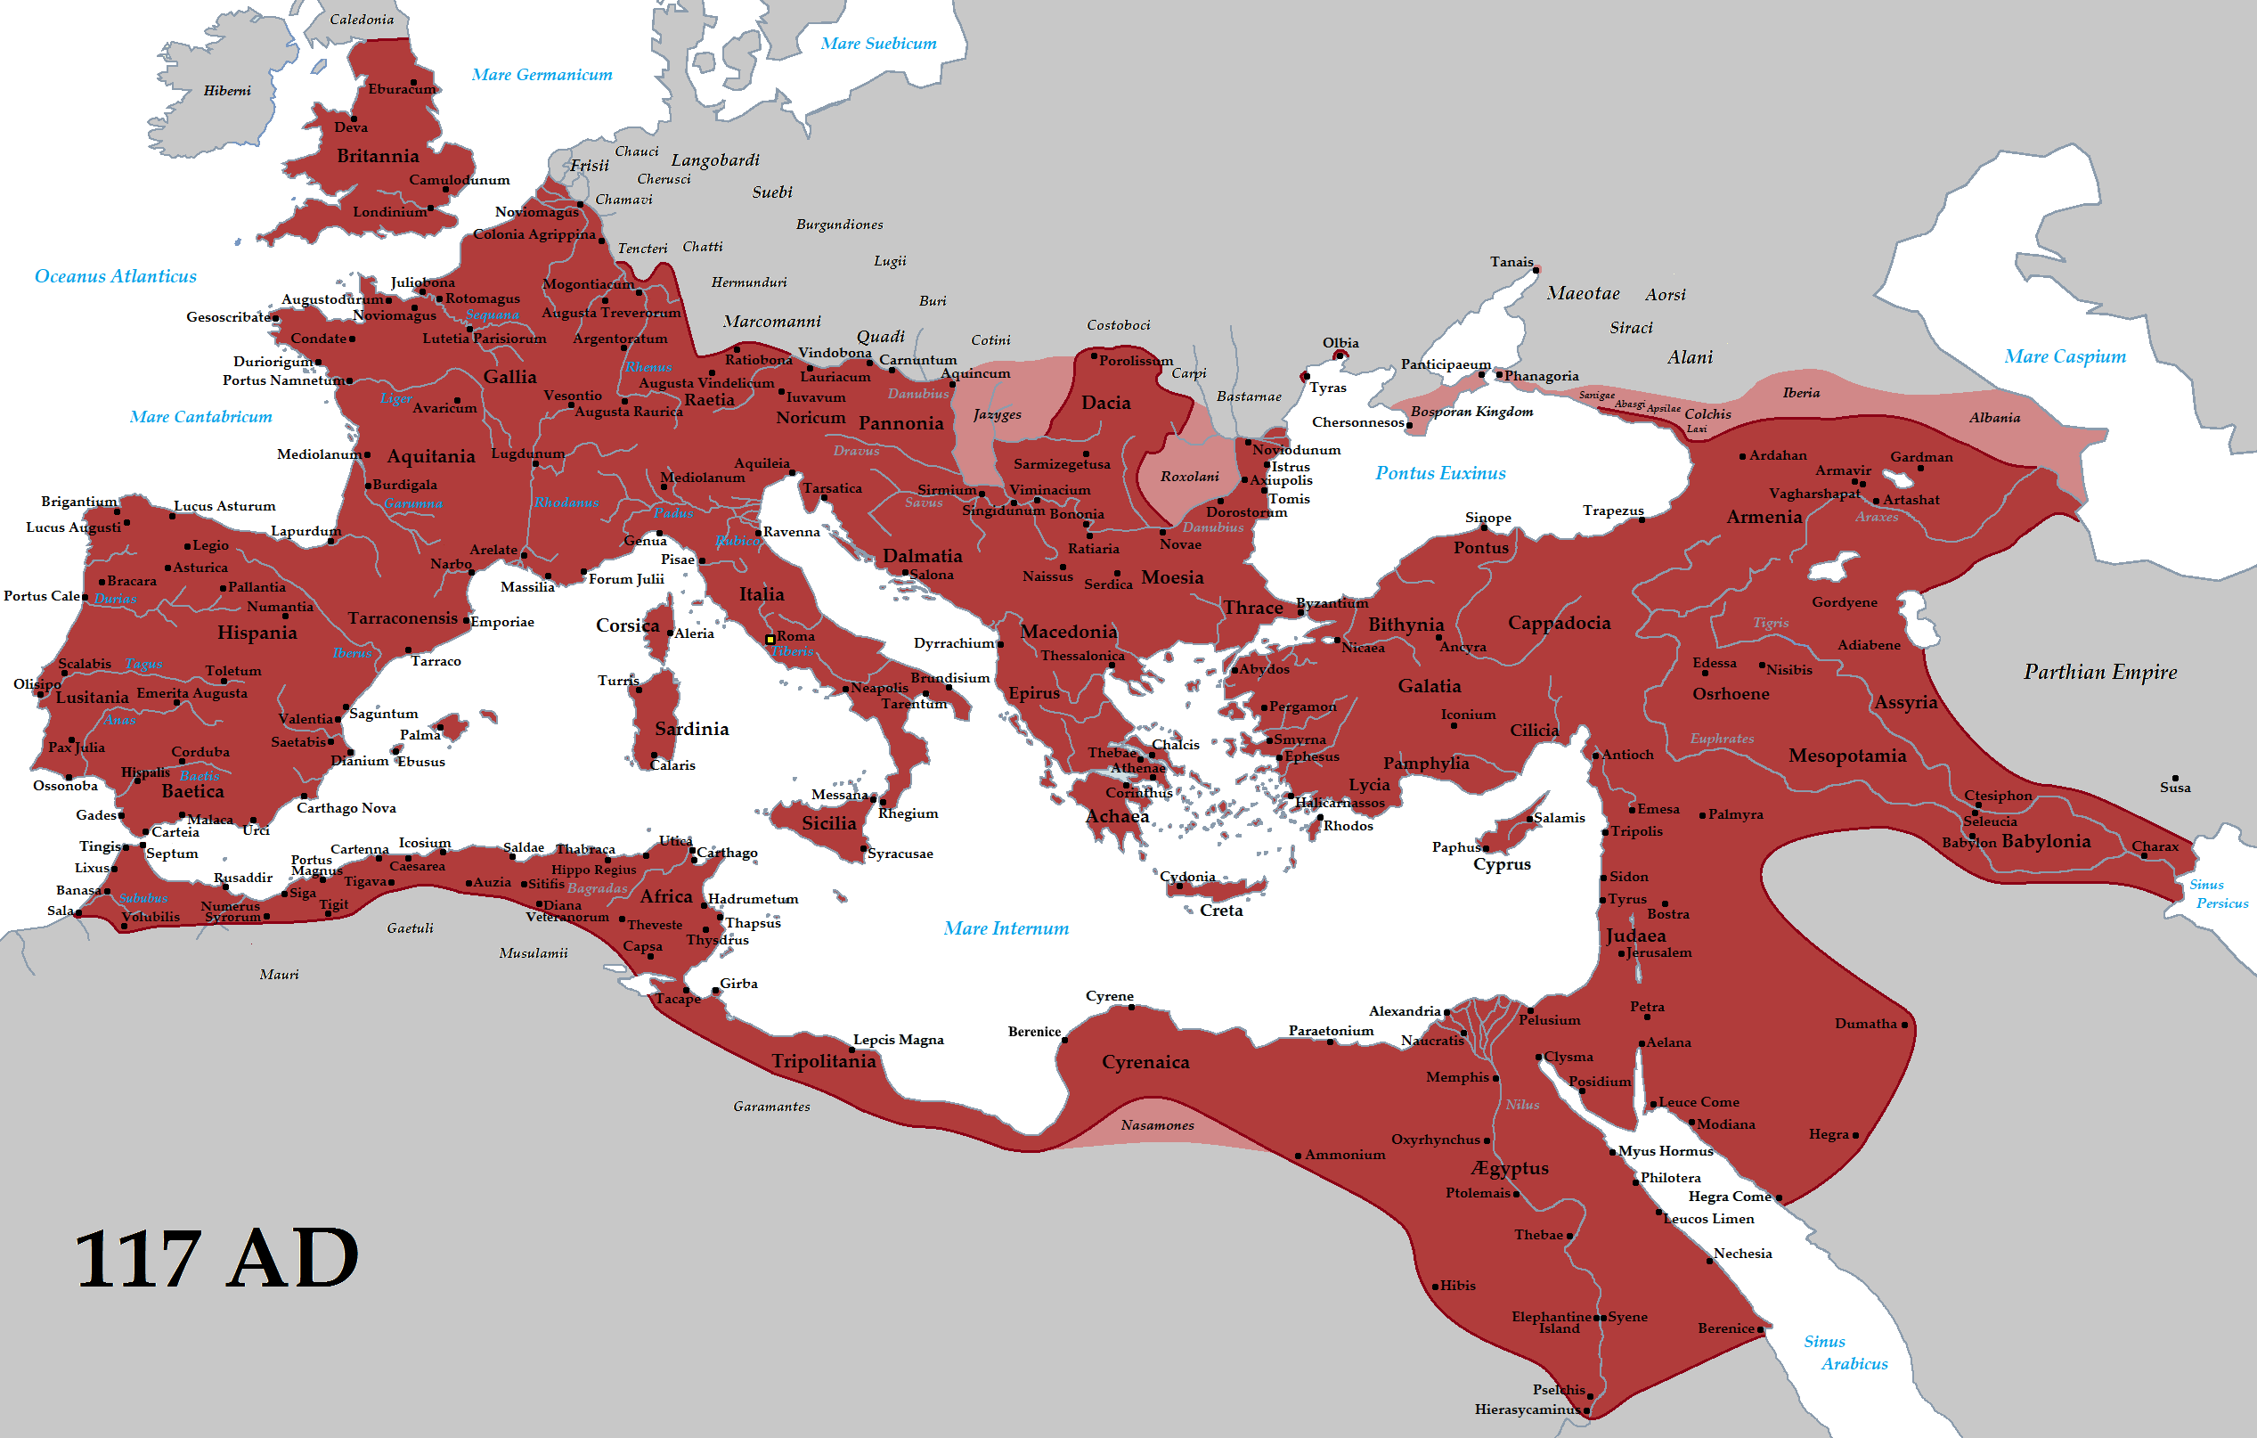
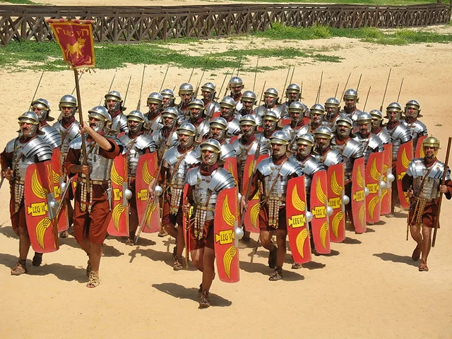
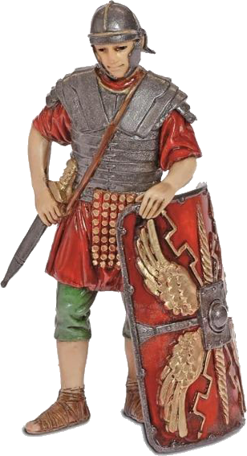
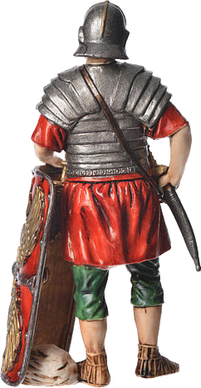
De Tataryn - Trabajo propio, CC BY-SA 3.0, https://commons.wikimedia.org/w/index.php?curid=19625326
The Roman Empire dominated the world for much longer than other great empires. The Empire began around 168 B.C. and ended its hegemony when the Roman emperor, Romulus Augustus was deposed by the German king Odoacer in 476 A.D.
The legionary armies were key to this great achievement. These armies were a veritable human war machine. Its troops became the most effective military organization in history. It was a professional army, composed of well-disciplined and rigorously trained soldiers. But the results in battle were attributed to his armor.
In the letter to the Ephesians, Paul compares the soldier's armor to the armor God gives to the Christian. We can read it in Ephesians 6:10-18.
Let's answer some important questions and learn more about this armor.

Slide 3

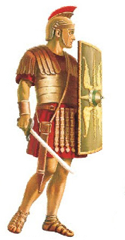
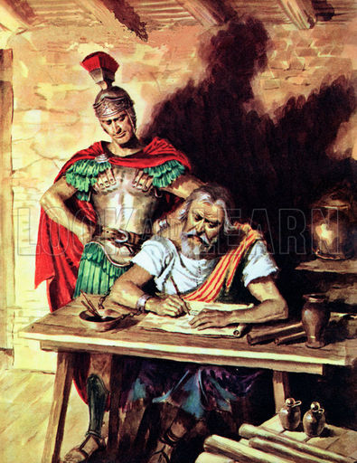
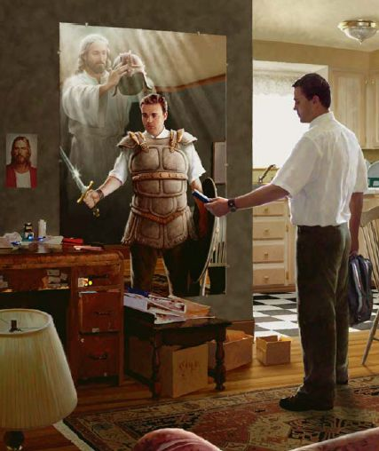
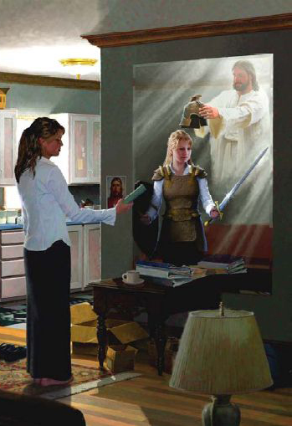
What inspired Paul with the metaphor of Roman armor with the Christian life?
“And when we came to Rome, the centurion delivered the prisoners to the captain of the guard: but Paul was suffered to dwell by himself with a soldier that kept him.” (Acts 28:16).
The apostle Paul was taken to Rome as a prisoner and chained to a soldier for two years. So Paul knew the armor of the Roman soldier very well.
He knew from experience the great conflict that every human being lives. He knew that the battlefield for this intense spiritual struggle is not a piece of earthly real estate; it is the human heart. Both Jesus and the devil are supremely interested in taking possession of our minds and hearts. For this reason, Paul exhorts Christians not to be mere spectators or peaceful mediators in this terrible conflict, but to fight on the front lines.

Slide 4


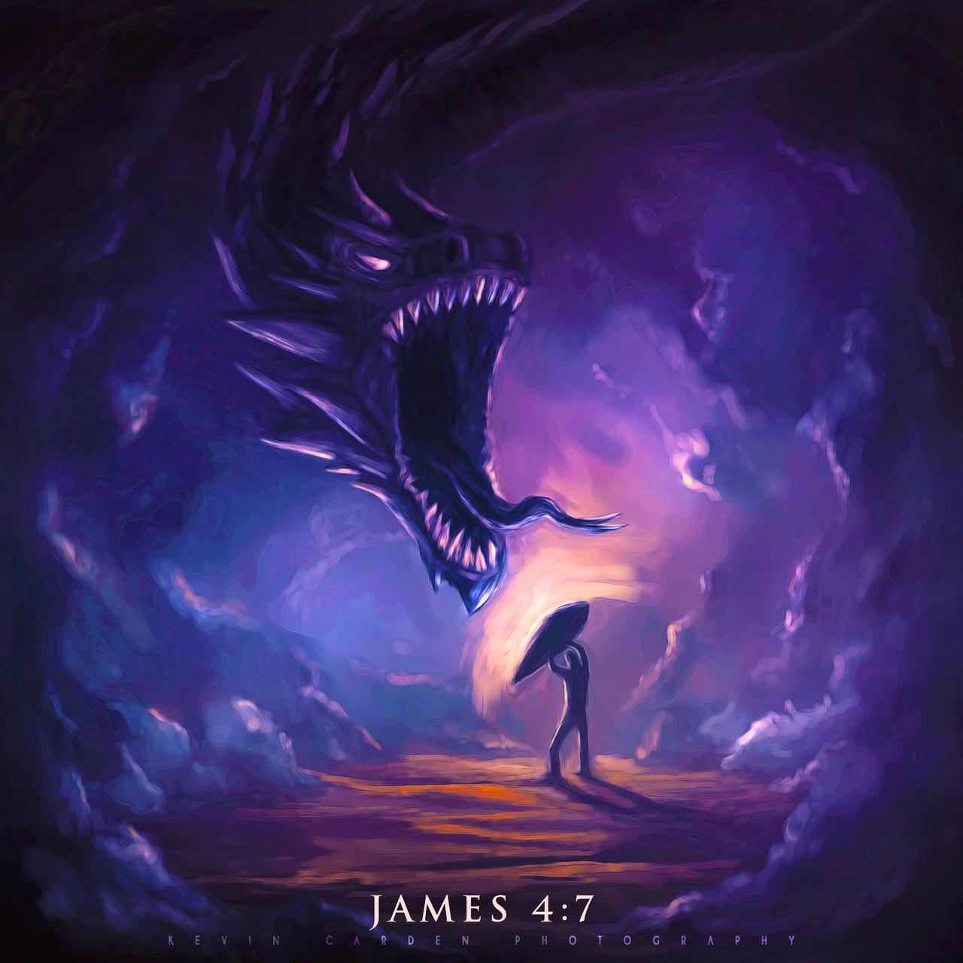
What do we have a fight against? Who are described in these expressions?
“For we wrestle not against flesh and blood, but against principalities, against powers, against the rulers of the darkness of this world, against spiritual wickedness in high places” (Ephesians 6:12)
If human beings could know the number of evil angels, if they could know their artifices and their activity, there would be much less pride and frivolity. Satan is the prince of demons. The evil angels over whom he rules, do his bidding. Through them, he multiplies its agents all over the world. He instigates all the evil that exists in our world.
But though the principalities and powers of darkness are many in number, and incessant in their activity, yet the Christian should never feel helpless or discouraged. He cannot hope to escape temptation because Satanic efficiency diminishes. He who sent a legion to torture a human being cannot be rejected solely by human wisdom or by human power.
Speaking of Satan, the Lord declares that there was no truth in him. It was once beautiful, resplendent with light; but the Word of God declares of him, "Thy heart was lifted up because of thy beauty."
Satan instigated others to rebel, and after they were cast out of heaven, he gathered them into a covenant to do all possible evil to man, as the only means of hurting God. Already excluded from heaven, he resolved to take revenge by harming the workmanship of God. (MS 33, 1911. CBA on Ephesians 6:12)

Slide 5

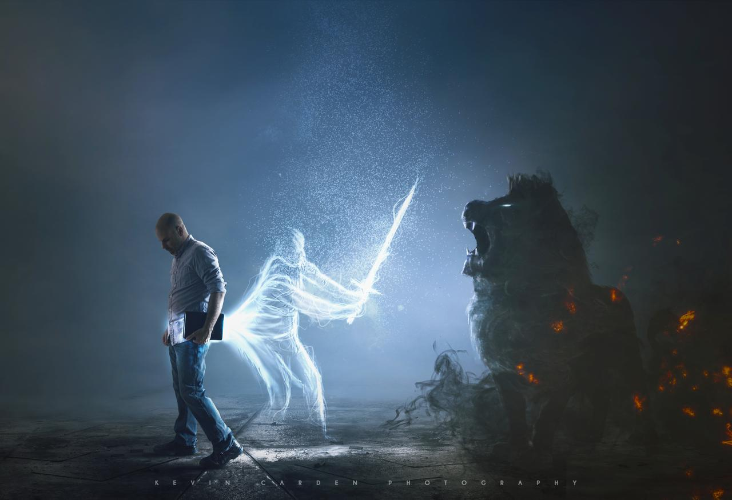
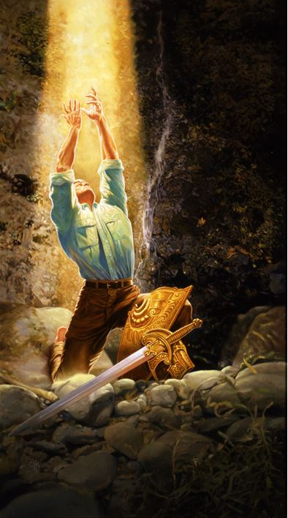

What is the state of our enemy?
“Be sober, be vigilant; because your adversary the devil, as a roaring lion, walketh about, seeking whom he may devour” (1 Peter 5:8)
Peter sees behind all the persecutions that afflicted his readers the supreme enemy: Satan. He sees him as a hungry lion who roars to frighten and catch its prey. A suitable figure of the devil, who through persecutions, causes Christians to be frightened to force them to apostatize. Or looking for various ways to corner their prey. The lion does not wait for the prey to go to his den, nor does Satan sit back and wait for his victims to fall into his nets. He goes from one place to another looking for how to hunt down those who he wants to make his victims. Just as the lion devours its prey, so too does the devil tear his victims from the bosom of the church and devours them.
.
Why are we in a disadvantage with respect to the enemy?
“For we wrestle not against flesh and blood, but against principalities, against powers, against the rulers of the darkness of this world, against spiritual wickedness in high places” (Ephesians 6:12)
If our conflict were only with men, the need for armor would not be so evident; But we have to deal with the stratagems and subtleties of the devil. The temptations that Christ suffered reveal how subtle is the devil's method, always directed at the weakest points of human nature (Matt. 4:1-11; 2 Cor. 2:11; Efe. 2:2; 4:17; 1Pet. 2:11; 5:8) It is much easier to face the declared enemy than the one who hides behind deception. The armor of God is made to defend against precisely these kinds of cunning attacks, which would otherwise destroy the Christian combatant. (CBA to Ephesians 6:11)

Slide 6


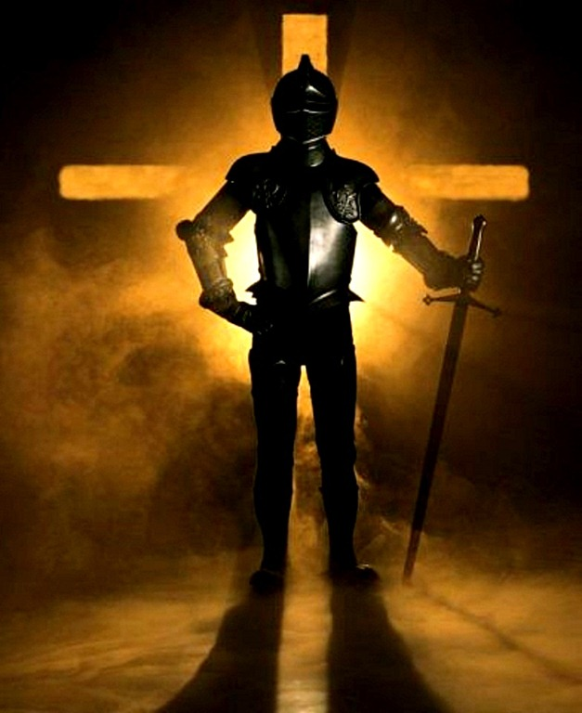
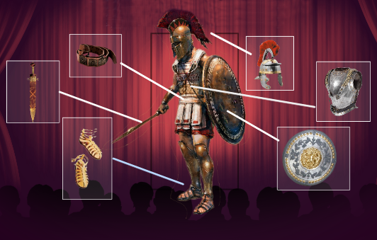
For which two reasons we should take up the armor of God? (Ephesians 6:11, 13)
“Put on the whole armour of God, that ye may be able to stand against the wiles of the devil” (Ephesians 6:11)
“Wherefore take unto you the whole armour of God, that ye may be able to withstand in the evil day, and having done all, to stand” (Ephesians 6:13)
A soldier protected with only half the armor can pay dearly for his carelessness and recklessness. He will go into battle with a false sense of security, for the enemy will no doubt attack the parts devoid of protection. The Christian is vulnerable in many ways, and often what he thinks is his strongest point turns out to be the weakest in the face of temptation. Just as a chain is not stronger than its weakest link, the Christian is not stronger than his most deficient character trait. Due to the variety of enemies that must be faced and the many weaknesses of the flesh, only the full armor will suffice.
What does it mean to stand firm?
“… and having done all, to stand” (Ephesians 6:13)
The Christian, having done his utmost by God's grace, can feel secure. (CBA to Ephesians 6:13) He will not fall into the temptations and wiles of Satan and nothing and no one will be able to separate him from God.
Having the armor that God provides for him, no matter how hard the battle, Satan will not be able to make him fall. He will stand firm in his post.

Slide 7

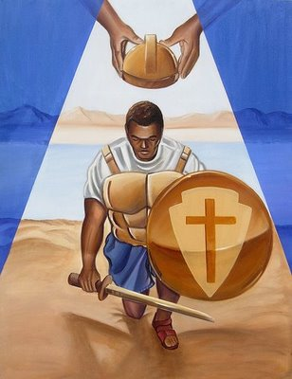
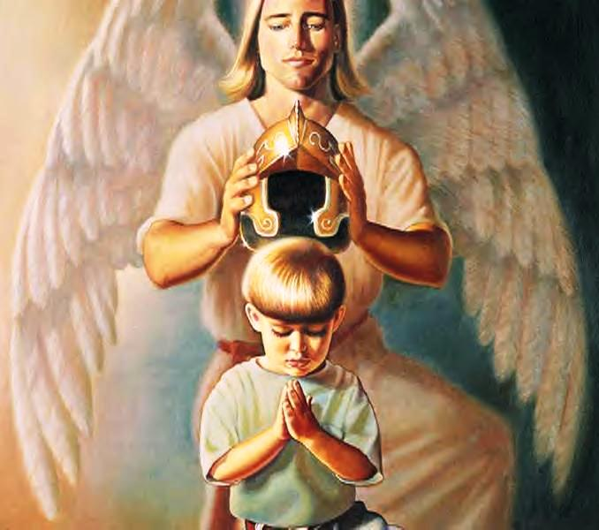
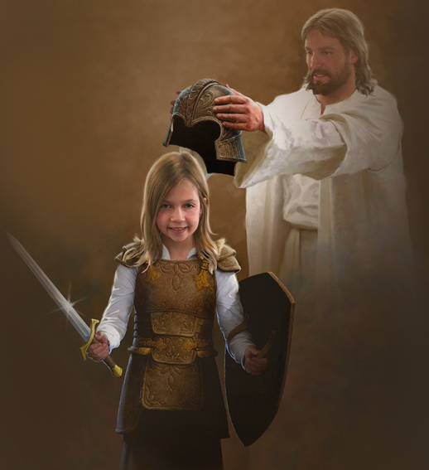
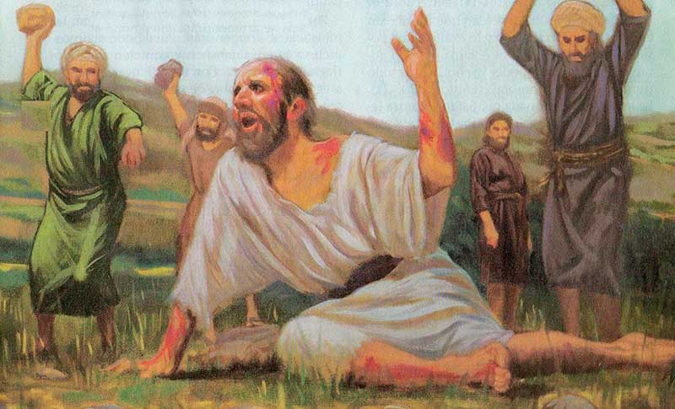
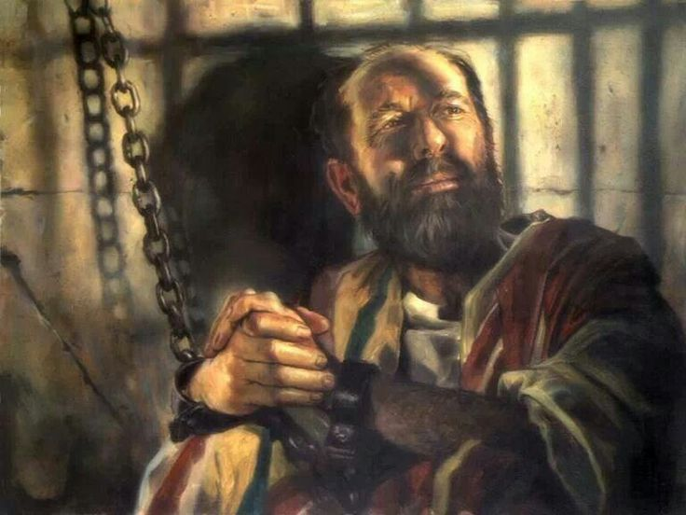
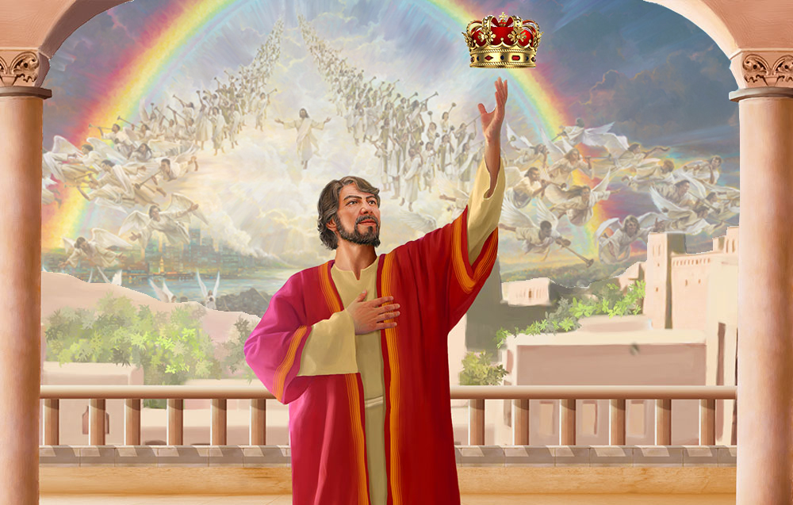
Is this armor one size fits all? Can anyone wear it?
“Finally, my brethren, be strong in the Lord, and in the power of his might” (Ephesians 6:10)
Children, young people, adults or the elderly; men or women; rich or poor... We all need to defend ourselves from Satan's temptations. Therefore, the armor of God is adapted to each one. No matter the size... it is universal.
What happens to the soldiers who enlist in this battle?
“I have fought a good fight, I have finished my course, I have kept the faith: Henceforth there is laid up for me a crown of righteousness, which the Lord, the righteous judge, shall give me at that day: and not to me only, but unto all them also that love his appearing.” (2 Timothy 4:7-8)
“Soldiers engaged in battle have to meet difficulties and hardships. Coarse food is given them, and that often in limited quantities. They have long marches, day by day, over rough roads and under burning suns, camping out at night, sleeping on the bare ground, with only the canopy of heaven for a covering, exposed to drenching rains and chilling frosts, hungry, faint, exhausted, now standing as a target for the foe, now in deadly encounter. Thus they learn what hardship means. Those who enlist in Christ's army are also expected to do difficult work, and to bear painful trials patiently for Christ's sake. But those who suffer with Him shall also reign with Him.” (YRP 345)”

Slide 8

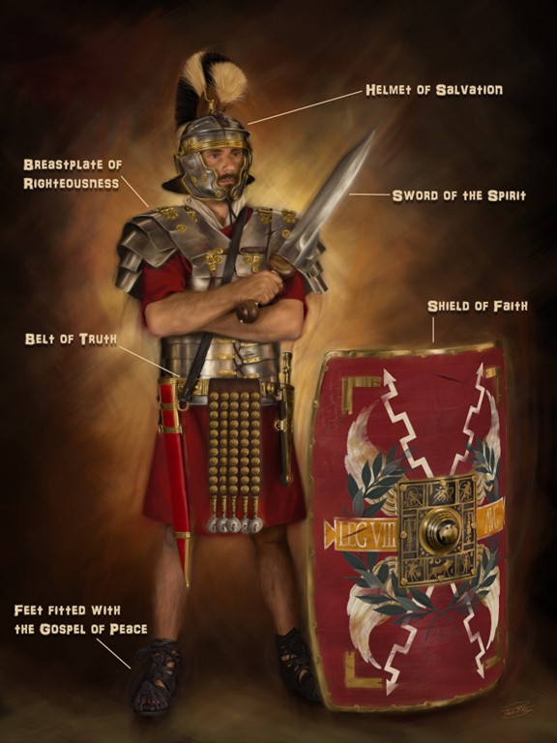
What parts make up the armor, where are they placed, and what do they represent?
Stand therefore, having your loins girt about with truth,
and having on the breastplate of righteousness,
And your feet shod with the preparation of the gospel of peace.
Above all, taking the shield of faith, wherewith ye shall be able to quench all the fiery darts of the wicked.
And take the helmet of salvation,
and the sword of the Spirit, which is the word of God.
(Ephesians 6:14-17)
5
2
6
4
1
3

Slide 9

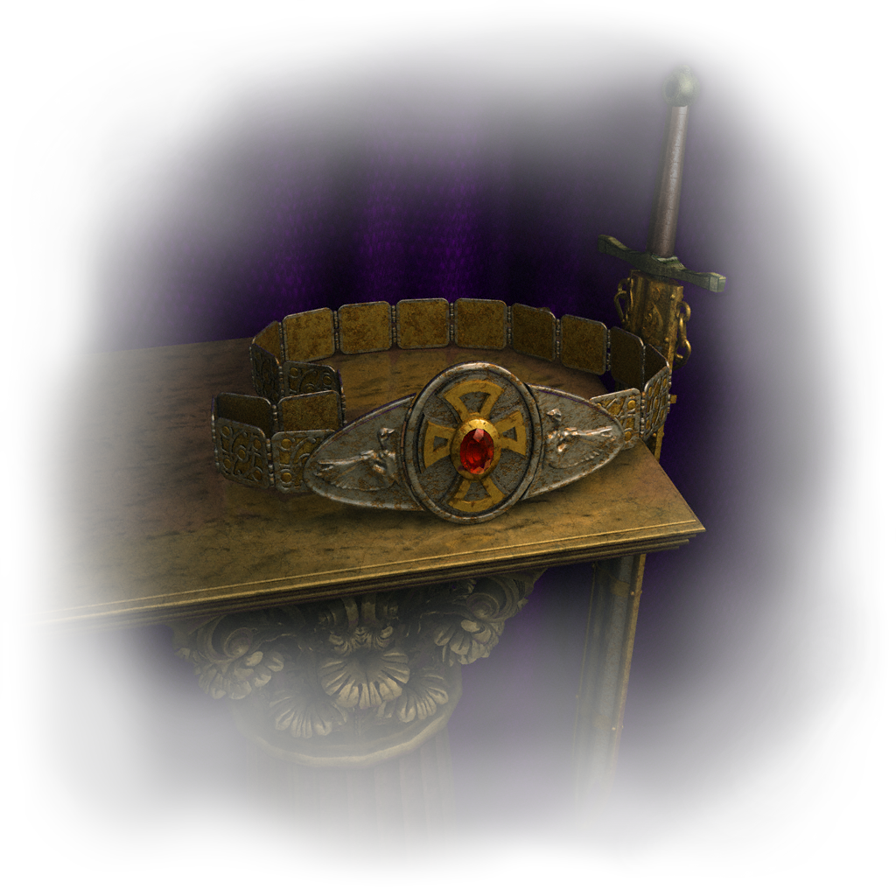
Stand therefore, having your loins girt about with truth (Ephesians 6:14; John, 8: 32; Proverbs, 23: 23)
Christ and His word is the truth. "I am the truth" (John 14:6) Jesus said.
So if Christ is in you, this will establish that the truth is in you. The belt of truth is our defense and protection against Satan's remarkable weapon of deception (John 8:44).
In the face of so much deception, lies, and false doctrine, the only truth will be found only in God's revealed Word, the Bible.
It is what teaches us the essence of the message of Christ, the only Savior and Mediator between God and men.
The belt of truth (which puts the other parts of the armor in place) is under relentless attack. You have to speak the truth in love (Ephesians 4:15) if you want to live free in Christ and have a true relationship. The only thing a believer has to recognize is the truth.
If a thought comes to your mind that is not in union with God's truth, throw it away. If you're offered the opportunity to say or do something that puts you in conflict with the truth, throw it away. Adopt a simple rule of life: If it is the truth, I am with it; If it's not the truth, don't count on me.
Jesus prayed: «I pray not that thou shouldest take them out of the world, but that thou shouldest keep them from the evil». How did he say? «Sanctify them through thy truth: thy word is truth» (Juan17:15-17).
You overcome the father of lies with Divine revelation, not with human reasoning or investigation.

Slide 10

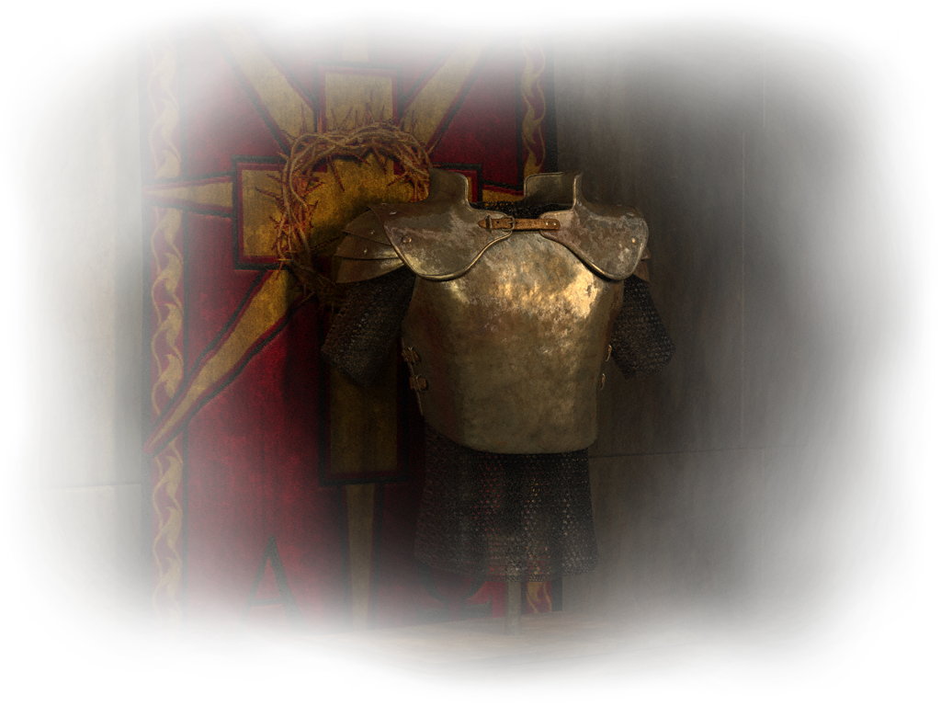
and having on the breastplate of righteousness (Ephesians 6:14; 1 Thessalonians, 5: 8 )
Just as the breastplate protected the heart of the soldier, justice preserves the life of the believer and protects the "vital organs" of his spiritual life. Some see here the righteousness of Christ covering the Son of God; others, the Christian's personal loyalty to biblical principles.
When you put on Christ with salvation, you were declared righteous before our Holy God (Romans 5:1). It is not your righteousness, but Christ's (1 Corinthians 1:30; Philippians 3:8,9). Putting on the breastplate of righteousness is your defense against the accuser of the brethren.
So when Satan says to you, "You're not good enough to be a Christian," you can respond like Paul, "Who will accuse God's elect? It is God who justifies" (Romans 8:33). Even when we are righteous in Christ, we must be aware of any injustice we may commit. Walking in the light of the gospel is not the same as living without sin. "If we confess our sins, he is faithful and just to forgive us our sins, and to cleanse us from all unrighteousness" (1 John 1:9). Confessing implies accepting your fault and feeling pain for having committed it, when you realize that you have committed something inappropriate. You can clothe yourself with righteousness because you have already been forgiven. You have been justified in Christ (2 Corinthians 5:21). Confession of sins cleanses our conscience and makes righteousness fruitful in your life.
It behooves us to be like Paul, who said, "... I seek always to have a conscience without offense before God and men" (Acts 24:16). It is necessary to practice justice and be fair to everyone.

Slide 11

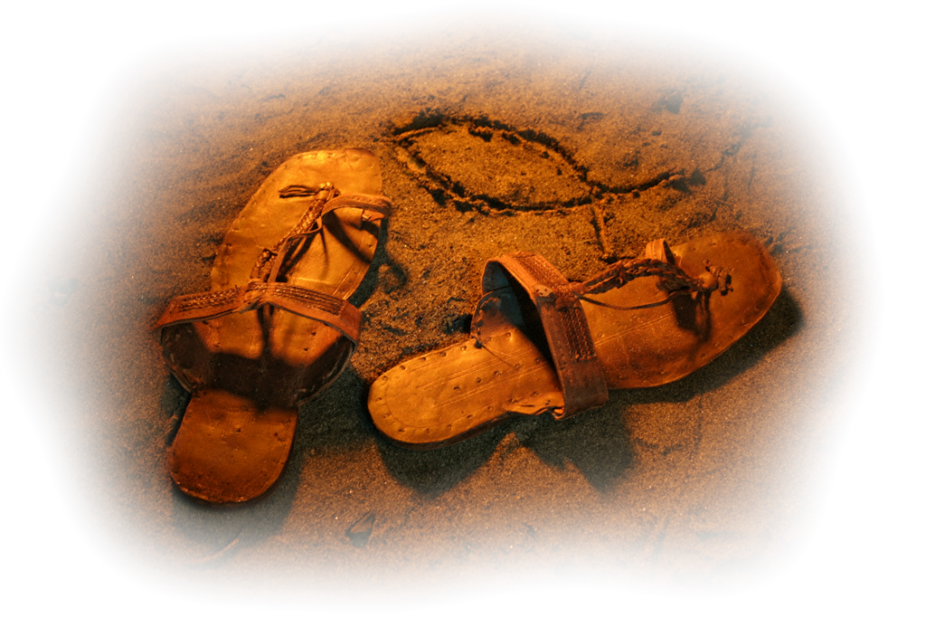
And your feet shod with the preparation of the gospel of peace (Ephesians 6:15; Psalm 119: 165; Luke, 10: 5)
The footwear of peace is protection against the divisive machinations of the devil when you act as a peacemaker among believers (Romans 14:19).
Peacemakers are experts at bringing people together. Peacemakers revive fellowship and possess a ministry of reconciliation. They conceive that communion and unity in the body of Christ are founded on a common affinity. True believers are children of God, and that is necessary to gather together in peace. If you hope to agree on every view of opinion in order to receive someone, you will be the loneliest Christian in the world. We are to be "anxious to keep the unity of the Spirit in the bond of peace" (Ephesians 4:3).
Fitting is the preparation that is made to the footwear so that it is in perfect condition. This allows our feet to walk safely and firmly. It is necessary to take the gospel to every creature and spread throughout the world, it is urgent. The earth groans as a result of so much wickedness, we hurry because wickedness has multiplied, times have been shortened, and the coming of the Lord will be soon. Nothing should prevent us from this task.
What gospel should we proclaim? The knowledge of Salvation: Jesus incarnate, crucified, risen and glorified. With this knowledge we can walk firmly.
Wherever your feet go, speak of peace.

Slide 12

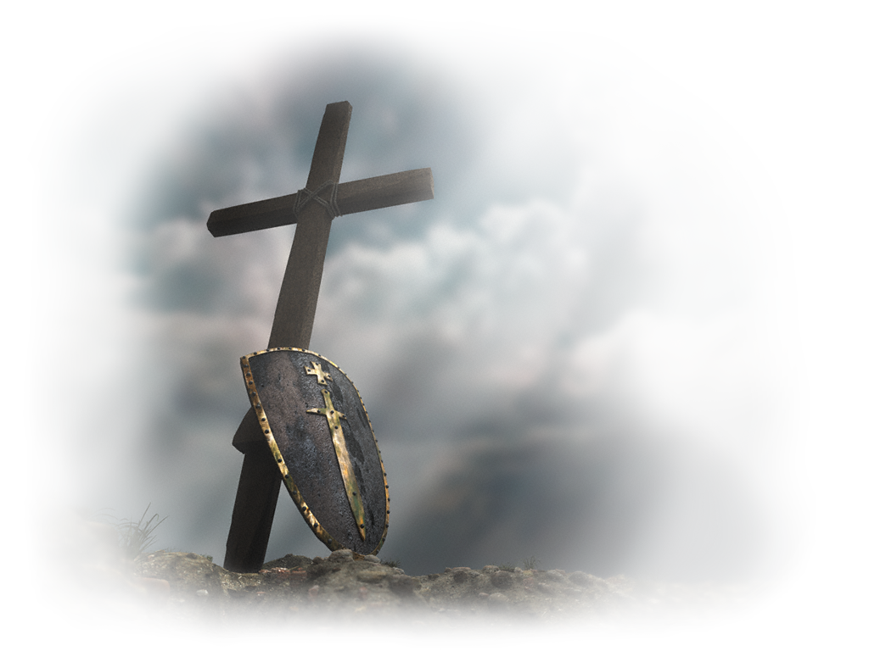
Above all, taking the shield of faith, wherewith ye shall be able to quench all the fiery darts of the wicked (Ephesians 6:16; Habakkuk, 2: 4)
The object of our faith is God and His Word. The better you know and the more intimate you are with Him and study His Word, the more faith you will have and Satan's fiery darts will not reach you, nor will they destroy your faith.
Satan's fiery darts are burning lies, burning accusations, and fiery temptations that bombard our minds. Whenever you discern a deceptive thought, an accusation, or a temptation, compare it to the truth you know about God and His Word.
What did Jesus do to deflect the satanic darts of temptation?
He shielded himself with affirmations of the Word of God. Every time you learn a Bible verse, hear the teachings in the congregation, or study the Bible, you increase your understanding of God, and your shield of faith increases.
“The work of conquering evil is to be done through faith. Those who go into the battlefield will find that they must put on the whole armor of God. The shield of faith will be their defense and will enable them to be more than conquerors. Nothing else will avail but this—faith in the Lord of hosts, and obedience to His orders. Vast armies furnished with every other facility will avail nothing in the last great conflict. Without faith, an angel host could not help. Living faith alone will make them invincible and enable them to stand in the evil day, steadfast, unmovable, holding the beginning of their confidence firm unto the end.” (CT 182)

Slide 13

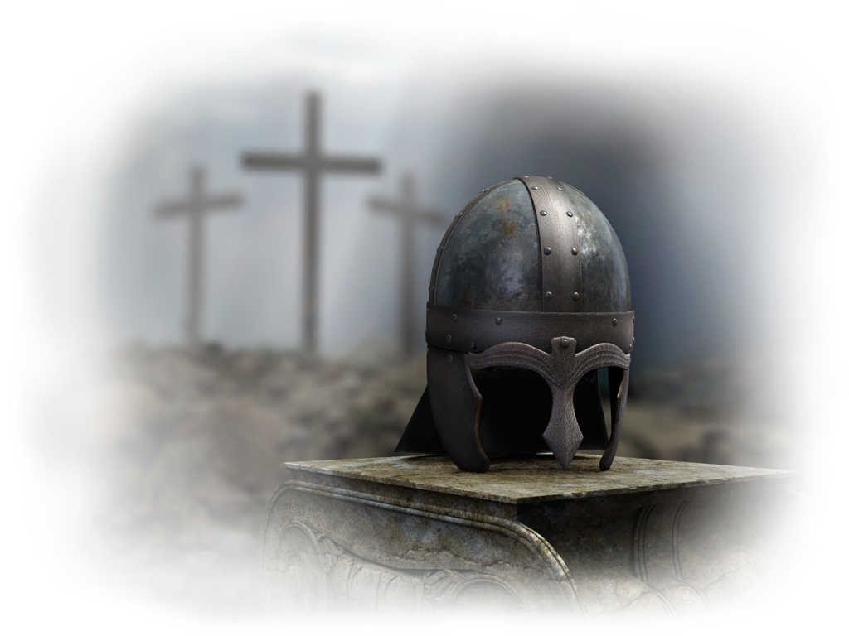
And take the helmet of salvation (Ephesians 6:17; 1 Thessalonians, 5: 8)
The helmet ensures the protection of the most important part: the mind. This is where battles are won or lost. Knowing that struggles with the world, the flesh, and the devil are constant, it is necessary to stand firm in our assurance of salvation.
We will continually be tempted to question our salvation. However, the believer wears the helmet of salvation which gives him the assurance that he is the possessor of redemption. With this knowledge, and united with the Lord Jesus Christ, the devil has no right over us.
As long as we stand with Christ doing His will, we will guard our salvation with fear and trembling (Philippians 2:12).
“We should meditate upon the Scriptures, thinking soberly and candidly upon the things that pertain to our eternal salvation. The infinite mercy and love of Jesus, the sacrifice made in our behalf, call for most serious and solemn reflection. We should dwell upon the character of our dear Redeemer and Intercessor. We should seek to comprehend the meaning of the plan of salvation. We should meditate upon the mission of Him who came to save His people from their sins. By constantly contemplating heavenly themes, our faith and love will grow stronger. Our prayers will be more and more acceptable to God, because they will be more and more mixed with faith and love. They will be more intelligent and fervent.” (OHC 113).

Slide 14
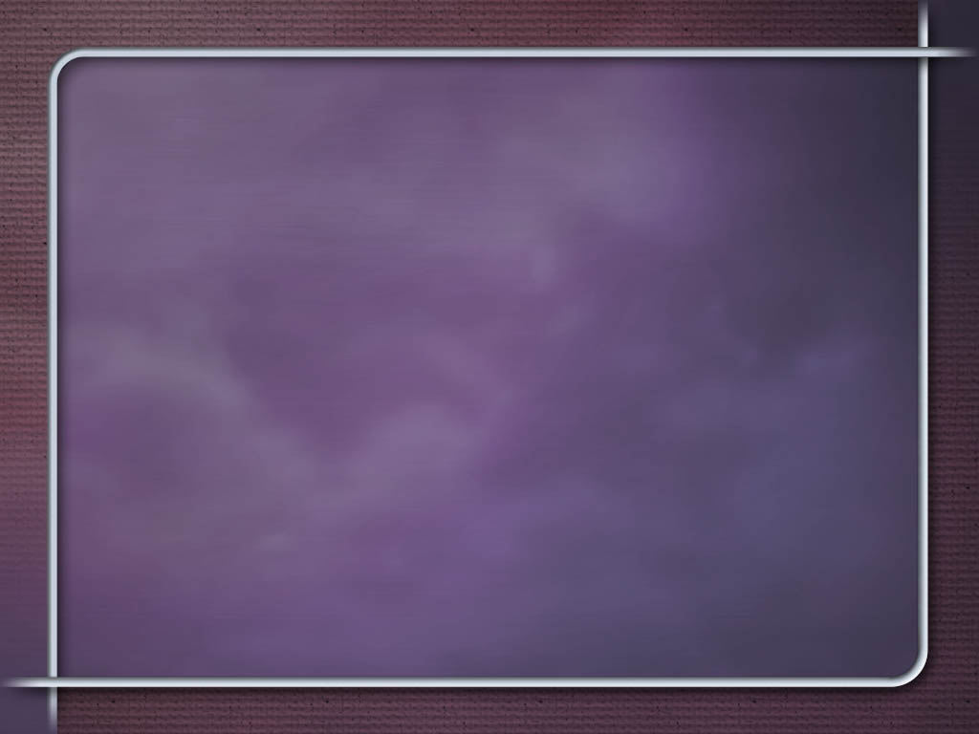

and the sword of the Spirit, which is the word of God (Ephesians; 6:17; Hebrews, 4: 12; John, 5: 39)
The sword of the Spirit is the word of God. We must preach his word, share it, and give life to others. God's word is life, and one of the most powerful weapons we can use, in the face of satan's attacks.
God's word, which is powerful, is the only weapon of attack in God's armor, although it can also be used as a defense.
It allows us to defend ourselves and fight back against the devil's direct attacks.
Therefore, it is important to memorize biblical texts, so that when necessary the Holy Spirit will remind us of them at the right time when we must bear witness to our faith or resist the attacks of the enemy, as the Lord Jesus did.
Becoming familiar with the scriptures sharpens the capacity for discernment and strengthens the soul. The Bible is the sword of the Spirit, always ready to overcome the adversary.
“The Bible is the sword of the Spirit, which will never fail to vanquish the adversary. It is the only true guide in all matters of faith and practice. The reason why Satan has so great control over the minds and hearts of men is that they have not made the Word of God the man of their counsel, and all their ways have not been tried by the true test. The Bible will show us what course we must pursue to become heirs of glory.” (OHC 31)

Slide 15
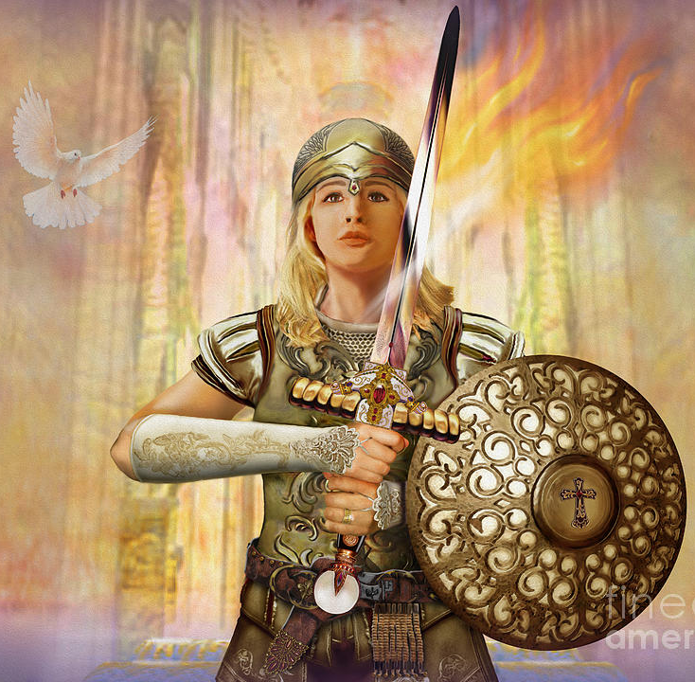
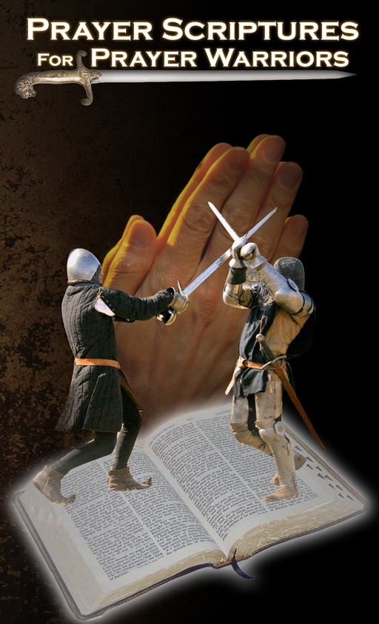
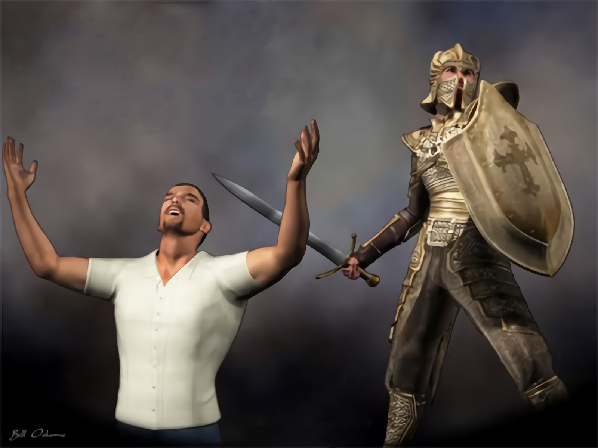
“The only hope for us if we would overcome is to unite our will to God's will and work in co-operation with Him, hour by hour and day by day. We cannot retain self and yet enter
the kingdom of God. If we ever attain unto holiness, it will be through the renunciation of self and the reception of the mind of Christ. Pride and self-sufficiency must be crucified. Are we willing to pay the price required of us? Are we willing to have our will brought into perfect conformity to the will of God? Until we are willing, the transforming grace of God cannot be manifest upon us.”
The warfare which we are to wage is the “good fight of faith.” “I also labor,” said the apostle Paul, “striving according to His working, which worketh in me mightily.” Colossians 1:29.” (MB 143)
Would you like to go out to spiritual warfare protected by celestial armor?
That is possible, you just have to make the right decisions in your daily life. Every day you must believe in the Truth: Jesus.
May God bless you! Don't forget Romans 8:31: What shall we then say to these things? If God be for us, who can be against us?”

