Slide 1
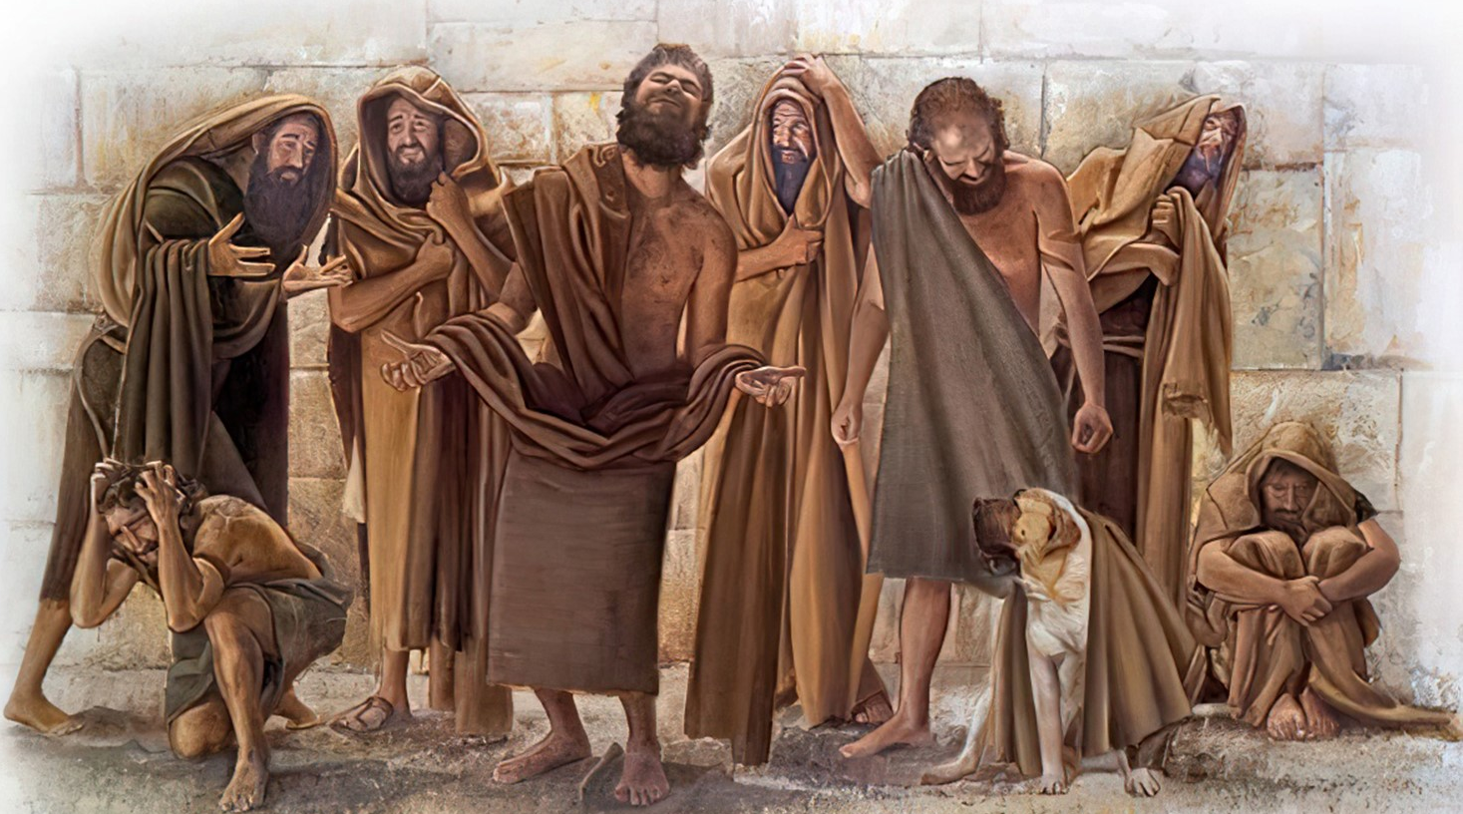
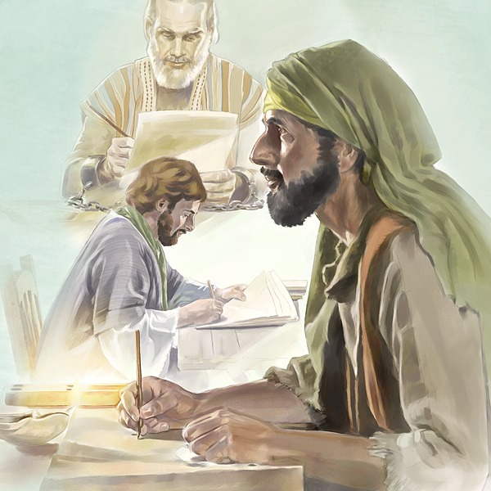


Slide 2
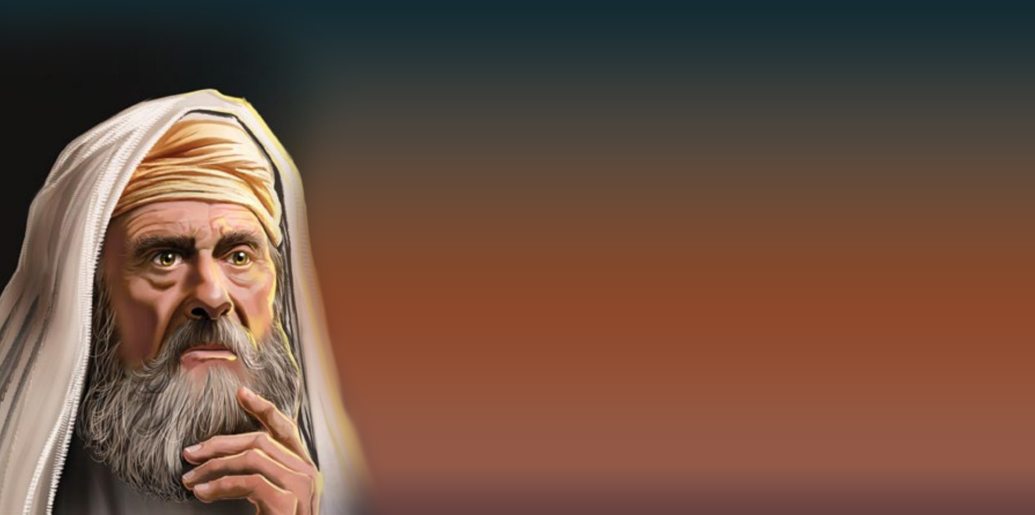
Today we are going to study the message of the minor prophets.
They are not called "minor" because they are less important than the older prophets, but because their books are shorter. For example, Obadiah has only one chapter.
Originally, all of these writings were collected and put into a single book of the Bible.
Although they lived many, many years ago, the time in which they lived is very similar to ours. People lived only to work, have fun, and do what they wanted, without caring about God or their neighbors.
Through the message of these prophets, we learn that, just as then, God wants us to seek Him and have eternal life. In all the prophets, God tells us, "Seek me, and ye shall live.”
He calls us to seek Him in different ways. Let us discover them through the interesting message of the minor prophets.

Slide 3
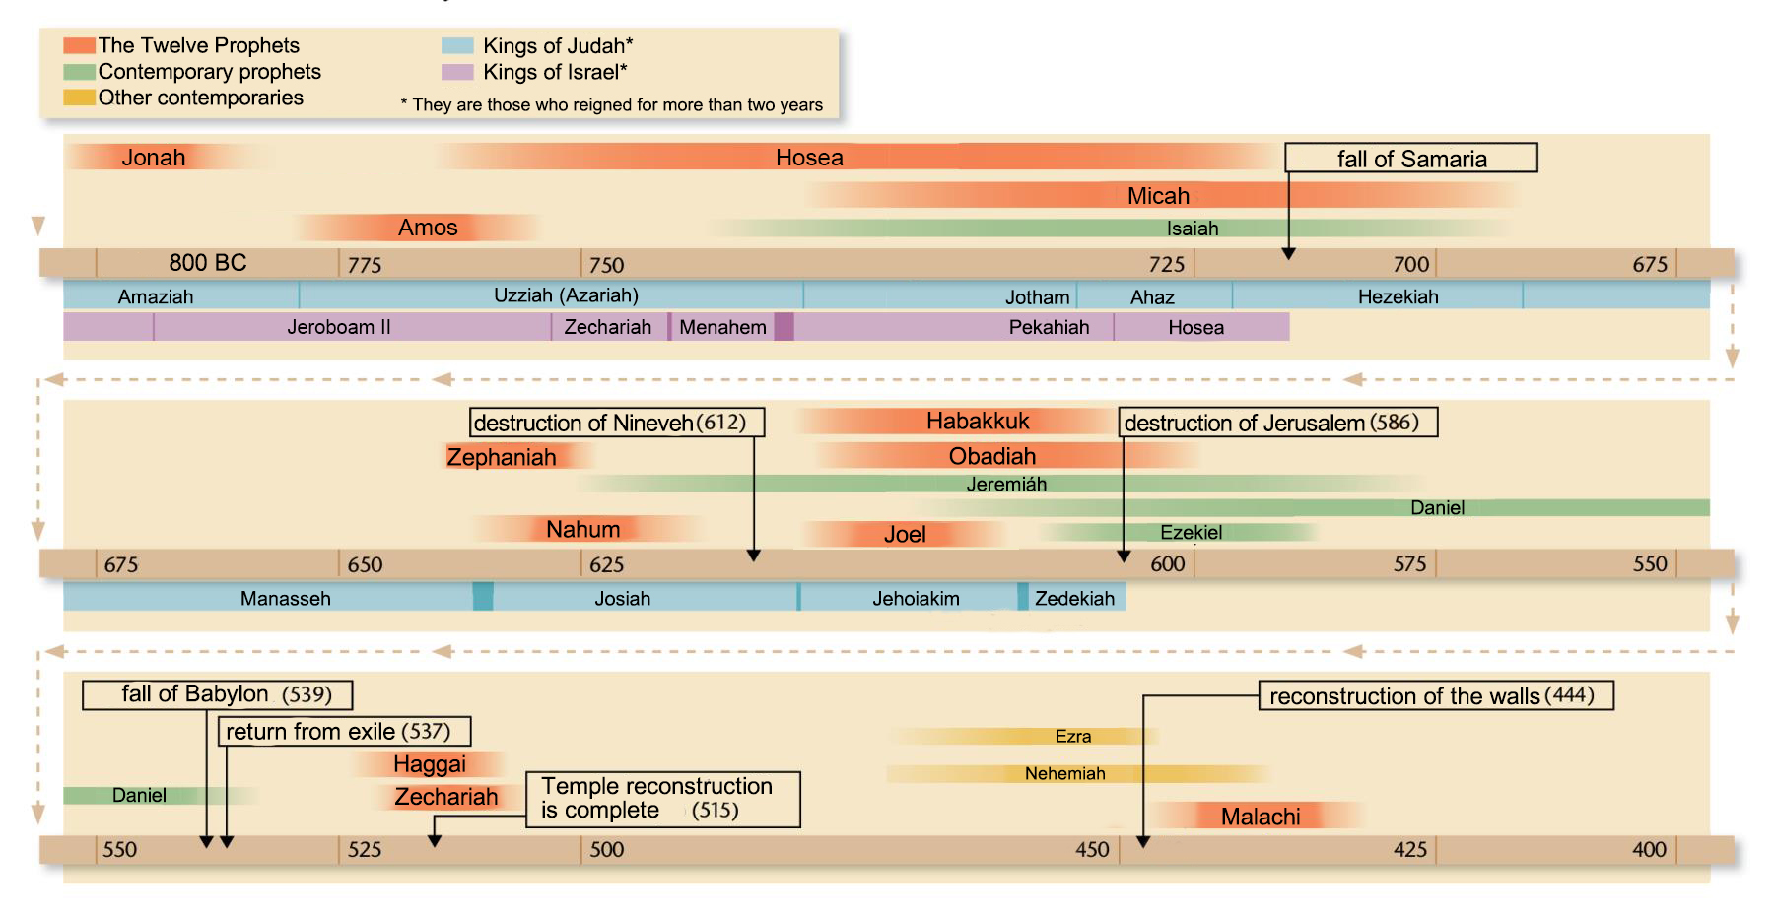
CHRONOLOGY (approximate)

Slide 4


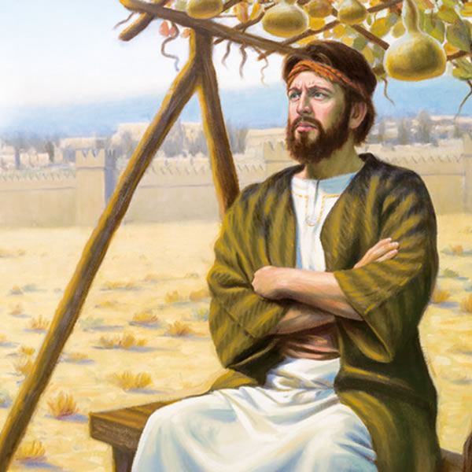

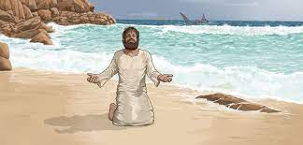
I am the first of the minor prophets. My name means "Dove". Do you know who I am?
I'm going to give you more clues. I was born in Gath-hepher and foretold the prosperity of Israel. Everything was going well until God asked me to preach to some foreigners. At that time, I decided to come to Spain so that I would not have to preach to them.
Now you know who I am, don't you? I am Jonah.
I knew that I had committed a very serious sin and deserved to die, because I had rebelled against God. While I was inside the fish, I repented and sought God. He forgave me and gave me a second chance.
JONAH
God Forgives Me
790 B.C.
“When my soul fainted within me, I remembered the LORD: and my prayer came in unto thee, into thine holy temple” (Jonah 2:7)
The people of Nineveh to whom I preached also repented. I didn't want God to forgive my enemies, yet He did.
I learned that God is always willing to forgive everyone, no matter who they are, no matter what sin they have committed. He wants us to seek Him so He can forgive us and give us eternal life.

Slide 5


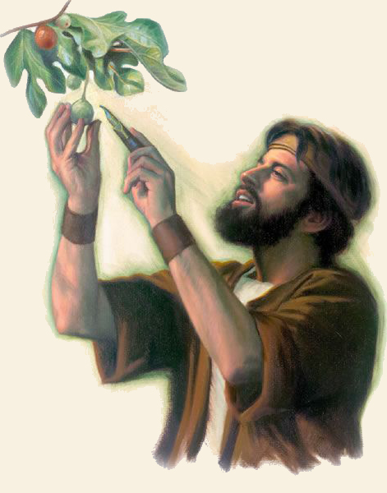
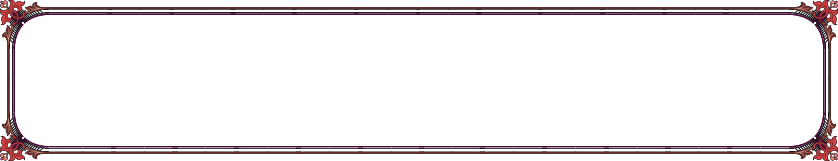
My name is Amos. My name means: "He who carries a burden." I lived in Judah, where I was a herder of oxen and gathered wild fruits. Although I am not educated, God gave me wisdom and ease of speech to do a great work: to preach His message to King Jeroboam, and to the people who worshipped before the golden calf in the kingdom of Israel.
At that time, we lived in peace and had everything. Since people had no worries, they dedicated themselves to doing bad things. He worshipped idols, squandered his money, and devoted himself to amusing himself by doing what was not pleasing to God. The rich oppressed the poor, and justice was not done.
I had to tell them that what they were doing was not right. That God was going to punish them for their sins. I had to tell not only the inhabitants of Judah and Israel, but also Syria, Philistia, Edom, Ammon, and Moab.
God asks us, begs us, implores us to repent of our sins, so that we do not receive divine punishments. When we seek Him in this way, He will give us life in abundance.
AMOS
God Begs Me To Repent
767-753 B.C.
“For thus saith the Lord unto the house of Israel, Seek ye me, and ye shall live… Seek the Lord, and ye shall live; lest he break out like fire in the house of Joseph, and devour it, and there be none to quench it in Bethel” (Amos 5:4, 6)

Slide 6


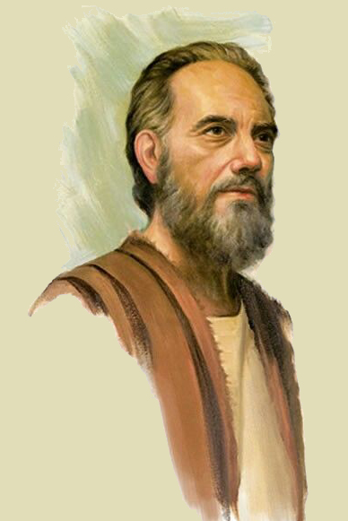

HOSEA
I had to say the most beautiful message of all. Although it was not easy for me to give it. I had to preach with my own life. As you know, I am Hosea.
The message I had to preach was God loves me; God loves me! God loves me!!; God loves me!!; God loves me!!!!
I loved my wife Gomer very much, but she preferred to go with other people. As I loved her so much, I went to look for her and got her to come back to me.
God showed me that this was the way He treats His children. He loves us so much that He pursues us and draws us "with cords of love." He loves us, even if we are unfaithful to him. And because He loves us so tenderly, He never ceases to beg us with messages of hope, that we may seek Him and turn to Him.
God Loves Me
755-725 B.C.
“I drew them with cords of a man, with bands of love: and I was to them as they that take off the yoke on their jaws, and I laid meat unto them… Therefore, turn thou to thy God: keep mercy and judgment, and wait on thy God continually” (Hosea 11:4; 12:6)

Slide 7


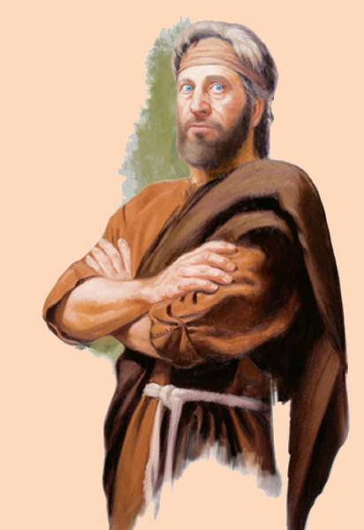

I like poetry and word games. I deal with sin with severity and denounce it boldly. In my book you will find vigorous, simple and frank language.
Allow me to introduce myself. I am Micah.
I prophesied with the prophet Isaiah. Together we helped King Hezekiah bring about a great reformation among the people of Judah.
God's people at that time kept all the outward forms of religion. They seemed faithful, but they were empty inside. Many other false prophets told them that they could live in peace.
They were not doing what God wanted them to do.
Therefore, I clearly warned them of the punishment they would receive if they continued to live an external religion. I continually encouraged them to seek God to receive His mercy and promises.
God sent me to teach them what they had to do to please God and live.
MICAH
God Teaches Me What To Do
740-700 B.C.
“He hath shewed thee, O man, what is good; and what doth the Lord require of thee, but to do justly, and to love mercy, and to walk humbly with thy God” (Micah 6:8)

Slide 8


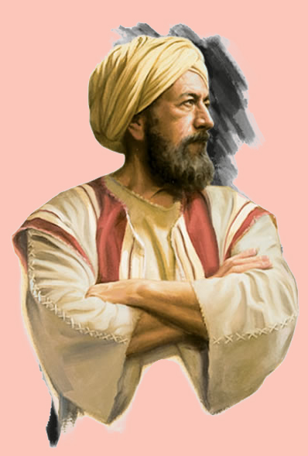

NAHUM
My prophecy complements Jonah's prophecy. Because of his preaching, Nineveh repented, and the city was spared.
But soon Nineveh fell back into his sins. Then, God gave me the mission of predicting the complete destruction of Nineveh. I am Nahum, and my name means "comforted.”
When I received the visions of Nineveh, this was the capital of the most powerful empire in the world. No one would have imagined then that, only about twenty years later, it would be totally destroyed.
They had a new opportunity to recognize God as the Creator of the universe and the only true God. Since they were unrepentant, they were totally destroyed after a siege of only three months.
God Reveals The Future To Me
640 B.C..
“The Lord is good, a strong hold in the day of trouble; and he knoweth them that trust in him. But with an overrunning flood he will make an utter end of the place thereof, and darkness shall pursue his enemies. ” (Nahum 1:7-8)
God reveals the future to us so that we may seek Him and, when He comes to seek us (as He has foretold us), we may live eternally by His side.

Slide 9


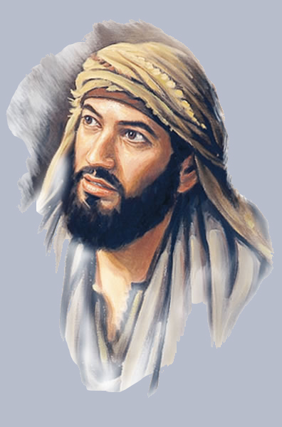

I ask myself a lot of questions about the things that happen around me. No one knows how to answer them. So, one day I decided to ask God the questions directly.
I am Habakkuk, the prophet who dared to question the way God acted. What were my questions?
I lived during the reign of Judah's worst kings: Manasseh and Ammon. I saw around me only violence and evil. And God did nothing to prevent it. So I asked him: Why don't you do anything to stop this evil?
God was not angry because I asked Him, but patiently answered that He would send Babylon to put an end to the wickedness of Judah.
I was appalled by the answer, and asked him again: How do you use a people worse than mine to punish us?
He answered me again patiently. He explained that he was sending him such a severe punishment because he wanted Judah to repent of his wickedness. He also told me that Babylon would eventually receive payment for her sins.
God wants me to seek Him out and ask Him what I don't understand. Sometimes he gives me the answer, and sometimes his answer is to wait a little, because now I can't understand it, and I'll understand later.
HABAKKUK
God Answers My Questions
630 B.C.
“For the vision is yet for an appointed time, but at the end it shall speak, and not lie: though it tarry, wait for it; because it will surely come, it will not tarry… But the Lord is in his holy temple: let all the earth keep silence before him” (Habakkuk 2:3, 20)

Slide 10


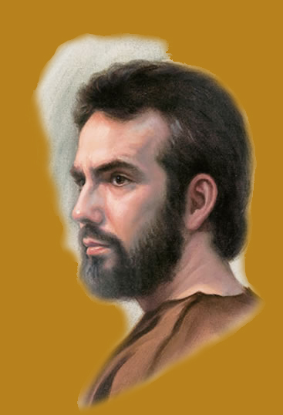

ZEPHANIAH
My name is Zephaniah, I am a prince of Judah, a direct descendant of the good king Hezekiah.
My message is not pleasant at all. "The day of the Lord" is near, the day when He will come to destroy the earth, and all who turn away from God and do not seek Him.
I would like everyone who reads my message to meditate on the terrible end that awaits them. Then they can repent of their sin, seek God, and escape punishment on that day.
Jesus Comes To Seek Me To Reward Me
630 B.C.
“Seek ye the Lord, all ye meek of the earth, which have wrought his judgment; seek righteousness, seek meekness: it may be ye shall be hid in the day of the Lord’s anger” (Zephaniah 2:3)
Jesus is coming to this earth soon. If you don't want to be destroyed by the brightness of His coming, seek Him now so that your reward may be eternal life.

Slide 11

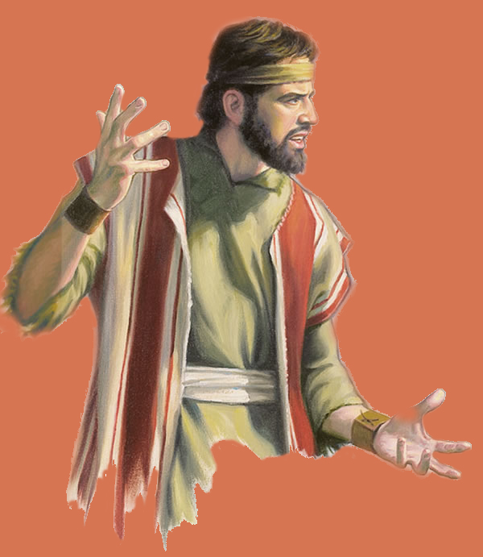

I like to describe in great detail what I see. I want you, when you read me, to live what I have lived and feel what I have felt. My name means, "Jehovah is God," that is, Joel.
The locusts passed by eating everything in their path. They left us no food. Because of this, we suffered a great drought.
Then God called me to say to my people, "Seek God, and He will give you rain." Early and latter rain. Heavy rains so that your crops will produce in abundance.
JOEL
God Gives Me Prosperity
620 B.C.
“Be glad then, ye children of Zion, and rejoice in the Lord your God: for he hath given you the former rain moderately, and he will cause to come down for you the rain, the former rain, and the latter rain in the first month. And the floors shall be full of wheat, and the fats shall overflow with wine and oil.” (Joel 2:23-24)
God also tells you to turn your whole heart to God, to seek Him. God will give you material and spiritual prosperity, pouring out the Holy Spirit on you.

Slide 12


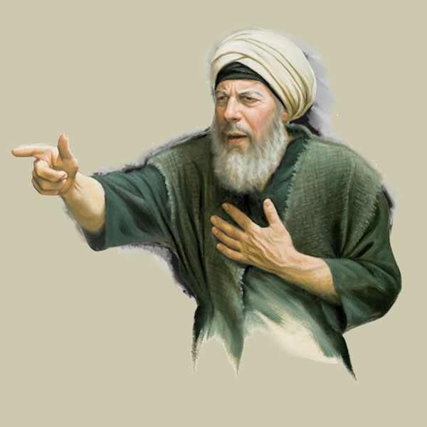

OBADIAH
That is, I, Obadiah, the servant of Jehovah.
I want to tell you the story of the people of Edom.
They are descended from Esau, the brother of our father Jacob. Although we are family, they have never treated us well.
Take a look at some examples:
When we were going to Canaan, they did not let us pass through their territory.
They made war against Saul and Solomon.
They joined with other peoples to invade Judah on several occasions.
When Nebuchadnezzar destroyed Jerusalem, the Edomites rejoiced at our calamity.
For all this, God gave me the mission of announcing the destruction of Edom and the restoration of Israel.
One more way that God has for us to seek Him is to deliver ourselves from our enemies. God is just and, sooner or later, he will do justice.
God Gives Me Justice From My Enemies
586 B.C.
“For the day of the Lord is near upon all the heathen: as thou hast done, it shall be done unto thee: thy reward shall return upon thine own head” (Obadiah 1:15)

Slide 13


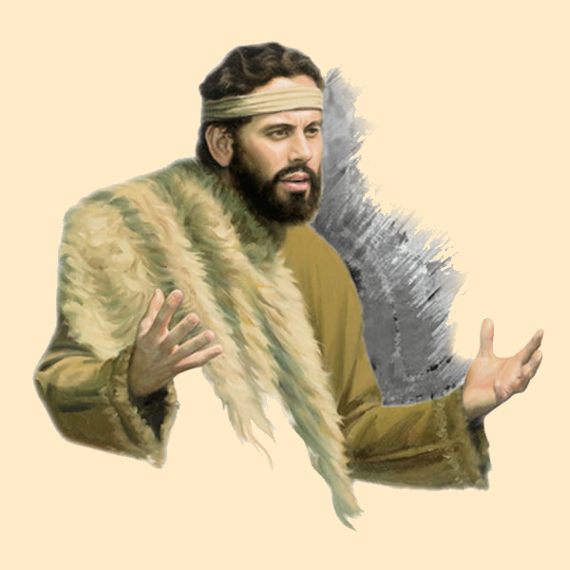

I am one of the most successful prophets. Unlike most prophets, people listened to me and took heed to my counsel. I am Haggai, and I will be happy to tell you my story.
Cyrus commanded us to rebuild the Temple in Jerusalem. Although we started in good spirits, we soon became discouraged and stopped building.
Then, God asked me to invite the poeple to work, assuring us that He would be with us.
HAGGAI
God Invites Me To Work
520 B.C.
“Yet now be strong, O Zerubbabel, saith the Lord; and be strong, O Joshua, son of Josedech, the high priest; and be strong, all ye people of the land, saith the Lord, and work: for I am with you, saith the Lord of hosts” (Haggai 2:4)
When I preached to them, all the people and the leaders got to work. Before long, the Temple was completely rebuilt.
God calls us today to labor in His work as one more way to seek Him. The more we work for Him, the better we will know Him, and the sooner God's eternal kingdom can be established.

Slide 14


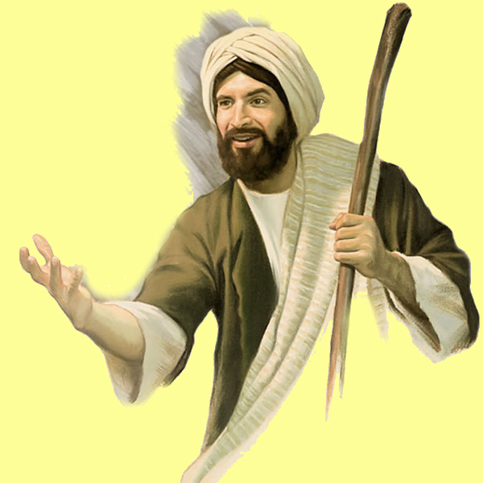

ZECHARIAH
My name is Zechariah, I am a priest born in Babylon. My name means "Jehovah has remembered." And indeed, He remembered to return us to our homeland, Jerusalem.
Together with Haggai, I encouraged the people to finish rebuilding the Temple. These were times of uncertainty and anxiety, because, because of our enemies, King Darius thought to prevent us from building.
But God said to me, "I will be like a wall of fire around Jerusalem, and in the midst of the city I will show my glory." Our trust in God's protection encouraged us to seek Him wholeheartedly, and He prospered the work of our hands.
God Protects Me
520-518 B.C.
“Therefore say thou unto them, Thus saith the Lord of hosts; Turn ye unto me, saith the Lord of hosts, and I will turn unto you, saith the Lord of hosts” (Zechariah 1:3)

Slide 15


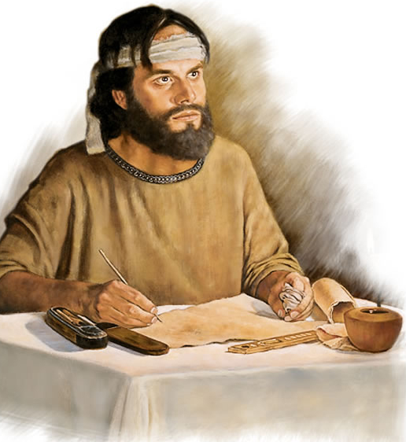

When I prophesied, the captivity was almost forgotten, the temple restored, and Jerusalem totally rebuilt.
I was the last of the Old Testament prophets. My name is Malachi.
After Nehemiah's good rule, the people had become indifferent. God told me that he was tired of so much religious formalism. With patience, he gave me up to eight different messages. He wanted to make them see that they had to seek God and obey Him from the heart and not just in words.
With each message, the people justified themselves, and did not want to admit that they were doing something wrong. Like the Laodiceans of the twenty-first century, they said they were rich, but in reality, they were poor; they claimed to see clearly, but they were spiritually blind.
Therefore, read my messages, for they are messages for the church today. God has the same patience with you as He did with My people then.
MALACHI
God Treats Me Patiently
425 B.C.
“For I am the Lord, I change not; therefore ye sons of Jacob are not consumed. Even from the days of your fathers ye are gone away from mine ordinances, and have not kept them. Return unto me, and I will return unto you, saith the LORD of hosts…” (Malachi 3:6-7)

Slide 16

Through the message of the minor prophets, we have seen how God works with us to get us to seek Him:
Jonah:
Amos:
Hosea:
Micah:
Nahum:
Habakkuk:
Zephaniah:
Joel:
Obadiah:
Haggai:
Zechariah:
Malachi:
He forgives us.
He begs us to repent.
He loves us.
It teaches us what to do.
It reveals the future to us.
He answers our questions.
He comes to us to reward us.
He gives us prosperity.
It does us justice from our enemies.
He invites us to work.
He protects us.
He treats us patiently.
How will you respond to all this love and concern from God? I want to seek Him every day of my life with all my heart, and I invite you to do the same.
Amos 5:8 invites us, “Seek him that maketh the seven stars and Orion, and turneth the shadow of death into the morning, and maketh the day dark with night: that calleth for the waters of the sea, and poureth them out upon the face of the earth: The LORD is his name”

