Slide 1
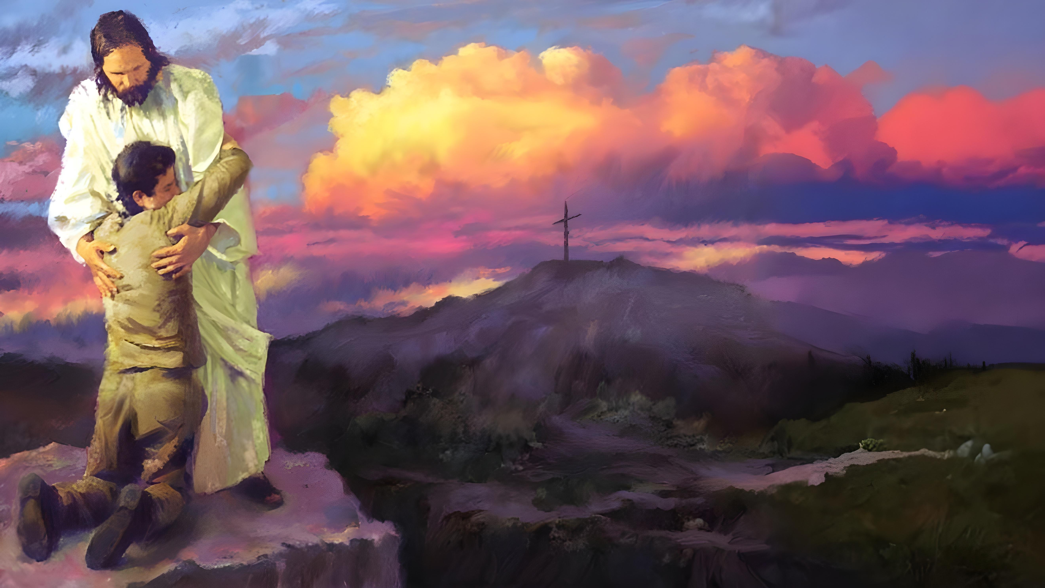

Lesson 1
Ellen G. White

Slide 2

These presentations are based on the book “Steps to Christ” by Ellen G. White, and the study guide prepared by the Trustees of the White Institute.
You can download or read the book at https://egwwritings.org/book/b108
Read the corresponding chapter in the book and answer these questions. Click on the chapter to access it.
Lesson 1
Chapter 1: “God’s Love for Man”
Chapter 2: “The Sinner’s Need of Christ”
Chapter 3: “Repentance”

Slide 3



Chapter 1: “God’s Love for Man”
1
What two important sources testify of God’s love? What does each say to us?
Nature and revelation alike testify of God's love.
Our Father in heaven is the source of life, of wisdom, and of joy. Look at the wonderful and beautiful things of nature. Think of their marvelous adaptation to the needs and happiness, not only of man, but of all living creatures. The sunshine and the rain, that gladden and refresh the earth, the hills and seas and plains, all speak to us of the Creator's love. It is God who supplies the daily needs of all His creatures. In the beautiful words of the psalmist. (Psalm 145:15, 16)
The word of God reveals His character. He Himself has declared His infinite love and pity. When Moses prayed, “Show me Thy glory,” the Lord answered, “I will make all My goodness pass before thee.” Exodus 33:18, 19. This is His glory. The Lord passed before Moses, and proclaimed, “The Lord, The Lord God, merciful and gracious, long-suffering, and abundant in goodness and truth, keeping mercy for thousands, forgiving iniquity and transgression and sin.” Exodus 34:6, 7. He is “slow to anger, and of great kindness,” “because He delighteth in mercy.” Jonah 4:2; Micah 7:18

Slide 4



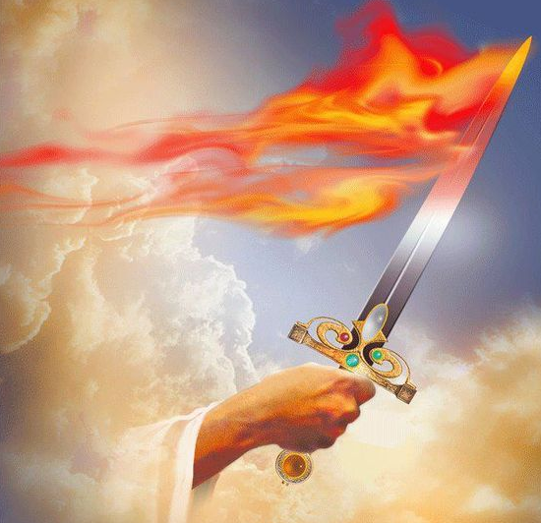
2
Even though transgression of God’s law has brought woe and death, what might we learn from the curse?
God made man perfectly holy and happy; and the fair earth, as it came from the Creator's hand, bore no blight of decay or shadow of the curse. It is transgression of God's law—the law of love—that has brought woe and death. Yet even amid the suffering that results from sin, God's love is revealed. It is written that God cursed the ground for man's sake. Genesis 3:17The thorn and the thistle—the difficulties and trials that make his life one of toil and care—were appointed for his good as a part of the training needful in God's plan for his uplifting from the ruin and degradation that sin has wrought. The world, though fallen, is not all sorrow and misery. In nature itself are messages of hope and comfort.
There are flowers upon the thistles, and the thorns are covered with roses.
3
How has Satan tried to misrepresent God to sinners?
Though all these evidences have been given, the enemy of good blinded the minds of men, so that they looked upon God with fear; they thought of Him as severe and unforgiving. Satan led men to conceive of God as a being whose chief attribute is stern justice,—one who is a severe judge, a harsh, exacting creditor. He pictured the Creator as a being who is watching with jealous eye to discern the errors and mistakes of men, that He may visit judgments upon them. It was to remove this dark shadow, by revealing to the world the infinite love of God, that Jesus came to live among men.

Slide 5

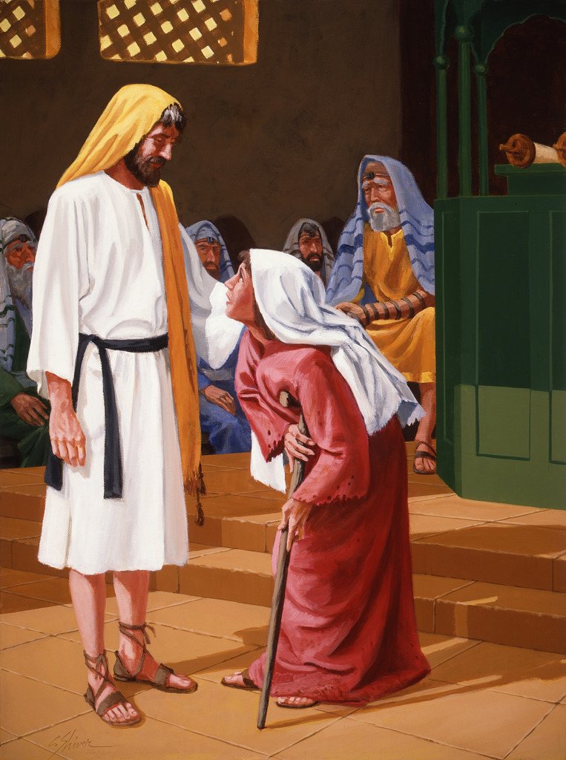
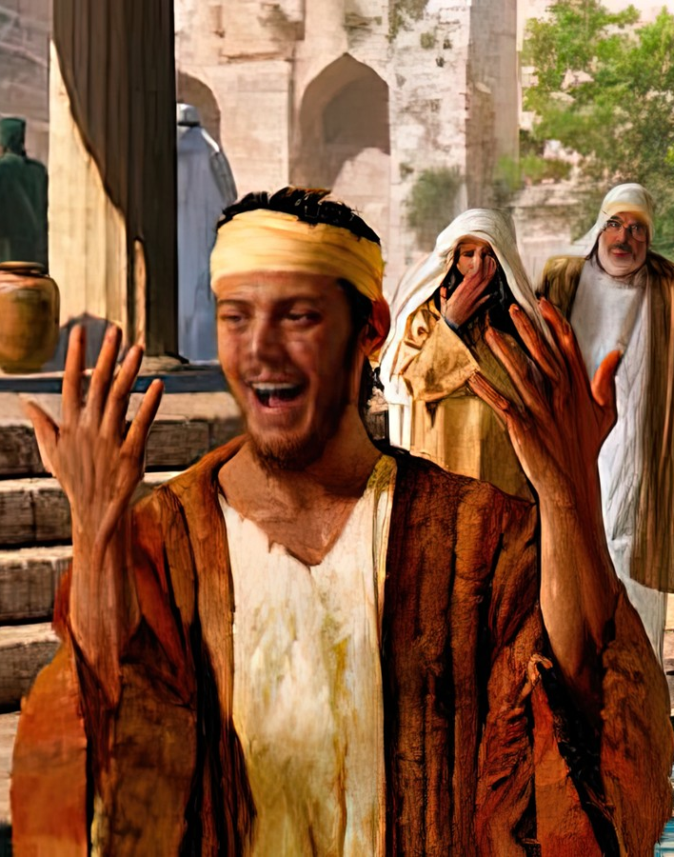
4
When Jesus came to live among men, how did He represent God?
In describing His earthly mission, Jesus said, The Lord “hath anointed Me to preach the gospel to the poor; He hath sent Me to heal the brokenhearted, to preach deliverance to the captives, and recovering of sight to the blind, to set at liberty them that are bruised.” Luke 4:18. This was His work. He went about doing good and healing all that were oppressed by Satan.
There were whole villages where there was not a moan of sickness in any house, for He had passed through them and healed all their sick. His work gave evidence of His divine anointing.
Love, mercy, and compassion were revealed in every act of His life; His heart went out in tender sympathy to the children of men.

Slide 6

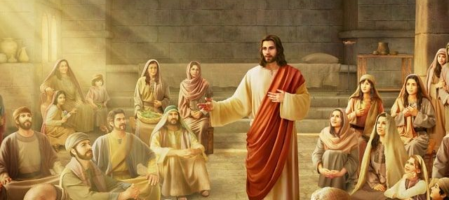
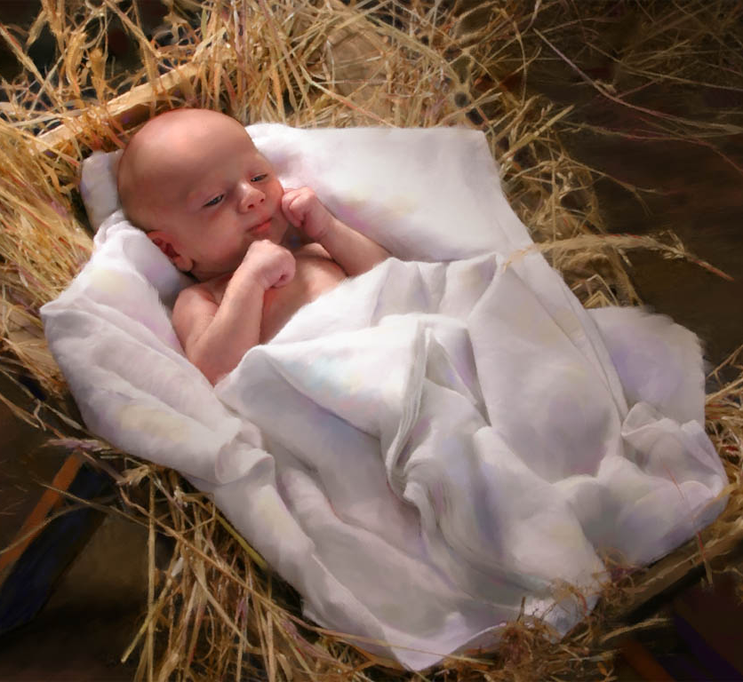
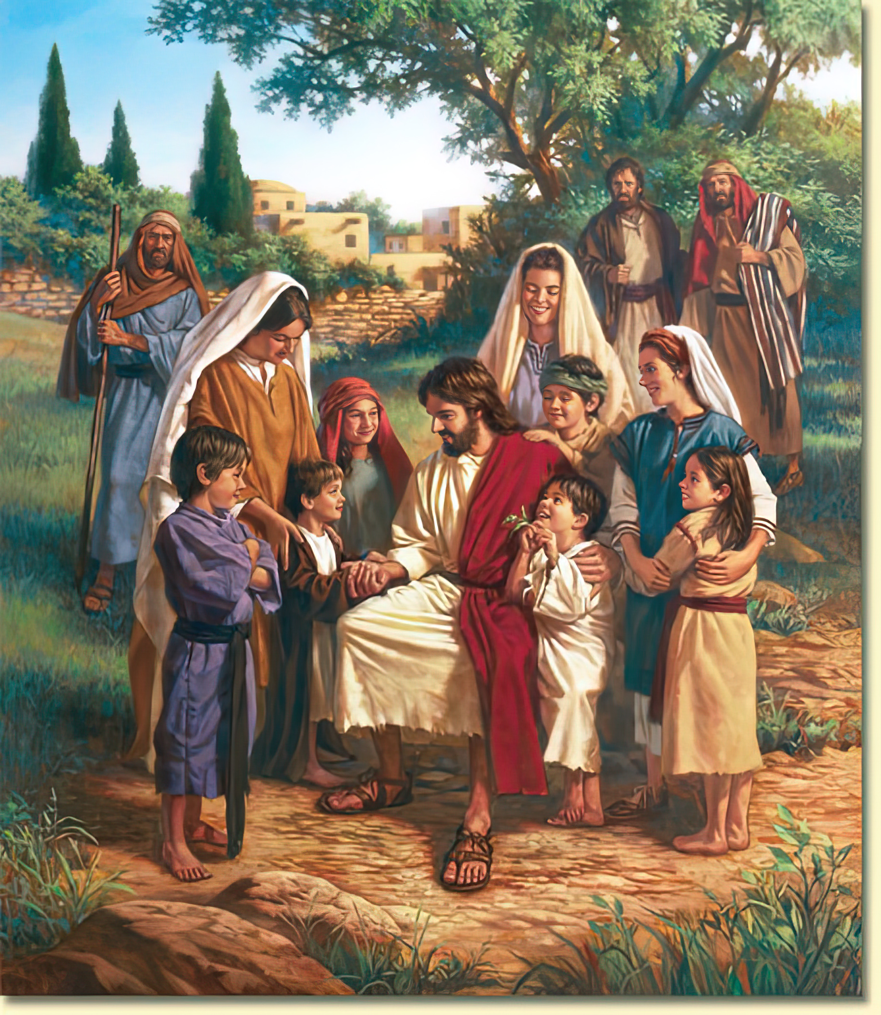
5
Complete:
Jesus’ work was to “preach the __________________ to the poor, heal the __________________, preach __________________ to the captives, recovering of __________________ to the blind, to set at __________________ them that are bruised". (Luke 4:18)
6
Why did Jesus take man’s nature?
He took man's nature, that He might reach man's wants.
Why do you think little children were attracted to Jesus?
7
Even little children were attracted to Him. They loved to climb upon His knees and gaze into the pensive face, benignant with love.

Slide 7

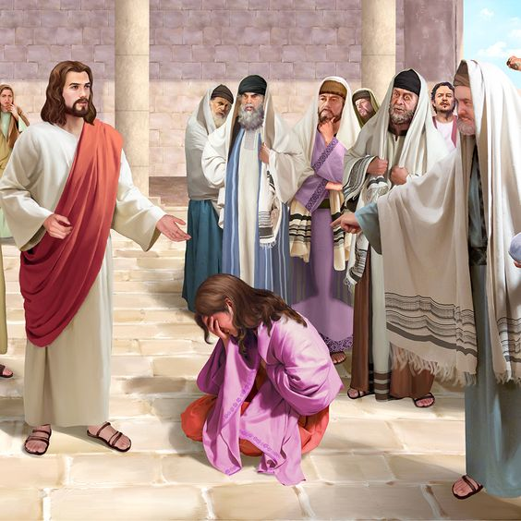
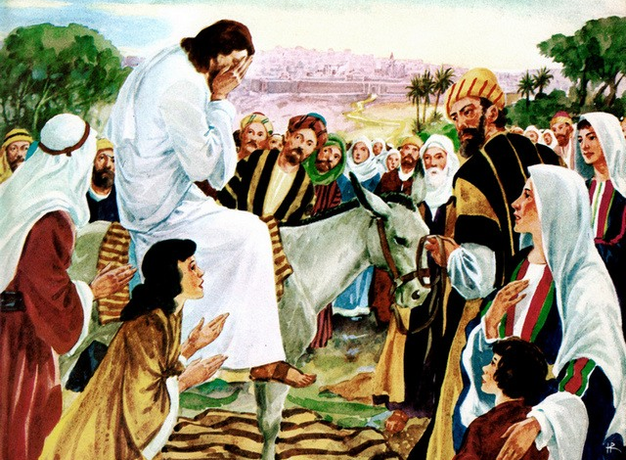
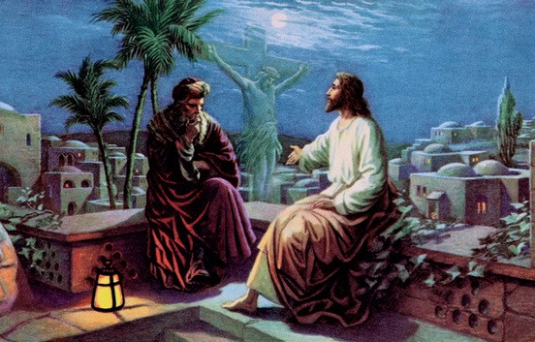
8
Describe how Jesus corrected or rebuked sin.
Jesus did not suppress one word of truth, but He uttered it always in love. He exercised the greatest tact and thoughtful, kind attention in His relationships with the people. He was never rude, never needlessly spoke a severe word, never gave needless pain to a sensitive soul. He did not censure human weakness. He spoke the truth, but always in love.
He denounced hypocrisy, unbelief, and iniquity; but tears were in His voice as He uttered His scathing rebukes. He wept over Jerusalem, the city He loved, which refused to receive Him, the way, the truth, and the life. They had rejected Him, the Saviour, but He regarded them with pitying tenderness.
His life was one of self-denial and thoughtful care for others. Every soul was precious in His eyes. While He ever bore Himself with divine dignity, He bowed with the tenderest regard to every member of the family of God. In all men He saw fallen souls whom it was His mission to save.
Such is the character of Christ as revealed in His life. This is the character of God. It is from the Father's heart that the streams of divine compassion, manifest in Christ, flow out to the children of men. Jesus, the tender, pitying Saviour, was God “manifest in the flesh.” 1 Timothy 3:16.

Slide 8
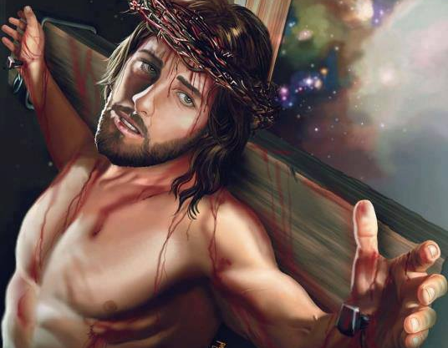
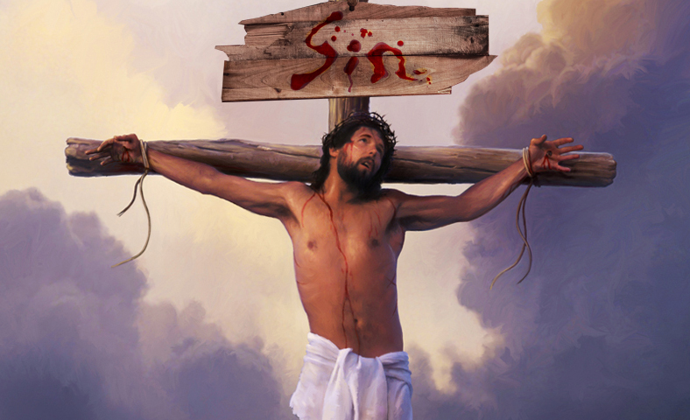
9
For what reason did Jesus become a “Man of Sorrows”?
It was to redeem us that Jesus lived and suffered and died. He became “a Man of Sorrows,” that we might be made partakers of everlasting joy. God permitted His beloved Son, full of grace and truth, to come from a world of indescribable glory, to a world marred and blighted with sin, darkened with the shadow of death and the curse. He permitted Him to leave the bosom of His love, the adoration of the angels, to suffer shame, insult, humiliation, hatred, and death. “The chastisement of our peace was upon Him; and with His stripes we are healed.” Isaiah 53:5. Behold Him in the wilderness, in Gethsemane, upon the cross!
10
What really broke the heart of the Son of God?
The spotless Son of God took upon Himself the burden of sin. He who had been one with God, felt in His soul the awful separation that sin makes between God and man. This wrung from His lips the anguished cry, “My God, My God, why hast Thou forsaken Me?” Matthew 27:46. It was the burden of sin, the sense of its terrible enormity, of its separation of the soul from God—it was this that broke the heart of the Son of God.

Slide 9
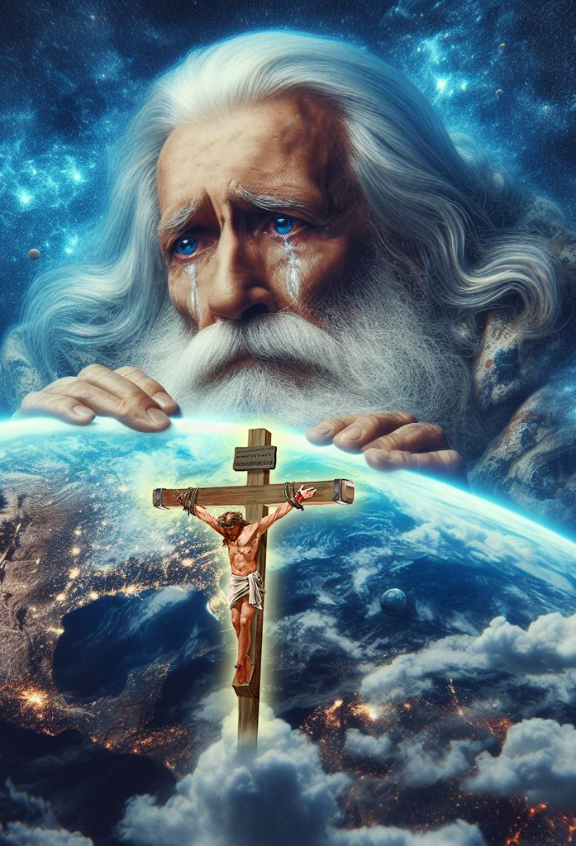
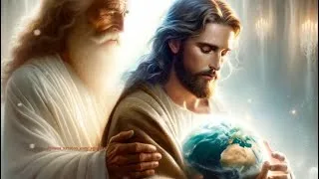
How are God’s love for man and the sacrifice provided really connected?
11
But this great sacrifice was not made in order to create in the Father's heart a love for man, not to make Him willing to save. No, no! “God so loved the world, that He gave His only-begotten Son.” John 3:16. The Father loves us, not because of the great propitiation, but He provided the propitiation because He loves us. Christ was the medium through which He could pour out His infinite love upon a fallen world. “God was in Christ, reconciling the world unto Himself.” 2 Corinthians 5:19. God suffered with His Son. In the agony of Gethsemane, the death of Calvary, the heart of Infinite Love paid the price of our redemption.
12
Why was Jesus the only possible sacrifice for sin?
None but the Son of God could accomplish our redemption; for only He who was in the bosom of the Father could declare Him. Only He who knew the height and depth of the love of God could make it manifest. Nothing less than the infinite sacrifice made by Christ in behalf of fallen man could express the Father's love to lost humanity.

Slide 10

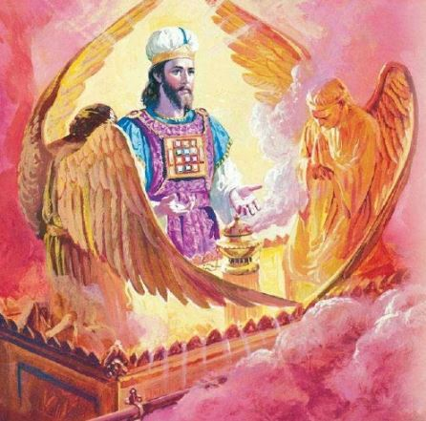

13
Beyond His sacrifice for sinners, how has Jesus connected Himself to the human race?
“God so loved the world, that He gave His only-begotten Son.” He gave Him not only to live among men, to bear their sins, and die their sacrifice. He gave Him to the fallen race. Christ was to identify Himself with the interests and needs of humanity. He who was one with God has linked Himself with the children of men by ties that are never to be broken.
Jesus is “not ashamed to call them brethren” (Hebrews 2:11); He is our Sacrifice, our Advocate, our Brother, bearing our human form before the Father's throne, and through eternal ages one with the race He has redeemed—the Son of man. And all this that man might be uplifted from the ruin and degradation of sin that he might reflect the love of God and share the joy of holiness.
14
What has Christ done for us beyond the pardon of sins?
Through faith in the atoning sacrifice of Christ the sons of Adam may become the sons of God. By assuming human nature, Christ elevates humanity. Fallen men are placed where, through connection with Christ, they may indeed become worthy of the name “sons of God.”

Slide 11
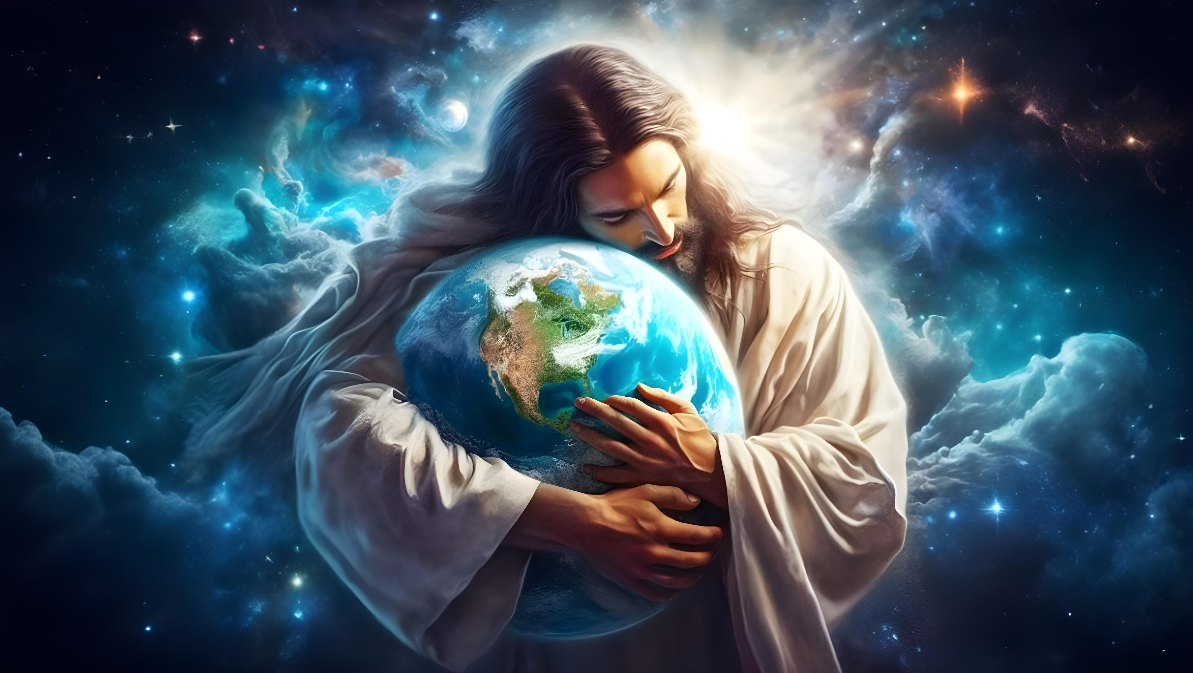

The more we study the divine character in the light of the cross, the more we see mercy, tenderness, and forgiveness blended with equity and justice, and the more clearly we discern innumerable evidences of a love that is infinite and a tender pity surpassing a mother's yearning sympathy for her wayward child.
“Every human bond may be broken,
Brother may separate from brother,
A mother may forget her children,
The stars may change their fixed paths;
But surely the provident love of Jehovah will never change.”

Slide 12

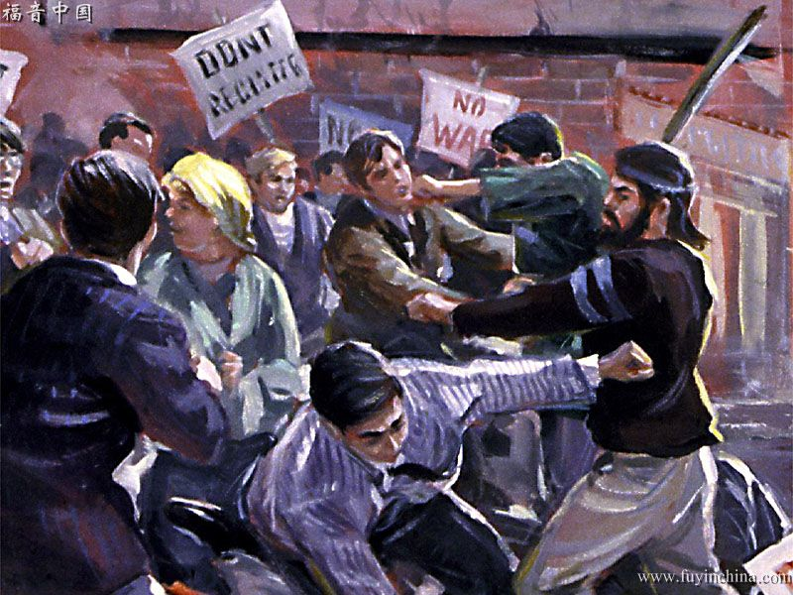


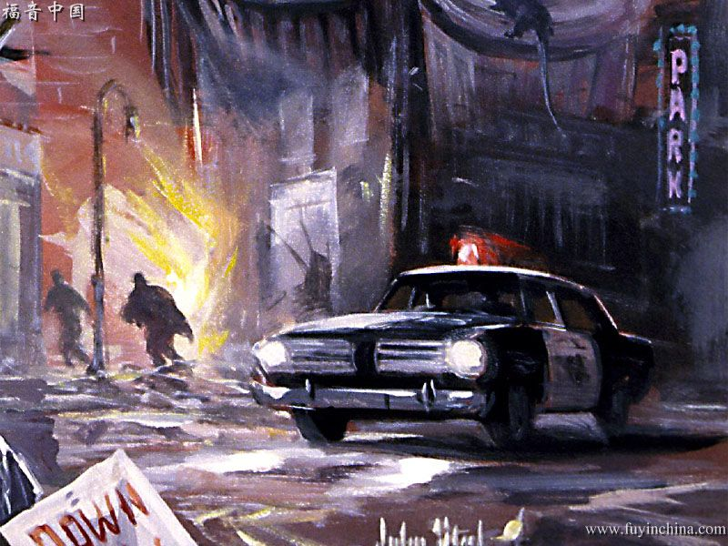


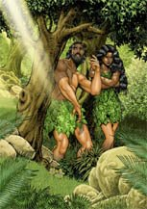
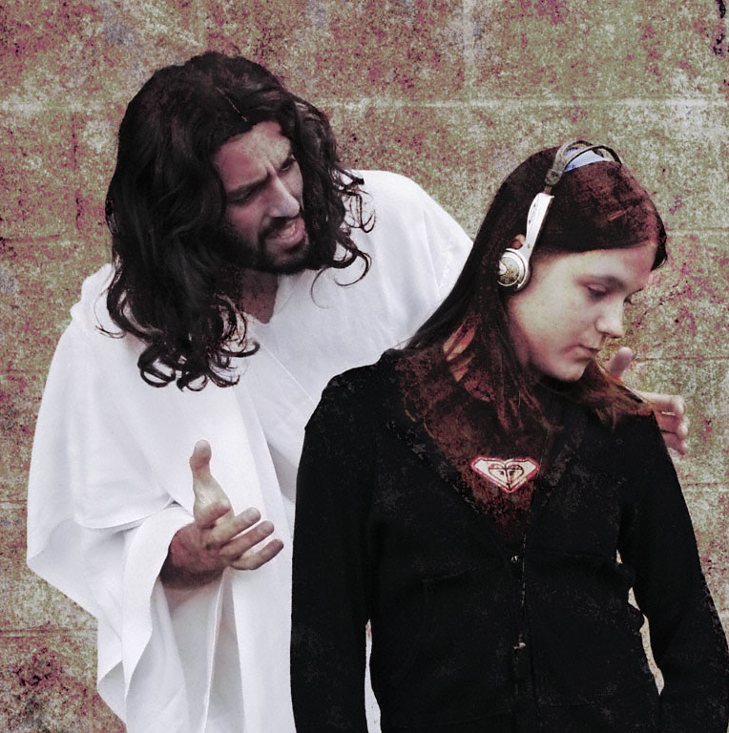
Chapter 2: “The Sinner’s Need of Christ”
1.
How has sin affected man’s mind?
But through disobedience, his powers were perverted, and selfishness took the place of love. His nature became so weakened through transgression that it was impossible for him, in his own strength, to resist the power of evil. He was made captive by Satan, and would have remained so forever had not God specially interposed. It was the tempter's purpose to thwart the divine plan in man's creation, and fill the earth with woe and desolation. And he would point to all this evil as the result of God's work in creating man.
2.
Describe the condition of the unrenewed heart.
In his sinless state, man held joyful communion with Him “in whom are hid all the treasures of wisdom and knowledge.” Colossians 2:3. But after his sin, he could no longer find joy in holiness, and he sought to hide from the presence of God. Such is still the condition of the unrenewed heart. It is not in harmony with God, and finds no joy in communion with Him.

Slide 13



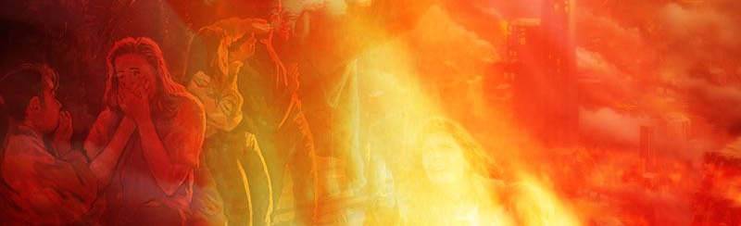
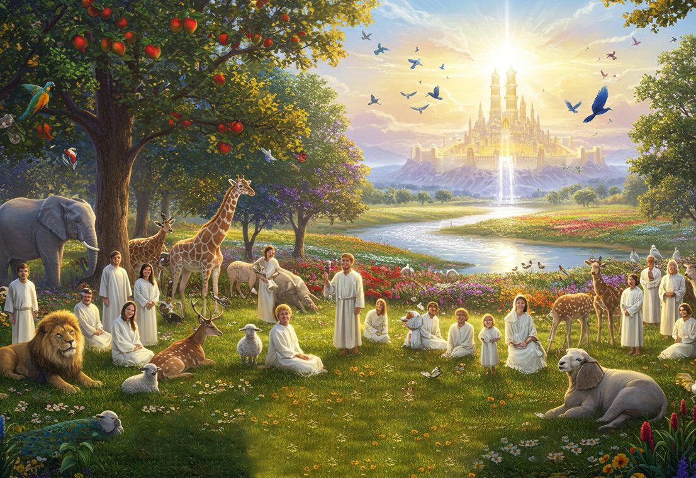
3.
What would heaven be like to an unrepentant sinner?
The sinner could not be happy in God's presence; he would shrink from the companionship of holy beings. Could he be permitted to enter heaven, it would have no joy for him. The spirit of unselfish love that reigns there—every heart responding to the heart of Infinite Love—would touch no answering chord in his soul. His thoughts, his interests, his motives, would be alien to those that actuate the sinless dwellers there. He would be a discordant note in the melody of heaven. Heaven would be to him a place of torture; he would long to be hidden from Him who is its light, and the center of its joy.
It is no arbitrary decree on the part of God that excludes the wicked from heaven; they are shut out by their own unfitness for its companionship. The glory of God would be to them a consuming fire. They would welcome destruction, that they might be hidden from the face of Him who died to redeem them.

Slide 14



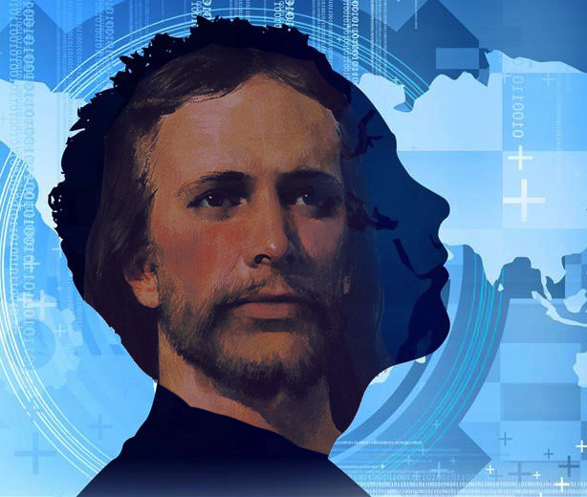


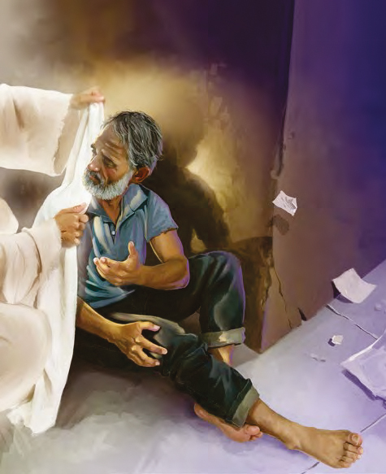
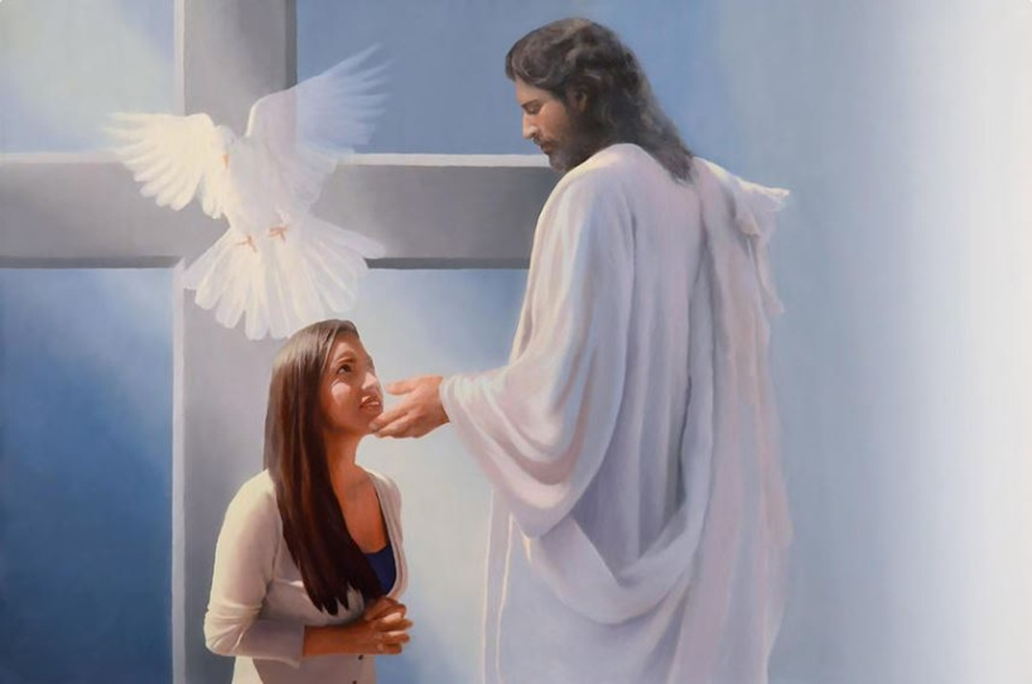
4.
Why are education, culture, the exercise of the will, human effort, not adequate to bring a person to holiness?
Education, culture, the exercise of the will, human effort, all have their proper sphere, but here they are powerless. They may produce an outward correctness of behavior, but they cannot change the heart; they cannot purify the springs of life. There must be a power working from within, a new life from above, before men can be changed from sin to holiness. That power is Christ. His grace alone can quicken the lifeless faculties of the soul, and attract it to God, to holiness.
5.
True or False. To develop the good that exists in man by nature is all that is necessary to be saved. [Explain your answer]
The idea that it is necessary only to develop the good that exists in man by nature, is a fatal deception. “The natural man receiveth not the things of the Spirit of God: for they are foolishness unto him: neither can he know them, because they are spiritually discerned.” “Marvel not that I said unto thee, Ye must be born again.” 1 Corinthians 2:14; John 3:7. Of Christ it is written, “In Him was life; and the life was the light of men”—the only “name under heaven given among men, whereby we must be saved.” John 1:4; Acts 4:12.

Slide 15



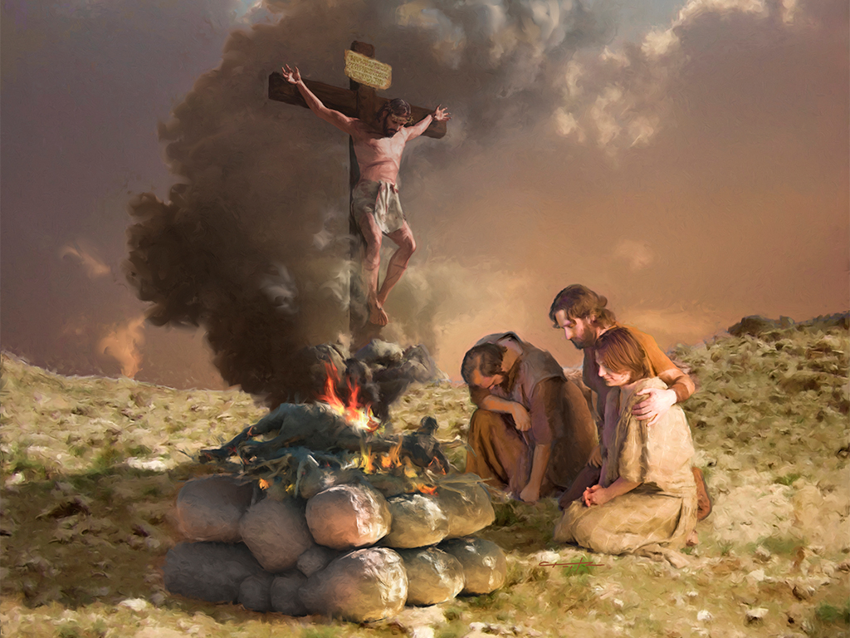
6.
Why is it not enough to know about God? Give Scripture support for your answer.
It is not enough to perceive the loving-kindness of God, to see the benevolence, the fatherly tenderness, of His character. It is not enough to discern the wisdom and justice of His law, to see that it is founded upon the eternal principle of love. Paul the apostle saw all this when he exclaimed, “I consent unto the law that it is good.” “The law is holy, and the commandment holy, and just, and good.” But he added, in the bitterness of his soul-anguish and despair, “I am carnal, sold under sin.” Romans 7:16, 12, 14. He longed for the purity, the righteousness, to which in himself he was powerless to attain, and cried out, “O wretched man that I am! who shall deliver me from this body of death?” Romans 7:24, margin. Such is the cry that has gone up from burdened hearts in all lands and in all ages. To all, there is but one answer, “Behold the Lamb of God, which taketh away the sin of the world.” John 1:29.

Slide 16



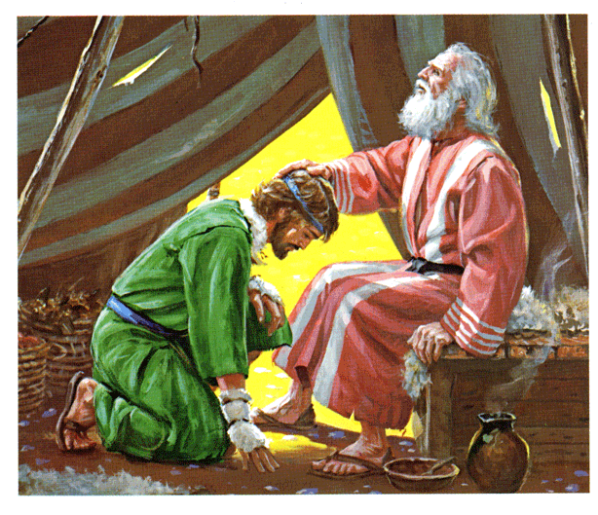
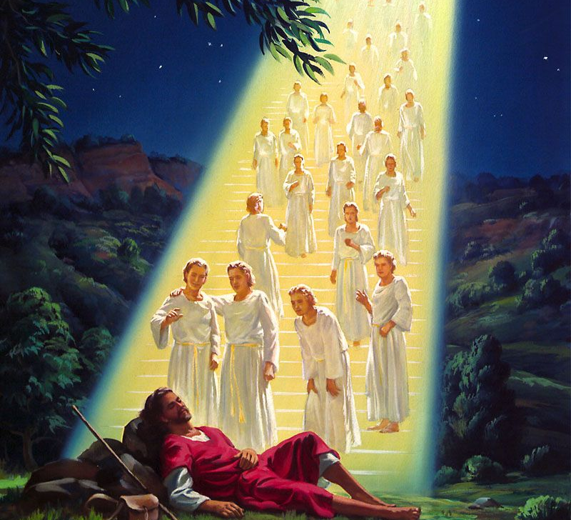
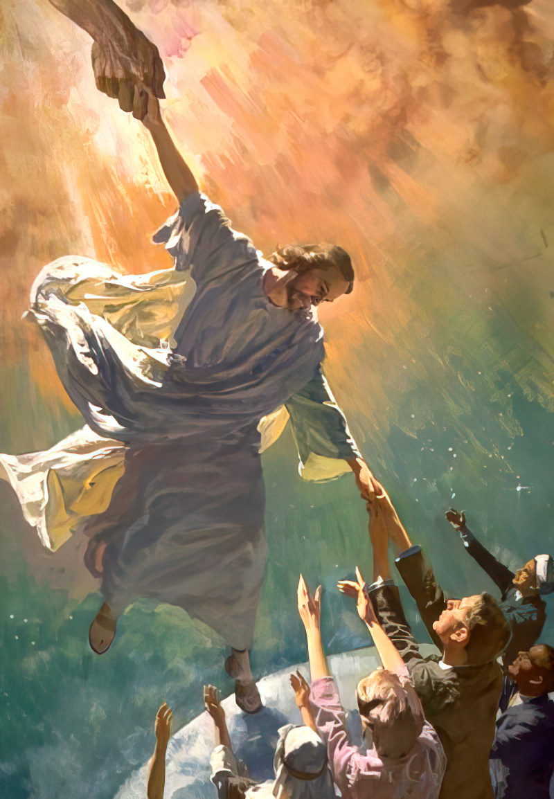
7.
What does the ladder in Jacob’s dream represent? Note also the New Testament application
When, after his sin in deceiving Esau, Jacob fled from his father's home, he was weighed down with a sense of guilt. Lonely and outcast as he was, separated from all that had made life dear, the one thought that above all others pressed upon his soul, was the fear that his sin had cut him off from God, that he was forsaken of Heaven. In sadness he lay down to rest on the bare earth, around him only the lonely hills, and above, the heavens bright with stars.
As he slept, a strange light broke upon his vision; and lo, from the plain on which he lay, vast shadowy stairs seemed to lead upward to the very gates of heaven, and upon them angels of God were passing up and down; while from the glory above, the divine voice was heard in a message of comfort and hope. Thus was made known to Jacob that which met the need and longing of his soul—a Saviour. With joy and gratitude he saw revealed a way by which he, a sinner, could be restored to communion with God. The mystic ladder of his dream represented Jesus, the only medium of communication between God and man.
This is the same figure to which Christ referred in His conversation with Nathanael, when He said, “Ye shall see heaven open, and the angels of God ascending and descending upon the Son of man.” John 1:51. In the apostasy, man alienated himself from God; earth was cut off from heaven. Across the gulf that lay between, there could be no communion. But through Christ, earth is again linked with heaven. With His own merits, Christ has bridged the gulf which sin had made, so that the ministering angels can hold communion with man. Christ connects fallen man in his weakness and helplessness with the Source of infinite power.

Slide 17




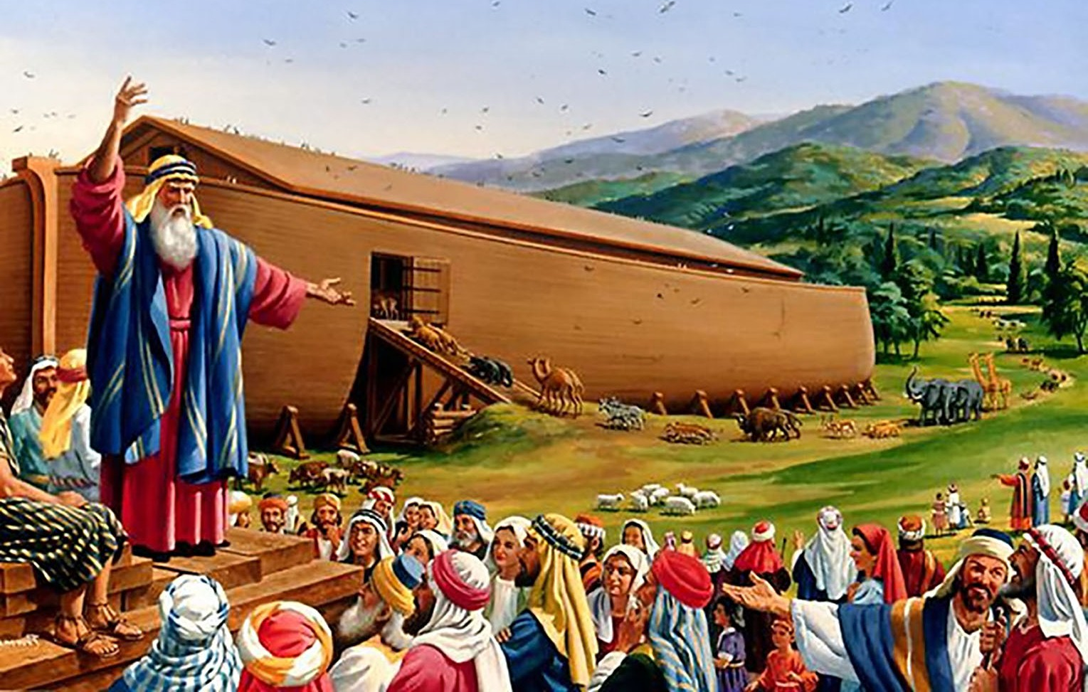
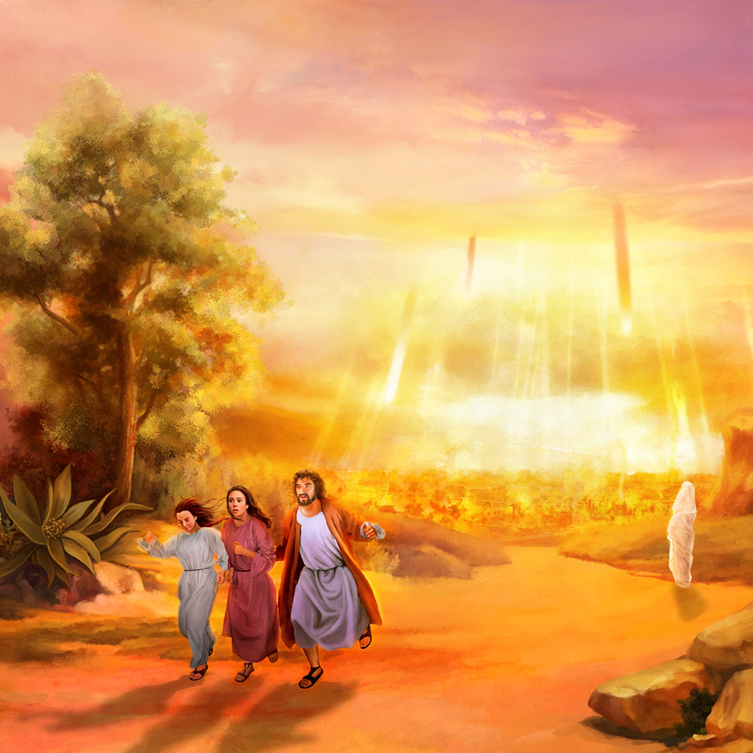
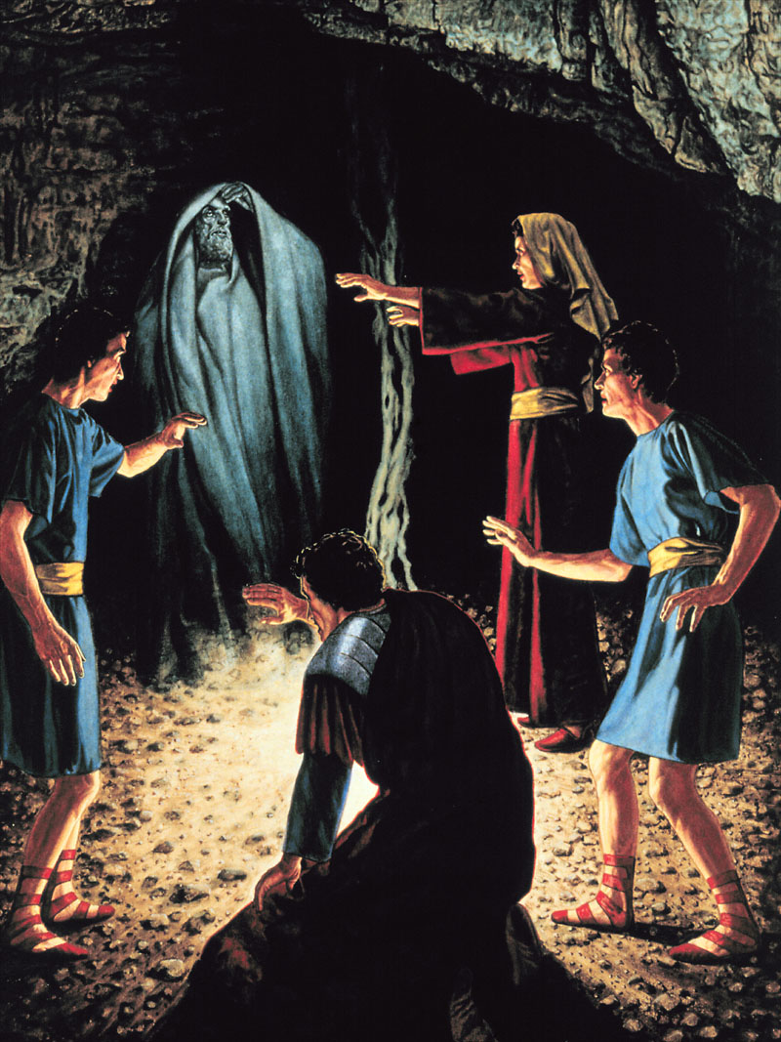

8.
Make a list of the agencies enlisted in man’s behalf to save him.
The heart of God yearns over His earthly children with a love stronger than death.
In giving up His Son, He has poured out to us all heaven in one gift
The Saviour's life and death and intercession
The ministry of angels
The pleading of the Spirit
The Father working above and through all
The unceasing interest of heavenly beings
All are enlisted in behalf of man's redemption
9.
What means does God use to warn us against the service of Satan?
And, on the other hand, the judgments of God pronounced against sin, the inevitable retribution, the degradation of our character, and the final destruction, are presented in God's word to warn us against the service of Satan.

Slide 18

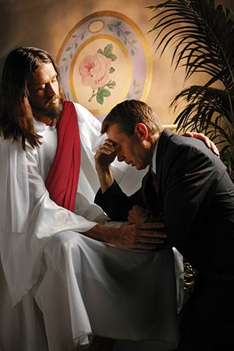








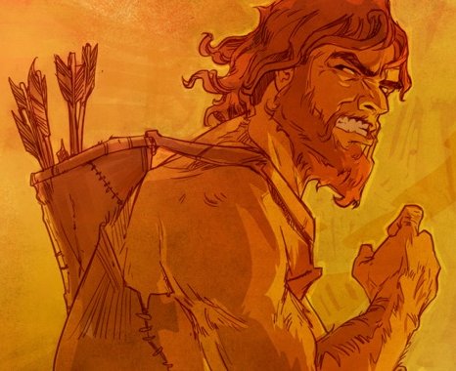
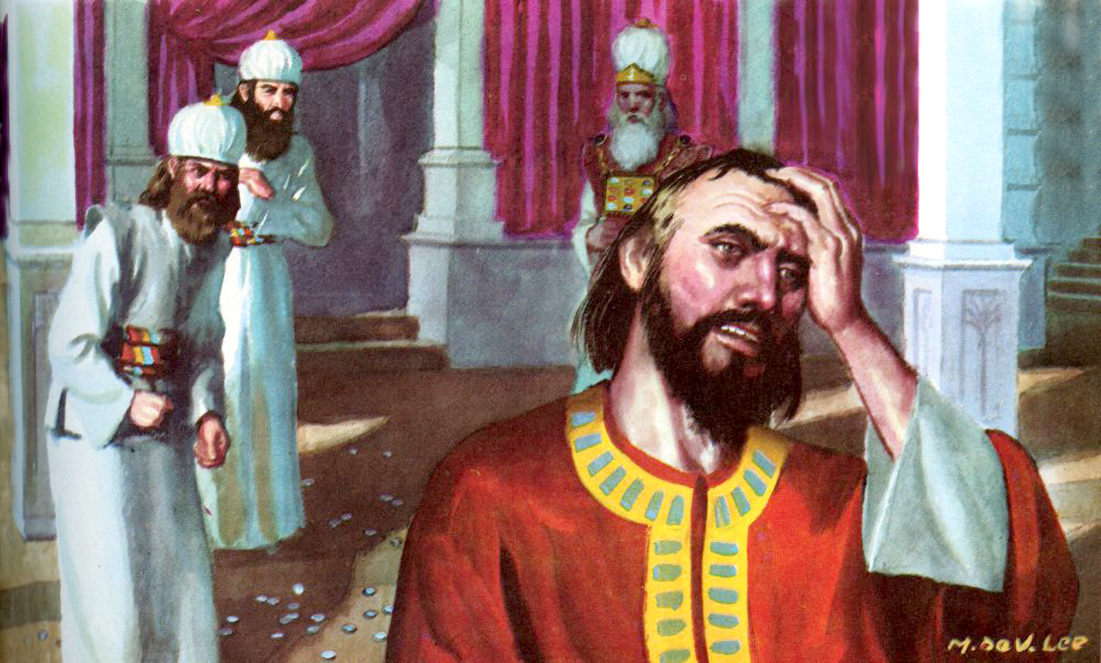
Chapter 3: “Repentance”
1
Define repentance.
Repentance includes sorrow for sin and a turning away from it. We shall not renounce sin unless we see its sinfulness; until we turn away from it in heart, there will be no real change in the life.
2
What was wrong with the repentance of Esau and Judas?
Multitudes sorrow that they have sinned and even make an outward reformation because they fear that their wrongdoing will bring suffering upon themselves. But this is not repentance in the Bible sense. They lament the suffering rather than the sin. Such was the grief of Esau when he saw that the birthright was lost to him forever.
Judas Iscariot, after betraying his Lord, exclaimed, “I have sinned in that I have betrayed the innocent blood.” Matthew 27:4.The confession was forced from his guilty soul by an awful sense of condemnation and a fearful looking for of judgment. The consequences that were to result to him filled him with terror, but there was no deep, heartbreaking grief in his soul, that he had betrayed the spotless Son of God and denied the Holy One of Israel.

Slide 19







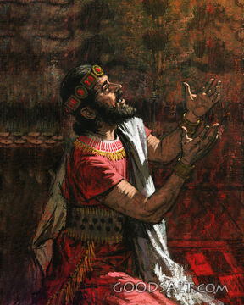



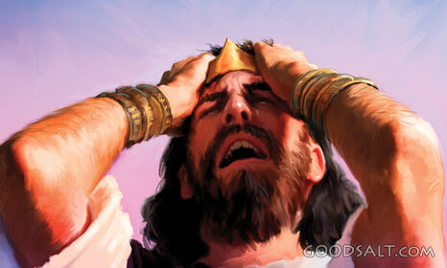
3
When the heart is opened to God’s Spirit, how is the sinner affected?
But when the heart yields to the influence of the Spirit of God, the conscience will be quickened, and the sinner will discern something of the depth and sacredness of God's holy law, the foundation of His government in heaven and on earth.
4
When David repented, what several things did he pray for?
The prayer of David after his fall, illustrates the nature of true sorrow for sin. His repentance was sincere and deep. There was no effort to palliate his guilt; no desire to escape the judgment threatened, inspired his prayer.
David saw the enormity of his transgression; he saw the defilement of his soul; he loathed his sin.
It was not for pardon only that he prayed, but for purity of heart. He longed for the joy of holiness—to be restored to harmony and communion with God. (Psalm 51)

Slide 20





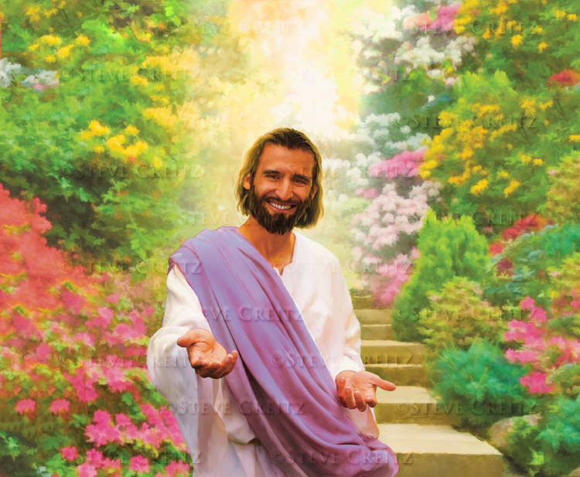




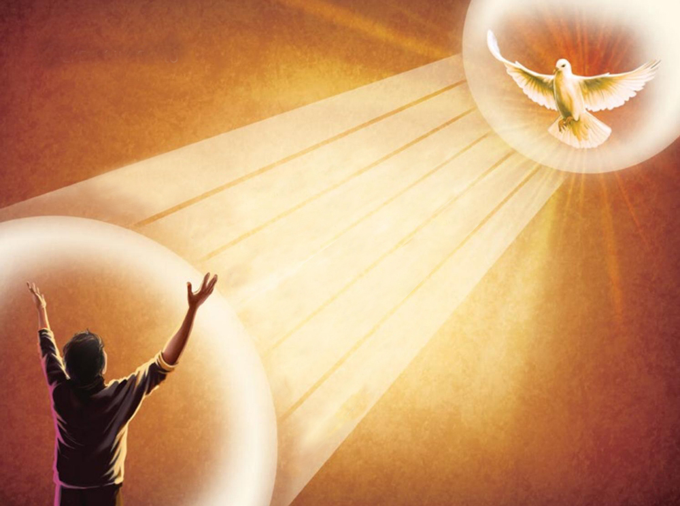
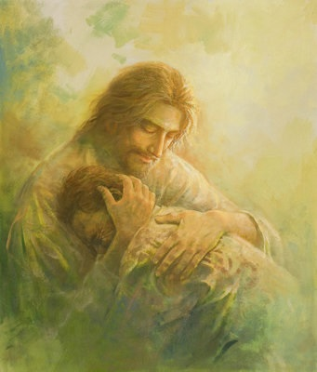
5
Which comes first--repentance or coming to Jesus?
The Bible does not teach that the sinner must repent before he can heed the invitation of Christ, “Come unto Me, all ye that labor and are heavy-laden, and I will give you rest.” Matthew 11:28. It is the virtue that goes forth from Christ, that leads to genuine repentance. Peter made the matter clear in his statement to the Israelites when he said, “Him hath God exalted with His right hand to be a Prince and a Saviour, for to give repentance to Israel, and forgiveness of sins.” Acts 5:31
6
Finish the sentence:
“We can no more repent__________________________ ________________________________________________________."
We can no more repent without the Spirit of Christ to awaken the conscience than we can be pardoned without Christ.

Slide 21






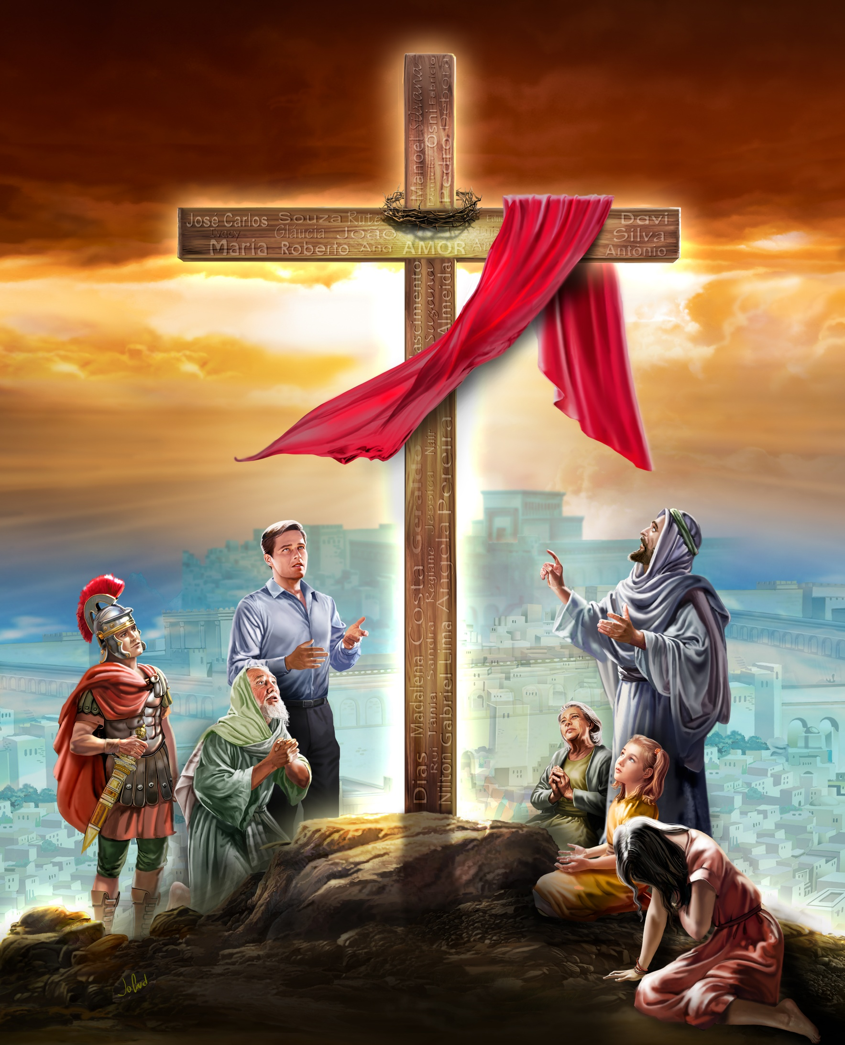




Is it possible to become ashamed of sin without a knowledge of Christ? Be prepared to discuss your answer.
7
It is true that men sometimes become ashamed of their sinful ways, and give up some of their evil habits, before they are conscious that they are being drawn to Christ. But whenever they make an effort to reform, from a sincere desire to do right, it is the power of Christ that is drawing them. An influence of which they are unconscious works upon the soul, and the conscience is quickened, and the outward life is amended. And as Christ draws them to look upon His cross, to behold Him whom their sins have pierced, the commandment comes home to the conscience. The wickedness of their life, the deep-seated sin of the soul, is revealed to them.
They begin to comprehend something of the righteousness of Christ, and exclaim, “What is sin, that it should require such a sacrifice for the redemption of its victim? Was all this love, all this suffering, all this humiliation, demanded, that we might not perish, but have everlasting life?”.
8
What will happen to the sinner who does not resist the love of Christ?
The sinner may resist this love, may refuse to be drawn to Christ; but if he does not resist he will be drawn to Jesus; a knowledge of the plan of salvation will lead him to the foot of the cross in repentance for his sins, which have caused the sufferings of God's dear Son.

Slide 22










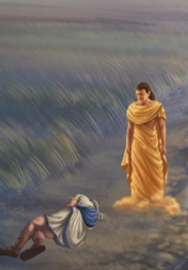
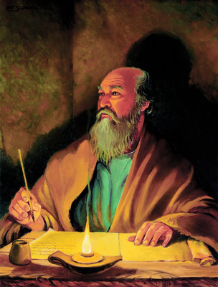
9
Thought question: Have I found in Christ the answer to my craving for something I do not have? If not, why not?
10
What happens when the light from Christ shines into our souls? Discuss the experience of Daniel and Paul.
One ray of the glory of God, one gleam of the purity of Christ, penetrating the soul, makes every spot of defilement painfully distinct, and lays bare the deformity and defects of the human character. It makes apparent the unhallowed desires, the infidelity of the heart, the impurity of the lips. The sinner's acts of disloyalty in making void the law of God, are exposed to his sight, and his spirit is stricken and afflicted under the searching influence of the Spirit of God. He loathes himself as he views the pure, spotless character of Christ.
When the prophet Daniel beheld the glory surrounding the heavenly messenger that was sent unto him, he was overwhelmed with a sense of his own weakness and imperfection.
But when [Paul] he looked into the depths of its holy precepts, and saw himself as God saw him, he bowed in humiliation and confessed his guilt. He says, “I was alive without the law once: but when the commandment came, sin revived, and I died.” Romans 7:9. When he saw the spiritual nature of the law, sin appeared in its true hideousness, and his self-esteem was gone.

Slide 23





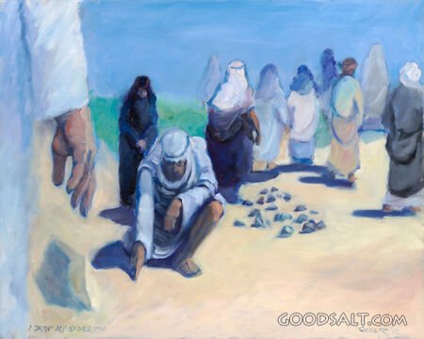




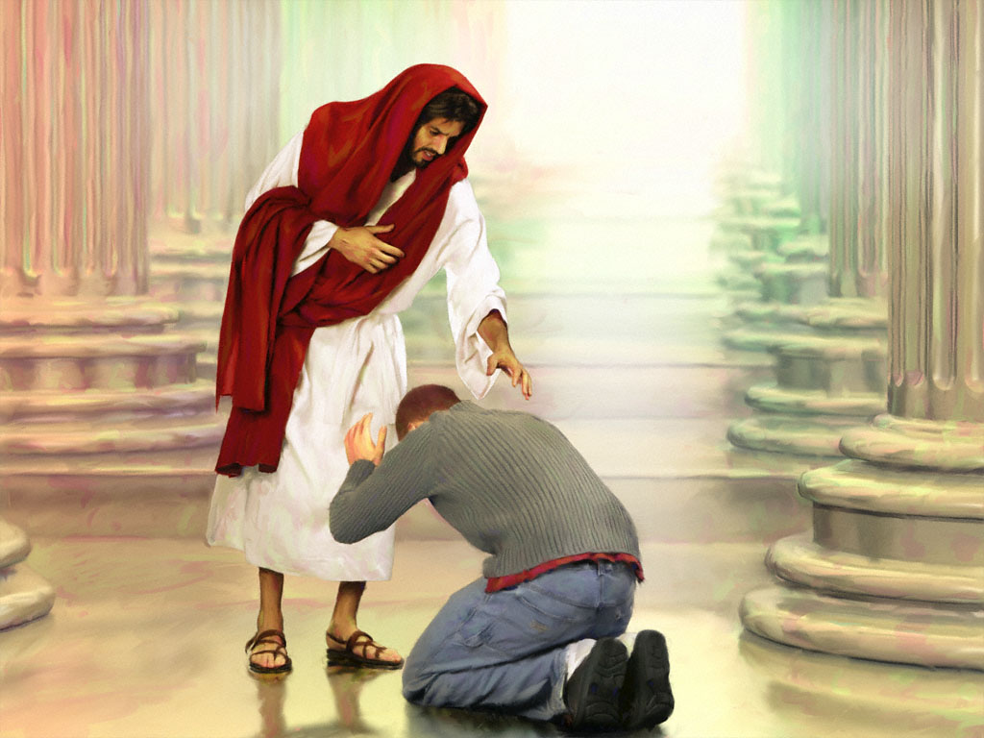
“God does not regard all sins as of equal magnitude; there are degrees of guilt in His estimation, as well as in that of man.” What does this mean? Prepare to discuss.
11
God does not regard all sins as of equal magnitude; there are degrees of guilt in His estimation, as well as in that of man; but however trifling this or that wrong act may seem in the eyes of men, no sin is small in the sight of God. Man's judgment is partial, imperfect; but God estimates all things as they really are.
12
Why should we not wait to make ourselves better before coming to Christ?
If you see your sinfulness, do not wait to make yourself better. How many there are who think they are not good enough to come to Christ. Do you expect to become better through your own efforts? “Can the Ethiopian change his skin, or the leopard his spots? then may ye also do good, that are accustomed to do evil.” Jeremiah 13:23. There is help for us only in God. We must not wait for stronger persuasions, for better opportunities, or for holier tempers. We can do nothing of ourselves. We must come to Christ just as we are.

Slide 24




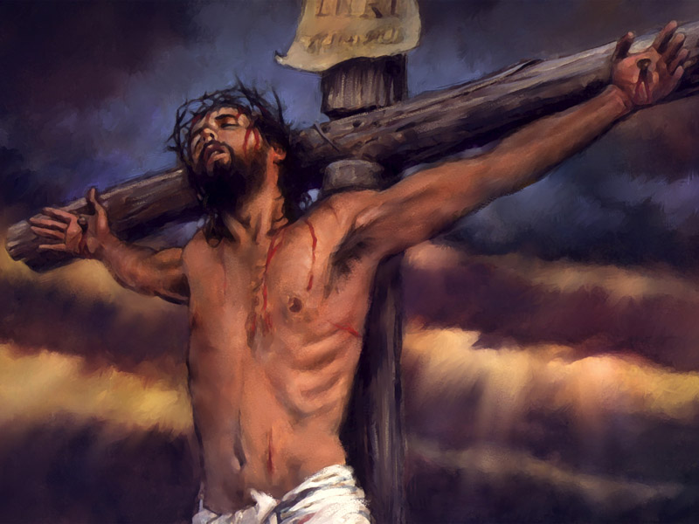





13
How would you answer the person who suggests that God is too good to destroy sinners?
When men urge that God is too good to cast off the sinner, let them look to Calvary. It was because there was no other way in which man could be saved, because without this sacrifice it was impossible for the human race to escape from the defiling power of sin, and be restored to communion with holy beings,—impossible for them again to become partakers of spiritual life,—it was because of this that Christ took upon Himself the guilt of the disobedient and suffered in the sinner's stead. The love and suffering and death of the Son of God all testify to the terrible enormity of sin and declare that there is no escape from its power, no hope of the higher life, but through the submission of the soul to Christ.
14
What answer would you give to someone who says, “I am as good as professed Christians?
Thus they make the faults of others an excuse for their own neglect of duty. But the sins and defects of others do not excuse anyone, for the Lord has not given us an erring human pattern. The spotless Son of God has been given as our example, and those who complain of the wrong course of professed Christians are the ones who should show better lives and nobler examples. If they have so high a conception of what a Christian should be, is not their own sin so much the greater? They know what is right, and yet refuse to do it.

Slide 25









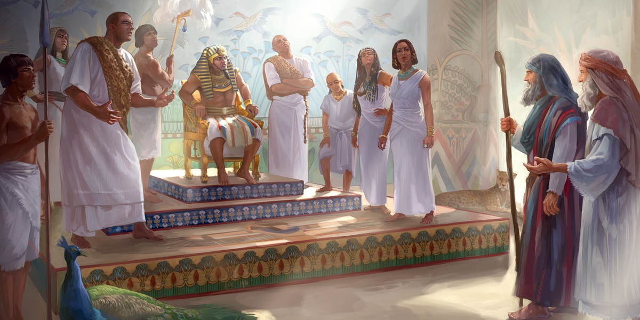
15
What are the dangers of procrastination in forsaking sin?
Beware of procrastination. Do not put off the work of forsaking your sins and seeking purity of heart through Jesus. Here is where thousands upon thousands have erred to their eternal loss. I will not here dwell upon the shortness and uncertainty of life; but there is a terrible danger—a danger not sufficiently understood—in delaying to yield to the pleading voice of God's Holy Spirit, in choosing to live in sin; for such this delay really is. Sin, however small it may be esteemed, can be indulged in only at the peril of infinite loss. What we do not overcome, will overcome us and work out our destruction.
16
How will neglect or rejection of the grace of Christ affect the sinner?
Every act of transgression, every neglect or rejection of the grace of Christ, is reacting upon yourself; it is hardening the heart, depraving the will, benumbing the understanding, and not only making you less inclined to yield, but less capable of yielding, to the tender pleading of God's Holy Spirit.

Slide 26





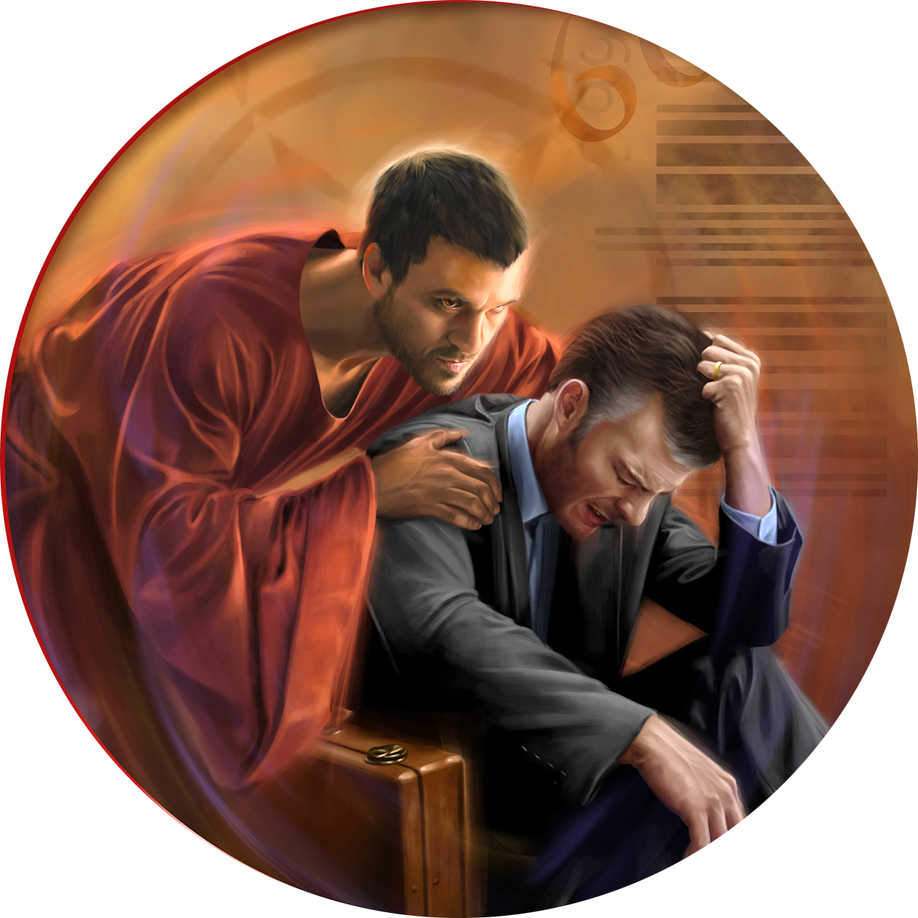
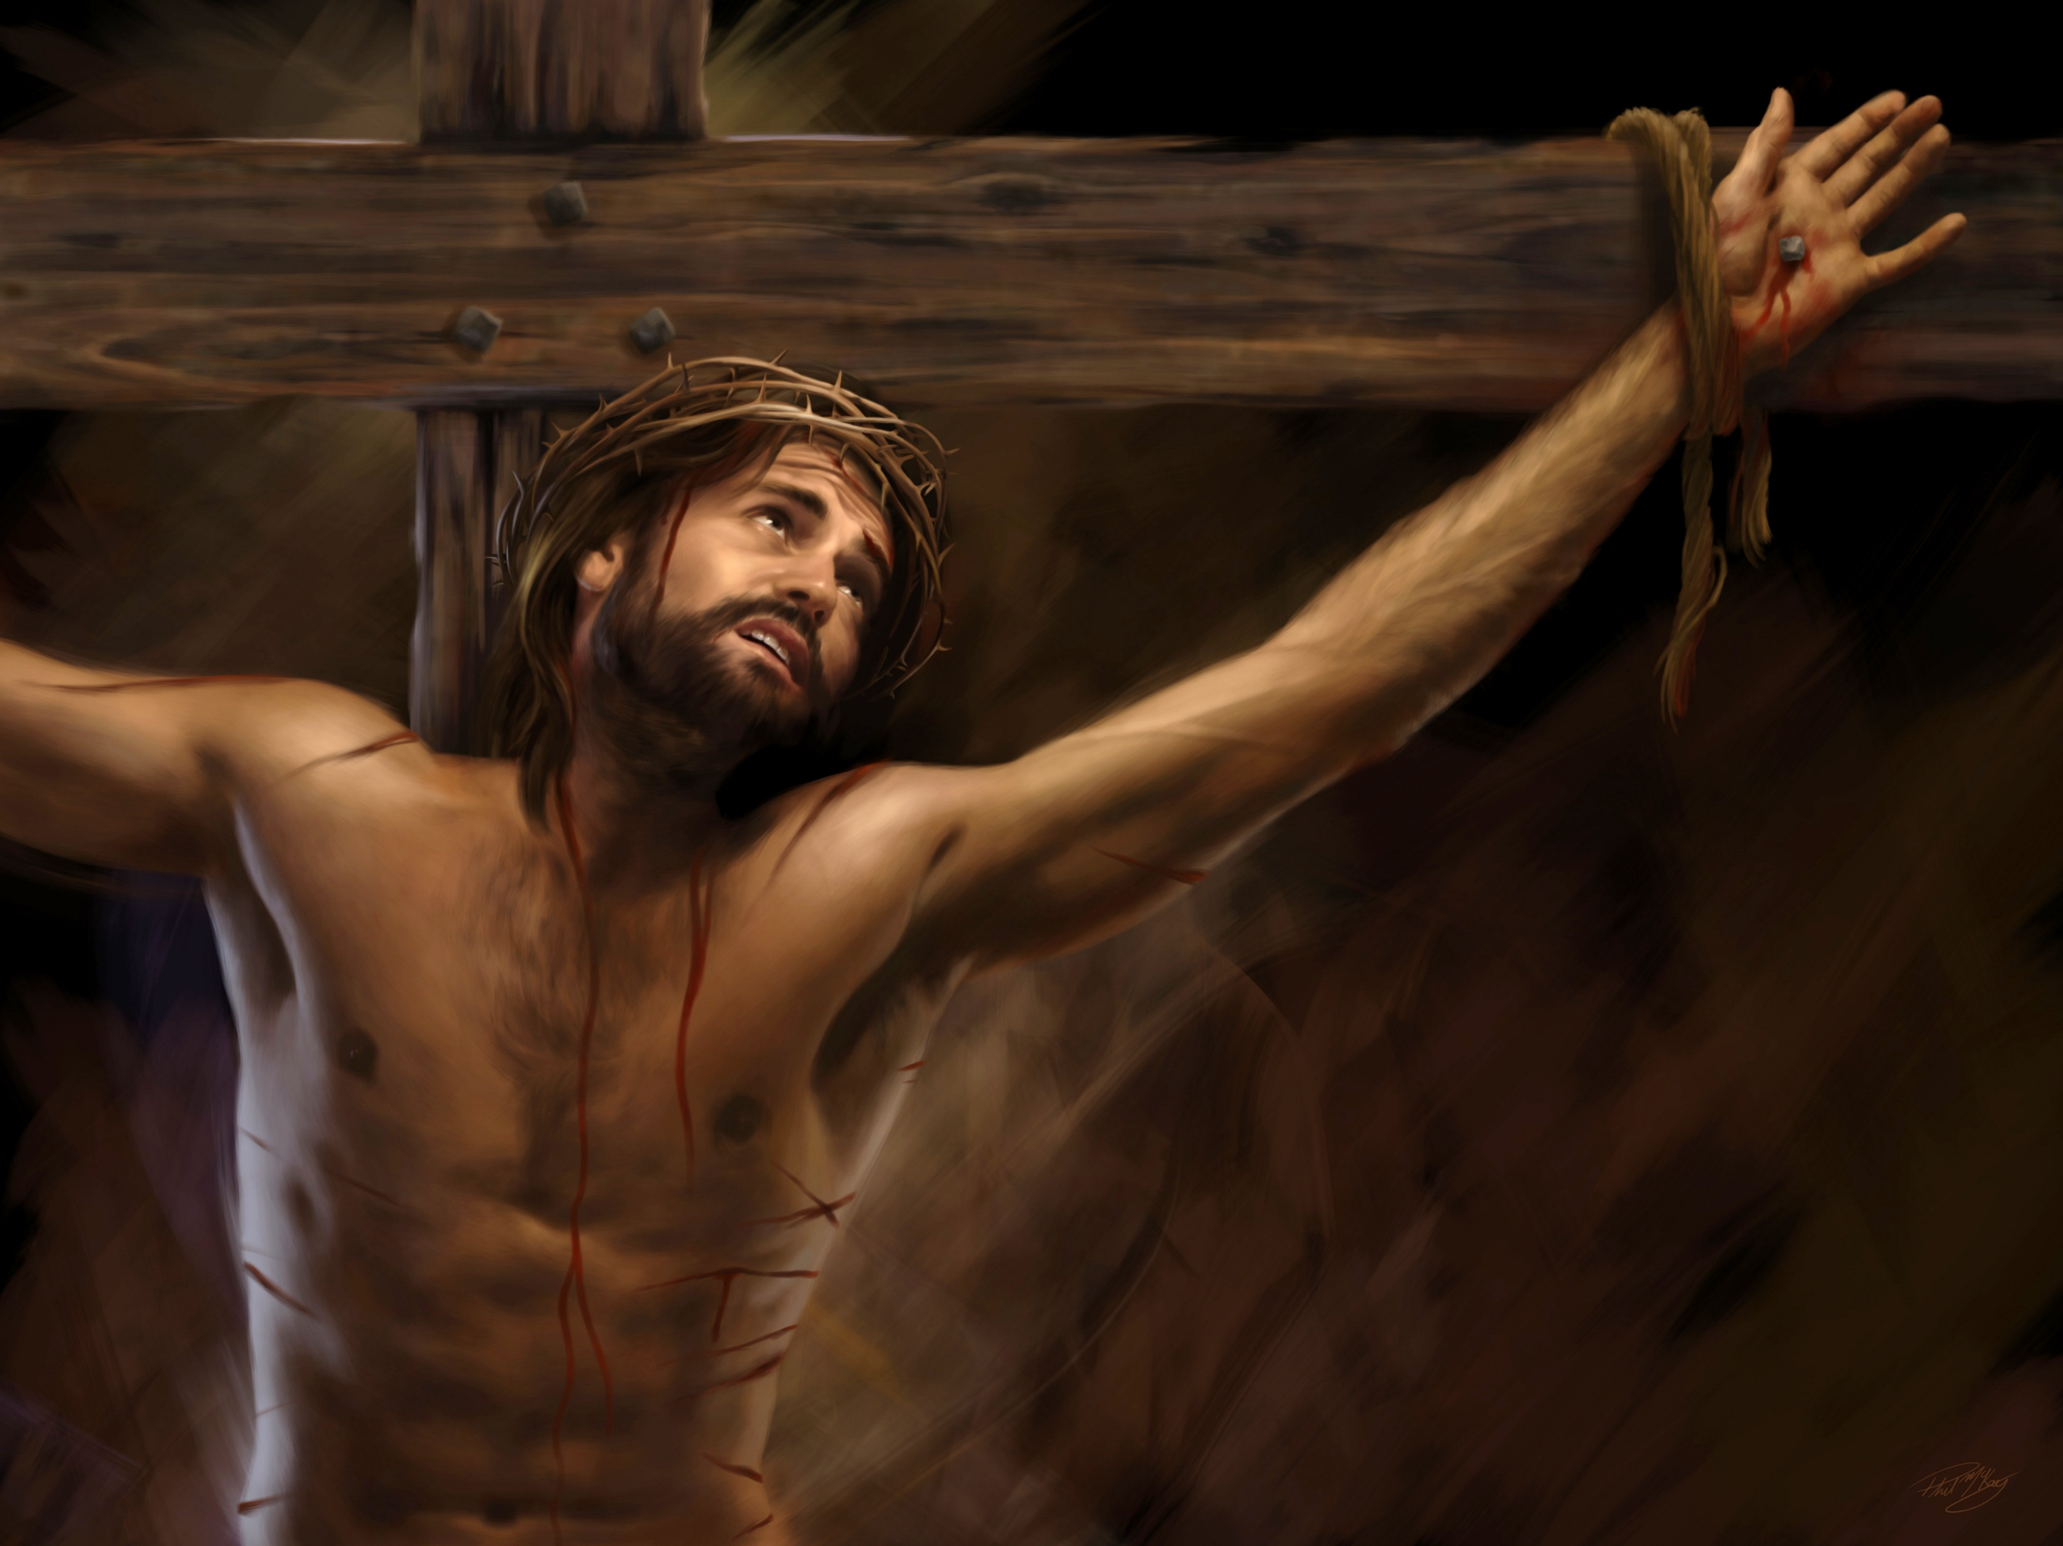
17
What encouragement is offered to those who are tempted to despair regarding their sins?
When Satan comes to tell you that you are a great sinner, look up to your Redeemer and talk of His merits. That which will help you is to look to His light. Acknowledge your sin, but tell the enemy that “Christ Jesus came into the world to save sinners” and that you may be saved by His matchless love.
We have been great sinners, but Christ died that we might be forgiven. The merits of His sacrifice are sufficient to present to the Father in our behalf. Those to whom He has forgiven most will love Him most, and will stand nearest to His throne to praise Him for His great love and infinite sacrifice. It is when we most fully comprehend the love of God that we best realize the sinfulness of sin. When we see the length of the chain that was let down for us, when we understand something of the infinite sacrifice that Christ has made in our behalf, the heart is melted with tenderness and contrition.

