Slide 1
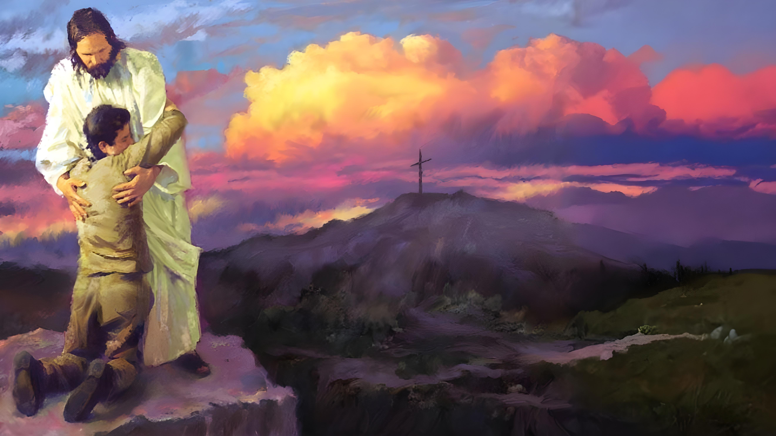

Lesson 2
Ellen G. White

Slide 2

These presentations are based on the book “Steps to Christ” by Ellen G. White, and the study guide prepared by the Trustees of the White Institute.
You can download or read the book at https://egwwritings.org/read?panels=p108.4&index=0
Read the corresponding chapter in the book and answer these questions. Click on the chapter to access it.
Lesson 2
Chapter 4: “Confession”
Chapter 5: “Consecration”
Chapter 6: “Faith and Acceptance”

Slide 3

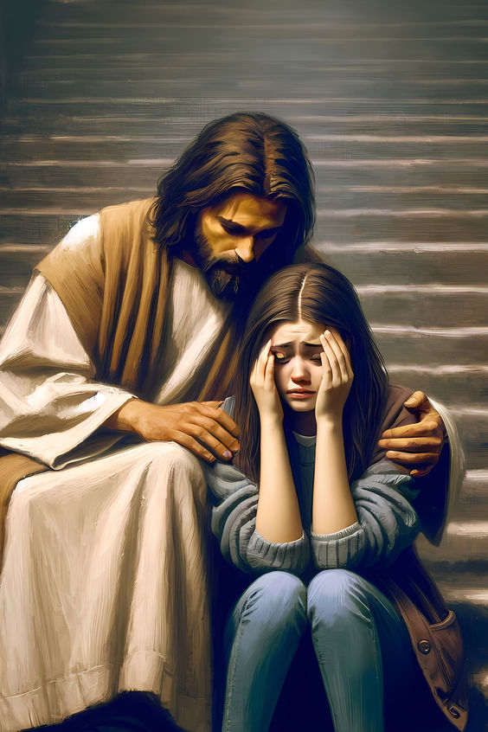




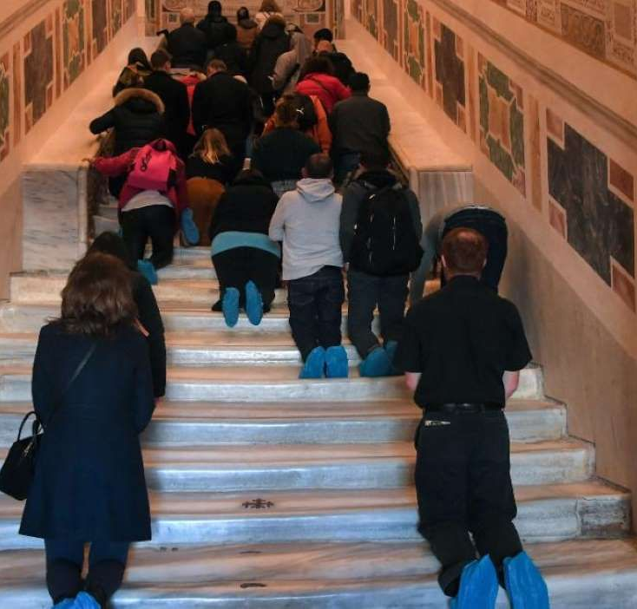
Chapter 4: "Confession"
1
According to Proverbs 28:13, we must not only confess our sins, but we are to __________________ them.
“He that covereth his sins shall not prosper: but whoso confesseth and forsaketh them shall have mercy.” (Proverbios 28:13)
2
Why are pilgrimages and penances not useful for sinners?
The Lord does not require us to do some grievous thing in order that we may have the forgiveness of sin. We need not make long and wearisome pilgrimages, or perform painful penances, to commend our souls to the God of heaven or to expiate our transgression; but he that confesseth and forsaketh his sin shall have mercy.

Slide 4



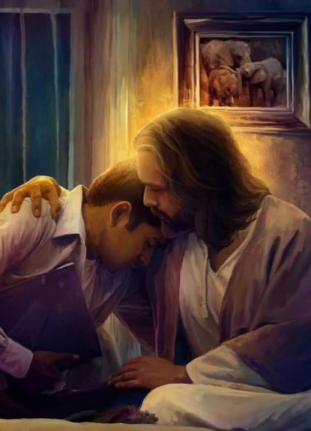



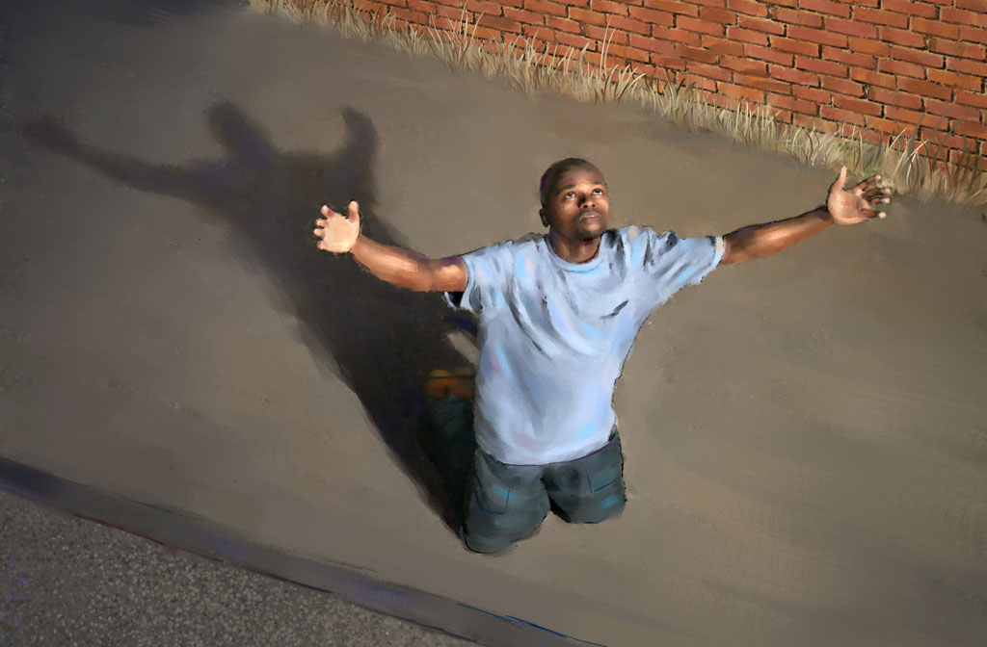
3
It is suggested we should confess sins to God and faults to one another. What does this mean?
Confess your sins to God, who only can forgive them, and your faults to one another. If you have given offense to your friend or neighbor, you are to acknowledge your wrong, and it is his duty freely to forgive you. Then you are to seek the forgiveness of God, because the brother you have wounded is the property of God, and in injuring him you sinned against his Creator and Redeemer. The case is brought before the only true Mediator, our great High Priest, who “was in all points tempted like as we are, yet without sin,” and who is “touched with the feeling of our infirmities,” and is able to cleanse from every stain of iniquity. Hebrews 4:15.
4
What is the first condition of acceptance with God?
Those who have not humbled their souls before God in acknowledging their guilt, have not yet fulfilled the first condition of acceptance. If we have not experienced that repentance which is not to be repented of, and have not with true humiliation of soul and brokenness of spirit confessed our sins, abhorring our iniquity, we have never truly sought for the forgiveness of sin; and if we have never sought, we have never found the peace of God.

Slide 5



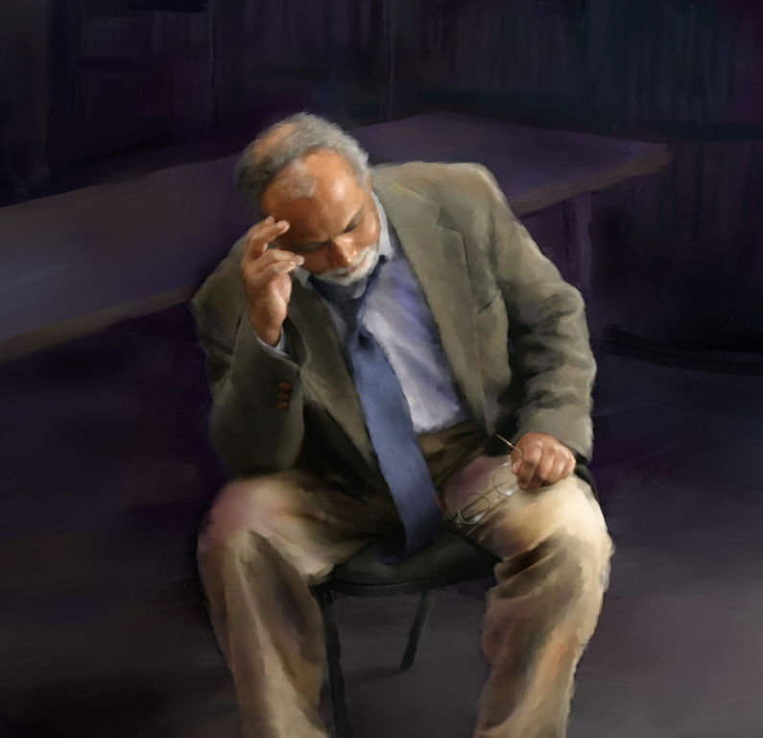


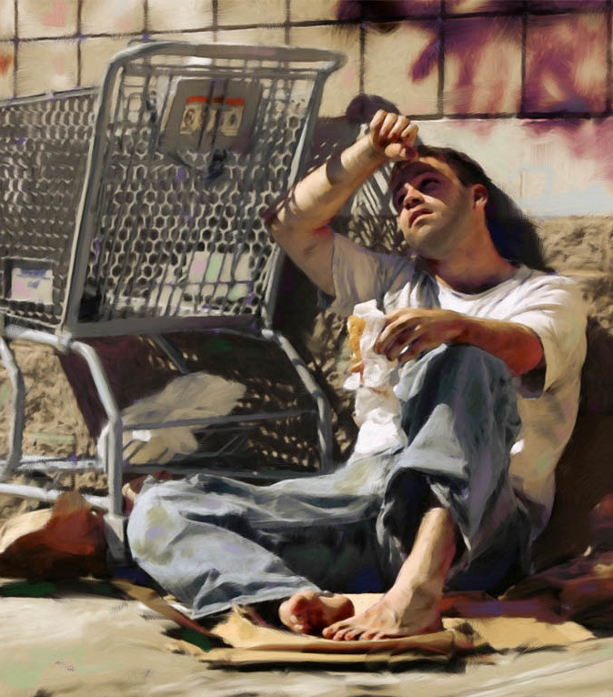
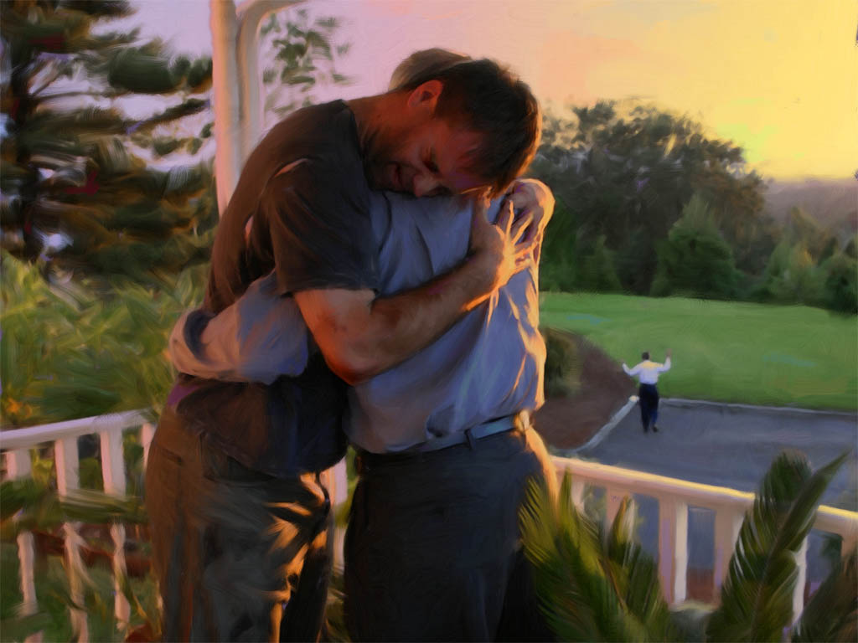
5
Finish the following sentence: “The only reason why we do not have remission of sins that are past is______________________________________."
The only reason why we do not have remission of sins that are past is that we are not willing to humble our hearts and comply with the conditions of the word of truth.
6
Confession: How should it be done? How should it not be done?
Confession of sin, whether public or private, should be heartfelt and freely expressed. It is not to be urged from the sinner. It is not to be made in a flippant and careless way, or forced from those who have no realizing sense of the abhorrent character of sin. The confession that is the outpouring of the inmost soul finds its way to the God of infinite pity. The psalmist says, “The Lord is nigh unto them that are of a broken heart; and saveth such as be of a contrite spirit.” (Psalm 34:18)

Slide 6



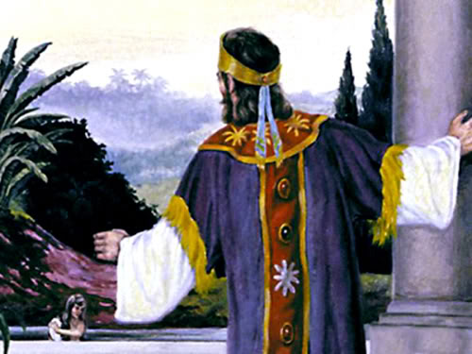
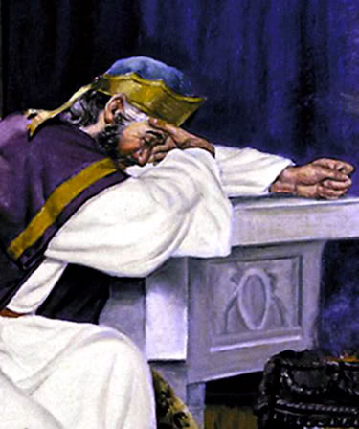


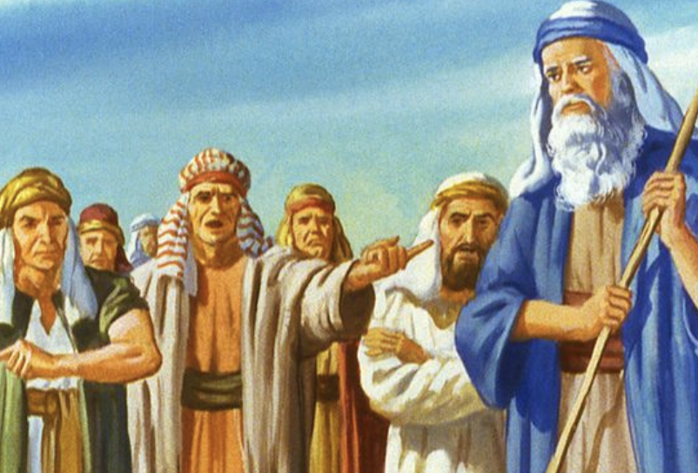
7
Why should confession be specific, acknowledging particular sins?
True confession is always of a specific character, and acknowledges particular sins. They may be of such a nature as to be brought before God only; they may be wrongs that should be confessed to individuals who have suffered injury through them; or they may be of a public character, and should then be as publicly confessed. But all confession should be definite and to the point, acknowledging the very sins of which you are guilty.
8
Discuss the example of Israel’s sin and why specific confession had to be made.
In the days of Samuel the Israelites wandered from God. They were suffering the consequences of sin; for they had lost their faith in God, lost their discernment of His power and wisdom to rule the nation, lost their confidence in His ability to defend and vindicate His cause. They turned from the great Ruler of the universe and desired to be governed as were the nations around them. Before they found peace they made this definite confession: “We have added unto all our sins this evil, to ask us a king.” 1 Samuel 12:19. The very sin of which they were convicted had to be confessed. Their ingratitude oppressed their souls and severed them from God.

Slide 7



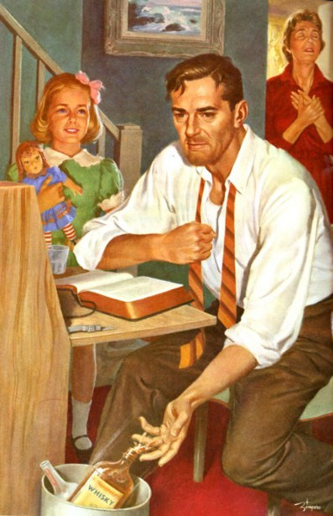
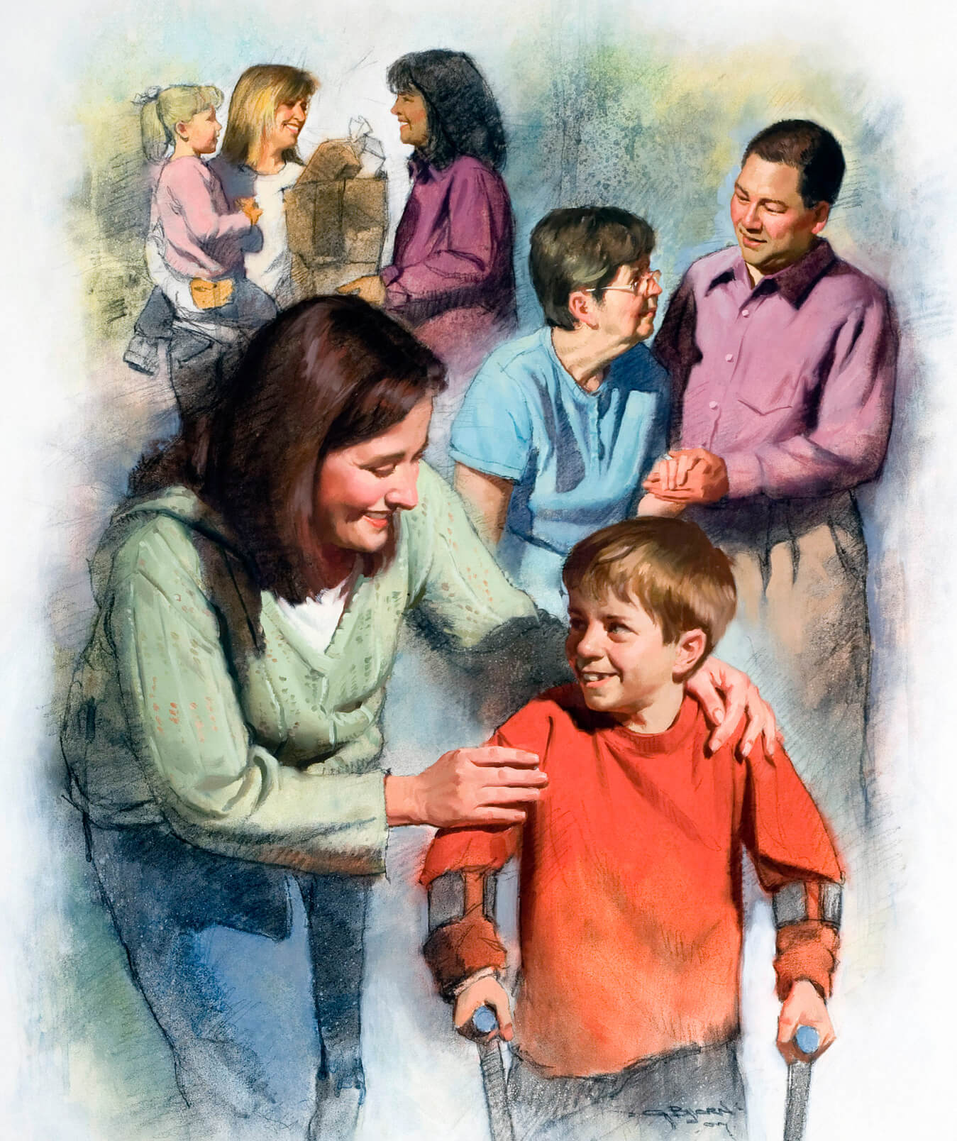
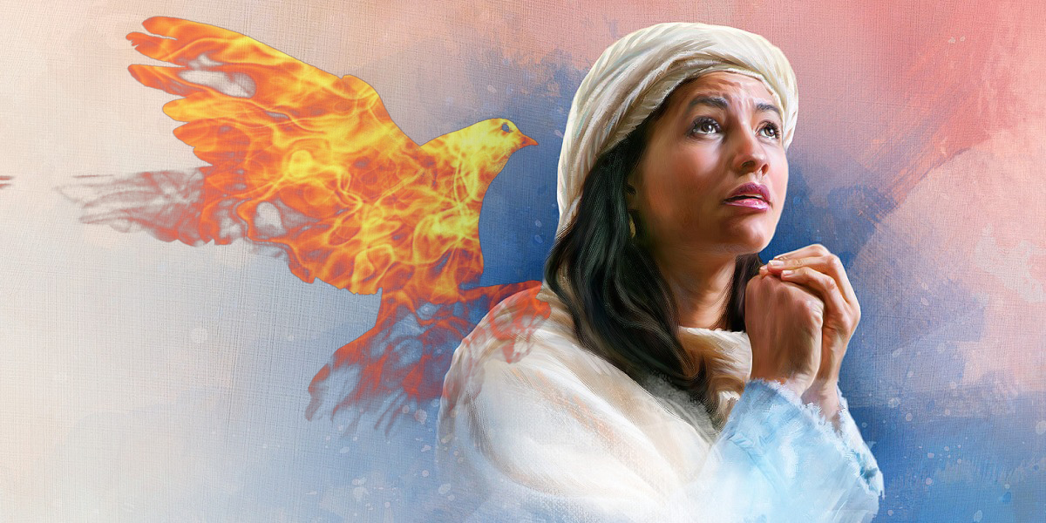


9
After confession of sin, what two additional steps must be taken? Discuss Scripture illustrations.
Confession will not be acceptable to God without sincere repentance and reformation. There must be decided changes in the life; everything offensive to God must be put away. This will be the result of genuine sorrow for sin. The work that we have to do on our part is plainly set before us: “Wash you, make you clean; put away the evil of your doings from before Mine eyes; cease to do evil; learn to do well; seek judgment, relieve the oppressed, judge the fatherless, plead for the widow.” (Isaiah 1:16, 17)
10
Why is it necessary for the sinner to yield to the Holy Spirit in order to correct character defects?
When sin has deadened the moral perceptions, the wrongdoer does not discern the defects of his character nor realize the enormity of the evil he has committed; and unless he yields to the convicting power of the Holy Spirit he remains in partial blindness to his sin.

Slide 8



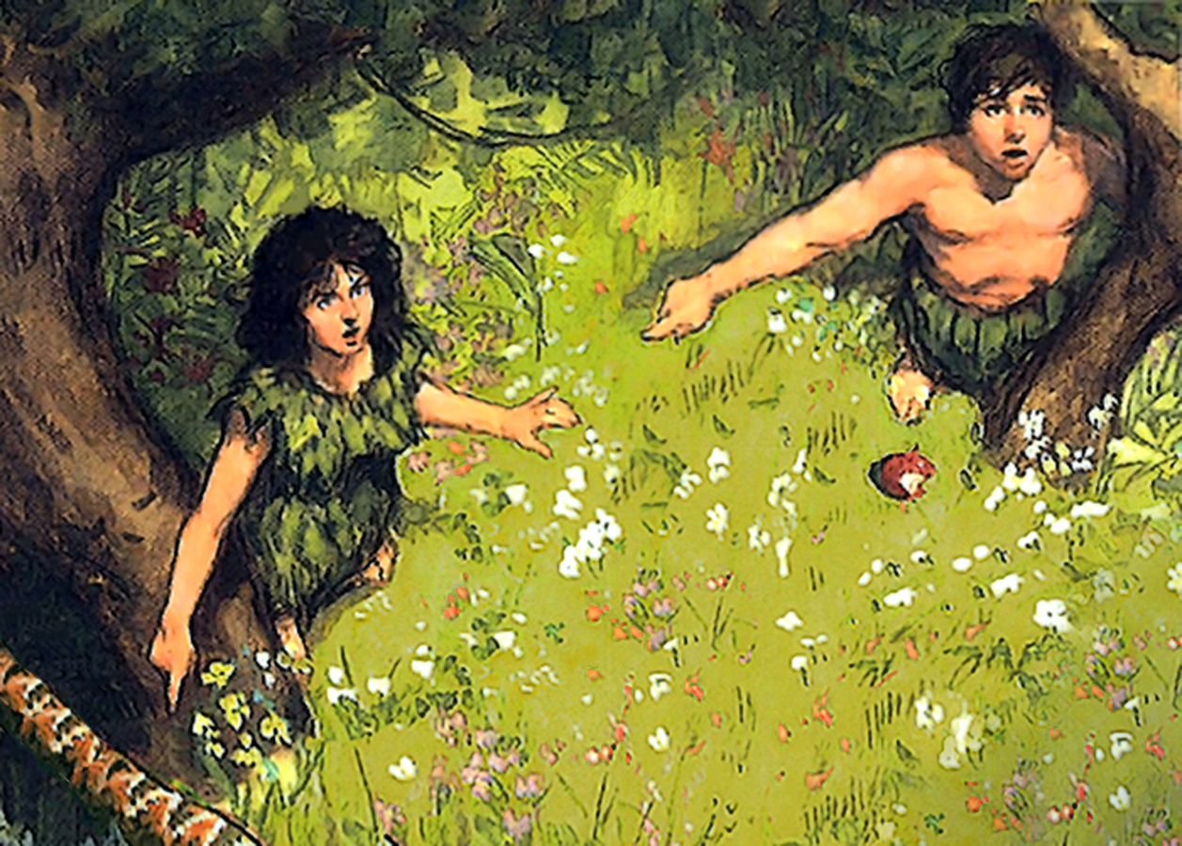


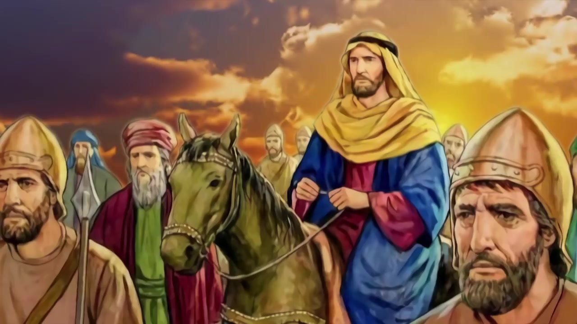

11
How did the sin of Adam and Eve affect their sense of responsibility for their actions?
After Adam and Eve had eaten of the forbidden fruit, they were filled with a sense of shame and terror. At first their only thought was how to excuse their sin and escape the dreaded sentence of death. When the Lord inquired concerning their sin, Adam replied, laying the guilt partly upon God and partly upon his companion: “The woman whom Thou gavest to be with me, she gave me of the tree, and I did eat.” The woman put the blame upon the serpent, saying, “The serpent beguiled me, and I did eat.” Genesis 3:12, 13. Why did You make the serpent? Why did You suffer him to come into Eden? These were the questions implied in her excuse for her sin, thus charging God with the responsibility of their fall.
12
By contrast, what will true repentance lead the sinner to do?
Discuss some Bible illustrations.
The examples in God's word of genuine repentance and humiliation reveal a spirit of confession in which there is no excuse for sin or attempt at self-justification. Paul did not seek to shield himself; he paints his sin in its darkest hue, not attempting to lessen his guilt. He says, “Many of the saints did I shut up in prison, having received authority from the chief priests; and when they were put to death, I gave my voice against them. And I punished them oft in every synagogue, and compelled them to blaspheme; and being exceedingly mad against them,
I persecuted them even unto strange cities.” Acts 26:10, 11. He does not hesitate to declare that “Christ Jesus came into the world to save sinners; of whom I am chief.” (1 Timothy 1:15).

Slide 9




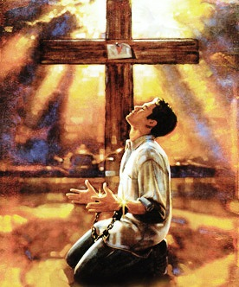
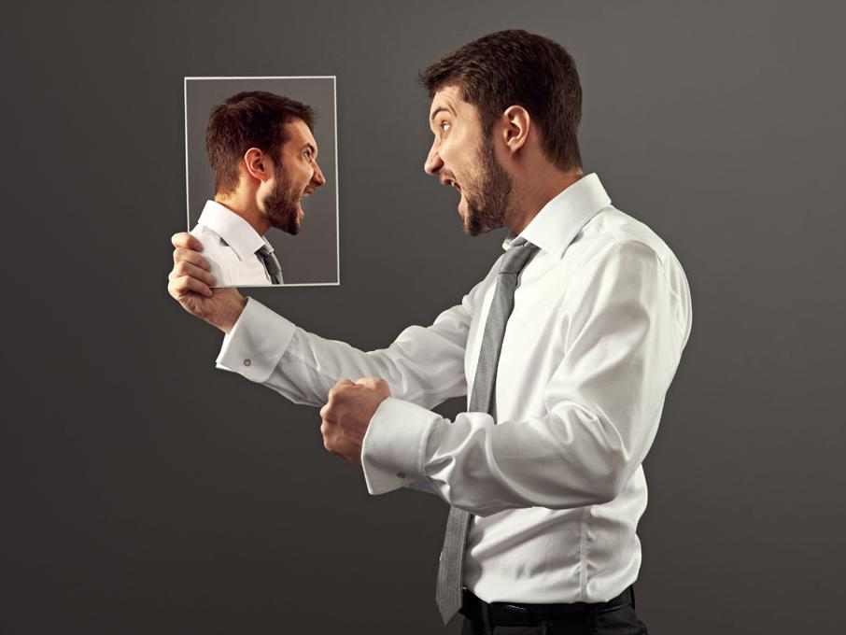



Chapter 5: "Consecration"
1
Review the Scripture descriptions of our natural condition as sinners.
The Holy Spirit describes our condition in such words as these:
“Dead in trespasses and sins,” Ephesians 2:1.
“the whole head is sick, and the whole heart faint.” Isaiah 1:5, 6.
“no soundness in it.” We are held fast in the snare of Satan, “taken captive by him at his will.” 2 Timothy 2:26.
God desires to heal us, to set us free. But since this requires an entire transformation, a renewing of our whole nature, we must yield ourselves wholly to Him.
2
What is the greatest battle to be fought?
The warfare against self is the greatest battle that was ever fought. The yielding of self, surrendering all to the will of God, requires a struggle; but the soul must submit to God before it can be renewed in holiness.

Slide 10




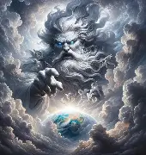
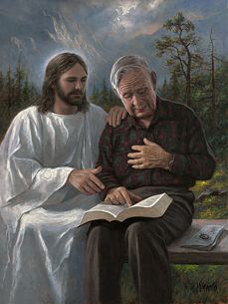
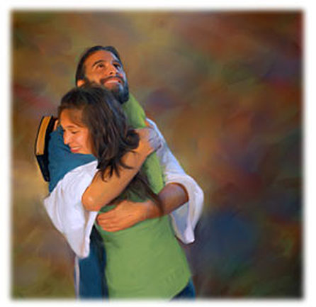
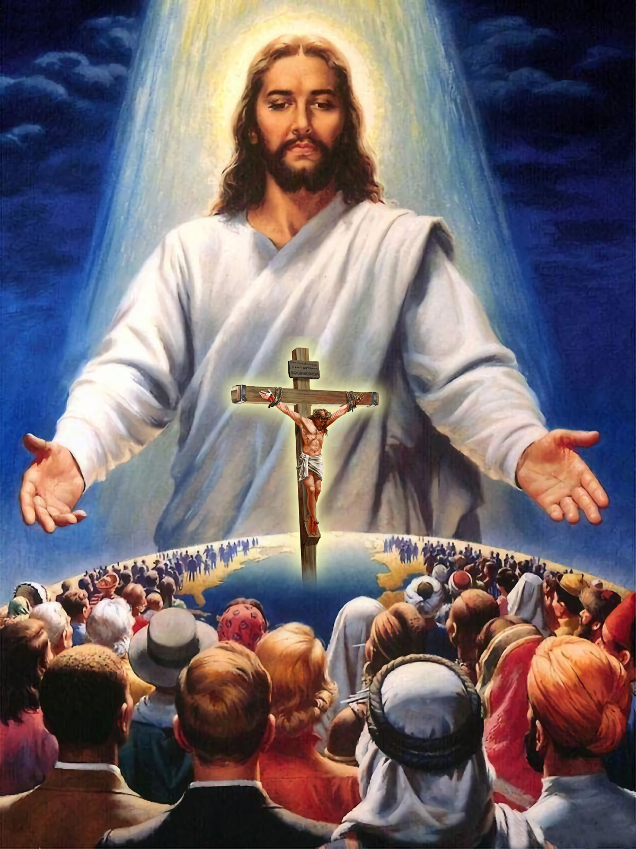



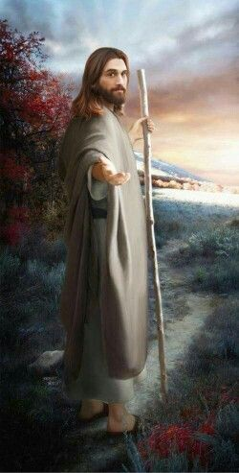
3
Summarize: A. Satan’s representation of God’s government: B. God’s government as it really is:
The government of God is not, as Satan would make it appear, founded upon a blind submission, an unreasoning control. It appeals to the intellect and the conscience. “Come now, and let us reason together” is the Creator's invitation to the beings He has made. Isaiah 1:18.
4
Why does God not force our submission?
God does not force the will of His creatures. He cannot accept an homage that is not willingly and intelligently given. A mere forced submission would prevent all real development of mind or character; it would make man a mere automaton. Such is not the purpose of the Creator. He desires that man, the crowning work of His creative power, shall reach the highest possible development. He sets before us the height of blessing to which He desires to bring us through His grace. He invites us to give ourselves to Him, that He may work His will in us. It remains for us to choose whether we will be set free from the bondage of sin, to share the glorious liberty of the sons of God.

Slide 11







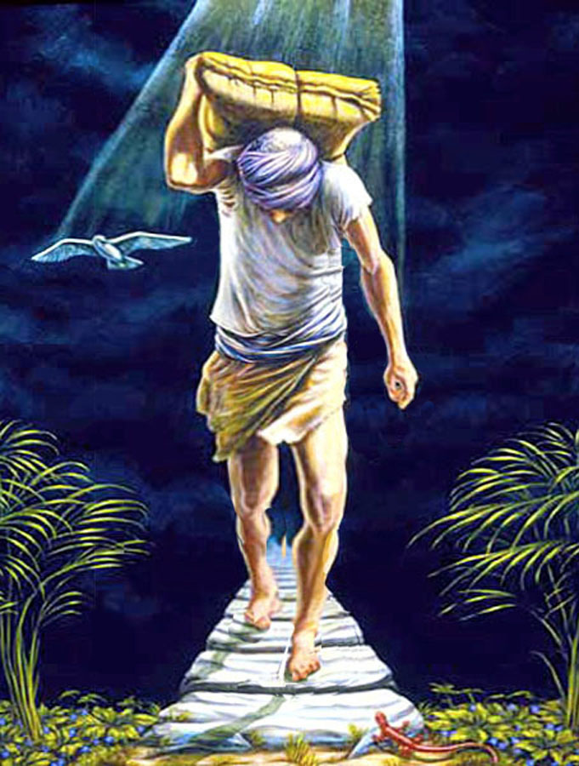

5
List some of the idols that might keep us from God.
Mammon is the idol of many. The love of money, the desire for wealth, is the golden chain that binds them to Satan. Reputation and worldly honor are worshiped by another class. The life of selfish ease and freedom from responsibility is the idol of others. But these slavish bands must be broken. We cannot be half the Lord's and half the world's. We are not God's children unless we are such entirely.
6
What kind of religion is suggested as “worth nothing”?
There are those who profess to serve God, while they rely upon their own efforts to obey His law, to form a right character, and secure salvation. Their hearts are not moved by any deep sense of the love of Christ, but they seek to perform the duties of the Christian life as that which God requires of them in order to gain heaven. Such religion is worth nothing. When Christ dwells in the heart, the soul will be so filled with His love, with the joy of communion with Him, that it will cleave to Him; and in the contemplation of Him, self will be forgotten. Love to Christ will be the spring of action.

Slide 12




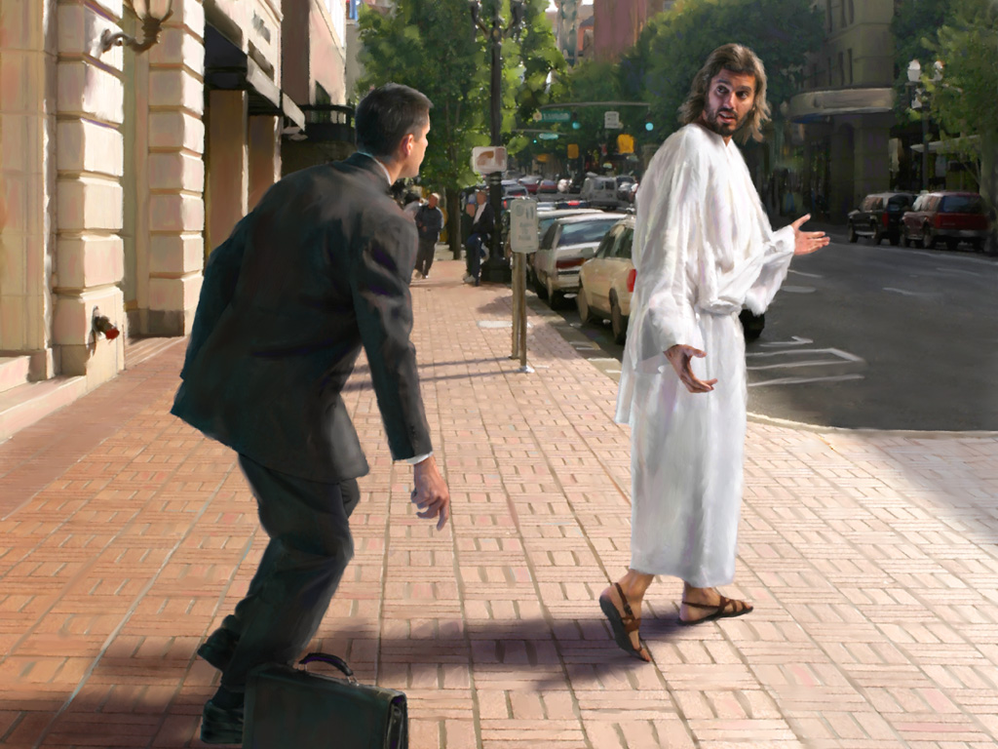



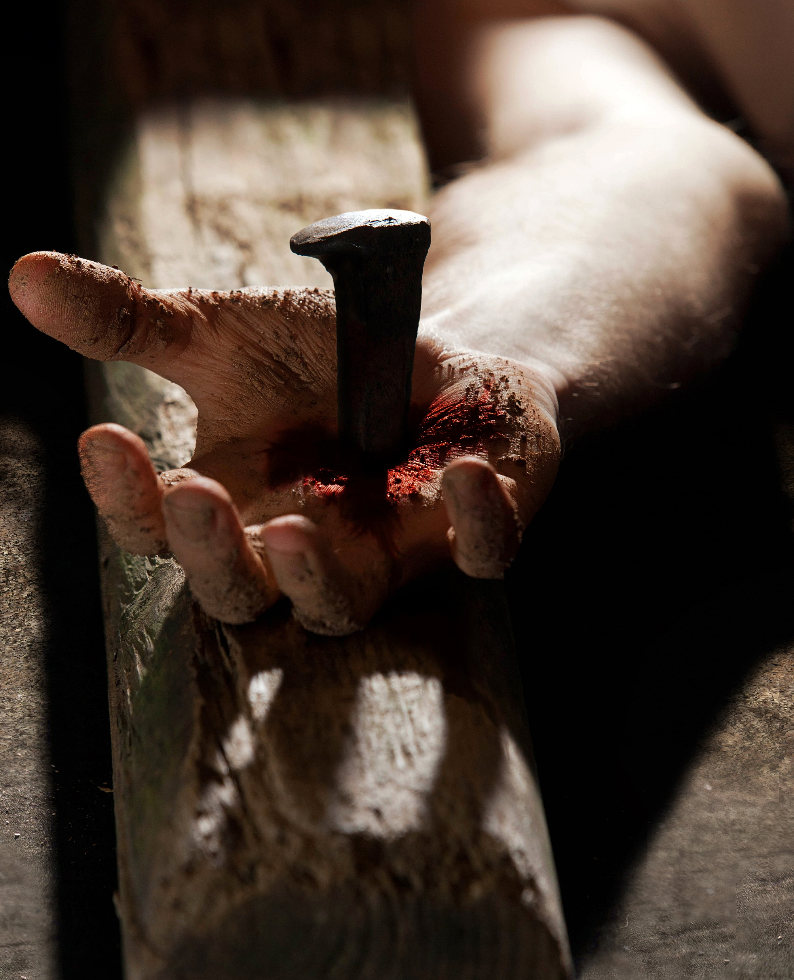
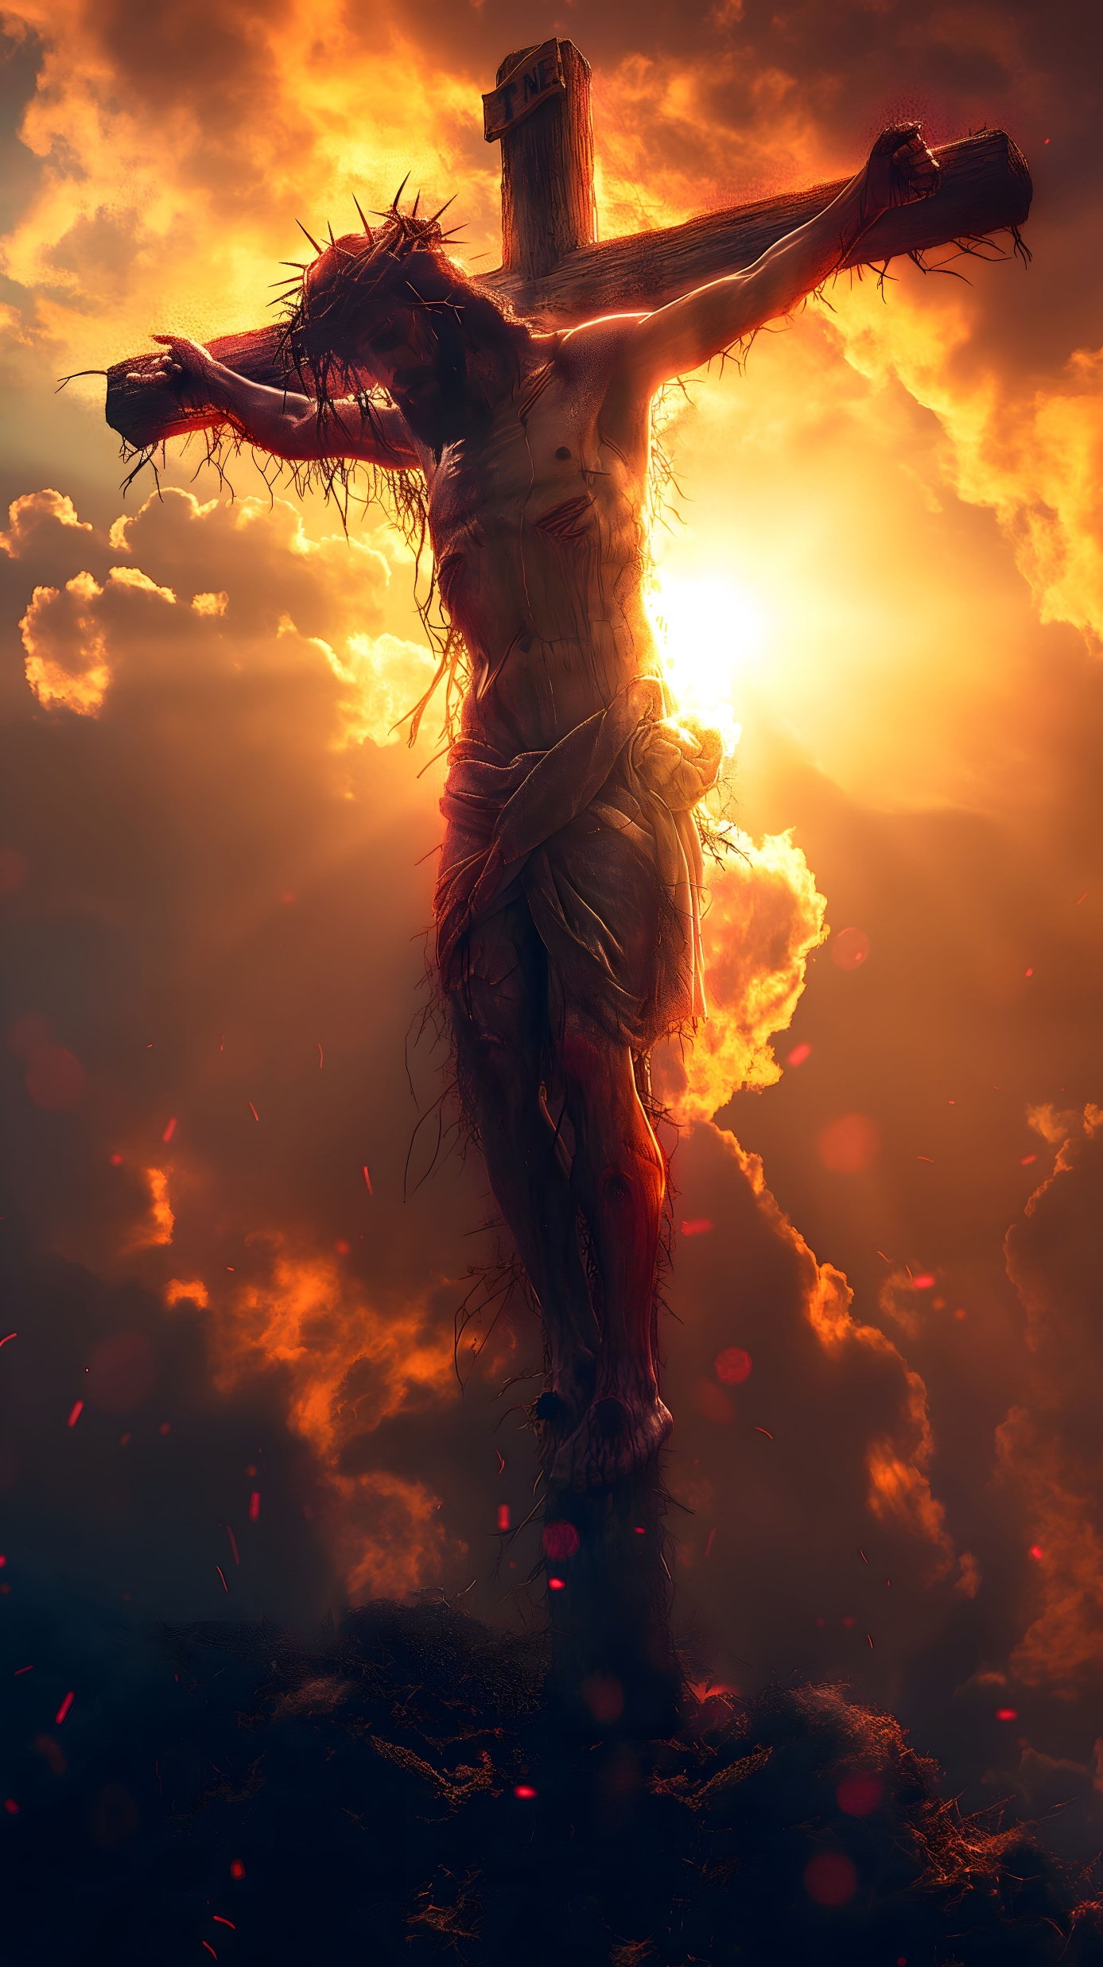
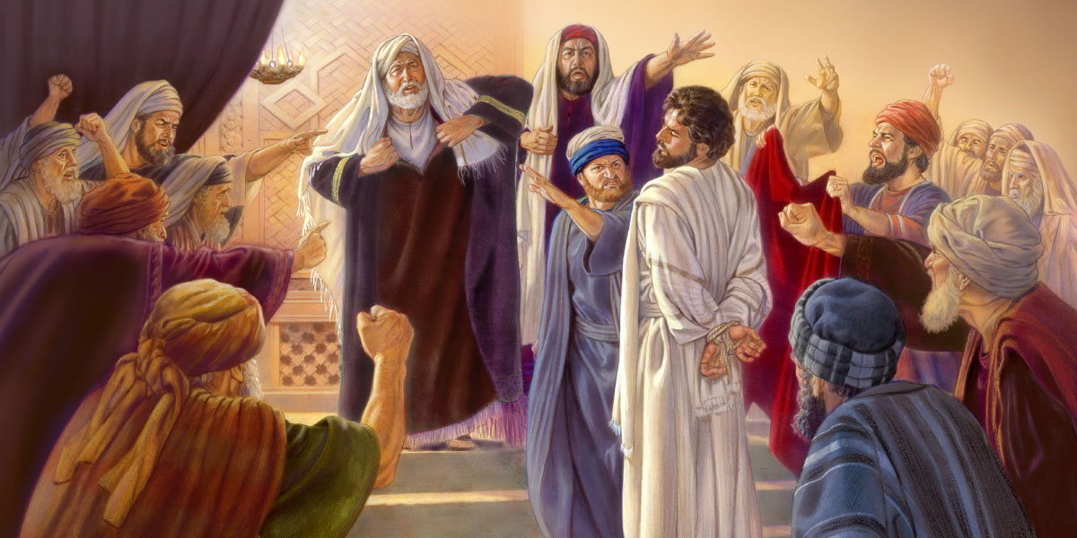
7
Rather than asking how little we must give to God, what should be our aim?
Those who feel the constraining love of God, do not ask how little may be given to meet the requirements of God; they do not ask for the lowest standard, but aim at perfect conformity to the will of their Redeemer. With earnest desire they yield all and manifest an interest proportionate to the value of the object which they seek.
8
What answer can be given to those who think it is too great a sacrifice to yield all to Christ?
Do you feel that it is too great a sacrifice to yield all to Christ? Ask yourself the question, “What has Christ given for me?” The Son of God gave all—life and love and suffering—for our redemption. And can it be that we, the unworthy objects of so great love, will withhold our hearts from Him?

Slide 13


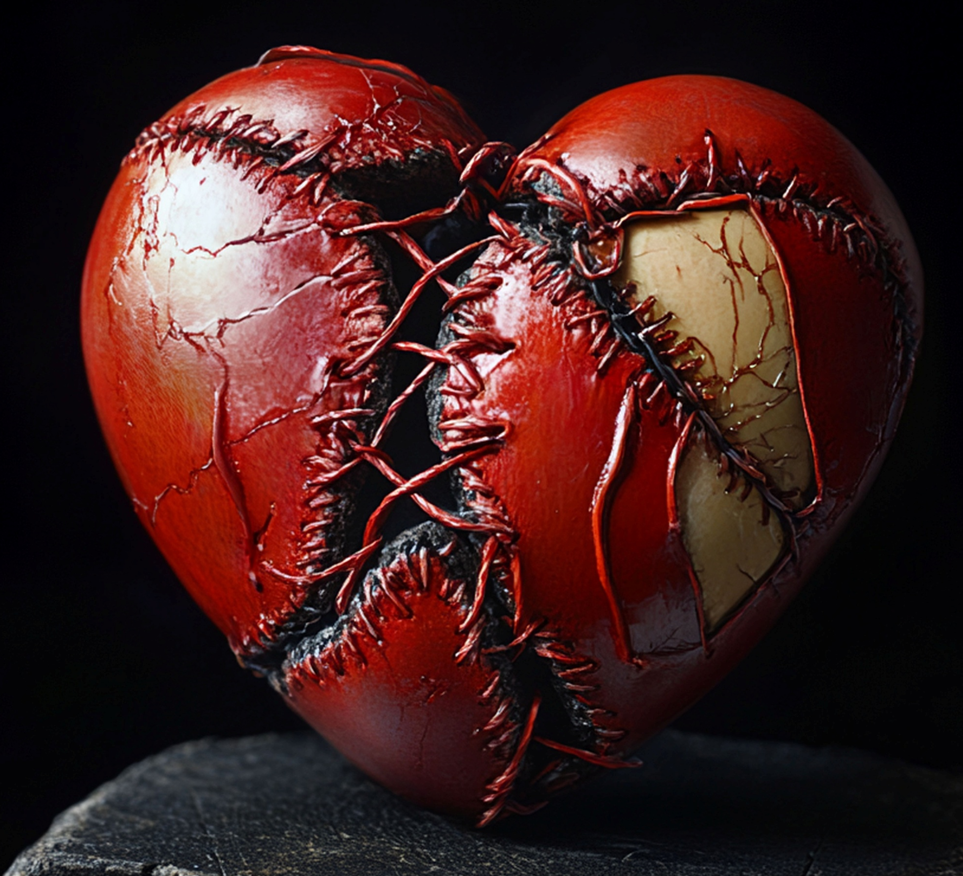







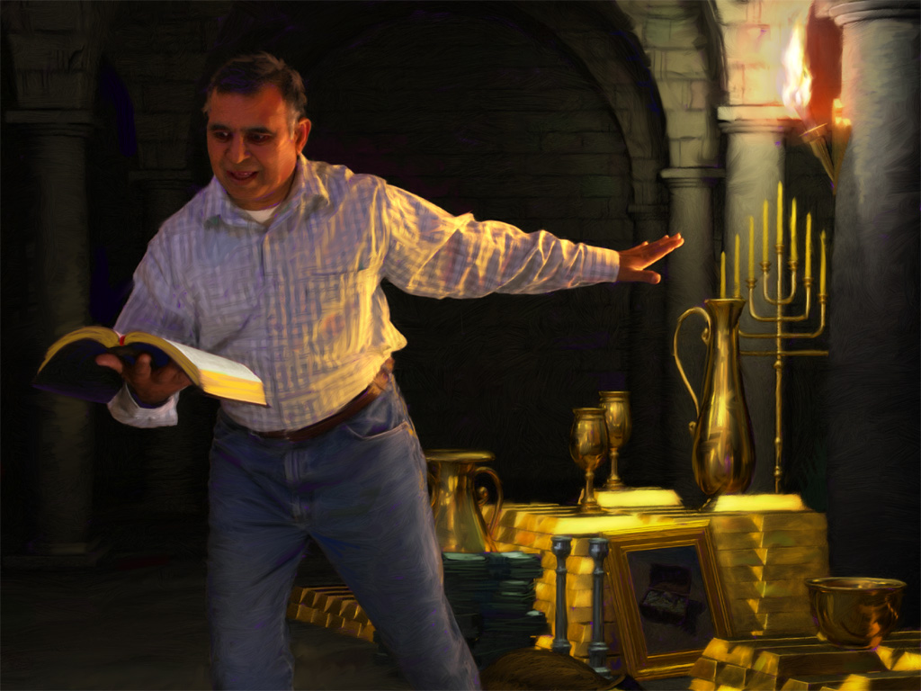
9
What do we give up when we give “all”?
But what do we give up, when we give all? A sin-polluted heart, for Jesus to purify, to cleanse by His own blood, and to save by His matchless love. And yet men think it hard to give up all! I am ashamed to hear it spoken of, ashamed to write it.
10
Discuss the statement: “God does not require us to give up anything that it is for our best interest to retain.”
God does not require us to give up anything that it is for our best interest to retain. In all that He does, He has the well-being of His children in view. Would that all who have not chosen Christ might realize that He has something vastly better to offer them than they are seeking for themselves. Man is doing the greatest injury and injustice to his own soul when he thinks and acts contrary to the will of God. No real joy can be found in the path forbidden by Him who knows what is best and who plans for the good of His creatures. The path of transgression is the path of misery and destruction.

Slide 14





11
Does God ask His children to save all joy and happiness for the future? How do you think the Christian can be at peace even in adversity?
All heaven is interested in the happiness of man. Our heavenly Father does not close the avenues of joy to any of His creatures. The divine requirements call upon us to shun those indulgences that would bring suffering and disappointment, that would close to us the door of happiness and heaven. The world's Redeemer accepts men as they are, with all their wants, imperfections, and weaknesses; and He will not only cleanse from sin and grant redemption through His blood, but will satisfy the heart-longing of all who consent to wear His yoke, to bear His burden. It is His purpose to impart peace and rest to all who come to Him for the bread of life. He requires us to perform only those duties that will lead our steps to heights of bliss to which the disobedient can never attain. The true, joyous life of the soul is to have Christ formed within, the hope of glory.

Slide 15




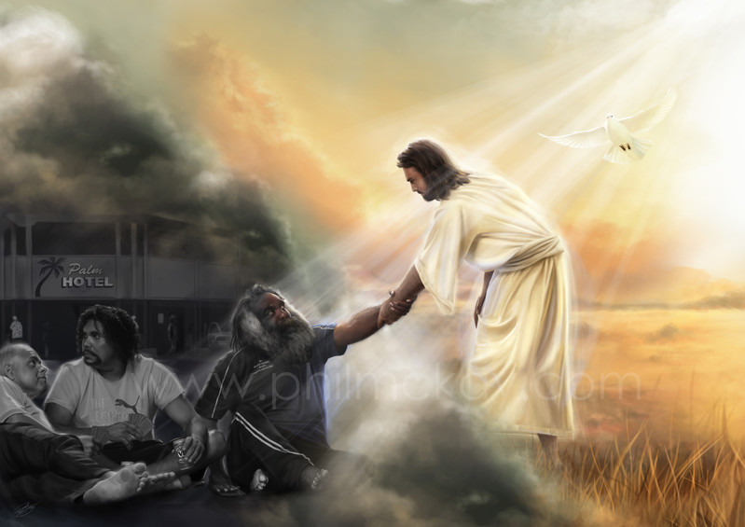
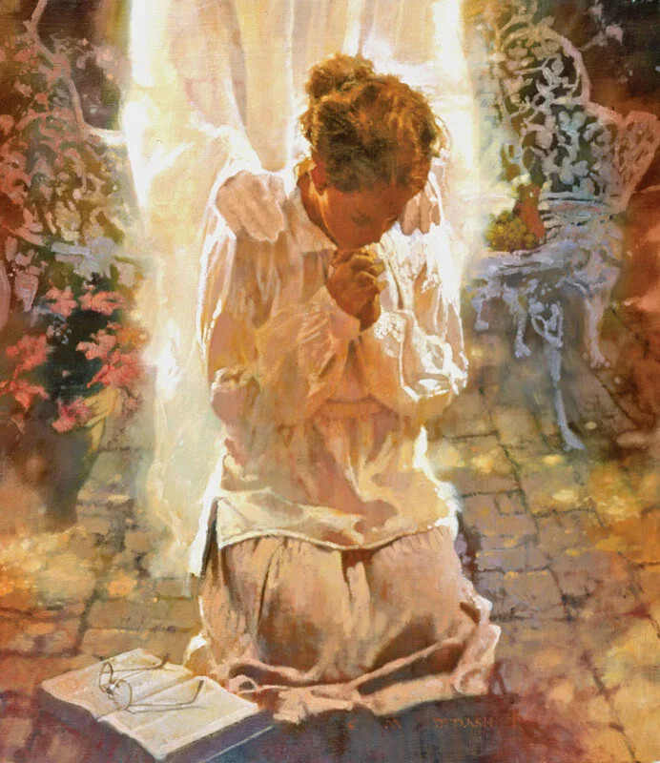



12
How do you understand the exercise of the power of choice, or the will?
What you need to understand is the true force of the will. This is the governing power in the nature of man, the power of decision, or of choice. Everything depends on the right action of the will. The power of choice God has given to men; it is theirs to exercise. You cannot change your heart, you cannot of yourself give to God its affections; but you can choose to serve Him. You can give Him your will; He will then work in you to will and to do according to His good pleasure. Thus your whole nature will be brought under the control of the Spirit of Christ; your affections will be centered upon Him, your thoughts will be in harmony with Him.
13
What is the difference between desires for goodness and choosing to be a Christian?
Desires for goodness and holiness are right as far as they go; but if you stop here, they will avail nothing. Many will be lost while hoping and desiring to be Christians. They do not come to the point of yielding the will to God. They do not now choose to be Christians. Through the right exercise of the will, an entire change may be made in your life. By yielding up your will to Christ, you ally yourself with the power that is above all principalities and powers. You will have strength from above to hold you steadfast, and thus through constant surrender to God you will be enabled to live the new life, even the life of faith.

Slide 16


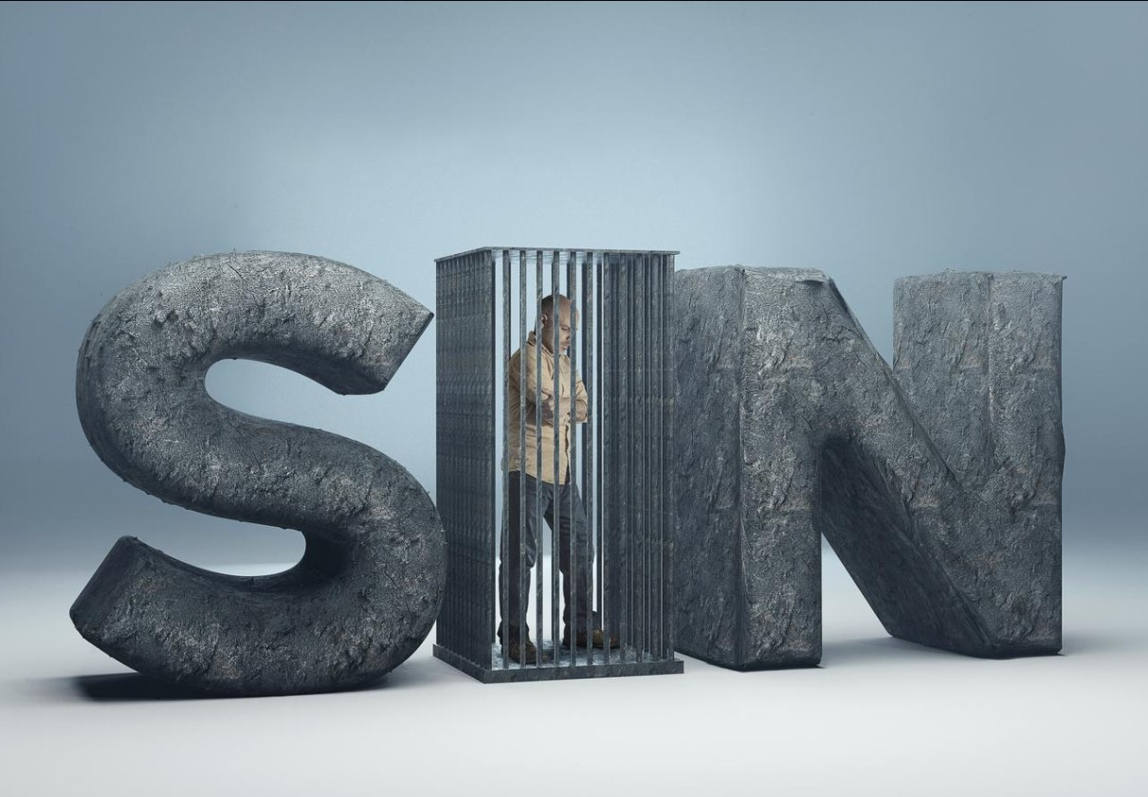



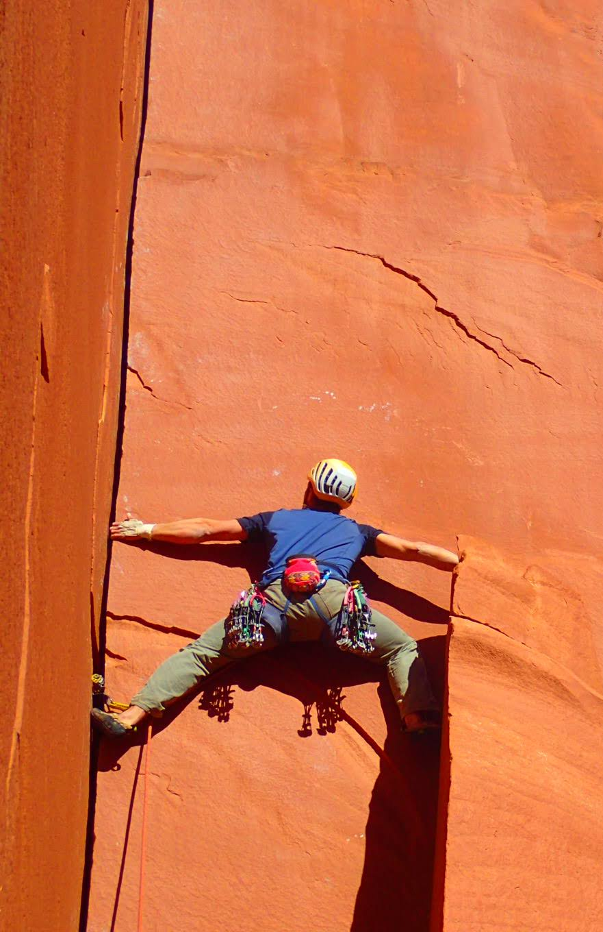
Chapter 6: "Faith and Acceptance"
1
How is the natural condition of the guilty sinner described?
As your conscience has been quickened by the Holy Spirit, you have seen something of the evil of sin, of its power, its guilt, its woe; and you look upon it with abhorrence. You feel that sin has separated you from God, that you are in bondage to the power of evil. The more you struggle to escape, the more you realize your helplessness. Your motives are impure; your heart is unclean. You see that your life has been filled with selfishness and sin. You long to be forgiven, to be cleansed, to be set free. Harmony with God, likeness to Him—what can you do to obtain it?
2
What are some of the ways that do not get peace of soul?
It is peace that you need—Heaven's forgiveness and peace and love in the soul. Money cannot buy it, intellect cannot procure it, wisdom cannot attain to it; you can never hope, by your own efforts, to secure it.
PAZ

Slide 17


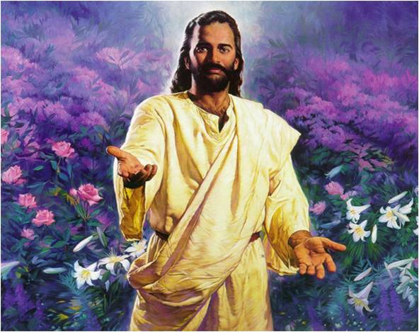

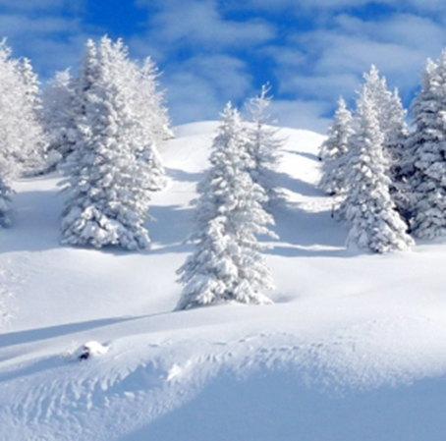
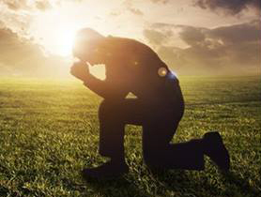

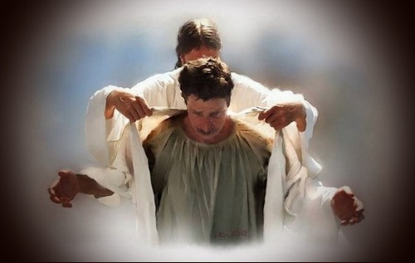
3
In what way only can peace be obtained?
But God offers it to you as a gift, “without money and without price.” Isaiah 55:1. It is yours if you will but reach out your hand and grasp it. The Lord says, “Though your sins be as scarlet, they shall be as white as snow; though they be red like crimson, they shall be as wool.” Isaiah 1:18. “A new heart also will I give you, and a new spirit will I put within you.” Ezekiel 36:26)
4
What steps should be taken after we have confessed sin?
You have confessed your sins, and in heart put them away. You have resolved to give yourself to God. Now go to Him, and ask that He will wash away your sins and give you a new heart. Then believe that He does this because He has promised.

Slide 18

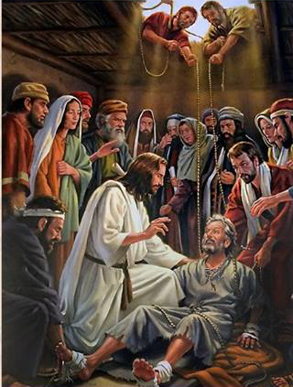


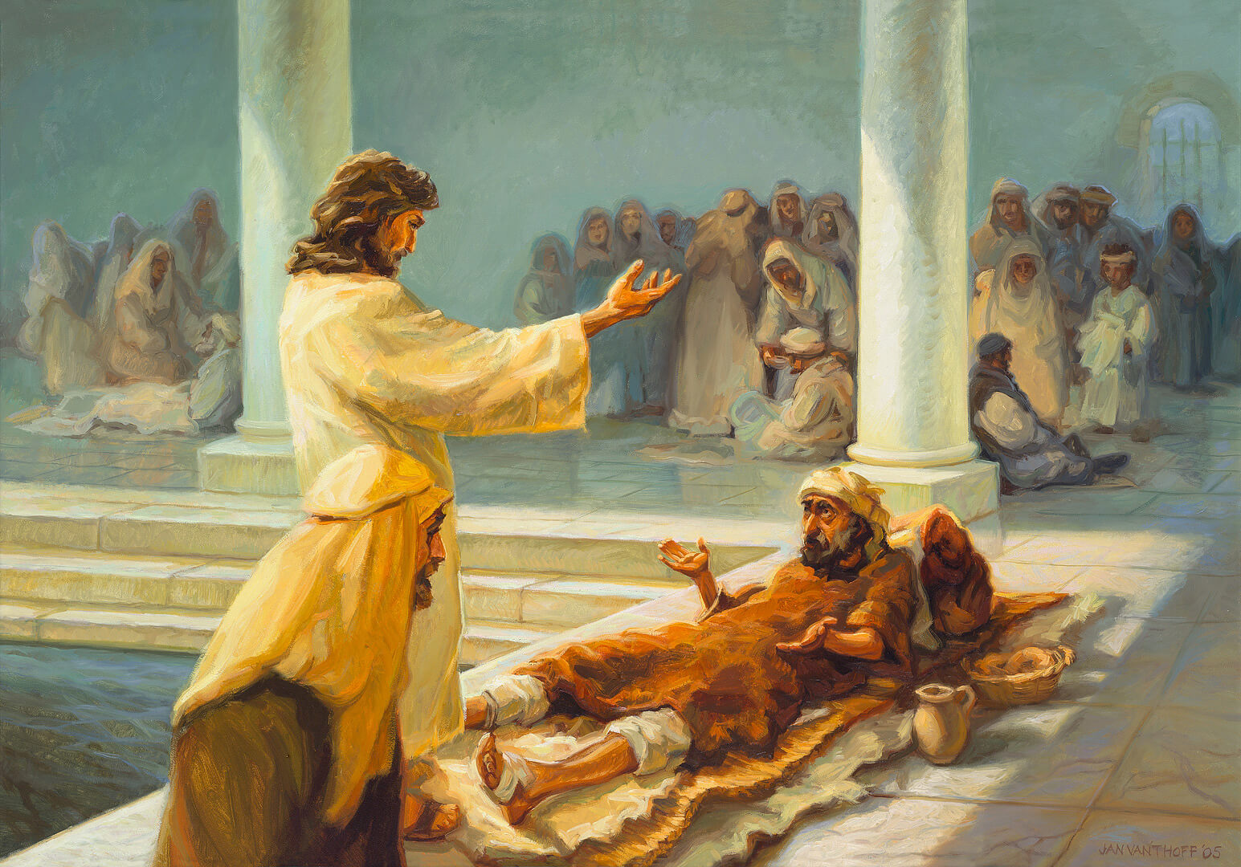
Why should we believe that our sins are forgiven? Illustrate from the ministry of Jesus.
5
This is the lesson which Jesus taught while He was on earth, that the gift which God promises us, we must believe we do receive, and it is ours. Jesus healed the people of their diseases when they had faith in His power; He helped them in the things which they could see, thus inspiring them with confidence in Him concerning things which they could not see—leading them to believe in His power to forgive sins. This He plainly stated in the healing of the man sick with palsy: “That ye may know that the Son of man hath power on earth to forgive sins, (then saith He to the sick of the palsy,) Arise, take up thy bed, and go unto thine house.” Matthew 9:6. So also John the evangelist says, speaking of the miracles of Christ, “These are written, that ye might believe that Jesus is the Christ, the Son of God; and that believing ye might have life through His name.” (John 20:31)
Why was the paralytic able to walk? ¡Make the application of this experience to your situation as a sinner.
6
From the simple Bible account of how Jesus healed the sick, we may learn something about how to believe in Him for the forgiveness of sins. Let us turn to the story of the paralytic at Bethesda. The poor sufferer was helpless; he had not used his limbs for thirty-eight years. Yet Jesus bade him, “Rise, take up thy bed, and walk.” The sick man might have said, “Lord, if Thou wilt make me whole, I will obey Thy word.” But, no, he believed Christ's word, believed that he was made whole, and he made the effort at once; he willed to walk, and he did walk. He acted on the word of Christ, and God gave the power. He was made whole.

Slide 19


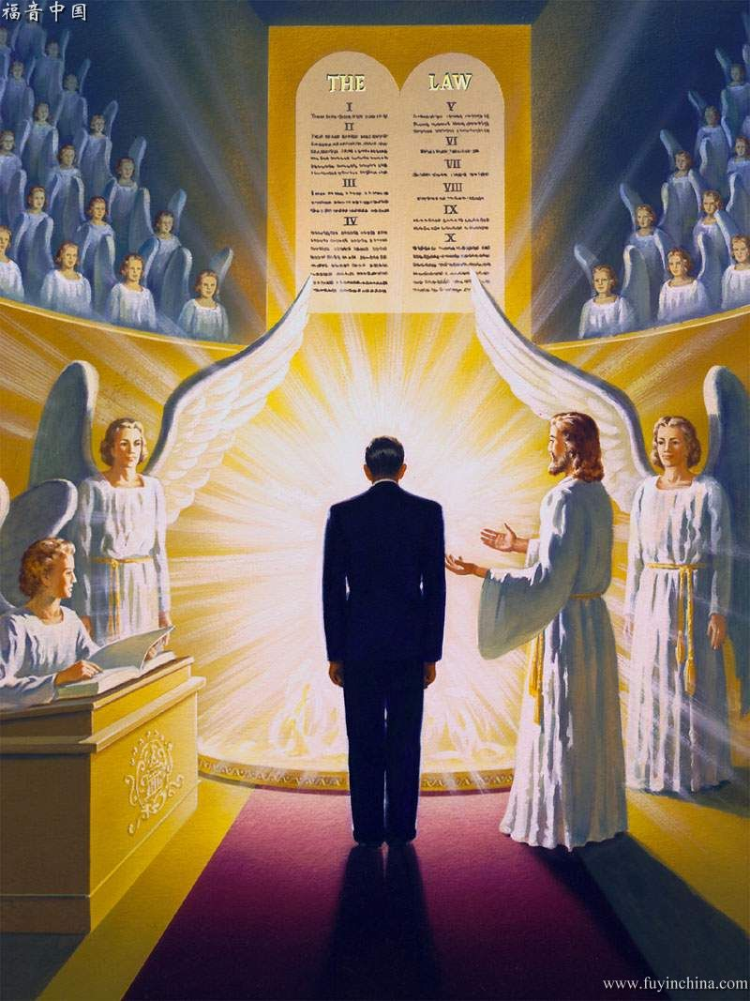
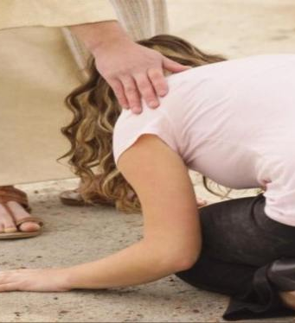

7
How is it possible for us to stand before God’s law without shame or remorse?
Jesus says, “What things soever ye desire, when ye pray, believe that ye receive them, and ye shall have them.” Mark 11:24. There is a condition to this promise—that we pray according to the will of God. But it is the will of God to cleanse us from sin, to make us His children, and to enable us to live a holy life. So we may ask for these blessings, and believe that we receive them, and thank God that we have received them. It is our privilege to go to Jesus and be cleansed, and to stand before the law without shame or remorse. “There is therefore now no condemnation to them which are in Christ Jesus, who walk not after the flesh, but after the Spirit.” (Romans 8:1).
Why is it impossible for us to come to God on probation, to prove ourselves?
8
Some seem to feel that they must be on probation, and must prove to the Lord that they are reformed, before they can claim His blessing. But they may claim the blessing of God even now. They must have His grace, the Spirit of Christ, to help their infirmities, or they cannot resist evil. Jesus loves to have us come to Him just as we are, sinful, helpless, dependent. We may come with all our weakness, our folly, our sinfulness, and fall at His feet in penitence. It is His glory to encircle us in the arms of His love and to bind up our wounds, to cleanse us from all impurity.

Slide 20

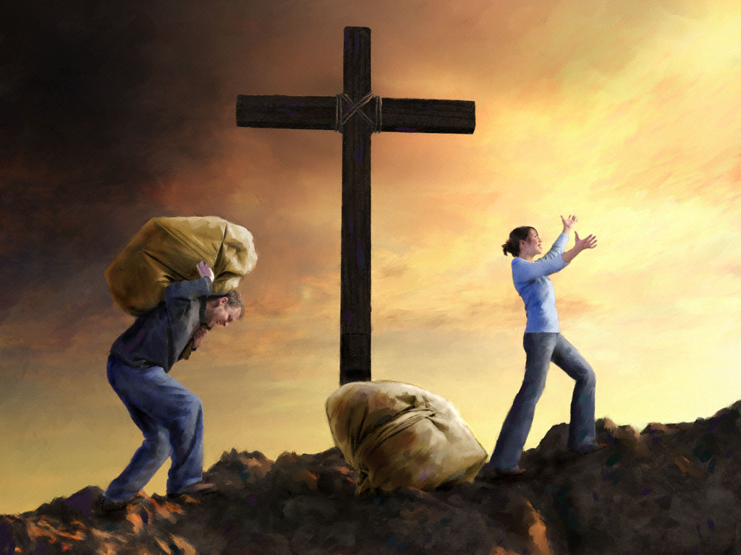

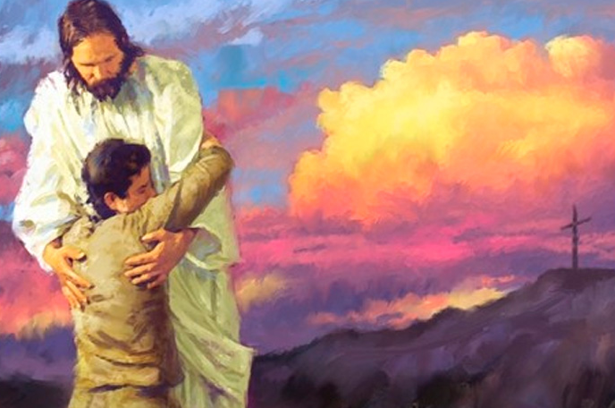


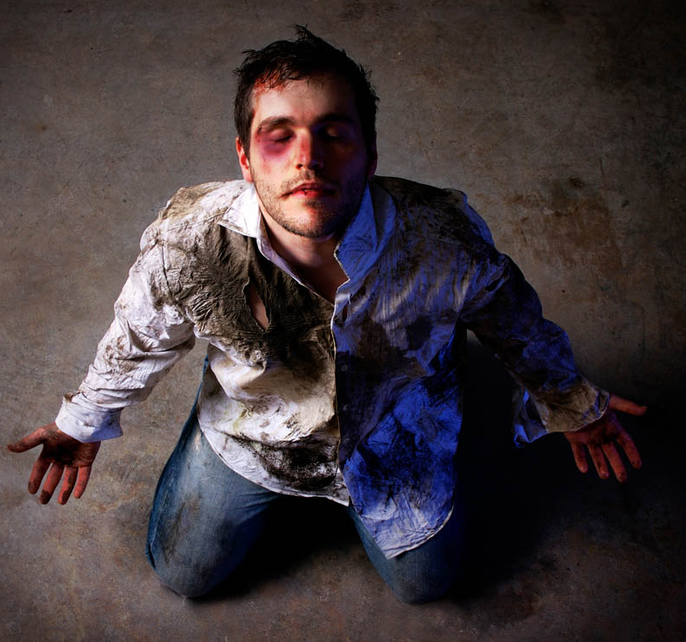
9
Why do thousands fail in their Christian experience?
Here is where thousands fail; they do not believe that Jesus pardons them personally, individually. They do not take God at His word. It is the privilege of all who comply with the conditions to know for themselves that pardon is freely extended for every sin.
10
From what suspicion should we be free? Why?
Put away the suspicion that God's promises are not meant for you. They are for every repentant transgressor. Strength and grace have been provided through Christ to be brought by ministering angels to every believing soul. None are so sinful that they cannot find strength, purity, and righteousness in Jesus, who died for them. He is waiting to strip them of their garments stained and polluted with sin, and to put upon them the white robes of righteousness; He bids them live and not die.

Slide 21


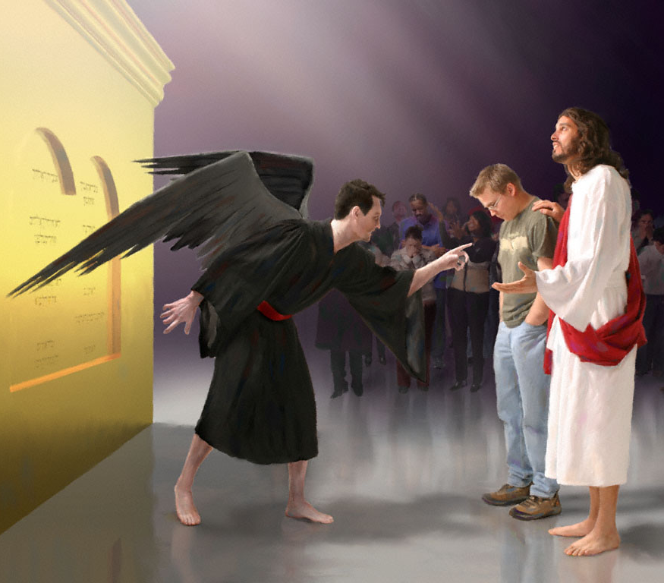
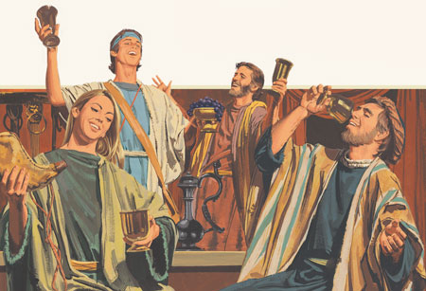

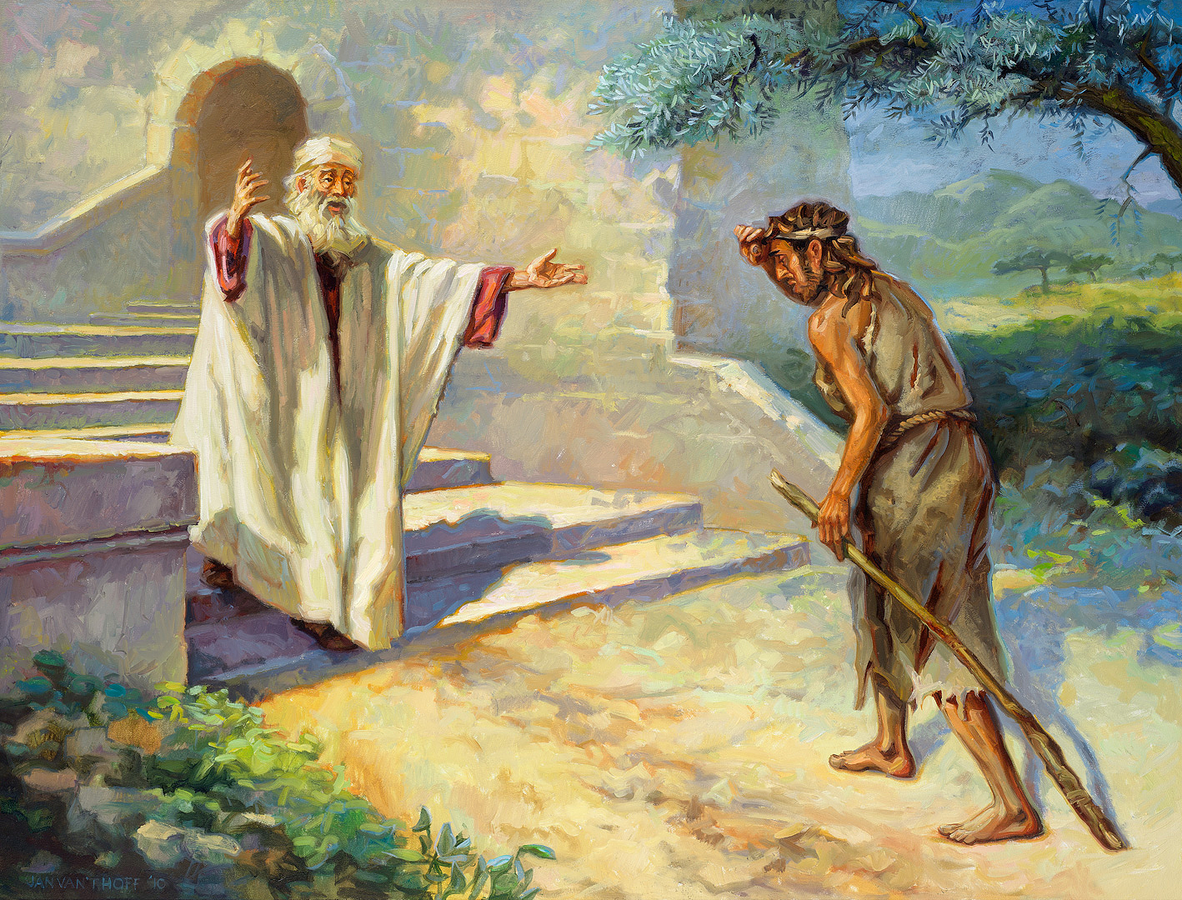
How should the repentant sinner respond to Satan’s efforts to steal his assurances of acceptance by God?
11
Satan is ready to steal away the blessed assurances of God. He desires to take every glimmer of hope and every ray of light from the soul; but you must not permit him to do this. Do not give ear to the tempter, but say, “Jesus has died that I might live. He loves me, and wills not that I should perish. I have a compassionate heavenly Father; and although I have abused His love, though the blessings He has given me have been squandered, I will arise, and go to my Father, and say, ‘I have sinned against heaven, and before Thee, and am no more worthy to be called Thy son: make me as one of Thy hired servants.’” The parable tells you how the wanderer will be received: “When he was yet a great way off, his father saw him, and had compassion, and ran, and fell on his neck, and kissed him.” (Luke 15:18-20)
How does Jeremiah add to the lesson of our heavenly Father’s love as portrayed in the parable of the prodigal son?
12
But even this parable, tender and touching as it is, comes short of expressing the infinite compassion of the heavenly Father. The Lord declares by His prophet, “I have loved thee with an everlasting love: therefore with loving-kindness have I drawn thee.” Jeremiah 31:3. While the sinner is yet far from the Father's house, wasting his substance in a strange country, the Father's heart is yearning over him; and every longing awakened in the soul to return to God is but the tender pleading of His Spirit, wooing, entreating, drawing the wanderer to his Father's heart of love.

Slide 22


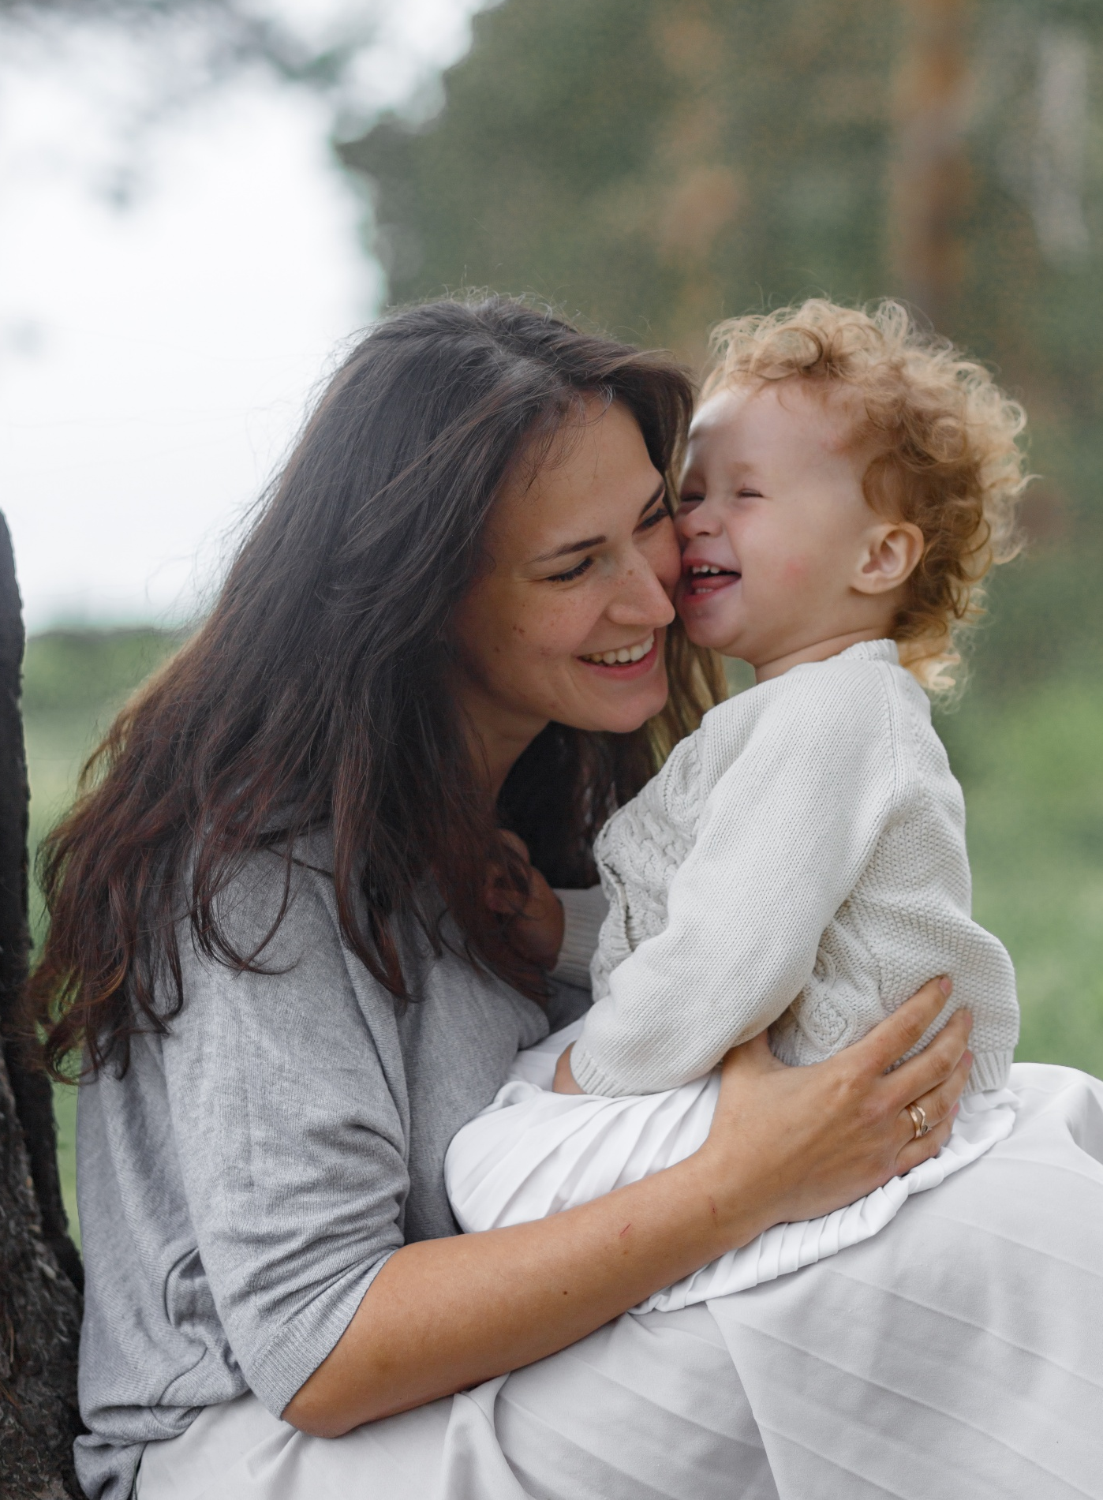
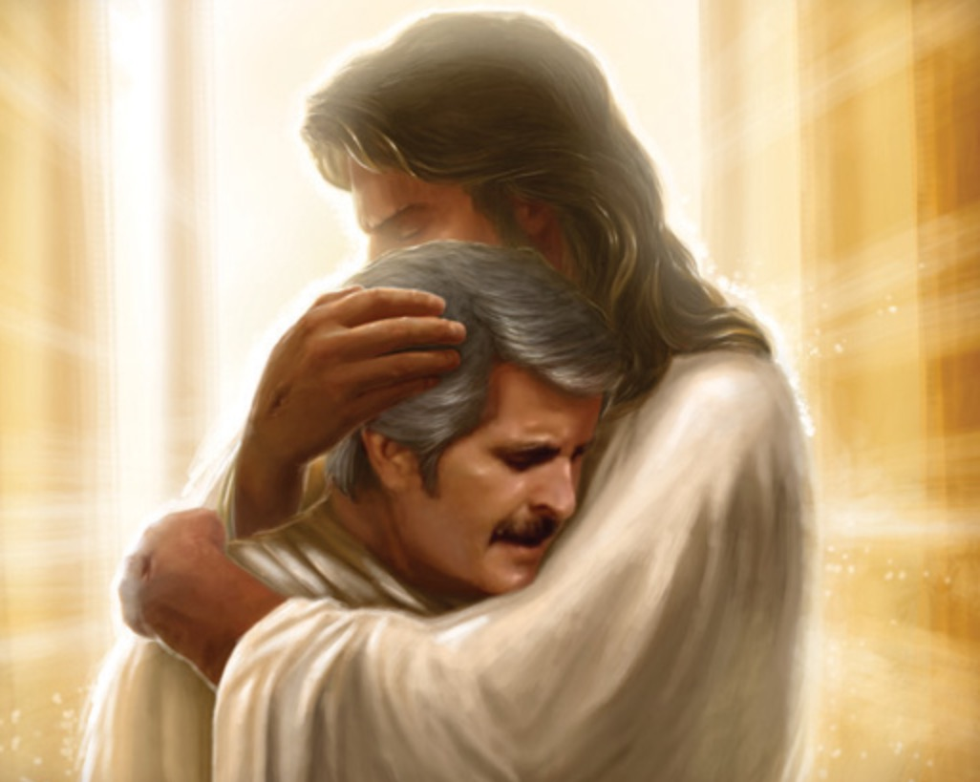

13
What comparison between God’s love and human love for a child does Isaiah give?
With the rich promises of the Bible before you, can you give place to doubt? Can you believe that when the poor sinner longs to return, longs to forsake his sins, the Lord sternly withholds him from coming to His feet in repentance? Away with such thoughts! Nothing can hurt your own soul more than to entertain such a conception of our heavenly Father. He hates sin, but He loves the sinner, and He gave Himself in the person of Christ, that all who would might be saved and have eternal blessedness in the kingdom of glory. What stronger or more tender language could have been employed than He has chosen in which to express His love toward us? He declares, “Can a woman forget her sucking child, that she should not have compassion on the son of her womb? yea, they may forget, yet will I not forget thee.” (Isaiah 49:15)
14
Complete:
As we draw near to God with __________________ and __________________, He will draw near to us with __________________ and __________________.
As you draw near to Him with confession and repentance, He will draw near to you with mercy and forgiveness.

