Slide 1
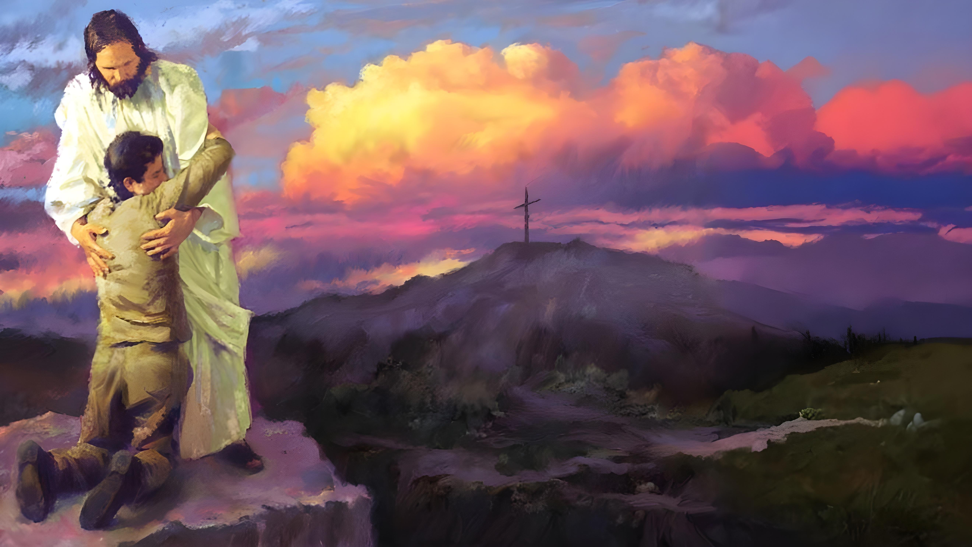

Lesson 3
Ellen G. White

Slide 2

These presentations are based on the book “Steps to Christ” by Ellen G. White, and the study guide prepared by the Trustees of the White Institute.
You can download or read the book at https://egwwritings.org/read?panels=p108.4&index=0
Read the corresponding chapter in the book and answer these questions. Click on the chapter to access it.
Lesson 3
Chapter 7: “The Test of Discipleship”
Chapter 8: “Growing Up Into Christ”
Chapter 9: “The Work and the Life”

Slide 3

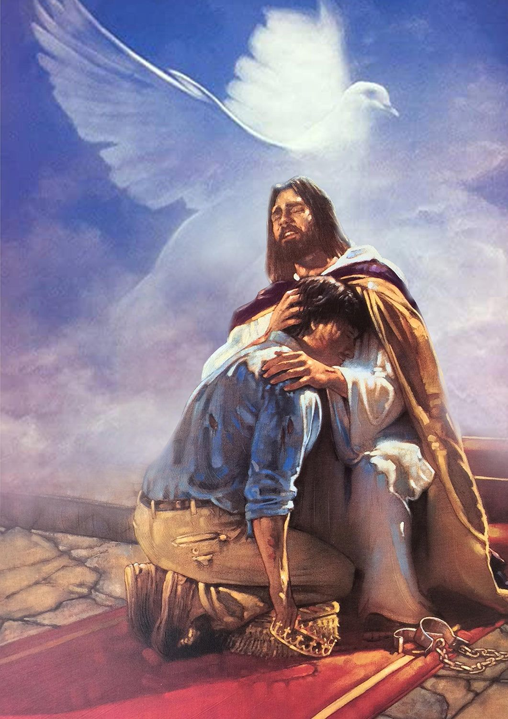


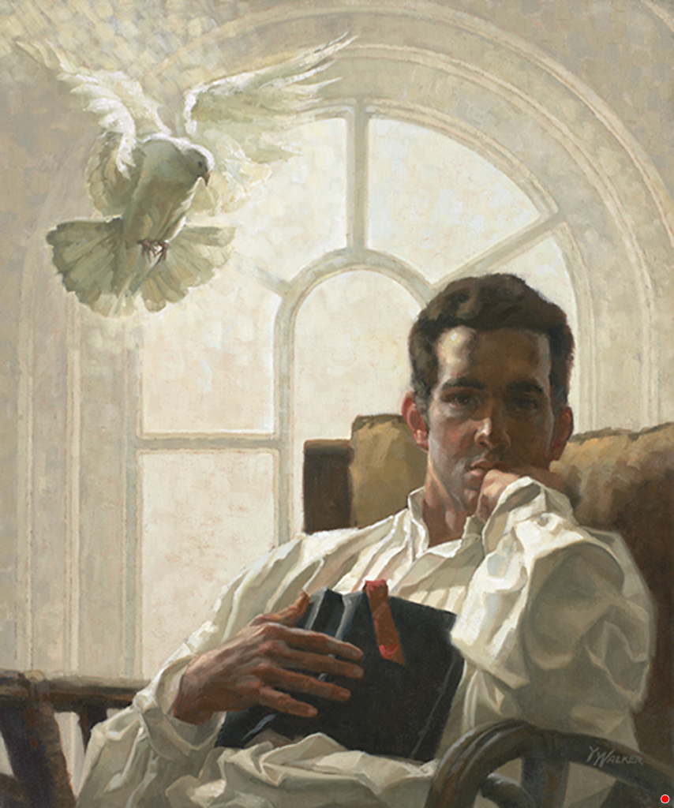
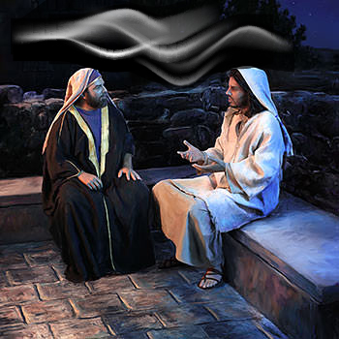
Chapter 7: “The Test of Discipleship”
TRUE OR FALSE. In order to tell whether or not he is truly converted, a person should be able to trace the circumstances and time of his conversion.
1
A person may not be able to tell the exact time or place, or trace all the chain of circumstances in the process of conversion; but this does not prove him to be unconverted.
How may it be known that the Spirit of God is working in a person’s life?
2
Christ said to Nicodemus, “The wind bloweth where it listeth, and thou hearest the sound thereof, but canst not tell whence it cometh, and whither it goeth: so is everyone that is born of the Spirit.” John 3:8. Like the wind, which is invisible, yet the effects of which are plainly seen and felt, is the Spirit of God in its work upon the human heart. That regenerating power, which no human eye can see, begets a new life in the soul; it creates a new being in the image of God.

Slide 4





By what is the character not revealed? By what, then, is it revealed?
3
While the work of the Spirit is silent and imperceptible, its effects are manifest. If the heart has been renewed by the Spirit of God, the life will bear witness to the fact. While we cannot do anything to change our hearts or to bring ourselves into harmony with God; while we must not trust at all to ourselves or our good works, our lives will reveal whether the grace of God is dwelling within us. A change will be seen in the character, the habits, the pursuits. The contrast will be clear and decided between what they have been and what they are. The character is revealed, not by occasional good deeds and occasional misdeeds, but by the tendency of the habitual words and acts.
What things may only produce an outward correctness of deportment?
4
It is true that there may be an outward correctness of deportment without the renewing power of Christ. The love of influence and the desire for the esteem of others may produce a well-ordered life. Self-respect may lead us to avoid the appearance of evil. A selfish heart may perform generous actions. By what means, then, shall we determine whose side we are on?

Slide 5


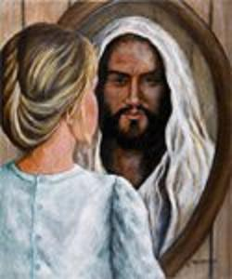
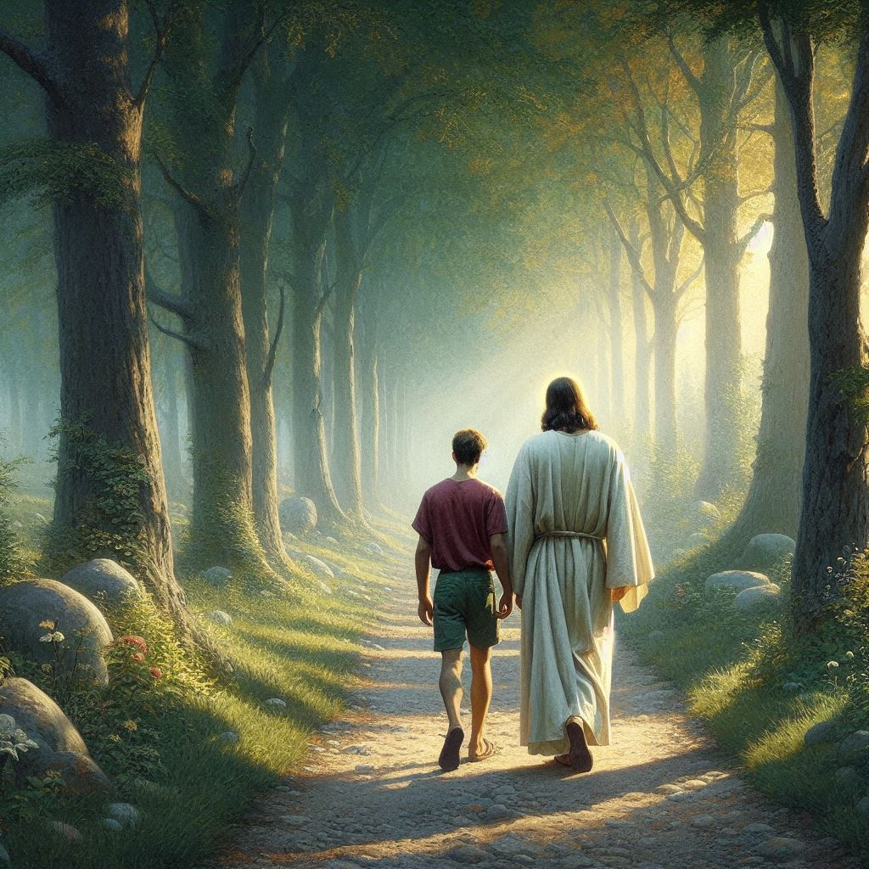
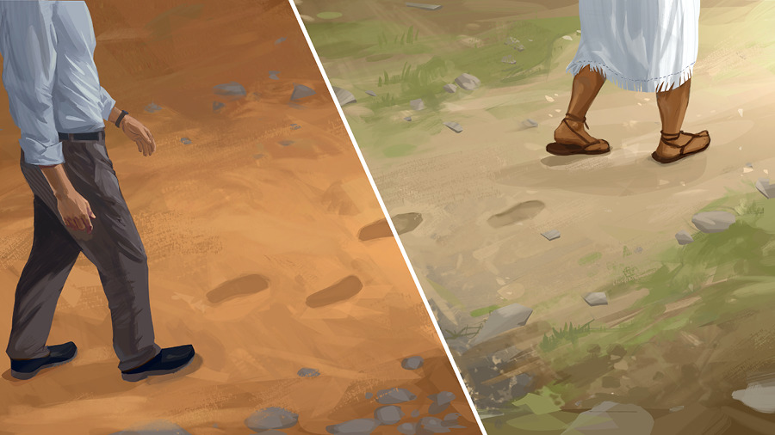


What are the inner evidences that we are Christ’s?
5
If we are Christ's, our thoughts are with Him, and our sweetest thoughts are of Him. All we have and are is consecrated to Him. We long to bear His image, breathe His spirit, do His will, and please Him in all things.
When we become new creatures in Christ, what happens to our priorities, tastes, and character?
6
Those who become new creatures in Christ Jesus will bring forth the fruits of the Spirit, “love, joy, peace, long-suffering, gentleness, goodness, faith, meekness, temperance.” Galatians 5:22, 23. They will no longer fashion themselves according to the former lusts, but by the faith of the Son of God they will follow in His steps, reflect His character, and purify themselves even as He is pure. The things they once hated they now love, and the things they once loved they hate. The proud and self-assertive become meek and lowly in heart. The vain and supercilious become serious and unobtrusive. The drunken become sober, and the profligate pure. The vain customs and fashions of the world are laid aside. Christians will seek not the “outward adorning,” but “the hidden man of the heart, in that which is not corruptible, even the ornament of a meek and quiet spirit.” 1 Peter 3:3, 4

Slide 6



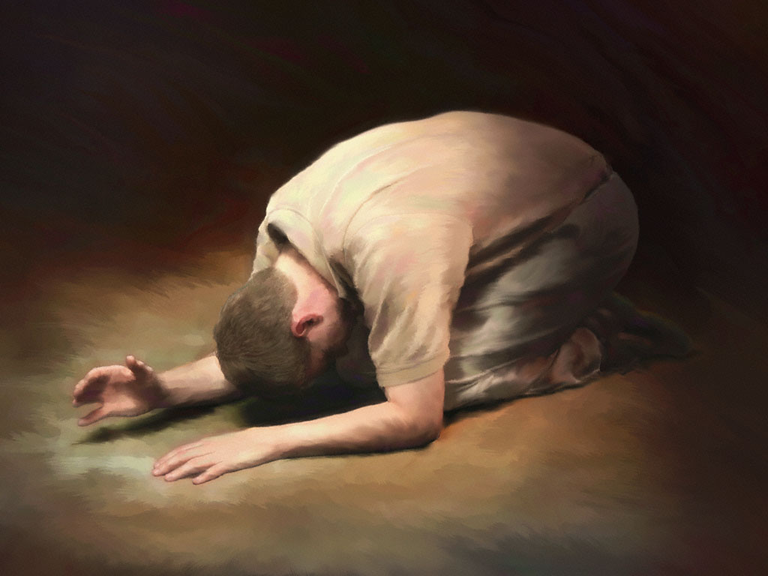

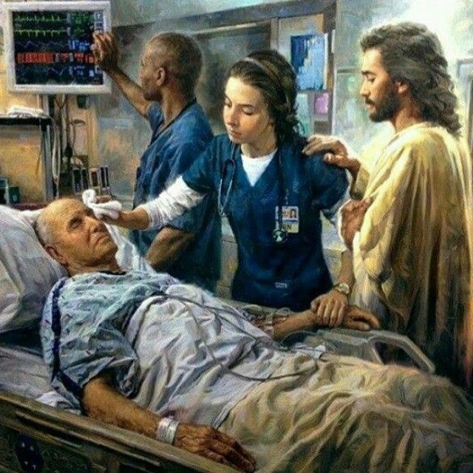
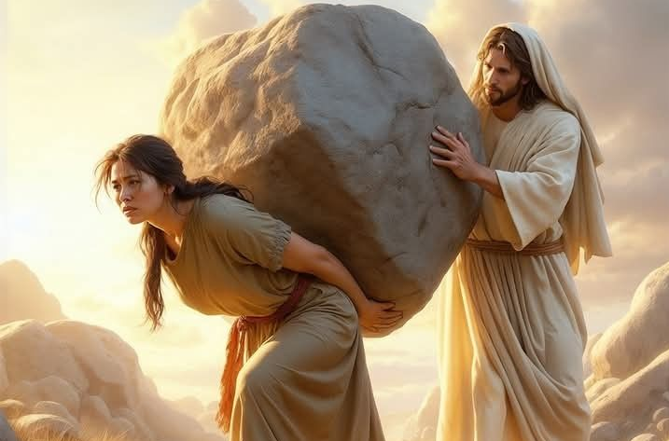
There is no genuine repentance unless there is ________________________________________________.
7
There is no evidence of genuine repentance unless it works reformation. If he restore the pledge, give again that he had robbed, confess his sins, and love God and his fellow men, the sinner may be sure that he has passed from death unto life.
What is the attitude of the true Christian toward duty or sacrifice?
8
When, as erring, sinful beings, we come to Christ and become partakers of His pardoning grace, love springs up in the heart. Every burden is light, for the yoke that Christ imposes is easy. Duty becomes a delight, and sacrifice a pleasure. The path that before seemed shrouded in darkness, becomes bright with beams from the Sun of Righteousness.

Slide 7


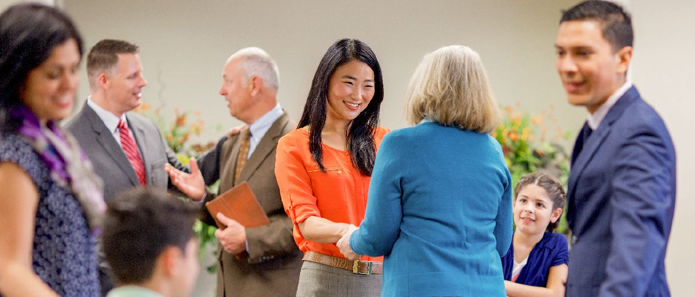

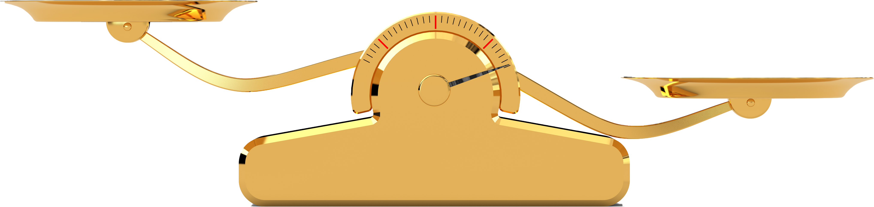
Make a list of seven results in the life when love is the principle of action.
9
In the heart renewed by divine grace, love is the principle of action. It modifies the character, governs the impulses, controls the passions, subdues enmity, and ennobles the affections. This love, cherished in the soul, sweetens the life and sheds a refining influence on all around.
Against what two errors do new Christians need especially to guard against?
10
The first, already dwelt upon, is that of looking to their own works, trusting to anything they can do, to bring themselves into harmony with God. He who is trying to become holy by his own works in keeping the law, is attempting an impossibility. All that man can do without Christ is polluted with selfishness and sin. It is the grace of Christ alone, through faith, that can make us holy.
The opposite and no less dangerous error is that belief in Christ releases men from keeping the law of God; that since by faith alone we become partakers of the grace of Christ, our works have nothing to do with our redemption.
Works
Faith

Slide 8



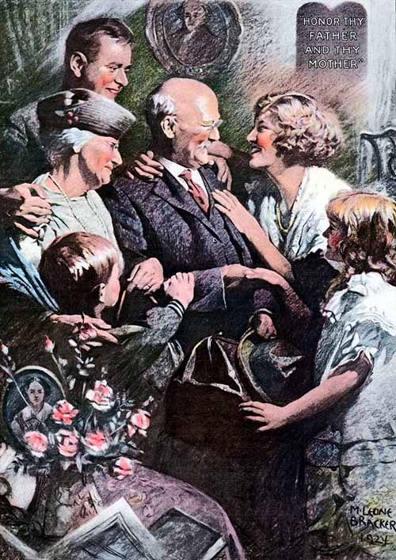

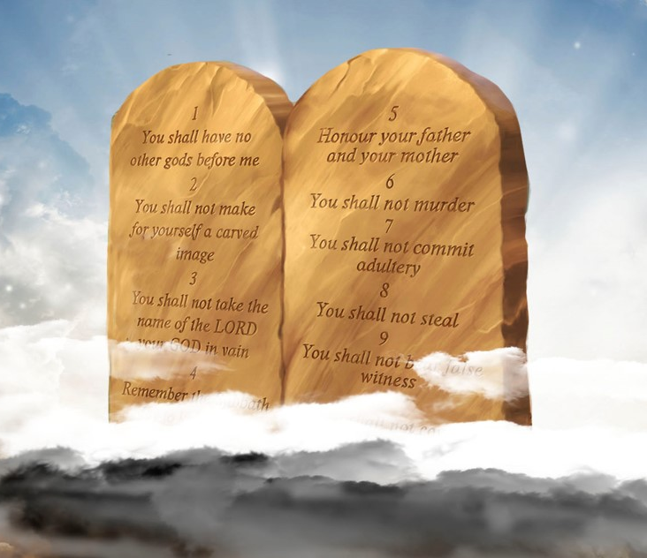
How do you think we can avoid either error?
11
If our hearts are renewed in the likeness of God, if the divine love is implanted in the soul, will not the law of God be carried out in the life? When the principle of love is implanted in the heart, when man is renewed after the image of Him that created him, the new-covenant promise is fulfilled, “I will put My laws into their hearts, and in their minds will I write them.” Hebrews 10:16. And if the law is written in the heart, will it not shape the life?
What is the true sign of discipleship?
12
Obedience—the service and allegiance of love—is the true sign of discipleship. Thus the Scripture says, “This is the love of God, that we keep His commandments.” “He that saith, I know Him, and keepeth not His commandments, is a liar, and the truth is not in him.” 1 John 5:3; 2:4. Instead of releasing man from obedience, it is faith, and faith only, that makes us partakers of the grace of Christ, which enables us to render obedience.

Slide 9

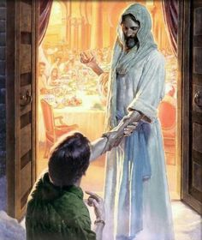


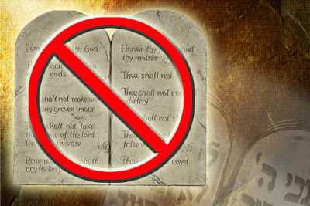
¿How do you understand these statements: “We do not earn salvation by our obedience.” “Obedience is the fruit of faith.”
13
We do not earn salvation by our obedience; for salvation is the free gift of God, to be received by faith. But obedience is the fruit of faith. “Ye know that He was manifested to take away our sins; and in Him is no sin. Whosoever abideth in Him sinneth not: whosoever sinneth hath not seen Him, neither known Him.” 1 John 3:5, 6. Here is the true test. If we abide in Christ, if the love of God dwells in us, our feelings, our thoughts, our purposes, our actions, will be in harmony with the will of God as expressed in the precepts of His holy law.
How is presumption or false faith defined?
14
That so-called faith in Christ which professes to release men from the obligation of obedience to God, is not faith, but presumption. “By grace are ye saved through faith.” But “faith, if it hath not works, is dead.” Ephesians 2:8; James 2:17. Jesus said of Himself before He came to earth, “I delight to do Thy will, O My God: yea, Thy law is within My heart.” Psalm 40:8. And just before He ascended again to heaven He declared, “I have kept My Father's commandments, and abide in His love.” John 15:10. The Scripture says, “Hereby we do know that we know Him, if we keep His commandments.... He that saith he abideth in Him ought himself also so to walk even as He walked.” 1 John 2:3-6.

Slide 10


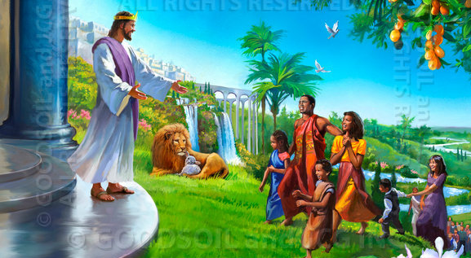

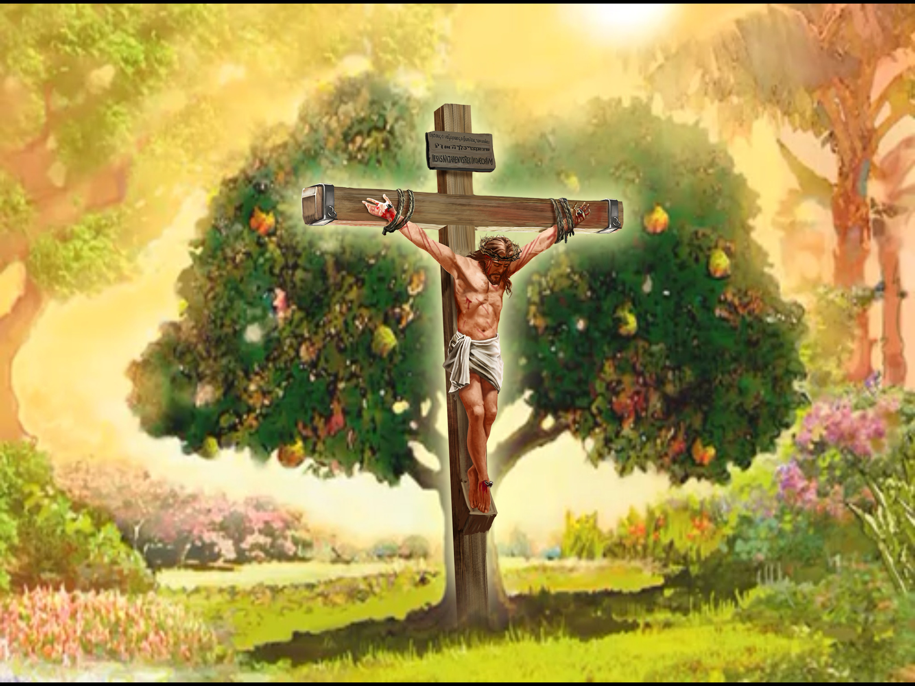
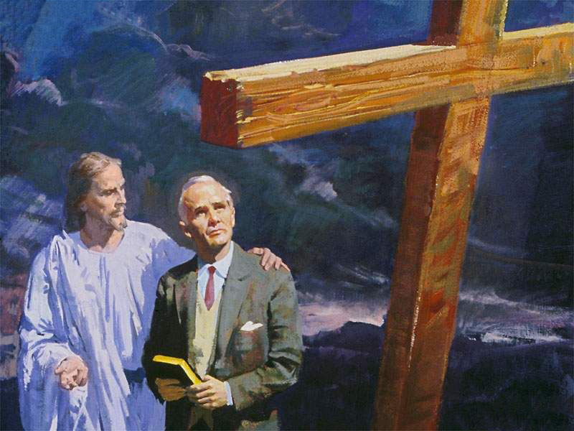
What is the condition of eternal life?
15
The condition of eternal life is now just what it always has been,—just what it was in Paradise before the fall of our first parents,—perfect obedience to the law of God, perfect righteousness. If eternal life were granted on any condition short of this, then the happiness of the whole universe would be imperiled. The way would be open for sin, with all its train of woe and misery, to be immortalized.
In your own words, summarize how “Christ has made a way of escape for us.”.
16
It was possible for Adam, before the fall, to form a righteous character by obedience to God's law. But he failed to do this, and because of his sin our natures are fallen and we cannot make ourselves righteous. Since we are sinful, unholy, we cannot perfectly obey the holy law. We have no righteousness of our own with which to meet the claims of the law of God. But Christ has made a way of escape for us. He lived on earth amid trials and temptations such as we have to meet. He lived a sinless life. He died for us, and now He offers to take our sins and give us His righteousness. If you give yourself to Him, and accept Him as your Saviour, then, sinful as your life may have been, for His sake you are accounted righteous. Christ's character stands in place of your character, and you are accepted before God just as if you had not sinned.

Slide 11


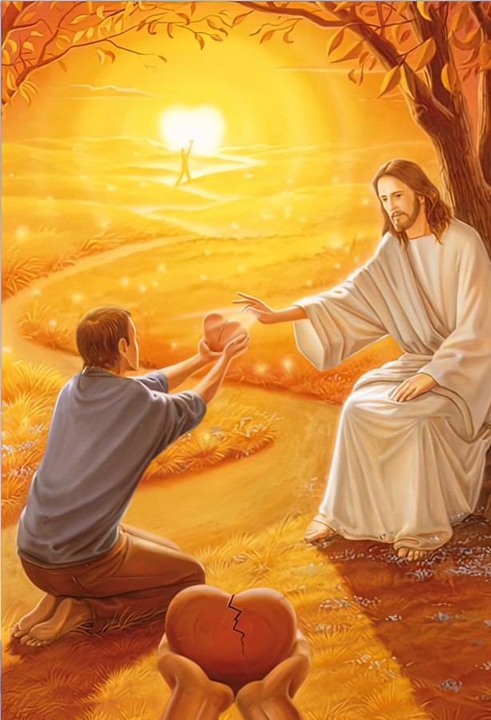
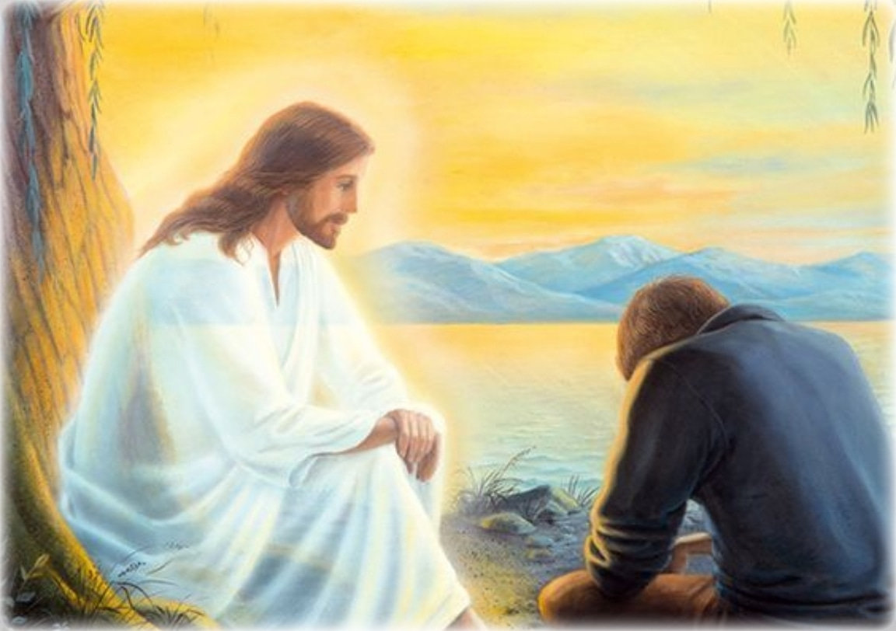

Contrast the “belief that is wholly distinct from faith” with the belief that is combined with faith.
17
When we speak of faith, there is a distinction that should be borne in mind. There is a kind of belief that is wholly distinct from faith. The existence and power of God, the truth of His word, are facts that even Satan and his hosts cannot at heart deny. The Bible says that “the devils also believe, and tremble;” but this is not faith. James 2:19. Where there is not only a belief in God's word, but a submission of the will to Him; where the heart is yielded to Him, the affections fixed upon Him, there is faith—faith that works by love and purifies the soul. Through this faith the heart is renewed in the image of God.
The closer we come to Jesus, the more faulty we will appear. Rather than causing discouragement, of what is this an evidence?
18
The closer you come to Jesus, the more faulty you will appear in your own eyes; for your vision will be clearer, and your imperfections will be seen in broad and distinct contrast to His perfect nature. This is evidence that Satan's delusions have lost their power; that the vivifying influence of the Spirit of God is arousing you.

Slide 12



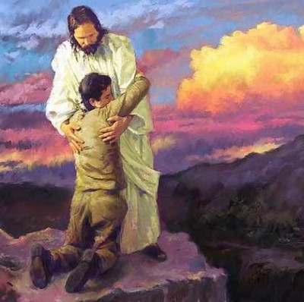
What should a sense of our sinfulness drive us to do?
19
No deep-seated love for Jesus can dwell in the heart that does not realize its own sinfulness. The soul that is transformed by the grace of Christ will admire His divine character; but if we do not see our own moral deformity, it is unmistakable evidence that we have not had a view of the beauty and excellence of Christ.
The less we see to esteem in ourselves, the more we shall see to esteem in the infinite purity and loveliness of our Saviour. A view of our sinfulness drives us to Him who can pardon; and when the soul, realizing its helplessness, reaches out after Christ, He will reveal Himself in power. The more our sense of need drives us to Him and to the word of God, the more exalted views we shall have of His character, and the more fully we shall reflect His image.

Slide 13





Chapter 8: “Growing Up Into Christ"
Give two illustrations from nature used in the Bible to describe birth as children of God
1
The change of heart by which we become children of God is in the Bible spoken of as birth. Again, it is compared to the germination of the good seed sown by the husbandman. In like manner those who are just converted to Christ are, “as new-born babes,” to “grow up” to the stature of men and women in Christ Jesus. 1 Peter 2:2; Ephesians 4:15.
2
How is Christian growth illustrated from nature?
Or like the good seed sown in the field, they are to grow up and bring forth fruit. Isaiah says that they shall “be called trees of righteousness, the planting of the Lord, that He might be glorified.” Isaiah 61:3. So from natural life, illustrations are drawn, to help us better to understand the mysterious truths of spiritual life.

Slide 14



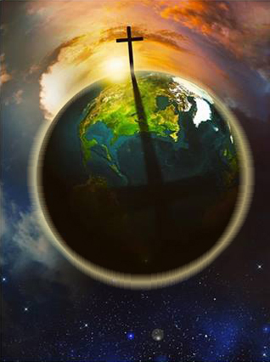


3
In what way does nature illustrate there should be no care or anxiety in Christian growth?
As with life, so it is with growth. It is God who brings the bud to bloom and the flower to fruit. It is by His power that the seed develops, “first the blade, then the ear, after that the full corn in the ear.” Mark 4:28. And the prophet Hosea says of Israel, that “he shall grow as the lily.” “They shall revive as the corn, and grow as the vine.” Hosea 14:5, 7. And Jesus bids us “consider the lilies how they grow.” Luke 12:27. The plants and flowers grow not by their own care or anxiety or effort, but by receiving that which God has furnished to minister to their life. The child cannot, by any anxiety or power of its own, add to its stature. No more can you, by anxiety or effort of yourself, secure spiritual growth. The plant, the child, grows by receiving from its surroundings that which ministers to its life—air, sunshine, and food. What these gifts of nature are to animal and plant, such is Christ to those who trust in Him. He is their “everlasting light,” “a sun and shield.” Isaiah 60:19; Psalm 84:11. He shall be as “the dew unto Israel.” “He shall come down like rain upon the mown grass.” Hosea 14:5; Psalm 72:6. He is the living water, “the Bread of God ... which cometh down from heaven, and giveth life unto the world.” John 6:33..”
4
How is a Christian’s continued growth assured?
In the matchless gift of His Son, God has encircled the whole world with an atmosphere of grace as real as the air which circulates around the globe. All who choose to breathe this life-giving atmosphere will live and grow up to the stature of men and women in Christ Jesus.

Slide 15

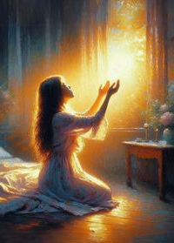


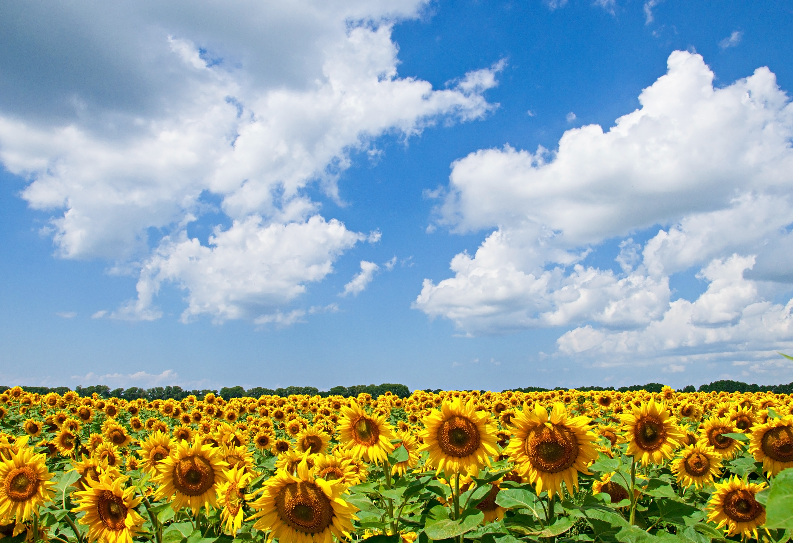

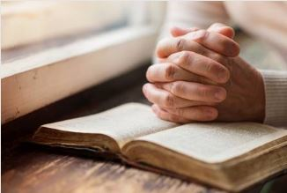
5
What should be the very first work of the day?
As the flower turns to the sun, that the bright beams may aid in perfecting its beauty and symmetry, so should we turn to the Sun of Righteousness, that heaven's light may shine upon us, that our character may be developed into the likeness of Christ. Many have an idea that they must do some part of the work alone. They have trusted in Christ for the forgiveness of sin, but now they seek by their own efforts to live aright. But every such effort must fail. Jesus says, “Without Me ye can do nothing.” Our growth in grace, our joy, our usefulness,—all depend upon our union with Christ. It is by communion with Him, daily, hourly,—by abiding in Him,—that we are to grow in grace. He is not only the Author, but the Finisher of our faith. It is Christ first and last and always. He is to be with us, not only at the beginning and the end of our course, but at every step of the way. David says, “I have set the Lord always before me: because He is at my right hand, I shall not be moved.” Psalm 16:8
6
How shall we “plan” each day?
Consecrate yourself to God in the morning; make this your very first work. Let your prayer be, “Take me, O Lord, as wholly Thine. I lay all my plans at Thy feet. Use me today in Thy service. Abide with me, and let all my work be wrought in Thee.” This is a daily matter. Each morning consecrate yourself to God for that day. Surrender all your plans to Him, to be carried out or given up as His providence shall indicate. Thus day by day you may be giving your life into the hands of God, and thus your life will be molded more and more after the life of Christ.

Slide 16



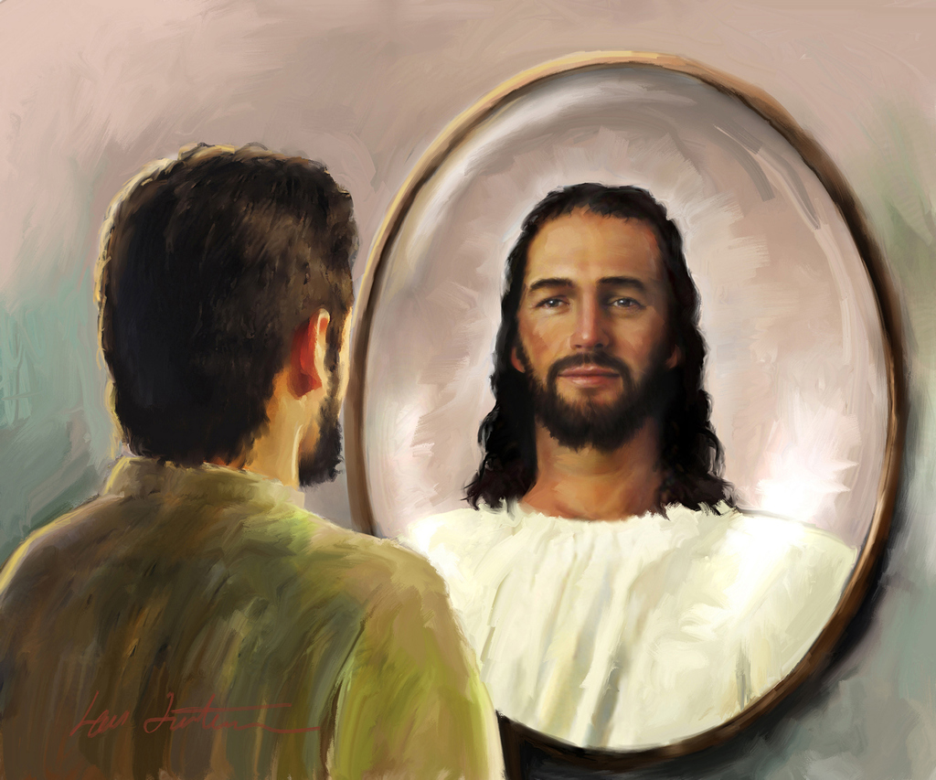

7
How do you understand the following statement: “A life in Christ is a life of restfulness”?
A life in Christ is a life of restfulness. There may be no ecstasy of feeling, but there should be an abiding, peaceful trust. Your hope is not in yourself; it is in Christ. Your weakness is united to His strength, your ignorance to His wisdom, your frailty to His enduring might. So you are not to look to yourself, not to let the mind dwell upon self, but look to Christ. Let the mind dwell upon His love, upon the beauty, the perfection, of His character. Christ in His self-denial, Christ in His humiliation, Christ in His purity and holiness, Christ in His matchless love—this is the subject for the soul's contemplation.
8
Fill out
“It is by __________________ Him, __________________ Him, __________________ wholly upon Him, that you are to be transformed into His __________________.”.
It is by loving Him, copying Him, depending wholly upon Him, that you are to be transformed into His likeness.

Slide 17

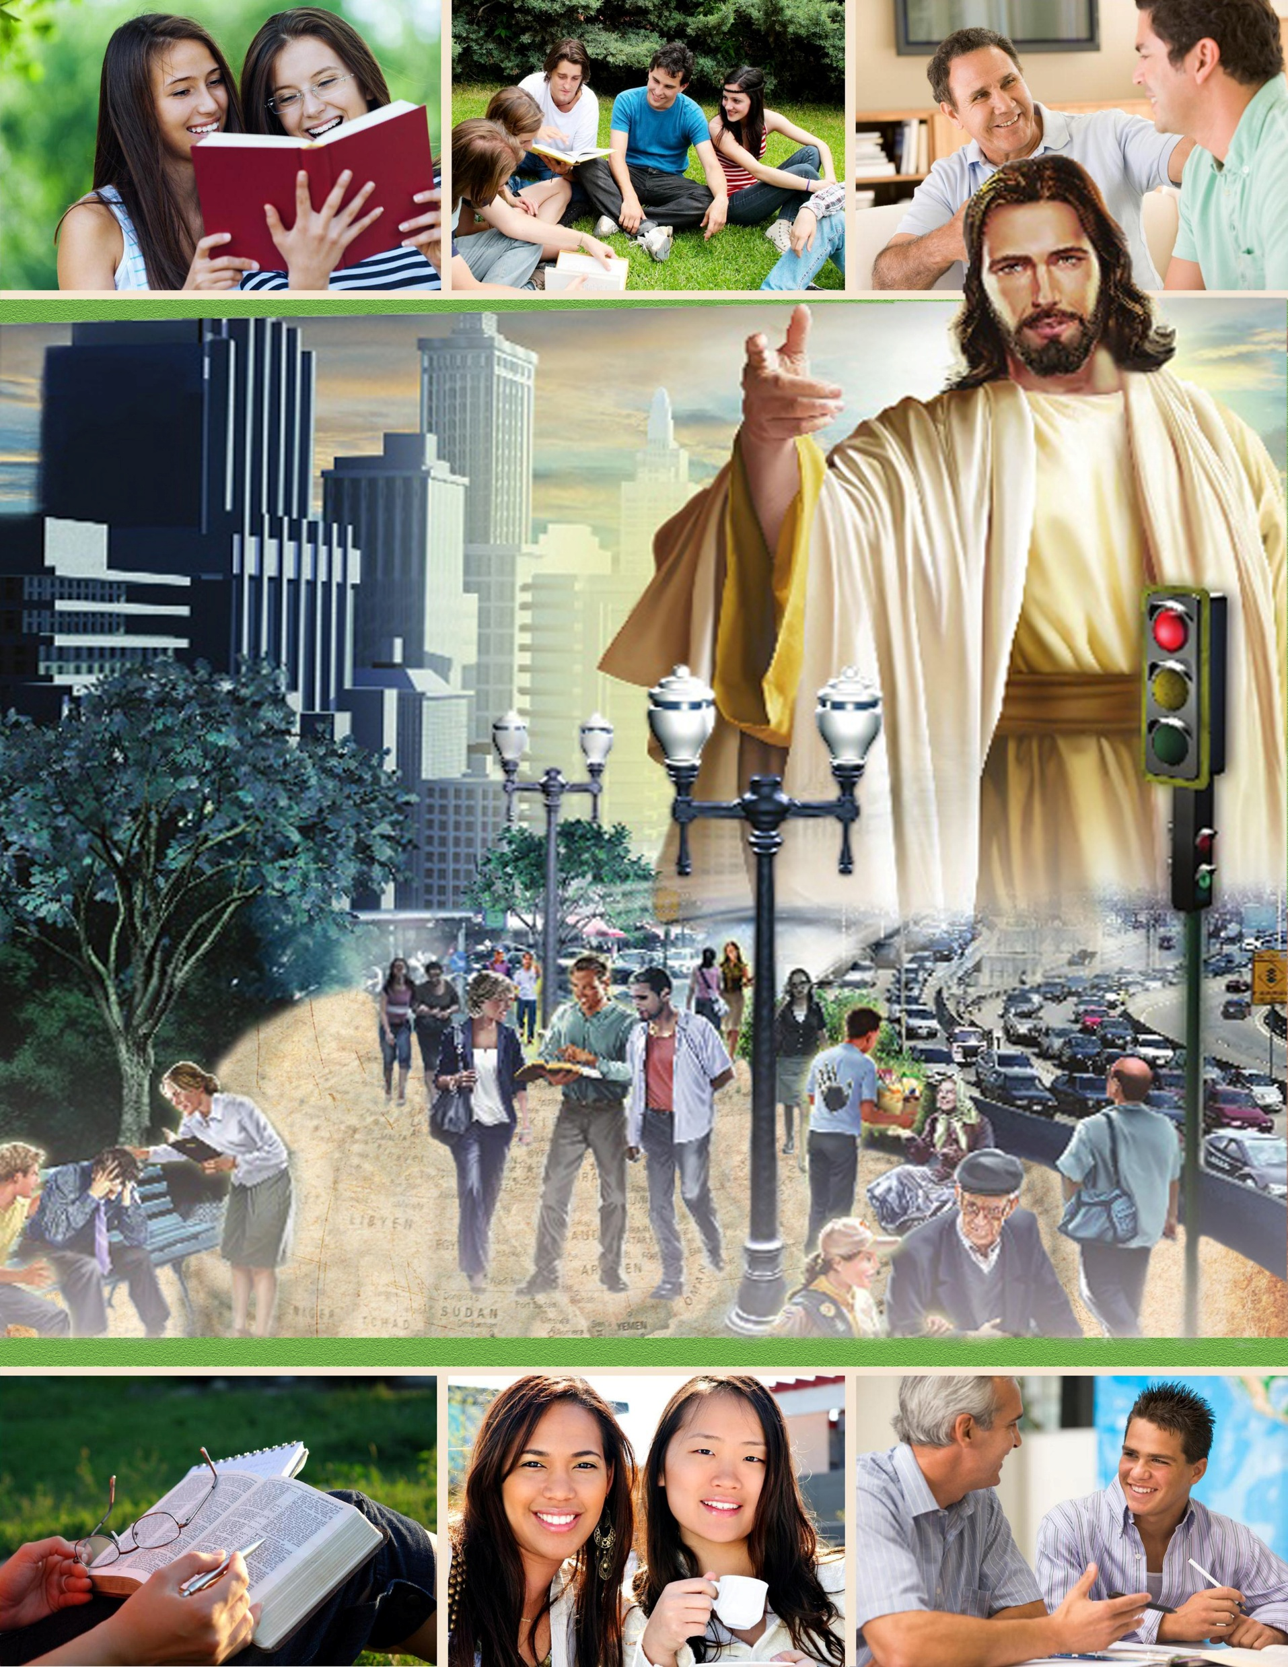




9
What will be the experience of those who rest most fully upon Christ?
Jesus says, “Abide in Me.” These words convey the idea of rest, stability, confidence. Again He invites, “Come unto Me, ... and I will give you rest.” Matthew 11:28. The words of the psalmist express the same thought: “Rest in the Lord, and wait patiently for Him.” And Isaiah gives the assurance, “In quietness and in confidence shall be your strength.” Psalm 37:7; Isaiah 30:15. This rest is not found in inactivity; for in the Saviour's invitation the promise of rest is united with the call to labor: “Take My yoke upon you: ... and ye shall find rest.” Matthew 11:29. The heart that rests most fully upon Christ will be most earnest and active in labor for Him.
10
To what subjects will Satan seek to divert our attention?
When the mind dwells upon self, it is turned away from Christ, the source of strength and life. Hence it is Satan's constant effort to keep the attention diverted from the Saviour and thus prevent the union and communion of the soul with Christ. The pleasures of the world, life's cares and perplexities and sorrows, the faults of others, or your own faults and imperfections—to any or all of these he will seek to divert the mind. Do not be misled by his devices.

Slide 18


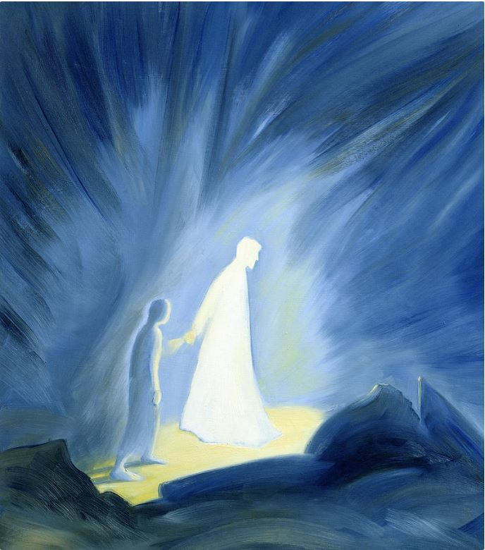

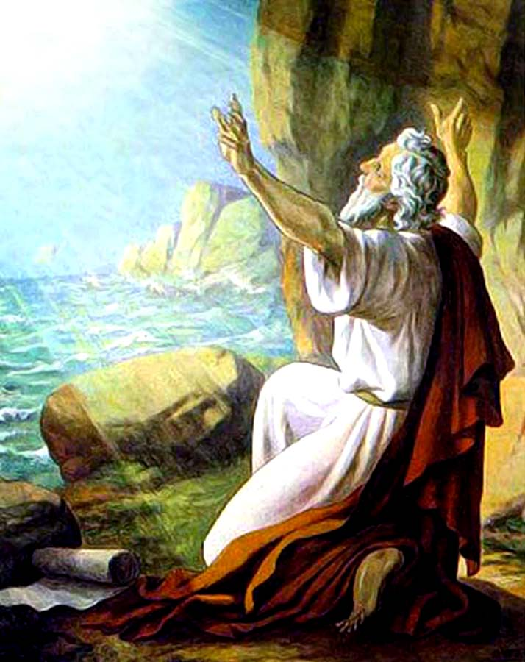
11
What is the only way the tie of love between Christ and humanity be broken?
When Christ took human nature upon Him, He bound humanity to Himself by a tie of love that can never be broken by any power save the choice of man himself. Satan will constantly present allurements to induce us to break this tie—to choose to separate ourselves from Christ. Here is where we need to watch, to strive, to pray, that nothing may entice us to choose another master; for we are always free to do this. But let us keep our eyes fixed upon Christ, and He will preserve us. Looking unto Jesus, we are safe. Nothing can pluck us out of His hand. In constantly beholding Him, we “are changed into the same image from glory to glory, even as by the Spirit of the Lord.” 2 Corinthians 3:18
John, the disciple, was not naturally loving. How did he become so?
Even John, the beloved disciple, the one who most fully reflected the likeness of the Saviour, did not naturally possess that loveliness of character.
12
The strength and patience, the power and tenderness, the majesty and meekness, that he beheld in the daily life of the Son of God, filled his soul with admiration and love. Day by day his heart was drawn out toward Christ, until he lost sight of self in love for his Master. His resentful, ambitious temper was yielded to the molding power of Christ. The regenerating influence of the Holy Spirit renewed his heart. The power of the love of Christ wrought a transformation of character. This is the sure result of union with Jesus. When Christ abides in the heart, the whole nature is transformed. Christ's Spirit, His love, softens the heart, subdues the soul, and raises the thoughts and desires toward God and heaven. He was not only self-assertive and ambitious for honor, but impetuous, and resentful under injuries. But as the character of the Divine One was manifested to him, he saw his own deficiency and was humbled by the knowledge.

Slide 19

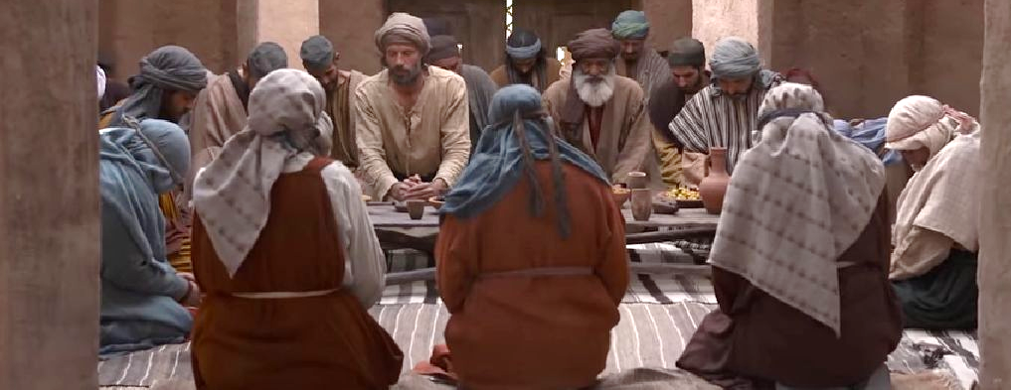

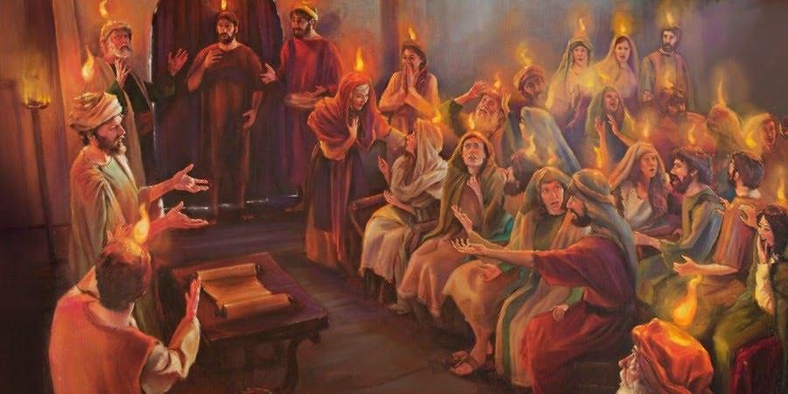
What lessons might we learn from the disciples’ experience after Jesus returned to heaven?
13
As they met together after the ascension they were eager to present their requests to the Father in the name of Jesus. In solemn awe they bowed in prayer, repeating the assurance, “Whatsoever ye shall ask the Father in My name, He will give it you. Hitherto have ye asked nothing in My name: ask, and ye shall receive, that your joy may be full.” John 16:23, 24. They extended the hand of faith higher and higher with the mighty argument, “It is Christ that died, yea rather, that is risen again, who is even at the right hand of God, who also maketh intercession for us.” Romans 8:34. And Pentecost brought them the presence of the Comforter, of whom Christ had said, He “shall be in you.” And He had further said, “It is expedient for you that I go away: for if I go not away, the Comforter will not come unto you; but if I depart, I will send Him unto you.” John 14:17; 16:7. Henceforth through the Spirit, Christ was to abide continually in the hearts of His children. Their union with Him was closer than when He was personally with them. The light, and love, and power of the indwelling Christ shone out through them, so that men, beholding, “marveled; and they took knowledge of them, that they had been with Jesus.” Acts 4:13.All that Christ was to the disciples, He desires to be to His children today; for in that last prayer, with the little band of disciples gathered about Him, He said, “Neither pray I for these alone, but for them also which shall believe on Me through their word.” John 17:20.Jesus prayed for us, and He asked that we might be one with Him, even as He is one with the Father. What a union is this! The Saviour has said of Himself, “The Son can do nothing of Himself;” “the Father that dwelleth in Me, He doeth the works.” John 5:19; 14:10. Then if Christ is dwelling in our hearts, He will work in us “both to will and to do of His good pleasure.” Philippians 2:13. We shall work as He worked; we shall manifest the same spirit. And thus, loving Him and abiding in Him, we shall “grow up into Him in all things, which is the head, even Christ.” Ephesians 4:15.”

Slide 20






Chapter 9: “The Work and the Life"
1
What lessons are to be learned from the ministry of angels?
Our Saviour's joy was in the uplifting and redemption of fallen men. For this He counted not His life dear unto Himself, but endured the cross, despising the shame. So angels are ever engaged in working for the happiness of others. This is their joy. That which selfish hearts would regard as humiliating service, ministering to those who are wretched and in every way inferior in character and rank, is the work of sinless angels. The spirit of Christ's self-sacrificing love is the spirit that pervades heaven and is the very essence of its bliss. This is the spirit that Christ's followers will possess, the work that they will do.
2
How will love to Jesus be manifested in our actions?
Love to Jesus will be manifested in a desire to work as He worked for the blessing and uplifting of humanity. It will lead to love, tenderness, and sympathy toward all the creatures of our heavenly Father's care.

Slide 21

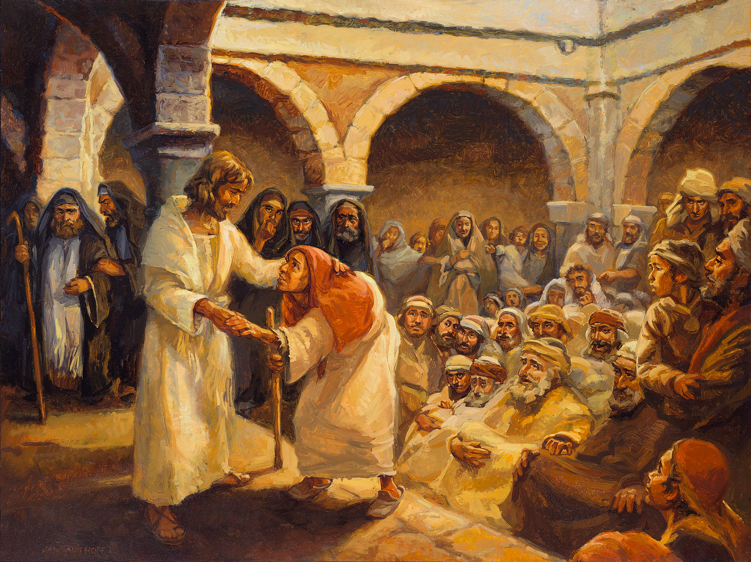
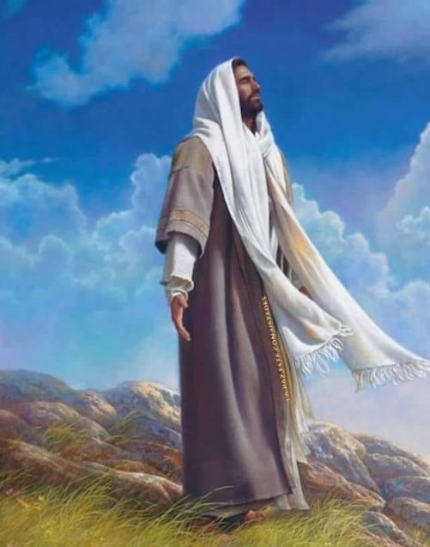
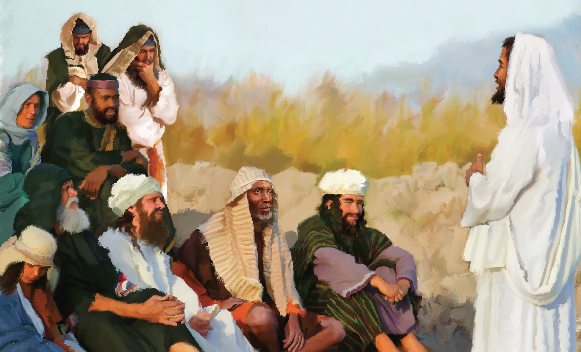
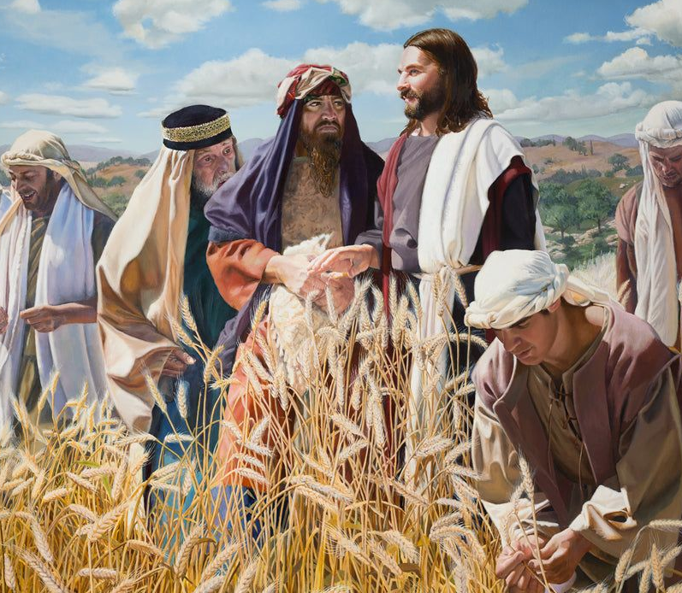
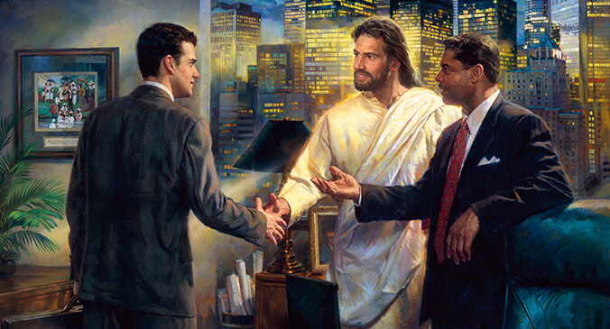
3
What was the “one great object” of Christ’s life on earth?
The Saviour's life on earth was not a life of ease and devotion to Himself, but He toiled with persistent, earnest, untiring effort for the salvation of lost mankind. From the manger to Calvary He followed the path of self-denial and sought not to be released from arduous tasks, painful travels and exhausting care and labor. He said, “The Son of man came not to be ministered unto, but to minister, and to give His life a ransom for many.” Matthew 20:28. This was the one great object of His life. Everything else was secondary and subservient. It was His meat and drink to do the will of God and to finish His work. Self and self-interest had no part in His labor.
4
What will be seen as the result of the grace of Christ in our lives?
So those who are the partakers of the grace of Christ will be ready to make any sacrifice, that others for whom He died may share the heavenly gift. They will do all they can to make the world better for their stay in it. This spirit is the sure outgrowth of a soul truly converted. No sooner does one come to Christ than there is born in his heart a desire to make known to others what a precious friend he has found in Jesus; the saving and sanctifying truth cannot be shut up in his heart.

Slide 22

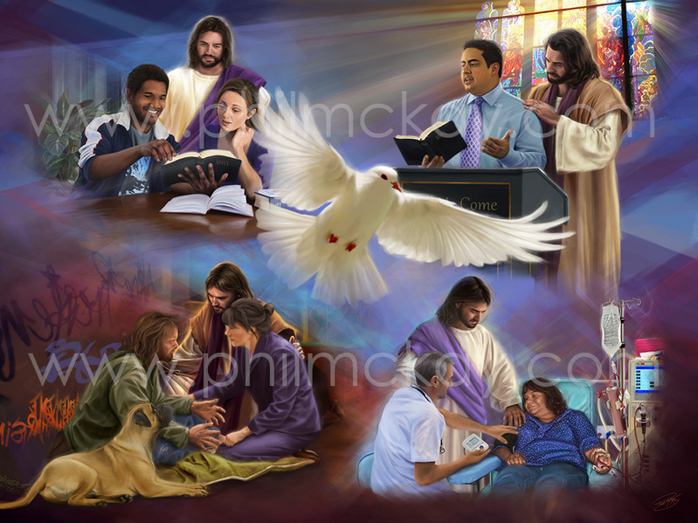
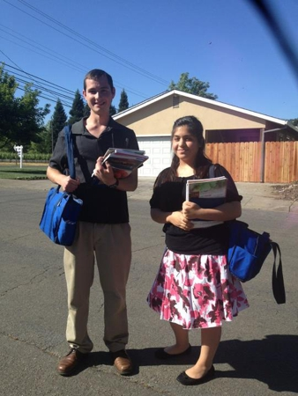
5
How will the effort to bless others react on us?
And the effort to bless others will react in blessings upon ourselves. This was the purpose of God in giving us a part to act in the plan of redemption. He has granted men the privilege of becoming partakers of the divine nature and, in their turn, of diffusing blessings to their fellow men. This is the highest honor, the greatest joy, that it is possible for God to bestow upon men. Those who thus become participants in labors of love are brought nearest to their Creator.
6
Why did God not permit the preaching of the gospel by angels?
God might have committed the message of the gospel, and all the work of loving ministry, to the heavenly angels. He might have employed other means for accomplishing His purpose. But in His infinite love He chose to make us co-workers with Himself, with Christ and the angels, that we might share the blessing, the joy, the spiritual uplifting, which results from this unselfish ministry.

Slide 23





7
List some of the benefits to us of working for others.
If you will go to work as Christ designs that His disciples shall, and win souls for Him, you will feel the need of a deeper experience and a greater knowledge in divine things, and will hunger and thirst after righteousness. You will plead with God, and your faith will be strengthened, and your soul will drink deeper drafts at the well of salvation. Encountering opposition and trials will drive you to the Bible and prayer. You will grow in grace and the knowledge of Christ, and will develop a rich experience. The spirit of unselfish labor for others gives depth, stability, and Christlike loveliness to the character, and brings peace and happiness to its possessor. The aspirations are elevated. There is no room for sloth or selfishness. Those who thus exercise the Christian graces will grow and will become strong to work for God. They will have clear spiritual perceptions, a steady, growing faith, and an increased power in prayer. The Spirit of God, moving upon their spirit, calls forth the sacred harmonies of the soul in answer to the divine touch. Those who thus devote themselves to unselfish effort for the good of others are most surely working out their own salvation.
8
What is the only way we will grow in grace?
The only way to grow in grace is to be disinterestedly doing the very work which Christ has enjoined upon us—to engage, to the extent of our ability, in helping and blessing those who need the help we can give them.

Slide 24

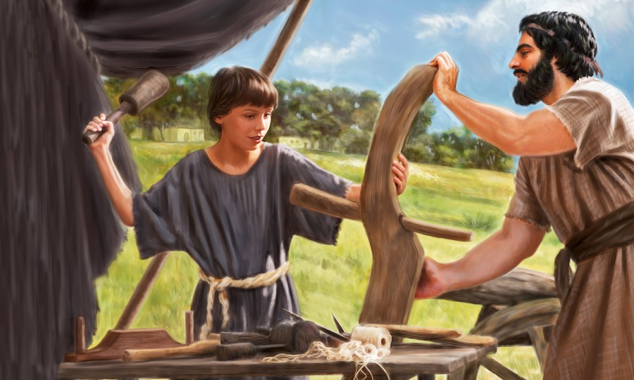
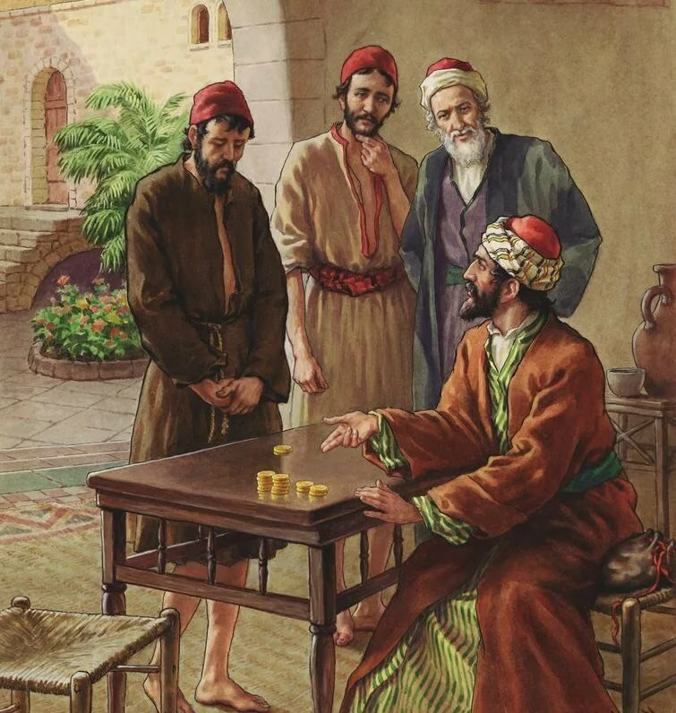
9
What might we learn from Jesus’ early years as a carpenter?
The greater part of our Saviour's life on earth was spent in patient toil in the carpenter's shop at Nazareth. Ministering angels attended the Lord of life as He walked side by side with peasants and laborers, unrecognized and unhonored. He was as faithfully fulfilling His mission while working at His humble trade as when He healed the sick or walked upon the storm-tossed waves of Galilee. So in the humblest duties and lowliest positions of life, we may walk and work with Jesus.
10
What important lesson is suggested regarding use of talents in the parable?
Many have excused themselves from rendering their gifts to the service of Christ because others were possessed of superior endowments and advantages. The opinion has prevailed that only those who are especially talented are required to consecrate their abilities to the service of God. It has come to be understood by many that talents are given to only a certain favored class to the exclusion of others who of course are not called upon to share in the toils or the rewards. But it is not so represented in the parable. When the master of the house called his servants, he gave to every man his work.

Slide 25

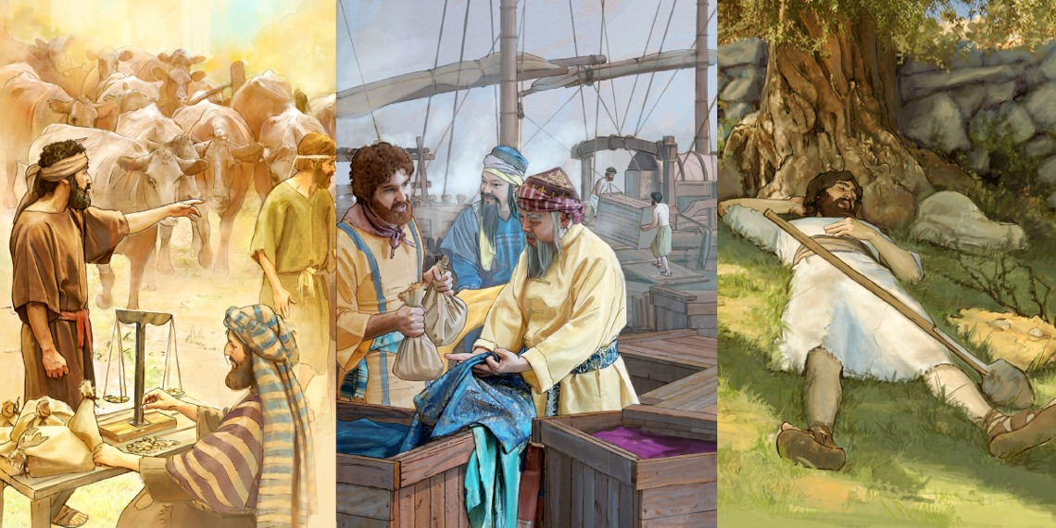
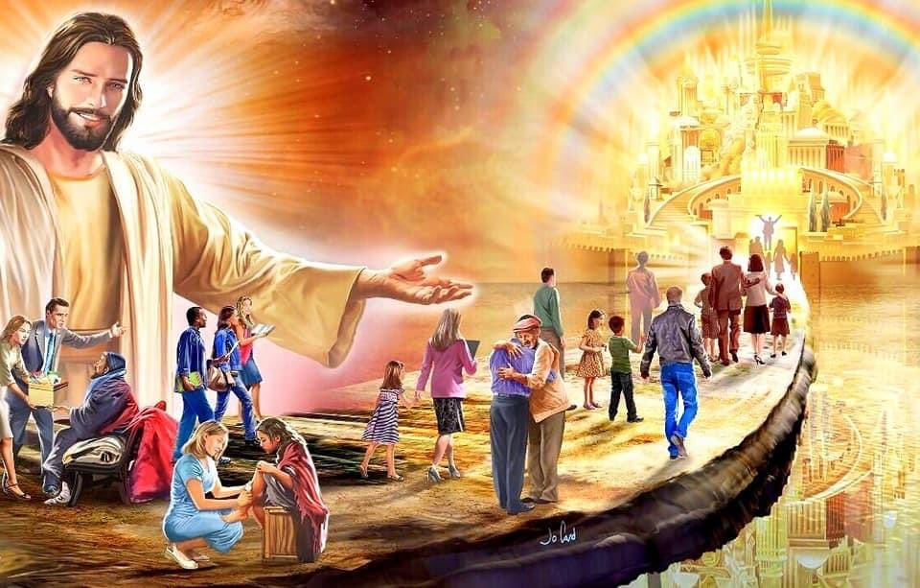
You are not to wait for great occasions or to expect extraordinary abilities before you go to work for God. You need not have a thought of what the world will think of you. If your daily life is a testimony to the purity and sincerity of your faith, and others are convinced that you desire to benefit them, your efforts will not be wholly lost.
The humblest and poorest of the disciples of Jesus can be a blessing to others. They may not realize that they are doing any special good, but by their unconscious influence they may start waves of blessing that will widen and deepen, and the blessed results they may never know until the day of final reward. They do not feel or know that they are doing anything great. They are not required to weary themselves with anxiety about success. They have only to go forward quietly, doing faithfully the work that God's providence assigns, and their life will not be in vain. Their own souls will be growing more and more into the likeness of Christ; they are workers together with God in this life and are thus fitting for the higher work and the unshadowed joy of the life to come.

