Slide 1
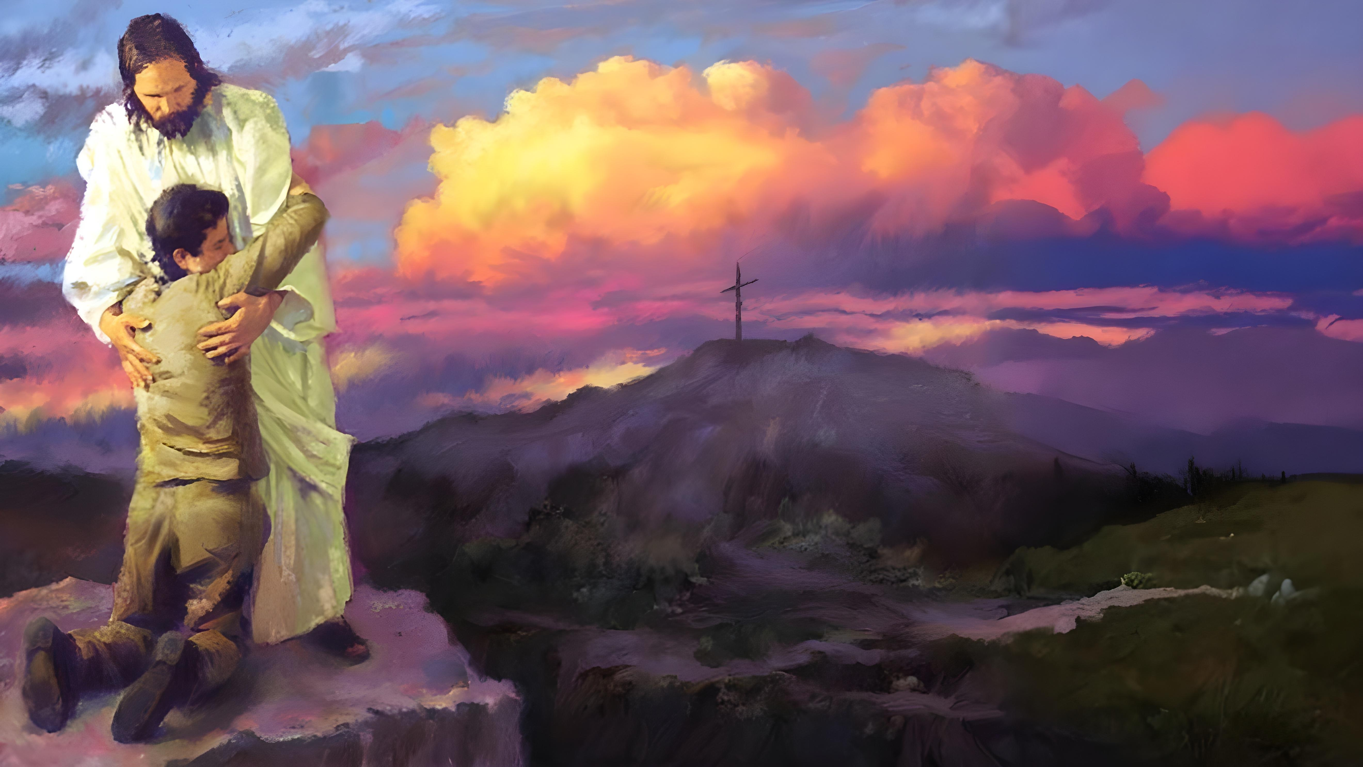

Lesson 4
E.G.W

Slide 2

These presentations are based on the book “Steps to Christ” by Ellen G. White, and the study guide prepared by the Trustees of the White Institute.
You can download or read the book at https://egwwritings.org/read?panels=p108.4&index=0
Read the corresponding chapter in the book and answer these questions. Click on the chapter to access it.
Lesson 4
Chapter 10: “A Knowledge of God”
Chapter 11: “The Privilege of Prayer”

Slide 3



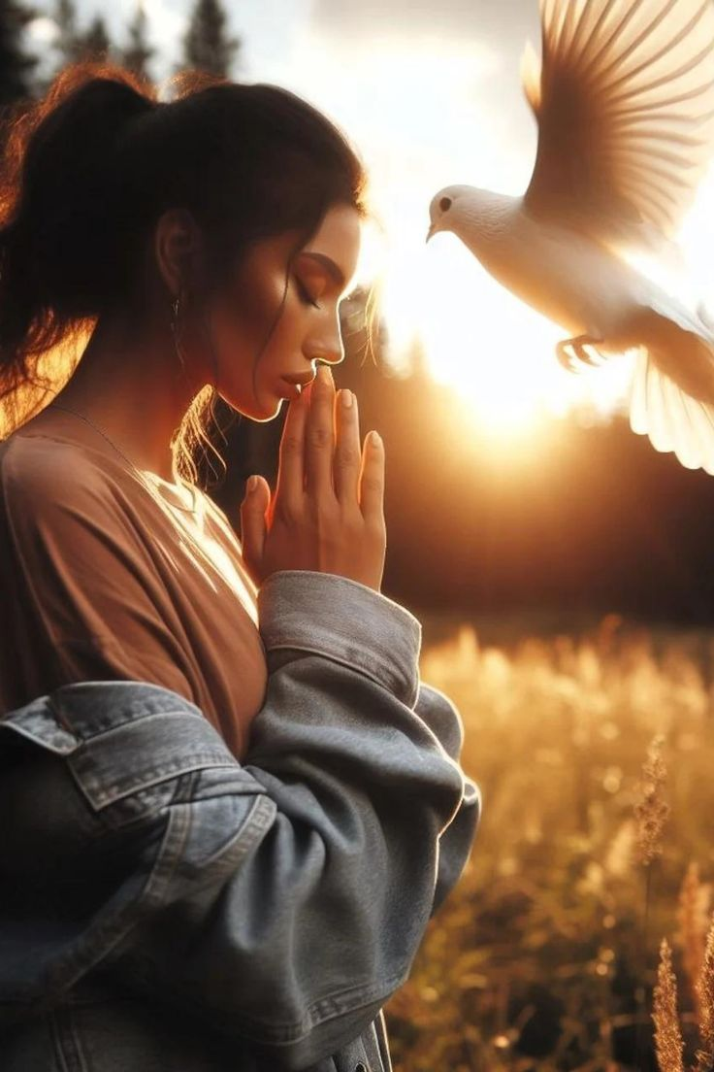
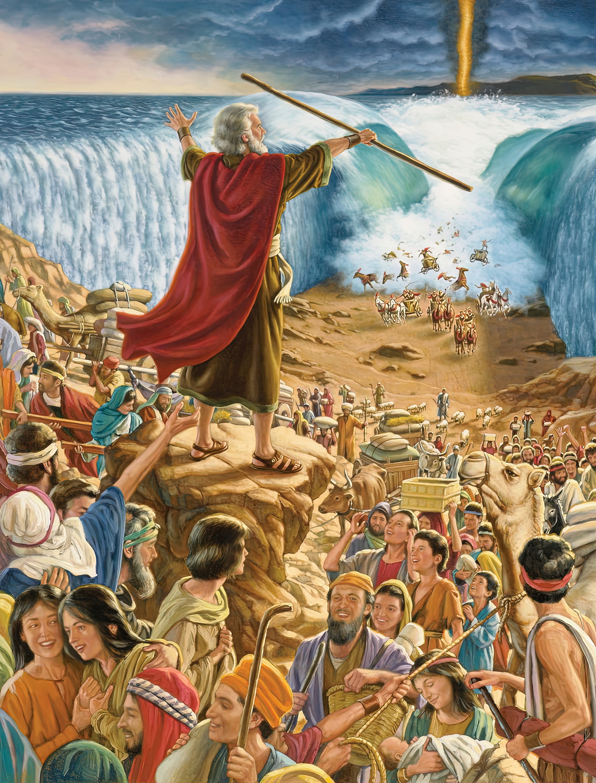
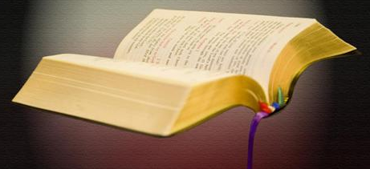


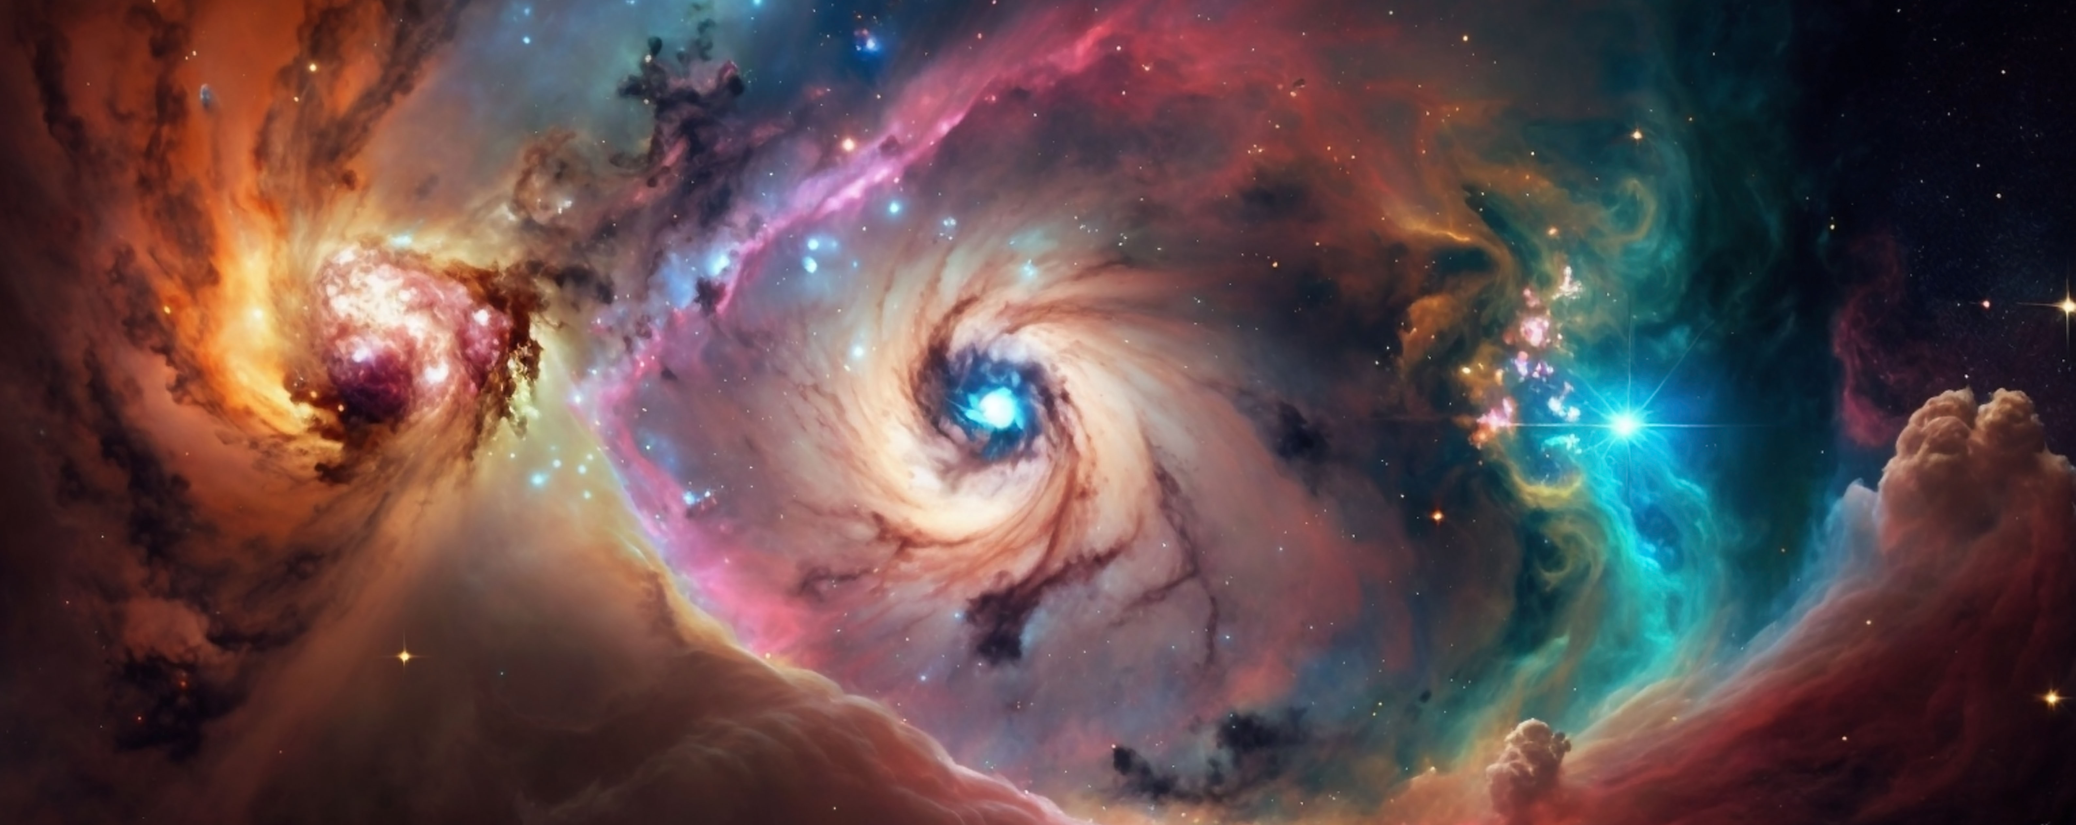



Chapter 10: “A Knowledge of God”
1
In what four ways does God speak to us today?
Nature speaks incessantly to our senses
God speaks to us through his providential works
Through the influence of His Holy Spirit on the heart
God also speaks to us in his Word
2
Why is nature one of the Saviour's most effective ways of teaching us?
The open heart will be impressed with the love and glory of God as revealed through the works of His hands. The listening ear can hear and understand the communications of God through the things of nature. The green fields, the lofty trees, the buds and flowers, the passing cloud, the falling rain, the babbling brook, the glories of the heavens, speak to our hearts, and invite us to become acquainted with Him who made them all.

Slide 4


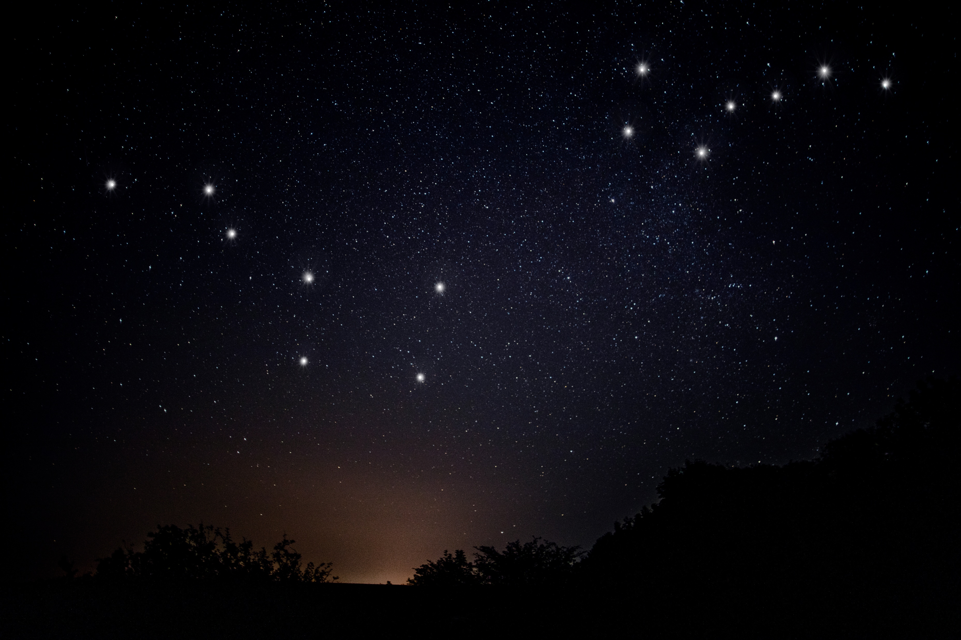

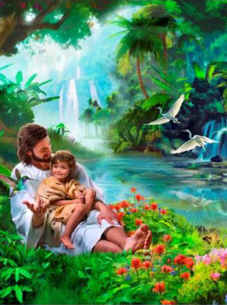
3
Make a list of some of the most important lessons we can learn from nature.
If we will but listen, God’s created works will teach us precious lessons of obedience and trust. From the stars that in their trackless courses through space follow from age to age their appointed path, down to the minutest atom, the things of nature obey the Creator’s will. And God cares for everything and sustains everything that He has created. He who upholds the unnumbered worlds throughout immensity, at the same time cares for the wants of the little brown sparrow that sings its humble song without fear.
When men go forth to their daily toil, as when they engage in prayer; when they lie down at night, and when they rise in the morning; when the rich man feasts in his palace, or when the poor man gathers his children about the scanty board, each is tenderly watched by the heavenly Father. No tears are shed that God does not notice. There is no smile that He does not mark.
If we would but fully believe this, all undue anxieties would be dismissed. Our lives would not be so filled with disappointment as now; for everything, whether great or small, would be left in the hands of God, who is not perplexed by the multiplicity of cares, or overwhelmed by their weight. We should then enjoy a rest of soul to which many have long been strangers. As your senses delight in the attractive loveliness of the earth, think of the world that is to come, that shall never know the blight of sin and death; where the face of nature will no more wear the shadow of the curse. Let your imagination picture the home of the saved, and remember that it will be more glorious than your brightest imagination can portray.

Slide 5


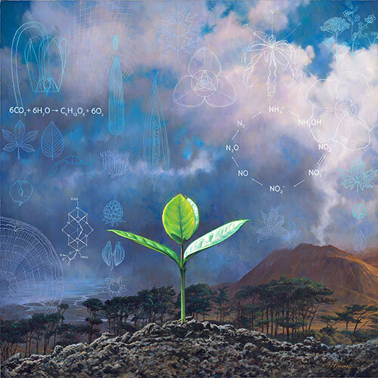
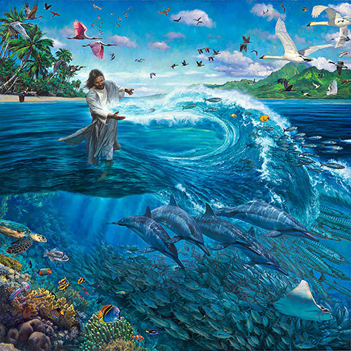
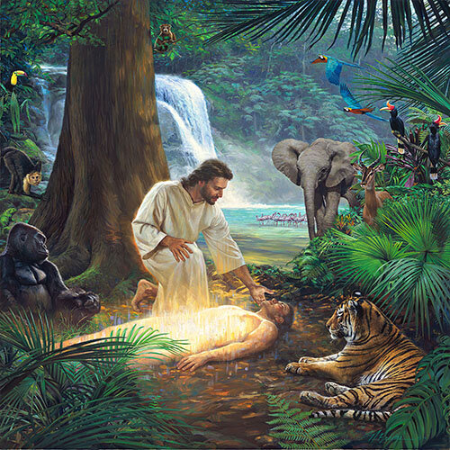

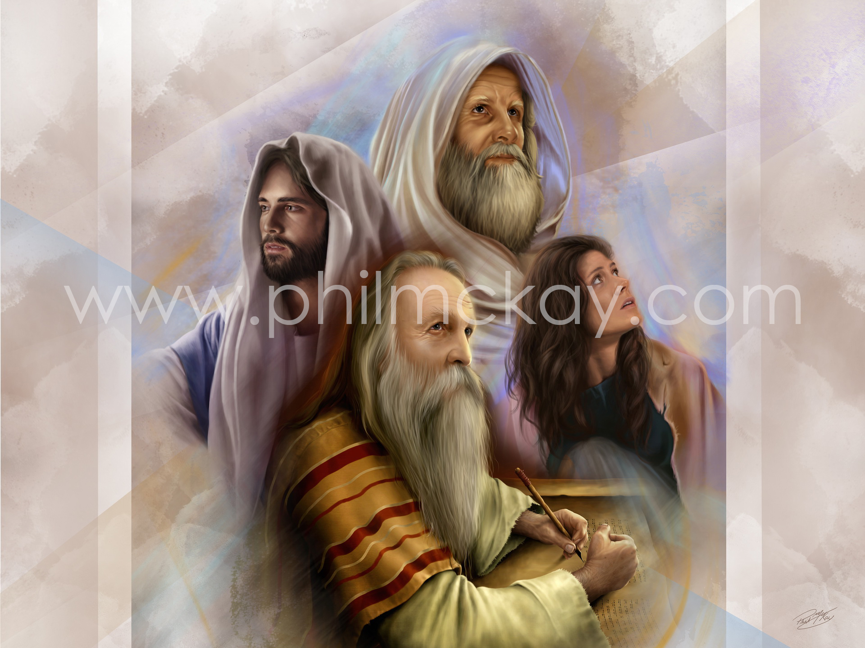
4
Why does the Christian have an advantage over the poet or the naturalist when studying nature?
The poet and the naturalist have many things to say about nature, but it is the Christian who enjoys the beauty of the earth with the highest appreciation, because he recognizes his Father’s handiwork and perceives His love in flower and shrub and tree. No one can fully appreciate the significance of hill and vale, river and sea, who does not look upon them as an expression of God’s love to man.
5
What special lessons are to be learned from a study of the Bible characters?
Here [the Bible] is open before us the history of patriarchs and prophets and other holy men of old. They were men “subject to like passions as we are.” James 5:17. We see how they struggled through discouragements like our own, how they fell under temptation as we have done, and yet took heart again and conquered through the grace of God; and, beholding, we are encouraged in our striving after righteousness. As we read of the precious experiences granted them, of the light and love and blessing it was theirs to enjoy, and of the work they wrought through the grace given them, the spirit that inspired them kindles a flame of holy emulation in our hearts and a desire to be like them in character—like them to walk with God.

Slide 6




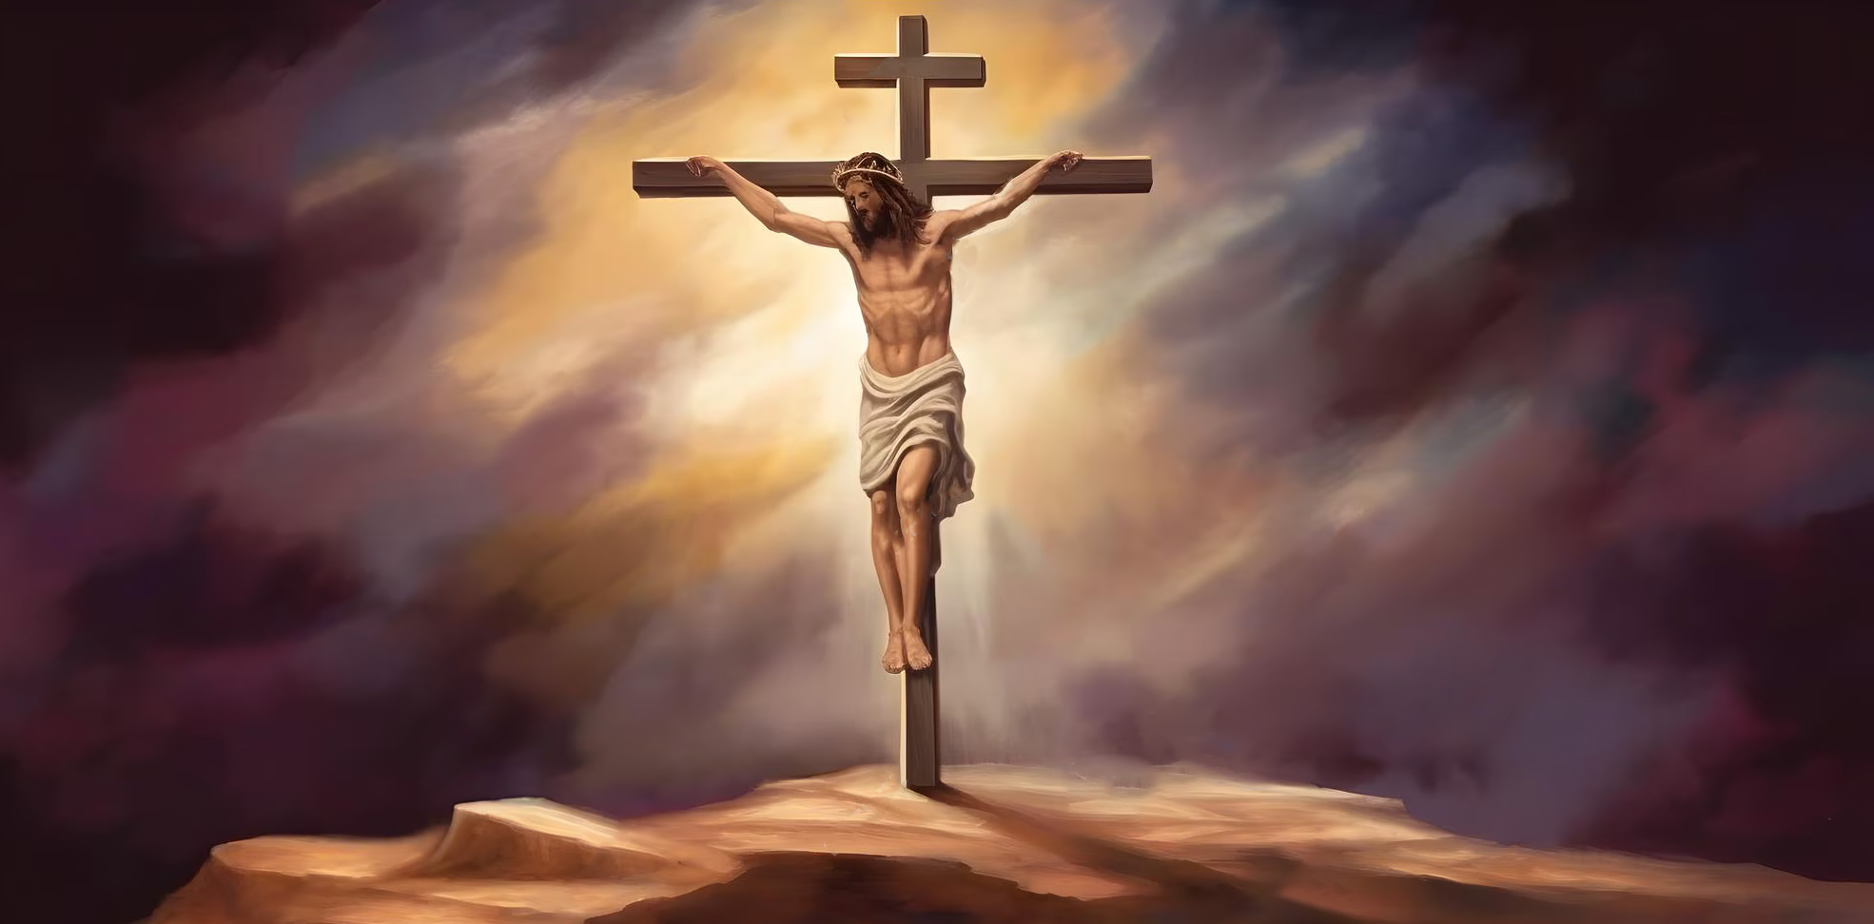
6
How can we “eat the flesh and drink the blood” of Christ?
Fill the whole heart with the words of God. They are the living water, quenching your burning thirst. They are the living bread from heaven. Jesus declares, “Except ye eat the flesh of the Son of man, and drink His blood, ye have no life in you.” And He explains Himself by saying, “The words that I speak unto you, they are spirit, and they are life.” John 6:53, 63. Our bodies are built up from what we eat and drink; and as in the natural economy, so in the spiritual economy: it is what we meditate upon that will give tone and strength to our spiritual nature.
7
What will be the science and song of the redeemed throughout the ages?
The theme of redemption is one that the angels desire to look into; it will be the science and the song of the redeemed throughout the ceaseless ages of eternity. Is it not worthy of careful thought and study now? The infinite mercy and love of Jesus, the sacrifice made in our behalf, call for the most serious and solemn reflection. We should dwell upon the character of our dear Redeemer and Intercessor. We should meditate upon the mission of Him who came to save His people from their sins.

Slide 7


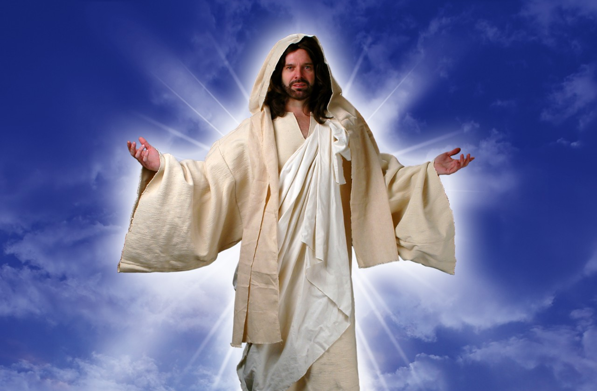

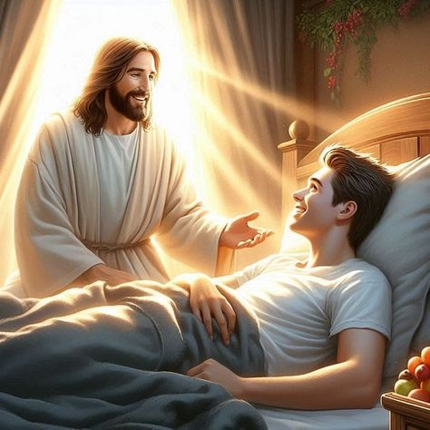
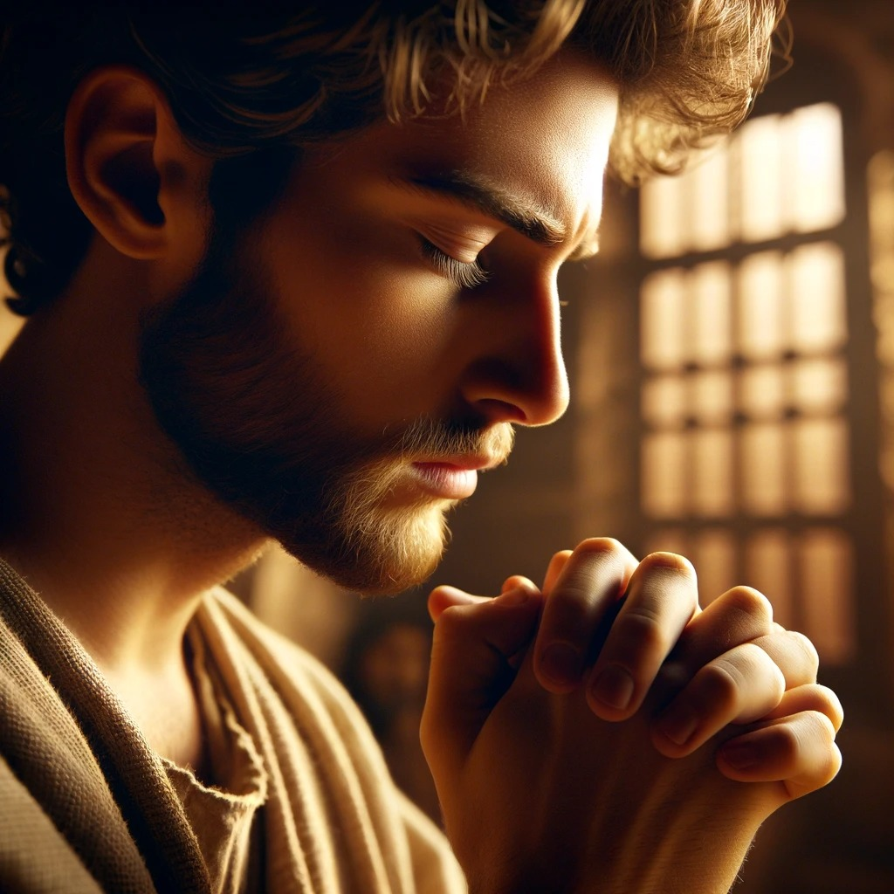
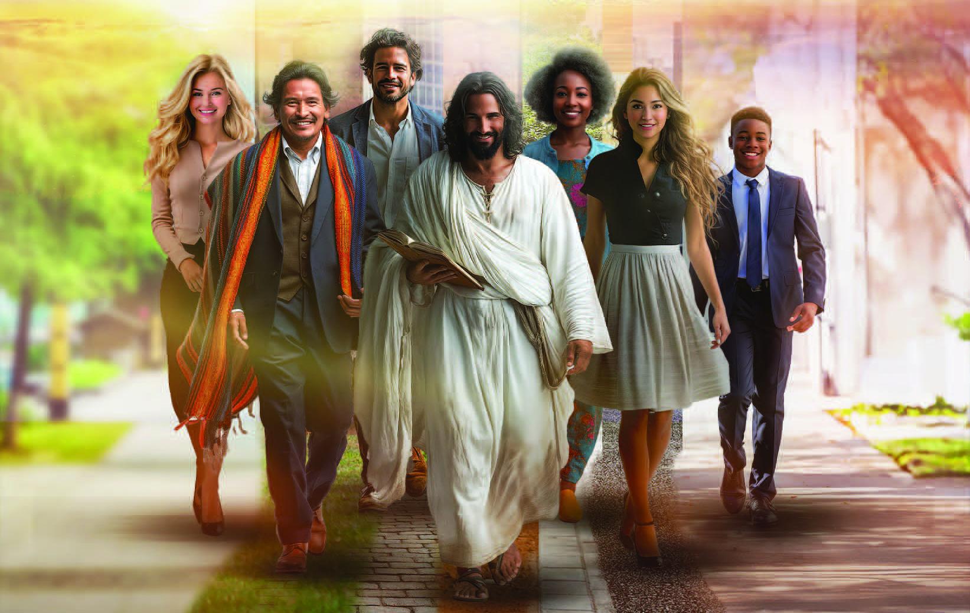
8
What will be the positive advantage of study of this subject even now?
As we thus contemplate heavenly themes, our faith and love will grow stronger, and our prayers will be more and more acceptable to God, because they will be more and more mixed with faith and love. They will be intelligent and fervent. There will be more constant confidence in Jesus, and a daily, living experience in His power to save to the uttermost all that come unto God by Him.
As we meditate upon the perfections of the Saviour, we shall desire to be wholly transformed and renewed in the image of His purity. There will be a hungering and thirsting of soul to become like Him whom we adore.
9
“The more our __________________ are upon Christ, the more we shall __________________ of Him to others and __________________ Him to the world?”
The more our thoughts are upon Christ, the more we shall speak of Him to others and represent Him to the world.

Slide 8

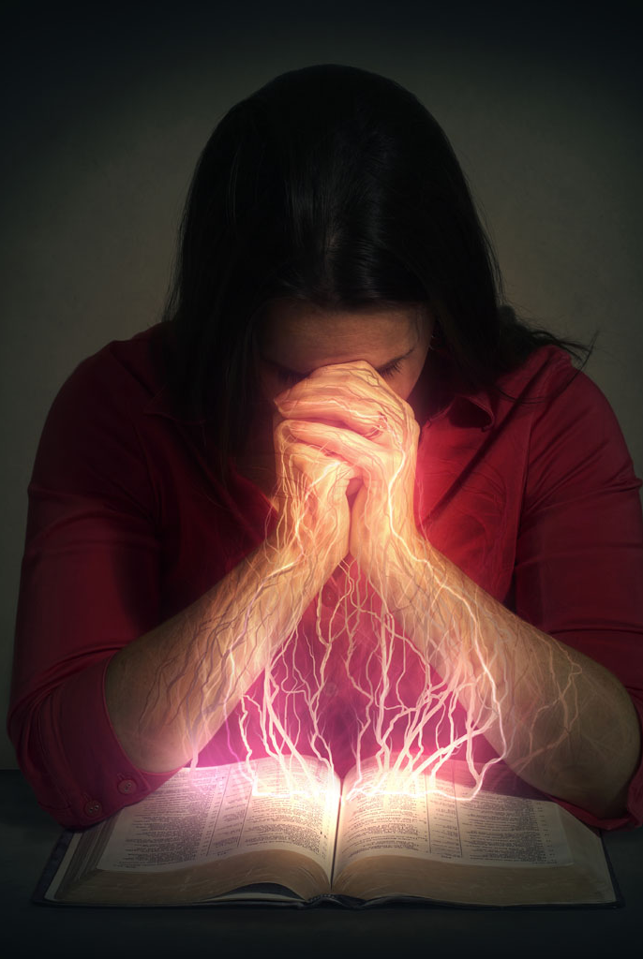

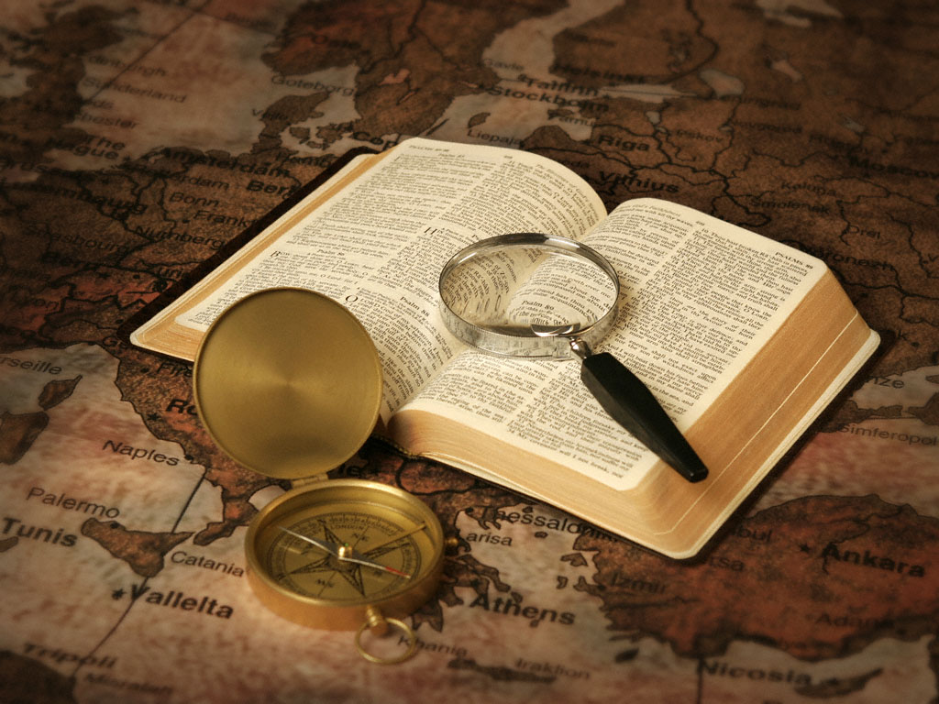
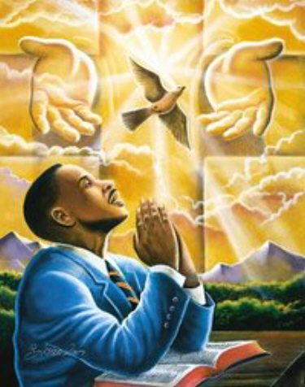
10
What will be the positive result of our study and meditation on Scripture?
There is nothing more calculated to strengthen the intellect than the study of the Scriptures. No other book is so potent to elevate the thoughts, to give vigor to the faculties, as the broad, ennobling truths of the Bible. If God’s word were studied as it should be, men would have a breadth of mind, a nobility of character, and a stability of purpose rarely seen in these times.
11
What suggestions are offered as to methods of study of the Scriptures?
But there is but little benefit derived from a hasty reading of the Scriptures. One may read the whole Bible through and yet fail to see its beauty or comprehend its deep and hidden meaning. One passage studied until its significance is clear to the mind and its relation to the plan of salvation is evident, is of more value than the perusal of many chapters with no definite purpose in view and no positive instruction gained. Keep your Bible with you. As you have opportunity, read it; fix the texts in your memory.
Even while you are walking the streets you may read a passage and meditate upon it, thus fixing it in the mind. Scripture must be compared with scripture. There must be careful research and prayerful reflection. And such study will be richly repaid. As the miner discovers veins of precious metal concealed beneath the surface of the earth, so will he who perseveringly searches the word of God as for hid treasure find truths of the greatest value, which are concealed from the view of the careless seeker. The words of inspiration, pondered in the heart, will be as streams flowing from the fountain of life.

Slide 9




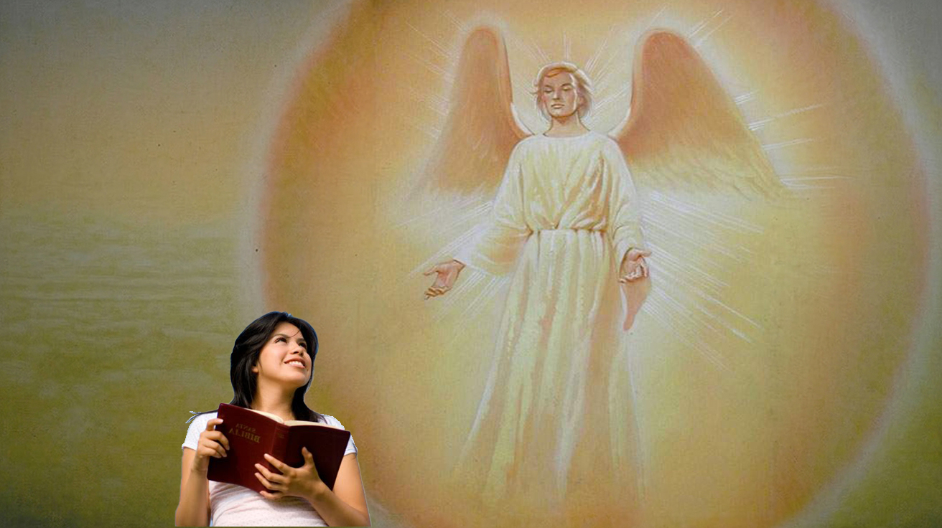
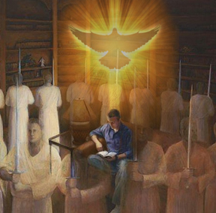
12
What should precede Bible study? Why?
Never should the Bible be studied without prayer. Before opening its pages we should ask for the enlightenment of the Holy Spirit, and it will be given. When Nathanael came to Jesus, the Saviour exclaimed, “Behold an Israelite indeed, in whom is no guile!” Nathanael said, “Whence knowest Thou me?” Jesus answered, “Before that Philip called thee, when thou wast under the fig tree, I saw thee.” John 1:47, 48. And Jesus will see us also in the secret places of prayer if we will seek Him for light that we may know what is truth.
13
What superhuman help is promised in our study of the Bible?
Angels from the world of light will be with those who in humility of heart seek for divine guidance.

Slide 10


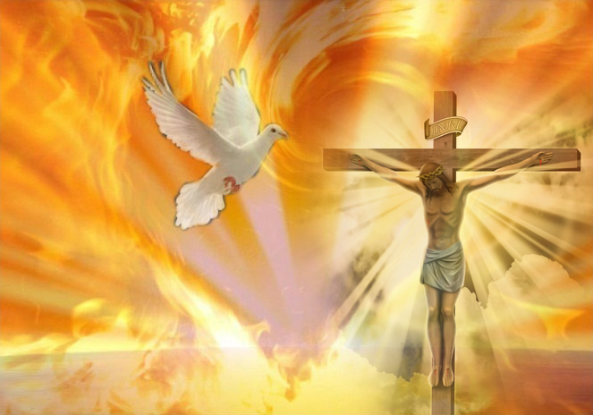
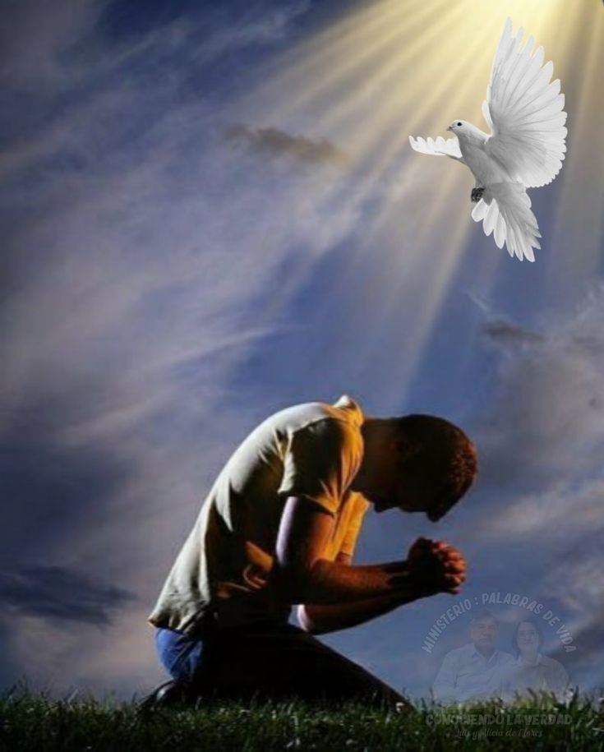
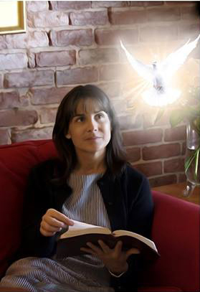
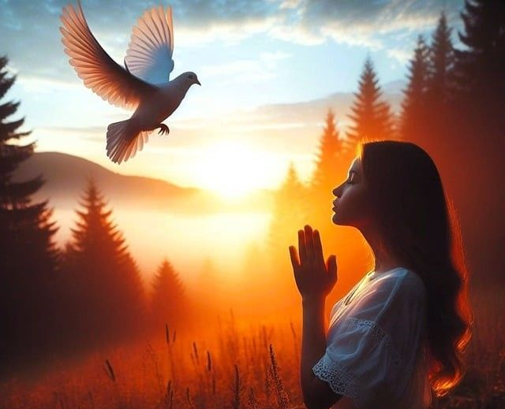
14
Who is the only effectual teacher of divine truth?
The Holy Spirit exalts and glorifies the Saviour.
It is His office to present Christ, the purity of His righteousness, and the great salvation that we have through Him.
Jesus says, “He shall receive of Mine, and shall show it unto you.” John 16:14.
The Spirit of truth is the only effectual teacher of divine truth.
How must God esteem the human race, since He gave His Son to die for them and appoints His Spirit to be man’s teacher and continual guide!

Slide 11



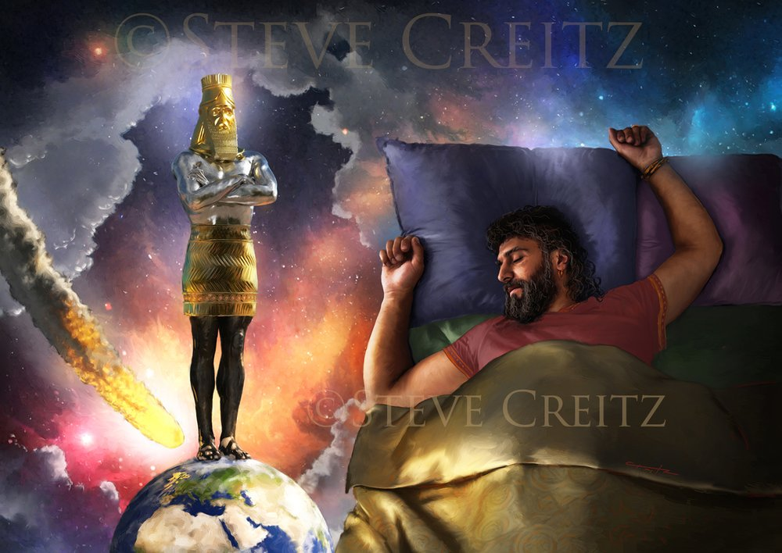
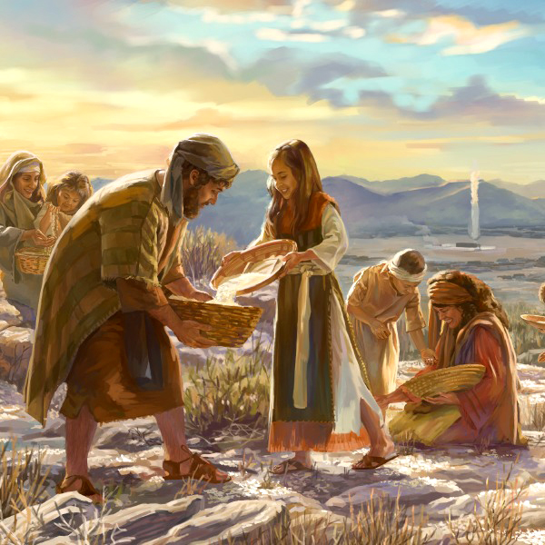
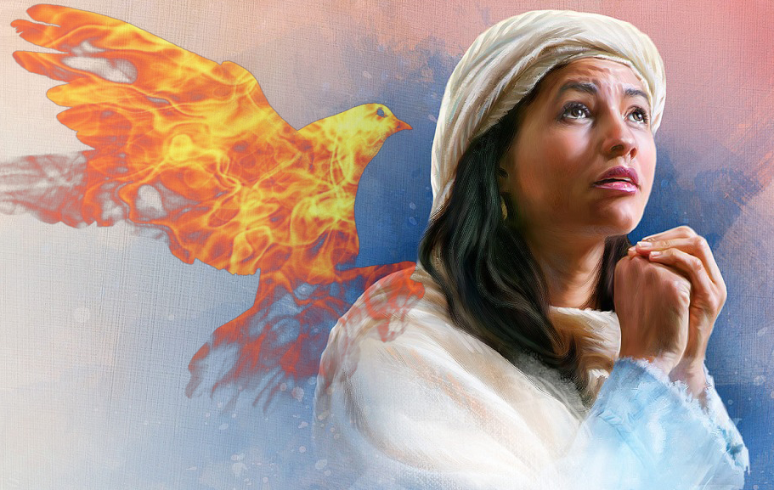

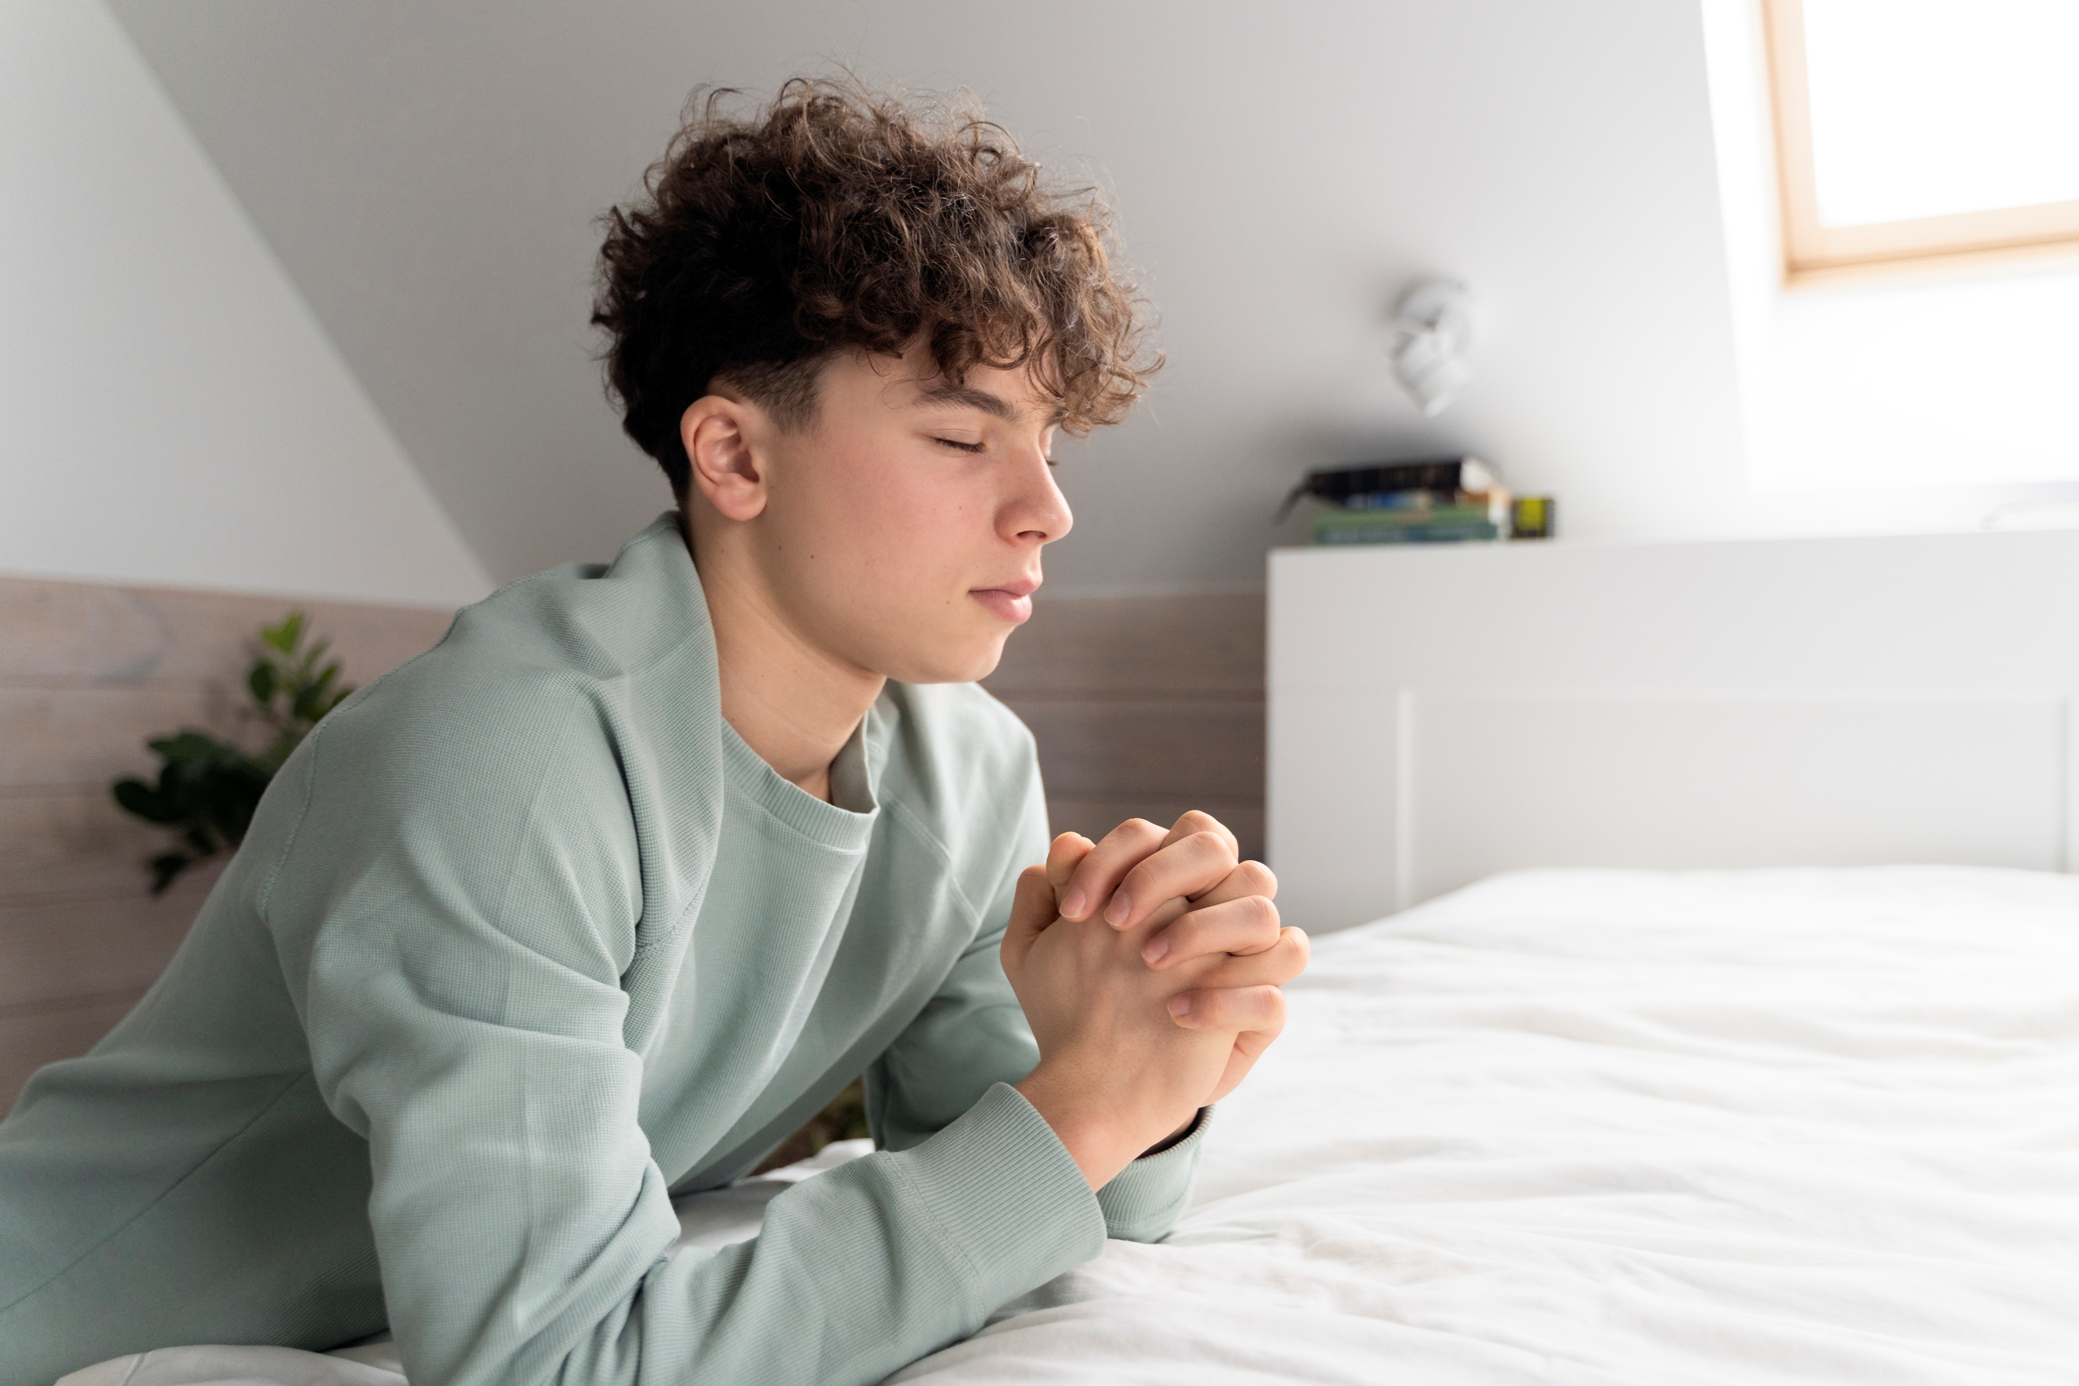
Chapter 11: “The Privilege of Prayer”
1
Notice the repetition of four ways God speaks to us.
Through nature and revelation, through His providence, and by the influence of His Spirit, God speaks to us.
2
Communion with God is two-way. What is our part?
Through nature and revelation, through His providence, and by the influence of His Spirit, God speaks to us. But these are not enough; we need also to pour out our hearts to Him. In order to have spiritual life and energy, we must have actual relationship with our heavenly Father. Our minds may be drawn out toward Him; we may meditate upon His works, His mercies, His blessings; but this is not, in the fullest sense, communing with Him. In order to commune with God, we must have something to say to Him concerning our actual life.

Slide 12


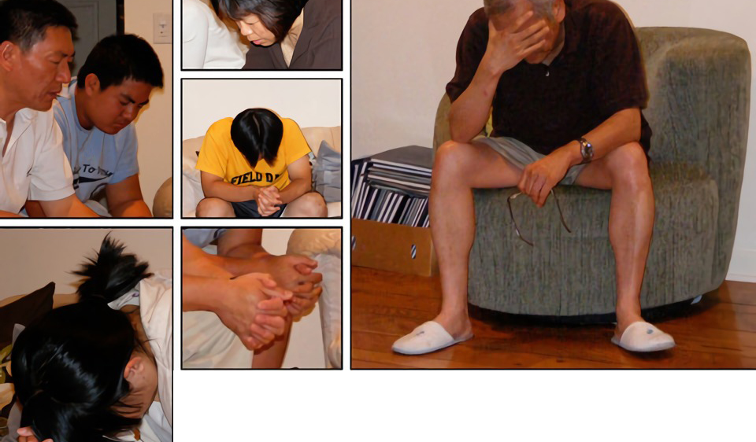
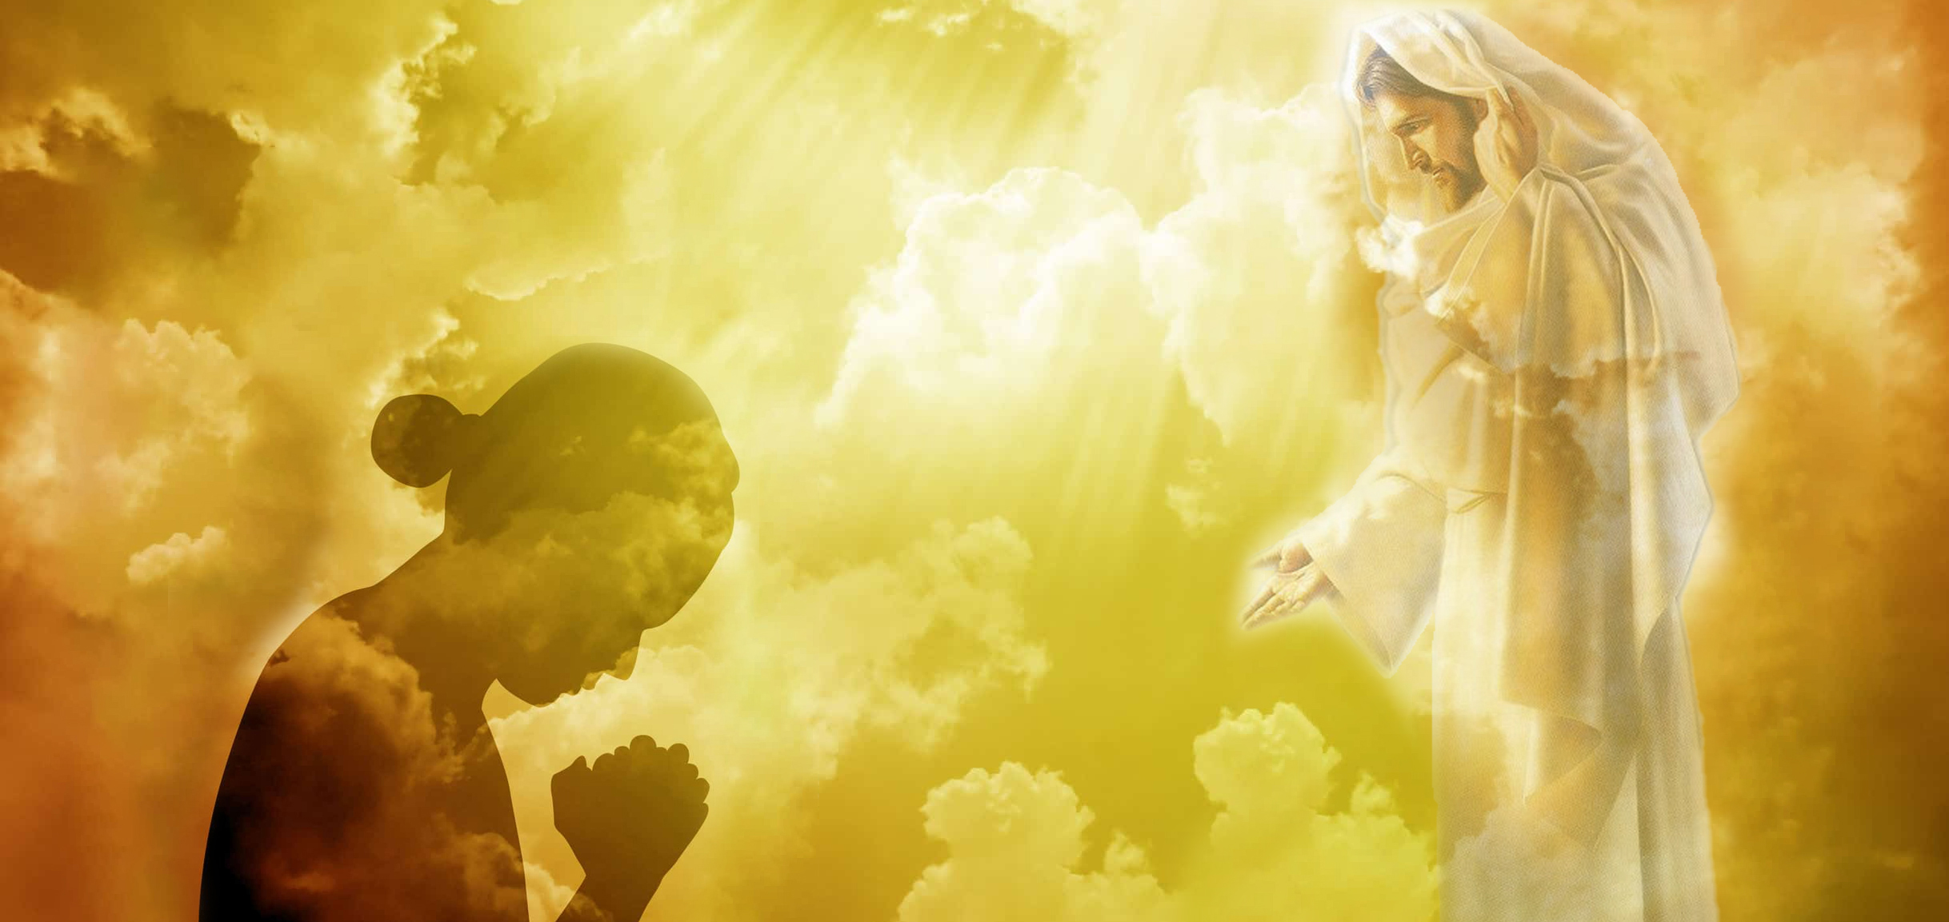

3
Finish the sentence:
“Prayer is
__________________________________________________________________________________________________________________________________ _______________________________________________________________________________________________________”.
Prayer is the opening of the heart to God as to a friend.
4
What purposes are suggested for prayer?
Not that it is necessary in order to make known to God what we are, but in order to enable us to receive Him. Prayer does not bring God down to us, but brings us up to Him.

Slide 13


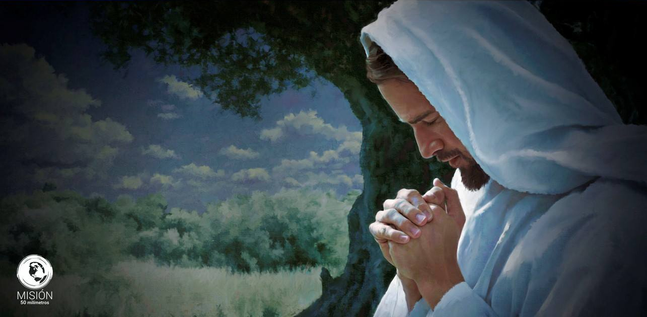


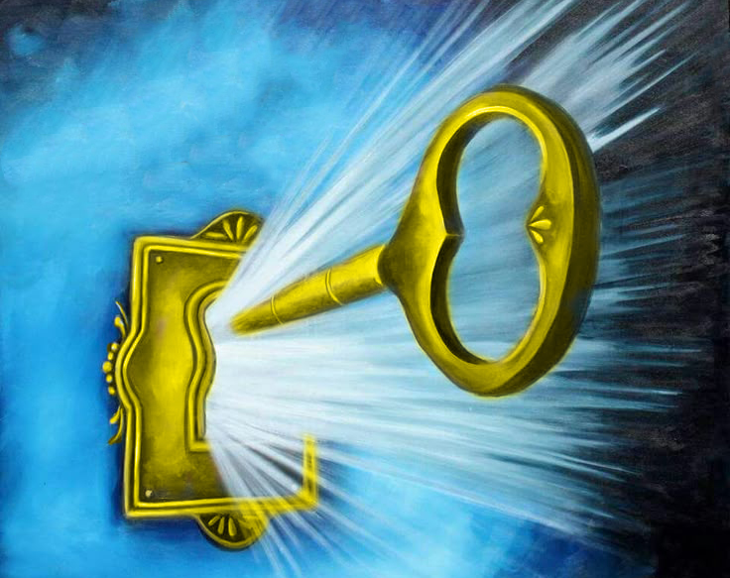

5
List several reasons Jesus prayed often while on earth.
Jesus became a suppliant, a petitioner, seeking from His Father fresh supplies of strength, that He might come forth braced for duty and trial.
His humanity made prayer a necessity and a privilege. He found comfort and joy in communion with His Father. And if the Saviour of men, the Son of God, felt the need of prayer, how much more should feeble, sinful mortals feel the necessity of fervent, constant prayer.
6
What happens to those who neglect prayer?
The darkness of the evil one encloses those who neglect to pray. The whispered temptations of the enemy entice them to sin; and it is all because they do not make use of the privileges that God has given them in the divine appointment of prayer.
7
Prayer is called the __________________ in the hand of faith. Write out the complete sentence.
Prayer is the key in the hand of faith to unlock heaven’s storehouse, where are treasured the boundless resources of Omnipotence.

Slide 14

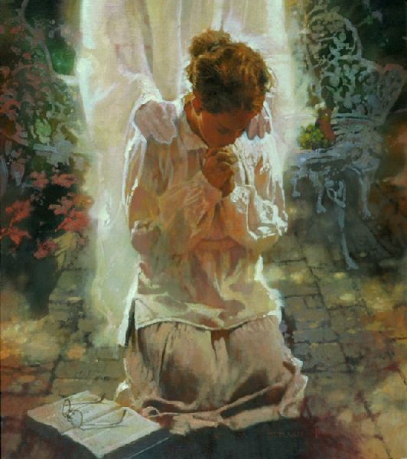


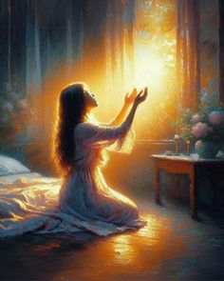
8
Four conditions of answered prayer are given. List them.
One of the first of these is that we feel our need of help from Him. He has promised, “I will pour water upon him that is thirsty, and floods upon the dry ground.” Isaiah 44:3. Those who hunger and thirst after righteousness, who long after God, may be sure that they will be filled.
The heart must be open to the Spirit’s influence, or God’s blessing cannot be received.
Our great need is itself an argument and pleads most eloquently in our behalf. But the Lord is to be sought unto to do these things for us. He says, “Ask, and it shall be given you.” And “He that spared not His own Son, but delivered Him up for us all, how shall He not with Him also freely give us all things?”
If we regard iniquity in our hearts, if we cling to any known sin, the Lord will not hear us; but the prayer of the penitent, contrite soul is always accepted. When all known wrongs are righted, we may believe that God will answer our petitions.
Another element of prevailing prayer is faith. “He that cometh to God must believe that He is, and that He is a rewarder of them that diligently seek Him.” Hebrews 11:6. Jesus said to His disciples, “What things soever ye desire, when ye pray, believe that ye receive them, and ye shall have them.” Mark 11:24. Do we take Him at His word?

Slide 15


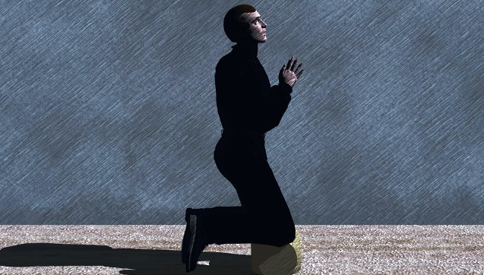


9
How does God sometimes answer our prayers when we ask for something that would not be a blessing?
When we do not receive the very things we asked for, at the time we ask, we are still to believe that the Lord hears and that He will answer our prayers. We are so erring and short-sighted that we sometimes ask for things that would not be a blessing to us, and our heavenly Father in love answers our prayers by giving us that which will be for our highest good—that which we ourselves would desire if with vision divinely enlightened we could see all things as they really are.
10
How is presumption defined in connection with prayer?
But to claim that prayer will always be answered in the very way and for the particular thing that we desire, is presumption. God is too wise to err, and too good to withhold any good thing from them that walk uprightly. Then do not fear to trust Him, even though you do not see the immediate answer to your prayers. Rely upon His sure promise, “Ask, and it shall be given you.”

Slide 16


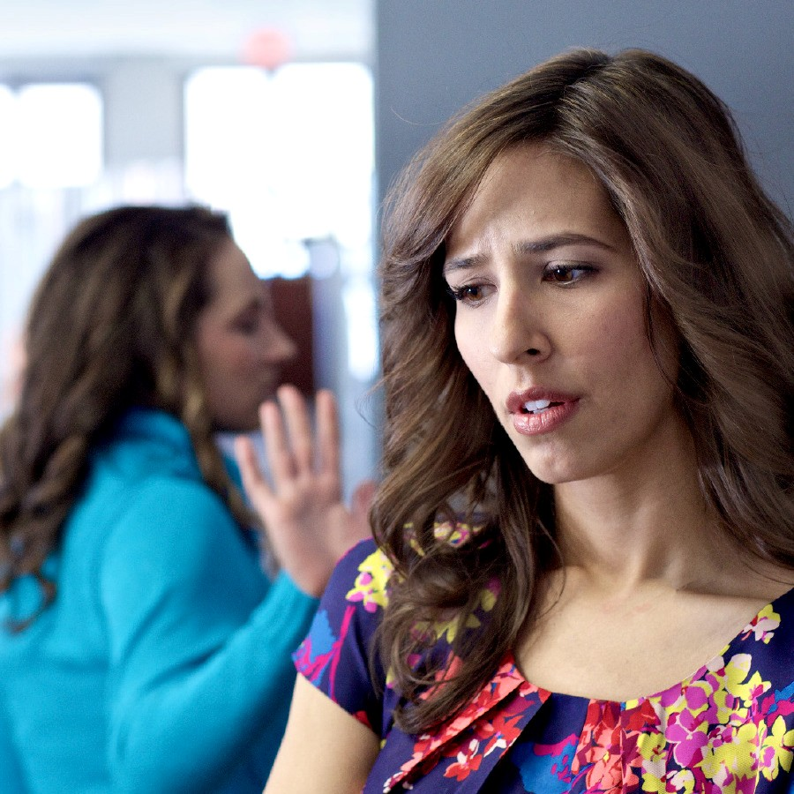


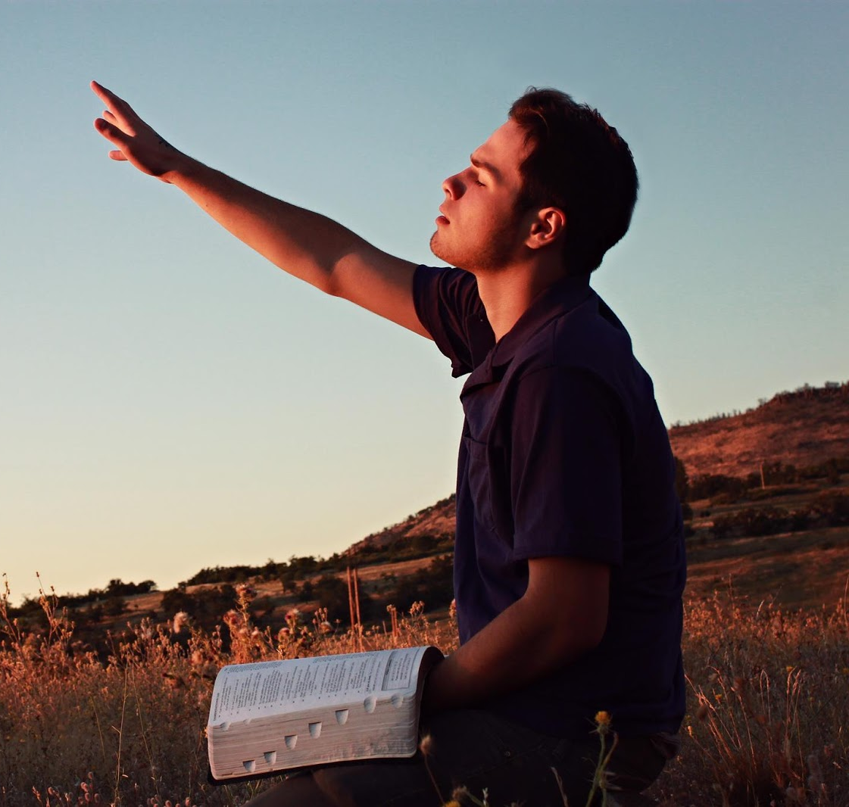
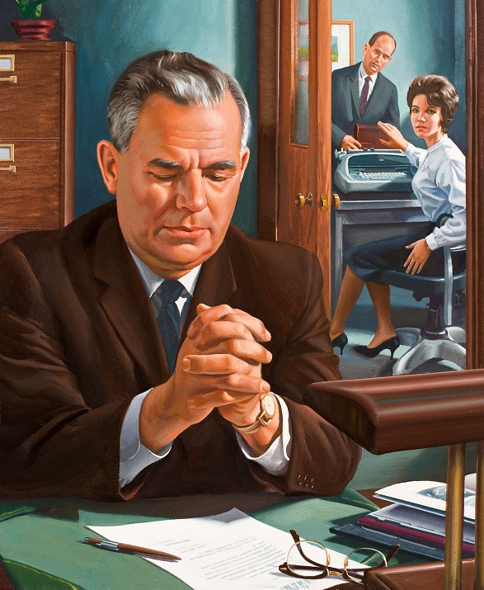
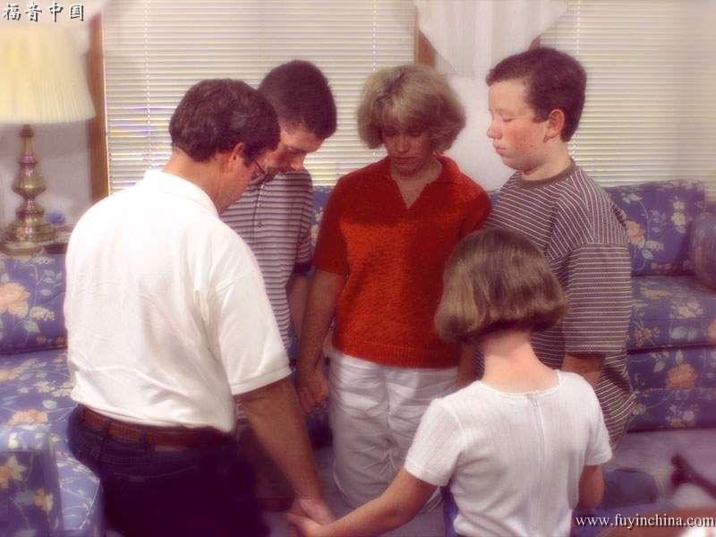

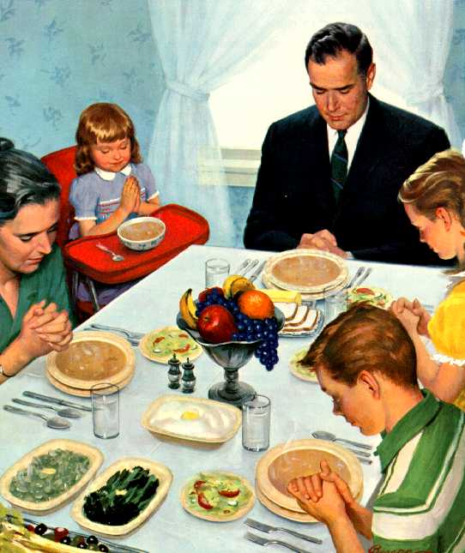
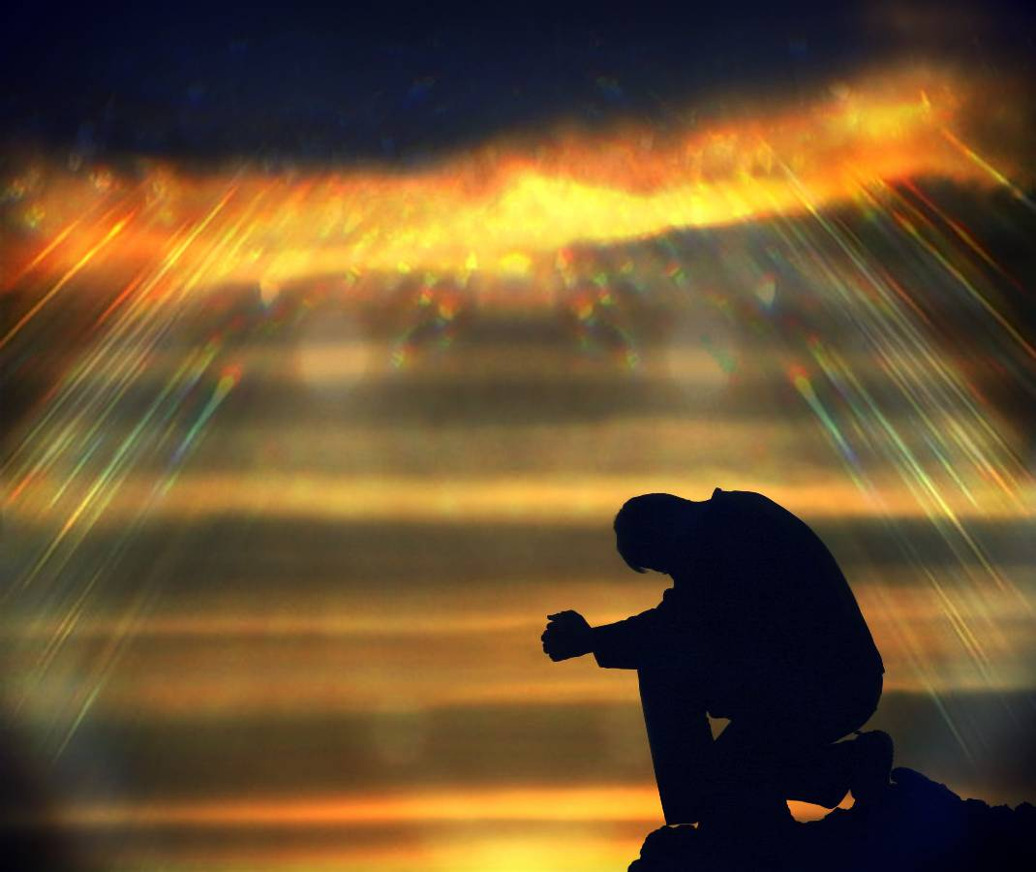

11
Under what circumstance only can we expect mercy and blessing from God when we pray?
When we come to ask mercy and blessing from God we should have a spirit of love and forgiveness in our own hearts. How can we pray, “Forgive us our debts, as we forgive our debtors,” and yet indulge an unforgiving spirit? Matthew 6:12. If we expect our own prayers to be heard we must forgive others in the same manner and to the same extent as we hope to be forgiven.
12
What do you think the Bible means when it says we are to be “instant in prayer”? See Romans 12:12
Perseverance in prayer has been made a condition of receiving. We must pray always if we would grow in faith and experience. We are to be “instant in prayer,” to “continue in prayer, and watch in the same with thanksgiving.” Romans 12:12; Colossians 4:2. Peter exhorts believers to be “sober, and watch unto prayer.” 1 Peter 4:7. Paul directs, “In everything by prayer and supplication with thanksgiving let your requests be made known unto God.” Philippians 4:6. “But ye, beloved,” says Jude, “praying in the Holy Ghost, keep yourselves in the love of God.” Jude 20, 21. Unceasing prayer is the unbroken union of the soul with God, so that life from God flows into our life; and from our life, purity and holiness flow back to God.

Slide 17


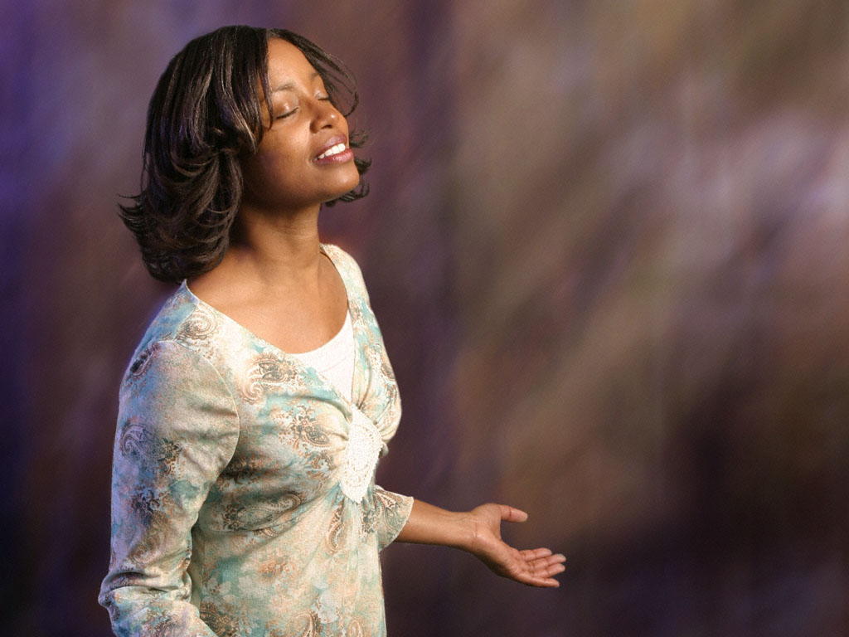


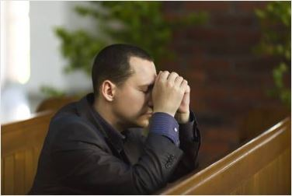
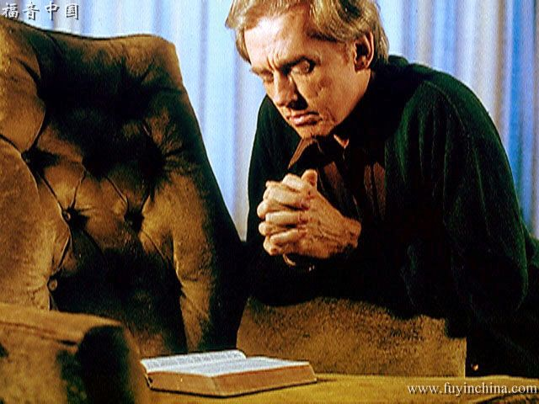
13
What kind of prayer is “the life of the soul”? Why?
…and above all we must not neglect secret prayer, for this is the life of the soul… In secret prayer the soul is free from surrounding influences, free from excitement. Calmly, yet fervently, will it reach out after God. Sweet and abiding will be the influence emanating from Him who seeth in secret, whose ear is open to hear the prayer arising from the heart. By calm, simple faith the soul holds communion with God and gathers to itself rays of divine light to strengthen and sustain it in the conflict with Satan. God is our tower of strength.
14
How did Enoch walk with God? What might we do to walk with God?
Seek every opportunity to go where prayer is wont to be made. Those who are really seeking for communion with God will be seen in the prayer meeting, faithful to do their duty and earnest and anxious to reap all the benefits they can gain. They will improve every opportunity of placing themselves where they can receive the rays of light from heaven…
We should pray in the family circle, and above all we must not neglect secret prayer, for this is the life of the soul. It is impossible for the soul to flourish while prayer is neglected. Family or public prayer alone is not sufficient…
Pray in your closet, and as you go about your daily labor let your heart be often uplifted to God. It was thus that Enoch walked with God. These silent prayers rise like precious incense before the throne of grace. Satan cannot overcome him whose heart is thus stayed upon God.

Slide 18


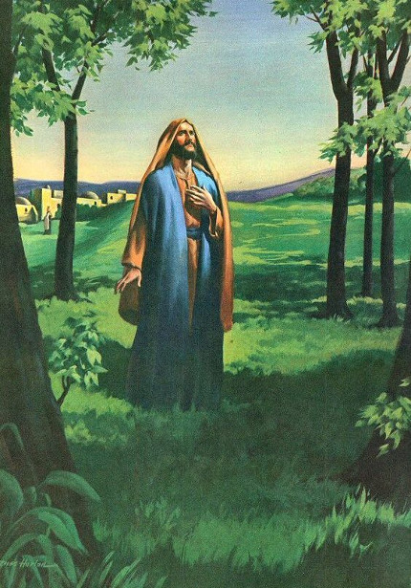
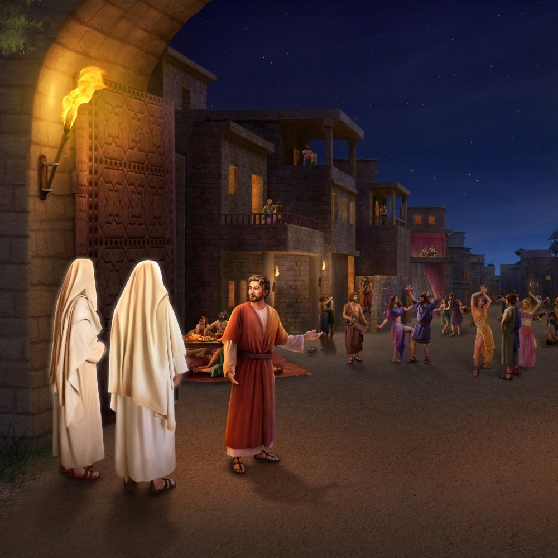


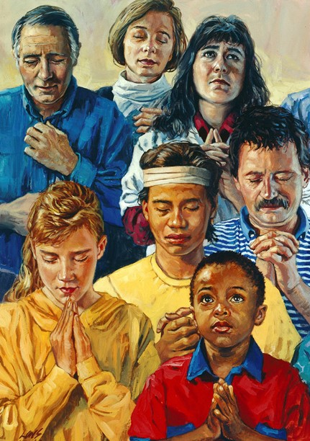
15
How might we live as in the atmosphere of heaven?
Although there may be a tainted, corrupted atmosphere around us, we need not breathe its miasma, but may live in the pure air of heaven. We may close every door to impure imaginings and unholy thoughts by lifting the soul into the presence of God through sincere prayer. Those whose hearts are open to receive the support and blessing of God will walk in a holier atmosphere than that of earth and will have constant communion with heaven.
Enoch
Lot
16
If we keep close to God, what will happen when unexpected trials come?
Let the soul be drawn out and upward, that God may grant us a breath of the heavenly atmosphere. We may keep so near to God that in every unexpected trial our thoughts will turn to Him as naturally as the flower turns to the sun.

Slide 19


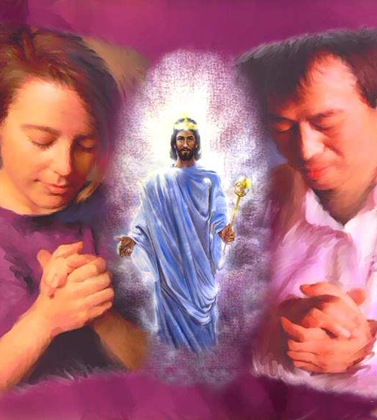
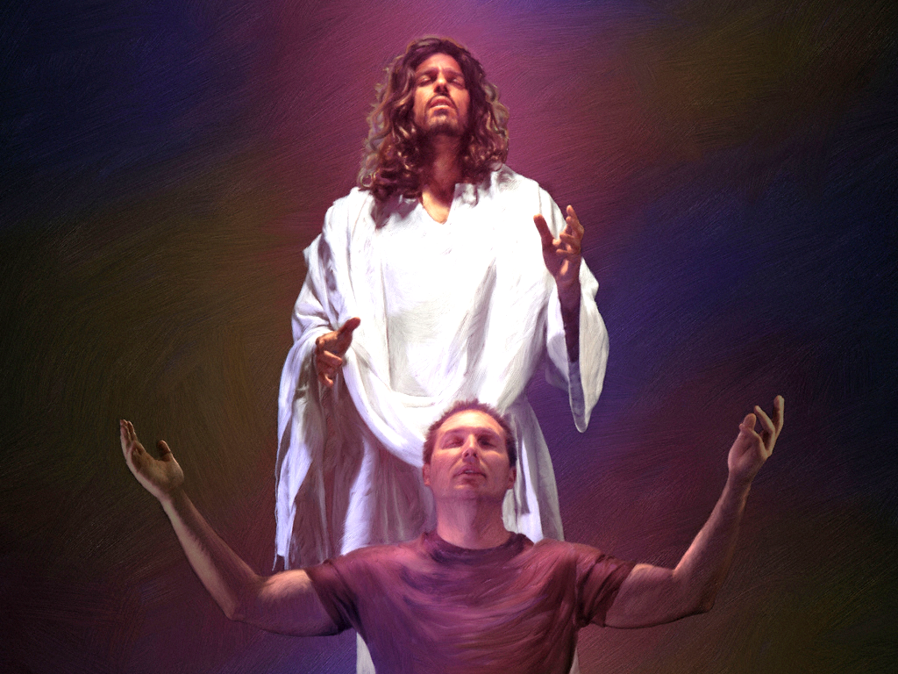

17
Review the many things God welcomes us to bring to His attention in prayer.
Keep your wants, your joys, your sorrows, your cares, and your fears before God. You cannot burden Him; you cannot weary Him.
He who numbers the hairs of your head is not indifferent to the wants of His children. “The Lord is very pitiful, and of tender mercy.” James 5:11. His heart of love is touched by our sorrows and even by our utterances of them. Take to Him everything that perplexes the mind. Nothing is too great for Him to bear, for He holds up worlds, He rules over all the affairs of the universe. Nothing that in any way concerns our peace is too small for Him to notice. There is no chapter in our experience too dark for Him to read; there is no perplexity too difficult for Him to unravel. No calamity can befall the least of His children, no anxiety harass the soul, no joy cheer, no sincere prayer escape the lips, of which our heavenly Father is unobservant, or in which He takes no immediate interest.
“He healeth the broken in heart, and bindeth up their wounds.” Psalm 147:3
18
How close are the relations between God and each soul?
The relations between God and each soul are as distinct and full as though there were not another soul upon the earth to share His watchcare, not another soul for whom He gave His beloved Son.

Slide 20






19
What can take away the subject matter of prayer and the incentive for devotion?
When men take themselves out of social life, away from the sphere of Christian duty and cross bearing; when they cease to work earnestly for the Master, who worked earnestly for them, they lose the subject matter of prayer and have no incentive to devotion. Their prayers become personal and selfish. They cannot pray in regard to the wants of humanity or the upbuilding of Christ’s kingdom, pleading for strength wherewith to work.
20
When we neglect association with others in Christian fellowship, how does it affect our Christian experience?
We sustain a loss when we neglect the privilege of associating together to strengthen and encourage one another in the service of God. The truths of His word lose their vividness and importance in our minds. Our hearts cease to be enlightened and aroused by their sanctifying influence, and we decline in spirituality. In our association as Christians we lose much by lack of sympathy with one another. He who shuts himself up to himself is not filling the position that God designed he should. The proper cultivation of the social elements in our nature brings us into sympathy with others and is a means of development and strength to us in the service of God.

Slide 21






21
When we do associate in Christian fellowship, how is our Christian experience affected?
If Christians would associate together, speaking to each other of the love of God and of the precious truths of redemption, their own hearts would be refreshed and they would refresh one another. We may be daily learning more of our heavenly Father, gaining a fresh experience of His grace; then we shall desire to speak of His love; and as we do this, our own hearts will be warmed and encouraged. If we thought and talked more of Jesus, and less of self, we should have far more of His presence.
22
What would happen in our Christian experience if we thought and talked more of Christ?
If we would but think of God as often as we have evidence of His care for us we should keep Him ever in our thoughts and should delight to talk of Him and to praise Him.
We talk of temporal things because we have an interest in them. We talk of our friends because we love them; our joys and our sorrows are bound up with them. Yet we have infinitely greater reason to love God than to love our earthly friends; it should be the most natural thing in the world to make Him first in all our thoughts, to talk of His goodness and tell of His power.

Slide 22





23
In addition to asking and receiving, what else should our prayers include?
We need to praise God more “for His goodness, and for His wonderful works to the children of men.” Psalm 107:8. Our devotional exercises should not consist wholly in asking and receiving. Let us not be always thinking of our wants and never of the benefits we receive. We do not pray any too much, but we are too sparing of giving thanks. We are the constant recipients of God’s mercies, and yet how little gratitude we express, how little we praise Him for what He has done for us.
24
In what spirit should we work for the glory of God?
Our God is a tender, merciful Father. His service should not be looked upon as a heart-saddening, distressing exercise. It should be a pleasure to worship the Lord and to take part in His work. God would not have His children, for whom so great salvation has been provided, act as if He were a hard, exacting taskmaster. He is their best friend; and when they worship Him, He expects to be with them, to bless and comfort them, filling their hearts with joy and love. The Lord desires His children to take comfort in His service and to find more pleasure than hardship in His work. He desires that those who come to worship Him shall carry away with them precious thoughts of His care and love, that they may be cheered in all the employments of daily life, that they may have grace to deal honestly and faithfully in all things.

Slide 23



25
What should be the theme of our most joyful emotion?
We must gather about the cross. Christ and Him crucified should be the theme of contemplation, of conversation, and of our most joyful emotion. We should keep in our thoughts every blessing we receive from God, and when we realize His great love we should be willing to trust everything to the hand that was nailed to the cross for us.
The soul may ascend nearer heaven on the wings of praise. God is worshiped with song and music in the courts above, and as we express our gratitude we are approximating to the worship of the heavenly hosts. “Whoso offereth praise glorifieth” God. Psalm 50:23. Let us with reverent joy come before our Creator, with “thanksgiving, and the voice of melody.” Isaiah 51:3

