Slide 1


Slide 2

I want to thank the mothers for their influence and for those activities of daily life that they carry out in favor of their children.
God will reward mothers who influenced their children to live in fellowship with God and work for the salvation of others.
I would like to encourage you, mother, to persevere in close fellowship with God, and to continue to lead your children on the path to heaven.
“Who can find a virtuous woman?… Her children arise up, and call her blessed”
Proverbs 31:10, 28. Thank you for your influence, Mom!

Slide 3




Because since I was a child you have shown me with your example that everything has its order and place, that order is the first rule in heaven and also in
our home. That cleanliness
in my clothes, my jobs, my thoughts and
my lips honor God.
Thank you, Mom, for your influence on my cleanliness and order.
That is why I will not forget that:

Slide 4

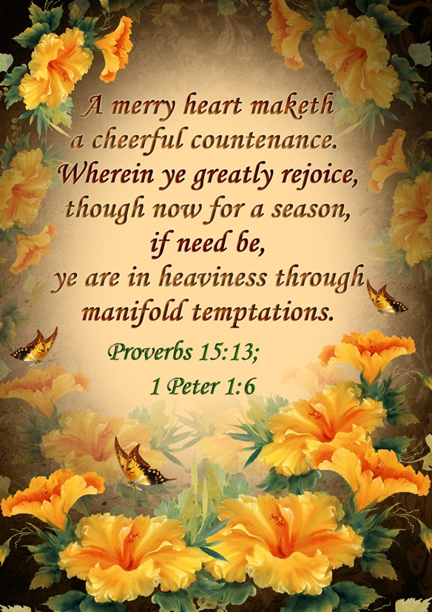
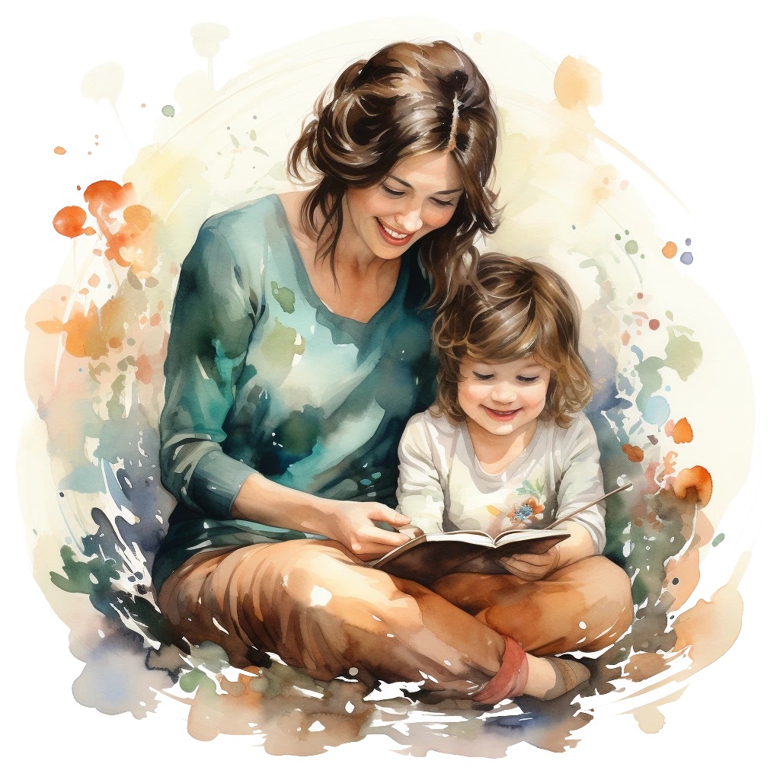
By seeing you every day you teach me that trials polish our character; that offensive words should not come from joyful lips; and that, no matter how difficult and dark the day looks, there is always the sun.
Thank you for your influence in keeping a song in the heart
Your smile and your singing, even when others insist on crying, has taught me that God's children walk to heaven with gratitude and joy, confident that Jesus will lead them.
That is why I will not forget that:

Slide 5


Thank you for your influence, Mom, on the value of time.
You have taught me to be friends with the clock, knowing that there is a time to learn, play, do homework, help with homework... That I must fulfill my commitments on time, and that every
day I must seek God. But, above all, I have learned to value the time of the Sabbath, as a day dedicated to God, honoring God in every activity.
That is why I will not forget that:

Slide 6


Thank you, Mom, for your influence in keeping me healthy.
Every day you teach me that I must eat well so that my body is healthier and my mind more receptive to the influence of the Holy Spirit.
You also teach me not to acquire bad habits; how important it is to get enough sleep; and that exercise helps me stay healthy.
That is why I will not forget that:

Slide 7

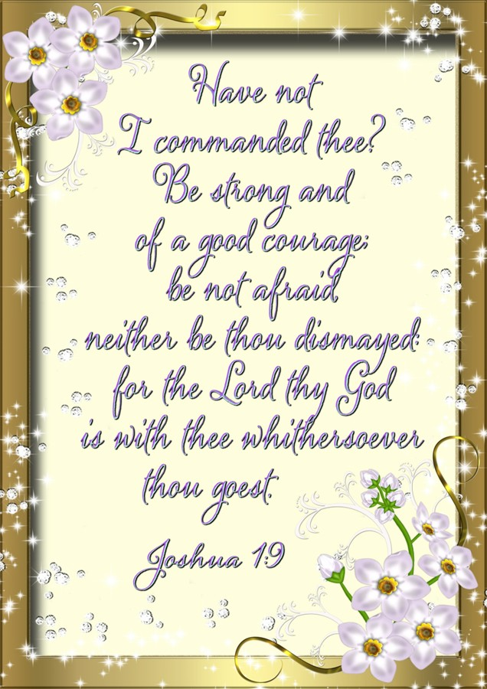
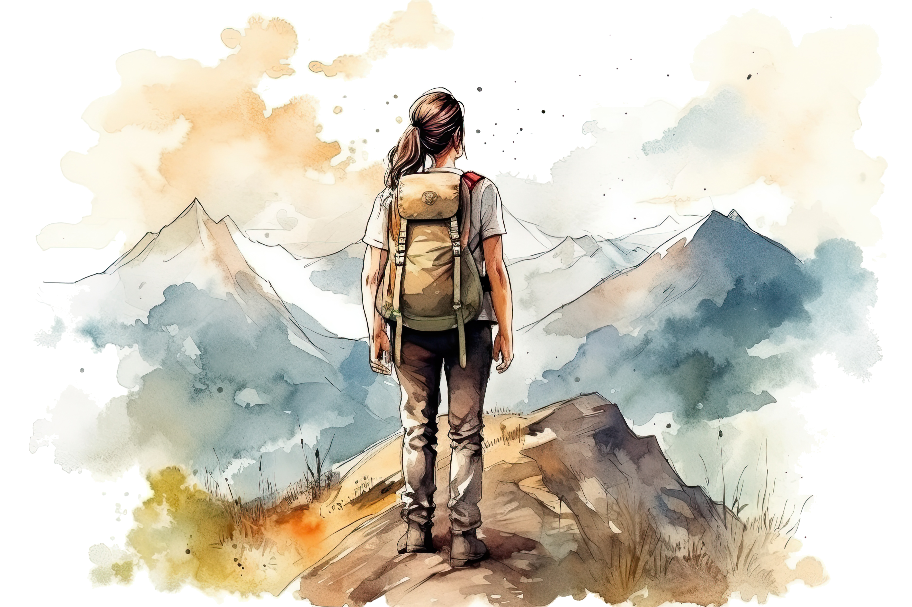
When I am about to lose heart and give up, it is when you remind me that perseverance is not paying attention to the difficulty of the road, or to the voices of the people, but to set your sights on the goal and insist until you get there. You give me as an example the heroes of the Bible, who even in the midst of difficulties, raised their eyes, hoping to receive the crown of righteousness.
Thank you for your influence in being perseverant.
And I can't forget:

Slide 8

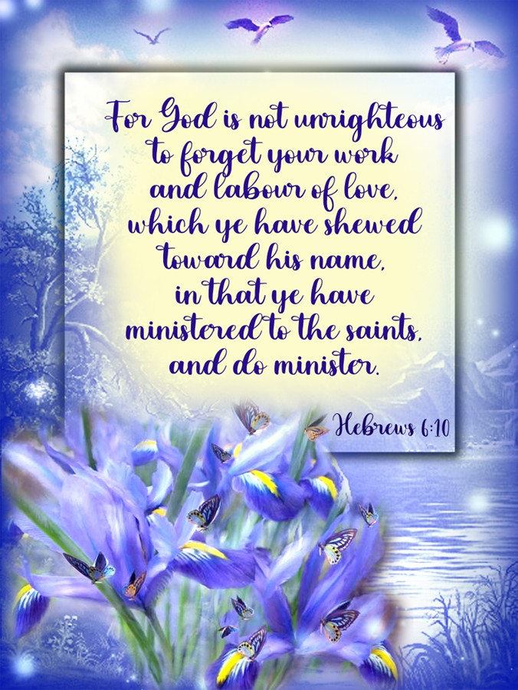
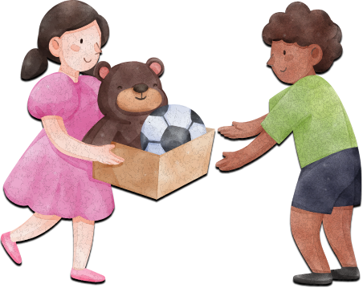

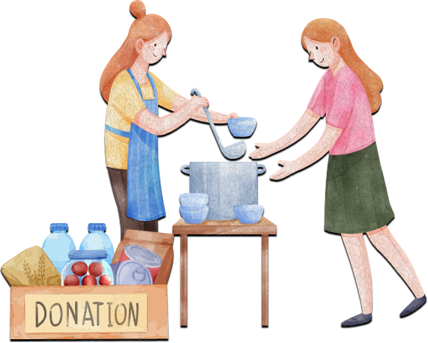
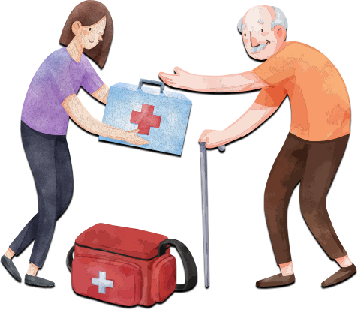
Every day I can see your willingness to serve, to share, and to give, even when you are tired. You have taught me to see the needs of others before my own; to be willing to walk the second mile; and to share blessings and talents. You have taught me that the more you share your time, your resources, your shelter, or your food, the more God gives us.
Thank you for your influence, Mom, in being helpful.
That is why I will not forget that:

Slide 9

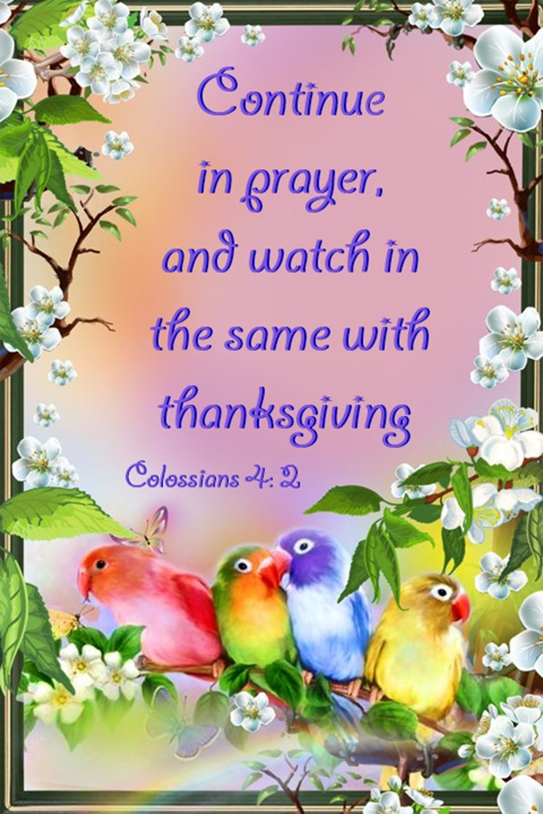
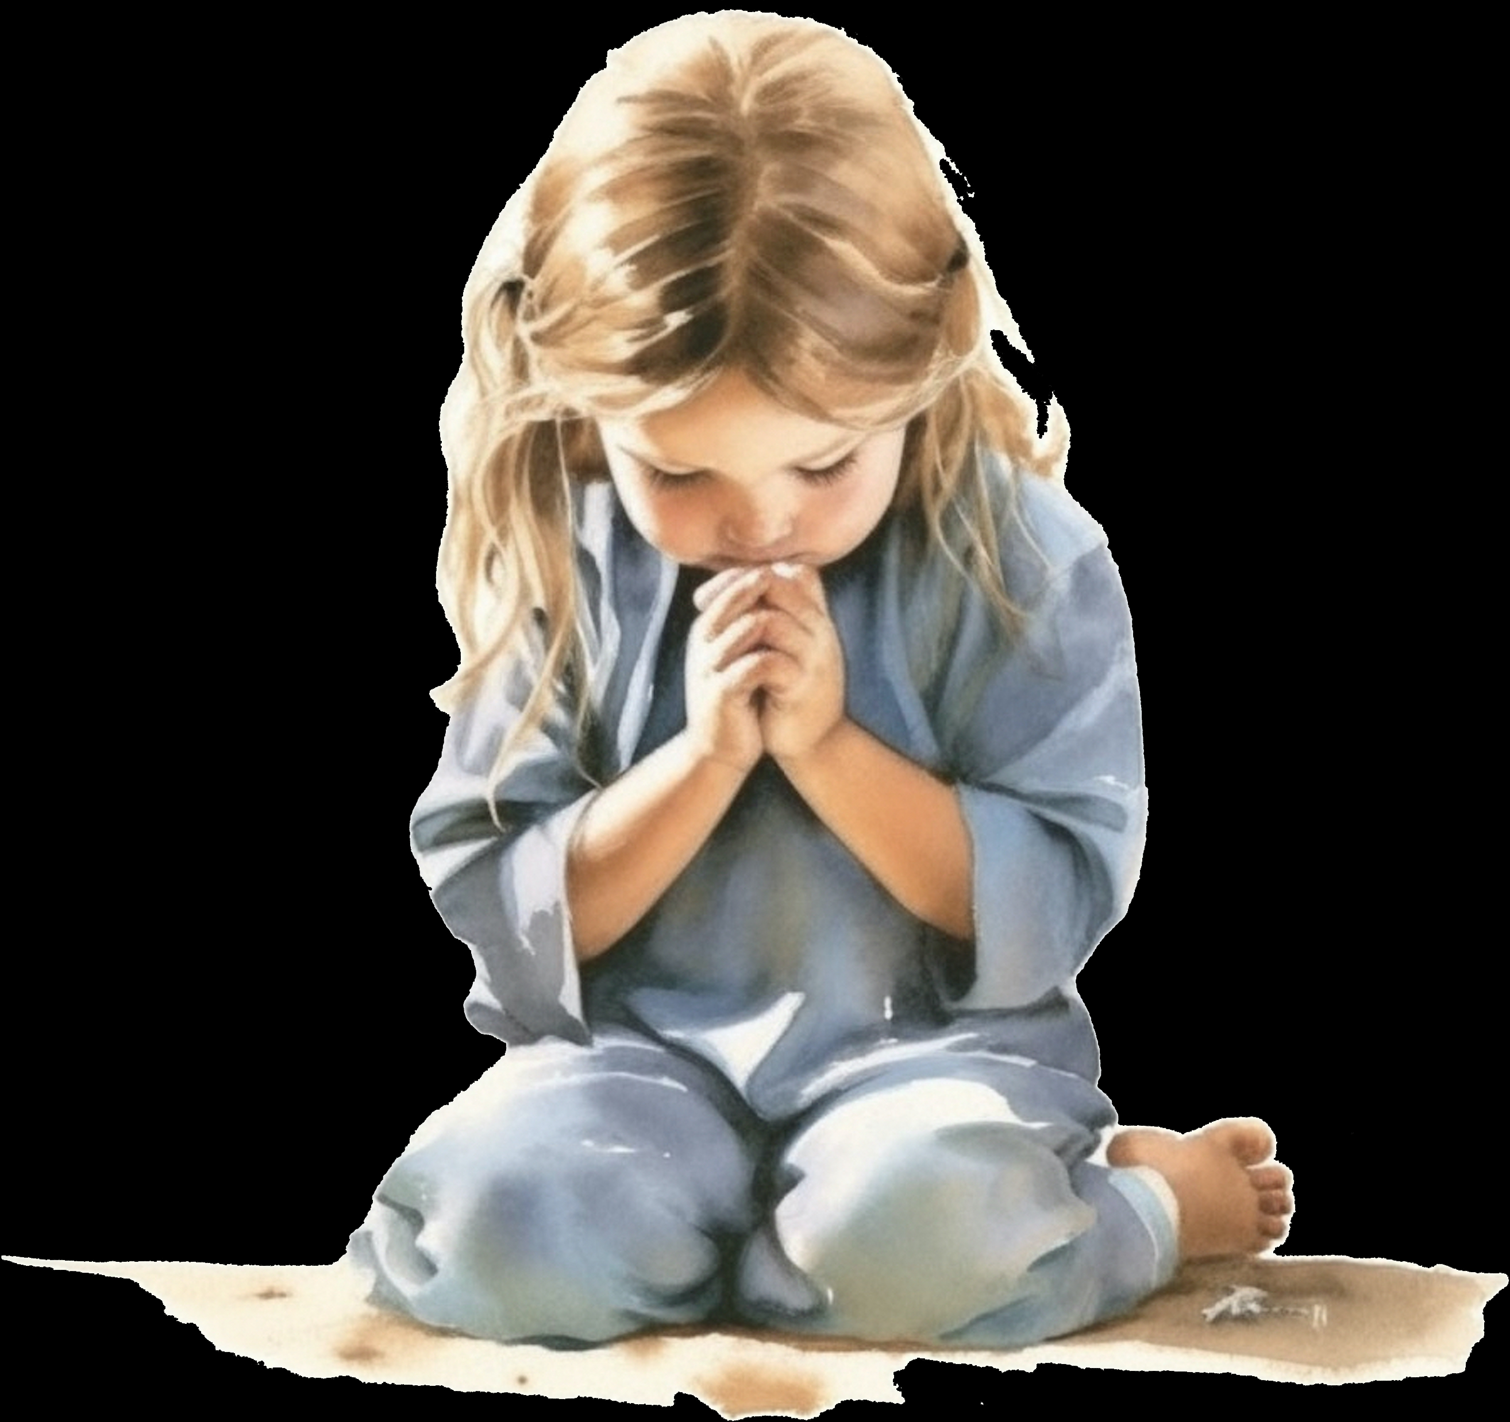
Thank you, Mom, for your influence on prayer.
I know you have a lot of activities to do at home, in church, and in the community, but I also know you have a special time of prayer, I know that when you pray you ask for wisdom, you ask for patience, you ask for strength and good cheer. I know that you put each child in God's hands, you ask him that we be children, young people and young women faithful as the compass to the pole. I have learned to seek God, to depend on Him, and to desire Him to be my companion and guide.
Therefore, I cannot forget:

Slide 10

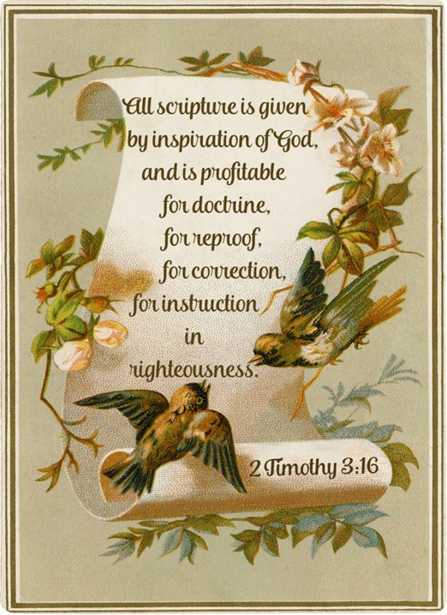

Thank you for your influence in appreciating good reading.
You work a lot but every day I see you pick up your Bible and study it. This is a good example for me.
Thank you for teaching me that in the Bible I will find food for my soul. Thank you for reading me the stories it contains and encouraging me to study it, so that I discover what I have to do here in my life and how to prepare myself for eternity.
Therefore, I cannot forget:

Slide 11
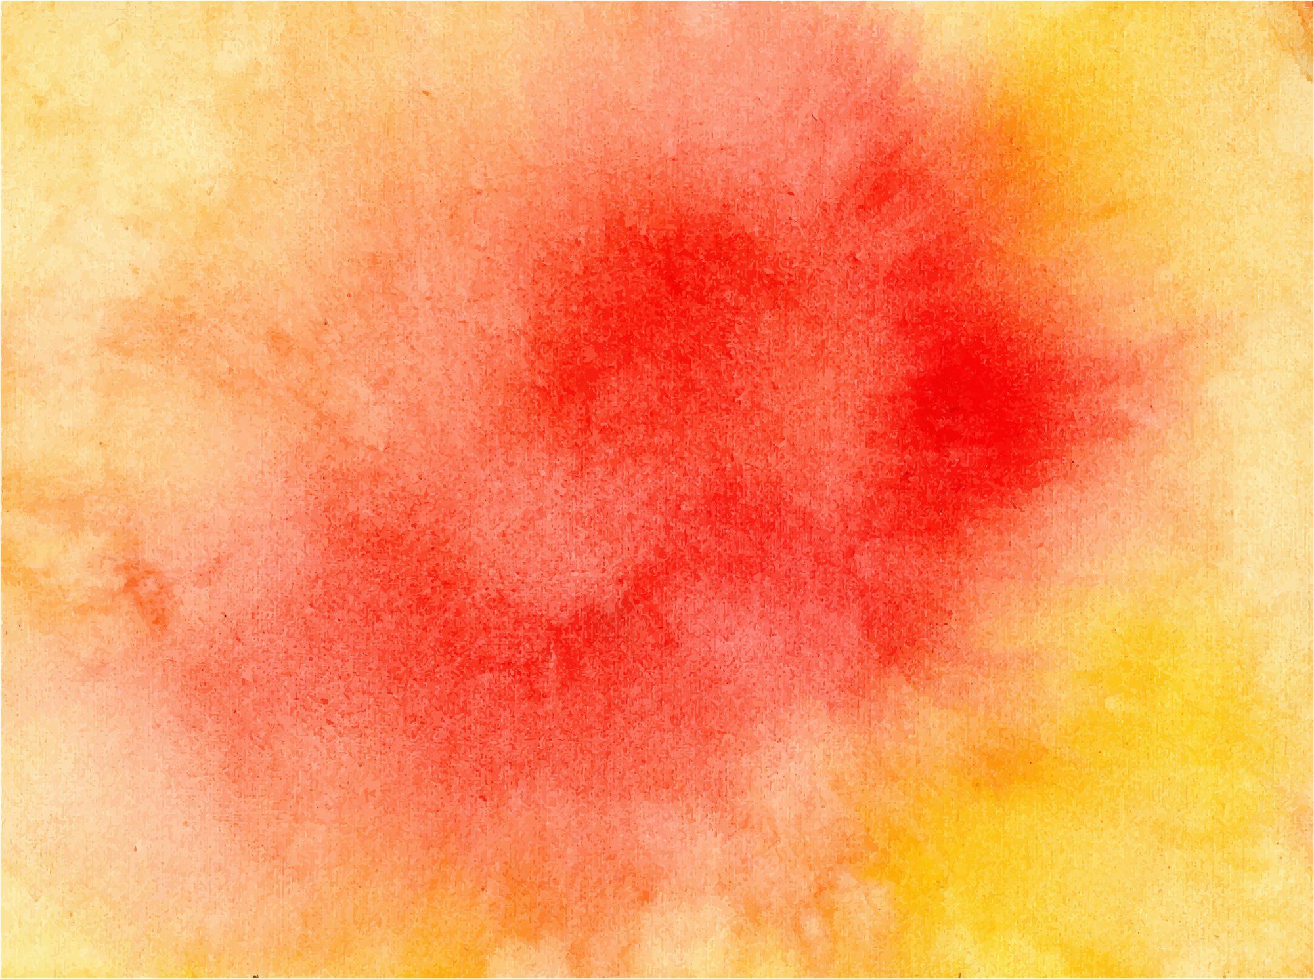
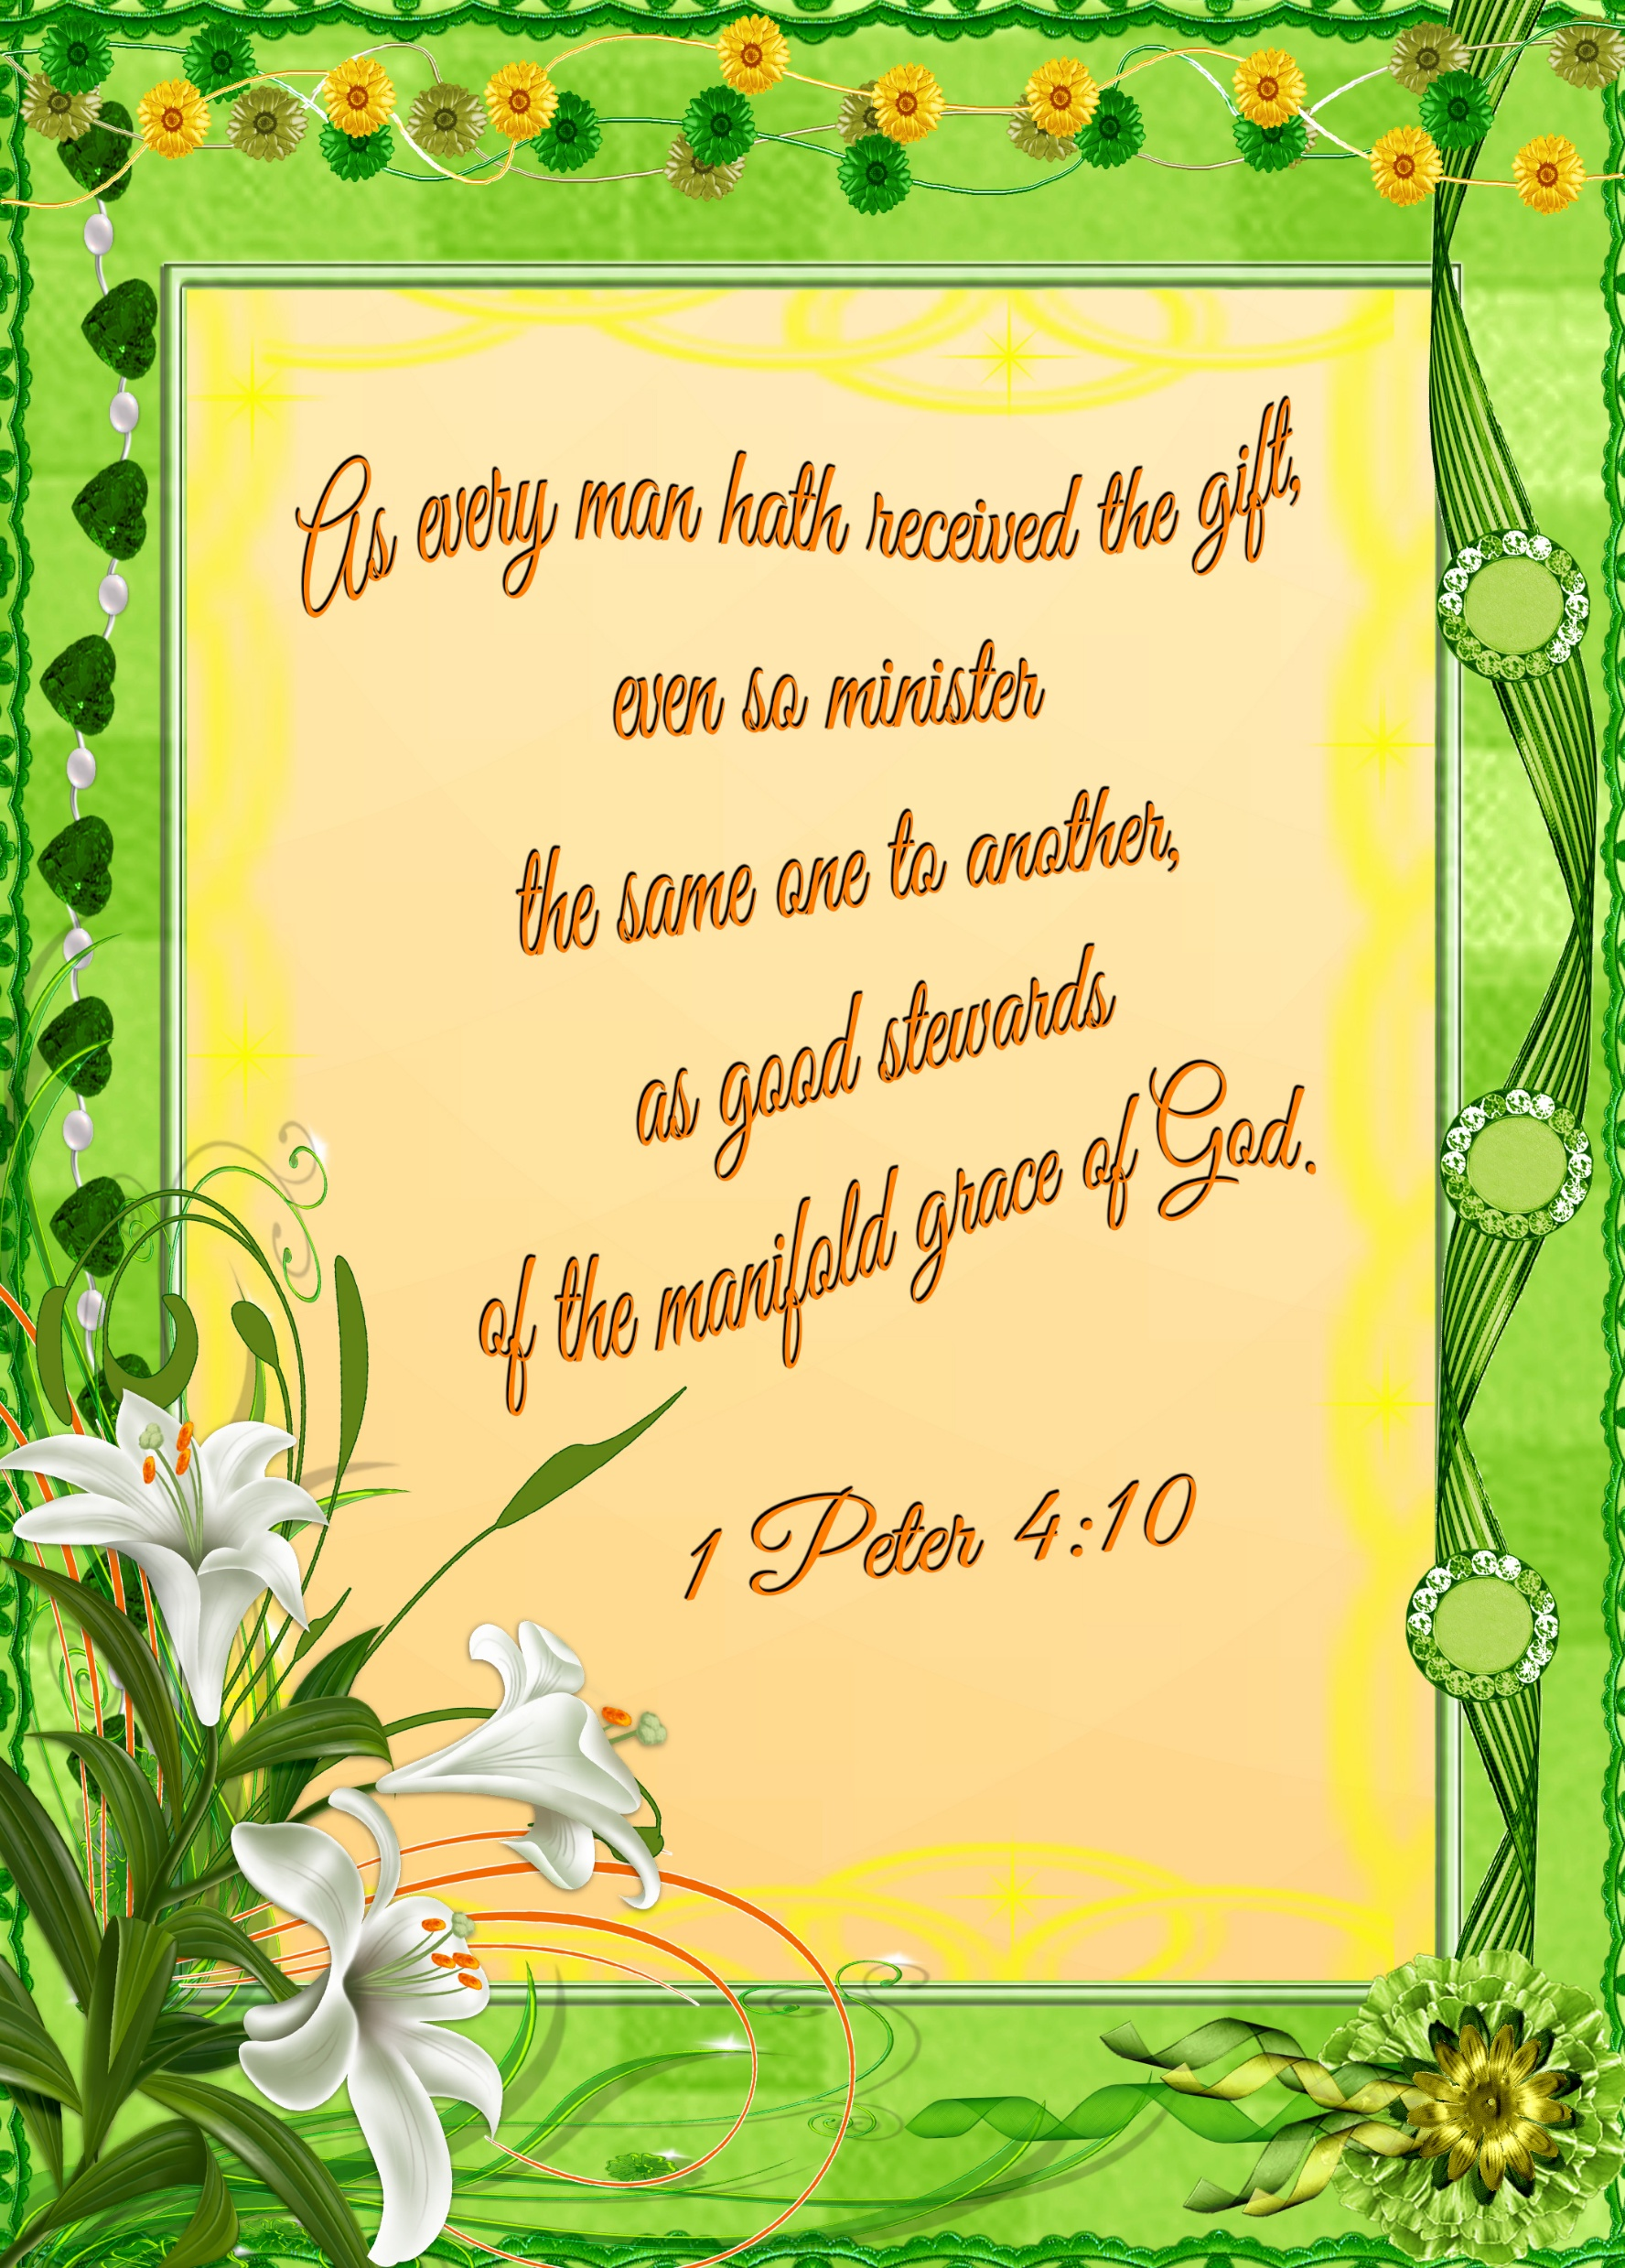
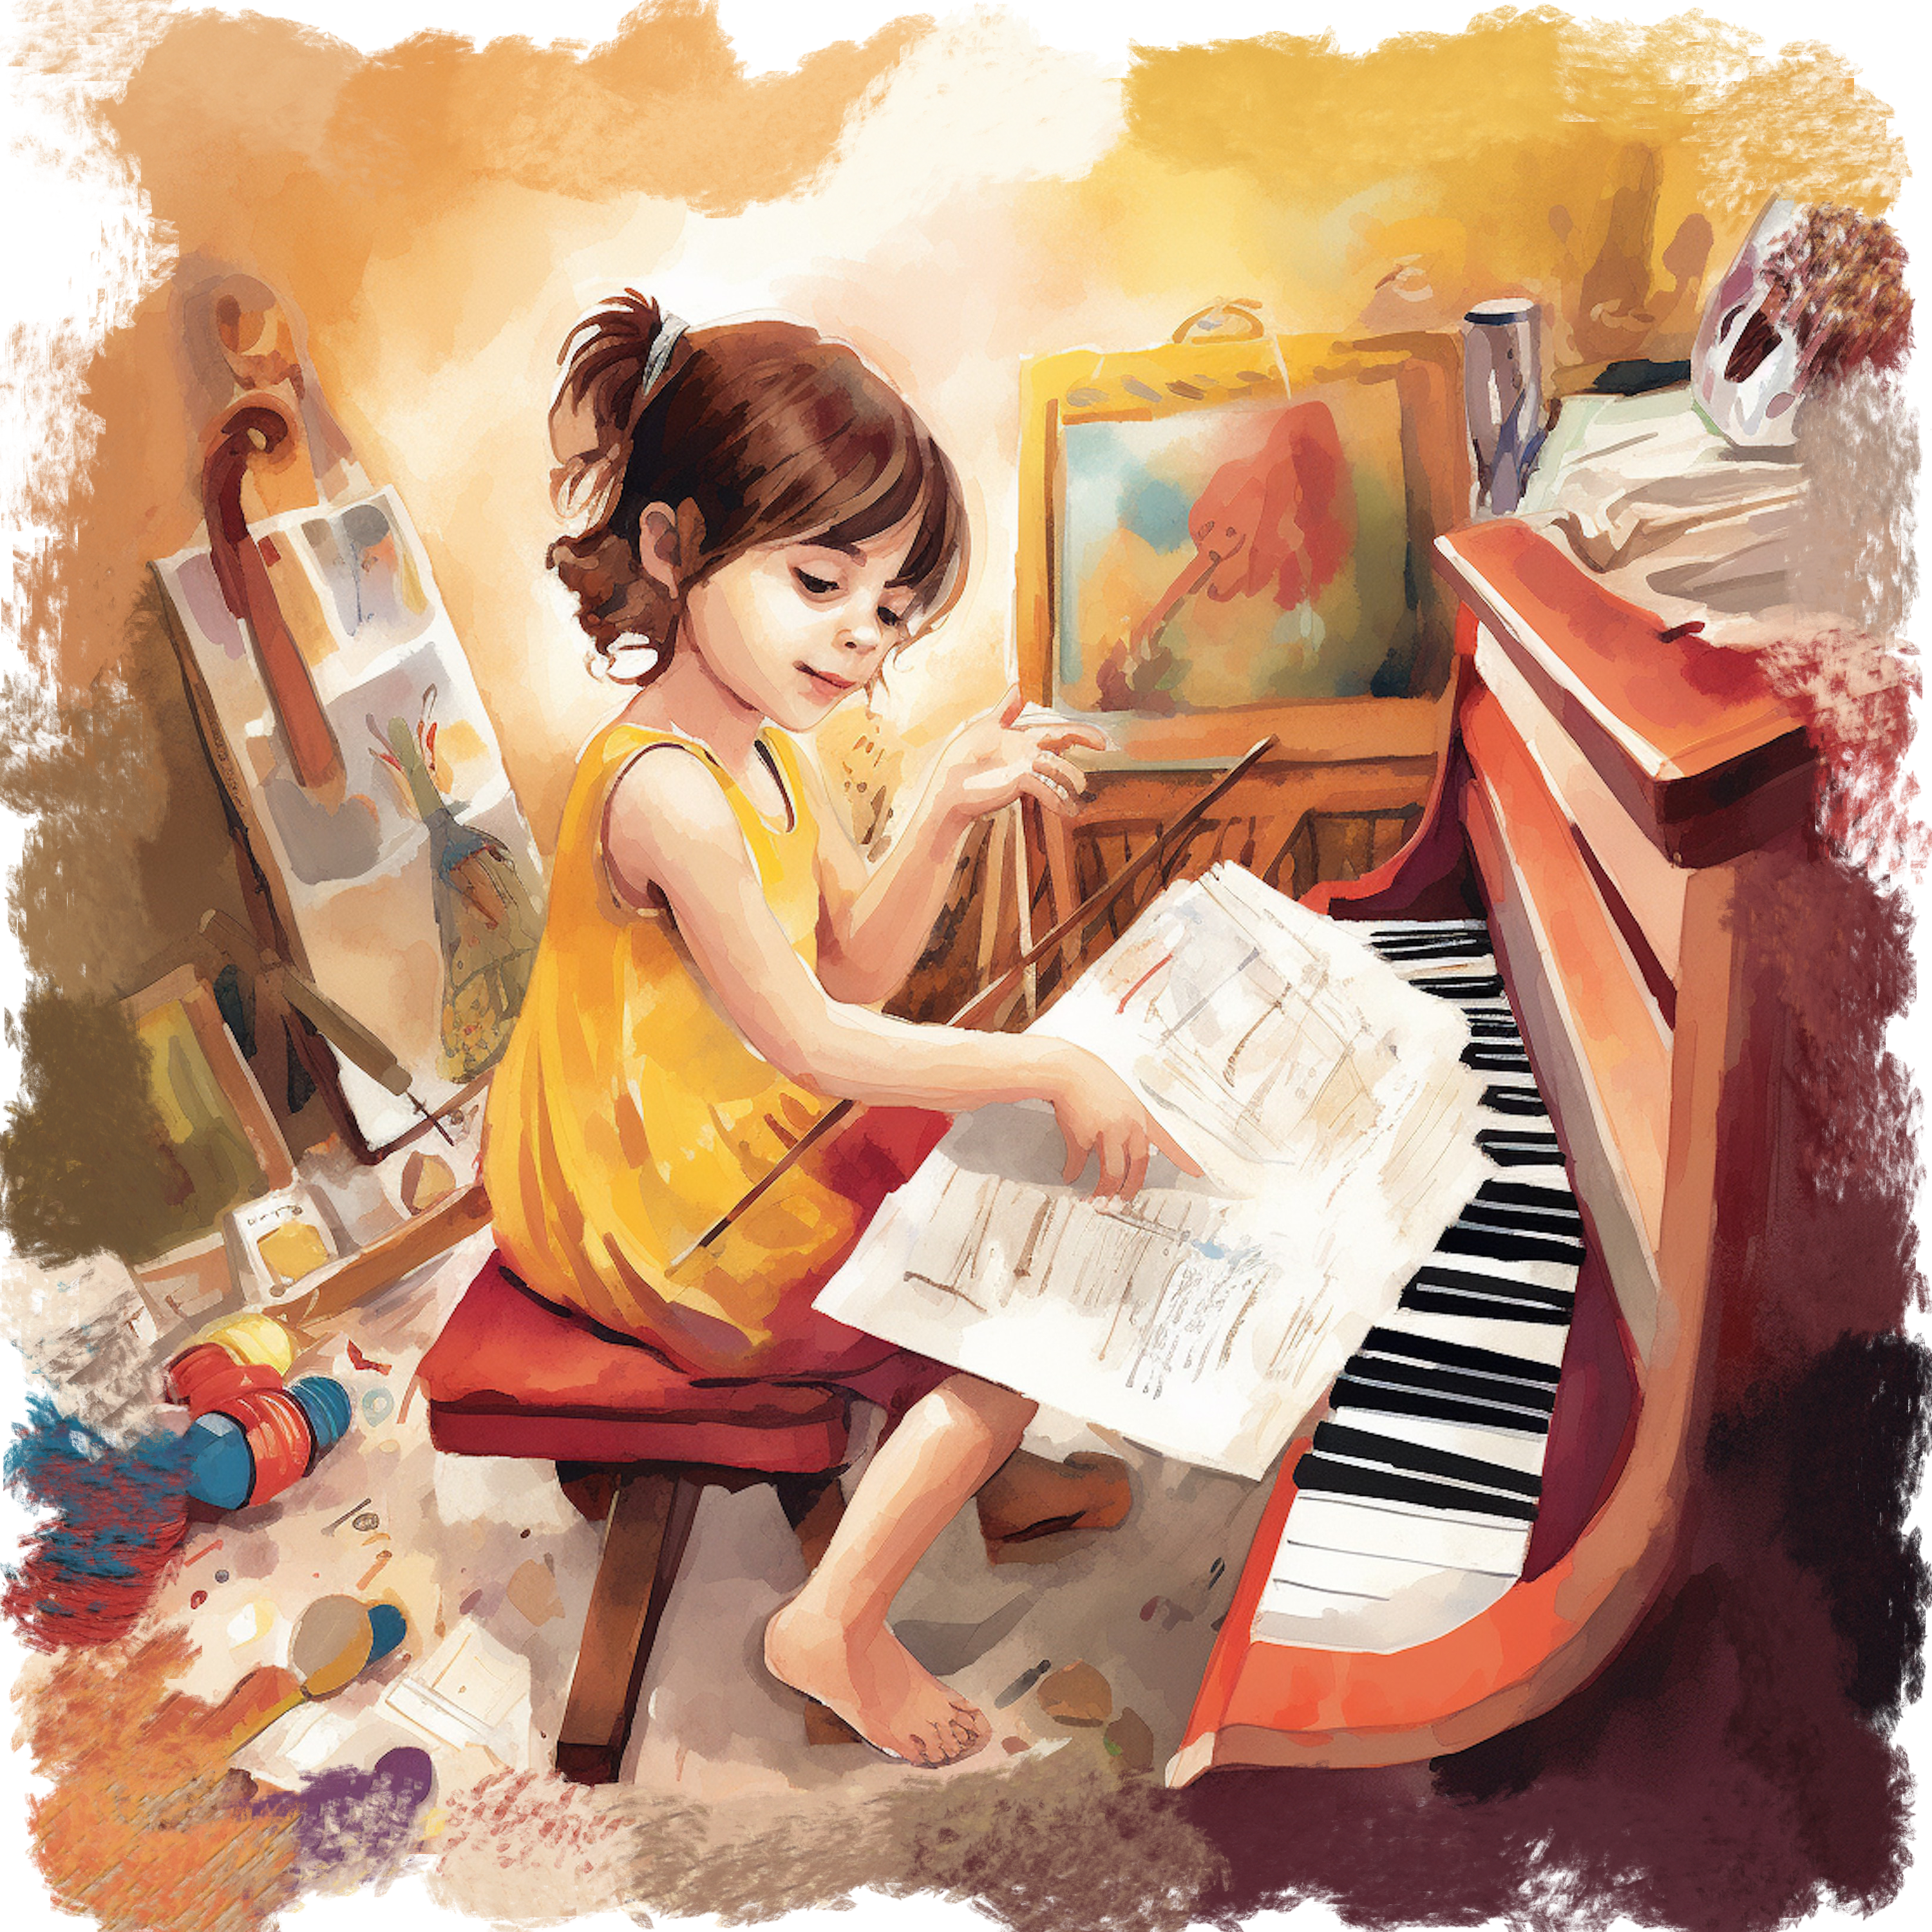
Thank you, Mom, for taking me to the places where I can develop my talents. By seeing your example I have learned to put them at God's disposal.
Thank you for your influence, mom, in developing my talents.
I know that the few I have, God will multiply if I put them at His service.
That is why I will not forget that:

Slide 12


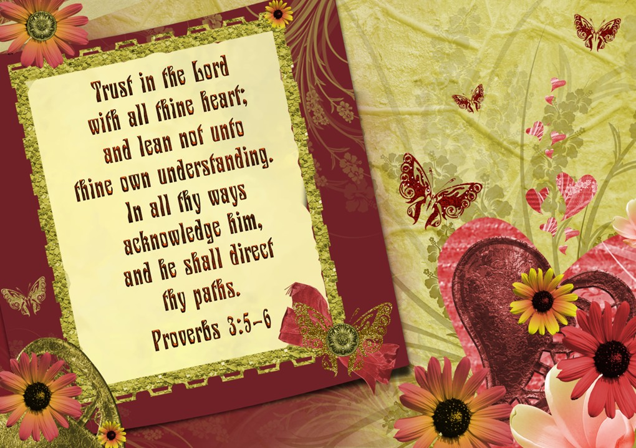
You have taught me that the choices I make will influence the course of my life.
As I have been told, for example, the story of Abigail, I have learned that sometimes I have to make quick and common-sense decisions, always keeping God's Word in mind.
Thank you for your influence in making the right decisions.
Therefore, I cannot forget:

Slide 13

GUIDING LIGHT MOM
Mom, from the time I was really young,
I realized I had someone...you,
who always cared,
who always protected me,
who was always there for me no matter what.
You taught me right from wrong,
and pushed me to do the right thing,
even when it was hard to do.
You took care of me when I was sick,
and your love helped make me well.
You had rules,
and I learned that when I obeyed them,
my life was simpler, better, richer.
You were and are
the guiding light of my life.
My heart is filled with love for you,
my teacher, my friend, my mother.
By Karl and Joanna Fuchs
Thank you God for my mother.
The love she shares like no other.
Thank you God for her tender care.
With my name upon her lips, as she goes to you in prayer.
Thank you God for dishes so very clean.
The Teaching, & the nursing, & the love I’ve always seen.
Thank you God for the food that she provides.
The hugs & the kisses & the tears she often hides.
Thank You God for the stories she always tells,
About gardens, & boats, & people inside of whales.
Thank you God for the mom you assigned to me,
For you knew no other could love me so unconditionally.
Thank you God for you knew right from the start,
Exactly which woman should take & hold my heart.
Thank you God, for another chance to say,
I LOVE YOU DEAR MOTHER

Slide 14
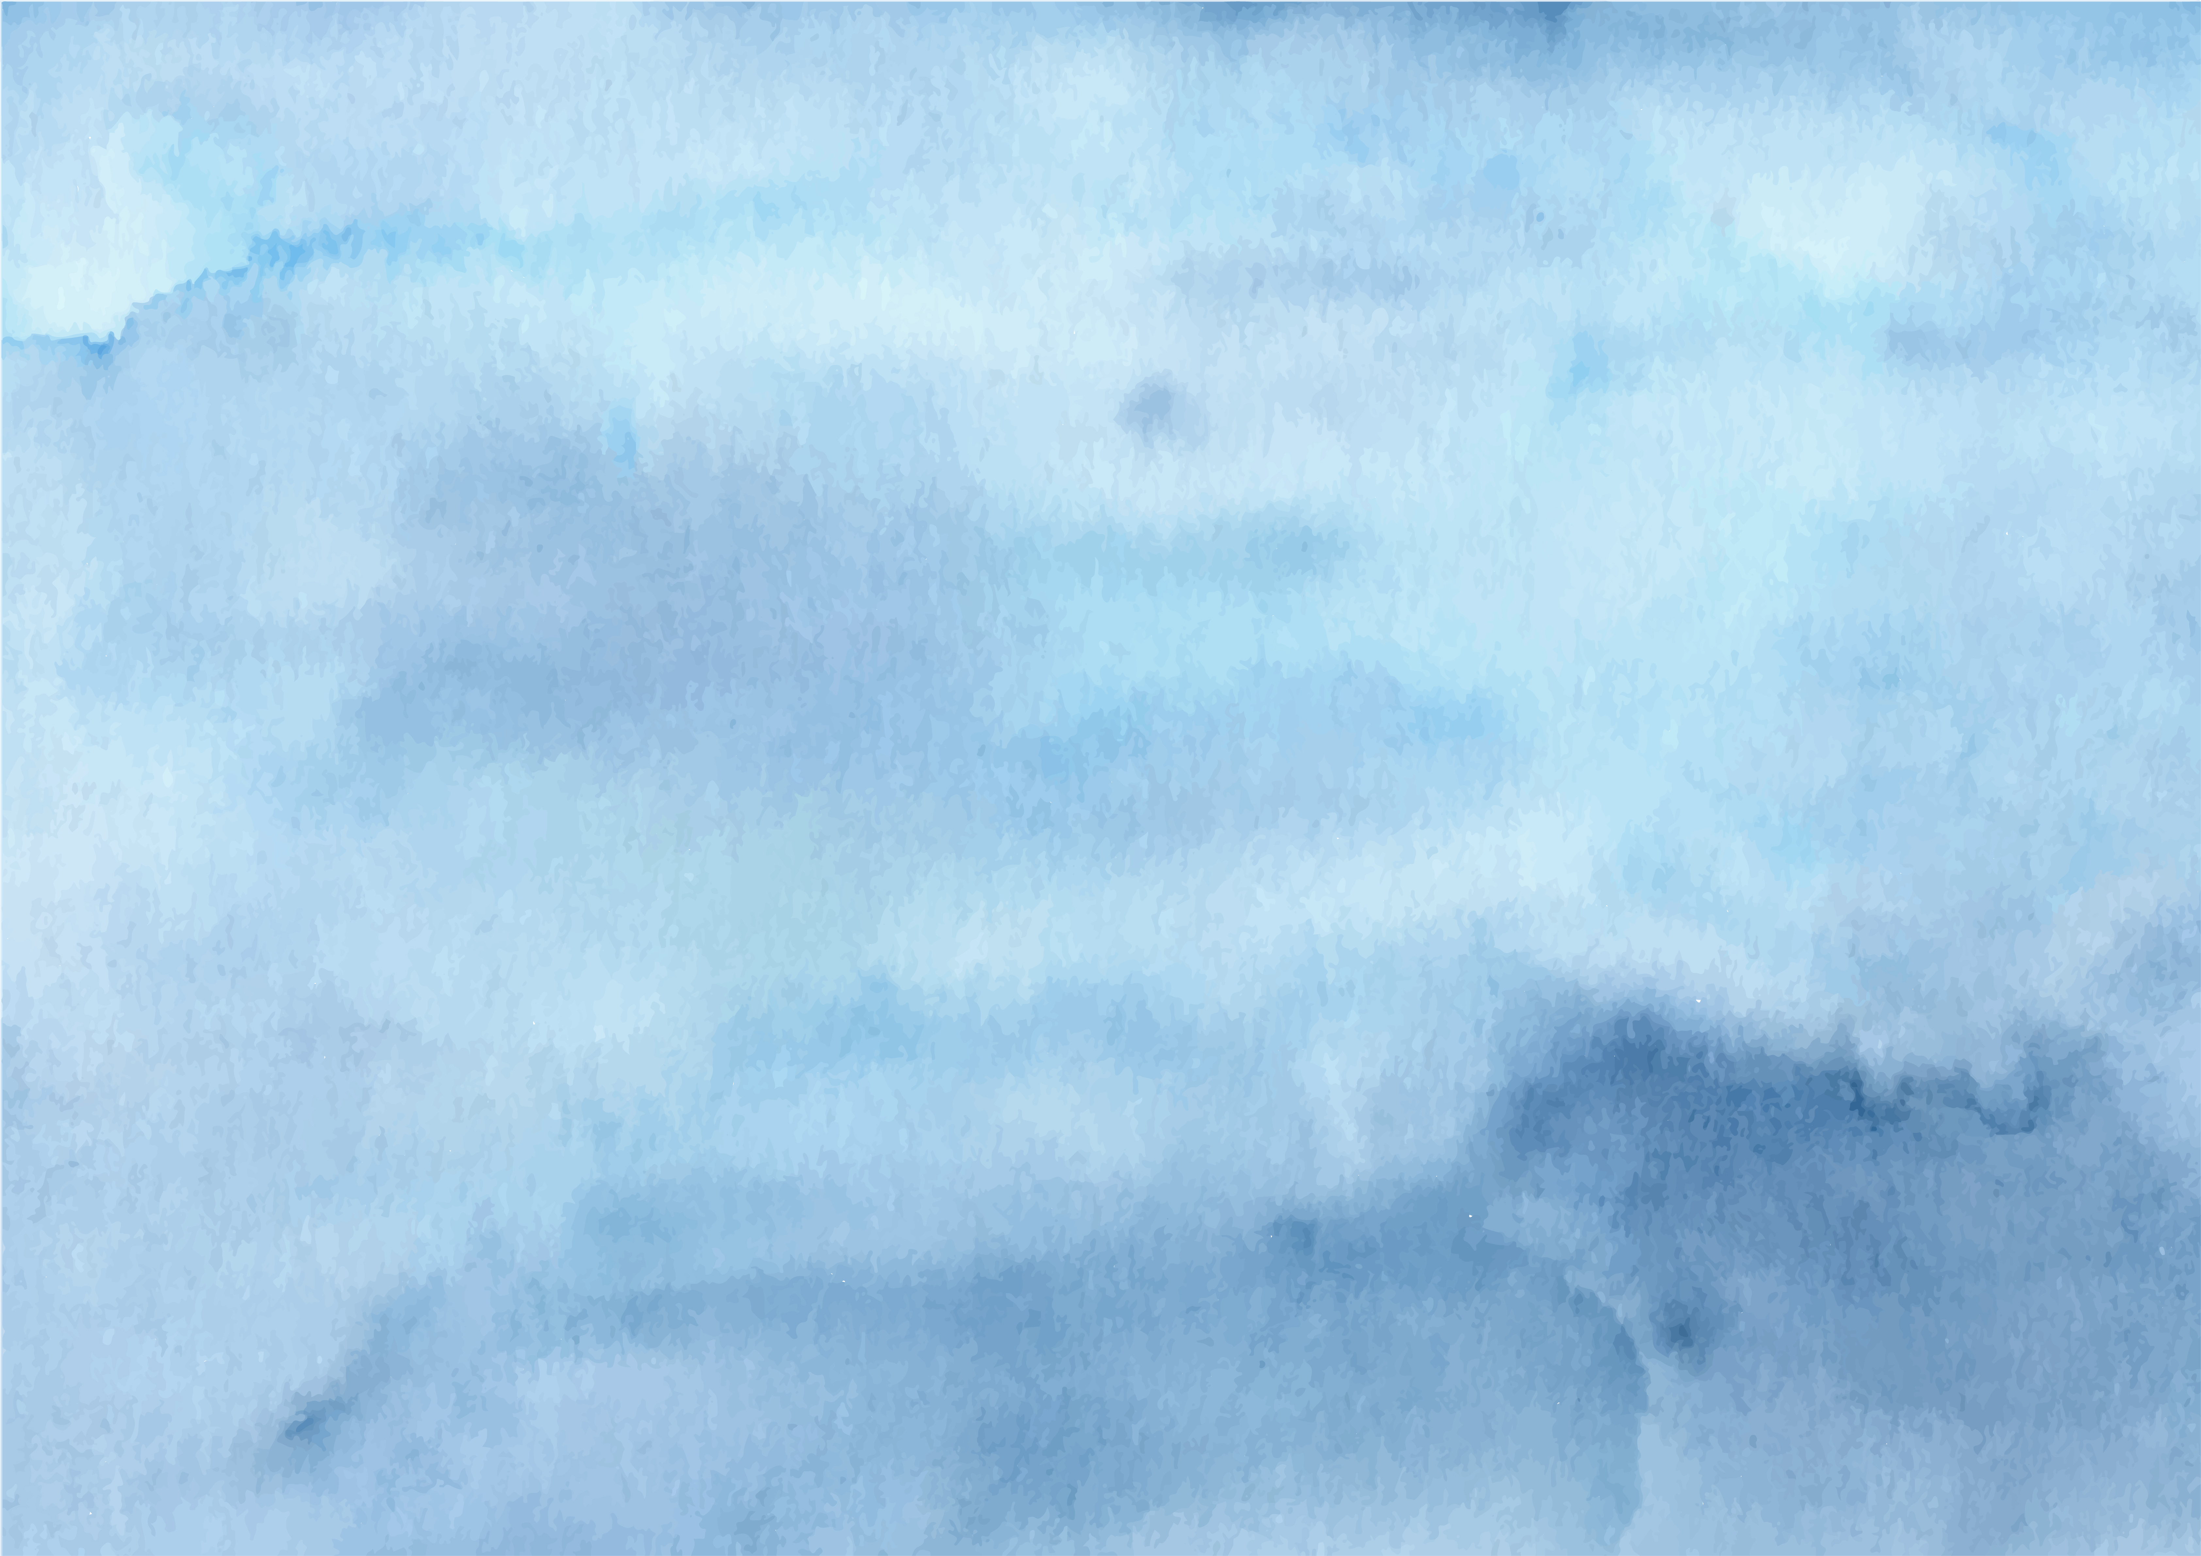


The mother has the privilege of benefiting the world by her influence, and in so doing she will impart joy to her own heart. Through lights and shadows you can trace straight paths for your children's feet that will lead them to the glorious heavenly heights. But only when she seeks to follow in her own life the way of Christ's teachings can the mother hope to form the character of her children according to the divine pattern.
Every mother is called to be a light for her home, a guide for her children, a counselor and an example with her spiritual life.
Every mother is a courageous woman, putting the development of her children's faculties at the forefront. Some may not receive the graces or reward for the influence on their children. However, when the Lord God comes, He will call every mother to congratulate her on the work done on behalf of her family.

