Slide 1
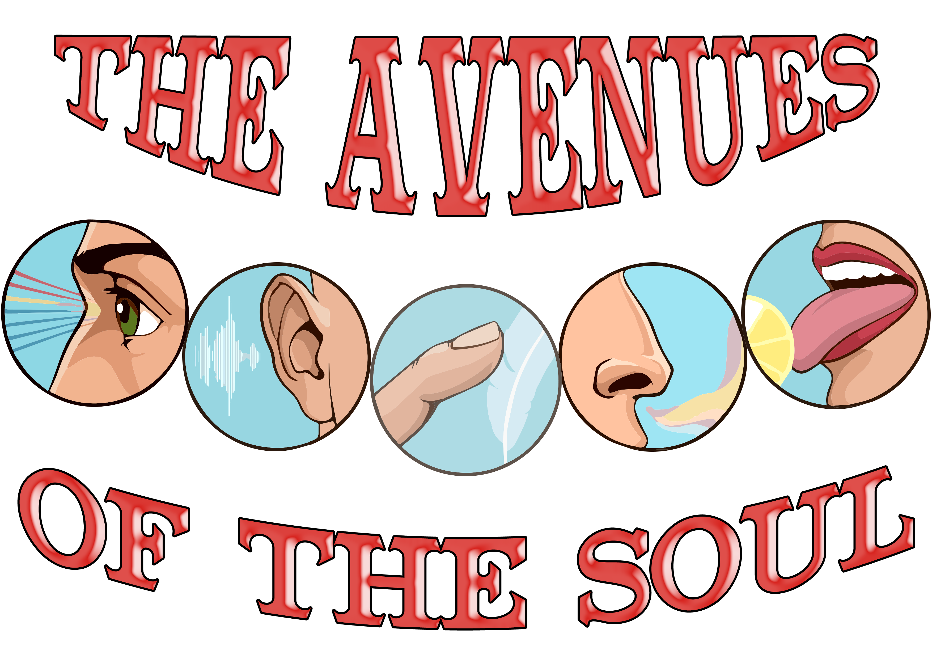

Slide 2

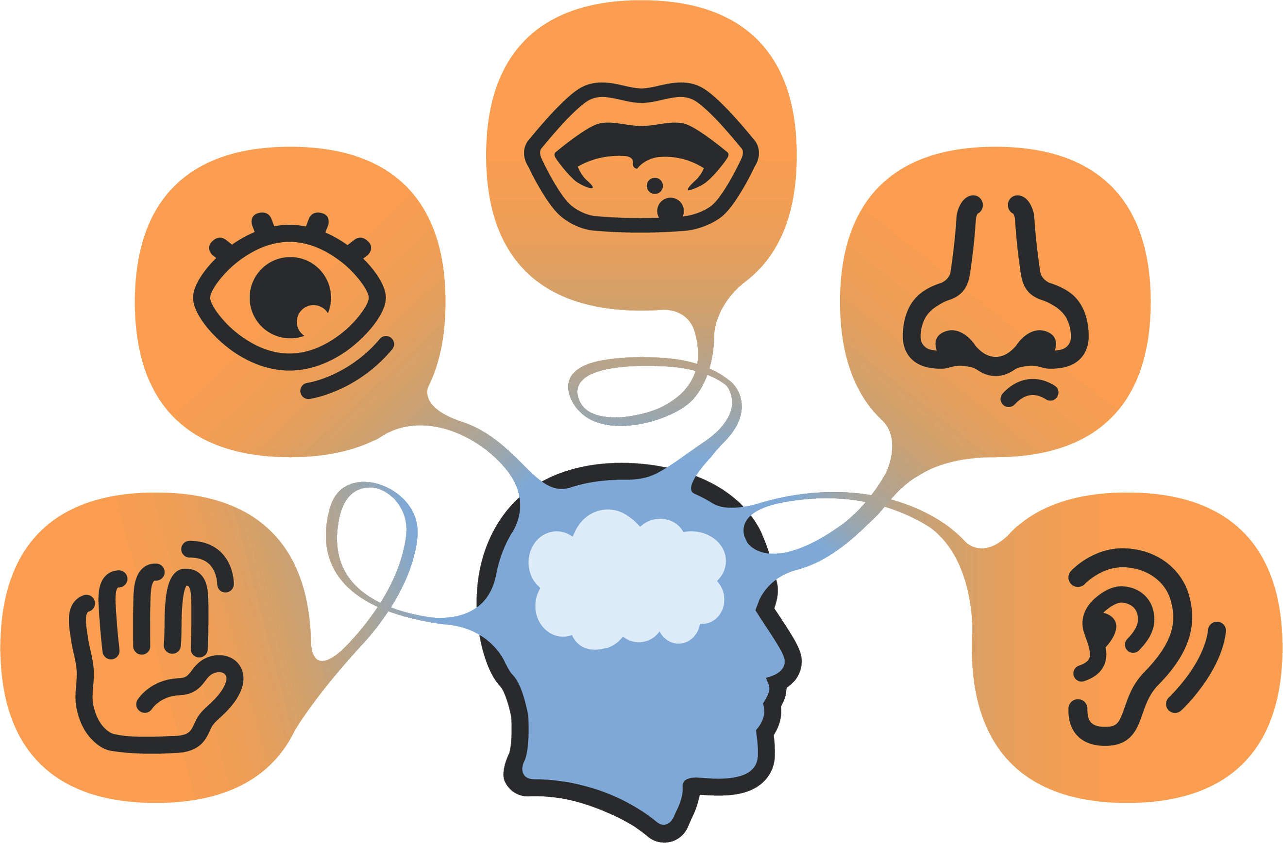

“Those who would not fall a prey to Satan's devices must guard well the avenues of the soul; they must avoid reading, seeing, or hearing that which will suggest impure thoughts. The mind must not be left to dwell at random upon every subject that the enemy of souls may suggest. The heart must be faithfully sentineled, or evils without will awaken evils within, and the soul will wander in darkness.” (AH 403)
The information we receive from the world comes to us through the senses. These are transmitted to the brain and, later, will become experiences that will be used to perform an action.
Sight, smell, hearing, taste, and touch allow us to acquire the knowledge that is essential for the development of our cognitive, physical, social, and spiritual faculties.
Our Creator also uses the senses to keep us in communion with Him. Ellen G. White tells us:
«The beauties of nature have a tongue that speaks to us without ceasing. The open heart can be impressed with the love and glory of God, as seen in the works of His hand. The listening ear can hear and understand the communications of God through the things of nature. There is a lesson in the sunbeam, and in the various objects of nature that God has presented to our view. The green fields, the lofty trees, the buds and flowers, the passing cloud, the falling rain, the babbling brook, the sun, moon, and stars in the heavens—all invite our attention and meditation» (FLB 25).
We will analyze the importance of taking care of the avenues of the soul and what the Bible tells us about these avenues.

Slide 3


Slide 4

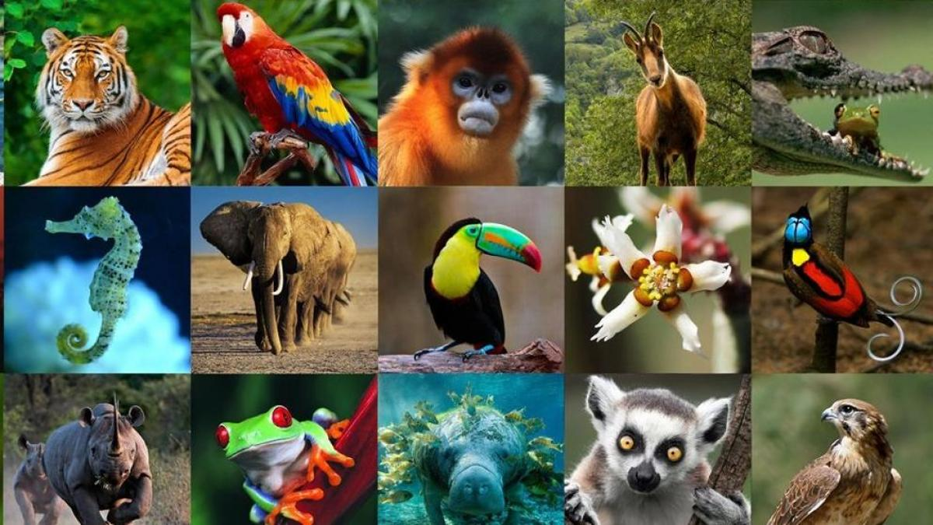

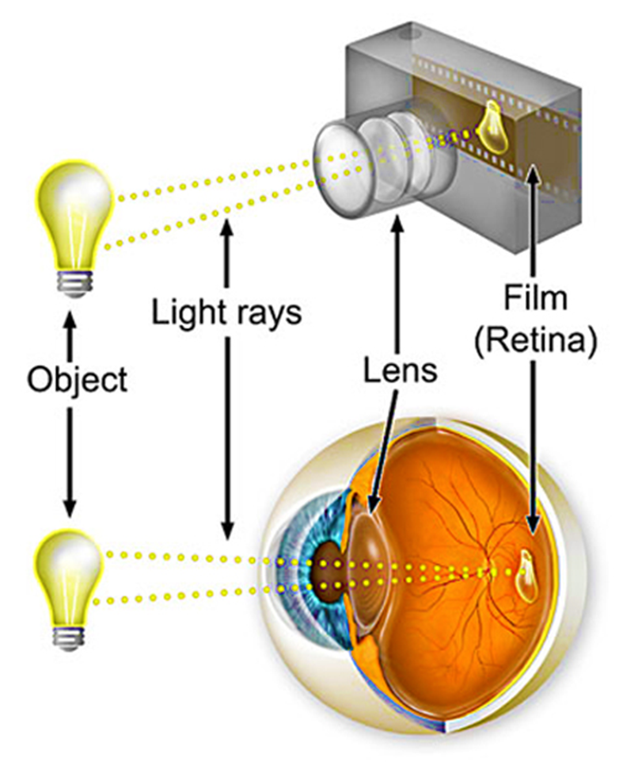
Of all the God-given gifts, sight is one of the most essential. Through it we know the colors, shapes, height or width of everything that surrounds us. Thanks to its ability to accommodate we can see objects that are near and far with clarity. In addition, it allows us to recognize people, places or things and acquire academic knowledge.
The human eye works like a camera. The cornea is transparent and forms the first lens of the eye's objective. The crystalline lens is the zoom: it focuses at all distances. The pupil is controlled by the iris, a colored circular muscle that has the ability to contract to adapt to different light conditions, like the diaphragm of a camera. The retina is like the photographic film that collects light, transforms it into electrical impulses that are transmitted through the optic nerve to the brain, which transforms it into images, resulting in stimuli that, depending on what is observed, may be for good or bad for the viewer.
Everything you see reaches your brain. Choose well what you see each day so that when it comes to making decisions, they are according to God's will.

Slide 5

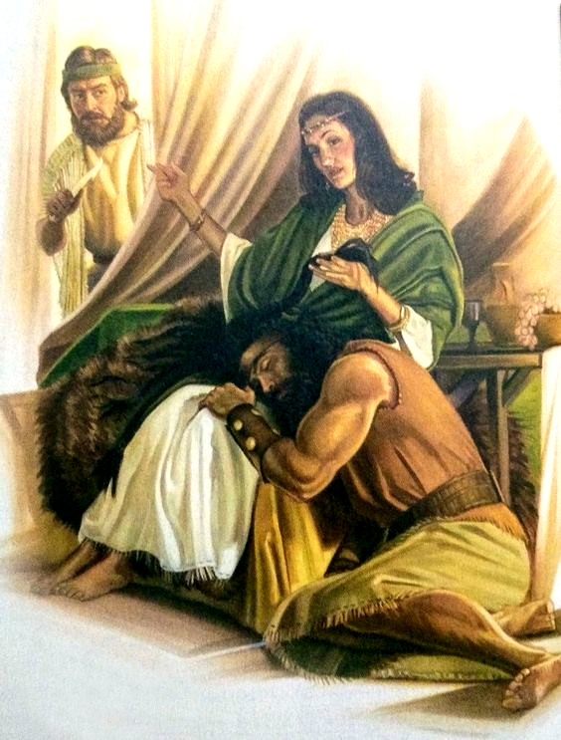

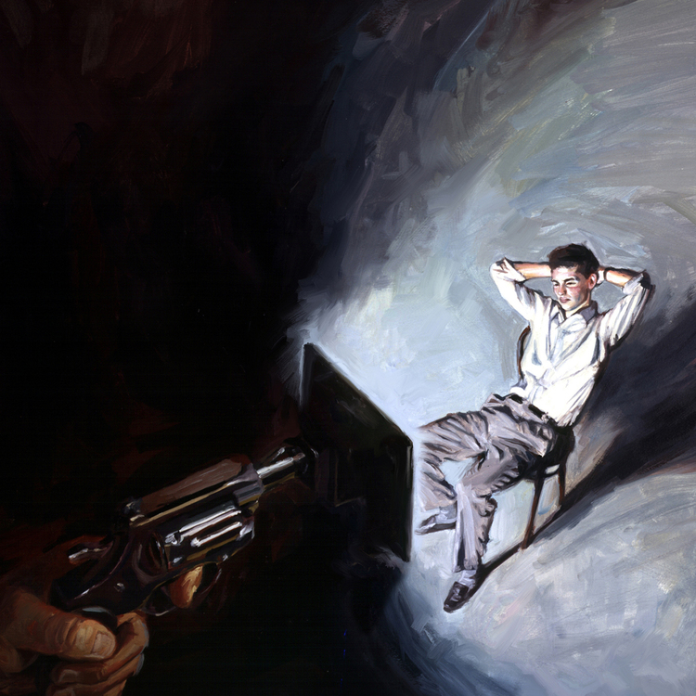
Many people are unaware of the influence that sight has on our spiritual lives, and they allow themselves to be controlled by the sensations or emotions they experience through it.
Samson is an example of this. He lived to please his eyes, choosing pagan women for the simple fact that they were "pleasing in his eyes." We all know the end of this judge of Israel: he lost his sight and died with his enemies (Judges 14:1-3).
Through reading the Bible we turn our eyes to Jesus, for by contemplating him we will be transformed into his image and likeness.
Refuse to look at anything that takes your thoughts away from God.

Slide 6


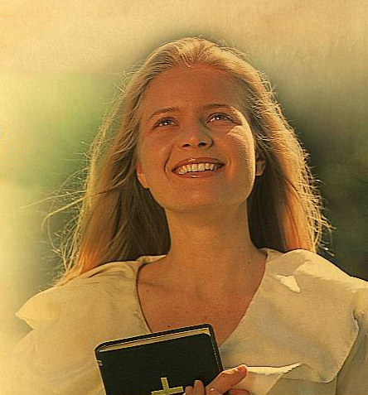
What does the Bible say about sight?
While we look not at the things which are seen, but at the things which are not seen: for the things which are seen are temporal; but the things which are not seen are eternal. (2 Corinthians 4:18).
Wherefore seeing we also are compassed about with so great a cloud of witnesses, let us lay aside every weight, and the sin which doth so easily beset us, and let us run with patience the race that is set before us, Looking unto Jesus the author and finisher of our faith; who for the joy that was set before him endured the cross, despising the shame, and is set down at the right hand of the throne of God. (Hebrews 12:1-2).
I made a covenant with mine eyes; why then should I think upon a maid? (Job 31:1).

Slide 7


Slide 8


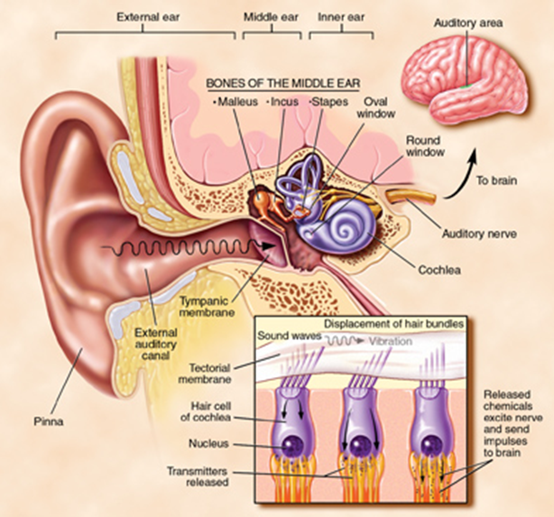
Thanks to the auditory sense, we can discriminate different types of sounds and identify their origin.
The sound waves enter the outer ear through the pinna, travel through the ear canal, and hit the eardrum, causing it to vibrate. The vibrations are transmitted through the middle ear through the hammer, anvil and stapes, which convert them into mechanical energy. This energy reaches the fluids in the inner ear where they are converted into electrical impulses that travel along the auditory nerve to the brain, where they are decoded and perceived as sounds.
The information that enters through the ear, like the other senses, passes to the brain, exerting its influence on our thoughts and later manifesting itself in our behavior. Hence the importance of carefully selecting everything we hear.

Slide 9


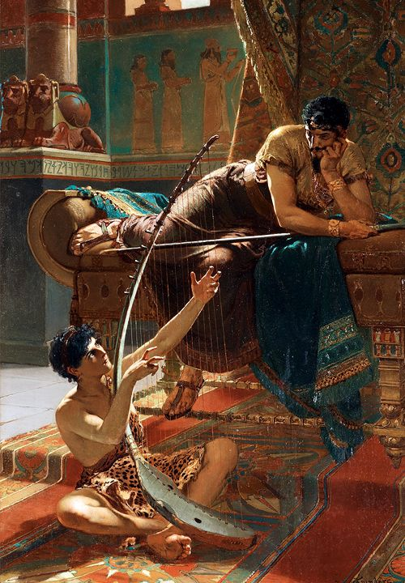
Music can be of great benefit to us or become an element that the enemy of souls uses to manipulate our minds.
«Music is the idol which many professed Sabbath keeping Christians worship. Satan has no objection to music if he can make that a channel through which to gain access to the minds of the youth. Anything will suit his purpose that will divert the mind from God and engage the time which should be devoted to His service. When allowed to take the place of devotion and prayer, it is a terrible curse.» (MRQI 19).
Satan knows very well that, through the senses, we can be led to worship God or to reject Him, and so he tries to win our soul through them. Have you ever tried to pray after watching an action or horror movie? You will see how difficult it will be to connect with heaven. The music used in movies incites us to experience fear, suspense or laughter and, in this way, manipulates our emotions.
Saul's story confirms to us that music can be used to our advantage. In his moments of insanity, David would play the harp for him, and in this way, Saul would calm down and come to his senses (1 Samuel 16:14-23).
God help us to know how to choose to listen to what pleases Him.

Slide 10

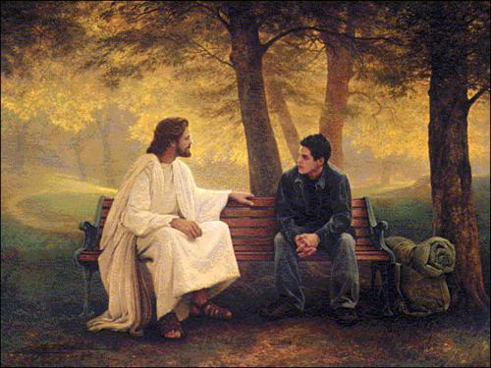


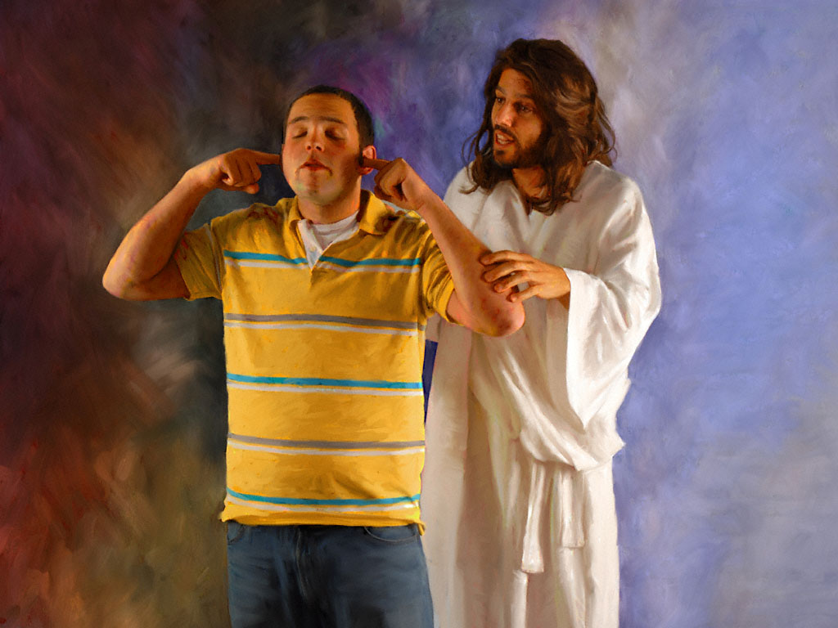
What does the Bible say about hearing?
The ear that heareth the reproof of life abideth among the wise. (Proverbs 15:31).
Give ear, O my people, to my law: incline your ears to the words of my mouth (Psalms 78:1).
He that refuseth instruction despiseth his own soul: but he that heareth reproof getteth understanding (Proverbs 15:32).
Hear counsel, and receive instruction, that thou mayest be wise in thy latter end (Proverbs 19:20).

Slide 11


Slide 12


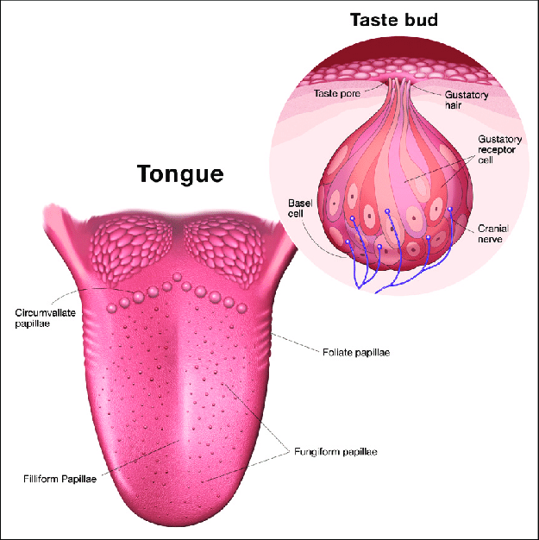
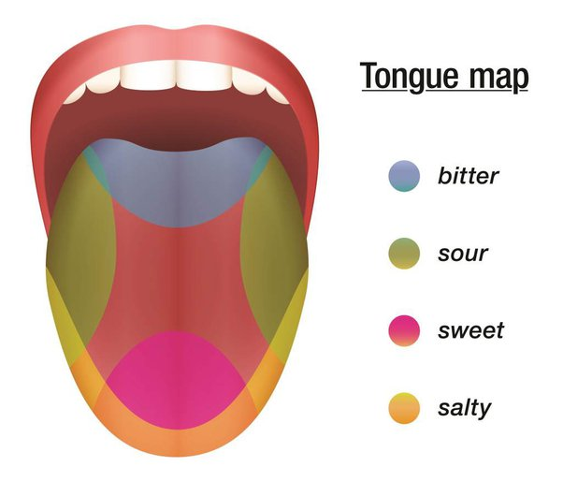
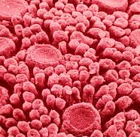
God endowed us with the sense of taste so that we can enjoy the good and diverse foods that He has created for the benefit of our bodies and minds.
Unfortunately, Satan has made this avenue of soul an important ally by getting things like alcohol, tobacco, drugs, and certain types of foods and beverages to disrupt our brains, thus taking control of our entire body.
The tongue contains the taste buds that allow us to discriminate the different types of flavors such as sweet, bitter, salty, sour and spicy.
Chemical compounds in food dissolve in saliva and penetrate the taste buds through pores on the surface of the tongue, where they come into contact with sensory cells. When a receptor is stimulated by one of the dissolved substances, it sends nerve impulses to the brain. The frequency with which the impulses are repeated indicates the intensity of the flavor.

Slide 13

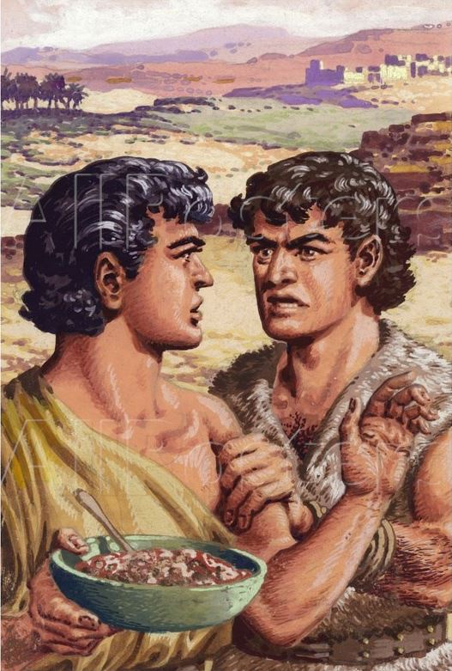
True temperance teaches us to dispense entirely with everything hurtful, and to use judiciously that which is healthful. There are few who realize as they should how much their habits of diet have to do with their health, their character, their usefulness in this world, and their eternal destiny. The appetite should ever be in subjection to the moral and intellectual powers. The body should be servant to the mind, and not the mind to the body (CG 398).
Controlling our sense of taste will help us maintain our physical, mental, and spiritual health. Remember that God, in creating our bodies, created perfect machinery and, at the same time, gave us the necessary laws for us to use it well.
An example of being carried away by the sense of taste is Esau, who sold his birthright for a bowl of lentils (Genesis 25:31-34).
Would Esau have died if he had waited a few more hours? Of course not; but the sensation he experienced through the sense of taste deceived him and thus he belittled his heritage.
Take care of your sense of taste so that it is a blessing for your spiritual perception.

Slide 14

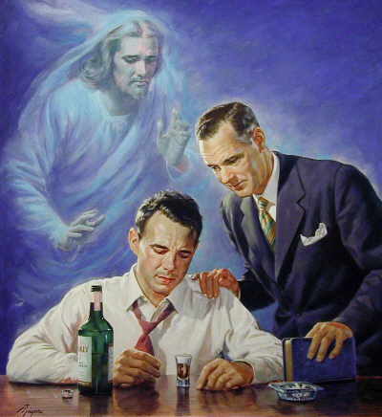

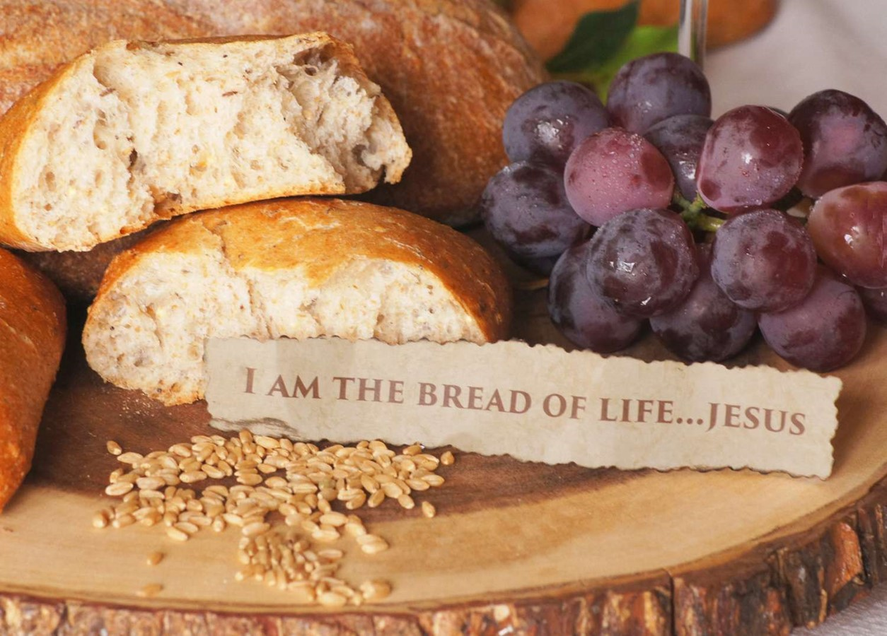
What does the Bible say about taste?
And put a knife to thy throat, if thou be a man given to appetite (Proverbs 23:2).
Look not thou upon the wine when it is red, when it giveth his colour in the cup, when it moveth itself aright. At the last it biteth like a serpent, and stingeth like an adder. (Proverbs 23:31-32).
For the drunkard and the glutton shall come to poverty: and drowsiness shall clothe a man with rags. (Proverbs 23:21).
And Jesus said unto them, I am the bread of life: he that cometh to me shall never hunger; and he that believeth on me shall never thirst. (John 6:35).

Slide 15


Slide 16


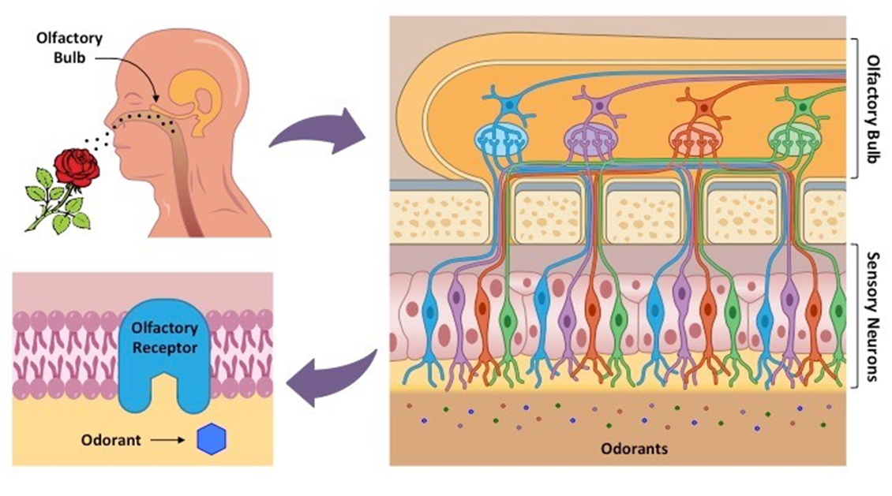
It is the nose that allows us to recognize the different types of aromas, as pleasant as flowers, perfumes, food, or the one that is breathed in an early walk in the mountains; but it has also been degraded by being used as an absorption medium for certain types of inhalants and drugs. By this means, millions of children, youth, and adults are currently falling prey to the enemy by leaving this important avenue in the hands of the adversary.
Odorant molecules interact with our olfactory receptors, which are located in the upper part of the nostrils. Specifically, in the pituitary gland or olfactory region.
These receptors trigger an electrical impulse that travels through the nerve fibers to the olfactory bulb and, consequently, to the limbic system, which is responsible, among other things, for the identification of odors (perception).
Finally, the amygdala connects that aroma with an emotion, and it is the hippocampus that is responsible for relating that smell to a memory.

Slide 17

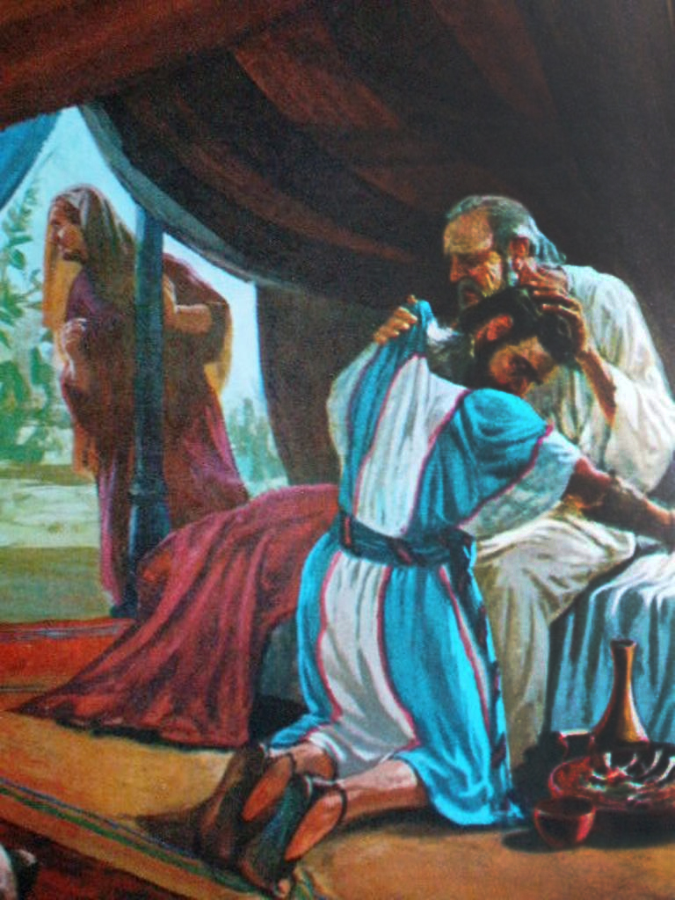
Smell allows us to perceive different scents. I'm sure that if I mention the smell of cut grass, your mind will immediately transport to the place where you've perceived this fragrance.
Depending on which scene of our life the smell is associated with, different emotions will awaken in us, causing us a good or bad feeling.
Isaac was deceived by his son Jacob, among other things, by the smell of Esau's clothes that he had put on (Genesis 27:27).
The patriarch, inspired by the scent of the field and forest exhaled by Jacob's clothes, formed in his mind a picture of his son's future prosperity.
The smell led him to bless him in this way: he saw him in possession of the promised land and fully enjoying the blessings that accompanied it (Genesis 27:27-29).
Imagine the smells you will perceive in the New Land. Exercise your sense of smell so that you can enjoy what God is preparing for you now.

Slide 18

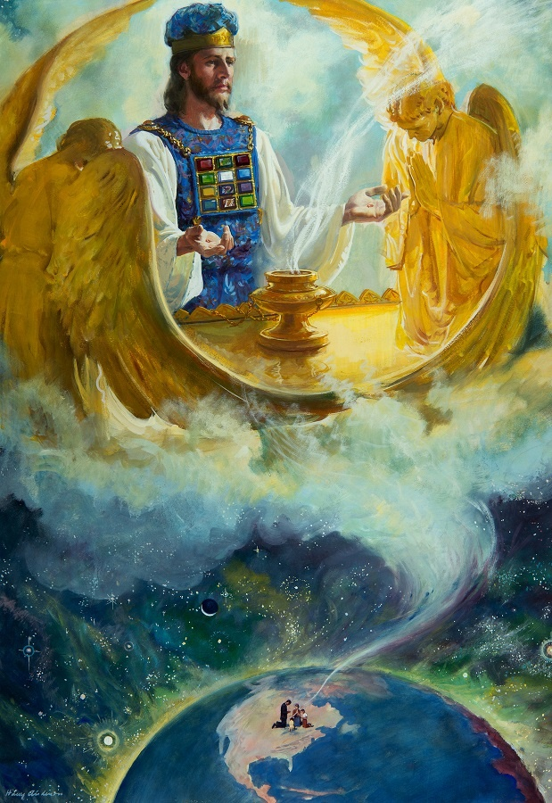


What does the Bible say about smell?
Dead flies cause the ointment of the apothecary to send forth a stinking savour: so doth a little folly him that is in reputation for wisdom and honour (Ecclesiastes 10:1).
For we are unto God a sweet savour of Christ, in them that are saved, and in them that perish (2 Corinthians 2:15).
All that are born of the country shall do these things after this manner, in offering an offering made by fire, of a sweet savour unto the Lord (Numbers 15:13).

Slide 19


Slide 20




By using the hands as the main organ of touch, we establish bonds of union and cordiality with others.
There are many studies that affirm that, without contact, many babies would not survive. Feeling affection, love and human warmth is essential for any baby to be able to move forward. This is much more important to him than to meet his basic needs.
Hugs are necessary, and they are very important as they reduce stress and tension levels, relax us, provide us with tranquility, security and confidence, make us feel good, and contribute to reducing the risk of dementia.
We release oxytocin, thus decreasing the production of cortisol and adrenaline, hormones that are emitted in high concentrations when we are under a stressful situation. In addition, we release serotonin and dopamine, generating a great sense of well-being and happiness.
Another great benefit of hugs is that they stimulate oxygenation of the body, which helps to prolong the life of cells and, therefore, prevent premature aging.
Hugs activate receptors in the skin called Pacini's corpuscles, which are responsible for sending signals to the brain, thus reducing blood pressure.

Slide 21

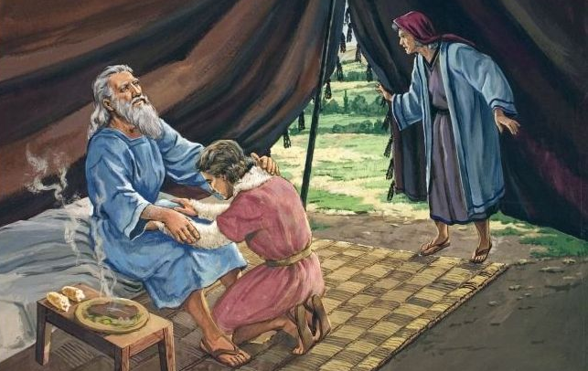
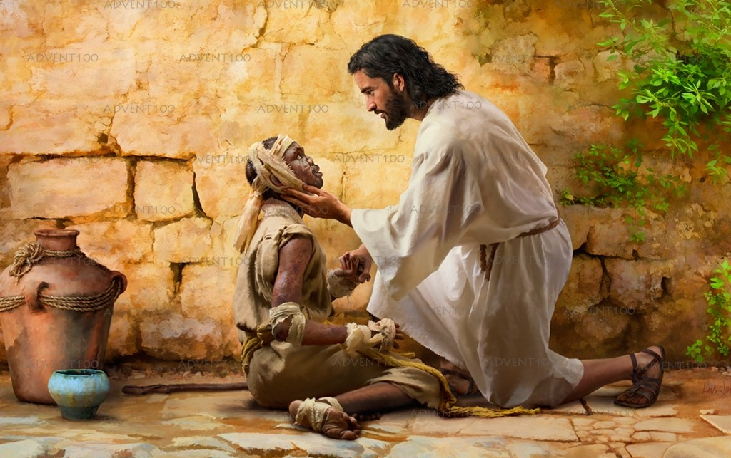
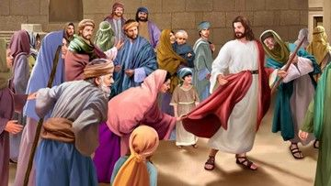
Scientifically, it has been proven that physical contact is as beneficial as therapies. However, many people have been seduced by the pleasurable events experienced through touch.
Jesus demonstrated His love and compassion through touch, performing many of His miracles by touching people.
He even touched lepers that no one was willing to touch: “And, behold, there came a leper and worshipped him, saying, Lord, if thou wilt, thou canst make me clean. And Jesus put forth his hand, and touched him, saying, I will; be thou clean. And immediately his leprosy was cleansed.” (Matthew 8:2-3).
Another example of the healing touch is seen in the woman who touched the hem of Jesus' garment with faith and was healed of her illness. " For she said, If I may touch but his clothes, I shall be whole. And straightway the fountain of her blood was dried up; and she felt in her body that she was healed of that plague. And Jesus, immediately knowing in himself that virtue had gone out of him, turned him about in the press, and said, Who touched my clothes? And his disciples said unto him, Thou seest the multitude thronging thee, and sayest thou, Who touched me? And he looked round about to see her that had done this thing. But the woman fearing and trembling, knowing what was done in her, came and fell down before him, and told him all the truth. And he said unto her, Daughter, thy faith hath made thee whole; go in peace, and be whole of thy plague." (Mark 5:25-34).
He harnessed the sense of touch to convey love and compassion to others.

Slide 22

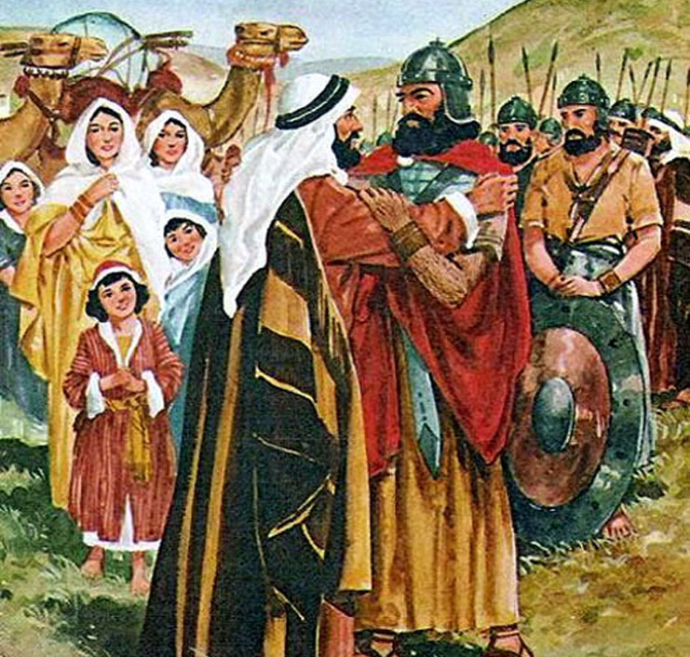


What does the Bible say about touch?
And it came to pass, when Laban heard the tidings of Jacob, his sister's son, that he ran to meet him, and embraced him, and kissed him, and brought him to his house. And he told Laban all these things. (Genesis 29:13)
And Esau ran to meet him, and embraced him, and fell on his neck, and kissed him: and they wept. (Genesis 33:4)
And besought him that they might only touch the hem of his garment: and as many as touched were made perfectly whole. (Matthew 14:36)

Slide 23

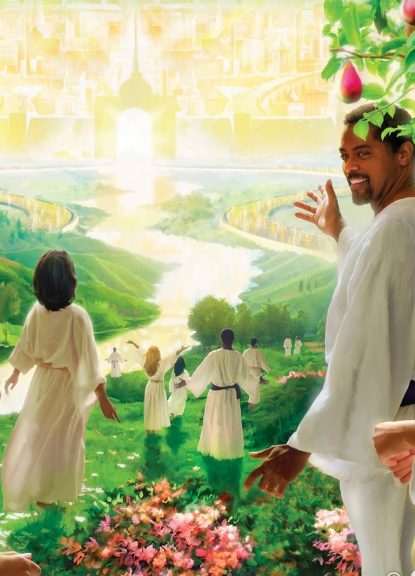
Our bodies have been created in such a way that we can feel God at all times, and we manifest in our lives the blessings that come from communing with Him.
The sensations or information that come to us from the senses help us in our spiritual life. However, we should not be guided by the senses, but by a "Thus saith the Lord.”
We need to take care of all the ways that the Lord has given us to communicate with Him, because, if we are not careful in this regard, the enemy of our souls will use them to distance us from God.
If we keep the Avenues of the Soul clear of obstacles, we will be able to advance smoothly on the path of encounter with our beloved Jesus.
“Finally, brethren, whatsoever things are true, whatsoever things are honest, whatsoever things are just, whatsoever things are pure, whatsoever things are lovely, whatsoever things are of good report; if there be any virtue, and if there be any praise, think on these things” (Philippians 4:8).

