Slide 1
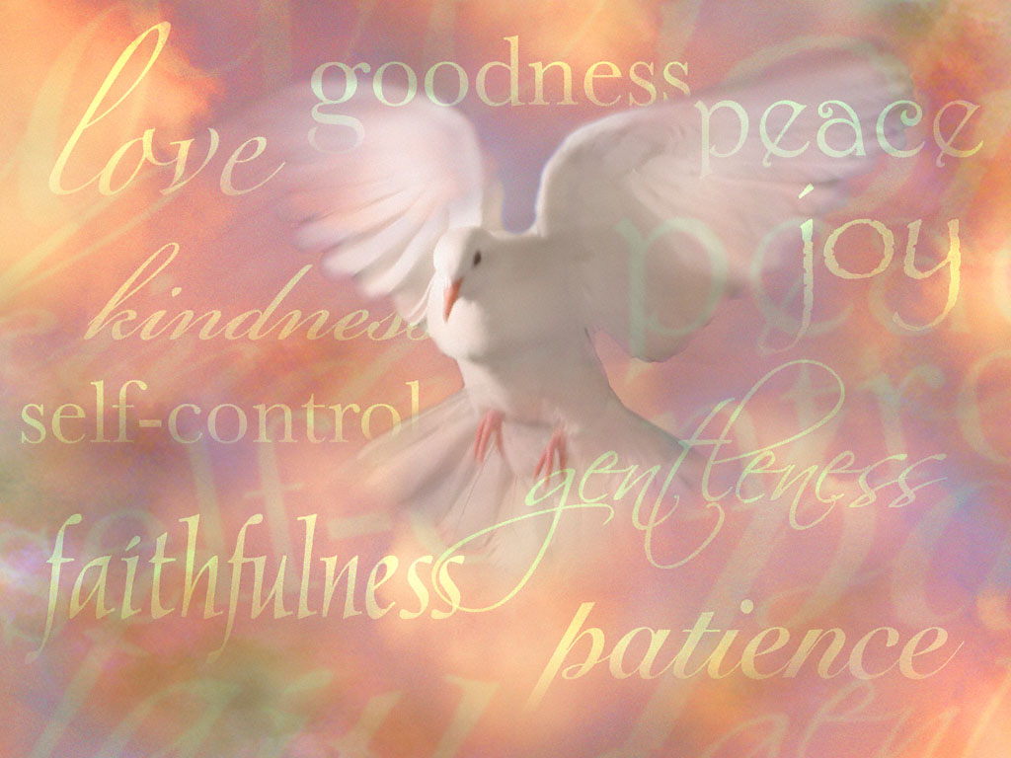
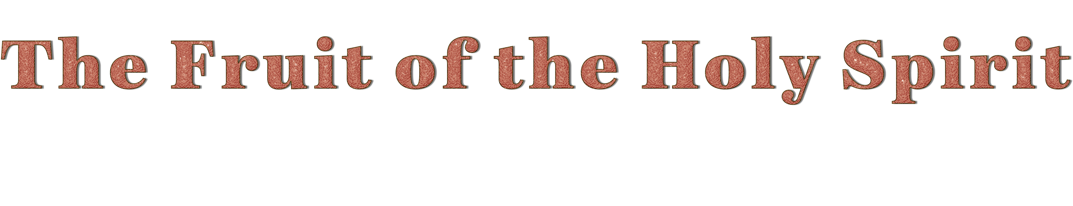

Slide 2
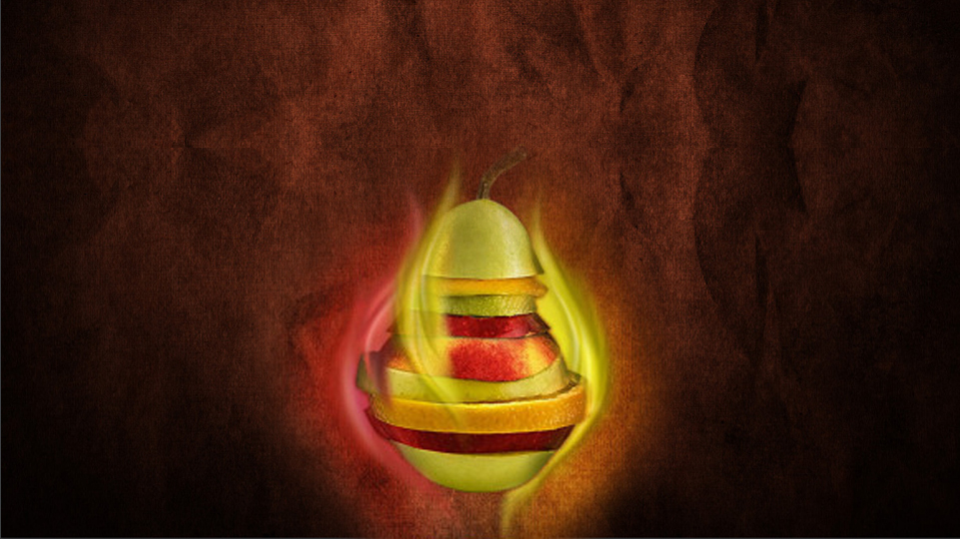
Your compassionate Redeemer is watching you in love and sympathy, ready to hear your prayers, and render you the assistance which you need in your life-work. Love, joy, peace, long-suffering, gentleness, faith and charity are the elements of the Christian character. These precious graces are the fruits of the Spirit. They are the Christian's crown and shield. The highest day-dreaming and most exalted aspirations can aim at nothing higher. Nothing can give more perfect content and satisfaction.—The Signs of the Times, November 29, 1877.
As you receive the Spirit of Christ—the Spirit of unselfish love and labor for others—you will grow and bring forth fruit. The graces of the Spirit will ripen in your character. Your faith will increase, your convictions deepen, your love be made perfect. More and more you will reflect the likeness of Christ in all that is pure, noble, and lovely.
“The fruit of the Spirit is love, joy, peace, longsuffering, gentleness, goodness, faith, meekness, temperance.” Galatians 5:22, 23. This fruit can never perish, but will produce after its kind a harvest unto eternal life. COL 67- 68
The Fruit of the Spirit is what naturally occurs in life when it is directed by the Spirit. The fruit of the Spirit is not a spontaneous product of human nature, but of a power entirely different from that of man.
In other words, all these graces or virtues must be present in the Christian's life, and he cannot be said to give the "fruit of the Spirit" if one of them is missing. (ABC Galatians 5:22)
We are going to learn the different aspects of this fruit of the Holy Spirit, which is multifaceted because it encompasses love, joy, peace, patience, kindness, goodness, faith, meekness and temperance.

Slide 3


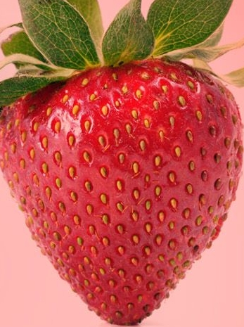
L
V
O
E
WHAT IS LOVE?
Agape love is pure and disinterested love, independent of circumstances; it is God's love for us. For it is a divine principle of thought and action which modifies the character, governs the impulses, controls the passions, and ennobles the affections. It is the highest kind of love, as it motivates us to do what is right and noble, no matter how we feel.

Slide 4

Suffereth long
Is kind
Is patient and calm when he is oppressed, slandered, or persecuted.
Rejoiceth in the truth
Longs to do good to others; It’s is gentle and courteous and seeks to help everyone to be happy.
Beareth all things
Takes pleasure in the virtues of others, It’s interested in the progress of truth and in the happiness of man.
Believeth all things
It conceals and is silent about the faults of others that the selfishness of the natural heart would gladly expose.
Hopeth all things
Interprets the behavior of others in the best possible way, attributing good motives to others.
Endureth all things
Has faith in his neighbor; is willing to face ridicule, strife, and contempt to defend him, knowing that in due time the truth will be exalted.
Calmly endures all the difficulties, trials, persecutions and injuries of human origin and all the attacks that God allows.
Envieth not
Vaunteth not itself
Does not manifest bad or unpleasant feelings toward others because they have some advantage over him.
Not puffed up
Does not proclaim his own praises; he is humble, he does not try to exalt himself.
Doth not behave itself unseemly
Does not inflate a person with vanity; it does not produce self-conceit or self-aggrandizement.
Seeketh not his own
Is never discourteous, rude or coarse; never does anything that could hurt the sensibilities of others.
Puts the "I" in the last place; Is willing to sacrifice comfort, time, tranquility, resources and talents in favor of others.
Thinketh no evil
Nothing can produce a manifestation of disgust, impatience or anger, but he gentle, kind and calm.
Rejoiceth not in iniquity
Does not take into account the harm done to him nor does he blame another.
He does not rejoice in the faults of others, nor rejoice that they have been found guilty of some evil; He is not pleased to hear that someone has made a mistake.
Not easily provoked

Slide 5
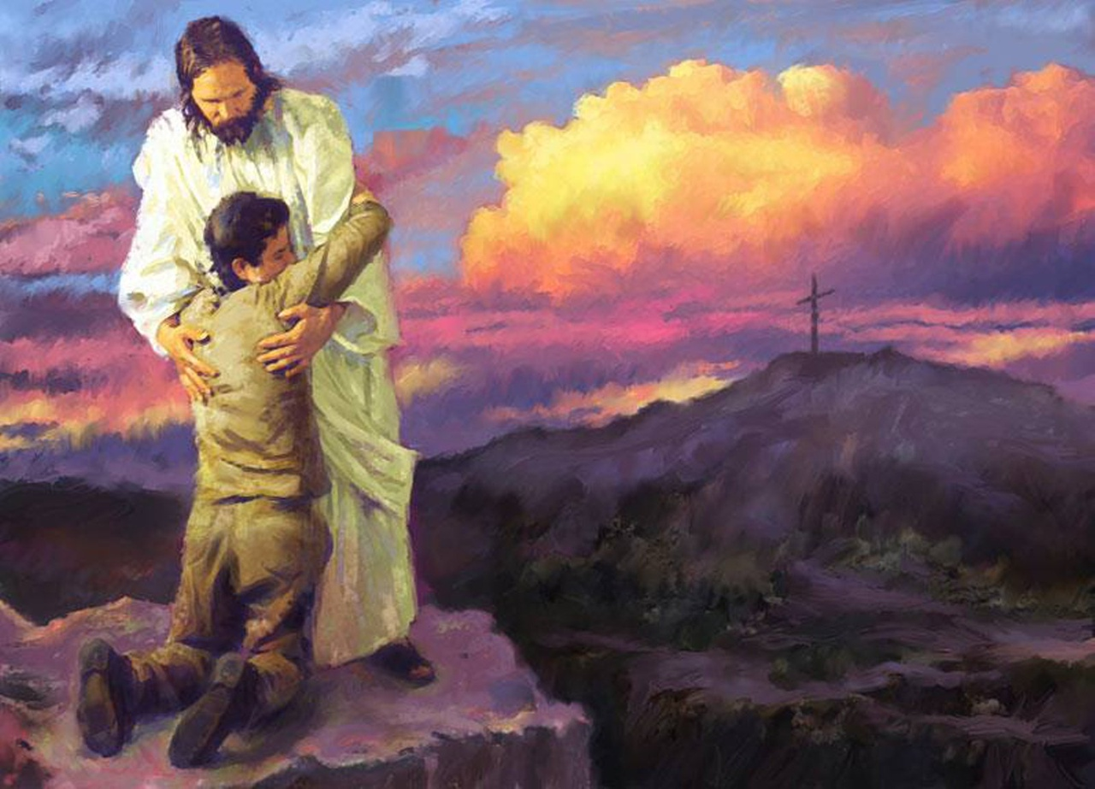


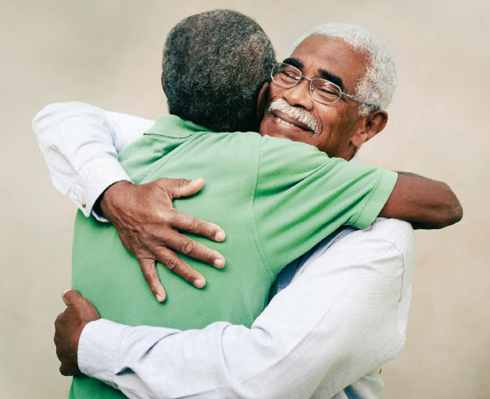

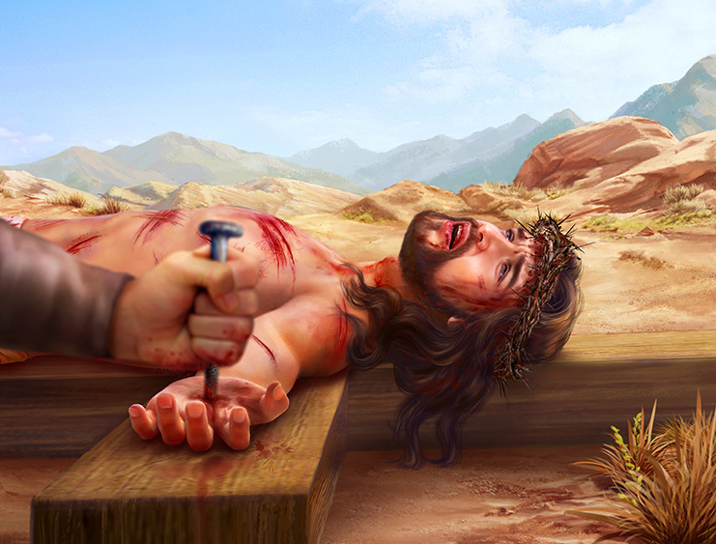
WHO DO I HAVE TO LOVE?
above all things
God
  “Love the Lord your God with all your heart and with all your soul and with all your strength" (Deuteronomy, 6:5.) We must love God with our reasoning, our will, our motives, our feelings, our affections and our desires. Our love for God must be unconditional, just as He loves us.
My Neighbor
as myself
“Love your neighbor as yourself" (Matt. 22:39)
  This love involves esteeming, respecting, helping, and loving everyone who is close to us in an altruistic way.
My Enemies
praying for them
“Love your enemies and pray for those who persecute you" (Matt. 5:44). We are not required to love them with filial love because we cannot feel the same affection we feel for our family or friends. We are asked to love them with agape love because it is under the dominion of the will. To love (agape) the bitterest enemies is to treat them with respect and courtesy, and to regard them as God regards them.

Slide 6
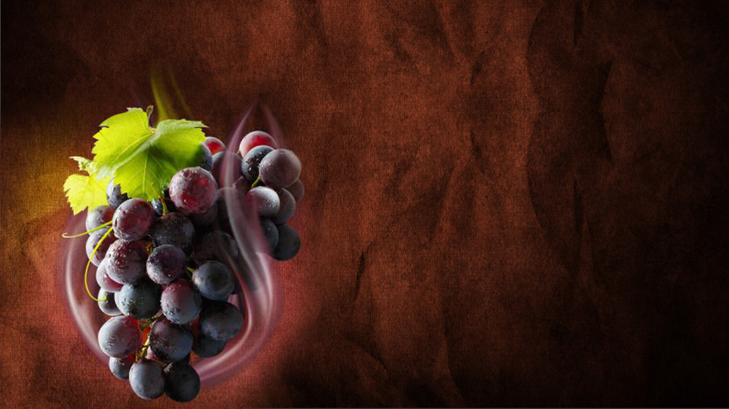

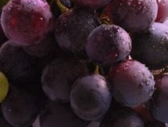
J
O
Y
“Rejoice in the Lord alway: and again I say, Rejoice”
WHAT IS JOY?
Philippians, 4: 4
Joy is the inner bliss that comes from the Lord and that can only be achieved by communion with Him.
Joy comes from perceiving God's presence in our lives, allowing us to rise above circumstances and focus on God's goodness and love.
“neither be ye sorry; for the joy of the Lord is your strength”
Nehemiah, 8: 10

Slide 7

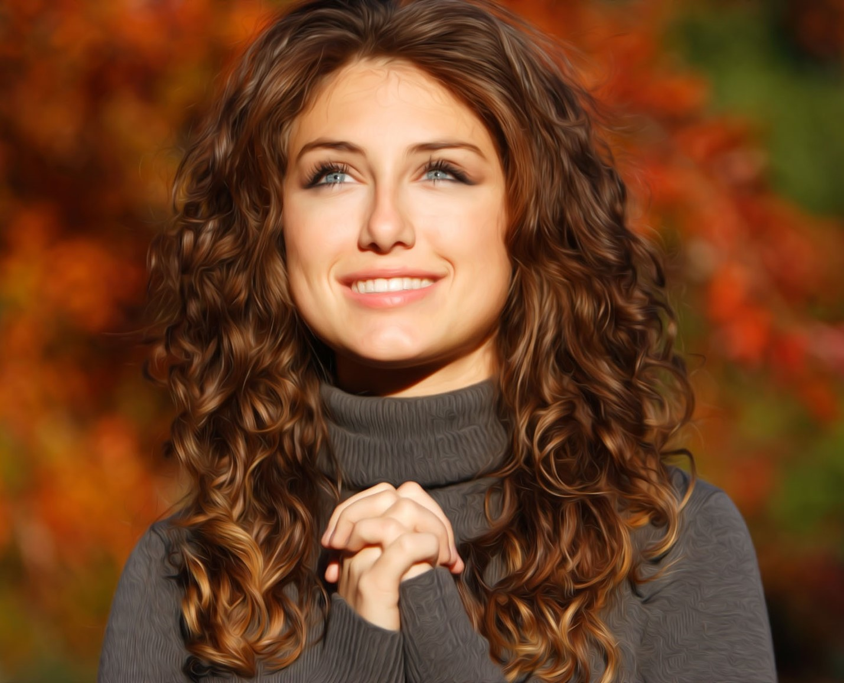
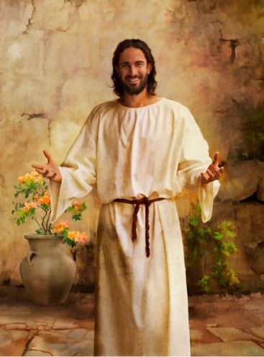
WHY HAVE JOY ALWAYS?
“God's love, His consideration, His power, are the same in times of affliction and in times of prosperity. Christ's power to provide peace of heart is not dependent on external circumstances. so that the heart that takes refuge in Him can continually rejoice." ABC, volume 7 on Philippians 4:4.
Also, because our faith is grounded in God's work for us in the past, His continued presence in our lives, and what we know God will do in the future. Finally, for the joy of being able to help other people and bring them the message of salvation.
WHAT EXAMPLE DO I HAVE IN CHRIST?
“Ever before Him, Christ saw the result of His mission. His earthly life, so full of toil and self-sacrifice, was cheered by the thought that He would not have all this travail for nought. By giving His life for the life of men, He would restore in humanity the image of God. He would lift us up from the dust, reshape the character after the pattern of His own character, and make it beautiful with His own glory.
Christ saw of the travail of His soul and was satisfied. He viewed the expanse of eternity and saw the happiness of those who through His humiliation should receive pardon and everlasting life. He was wounded for their transgressions, bruised for their iniquities. The chastisement of their peace was upon Him, and with His stripes they were healed. He heard the shout of the redeemed. He heard the ransomed ones singing the song of Moses and the Lamb. Although the baptism of blood must first be received, although the sins of the world were to weigh upon His innocent soul, although the shadow of an unspeakable woe was upon Him; yet for the joy that was set before Him He chose to endure the cross and despised the shame. (Mar 316)

Slide 8
WHAT REASONS ARE THERE TO REJOICE?
Because God gives us salvation:
“Restore unto me the joy of thy salvation; and uphold me with thy free spirit”. (Palm 51: 12)
Because we are in the presence of God:
“in thy presence is fulness of joy; at thy right hand there are pleasures for evermore”. (Psalm 16: 11)
For what God does:
“For thou, Lord, hast made me glad through thy work: I will triumph in the works of thy hands”. (Psalm 92: 4)
“And the ransomed of the Lord shall return, and come to Zion with songs and everlasting joy upon their heads: they shall obtain joy and gladness, and sorrow and sighing shall flee away” (Isaiah 35: 10)
For the future:
For being able to study the Bible:
“Thy words were found, and I did eat them; and thy word was unto me the joy and rejoicing of mine heart” (Jeremiah, 15: 16)

Slide 9




WHAT REASONS ARE THERE TO REJOICE?
For proclaiming the gospel:
“Christ is preached; and I therein do rejoice, yea, and will rejoice” (Philippians, 1: 18)
For the conversion of unbelievers:
“And being brought on their way by the church, they passed through Phenice and Samaria, declaring the conversion of the Gentiles: and they caused great joy unto all the brethren” (Acts, 15: 3)
Because we see that others are still standing firm in the truth:
“I have no greater joy than to hear that my children walk in truth” (3 John, 1: 4)
For believing in Jesus:
“[Jesus] Whom having not seen, ye love; in whom, though now ye see him not, yet believing, ye rejoice with joy unspeakable and full of glory” (1 Peter, 1: 8)
Because we keep the commandments:
“The statutes of the Lord are right, rejoicing the heart” (Psalm 19: 8)

Slide 10
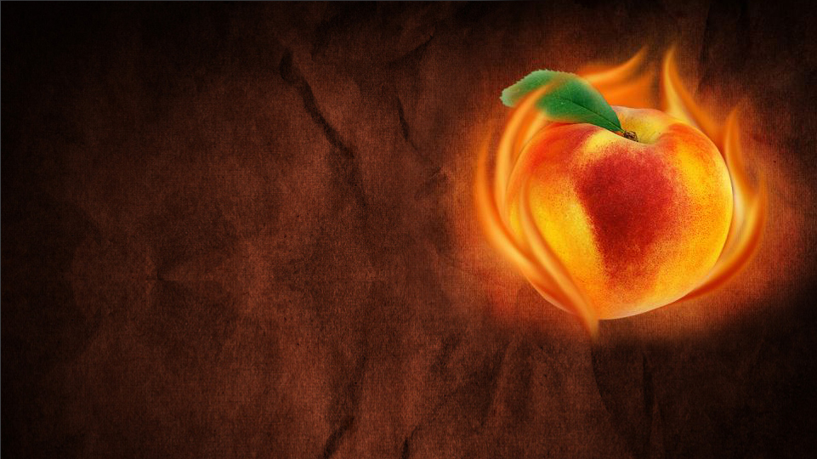

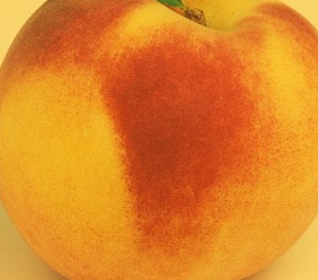
P
E
A
C
E
WHAT IS PEACE?
Hebrew- shalom, a word that often encompasses all the good that life can offer. It means not only "peace but also health", "prosperity", "well-being", "friendship", etc.
Jesus left us with a beautiful promise about peace: “Peace I leave with you, my peace I give unto you: not as the world giveth, give I unto you. Let not your heart be troubled, neither let it be afraid” (John 14:27).
We must not equate peace with a trouble-free life. It is rare for even the most faithful Christian to go through life without trials, pain, and suffering. In fact, some people seem to have more than their share of suffering. However, peace has more to do with how we handle these situations than with the situations themselves. Peace is about the deepest trust in a God who loves and cares about us, who knows what we are going through, and who has promised not to abandon us, no matter what happens to us along the way.

Slide 11

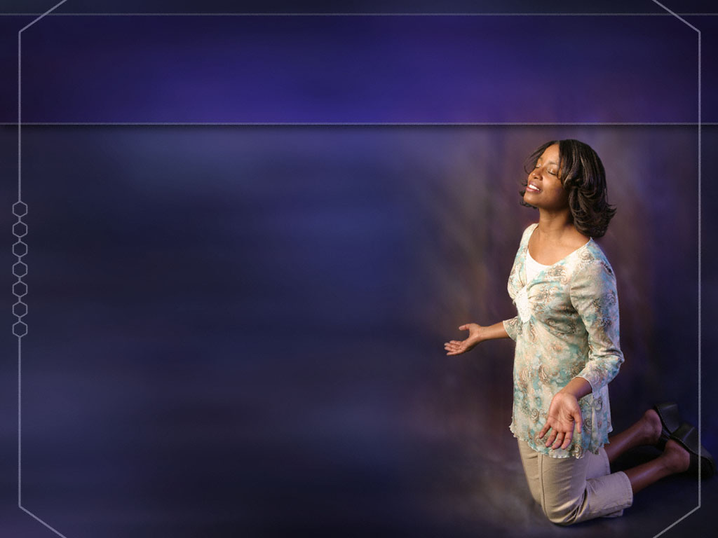
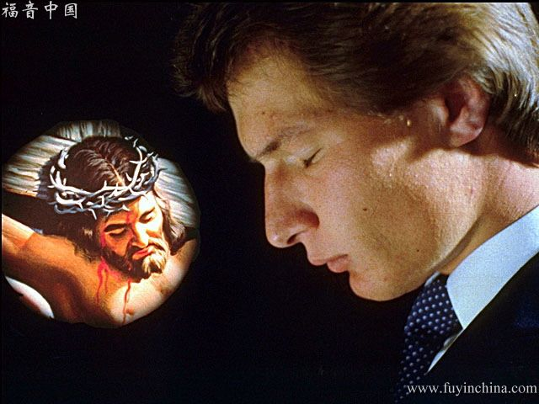
PEACE WITH GOD
“Therefore being justified by faith, we have peace with God through our Lord Jesus Christ” (Romans 5:1).
Having peace with God is more than being comfortable in His presence. It means that we, who were once "strangers and enemies in your minds, doing evil works" (Col. 1:21), have been reconciled and restored to fellowship with God. We were at war with God, but by His death on the cross, Jesus has made it possible for hostilities to cease and for us to be God's friends and not His enemies.
We can grow in peace with God. The more clearly we see God's ways and walk in them, the more we appropriate His power to live as His sons and daughters. In this sense, peace with God is truly a fruit of the Spirit.
FINDING PEACE
“It is the love of self that brings unrest. [...] Those who take Christ at His word, and surrender their souls to His keeping, their lives to His ordering, will find peace and quietude. Nothing of the world can make them sad when Jesus makes them glad by His presence. In perfect acquiescence there is perfect rest. The Lord says, “Thou wilt keep him in perfect peace, whose mind is stayed on Thee: because he trusteth in Thee.” Isaiah 26:3 (DA 331)

Slide 12
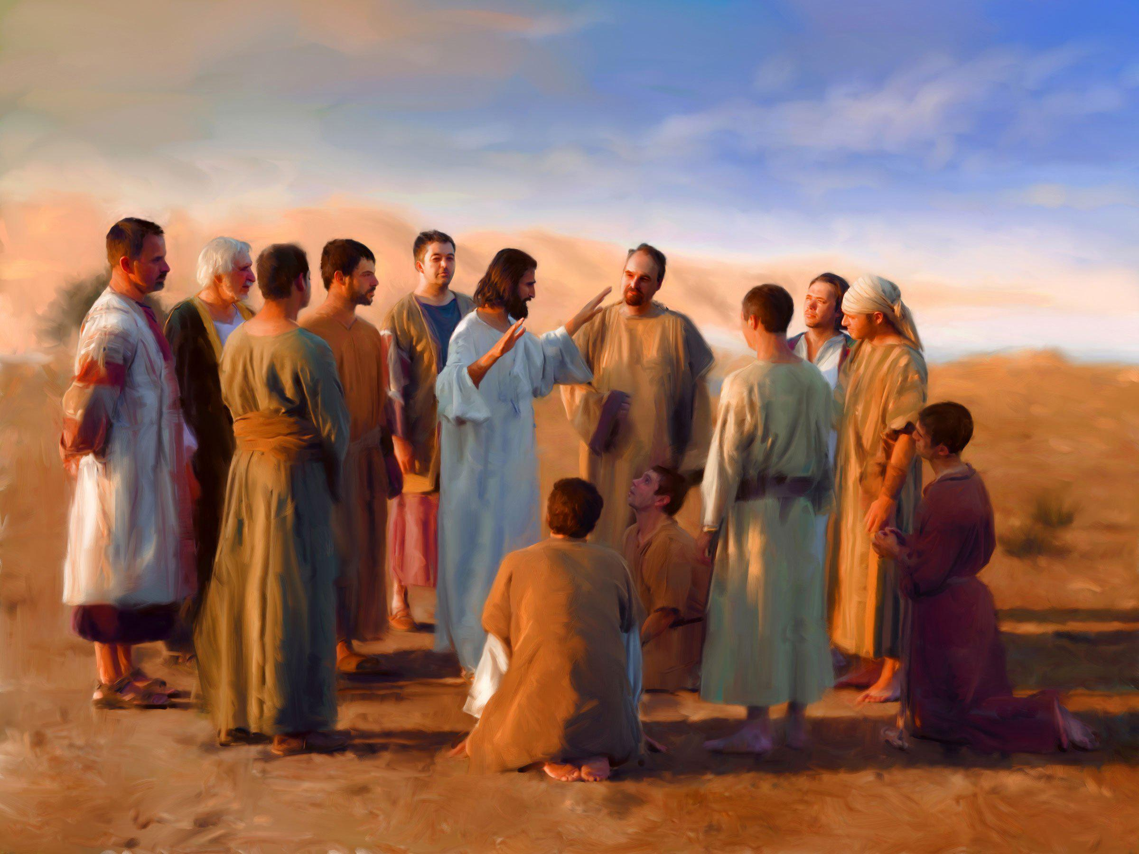
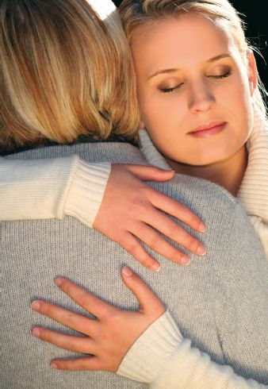
PEACE WITH OTHERS
“Pursue peace with all, and holiness, without which no man shall see the Lord" (Heb. 12:14). "If it is possible, as far as it depends on you, be at peace with all men" (Rom. 12:18).
When we are at peace with God—made possible by His sacrifice, which brought about reconciliation with Him—we will be at peace with ourselves and with those around us.
THE LEGACY OF CHRIST
Before our Lord went to His agony on the cross, He made His will. He had no silver or gold or houses to leave His disciples. He was a poor man, as far as earthly possessions were concerned. Few in Jerusalem were so poor as He. But He left His disciples a richer gift than any earthly monarch could bestow on his subjects. “Peace I leave with you, my peace I give unto you,” He said.... He left them the peace which had been His during His life on the earth, which had been with Him amid poverty, buffeting, and persecution, and which was to be with Him during His agony in Gethsemane and on the cruel cross. The Saviour's life on this earth, though lived in the midst of conflict, was a life of peace.... No storm of satanic wrath could disturb the calm of that perfect communion with God. And He says to us, “My peace I give unto you.” Those who take Christ at His word and surrender their souls to His keeping, their lives to His ordering, will find peace and quietude. Nothing of the world can make them sad when Jesus makes them glad by His presence. In perfect acquiescence there is perfect rest. The Lord says, “Thou wilt keep him in perfect peace, whose mind is stayed on thee: because he trusteth in thee” Isaiah 26:3. (HP 249)

Slide 13


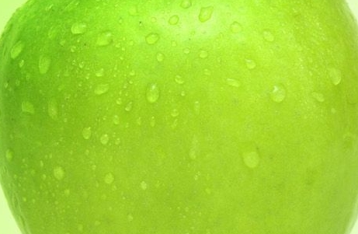
L
O
N
G
S
U
F
F
E
R
N
G
I
WHAT IS LONGSUFFERING?
Makrothumía. Longanimity, with a calm response; Opposite of: Quick, impatient or easily frustrated genius.
Hupomoné. Endurance, constancy, integrity, perseverance.
In general, it means staying underailed by adversity. It is generally applied to having patience with people.
“Put on therefore, as the elect of God, holy and beloved, bowels of mercies, kindness, humbleness of mind, meekness, makrothumía” (Colossians, 3: 12)
“For ye have need of hupomoné, that, after ye have done the will of God, ye might receive the promise” (Hebrews, 10: 36)

Slide 14

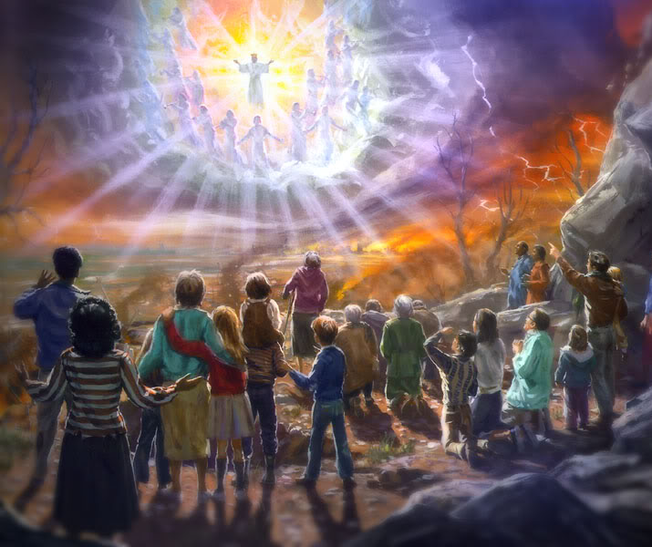
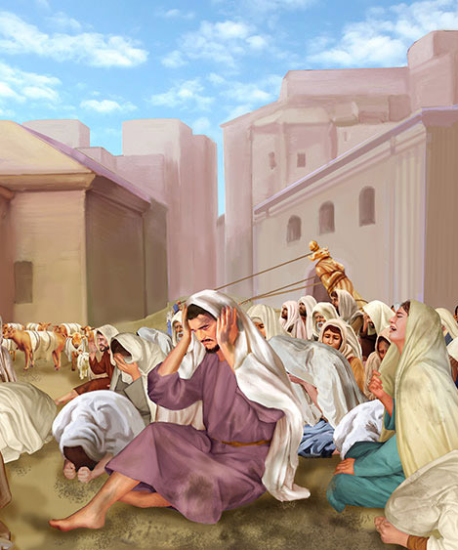

GOD’S LONGSUFFERING
God is “longsuffering" (Exodus, 34:6). He is long-tempered, of great disposition, peaceful, kind, and constant in all circumstances.
“for I knew that thou art a gracious God, and merciful, slow to anger, and of great kindness, and repentest thee of the evil” (Jonah, 4: 2)
His Character
His Dealings With Sinners:
“The Lord is not slack concerning his promise, as some men count slackness; but is longsuffering to us-ward, not willing that any should perish, but that all should come to repentance… And account that the longsuffering of our Lord is salvation” (2 Peter, 3: 9, 15)
The Flood (1 Peter, 3: 20)
For 120 years "God waited patiently while the ark was being built”
Sodom and Gomorrah (Genesis 18:16-33)
He was willing to forgive her if He found 10 righteous ones.
The inhabitants of Canaan (Exodus 12:41)
He waited more than 400 years and forgave even those who could be saved like Rahab in Jericho.
The destruction of Jerusalem (2 Kings 20:16-18)
Prophesied since Hezekiah, he waited more than 130 years before executing her sentence.

Slide 15





OUR LONGSUFFERING
A patient person is gentle, kind, and consistent in all circumstances. The real test of patience is not in waiting, but in how one conducts oneself while waiting. "But let patience have its complete work, that you may be perfect and complete, lacking nothing" (James 1:41:4).
Getting to that point takes practice, demands God's grace, and a willingness to put self aside and surrender to the Holy Spirit's leading. The good news is that if we learn patience, we will be able to receive many other blessings from God as well.
Patience in suffering
Patience until the Second Coming
Patience to get the promise
Patience with others in love
“Be patient therefore, brethren, unto the coming of the Lord. Behold, the husbandman waiteth for the precious fruit of the earth, and hath long patience for it, until he receive the early and latter rain” (James 5:7).
…beseech you that ye walk worthy of the vocation wherewith ye are called, with all lowliness and meekness, with longsuffering, forbearing one another in love” (Ephesians 4:1-2).
“Rejoicing in hope; patient in tribulation; continuing instant in prayer”
(Romans 12:12).
“For ye have need of patience, that, after ye have done the will of God, ye might receive the promise”
(Hebrews 10:36).

Slide 16


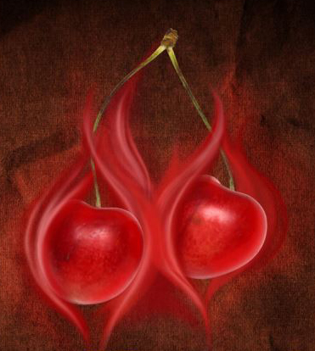
G
E
N
T
L
E
N
E
S
S
WHAT IS GENTLENESS?
From the Greek “jrestós” , it means "gentle", "kind”.
This word expresses love in action. It describes gentle, kind, and considerate both in disposition and action toward the needs of our neighbor.
Simple kindness or gentleness is one of the deepest positive characteristics that speak for the Christian.
Benignity is the opposite of malice. Conversion transforms malice into kindness through spiritual alchemy.

Slide 17


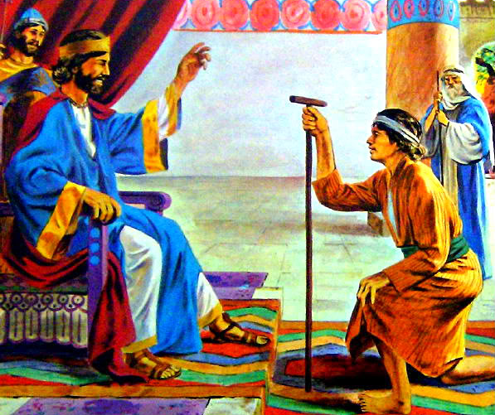
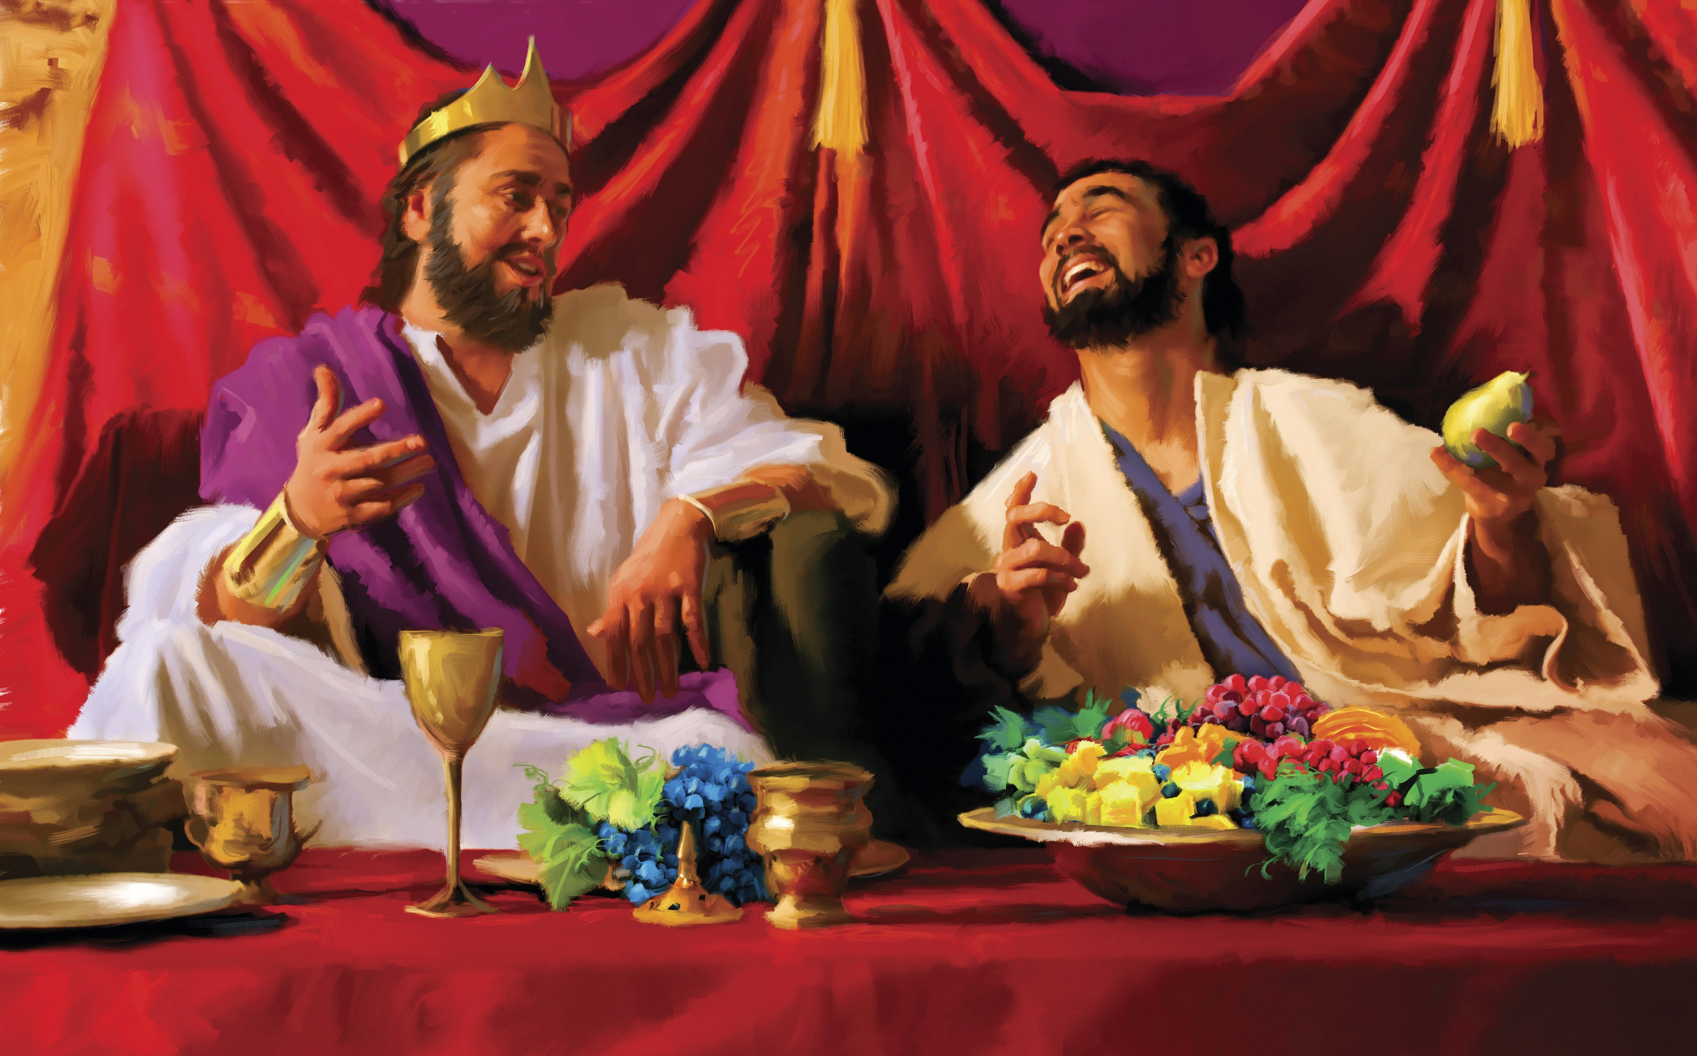
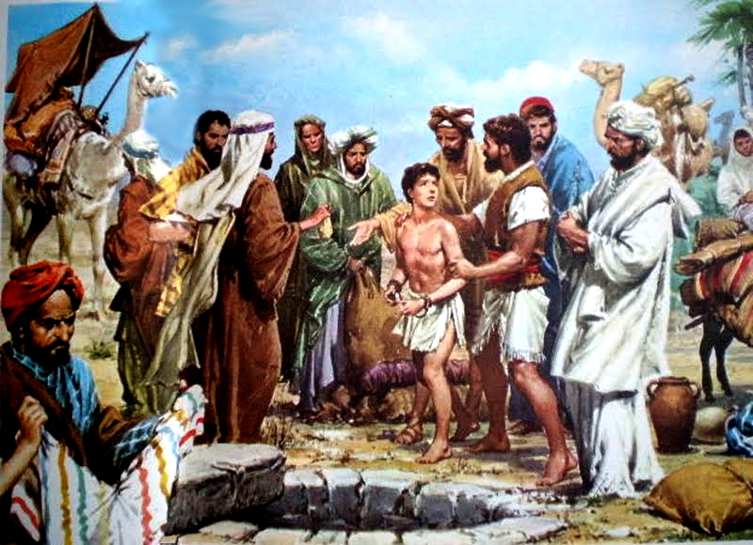
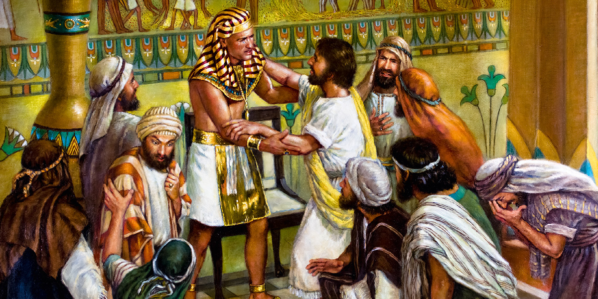
EXAMPLES OF GENTLENESS
Ephesians 4:32 begins with the words, "Be kind to one another." Consider how this verse matches perfectly with David's example of treating others as God has treated us.
His dealings with Mephibosheth reveal that David sought to use God as the model for what he wanted to do for Saul's house. He recognized that he, a sinner like all of us, had received undeserved mercy and kindness from the hand of God, and he was about to reflect some of that kindness toward others.
“Through reports from the enemies of David, Mephibosheth had been led to cherish a strong prejudice against him as a usurper; but the monarch's generous and courteous reception of him and his continued kindness won the heart of the young man; he became strongly attached to David, and, like his father Jonathan, he felt that his interest was one with that of the king whom God had chosen.” (PP 713)
Joseph was sold into Egypt by his brothers, but he understood that everything that had happened to him had been guided by God's gracious hand.
He forgave his brothers and behaved kindly towards them, seeking their good at all times.

Slide 18
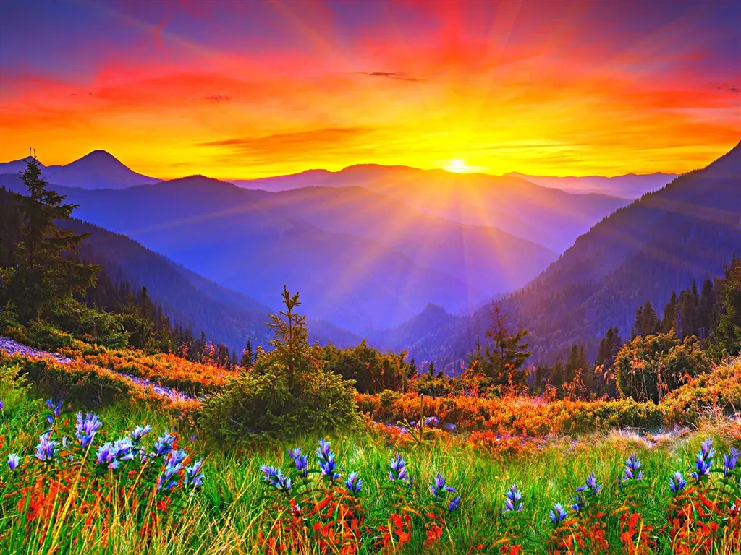



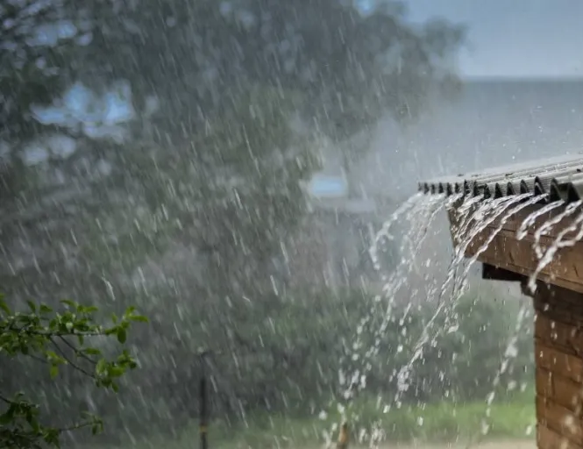


GOD IS BENIGN AND ACTS KINDLY TO EVERYONE
“Although God faithfully rewards virtue and punishes guilt, yet he does not withhold his blessings from the wicked, although they daily dishonor His name. He allows the sunshine and the showers to fall upon the just and the unjust, bringing alike worldly prosperity to both. If a holy God exercises such forbearance and benevolence toward the rebellious and the idolatrous, how necessary it is that erring man should manifest a like spirit toward his fellow-men.” (Redemption: or the Teachings of Christ, the Anointed One, pp. 76, 77)
JESUS INVITES US TO FOLLOW GOD'S EXAMPLE
Luke 6:35
But love ye your enemies, and do good, and lend, hoping for nothing again; and your reward shall be great, and ye shall be the children of the Highest: for he is kind unto the unthankful and to the evil.
Colossians
3:12
Put on therefore, as the elect of God, holy and beloved, bowels of mercies, kindness, humbleness of mind, meekness, longsuffering.
1 Peter 2: 1, 3
Wherefore laying aside all malice, and all guile, and hypocrisies, and envies, and all evil speakings…
If so be ye have tasted that the Lord is gracious.
Or despisest thou the riches of his goodness and forbearance and longsuffering; not knowing that the goodness of God leadeth thee to repentance?
Romans 2:4
But I say unto you, Love your enemies, bless them that curse you, do good to them that hate you, and pray for them which despitefully use you, and persecute you.
Matthew 5:44

Slide 19


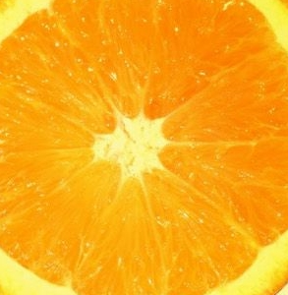
G
O
O
D
N
E
S
S
WHAT IS GOODNESS?
Goodness is holiness put into practice. Goodness is what we do; otherwise, it is not "Goodness" in any way.
The word translated "Goodness" (agathosune) in Galatians 5:22 denotes active, even aggressive goodness. More than an excellence of character, it is energized character, which is expressed in good actions.
A "good heart" is revealed in good deeds, good works; precisely, in practical acts of Goodness for the benefit of others. Good intentions, good thoughts, and good motives are fine, and they have their place; but, in the end, goodness is doing good.

Slide 20


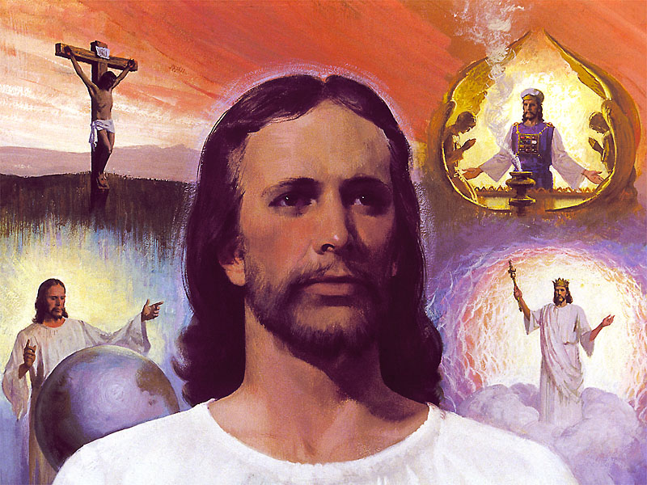
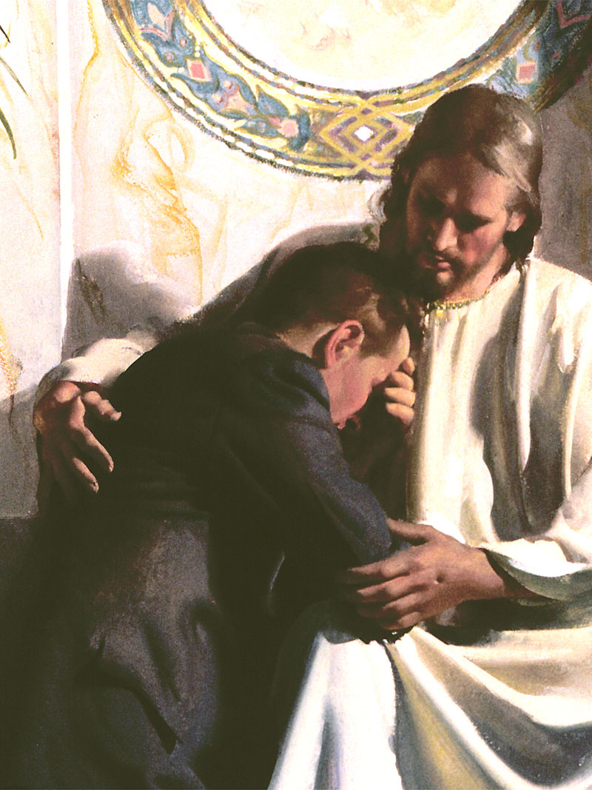
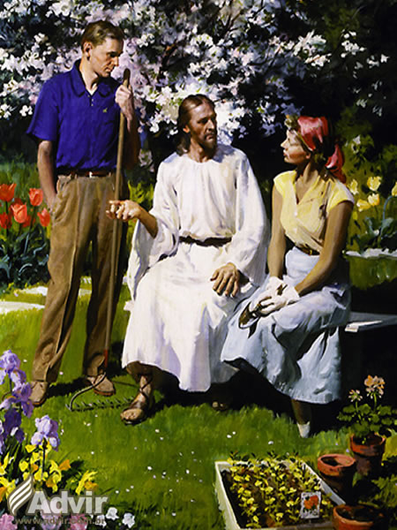
“There is none good, but only one, God” Mark. 10:18
How does God prove that he is good?
Creating Us (Genesis, 1: 31)
For his mercy endures forever (1 Chronicles, 16: 34)
Teach sinners the way (Psalm 5:8; Micah, 6: 8)
Forgive (Psalm 86: 5)
He has mercy on all Creation (Psalm 145: 9)
It is strength in the day of trouble (Nahum, 1: 7)
He keeps his promises (Nehemiah, 9: 25)
Forget sin (Psalm 25: 7)
It encourages us (Psalm 27: 13)
Provides for the poor (Psalm 68: 10)
He gave us His Son (Ephesians, 2: 7)
He has a purpose of kindness toward us (2 Thess. 1: 11)
He manifests love for men (Titus, 3: 4)

Slide 21

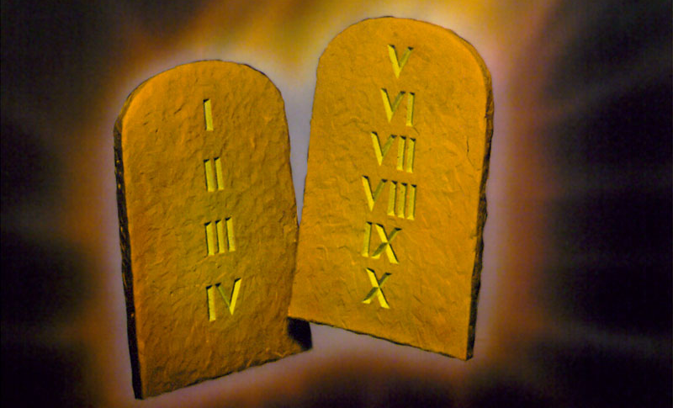
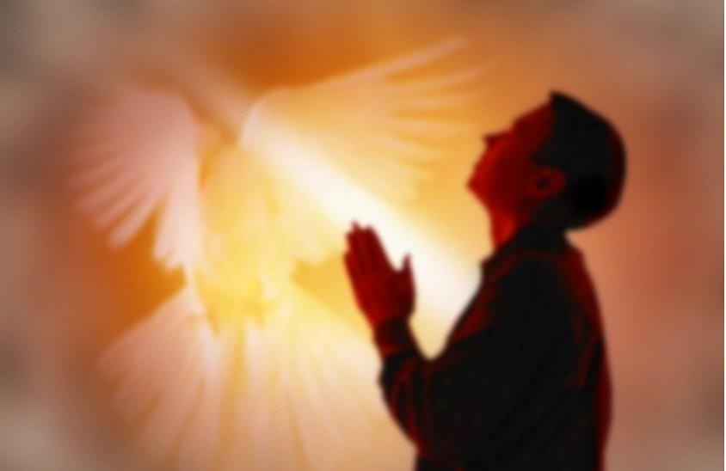
Although only God is good, we can have some degree of goodness, even if we do not have absolute goodness.
How can we measure our degree of goodness?
God's Law is the rule by which we can distinguish good from evil.
“If it were not for the law, I would not have realized what sin is” (Romans, 7: 7)
As a manifestation of God's kind disposition, the Law teaches us how to behave, not only to be good, but to act kindly toward others.
Who is good when compared to the Rule of Divine Law?
“They are all gone out of the way, they are together become unprofitable; there is none that doeth good, no, not one” (Romans 3:12)
“Can the Ethiopian change his skin, or the leopard his spots? then may ye also do good, that are accustomed to do evil” (Jeremiah 13:23)
No one can be good on their own, no matter how hard they try. We can perform acts of kindness, but that doesn't make us good people. Goodness is a fruit of the Spirit and only the Holy Spirit can cause that fruit to be born in us.

Slide 22
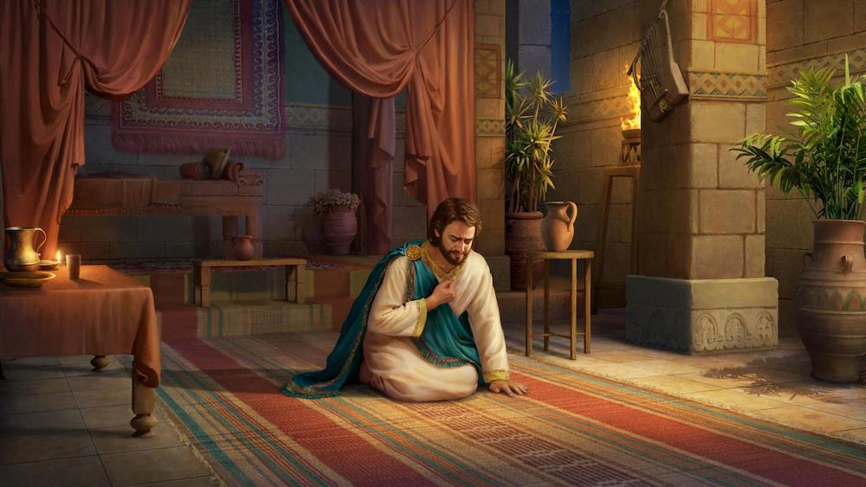
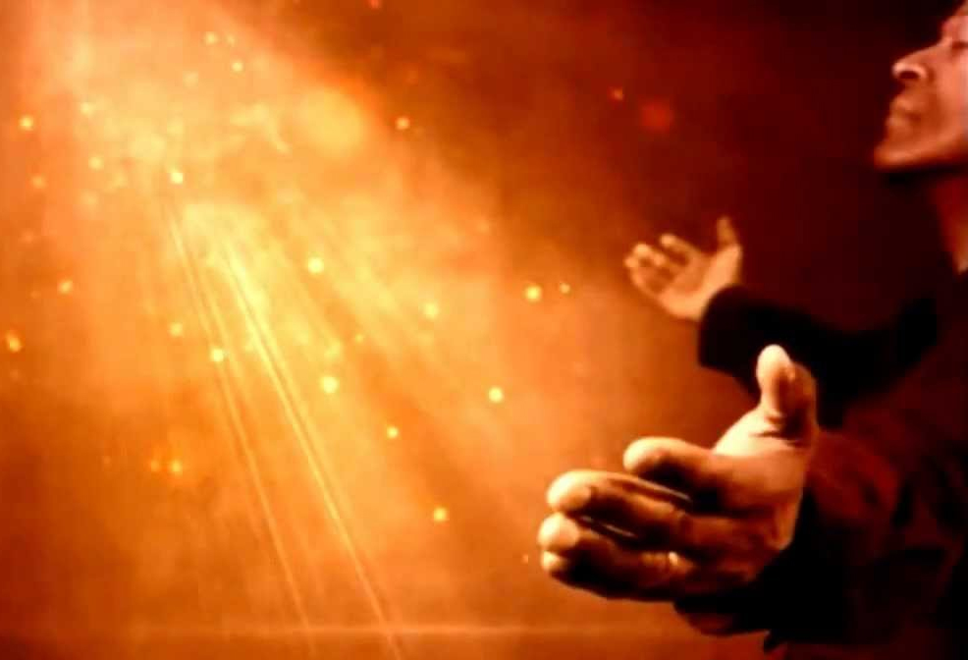
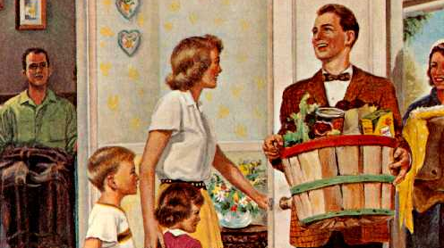
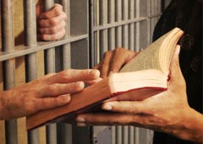
“One of the most earnest prayers recorded in the Word of God is that of David when he pleaded, “Create in me a clean heart, O God.” Psalm 51:10. God's response to such a prayer is, A new heart will I give you. This is a work that no finite man can do. Men and women are to begin at the beginning, seeking God most earnestly for a true Christian experience. They are to feel the creative power of the Holy Spirit.
They are to receive the new heart, that is kept soft and tender by the grace of heaven. The selfish spirit is to be cleansed from the soul. They are to labor earnestly and with humility of heart, each one looking to Jesus for guidance and encouragement. Then the building, fitly framed together, will grow into a holy temple in the Lord.” (OHC 159)
We are not "good" in the sense that we deserve salvation, because only God's goodness gives us salvation. We are "good" in the sense that our hearts, our motives, our deeds, reveal to the world the reality of the God whom we profess to serve.

Slide 23


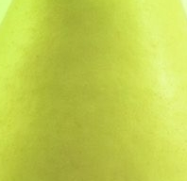
F
A
I
T
H
The fruit of the Spirit known as "faith" could also be called "faithfulness." It speaks of perseverance, a steadfastness of purpose, especially when it becomes difficult to move forward.
Fidelity implies firm adherence. Synonyms include loyalty, which implies unchanging allegiance; constancy, which suggests freedom from uncertainty; firmness, which implies a loyalty so strong to principles or purposes that it cannot be deviated; and determination, which emphasizes an invariable decision.
"Faith" and "faithfulness," while closely linked, are not the same thing. Faith is that indefinable power, a gift from God, by which we can believe in a reality that still remains invisible. "Faith is the assurance of things hoped for, the evidence of things not seen" (Heb. 11:1). Faithfulness, in contrast, is the result of this inner belief system. When we have faith in God, we act faithfully. Acts of faithfulness are a demonstration of our faith, and such acts are the threads that hold together our belief and behavior systems.
WHAT IS FAITH?

Slide 24

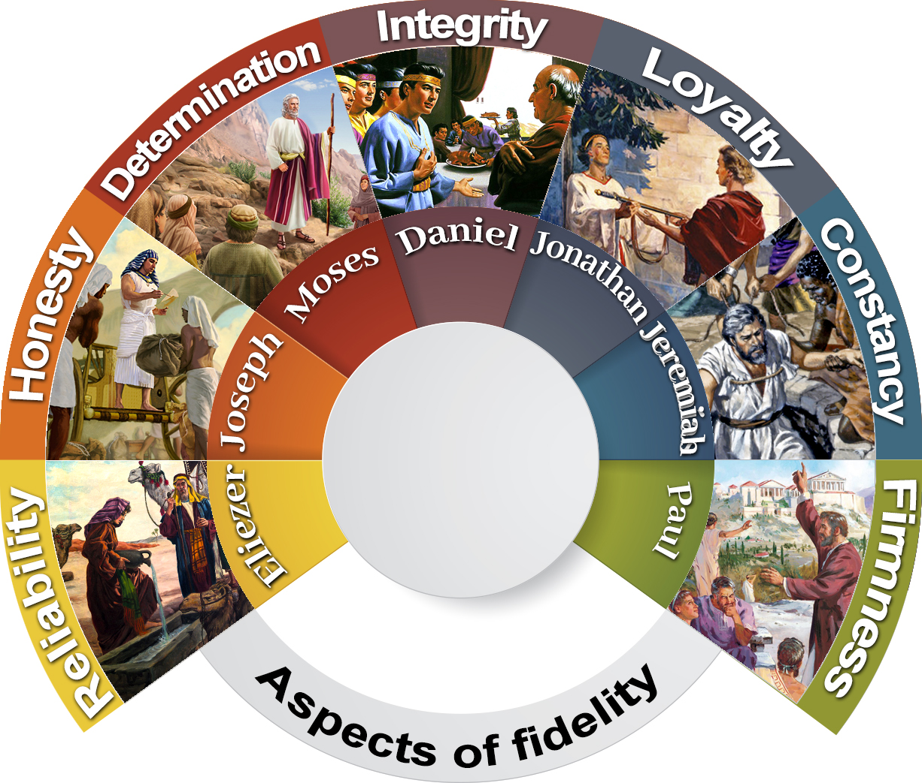







COMPONENTS OF FIDELITY
Reliability: This means you can be counted on.
Honesty: Honesty is truthfulness. It means that you are not going to lie, cheat, or steal.
Determination: It is to make the firm decision to do the thing that is expressed.
Integrity: You have certain values and beliefs by which you live. It also means that you respect the values and beliefs of others.
Loyalty: It means being with someone even when the circumstances are difficult. Loyalty is an important part of friendship.
Constancy: To be persevering and determined in the face of a purpose or decision.
Firmness: Unbreakable will and constancy in the realization of something.

Slide 25
GOD'S FAITHFULNESS
Faithfulness is part of his character.
O Lord God of hosts, who is a strong Lord like unto thee? or to thy faithfulness round about thee” (Psalm. 89: 8).
“…and thy faithfulness reacheth unto the clouds” (Psalm 36:5)
God's faithfulness goes a long way
God's faithfulness is eternal.
“And the faithfulness of the Lord endures forever” (Psalm 117: 2).
“Nevertheless My lovingkindness I will not utterly take from it, Nor allow My faithfulness to fail” (Psalm 89:33 NKJV)
God's faithfulness is sure
Each generation can count on its faithfulness
“Thy faithfulness is unto all generations” (Psalm 119: 90).
“They are new every morning: great is thy faithfulness” (Lamentations 3:23)
God's faithfulness is great
God's faithfulness is immeasurable
“…great is thy faithfulness” (Lamentations 3: 23).
“For I have said, “Mercy shall be built up forever; Your faithfulness You shall establish in the very heavens.” (Ps. 89:2)
God's faithfulness is established in the heavens
His faithfulness is personal to each of us.
“will even betroth thee unto me in faithfulness: and thou shalt know the Lord” (Hosea, 2: 20).
“For the word of the LORD is right; and all his works are done in faithfulness” (Psalm 33: 4)
God does
everything faithfully,
until it is finished

Slide 26
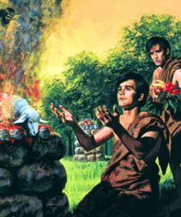
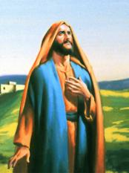
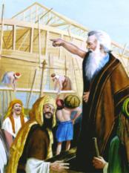
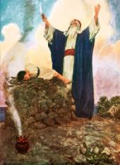
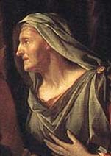
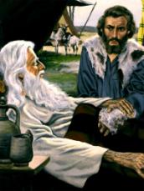
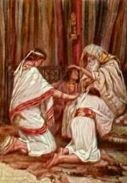
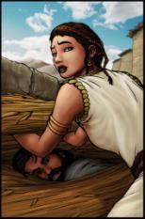
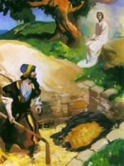
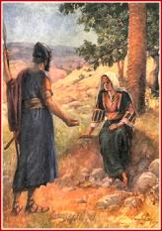
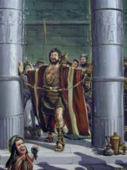



EXAMPLES OF FAITH AND FAITHFULNESS ACCORDING TO HEBREWS 11
Abel
Enoch
Noah
Abraham
Sara
Isaac
Jacob
Rahab
Gideon
Barak
Samson
Jephthah
David
Samuel

Slide 27




MY FAITH AND MY FAITHFULNESS
As believers, we need to be faithful in all aspects of our lives.
First, faithfulness to God and His teachings.
Second, to show our faithfulness in our relationships with others.
This is only possible with a constant and daily surrender to God, letting the Holy Spirit develop this fruit in us.
God expects us to be faithful to Him throughout our lives: "Be faithful unto death, and I will give you the crown of life”
Despite the apparent delay of the Second Coming, God expects us to remain faithful until we hear from the lips of Jesus the following words:
“Well done, good and faithful servant; you have been faithful over a few things, I will make you ruler over many things; enter into the joy of your Lord”

Slide 28



M
E
E
K
N
E
S
S
WHAT IS MEEKNESS?
“Meekness is a precious grace, willing to suffer silently, willing to endure trials. Meekness is patient and labors to be happy under all circumstances. Meekness is always thankful and makes its own songs of happiness, making melody in the heart to God. Meekness will suffer disappointment and wrong, and will not retaliate. Meekness is not to be silent and sulky. A morose temper is the opposite of meekness; for this only wounds and gives pain to others, and takes no pleasure to itself.” —1873, Testimonies for the Church 3:335. 3TT 48

Slide 29


A FRUIT WITH A REWARD
The New Land
“Blessed are the meek: for they shall inherit the earth”
(Matthew, 5: 5)
They are taught by God
“The meek will he guide in judgment: and the meek will he teach his way”
(Psalm 25:9)
They will have peace
“But the meek shall inherit the earth; and shall delight themselves in the abundance of peace” (Psalm 37:11)
They will be saved
“When God arose to judgment, to save all the meek of the earth.” (Psalm 76:9)
God will give them a righteous ruling
“But with righteousness shall he judge the poor, and reprove with equity for the meek of the earth”
(Isaiah, 11:4)

Slide 30





WHAT IS MEEKNESS NECESSARY FOR?
James 1:21
1 Peter 3:15
To receive the Word of God.
For effective witnessing.
Micah 6:8
To please God with it.
Ephesians 4:2
To put up with each other.
Matthew 5:39
To react correctly to provocations.
Galatians 6:1
To forgive.
2 Timothy 2:24-25
To correct.

Slide 31
MODELS OF MEEKNESS
Noah with the antediluvians
Abraham with Lot
Moses with the people of Israel
Gideon with the Ephraimites
David with Saul
Daniel with Melzar

Slide 32







JESUS THE MODEL PAR EXCELLENCE
“Take my yoke upon you, and learn of me; for I am meek and lowly in heart: and ye shall find rest unto your souls” Matthew 11:29
“In view of what is soon to come upon the earth, I entreat you, brethren and sisters, to walk before God in all meekness and lowliness of mind, remembering the care that Jesus has for you.” HP 30

Slide 33



T
E
M
P
E
R
A
N
C
E
WHAT IS TEMPERANCE?
Temperance is self-control, self-discipline, strength of mind, willpower.
Self-control or temperance is an integral part of grace itself. If we don't control ourselves—our feelings, our appetites, our impulses—then they control us. Therefore, it is either self-control under the grace and power of the Holy Spirit, or it is being controlled by some other person or thing.

Slide 34


Using self-control…
whatsoever things are true.
whatsoever things are honest.
whatsoever things are just.
whatsoever things are pure.
whatsoever things are lovely.
whatsoever things are of good report.
if there be any virtue.
Whatever is worthy of praise.
I DO AND THINK ABOUT
Philippians, 4: 8)
I STOP DOING AND THINKING ABOUT
(1 John, 2: 16)
the lust of the flesh.
the lust of the eyes,.
The pride of life.

Slide 35




SAMSON
Vs.
JOSEPH
CONTRASTING EXAMPLES
Having everything in his favor, he did not want to repress his desires.
Having everything against him, he determined to do the right thing with God's help.
ADAM
Vs.
JESUS

Slide 36


GROWING IN TEMPERANCE
Step 1:
To give up sin and renounce the old man.
“Wherefore seeing we also are compassed about with so great a cloud of witnesses, let us lay aside every weight, and the sin which doth so easily beset us, and let us run with patience the race that is set before us” (Hebrews, 12: 1)
“Mortify therefore your members which are upon the earth; fornication, uncleanness, inordinate affection, evil concupiscence, and covetousness, which is idolatry: For which things' sake the wrath of God cometh on the children of disobedience: In the which ye also walked some time, when ye lived in them. But now ye also put off all these; anger, wrath, malice, blasphemy, filthy communication out of your mouth. Lie not one to another, seeing that ye have put off the old man with his deeds” (Colossians, 3: 5-9)
Step 2:
Being new creatures, seek heavenly things, letting the Holy Spirit manifest His fruit in us.
“If ye then be risen with Christ, seek those things which are above, where Christ sitteth on the right hand of God. Set your affection on things above, not on things on the earth.” (Colossians, 3: 1-2)
“For it is God which worketh in you both to will and to do of his good pleasure” (Philippians, 2: 13)
“But the fruit of the Spirit is love, joy, peace, longsuffering, gentleness, goodness, faith, Meekness, temperance: against such there is no law.” (Galatians, 5: 22-23)

Slide 37


Practicing Self-Control Daily and Turning Away from Temptation.
Step 3:
“Not as though I had already attained, either were already perfect: but I follow after, if that I may apprehend that for which also I am apprehended of Christ Jesus” (Philippians, 3: 12)
Know ye not that they which run in a race run all, but one receiveth the prize? So run, that ye may obtain. And every man that striveth for the mastery is temperate in all things. Now they do it to obtain a corruptible crown; but we an incorruptible. I therefore so run, not as uncertainly; so fight I, not as one that beateth the air: But I keep under my body, and bring it into subjection: lest that by any means, when I have preached to others, I myself should be a castaway.” (1 Corinthians, 9: 24-27)
“Let us walk honestly, as in the day; not in rioting and drunkenness, not in chambering and wantonness, not in strife and envying. But put ye on the Lord Jesus Christ, and make not provision for the flesh, to fulfil the lusts thereof.” (Romans, 13: 13-14)
“Every besetting sin must be put away. Warfare must be waged against it until it is overcome. The Lord will work with your efforts. As finite, sinful man works out his own salvation with fear and trembling, it is God who works in him, to will and to do of His own good pleasure. But God will not work without the co-operation of man. He must exercise his powers to the very utmost; he must place himself as an apt, willing student in the school of Christ; and as he accepts the grace that is freely offered to him, the presence of Christ in the thought and in the heart will give him decision of purpose to lay aside every weight of sin, that the heart may be filled with all the fullness of God, and of His love.” E.G.W. (Fundamentals of Christian Education, pp. 134)

Slide 38

The fruit of the Spirit is a change of being. "Old things have passed away; behold, they are all made new" (2 Cor. 5:17). The fruit of the Spirit is the "new" in the life of a person who has passed from death to life in Christ (1 John 3:14).
We should not focus on how we can become more patient, or more loving, or kinder, or more faithful, but how we can allow the Holy Spirit to make us more like Jesus, who is the embodiment of patience, love, kindness, and faith.
I encourage you to cultivate the graces of the fruit of the Spirit at all times. The key is to surrender to God, it is a willingness to die to self,
and to live for God and for others.
Remember that everything you
do must be done under the conviction
that you are a sinner, that you need
to be covered by the grace of Christ,
who loves you, whether the harvest is
abundant or meager.
You must never forget that the fruit
of the Spirit is just that: the 'fruit’;
the result of salvation,
not the means to obtain it.
The means is always Jesus
and what he did for us.

