Slide 1
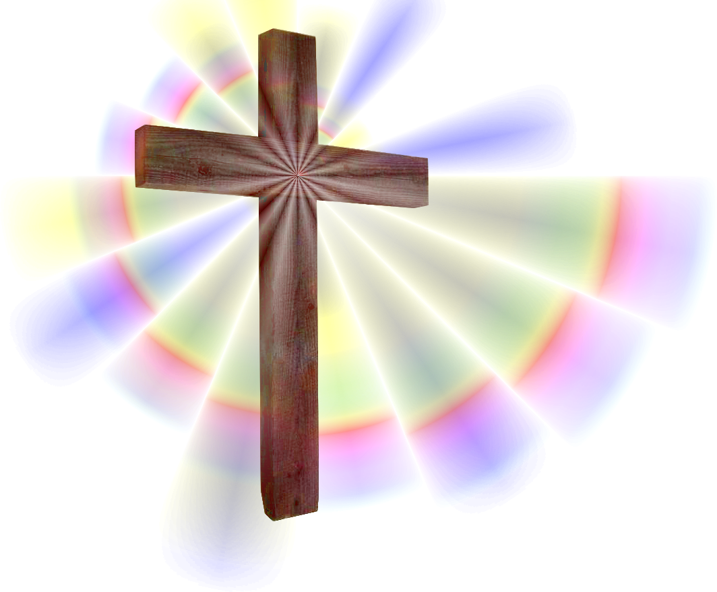
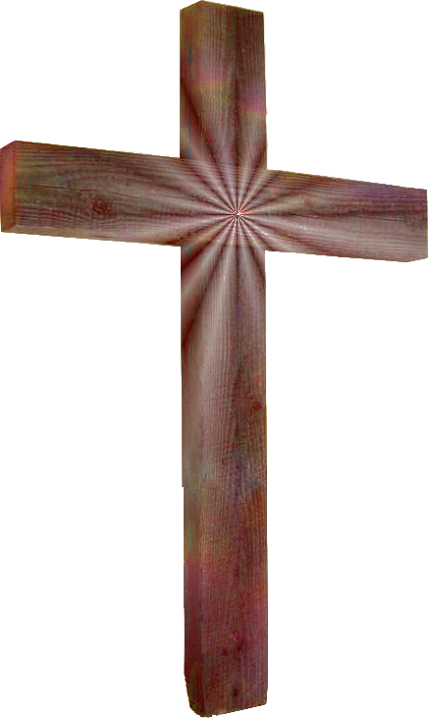
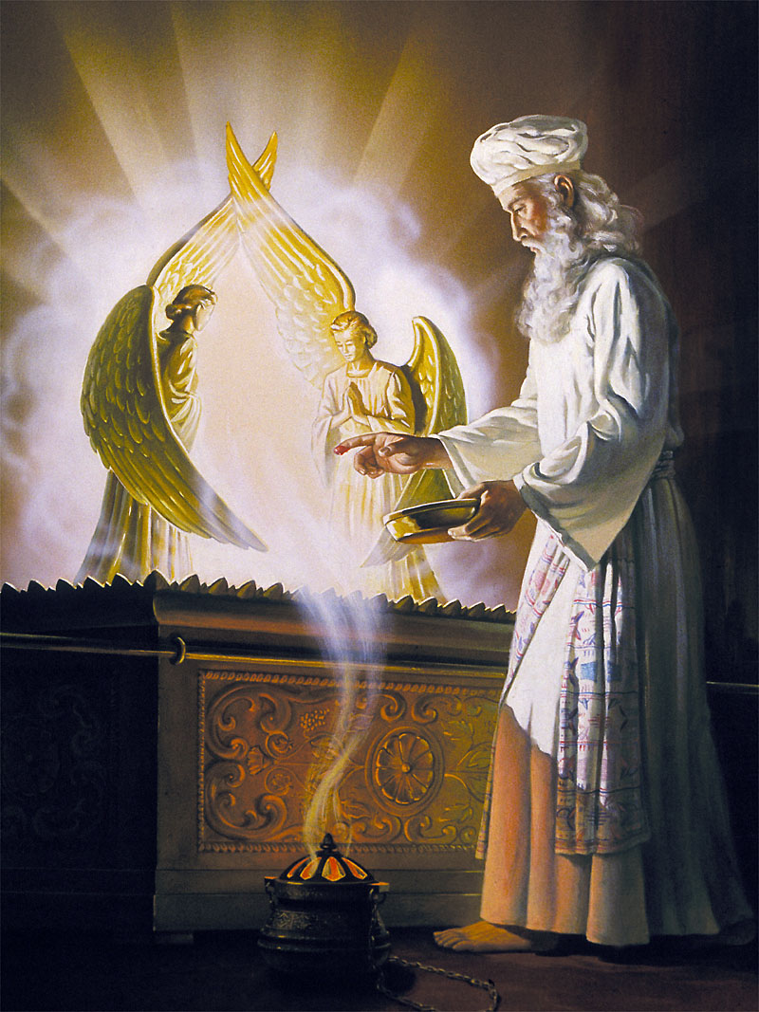
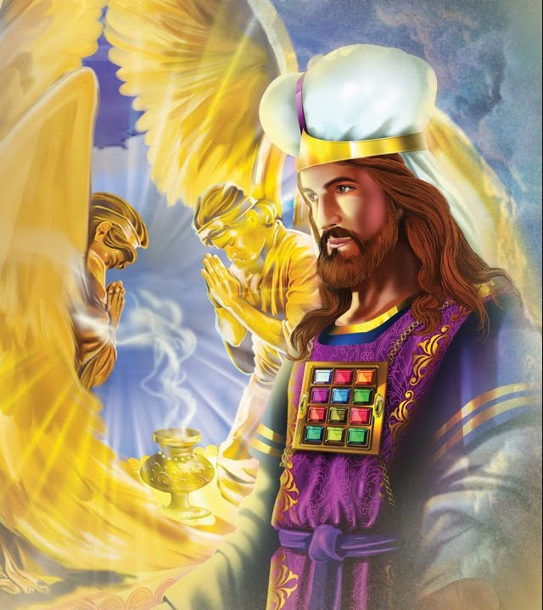
the
intercession
´

Slide 2
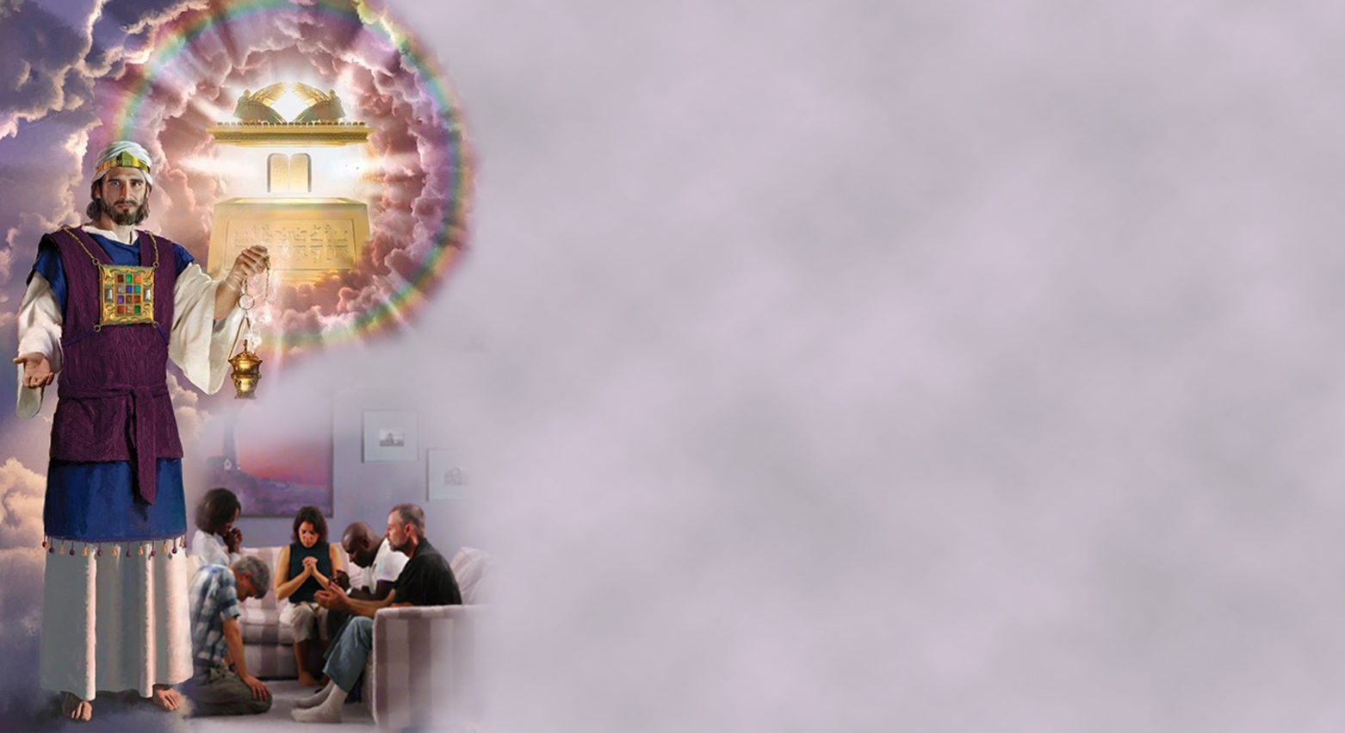
What is intercession? To intercede is to speak on behalf of someone in order to obtain good or deliver him from evil.
What does intercession comprehend? It is the golden chain which binds finite man to the throne of the infinite God. The human agent whom Christ has died to save importunes the throne of God, and his petition is taken up by Jesus who has purchased him with His own blood. Our great High Priest places His righteousness on the side of the sincere suppliant, and the prayer of Christ blends with that of the human petitioner.
Christ has urged that His people pray without ceasing. This does not mean that we should always be upon our knees, but that prayer is to be as the breath of the soul. Our silent requests, wherever we may be, are to be ascending unto God, and Jesus our Advocate pleads in our behalf, bearing up with the incense of His righteousness our requests to the Father.
The Lord Jesus loves His people, and when they put their trust in Him, depending wholly upon Him, He strengthens them. He will live through them, giving them the inspiration of His sanctifying Spirit, imparting to the soul a vital transfusion of Himself. He acts through their faculties and causes them to choose His will and to act out His character....
The Lord will not leave His afflicted, tried children to be the sport of Satan's temptations. It is your privilege to trust in Jesus. The heavens are full of rich blessings. TMK 78
What biblical examples do we have that teach us the most about why or how intercession occurs?

Slide 3


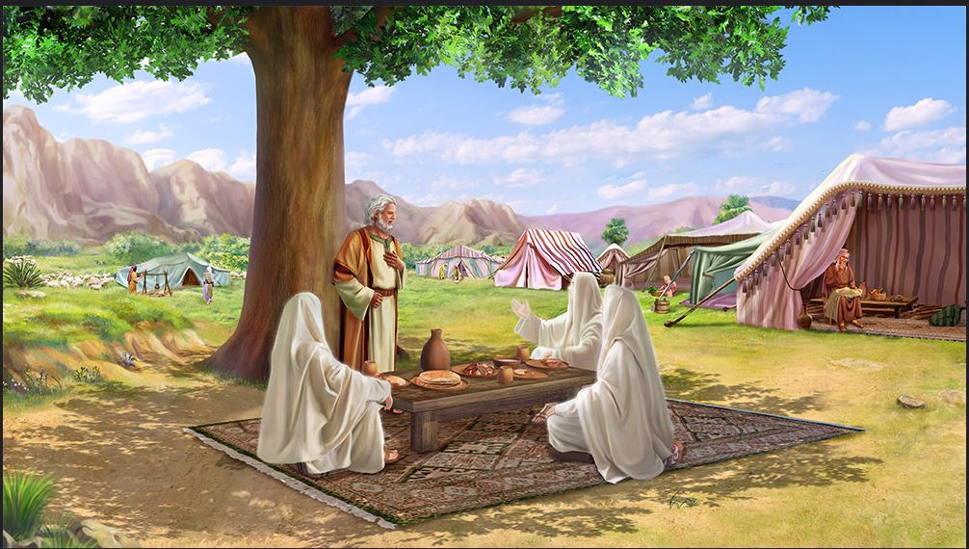
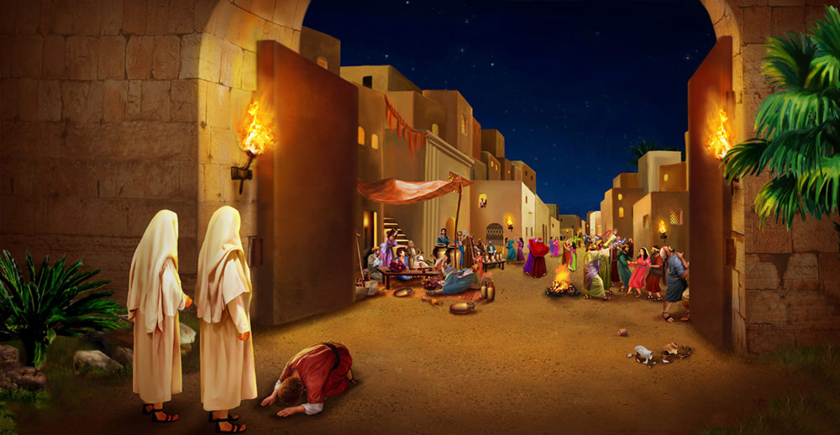
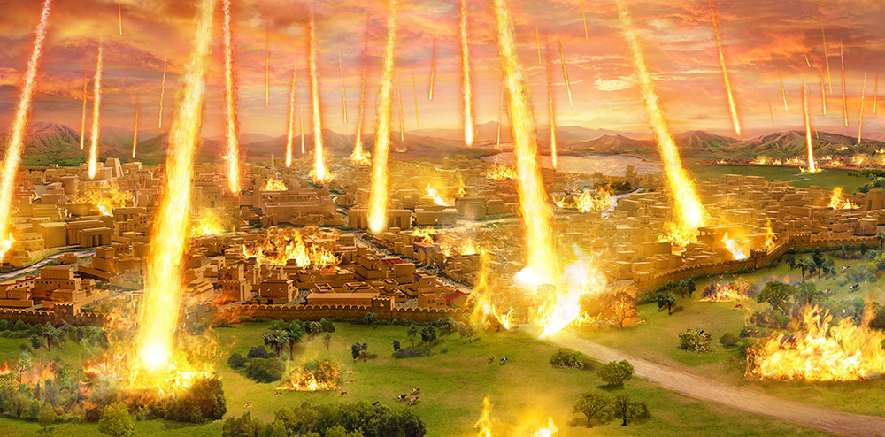
Abraham intercedes for Sodom
Genesis 18:22-33
After Abraham was with the three heavenly messengers, two of them left for Sodom, leaving Abraham alone with the One whom he now recognized as the Son of God.
He explained that he was going to destroy Sodom and Gomorrah because of their wickedness.
And Abraham, a man of faith, interceded on behalf of its inhabitants. Formerly he had saved them by his sword, now he sought to save them from the tempest of divine judgment, if it was God's will, by intercession.
Knowing that Lot and his family lived there, he tried to save their lives from destruction.
Let us hear him intercede:

Slide 4



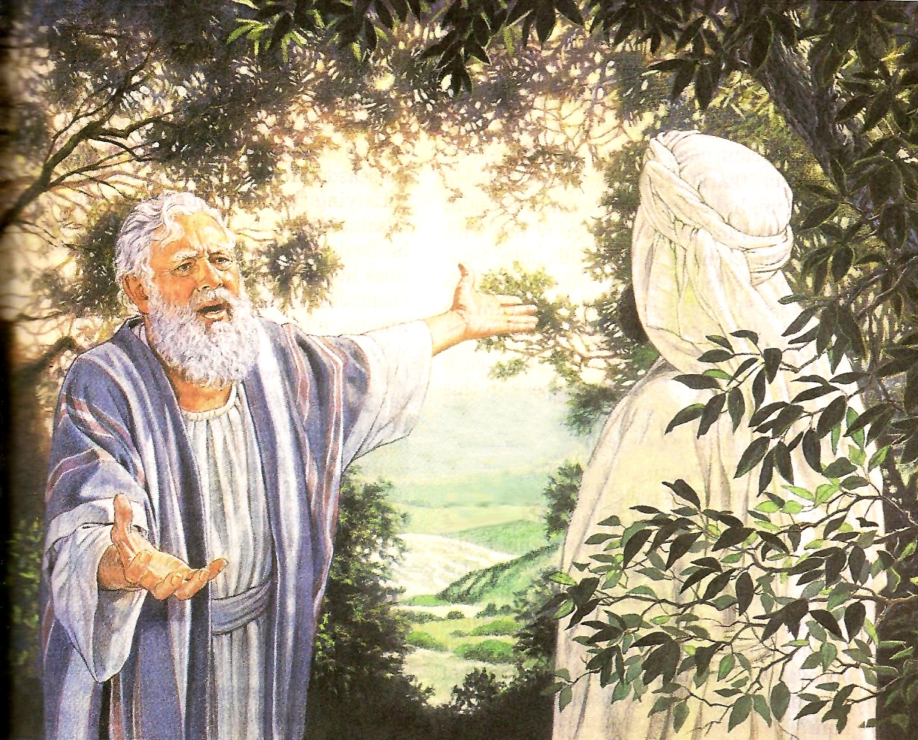
And Abraham drew near, and said, Wilt thou also destroy the righteous with the wicked? Peradventure there be fifty righteous within the city: wilt thou also destroy and not spare the place for the fifty righteous that are therein? That be far from thee to do after this manner, to slay the righteous with the wicked: and that the righteous should be as the wicked, that be far from thee: Shall not the Judge of all the earth do right?
And the LORD said, If I find in Sodom fifty righteous within the city, then I will spare all the place for their sakes.
And Abraham answered and said, Behold now, I have taken upon me
to speak unto the Lord, which am but dust and ashes: Peradventure
there shall lack five of the fifty righteous: wilt thou destroy all
the city for lack of five?
And he said, If I find there forty and five, I will not destroy it.
And he spake unto him yet again, and said, Peradventure there
shall be forty found there.
And he said, I will not do it for forty's sake.
And he said unto him, Oh let not the Lord be angry, and I will speak: Peradventure there shall thirty be found there.
And he said, I will not do it, if I find thirty there.
And he said, Behold now, I have taken upon me to speak unto
the Lord: Peradventure there shall be twenty found there.
And he said, I will not destroy it for twenty's sake.
And he said, Oh let not the Lord be angry, and I will speak yet but this once: Peradventure ten shall be found there.
And he said, I will not destroy it for ten's sake.
And the LORD went his way, as soon as he had left communing with Abraham: and Abraham returned unto his place.

Slide 5

Christ
Abraham asked not once merely, but many times. Waxing bolder as his requests were granted, he continued until he gained the assurance that if even ten righteous persons could be found in it, the city would be spared.
Love for perishing souls inspired Abraham's prayer. While he loathed the sins of that corrupt city, he desired that the sinners might be saved…
The spirit of Abraham was the spirit of Christ. The Son of God is Himself the great Intercessor in the sinner's behalf. He who has paid the price for its redemption knows the worth of the human soul. With an antagonism to evil such as can exist only in a nature spotlessly pure, Christ manifested toward the sinner a love which infinite goodness alone could conceive.
EGW (Patriarchs and prophets p. 118-119)
Jesus intercedes for the unrighteous and sinners, as well as for his family (those adopted as children of God), so that they will not be destroyed.

Slide 6


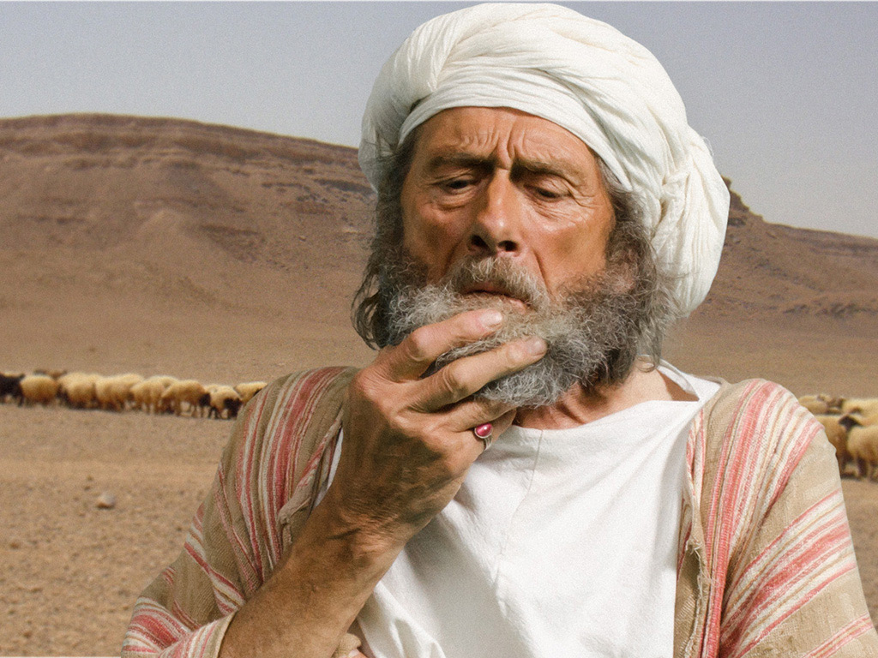
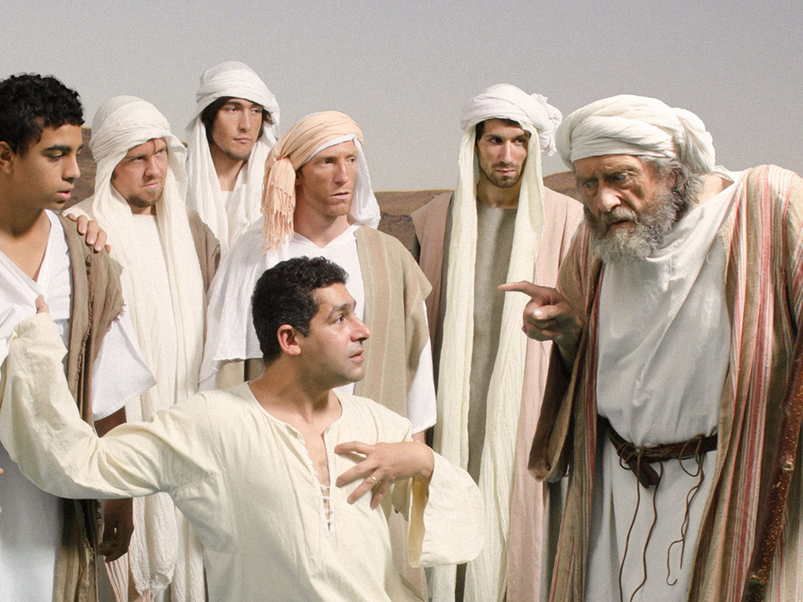
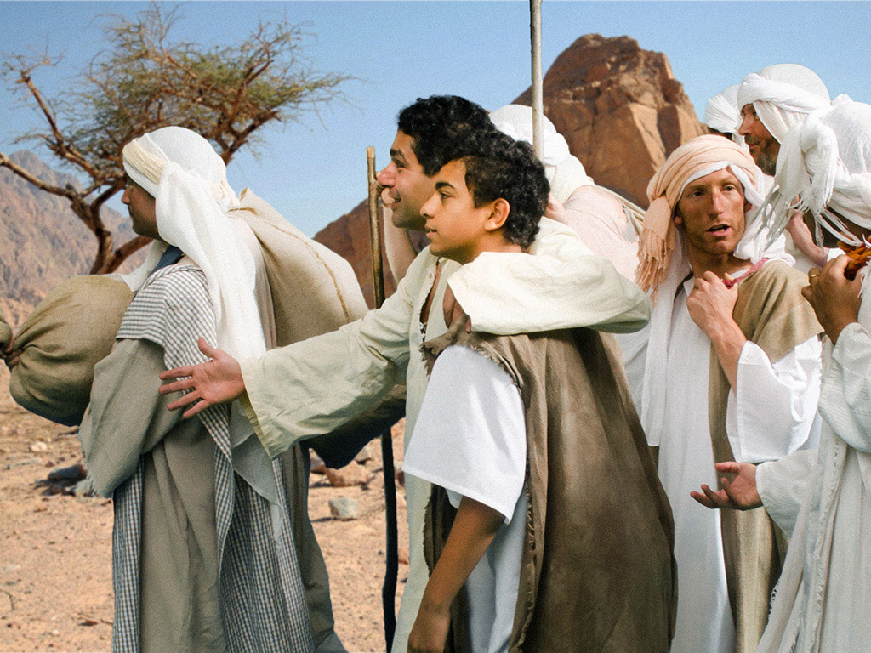
Judah Intercedes for Benjamin
Genesis 43; 44
There was a famine throughout the land. Jacob sent his sons to Egypt, because he heard that there was food there. After the provisions brought from Egypt ran out, the famine began to take effect. Jacob read the need they had on the anxious faces of the whole camp; at last he said, "Go back, and buy for us a little food.”.
Judah answered him, "The man warned us with a resolute spirit, 'You will not see my face unless you bring your brother with you.' If you send our brother with us, we will go down and buy you food. But if you do not send him, we will not go down, for that man said to us, 'You will not see my face unless you bring your brother with you.'”.
Seeing that his father's resolve was beginning to waver, Judah offered himself as his brother's guarantor, pledging to accept the blame forever if he did not return Benjamin to his father. "Send the young man with me, and we will arise and go, that we may live and not die, and thou, and our children. I answer for him; you will ask me for an account. If I do not bring him back to you, and if I do not set him before you, I will be guilty of you forever.”.

Slide 7

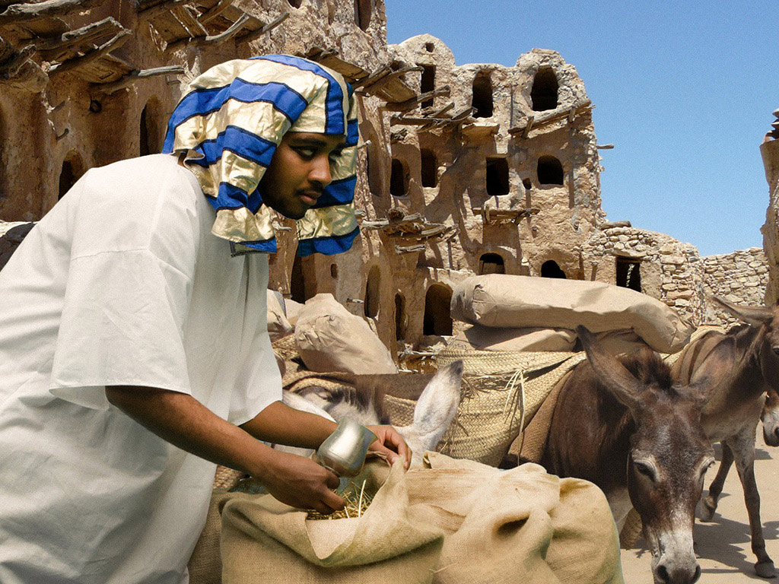
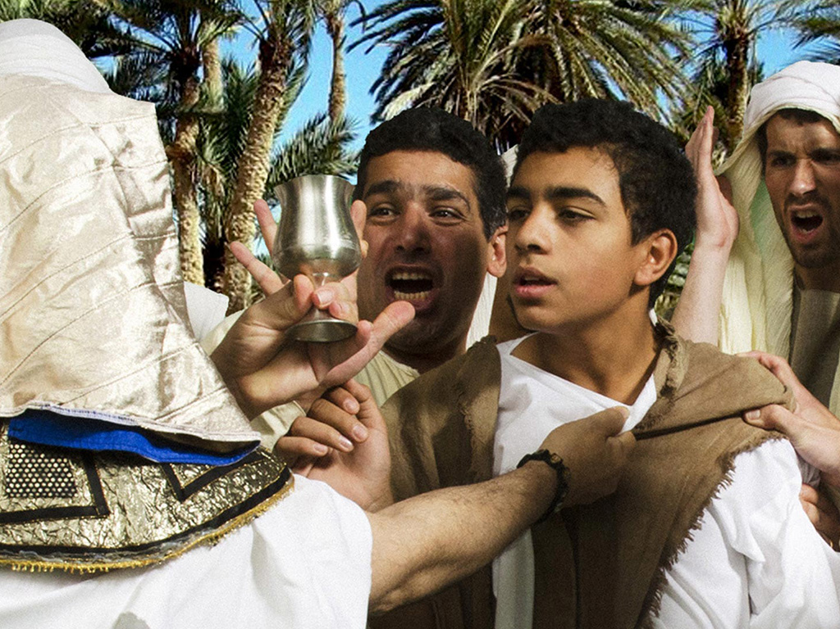
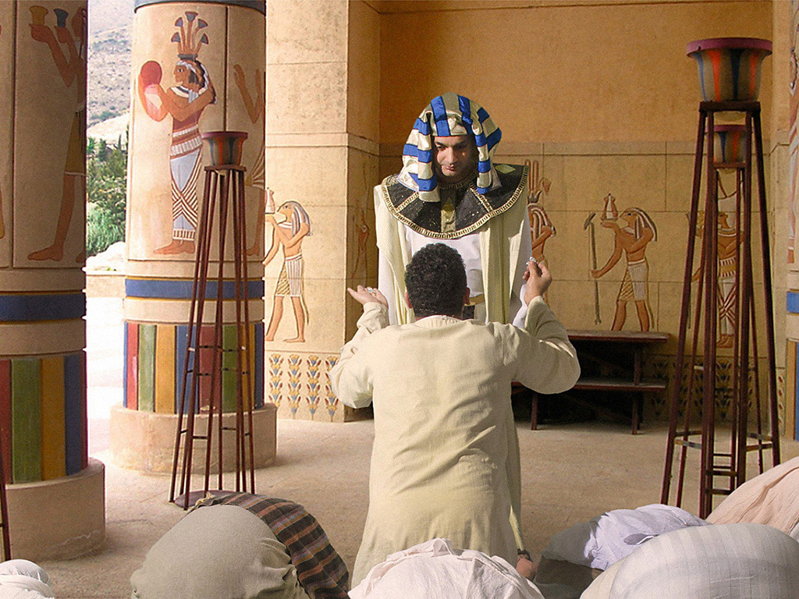
In Egypt they bought food and, when they left, they were accused of stealing Joseph's silver cup. When they looked in the sacks, the cup was in Benjamin's sack.
Judah said to the steward, "What shall we say to my lord? What will we talk about or with what will we justify ourselves? God has found the wickedness of your servants. We are servants of my lord, we eloquence, the one in whose possession the cup was found.”.
“"I never did such a thing," was the reply. The man in whose possession the cup was found, that shall be my servant; you go in peace with your Father.”.
Then they all returned to Egypt and bowed down before Joseph to the ground.
In his deep grief, Judah approached the governor – not knowing that it was Joseph – and interceded for Benjamin: "Alas, my lord, please allow your servant to speak a word in the hearing of my lord, and do not let your anger be kindled against your servant, for you are like Pharaoh.”
In words of touching eloquence, he described his father's deep sorrow for the loss of Joseph, and his refusal to allow Benjamin to travel with them to Egypt, for he was the only son left to him by his mother Rachel, whom Jacob had loved so tenderly.
And now, when I return to thy servant my father, if the young man does not go with me, as his life is bound up with his life, it shall come to pass, that when I do not see the young man, he shall die; and your servants will cause the gray hairs of our Father, your servant, to descend into Sheol in sorrow. As your servant gave surety for the young man before my father, saying, 'If I do not bring him back to you, then I will be guilty before my father forever,' so I beg you to stay now your servant instead of the young man as my master's servant, and let the young man go with his brothers, for how shall I return to my father without the young man? I will not be able to, because I do not see the evil that will befall my father.”

Slide 8


Christ
Judah first offered himself as a guarantor for his brother Benjamin, and then he interceded with Joseph for his brother and was surety for him so that he would not hurt his father.
Jesus said, “Therefore doth My Father love Me, because I lay down My life, that I might take it again.” John 10:17. That is, “My Father has so loved you that He even loves Me more for giving My life to redeem you. In becoming your Substitute and Surety, by surrendering My life, by taking your liabilities, your transgressions, I am endeared to My Father; for by My sacrifice, God can be just, and yet the Justifier of him who believeth in Jesus.” SC 14
Jesus came out as a guarantor for us, and intercedes so that we will not be slaves to sin, but that we will obtain true freedom.

Slide 9


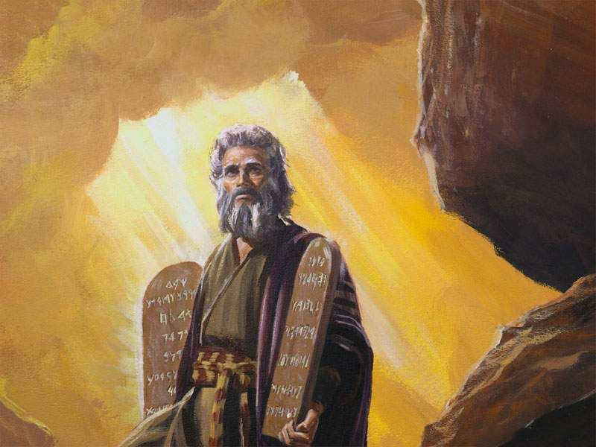
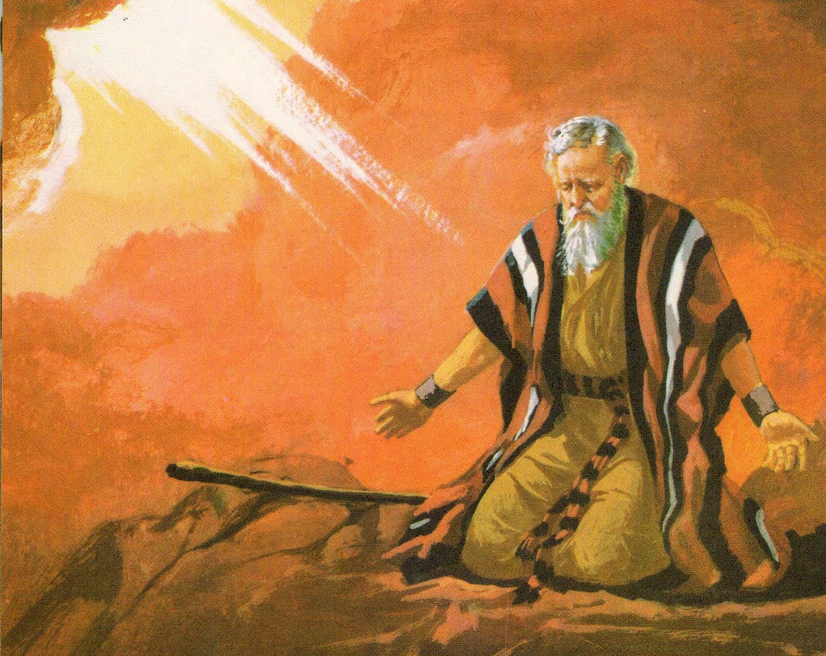
Moses intercedes for the people of Israel
Exodus 32:7-35
Moses was on the mountain with God, and God commanded him, "Go down, for your people whom you brought out of the land of Egypt have become corrupt. They have soon turned away from the path I commanded them; they have made themselves a molten calf, and they have worshipped it, and they have offered sacrifices to it, and they have said, 'Israel, these are your gods, who brought you out of the land of Egypt.'" In addition, he added: "Son pueblo was stiff-necked. Now therefore, let me kindle my wrath in them, and consume them; and out of you I will make a great nation.”.
Here we see Moses interceding:
Moses answered: "O Lord, why will your wrath be kindled against your people, whom you brought out of the land of Egypt with great power and with a mighty hand? Why should the Egyptians speak, saying, He brought them out for evil, to kill them on the mountains, and to wipe them off the face of the earth? Turn from the fierceness of your anger, and repent of this evil against your people. Remember Abraham, Isaac, and Israel your servants, to whom you have sworn by yourself, and said to them, I will multiply your descendants like the stars of heaven; and I will give to your descendants all this land of which I have spoken, and they shall take it as an inheritance forever.”.
Then Jehovah repented of the evil he said he would do to his people.

Slide 10

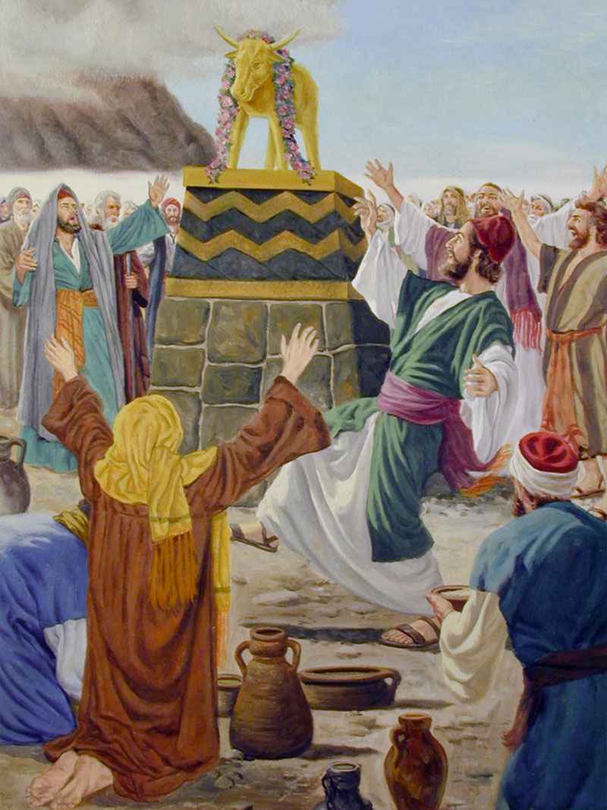
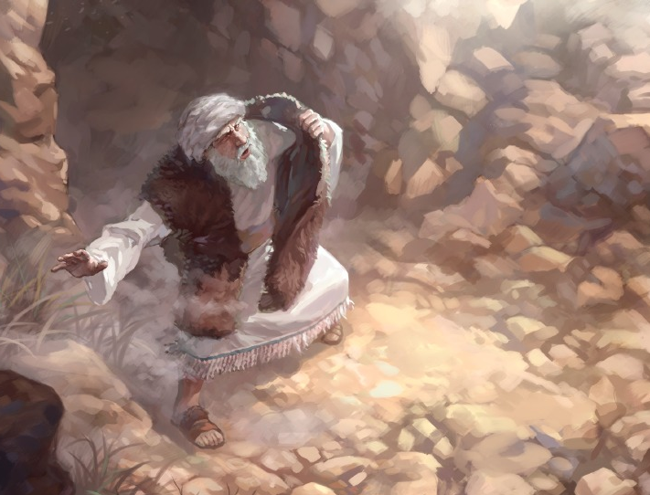
Moses came down from the mountain, carrying in his hand the two tablets of testimony. As he approached the camp, he and Joshua heard shouting. Joshua thought they were fighting, but Moses said they were singing. When they arrived at the camp, they saw the calf and the dances. Moses burned with anger, and threw the tablets out of his hands, and broke them at the foot of the mountain. He took the calf that they had made, and burned it in the fire, and ground it to powder.
When Moses saw that the people were in riot, because Aaron had permitted it, to the shame of his enemies, Moses stood at the gate of the camp and said, "Who is for the Lord? Join me." And all the sons of Levi joined him together. The next day Moses said to the people, "You have committed a great sin, but now I will ascend to the Lord; perhaps I will placate him about your sin.
Let us hear him intercede:
Then Moses returned to the Lord and said: “And Moses returned unto the LORD, and said, Oh, this people have sinned a great sin, and have made them gods of gold. Yet now, if thou wilt forgive their sin; and if not, blot me, I pray thee, out of thy book which thou hast written.”
And the Lord said to Moses: “hosoever hath sinned against me, him will I blot out of my book. Therefore now go, lead the people unto the place of which I have spoken unto thee: behold, mine Angel shall go before thee: nevertheless in the day when I visit I will visit their sin upon them”. And the LORD plagued the people, because they made the calf, which Aaron made.

Slide 11


Christ
Moses supplicated God in behalf of sinning Israel. He did not try to lessen their sin before God; he did not excuse them in their sin. He frankly acknowledged that they had sinned a great sin and had made them gods of gold. Then he loses his timidity, and the interest of Israel is so closely interwoven with his life that he comes with boldness to God and prays for Him to forgive His people. If their sin, he pleads, is so great that God cannot forgive them, if their names must be blotted from His book, he prays the Lord to blot out his name also 3T 303
But no; the man who had learned to seek after the lost sheep in the wilderness, who had endured cold and storm rather than leave one sheep to perish, could not give up the people placed in his care. He pleaded with God not to give them up, but to forgive their transgression....... And her fervent intercession prevailed. CTr 116
The intercession of Moses in behalf of Israel illustrates the mediation of Christ for sinful men. But the Lord did not permit Moses to bear, as did Christ, the guilt of the transgressor. “Whosoever hath sinned against Me,” He said, “him will I blot out of My book.” PP 326.3
Christ intercedes with the Father so that he will fulfill the promises he has made to us, so that enemies will not mock God, so that he will give us the Holy Spirit, so that his sacrifice will not be in vain on our behalf, so that he will give us eternal life because he was willing to lose his eternity for each one of us.

Slide 12


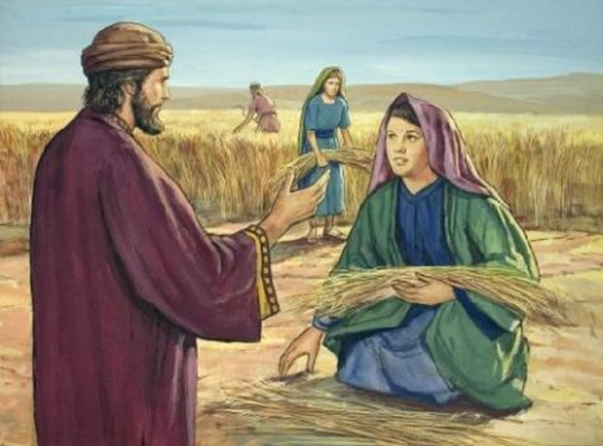
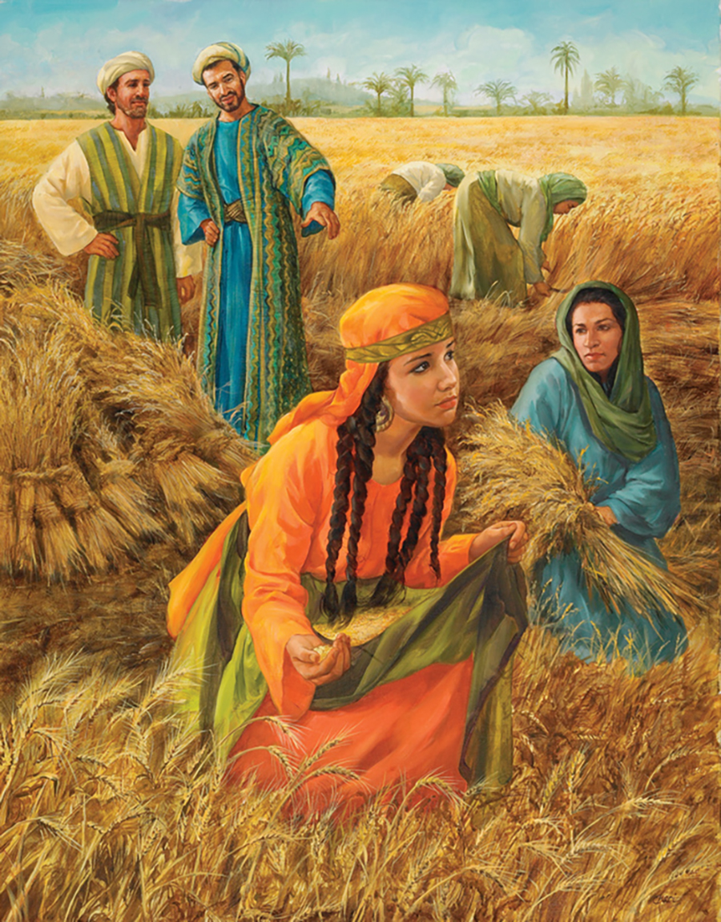
Boaz intercedes for Ruth
Ruth 2-4
Ruth, a Moabite, returns with her mother-in-law to Bethlehem in Judah. Both of them, widows and poor, have no livelihood. Ruth offers to go gleaning. So he arrives at the camp of Boaz, a relative of Naomi.
When Boaz asks who she is and learns that she is Ruth, the Moabitess begins to intercede for her.
Boaz speaks kindly of Ruth, telling her to stay the whole harvest to gather ears of corn in his fields. With this you would have several blessings:
Company. She would be accompanied by her workers.
Safety. She was a foreigner and had no one to protect her.
Personal well-being. He would have food and drink every day.
Economic benefit. She could pick up ears of grain from among sheaves, and even pick up what the reapers dropped for her.
God's blessing. “The LORD recompense thy work, and a full reward be given thee of the LORD God of Israel, under whose wings thou art come to trust” (Ruth 2:12).

Slide 13

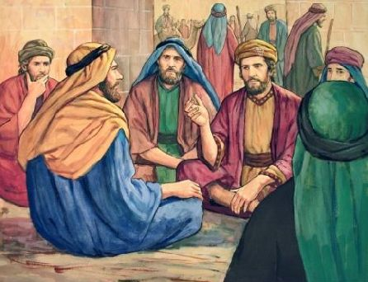
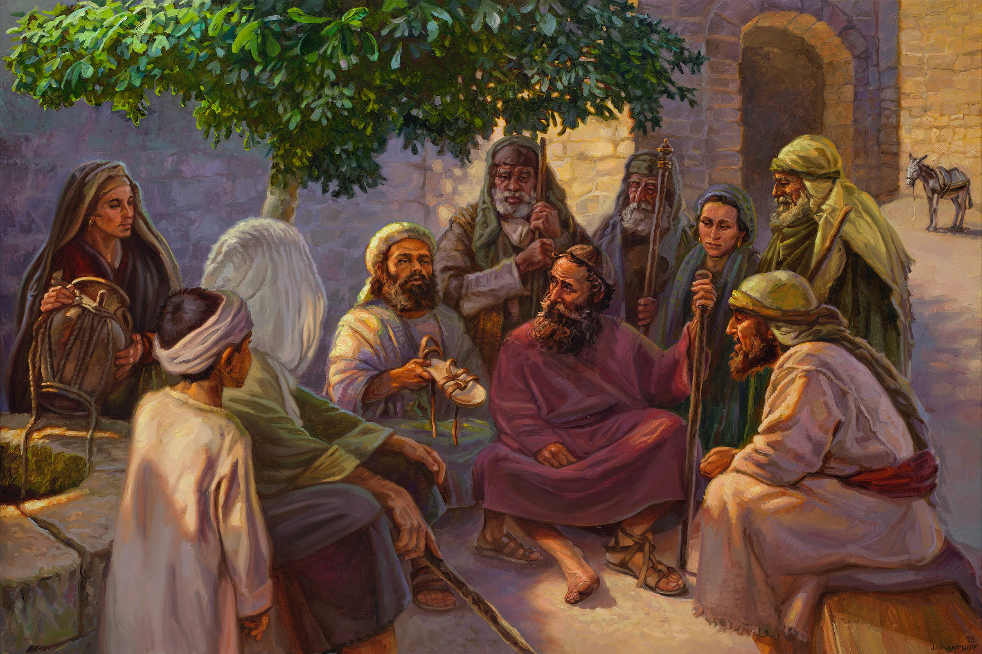
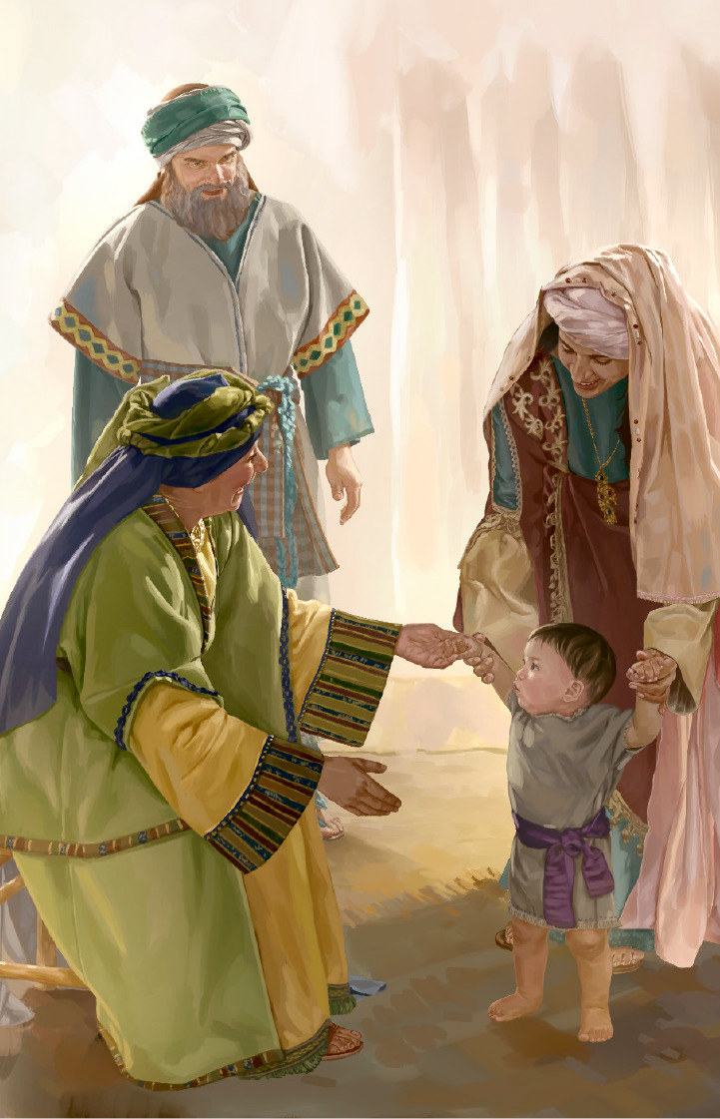
Naomi, seeing how well Boaz treats Ruth and knowing that he can take care of her, asks Ruth to tell her that he redeems her. Boaz knows that there is another, closer relative, who has the right to keep Naomi's fields and marry Ruth.
So one day he knocks on the door of the city where he gathered a group of 10 elders to be the jury. When the relative entered, he proposed that he keep Naomi's lands. The relative says yes. But when Boaz tells him that he has to marry Ruth in order to have offspring who will inherit everything, he does not want to marry Ruth and declines the offer.
Boaz, who had more interest in Ruth than in the land, buys the property in order to be able to take Ruth as a woman. The next of kin had been unwilling to take Ruth for the property, but Boaz was ready to take the property, if necessary, in order to marry Ruth. So, as the law said, and to seal the agreement, he gives Boaz his shoe.
Boaz keeps Ruth and everything Naomi. Boaz is Ruth's redeemer.

Slide 14


Christ
Christ intercedes for you so that you may have blessings: companionship, safety and security, personal well-being, financial benefit, reward, and special remuneration for you.
The biblical authors took the figure of the "kinsman" who acted as "redeemer," and applied it to Christ as man's Redeemer from sin and death. For example, Job said, "I know that my Redeemer [go'el] lives" (Job 19:25): the one who would redeem him from the grave in the resurrection. Isaiah uses the words ga'al (verb) and go'el (noun) 18 times to refer to God as the one who redeems Israel from their enemies and men from the clutches of sin (Isa. 43:1, 14; 44:22; 49:7; 54:5, 8; 63:16; etc.). We may well rejoice in Christ, our "kinsman," who accepted for us the responsibilities of that relationship. He is the one who has redeemed us from the power of sin and death (Isa. 44:22; Ose. 13: 14). If we will only approach him, he will not reject us, like Ruth's relative (Ruth 4:6). He will in no way cast us out (John 6:37). And as we draw near to him, we will find home and rest for our souls (Ruth 3:1; Matt. 11:29).
All life comes from God, and He is the one who gives "every good gift and every perfect gift" (Jas. 1:17). He is the one who gives "rains from heaven and fruitful times" (Acts 14:17) and "the power to make riches" (Deut. 8:17, 18). Christ asks the Father to give you all the blessings you receive. Christ is your Redeemer who is always working on your behalf.

Slide 15


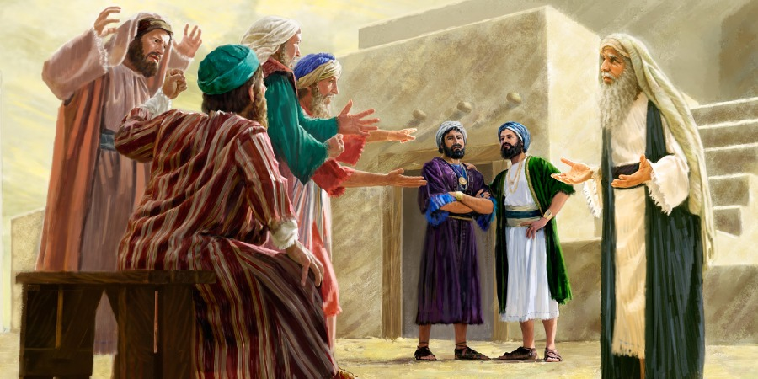
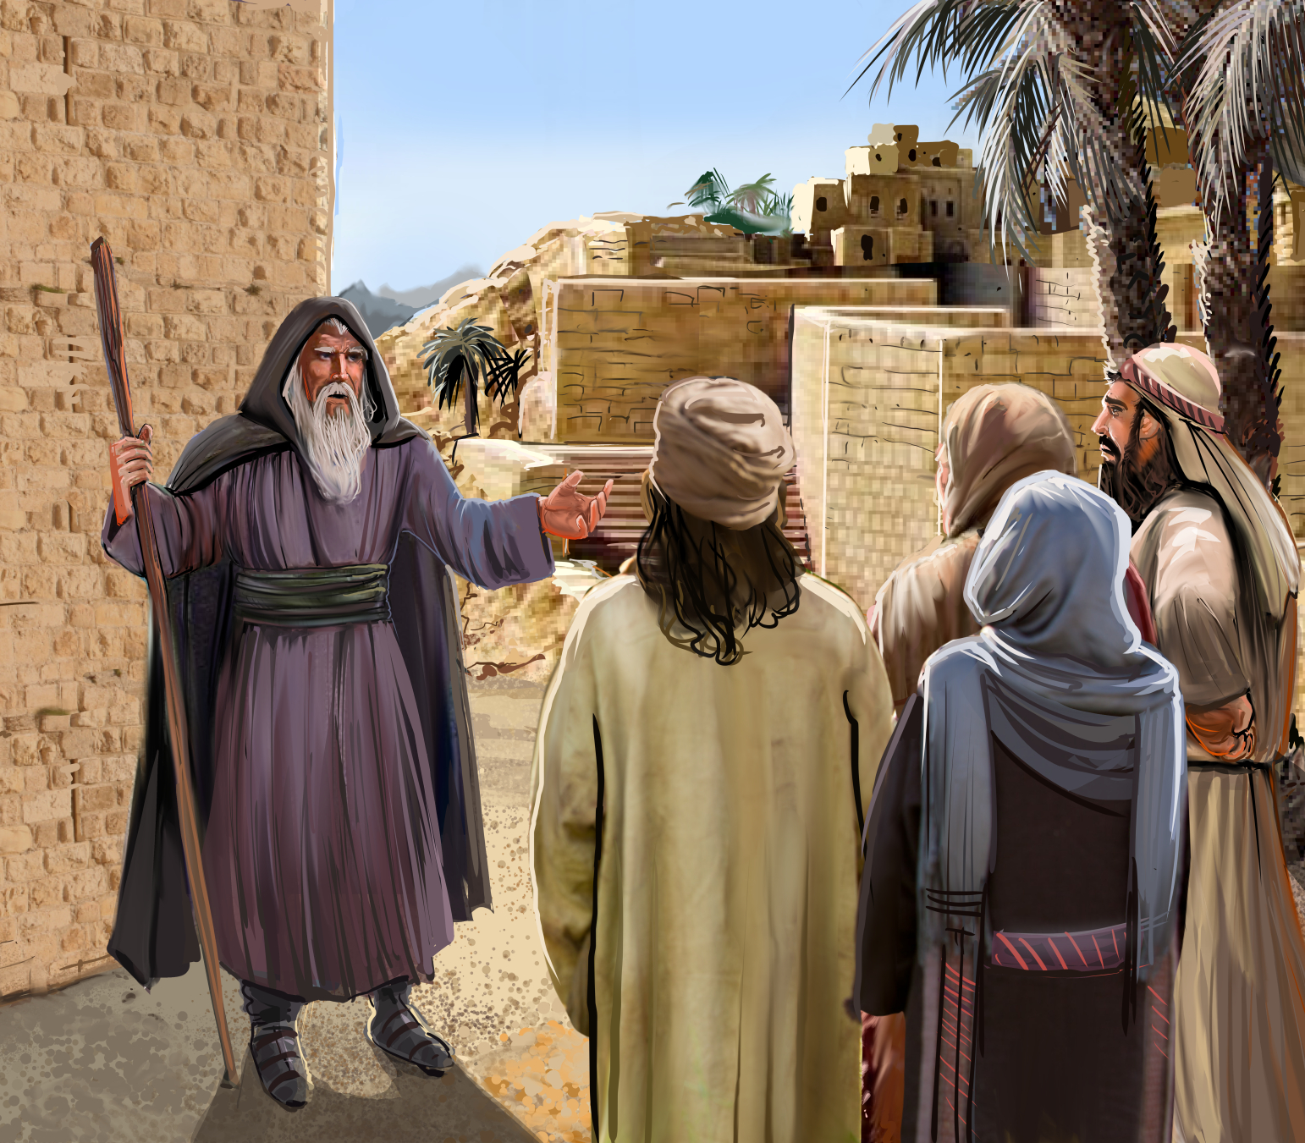
Samuel promises to intercede for the people
1 Samuel 12
Samuel, now older, bids farewell to the people of Israel. He asks them to witness whether he has behaved correctly with them and reminds them of past history. He tells them that he has made them king, as they wanted, but that they must not forget God. "If ye fear the Lord and serve him, and listen to his voice, and be not rebellious to the word of the Lord, and if both you and the king who reigns over you serve the Lord your God, you shall do well.”
If they forget God, "But if ye will not hearken unto the voice of the Lord, and though ye be rebellious unto the words of the Lord, the hand of the Lord shall be against you as it was against your fathers.”
He proceeds to give them a sign: "Wait even now, and behold this great thing that Jehovah will do before your eyes. Is it not now the harvest of the wheat? I will cry unto the Lord, and he shall give thunders and rains, that ye may know and see that your wickedness is great, which ye have done in the sight of the Lord, asking for a king for yourselves.”
And Samuel cried unto the Lord, and the Lord gave thunder and rain that day; and all the people had great fear of the Lord and of Samuel.

Slide 16

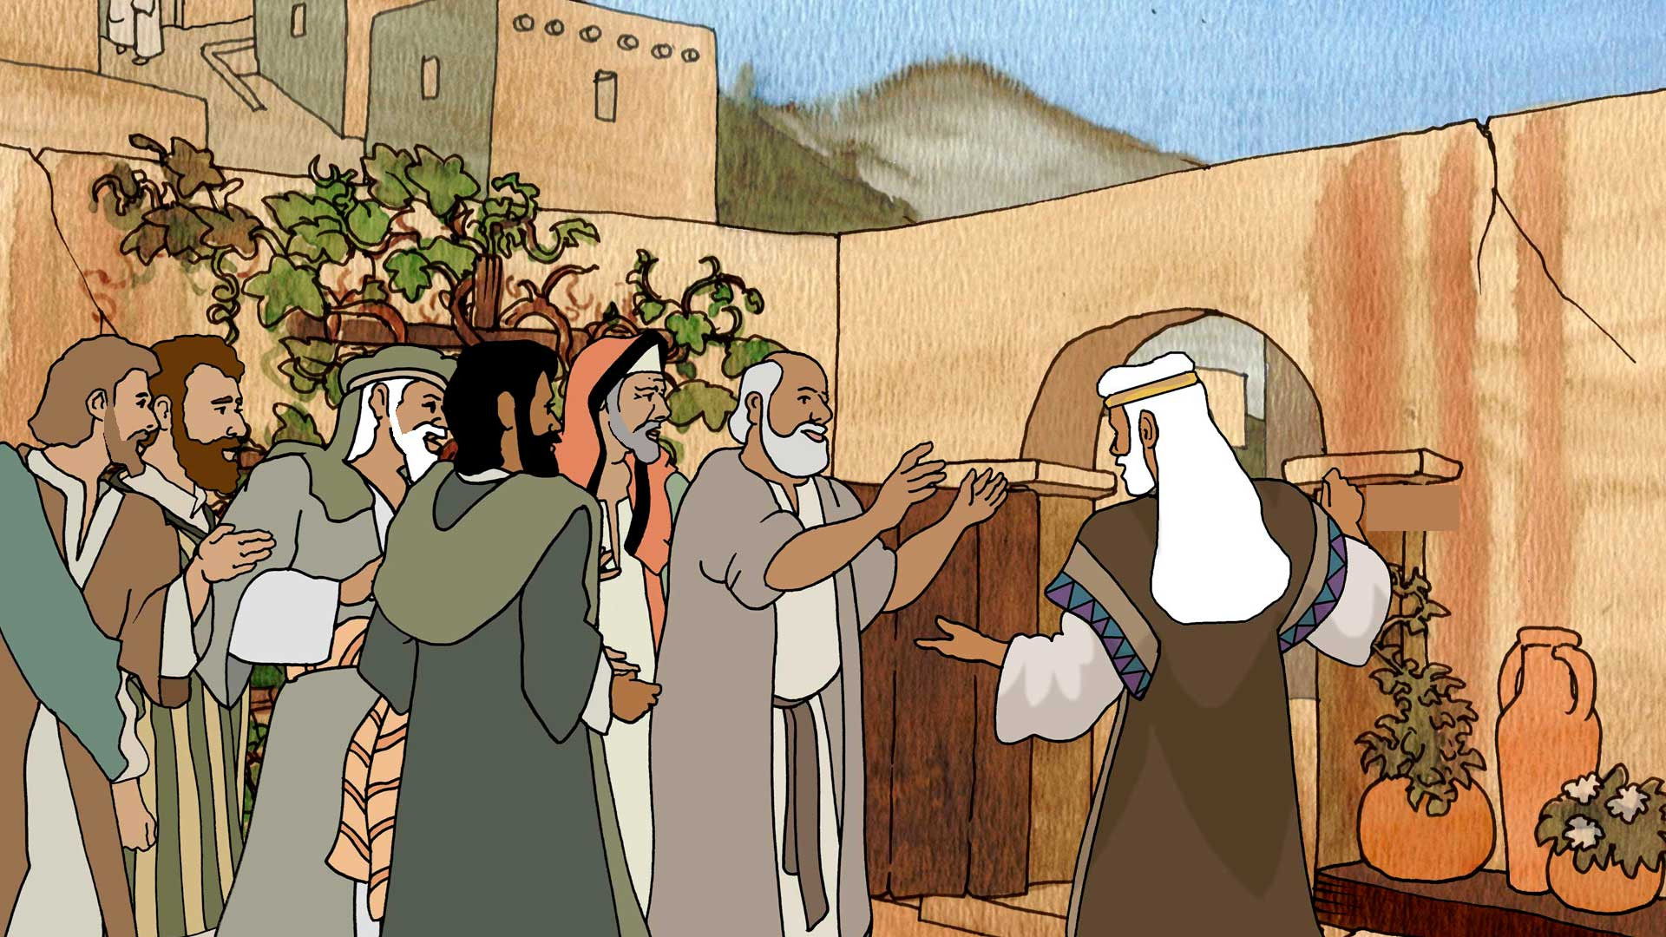
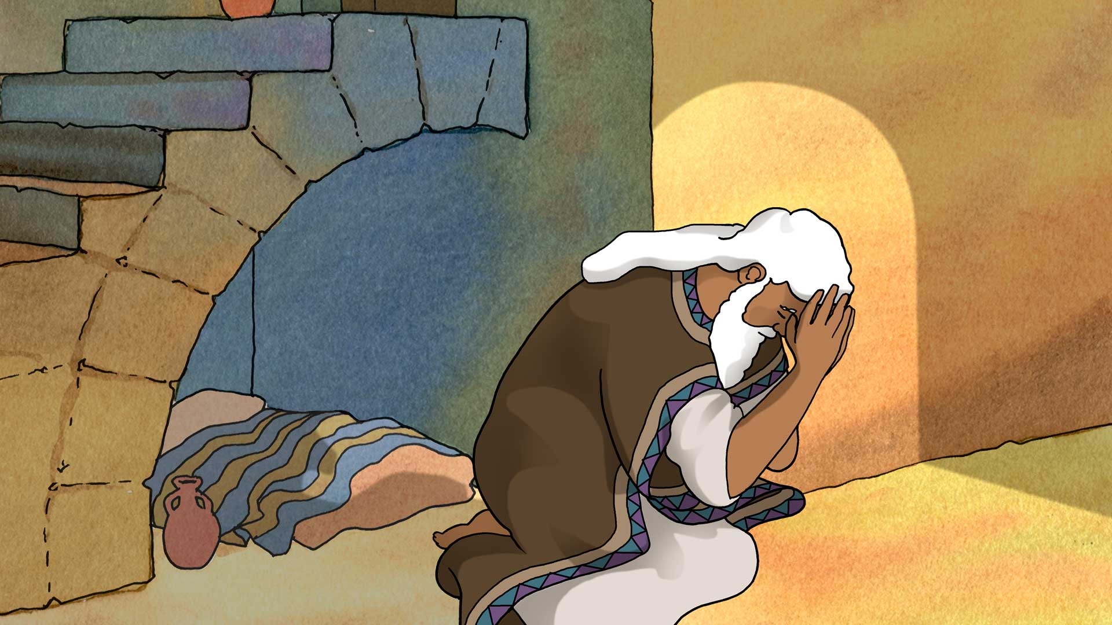
And all the people said unto Samuel, Pray for thy servants unto the LORD thy God, that we die not: for we have added unto all our sins this evil, to ask us a king.
And Samuel said unto the people, Fear not: ye have done all this wickedness: yet turn not aside from following the LORD, but serve the LORD with all your heart; And turn ye not aside: for then should ye go after vain things, which cannot profit nor deliver; for they are vain. For the LORD will not forsake his people for his great name's sake: because it hath pleased the LORD to make you his people. Moreover as for me, God forbid that I should sin against the LORD in ceasing to pray for you: but I will teach you the good and the right way. Solamente temed a Jehová y servidle de verdad con todo vuestro corazón, pues considerad cuán grandes cosas ha hecho por vosotros. Mas si perseverareis en hacer mal, vosotros y vuestro rey pereceréis.”

Slide 17


Christ
In Love and Mercy Jesus Pleads With Us and for Us.
Our Advocate, Jesus, is pleading before His Father's throne in our behalf, and He is also pleading with the sinner, saying, “Turn ye, for why will ye die?” Has not God done everything possible through Christ to win us from satanic deception? ... Is He not a risen Savior, ever living to make intercession for us? Is He not ever following up His great work of atonement by the work of the Holy Spirit on every heart? The bow of mercy still arches the throne of God, testifying to the fact that every soul who believes in Christ as a personal Savior shall have everlasting life. Mercy and justice are blended in God's dealing with His heritage.—The Signs of the Times, September 19, 1895. BLJ 339
The blood of Jesus is pleading with power and efficacy for those who are backslidden, for those who are rebellious, for those who sin against great light and love. Satan stands at our right hand to accuse us, and our Advocate stands at God's right hand to plead for us. He has never lost a case that has been committed to Him. We may trust in our Advocate; for He pleads His own merits in our behalf.... He is making intercession for the most lowly, the most oppressed and suffering, for the most tried and tempted ones. With upraised hands He pleads, “I have graven thee upon the palms of my hands.” Isaiah 49:16. OHC 49
He has paid an infinite price for the soul; and He intercedes before the Father as our Mediator, pleading not as a petitioner, but as conqueror who would claim that which is His own. He is able to save to the uttermost, for He ever lives to make intercession for us. MYP 407

Slide 18


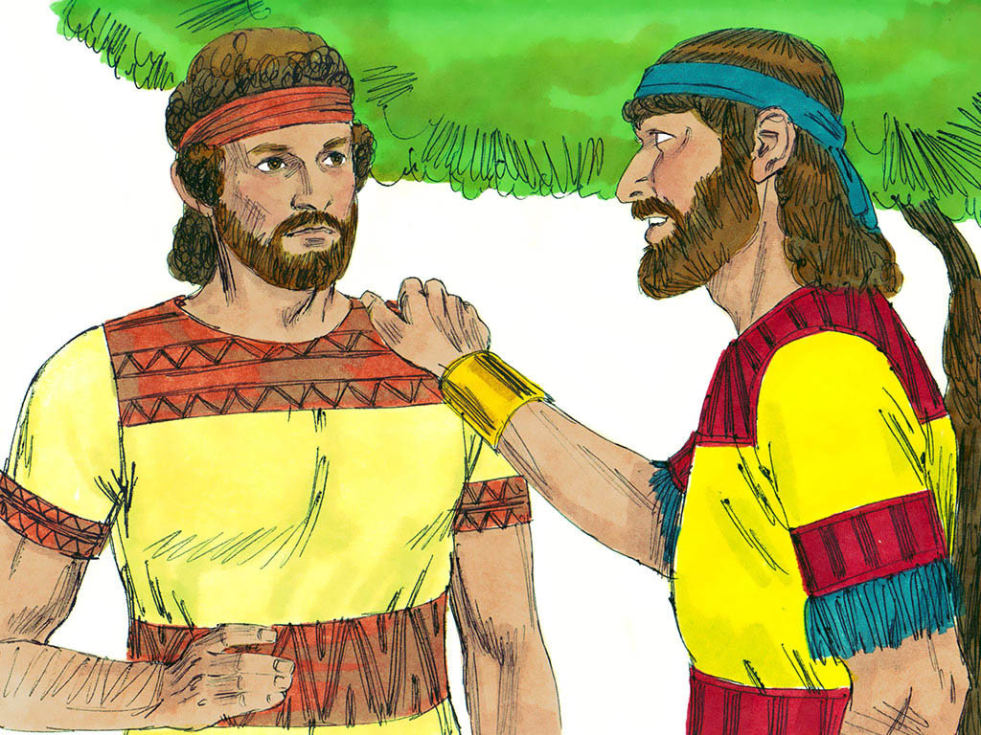
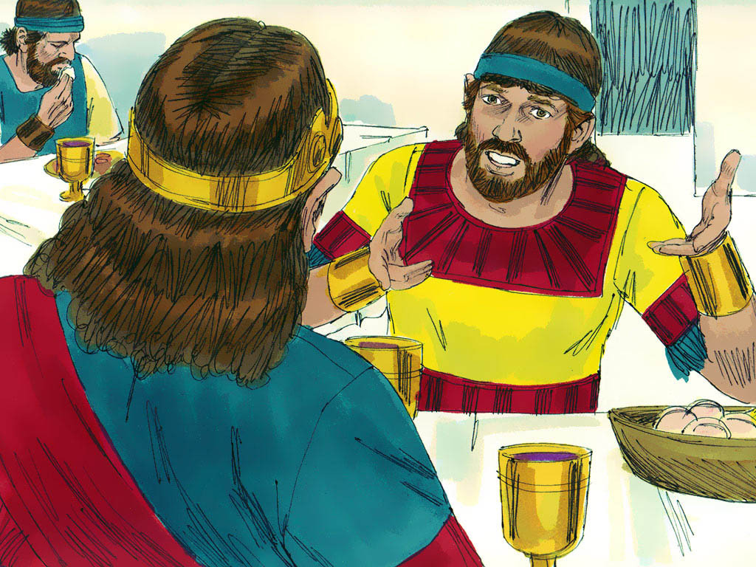
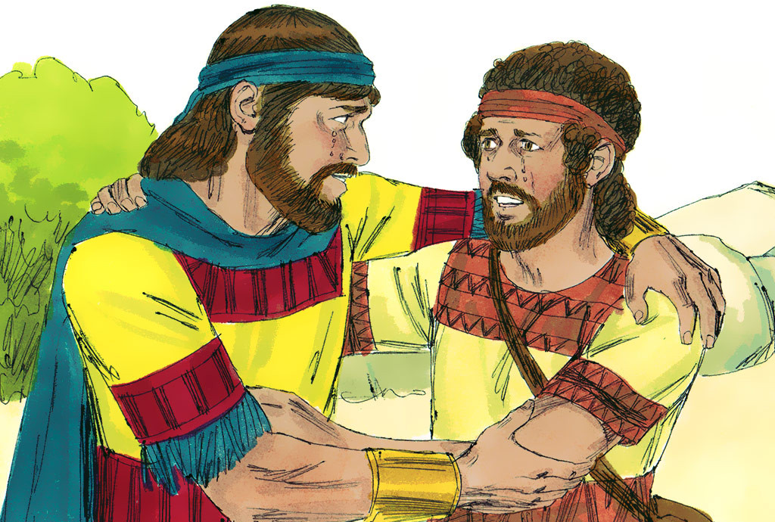
Jonathan Intercedes for David
1 Samuel 19:1-6
And Saul spake to Jonathan his son, and to all his servants, that they should kill David. But Jonathan Saul's son delighted much in David: and Jonathan told David, saying, Saul my father seeketh to kill thee: now therefore, I pray thee, take heed to thyself until the morning, and abide in a secret place, and hide thyself: And I will go out and stand beside
my father in the field where thou art, and I will commune with my father of thee; and what I see, that I will tell thee. And Jonathan spake good of David unto Saul his father, and said unto him,
Let not the king sin against his servant, against David; because he hath not sinned against thee, and because his works have been to thee-ward very good: For he did put
his life in his hand, and slew
the Philistine, and the LORD
Wrought a great salvation for
all Israel: thou sawest it, and didst
rejoice: wherefore then wilt thou
sin against Innocent blood,
to slay David without a cause?
And Saul hearkened unto the voice of Jonathan: and Saul sware, As the LORD liveth, he shall not be slain.”

Slide 19

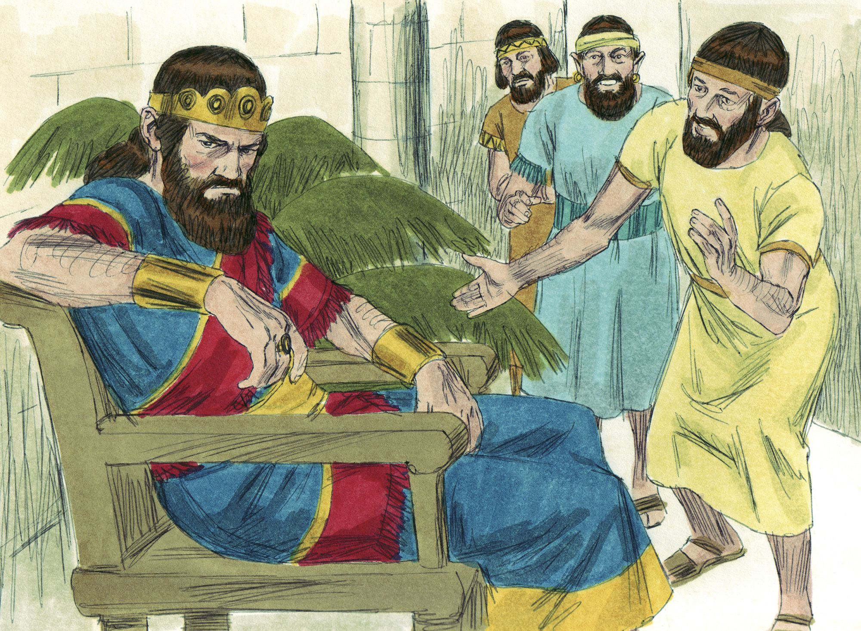
Adversity proves the sincerity of true friendship. Jonathan well knew that David had no thought of usurping the throne, but was unable to convince Saul of that fact. Jonathan’s position was not easy, for he would be in the role of opposing the desires of a tyrant, and would be thought disloyal to his own father. However, as a true friend, Jonathan told David the truth about Saul, not to frighten, but to forewarn and assure him of a true friend’s allegiance. This was a real test for Jonathan. Jonathan had to decide between loyalty to his father and loyalty to David. It was impossible longer to be loyal to both. He demonstrated good judgment by conducting himself in such a way as to retain influence over his father and yet at the same time save David from certain death.
Bound to his friend by ties even closer than those of blood relationship, with a love “passing the love of women” (2 Sam. 1:26), and knowing the innermost thoughts of David’s heart, Jonathan was ideally fitted to mediate between him and Saul. In Jonathan’s plea to his father, respect for authority and strict regard for principle were both manifested. As Saul’s son, he knew the arguments that would have the most weight with the king — David’s victory over Goliath and his continued, loyal service to the king personally on all occasions.
Jonathan tactfully proved to Saul that he had no reason for slaying David, by reminding him that he had every reason to appreciate David’s loyal service. How effective are right words at the right moment (see Prov.25:1 1 ; Isa. 50:4)! Jonathan knew his father was wrong, not only in this instance, but in many others as well. But he would have gained nothing had he berated his father for his mistakes. (ABC about 1 Samuel 19:3-6)

Slide 20

Christ
Jesus is attractive. He is full of love, mercy, and compassion. He proposes to be our friend, to walk with us through all the rough pathways of life. He says to us, I am the Lord thy God; walk with Me, and I will fill thy path with light. Jesus, the Majesty of heaven, proposes to elevate to companionship with Himself those who come to Him with their burdens, their weaknesses, and their cares. He will count them as His children, and finally give them an inheritance of more value than the empires of kings, a crown of glory richer than has ever decked the brow of the most exalted earthly monarch LHU 98
We may reach up to Jesus Christ who is our Advocate in the heavenly courts. We need a friend at court. We have been sinning, been disobedient, been transgressors, and it is of the highest consequence to us that we have a Friend at court to plead our cases to the Father. He says, “If I be lifted up I will draw all men unto Me.” Well, will all be drawn? Christ draws but will they respond to the drawing? Will they come? The invitation here in Revelation is this: “And the Spirit and the bride say, Come. And let him that heareth say, Come. And let him that is athirst come. And whosoever will, let him take the water of life freely” (Revelation 22:17). TDG 223
Christ is our best friend. By interceding for us, he highlights our positive qualities and tries to save our lives from eternal death.

Slide 21


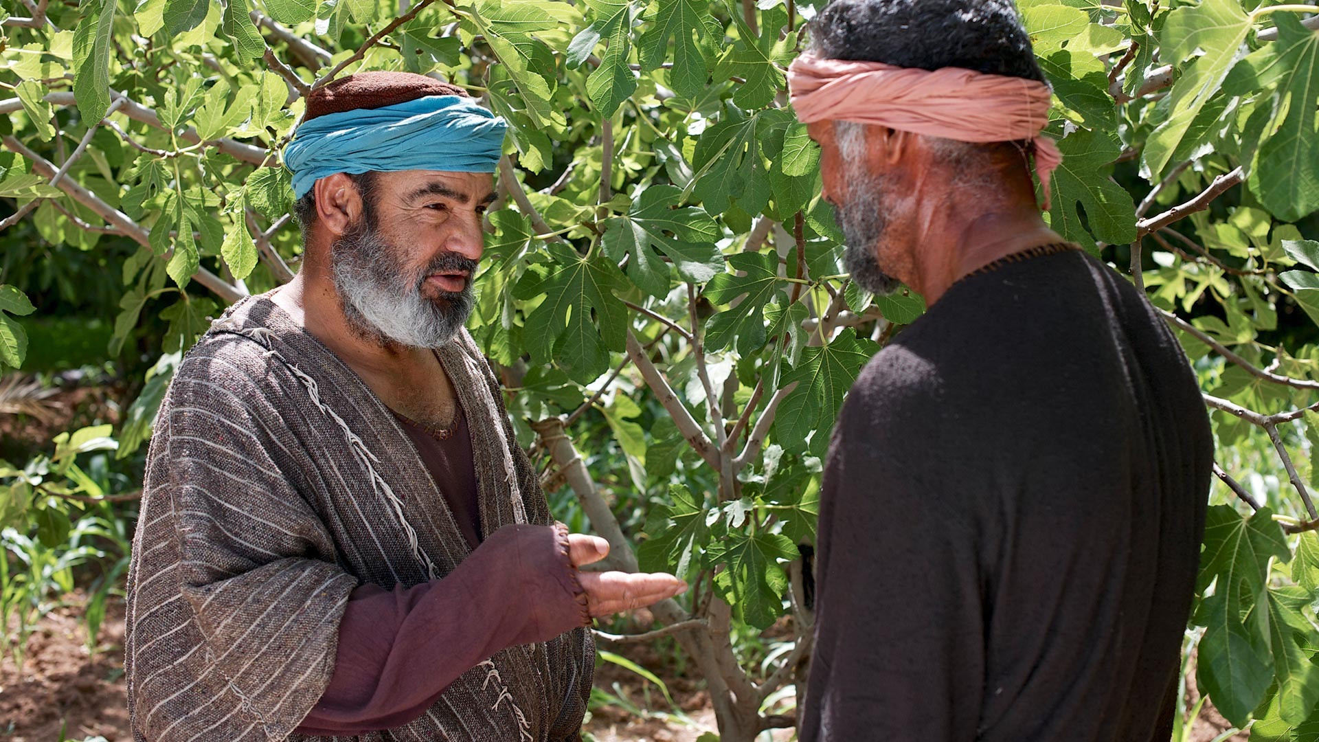
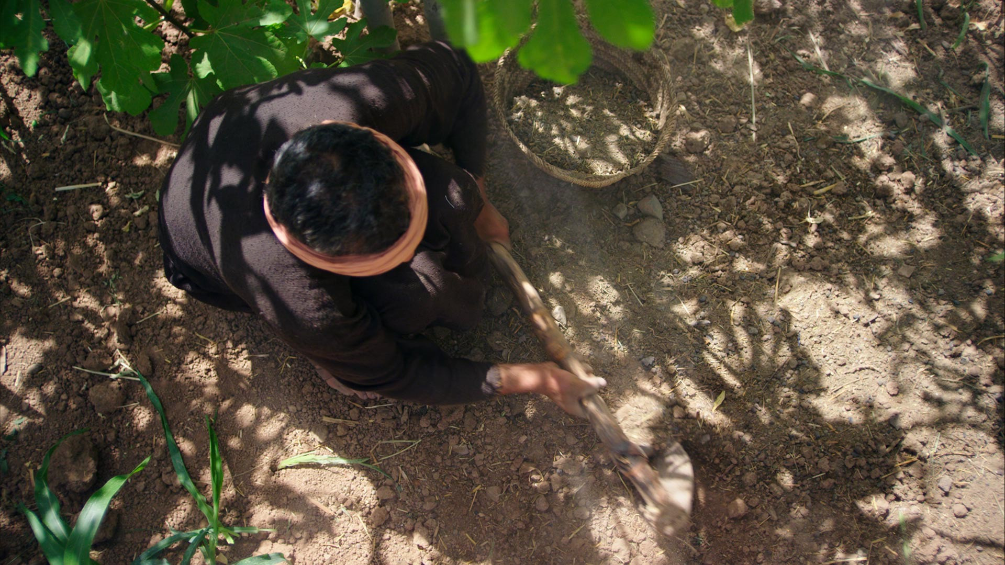
Parable of the barren fig tree and the vineyard
Luke 13:6-9; Isaiah 5:1-7
He spake also this parable; A certain man had a fig tree planted in his vineyard; and he came and sought fruit thereon, and found none. Then said he unto the dresser of his vineyard, Behold, these three years I come seeking fruit on this fig tree, and find none: cut it down; why cumbereth it the ground? And he answering said unto him, Lord, let it alone this year also, till I shall dig about it, and dung it: And if it bear fruit, well: and if not, then after that thou shalt cut it down.
In this parable, God's patience is presented in the face of man's need to repent in a timely manner. God loves even those who do not bear fruit, but His mercy may eventually be exhausted. The fig tree was to be cut down if it did not produce acceptable fruit (Isaiah 5:1-7). The fig tree represents, in a general sense, each person; and in a special sense, to the Jewish nation.
When a person comes to the point where he is not only useless in fulfilling his God-appointed role, but has also become an obstacle in preaching the plan of salvation to others, God says he is useless. But he still tries even harder, doing everything he can to save her.

Slide 22
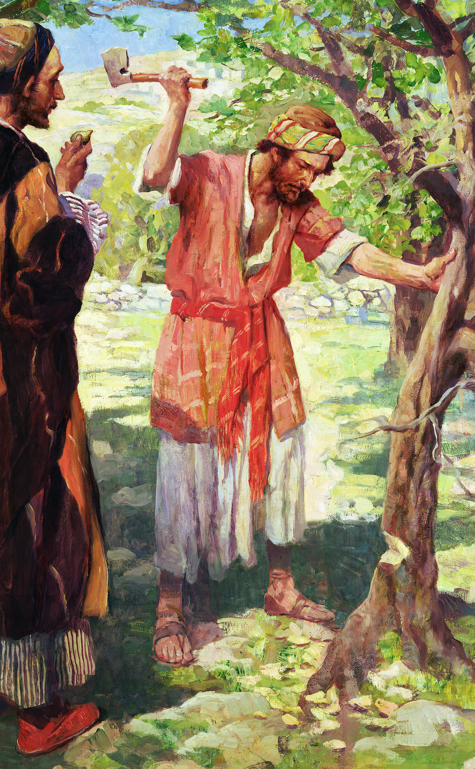
The warning sounds down along the line to us in this generation. Are you, O careless heart, a fruitless tree in the Lord's vineyard? Shall the words of doom erelong be spoken of you? How long have you received His gifts? How long has He watched and waited for a return of love? Planted in His vineyard, under the watchful care of the gardener, what privileges are yours! How often has the tender gospel message thrilled your heart! You have taken the name of Christ, you are outwardly a member of the church which is His body, and yet you are conscious of no living connection with the great heart of love. The tide of His life does not flow through you. The sweet graces of His character, “the fruits of the Spirit,” are not seen in your life.
The barren tree receives the rain and the sunshine and the gardener's care. It draws nourishment from the soil. But its unproductive boughs only darken the ground, so that fruit-bearing plants cannot flourish in its shadow. So God's gifts, lavished on you, convey no blessing to the world. You are robbing others of privileges that, but for you, might be theirs. COL 217.1 You realize, though it may be but dimly, that you are a cumberer of the ground. Yet in His great mercy God has not cut you down. He does not look coldly upon you. He does not turn away with indifference, or leave you to destruction. Looking upon you He cries, as He cried so many centuries ago concerning Israel, “How shall I give thee up, Ephraim? How shall I deliver thee, Israel? ... I will not execute the fierceness of Mine anger. I will not return to destroy Ephraim; for I am God, and not man.” Hosea 11:8, 9. The pitying Saviour is saying concerning you, Spare it this year also, till I shall dig about it and dress it. COL 217

Slide 23

Christ
The owner and the dresser of the vineyard are one in their interest in the fig tree. So the Father and the Son were one in their love for the chosen people. Christ was saying to His hearers that increased opportunities would be given them. Every means that the love of God could devise would be put in operation that they might become trees of righteousness, bringing forth fruit for the blessing of the world…. So His care and labor for you are not lessened, but increased. Still He says, “I the Lord do keep it; I will water it every moment; lest any hurt it, I will keep it night and day.” Isaiah 27:3. COL 218
The heart that does not respond to divine agencies becomes hardened until it is no longer susceptible to the influence of the Holy Spirit. Then it is that the word is spoken, “Cut it down; why cumbereth it the ground?” COL 218.3 Today He invites you: “O Israel, return unto the Lord thy God.... I will heal their backsliding, I will love them freely.... I will be as the dew unto Israel; he shall grow as the lily, and cast forth his roots as Lebanon.... They that dwell under his shadow shall return; they shall revive as the corn, and grow as the vine.... From Me is thy fruit found.” Hosea 14:1-8. COL 218
Christ is patient with us. As long as there is a minimal possibility of response, he intercedes so that we may bear fruit and be useful for his work.

Slide 24


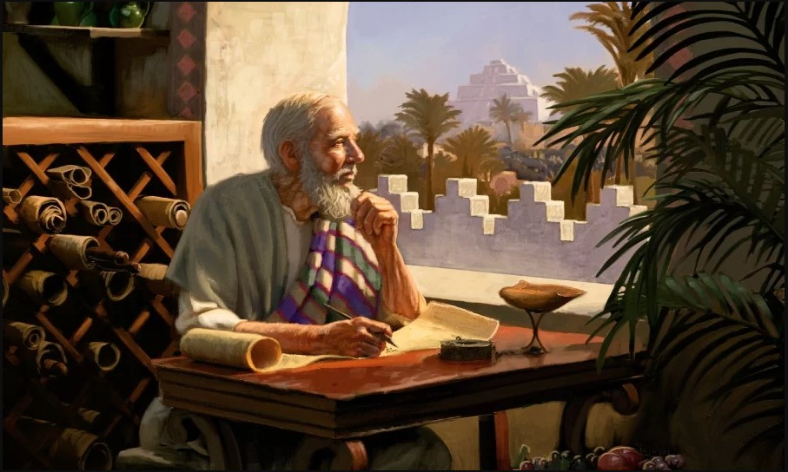
Daniel intercedes for the people
Daniel 9:1-19
Daniel, though busy with the affairs of the state, did not fail to study God's Word. Studying Jeremiah, Daniel looked at the prophecy that spoke of the return of the Jews at the end of the 70 years (Jer. 29:10).
That period was almost over, and Daniel was anxious that the Lord would not delay the deliverance of his captive people.
Daniel knew the conditional nature of many of God's promises. He may have feared that the impenitence of his people might delay the fulfillment of the promise, so he says, “And I set my face unto the Lord God, to seek by prayer and supplications, with fasting, and sackcloth, and ashes. And I prayed unto the LORD my God”.
Daniel, in this prayer, recognizes God's faithfulness: God never fails to keep his promises; he is a God faithful to his covenants; will hold up its end of the agreement. If the covenant fails, it is man's fault. For this reason, Daniel, in praying, identifies himself with his people. There is nothing self-righteous in his prayer. Let us hear him intercede:

Slide 25
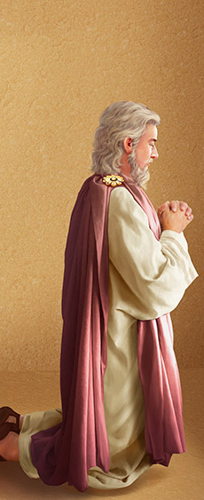
O Lord, the great and dreadful God, keeping the covenant and mercy to them that love him, and to them that keep his commandments; We have sinned, and have committed iniquity, and have done wickedly, and have rebelled, even by departing from thy precepts and from thy judgments: Neither have we hearkened unto thy servants the prophets, which spake in thy name to our kings, our princes, and our fathers, and to all the people of the land.
O Lord, righteousness belongeth unto thee, but unto us confusion of faces, as at this day; to the men of Judah, and to the inhabitants of Jerusalem, and unto all Israel, that are near, and that are far off, through all the countries whither thou hast driven them, because of their trespass that they have trespassed against thee.
O Lord, to us belongeth confusion of face, to our kings, to our princes, and to our fathers, because we have sinned against thee. To the Lord our God belong mercies and forgivenesses, though we have rebelled against him; Neither have we obeyed the voice of the LORD our God, to walk in his laws, which he set before us by his servants the prophets. Yea, all Israel have transgressed thy law, even by departing, that they might not obey thy voice; therefore the curse is poured upon us, and the oath that is written in the law of Moses the servant of God, because we have sinned against him.
And he hath confirmed his words, which he spake against us, and against our judges that judged us, by bringing upon us a great evil: for under the whole heaven hath not been done as hath been done upon Jerusalem. As it is written in the law of Moses, all this evil is come upon us: yet made we not our prayer before the LORD our God, that we might turn from our iniquities, and understand thy truth. Therefore hath the LORD watched upon the evil, and brought it upon us: for the LORD our God is righteous in all his works which he doeth: for we obeyed not his voice.

Slide 26
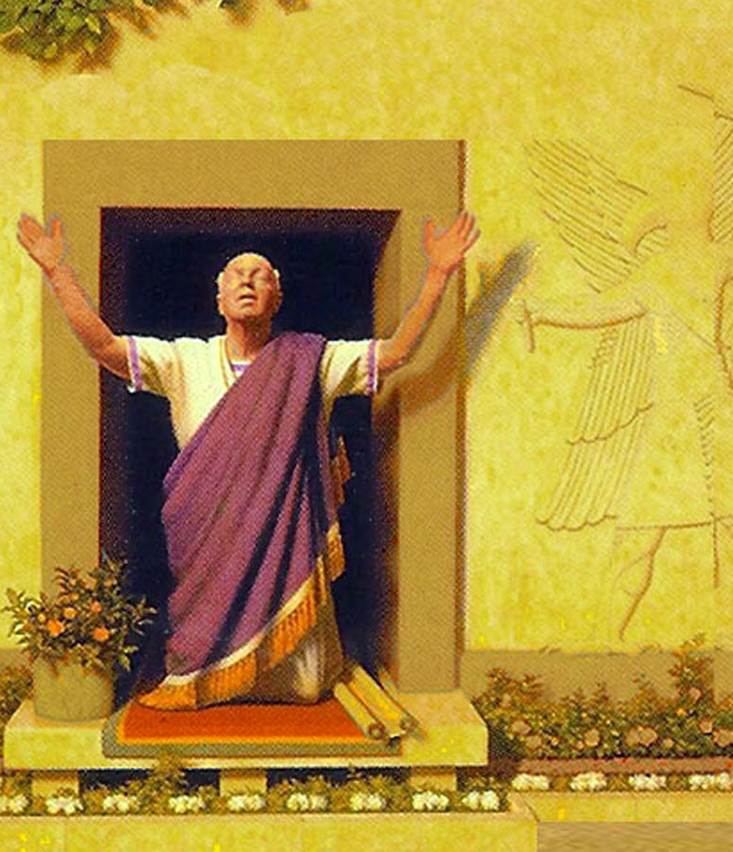
And now, O Lord our God, that hast brought thy people forth out of the land of Egypt with a mighty hand, and hast gotten thee renown, as at this day; we have sinned, we have done wickedly. O Lord, according to all thy righteousness, I beseech thee, let thine anger and thy fury be turned away from thy city Jerusalem, thy holy mountain: because for our sins, and for the iniquities of our fathers, Jerusalem and thy people are become a reproach to all that are about us.
Now therefore, O our God, hear the prayer of thy servant, and his supplications, and cause thy face to shine upon thy sanctuary that is desolate, for the Lord's sake. O my God, incline thine ear, and hear; open thine eyes, and behold our desolations, and the city which is called by thy name: for we do not present our supplications before thee for our righteousnesses, but for thy great mercies. O Lord, hear; O Lord, forgive; O Lord, hearken and do; defer not, for thine own sake, O my God: for thy city and thy people are called by thy name.

Slide 27

Christ
“Seeing then that we have a great high priest, that is passed into the heavens, Jesus the Son of God, let us hold fast our profession. For we have not an high priest which cannot be touched with the feeling of our infirmities; but was in all points tempted like as we are, yet without sin. Let us therefore come boldly unto the throne of grace, that we may obtain mercy, and find grace to help in time of need.” (Hebrews 4:14-16).
Christ is in complete sympathy with the sincere Christian who often has to face problems and difficulties, because he suffered in his own human nature, but without sinning, the weaknesses that are inherent in mankind. One of the purposes of the incarnation was for Deity to come so close to humanity that he could experience the same weaknesses and problems that we participate in. When Christ did this, He was enabled to become our High Priest and represent us before the Father.
We approach it with confidence because he freely offers his grace to all who seek it.
Christ, by His great mercy, is always ready to forgive those who come to Him with a contrite heart. With this trust, we can plead on our behalf and present our sinfulness by trusting in Christ's forgiveness and compassion.

Slide 28


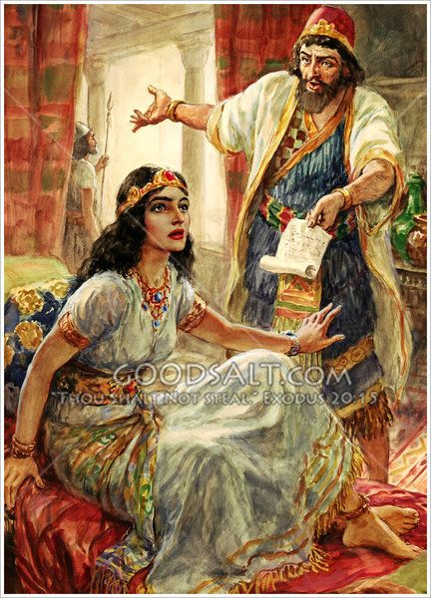
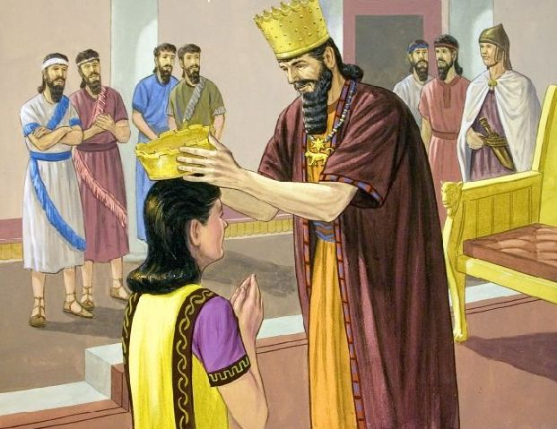
Esther intercedes for the people
Esther 3-8
King Ahasuerus had chosen Esther as queen of the Persian empire. Her uncle Mordecai, who had raised her, told her not to tell anyone that she was Jewish. Haman the Agagite, an enemy of the people of Israel, upon learning that Mordecai did not bow down to him, decided to hang him. When he learned that he was a Jew, he influenced the king to exterminate all the Jews on the thirteenth day of the twelfth month, which is the month of Adar, and to seize their property. When the Jews heard about it, there was great mourning, fasting, weeping, and lamentation throughout the city; sackcloth and ashes was the bed of many. Mordecai tore his clothes, put on sackcloth and ashes, and stood before the king's door. The maidens told Esther, and she sent clothes to Mordecai, but he did not accept them. Then Esther called Hathac, one of the king's eunuchs, whom he had placed in her service, and sent him to Mordecai, with orders to know what was happening, and why he was so.
Mordecai told the eunuch what Haman had done, and gave him a copy of the decree. He also told him that Esther had to go before the king to plead with him and to intercede for her people.
Then Esther told Hathach to say to Mordecai, "All the king's servants, and the people of the king's provinces, know that whatever man or woman enters the inner court to see the king, without being called, there is only one law concerning him: he must die; except he to whom the king stretches out the golden scepter, and he shall live; and I have not been called to see the king these thirty days.”

Slide 29
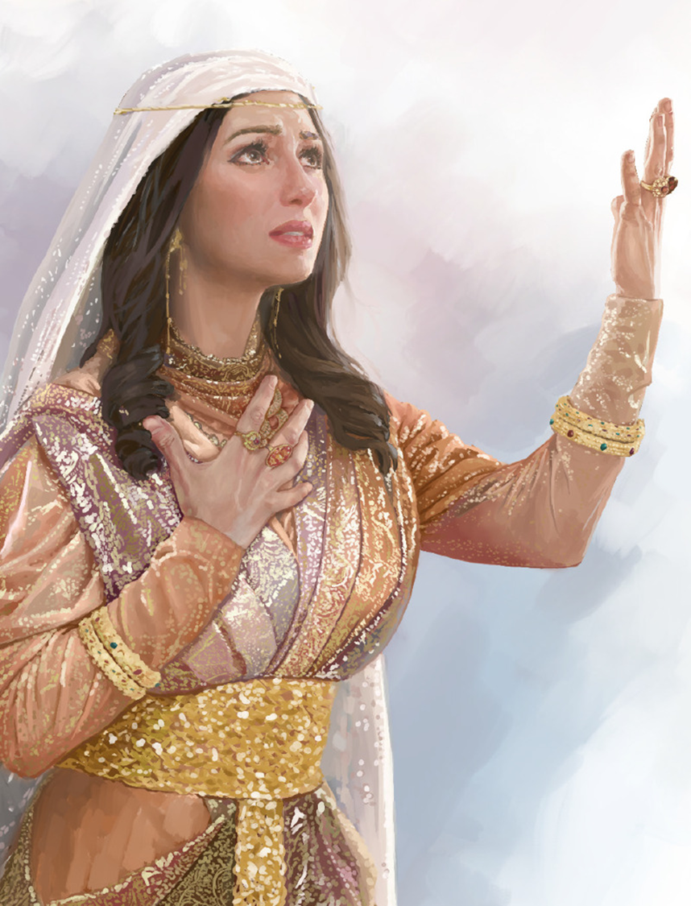
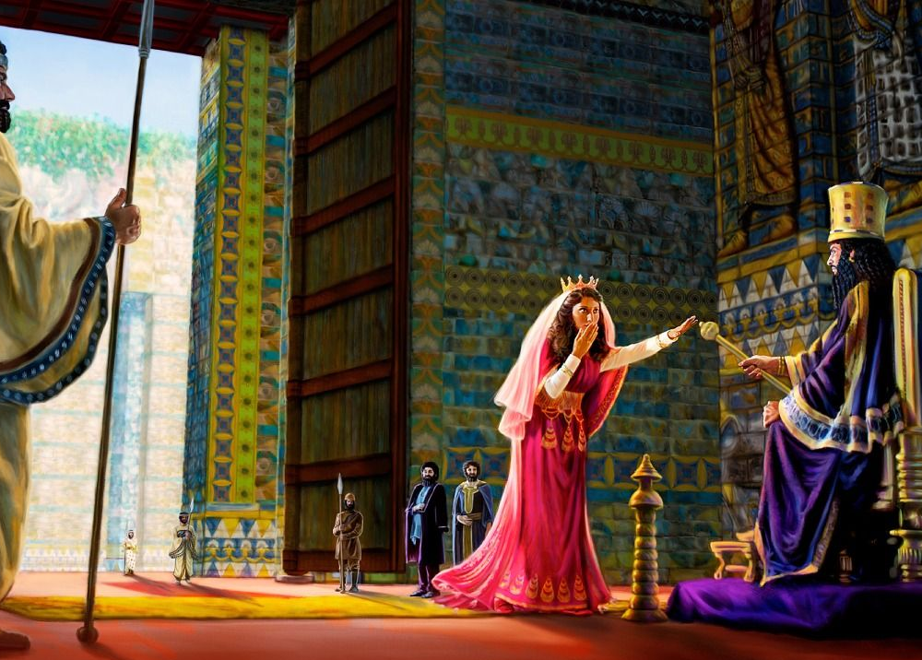
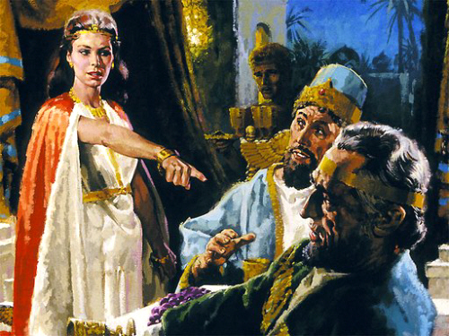
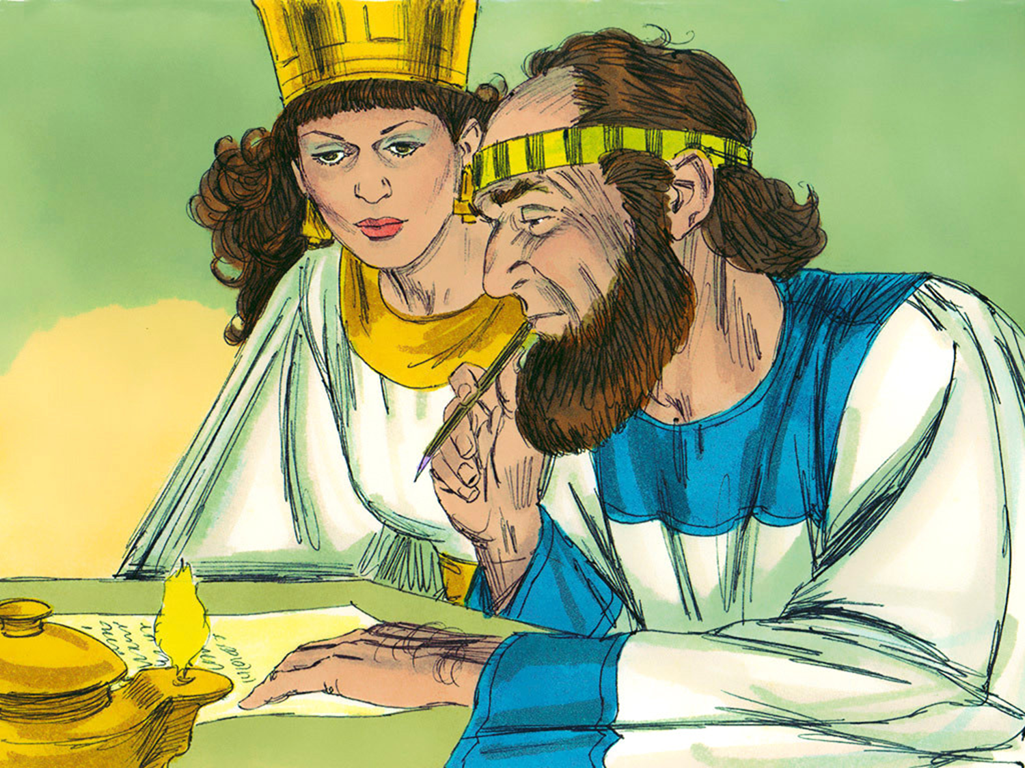
And they told Mordecai the words of Esther. Then Mordecai told them to answer Esther, "Do not think that you will escape into the king's house more than any other Jew. For if you are absolutely silent at this time, respite and deliverance will come from somewhere else for the Jews; but you and your father's house will perish. And who knows if by this hour you have reached the kingdom?”
Here we see what Esther does before interceding, and how she intercedes.
And Esther said to answer Mordecai:
“Go and gather together all the Jews who are in Susa, and fast for me, and neither eat nor drink for three days, night and day; I will also fast with my maidens, and then I will go in to the king, even if it is not according to the law; and if I perish, let him perish.”.
Then Mordecai went and did according to all that Esther commanded him.
Esther went before the king, and he stretched out his scepter. Esther invited the king and Haman to a banquet. The king offered her half of his kingdom, but Esther invited them to another banquet, and at that moment she told him what would happen to her people.
The king was angry with Haman and ordered him to be hanged on the gallows that Haman had prepared for Mordecai.
They also wrote another edict so that the Jews could defend themselves against those who attacked them.

Slide 30

Christ
Esther, with the phrase "if I perish, let me perish," meant: "If I lose my life in this attempt to save my people, I will lose it joyfully. I understand that it is my duty to do the test. And whatever happens, I am determined to do the best I can.”
In order to secure man to Himself and ensure his eternal salvation, Christ left the royal courts of heaven and came to this earth, endured the agonies of sin and shame in man's stead, and died to make him free. 5T 614
Christ in the weakness of humanity was to meet the temptations of one possessing the powers of the higher nature that God had bestowed on the angelic family.—The Review and Herald, January 28, 1909. TA 156
Christ, like Esther, intercedes for his people. He presented Himself in this world as a human being and Satan was tempting Him and making His life very bitter. Jesus was not only willing to die, but he gave his life so that we, who are his people, would not perish.

Slide 31


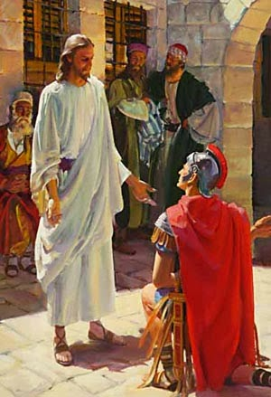
Luke 7:1-10; Matthew 8:5-13
A Roman centurion intercedes for his servant
After he [Jesus] had finished all his words to the people who heard him, he entered Capernaum. And the servant of a centurion, whom he loved very much, was sick and about to die. When the centurion heard about Jesus, he sent some elders of the Jews to him, begging him to come and heal his servant. And they came to Jesus and begged him earnestly, saying, "It is worthy that you should grant him this; because he loves our nation, and he built us a synagogue. And Jesus went with them.
But when they were no longer far from the house, the centurion sent some friends to him, saying, "Lord, do not be troubled, for I am not worthy to have you come under my roof; so that I did not even consider myself worthy to come to you; but say the word, and my servant will be healed. For I also am a man placed under authority, and I have soldiers under my command; and I say to him, Go, and go; and to the other: Come, and come; and to my servant, Do this, and do it. When Jesus heard this, he marveled at him, and turned and said to the people who were following him, "I tell you, I have not found such faith even in Israel." And when those who had been sent returned home, they found the servant who had been sick healed (Luke 7:1-10).

Slide 32

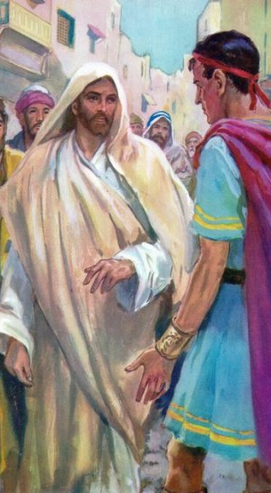
As Jesus entered Capernaum, he was received by a delegation of elders, who presented the centurion's wish to him. They remarked that he was "worthy to grant him this; who loves our nation, and he built us a synagogue.”
Jesus immediately set out for the officer's house; but, besieged by the crowd, he advanced slowly. The centurion sent him this message: "Lord, do not be troubled, for I am not worthy that you should enter under my roof." But the Savior walked on, and the centurion, daring at last to approach him, completed his message by saying, "I did not even consider myself worthy to come unto thee; but say the word, and my servant will be healed. For I also am a man in power, who has soldiers under me; and I say to this one, Go, and go; and to the other: Come, and come; and to my servant, Do this, and do it." In other words: "As I represent the power of Rome and my soldiers recognize my authority as supreme, so you represent the power of the infinite God and all created things obey your word. You can command sickness to go away, and it will obey you. You can call upon your heavenly messengers, and they will impart healing virtue. Just speak the word, and my servant will be healed.”
“When Jesus heard this, he marveled at him, and turned and said to the crowds who followed him, 'I tell you, I have not found such faith even in Israel.'" And to the centurion he said, "As you thought it should be done to you. And his waiter was healthy at the same time.”.
His heart had been touched by the grace of Christ. He saw his own unworthiness; but he was not afraid to ask for help. He did not trust in his own goodness; His argument was his great need. Their faith laid hold of Christ in their true character. He did not believe in him merely as a miracle worker, but as the Friend and Savior of mankind. When Satan tells us that we are sinners and that we cannot expect to receive God's blessing, let us tell him that Christ came into the world to save sinners. We have nothing that commends us to God; but the supplication we can present now and always is that which is based on our utter lack of strength, which makes His redemptive power a necessity.

Slide 33

The Bible shows us God in His high and holy place, not in a state of inactivity, not in silence and solitude, but surrounded by ten thousand times ten thousand and thousands of thousands of holy intelligences, all waiting to do His will. Through channels which we cannot discern He is in active communication with every part of His dominion. But it is in this speck of a world, in the souls that He gave His only-begotten Son to save, that His interest and the interest of all heaven is centered. God is bending from His throne to hear the cry of the oppressed. To every sincere prayer He answers, “Here am I.” He uplifts the distressed and downtrodden. In all our afflictions He is afflicted. In every temptation and every trial the angel of His presence is near to deliver. DA 356.
Christ
[Jesus] He explained that the secret of their success would be in asking for strength and grace in His name. He would be present before the Father to make request for them. The prayer of the humble suppliant He presents as His own desire in that soul's behalf. Every sincere prayer is heard in heaven. It may not be fluently expressed; but if the heart is in it, it will ascend to the sanctuary where Jesus ministers, and He will present it to the Father without one awkward, stammering word, beautiful and fragrant with the incense of His own perfection.
The path of sincerity and integrity is not a path free from obstruction, but in every difficulty we are to see a call to prayer. There is no one living who has any power that he has not received from God, and the source whence it comes is open to the weakest human being. “Whatsoever ye shall ask in My name,” said Jesus, “that will I do, that the Father may be glorified in the Son. If ye shall ask anything in My name, I will do it.” DA 667
Christ hears every prayer presented with faith. Even if the person considers himself unworthy, who deserves nothing, he must pray to his intercessor: Christ. He will present his prayer to the Father without babbling, beautiful and fragrant with the incense of his own perfection.

Slide 34


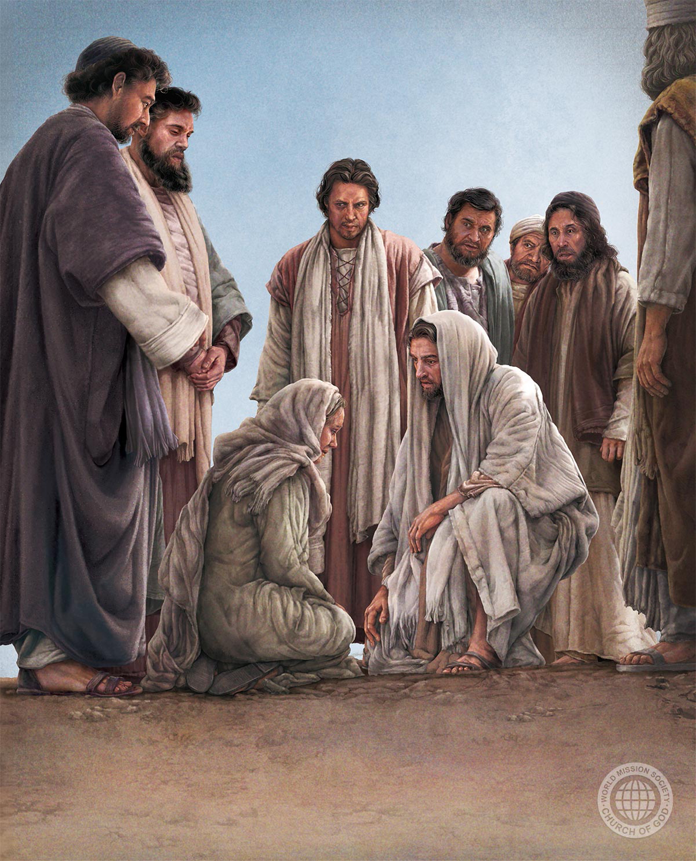
The Canaanite intercedes for her daughter
Matthew 15:21-28
Then Jesus went thence, and departed into the coasts of Tyre and Sidon. And, behold, a woman of Canaan came out of the same coasts, and cried unto him, saying, Have mercy on me, O Lord, thou Son of David; my daughter is grievously vexed with a devil.
But he answered her not a word.
And his disciples came and besought him, saying, Send her away; for she crieth after us.
But he answered and said, I am not sent but unto the lost sheep of the house of Israel.
Then came she and worshipped him, saying, Lord, help me.
But he answered and said, It is not meet to take the children's bread, and to cast it to dogs.
And she said, Truth, Lord: yet the dogs eat of the crumbs which fall from their masters' table.
Then Jesus answered and said unto her, O woman, great is thy faith: be it unto thee even as thou wilt. And her daughter was made whole from that very hour.

Slide 35

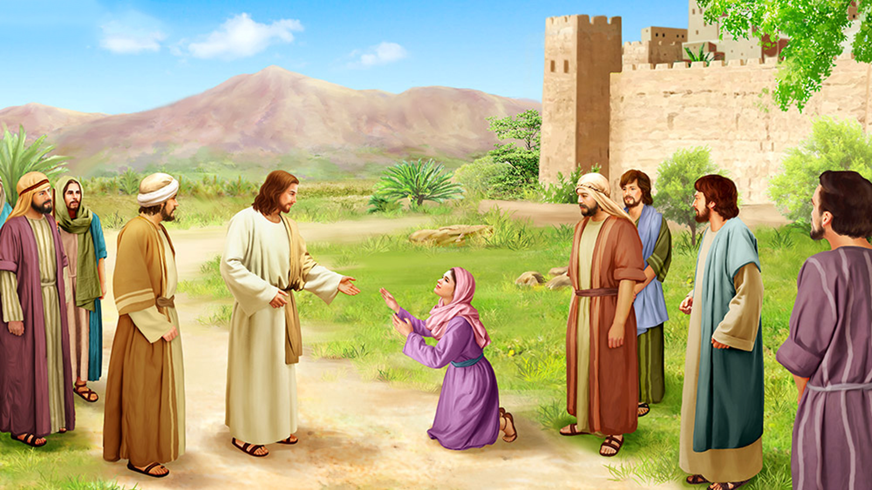
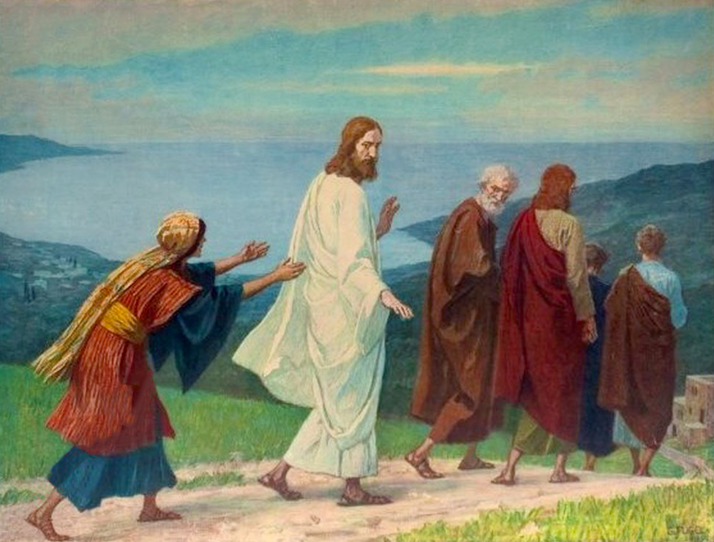
In making her request to Jesus, the woman seems to have detected the tender compassion that flowed in streams from the loving heart of Christ. No doubt the mere fact that he discussed the matter with her—rather than abruptly dismissing her as the rabbis would have done—gave her courage to believe that Jesus would accede to her request.
This Canaanite woman was willing to endure Jesus' silence, the contempt of his disciples, the fact that she was not Jewish.
She was ready to prostrate herself at the feet of Jesus, adopting the usual position of one who presents a request to a superior or to an object of adoration.
She was ready to place herself on any social level that Christ could assign her, without even discussing it, if only He would grant her what she asked for.
He showed that he was persistent in the face of great obstacles.
He faced the trial, and his faith remained steadfast. Finally, the Canaanite woman's daughter was healed from a distance, not in the presence of Jesus. The cure was immediate and complete.

Slide 36

Christ
Christ has pledged Himself to be our substitute and surety, and He neglects no one. There is an inexhaustible fund of perfect obedience accruing from His obedience. In heaven His merits, His self-denial and self-sacrifice, are treasured as incense to be offered up with the prayers of His people.
As the sinner's sincere, humble prayers ascend to the throne of God, Christ mingles with them the merits of His own life of perfect obedience. Our prayers are made fragrant by this incense. Christ has pledged Himself to intercede in our behalf, and the Father always hears the Son. SD 22
If we come to God, feeling helpless and dependent, as we really are, and in humble, trusting faith make known our wants to Him whose knowledge is infinite, who sees everything in creation, and who governs everything by His will and word, He can and will attend to our cry, and will let light shine into our hearts. Through sincere prayer we are brought into connection with the mind of the Infinite. We may have no remarkable evidence at the time that the face of our Redeemer is bending over us in compassion and love, but this is even so. We may not feel His visible touch, but His hand is upon us in love and pitying tenderness.—(Steps to Christ, 97.) Pr 117.
Our need of Christ's intercession is constant. Day by day, morning and evening, the humble heart needs to offer up prayers to which will be returned answers of grace and peace and joy. “By him therefore let us offer the sacrifice of praise to God continually.” Hebrews 13:15. OHC 50
Christ does not tire or stop interceding for us for a single moment. He persists with all his efforts until he ensures the salvation of his children, whom he loves.

Slide 37
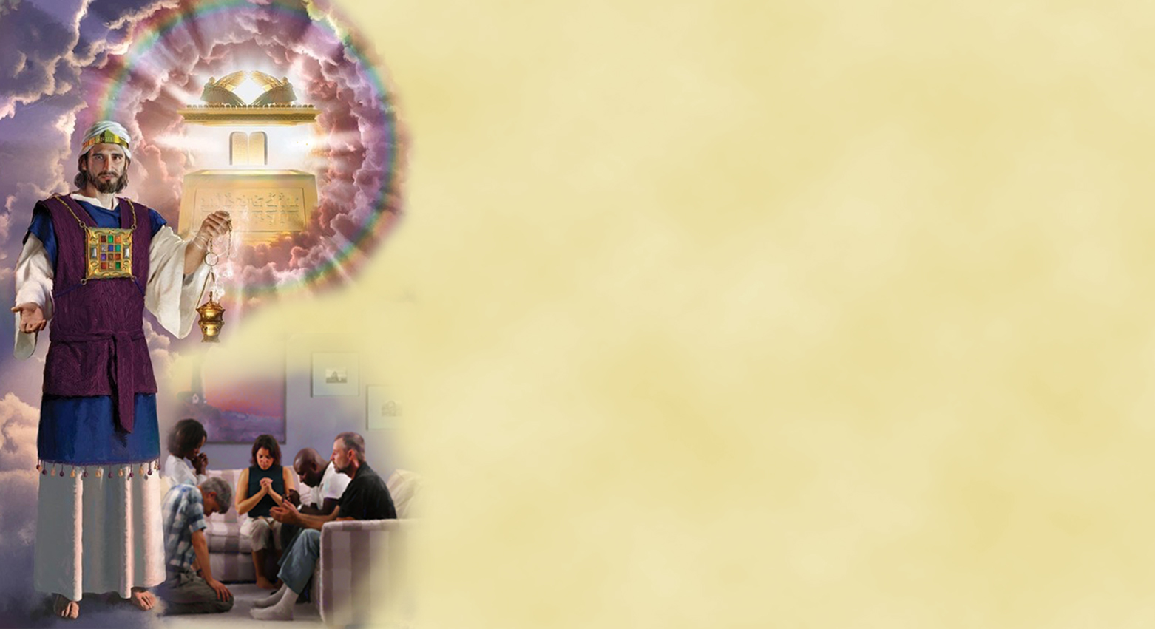
The intercession of Christ in our behalf is that of presenting His divine merits in the offering of Himself to the Father as our substitute and surety; for He ascended up on high to make an atonement for our transgressions.... “Herein is love, not that we loved God, but that he loved us, and sent his Son to be the propitiation for our sins” (1 John 4:10). “He is able also to save them to the uttermost that come unto God by him, seeing he ever liveth to make intercession for them” (Hebrews 7:25). From these scriptures it is evident that it is not God's will that you should be distrustful, and torture your soul with the fear that God will not accept you because you are sinful and unworthy.... RC 75
Present your case before Him, pleading the merits of the blood shed for you upon Calvary's cross. Satan will accuse you of being a great sinner, and you must admit this, but you can say: “I know I am a sinner, and that is the reason I need a Saviour. Jesus came into the world to save sinners. ‘The blood of Jesus Christ his Son cleanseth us from all sin.’ ... I have no merit or goodness whereby I may claim salvation, but I present before God the all-atoning blood of the spotless Lamb of God, which taketh away the sin of the world. This is my only plea. RC 75
The name of Jesus gives me access to the Father. His ear, His heart, is open to my faintest pleading, and He supplies my deepest necessities.... It is the righteousness of Christ that makes the penitent sinner acceptable to God and works his justification. However sinful has been his life, if he believes in Jesus as his personal Saviour, he stands before God in the spotless robes of Christ's imputed righteousness. The sinner so recently dead in trespasses and sins is quickened by faith in Christ. He sees by faith that Jesus is his Saviour, and alive forevermore, able to save unto the uttermost all that come unto God by Him RC 75

