Slide 1


Slide 2

In the continuous struggle of this life, full of difficulties and problems, we often find ourselves discouraged, sad, and lacking in strength. At these times, it seems to us that everything is closed to us and that nothing can get us out of confinement. However, we have at our disposal ten keys of power that will help us open again the doors of hope and happiness in our hearts, to find the solution to our problems.
Our good God is the owner and Lord of all these precious keys. He, in His great love, puts them in our hands so that we may use them and see their wonderful results.

Slide 3

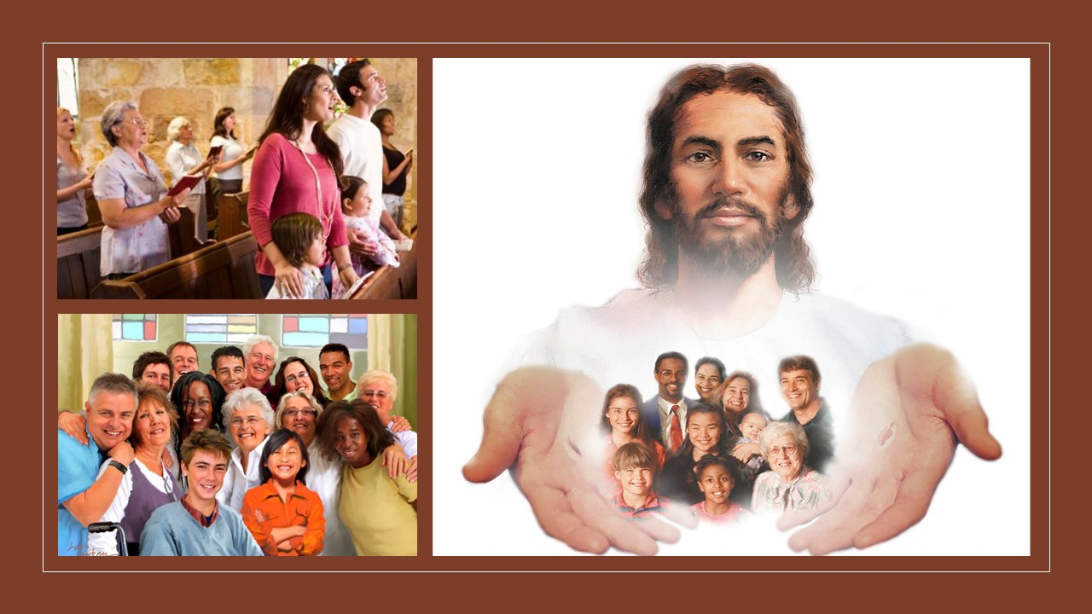
The key to the fervent desire to worship God
When the doors of our temples open with that powerful key of the fervent desire to worship God, we feel rejoiced to be in His courts. Upon receiving the warm welcome that Jesus gives us in the arms of His love, we feel as if our church were a little piece of heaven here on earth.
Therefore, worship God in His house for His attributes: goodness, mercy, power, sovereignty, creation…
Going to church to worship God unites us with other believers to honor Christ as one united and healthy body.
Worshiping God alone is wonderful, but nothing can replace the beauty of joining others who also have His Spirit in them through the redemptive work of salvation.
Knowing God and His character as revealed in the Scriptures will awaken in His children a heart of gratitude that is expressed in worship that brings Him glory, rather than a selfish emotional experience. The Spirit makes true worshipers long to join with other believers to honor Christ.

Slide 4

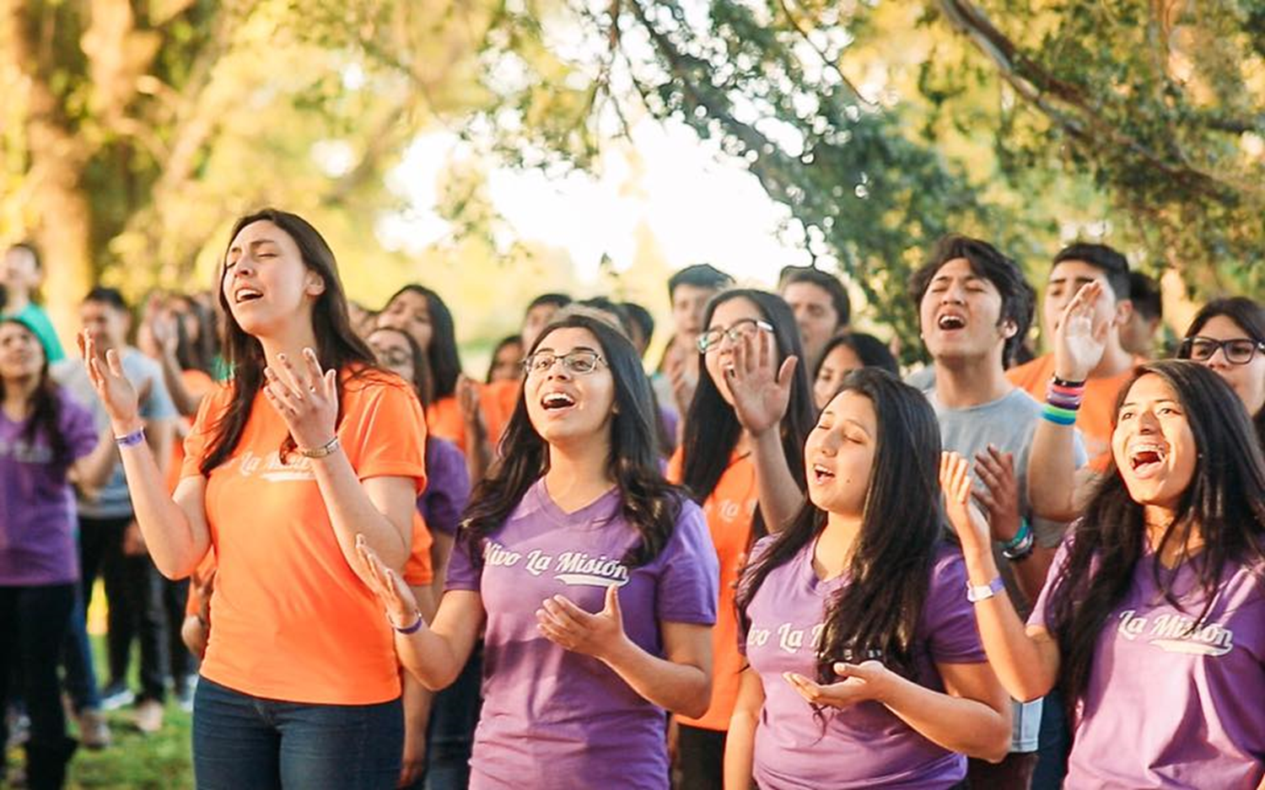

The key to song
How pleasant it is for us when we open a beautiful little box with a small key and hear soft and melodious music! We all like to listen to the beautiful melodies of a music box, don't we?
There is a key that opens the door of our hearts to joy and gladness and removes the despondency from our hearts. This is the key to song. When we find ourselves sad and discouraged, let us sing an inspiring hymn and we will feel comforted.
Great have been the blessings received by men in response to hymns of praise. How often this story is repeated in the spiritual life! How often, through the words of a sacred song, springs of penance and faith, of hope, of love and joy, spring up in the soul!
The singing has power to subdue rude and uncultivated natures; power to quicken thought and to awaken sympathy, to promote harmony of action, and to banish the gloom and foreboding that destroy courage and weaken effort. EGW (VSS 407)

Slide 5


The Key to the Bible
At all times, we can always enjoy the privilege of opening our Bibles and reading a few verses as a key that unlocks our hearts and minds to trust and faith in the Lord.
The key to systematic Bible study and Sabbath school study is one of the most effective for opening our minds and hearts to God's wonderful truths and promises.
Everyone must now search the Bible for himself upon his knees before God, with the humble, teachable heart of a child if he would know what the Lord requires of him. EGW (2TT 68).
I saw that the time for Jesus to be in the most holy place was nearly finished and that time can last but a very little longer. What leisure time we have should be spent in searching the Bible, which is to judge us in the last day. EGW (EW 58).

Slide 6

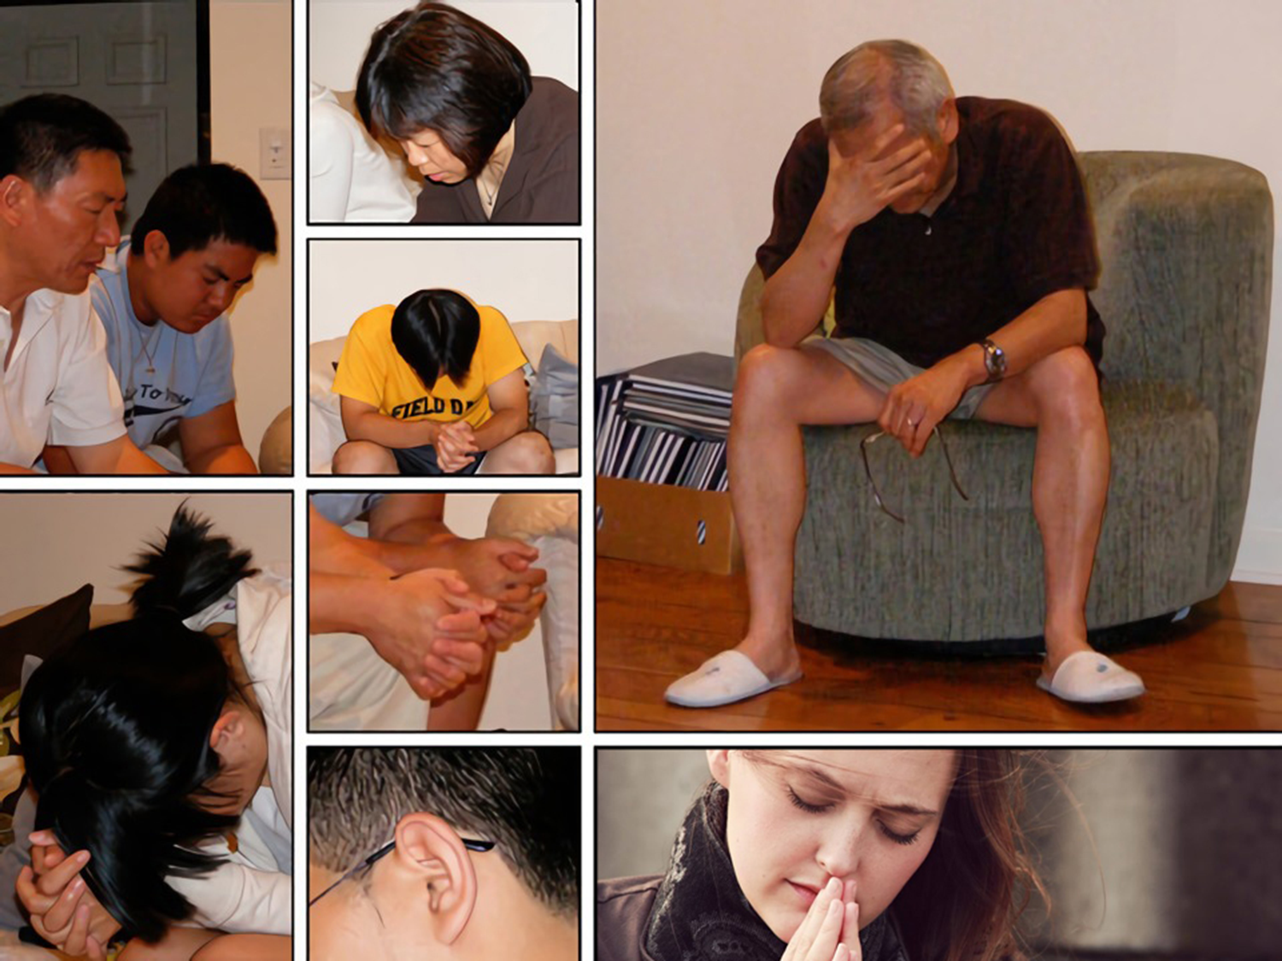
The Key to Prayer
I have in my hands a key that can make everyone rich. This key does not open chests overflowing with gold, silver, or precious stones; but it opens a chest much more abundant in riches; Open the heavenly storehouses filled with wonderful blessings. In addition, it gives us unlimited access to fellowship with God. This precious key is the key of prayer. When we feel sad and discouraged, let's reach for this valuable key.
Pray often to your heavenly Father. The oftener you engage in prayer, the closer your soul will be drawn into a sacred nearness to God. EGW (HP 89).
The Holy Spirit will make intercession for the sincere petitioner with groanings which cannot be uttered, and the heart will be softened and subdued by the love of God. The clouds and shadows which Satan casts about the soul will be dispelled by the bright beams of the Sun of Righteousness, and the chambers of mind and heart will be illuminated by the light of Heaven. EGW (HP 89).

Slide 7


The Key to Gratitude
We can only be worried and anxious if we forget how God has helped us so far. For this reason, we must be grateful to God every day, for the life and health that he lavishes on us daily and how he has helped us so far. The key to gratitude is an effective key that opens our hearts to gratitude and happiness.
I am sure that we are all grateful to our heavenly Father for all that He has done for us.
Thanksgiving and praise should be shown to God for the temporal blessings and for all the comfort He bestows upon us. God desires that all who are preparing to dwell in the heavenly mansions give Him glory for the rich treasures of His grace. If we were thankful to the Giver of all good, we would see heavenly grace manifest in us. Joy will be seen in our lives, and a spirit of respect and reverence before God (SD 122). [Nota: paraphrased].

Slide 8

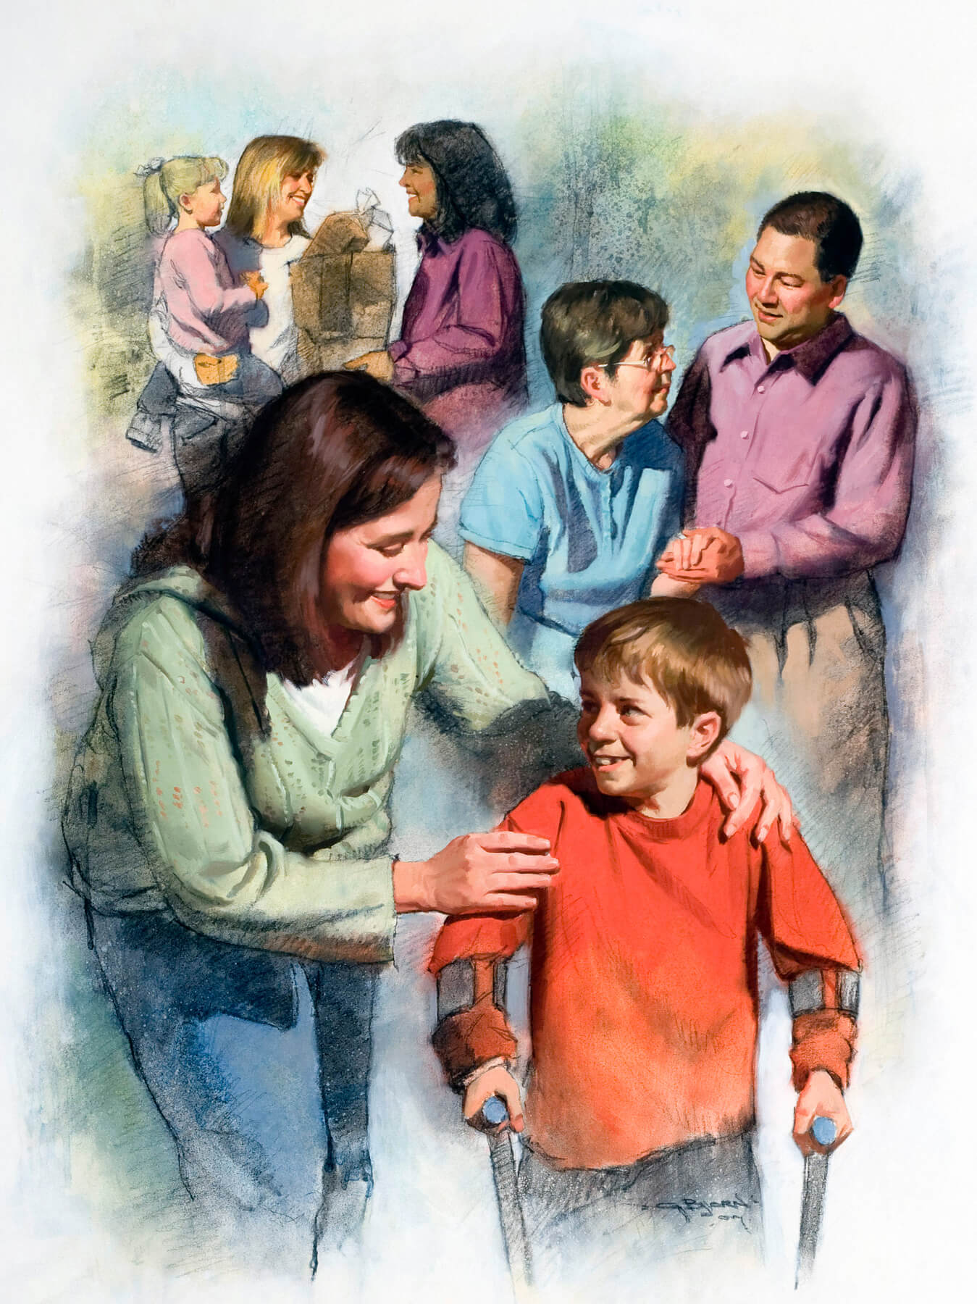
The key to help
If we are sad and discouraged and withdraw into ourselves, we will surely feel worse.
There is a key that opens the doors of happiness and joy. It is the key to sharing our gifts with others. A smile, an affectionate greeting, an act of kindness, are graces or gifts that we can share, as well as words full of sympathy, or a song full of love.
Nothing will so arouse a self-sacrificing zeal and broaden and strengthen the character as to engage in work for others.... None need wait until called to some distant field before beginning to help others. Doors of service are open everywhere. All around us are those who need our help. The widow, the orphan, the sick and the dying, the heartsick, the discouraged, the ignorant, and the outcast are on every hand. EGW (AG 310).

Slide 9

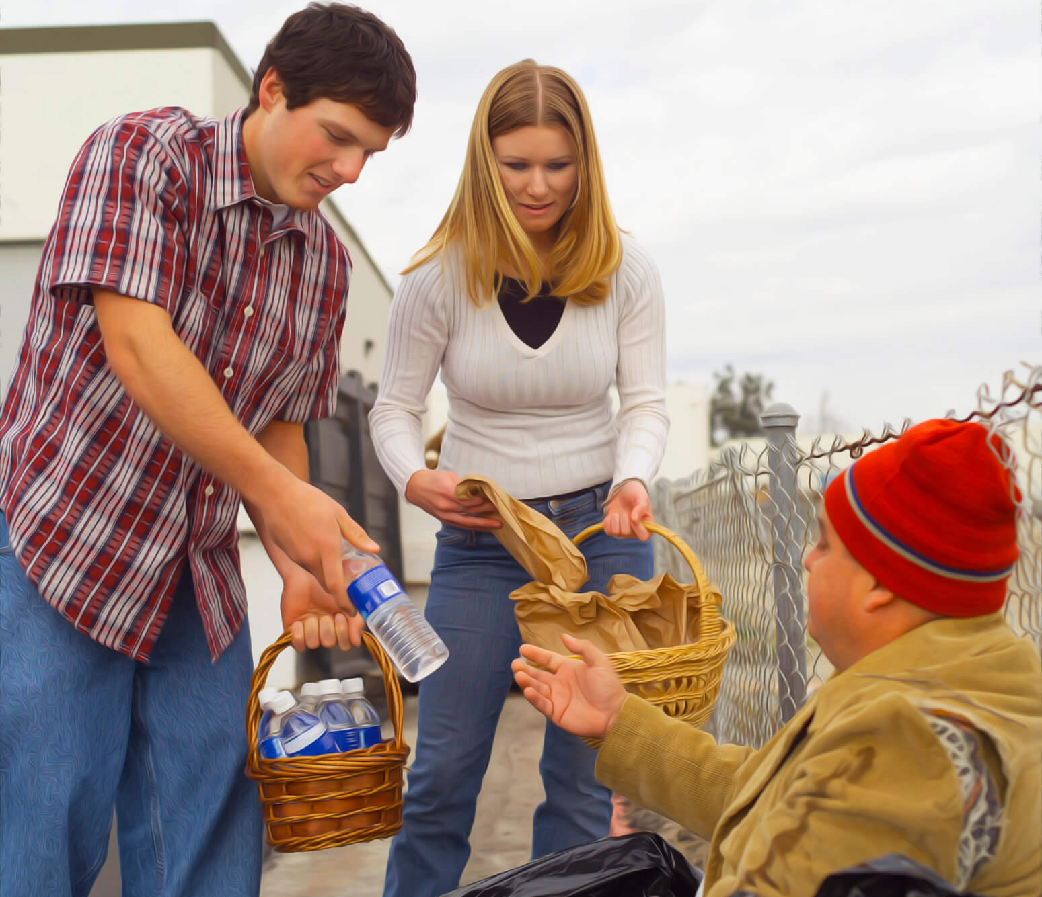
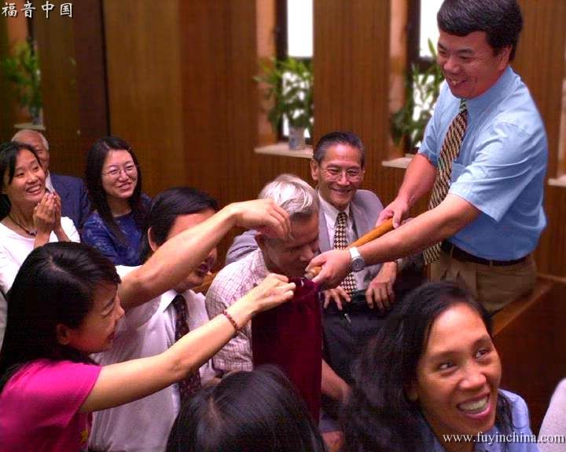
The Key to Generosity
Generosity is a key that opens the doors of our hearts, filling it with great blessings.
The reward of whole-souled liberality is the leading of mind and heart to a closer fellowship with the Spirit. EGW (3TT 41).
God planned the system of beneficence in order that man might become like His Creator, benevolent and unselfish in character, and finally be a partaker with Christ of the eternal, glorious reward. EGW (3TT 403).
When human sympathy is blended with love and benevolence, and sanctified by the Spirit of Jesus, it is an element which can be productive of great good. Those who cultivate benevolence are not only doing a good work for others, and blessing those who receive the good action, but they are benefiting themselves by opening their hearts to the benign influence of true benevolence. EGW (CS 345).

Slide 10



The Key to Forgiveness
We have a key that sets us free, it is the key to forgiveness. Forgiveness means that if someone has wronged us, instead of applying justice or demanding that they "pay" for their offense, we let them off the hook and shoulder, and treat them as if they had never offended or injured us.
Forgiveness is the shortest way to free ourselves from the heavy burden of offense. Holding a grudge becomes a difficult burden to bear and over time, it becomes heavier. It robs us of peace and causes our actions and thoughts to be turned toward the offender. Resentment becomes a shadow that follows us everywhere.
What should we do? First, confess to God the negative feelings that invade us, and ask for His forgiveness and help to forgive the offense. Study the Bible daily and reflect on forgiveness, considering the example of Jesus and those who forgave, or did not forgive. Avoid remembering the offense, at least until you have healed, as this makes healing difficult. Pray daily for the conversion and salvation of the offender. Returning good for evil makes us more Christlike. Finally, forgive, that is, leave the offense in the Lord's hands and feel as if we have never been offended.
Think that forgiving makes you free.

Slide 11



The Key to Faith
There is a key that is capable of moving mountains. It is the key to faith. How strong is true faith! With it the supplicant seizes the power of Infinite Love. Faith consists in trusting in God, in believing that he loves us and knows what is best for our good. Thus, instead of our way, it induces us to prefer theirs. Instead of our ignorance, accept his wisdom; instead of our weakness, his strength; instead of our sin, his righteousness.
Our lives, ourselves, are already His; faith acknowledges His ownership, and accepts its blessings. Truth, uprightness, purity, are pointed out as secrets of life's success. It is faith that puts us in possession of these. Every good impulse or aspiration is the gift of God; faith receives from God the life that alone can produce true growth and efficiency. EGW (GW 259).

Slide 12

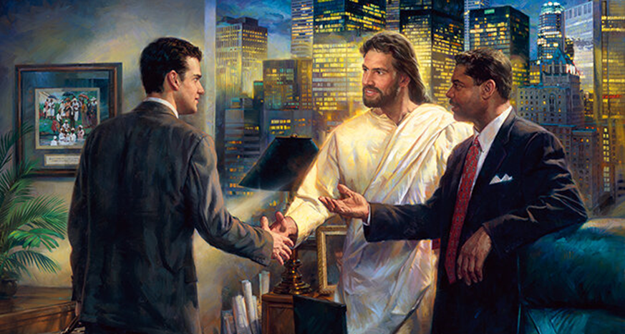
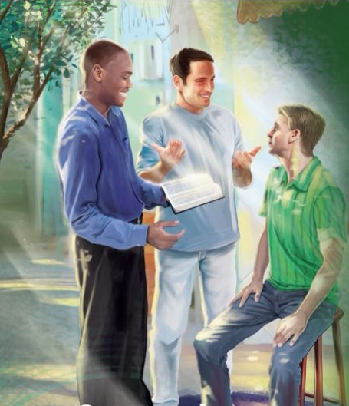

The Key to Sharing Jesus
The last key, that of sharing Jesus, holds the key to a useful and effective life here, and for eternity.
The more we talk of Jesus, the more we shall reflect His divine image. By beholding we become transformed. We need to bring Christ into our religious experience. When you assemble together, let the conversation be on Christ and His salvation.... The more we talk of Jesus the more of His matchless charms we shall behold. EGW (Mar 331).
Talk of Jesus, His loveliness and glory, and of His undying love for you, and let your heart flow out in love and gratitude to Him, who died to save you. EGW (SD 362).

Slide 13

The Key to the Fervent Desire to Worship God
The key to the song
The Key to the Bible
The Key to Prayer
The Key to Gratitude
The key to help
The Key to Generosity
The Key to Forgiveness
The Key to Faith
The Key to Sharing Jesus
May the Lord allow that, at every moment of our lives, we may make the proper use of these precious keys, which will always help us, and especially when we find ourselves dragging difficulties.

