Slide 1
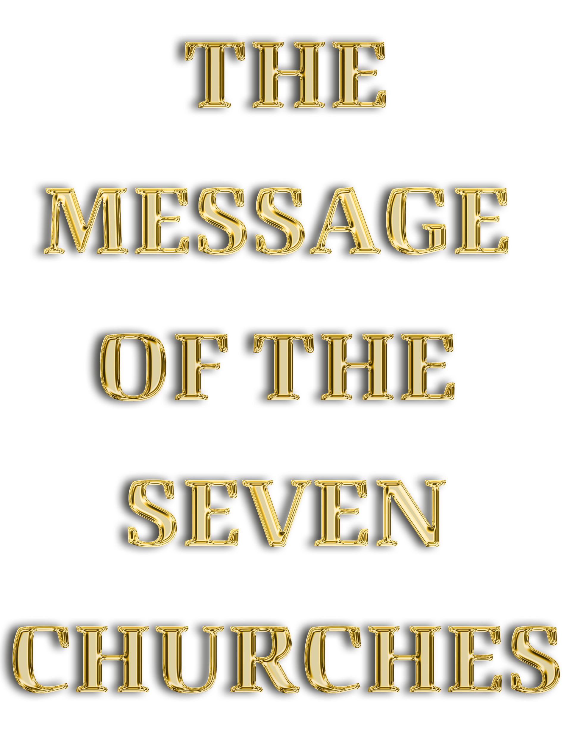
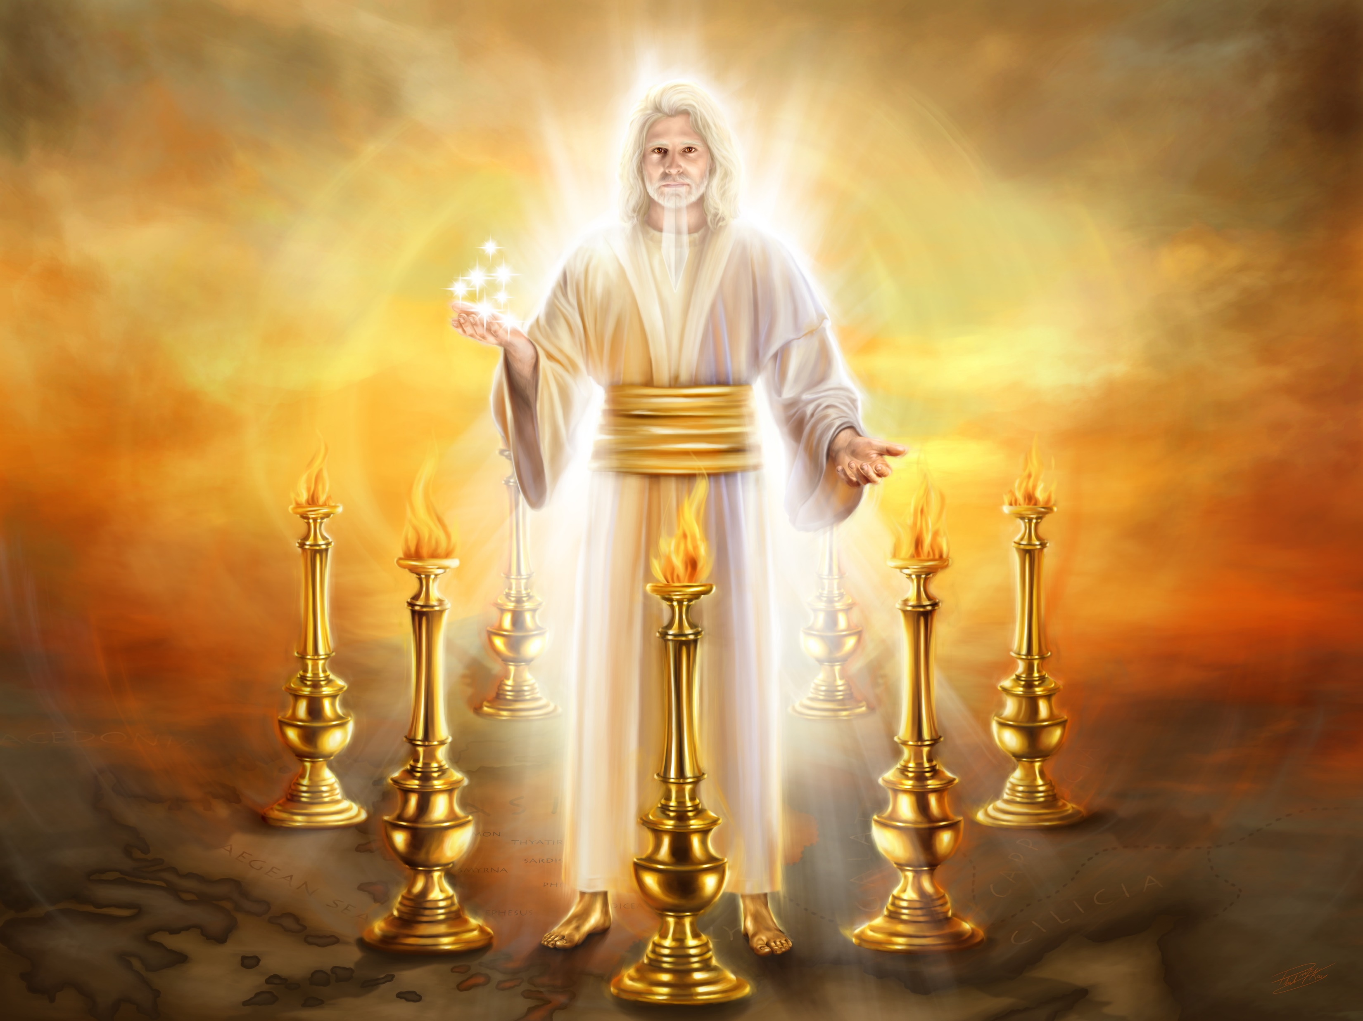


Slide 2

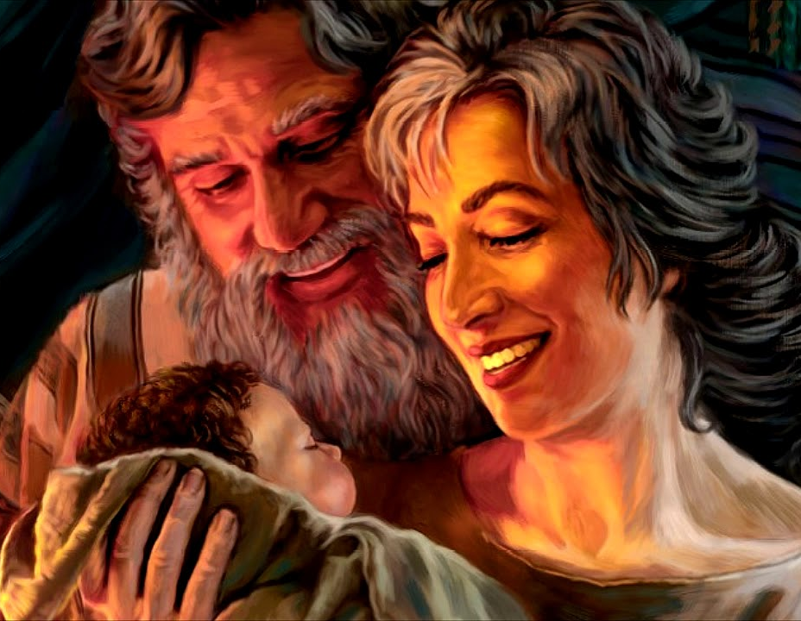


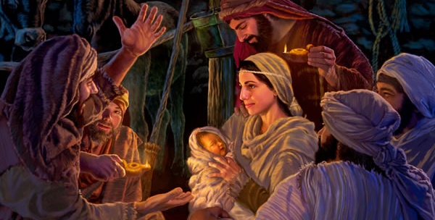

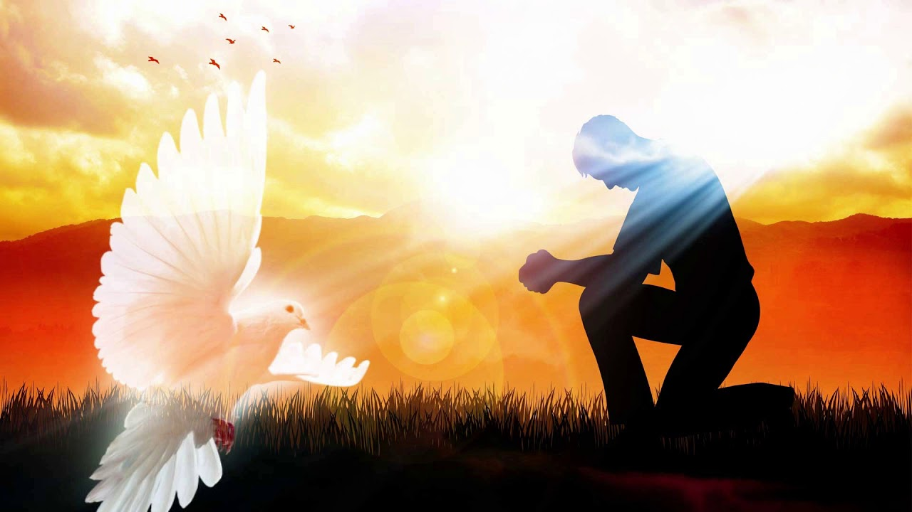
Bible prophecy can be interpreted in a variety of ways. Some prophecies may encompass as many as three different fulfillments. Let's take an example: Isaiah 7:14. "Therefore the Lord Himself will give you a sign: Behold, the virgin shall conceive, and bear a son, and shall call his name Immanuel.”
Immediate Fulfillment:
The prophecy is fulfilled in the life of the prophet himself, or at a time very close to him. That is, in the lives of those to whom the prophecy is written directly.
According to Isaiah 8:3 the prophecy was fulfilled in the son of the prophet himself. "And I came unto the prophetess, and she conceived, and bore a son. And the Lord said to me, 'Call his name Maher-salal-hasbaz.'”
Future Fulfillment:
The prophecy is fulfilled long after the prophet's lifetime.
This prophecy was fulfilled at the birth of Jesus, through the Virgin Mary. "All this came to pass that it might be fulfilled which was spoken by the Lord through the prophet, when he said, Behold, a virgin shall conceive and bear a son, and thou shalt call his name Immanuel, which is translated, 'God with us'" (Matt. 1: 22-23).
Universal Fulfillment:
The prophecy can be applied to anyone at any time in history. This fulfillment is usually a spiritual application useful to the believer's individual experience.
Neither of the two children who fulfilled the prophecy was really named Immanuel. So, this name has a special meaning for you and me: through the Holy Spirit, God is with us, he dwells in each one of us, we are his temple.

Slide 3

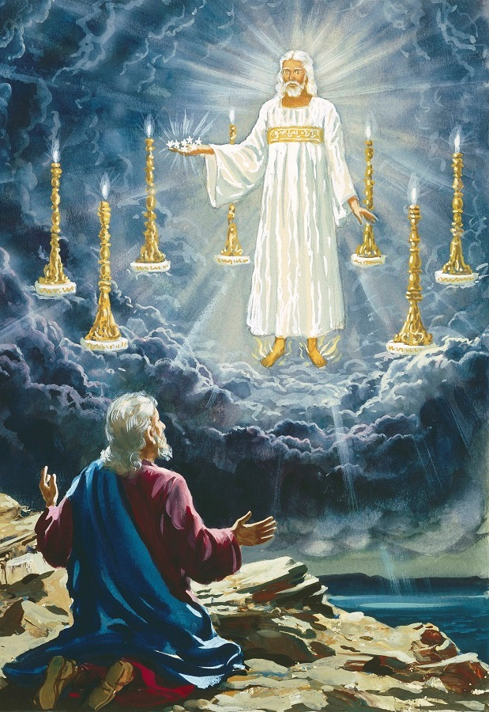
Let's apply this concept to the prophecy of the seven churches that we find in chapters 2 and 3 of Revelation:
Immediate Fulfillment:
Each message was related to a real church, which existed in the time of the John the Apostle, and that he had specific characteristics. The message written to each of the churches had a special meaning for that particular church. Even the order in which they appear coincides with the order in which a mailman would go to deliver the letters to these churches.
Future Fulfillment:
Each message coincides with an era of the Christian church.
EPHESUS
31
100
SMYRNA
100
323
PERGAMOS
323
538
THYATIRA
538
1517
SARDIS
1517
1798
PHILADELPHIA
1798
1844
LAODICEA
1844
…
The Apostolic Age Until John's Death
The persecution of the church by the Roman Empire until the conversion of Constantine
The church gains adherents and the truth is corrupted until Justinian gives political powers to the Papacy
It begins with the political power of the church until the rise of Protestantism with Luther's Reformation
Final period of persecution and the decline of Protestantism until the imprisonment of the Pope
Since the great awakening, when the world was actively waiting for the Coming of Jesus. Until the end of the 2,300 days
Final period of the church until the Second Coming of Jesus
Universal Fulfillment:
The message written to each of the churches can correspond to the spiritual state of the believer at some point in his life. Since we don't all go through the same experiences, we can each identify better with one church than another.

Slide 4


Today we are joined by the seven angels to whom Jesus wrote his letters for the churches.
They will remind us of the essence of the message that Jesus wanted to convey.
These angels represent each one of us. They represent not only those who have the responsibility to care for the church, but they also represent each of us individually.
As we listen to these messages, let us examine ourselves. We cannot and should not apply all the messages to us.
If our spiritual condition needs fixing, let us listen to our Savior's counsel. If we see ourselves reflected in the praises of Jesus, let us move on.
All the messages for the churches agree on one thing: there is a promise for the overcomer.
Each of us is invited to be an overcomer!

Slide 5
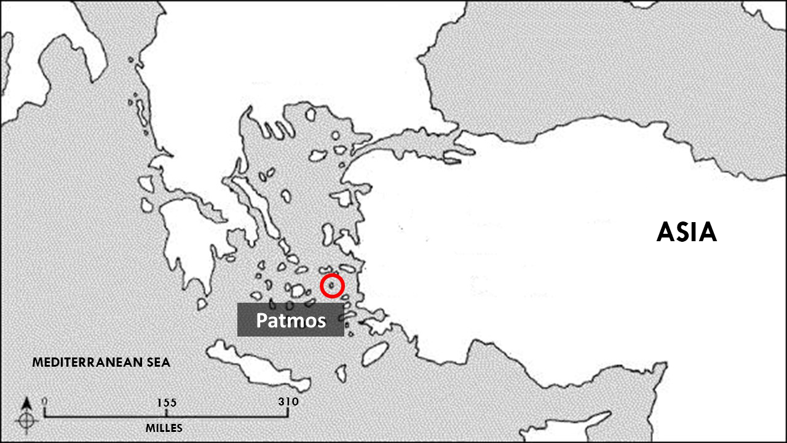
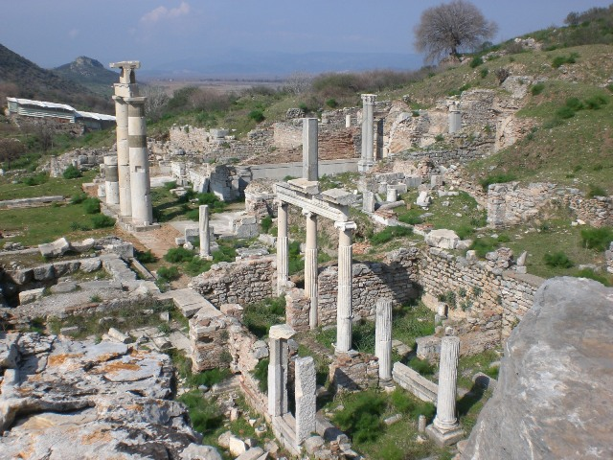
EPHESUS
“DESIRABLE." Apostolic Period 31-100
2-3. Took the gospel to the whole known world
4-6. After the death of the apostles, Ephesus fell in zeal, but resisted heresies for a time
Ephesus
Patmos
Revelation 2:1-7

Slide 6

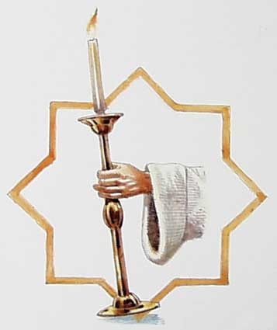
EPHESUS
I am the angel of the church of Ephesus. Jesus has written me a special letter for me. Let's read it in Revelation 2:1-7.
“Unto the angel of the church of Ephesus write; These things saith he that holdeth the seven stars in his right hand, who walketh in the midst of the seven golden candlesticks; I know thy works, and thy labour, and thy patience, and how thou canst not bear them which are evil: and thou hast tried them which say they are apostles, and are not, and hast found them liars: And hast borne, and hast patience, and for my name's sake hast laboured, and hast not fainted. Nevertheless I have somewhat against thee, because thou hast left thy first love. Remember therefore from whence thou art fallen, and repent, and do the first works; or else I will come unto thee quickly, and will remove thy candlestick out of his place, except thou repent. But this thou hast, that thou hatest the deeds of the Nicolaitanes, which I also hate. He that hath an ear, let him hear what the Spirit saith unto the churches; To him that overcometh will I give to eat of the tree of life, which is in the midst of the paradise of God.”

Slide 7

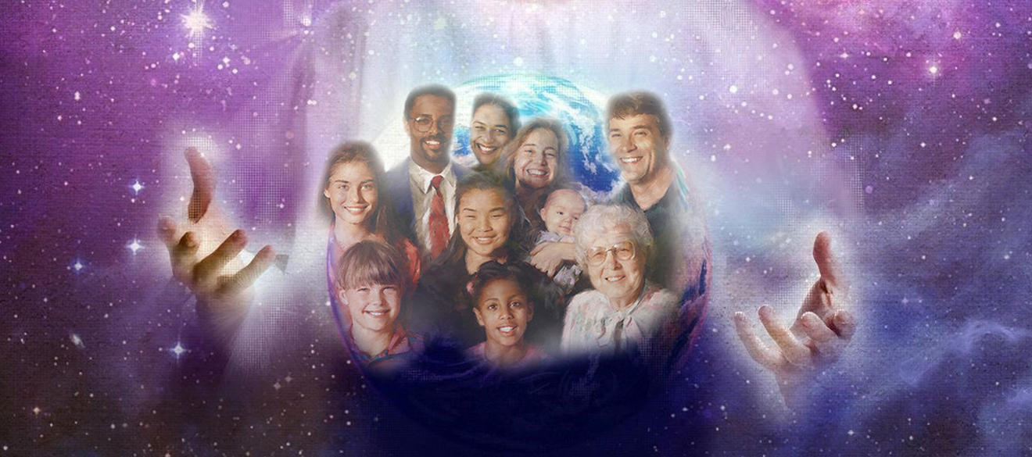
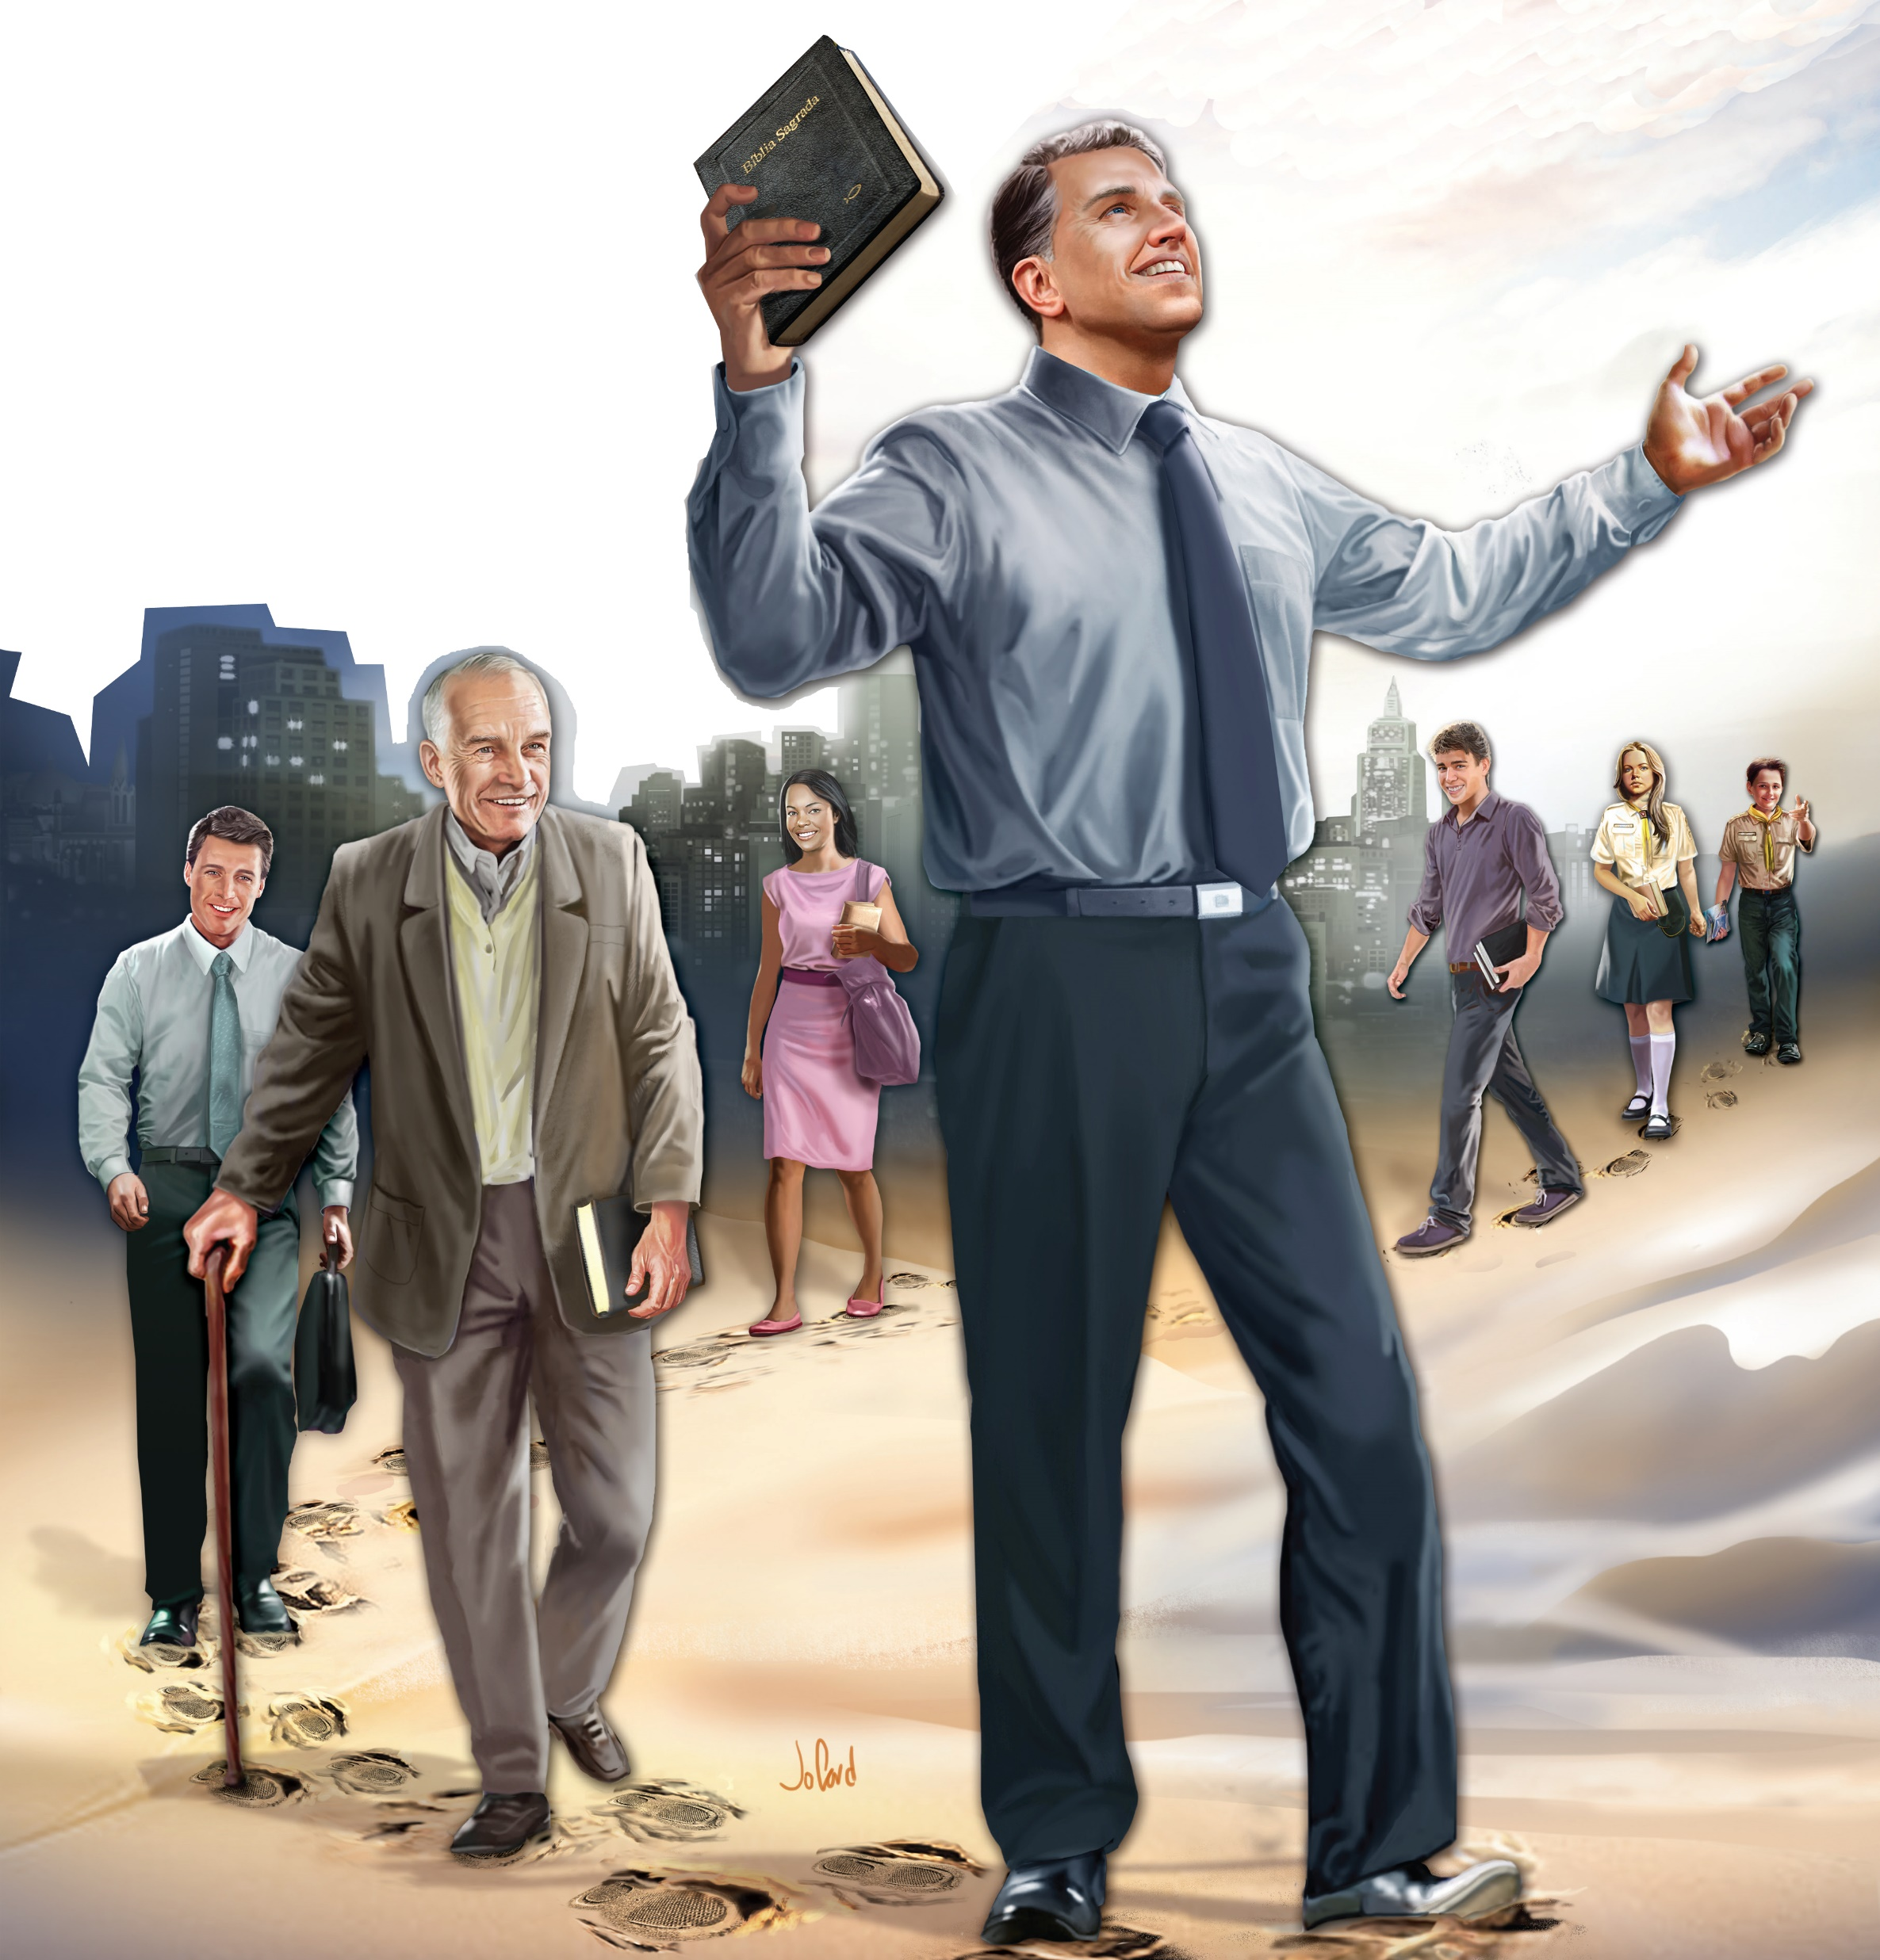
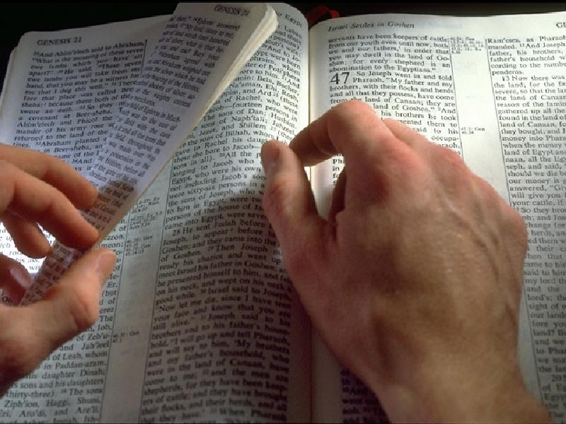
Jesus presents Himself as the one who has the seven stars and walks among the seven candlesticks. The seven stars are us, that is, the angels of the churches, their leaders. We are in the hands of Jesus.
Elders, deacons and deaconesses, Sabbath School leaders, Personal Ministry, or other church departments; we are all in the hands of Jesus.
The candlesticks represent the churches. Jesus walks through the churches. He also walks through your church. Can you feel His presence?
The letter Jesus wrote to me could have been written for you, who are a church leader. Or for you, who, although at this time you have no responsibility, are also part of the beloved church of Jesus.
In this letter He tells me that He knows my works, which show who I am and what I believe. He also knows my effort to do what pleases Him, and the perseverance with which I follow in His footsteps.
Jesus knows that I like to research the Bible to find out if what I'm being taught is true or not, and He praises me for it. I don't believe anything that new teachers teach me, unless it is in complete agreement with God's Word. If it is not, I reject its teaching.

Slide 8
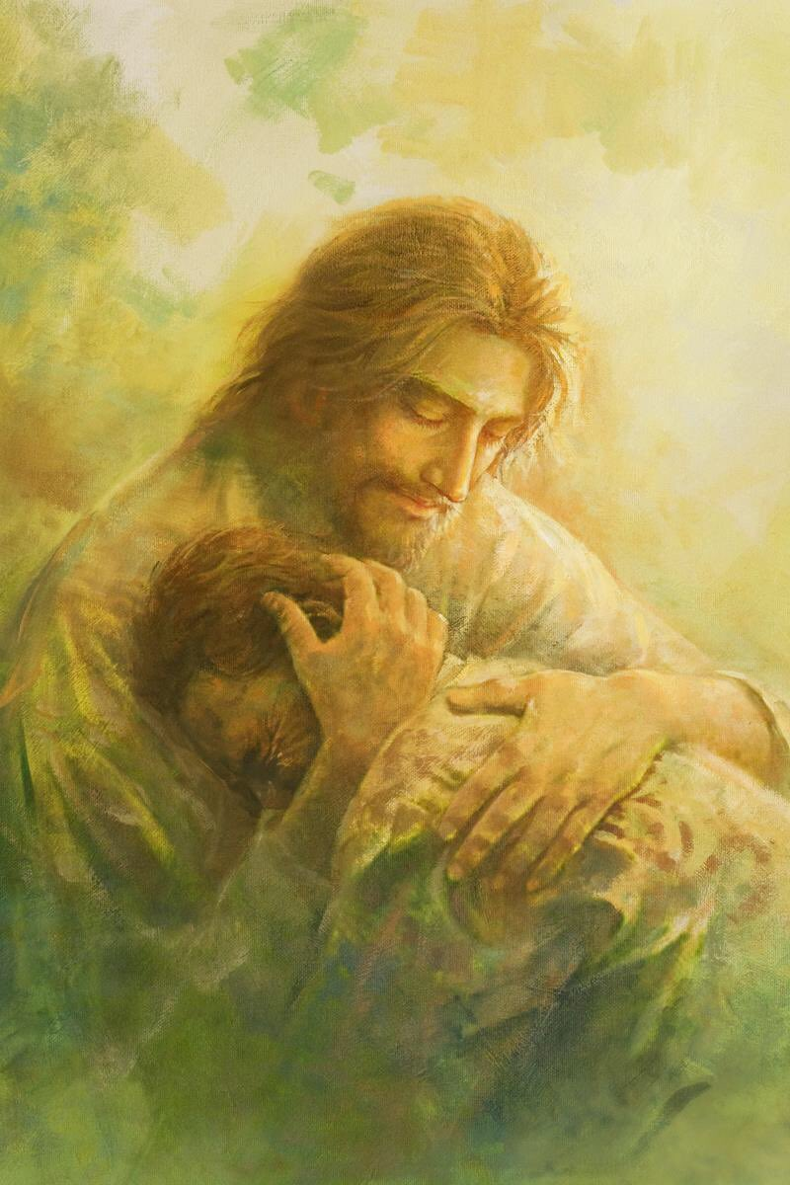

But not everything is pretty on this menu. Jesus knows I have a problem. I don't love Him like I used to. I no longer speak of Him with the same enthusiasm as I once did.
That's why Jesus gives me three pieces of advice: repent, remember, and come back.
I must repent because I no longer love Him as I did. I must remember how and why I fell in love with Jesus. And I must relive my faith as I did when I learned the truth.
If I don't follow His advice, He warns me of something terrible: He will remove my candlestick from its place.
What I do doesn't just affect me, it affects the whole church! The whole church can be infected by the lack of faith of some of its members.
That's why the apostle Paul tells us in 1 Thessalonians 5:11: “Encourage one another and build one another up, just as you do.”
Jesus ends His letter with a promise of victory. The one who overcomes will be able to eat from the tree of life, in the paradise that God will place again in the middle of the New Jerusalem.
Remember: you could be a member of the church in Ephesus.

Slide 9
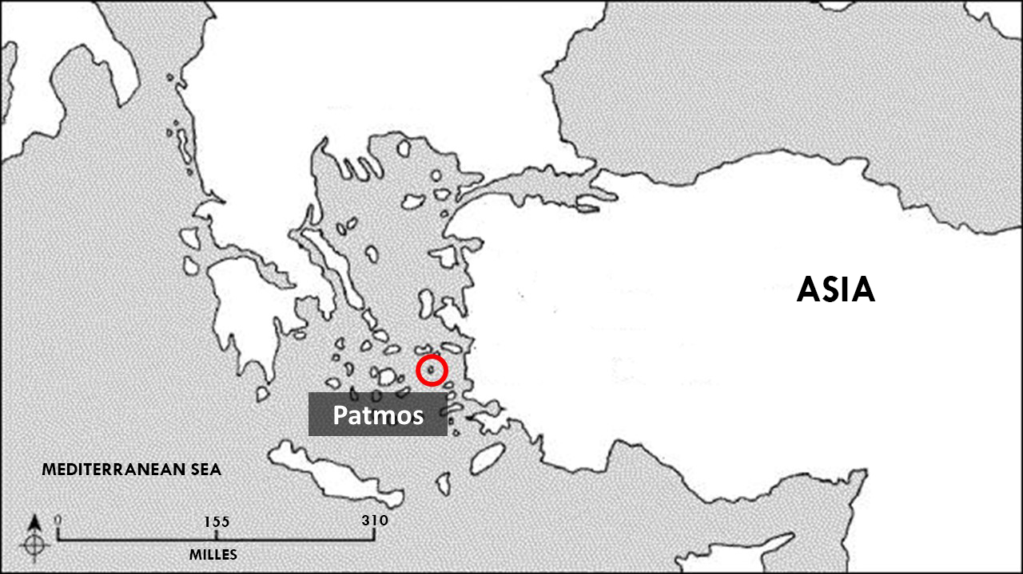
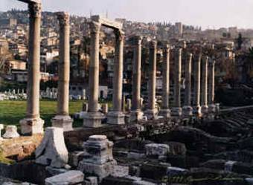
“MYRRH.“ PERSECUTION 100-323
9. The Jews incite Rome to persecute Christians
10. Persecution of 303-313 AC
SMYRNA
Smyrna
Ephesus
Patmos
Revelation 2:8-11

Slide 10

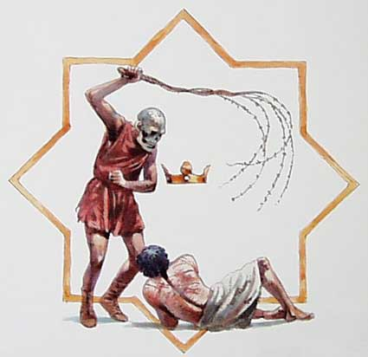
SMYRNA
I am the angel of the church of Smyrna. Jesus has written me a special letter for me. Let's read it in Revelation 2:8-11.
“And unto the angel of the church in Smyrna write; These things saith the first and the last, which was dead, and is alive; I know thy works, and tribulation, and poverty, (but thou art rich) and I know the blasphemy of them which say they are Jews, and are not, but are the synagogue of Satan. Fear none of those things which thou shalt suffer: behold, the devil shall cast some of you into prison, that ye may be tried; and ye shall have tribulation ten days: be thou faithful unto death, and I will give thee a crown of life. He that hath an ear, let him hear what the Spirit saith unto the churches; He that overcometh shall not be hurt of the second death..”

Slide 11

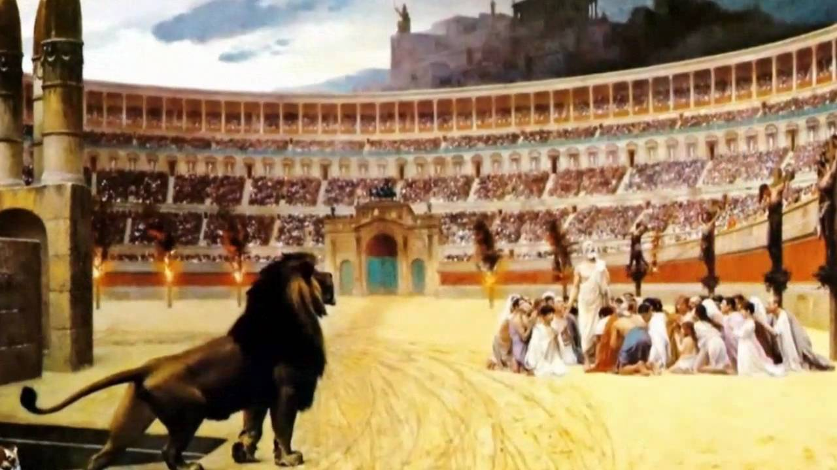
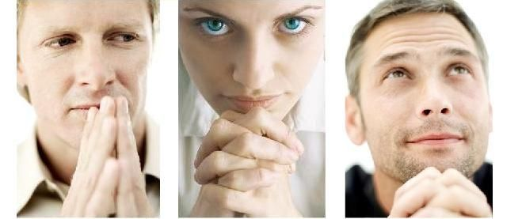
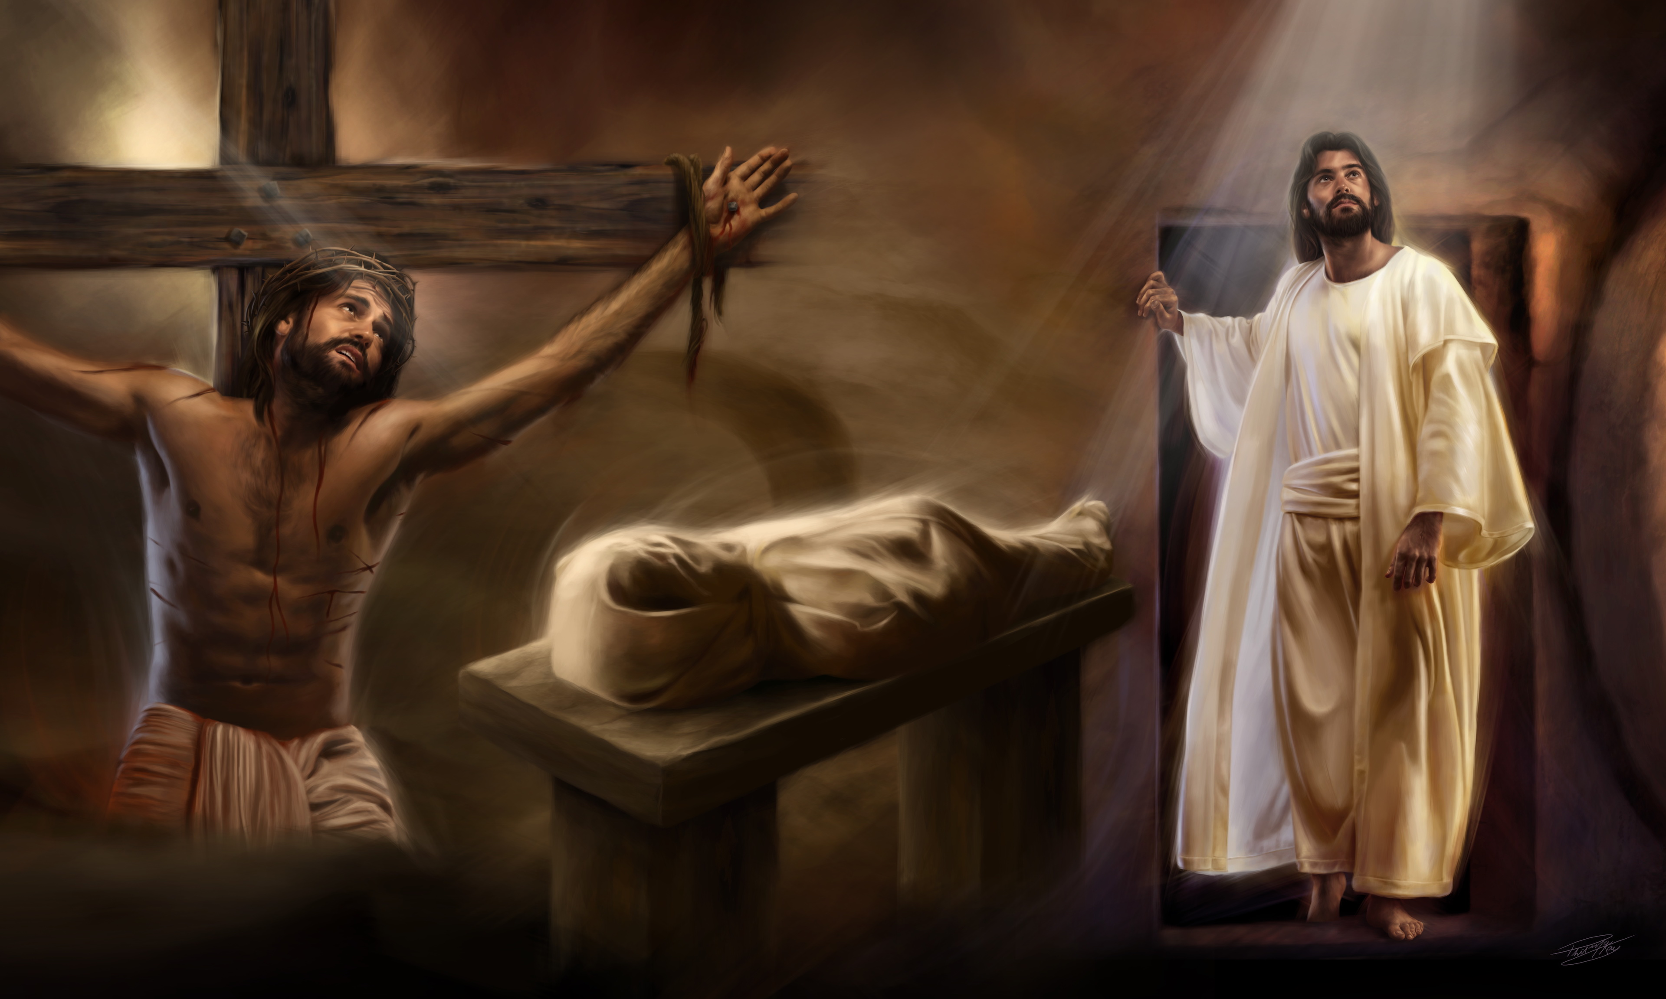
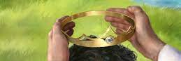
This is a short letter, but full of love.
Jesus tells me that I am rich, that I have a lot of faith, even though I consider myself very poor.
There is no rebuke, no warning. It seems that everything is going well. Or, simply, He knows how much I am suffering. How many trials am I going through. How much they talk badly about me. How many problems I have to face to stand firm in my faith. He knows that I could not carry any more burdens. That I would not tolerate any more criticism, no matter how deserved it was.
Jesus presents Himself as the first and the last. Every morning when I wake up, He is the first thought of the day. and He is the last thought of the day, before I go to bed.
It also reminds me that He is the one who died, but He is still alive. That's why He advises me: "don't be afraid! Stay faithful, whatever the consequences." As the apostle Paul said in Philippians 3:8 and 10, "Surely I count all things loss because of the excellency of the knowledge of Christ Jesus my Lord, for whose sake I have lost all things, and count them as rubbish, that I may gain Christ... that I may know him, and the power of his resurrection, and the sharing of his sufferings, becoming like him in his death." He died, but He overcame and is still alive today, I too can overcome, even if I have to give my life for His name's sake.
And if I win, Jesus will give me the crown of life.
Remember: you could be a member of the church in Smyrna.

Slide 12
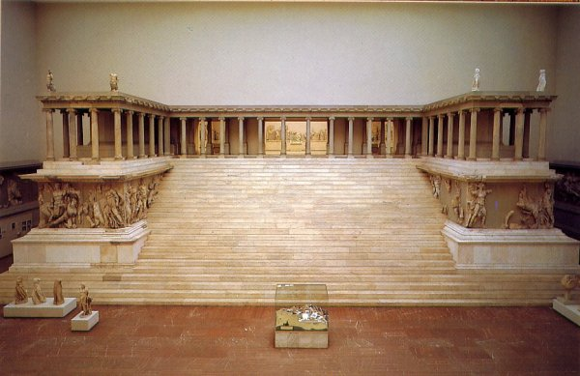
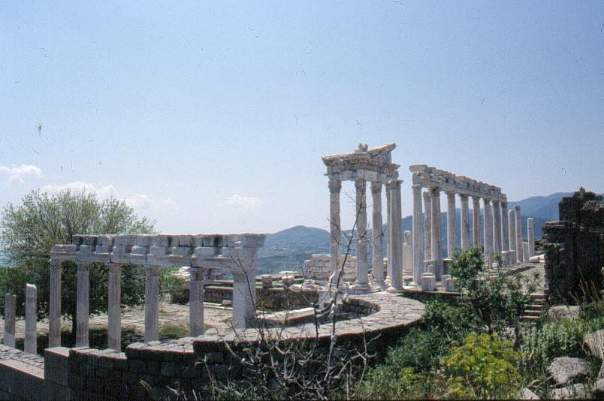
“HEIGHT." Decay 323 to 538
13. The Papacy consolidates Rome as its seat.
14-16. The union of the Christian with the pagan
PERGAMOS
Altar of Zeus
(Berlin Museum)
Pergamos
Smyrna
Ephesus
Patmos
Revelation 2:12-17

Slide 13

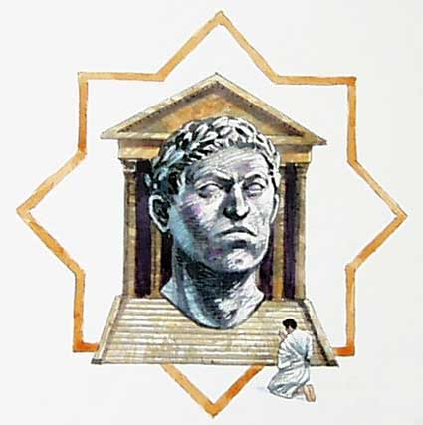
PERGAMOS
I am the angel of the church in Pergamos, I was frightened when I started reading the letter that Jesus wrote to me. Let's read it in Revelation 2:12-17.
“And to the angel of the church in Pergamos write; These things saith he which hath the sharp sword with two edges; I know thy works, and where thou dwellest, even where Satan's seat is: and thou holdest fast my name, and hast not denied my faith, even in those days wherein Antipas was my faithful martyr, who was slain among you, where Satan dwelleth. But I have a few things against thee, because thou hast there them that hold the doctrine of Balaam, who taught Balac to cast a stumblingblock before the children of Israel, to eat things sacrificed unto idols, and to commit fornication. So hast thou also them that hold the doctrine of the Nicolaitanes, which thing I hate. Repent; or else I will come unto thee quickly, and will fight against them with the sword of my mouth. He that hath an ear, let him hear what the Spirit saith unto the churches; To him that overcometh will I give to eat of the hidden manna, and will give him a white stone, and in the stone a new name written, which no man knoweth saving he that receiveth it.”

Slide 14

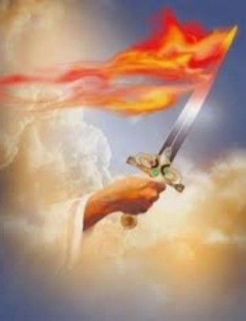
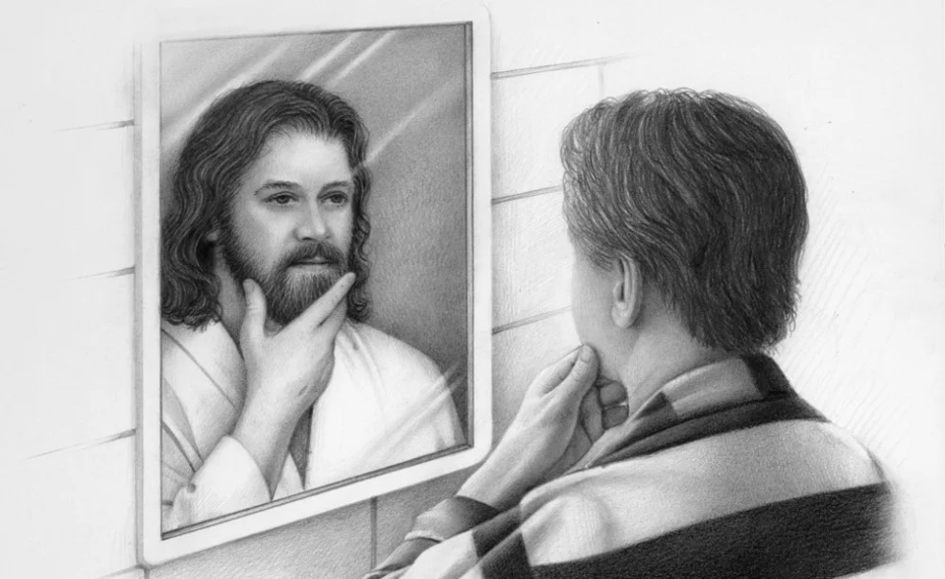
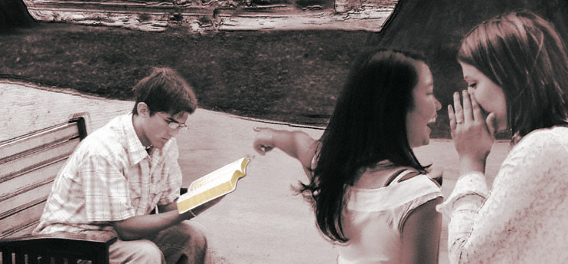
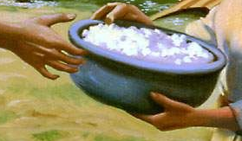
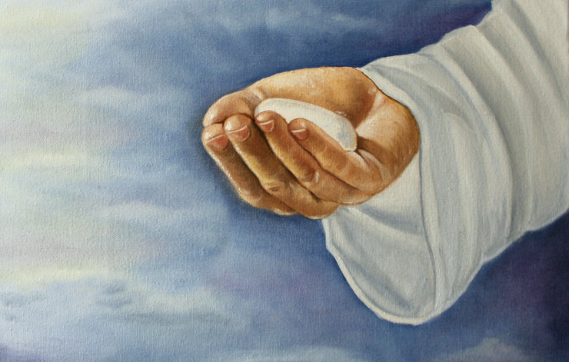
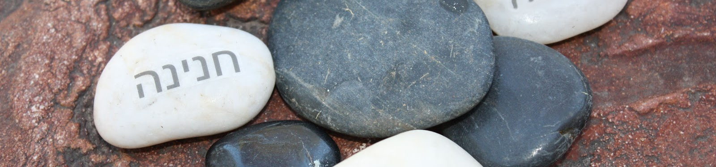
He shows up with a sword! and it does not seem that He is referring, precisely, to the Bible!
It reminds me of Paul's text in Romans 13:4: "The magistrates are God's servants for your good. But if you do wrong, be afraid; for it is not in vain that he bears the sword, for he is the servant of God, an avenger to punish him who does evil.”
As I read on, I can realize that Jesus has some things against me.
I know some people who are teaching things that are not right. Others do things that Christians shouldn't do. However, I do not correct them. On the contrary, I like to be told these things and, sometimes, I even agree with them. That's why He tells me that He will come to fight with his sword, if I don't repent.
But Jesus knows that I keep trying to imitate His character.
He also knows that I am surrounded by people who do not believe the same as I do, and who try to get me to participate with them in their feasts, where they worship their saints. And He knows that I have never denied my faith, even when I am mocked.
And He promises me a special reward if I remain faithful. When Jesus comes, He will give me three things: manna, a white stone, and a new name.
I still don't know what I'll be able to do with the white stone, but I'm sure I'll enjoy eating manna.
But the best thing will be the new name. Because that means that I will finally have the character of Jesus that I want to imitate so much now.
Remember: you could be a member of the Pergamos church.

Slide 15
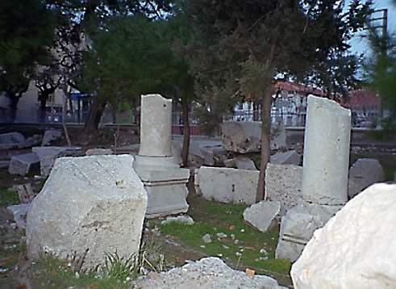
THYATIRA
Corruption 538 to 1517
20-24. Moral and doctrinal corruption.
19, 24-25. E.g. the mistakes of the Waldenses are tolerated
Pergamos
Thyatira
Smyrna
Ephesus
Patmos
Revelation 2:18-29

Slide 16

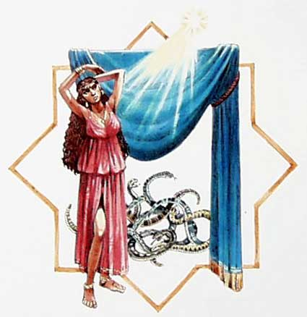
THYATIRA
I am the angel of the church of Thyatira. We can read the letter Jesus wrote to me in Revelation 2:18-29.
“And unto the angel of the church in Thyatira write; These things saith the Son of God, who hath his eyes like unto a flame of fire, and his feet are like fine brass; I know thy works, and charity, and service, and faith, and thy patience, and thy works; and the last to be more than the first. Notwithstanding I have a few things against thee, because thou sufferest that woman Jezebel, which calleth herself a prophetess, to teach and to seduce my servants to commit fornication, and to eat things sacrificed unto idols. And I gave her space to repent of her fornication; and she repented not. Behold, I will cast her into a bed, and them that commit adultery with her into great tribulation, except they repent of their deeds. And I will kill her children with death; and all the churches shall know that I am he which searcheth the reins and hearts: and I will give unto every one of you according to your works. But unto you I say, and unto the rest in Thyatira, as many as have not this doctrine, and which have not known the depths of Satan, as they speak; I will put upon you none other burden. But that which ye have already hold fast till I come. And he that overcometh, and keepeth my works unto the end, to him will I give power over the nations: And he shall rule them with a rod of iron; as the vessels of a potter shall they be broken to shivers: even as I received of my Father. And I will give him the morning star. He that hath an ear, let him hear what the Spirit saith unto the churches.”

Slide 17

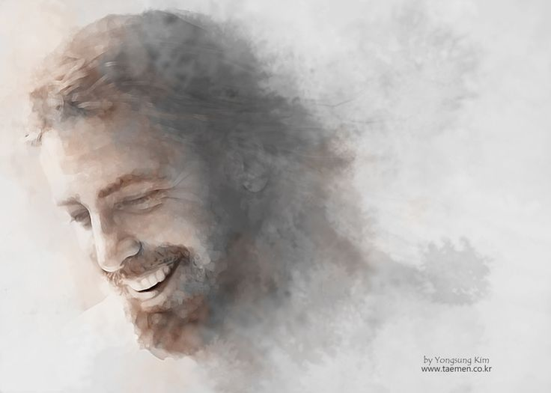
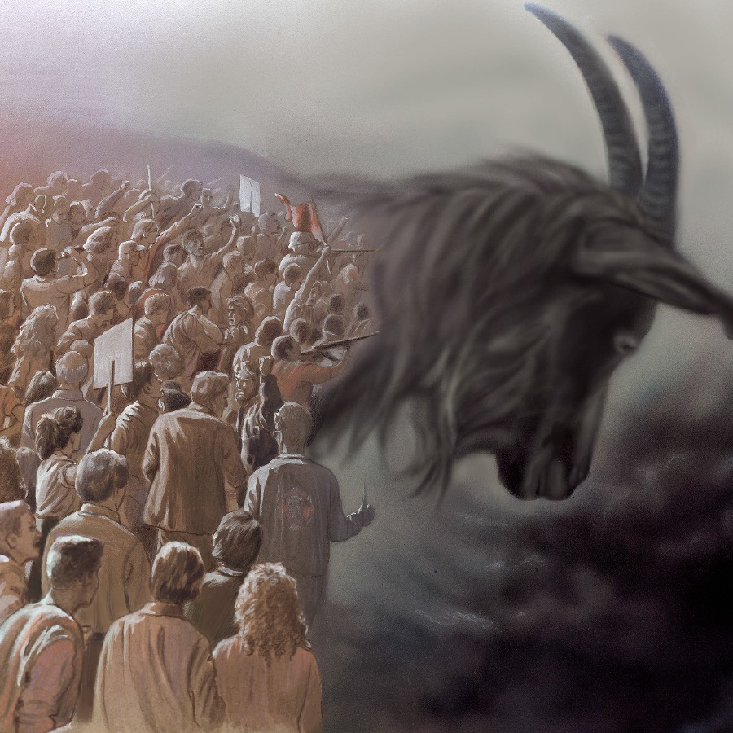
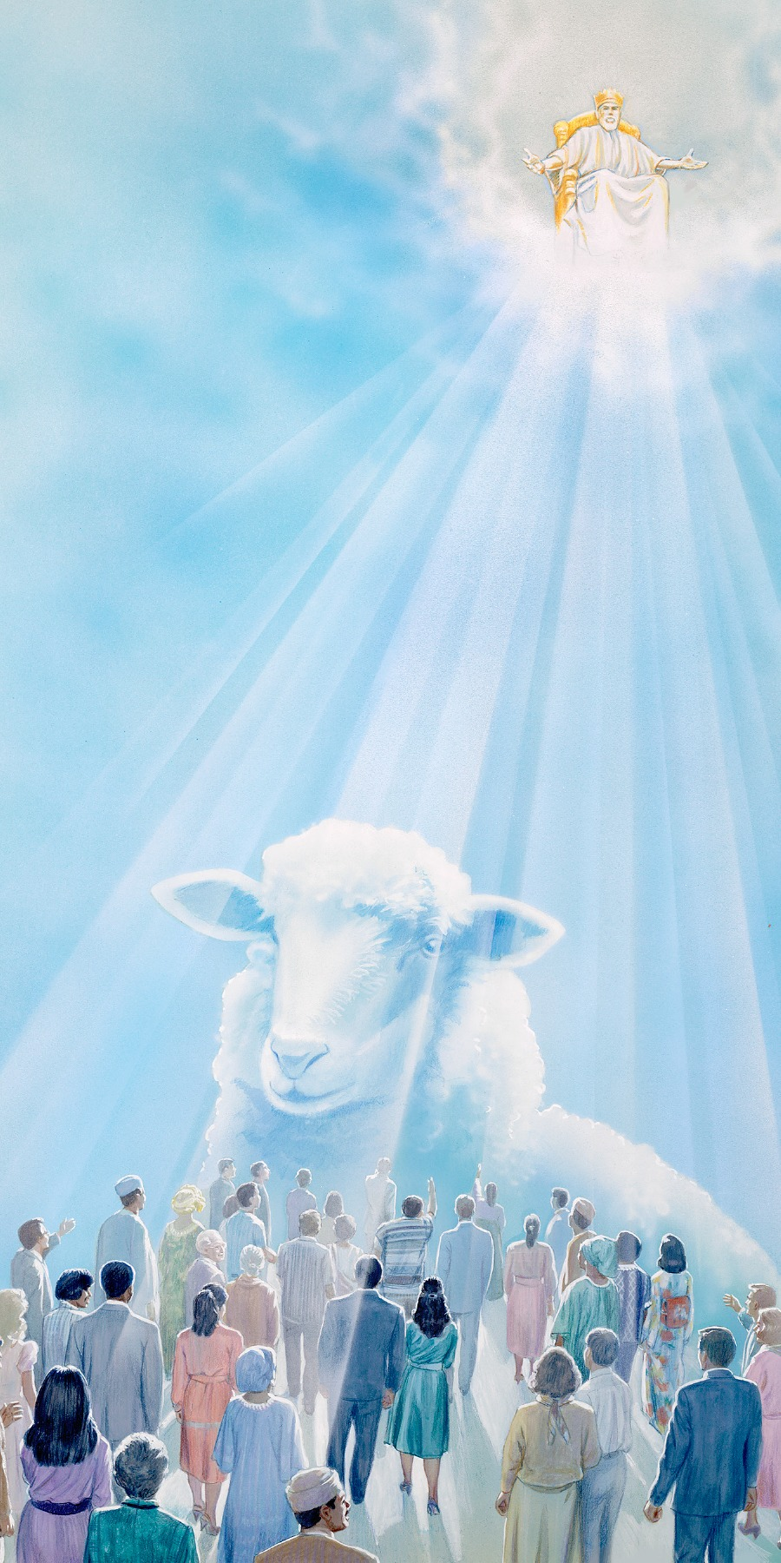
I should rejoice, Jesus has written me the longest letter of all.
In addition, the beginning is spectacular. He knows my works, my love, my faith, my service, and my patience. And He knows that I am trying harder and harder.
And the ending, apotheotic. We will be kings, and we will have the "morning star". Revelation 22:16 tells us that Jesus is "the bright morning star," so we will always be with Jesus.
But the "eyes of fire“ ... Yes, Jesus presents Himself at the beginning of the letter as the One who sees everything with His eyes of fire. He sees even the innermost of my thoughts. He knows what I'm like inside, nothing escapes His gaze.
He also knows that in my church, there are different kinds of people.
Some members are Christians in name only, others try to remain faithful. But there are so many Christians in name that the faithful do not dare to raise their voices.
Jesus has a message for every group.
To those who seem to be Christians, but with their lives show that they are not, He asks them to repent. If they do not repent, He will let them suffer the consequences of their actions. Jesus will use every instrument possible to get them to turn away their sins.
To the faithful, and to those who repent, Jesus says, "Hold fast your faithfulness until I come.”
Remember: you could be a member of the church in Thyatira.

Slide 18
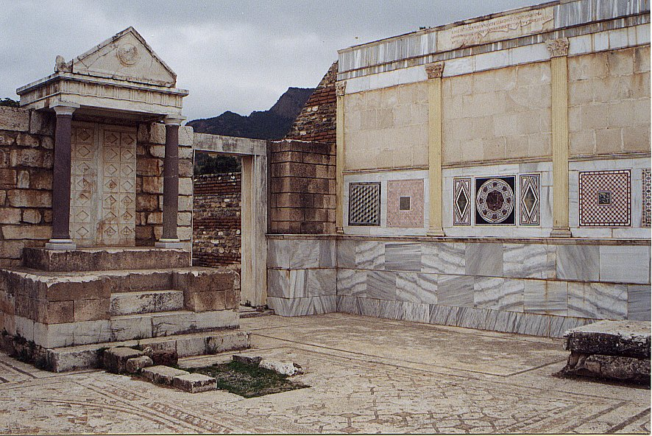
SARDIS
The Reform 1517 to 1798
2-3. The Reformers became lukewarm.
4. Some remained pure (e.g. Puritans)
Pergamos
Thyatira
Sardis
Smyrna
Ephesus
Patmos
Revelation 3:1-6

Slide 19

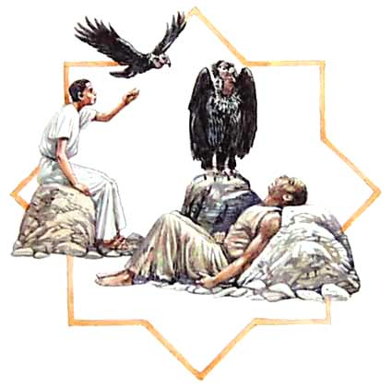
SARDIS
I am the angel of the church of Sardis. In Revelation 3:1-6 we can read the short letter that Jesus has written to me.
“And unto the angel of the church in Sardis write; These things saith he that hath the seven Spirits of God, and the seven stars; I know thy works, that thou hast a name that thou livest, and art dead.Be watchful, and strengthen the things which remain, that are ready to die: for I have not found thy works perfect before God. Remember therefore how thou hast received and heard, and hold fast, and repent. If therefore thou shalt not watch, I will come on thee as a thief, and thou shalt not know what hour I will come upon thee. Thou hast a few names even in Sardis which have not defiled their garments; and they shall walk with me in white: for they are worthy. He that overcometh, the same shall be clothed in white raiment; and I will not blot out his name out of the book of life, but I will confess his name before my Father, and before his angels. He that hath an ear, let him hear what the Spirit saith unto the churches.”

Slide 20

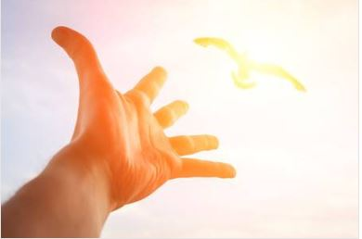
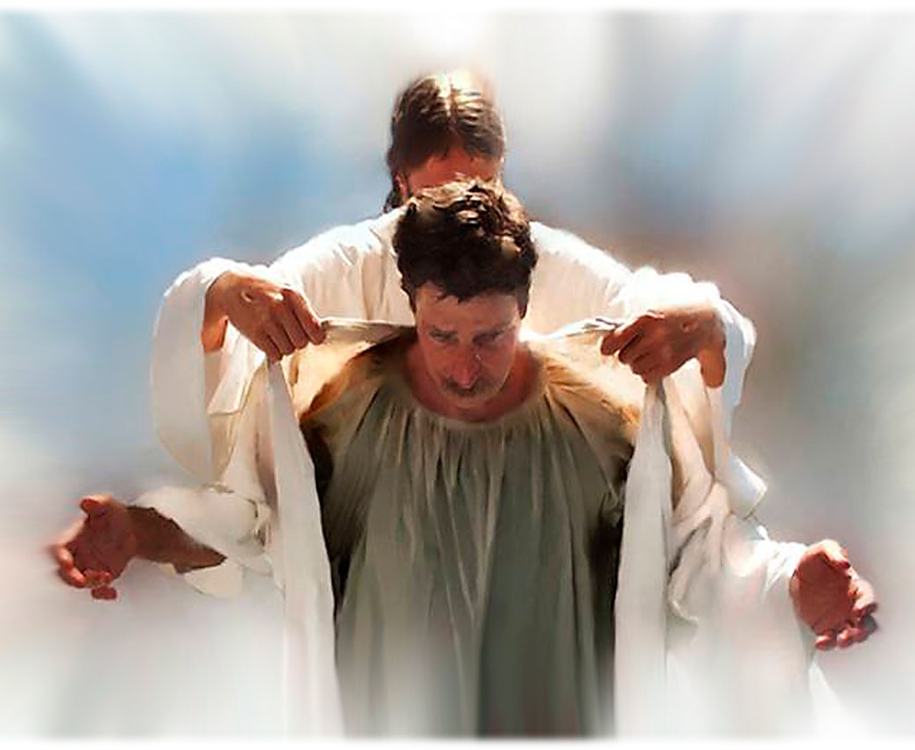
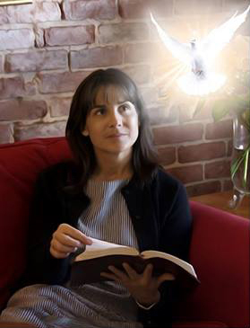
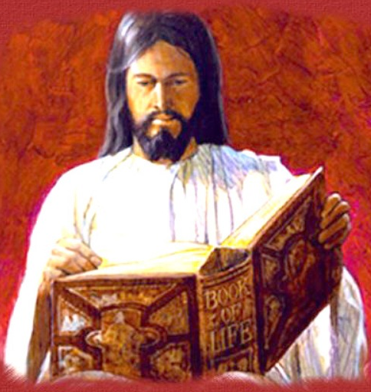
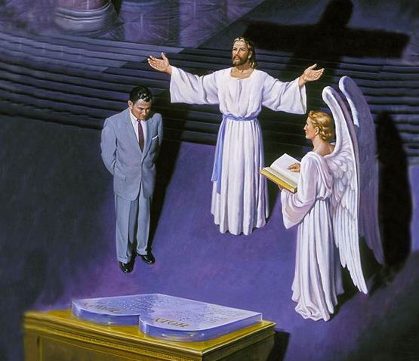
He begins by telling me that He keeps the leaders in His hand. He also tells me that He has the "seven spirits," that is, that He has the fullness of the Holy Spirit. Without a doubt, He knows that this is precisely my greatest need.
It doesn't paint a good picture of me. I have been leaving the Holy Spirit behind, and therefore my works are imperfect. Although I seem to be very active, I am almost dead spiritually.
That's why He asks me to stop. May I take time to remember what I was like when I let the Holy Spirit work in me. May I repent, and may I return to being a faithful steward of Jesus.
But some of my members are not like that. They are faithful, worthy. They are clothed with the righteousness of Christ. Jesus wants us all to be like them.
That is why He promises us that, if we overcome, we will be clothed with His righteousness.
He assures us that our names will continue to be written in the book of life.
When our names are examined at the Judgment, Jesus will declare, "He is worthy, I have given my blood for Him.”
Remember: you could be a member of the church in Sardis.

Slide 21
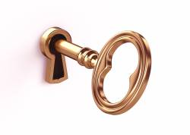
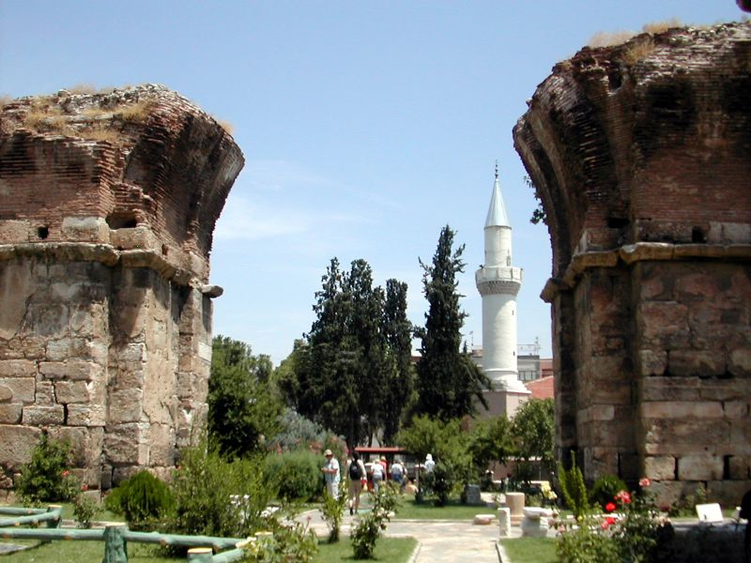
PHILADELPHIA
“BROTHERLY LOVE." Revival 1798 to 1844
8. Small but powerful group.
9-11. They suffered from the Christians because of the 2nd coming
Pergamos
Thyatira
Sardis
Smyrna
Philadelphia
Ephesus
Patmos
Revelation 3:7-13

Slide 22

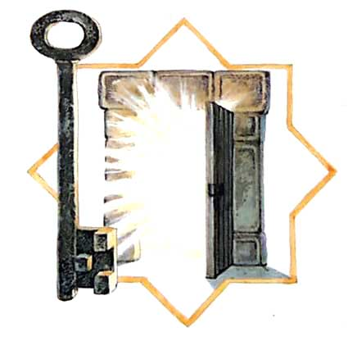
PHILADELPHIA
I am the angel of the church of Philadelphia. I have received a letter from Jesus that speaks of a key, doors and pillars. Strange, don't you think? We can read it in Revelation 3:7-13.
“And to the angel of the church in Philadelphia write; These things saith he that is holy, he that is true, he that hath the key of David, he that openeth, and no man shutteth; and shutteth, and no man openeth; I know thy works: behold, I have set before thee an open door, and no man can shut it: for thou hast a little strength, and hast kept my word, and hast not denied my name. Behold, I will make them of the synagogue of Satan, which say they are Jews, and are not, but do lie; behold, I will make them to come and worship before thy feet, and to know that I have loved thee. Because thou hast kept the word of my patience, I also will keep thee from the hour of temptation, which shall come upon all the world, to try them that dwell upon the earth. Behold, I come quickly: hold that fast which thou hast, that no man take thy crown. Him that overcometh will I make a pillar in the temple of my God, and he shall go no more out: and I will write upon him the name of my God, and the name of the city of my God, which is new Jerusalem, which cometh down out of heaven from my God: and I will write upon him my new name. He that hath an ear, let him hear what the Spirit saith unto the churches.”

Slide 23

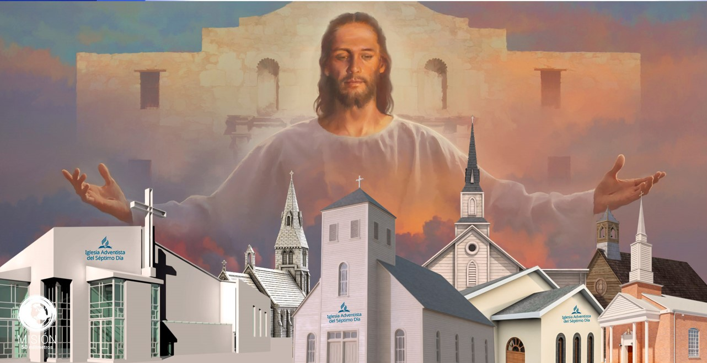
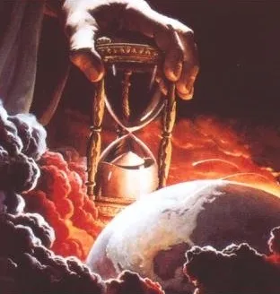
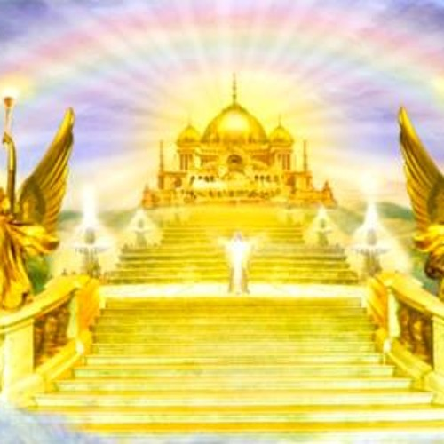
Let's start with the key. Jesus tells me that He has the key of David. That when He opens, no one can close, and vice versa. This is precisely what was said of Eliakim in Isaiah 22:22: "And the key of the house of David will I lay upon his shoulder; so he shall open, and none shall shut; and he shall shut, and none shall open.”
And who was Eliakim? He was the chief steward of King Hezekiah, a descendant of David. He had authority over everything that was done in the king's household. What he did, no one could undo. That same authority Jesus has over His church. No one can alter God's purpose for her.
God's purpose for the members of the church in Philadelphia is that they be sealed on their foreheads with the name of God and the Lamb.
In this letter, Jesus is warning me that a time of trial is coming for the whole world. Jesus is very near, and the final events are already very close to taking place.
Therefore, He encourages me and you to remain faithful so as not to lose our crown. The door of salvation is still open. Today is the day when we can freely enter it. Let's not wait for it to close, for the grace time to end.
Because, when Jesus closes the door of grace, no one will be able to open it.
And the pillar? What does the pillar have to do with all this?
In His farewell, Jesus promises that He will make us pillars of the temple. He is talking about the columns that held up the veil that separated the Holy Place from the Holy of Holies. It is the closest place to the presence of God.
Would you like to always live close to God? The one who overcomes will always be in the presence of God.
Remember: you could be a member of the church in Philadelphia.

Slide 24
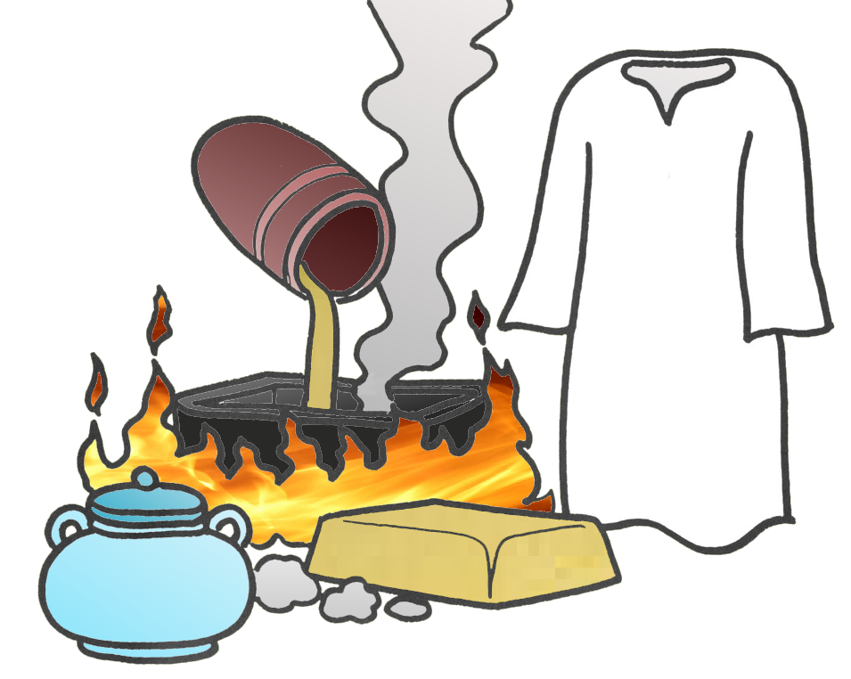
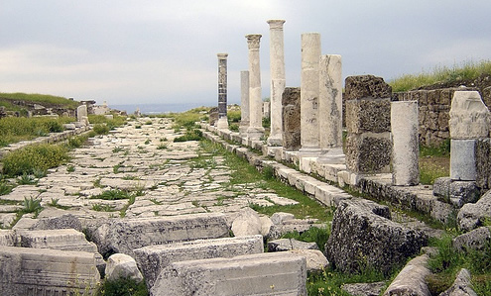
LAODICEA
“PEOPLE JUDGED" Adventism 1844 to the end
15-17. Spiritual arrogance.
18. Necessary: Spiritual Wealth, Vision, and Purity
19-20. Call to a personal relationship with Jesus
Pergamos
Thyatira
Sardis
Smyrna
Philadelphia
Ephesus
Laodicea
Patmos
Revelation 3:14-22

Slide 25

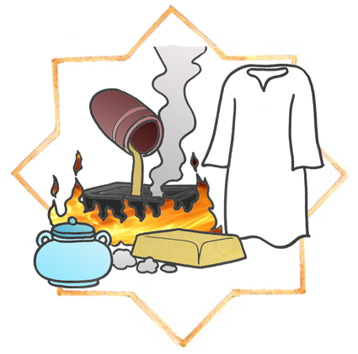
LAODICEA
I am the angel of the church of Laodicea. After reading the letters that Jesus addressed to the other angels, I ask myself a question: why does Jesus not have any praise for me? We can read the entire letter in Revelation 3:14-22.
“And unto the angel of the church of the Laodiceans write; These things saith the Amen, the faithful and true witness, the beginning of the creation of God; I know thy works, that thou art neither cold nor hot: I would thou wert cold or hot. So then because thou art lukewarm, and neither cold nor hot, I will spue thee out of my mouth. Because thou sayest, I am rich, and increased with goods, and have need of nothing; and knowest not that thou art wretched, and miserable, and poor, and blind, and naked: I counsel thee to buy of me gold tried in the fire, that thou mayest be rich; and white raiment, that thou mayest be clothed, and that the shame of thy nakedness do not appear; and anoint thine eyes with eyesalve, that thou mayest see. As many as I love, I rebuke and chasten: be zealous therefore, and repent. Behold, I stand at the door, and knock: if any man hear my voice, and open the door, I will come in to him, and will sup with him, and he with me. To him that overcometh will I grant to sit with me in my throne, even as I also overcame, and am set down with my Father in his throne. He that hath an ear, let him hear what the Spirit saith unto the churches..”

Slide 26




With how well I always do things, how can Jesus tell me that I am wretched, and miserable, and poor, and blind, and naked?
It's true that I'm not much of a missionary. But to throw up because of that? There should be more praise and less criticism. I say it's not that bad.
But, of course, He is the Amen, the Faithful Witness, the One who always tells the truth. Could it be that He is right? I'm going to read His advice.
He says to buy gold refined in fire, and white raiment, and to anoint my eyes with eye salve.
Will I be able to buy this with my money? I'm sure not. Isaiah 55:1 tells us, "You who have no money, come, buy, and eat. Come, buy without money and without price.”
I will have to go to Jesus so that he can sell me that faith, like gold, which is purified in the fire of trials; that he give me the white raiment of His justice; and that I anoint my eyes with the eye salve of the Holy Spirit so that I can see clearly my true condition.
I can already hear the knock of His hand on the door. He's waiting for my reply. Shall I open the door for Him? Will I let Him come in and dine with me?
And if it wasn't reward enough for Jesus to come into my heart, He has even more promises for me.
If I invite Him into my house, He will invite me into His, and to sit on His throne.
I am looking forward to the time described in 1 Thessalonians 4:17, when "we who are alive and remain will be caught up with them in the clouds to meet the Lord in the air, and so we shall ever be with the Lord.”
Remember: you could be a member of the Laodicean church.

Slide 27
Remember: you could be a member of any of these churches.
But don't be tempted to think about which church the person next to you will belong to.
This message is for you and only for you. Only you and Jesus know your true spiritual condition.
No matter what your condition is, you can rest assured that with Jesus' help and counsel, you can improve it every day.
1 Corinthians 9:24 tells us, "Know ye not that they which run in a race run all, but one receiveth the prize? So run, that ye may obtain.”
Paul invites us to live our Christian lives with one goal: to achieve victory.

Slide 28


Eat from the tree of life.
Not to be harmed by the second death.
To eat of the hidden manna.
Receive a white stone.
To receive a new name, a perfect character.
Reign with Jesus.
To live with Him.
To put on white raiment, that is, of the righteousness of Christ.
Our name will never be erased from the book of life.
Jesus will confess us before the Father and the angels.
We will be a pillar in the temple of God.
We will receive God's name, His own character.
We will sit with Jesus on His throne.
Unlike sports races, where only one takes the prize, in the Christian race all those who reach the finish line will receive their reward:
The effort is worth it.
Also, remember that you are not alone in this race. Jesus is the one who gives you strength: "My power is made perfect in weakness" (2 Corinthians 12:9.)
God is the one who makes you advance, grow and overcome. He gives us this promise: "The Lord will fulfill his purpose in me" (Psalm 138:8.)
Clinging to Jesus, our victory is assured. So let us go forward each day, "looking unto Jesus, the author and finisher of our faith" (Hebrews 12:2.)

