Slide 1
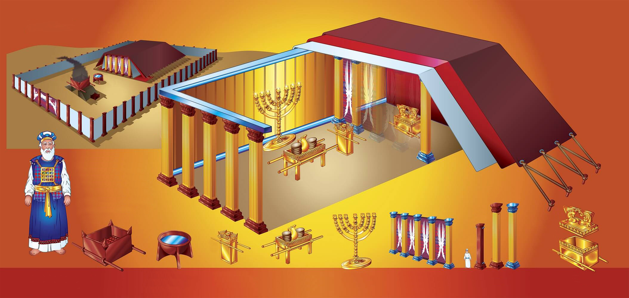

Slide 2

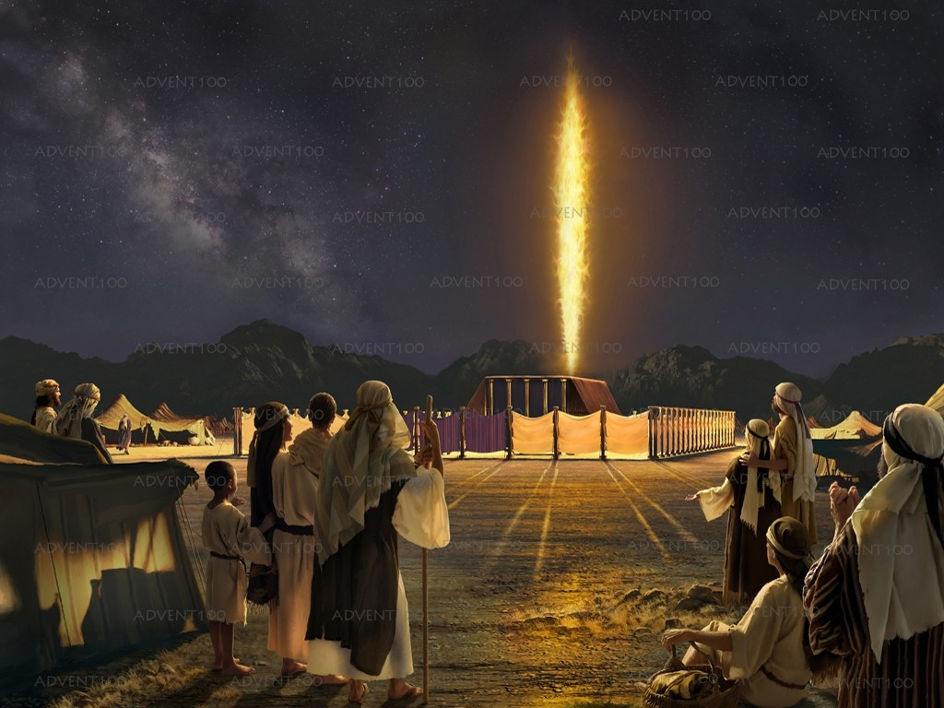
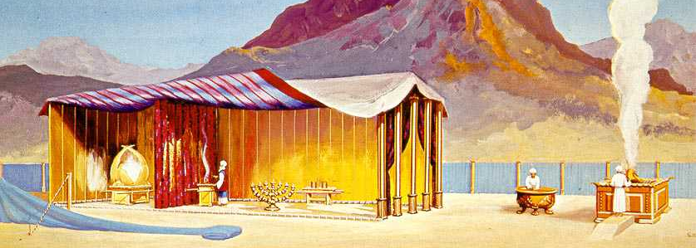
We know that God loves the sinner but hates sin. So, because he wanted to save the sinner, he developed a concrete plan and illustrated it through the Sanctuary and its services.
In addition to showing the plan of salvation, God wanted to use the sanctuary to dwell in the midst of His people, so that they would not forget Him.
He gave Moses exact instructions as to how the earthly sanctuary with all its objects and services was to be built.
“And let them make me a sanctuary; that I may dwell among them. According to all that I shew thee, after the pattern of the tabernacle, and the pattern of all the instruments thereof, even so shall ye make it. ” (Exodus 25:8-9)
These instructions are found in the book of Exodus, chapters 25 through 40.

Slide 3
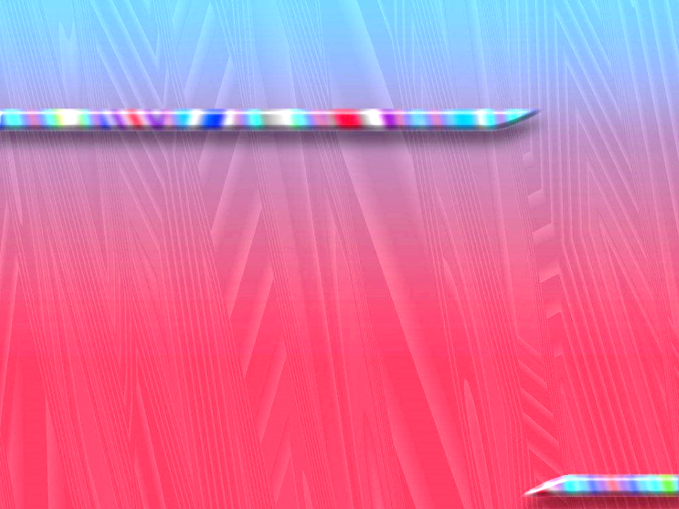
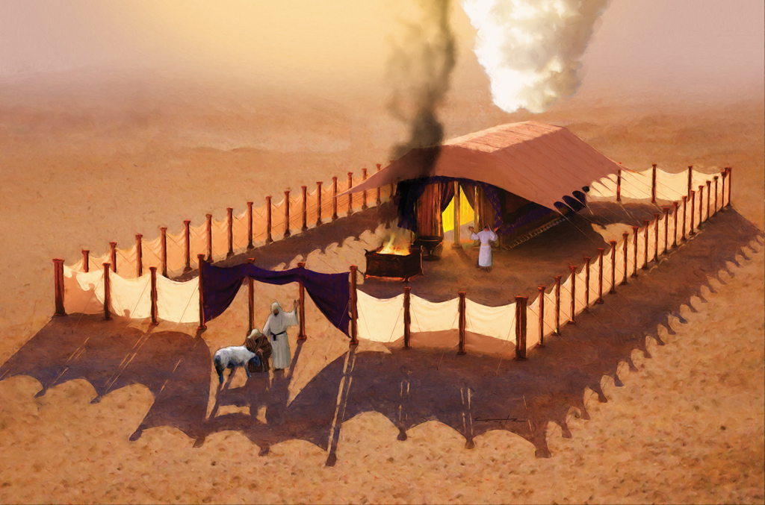
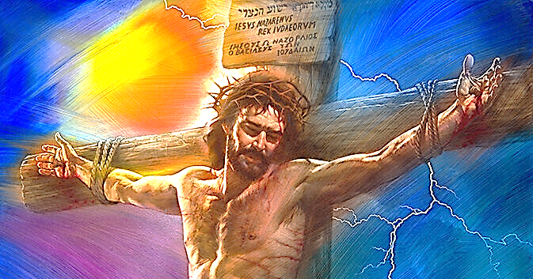
God became man and, through a beautiful system of transfer of sin and punishment, took upon himself the sin of the whole world, to provide every human being with the possibility of reconciliation.
Since the wages of sin is death, forgiveness could only be achieved through the shedding of the blood of an innocent being (Romans 6:23); but not of any innocent being.
Only the author of the Ten Commandments, who also lived according to His commands, could be the substitute to die and forgive those who disobey God's commandments! In this way we understand that the main theme of all the Holy Scriptures from beginning to end is the wonderful forgiveness of sins, and reconciliation with the Creator.

Slide 4

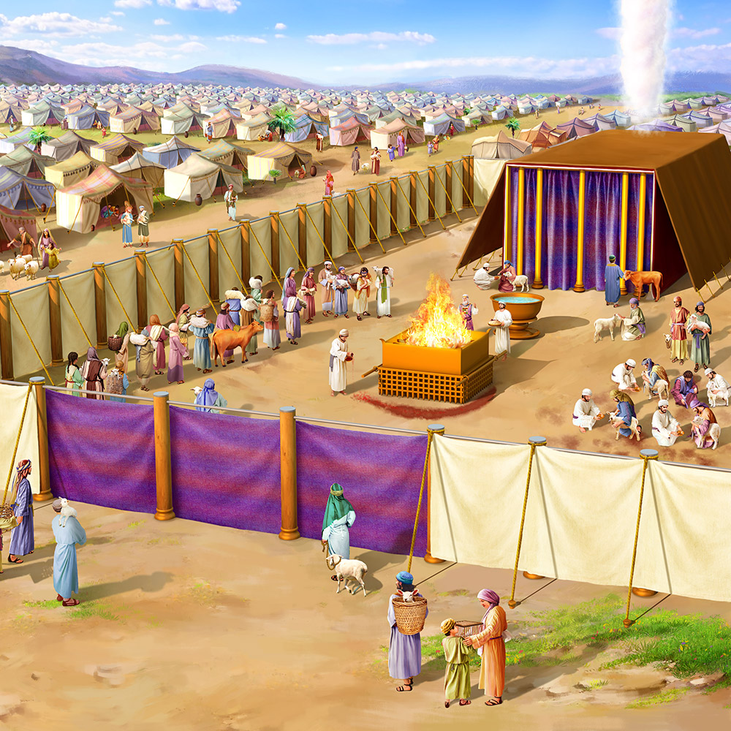

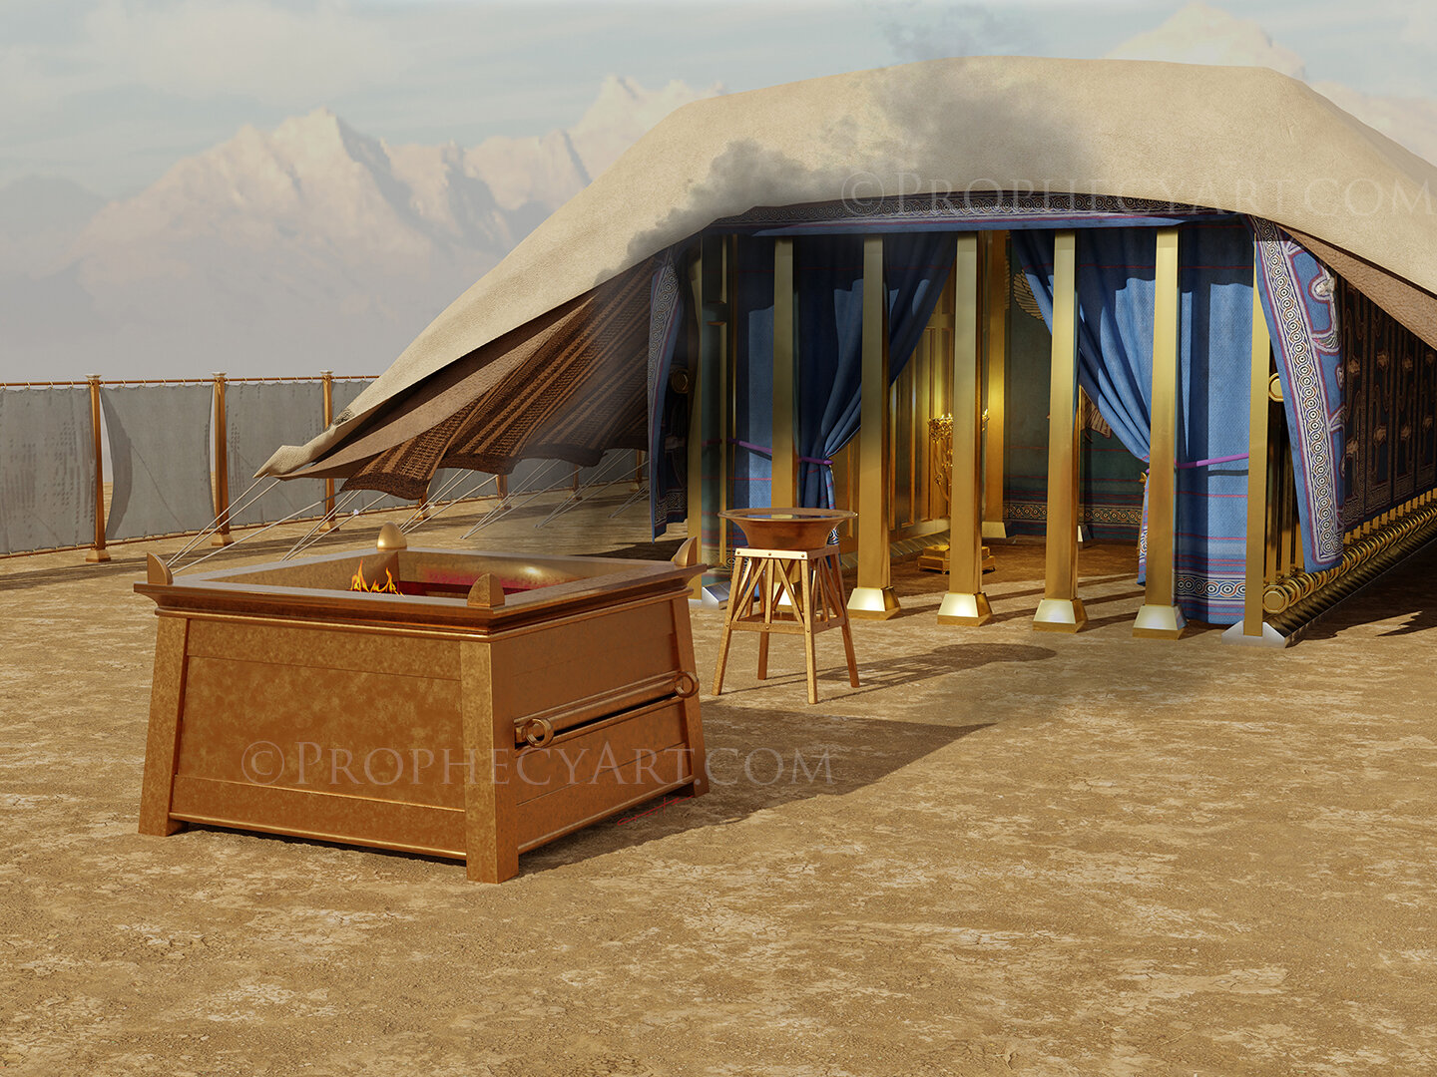
THE OUTER COURT
The Outer Court was a rectangular space 145.83 ft long by 72.93 ft wide surrounded by curtains of twisted linen 7.38 ft high, supported by 60 columns seated on bronze bases, with silver capitals, and joined at the top by silver crossbars. The entrance was on the eastern side, covered with a curtain of blue, purple, scarlet, and white linen, excellently adorned and supported by four columns. It was the only possible entrance to the tabernacle. The outer court was freely accessible to all Israelites.
Everyone has access to salvation.
When you want to know more about God, you are entering through the door of the court.
There was only one door because there is only one way to approach God correctly: Jesus.
“I am the door: by me if any man enter in, he shall be saved, and shall go in and out, and find pasture. ” (John 10: 9)
In the Outer Court there were two objects: the altar of burnt offerings and the laver of bronze.

Slide 5
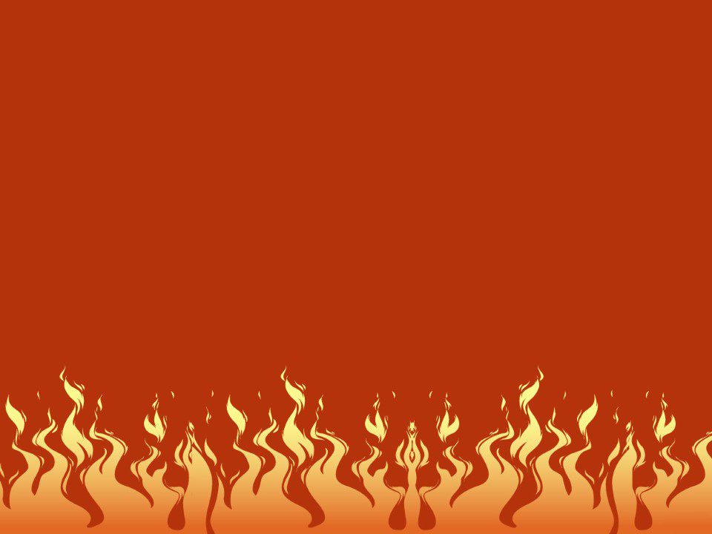
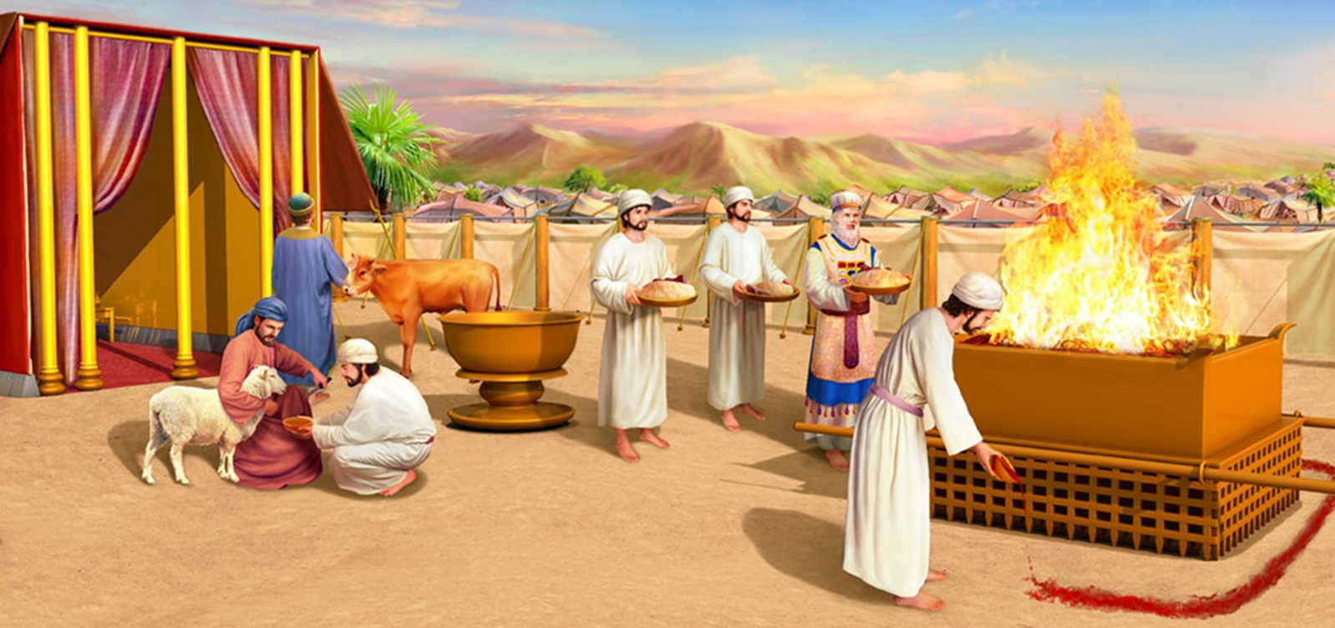
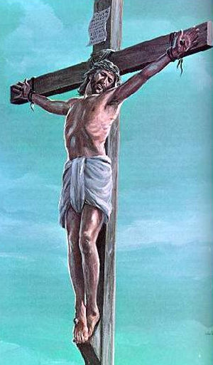
ALTAR OF BURNT OFFERINGS
It was the place where the sacrifices of pure animals (sheep, rams, etc.) were performed, after confession of sin, the animal died in the place of the repentant sinner (Ex. 27: 1-8).
It was a hollow, square altar made of acacia wood boards measuring 7,28 ft on a side by 4,36 ft high, covered with bronze.
In each upper corner it had a horn, on which the blood of the sin offerings was sprinkled. The excess blood was spilled at the foot of the altar.
Halfway up there was a bronze trellis on which the victims were placed.
Our first need is for our sins to be forgiven. This is only possible through Christ's sacrifice on the cross.
Jesus accepts every sinner who comes to Him, no matter what they have done. For his blood shed on Calvary, he offers him forgiveness and enables him to live a new life in her company.
The altar of burnt offerings represents the acceptance of the sacrifice of the cross and Jesus as our personal Savior.

Slide 6

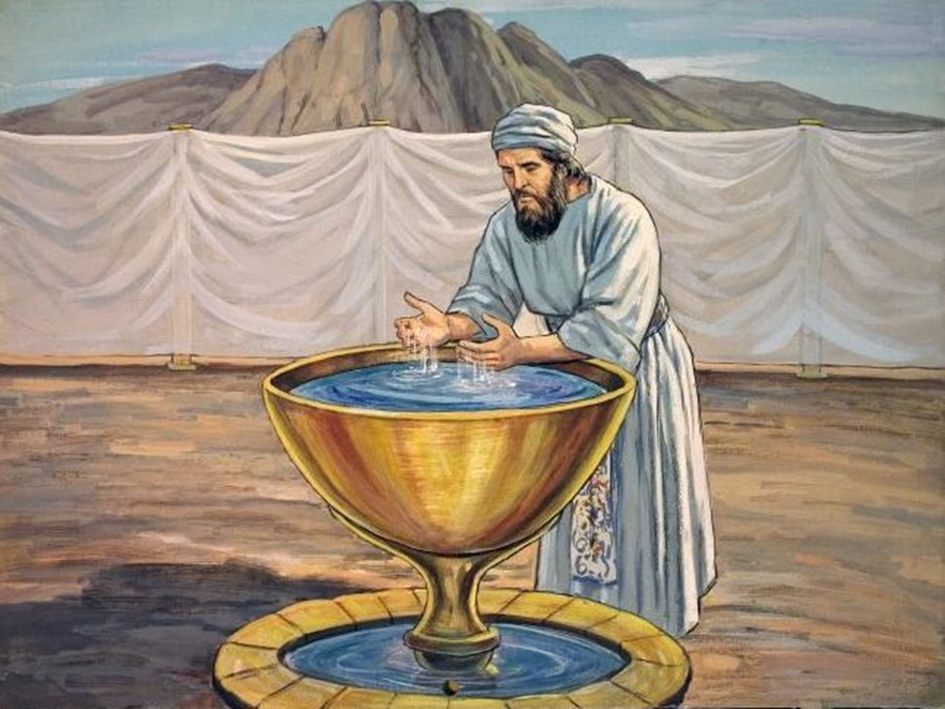
LAVER OF BRONZE
Nothing is said about the shape or size of this laver. It was placed on a bronze base in the outer court of the tabernacle, between the entrance of the tabernacle and the altar of burnt offerings. It was built with the mirrors that the women offered.
In this fountain the priest washed his hands and feet before entering the Holy Place to mediate between the people and God. This was because God asked for holiness and purity from those who mediated between Him and his people (Exod. 30:18-21).
The ceremonies that symbolize the washing of the believer today are baptism and the washing of the feet in Holy Communion (Rom. 6:4; John 13:14-15).
Just as the priest could not enter the Holy Place without first having been washed, so the believer cannot enter fully into the path of sanctification and service to God without first having washed away his sins in the blood of Christ, making a public profession of his faith through baptism. We renew this commitment every time we partake of the rite of the sacrament.
The moment we are baptized, we die to the old man and are born into new life, becoming priests to God
(2 Corinthians 5:17; 1 Peter 2:9).

Slide 7

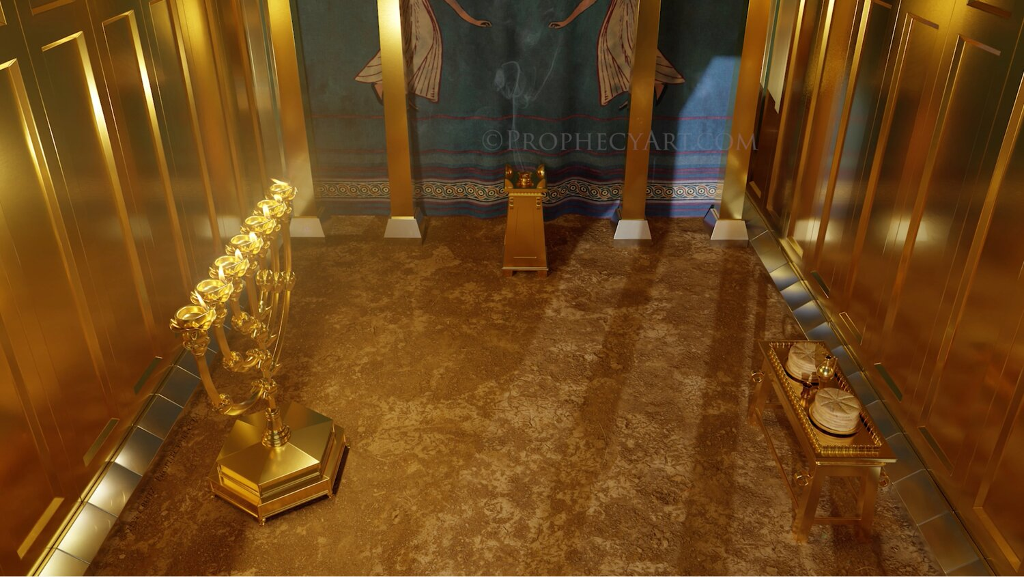
THE HOLY PLACE
The Tabernacle was a building that consisted of two spaces: the Holy Place and the Holy of Holies. The first, the Holy Place, was 29.52 ft long by 14.76 ft wide.
Its two sides were made of acacia wood boards covered with gold. The entrance and back were closed by veils made of bleached linen, blue, purple, and scarlet, with exquisitely embroidered cherubims. In the Holy Place there were three pieces of furniture: a lampstand, a table, and an altar.
Just as the outer court symbolizes the believer's justification, the Holy Place symbolizes the life of sanctification. We enter the Holy Place to begin this process of sanctification, and to carry out our work of intercession before the world. What we receive from God we impart to others.
We can understand what sanctification means by studying each of the furnishings contained in the Holy Place.

Slide 8

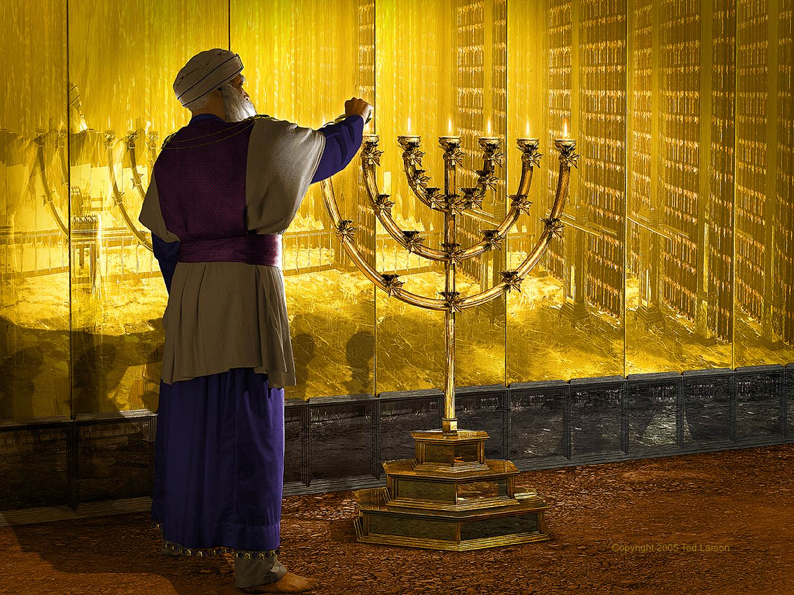
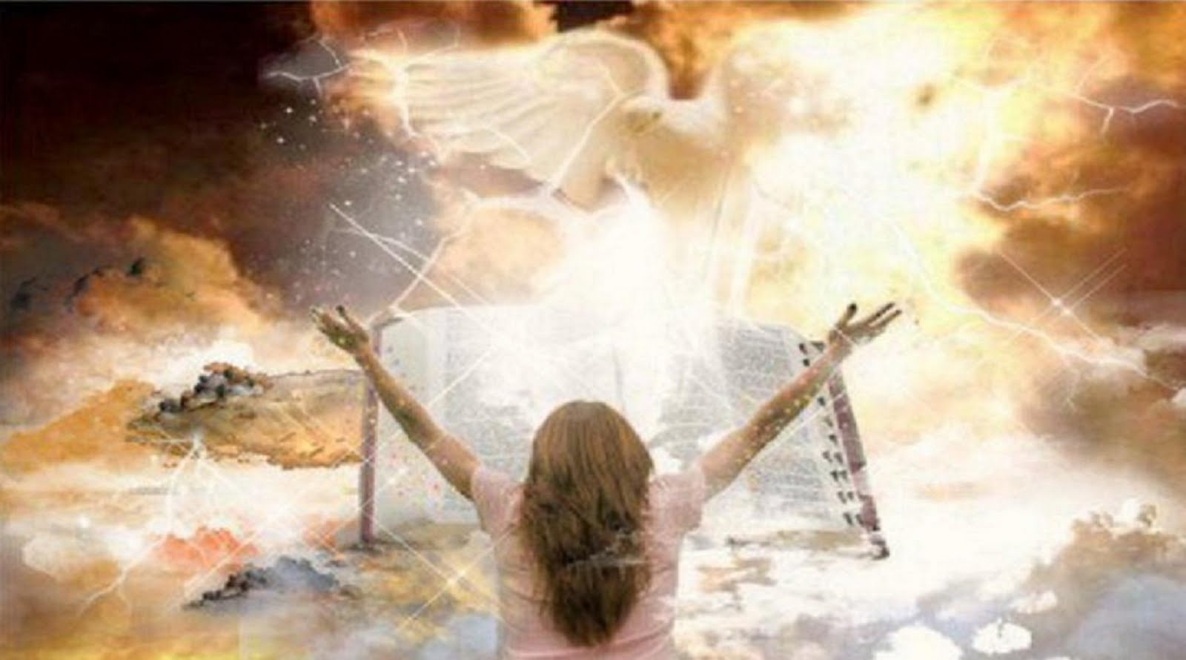
THE LAMPSTAND
It was made of a piece of pure gold, weighing 75.38 lbs, hammered with a central cane and three arms on each side.
Both the central cane and each of the arms had a lamp full of oil at the top that had to shine continuously forward. During the night, some of the lamps could be turned off, but never all seven at a time. It was the only source of light in the Holy Place (Exod. 37:17-23).
By communing with Jesus, who is the light of the world, He imparts to us "every good gift and every perfect gift" (James 1:17).
The candlestick also represents that we are the moral and spiritual light of the world (Matt. 5:14-16).
Olive oil is a symbol of the Holy Spirit, the source and means of spiritual illumination (Zech. 4:2-6; Acts 2:1-4). We must allow ourselves to be filled by the Holy Spirit. We must ask for it insistently so that, thanks to Him, we can share the Gospel with others, thus being the light of the world.
The psalmist reminds us that we also have a light available to our lives: God's Word, the Bible (Ps. 119:105).

Slide 9


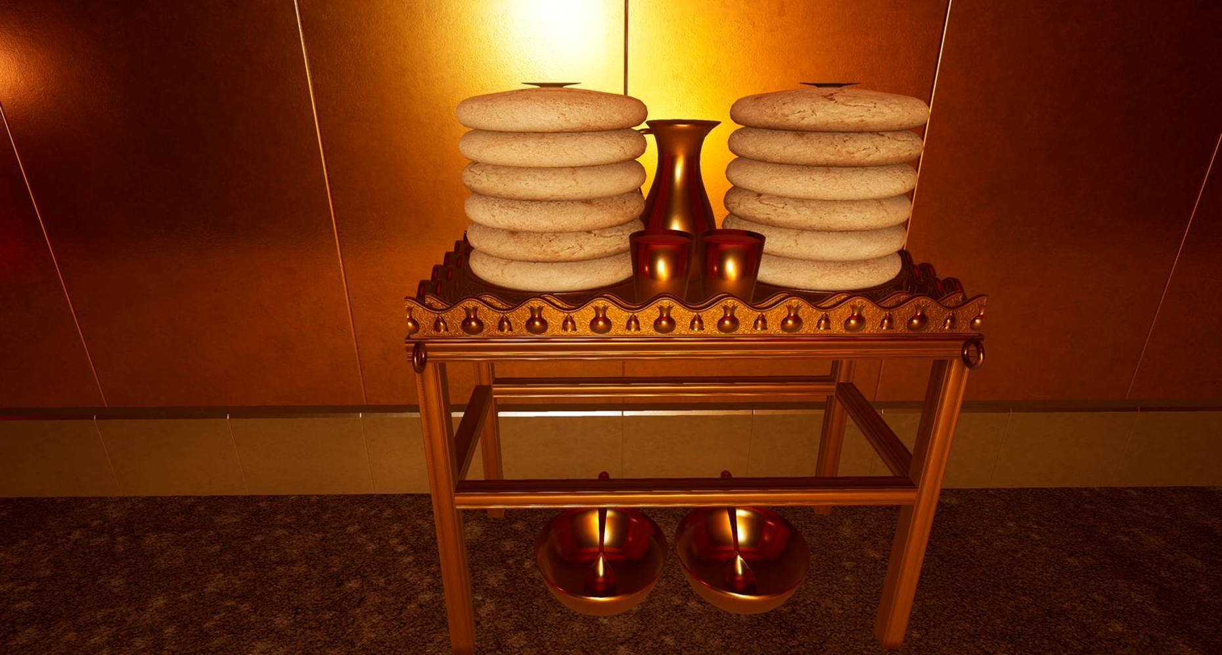
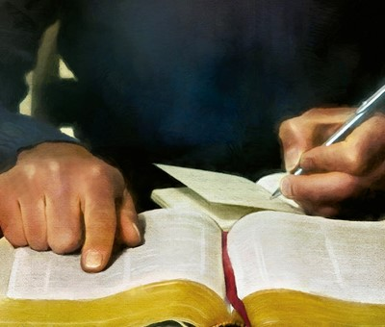
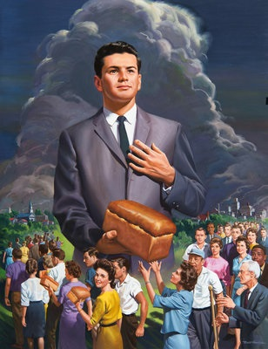
THE TABLE OF SHOWBREAD
To the right of the Holy Place, on the north side, we find a table measuring 2.96 ft long by 1.48 ft wide and 2.20 ft high.
It was made of acacia wood covered with gold, with four rings at its corners so that the poles could pass through them when they had to be transported.
It also had a cornice around it to prevent the utensils that were placed on it from falling.
Every Sabbath twelve loaves, called showbread, were placed in two rows, one for each tribe of Israel. The loaves withdrawn from the previous week were to be consumed by the attending priests (Ex. 25:23-30; Lev. 24:5-9).
This table reminds us of our dependence on God, both for our temporal and spiritual food. Only by learning from Jesus and His Word can we grow spiritually (Matt. 4:4).
As priests of God, we are responsible to feed on Christ so that we can spiritually feed the world, teaching them about Jesus and His Word.

Slide 10


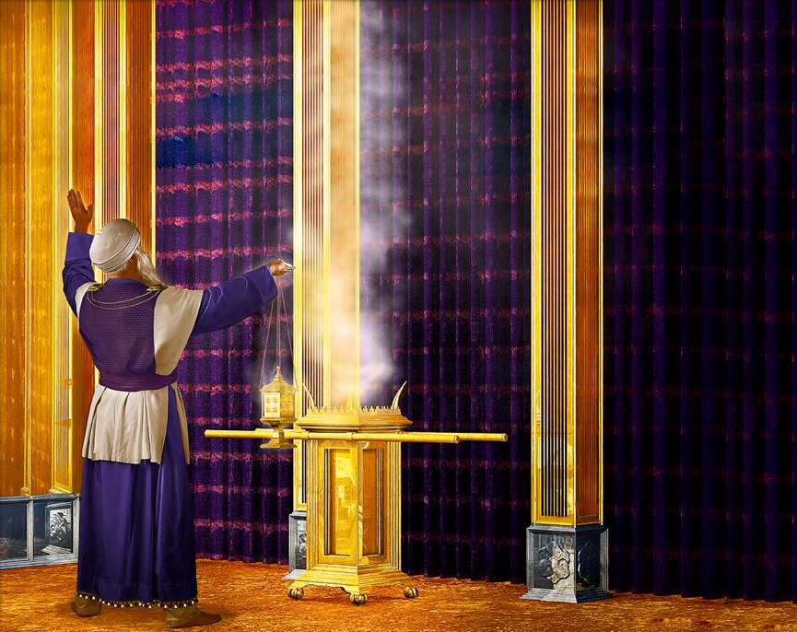
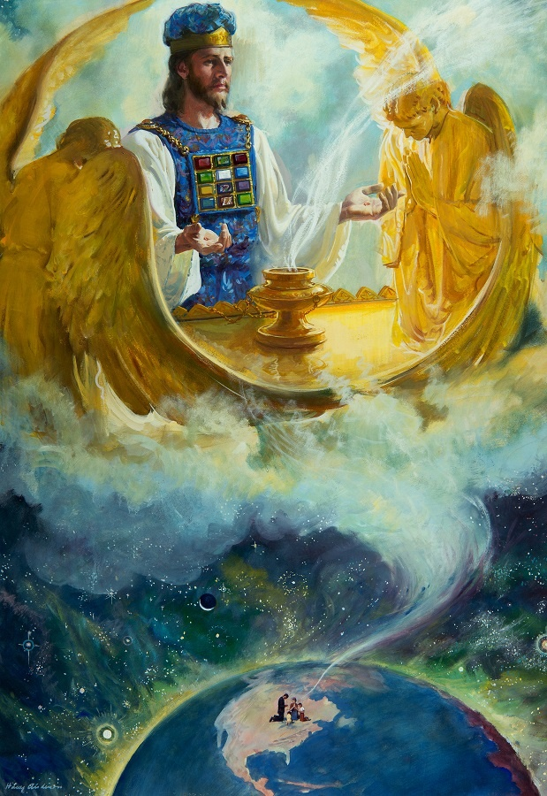
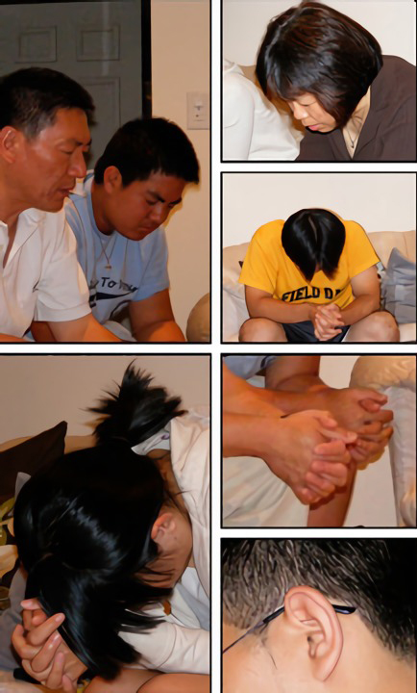
THE ALTAR OF INCENSE
A small square altar made of acacia wood covered with gold measuring only 1.46 ft on a side by 2.92 ft high. On its top it had four horns at each corner, and a cornice around it.
Every morning and evening, in the center of the altar, incense was offered, while the continuous sacrifice was offered, and the lamps of the lampstand were arranged.
It was a scent or perfume pleasing to God that rose into His heavenly presence. Smoke ascended over the veil and into the Holy of Holies (Exod. 30:34-38).
Incense symbolizes the prayers that ascend from the altar of the heart to God (Ps. 141:2). Prayer must spring from a loyal, honest, and resolute heart. The Holy Spirit transforms and elevates our prayers to the throne of God, where Jesus presents them before the Father as our intercessor (Rom. 8:26;
Heb. 7:25).
As priests, our prayers should also be raised on behalf of others (1 Tim. 2:1).

Slide 11
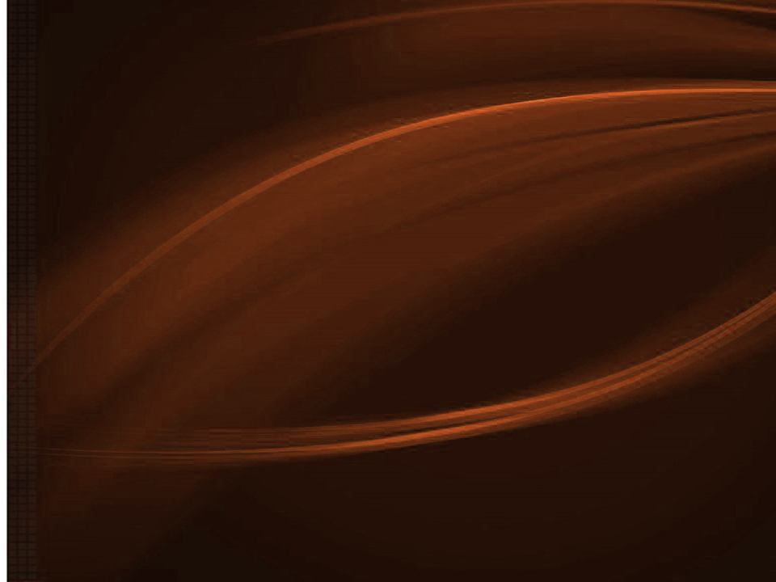

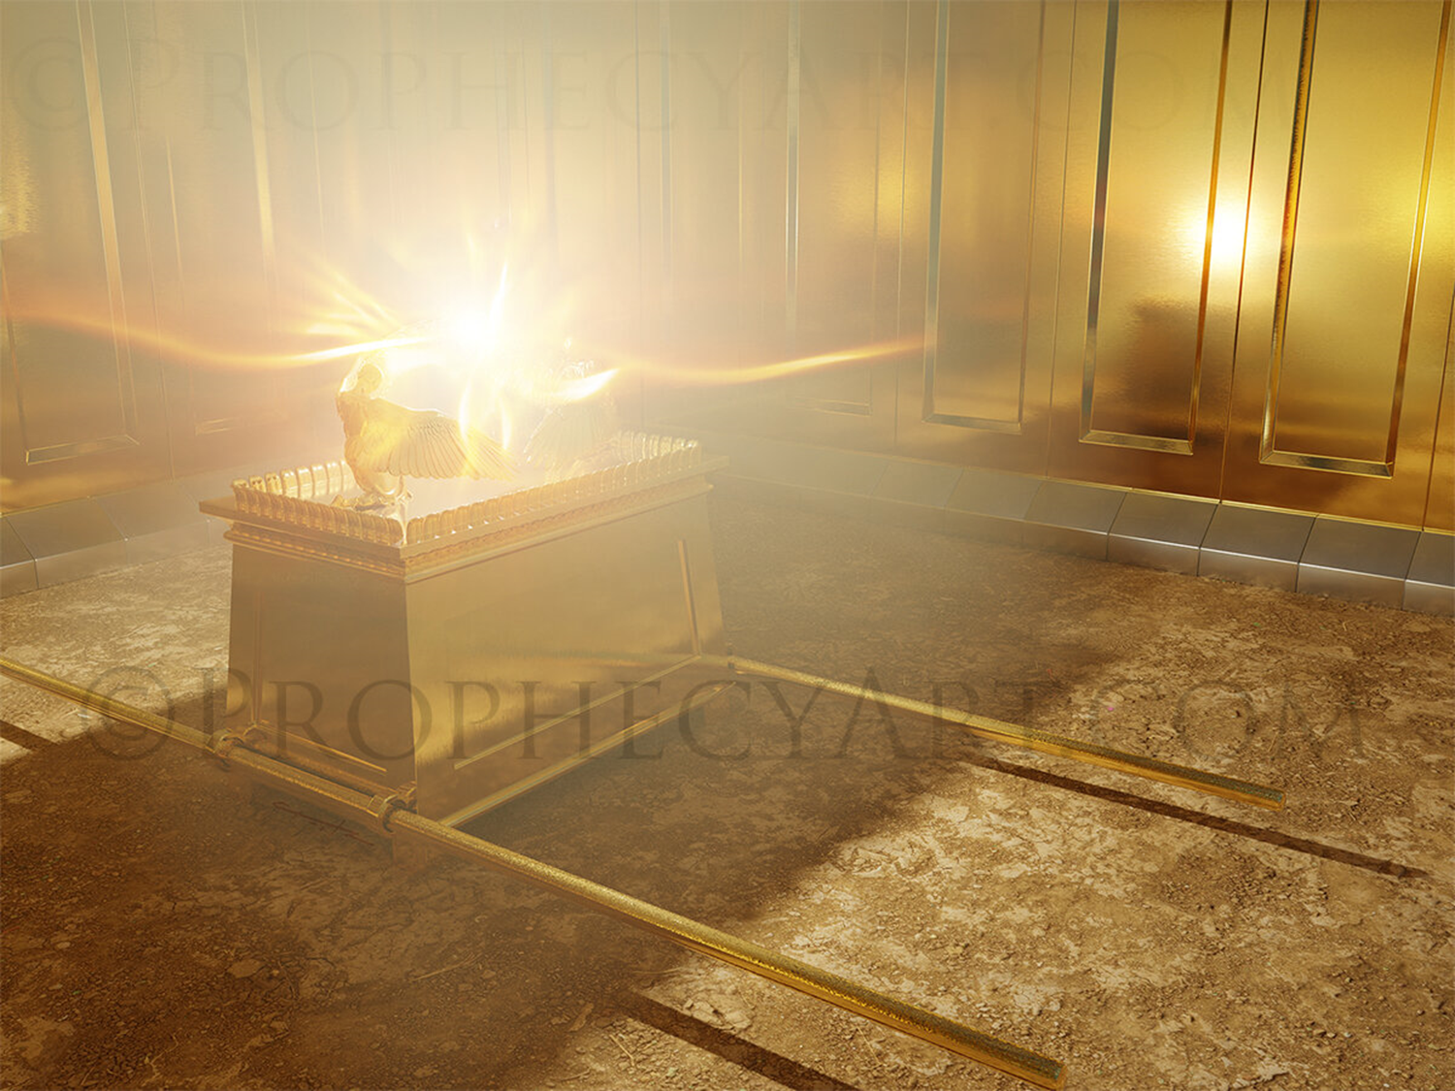
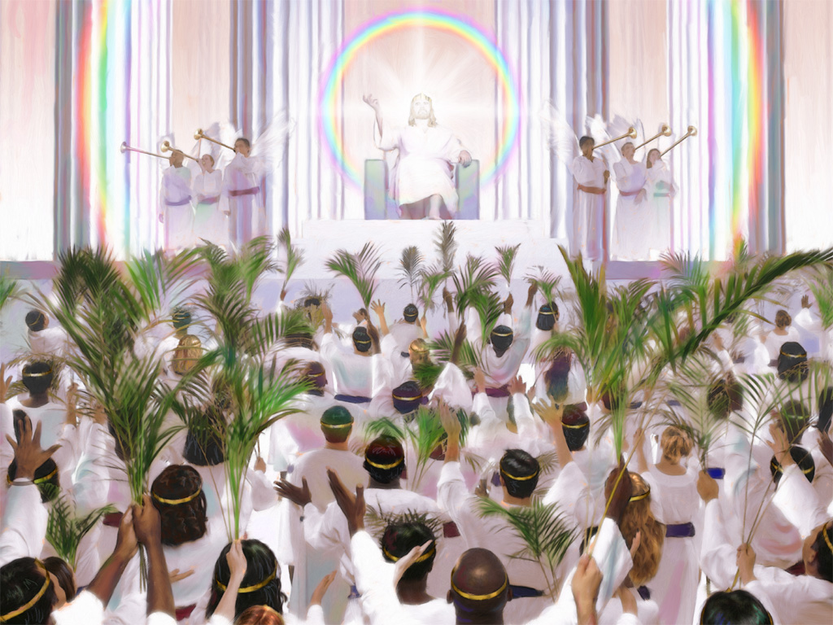
THE HOLY OF HOLIES
The last part of the Tabernacle, called the Holy of Holies, was a perfect cube, 14.60 ft on a side.
A thick veil separated it from the Holy Place. This veil was of the same material and workmanship as that of the entrance to the Tabernacle and was cleansed every year. The veil did not reach to the ceiling, but allowed the glory of God, manifested on the mercy seat of the ark, to be partially visible from the Holy Place.
The High Priest was only allowed to enter once a year, during the feast of the Day of Atonement.
In this space there was a single object: The Ark of the Covenant.
If the outer court symbolizes the justification of the believer, and the Holy Place symbolizes the life of sanctification, the Holy of Holies symbolizes glorification, when we ascend with Jesus to Heaven and stand before the throne of God.

Slide 12
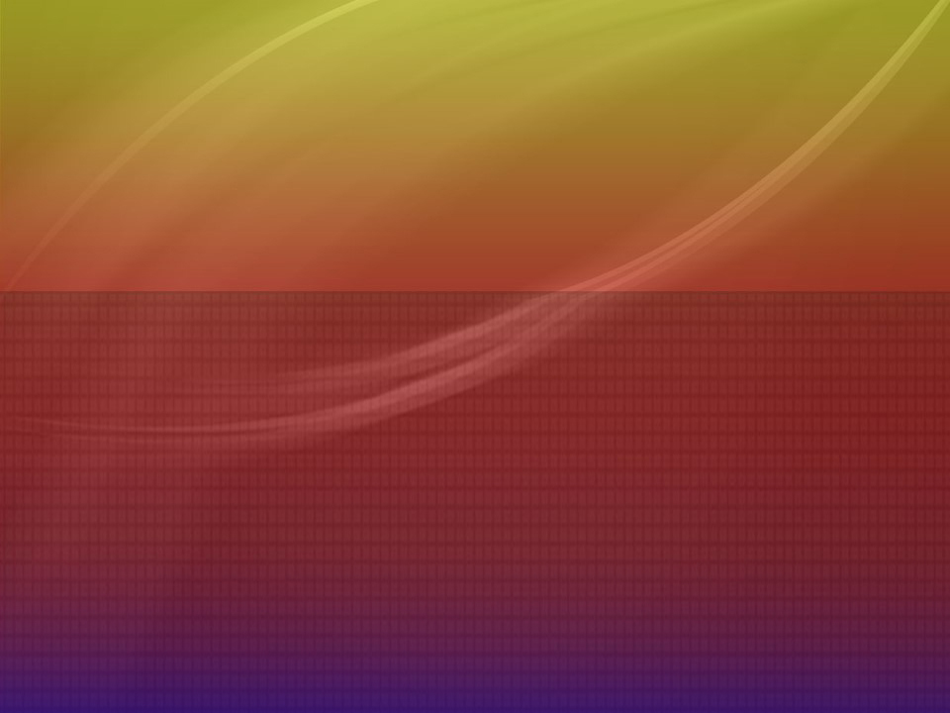

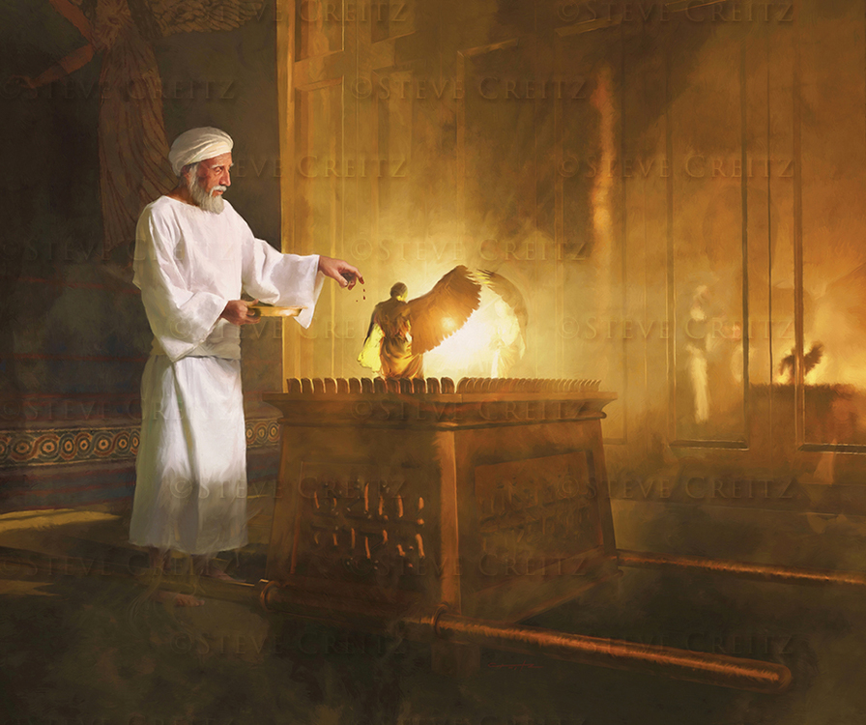
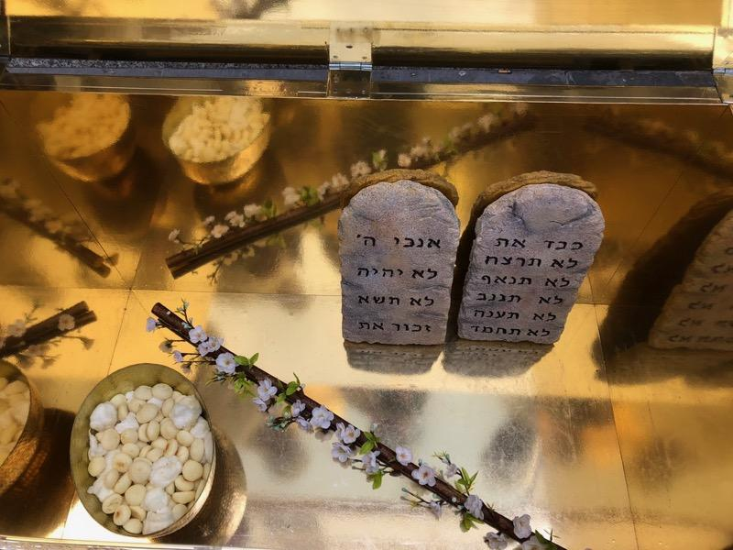
THE ARK OF THE COVENANT
It was an ark of acacia wood covered with gold, open at the top, 3.64 ft long and 2,20 ft wide and high. At the bottom it had a gold ring at each corner, where two rods passed to carry it. These rods were never removed.
Inside were the tablets of the law, Aaron's rod that bloomed, and a vessel of manna.
Its lid, called the mercy seat, was of pure gold, as were the two cherubim that were on it. In the midst of the cherubim was displayed the glory of God or Shekinah (Ex. 25:10-22).
The ark represents the throne of God, where He manifests Himself, and where justice (the Law) and mercy (the mercy-seat) are united. The mercy-seat represents Jesus who is "the propitiation for our sins" (1 John 2:1-2). He places himself between the perfect Law and God, so that, before the Father, our sinful life is replaced by the perfect life of Jesus.
Therefore, we, like the tax collector, must turn to Jesus begging him: "Be merciful to me, a sinner”.
Just as the feast of the Day of Atonement (when the high priest entered before the ark) symbolizes, we are judged and declared righteous because of Jesus. In this way, when the judgment is over and He returns, we can stand before God free from sin, and we can stand in His presence for eternity.

Slide 13
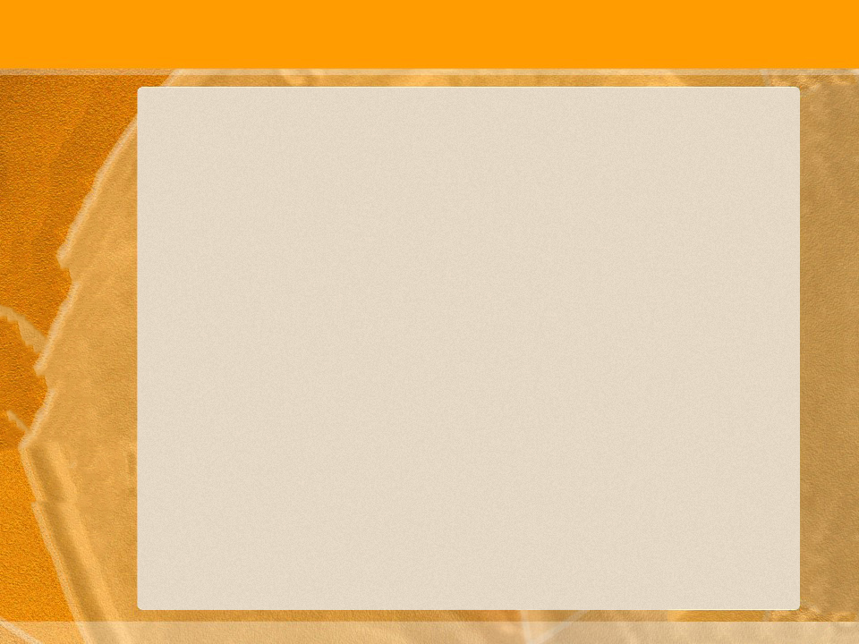
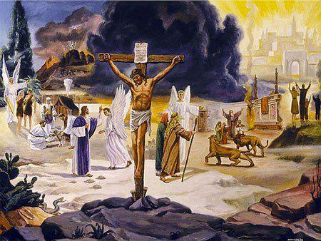
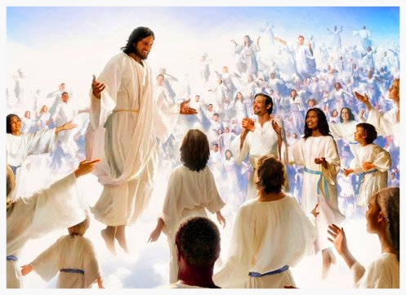
In the tabernacle service, the people were daily taught the great truths concerning the death and ministry of Christ, and once a year their thoughts were drawn to the final events of the great controversy between Christ and Satan, and to the final purification of the universe, which will cleanse them from sin and sinners.
We invite you to continue studying the Sanctuary to learn more about redemption because: “The science of redemption is the science of all sciences; the science that is the study of the angels and of all the intelligences of the unfallen worlds; the science that engages the attention of our Lord and Savior; the science that enters into the purpose brooded in the mind of the Infinite...; the science that will be the study of God's redeemed throughout endless ages.— EGW (Education, 126. TA 298)
“To Christ belongs the glory of redemption for the fallen race. Through the eternal ages, the song of the ransomed ones will be: “Unto Him that loved us and washed us from our sins in His own blood, ... to Him be glory and dominion for ever and ever.” EGW (Revelation 1:5, 6. GC 416)

