Slide 1

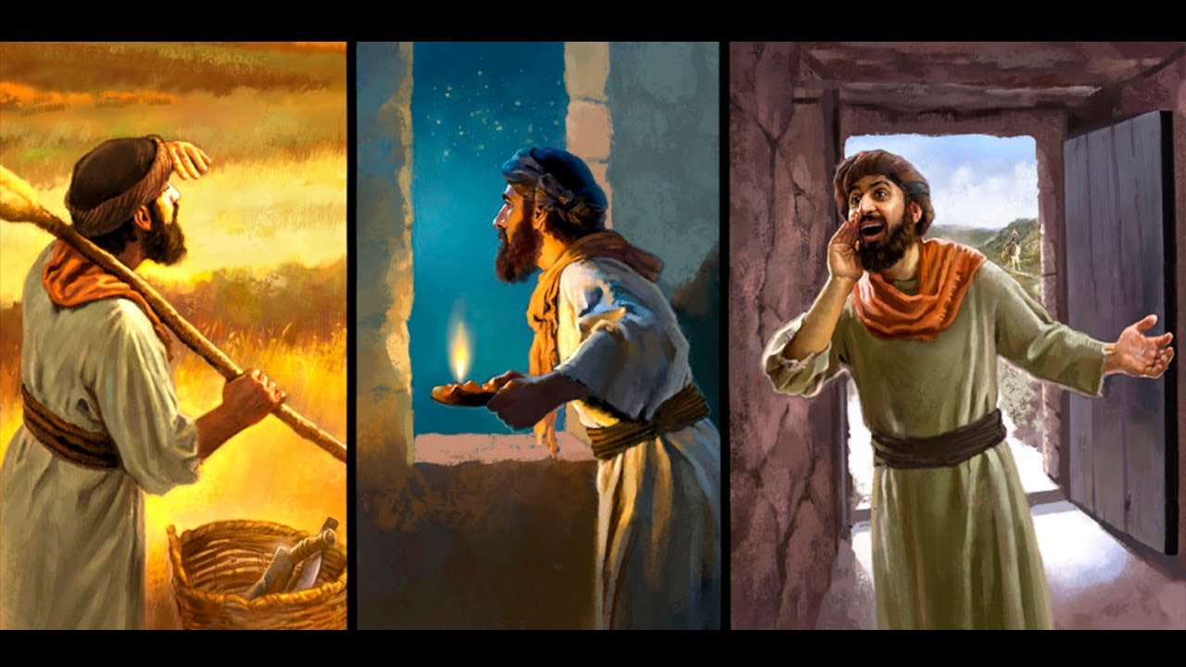

Slide 2

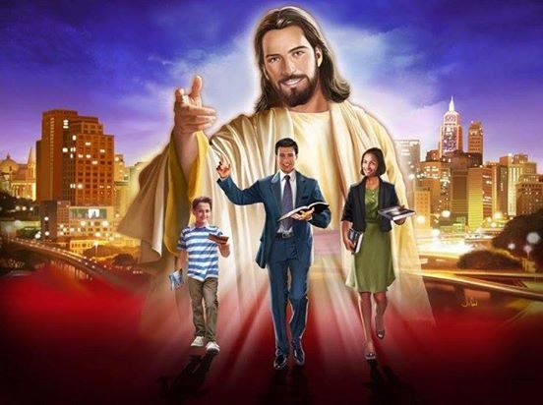

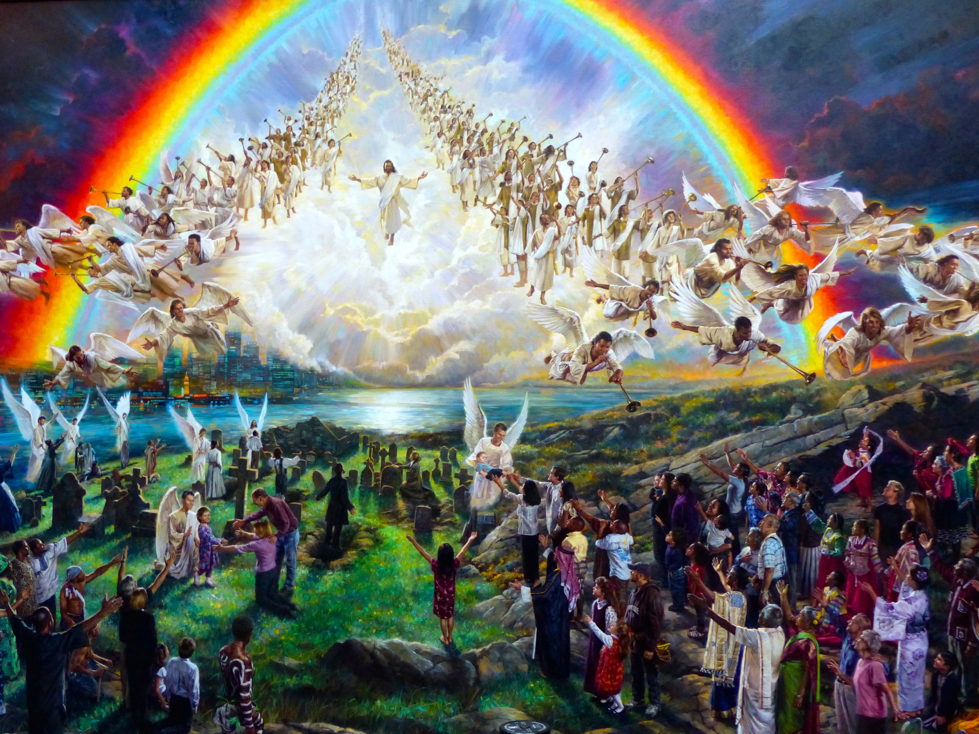
We Christians have a great mission of great responsibility in this world. Our mission is to be sentinels who bring this message of urgency to the world:
We are responsible for sounding this alarm message. This world will not last much longer. The danger is imminent. We have also been entrusted with watching. We cannot fall asleep at our guard posts because this can be devastating, as Satan is like a roaring lion looking for someone to devour. We are in charge of alerting the world to the danger so that it can prepare and face it properly.

Slide 3



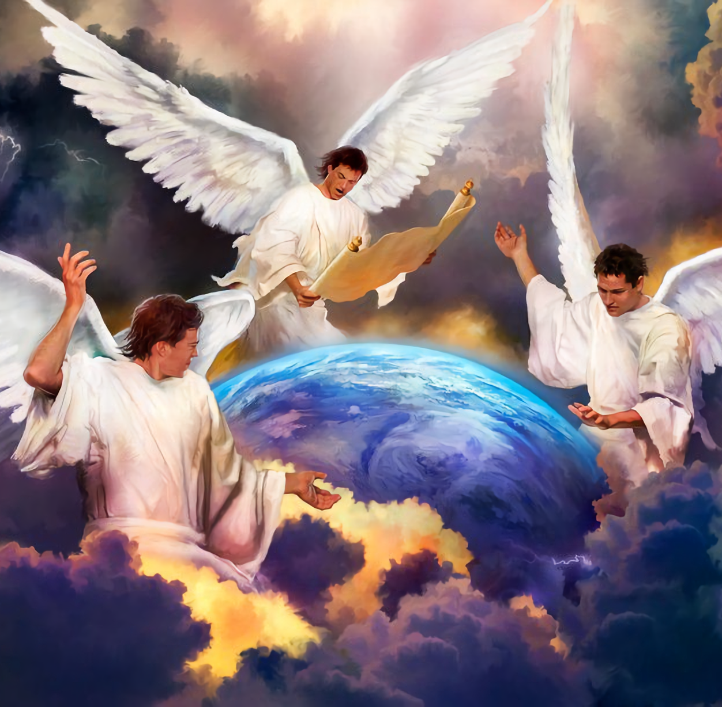
Sentinels
That
Proclaim
All Christians are called to be sentinels who give a message of urgency to this world. Let us proclaim the truth so that the enemy cannot deceive the world and overcome us. We are not ordinary sentinels, we are "sentinels of the Master", and we carry a message of salvation.
“And I saw another angel fly in the midst of heaven, having the everlasting gospel to preach unto them that dwell on the earth, and to every nation, and kindred, and tongue, and people, Saying with a loud voice, Fear God, and give glory to him; for the hour of his judgment is come: and worship him that made heaven, and earth, and the sea, and the fountains of waters. And there followed another angel, saying, Babylon is fallen, is fallen, that great city, because she made all nations drink of the wine of the wrath of her fornication. And the third angel followed them, saying with a loud voice, If any man worship the beast and his image, and receive his mark in his forehead, or in his hand, The same shall drink of the wine of the wrath of God, which is poured out without mixture into the cup of his indignation; and he shall be tormented with fire and brimstone in the presence of the holy angels, and in the presence of the Lamb: And the smoke of their torment ascendeth up for ever and ever: and they have no rest day nor night, who worship the beast and his image, and whosoever receiveth the mark of his name. Here is the patience of the saints: here are they that keep the commandments of God, and the faith of Jesus. (Revelation 14:6-12)”

Slide 4


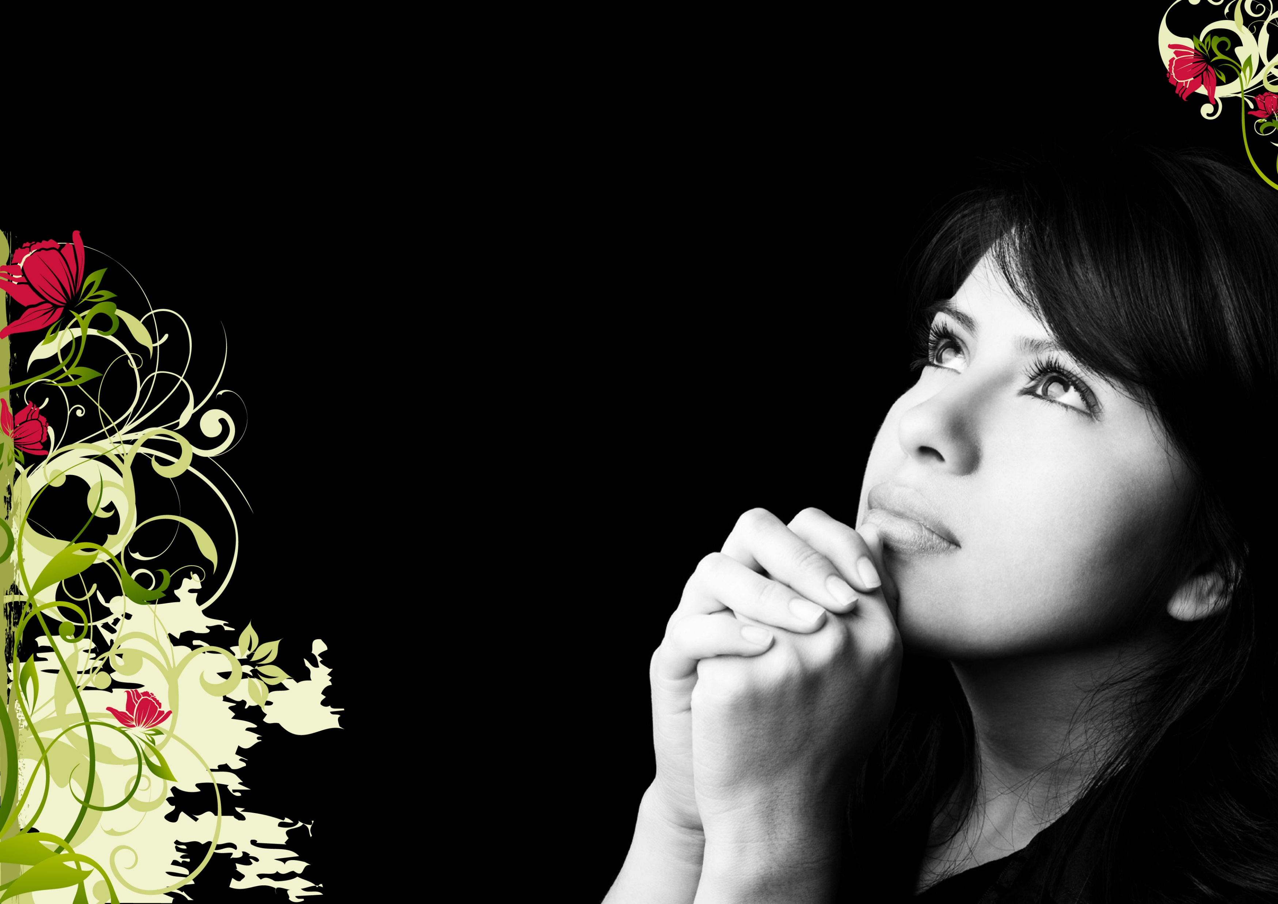
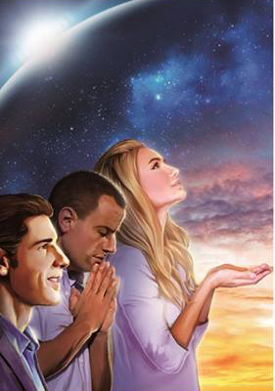

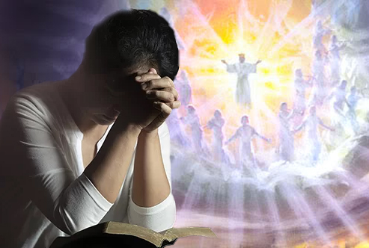
We must be sentinels who keep watch during the night. This night of sin will soon be over; but in the meantime we must be watching and praying not to let evil in. Our light must always shine, lighting the place where we are so as not to allow Satan to enter. We can never let go of our guard, we must always be vigilant, watchful, and praying. Let us pray at least three times a day so that we do not enter into temptation.
Watchmen Who
Watch
“Watch and pray, that ye enter not into temptation: the spirit indeed is willing, but the flesh is weak” Matthew 26:41)
“Be sober, be vigilant; because your adversary the devil, as a roaring lion, walketh about, seeking whom he may devour” (1 Peter 5:8)
“Watch therefore, for ye know neither the day nor the hour wherein the Son of man cometh” (Matthew 25:13)
“Watch ye therefore, and pray always, that ye may be accounted worthy to escape all these things that shall come to pass, and to stand before the Son of man” (Luke 21:36)
“But the end of all things is at hand: be ye therefore sober, and watch unto prayer” (1 Peter 4:7)

Slide 5


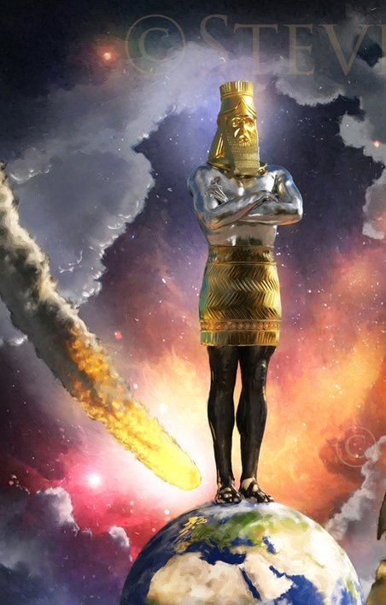

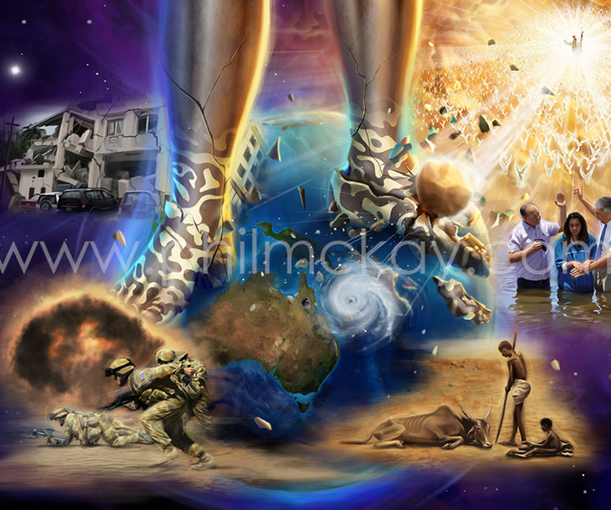
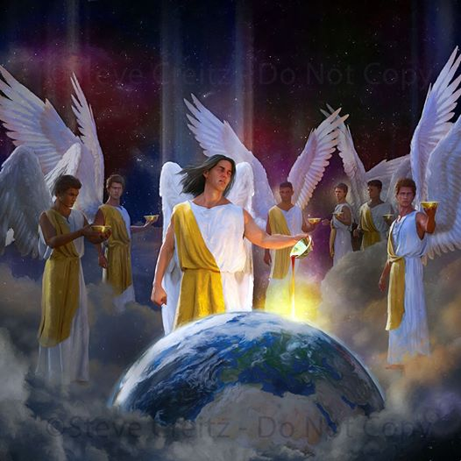
As sentinels we must always be on guard, looking beyond what our finite eyes can see.
The best way is by using the binoculars of the prophecies that allow us to see beyond what our eyes can see, and alert us to things that are going to happen in this world. In this way we will be prepared against the snares of the enemy.
Sentinels
Always
On Guard
“We have also a more sure word of prophecy; whereunto ye do well that ye take heed, as unto a light that shineth in a dark place, until the day dawn, and the day star arise in your hearts” (2 Peter 1:19)

Slide 6


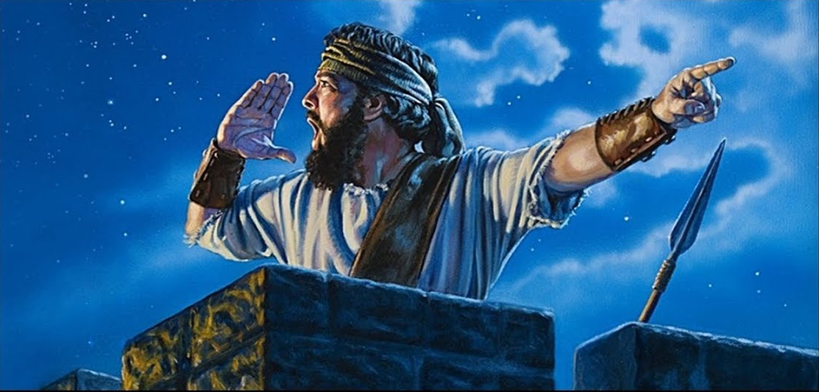

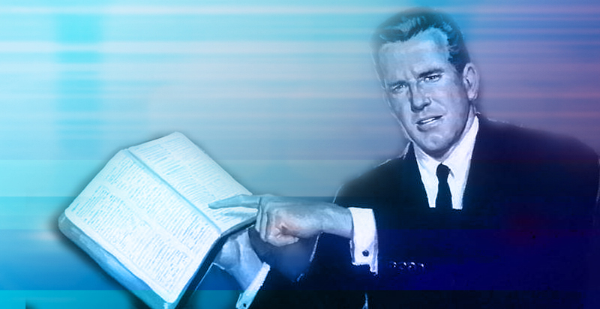
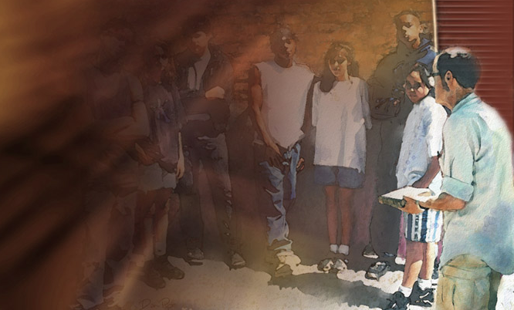
As sentinels we must watch and warn those who are sleeping of the danger, so that they prepare for the fight and the enemy does not take them unnoticed. This warning must be heard in all parts of the earth.
Sentinels Warning of Danger
“O Zion, that bringest good tidings, get thee up into the high mountain; O Jerusalem, that bringest good tidings, lift up thy voice with strength; lift it up, be not afraid; say unto the cities of Judah, Behold your God!” (Isaiah 40:9)
“If thou forbear to deliver them that are drawn unto death, and those that are ready to be slain” (Proverbs 24:11)
“When I say unto the wicked, Thou shalt surely die; and thou givest him not warning, nor speakest to warn the wicked from his wicked way, to save his life; the same wicked man shall die in his iniquity; but his blood will I require at thine hand” (Ezekiel 3:18)

Slide 7


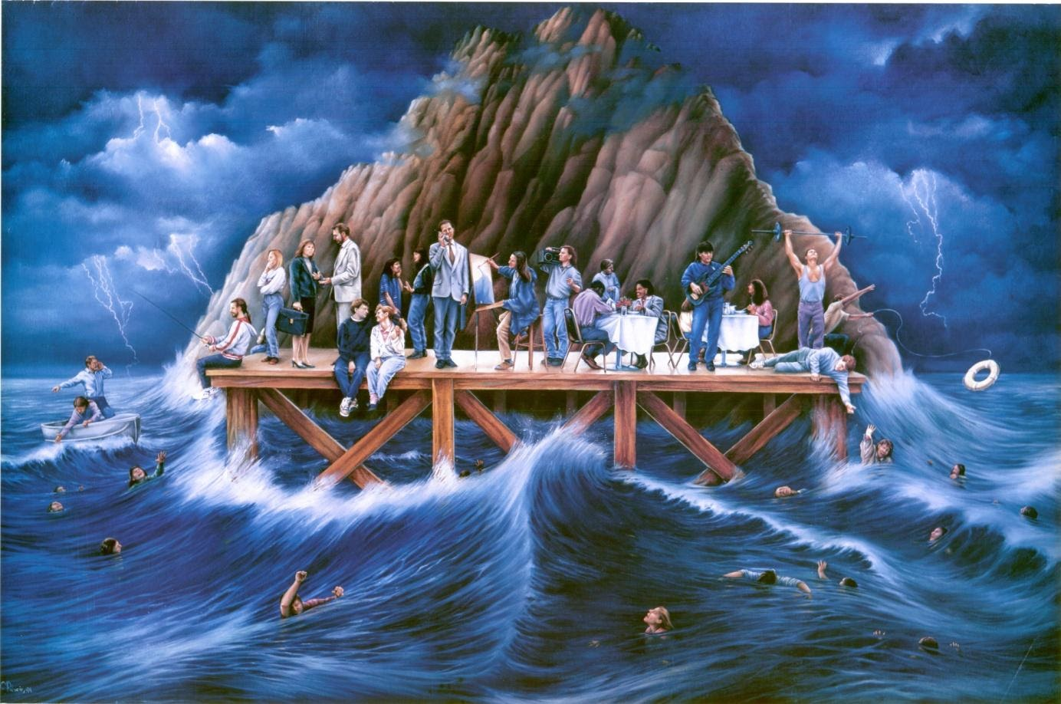

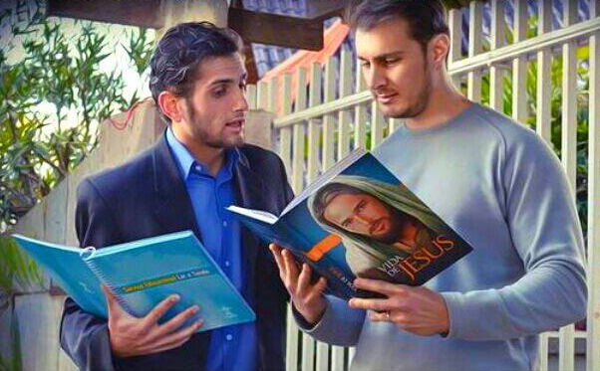
We, as the master's sentinels, have a rescue mission in which we have to work tenaciously. We must try to rescue the souls who are lost in this world. If we are always alert we can help to save them by throwing them the lifeline of faith in Christ Jesus, which is the only thing that can save us from this sea of sin. But let us remember that faith comes by hearing and hearing the word of God. We must take this message to those who do not know Jesus.
Sentinels
to the
Rescue
“…He which converteth the sinner from the error of his way shall save a soul from death, and shall hide a multitude of sins.” (James 5:20)

Slide 8


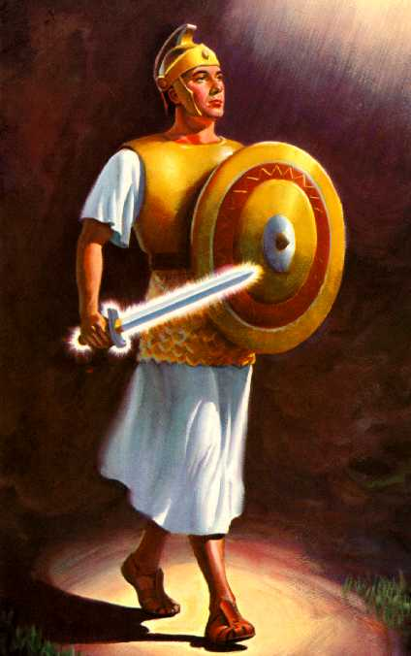
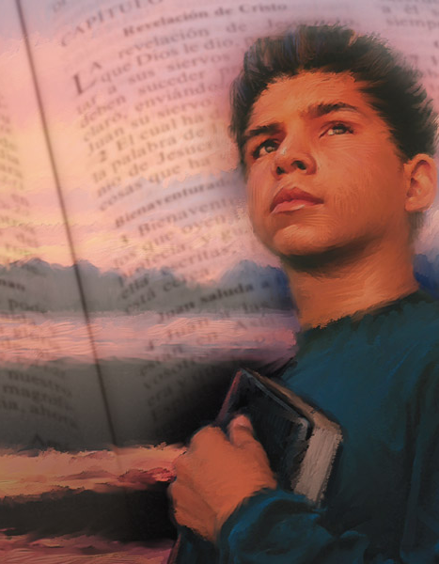

A good sentinel must be armed to combat the snares of evil. We must always use the two-edged sword, the Word of God, which is what will help us to overcome the "enemy of souls". If we use this powerful weapon every day, we will be strengthened and armed at all times to respond with a "thus saith the Lord.”
Armed
Sentinels
“or the word of God is quick, and powerful, and sharper than any twoedged sword, piercing even to the dividing asunder of soul and spirit, and of the joints and marrow, and is a discerner of the thoughts and intents of the heart” (Hebrews 4:12)
“All scripture is given by inspiration of God, and is profitable for doctrine, for reproof, for correction, for instruction in righteousness” (2 Timothy 3:16)
“For whatsoever things were written aforetime were written for our learning, that we through patience and comfort of the scriptures might have hope.” (Romans 15:4)

Slide 9

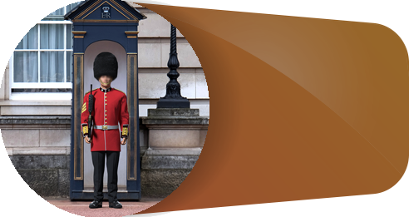
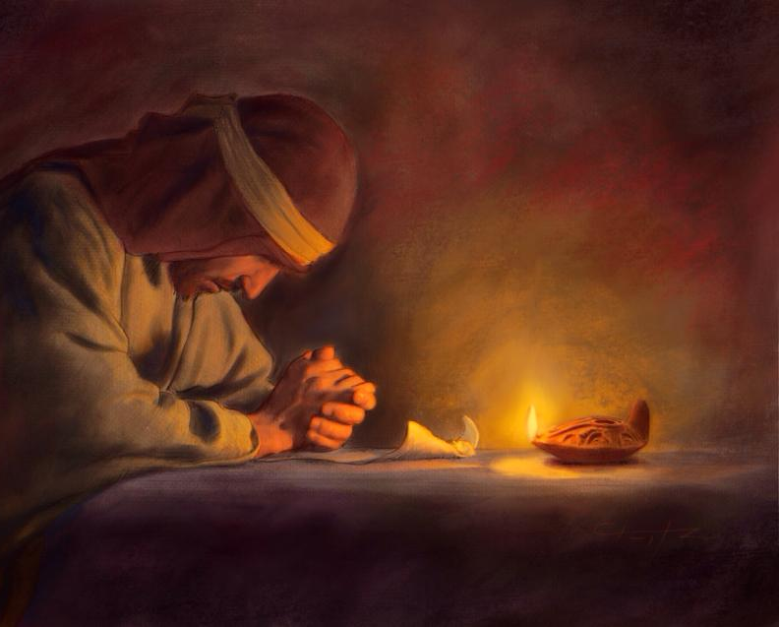
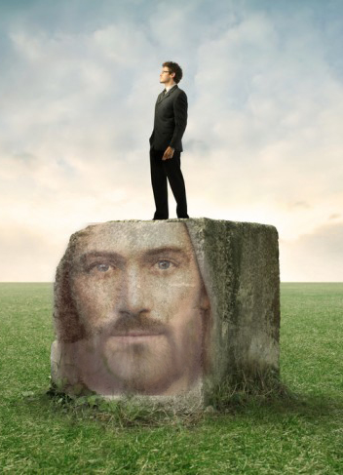

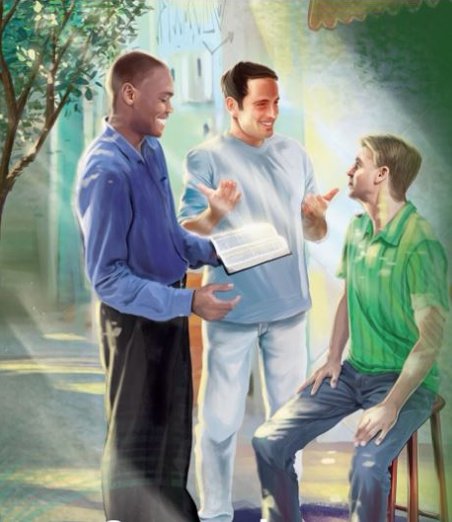
If we are true sentinels of the master, we will continue permanently in our posts. We will remain firm in doctrine, without wavering.
We will not let doubts or circumstances take us away from our duty as sentinels of the master.
Sentinels
Who
Persevere
“Let us hold fast the profession of our faith without wavering; (for he is faithful that promised.
(Hebrews 10:23)”
“Seeing then that we have a great high priest, that is passed into the heavens, Jesus the Son of God, let us hold fast our profession.” (Hebrews 4:14)
“But he that shall endure unto the end, the same shall be saved” (Matthew 24:13)
“For I am persuaded, that neither death, nor life, nor angels, nor principalities, nor powers, nor things present, nor things to come, Nor height, nor depth, nor any other creature, shall be able to separate us from the love of God, which is in Christ Jesus our Lord.” (Romans 8:38-39)

Slide 10

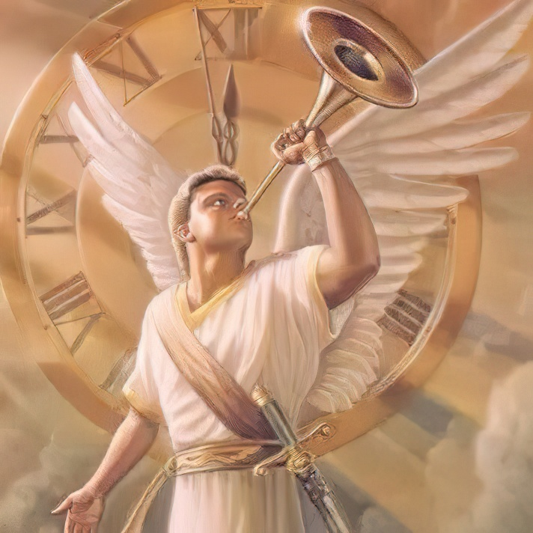
It is the privilege of the watchmen on the walls of Zion to live so near to God, and to be so susceptible to the impressions of His Spirit, that He can work through them to tell sinners of their peril, and point them to the place of safety. Chosen of God, sealed with the blood of consecration, they are to rescue men and women from impending destruction. Faithfully are they to warn their fellow-men of the sure result of transgression, and faithfully are they to safeguard the interest of the church. At no time may they relax their vigilance. Theirs is a work requiring the exercise of every faculty of the being. In trumpet tones their voices are to be lifted, and never should they sound one wavering, uncertain note. Not for wages are they to labor, but because they cannot do otherwise, because they realize that there is a woe upon them if they fail to preach the gospel. GW 15
The Lord is soon coming. The watchmen on the walls of Zion are called upon to awake to their God-given responsibilities. God calls for watchmen who, in the power of the Spirit, will give to the world the last warning message; who will proclaim the time of night. He calls for watchmen who will arouse men and women from their lethargy, lest they sleep the sleep of death. 8T 304

