Slide 1


Slide 2
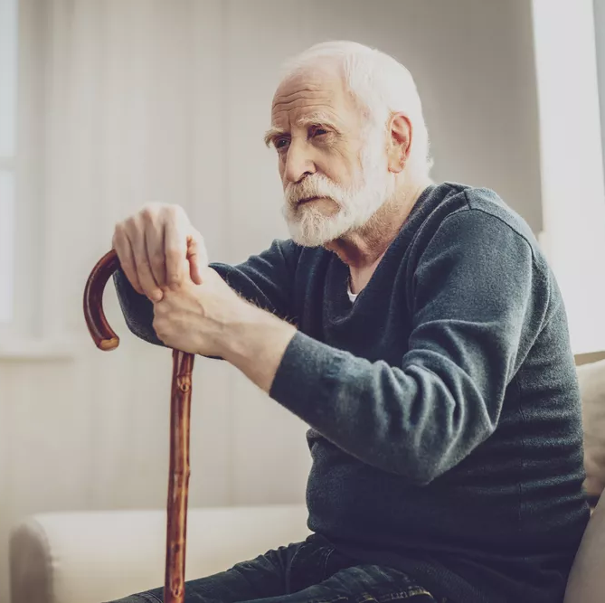
For many, talking about a senior person is synonymous with talking about someone who has suffered the loss of physical, intellectual, work and social strength.
The Bible tells us about them and tells us that they deserve our honor.
These people that heaven values are often the most disadvantaged and marginalized by our society.
This presentation is dedicated to you, the older person who is staying or wants to stay close to God.
I invite you to reflect on these questions:
How do you feel as an older adult?
What examples in the Bible can make you feel loved and valued?
Do you understand the value you have to God as an older adult?

Slide 3


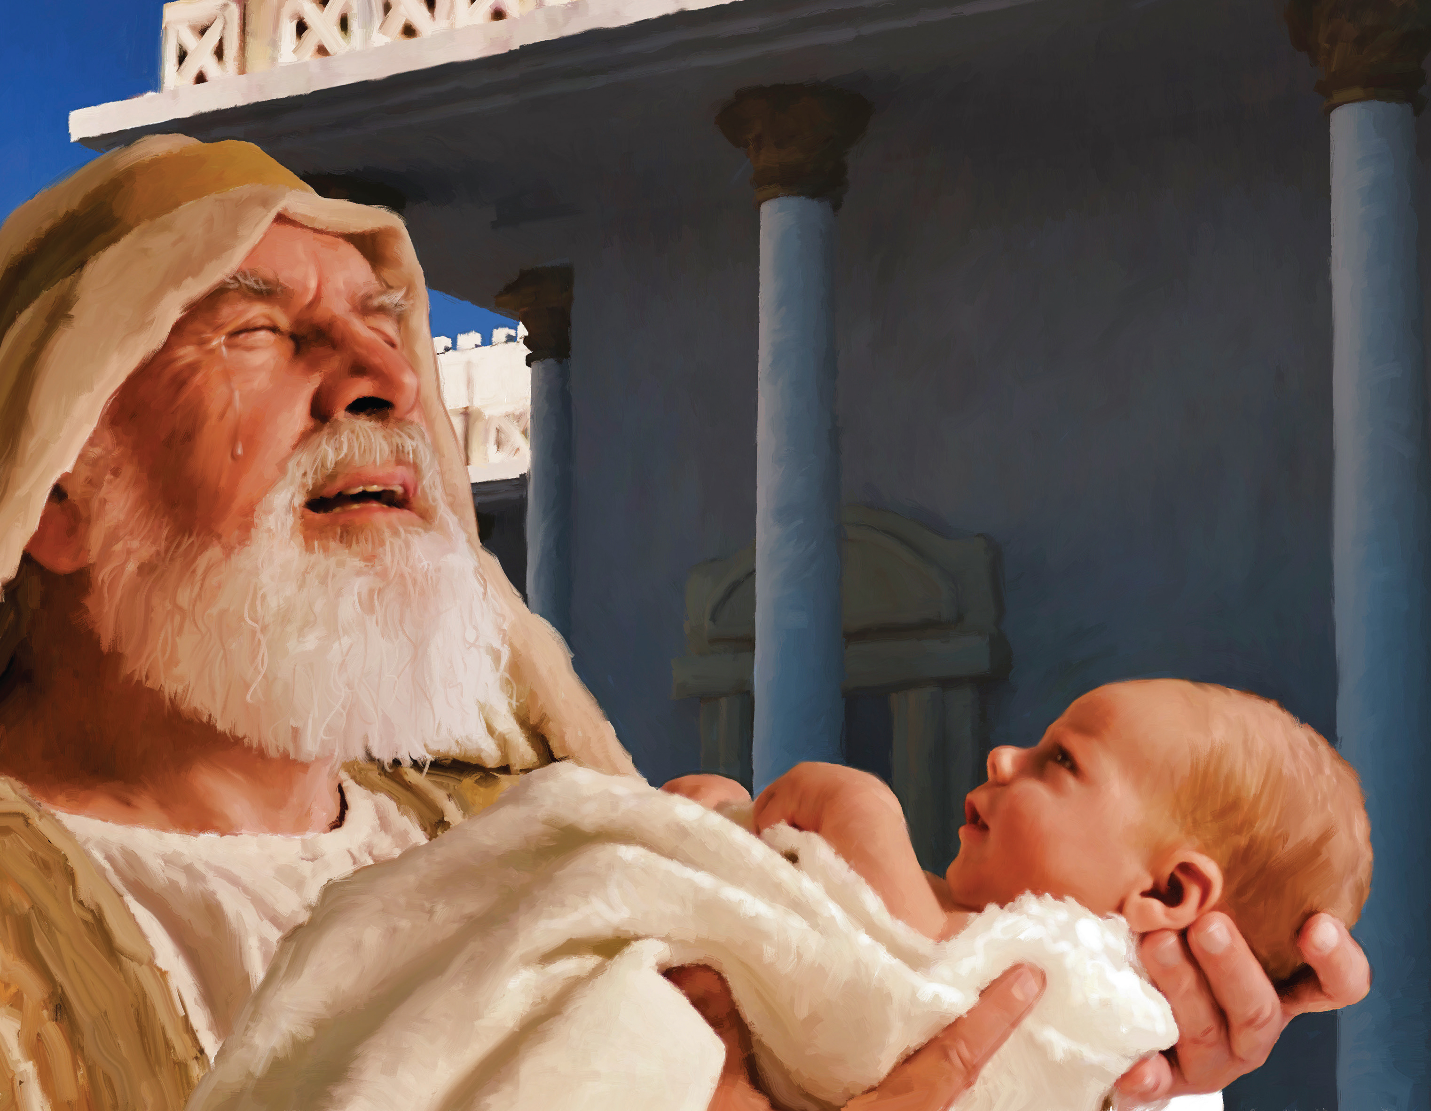
GOD GIVES YOU THE OPPORTUNITY TO SEE PROPHECIES BEING FULFILLED
Simeon
For God, older adults have always held a special place. The story of Simeon is recorded in the Bible; He was one of those who was blessed to see the promise fulfilled.
He held the Savior of the world in his arms: "Now, Lord, you send away your servant in peace, according to your word, because my eyes have seen your salvation" (Luke 2:29, 30).
Among so many sages and religious leaders, the Lord granted this old man, who probably had no value to society, the opportunity to see the prophecy fulfilled, indicating that He values those who, through the years, are faithful to him.

Slide 4

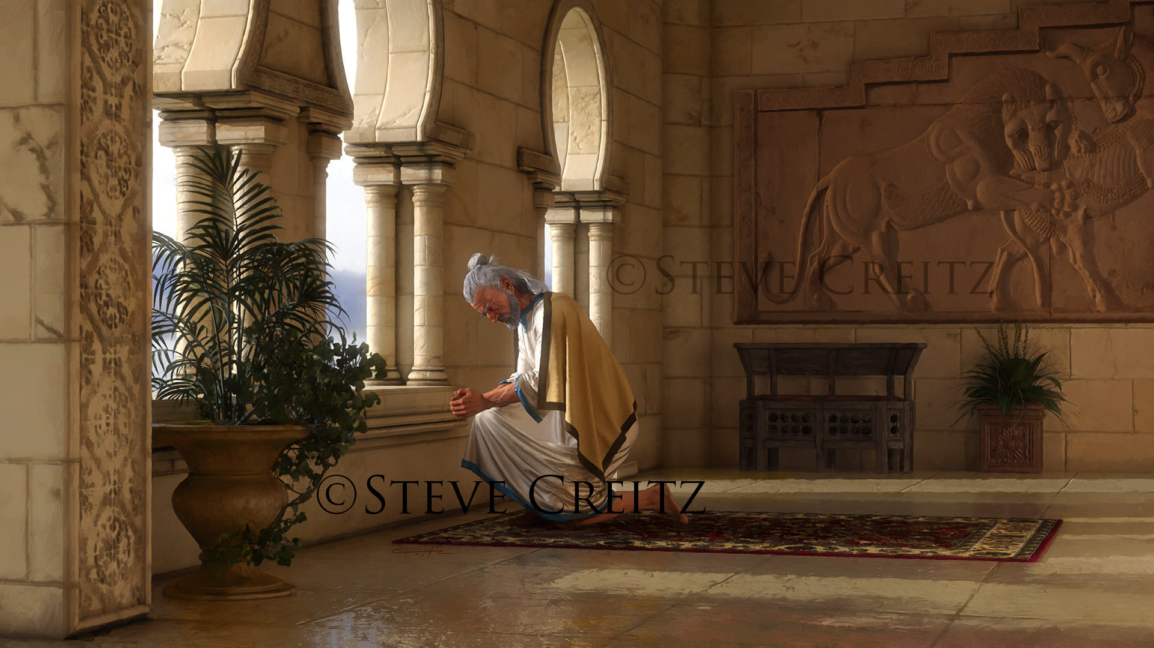
GOD HEARS YOU, ANSWERS YOU, AND GIVES YOU SPECIAL REVELATIONS
Daniel
The Bible also teaches us that the Lord does not cast away His servants because they are seniors. He is faithful to those who, from their youth, have dedicated themselves to serving Him. Daniel is an example of this. During his youth, he did not hesitate to exalt the name of the Most High, and even in his old age, the Lord continued to bless him.
It was while in his bed that the Lord revealed to Daniel the future of the world in response to the anxieties of the old prophet (who, although he was an old man, was not retired to God).
Daniel says: "Then he said to me, 'Daniel, do not be afraid, for from the first day that you disposed your heart to understand and to humble yourself in the presence of your God, your words were heard; and because of your words I have come'" (Daniel 10:12).
Isn't that wonderful? God hears you. It doesn't matter if you are no longer important to society, you matter to God. You must only cling to your Lord.

Slide 5

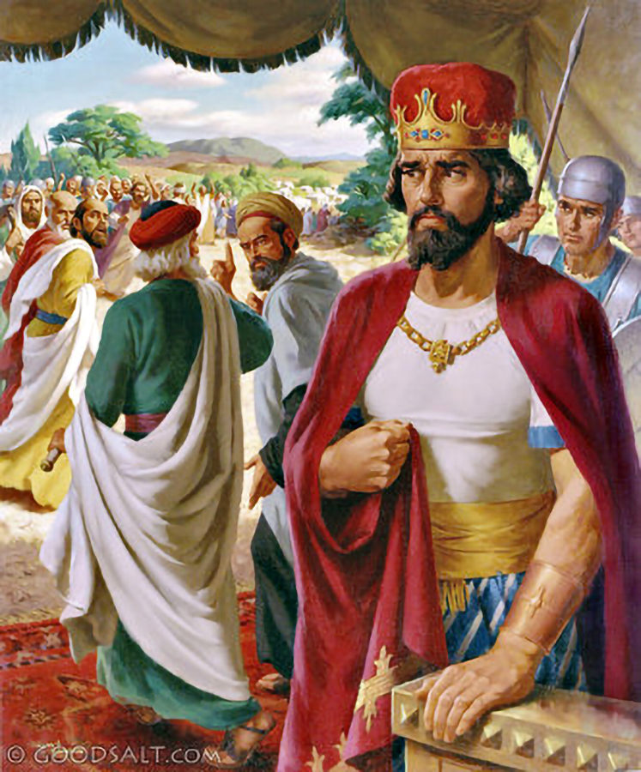
GOD HAS GIVEN YOU WISDOM THAT YOU MUST SHARE
The Elders
In 2 Chronicles 10, we find the story of Rehoboam, the son of Solomon.
When the people came to ask him to relieve them of the burden their father had placed on them, he asked the elders who served his father for advice.
Then, having despised their wisdom, he sought advice from the young men who had grown up with him. As a result, the people rejected him as king and his rulership was not stable.
Don't mind being rejected for your wise advice; share it whenever someone needs it.

Slide 6

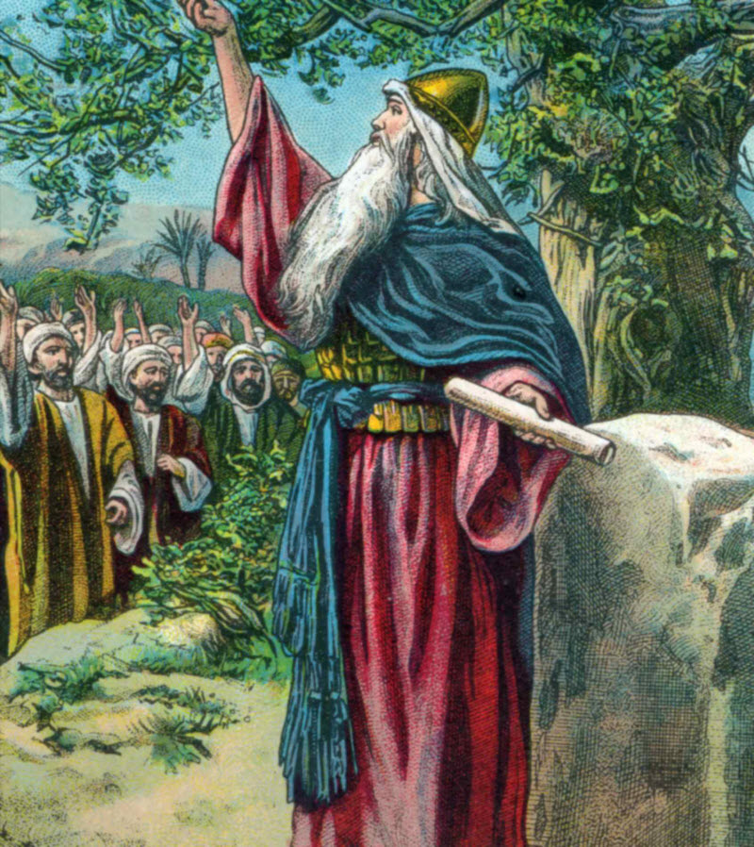
Joshua
ENCOURAGE OTHERS TO FOLLOW GOD'S WAYS
As an old man, Joshua gathered all the tribes of Israel to give them his last counsel and warnings.
He reminded them of the way God had led His people in the past, right up to the present moment.
He urged them to take God's side by serving Him with integrity and truth, forsaking false gods.
Joshua ended his speech by assuring that he and his household would serve God, and urging them to follow his example:
«And if it seem evil unto you to serve the Lord, choose you this day whom ye will serve; whether the gods which your fathers served that were on the other side of the flood, or the gods of the Amorites, in whose land ye dwell: but as for me and my house, we will serve the Lord. » (Joshua 24:15).

Slide 7
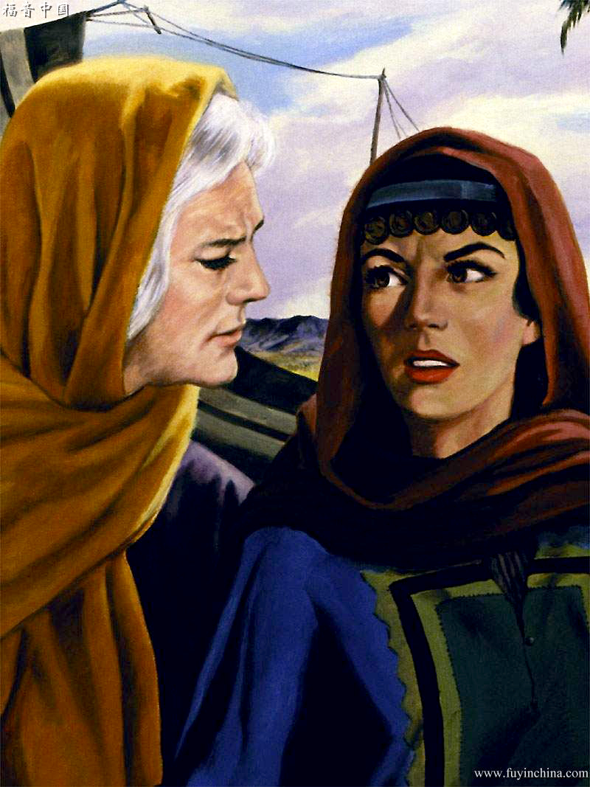

Naomi
GOD VALUES YOU AND GIVES YOU WHAT YOU NEED
Senior women were also of great importance to God; for He did not abandon them to their fate.
The Bible tells us of Naomi, a woman who to society, was a simple old widow who had met a sad end.
But the Lord, in His mercy, granted her the love and faithfulness of Ruth, who became like a daughter to this lonely mother.
If you, like Naomi, are only embittered and others consider you of little value, remember that you are of great value to the Lord, and He can turn your sorrows into joy. Ask Him and He will give you what you need.
You are important to God, and you belong to His family.

Slide 8

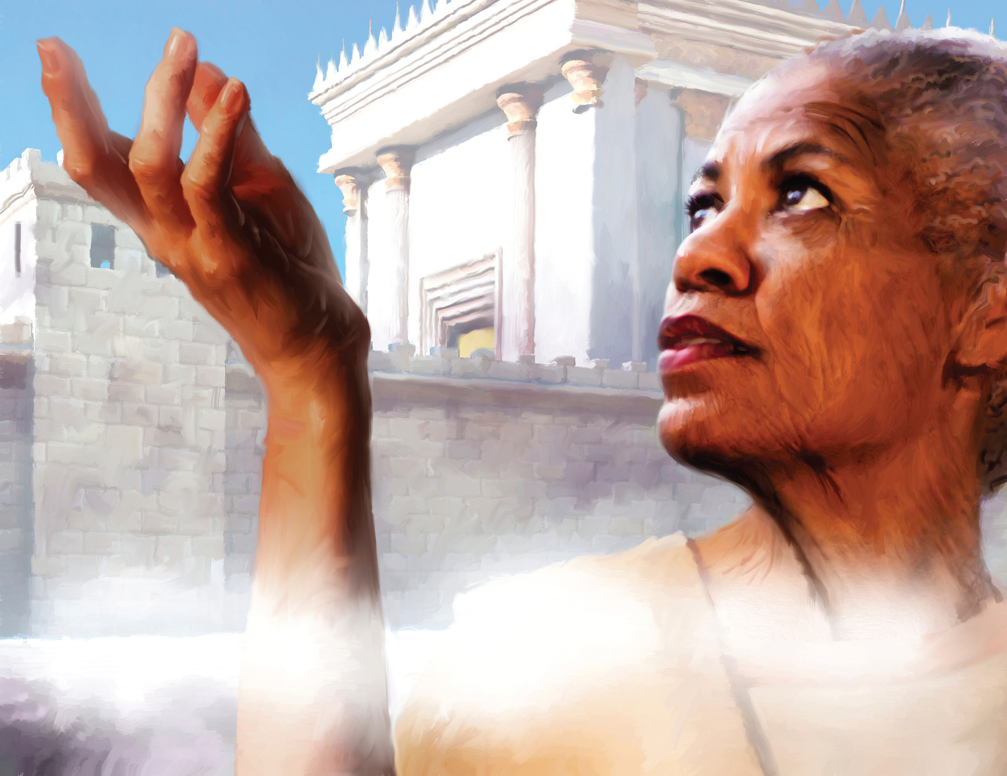
Anna
GOD PRAISES AND REWARDS YOUR SELFLESS WORK
Another woman distinguished by heaven was Anna.
The Bible tells us that she was eighty-four years old as a widow, and that night and day she served in the temple.
These few qualities tell us that this woman did not allow the loss of her husband to prevent her from working for God, and the Lord gave her the gift of being able to know the One who would save the world. «And she coming in that instant gave thanks likewise unto the Lord, and spake of him to all them that looked for redemption in Jerusalem. » (Luke 2: 38).
Heaven did not reject the self-sacrificing work of this servant of God. She served in the temple despite her age. The Lord accepted what her physical strength allowed her to do.
What work or activity can you do? Value your efforts; you have much to give; Don't limit yourself because you lack the energy of youth.

Slide 9

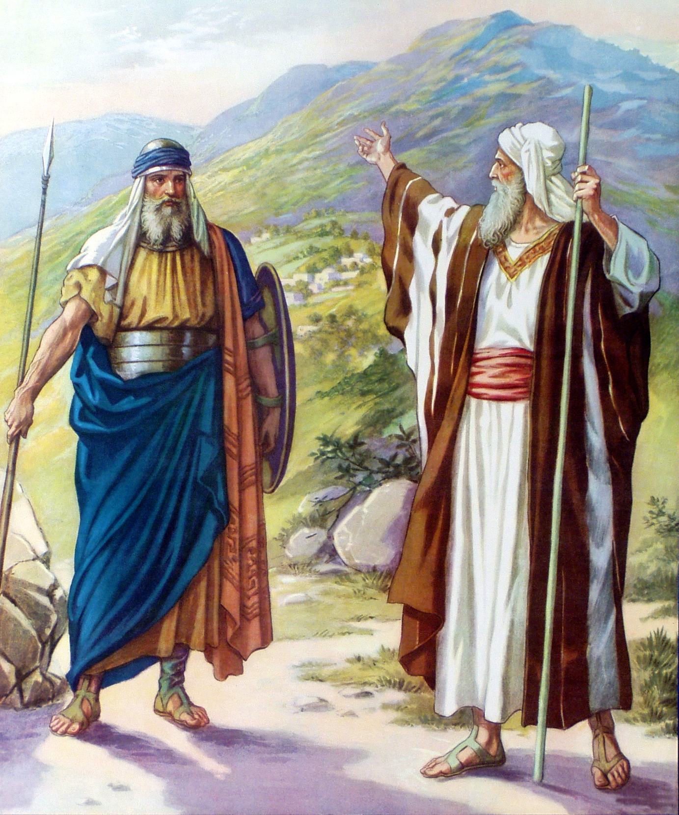
TRUST GOD WHOLEHEARTEDLY AND MOVE FORWARD BY FAITH ACCOMPLISHING YOUR MISSION
Caleb
Don't corner yourself and tend to remain anonymous. Your attitude towards life must be optimistic and willing to make great achievements.
Caleb is a good example of what God expects of you.
At eighty-five, he was willing to fight to acquire the promised land. He didn't care how dangerous his mission seemed or the indifference of those around him; he trusted God wholeheartedly. "Give me now this mountain, of which the Lord spoke that day; For you heard in that day that the Anakims are there, and that there are great and fortified cities. Perhaps the Lord will be with me, and I will cast them out, as the Lord has said" (Joshua 14:12).
Trust God, act and he will work wonders in your life.

Slide 10
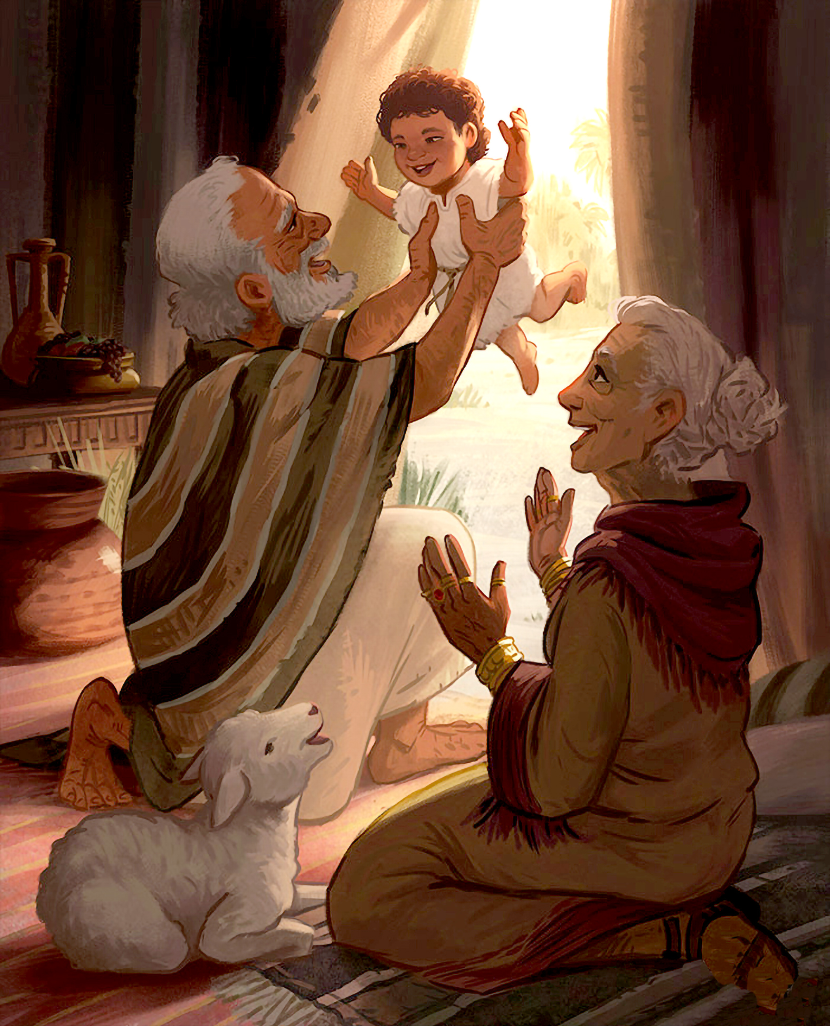

TODAY GOD CAN FULFILL THE LONGINGS OF YOUR HEART
Abraham and Sarah were seniors. He was a hundred years old, and she was ninety. It seems that their dreams and hopes had gone over the years.
To the Lord's announcement that they would have a son, they reacted by laughing. This was impossible for men (Genesis 17:17; 18:12).
Thus, God, showing His love and mercy toward His servants, fulfilled their desires; And that promise that seemed like a fantasy came true at a time when they least expected it.
What are your unfulfilled dreams? What is that illusion that you harbored with so much longing? Remember that the God you serve does not change, nor does He grow weary, and that His power is forever.
He can still fulfill the desires of your heart today, if they are in harmony with His will.
Abraham and Sarah

Slide 11
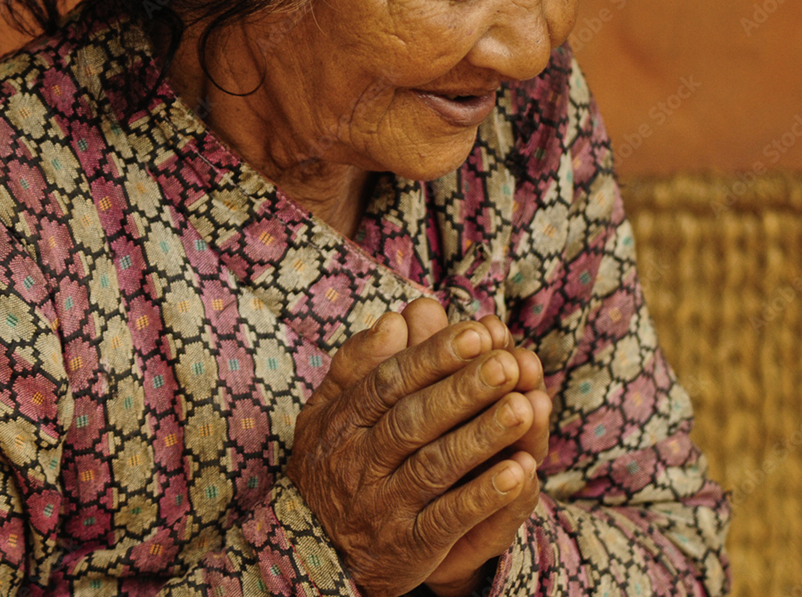
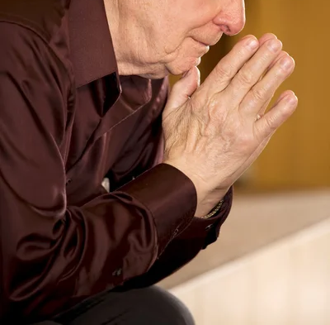
SIMEON
DANIEL
ELDERS
JOSHUA
NAOMI
ANNA
CALEB
ABRAHAM AND SARAH
God gives you the opportunity to see prophecies fulfilled.
God listens to you, responds to you, and gives you special revelations.
God has given you wisdom that you must share.
Encourage others to follow in God's ways.
God values you and gives you what you need.
God praises and rewards your selfless work.
Trust God wholeheartedly and move forward by faith in carrying out your mission.
Today God can fulfill the longings of your heart.
When sad or negative thoughts come to your mind, remember all these biblical characters.
Make David's prayer your own: "Cast me not off in the time of old age; forsake me not when my strength faileth." (Psalm 71:9).
God will answer this prayer and give you encouragement.

