Slide 1






Slide 2
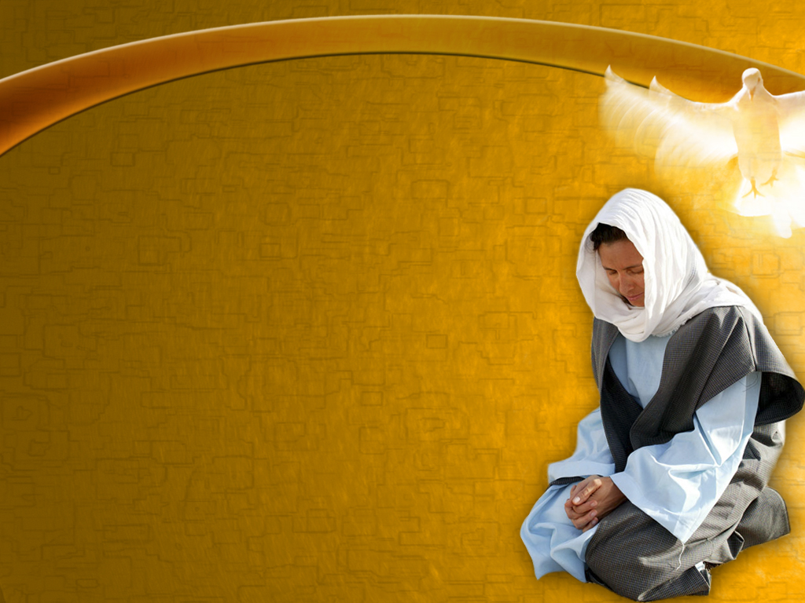
Faith is trusting God—believing that He loves us and knows best what is for our good. Thus, instead of our own, it leads us to choose His way. In place of our ignorance, it accepts His wisdom; in place of our weakness, His strength; in place of our sinfulness, His righteousness. Our lives, ourselves, are already His; faith acknowledges His ownership and accepts its blessing. Truth, uprightness, purity, have been pointed out as secrets of life's success. It is faith that puts us in possession of these principles.” (Ed 253)
As we study the Bible, we can read the stories of various women who are worthy of admiration. Regardless of the customs of their time, they decided to face the difficulties that were presented to them because their trust was placed in the Lord. These women of faith, as they may be called, inspire us to grasp God and believe His Word.
Their attitudes show us that they were women given to their children and their husbands, but above all, given to God. And it was this surrender that developed in them the confidence that gave them the strength to change their obstacles into a means of saving others.

Slide 3


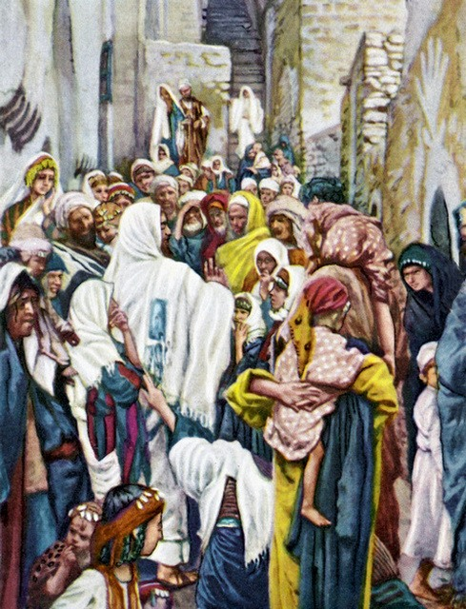
Matthew 9:20-22
The Woman of Faith Trusts in God
God's Word shows us a woman who trusted that only the Lord could do for her what science had not been able to accomplish.
Her faith led her to approach Jesus and touch the hem of his garment.
As I think of this story, I can imagine her making her way through the crowd; perhaps at some point someone pushed her away from the Savior; Perhaps she was trampled by the crowd that crowded around. There was probably no lack of people in her life who discouraged her, because she had spent everything she had on the doctors of her day. But her trust in Jesus made her fight against every obstacle in the way, and by her faith, she was healed.

Slide 4

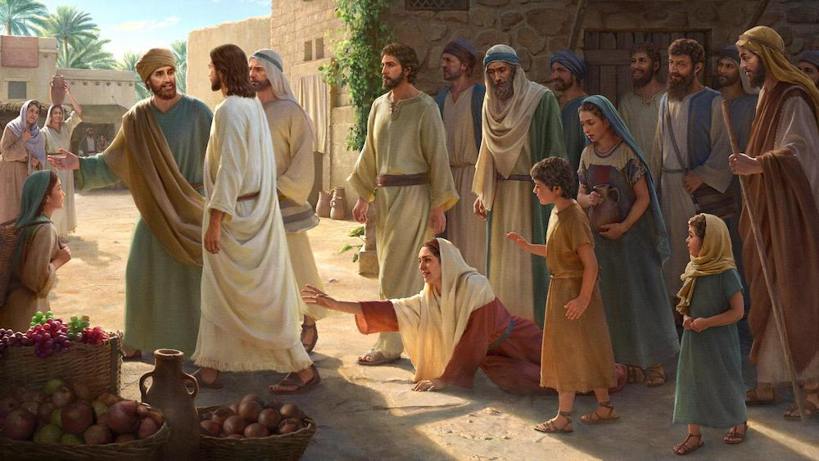
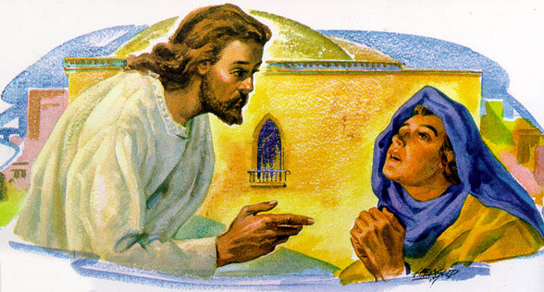
“a poor woman who had been many years a great sufferer and had spent all her living upon physicians but was made no better, but rather worse, thought if she could get within reach of Him, if she could only touch the hem of His garment, she would be made whole. Christ understood all that was in her heart, and He placed Himself where she could have the opportunity she desired. He would use that act to distinguish the touch of genuine faith from the casual contact of those who were crowding about Him out of sheer curiosity.
Trusts in God
When the woman reached forth her hand and touched the hem of His garment, she thought this stealthy touch would not be known by anyone; but Christ recognized that touch and responded to her faith by His healing power. She realized in a moment that she was made whole, and the Lord Jesus would not let such faith pass unnoticed. He turned about quickly and said, “Who touched me?” All the disciples were pressing close around Him, and Peter said, “The multitude throng thee and press thee, and sayest thou, Who touched me? And Jesus said, Somebody hath touched me: for I perceive that virtue is gone out of me” (Luke 8:45, 46).
When the woman saw that she was not hid she came tremblingly and cast herself at His feet, telling the whole story. For twelve years she had been afflicted, but as soon as her finger touched the hem of His garment she was made whole. Jesus said to her, “Daughter, be of good comfort: thy faith hath made thee whole; go in peace” (verse 48). The mere touch of faith brought its reward. (HP 108)

Slide 5


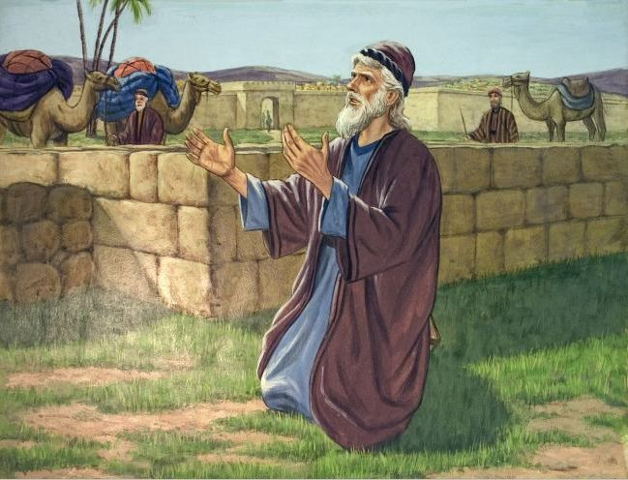
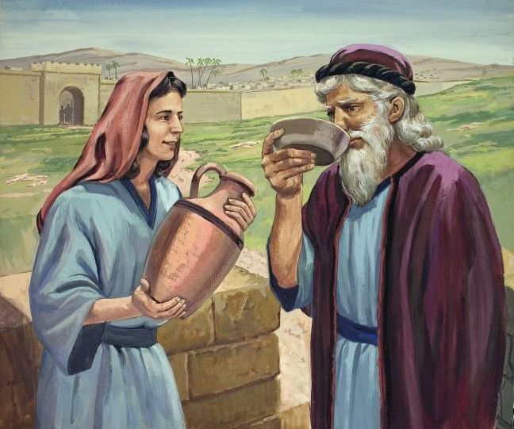
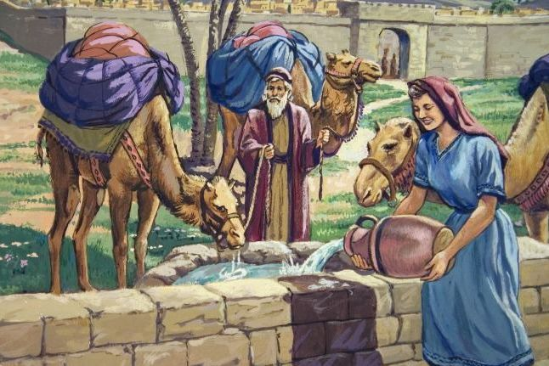
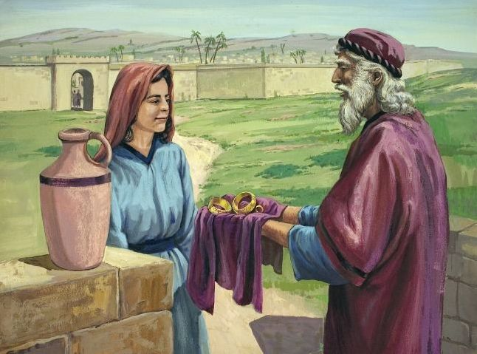
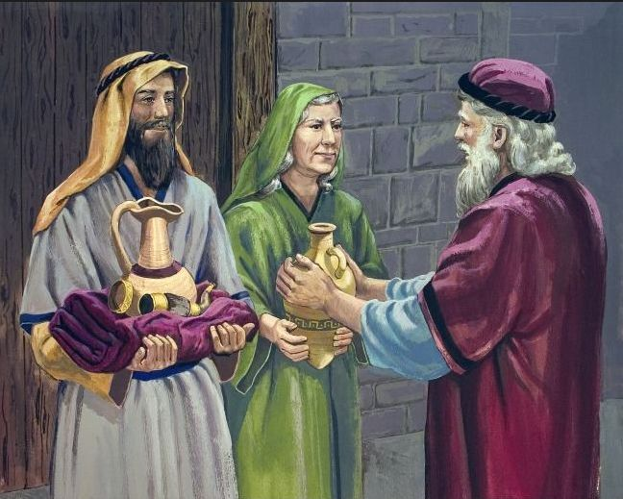
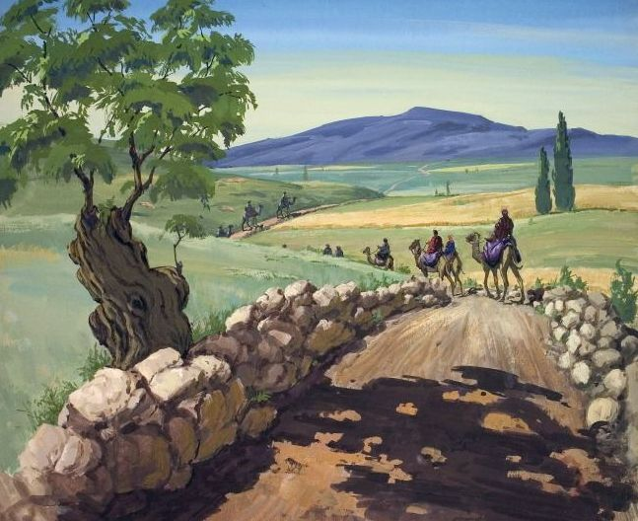
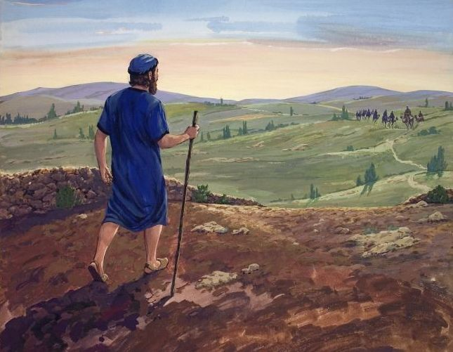
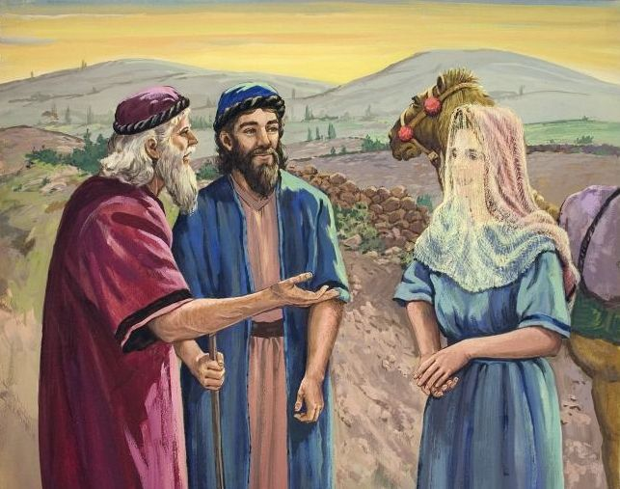
Genesis 24
The Woman of Faith is Courageous
Rebeca was a hard-working young woman. She lived quietly in her parents' house in the city of Haran. She lacked nothing. Her future was assured, because thanks to her beauty, she would not lack suitors. Suddenly, her life was at a crossroads. An unknown man made an unexpected request: to be the spouse of a distant relative she didn't even know.
There was evidence that this request came from God (Genesis 24:50). So Rebekah was asked directly whether or not she wanted to marry the person God had chosen for her.
Despite the challenges involved, she was courageous and, leaving her home, her family, her comforts, and everything she was used to, she decided to obey God and go where He called her.
By this decision and this demonstrated courage, Rebekah became part of the genealogical line of the promised Messiah.

Slide 6

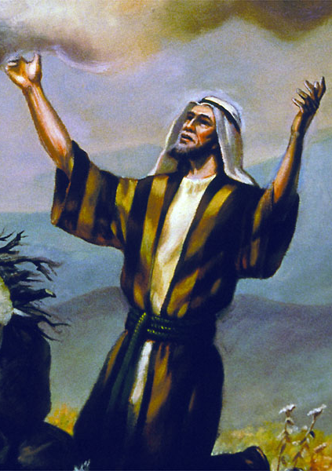
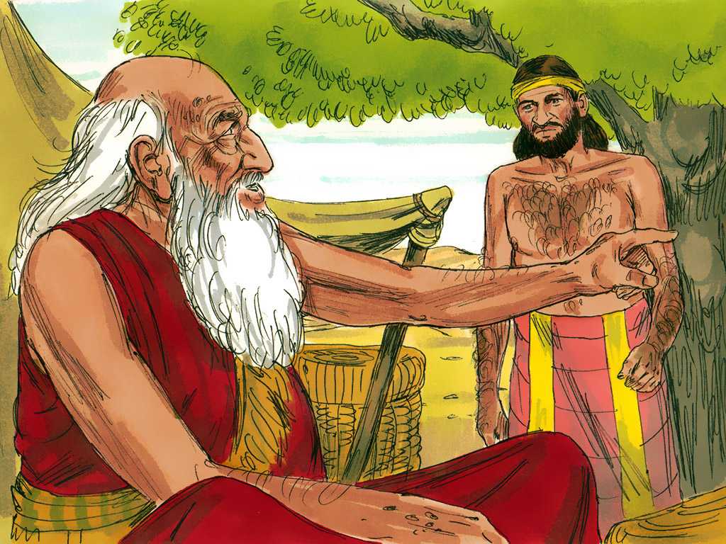
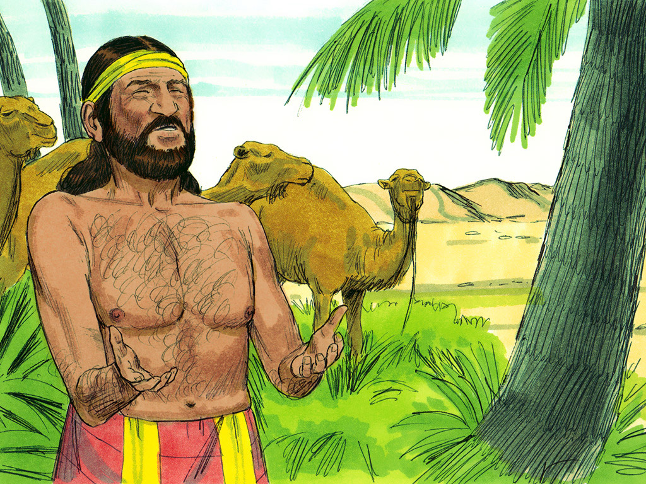
The Canaanites were idolaters, and the Lord had commanded that His people should not intermarry with them, lest they should be led into idolatry. Abraham was old, and he expected soon to die. Isaac was yet unmarried. Abraham was afraid of the corrupting influence surrounding his son, and wanted to select for him a wife who would not lead him away from God.
She's brave
He committed this matter to his faithful, experienced servant who ruled over all that he had. Abraham required his servant to make a solemn oath to him before the Lord, that he would not take a wife for Isaac of the Canaanites, but that he would go to Abraham's kindred, who believed in the true God, and select a wife for the young man. He charged him not to take Isaac to the country from which he came; for they were nearly all affected with idolatry. If he could not find a wife for Isaac who would leave her kindred and come where he was, then he should be clear of the oath which he had made.—The Signs of the Times, April 10, 1879.
Abraham told his servant that God will send His angel before him to direct him in his choice. The servant to whom this mission was entrusted started on his long journey. As he entered the city where Abraham's kindred dwelt, he prayed earnestly to God to direct him in his choice of a wife for Isaac. He asked that certain evidence might be given him, that he should not err in the matter.” (HD 26-27)

Slide 7
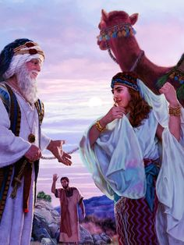
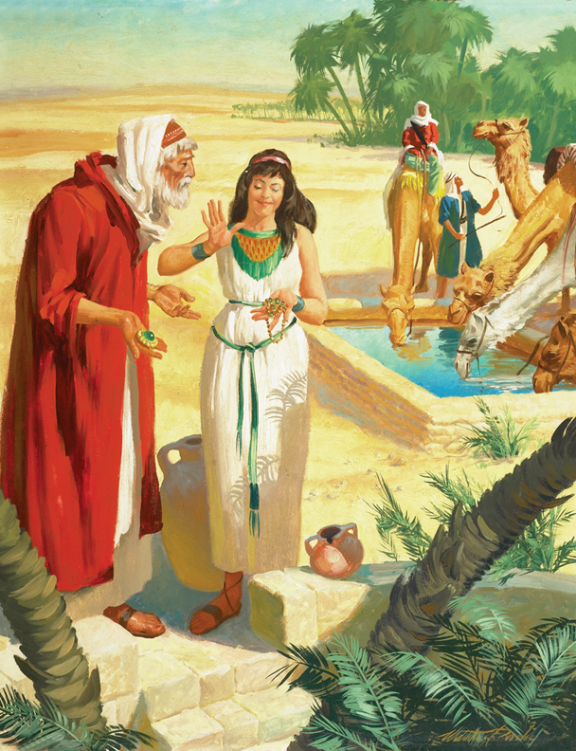
He rested by a well which was a place of the greatest gathering. It was there where he particularly noticed the engaging manners and courteous conduct of Rebekah. He receives all the evidence he asked of God that Rebekah is the one whom God has been pleased to select to become Isaac's wife. She invites the servant to her father's house. He then relates to Rebekah's father, and her brother, the evidences he has received from the Lord, that Rebekah should become the wife of his master's son, Isaac.
She's brave
Abraham's servant then said to them, “And now if ye will deal kindly and truly with my master, tell me: and if not, tell me; that I may turn to the right hand, or to the left.” The father and son answered, “The thing proceedeth from the Lord: we cannot speak unto thee bad or good. Behold, Rebekah is before thee, take her, and go, and let her be thy master's son's wife, as the Lord hath spoken. And it came to pass, that, when Abraham's servant heard their words, he worshipped the Lord, bowing himself to the earth. After the consent of the family had been obtained, Rebekah herself was consulted as to whether she would go to so great a distance from her father's house, to marry the son of Abraham. She believed, from what had taken place, that God had selected her to be Isaac's wife, and she said, “I will go.”.
The servant, anticipating his master's joy at the success of his mission, was impatient to be gone; and with the morning they set out on the homeward journey. Abraham dwelt at Beersheba, and Isaac, who had been attending to the flocks in the adjoining country, had returned to his father's tent to await the arrival of the messenger from Haran. “And Isaac went out to meditate in the field at the eventide: and he lifted up his eyes, and saw, and, behold, the camels were coming. And Rebekah lifted up her eyes, and when she saw Isaac, she lighted off the camel. For she had said unto the servant, What man is that that walketh in the field to meet us? And the servant had said, It is my master: therefore she took a veil, and covered herself. And the servant told Isaac all things that he had done. (DG 29-30)

Slide 8


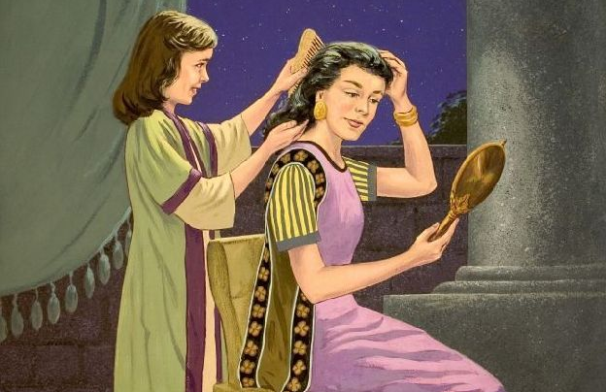
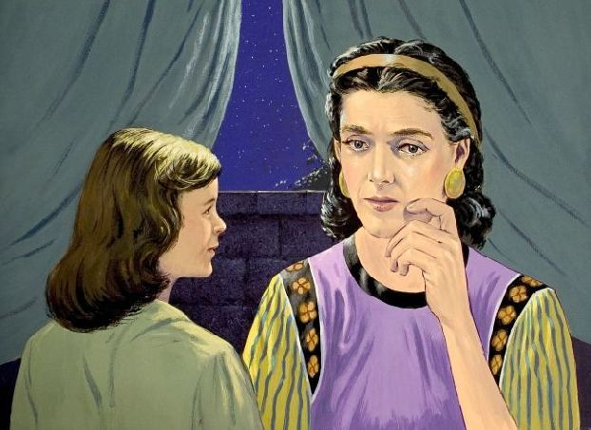
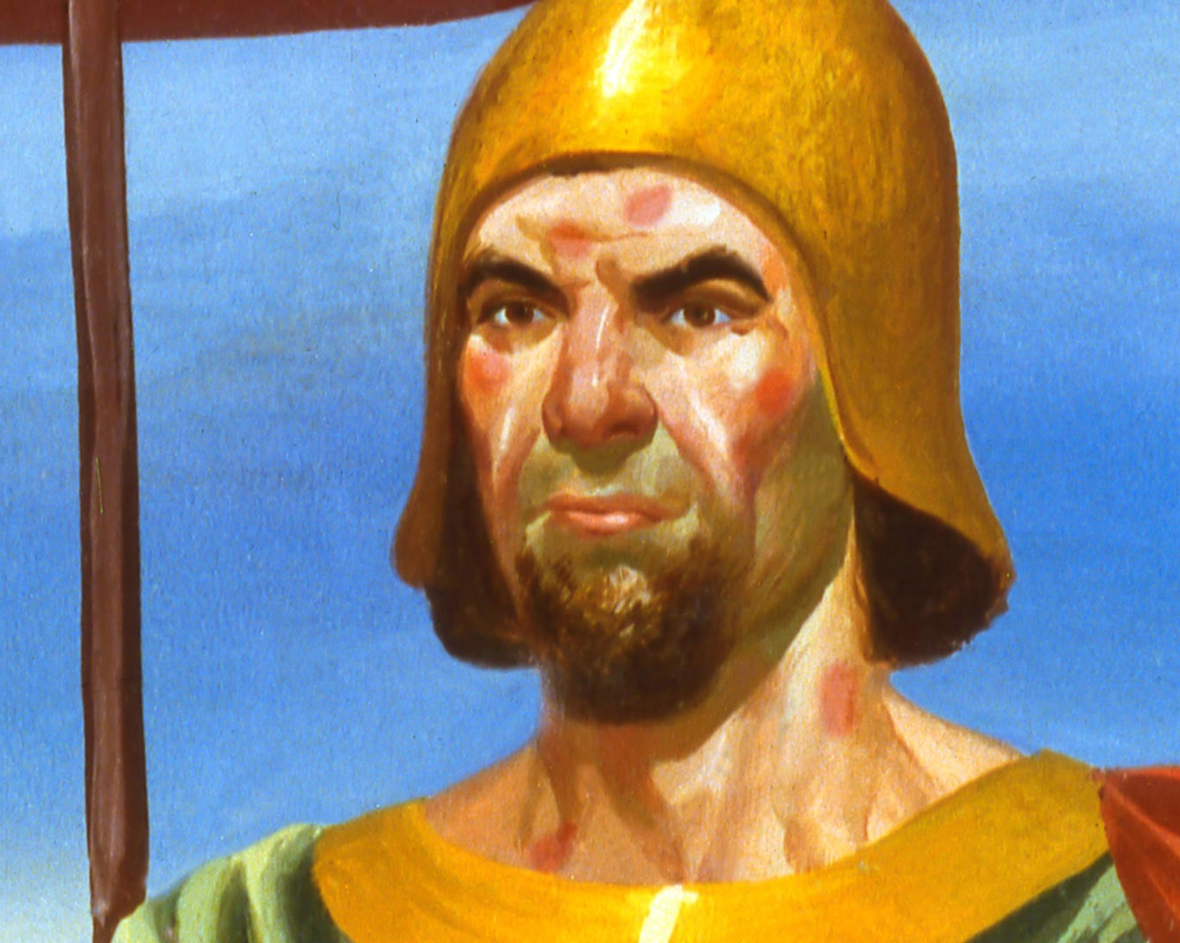
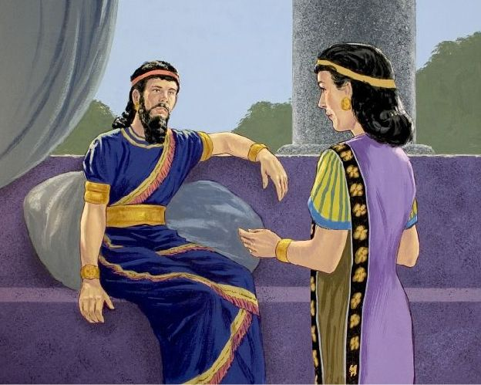
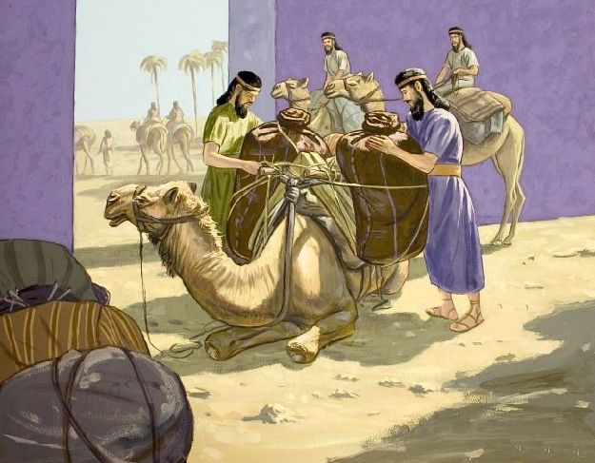
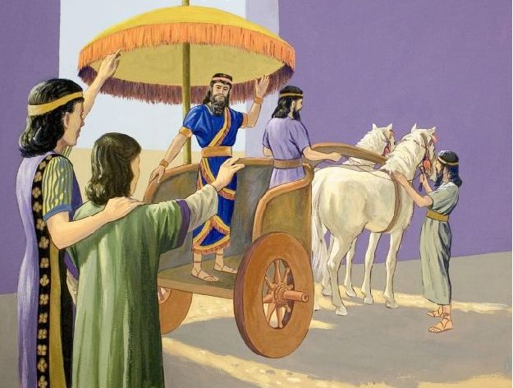
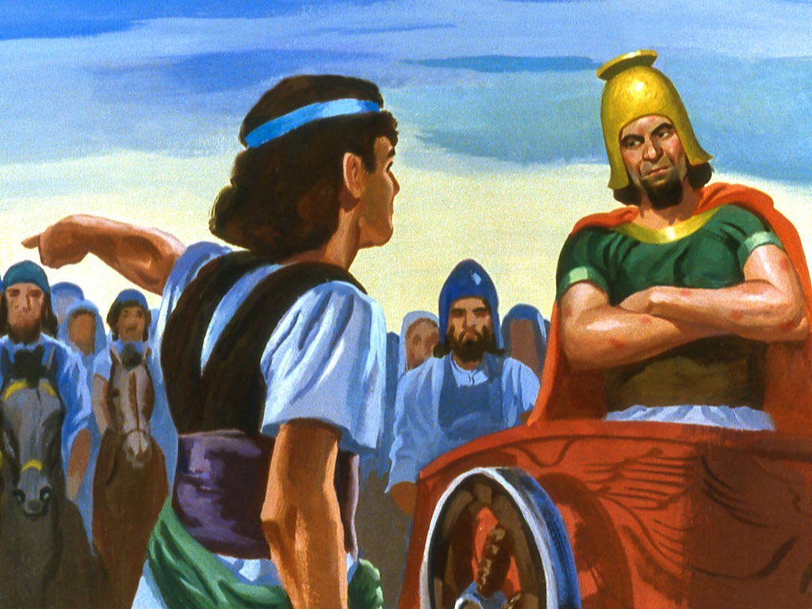
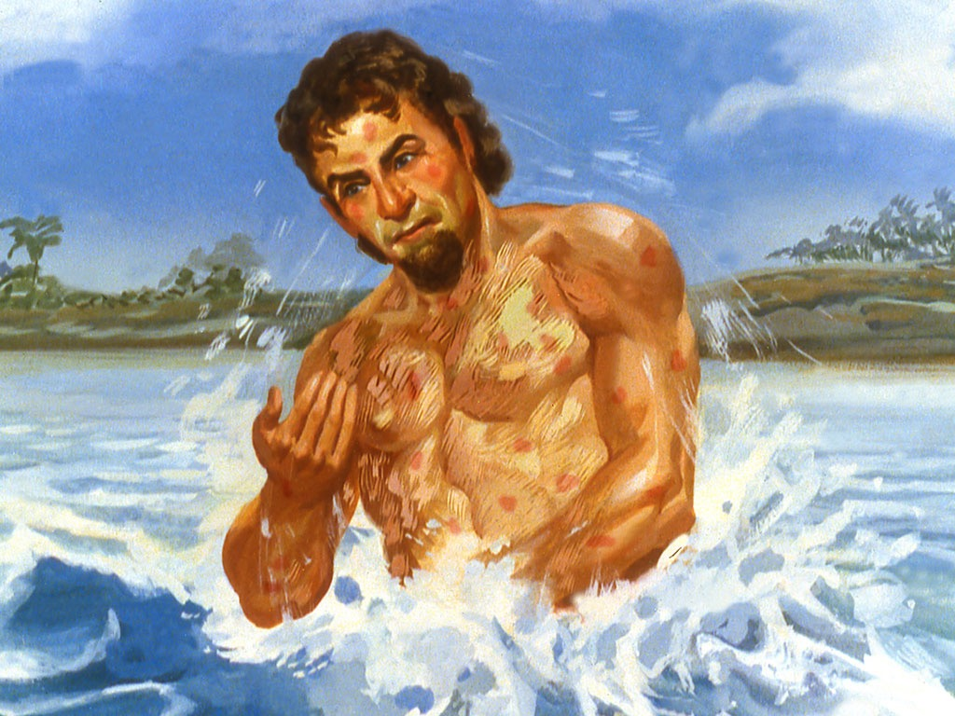
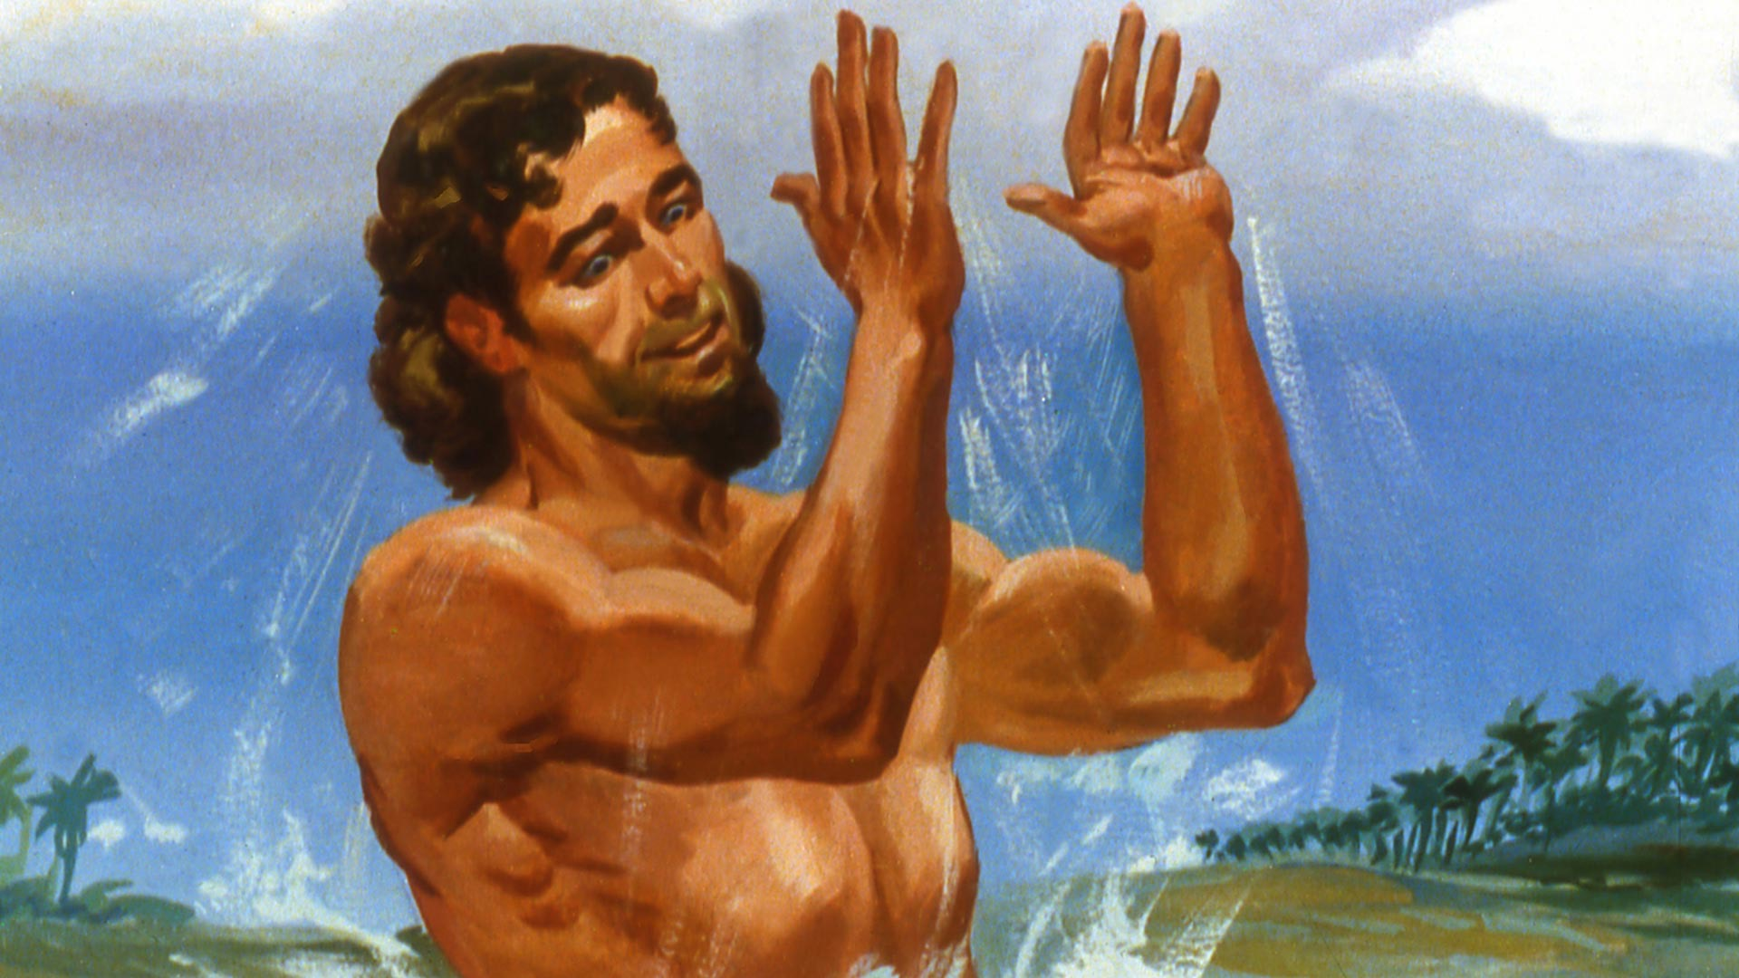
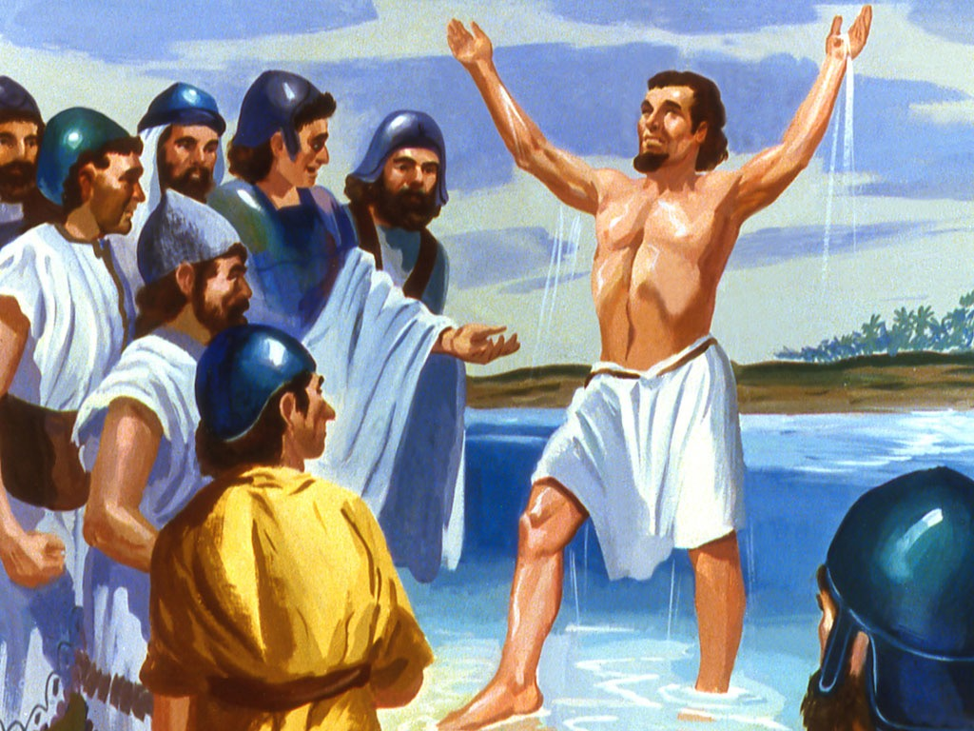
2 Kings 5
The Woman of Faith Testifies of God's Power
The young slave girl, as many know her, is an excellent example of how faith in God can serve as a witness to bring souls to the feet of Christ. We don't know her name or her age, what we do know is that she was a faithful servant of the Lord, and she became an example of faith. She was not afraid to speak up despite being the maid; she was not afraid to make a mistake in sending the general Naamam to Elisha the prophet, because she knew the God of Israel.
She did not allow the pain of being estranged from her family, or being held captive in another country, to prevent her from testifying of the power of her Maker. Perhaps mistreated and discriminated against during her transfer, she decided to present the only source of salvation and healing to a pagan people. As a result, General Naaman was healed and gave his heart to God.

Slide 9

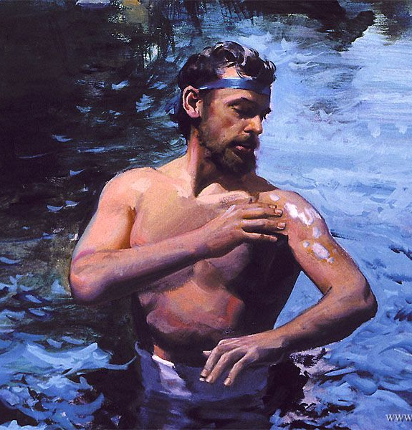
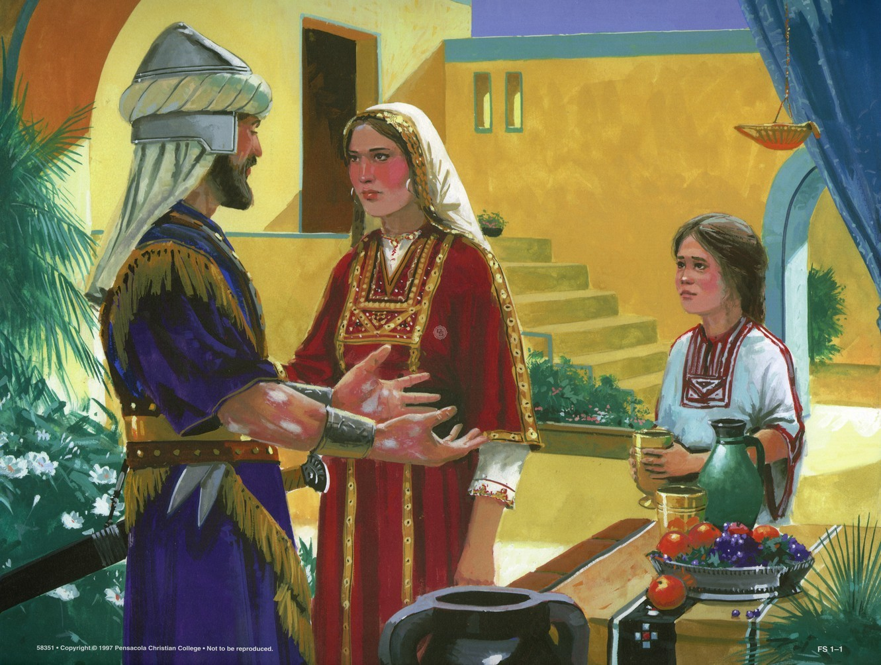
Ben-hadad, king of Syria, had defeated the armies of Israel in the battle which resulted in the death of Ahab. Since that time the Syrians had maintained against Israel a constant border warfare, and in one of their raids they had carried away a little maid who, in the land of her captivity, “waited on Naaman's wife.”
Testifies of God's Power
A slave, far from her home, this little maid was nevertheless one of God's witnesses, unconsciously fulfilling the purpose for which God had chosen Israel as His people. As she ministered in that heathen home, her sympathies were aroused in behalf of her master; and, remembering the wonderful miracles of healing wrought through Elisha, she said to her mistress, “Would God my lord were with the prophet that is in Samaria! for he would recover him of his leprosy.” She knew that the power of Heaven was with Elisha, and she believed that by this power Naaman could be healed.
The conduct of the captive maid, the way that she bore herself in that heathen home, is a strong witness to the power of early home training. There is no higher trust than that committed to fathers and mothers in the care and training of their children. Parents have to do with the very foundations of habit and character. By their example and teaching the future of their children is largely decided. Happy are the parents whose lives are a true reflection of the divine, so that the promises and commands of God awaken in the child gratitude and reverence; the parents whose tenderness and justice and long-suffering interpret to the child the love and justice and long-suffering of God, and who by teaching the child to love and trust and obey them, are teaching him to love and trust and obey his Father in heaven…
All are alike called to be missionaries for God, ministers of mercy to the world. They are to obtain an education that will help them to stand by the side of Christ in unselfish service. The parents of that Hebrew maid, as they taught her of God, did not know the destiny that would be hers. But they were faithful to their trust; and in the home of the captain of the Syrian host, their child bore witness to the God whom she had learned to honor. PK 244-246

Slide 10


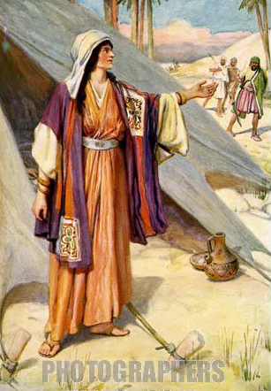
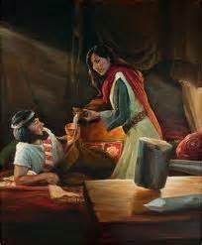
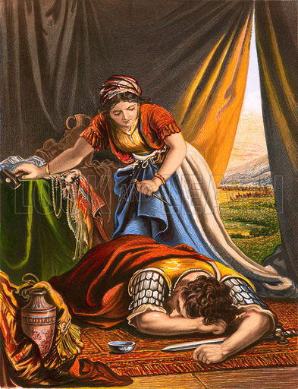
Judges 4
The woman of Faith Is Determined
Jael belonged to the tribe of the Kenites, descendants of Jethro, Moses' father-in-law.
Although they lived close to the Israelites, they did not unite with them.
Jael's spouse, Heber, lived peacefully and peacefully with both Israel and Jabin, a Canaanite king who was oppressing Israel.
When Sisera, the general of Jabin's army, was fleeing the battle, he arrived at Jael's tents and felt safe. When he asked for hospitality, Jael introduced him to a tent.
But when she learned that her guest was Sisera fleeing Israel, Jael set out to take the side of God's people. She decisively took a stake and killed the enemy of God, thus giving Israel the ultimate victory over their enemies.

Slide 11

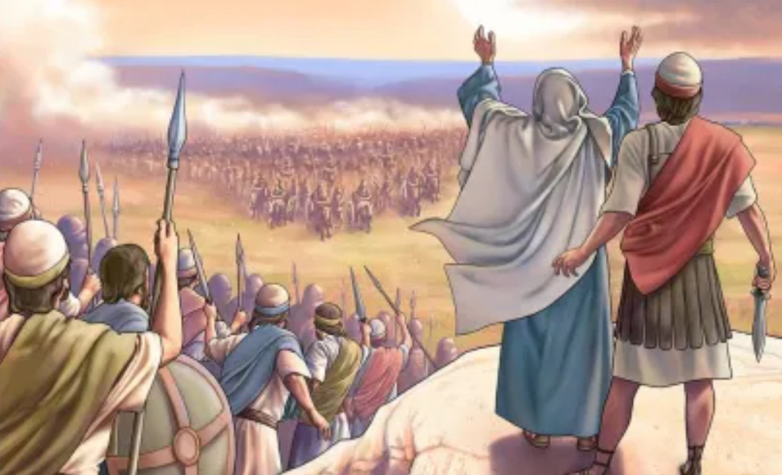
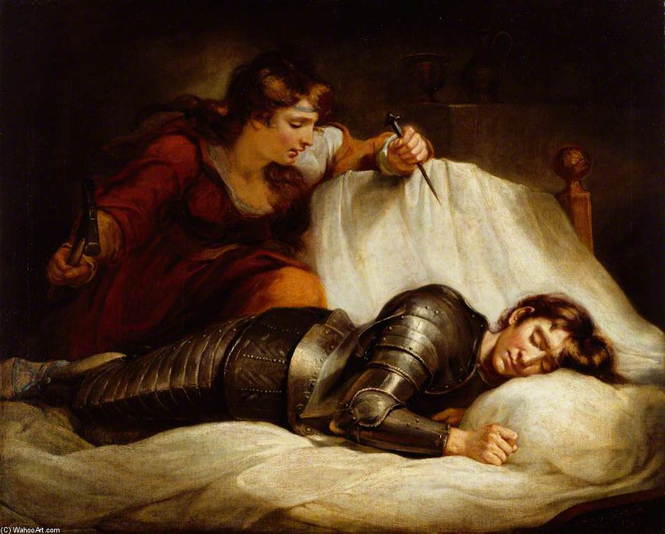
For twenty years the Israelites groaned under the oppressive yoke of the king of Canaan; Jabin. They cried out to God and he heard them. God sent Barak who asked Deborah, prophetess, to accompany him to fight against the enemy army commanded by Sisera.
She’s Determined
When Sisera saw that his army was defeated, he left his chariot, and endeavored to make his escape on foot, as a common soldier. Approaching the tent of Heber, one of the descendants of Jethro, the fugitive was invited to find shelter there. In the absence of Heber, Jael, his wife, courteously offered Sisera a refreshing draught, and opportunity for repose, and the weary general soon fell asleep.
Jael was at first ignorant of the character of her guest, and she resolved to conceal him; but when she afterward learned that he was Sisera, the enemy of God and of His people, her purpose changed. As he lay before her asleep, she overcame her natural reluctance to such an act, and slew him by driving a nail through his temples, pinning him to the earth. As Barak, in pursuit of his enemy, passed that way, he was called in by Jael to behold the vainglorious captain dead at his feet—slain by the hand of a woman. Deborah celebrated the triumph of Israel in a most sublime and impassioned song. She ascribed to God all the glory of their deliverance, and bade the people praise Him for His wonderful works… She set before Israel their helpless and distressed condition, under the oppression of their enemies, and related in glowing language the history of their deliverance. DG 38
In his song he praised the sagacious Jael: “Blessed above women shall Jael the wife of Heber the Kenite be, blessed shall she be above women in the tent. He asked water, and she gave him milk; she brought forth butter in a lordly dish. She put her hand to the nail, and her right hand to the workmen's hammer; and with the hammer she smote Sisera, she smote off his head, when she had pierced and stricken through his temples. (Judges 5:24-26)

Slide 12



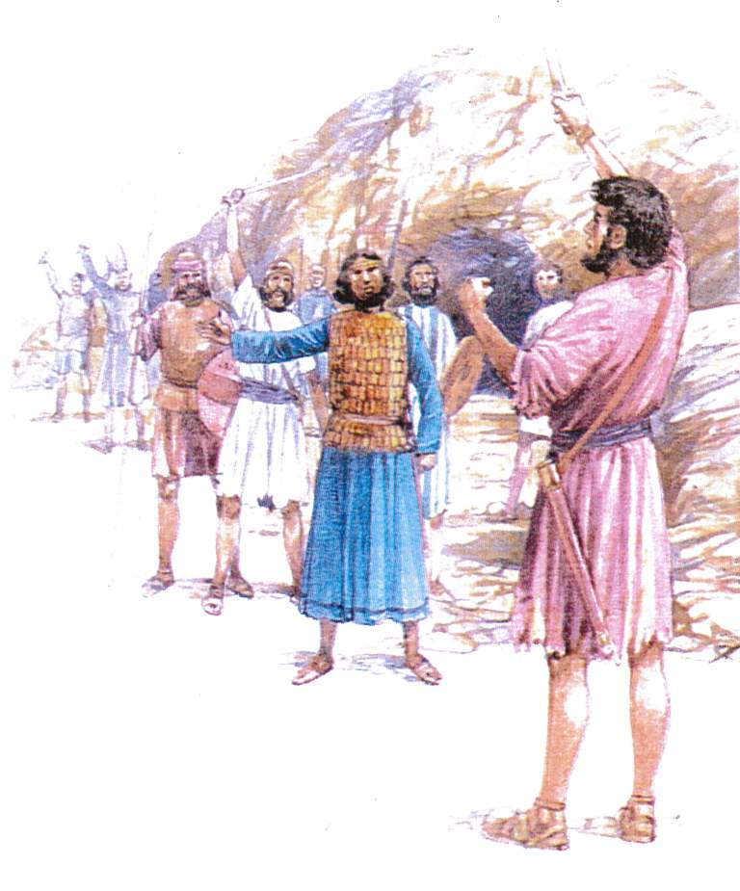
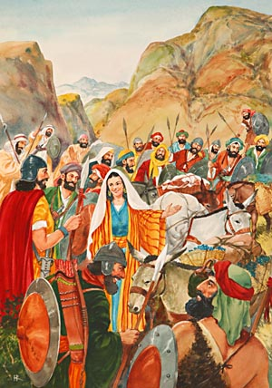
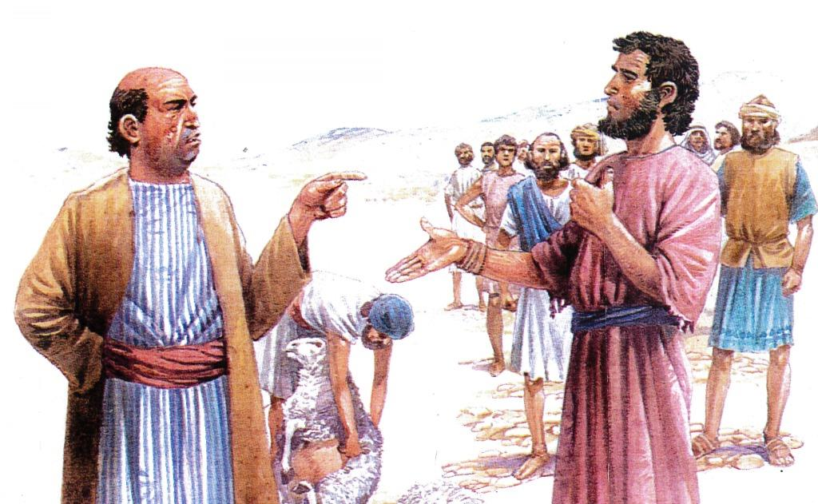
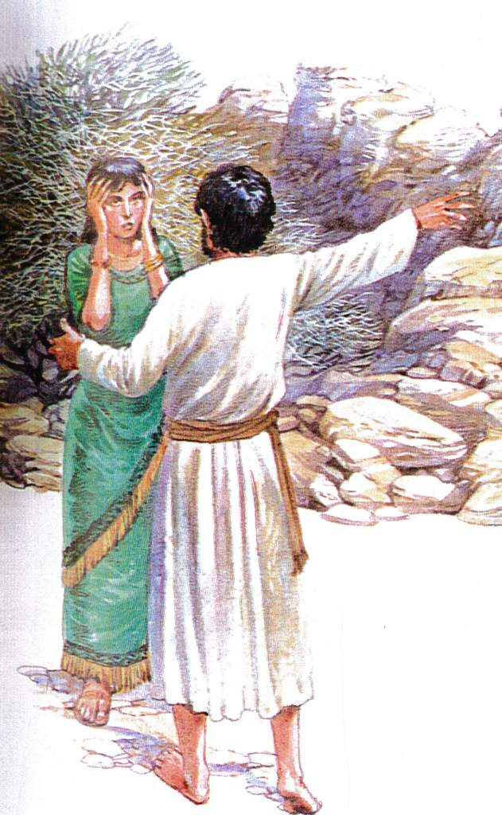
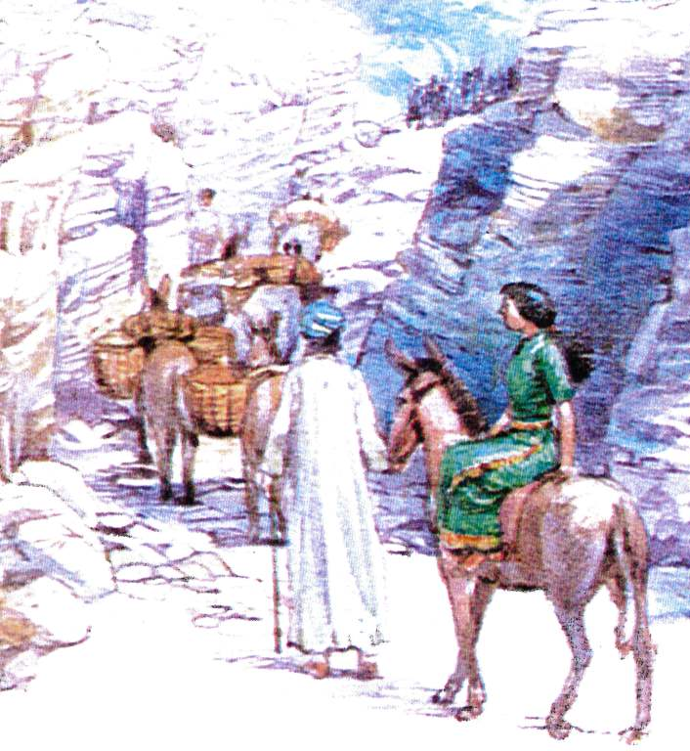
1 Samuel 25
The Woman of Faith Acts with Wisdom
Abigail was the beautiful, merciful, and intelligent spouse of Nabal, a petty man with a violent temper.
Upon learning that Nabal had offended the men David had sent to ask for what was right, Abigail immediately saw the danger to which her entire household was exposed.
Knowing that David and his men had helped and protected their servants and livestock, Abigail acted promptly and wisely. She decided to appease David by bringing him what his righteous actions had deserved.
Upon meeting David, she humbly treated him as the future king of Israel.
By her wise action, she was able to avoid unnecessary bloodshed on David's part.

Slide 13

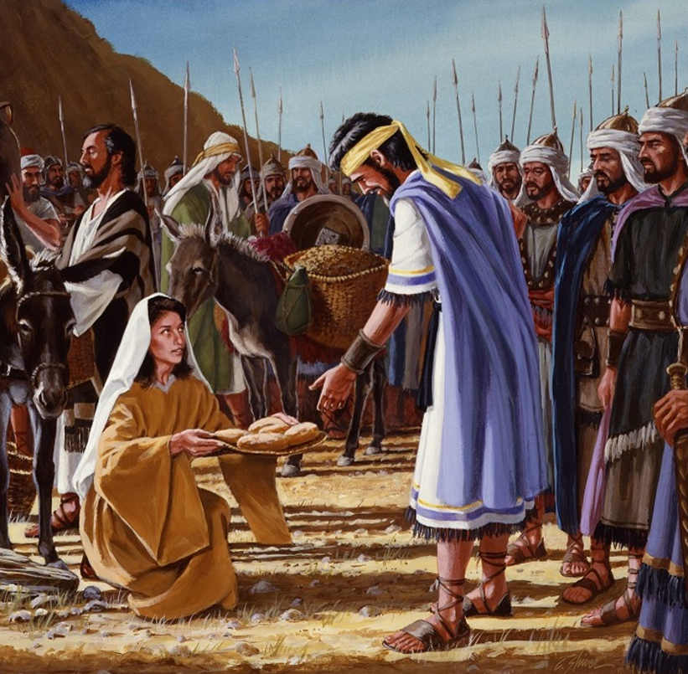
When David was a fugitive fleeing from Saul, he had encamped near Nabal's possessions and protected his shepherds and flocks. In times of need, David sent messengers to Nabal in polite request for food for himself and his men. Nabal responded insolently and returned evil for good by refusing to share his abundance with his neighbors.
She Acts Wisely
David's message could not have been more respectful; but Nabal falsely accused David and his men, in order to justify his selfishness. He compared them to slaves fleeing from their masters. When the messengers returned with this insolent reply, David's indignation was aroused, and he resolved to seek swift vengeance. After Nabal had sent David's young men away, one of Nabal's servants hurriedly went to Nabal’s wife, Abigail, and informed her of what had happened. “But one of the young men told Abigail, Nabal's wife, saying, Behold, David sent messengers out of the wilderness to salute our master; and he railed on them. But the men were very good unto us, and we were not hurt, neither missed we any thing, as long as we were conversant with them, when we were in the fields: They were a wall unto us both by night and day, all the while we were with them keeping the sheep. Now therefore know and consider what thou wilt do; for evil is determined against our master, and against all his household: for he is such a son of Belial, that a man cannot speak to him.” (1 Samuel 25:14-17)
Without consulting her husband or telling him of her intention, Abigail made up an ample supply of provisions, which, laded upon asses, she sent forward in the charge of servants, and herself started out to meet the band of David. She met them in a covert of a hill. “And when Abigail saw David, she hasted, and lighted off the ass, and fell before David on her face, and bowed herself to the ground, and fell at his feet, and said, Upon me, my lord, upon me let this iniquity be: and let thine handmaid, I pray thee, speak in thine audience.” DG 42

Slide 14
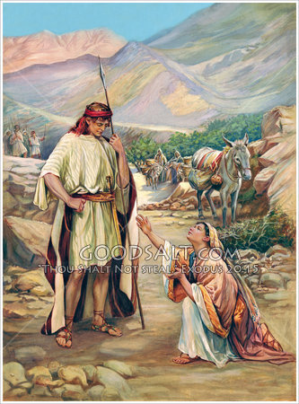
Abigail addressed David with as much reverence as though speaking to a crowned monarch. Nabal had scornfully exclaimed, “Who is David?” but Abigail called him, “my lord.” With kind words she sought to soothe his irritated feelings, and she pleaded with him in behalf of her husband. DG 42.
She Acts Wisely
Abigail revealed the strength of her devotion to her household; and she made it plain to David that the unkind course of her husband was in no wise premeditated against him as a personal affront, but was simply the outburst of an unhappy and selfish nature. DG 42.3 “Now therefore, my lord, as the Lord liveth, and as thy soul liveth, seeing the Lord hath withholden thee from coming to shed blood, and from avenging thyself with thine own hand, now let thine enemies, and they that seek evil to my lord, be as Nabal.” Abigail did not take to herself the credit of this reasoning to turn David from his hasty purpose, but gave to God the honor and the praise. She then offered her rich provision as a peace offering to the men of David, and still pleaded as if she herself were the one who had so excited the resentment of the chief.—Patriarchs and Prophets, 665, 666 (1890). DG 43.
From this history, we can see that there are circumstances under which it is proper for a woman to act promptly and independently, moving with decision in the way she knows to be the way of the Lord. The wife is to stand by the side of the husband as his equal, sharing all the responsibilities of life, rendering due respect to him who has selected her for his lifelong companion. The Lord would have the wife render respect unto her husband, but always as it is fit in the Lord. In the character of Abigail, the wife of Nabal, we have an illustration of womanhood after the order of Christ, while her husband illustrates what a man may become who yields himself to the control of Satan.—Manuscript Releases 21:213 (1891). DG 43

Slide 15


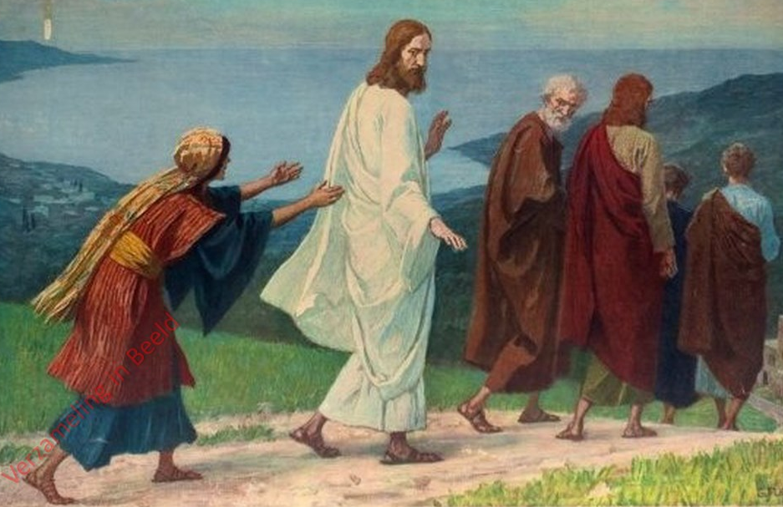
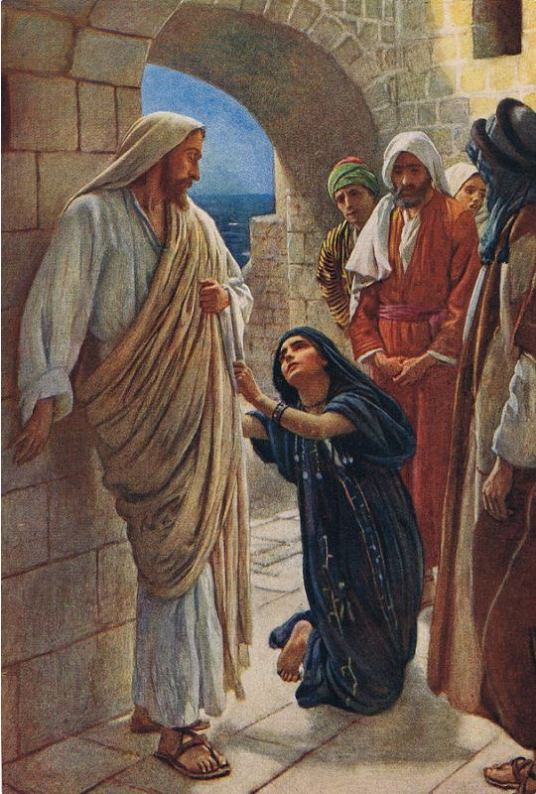
Matthew 15:21-28
The Woman of Faith is Persevering
The Canaanite woman has been a great inspiration to me; for she cried out for Jesus to have mercy on her without caring that, apparently, the Master ignored her. She didn't even pay attention to the disciples dismissing her from their presence because they were annoyed that this woman was screaming behind them. Even Jesus said to the woman:
“But he answered and said, It is not meet to take the children's bread, and to cast it to dogs. And she said, Truth, Lord: yet the dogs eat of the crumbs which fall from their masters' table.” (Matthew 15: 26, 27).
Her faith was manifested in her perseverance and humble attitude in prostrating herself before the Master. so much so that Jesus said to her:
“O woman, great is thy faith: be it unto thee even as thou wilt. And her daughter was made whole from that very hour” (Matthew 15: 28).

Slide 16

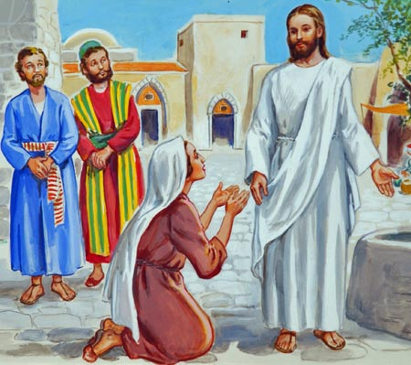
“And, behold, a woman of Canaan came out of the same coasts, and cried unto him, saying, Have mercy on me, O Lord, thou Son of David; my daughter is grievously vexed with a devil”. Matthew 15:22.
She Perseveres
Christ did not immediately reply to the woman's request. He received this representative of a despised race as the Jews would have done. In this He designed that His disciples should be impressed with the cold and heartless manner in which the Jews would treat such a case, as evinced by His reception of the woman, and the compassionate manner in which He would have them deal with such distress, as manifested by His subsequent granting of her petition. But although Jesus did not reply, the woman did not lose faith. As He passed on, as if not hearing her, she followed Him, continuing her supplications. Annoyed by her importunities, the disciples asked Jesus to send her away. They saw that their Master treated her with indifference, and they therefore supposed that the prejudice of the Jews against the Canaanites was pleasing to Him. But it was a pitying Saviour to whom the woman made her plea, and in answer to the request of the disciples, Jesus said, “I am not sent but unto the lost sheep of the house of Israel.” Although this answer appeared to be in accordance with the prejudice of the Jews, it was an implied rebuke to the disciples, which they afterward understood as reminding them of what He had often told them,—that He came to the world to save all who would accept Him. DA 400.3. The woman urged her case with increased earnestness, bowing at Christ's feet, and crying, “Lord, help me.” Jesus, still apparently rejecting her entreaties, according to the unfeeling prejudice of the Jews, answered, “It is not meet to take the children's bread, and to cast it to dogs.”
This was virtually asserting that it was not just to lavish the blessings brought to the favored people of God upon strangers and aliens from Israel. This answer would have utterly discouraged a less earnest seeker. But the woman saw that her opportunity had come. DA 400-401.

Slide 17

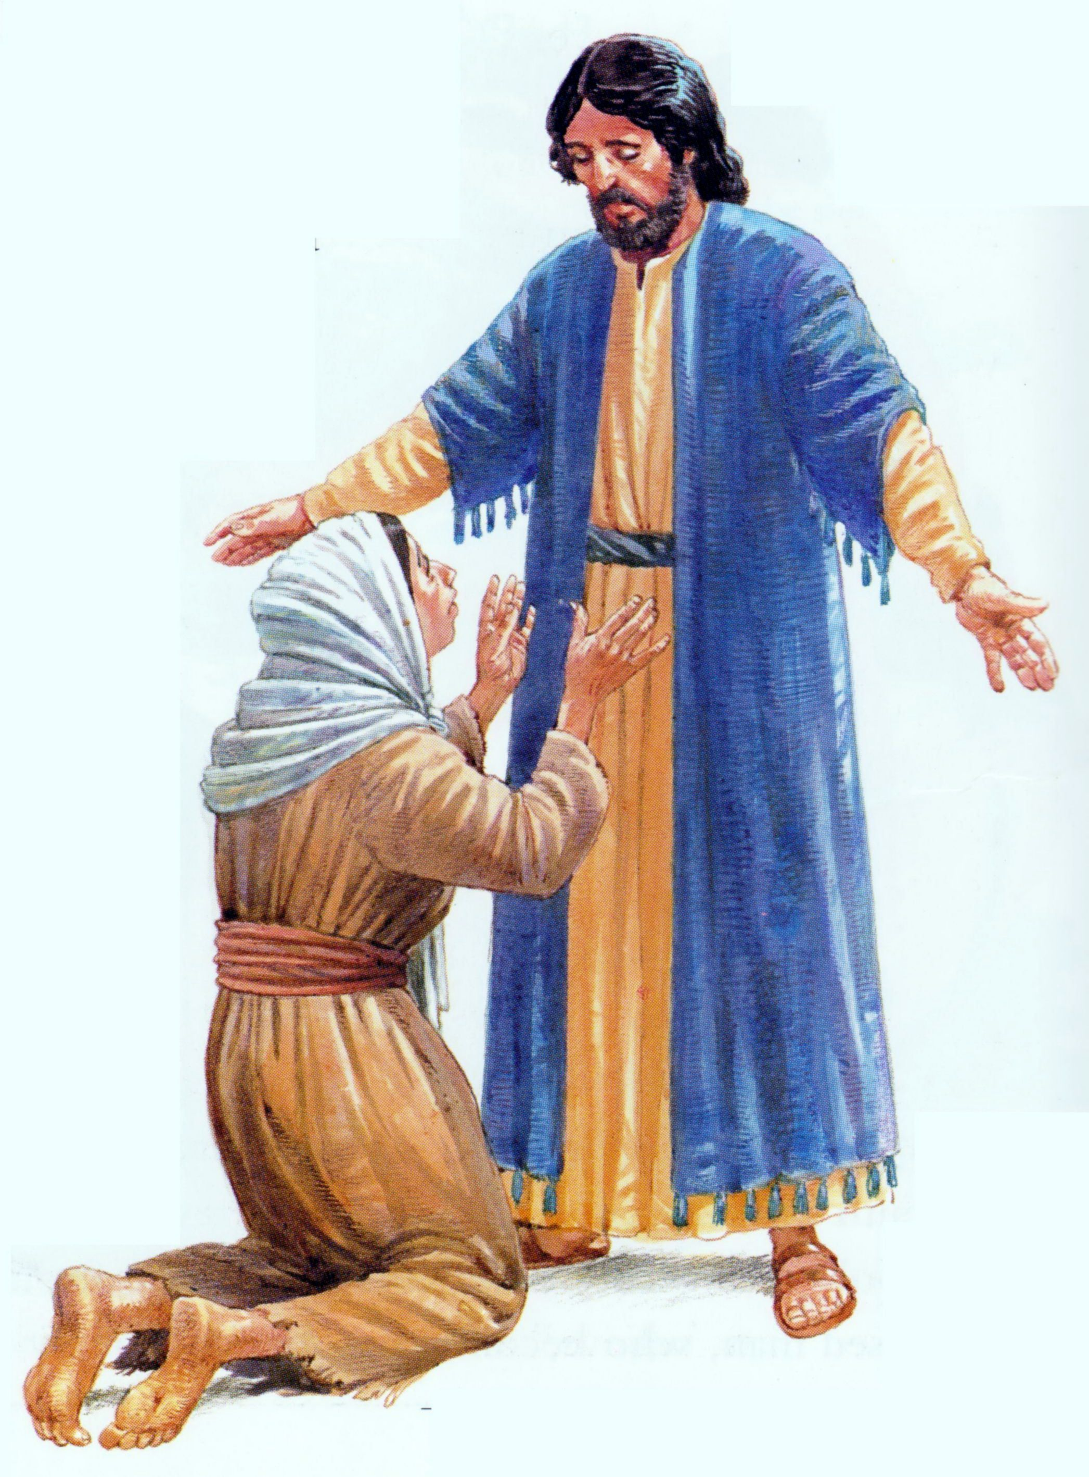
Beneath the apparent refusal of Jesus, she saw a compassion that He could not hide. “Truth, Lord,” she answered, “yet the dogs eat of the crumbs which fall from their masters’ table.” While the children of the household eat at the father's table, even the dogs are not left unfed. They have a right to the crumbs that fall from the table abundantly supplied. So while there were many blessings given to Israel, was there not also a blessing for her? She was looked upon as a dog, and had she not then a dog's claim to a crumb from His bounty?
She perseveres
Jesus had just departed from His field of labor because the scribes and Pharisees were seeking to take His life. They murmured and complained. They manifested unbelief and bitterness, and refused the salvation so freely offered them. Here Christ meets one of an unfortunate and despised race, that has not been favored with the light of God's word; yet she yields at once to the divine influence of Christ, and has implicit faith in His ability to grant the favor she asks. She begs for the crumbs that fall from the Master's table. If she may have the privilege of a dog, she is willing to be regarded as a dog.
She has no national or religious prejudice or pride to influence her course, and she immediately acknowledges Jesus as the Redeemer, and as being able to do all that she asks of Him. The Saviour is satisfied. He has tested her faith in Him. By His dealings with her, He has shown that she who has been regarded as an outcast from Israel is no longer an alien, but a child in God's household. As a child it is her privilege to share in the Father's gifts. Christ now grants her request, and finishes the lesson to the disciples. Turning to her with a look of pity and love, He says, “O woman, great is thy faith: be it unto thee even as thou wilt.” From that hour her daughter became whole. The demon troubled her no more. The woman departed, acknowledging her Saviour, and happy in the granting of her prayer. DA 401

Slide 18


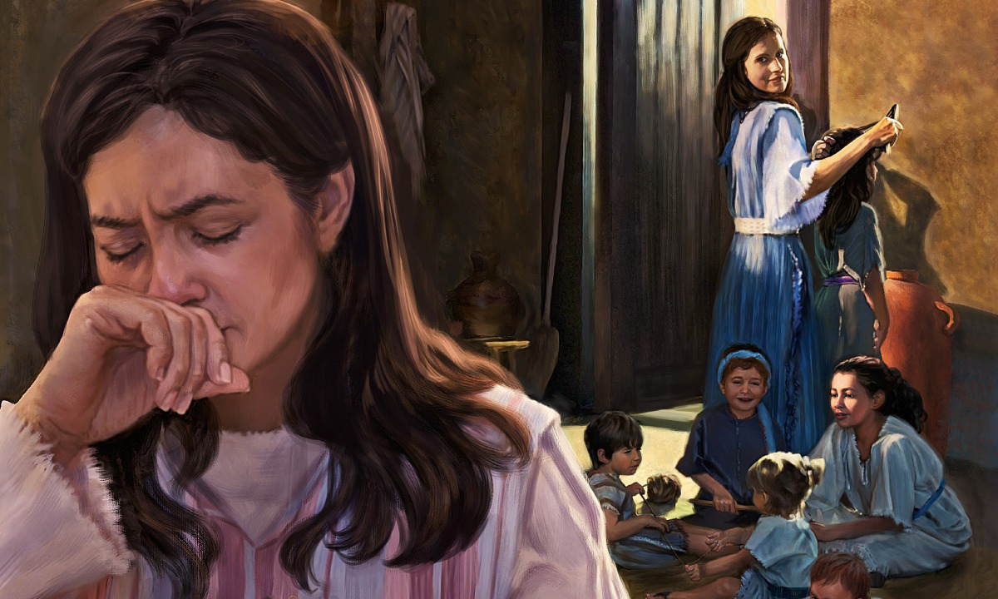
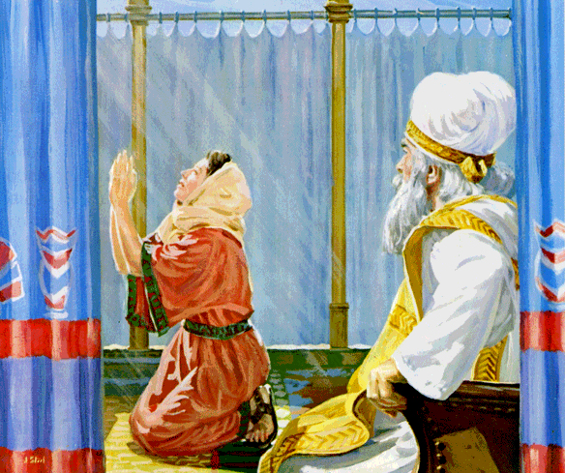
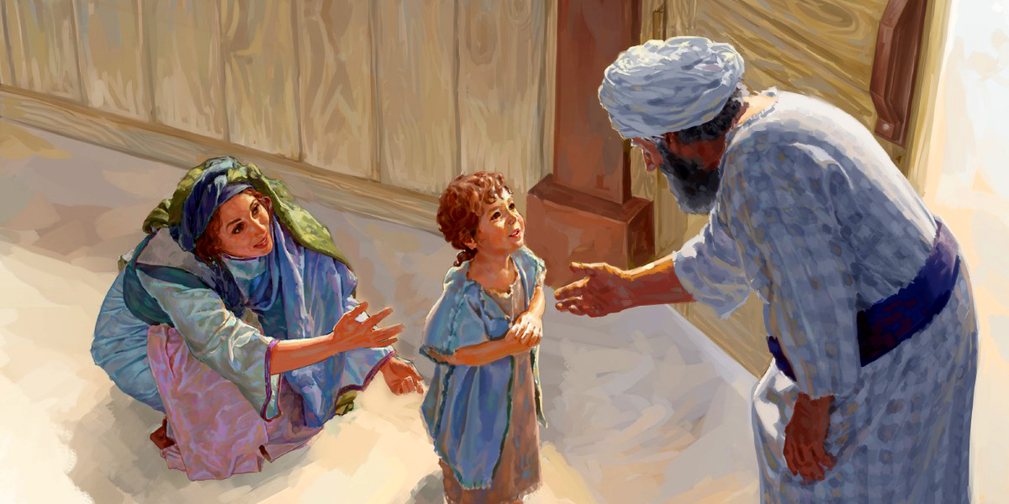
1 Samuel 1
The woman of Faith Keeps Her Word
We all know Hannah as the woman who prayed to the Lord to grant her to have a son.
God, in his mercy, granted it to her, after she had suffered much because of her sterility, and because of the mockery inflicted on her by her rival, Peninnah.
She was even treated unjustly by the priest Eli, who, not understanding her pain, accused her of being drunk in the house of God.
Anna, in the moment of pain and despair, promised the Lord that, if he would grant her the son she had so longed for, she would dedicate him to God all the days of her life. And so he did. She kept her promise, and, once the boy was old enough to serve in the house of God, she dedicated him to the Lord. Like Hannah, we must keep any promises we have made, even if it means losing some personal benefits.

Slide 19

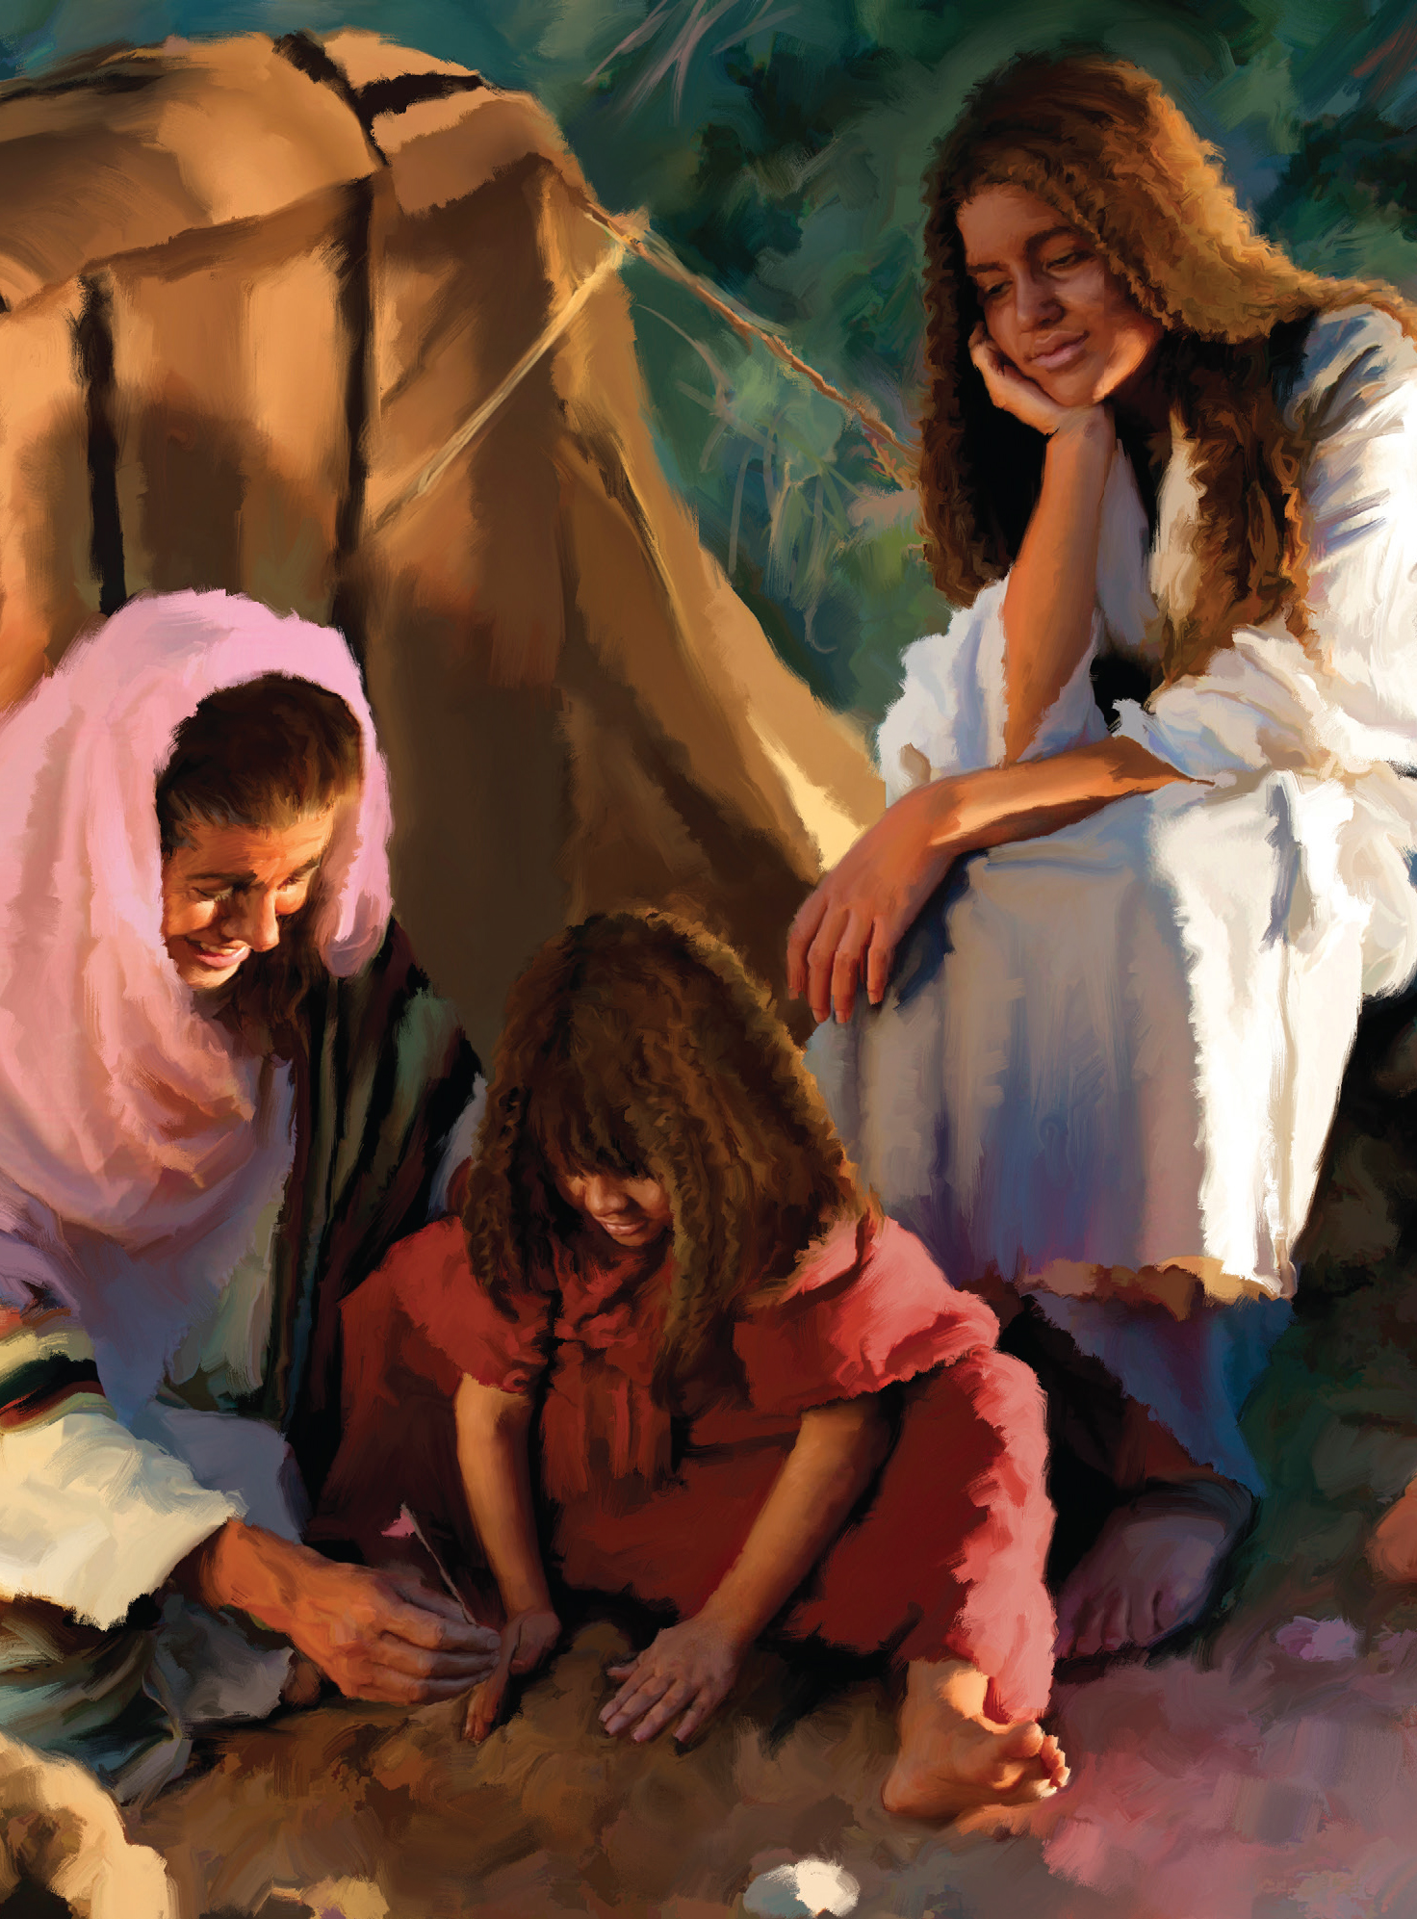
Elkanah, a Levite of Mount Ephraim, was a man of wealth and influence, and one who loved and feared the Lord. His wife, Hannah, was a woman of fervent piety. Gentle and unassuming, her character was marked with deep earnestness and a lofty faith. The blessing so earnestly sought by every Hebrew was denied this godly pair; their home was not gladdened
She Keeps Her Word
by the voice of childhood; and the desire to perpetuate his name led the husband—as it had led many others—to contract a second marriage. But this step, prompted by a lack of faith in God, did not bring happiness. Sons and daughters were added to the household; but the joy and beauty of God's sacred institution had been marred and the peace of the family was broken. Peninnah, the new wife, was jealous and narrow-minded, and she bore herself with pride and insolence. To Hannah, hope seemed crushed and life a weary burden; yet she met the trial with uncomplaining meekness.
Elkanah faithfully observed the ordinances of God. The worship at Shiloh… [Elkanah] up with his family to worship and sacrifice at the appointed gatherings.
After presenting the thank offerings, all the family, according to the established custom, united in a solemn yet joyous feast. Upon these occasions Elkanah gave the mother of his children a portion for herself and for each of her sons and daughters; and in token of regard for Hannah, he gave her a double portion, signifying that his affection for her was the same as if she had had a son. Then the second wife, fired with jealousy, claimed the precedence as one highly favored of God, and taunted Hannah with her childless state as evidence of the Lord's displeasure. This was repeated from year to year, until Hannah could endure it no longer. Unable to hide her grief, she wept without restraint, and withdrew from the feast. Her husband vainly sought to comfort her. “Why weepest thou? and why eatest thou not? and why is thy heart grieved?” he said; “am I not better to thee than ten sons?” PP 569

Slide 20
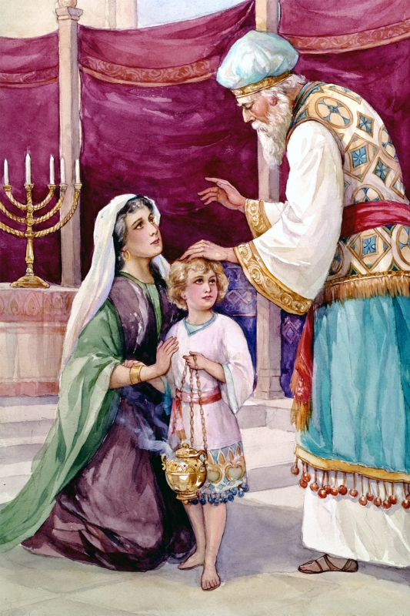
Hannah uttered no reproach. The burden which she could share with no earthly friend she cast upon God. Earnestly she pleaded that He would take away her reproach and grant her the precious gift of a son to nurture and train for Him. And she made a solemn vow that if her request were granted, she would dedicate her child to God, even from its birth.
She Keeps Her Word
Hannah had drawn near to the entrance of the tabernacle, and in the anguish of her spirit she “prayed, ... and wept sore.” Yet she communed with God in silence, uttering no sound. In those evil times such scenes of worship were rarely witnessed. Irreverent feasting and even drunkenness were not uncommon, even at the religious festivals; and Eli the high priest, observing Hannah, supposed that she was overcome with wine. Thinking to administer a deserved rebuke, he said sternly, “How long wilt thou be drunken? put away thy wine from thee!” Pained and startled, Hannah answered gently, “No, my lord, I am a woman of a sorrowful spirit: I have drunk neither wine nor strong drink, but have poured out my soul before the Lord. Count not thine handmaid for a daughter of Belial: for out of the abundance of my complaint and grief have I spoken hitherto.”
The high priest was deeply moved, for he was a man of God; and in place of rebuke he uttered a blessing: “Go in peace: and the God of Israel grant thee thy petition that thou hast asked of Him.” Hannah's prayer was granted; she received the gift for which she had so earnestly entreated.
As she looked upon the child, she called him Samuel—“asked of God.” As soon as the little one was old enough to be separated from his mother, she fulfilled her vow. She loved her child with all the devotion of a mother's heart; day by day, as she watched his expanding powers and listened to his childish prattle, her affections entwined about him more closely. He was her only son, the special gift of Heaven; but she had received him as a treasure consecrated to God, and she would not withhold from the Giver His own.
Once more Hannah journeyed with her husband to Shiloh and presented to the priest, in the name of God, her precious gift, saying, “For this child I prayed; and the Lord hath given me my petition which I asked of Him: therefore also I have lent him to the Lord; as long as he liveth he shall be lent to the Lord.” Eli was deeply impressed by the faith and devotion of this woman of Israel. PP 569- 571

Slide 21




2 Timothy 1:5
The Woman of Faith Instructs Her Children in the Word of God
Lois and Eunice are two women mentioned by the apostle Paul as having unfeigned faith: “When I call to remembrance the unfeigned faith that is in thee, which dwelt first in thy grandmother Lois, and thy mother Eunice; and I am persuaded that in thee also” (2 Timothy 1:5).
They are the example of women who passed on their faith to their children, thus fulfilling a divine command: “And thou shalt teach them diligently unto thy children, and shalt talk of them when thou sittest in thine house, and when thou walkest by the way, and when thou liest down, and when thou risest up” (Deuteronomy 6:7).
We see in the young Timothy a knowledge of God and his exceptional Word. This was the result of the instruction he had received in his childhood. As a result, he stayed in God's ways and became a valuable leader.

Slide 22


The mother's work is given her of God, to bring up her children in the nurture and admonition of the Lord. The love and fear of God should ever be kept before their tender minds. When corrected, they should be taught to feel that they are admonished of God, that He is displeased with deception, untruthfulness, and wrongdoing.
Instructs Her Children in God's Word
Thus the minds of little ones may be so connected with God that
all they do and say will be in reference to His glory; and in afteryears they will not be like the reed in the wind, continually wavering between inclination and duty.
If in their tender years, the minds of children are filled with pleasant images of truth, of purity and goodness, a taste will be formed for that which is pure and elevated, and their imagination will not become easily corrupted or defiled. While if the opposite course is pursued, if the minds of the parents are continually dwelling upon low scenes; if their conversation lingers over objectionable features of character; if they form a habit of speaking complainingly of the course others have pursued, the little ones will take lessons from the words and expressions of contempt, and will follow the pernicious example. The evil impress, like the taint of the leprosy, will cleave to them in afterlife. The seeds sown in infancy by the careful, God-fearing mother will become trees of righteousness, which will blossom and bear fruit; and the lessons given by a God-fearing father by precept and example will, as in the case of Joseph, yield an abundant harvest by and by.
Will parents review their work in the educating and training of their children, and consider whether they have done their whole duty in hope and faith that these children may be a crown of rejoicing in the day of the Lord Jesus? Have they so labored for the welfare of their children that Jesus can look down from heaven and by the gift of His Spirit sanctify their efforts? Parents, it may be yours to prepare your children for the highest usefulness in this life, and to share at last the glory of that which is to come.—Good Health, January 1, 1880. YRP 214

Slide 23






Judges 13
The Woman of Faith Accepts God’s Will
There was a woman in Israel who loved God and served Him, even in the midst of the apostasy that was around her.
God loved her in a special way and therefore sent a message directly to her.
She believed, accepted, and obeyed all the orders the angel instructed her regarding the education and upbringing of the child she was about to conceive. Thus, she became the mother of Samson, the great judge of Israel.

Slide 24



Amid the widespread apostasy the faithful worshipers of God continued to plead with Him for the deliverance of Israel. Though there was apparently no response, though year after year the power of the oppressor continued to rest more heavily upon the land, God's providence was preparing help for them. Even in the early years of the Philistine oppression a child was born through whom God designed to humble the power of these mighty foes.
She Accepts God’s Will
On the border of the hill country overlooking the Philistine plain was the little town of Zorah. Here dwelt the family of Manoah, of the tribe of Dan, one of the few households that amid the general defection had remained true to Jehovah. To the childless wife of Manoah “the Angel of Jehovah” appeared with the message that she should have a son, through whom God would begin to deliver Israel. In view of this the Angel gave her instruction concerning her own habits, and also for the treatment of her child: “Now therefore beware, I pray thee, and drink not wine nor strong drink, and eat not any unclean thing.” And the same prohibition was to be imposed, from the first, upon the child, with the addition that his hair should not be cut; for he was to be consecrated to God as a Nazarite from his birth.
The woman sought her husband, and, after describing the Angel, she repeated His message. Then, fearful that they should make some mistake in the important work committed to them, the husband prayed, “Let the Man of God which Thou didst send come again unto us, and teach us what we shall do unto the child that shall be born.” PP 560.3 When the Angel again appeared, Manoah's anxious inquiry was, “How shall we order the child, and how shall we do unto him?” The previous instruction was repeated—“Of all that I said unto the woman let her beware. She may not eat of anything that cometh of the vine, neither let her drink wine or strong drink, nor eat any unclean thing: all that I commanded her let her observe.” PP 560

Slide 25



When King Josiah read about the punishment God would send to Israel for departing from His Law, he was greatly distressed because the people were doing exactly the wicked things foretold in Deuteronomy.
2 Kings 22:8-20
The Woman of Faith is Trustworthy
Wanting to know the remedy to this situation, he decided to consult God through a prophetess: Huldah.
Although there were other prophets of God at that time, the king preferred to make this consultation through the prophetess whom he considered most trustworthy, and who was respected for it throughout Jerusalem.
When consulted, Hulda did not hesitate to convey the message without omitting anything.
With strong words, she indicated the harsh punishment of the people of Judah for their apostasy. However, he used tender words when addressing the king with a message of encouragement and praise for the way he had reacted to God's Word.

Slide 26




She Is Trustworthy
Josiah, from his earliest manhood, had endeavored to take advantage of his position as king to exalt the principles of God's holy law. And now, while Shaphan the scribe was reading to him out of the book of the law, the king discerned in this volume a treasure of knowledge, a powerful ally, in the work of reform he so much desired to see wrought in the land .
He resolved to walk in the light of its counsels, and also to do all in his power to acquaint his people with its teachings and
to lead them, if possible, to cultivate reverence and love for the law of heaven. But was it possible to bring about the needed reform? Israel had almost reached the limit of divine forbearance; soon God would arise to punish those who had brought dishonor upon His name. Already the anger of the Lord was kindled against the people. Overwhelmed with sorrow and dismay, Josiah rent his garments and bowed before God in agony of spirit, seeking pardon for the sins of an impenitent nation. DG 44.

Slide 27


At that time the prophetess Huldah lived in Jerusalem, near the temple. With his mind filled with anxiety, the king turned to her to inquire of the Lord through his chosen messenger. He wanted to know if by any means of his own he could save the sinner Judah who was on the very threshold of ruin. The gravity of the situation and the respect he felt for the prophetess led him to choose the leading men of the kingdom to be his messengers.
She Is Trustworthy
Through Huldah, the Lord sent Josiah the message that the ruin upon Jerusalem would not be averted. Even if the people now humbled themselves before God, they could not escape punishment. Their senses had been deadened by the continual practice of evil, and if judgment did not come upon them, they would soon return to the same sinful practices. "Tell the man who sent you," declared the prophetess, "Thus says the Lord: 'Behold, I bring upon this place, and upon those who dwell therein, all the evil of which this book speaks, which the king of Judah has read; because they forsook me, and burned incense to other gods, provoking me to anger with all the work of their hands; my wrath is kindled against this place, and it will not be quenched" 2 Kings 22:15-17.
However, because the king had humbled his heart before God, the Lord would recognize his readiness to seek forgiveness and mercy. To him was sent the message: "Because you heard the words of the book, and your heart was softened, and you humbled yourself before the Lord, when you heard what I have spoken against this place, and against its inhabitants, which will be made desolate and cursed, and you tore your clothes, and wept before me, I also have heard you, says Jehovah. Therefore, behold, I will gather you to your fathers, and you will be brought to your tomb in peace, and your eyes will not see all the evil that I bring upon this place" 2 Kings 22:18-20. DG 44

Slide 28





Acts 16:11-15
The Woman of Faith Is Hospitable
Lydia lived in the city of Thyatira. She was engaged in commerce, selling expensive purple garments. She was Jewish, worshiping the true God.
Every Saturday she gathered with other believing women to worship God by the river.
When Paul preached the gospel of Jesus to them, she immediately accepted it.
Once baptized, her first joyful response was to give hospitality to the disciples who had passed on to her the good news of salvation.

Slide 29


The time had come for the gospel to be preached beyond the confines of Asia Minor. The call was imperative and did not admit of delay [...]. Luke declares [...]: "Setting sail, then, from Troas, we came straight to Samothrace, and the next day to Neapolis; and thence to Philippi, which is the first city of the province of Macedonia, and a colony” Acts 16:11-12.
She Is Hospitable
“On the Sabbath,” Luke continues, “we went out of the city by a river side, where prayer was wont to be made; and we sat down, and spake unto the women which resorted thither. And a certain woman named Lydia, a seller of purple, of the city of Thyatira, which worshipped God, heard us: whose heart the Lord opened.” Lydia received the truth gladly. She and her household were converted and baptized, and she entreated the apostles to make her house their home.—The Acts of the Apostles, 211, 212 (1911). God's Spirit can only enlighten the understanding of those who are willing to be enlightened. We read that God opened the ears of Lydia, so that she attended to the message spoken by Paul. To declare the whole counsel of God and all that was essential for Lydia to receive—this was the part Paul was to act in her conversion; and then the God of all grace exercised His power, leading the soul in the right way. God and the human agent cooperated, and the work was wholly successful.—The S.D.A. Bible Commentary 6:1062 (1900). Acting upon the instruction given by Christ, the apostles would not urge their presence where it was not desired. “They went out of the prison, and entered into the house of Lydia: and when they had seen the brethren, they comforted them, and departed.” DG 73.

Slide 30






Ruth
The Woman of Faith Is Filial
After a ten-year stay in the land of Moab, Naomi, whose spouse and children had died, learned that there was again plenty in the land of Judah, and she decided to return. Ruth, with a devotion that almost speaks for Naomi as much as for Ruth herself, broke all ties of home and kinship to accompany her. With a final glance at the fertile fields of her homeland, Moab, and with an impassioned exclamation addressed to Naomi, "Thy people shall be my people, and thy God my God," she entered a strange land, united with God's true people, and became a worshiper of the God of heaven.
This loyalty to her mother-in-law eventually resulted in her becoming one of the progenitors of David, the sweet psalmist of Israel; of Solomon, the wisest of the sons of men; of Zerubbabel, the later Moses; and of the Messiah, the son of David. (SDABC Introduction to the Book of Ruth).

Slide 31




When her spouse died, Ruth found herself in a very disadvantaged situation. Being a widow and childless drove her into poverty.
She Is Filial
Although she could rely on her family to overcome this situation, Ruth chose to share her fate with a person who was in an even worse situation than her: her mother-in-law, Naomi. She had lost her husband and children, and she had no one in Moab who could care for her. Ruth demonstrated unwavering resolve by refusing to allow her mother-in-law to go through such a horrific stage alone.
Ruth's decision implied a renunciation of her own safety and the support she could receive in her homeland, to face an uncertain future in a strange land. Her words express her love and loyalty (Ruth 1:16-17).
Upon returning to Israel, Ruth went to gather ears of grain in Boaz's field so that she could support herself and her mother-in-law. Boaz showed her extraordinary kindness by inviting her to eat and treating her as one of his own workers.
When Naomi learned that Ruth had gleaned in Boaz's field, she told her that he was a redeemer, a close relative who could marry her and save her family.
One night, Ruth (advised by her mother-in-law) proposed to Boaz, and he agreed to redeem her. He had observed in Ruth a special filial love for her mother-in-law and a character worthy of a true daughter of God. Without wasting any time, Boaz made all the necessary arrangements to marry her. From his descendants the Messiah was born.
The story of Ruth does not tell us the story of romantic love, but of the reverent love of a young widow for her spouse's mother (filial love). The love that is revealed in Ruth's character is of the purest, most self-sacrificing, and extraordinary kind.

Slide 32




Priscilla and her husband Aquila were tentmakers. They were faithful in teaching others about Jesus Christ. Paul, also being a tentmaker, worked closely with them, teaching them more about Christ. The envy and rage of the Jews against the Christians [in Rome] knew no bounds, and the unbelieving residents were constantly stirred up. They made complaints that the Christian Jews were disorderly, and dangerous to the public good. Constantly they were setting in motion something that would stir up strife. This caused the Christians to be banished from Rome.—The Review and Herald, March 6, 1900. DG 73.
Acts 18:1-3
The woman of Faith Is a Collaborator
Soon after his arrival at Corinth, Paul found “a certain Jew named Aquila, born in Pontus, lately come from Italy, with his wife Priscilla.” These were “of the same craft” with himself. Banished by the decree of Claudius, which commanded all Jews to leave Rome, Aquila and Priscilla had come to Corinth, where they established a business as manufacturers of tents. Paul made inquiry concerning them, and learning that they feared God and were seeking to avoid the contaminating influences with which they were surrounded, “he abode with them, and wrought: ... And he reasoned in the synagogue every sabbath, and persuaded the Jews and the Greeks.” Acts 18:2-4.—The Acts of the Apostles, 349, 350 (1911). DG 74.

Slide 33



The apostle Paul was an able minister of the gospel, and yet he labored with his hands, doing the humble work of a tent-maker. By working with his hands he did not lessen his work of communicating to Aquila and Priscilla the great truth of the gospel of Christ DG 74.
She Is a Collaborator
These two men and Priscilla labored with their hands, and Paul's designs in tent-making were ingenious. He brought fresh methods into his work also as he labored for the people, preaching the gospel of Jesus Christ. Many were brought to a knowledge of the truth by witnessing the faithful toiler making tents to support himself, that he might not be dependent upon anyone for food and raiment. While thus at work, he showed himself skillful, “not slothful in business; fervent in spirit; serving the Lord.” And in preaching the Word, he
was no less fervent and able in speech because of his business tact. Why did Paul thus connect mechanical labor with the preaching of the gospel? Was not the laborer worthy of his hire? Why did he not labor all his time in preaching? Why waste time and strength in making tents? But Paul did not regard the time spent in making tents lost by any means. As he worked with Aquila, he kept in touch with the great Teacher. He gave Aquila needed instruction in spiritual things, and he also educated the believers in unity. While working at his trade he gave an example in diligence and thoroughness. He was diligent in business, fervent in spirit, serving the Lord. He and Aquila and Priscilla had more than one prayer-and-praise meeting with those associated with them in tent-making. This was a testimony to the value of the truth they were presenting.
Aquila and Priscilla were not called to give their whole time to the ministry of the gospel, yet these humble laborers were used by God to show Apollos the way of truth more perfectly. The Lord employs various instrumentalities for the accomplishment of His purpose, and while some with special talents are chosen to devote all their energies to the work of teaching and preaching the gospel, many others, upon whom human hands have never been laid in ordination, are called to act an important part in soulsaving. After leaving Corinth, Paul's next scene of labor was Ephesus. He was on his way to Jerusalem to attend an approaching festival, and his stay at Ephesus was necessarily brief. He reasoned with the Jews in the synagogue, and so favorable was the impression made upon them that they entreated him to continue his labors among them. His plan to visit Jerusalem prevented him from tarrying then, but he promised to return to them, “if God will.” Aquila and Priscilla had accompanied him to Ephesus, and he left them there to carry on the work that he had begun.—The Acts of the Apostles, 269 (1911). DG 75.2

Slide 34














Matthew 27:19
The Woman of Faith Transmits the Message that God Gives Her
Pilate's spouse knew about the miracles that were performed by Jesus, and she spoke to him about it.
When Pilate was judging Jesus, an angel was sent to impress her through dreams of the nature of the man who was being judged by her husband.
As soon as she awoke, she wrote a letter in which she told Pilate that she had suffered much in a dream for Jesus' sake, and that Jesus was innocent, and that he should not have anything to do with His condemnation.
Unable to appear in court, she gave the letter to a soldier to be taken immediately to Pilate, hoping that he would heed the message God had given her.

Slide 35



Jesus had many sympathizers in the company about Him, and His answering nothing to the many questions put to Him amazed the throng. Under all the mockery and violence of the mob, not a frown, not a troubled expression, rested upon His features. He was dignified and composed. The spectators looked upon Him with wonder. They compared His perfect form and firm, dignified bearing with the appearance of
She Transmits the Message that God Gives Her
those who sat in judgment against Him, and said to one another that He appeared more like a king than any of the rulers. He bore no marks of being a criminal. His eye was mild, clear, and undaunted, His forehead broad and high. Every feature was strongly marked with benevolence and noble principle. His patience and forbearance were so unlike man that many trembled. Even Herod and Pilate were greatly troubled at His noble, Godlike bearing. From the first, Pilate was convicted that Jesus was no common man. He believed Him to be an excellent character, and entirely innocent of the charges brought against Him.
The angels who were witnessing the scene marked the convictions of the Roman governor, and to save him from engaging in the awful act of delivering Christ to be crucified, an angel was sent to Pilate's wife, and gave her information through a dream that it was the Son of God in whose trial her husband was engaged, and that He was an innocent sufferer. She immediately sent a message to Pilate, stating that she had suffered many things in a dream on account of Jesus and warning him to have nothing to do with that holy man. PE 172.

Slide 36

The messenger, pressing hastily through the crowd, placed the letter in the hands of Pilate. As he read, he trembled and turned pale, and at once determined to have nothing to do with putting Christ to death. If the Jews would have the blood of Jesus, he would not give his influence to it, but would labor to deliver Him. EW 173.
Pilate looked at the men who had Jesus in charge, and then his gaze rested searchingly on Jesus. He had had to deal with all kinds of criminals; but never before had a man bearing marks of such goodness and nobility been brought before him. On His face he saw no sign of guilt, no expression of fear, no boldness or defiance. He saw a man of calm and dignified bearing, whose countenance bore not the marks of a criminal, but the signature of heaven. DA 724.1 Christ's appearance made a favorable impression upon Pilate. His better nature was roused. He had heard of Jesus and His works. His wife had told him something of the wonderful deeds performed by the Galilean prophet, who cured the sick and raised the dead. Now this revived as a dream in Pilate's mind. He recalled rumors that he had heard from several sources. He resolved to demand of the Jews their charges against the prisoner. DA 724.
She transmits the message that God gives her

Slide 37




2 Kings 11
The woman of Faith Is Bold
Jehosheba was the daughter of Jehoram king of Judah. When Jehoram died, Ahaziah, Jehosheba's brother ascended the throne. Shortly thereafter he was killed by Jehu, king of Israel.
Then Athaliah (daughter of Jezebel and spouse of Jehoram) ordered all the royal descendants to be killed.
If Athaliah succeeded in her purpose, King David's descendants would disappear and, with it, the birth of the Messiah would be compromised.
With this in mind, Jehosheba boldly decided to save the life of Ahaziah's youngest son, her nephew Joash.
Because she was the high priest's spouse, she took him (along with his nurse) to a room in the temple where he was safe for six years.
Athaliah did not suspect at any time that one of the grandchildren had survived the massacre.
In the seventh year, with a large deployment of soldiers, Jehoiada, Jehosheba's spouse, the high priest, proclaimed Joash king of Judah.

Slide 38



After he had been proclaimed king by the army, Jehu hastened to Jezreel, where he began his work of execution on those who had deliberately chosen to continue in sin and to lead others into sin. Jehoram of Israel, Ahaziah of Judah, and Jezebel the queen mother, with “all that remained of the house of Ahab in Jezreel, and all his great men, and his kinsfolks, and his priests,” were slain. “All the prophets of Baal, all his servants, and all his priests” dwelling at the center of Baal worship near Samaria, were put to the sword. The idolatrous images were broken down and burned, and the temple of Baal was laid in ruins. “Thus Jehu destroyed Baal out of Israel.” 2 Kings 10:11, 19, 28. PK 215.
Tidings of this general execution reached Athaliah, Jezebel's daughter, who still occupied a commanding position in the kingdom of Judah. When she saw that her son, the king of Judah, was dead, “she arose and destroyed all the seed royal of the house of Judah.” In this massacre all the descendants of David who were eligible to the throne were destroyed, save one, a babe named Joash, whom the wife of Jehoiada the high priest hid within the precincts of the temple.
For six years the child remained hidden, while “Athaliah reigned over the land.” 2 Chronicles 22:10, 12. At the end of this time, “the Levites and all Judah” (2 Chronicles 23:8) united with Jehoiada the high priest in crowning and anointing the child Joash and acclaiming him their king. “And they clapped their hands, and said, God save the king.” 2 Kings 11:12. PK 215.
She’s Bold

Slide 39


The Woman Who Touched Jesus' Mantle: She Trusts in God
Rebeca: She Is Brave
Slave Girl: Testifies of God's Power
Jael: She Is Determined
Abigail: She Acts Wisely
The Canaanite Woman: She Is Persevering
Ana: She Keeps Her Word
Lois and Eunice: She Instructs Her Children in God's Word
Samson's Mother: She Accepts God's Will
Hulda: She Is Trustworthy
Lidia: She Is Hospitable
Ruth: She Is Filial
Priscila: She is a Collaborator
Pilate's Wife: She Transmits the Message God Gives Her
Josaba: She's bold

Slide 40


The woman of faith allows God's will to be fulfilled in her life; and in obeying Him he cultivates the courage developed by all who trust in the Lord to face the challenges that lie ahead. She learns to persevere in all that she undertakes, and as a result, she acquires the wisdom that will enable her to witness to her neighbors, family, and friends.
The women of faith we find in the Bible were human like you and me. They had trials, they made mistakes, they experienced losses; but success in their lives was based on the confidence they had that the Almighty God was there to help them gain the victory. Be a woman of faith.

