Slide 1
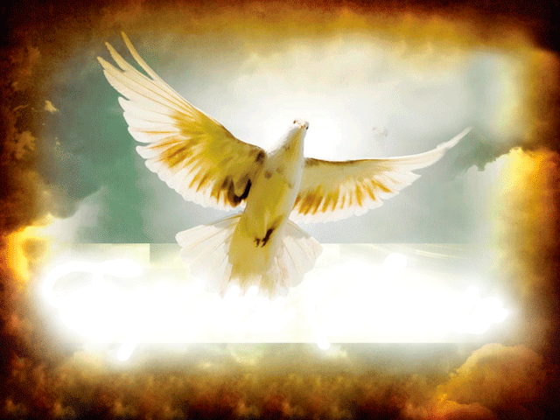

Slide 2
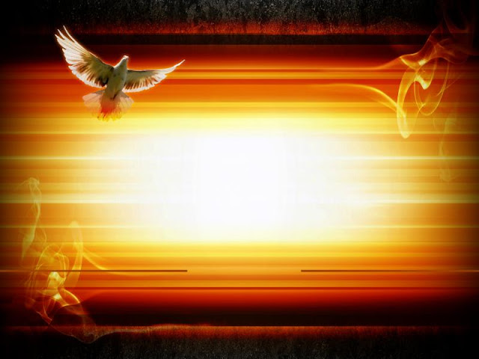
Whenever we speak of the Holy Spirit, we think of the New Testament and specifically of Pentecost. God did not reserve the special graces of the Holy Spirit only for New Testament times. Also, in ancient times He trained His servants to fulfill their tasks by the outpouring of the Holy Spirit.
What happens when we have received the Holy Spirit? Do we stay inactive, or does it drive us to act?
When we have received the Holy Spirit, we are asked to act. The Spirit of God is the originator of all good things and all great achievements, and He works through human instruments.
What happens when a person is filled with the Holy Spirit? What does He give that person to train him for his mission?

Slide 3

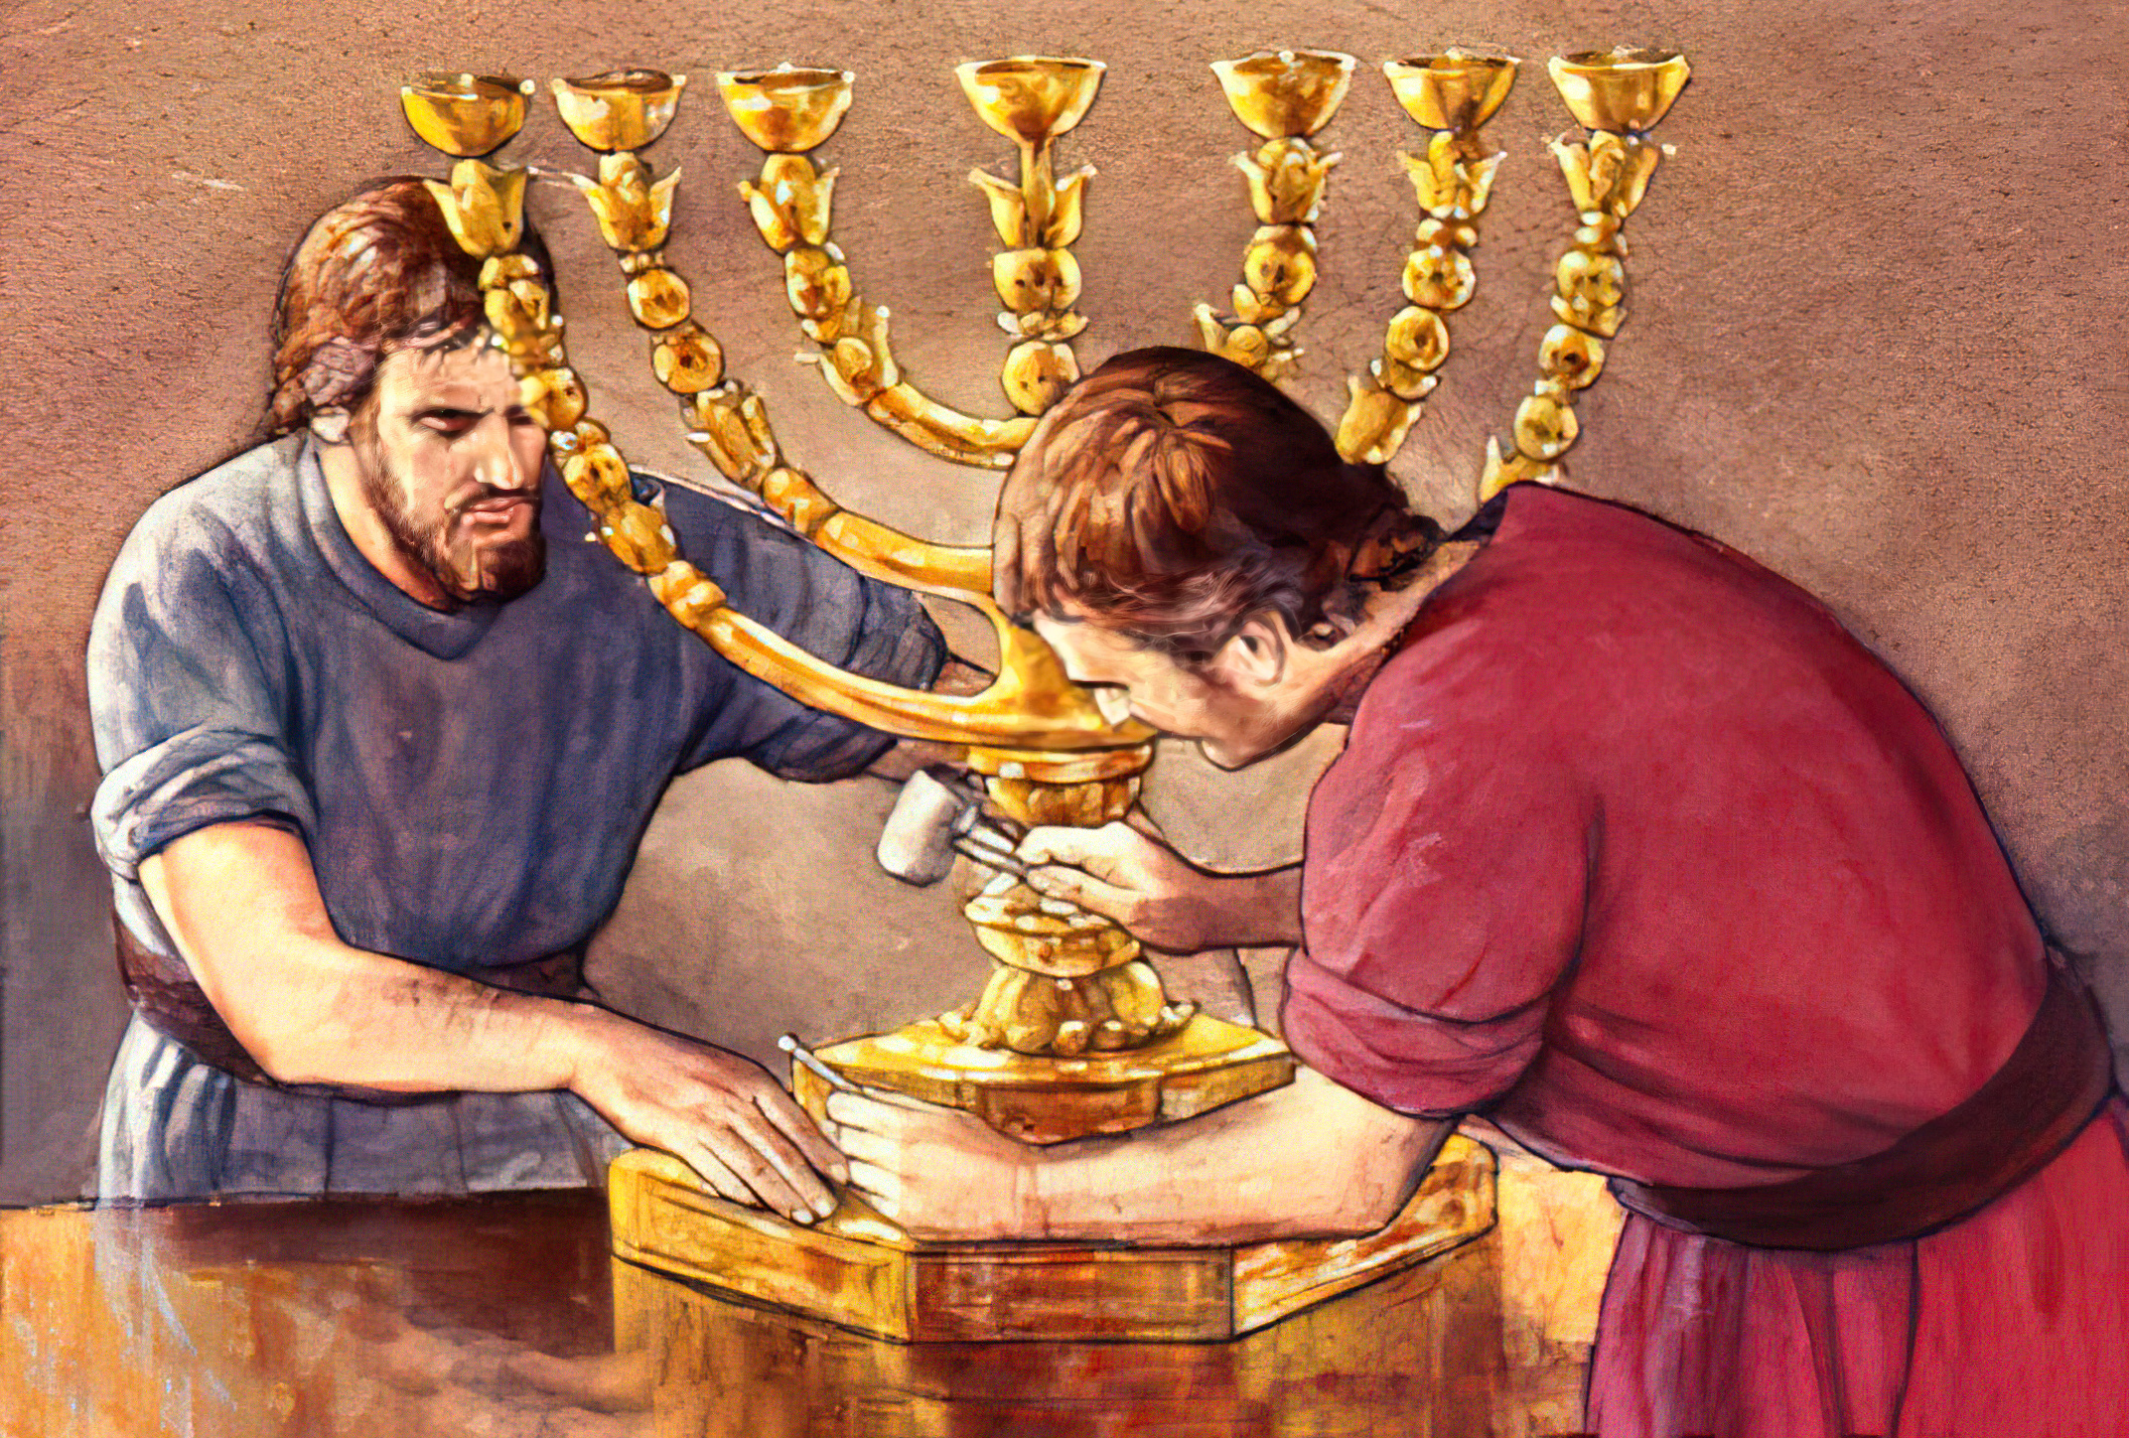

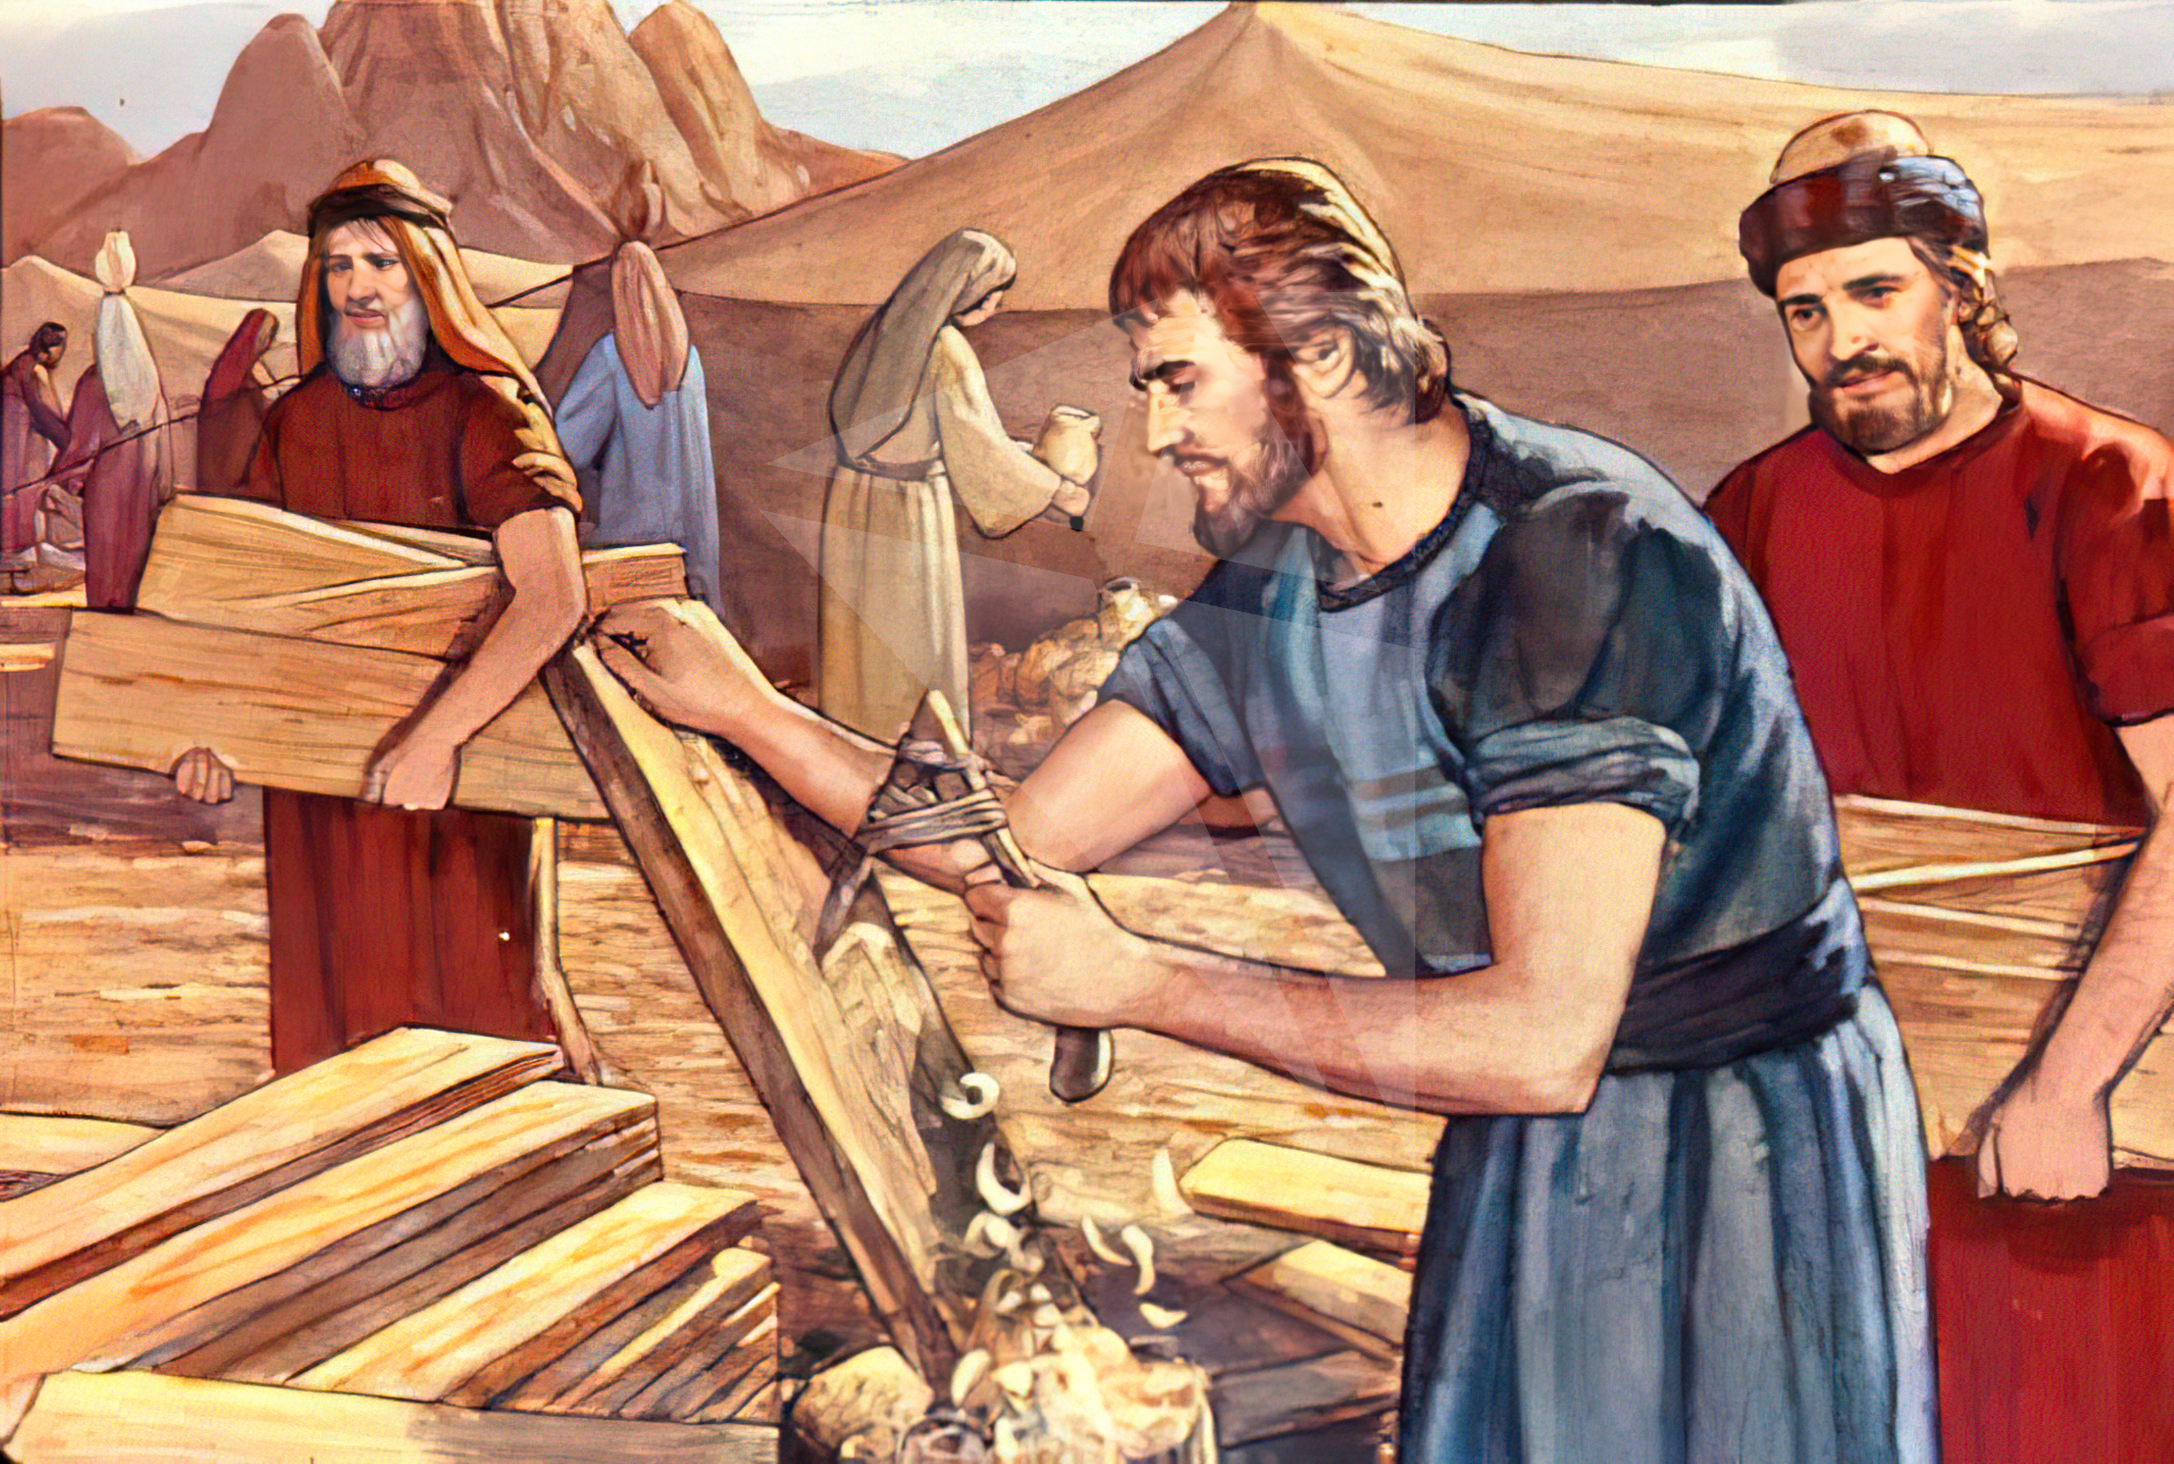
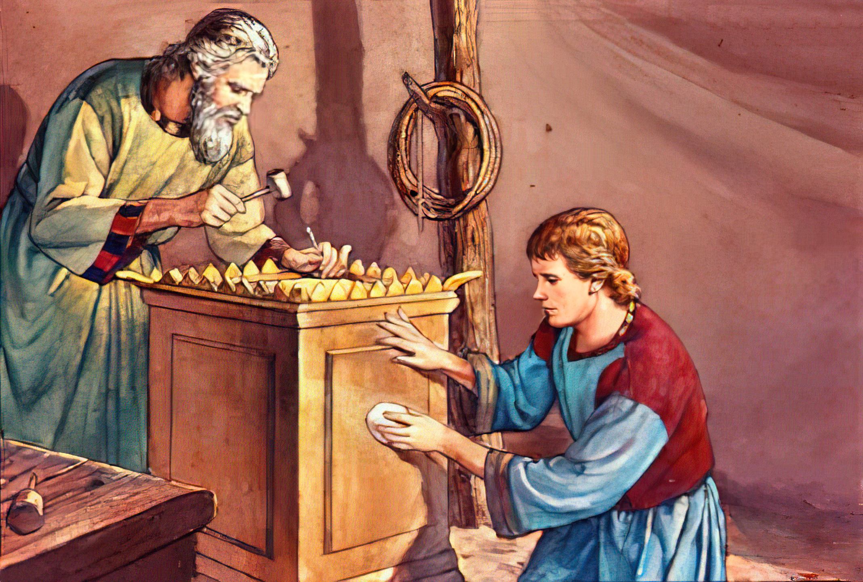
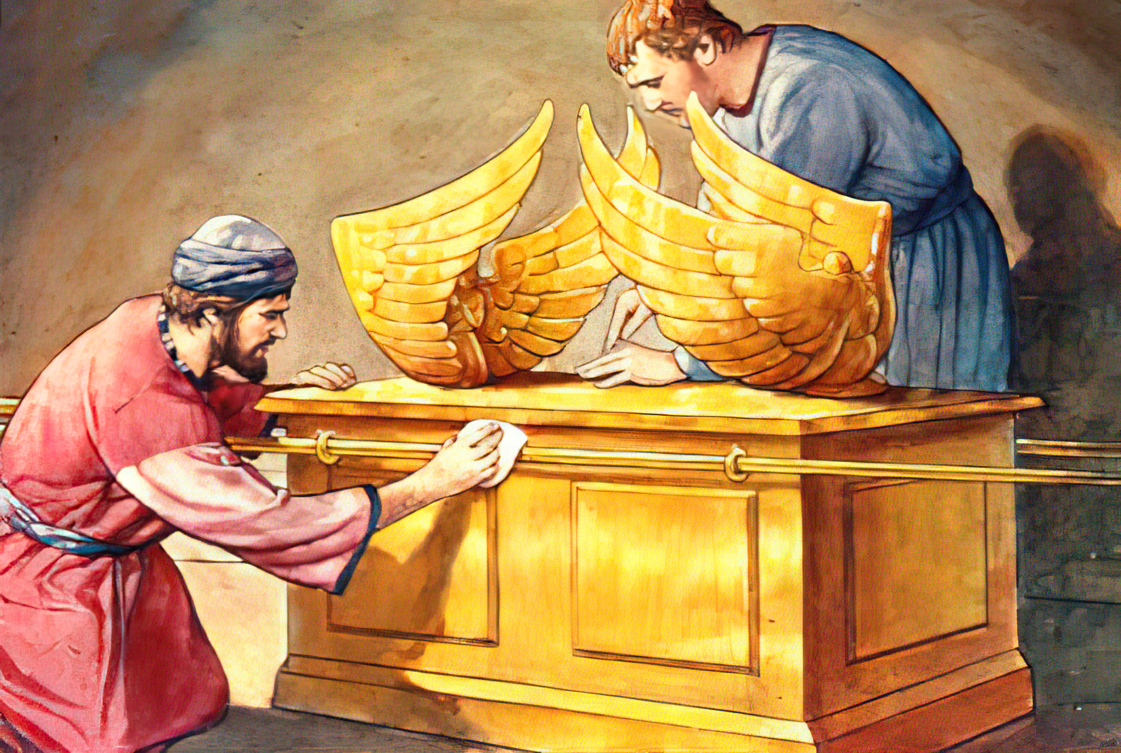
The Holy Spirit Gives Knowledge, Intelligence, Wisdom, and Skill
“And the Lord spake unto Moses, saying, See, I have called by name Bezaleel the son of Uri, the son of Hur, of the tribe of Judah: And I have filled him with the spirit of God, in wisdom, and in understanding, and in knowledge, and in all manner of workmanship, To devise cunning works, to work in gold, and in silver, and in brass, And in cutting of stones, to set them, and in carving of timber, to work in all manner of workmanship.” (Exodus 31:1-5)
Notes:
El Espíritu Santo le impartiría a Bezaleel "ciencia", es decir información fidedigna; "inteligencia", o sea sentido común para aplicar los conocimientos; y "sabiduría", o sea discernimiento, buen juicio y discreción. Además recibiría “destreza adicional en todo arte”, lo que incluía pericia o don artístico en su calidad de artífice principal.

Slide 4

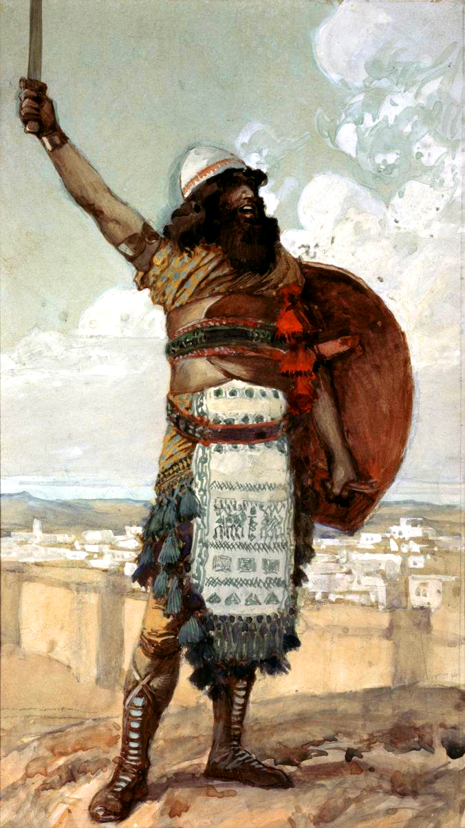
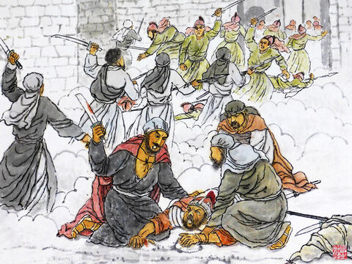

He Gives Wisdom for Judgment and Courage
“And when the children of Israel cried unto the LORD, the LORD raised up a deliverer to the children of Israel, who delivered them, even Othniel the son of Kenaz, Caleb's younger brother. And the Spirit of the LORD came upon him, and he judged Israel, and went out to war: and the LORD delivered Chushan-rishathaim king of Mesopotamia into his hand; and his hand prevailed against Chushan-rishathaim. ” (Judges 3:9-10)
Notes:
Otoniel fue un juez destacado, ya que no se registra que hubiera cometido ningún desatino ni acto impío.
Cuando fue imbuido del Espíritu de Jehová, Otoniel primero juzgó a Israel y después salió a la guerra. Esto indicaría que arregló lo que estaba mal en medio del pueblo antes de intentar luchar contra el enemigo. Así debería hacerse siempre. Es necesario vencer en primer lugar el pecado, el peor de los enemigos. Sólo cuando este enemigo está dominado, podemos esperar vencer a nuestros enemigos externos.

Slide 5

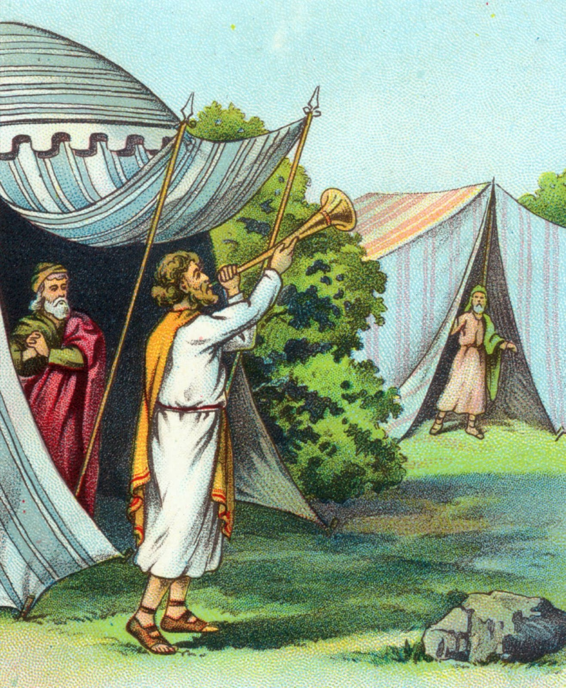

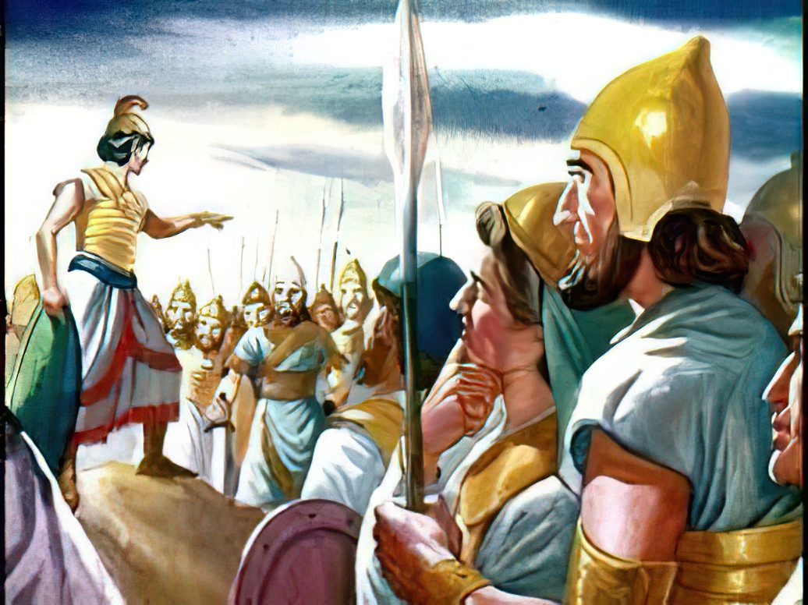
The Holy Spirit Endows With Power to Do His Work
“But the Spirit of the Lord came upon Gideon, and he blew a trumpet; and Abiezer was gathered after him. And he sent messengers throughout all Manasseh; who also was gathered after him: and he sent messengers unto Asher, and unto Zebulun, and unto Naphtali; and they came up to meet them.” (Judges 6:34-35)
Notes:
Literalmente, "revistió" . Gedeón no comenzó la campaña vestido sólo con la armadura de los soldados, sino "revestido" del poder de Dios. A los que Dios llama para realizar su obra, también los capacita para hacerla.

Slide 6

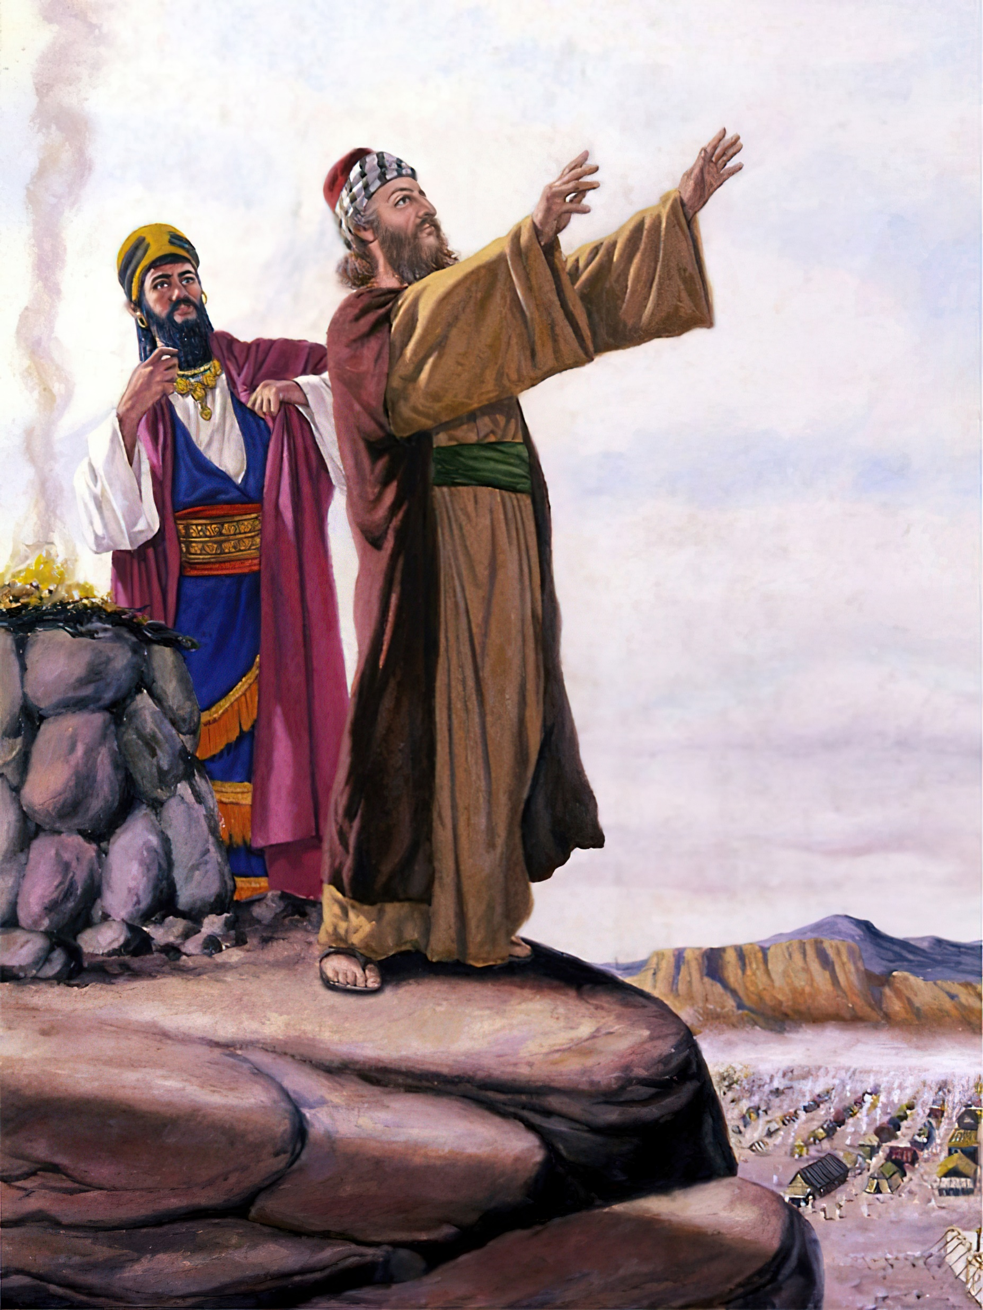

The Holy Spirit Causes Blessings to Come from Our Mouths
“And when Balaam saw that it pleased the LORD to bless Israel, he went not, as at other times, to seek for enchantments, but he set his face toward the wilderness. And Balaam lifted up his eyes, and he saw Israel abiding in his tents according to their tribes; and the spirit of God came upon him. And he took up his parable, and said, Balaam the son of Beor hath said, and the man whose eyes are open hath said: He hath said, which heard the words of God, which saw the vision of the Almighty, falling into a trance, but having his eyes open: How goodly are thy tents, O Jacob, and thy tabernacles, O Israel! As the valleys are they spread forth, as gardens by the river's side, as the trees of lign aloes which the LORD hath planted, and as cedar trees beside the waters. He shall pour the water out of his buckets, and his seed shall be in many waters, and his king shall be higher than Agag, and his kingdom shall be exalted. God brought him forth out of Egypt; he hath as it were the strength of an unicorn: he shall eat up the nations his enemies, and shall break their bones, and pierce them through with his arrows. He couched, he lay down as a lion, and as a great lion: who shall stir him up? Blessed is he that blesseth thee, and cursed is he that curseth thee.” (Numbers 24:1-9)

Slide 7

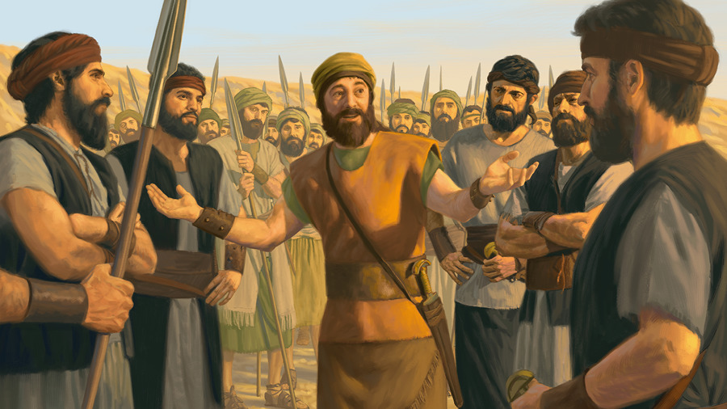
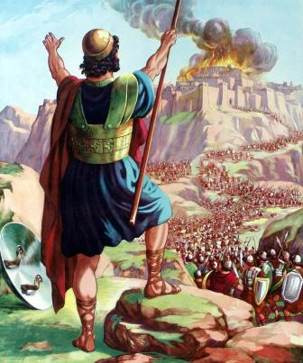

He Makes Service to God Effective, Enduring, and Victorious
“Wherefore I have not sinned against thee, but thou doest me wrong to war against me: the Lord the Judge be judge this day between the children of Israel and the children of Ammon. Howbeit the king of the children of Ammon hearkened not unto the words of Jephthah which he sent him. Then the Spirit of the Lord came upon Jephthah, and he passed over Gilead, and Manasseh, and passed over Mizpeh of Gilead, and from Mizpeh of Gilead he passed over unto the children of Ammon. And Jephthah vowed a vow unto the Lord, and said, If thou shalt without fail deliver the children of Ammon into mine hands, Then it shall be, that whatsoever cometh forth of the doors of my house to meet me, when I return in peace from the children of Ammon, shall surely be the Lord’s, and I will offer it up for a burnt offering. So Jephthah passed over unto the children of Ammon to fight against them; and the LORD delivered them into his hands.” (Judges 11:27-32)
Notes:
La presencia del Espíritu Santo es lo que hace que el servicio para Dios sea eficaz para el bien. Puede haber mucha actividad y febril ansiedad, pero a menos que la obra sea santificada por la presencia y el poder del Espíritu, se lograrán pocos resultados buenos y perdurables.

Slide 8

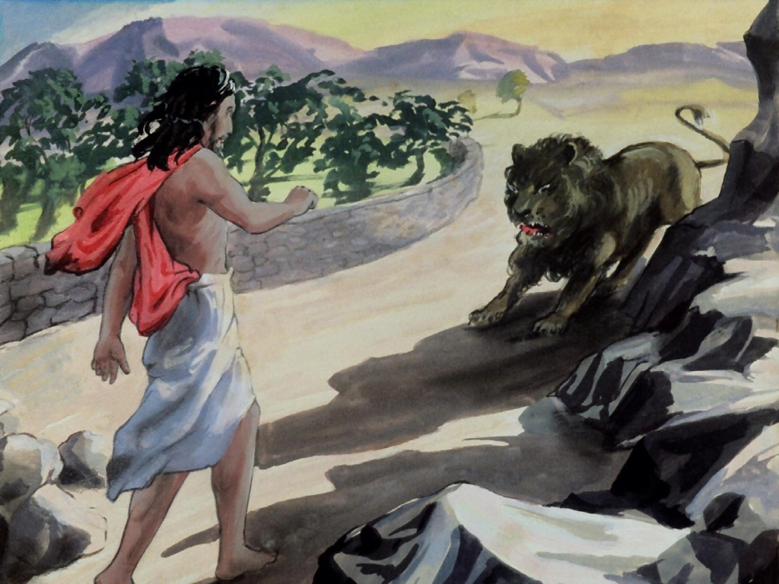

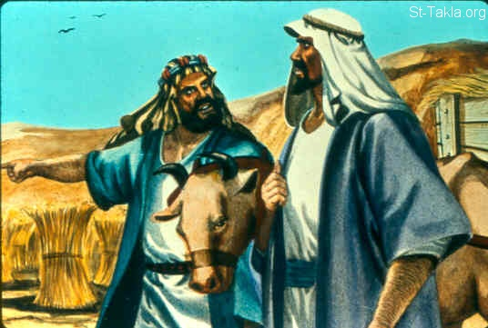
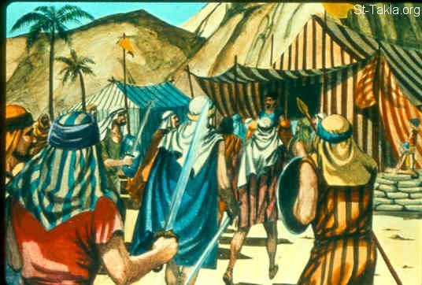
He Stirs Us, Unsettling Our Minds to Make Plans and Take Action
“And the Spirit of the LORD began to move him at times in the camp of Dan between Zorah and Eshtaol.” (Judges 13:25)
“Then Nahash the Ammonite came up, and encamped against Jabeshgilead: and all the men of Jabesh said unto Nahash, Make a covenant with us, and we will serve thee. And Nahash the Ammonite answered them, On this condition will I make a covenant with you, that I may thrust out all your right eyes, and lay it for a reproach upon all Israel. And the elders of Jabesh said unto him, Give us seven days' respite, that we may send messengers unto all the coasts of Israel: and then, if there be no man to save us, we will come out to thee. Then came the messengers to Gibeah of Saul, and told the tidings in the ears of the people: and all the people lifted up their voices, and wept. And, behold, Saul came after the herd out of the field; and Saul said, What aileth the people that they weep? And they told him the tidings of the men of Jabesh. And the Spirit of God came upon Saul when he heard those tidings, and his anger was kindled greatly.”
(1 Samuel 11:1-6)
Notes:
Sansón: Comenzó a excitarle" (BJ). El verbo hebreo significa "impeler", "impulsar", "turbar", "inquietar", "agitar". Los impulsos del Señor comenzaron a inquietarle, a agitarle la mente para que hiciese planes de actuar en contra de la opresión de los filisteos. Sansón se sintió impulsado a ejercitar en hechos de valor su fuerza poco común.

Slide 9

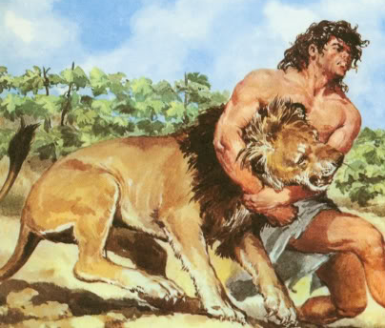
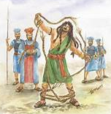

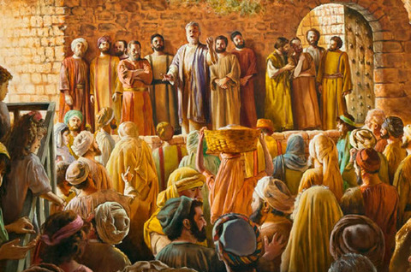
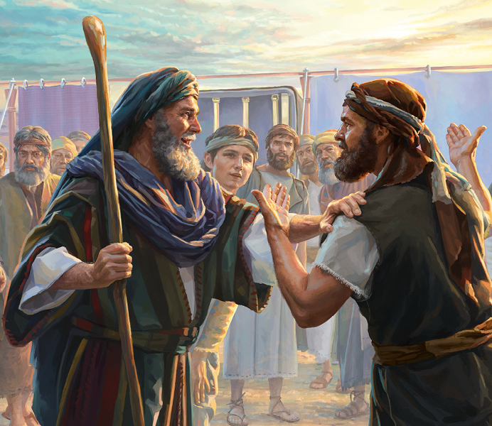
He Provides Us With a Specific Gift for a Mission
“And the Spirit of the LORD came mightily upon him, and he rent him as he would have rent a kid, and he had nothing in his hand: but he told not his father or his mother what he had done.” (Judges 14:6)
“And when he came unto Lehi, the Philistines shouted against him: and the Spirit of the LORD came mightily upon him, and the cords that were upon his arms became as flax that was burnt with fire, and his bands loosed from off his hands.” (Judges 15:14)
“And they were all filled with the Holy Ghost, and began to speak with other tongues, as the Spirit gave them utterance.” (Acts 2:4)
“I am not able to bear all this people alone, because it is too heavy for me. And if thou deal thus with me, kill me, I pray thee, out of hand, if I have found favour in thy sight; and let me not see my wretchedness. And the LORD said unto Moses, Gather unto me seventy men of the elders of Israel, whom thou knowest to be the elders of the people, and officers over them; and bring them unto the tabernacle of the congregation, that they may stand there with thee. And I will come down and talk with thee there: and I will take of the spirit which is upon thee, and will put it upon them; and they shall bear the burden of the people with thee, that thou bear it not thyself alone.
And Moses went out, and told the people the words of the LORD, and gathered the seventy men of the elders of the people, and set them round about the tabernacle. And the LORD came down in a cloud, and spake unto him, and took of the spirit that was upon him, and gave it unto the seventy elders: and it came to pass, that, when the spirit rested upon them, they prophesied, and did not cease. But there remained two of the men in the camp, the name of the one was Eldad, and the name of the other Medad: and the spirit rested upon them; and they were of them that were written, but went not out unto the tabernacle: and they prophesied in the camp.” (Numbers 11:14-17 Y 24-26)

Slide 10

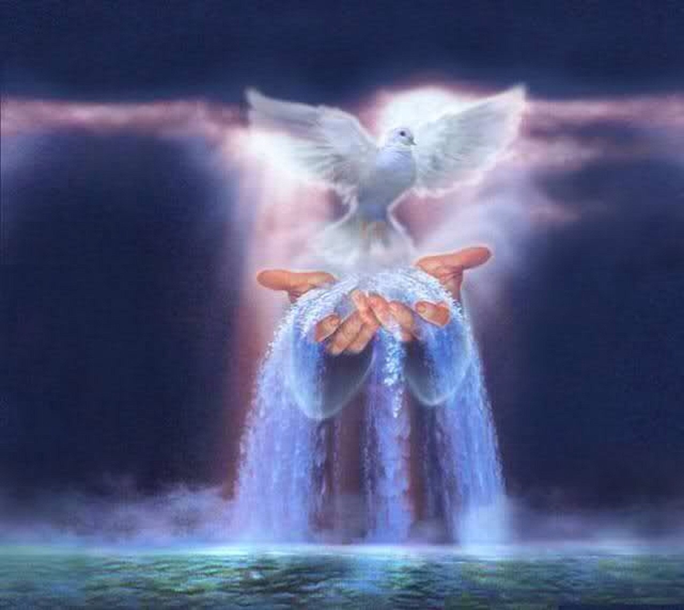

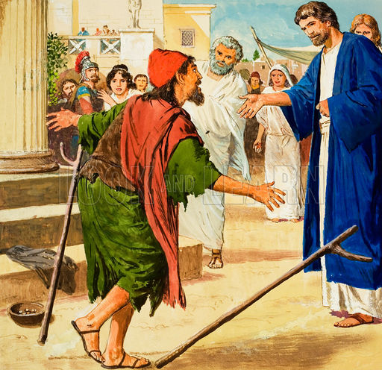
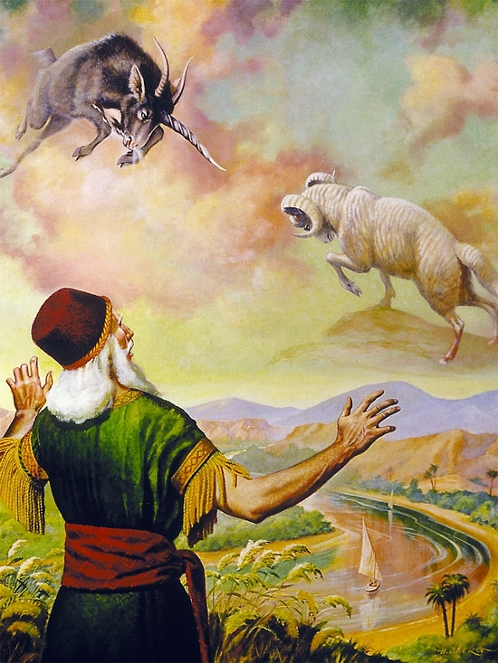
He Distributes Gifts
“ “For to one is given by the Spirit the word of wisdom; to another the word of knowledge by the same Spirit; To another faith by the same Spirit; to another the gifts of healing by the same Spirit; To another the working of miracles; to another prophecy; to another discerning of spirits; to another divers kinds of tongues; to another the interpretation of tongues: But all these worketh that one and the selfsame Spirit, dividing to every man severally as he will.“ (1 Corinthians 12:8-11)

Slide 11

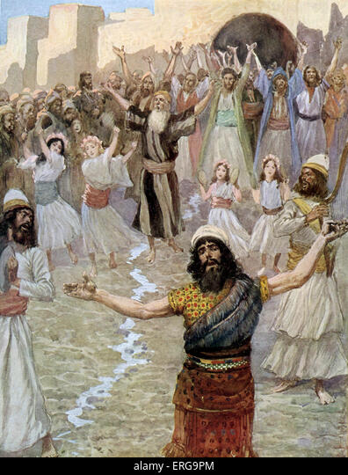

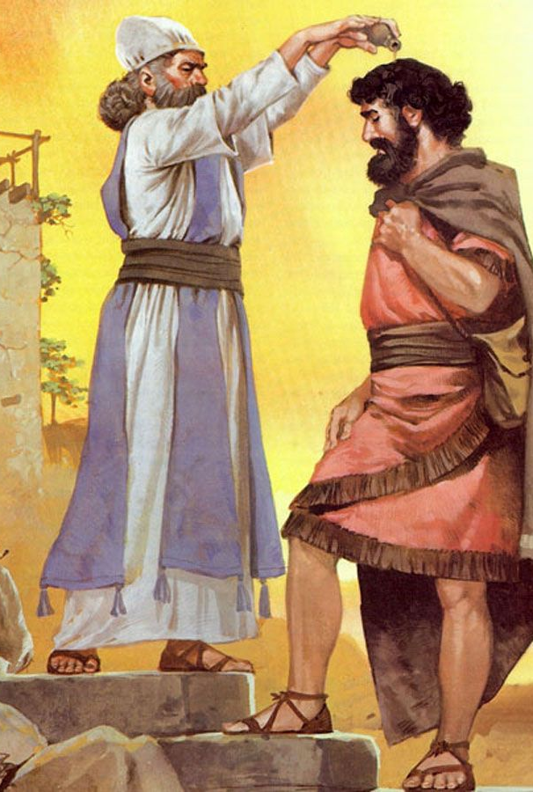
He Changes You Into Another Man, or Another Woman
“And it was so, that when he had turned his back to go from Samuel, God gave him another heart: and all those signs came to pass that day.
And when they came thither to the hill, behold, a company of prophets met him; and the Spirit of God came upon him, and he prophesied among them. And it came to pass, when all that knew him beforetime saw that, behold, he prophesied among the prophets, then the people said one to another, What is this that is come unto the son of Kish? Is Saul also among the prophets?”
(1 Samuel 10:9-11)
Notes:
Indudablemente, la vida de Saúl antes de ese momento no podía haberse considerado como un modelo de piedad. Era poco menos que un milagro que se hubiera convertido en profeta aunque, es cierto, no en el sentido de haber sido llamado al oficio profético. Pero he aquí que estaba ensalzando la majestad y el poder de Dios y expresándose en forma inspirada en cuanto a verdades sagradas. Guardaba un secreto que le debe haber sido difícil mantener, y las confirmatorias pruebas recientes de la gracia y providencia divinas lo conmovían hasta lo más íntimo del alma. Sus emociones reprimidas estallaron ante la evidencia de que las palabras de Samuel se habían cumplido ciertamente: él se había "mudado en otro hombre" (vers. 6). Su experiencia también testificó de que Dios puede transformar a los hombres menos promisorios en instrumentos que le serán útiles.

Slide 12

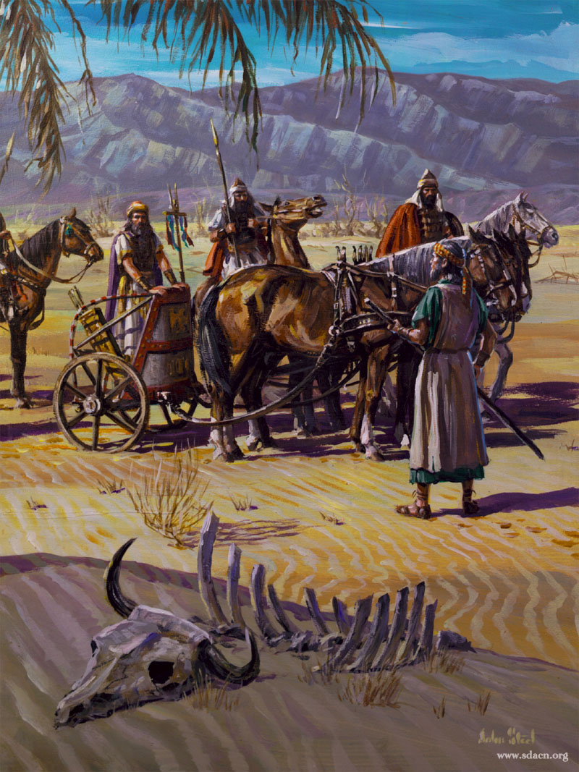


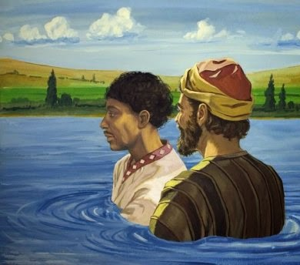
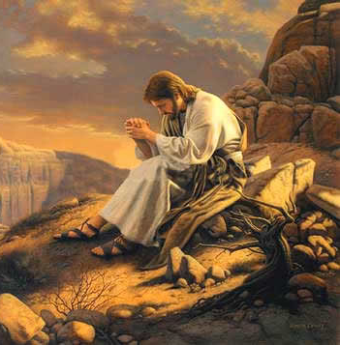
The Holy Spirit Takes You Where He Wants
[Obadiah says to Elijah] : “And it shall come to pass, as soon as I am gone from thee, that the Spirit of the Lord shall carry thee whither I know not; and so when I come and tell Ahab, and he cannot find thee, he shall slay me: but I thy servant fear the LORD from my youth.” (1 Kings 18:12)
“And when they were come up out of the water, the Spirit of the Lord caught away Philip, that the eunuch saw him no more: and he went on his way rejoicing.” (Acts 8:39)
“Then was Jesus led up of the Spirit into the wilderness to be tempted of the devil.” (Matthew 4:1)

Slide 13

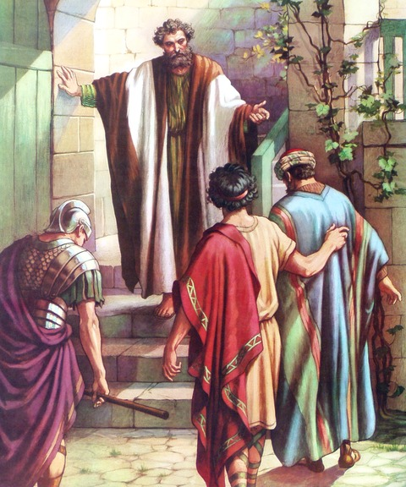

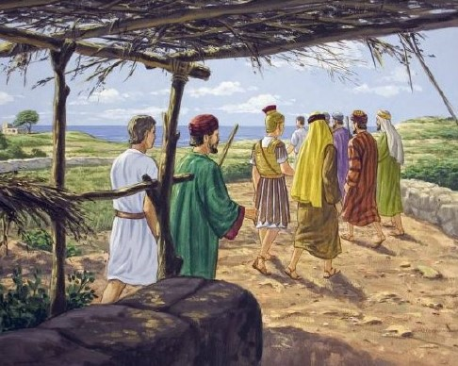
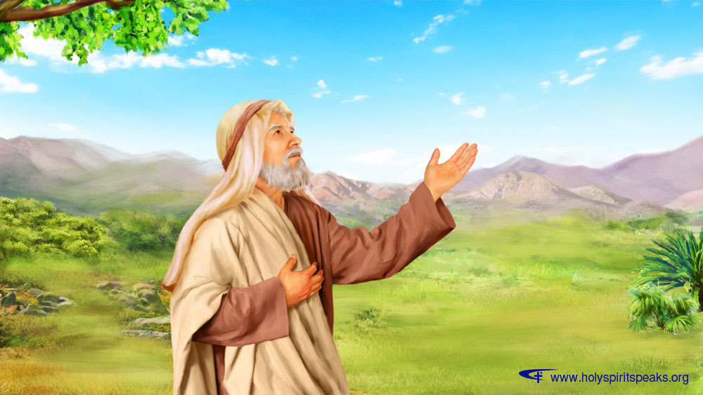
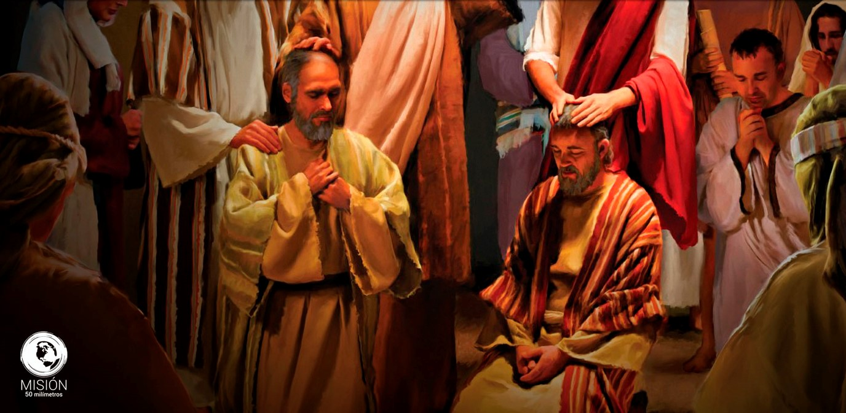
He Gives Specific Messages
“While Peter thought on the vision, the Spirit said unto him, Behold, three men seek thee.” (Acts 10:19)
“And the Spirit bade me go with them, nothing doubting. Moreover these six brethren accompanied me, and we entered into the man's house.” (Acts 11:12)
“As they ministered to the Lord, and fasted, the Holy Ghost said, Separate me Barnabas and Saul for the work whereunto I have called them.” (Acts 13:2)
“And the hand of the Lord was there upon me; and he said unto me, Arise, go forth into the plain, and I will there talk with thee. Then I arose, and went forth into the plain: and, behold, the glory of the Lord stood there, as the glory which I saw by the river of Chebar: and I fell on my face. Then the spirit entered into me, and set me upon my feet, and spake with me, and said unto me, Go, shut thyself within thine house. But thou, O son of man, behold, they shall put bands upon thee, and shall bind thee with them, and thou shalt not go out among them.” (Ezekiel 3:22-25)

Slide 14

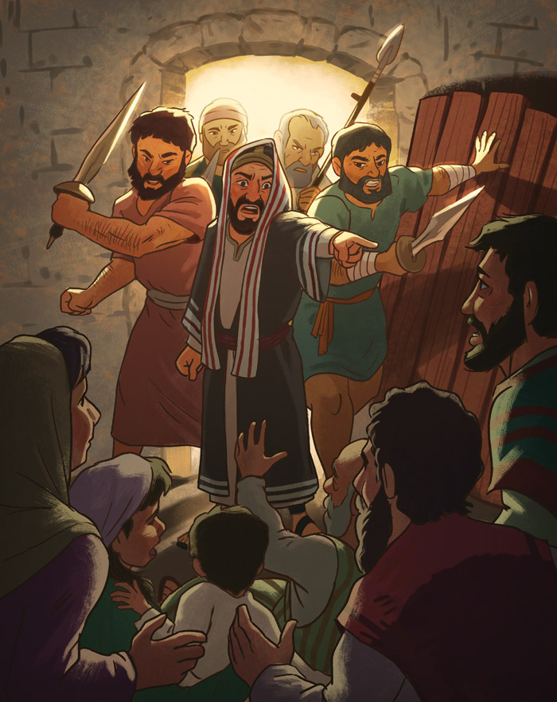
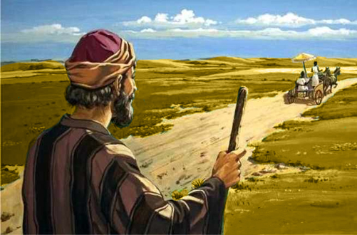

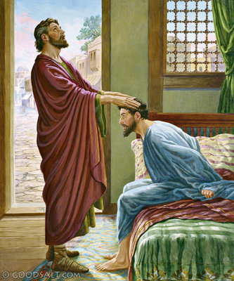
He Gives Explicit Orders
“And the angel of the Lord spake unto Philip, saying, Arise, and go toward the south unto the way that goeth down from Jerusalem unto Gaza, which is desert…Then the Spirit said unto Philip, Go near, and join thyself to this chariot.” (Acts 8:26, 29)
“And there was a certain disciple at Damascus, named Ananias; and to him said the Lord in a vision, Ananias. And he said, Behold, I am here, Lord. And the Lord said unto him, Arise, and go into the street which is called Straight, and enquire in the house of Judas for one called Saul, of Tarsus: for, behold, he prayeth, And hath seen in a vision a man named Ananias coming in, and putting his hand on him, that he might receive his sight. Then Ananias answered, Lord, I have heard by many of this man, how much evil he hath done to thy saints at Jerusalem: And here he hath authority from the chief priests to bind all that call on thy name. But the Lord said unto him, Go thy way: for he is a chosen vessel unto me, to bear my name before the Gentiles, and kings, and the children of Israel: For I will shew him how great things he must suffer for my name's sake.” (Acts 9:10-16)

Slide 15

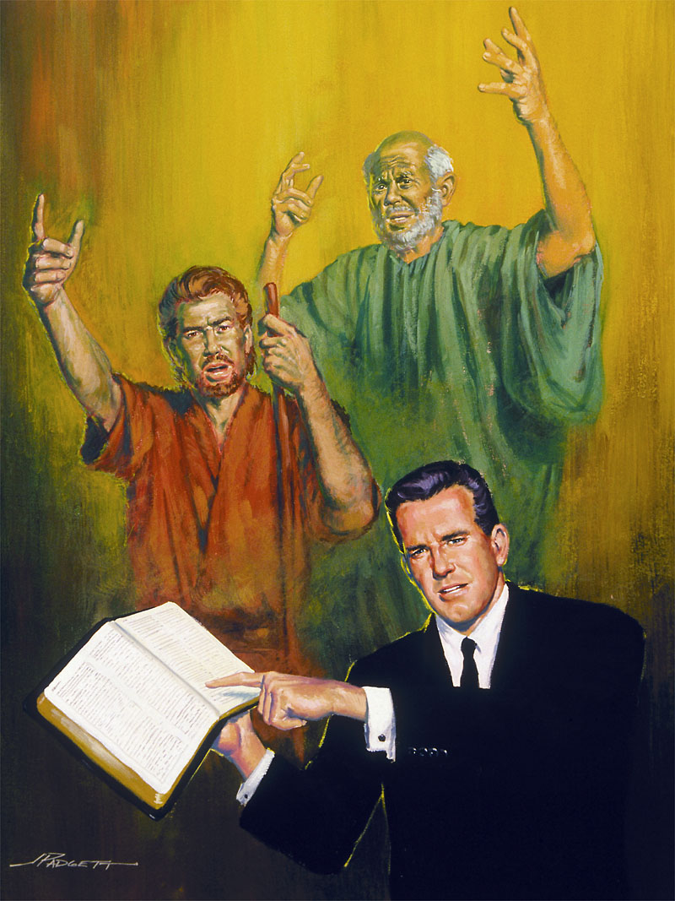

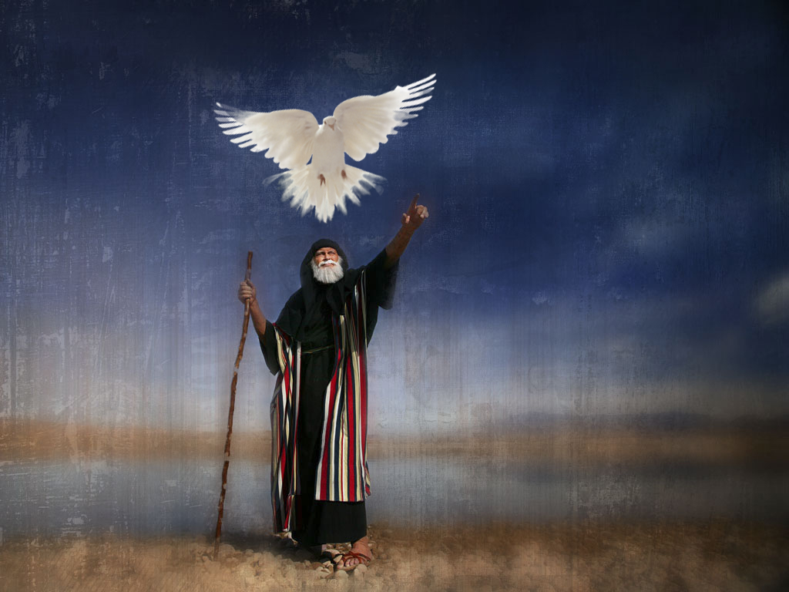
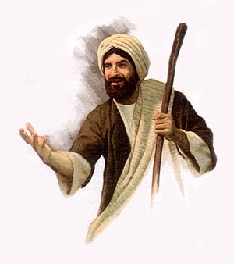
He inspires messages of repentance and turning to God
“And the Spirit of God came upon Zechariah the son of Jehoiada the priest, which stood above the people, and said unto them, Thus saith God, Why transgress ye the commandments of the Lord, that ye cannot prosper? Because ye have forsaken the Lord, he hath also forsaken you.” (2 Chronicles 24:20)
“But truly I am full of power by the spirit of the Lord, and of judgment, and of might, to declare unto Jacob his transgression, and to Israel his sin.” (Micah 3:8)

Slide 16

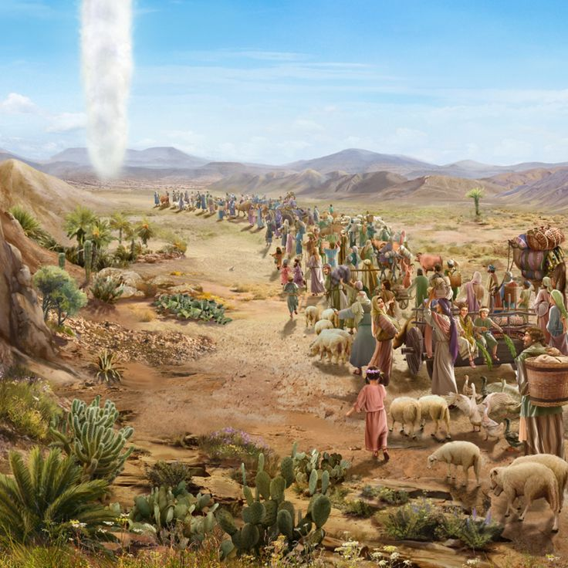
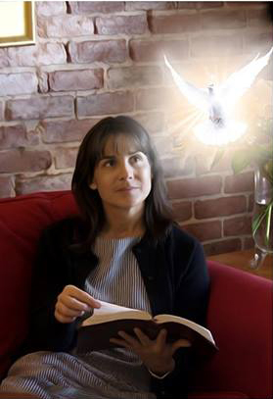
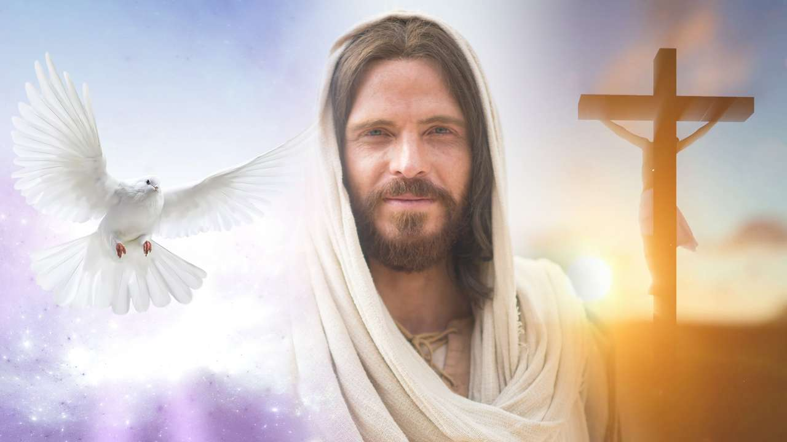

He Teaches Us All Things, and Everything About Jesus
“Thou gavest also thy good spirit to instruct them, and withheldest not thy manna from their mouth, and gavest them water for their thirst.” (Nehemiah 9:20)
“But the Comforter, which is the Holy Ghost, whom the Father will send in my name, he shall teach you all things, and bring all things to your remembrance, whatsoever I have said unto you.” (John 14:26)
“But when the Comforter is come, whom I will send unto you from the Father, even the Spirit of truth, which proceedeth from the Father, he shall testify of me.” (John 15:26)

Slide 17

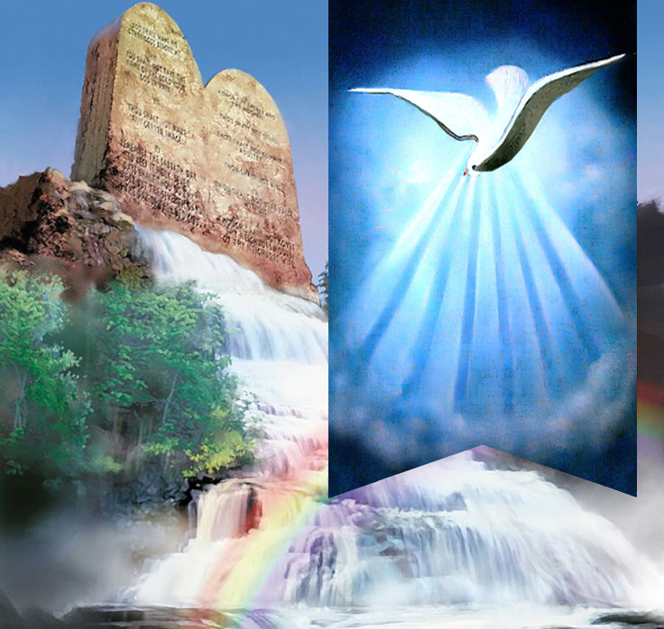

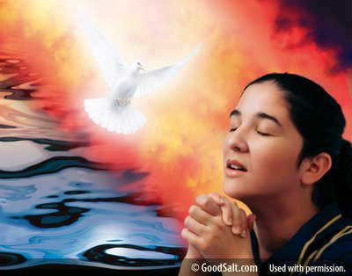
He Helps Us to Keep and Put Into
Practice His Commandments
“And I will put my spirit within you, and cause you to walk in my statutes, and ye shall keep my judgments, and do them.” (Ezekiel 36:27)

Slide 18

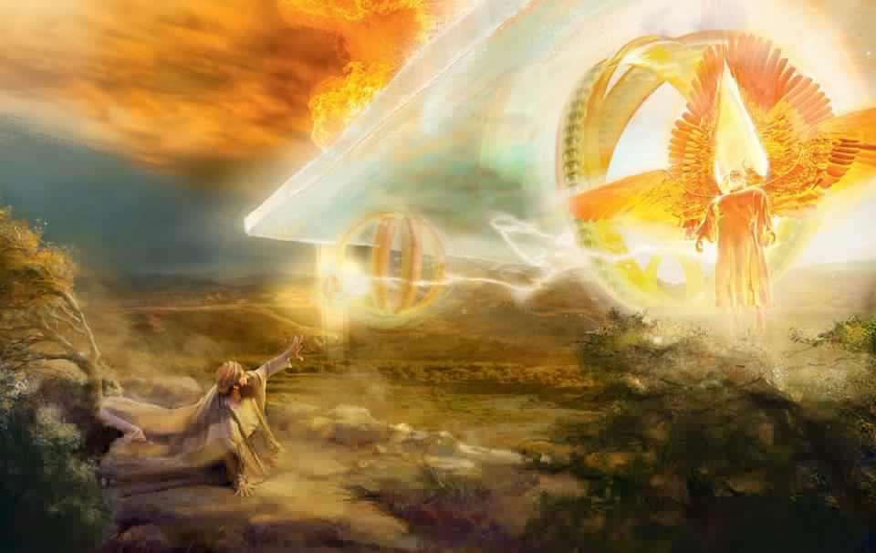

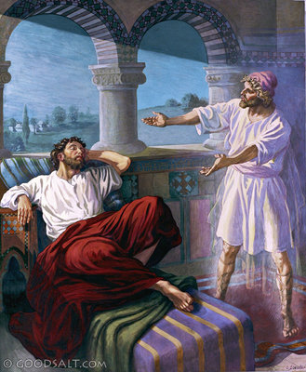

He Gives Visions and Dreams
“Now it came to pass in the thirtieth year, in the fourth month, in the fifth day of the month, as I was among the captives by the river of Chebar, that the heavens were opened, and I saw visions of God.” (Ezekiel 1:1)
“And I saw in a vision; and it came to pass, when I saw, that I was at Shushan in the palace, which is in the province of Elam; and I saw in a vision, and I was by the river of Ulai. Then I lifted up mine eyes, and saw, and, behold, there stood before the river a ram which had two horns: and the two horns were high; but one was higher than the other, and the higher came up last.”
(Daniel 8:2-3)
“And a vision appeared to Paul in the night; There stood a man of Macedonia, and prayed him, saying, Come over into Macedonia, and help us.” (Acts 16:9)
“And it shall come to pass in the last days, saith God, I will pour out of my Spirit upon all flesh: and your sons and your daughters shall prophesy, and your young men shall see visions, and your old men shall dream dreams.” (Acts 2:17)

Slide 19
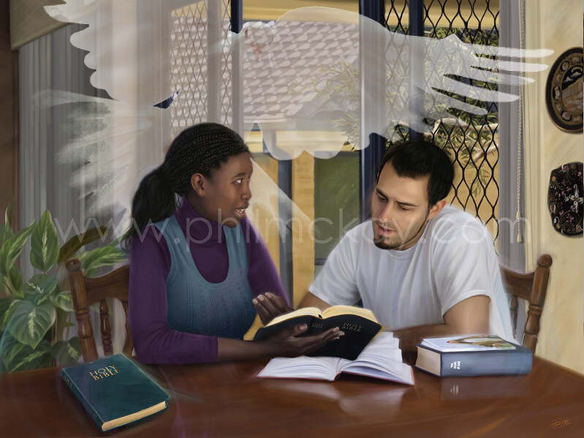

He Puts in Our Minds the Words We Need to Say
“But when they shall lead you, and deliver you up, take no thought beforehand what ye shall speak, neither do ye premeditate: but whatsoever shall be given you in that hour, that speak ye: for it is not ye that speak, but the Holy Spirit.” (Mark 13:11)
“For the Holy Spirit shall teach you in the same hour what ye ought to say.” (Luke 12:12)

Slide 20

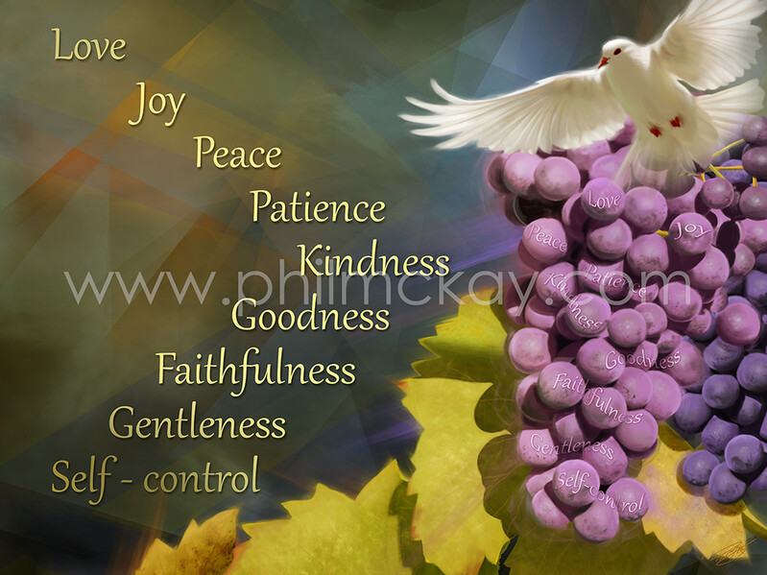

He Gives Us His Fruit
“And hope maketh not ashamed; because the love of God is shed abroad in our hearts by the Holy Ghost which is given unto us.”
(Romans 5:5)
“But the fruit of the Spirit is love, joy, peace, longsuffering, gentleness, goodness, faith, meekness, temperance: against such there is no law.”
(Galatians 5:22-23)

Slide 21

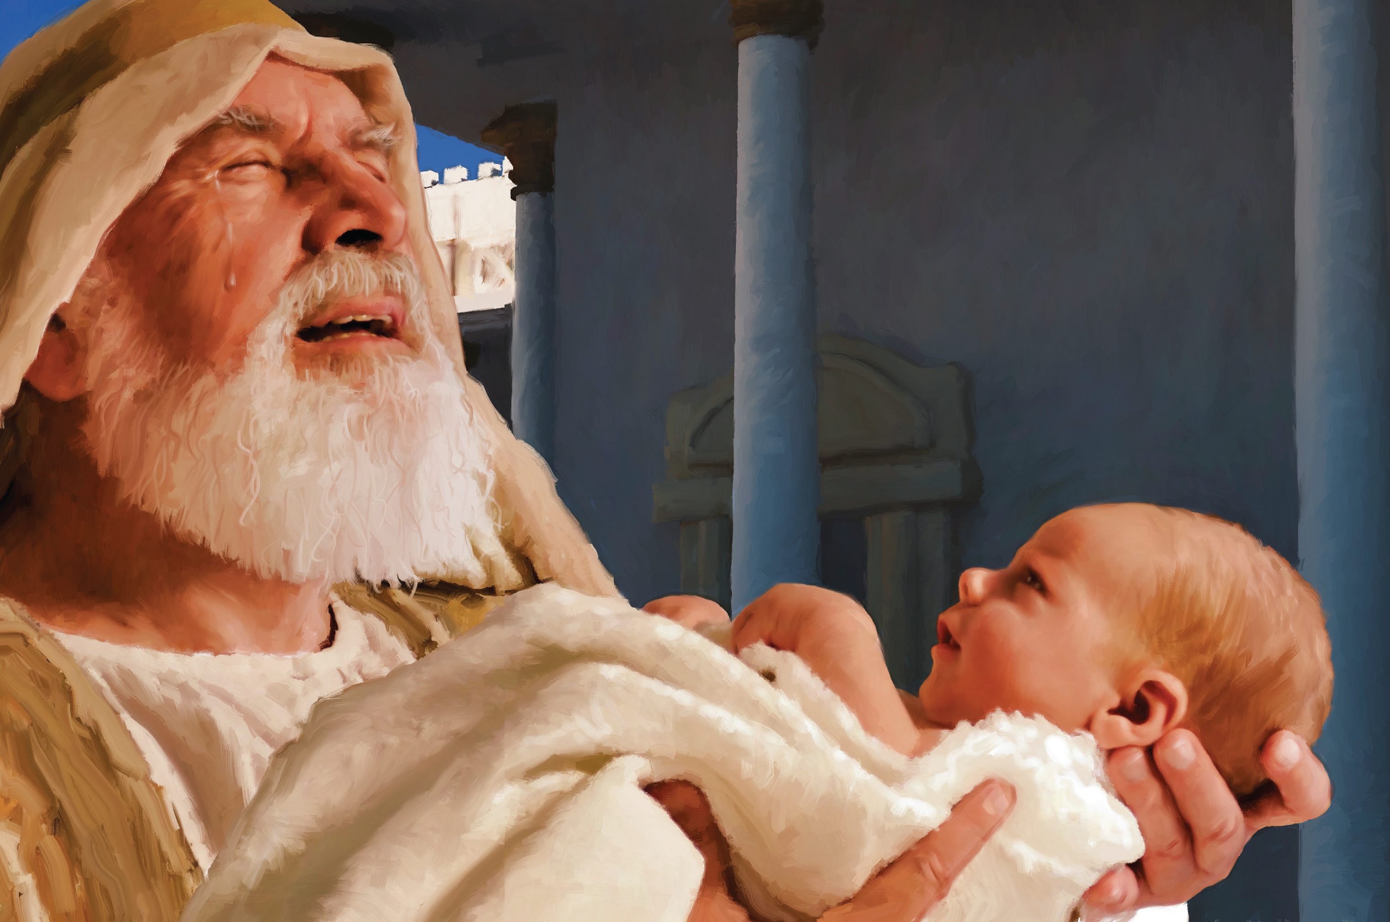
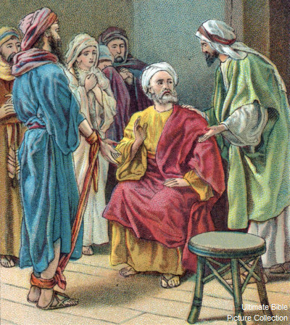

He Reveals the Future to Us
[To Simeon] “And it was revealed unto him by the Holy Ghost, that he should not see death, before he had seen the Lord's Christ.” (Luke 2:26)
“And there stood up one of them named Agabus, and signified by the Spirit that there should be great dearth throughout all the world: which came to pass in the days of Claudius Caesar.” (Acts 11:28)

Slide 22


He Intercedes When We Pray
“Likewise the Spirit also helpeth our infirmities: for we know not what we should pray for as we ought: but the Spirit itself maketh intercession for us with groanings which cannot be uttered.” (Romans 8:26)

Slide 23

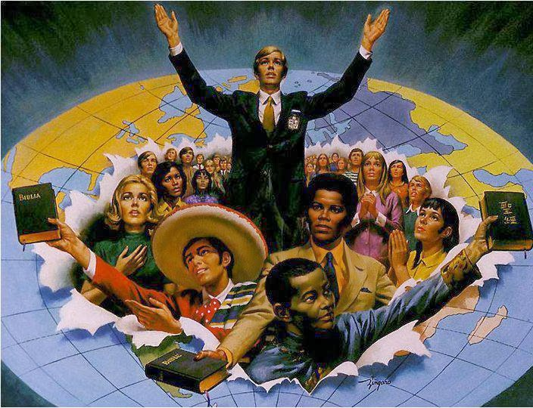



He Gives Us Power to Testify
“But ye shall receive power, after that the Holy Ghost is come upon you: and ye shall be witnesses unto me both in Jerusalem, and in all Judaea, and in Samaria, and unto the uttermost part of the earth.” (Acts 1:8)
“And when they had prayed, the place was shaken where they were assembled together; and they were all filled with the Holy Ghost, and they spake the word of God with boldness.” (Acts 4:31)

Slide 24

The Holy Ghost gives everyone, among many other things, power to testify (John 15:26; Acts 1:8) or the benefit of interceding in prayer (Romans 8:26) or its fruit (Galatians 5:22) or teaching us about Jesus (John 15:26). He also gives each of us what we need to fulfill the mission that has been entrusted to us on this earth.
Listen to what God tells us in Zechariah 4:6 “Then he answered and spoke to me, saying, 'This is the word of the Lord to Zerubbabel, who says, 'Not with might, nor with might, but with my Spirit, says the Lord of hosts.”
How to receive the Holy Spirit? "If you, then, being evil, know how to give good gifts to your children, how much more will your heavenly Father give the Holy Spirit to those who ask Him?" (Luke 11:13)
God is willing to give us the Holy Spirit just by asking for it. Ask for it, and the Holy Spirit will give you what you need to accomplish your mission.

