Slide 1
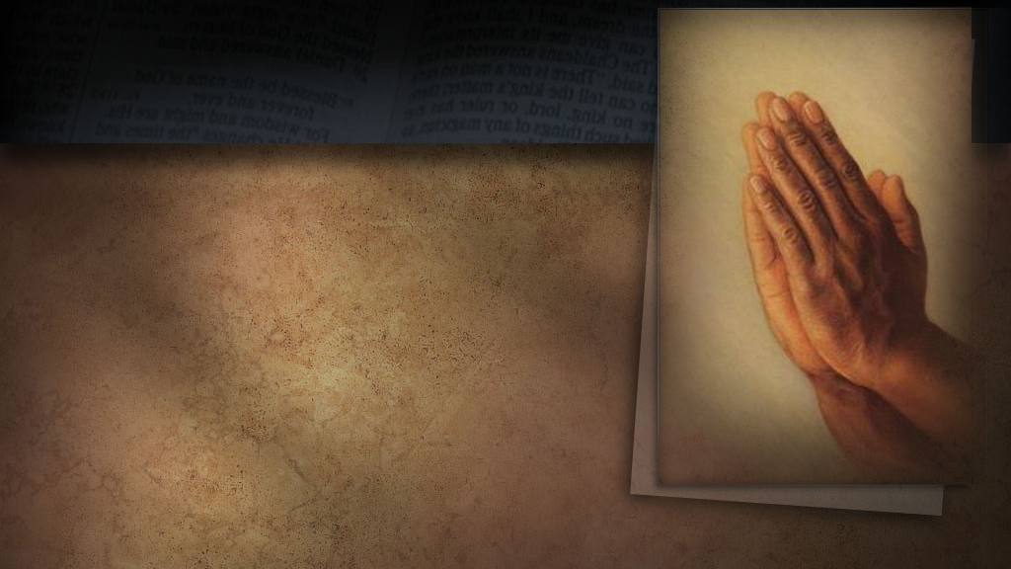


Slide 2



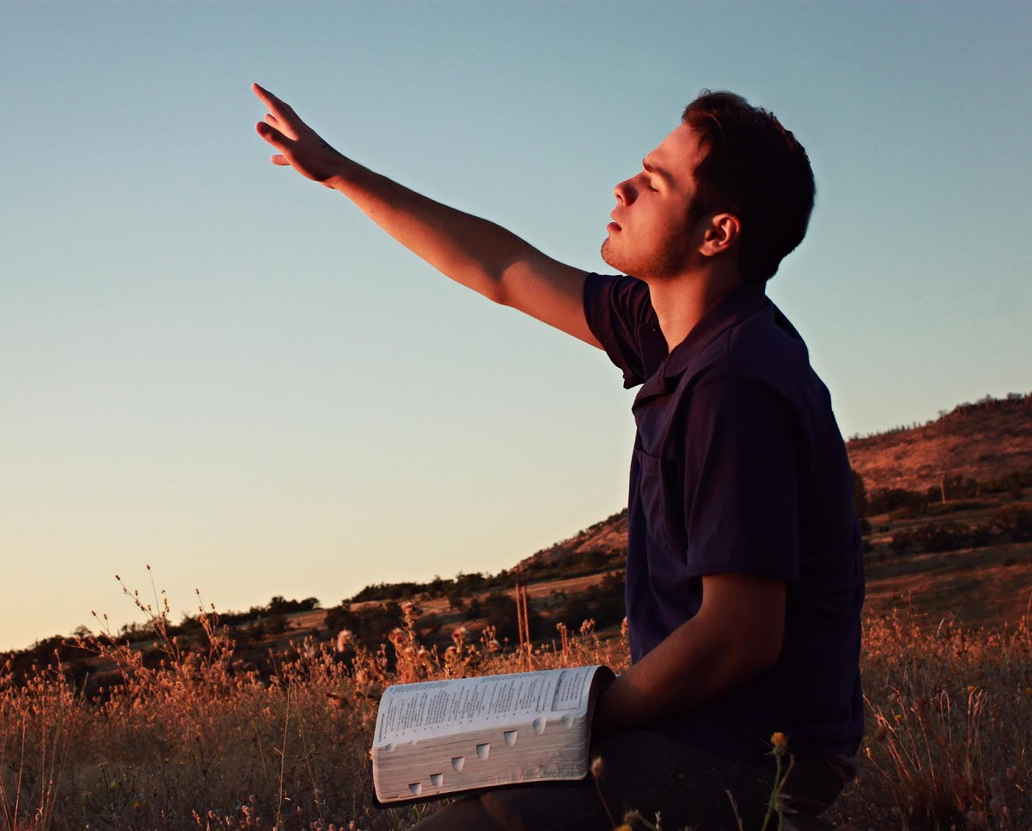
Prayer is
the act of opening our hearts to God as a friend
an extraordinary privilege
a foretaste of heaven
a refuge always open
a necessity for the life of our soul
Our life is to be bound up with the life of Christ; we are to draw constantly from Him, partaking of Him, the living Bread that came down from heaven, drawing from a fountain ever fresh, ever giving forth its abundant treasures. If we keep the Lord ever before us, allowing our hearts to go out in thanksgiving and praise to Him, we shall have a continual freshness in our religious life. Our prayers will take the form of a conversation with God as we would talk with a friend. He will speak His mysteries to us personally. Often there will come to us a sweet joyful sense of the presence of Jesus. Often our hearts will burn within us as He draws nigh to commune with us as He did with Enoch. When this is in truth the experience of the Christian, there is seen in his life a simplicity, a humility, meekness, and lowliness of heart, that show to all with whom he associates that he has been with Jesus and learned of Him. COL 129

Slide 3
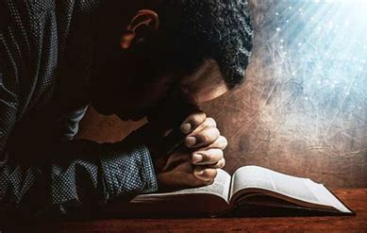
Prayer is
the act of opening our hearts to God as a friend
an extraordinary privilege
a foretaste of heaven
a refuge always open
a necessity for the life of our soul
When in trouble, when assailed by fierce temptations, they [God's children] have the privilege of prayer. What an exalted privilege! Finite beings, of dust and ashes, admitted through the mediation of Christ, into the audience chamber of the Most High. In such exercises the soul is brought into a sacred nearness with God, and is renewed in knowledge, and true holiness, and fortified against the assaults of the enemy.—(An Appeal to Mothers, 24.) Pr 9

Slide 4
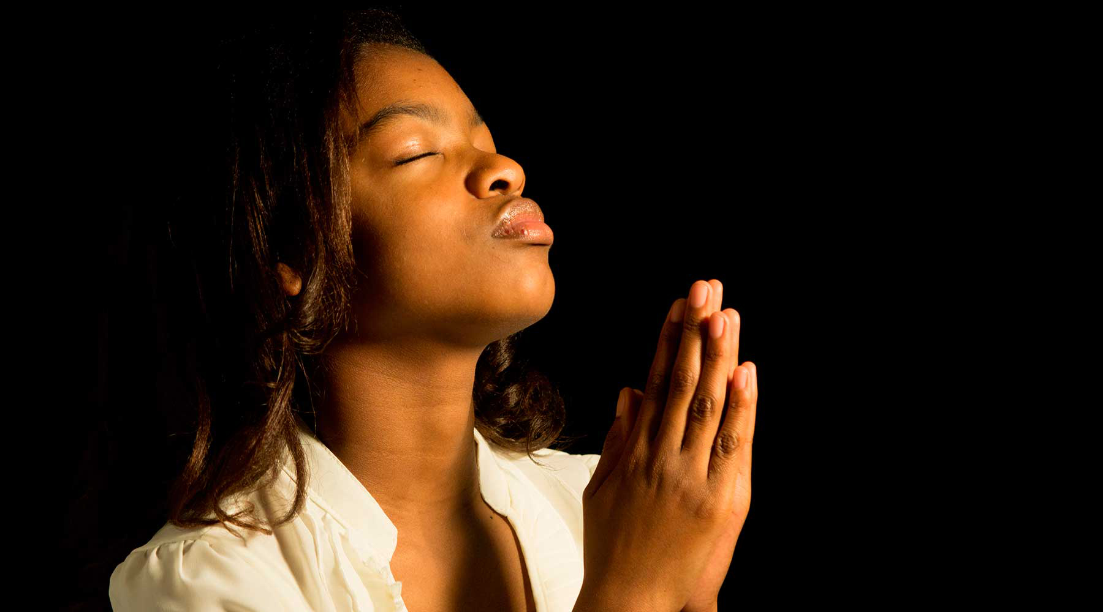
Prayer is
the act of opening our hearts to God as a friend
an extraordinary privilege
a foretaste of heaven
a refuge always open
a necessity for the life of our soul
“Prayer is a necessity; for it is the life of the soul. Family prayer, public prayer, have their place; but it is secret communion with God that sustains the soul life.—(Education, 258.) Pr 18
Communion with God is highly essential for spiritual health, and here only may be obtained that wisdom and correct judgment so necessary in the performance of every duty.—(Testimonies for the Church 4:459.) Pr 18

Slide 5
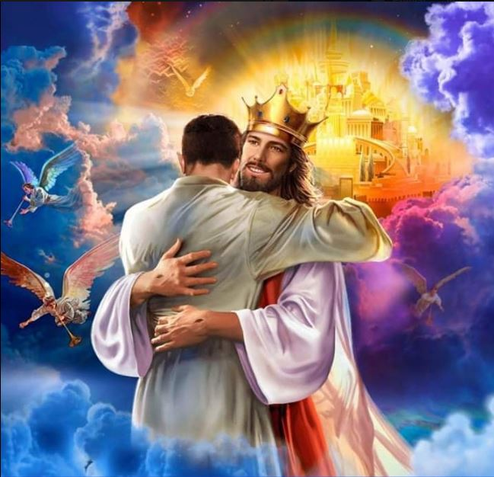
Prayer is
the act of opening our hearts to God as a friend
an extraordinary privilege
a foretaste of heaven
a refuge always open
a necessity for the life of our soul
As we pray, He [God] draws our soul and makes us feel His precious love. We draw near to him, and we can maintain a sweet fellowship with him. We see clearly His tenderness and compassion, and the heart is broken and moved as we contemplate the love that is given to us. We certainly feel that there is a Christ dwelling in the soul. We live in it, and we feel at ease with Jesus.
Promises fill the soul. Our peace is like a river; wave after wave of glory floods the heart, and, no doubt, we dine with Jesus and he with us. We feel that we understand God's love and rest in His love. No language can describe this; it is beyond knowledge. We are one with Christ; our life is hidden with Christ in God. We feel assured that when He who is our life is revealed, then we will also be manifested with Him in glory. With deep confidence we can call God our Father.—SDABC on Psalm 63.

Slide 6
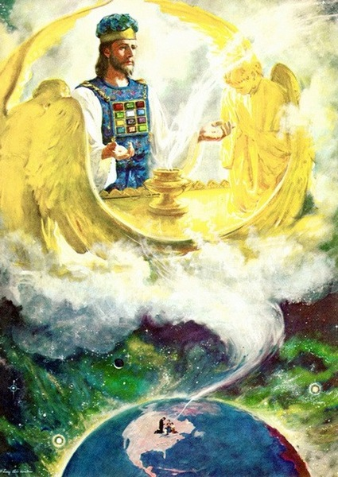

Prayer is
the act of opening our hearts to God as a friend
an extraordinary privilege
a foretaste of heaven
a refuge always open
a necessity for the life of our soul
The way to the throne of God is always open. You cannot always be on your knees in prayer, but your silent petitions may constantly ascend to God for strength and guidance. When tempted, as you will be, you may flee to the secret place of the Most High. His everlasting arms will be underneath you. HP 86.

Slide 7


Prayer is
the Secret of Spiritual Power
the soul of religion
a solution to our needs
our daily food
a plea always heard
Prayer is the breath of the soul. It is the secret of spiritual power. No other means of grace can be substituted and the health of the soul be preserved. Prayer brings the heart into immediate contact with the Wellspring of life, and strengthens the sinew and muscle of the religious experience. Neglect the exercise of prayer, or engage in prayer spasmodically, now and then, as seems convenient, and you lose your hold on God. The spiritual faculties lose their vitality, the religious experience lacks health and vigor... Pr 12
It is a wonderful thing that we can pray effectually, that unworthy, erring mortals possess the power of offering their requests to God. What higher power can man desire than this,—to be linked with the infinite God? Feeble, sinful man has the privilege of speaking to his Maker. We may utter words that reach the throne of the Monarch of the universe.
We may utter words that reach the throne of the Monarch of the universe. We may speak with Jesus as we walk by the way, and He says, I am at thy right hand.—(Messages to Young People, 249, 250.) Pr 13

Slide 8

Prayer is
the Secret of Spiritual Power
the soul of religion
a solution to our needs
our daily food
a plea always heard
Do not neglect secret prayer, for it is the soul of religion. With earnest, fervent prayer, plead for purity of soul. Plead as earnestly, as eagerly, as you would for your mortal life, were it at stake. Remain before God until unutterable longings are begotten within you for salvation, and the sweet evidence is obtained of pardoned sin. 1TT 56

Slide 9
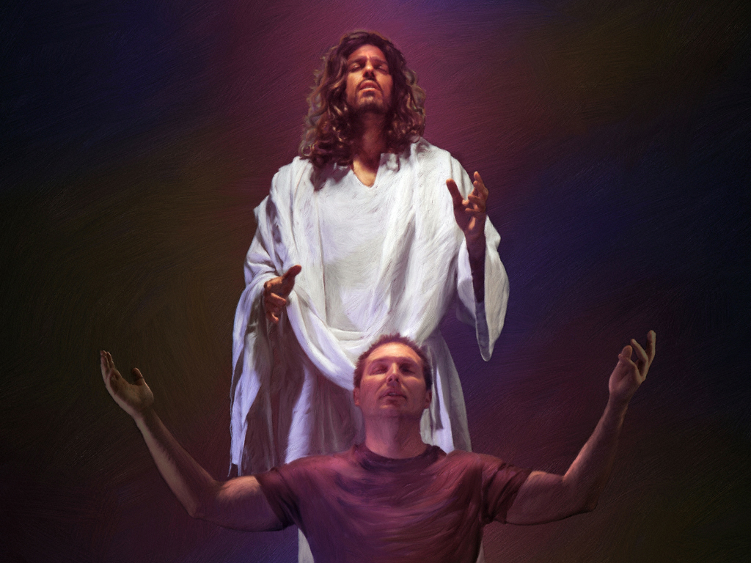
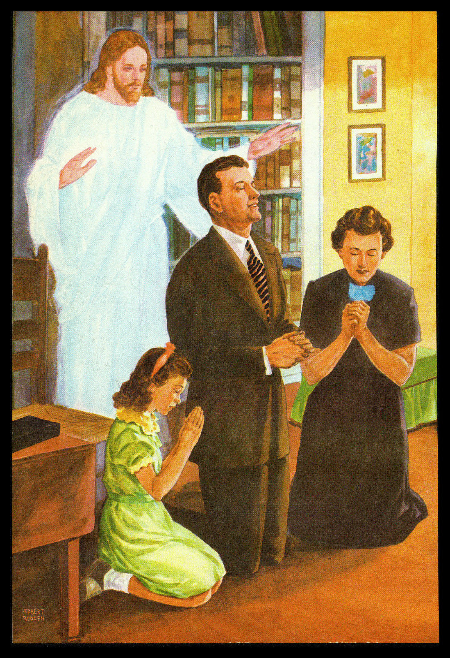
Prayer is
the Secret of Spiritual Power
the soul of religion
a solution to our needs
our daily food
a plea always heard
Every sincere prayer is heard in heaven. It may not be fluently expressed; but if the heart is in it, it will ascend to the sanctuary where Jesus ministers, and He will present it to the Father without one awkward, stammering word, beautiful and fragrant with the incense of His own perfection.—(The Desire of Ages, 667.) Pr 48
The path of sincerity and integrity is not a path free from obstruction, but in every difficulty we are to see a call to prayer. There is no one living who has any power that he has not received from God, and the source whence it comes is open to the weakest human being. “Whatsoever ye shall ask in My name,” said Jesus, “that will I do, that the Father may be glorified in the Son. If ye shall ask anything in My name, I will do it.” DA 667

Slide 10
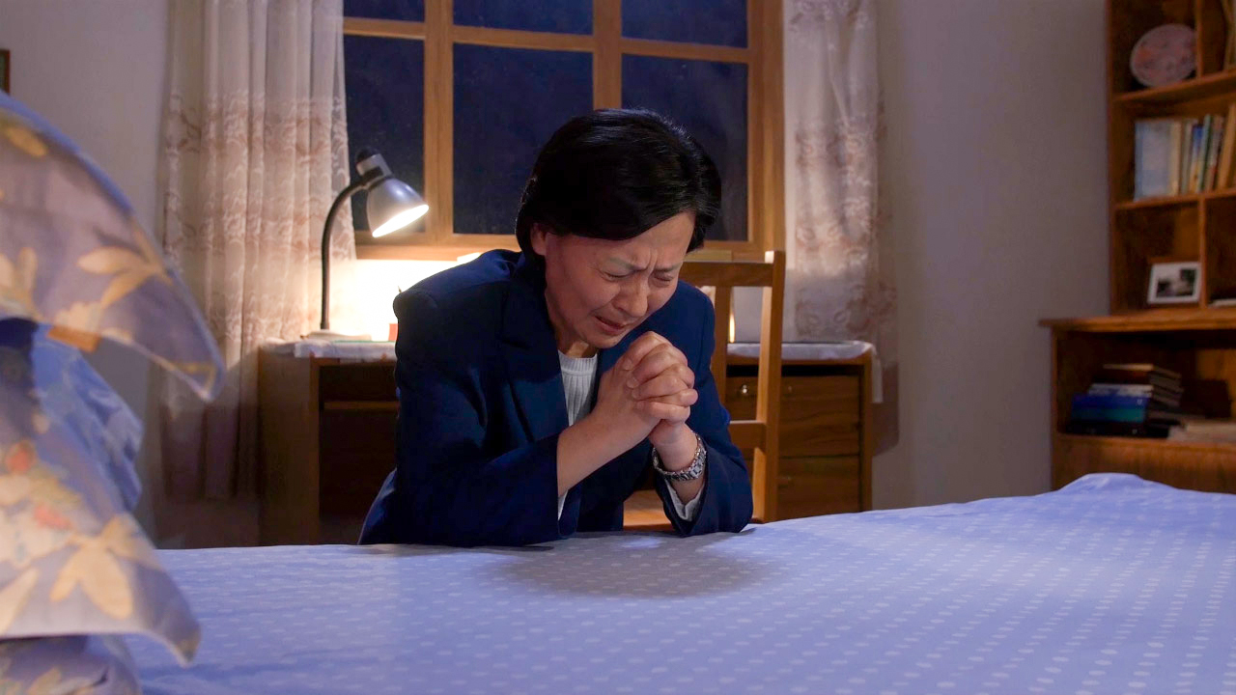
Prayer is
the Secret of Spiritual Power
the soul of religion
a solution to our needs
our daily food
a plea always heard
Every promise in the word of God furnishes us with subject matter for prayer, presenting the pledged word of Jehovah as our assurance. Whatever spiritual blessing we need, it is our privilege to claim through Jesus. We may tell the Lord, with the simplicity of a child, exactly what we need. We may state to Him our temporal matters, asking Him for bread and raiment as well as for the bread of life and the robe of Christ's righteousness. Your heavenly Father knows that you have need of all these things, and you are invited to ask Him concerning them. It is through the name of Jesus that every favor is received. God will honor that name, and will supply your necessities from the riches of His liberality. MB 133

Slide 11
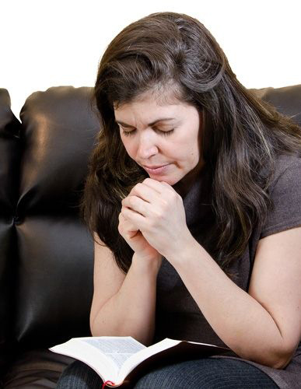
Prayer is
the Secret of Spiritual Power
the soul of religion
a solution to our needs
our daily food
a plea always heard
Daily prayer is as essential to growth in grace, and even to spiritual life itself, as is temporal food to physical well-being. Pr 17
Consecrate yourself to God in the morning; make this your very first work. Let your prayer be, “Take me, O Lord, as wholly Thine. I lay all my plans at Thy feet. Use me today in Thy service. Abide with me, and let all my work be wrought in Thee.” This is a daily matter. Each morning consecrate yourself to God for that day. Surrender all your plans to Him, to be carried out or given up as His providence shall indicate. Thus day by day you may be giving your life into the hands of God, and thus your life will be molded more and more after the life of Christ. SC 70
The very first out-breathing of the soul in the morning should be for the presence of Jesus. “Without Me,” He says, “ye can do nothing.” It is Jesus that we need; His light, His life, His spirit, must be ours continually. We need Him every hour. And we should pray in the morning that as the sun illuminates the landscape, and fills the world with light, so the Sun of Righteousness may shine into the chambers of mind and heart, and make us all light in the Lord. Pr 23

Slide 12


Prayer is
the key in the hand of faith to open the storehouse of heaven
constantly keeping the mind lifted up to God
to be in communion with God in any circumstance
the means by which God listens
the door to understanding God
The darkness of the evil one encloses those who neglect to pray. The whispered temptations of the enemy entice them to sin; and it is all because they do not make use of the privileges that God has given them in the divine appointment of prayer. Why should the sons and daughters of God be reluctant to pray, when prayer is the key in the hand of faith to unlock heaven's storehouse, where are treasured the boundless resources of Omnipotence?—(Steps to Christ, 94.) Pr 24
Prayer

Slide 13

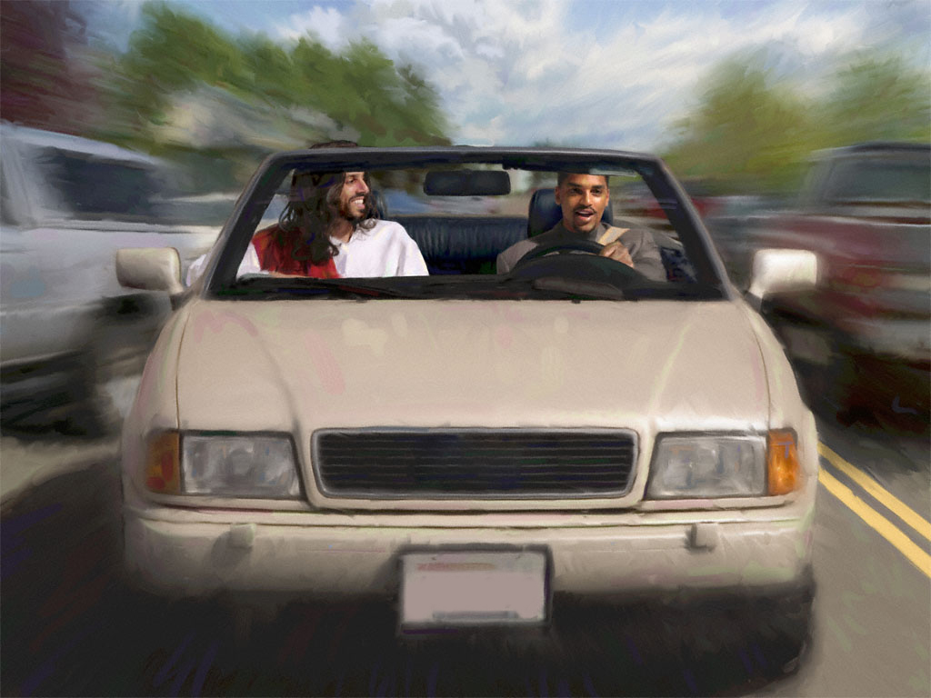
Prayer is
the key in the hand of faith to open the storehouse of heaven
constantly keeping the mind lifted up to God
to be in communion with God in any circumstance
the means by which God listens
the door to understanding God
“Pray always;” that is, be ever in the spirit of prayer, and then you will be in readiness for your Lord's coming.—(Testimonies for the Church 5:235.) Pr 29
“Pray without ceasing;” that is, keep the mind uplifted to God, the source of all power and efficiency.—(Testimonies to Ministers and Gospel Workers, 510.) Pr 29
ORAD SIN CESAR
In the work of heart-keeping we must be instant in prayer, unwearied in petitioning the throne of grace for assistance. Those who take the name of Christian should come to God in earnestness and humility, pleading for help. The Saviour has told us to pray without ceasing. The Christian can not always be in the position of prayer, but his thoughts and desires can always be upward. Our self-confidence would vanish, did we talk less and pray more.—(Sons and Daughters of God, 99.) Pr 76

Slide 14
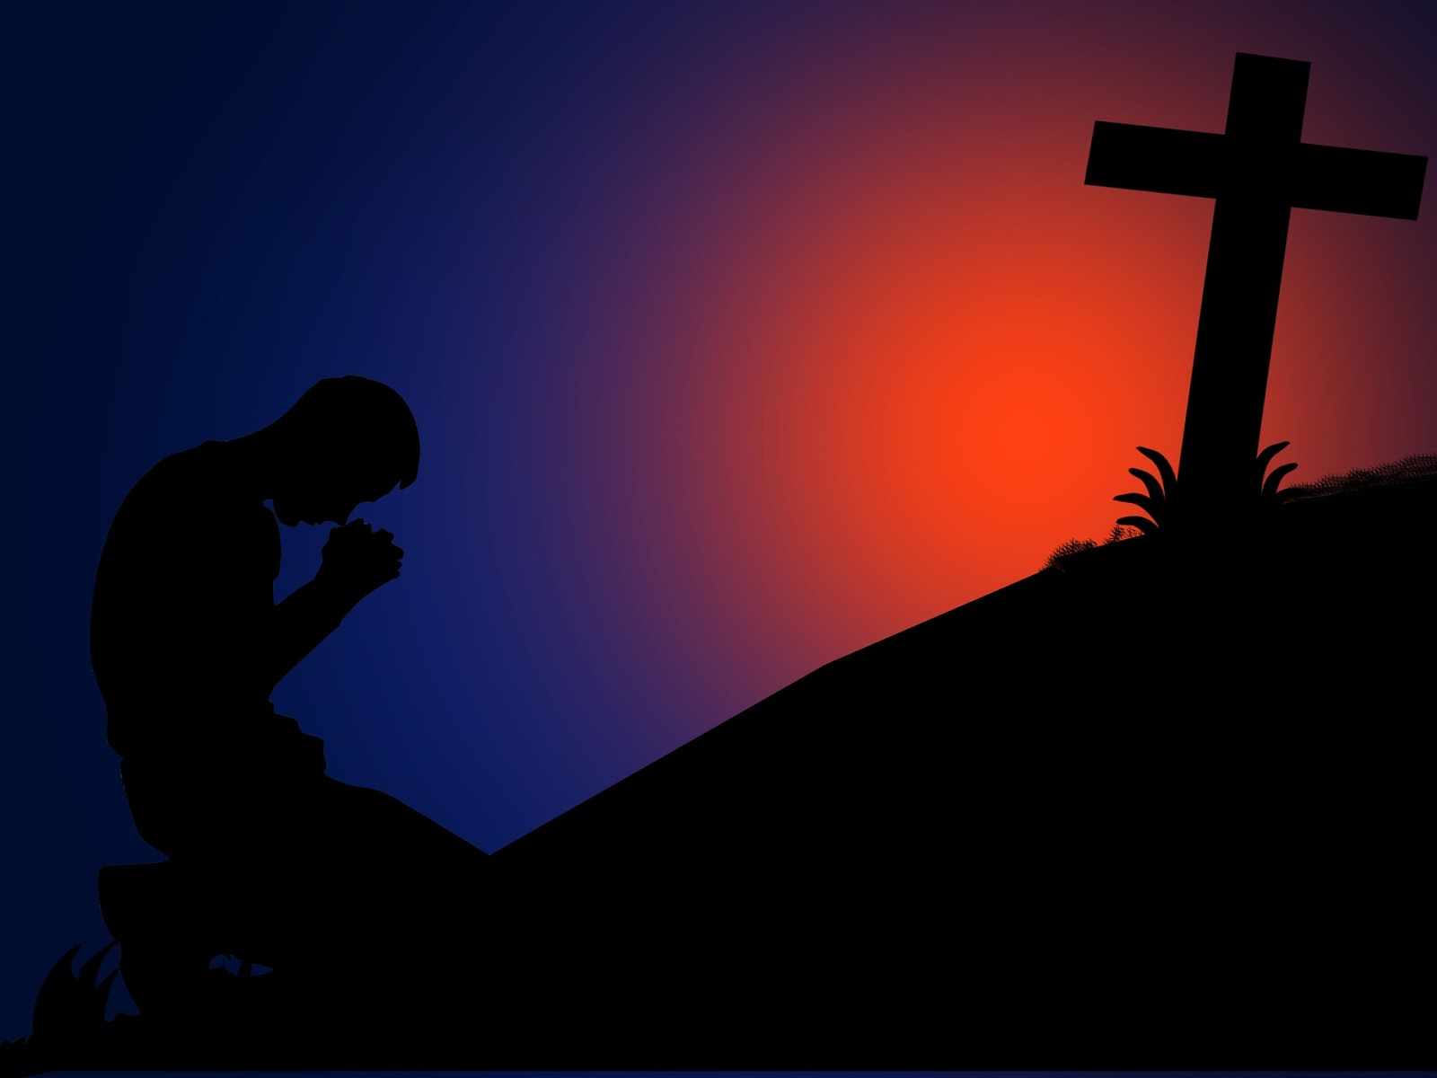
Prayer is
the key in the hand of faith to open the storehouse of heaven
constantly keeping the mind lifted up to God
to be in communion with God in any circumstance
the means by which God listens
the door to understanding God
The themes of redemption are momentous themes, and only those who are spiritually-minded can discern their depth and significance. It is our safety, our joy, to dwell upon the truths of the plan of salvation. Faith and prayer are necessary in order that we may behold the deep things of God. Our minds are so bound about by narrow ideas that we catch but limited views of the experience it is our privilege to have. OFC 131
How little do we comprehend what is meant by the prayer of the apostle, when he says, “That he would grant you, according to the riches of his glory, to be strengthened with might by his spirit in the inner man; that Christ may dwell in your hearts by faith; that ye, being rooted and grounded in love, may be able to comprehend with all saints what is the breadth, and length, and depth, and height; and to know the love of Christ, which passeth knowledge, that ye might be filled with all the fullness of God. Now unto him that is able to do exceeding abundantly above all that we ask or think, according to the power that worketh in us, unto him be glory in the church by Christ Jesus throughout all ages, world without end. Amen.” (The Review and Herald, November 17, 1891.) Pr 30

Slide 15





Prayer is
the key in the hand of faith to open the storehouse of heaven
constantly keeping the mind lifted up to God
to be in communion with God in any circumstance
the means by which God listens
the door to understanding God
In your business, in companionship for leisure hours, and in alliance for life, let all the associations you form be entered upon with earnest, humble prayer. You will thus show that you honor God, and God will honor you. Pray when you are fainthearted. When you are desponding, close the lips firmly to men; do not shadow the path of others; but tell everything to Jesus. Reach up your hands for help. In your weakness lay hold of infinite strength. Ask for humility, wisdom, courage, increase of faith, that you may see light in God's light and rejoice in His love. MH 513

Slide 16

Prayer is
the key in the hand of faith to open the storehouse of heaven
constantly keeping the mind lifted up to God
to be in communion with God in any circumstance
the means by which God listens
the door to understanding God
Make your requests known to your Maker. Never is one repulsed who comes to Him with a contrite heart. Not one sincere prayer is lost. Amid the anthems of the celestial choir, God hears the cries of the weakest human being. We pour out our heart's desire in our closets, we breathe a prayer as we walk by the way, and our words reach the throne of the Monarch of the universe.
They may be inaudible to any human ear, but they cannot die away into silence, nor can they be lost through the activities of business that are going on. Nothing can drown the soul's desire. It rises above the din of the street, above the confusion of the multitude, to the heavenly courts. It is God to whom we are speaking, and our prayer is heard. HP 82
This should be an encouragement to us. We are sometimes tempted to think that the promise, “Ask, and it shall be given you; seek, and ye shall find; knock, and it shall be opened unto you,” is not fulfilled unless the answer comes immediately when the request is made. It is our privilege to ask for special blessings, and to believe that they will be given us. But if the blessings asked for are not immediately granted, we are not to think that our prayers are not heard. We shall receive, even if the answer is delayed for a time... but He who knows what is for the highest good of His children will bestow a much greater good than we have asked, if we do not become faithless and discouraged.—(The Youth's Instructor, April 6, 1899.) Pr 106

Slide 17

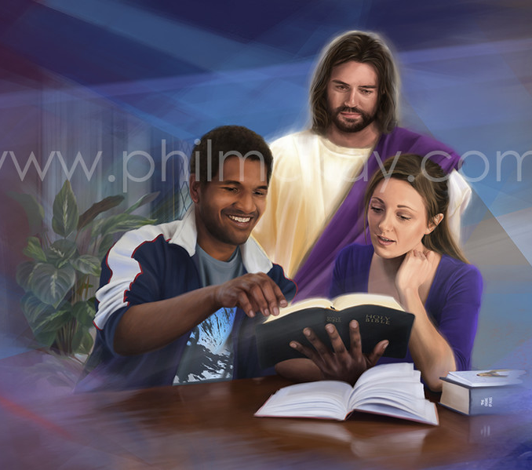
Prayer is
a fundamental part in soul winning
our security of forgiveness
how we can ask for the holy spirit
power to resist temptation
the heaven-ordained means to overcome sin
Select another and still another soul, daily seeking guidance from God, laying everything before Him in earnest prayer, and working in divine wisdom. As you do this, you will see that God will give the Holy Spirit to convict, and the power of truth to convert, the soul.—(Medical Ministry, 245). Pr 39
Do not neglect earnest prayer that you may possess a lowly mind, and that angels of God may go before you to work upon the hearts you are trying to reach, and so soften them by heavenly impressions that your efforts may avail.—(Testimonies for the Church 2:53.) Pr 40
Begin to pray for souls; come near to Christ, close to His bleeding side. Let a meek and quiet spirit adorn your lives, and let your earnest, broken, humble petitions ascend to Him for wisdom that you may have success in saving not only your own soul, but the souls of others.—(Testimonies for the Church 1:513.) Pr 246

Slide 18
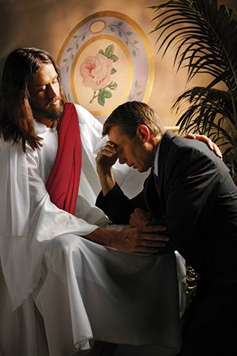
Prayer is
a fundamental part in soul winning
our security of forgiveness
how we can ask for the holy spirit
power to resist temptation
the heaven-ordained means to overcome sin
When we pray for earthly blessings, the answer to our prayer may be delayed, or God may give us something other than we ask, but not so when we ask for deliverance from sin. It is His will to cleanse us from sin, to make us His children, and to enable us to live a holy life. Christ “gave Himself for our sins, that He might deliver
us from this present evil world, according
to the will of God and our Father.”
Galatians 1:4. And “this is the confidence
that we have in Him, that, if we ask
anything according to His will, He heareth
us: and if we know that He hear us,
whatsoever we ask, we know that we have
the petitions that we desired of Him.”
1 John 5:14, 15. “If we confess our sins,
He is faithful and just to forgive us our sins,
and to cleanse us from all unrighteousness.”
1 John 1:9.—(The Desire of Ages, 266.)
Pr 238.
No sooner does the child of God approach the mercy seat than he becomes the client of the great Advocate. At his first utterance of penitence and appeal for pardon Christ espouses his case and makes it His own, presenting the supplication before the Father as His own request 3TT 30.

Slide 19
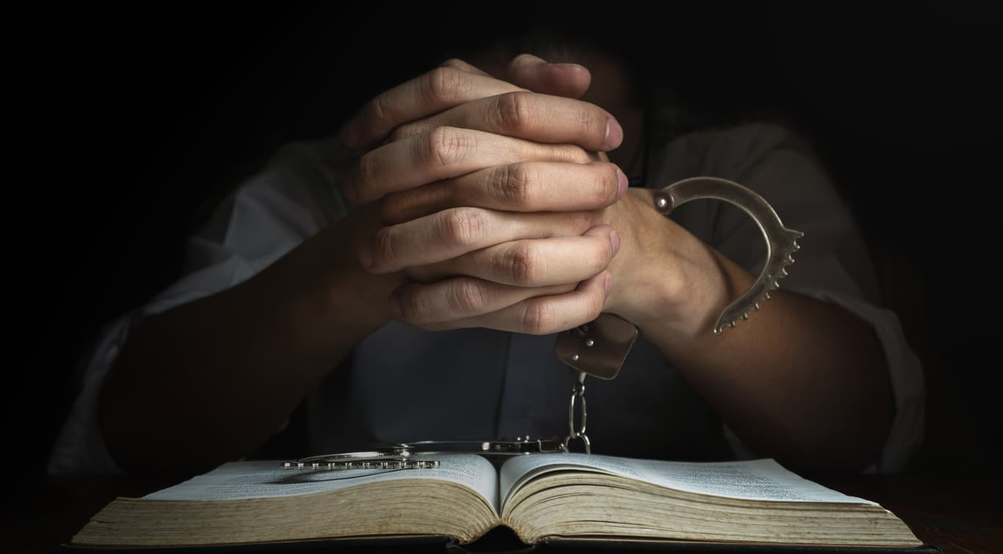
Prayer is
a fundamental part in soul winning
our security of forgiveness
how we can ask for the holy spirit
power to resist temptation
the heaven-ordained means to overcome sin
Prayer is heaven's ordained means of success in the conflict with sin and the development of Christian character. The divine influences that come in answer to the prayer of faith will accomplish in the soul of the suppliant all for which he pleads. For the pardon of sin, for the Holy Spirit, for a Christlike temper, for wisdom and strength to do His work, for any gift He has promised, we may ask; and the promise is, “Ye shall receive.”(The Acts of the Apostles, 563, 564.) Pr 52

Slide 20
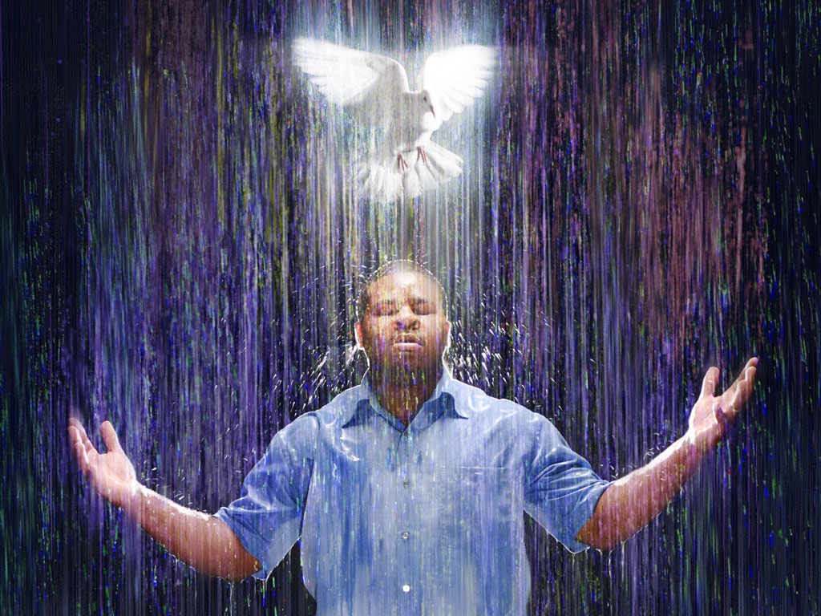
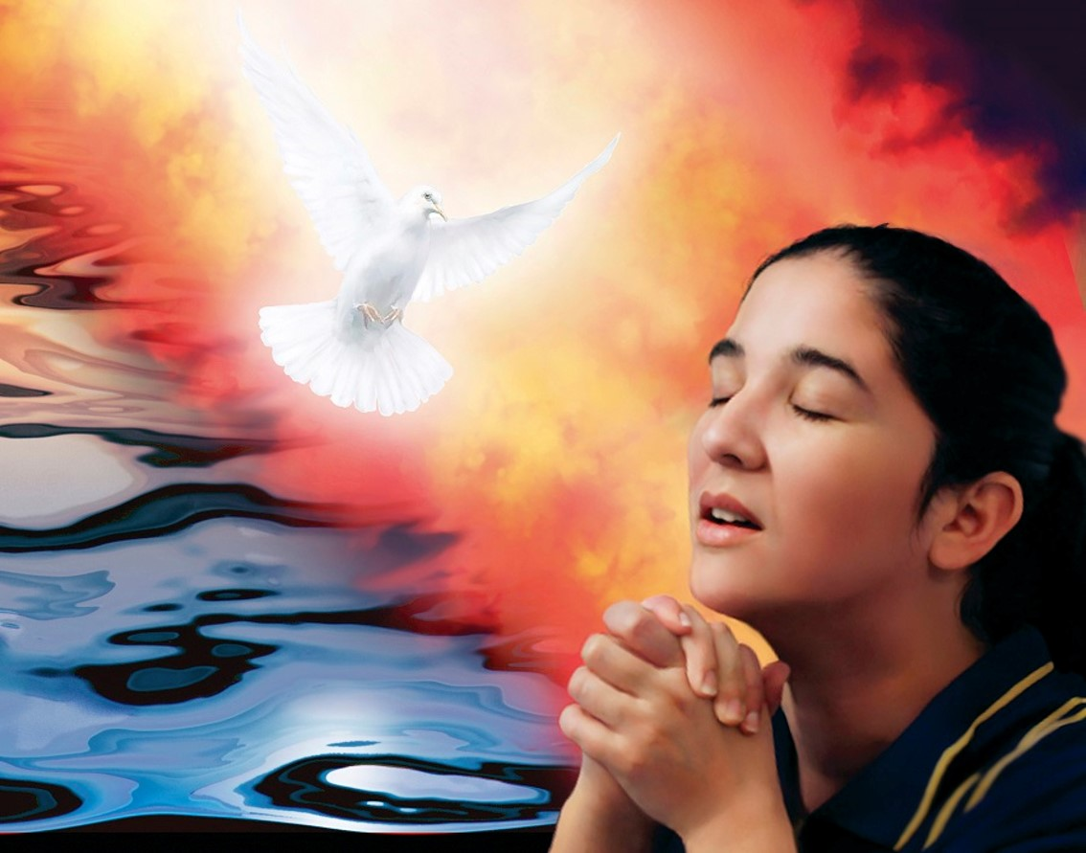
Prayer is
a fundamental part in soul winning
our forgiveness security
how we can ask for the holy spirit
power to resist temptation
the heaven-ordained means to overcome sin
At all times and in all places, in all sorrows and in all afflictions, when the outlook seems dark and the future perplexing, and we feel helpless and alone, the Comforter will be sent in answer to the prayer of faith. AG 191. Circumstances may separate us from every earthly friend; but no circumstance, no distance, can separate us from the heavenly Comforter. Wherever we are, wherever we may go, He is always at our right hand to support, sustain, uphold, and cheer.—The Desire of Ages, 669, 670. ChS 251
What we need is the quickening influence of the Holy Spirit of God. “Not by might, nor by power, but by My Spirit, saith the Lord of hosts.” Pray without ceasing, and watch by working in accordance with your prayers. As you pray, believe, trust in God. It is the time of the latter rain, when the Lord will give largely of His Spirit. Be fervent in prayer, and watch in the Spirit.—(Testimonies to Ministers and Gospel Workers, 512.) Pr 120

Slide 21
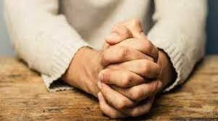
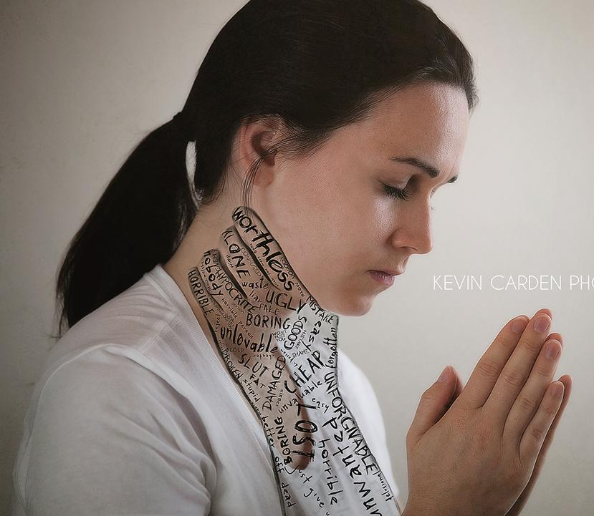

Prayer is
a fundamental part in soul winning
our forgiveness security
how we can ask for the holy spirit
power to resist temptation
the heaven-ordained means to overcome sin
In the daily life you will meet with sudden surprises, disappointments, and temptations. What saith the word? “Resist the devil,” by firm reliance upon God, “and he will flee from you. Draw nigh to God, and He will draw nigh to you. “Let him take hold of My strength, that he may make peace with Me; and he shall make peace with Me.” Look unto Jesus at all times and in all places, offering a silent prayer
from a sincere heart that you may know how to do His will. Then when the enemy comes in like a flood, the Spirit of the Lord will lift up a standard for you against the enemy. When you are almost ready to yield, to lose patience and self-control, to be hard and denunciatory, to find fault and accuse—this is the time for you to send to heaven the prayer, “Help me, O God, to resist temptation, to put all bitterness and wrath and evil-speaking out of my heart. Give me Thy meekness, Thy lowliness, Thy longsuffering, and Thy love. Leave me not to dishonor my Redeemer, to misinterpret the words and motives of my wife, my children, and my brethren and sisters in the faith. Help me that I may be kind, pitiful, tenderhearted, forgiving. Help me to be a real house-band in my home and to represent the character of Christ to others.”(The Adventist Home, 214, 215.) Pr 68

Slide 22


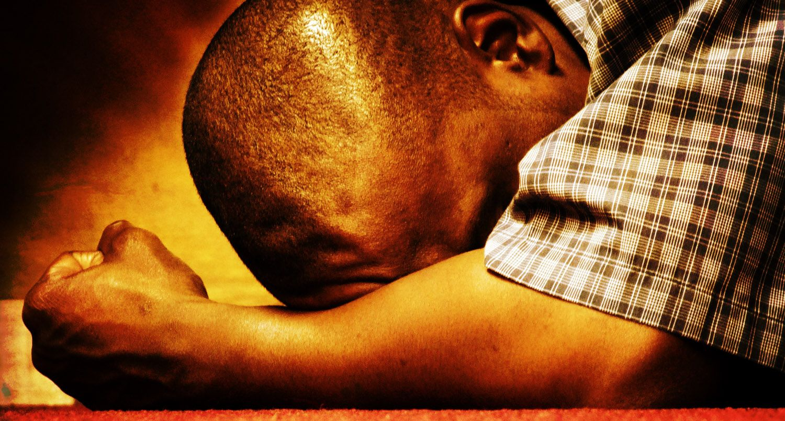
Prayer is
the tool to achieve victory
praise and thanksgiving
the way to ask for a transformation of character
the means to intercede for others
the weapon to defeat Satan
ask to give
Oh, we need to press our petitions! Ask in faith, wait in faith, receive in faith, rejoice in hope, for everyone that seeketh findeth. Be in earnest in the matter. Seek God with all the heart. People put soul and earnestness into everything they undertake in temporal things, until their efforts are crowned with success. With intense earnestness learn the trade of seeking the rich blessings that God has promised, and with persevering, determined effort you shall have His light and His truth and His rich grace.
In sincerity, in soul hunger, cry after God. Wrestle with the heavenly agencies until you have the victory. Put your whole being into the Lord's hands, soul, body, and spirit, and resolve to be His loving, consecrated agency, moved by His will, controlled by His mind, infused by His Spirit. Pr 56
The greatest victories gained for the cause of God are not the result of labored argument, ample facilities, wide influence, or abundance of means; they are gained in the audience chamber with God, when with earnest, agonizing faith men lay hold upon the mighty arm of power. GW 259.

Slide 23
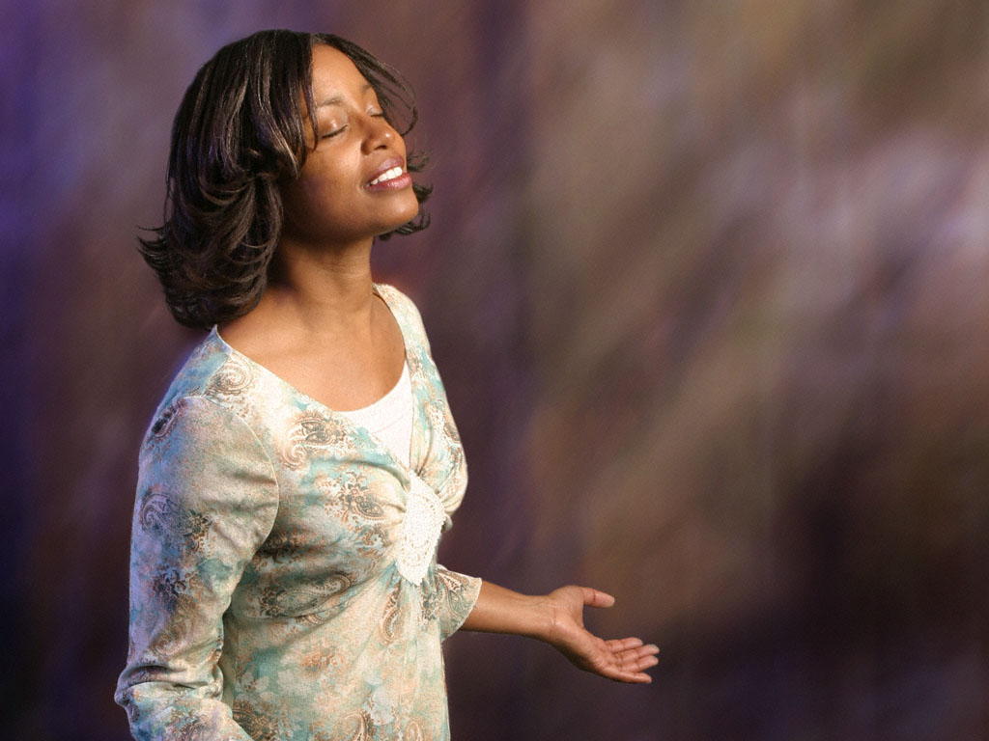
Prayer is
the tool to achieve victory
praise and thanksgiving
the way to ask for a transformation of character
the means to intercede for others
the weapon to defeat Satan
ask to give
Shall all our devotional exercises consist in asking and receiving? Shall we be always thinking of our wants and never of the benefits we receive? Shall we be recipients of His mercies and never express our gratitude to God, never praise Him for what He has done for us? We do not pray any too much, but we are too sparing of giving thanks.
If the loving-kindness of God called forth more thanksgiving and praise, we would have far more power in prayer. We would abound more and more in the love of God and have more bestowed to praise Him for. You who complain that God does not hear your prayers, change your present order and mingle praise with your petitions. When you consider His goodness and mercies you will find that He will consider your wants.
Pray, pray earnestly and without ceasing, but do not forget to praise.—(Testimonies for the Church 5:317.) Pr 87-88

Slide 24

Prayer is
the tool to achieve victory
praise and thanksgiving
the way to ask for a transformation of character
the means to intercede for others
the weapon to defeat Satan
ask to give
The enemy cannot overcome the humble learner of Christ, the one who walks prayerfully before the Lord. Christ interposes Himself as a shelter, a retreat, from the assaults of the wicked one. The promise is given, “When the enemy shall come in like a flood, the Spirit of the Lord shall lift up a standard against him.” ... There is no power in the whole satanic force that can disable the soul that trusts, in simple confidence, in the wisdom that comes from God. Pr 88
There is a mighty power in prayer. Our great adversary is constantly seeking to keep the troubled soul away from God. An appeal to Heaven by the humblest saint is more to be dreaded by Satan than the decrees of cabinets or the mandates of kings.—(In Heavenly Places, 82.) Pr 89

Slide 25
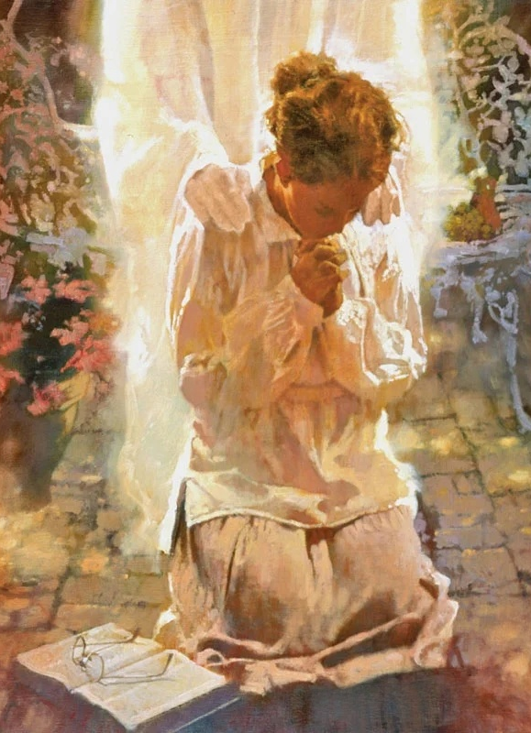
Prayer is
the tool to achieve victory
praise and thanksgiving
the way to ask for a transformation of character
the means to intercede for others
the weapon to defeat Satan
ask to give
The change we need is a change of heart, and can only be obtained by seeking God individually for His blessing, by pleading with Him for His power, by fervently praying that His grace may come upon us, and that our characters may be transformed. This is the change we need today, and for the attainment of this experience we should exercise persevering energy and manifest heartfelt earnestness. We should ask with true sincerity, “What shall I do to be saved?” We should know just what steps we are taking heavenward.—(Selected Messages 1:187.) Pr 94

Slide 26

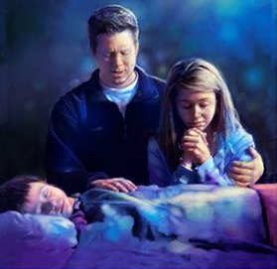
Prayer is
the tool to achieve victory
praise and thanksgiving
the way to ask for a transformation of character
the means to intercede for others
the weapon to defeat Satan
ask to give
In calling God our Father, we recognize all His children as our brethren. We are all a part of the great web of humanity, all members of one family. In our petitions we are to include our neighbors as well as ourselves. No one prays aright who seeks a blessing for himself alone. Thoughts From the Mount of Blessing, 103-105. SD 267.
There are souls who have lost their courage; speak to them, pray for them. There are those who need the bread of life. Read to them from the Word of God. There is a soul sickness no balm can reach, no medicine heal. Pray for these, and bring them to Jesus Christ. And in all your work Christ will be present to make impressions upon human hearts.—(Welfare Ministry, 71.) Pr 245

Slide 27


Prayer is
the tool to achieve victory
praise and thanksgiving
the way to ask for a transformation of character
the means to intercede for others
the weapon to defeat Satan
ask to give
Our prayers are not to be a selfish asking, merely for our own benefit. We are to ask that we may give. The principle of Christ's life must be the principle of our lives. “For their sakes,” He said, speaking of His disciples, “I sanctify Myself, that they also might be sanctified.” John 17:19. The same devotion, the same self-sacrifice, the same subjection to the claims of the word of God, that were manifest in Christ, must be seen in His servants. Our mission to the world is not to serve or please ourselves; we are to glorify God by co-operating with Him to save sinners. We are to ask blessings from God that we may communicate to others. The capacity for receiving is preserved only by imparting. We cannot continue to receive heavenly treasure without communicating to those around us.—(Christ's Object Lessons, 142, 143.) Pr 247

Slide 28

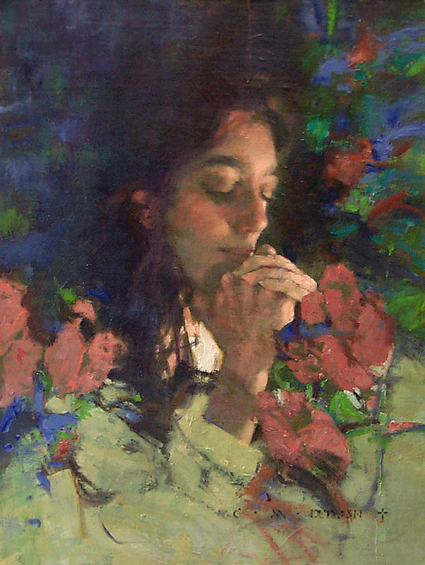

The Scriptures counsel us, "Pray without ceasing." It means that we are to live and serve our Lord in the atmosphere of prayer. Prayer is the channel of communication between us and God.
God speaks to us through His Word, we respond to Him through prayer, and He always listens to us.
We live in difficult times. The events occurring around us demand that every follower of Christ fervently maintain his or her relationship with God.
When God's people pray earnestly and sincerely, God will answer. Great things will happen among God's people, and the world will feel the impact of the Holy Spirit's agency in the training and enabling of their children.
Pray Without Ceasing

