Slide 1
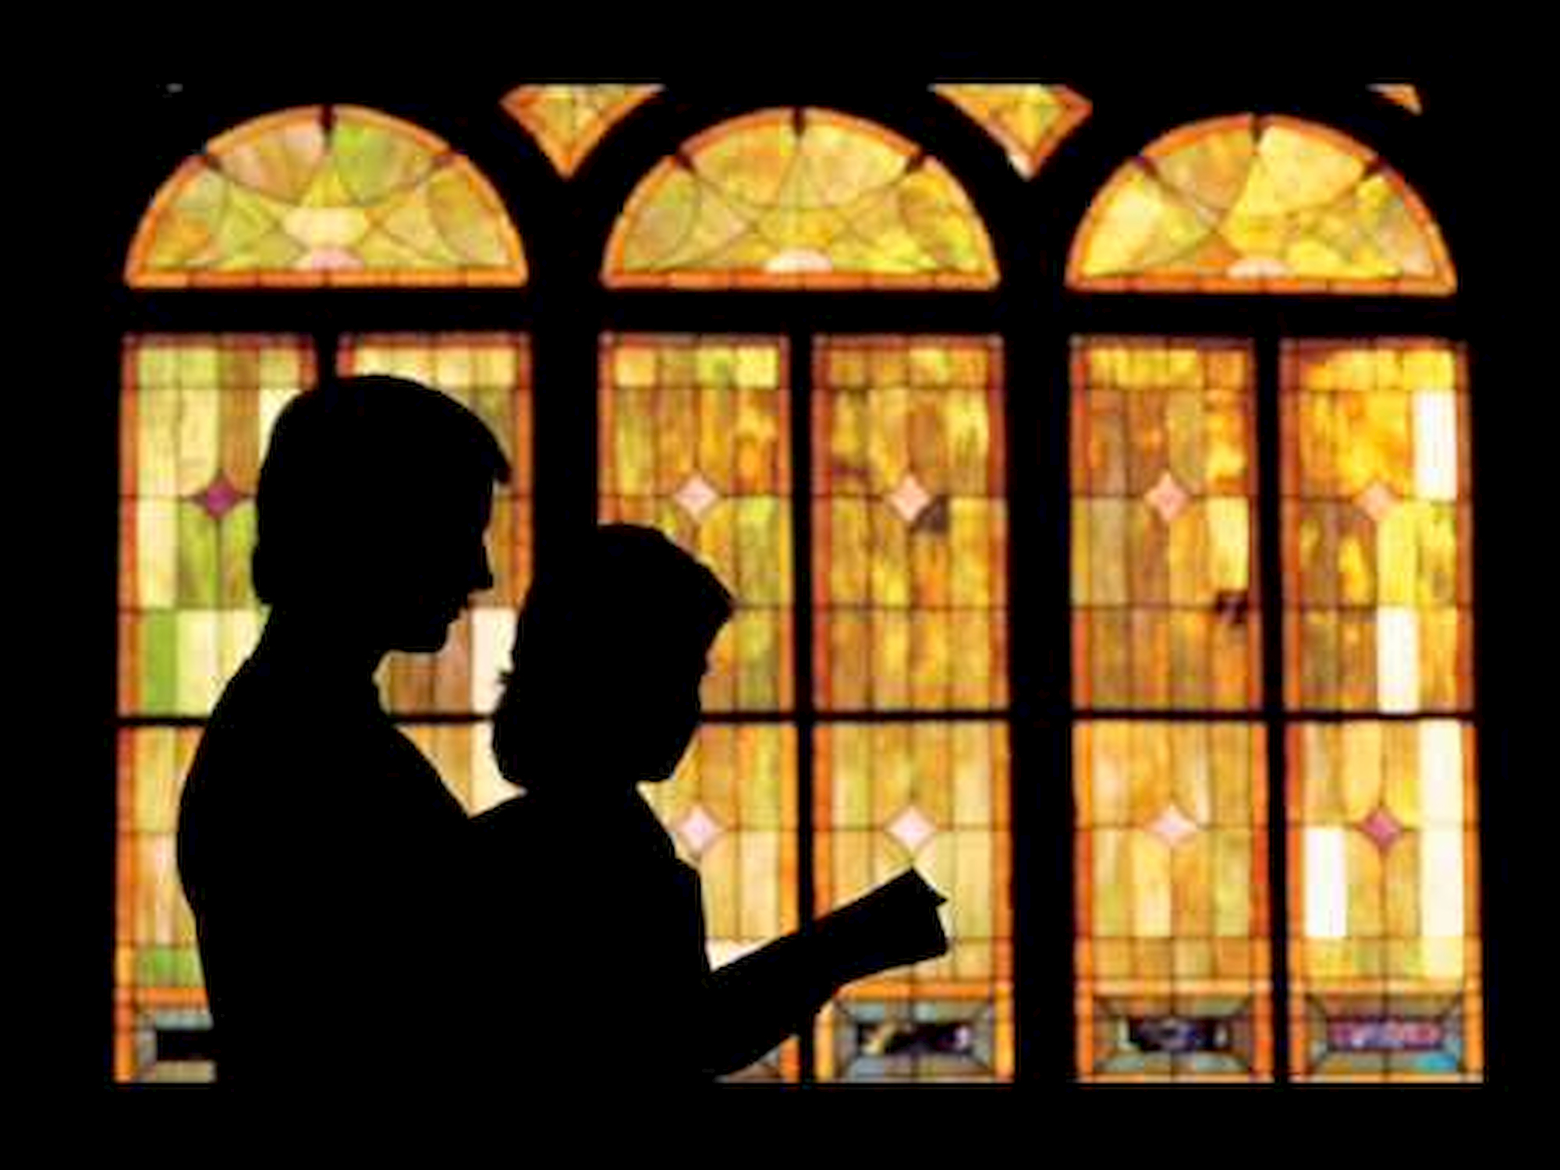
WHAT IS THE CHURCH?

Slide 2
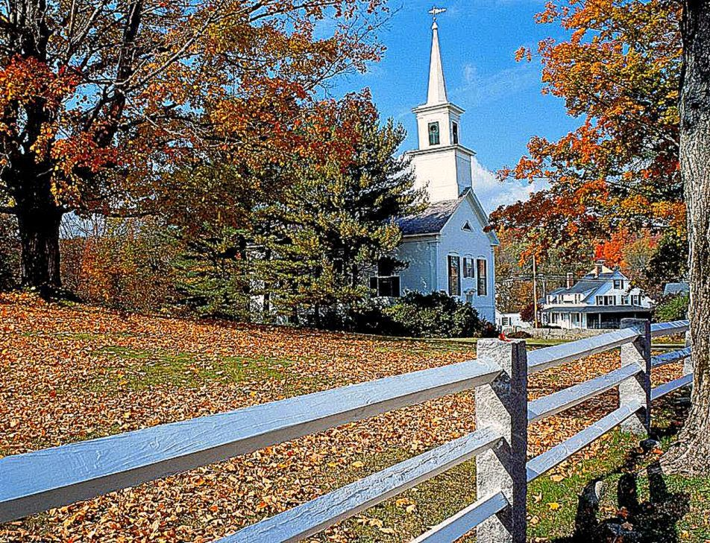
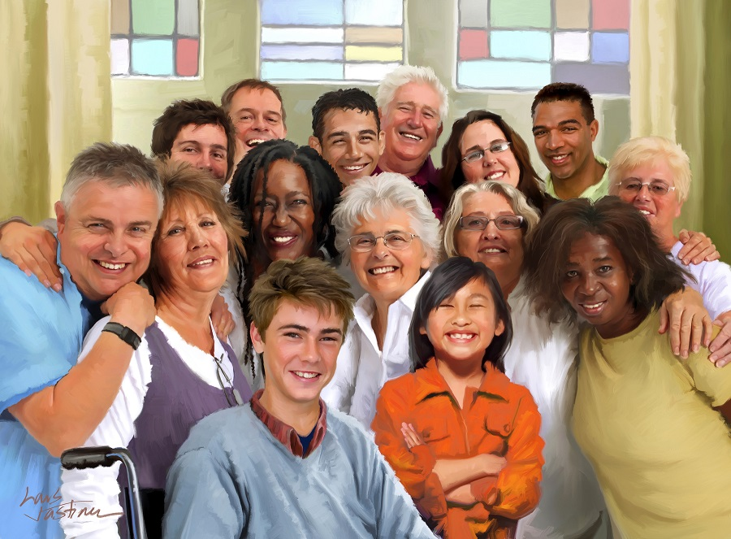
What is the Church for you?
Is it perhaps the temple in which we worship or the members that compose it?
Let Paul explain the purpose that God has for us as a Church.
עֵדָהQAHAL, means CONGREGATION or ASSEMBLY.
ἐκκλησία EKKLESIA which means CHURCH or MEETING.

Slide 3
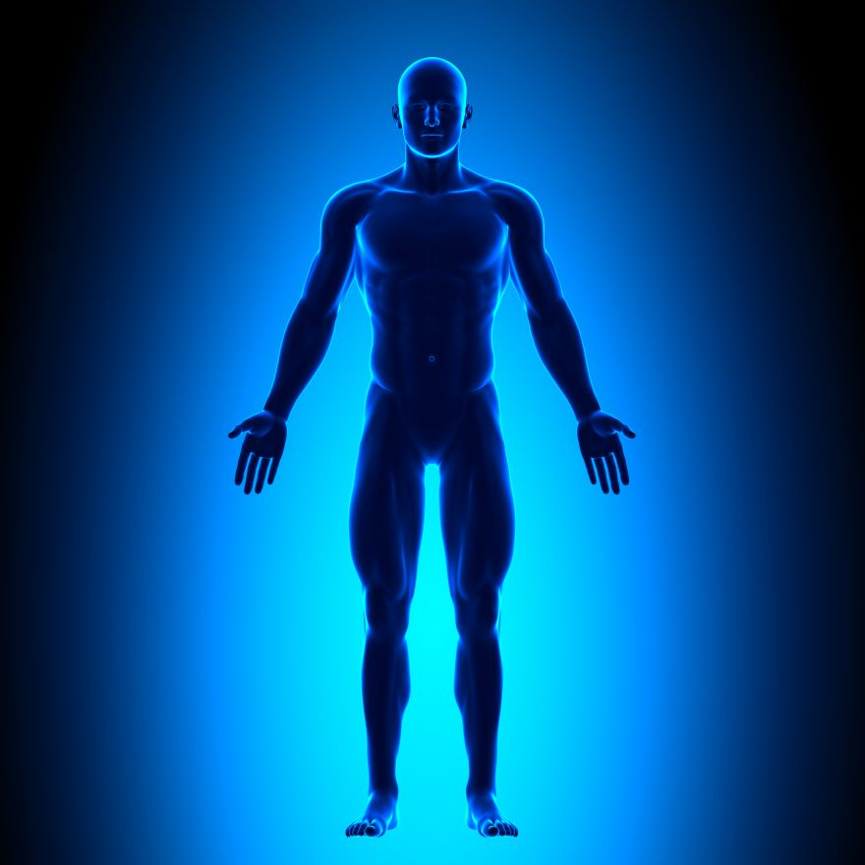

For as the body is one, and hath many members, and all the members of that one body, being many, are one body: so also is Christ.
For by one Spirit are we all baptized into one body, whether we be Jews or Gentiles, whether we be bond or free; and have been all made to drink into one Spirit.
For the body is not one member, but many.
If the foot shall say, Because I am not the hand, I am not of the body; is it therefore not of the body?
And if the ear shall say, Because I am not the eye, I am not of the body; is it therefore not of the body?
If the whole body were an eye, where were the hearing? If the whole were hearing, where were the smelling?
But now hath God set the members every one of them in the body, as it hath pleased him.
And if they were all one member, where were the body? But now are they many members, yet but one body.
1 Corinthians 12:12-27

Slide 4
1 Corinthians 12:12-27
And the eye cannot say unto the hand, I have no need of thee: nor again the head to the feet, I have no need of you.
Nay, much more those members of the body, which seem to be more feeble, are necessary:
And those members of the body, which we think to be less honourable, upon these we bestow more abundant honour; and our uncomely parts have more abundant comeliness.
For our comely parts have no need: but God hath tempered the body together, having given more abundant honour to that part which lacked.
That there should be no schism in the body; but that the members should have the same care one for another.
And whether one member suffer, all the members suffer with it; or one member be honoured, all the members rejoice with it.
Now ye are the body of Christ, and members in particular.

Slide 5
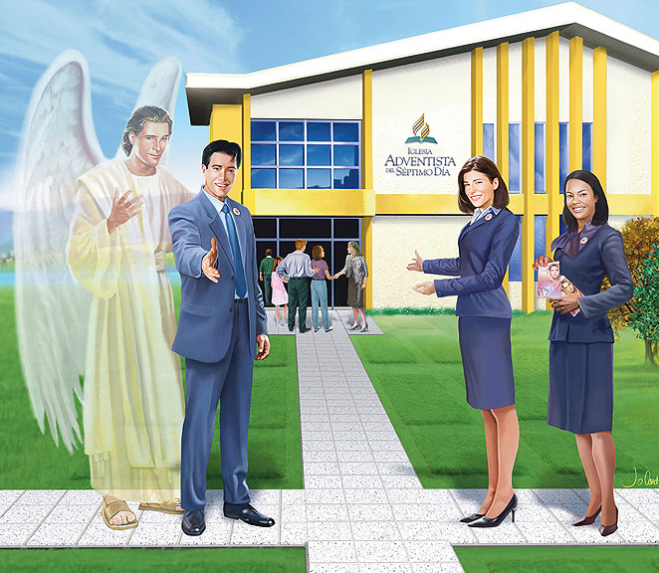
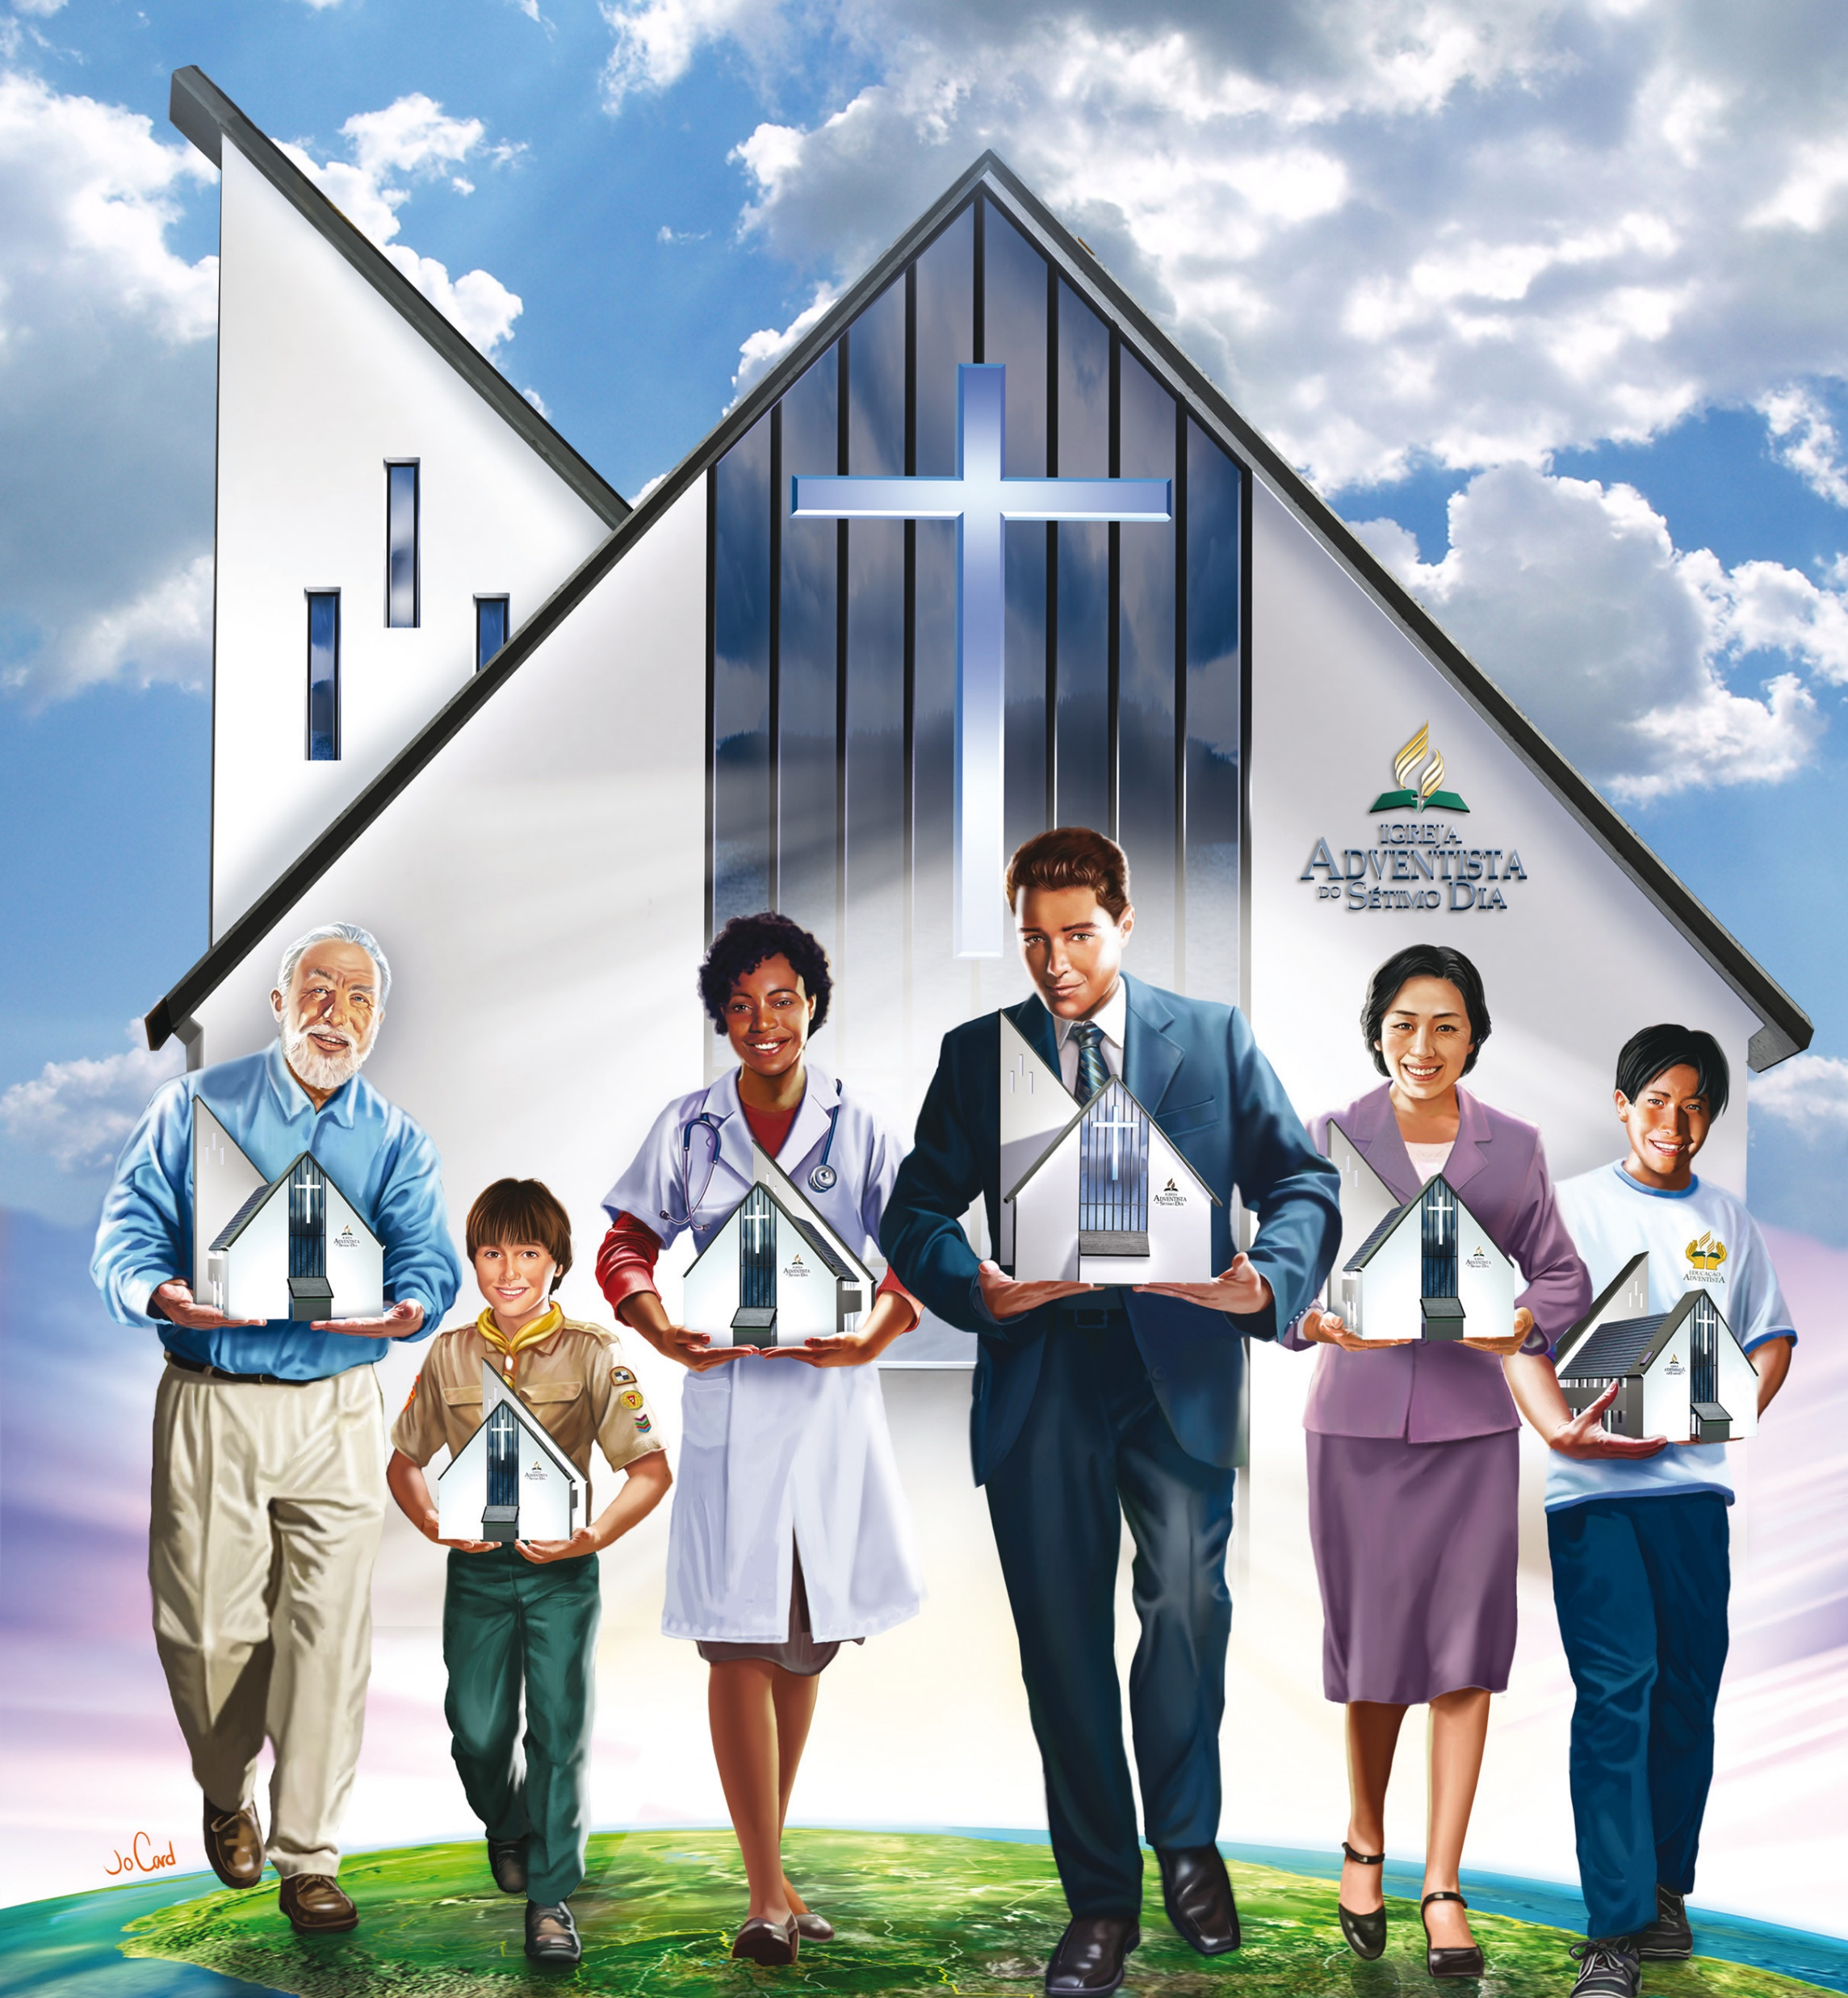
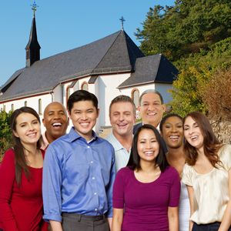

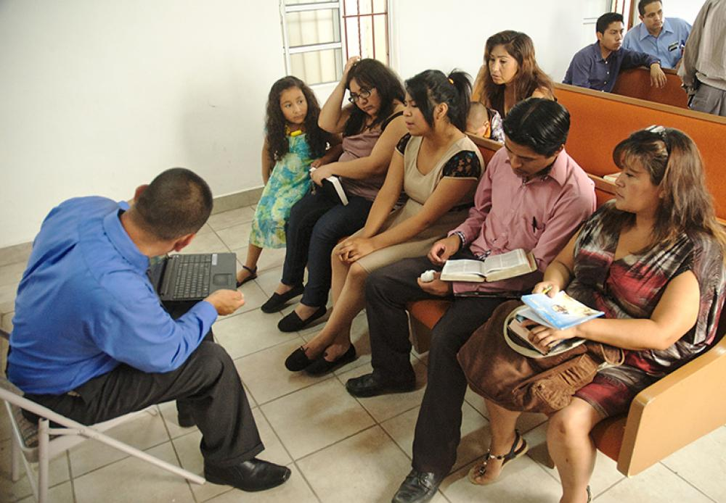
WE ARE ALL NECESSARY
UNIT
BODY
Here Paul illustrates what the Church is, it is the Body. The Apostle Paul wrote that we are all members of the same body and must work together for the body to function properly. The fundamental principle of this first image is unity. We are a group of members who must stand together so that the Church (the body) can honor and glorify God. We are one in Christ.
We pray that God will help us stick together and together support each other to stand strong as we await the return of our Lord Jesus Christ.

Slide 6

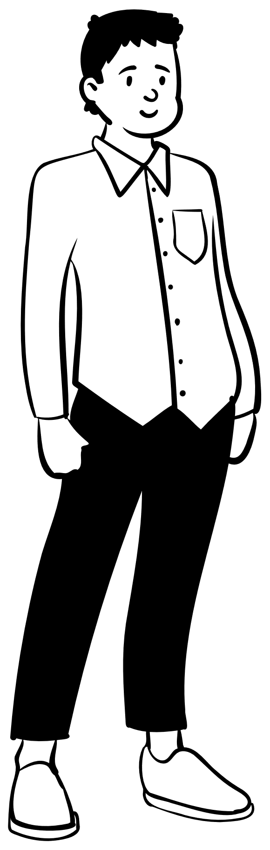





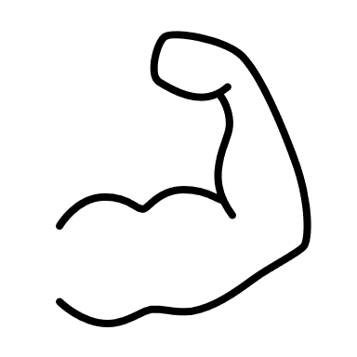
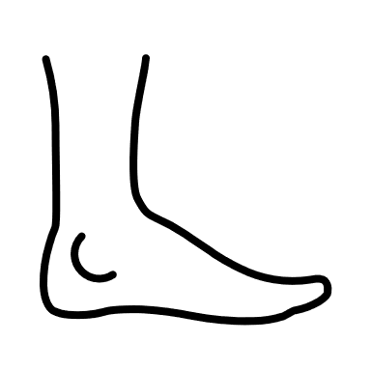
The church is the body of Christ, and Christ its head (see 1 Cor. 12:27; Eph. 1:22-23; Col. 1:18-24).
All the members of the church are separate units having various offices and different responsibilities in the church. They receive gifts from God for these functions, gifts appropriate to their individual needs; but all have to answer to Christ and are united in him.
No part of the body can be dispensed with if the body is to continue to function efficiently.
The members need to fully complement each other so that together they fulfill all the necessary functions for the good of the whole.
The church needs consecrated and active members who continually contribute to the full accomplishment of the church's work in winning souls for the kingdom of God.
No member, no matter how weak, ignorant, or small, should be considered unnecessary or worthless. Christ loves all members. He gave his life for all, and he would have died for one soul.
Each one has its place, and it is not correct to think that the members belong to different bodies and that, therefore, they cannot be related to each other.
Notes:
La iglesia es el cuerpo de Cristo, y Cristo su cabeza (ver 1 Cor. 12: 27; Efe. 1: 22-23; Col. 1: 18-24).
El apóstol presenta a la iglesia como el cuerpo de Cristo, lo que significa que ella es un cuerpo unido, con Cristo como su cabeza (ver 1 Cor. 12: 27; Efe. 1: 22-23; Col. 1: 18-24). Mediante una figura de lenguaje en que una parte representa o se nombra por el todo, Cristo, cabeza de la iglesia, representa a la iglesia entera. Todos los miembros de la iglesia son unidades separadas que tienen cargos diversos y diferentes responsabilidades en la iglesia. Reciben dones de Dios para esas funciones, dones apropiados para sus necesidades individuales; pero todos tienen que responder ante Cristo, y están unidos en él.
en el cual cada parte cumple una función necesaria. No se puede prescindir de ninguna parte del cuerpo si se quiere que continúe funcionando eficientemente.
se necesita es que los miembros se complementen plenamente para que unidos cumplan todas las funciones necesarias para el bien del todo. El cuerpo humano no tiene lugar para miembros inactivos ni necesita a los que no contribuyan para la eficiencia general de todo el organismo. La iglesia necesita miembros consagrados y activos que contribuyan continuamente a la completa realización 768 de la obra de la iglesia en la ganancia de almas para el reino de Dios (ver 1JT 588-589; 2JT 156-157; 3JT 67-69).
El miembro más humilde de la iglesia es tan miembro del cuerpo de Cristo como el que posee los más destacados dones (ver Mat. 23: 8-12; Sant. 3: 1; 1 Ped. 5: 3). Cristo ama a todos los miembros. Dio su vida por todos, y hubiera muerto por una sola alma (ver Luc. 15: 4-7-, DTG 446; MB 261).
Si todos los miembros tuvieran el mismo don o los mismos dones, y todos fueran aptos para el mismo cargo o la misma clase de servicio, se descuidarían importantes fases de la actividad de la iglesia para la proclamación del Evangelio, y la iglesia declinaría en espiritualidad y vigor. Cada parte debe hacer su debida contribución para el bienestar del cuerpo; de lo contrario no se puede mantener una eficiencia máxima.
Unidad en la diversidad y diversidad en la unidad es la disposición o arreglo que produce los mejores tratados (ver Eze. 1: 28; 10; 2JT 350; OE 504). La mano de Dios lo preside todo, e individualmente los cristianos pueden regocijarse de ser considerados dignos de una parte -aunque sea pequeña- en la grandiosa obra de llevar a una gloriosa terminación el plan de redención.
Ningún miembro, no importa cuán débil, ignorante o pequeño sea, debe ser considerado como innecesario o sin valor. Cada uno es en su lugar, y no es correcto pensar que los miembros pertenecen a diferentes cuerpos y que, por lo tanto, no pueden relacionarse entre sí.
No importa qué parte del cuerpo humano esté afectada por el dolor o la enfermedad, los recursos y las energías de todo el organismo se concentran para aliviar ese dolor y restaurar el miembro lesionado a su estado normal. En el cuerpo espiritual cada miembro también debe interesarse en el bienestar de los otros, sin hacer acepción de personas ni de dones.

Slide 7
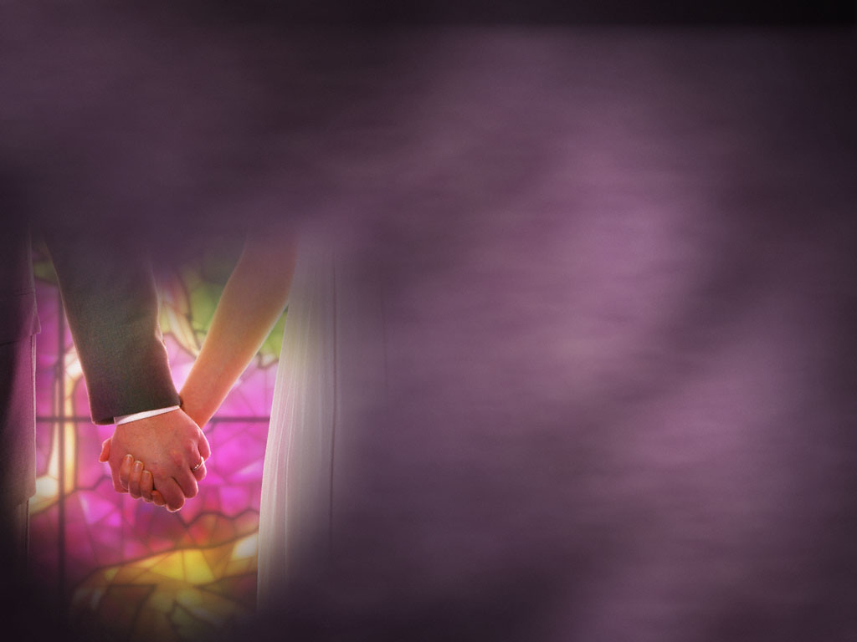

Wives, submit yourselves unto your own husbands, as unto the Lord.
For the husband is the head of the wife, even as Christ is the head of
the church: and he is the saviour of the body. Therefore as the church is subject unto Christ, so let the wives be to their own husbands in every thing. Husbands, love your wives, even as Christ also loved the church, and gave himself for it; That he might sanctify and cleanse it with the washing of water by the word, That he might present it to himself a glorious church, not having spot, or wrinkle, or any such thing; but that it should be holy and without blemish.
Ephesians 5:22-32
So ought men to love their wives as their own bodies. He that loveth his wife loveth himself. For no man ever yet hated his own flesh; but nourisheth and cherisheth it, even as the Lord the church: For we are members of his body, of his flesh, and of his bones. For this cause shall a man leave his father and mother, and shall be joined unto his wife, and they two shall be one flesh. This is a great mystery: but I speak concerning Christ and the church.

Slide 8
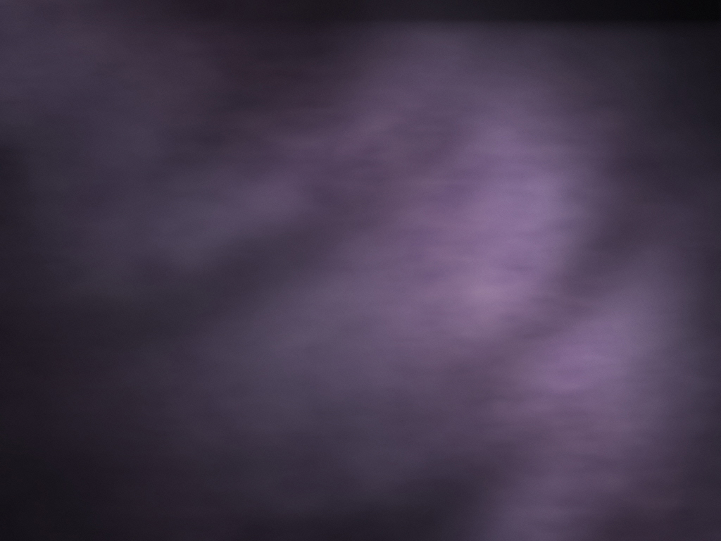
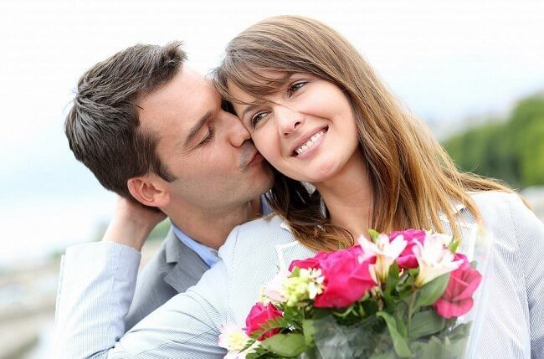
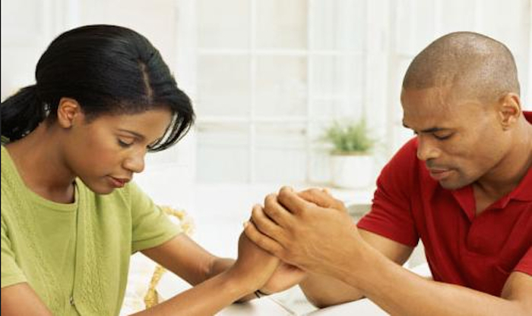
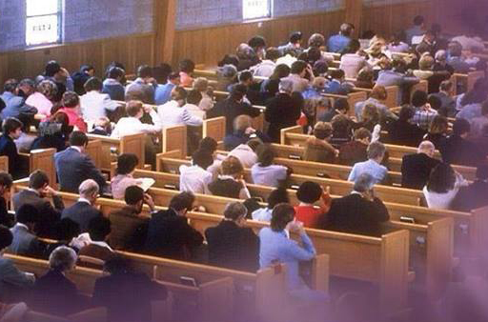
GOOD RELATIONSHIP
MARRIAGE
LOVE
FIDELITY
RESPECT
Now the apostle Paul sets aside objects to refer to people. On this occasion he uses the example of marriage to show the beginning of a good relationship, where love, respect, fidelity, etc. are encouraged.
As a Church we must love God above all things, also love one another with brotherly love.
Trust between us is also important because that is how we
work safely.
We must show respect towards God with our actions and thoughts, as well as respect each other inside and outside the church.
Fidelity to God is very important to receive His blessings every day, but we must also be faithful to our brothers by not speaking ill of them behind their backs, accusing them or despising them.
A marriage that loves, respects and is faithful to each other will last. The same goes for the church.

Slide 9

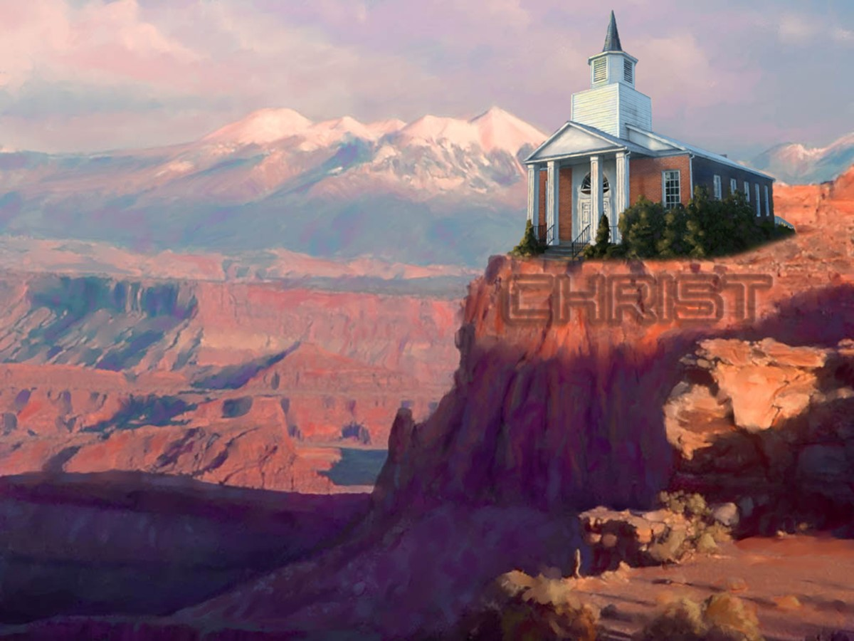
For we are labourers together with God: ye are God's husbandry, ye are God's building.
1 Corinthians 3:9-17
According to the grace of God which is given unto me, as a wise masterbuilder, I have laid the foundation, and another buildeth thereon. But let every man take heed how he buildeth thereupon. For other foundation can no man lay than that is laid, which is Jesus Christ.
Now if any man build upon this foundation gold, silver, precious stones, wood, hay, stubble; Every man's work shall be made manifest: for the day shall declare it, because it shall be revealed by fire; and the fire shall try every man's work of what sort it is.
If any man's work abide which he hath built thereupon, he shall receive a reward. If any man's work shall be burned, he shall suffer loss: but he himself shall be saved; yet so as by fire. Know ye not that ye are the temple of God, and that the Spirit of God dwelleth in you? If any man defile the temple of God, him shall God destroy; for the temple of God is holy, which temple ye are.

Slide 10
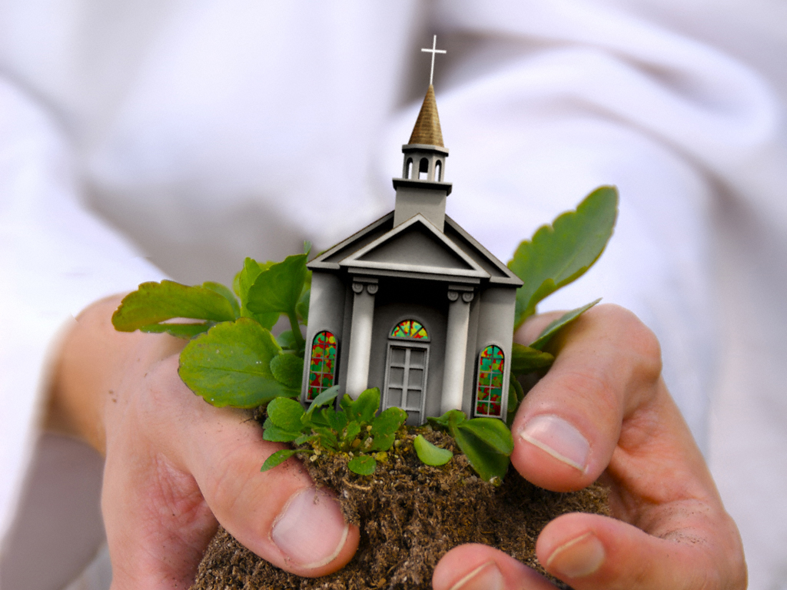

THE FOUNDATION IS CHRIST
BUILDING
Paul is referring to a building where the main key is found in verse 11: "For other foundation can no man lay than that is laid, which is Jesus Christ."
As a Church we need to have a strong and firm foundation so that we do not collapse, and this foundation is Christ.
Our doctrines are based on Christ, our preaching must be based on Christ, our testimony must be based on Christ.
Everything must be founded on Christ so that we can be a strong and united Church.

Slide 11
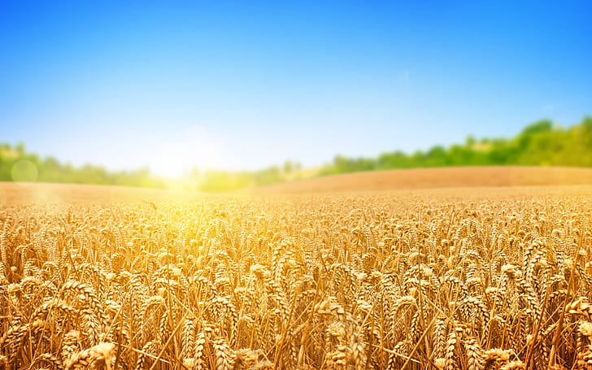

I have planted, Apollos watered; but God gave the increase.
So then neither is he that planteth any thing, neither he that watereth; but God that giveth the increase.
Now he that planteth and he that watereth are one: and every man shall receive his own reward according to his own labour.
For we are labourers together with God: ye are God's husbandry, ye are God's building.
1 Corinthians 3:6-9

Slide 12
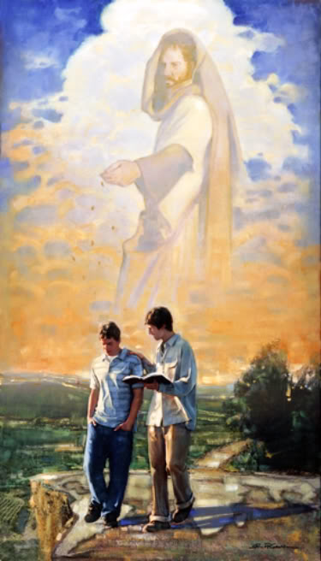
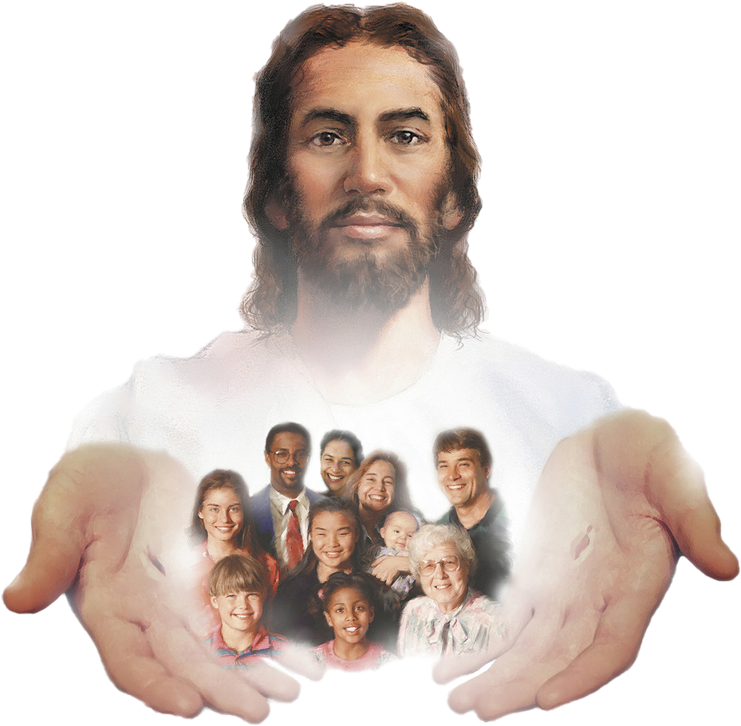
GOD GIVES GROWTH
FIELD
This biblical passage shows the Church as a cultivated field, where God is the one who gives the growth.
As church members we must understand that we are all growing together to the fullness of Christ.
Likewise, the glory of our success as a church must be given to God, because thanks to the blessings that He gives, all success is due.
We must also understand that it is not about seeing who sows the most seeds or who reaps the most souls, but to make sure that we grow together and are prepared for when the Sower comes to reap, we are counted as wheat and not as tares.

Slide 13
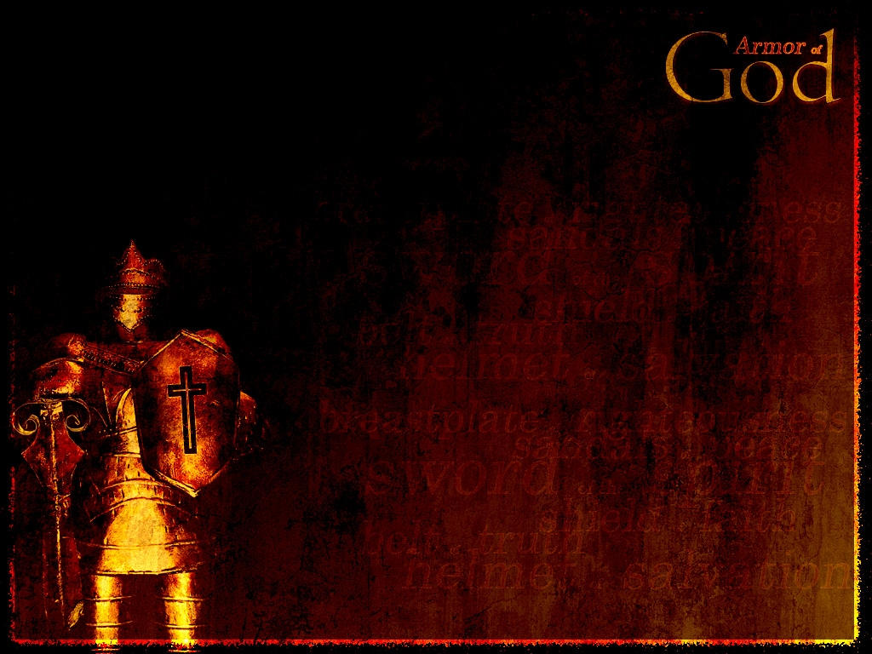

Ephesians 6:11-17
Put on the whole armour of God, that ye may be able to stand against the wiles of the devil.
For we wrestle not against flesh and blood, but against principalities, against powers, against the rulers of the darkness of this world, against spiritual wickedness in high places.
Wherefore take unto you the whole armour of God, that ye may be able to withstand in the evil day, and having done all, to stand.
Stand therefore, having your loins girt about with truth, and having on the breastplate of righteousness;
And your feet shod with the preparation of the gospel of peace;
Above all, taking the shield of faith, wherewith ye shall be able to quench all the fiery darts of the wicked.
And take the helmet of salvation, and the sword of the Spirit, which is the word of God.

Slide 14
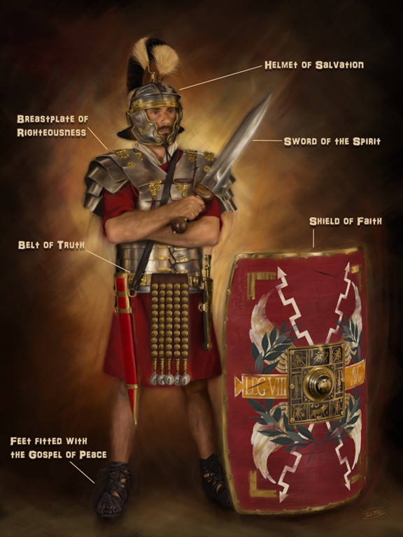
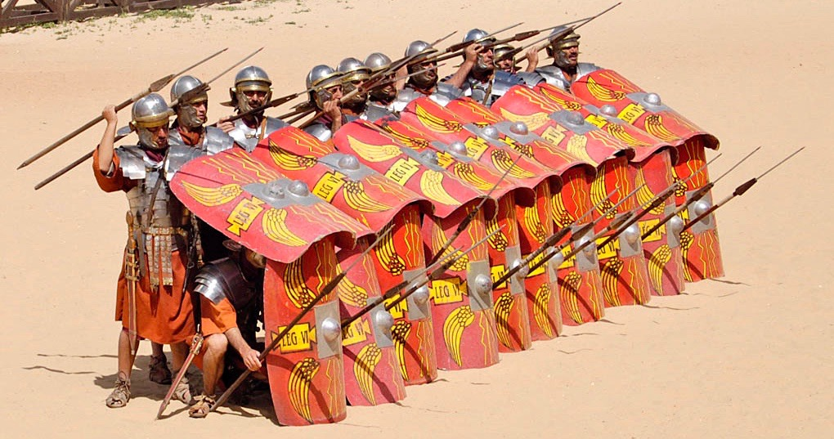
OBEDIENT AND LOYAL
ARMY
Paul refers to an army prepared and full of loyalty to the King of kings.
An army must be fully equipped before going out on the battlefield; the Christian must also be well prepared with all his spiritual
armor before facing the devil,
otherwise, he will inevitably be
defeated.
As a Church we are an army of faithful servants of God, equipped with the armor that He prepared and that is effective to face each day in the fight against the enemy.
We are convinced that Christ goes with us to give us victory. He, our great General, is our hope, we obey Him, and we are loyal to him.

Slide 15
We have seen, through five images, what the Church is. In summary the Church is a group of believers:
That maintains unity (Body).
That maintains a good personal relationship with God and with others (Marriage).
Which has Christ as its solid foundation (Building).
Which is constantly growing (Field).
Who is standing in the fight against the Evil One, and maintains his obedience and loyalty to God (Army).
That is the Church, therefore, we must ask God every day that we reach the ideal that God expects us to achieve as his people and holy nation that we are. Let's fight together to fulfill God's dream with his Church.

