Slide 1
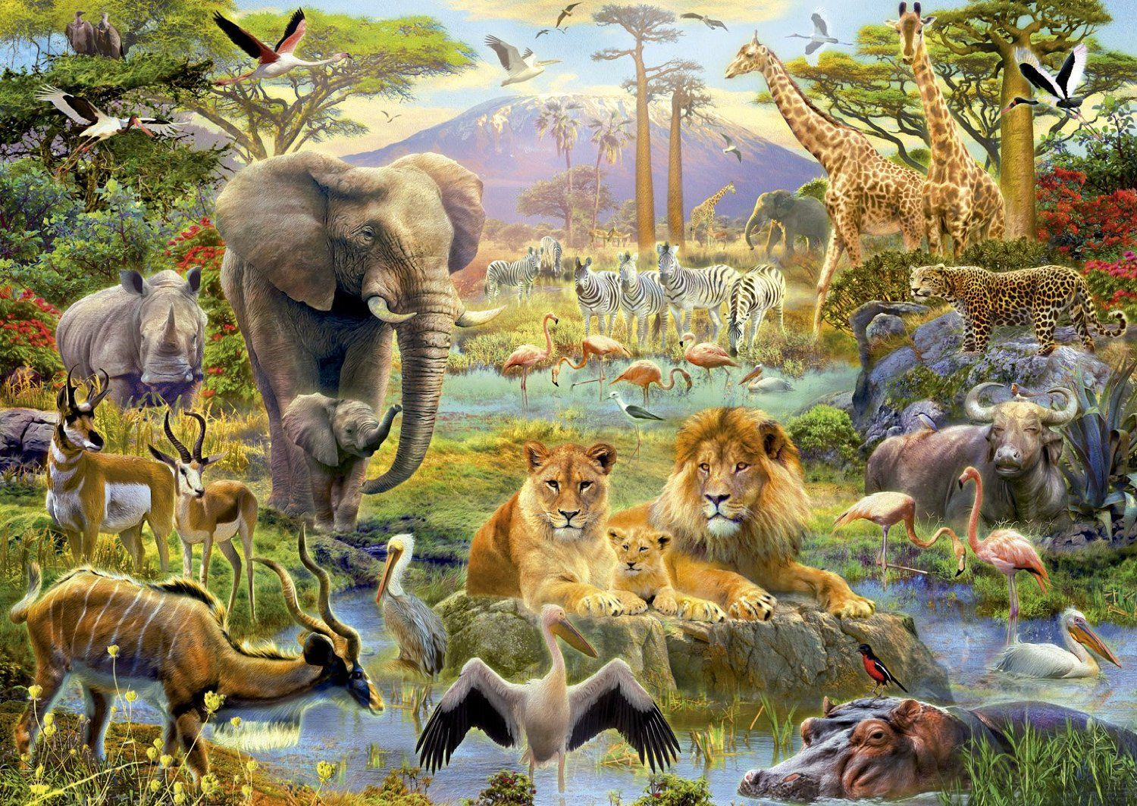
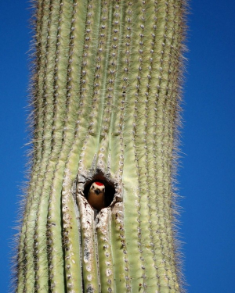
WHERE DO YOU LIVE?

Slide 2
Solomon observed nature and was aware of its ignorance. This humbled him. He tells us about four animals that he observed. “There be four things which are little upon the earth, but they are exceeding wise”. Proverbs 30:24-28 NIV
Ants are creatures of little strength, yet they store up their food in the summer
hyraxes are creatures of little power, yet they make their home in the crags
locusts have no king, yet they advance together in ranks
a lizard can be caught with the hand, yet it is found in kings’ palaces
Let's see where some animals live and thus learn more about the greatness of God manifested in His creation. I hope it leads you to praise and exalt God.

Slide 3

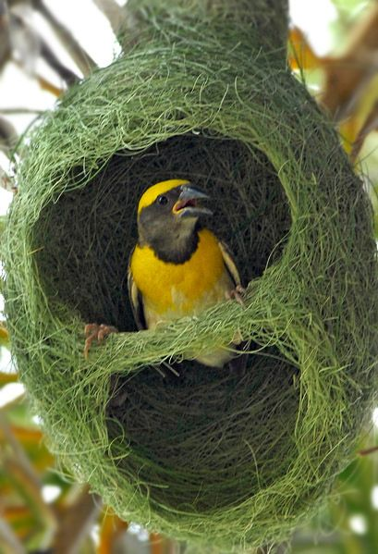
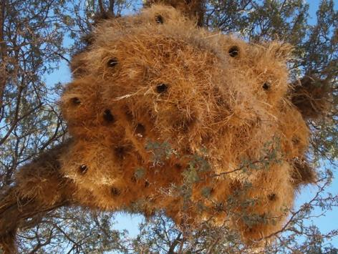
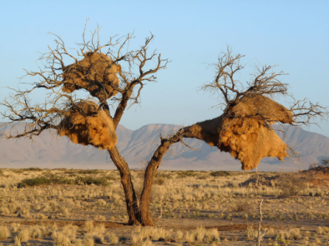
Where do you live?
With my family in a tree
Weavers use straw to build hanging nests at the tips of tree branches or on the stems of tall grasses that can reach up to four meters in height.
Nests contain up to 300 baskets (chambers). In summer, each chamber houses a couple of weavers, in winter it houses a couple of adults who take shelter from the cold.
Males usually weave the nest and use it as a form of display to seduce prospective females. Colonies can be found near bodies of water.

Slide 4

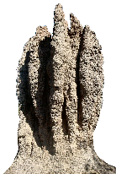
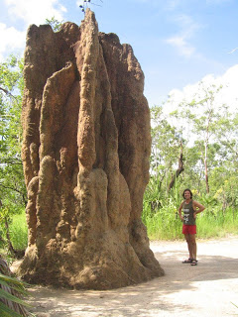
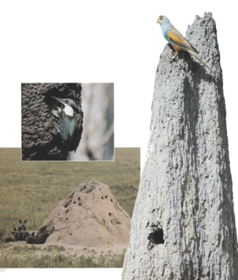
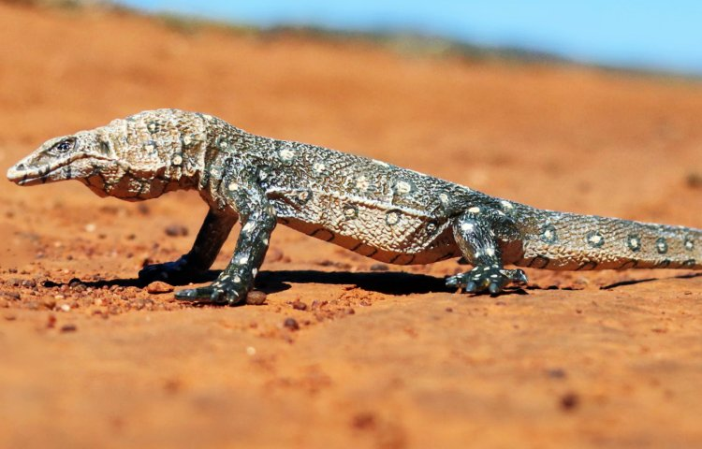
Where do you live?
Of unwanted tenants
Termite nests are made of chewed vegetable covered in clay. They form towers up to 23 ft high and contain countless chambers and galleries. They are air-conditioned.
The golden-shouldered parakeet tunnels and lays eggs. Termites close the hole at night, but the parakeet opens it every morning.
Kingfishers also use termite nests.
The Australian Giant Monitor Lizard pierces the termite mound and deposits its eggs there. Termites repair damage quickly and leave the eggs safe inside the nest. Thus, the eggs are assured of almost perfect conditions for incubation for the next nine months.
The new monitor lizards will hatch and be trapped between the hard clay walls of the nest, but they will remain motionless until their mother returns for them. They are not in danger, because she knows exactly when to take them out.

Slide 5

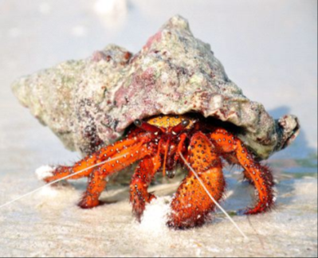
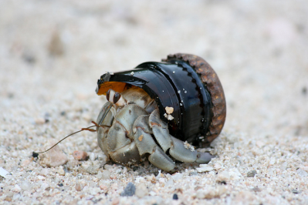
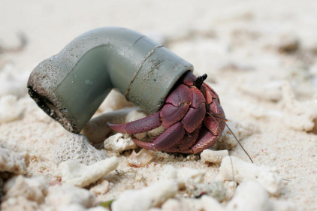
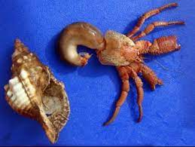

Where do you live?
I am a squatter
The hermit crab is very vulnerable to predators and this forces it to seek shelter and defense in the empty shells of mollusks. When he finds one, he introduces his body in such a way that he can retract into it and support it with his upper body when walking.
As the crab increases in size, it leaves the shell and looks for a larger one. Some species of hermit crab may use corals, wood, or stones, instead of shells.

Slide 6

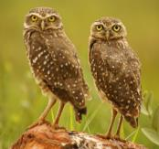
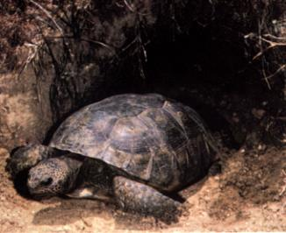
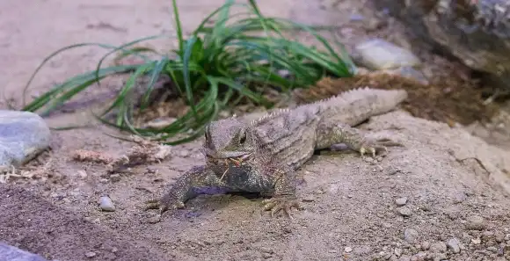
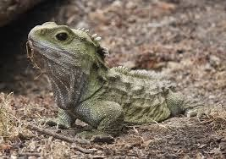
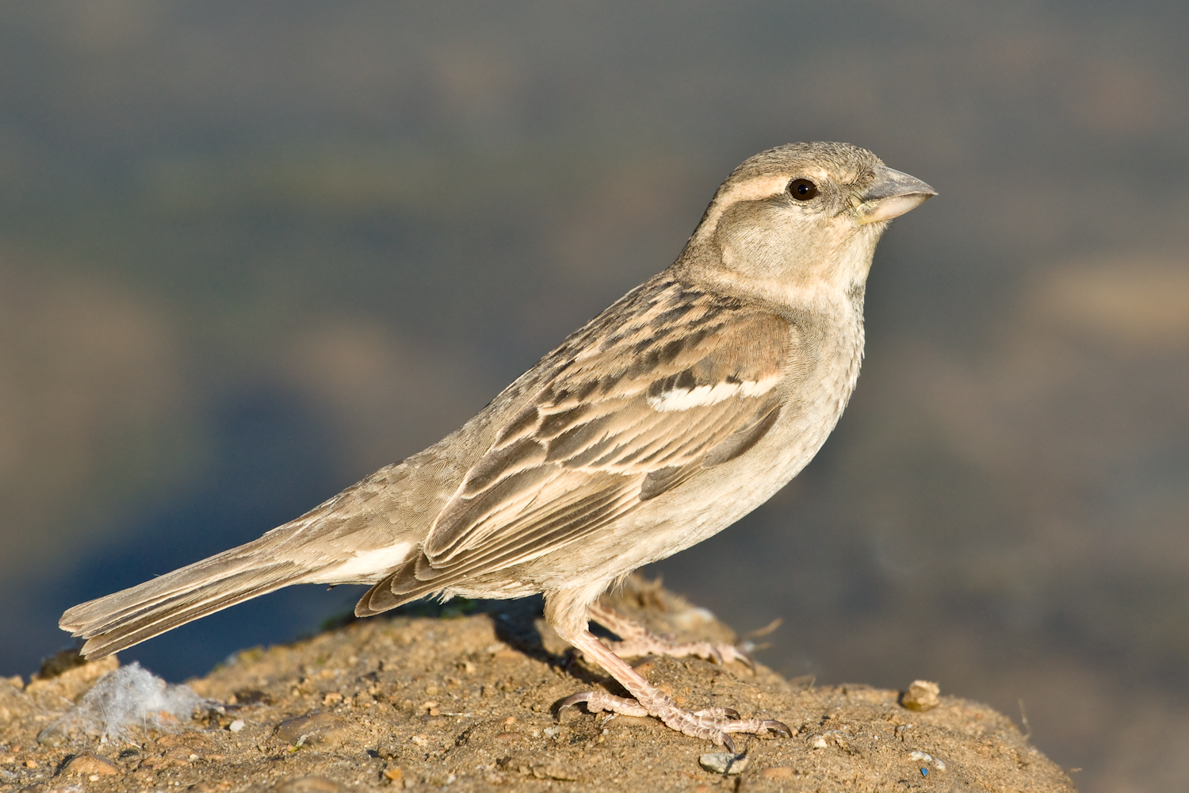
Where do you live?
Sharing a flat
Long-legged warblers
Tortoise
The land tortoise, from eastern North America, digs its burrow by pushing the earth aside with its flattened front legs.
Frogs, various insects, and long-legged warblers become permanent companions to the turtle's roommates.
Pardalas dig their nests on the crags of some remote islands in New Zealand.
The Tuatara settles there when the shearwater is not there. The Tuatara is a good housewife and keeps the nest clean, so the Pardala is very comfortable with her. There is one exception, when the hatching is born you have to be careful or your ungrateful roommate will eat your hatching.
Pardala
Tuatara

Slide 7

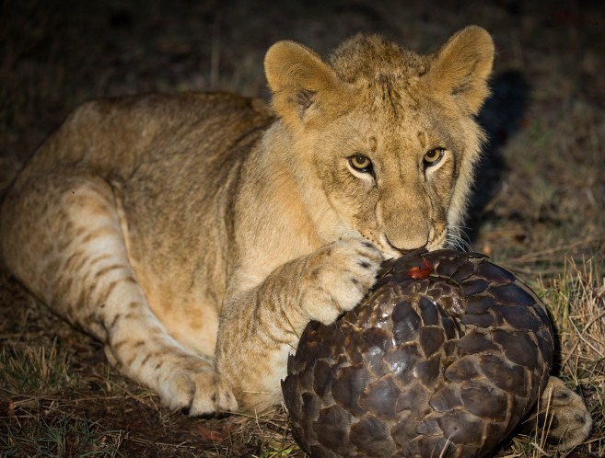
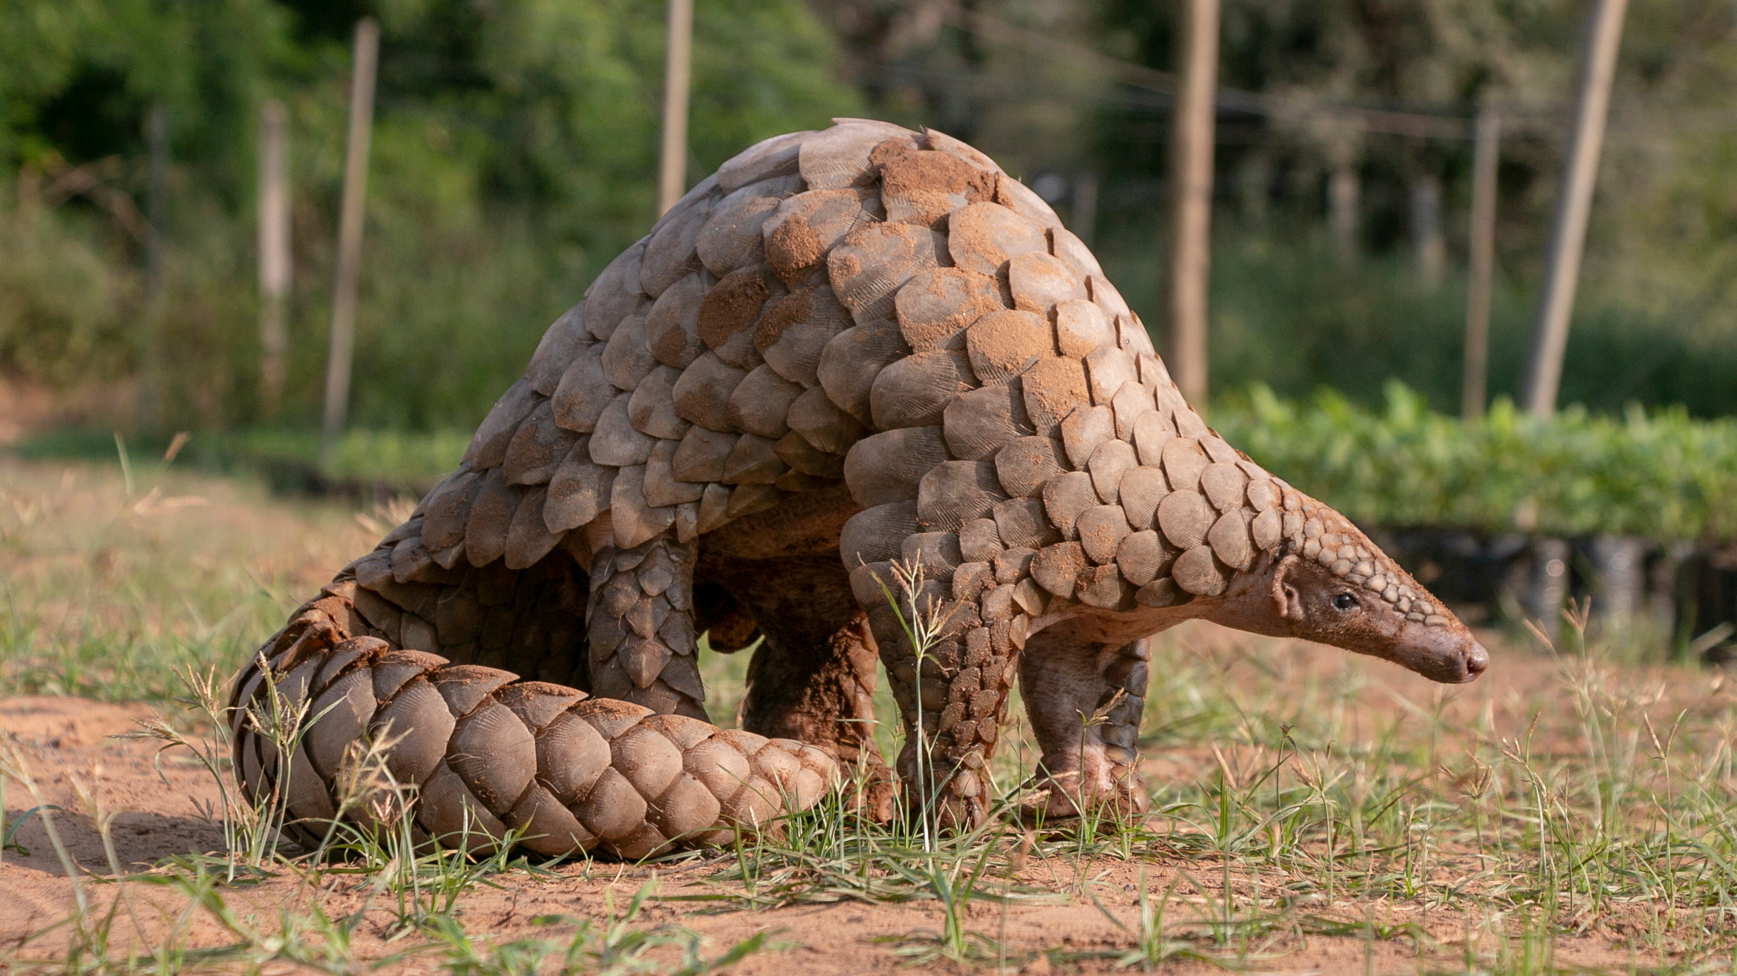
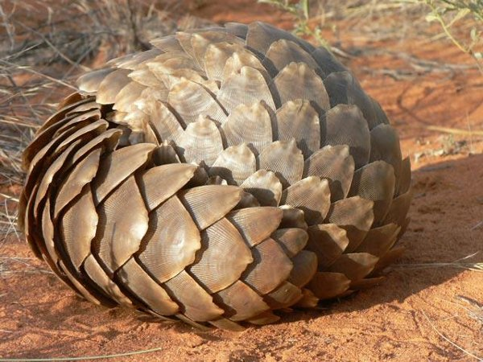
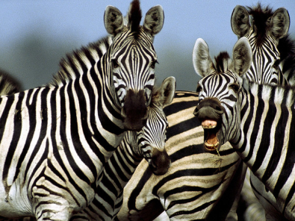
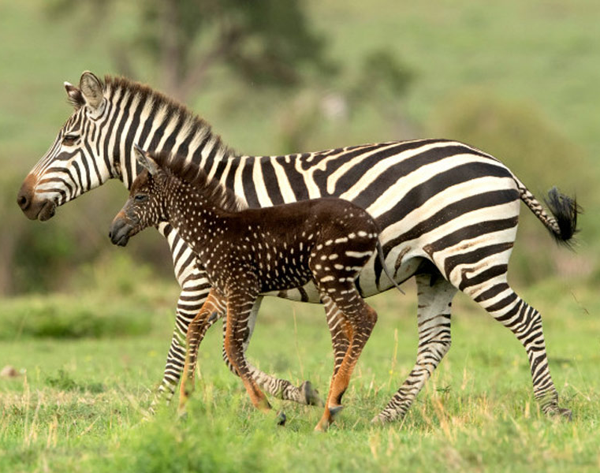
Where do you live?
I'm a nomad
The pangolin has a body covered with scales, feeds mainly on termites, for which it has developed a long sticky tongue, and its mouth is completely devoid of teeth. When attacked, it tends to curl into a ball to protect itself with its tough skin. They are nomadic and solitary animals. They inhabit the forests of central Africa and savannahs.
Zebras are black animals with white stripes, and with a large white spot on the belly that serves to camouflage themselves. The stripes of zebras are absent in the foal, which is totally black; The stripes appear later and grow along with the size of the body. The stripes are a camouflage mechanism and confuse the visual system of the blood-sucking tsetse fly.

Slide 8

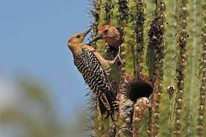
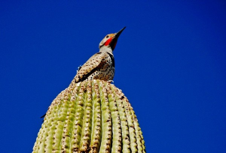
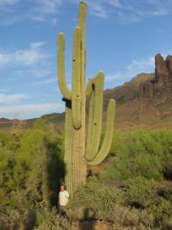
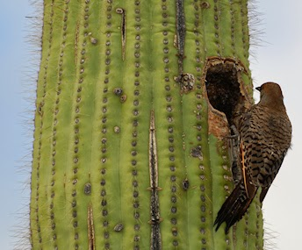
Where do you live?
In a cactus
Golden woodpecker
The chickadee woodpecker and the golden woodpecker live in the "saguaro", a cactus from the Mexican desert.
They live in this gigantic plant, which can be 50 feet high and is an oasis. Inside it is soft and fluffy, so its interior is a placid place to live.

Slide 9

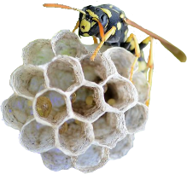
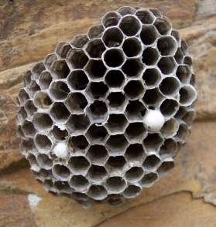
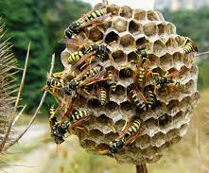
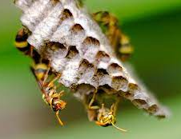
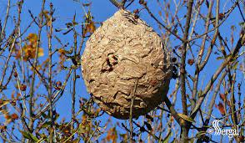
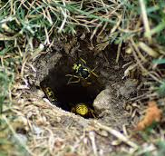
Where do you live?
In my papery home
Wasps build their papery home. Papery home is made from the fiber that wasps get from grass, plant stems, poles, cardboard boxes, and dried vegetables, among many other sources. They mix this with their saliva and water to soften it all up.
Wasps arrange cells irregularly; others vertically. The nests have several floors and each of these is separated from the other by papery ropes. Most nests are hung between tree branches, although some are at ground level, in burrows.

Slide 10

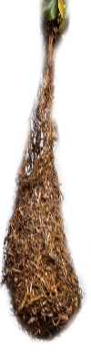
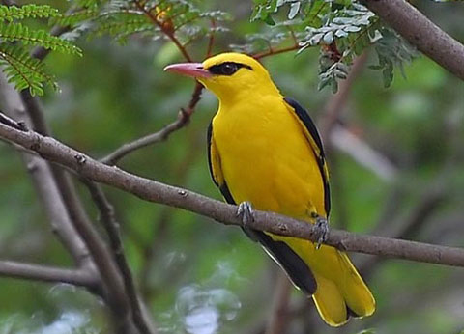
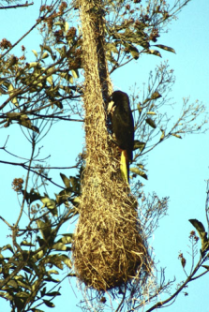
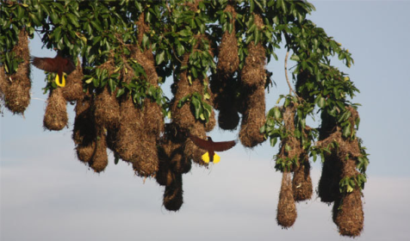
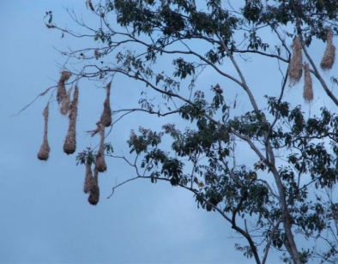
Where do you live?
Hanging from a branch
Strips of banana leaf and vines serve as material for orioles to weave their nests. These hearths are waterproof (because of the tightness of the fabric), measure up to 6.5 ft in length and hang from the tips of the branches of trees in South and Central America. The entrance to the nests is located at the top, and the incubation chamber at the bottom. An oriole builds the nest without the help of the male, as he spends a lot of time courting other females. All the pairs that the male attracts build their nests near the others; A male has a harem of 40 nests in the same tree.

Slide 11

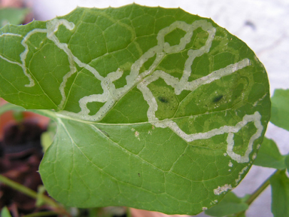
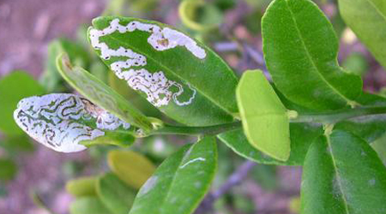
Where do you live?
Inside a leaf
The presence of white lines on green leaves is a sign of the work of screwworms. Some moth caterpillars and the larvae of certain beetles, weevils, and flies are so small that they can tunnel into the leaves of any plant without breaking the surface.
Screwworms have a flattened shape and can live inside a leaf. They feed on the new cells inside the leaves, and the tunnels they make. They are those that appear as white lines on the surface of these. To reach the soft center of a leaf, large animals are forced to eat the hard outer layer of the leaf, but for the screwworm this outer covering serves as protection, just as it is for the leaf.

Slide 12

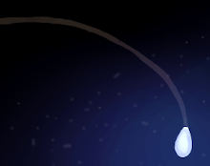
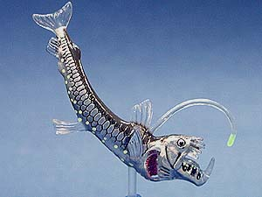
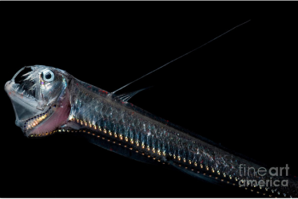
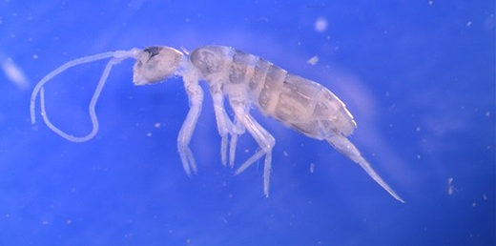
Where do you live?
In the dark
The viperfish has been found at depths of more than 13,120 feet. They have 350 light-producing organs along their body, mouth, and at the end of a fin, with which they attract their prey. The jaw is so large that it must dislocate to swallow its prey.
This fish is currently the most ubiquitous marine animal, occupying a quarter of the oceans.
The newly discovered Ortobalaganensis Plutomurus (2012), was found at a depth of 7,188 feet and holds the title of "deepest terrestrial arthropod ever found." They found it in Krubera-Voronja, the deepest cave in the world. They are like flightless insects, six-limbed creatures, without pigments and without eyes. It has an external chemoreceptor sensory organ to help navigate the deepest darkness.

Slide 13

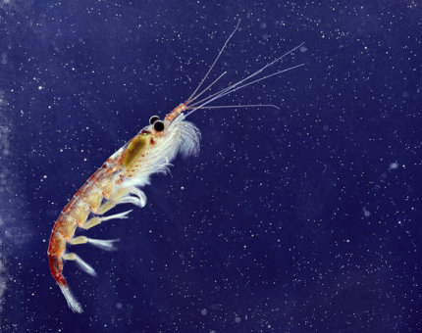
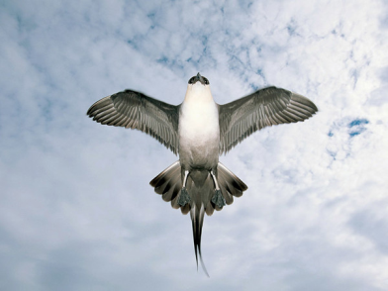
Where do you live?
On the ice
The role of Antarctic Krill is fundamental in the Antarctic ecosystem. It measures about 1" to 2" in length and is the main source of food for many marine mammals and fish. Krill feed primarily on algae. It can grow by molting its shell and shrinking if it does not feed.
Arctic Skuas, also called parasitic hunters, have earned a well-deserved reputation as pirate birds, stealing much of their food from terns, puffins, and other birds that carry fish and other prey to their nests and young.
The Skuas attack in mid-flight, forcing their victims to throw their catches. These filibusters often band together to overwhelm their victims, whom they pursue tirelessly.

Slide 14

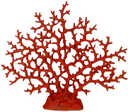
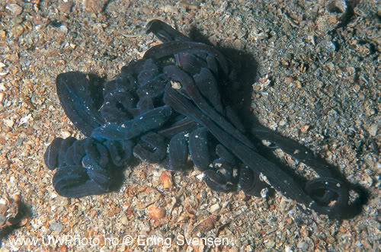
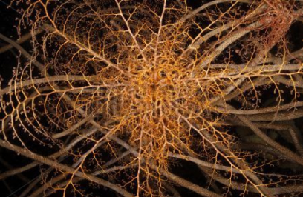
Where do you live?
On the reef
The Bootlace Worm is the longest animal in the world. It can measure approximately 195 feet in length. The body of the bootlace worm is limp and fragile brownish in color, with clear lines running the length of the body. It is mostly found on the British coasts; It is usually hidden under rocks and camouflaged in the middle of reefs in clean areas, with very cold waters and that are protected from sea currents.
The giant basket star is an invertebrate that lives in the Caribbean Sea and the Gulf of Mexico. During the day it rolls up into a ball to protect itself from predators. At night, it climbs to an elevated point, extending its tightly branched arms in the shape of a bowl. It then curls around its prey and the small hooks along these weapons will prevent its prey from escaping.

Slide 15

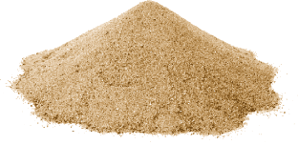


Where do you live?
In the sand
Horned vipers are so named because of the prominent scales they have over their eyes. When it hides in the sand, only its two horns are visible. Naïve bugs approach them believing that they are food, becoming easy prey for the viper. In addition to being very cunning, it is one of the most flexible snakes on the planet.
The Australian water retention frog, in dry periods, as surface waters disappear, bury itself in the ground in a waterproof cocoon chamber, lined with shedding skin. Water is stored in the bladder or in pockets under the skin, and the frog can reduce its metabolic rate and remain in this chamber for years during dry periods. This process is called estivation. Water can make up to sixty percent of the frog's weight. A slight pressure causes the frog to release this water, which is drinkable, without damaging it.

Slide 16




Where do you live?
Between silk threads
All spiders are generally solitary and predatory of small animals. They have venomous glands in the chelicerae, with which they paralyze their prey.
Spiders produce silk, called spider web or web, which they use to weave hunting webs, nests, protections for their eggs, or even to transport themselves through the air as a paraglider. To date, more than 40,000 species of spiders have been described.

Slide 17




Where do you live?
In a garden
Gardeners are found in Oceania, mainly in the northern tropical regions of Australia and New Guinea. Gardening birds build complicated houses that are intended to attract mates. Their houses are called pergolas.
There are two main types of pergolas. Some birds build the pergola by placing twigs around a sapling. This type of pergola has something similar to a roof. Others, the majority, form their pergolas by building two vertical walls with twigs, leaving an avenue between them. Around his pergola the male places shells, leaves, flowers, feathers, stones, berries and even plastic things, coins, shells, shells or pieces of glass. The male can spend hours arranging his collection.

Slide 18




Where do you live?
On the rocks
The snow vole lives in areas with stable rock accumulations and high mountain areas. In winter, when temperatures drop to negative 25º in its shelters, it enjoys a "warm" 5 degrees. Much of the year it lives in the galleries formed by the large stones and under the snow. The vole has a curious habit, it accumulates grasses on the rocks and lets them dry in the sun. Then it introduces them into its galleries to feed on them during the winter. It also eats insects.
The Canadian mouflon prefers steep terrain where the dominant vegetation type is xerophilous scrub and grassland. Usually, these sites allow them to easily escape from predators or have visual communication. Males are solitary. During the mating season the males descend from the peaks in search of groups of females, during courtship the males engage in combat.

Slide 19





Where do you live?
Traveling for free
Sea acorns are named for the resemblance to land acorns. It is a type of crustacean that sticks for life to whales and boats thanks to a substance like cement.
The remora moves by letting itself be carried away by marine animals thanks to a suction cup on the top of its head. With this free travel system, it saves energy when being dragged. On the other hand, the remora obtains food easily, either by collecting the small crustaceans attached to the body of its host, or by taking advantage of the fragments that fall into its mouth. In addition, it is very unlikely that any predator would think of attacking a remora when it is accompanied by a shark or a ray.

Slide 20








Where do you live?
In a mud house
OVENBIRD
MUD WASP
SWALLOW EARWIG
SWALLOW DAURIC

Slide 21




Where do you live?
I adapt to any place
Tardigrades are known as water bears because of the way they move. They measure between 0.2" and 0.6". If the environment in which they live loses its water, these animals reduce their water by 85% to 3% and go into a state of torpor. They are capable of spending 100 years in this state.
In a state of lethargy, they endure temperatures between 457.6 ºF degrees below zero and 303.8 ºF, a temperature well above the boiling of water.
They withstand extreme pressures almost 6 times above the deepest point of the earth. In 2007 they were placed on the outside of the Foton-M3 spacecraft and survived the trip. They inhabit every place on the planet where there is fresh or salt water and are present in every ecosystem on Earth.

Slide 22





Where do you live?
In the forests
The matamata turtle prefers shallow water, but can hold its breath for a long time, remaining motionless on the bottom.
It is a predator that stalks and waits for its prey, remaining submerged and motionless, with the rare protrusions of its skin helping it to camouflage itself among the surrounding vegetation. The turtle opens its huge mouth to the maximum, causing a current that allows it to catch the prey. The matamata slams its mouth shut and as the water is slowly expelled, it engulfs the whole fish.
The Margay is carnivorous; It feeds on small mammals. It is the only feline in the Neotropical region that has an ankle joint that allows it to rotate its feet 180 degrees and descend vertical trunks with its head down. Solitary and territorial. A unique behavior of this species is that it covers its droppings with leaves and soil after defecating. It can jump up to 121.4 ft horizontally.

Slide 23

O Lord our Lord, how excellent is thy name in all the earth!!! Psalm 8:9
My house will be there.
Do you want to be my neighbor?

