Slide 1
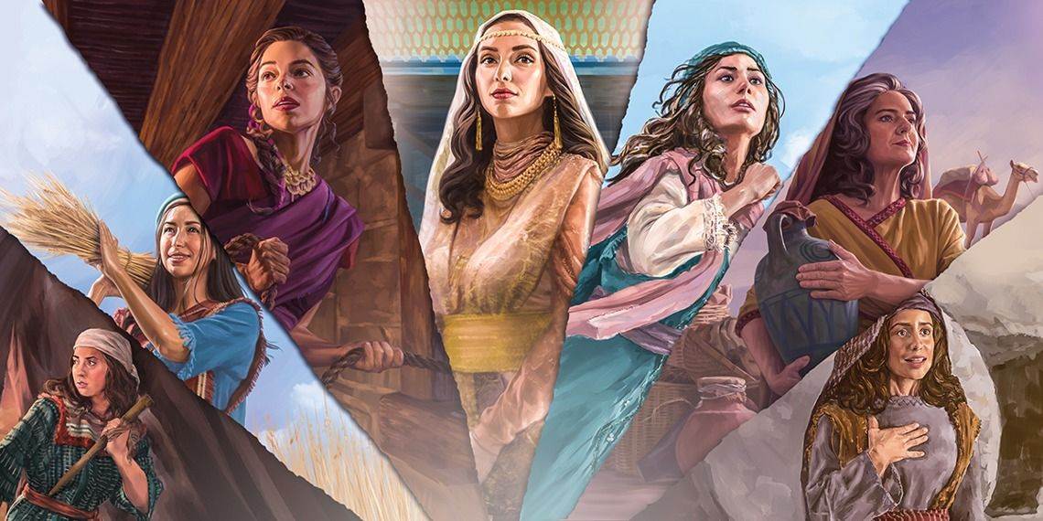
WOMEN FILLED WITH THE HOLY SPIRIT

Slide 2
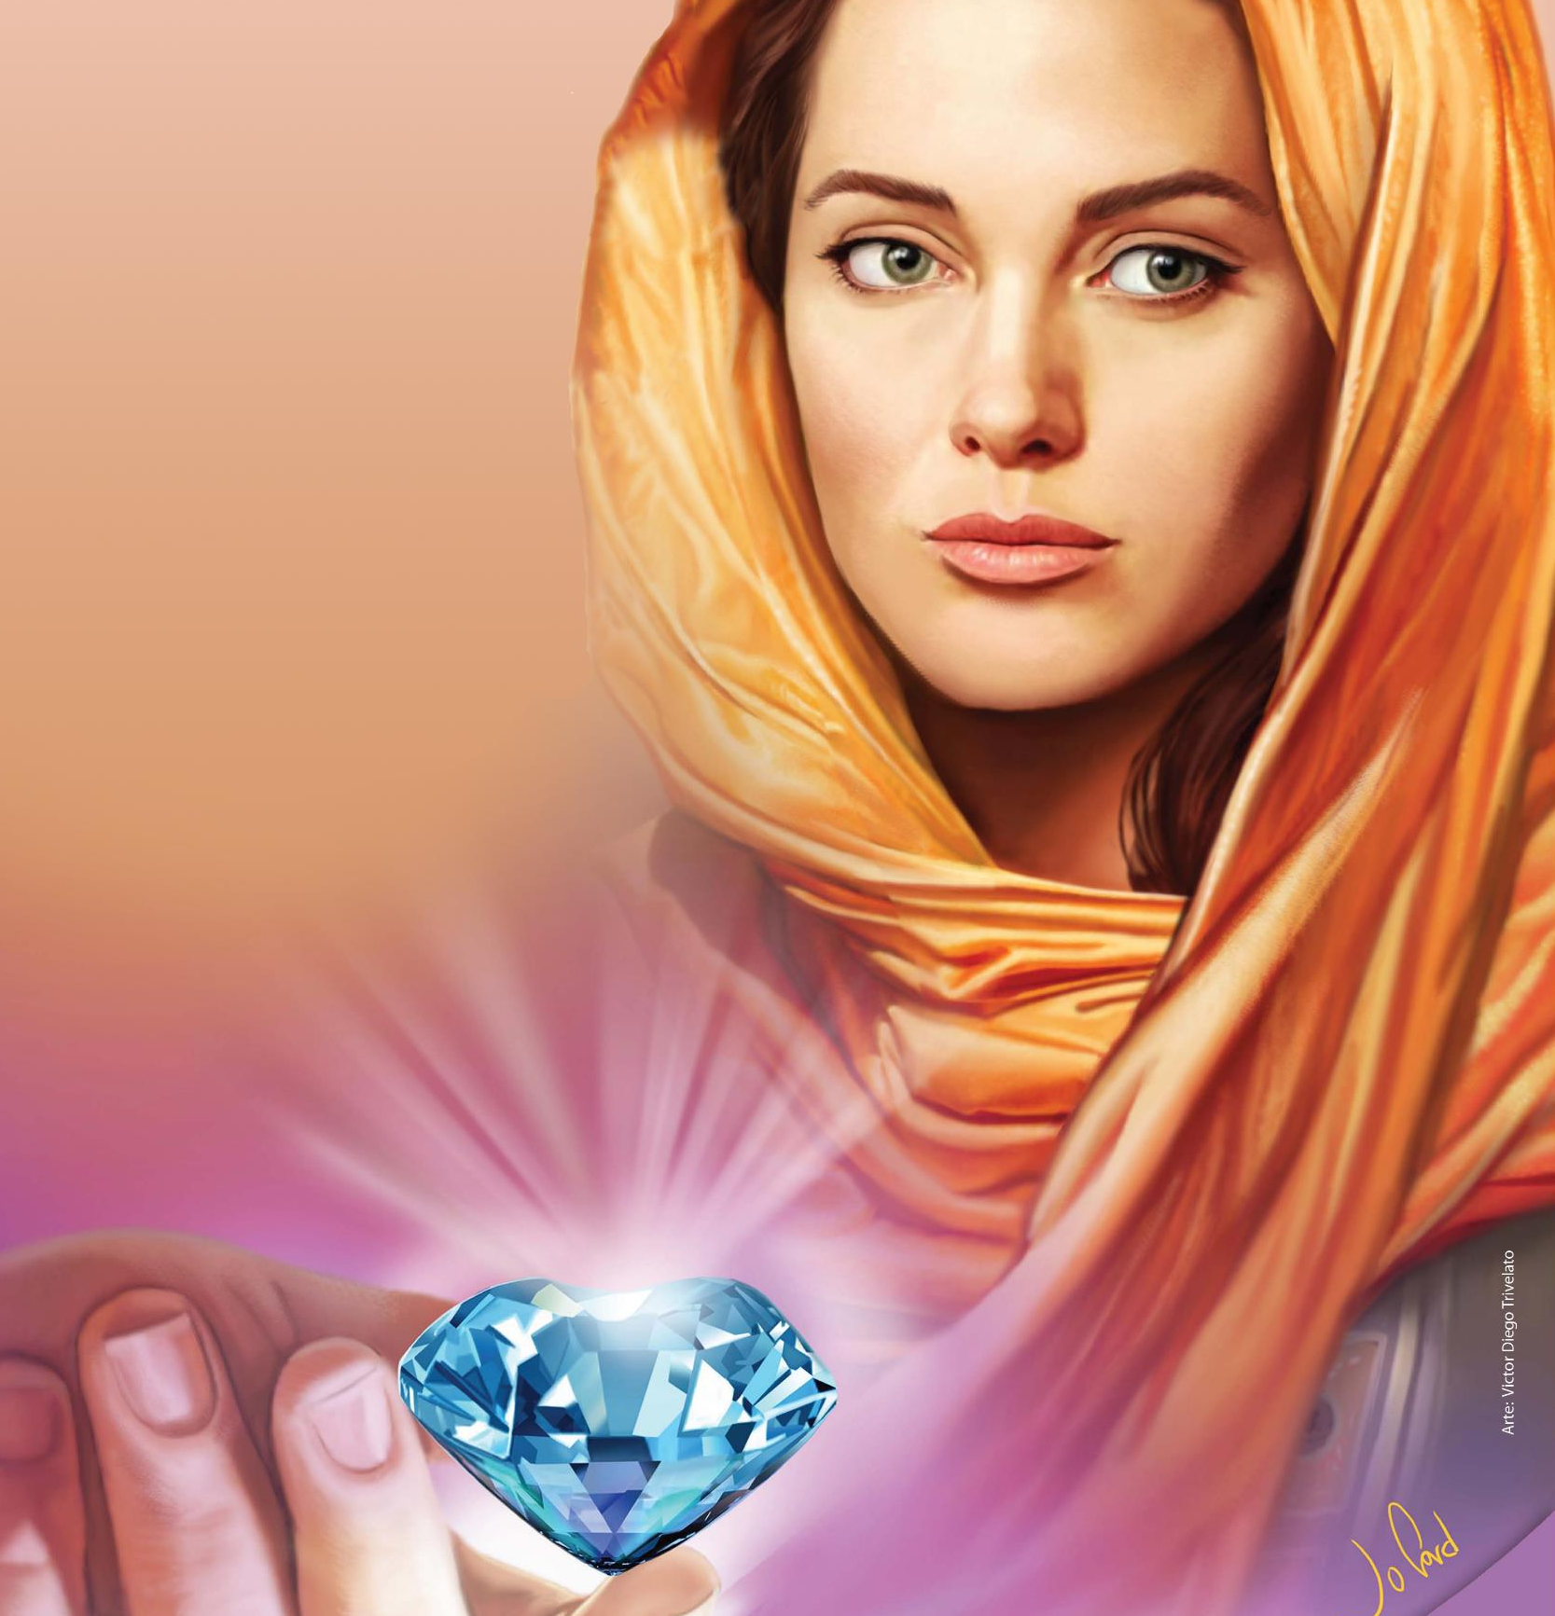
“Who can find a virtuous woman? for her price is far above rubies.” (Proverbs 31:10)
There are women who, at decisive moments and under the influence of the Holy Spirit, were the instruments that God used to meet a specific need of his people.
Let’s review some of these women.

Slide 3

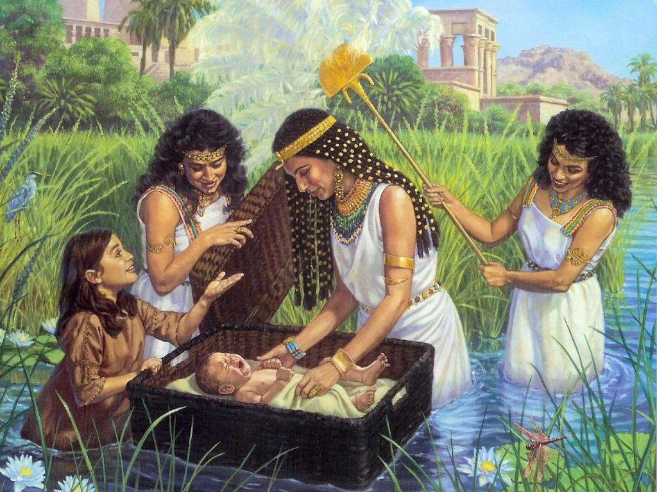
MIRIAM
THE LEADER
Today I present to you a great woman: Miriam. Born leader. She was chosen by God and sustained by the Holy Spirit to lead the people of Israel at a specific time.
Miriam was the older sister of Aaron and Moses.
From a very young age, due to her determination and character of leadership, her parents entrusted her with the care of her younger brother, Moses, since Pharaoh had given the order to kill all male children born to the people of Israel.
When the baby was in danger, fearless and cool-headed, she didn't hesitate for a second to offer her help. She took care of the small basket while sailing on the Nile River and introduced the princess to her own mother for the baby's upbringing.
This woman is an example of leadership from childhood and throughout her life. But what could she tell us about her own story?

Slide 4
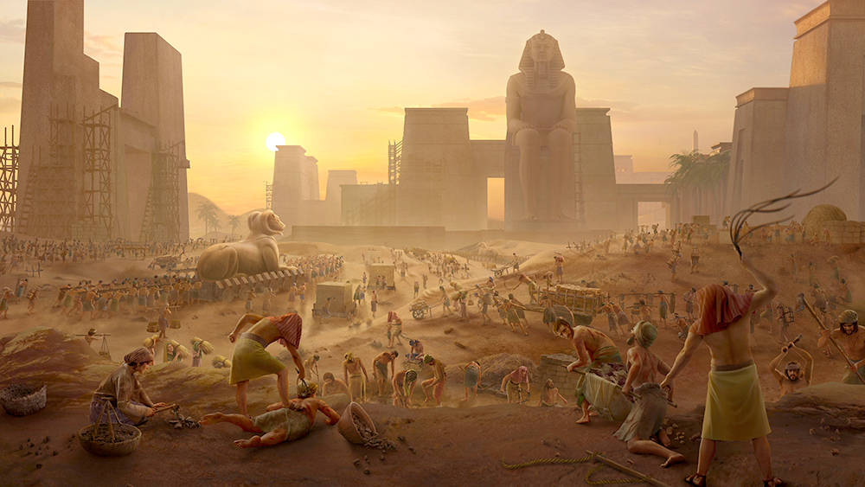
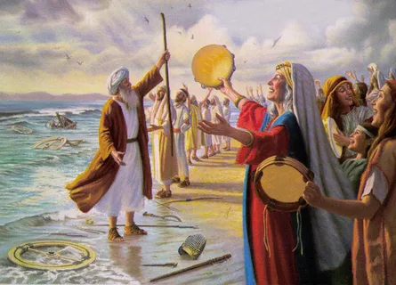


What happened in your life during the time Moses was separated from his people?
I grew up with the people of Israel, I suffered their deprivations and mistreatment, which was a blessing to me. Some will say: A blessing? Yes, it was. During this time I was able to identify closely with my people. I became their friend, someone who understood them, and who they could trust.
God, through the Holy Spirit, was preparing me for the great responsibility of supporting my brothers Aaron and Moses in their God-given work.
It was an important role in that very moment of discouragement for Israel. I notice, from what you say, that they trusted you deeply. Am I right?
It's true. By the grace of the Holy Spirit, I was endowed with leadership. God made me his prophetess and very soon I became the right hand of my brother Moses. I led the women of Israel and enthusiastically sang praises to God by the dunes of the Red Sea.

Slide 5

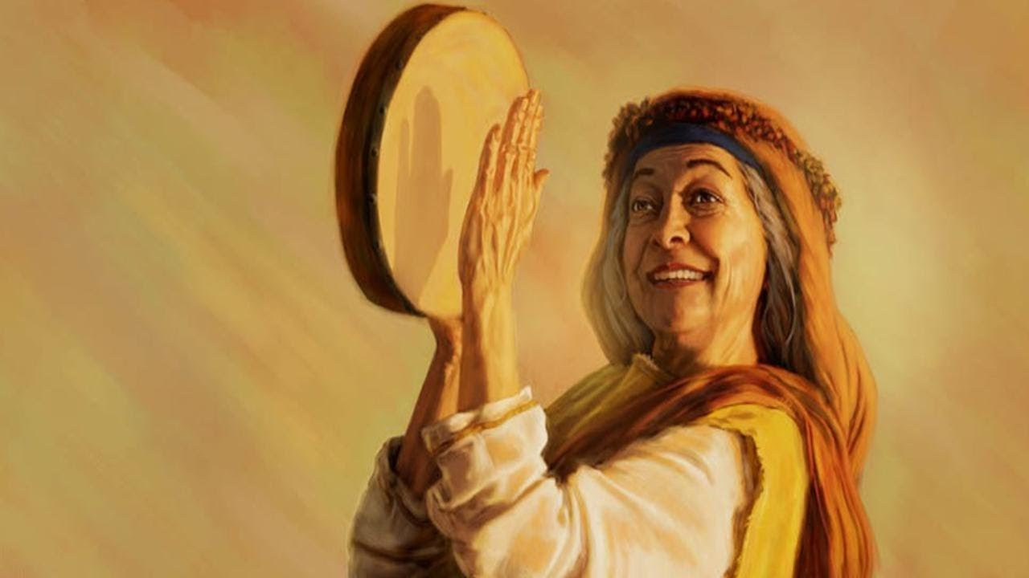
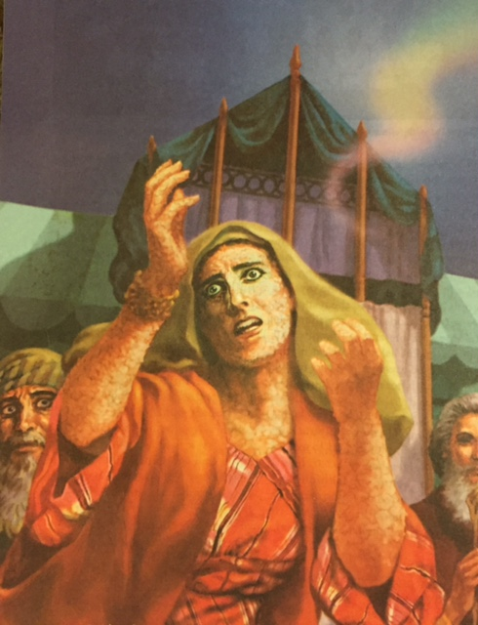
What a beautiful, important and at the same time overwhelming task was entrusted to you. Did you ever feel like it was too much for you?
Yes. But now I understand that I was not the one who did the work. It was the Holy Spirit working through me. Don't think it was easy to learn. I made a terrible mistake against God and against the leader He had chosen, Moses. For this reason, I had to suffer from leprosy and be out of camp for a week. But even in those moments I felt the sustaining power of God through His Spirit. In addition, I was encouraged by the love of my people who were halted during that time, waiting for my return. The Spirit touched my heart, God healed my leprosy and forgave me of my sin.
Praise God for His love, for His forgiveness, and for His sustaining power

Slide 6

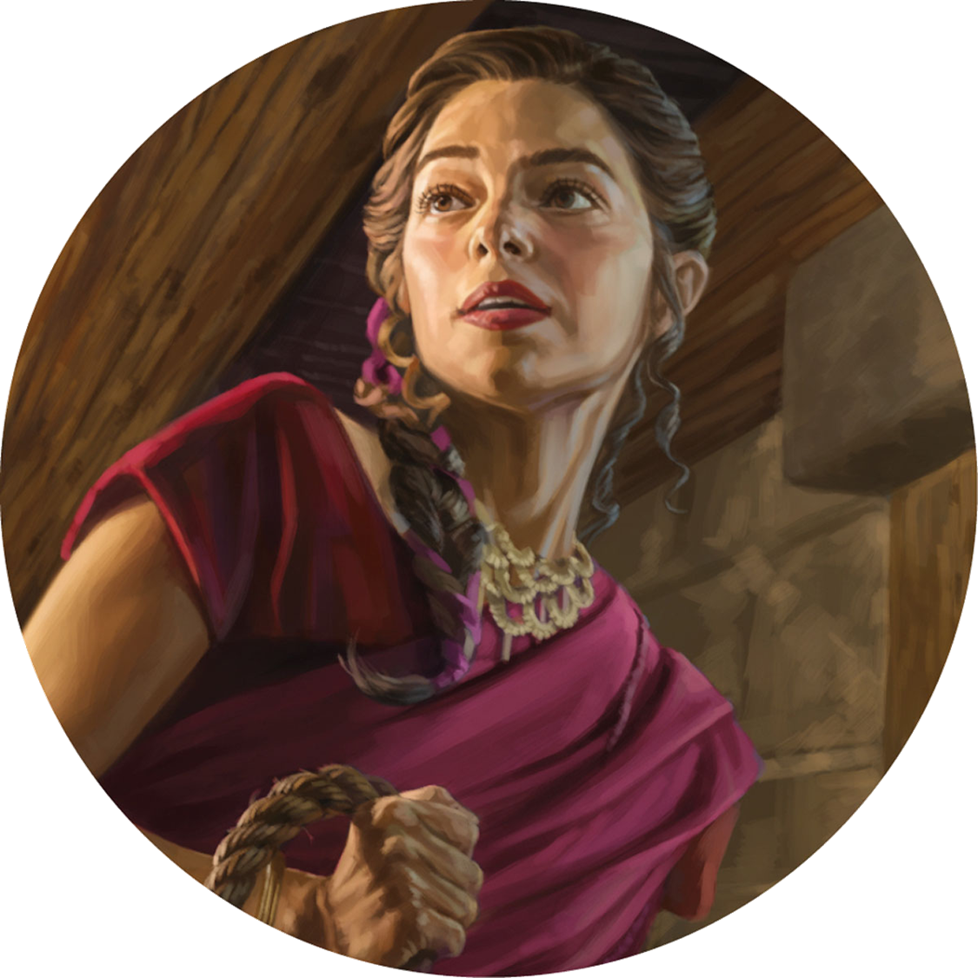
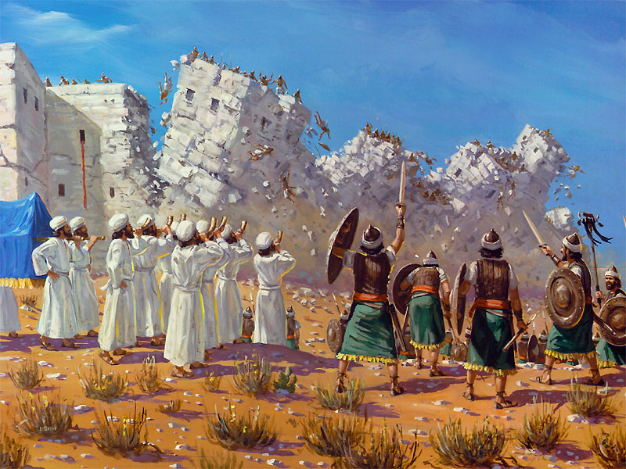
FAITH IN ACTION
Rahab's life shows us how someone who lived totally in darkness can be touched and used by the Holy Spirit to play an important role in the unfolding of the Lord's plans.
RAHAB
Rahab was a woman who was born and raised in a pagan nation, full of idolatry. At the most important moment of her life, she clung to a God who had been unknown to her until that moment. He showed greater faith than the spies themselves.

Slide 7

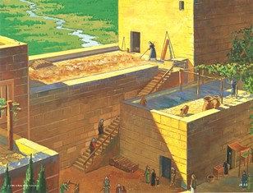
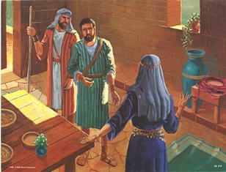
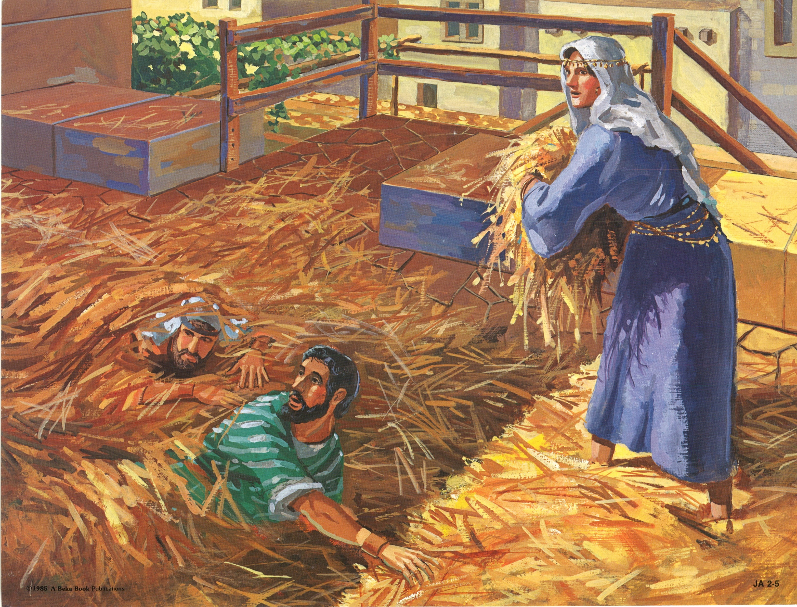
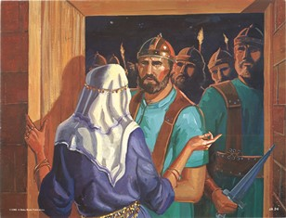


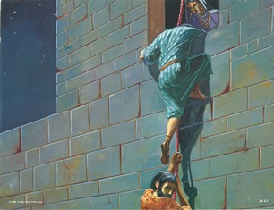
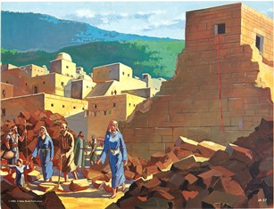
Can you tell us the amazing story that split your life in two?
As you know, I grew up in a pagan and idolatrous community. I prided myself on living in a walled city that seemed impenetrable. I was dedicated to a profession, which although it is the oldest in humanity, was not something I could be proud of. All kinds of people passed through my house and, therefore, I found out about everything that was happening. I learned that the Israelite camp had crossed the Jordan and encamped near the city.
What were the reactions to this situation?
The people of Jericho were afraid, for they had heard what the God of the Israelites had done before, and they prepared to defend the city.
I decided to believe in that wonderful God who had parted the Red Sea, and who had defeated powerful enemies.
One day I received a visit from two young foreigners who were being persecuted. Thanks to the Holy Spirit, I felt in my heart the desire to help them, so I made the decision to support them, even at the risk of my own life.

Slide 8

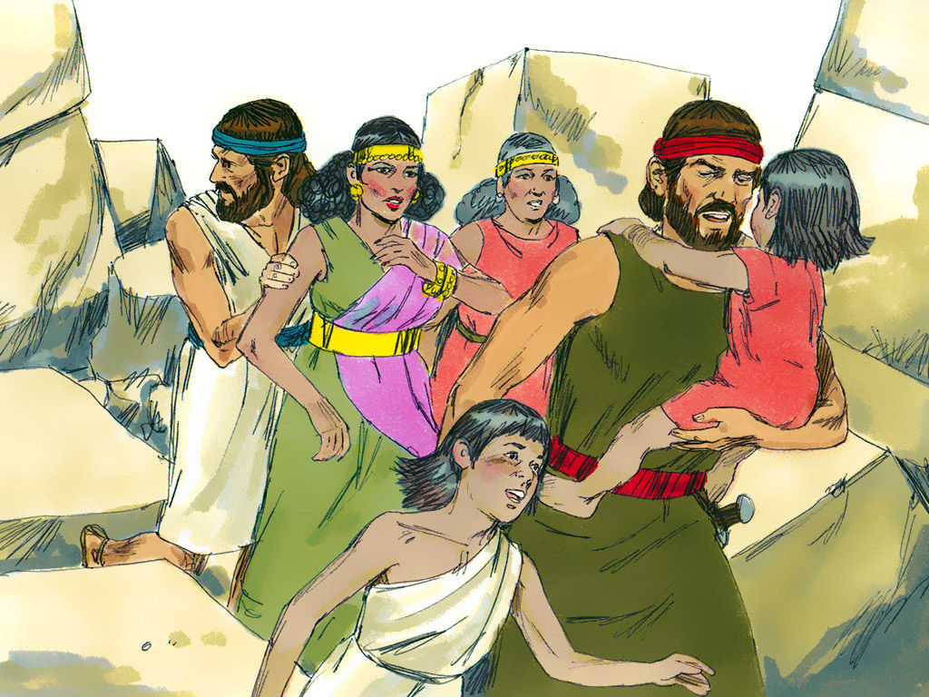
Didn't you feel afraid of the consequences that this could bring you?
I can't deny that it wasn't an easy decision to make, but the Spirit had already done his work in me, his strength keeping me firm in my purpose to help them escape from Jericho.
So I decided to make a covenant with them, and to join their people and their God.
When the Israelite army returned to invade the city, my life and that of my family was preserved. I joined the people of Israel and was greatly blessed to be part of the genealogy of the Savior of the world.
Live by faith and be the human instrument to help others reach the promised land

Slide 9
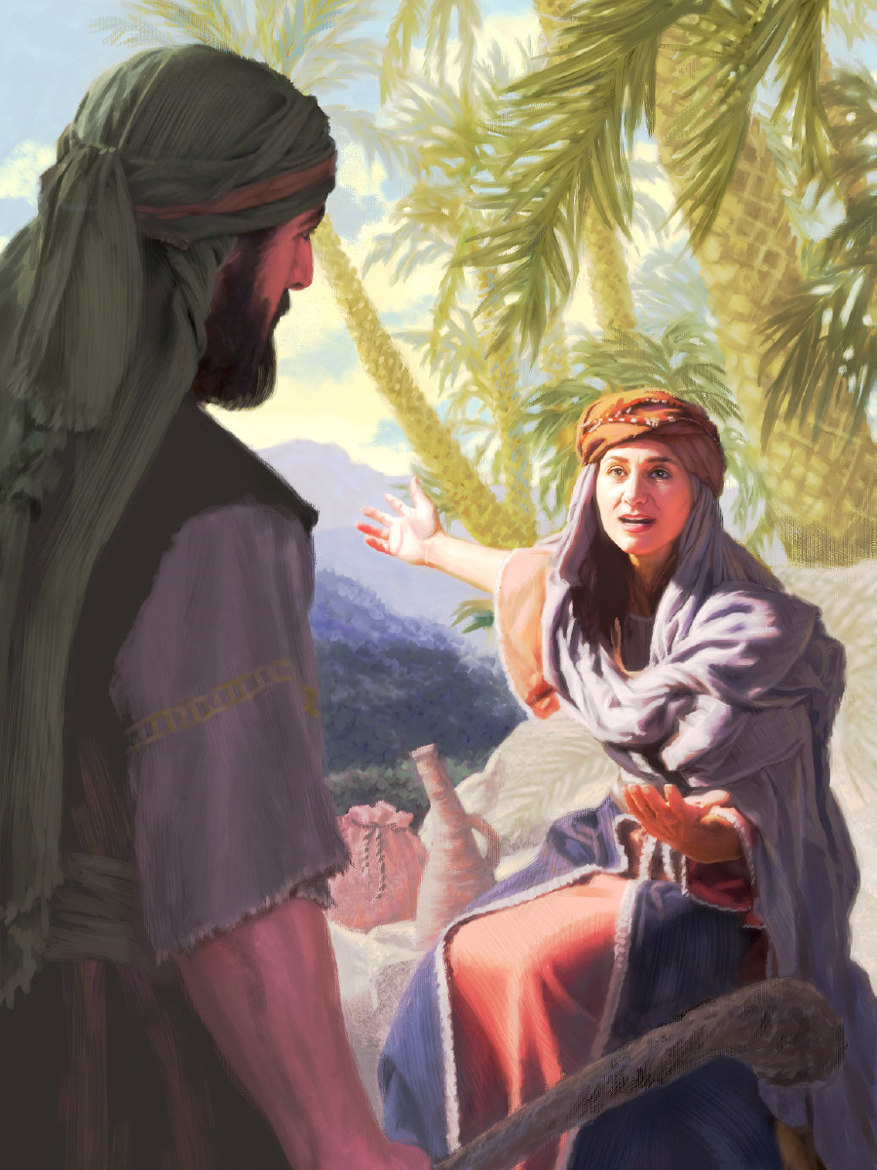
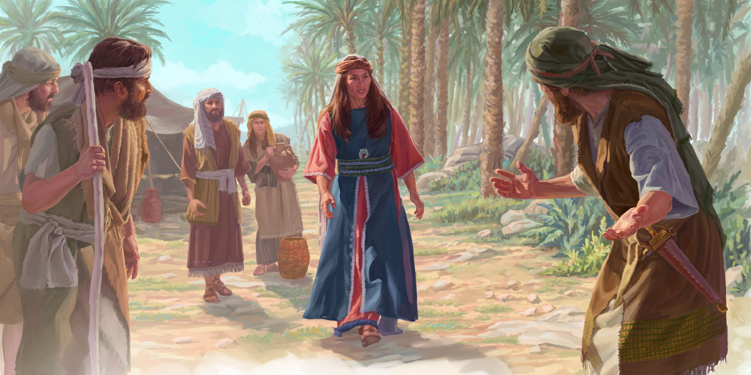
DEBORAH
THE PROPHETESS
Deborah was a woman who lived in a time when the leadership of the villages was almost entirely limited to men. But, thanks to her strong but merciful character, she became the only woman to hold the position of judge in Israel.

Slide 10
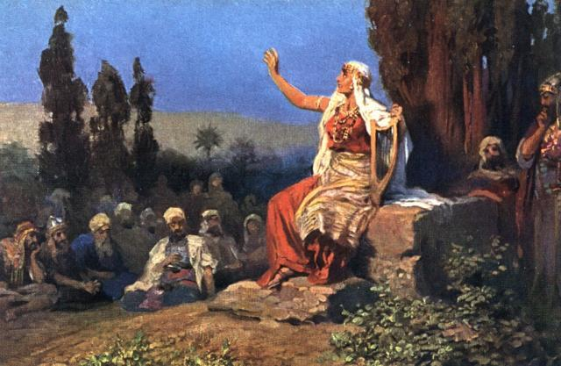
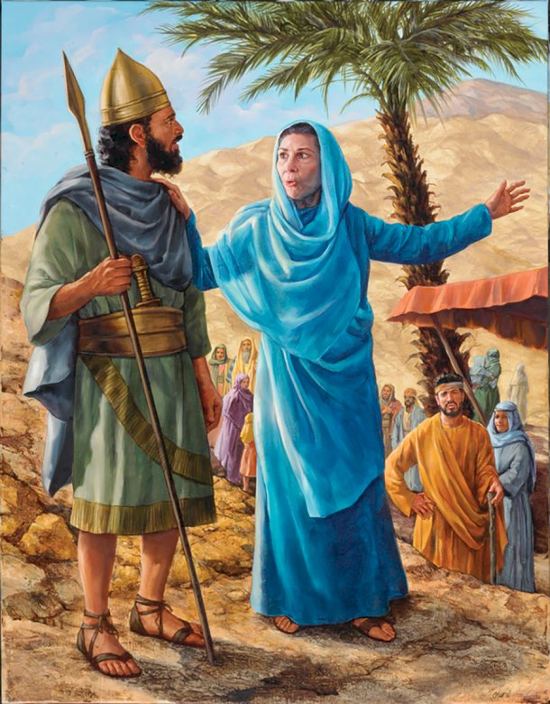


It must have been difficult for you to live in the time when the people of Israel, whom you loved so much, were oppressed and cornered by a pagan people.
That's how it was. In those difficult times, I was chosen by God to be judge and prophetess of Israel.
My house was near a beautiful palm tree under which I delighted to hear the voice of the Holy Spirit, and to judge the Israelites.
The love I felt for my people made me become like a mother to them. That was what the people really needed.
Tell us about a special revelation given to you by the Holy Ghost.
The Holy Spirit has spoken to me many times.
Once, the best known occasion, He revealed to me that we should go to battle against Sisera, the general of the armies who oppressed us.
I called Barak, and he told me that he would go only if I went with him.
I accepted and, together with the whole army, we went into battle.

Slide 11
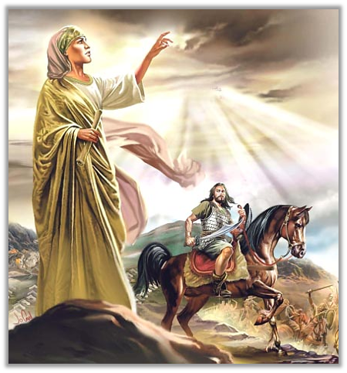
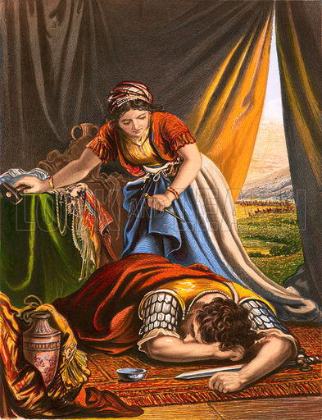
How was the battle?
Just as I had prophesied, God granted victory to Israel at the hands of a woman, Jael.
Fleeing the battle, Sisera took refuge in Jael's tent, since there was a peace pact between the two peoples.
Jael gave her hot milk to drink and waited for Sisera to sleep soundly. He took advantage of that moment to kill him with a stake. This is how the battle was won.
Barak and I sang a beautiful song of praise, which to this day rings in the ears of many. We declare, before all the people, that God is the only one who deserves praise, honor and glory.
Victory is certain, fight for God, do His work, and exalt Him and praise Him

Slide 12

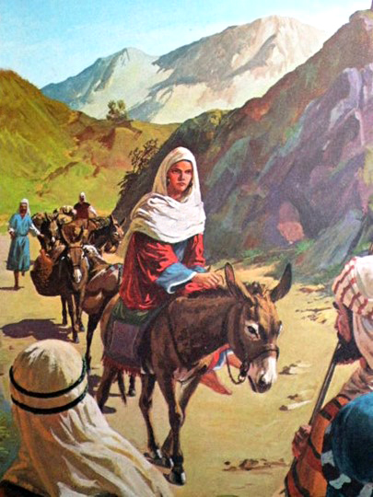
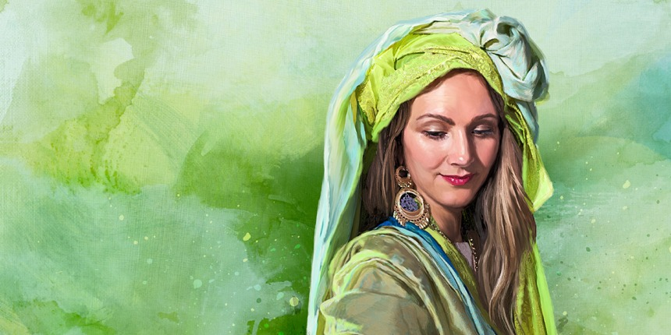
ABIGAIL
THE PRUDENT
Abigail stood out for her wisdom and prudence in the face of the difficult situations she had to face. Moved by the Holy Spirit, she became the instrument of salvation for her entire family. Let's get to know a little more about her.

Slide 13
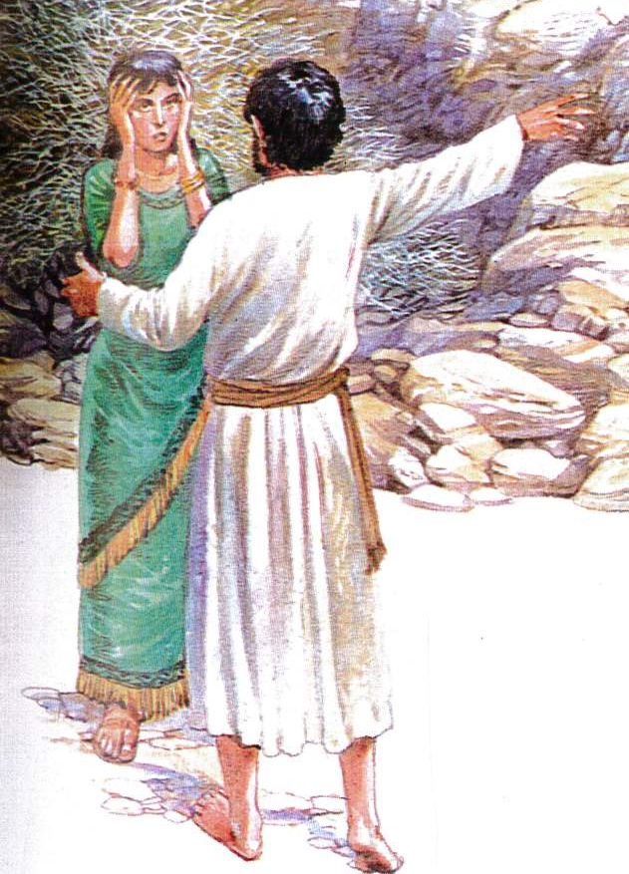
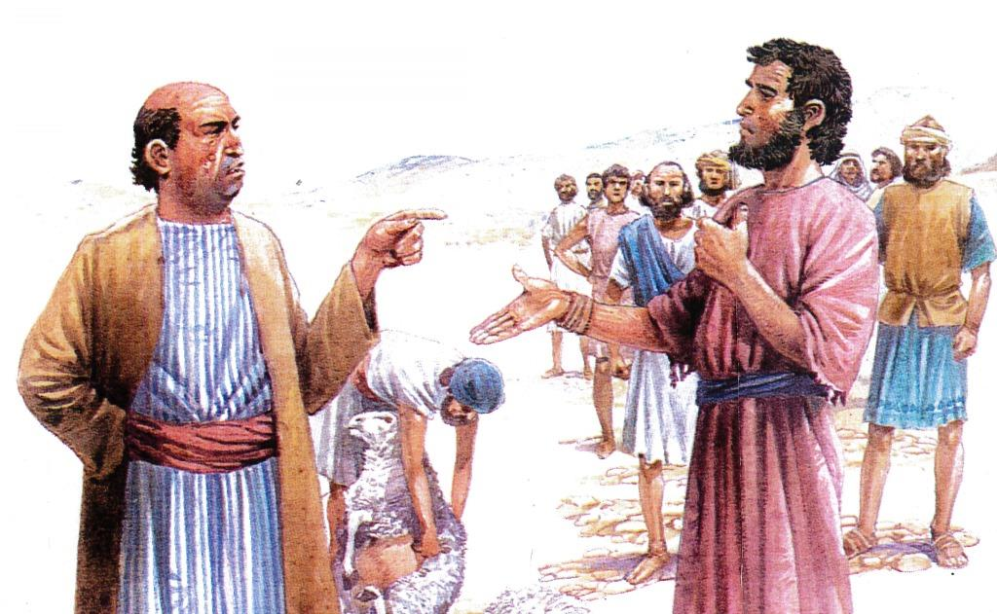

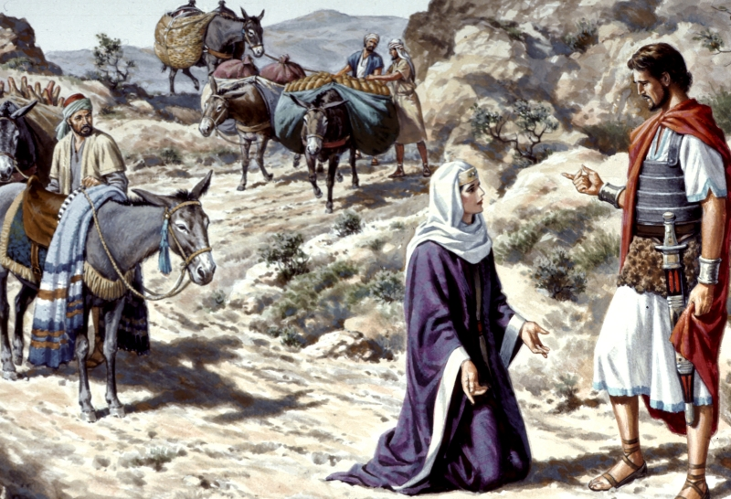
What was it that your husband did that provoked so much anger in David, the future king of Israel?
My husband Nabal had a selfish and petty character that led him to make a terrible mistake against the Lord's anointed.
David and his men had been caring for and protecting Nabal's flocks. When the shearing season came, David sent some men to ask Nabal for some food. But my husband denied them the help they requested.
I immediately realized the consequences that their foolishness would bring. Therefore, seek Divine help to be able to act correctly.
The Holy Spirit motivated me to come before David bringing an ample supply of food and gifts. On my knees I begged forgiveness for my husband's mistake.

Slide 14

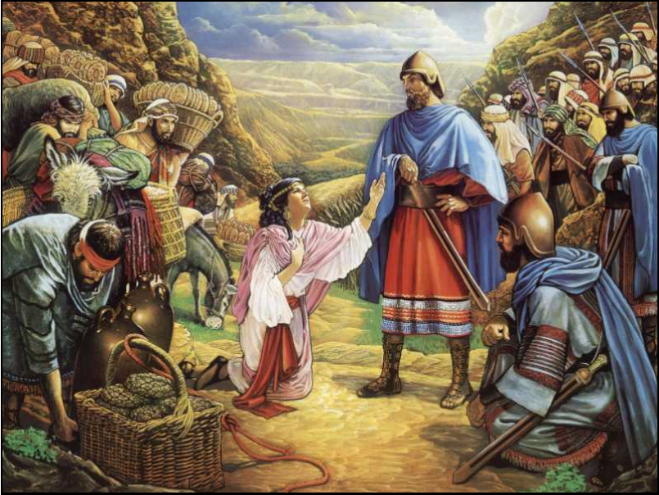
What was David's reaction to your intercession?
David then understood what a serious fault he would commit by shedding innocent blood.
The future king praised my words, and the way I had prevented an injustice from being committed.
You don't know how important it was for me to feel the presence of the Holy Spirit, putting words on my lips, directing my steps, and guiding my actions to face this desperate situation.
Ask the Holy Spirit to give you divine wisdom to resolve extreme situations

Slide 15

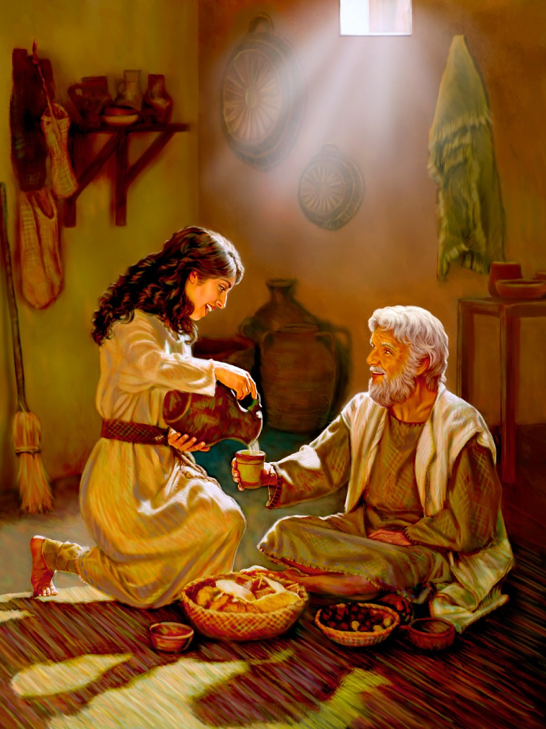
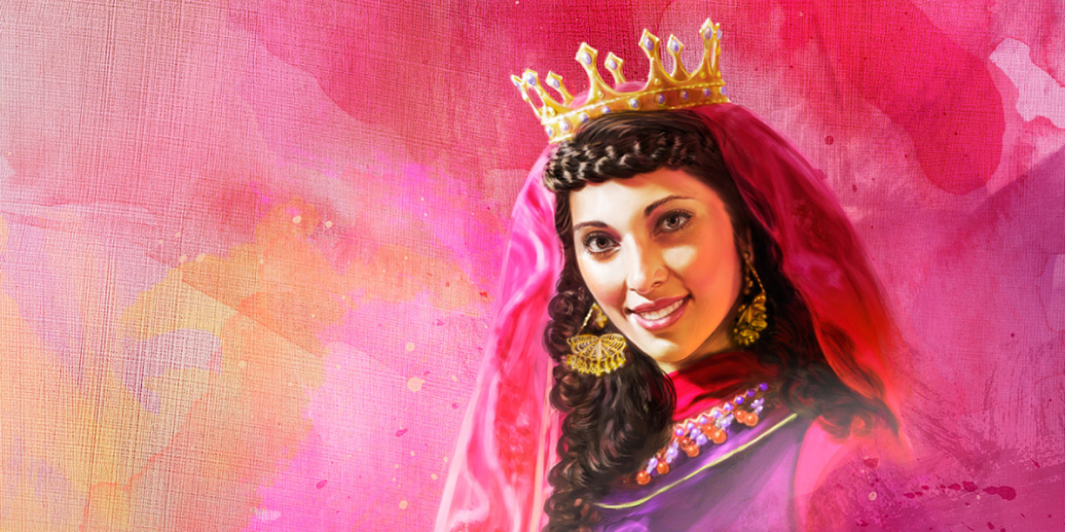
ESTHER
THE BRAVE
Esther made one of the dreams that most of us had when we were children come true, that of becoming queen of a beautiful country.
Esther was orphaned when she was very young. She grew up with her cousin Mordecai, who taught her to trust and depend on God in all her decisions.
This gave her the strength to face the greatest challenge of her life. Let's get to know her a little more.

Slide 16

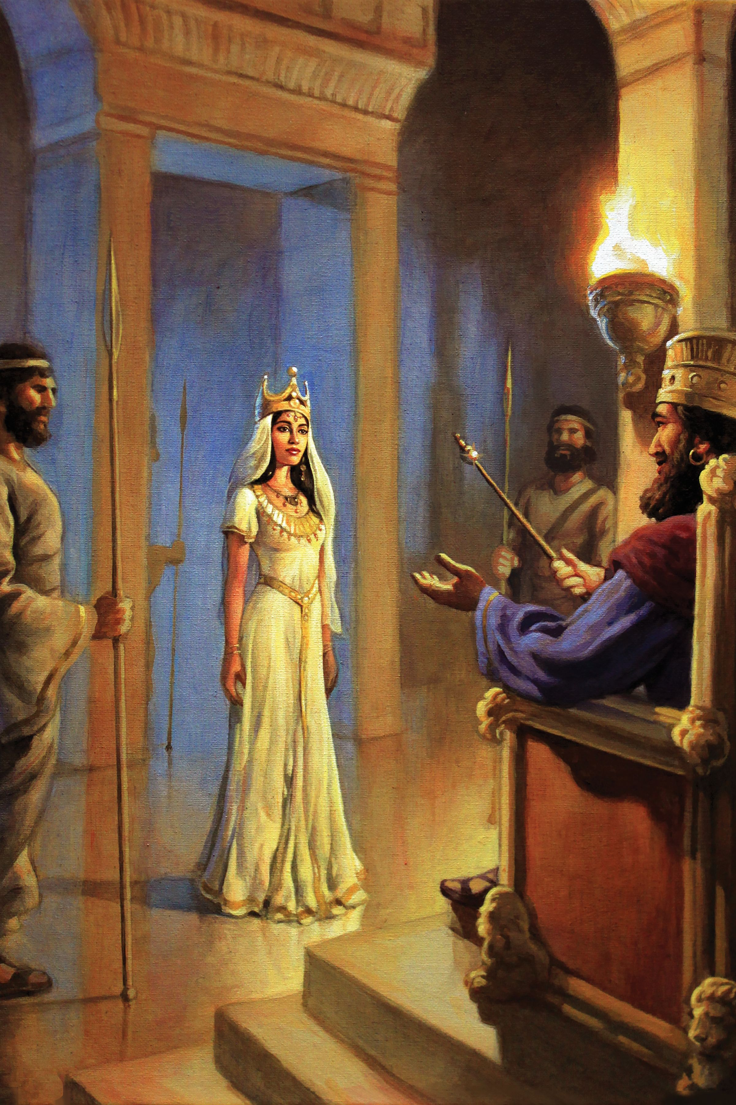
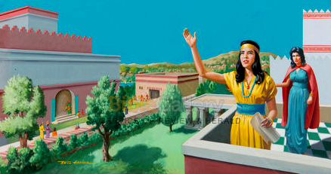
Queen Esther, what was your experience like while living in the largest palace in Persia?
It was a big change in my life to arrive at the King's palace as his wife. I realized that I was taken by God to the exact place where He could use me.
When my people found themselves in mortal danger, the Holy Spirit showed me the need to fast and pray. I invited the whole town to join me in this prayer.
In this way I obtained the necessary strength for the step I had to take: to present myself before the king at the risk of my life.

Slide 17
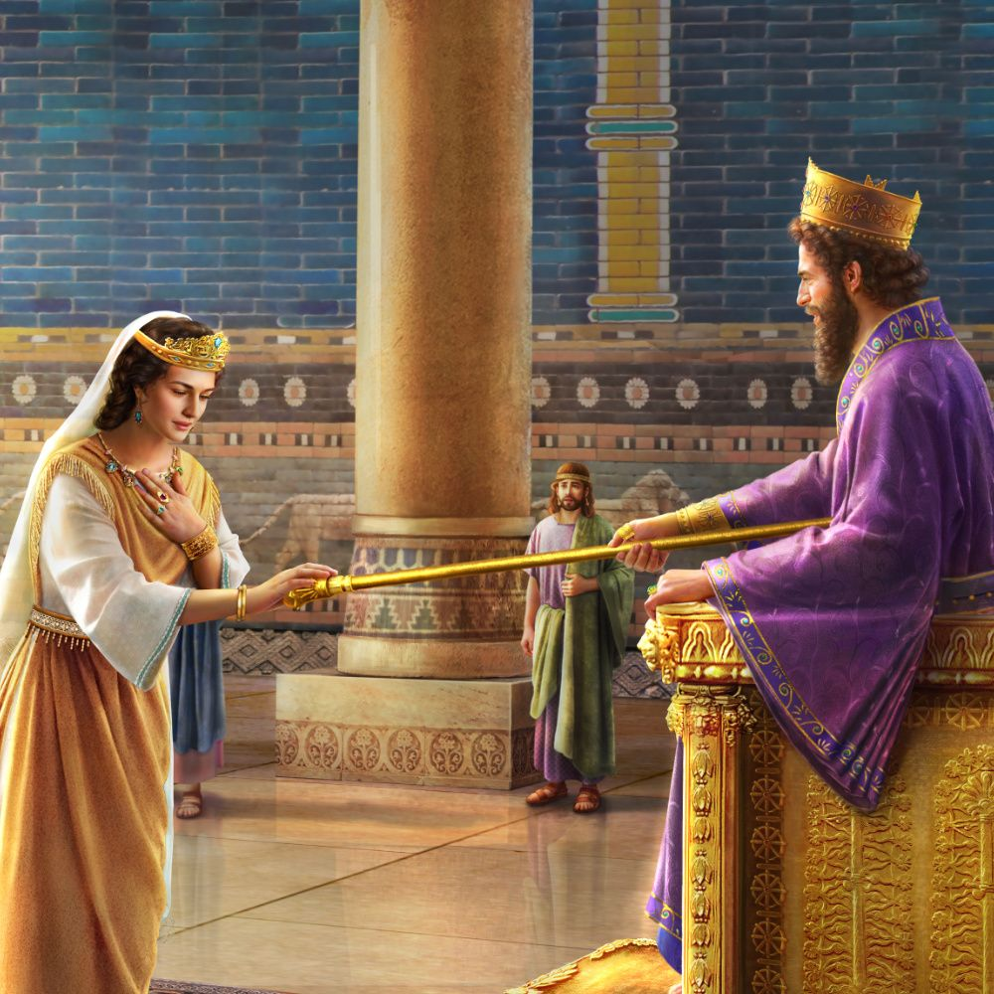

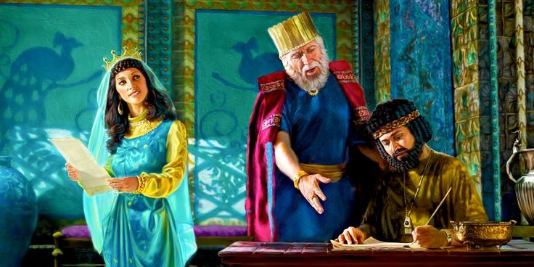
What did it feel like to put your life in danger, and what was the result?
I was confident in God, and at all times I felt the sustaining and comforting power of the Holy Ghost. I knew that I was completely lost on my own, so I was completely dependent on His help.
At the end of the three days of prayer I felt completely safe, and this led me to make the decision: "if I perish, I perish", but I will try to save my people.
I went before the King and, after inviting him to two banquets, I told him about the death decree, and asked him to save us.
By God's grace, my life and the life of my people was preserved.
Decide to follow God and work for His people, and He will give you courage to make decisions that lead to the salvation of others

Slide 18


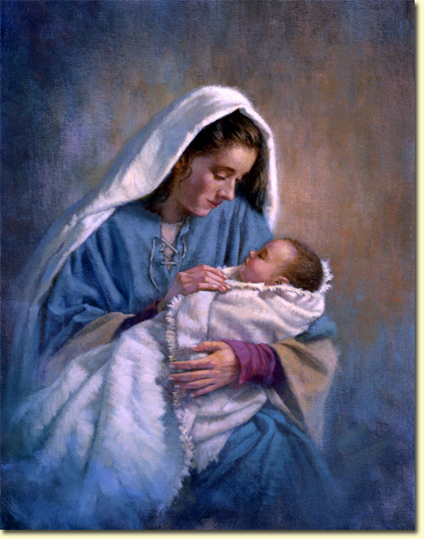
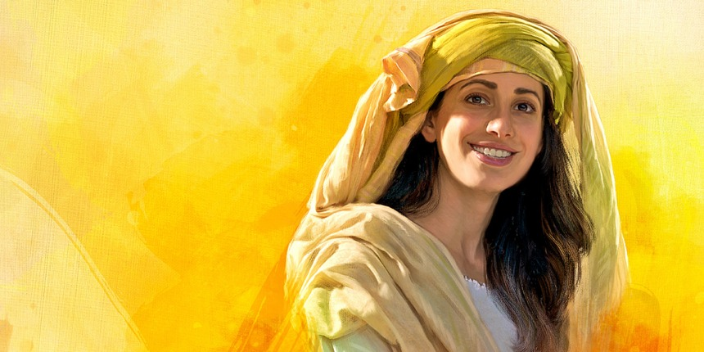
MARY
THE MOTHER
Jewish women had been waiting for hundreds of years for the promise of being the mother of the awaited Messiah to be fulfilled in them.
Mary, a humble young woman, who was born and raised in one of the poorest villages in Israel, was appointed by Heaven to bear upon her the greatest responsibility given to any woman: to be the earthly mother of the Savior of the World.

Slide 19
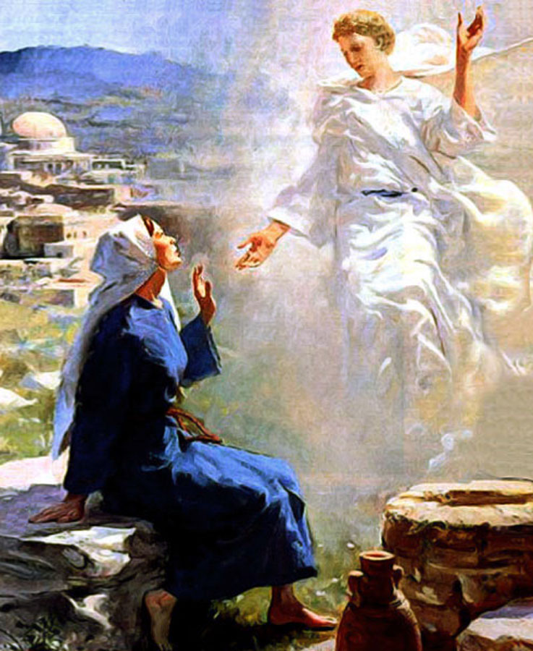
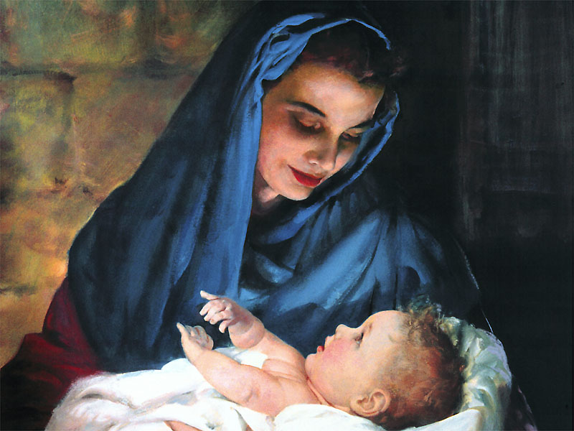
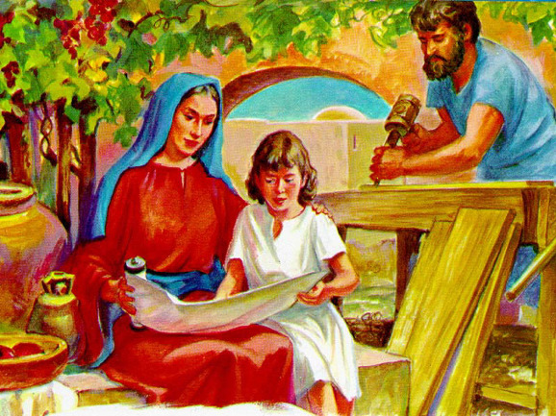
What a great responsibility fell on you! Did you feel prepared being so young?
When the majesty of heaven came down like a baby, I was the one appointed to take care of him. It was a very big responsibility. I was to educate and help form the character of the one who would be the Savior of the world. What a great responsibility! Not a detail of His physical, mental, and spiritual growth could be neglected.
I learned to depend completely on the wisdom of the Holy Ghost to guide Him. I saw Him grow in stature and grace toward God and man.

Slide 20
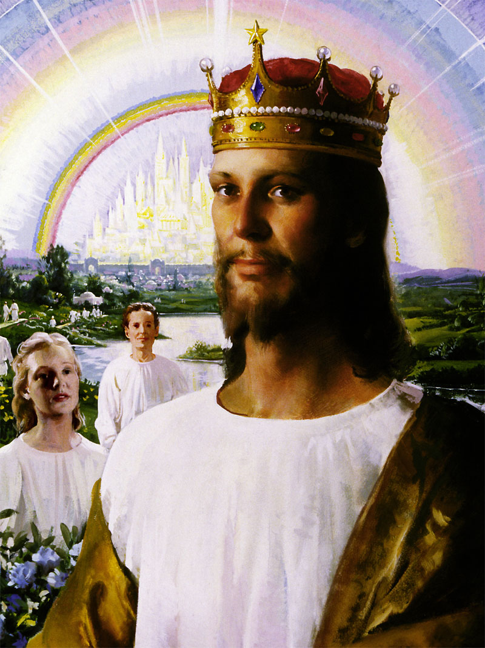
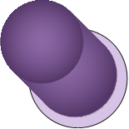
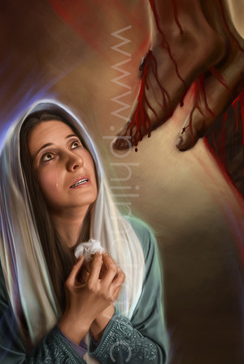

It must have been very difficult for you to contemplate the death of Jesus.
My heart bled as I watched my son die on a cross for those who rejected him. I don't know what would have become of me if I hadn't felt the power of the Holy Spirit strengthening and sustaining me in that moment.
Today, my son is no longer with me physically, but I raise a song of victory knowing that He has fulfilled the great mission of His life on this earth.
Allow the Holy Spirit to guide you and give you wisdom. May love, surrender and complete dependence on God help you to achieve the task that has been entrusted to you.

Slide 21

“Now the God of hope fill you with all joy and peace in believing, that ye may abound in hope, through the power of the Holy Ghost.” (Romans 15:13)
These women, like us, made mistakes. But, at the same time, they were an example of the power of the Holy Spirit that can change the life of whom allows itself to be guided by Him.
In this way, we can become a blessing, not only for our family, but also for the community where we operate.
May God help us to place our lives in the hands of the powerful Holy Spirit.

